Slide 1

CEPC SRF Progress
Jiyuan Zhai (IHEP)
On behalf of CEPC SRF Team
IAS Program on Fundamental Physics (FP 2026)
Hongkong, Jan 13, 2026

Slide 2
Content
CEPC SRF EDR Design
CEPC SRF R&D Progress
Summary

Slide 3
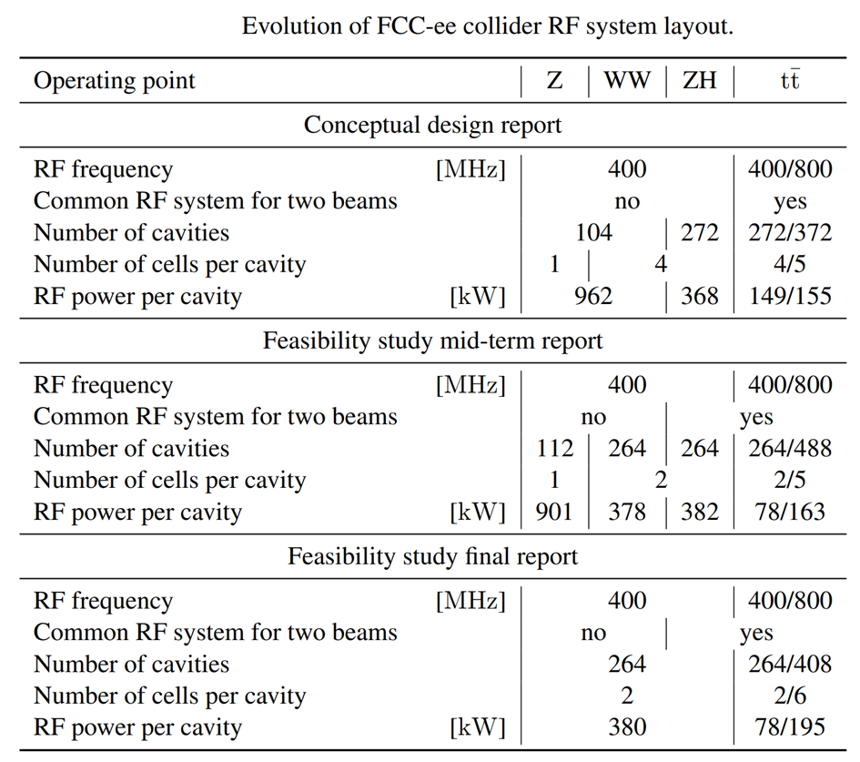
CEPC and FCC-ee RF System Design Evolution
Evolution of CEPC collider 650 MHz RF system layout
Operating point | Z | W | H | ttbar
Preliminary conceptual design report (Pre-CDR, 2015)
Common RF system for two beams |  |  | Pretzel
Number of cavities (54 km, 6.87 GV) |  |  | 384
Number of cells per cavity |  |  | 5
RF power per cavity [kW] (52 MW/beam) |  |  | 280
Conceptual design report (CDR, 2018)
Common RF system for two beams | no | no | yes
Number of cavities (100 km, 2.17 GV) | 120 | 216 | 240
Number of cells per cavity | 2 | 2 | 2
RF power per cavity [kW] (H/W 30 MW per beam, Z 16.5 MW/beam) | 275 | 278 | 250
Technical design report (TDR, 2023)
Common RF system for two beams | no |  | yes
Number of cavities | 100 | 336 | 336 | 336/192
Number of cells per cavity (Z 50/10 MW/beam) | 1/2 | 2 | 2 | 2/5
RF power per cavity [kW] (H/W 50 MW per beam, Z 50/10 MW/beam) | 1000 /200 | 298 | 298 | 118/315
(2019)
(2024)
(2025)

Slide 4
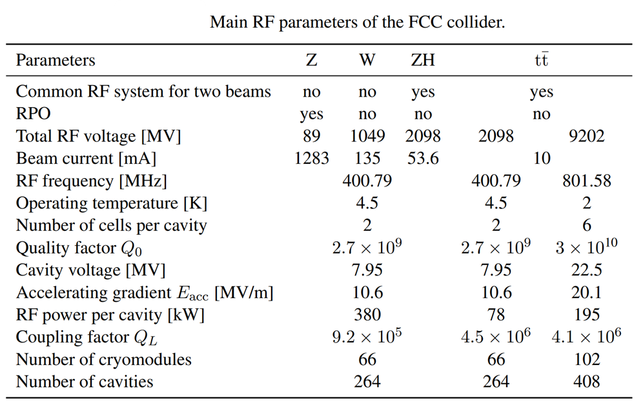
Collider RF Parameters of CEPC TDR and FCC-ee FSR
Main RF parameters of the CEPC collider
Parameters (50 MW/beam) | Z (50/10 MW) |  | W | H | ttbar
Common RF system for two beams | no |  | no | yes | yes
RPO | no |  | no | no | no
Total RF voltage [MV] | 0.12 |  | 0.7 | 2.2 | 6.1 | 3.9
Beam current [mA] | 1345 | 267 | 140 | 2×27.8 | 2×5.6
RF frequency [MHz] | 650
Operating temperature [K] | 2
Number of cells per cavity | 1 | 2 | 2 | 2 | 2 | 5
Quality factor Q₀ | 2E10 | 3E10
Cavity voltage [MV] | 2 | 2.5 | 4.2 | 6.6 | 11.6 | 31.8
Accelerating gradient Eacc [MV/m] | 8.7 | 5.4 | 9.1 | 14.2 | 25.2 | 27.6
RF power per cavity [kW] | 1000 | 206 | 298 |  | 118 | 315
Coupling factor Q_{L} | 3.8E4 | 1.4E5 | 2.7E5 | 6.8E5 | 5.4E6 | 6E6
Number of cryomodules | 100 | 16 | 56 |  |  | 48
Number of cavities | 2×50 | 2×48 | 336 | 336 |  | 192
Optimal detuning [kHz] | 21.7 | 7 | 2 | 0.2 | 0.03 | 0.02
HOM power per cavity [kW] | 6.2 | 1.9 | 1.54 | 0.67 | 0.26 | 0.66
Same cavity voltage and QL for Z/W/H, RPO for Z operation
Reactive waveguide tuning to change QL for ttbar operation
Coupler inner conductor moving to change QL

Slide 5
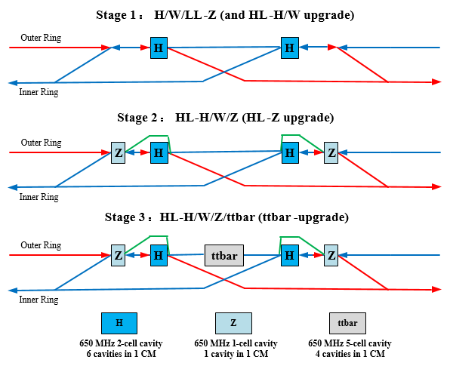
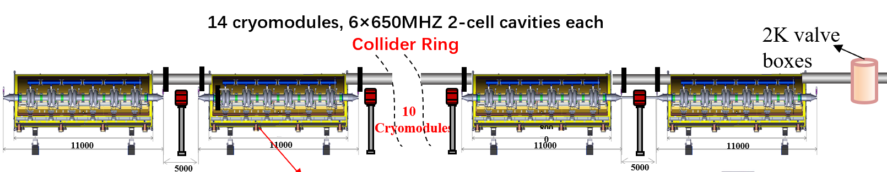
RF Configuration: H-W-LLZ HLZ ttbar (CEPC EDR)
650 MHz 1-cell
650 MHz 2-cell
650 MHz 5-cell
30 MW: 15 CM
50 MW: 25 CM
30 MW: 8 CM (48 CAV)
50 MW: 14 CM (84 CAV)
12 CM (48 CAV)
1.3 GHz
9-cell
1 CM (8 CAV)
3 CM (24 CAV)
8 CM (64 CAV)
Center of IP2/4
Collider RF Staging and Bypass Scheme
2x1.8 km RF section, 3 km RF module footprint, 2 km RF module length
628 650 MHz cavities, 384 1.3 GHz cavities, total 1012 cavities, 5188 cells
Collider and booster RF bypass for mode switch.

Slide 6
Integrate High Luminosity Z to Higgs Cavities
FCC-ee FSR: universal 2-cell cavity for H, W, Z (HL)
More than 100 x Qe tuning (reverse phase operation, RPO)
Transient beam loading and FM instability: twice R/Q, lower stored energy, RPO will help?
Higher HOM power in multi-cavity cryomodule for Z-pole
4 x impedance for Z-pole HOM damping
CEPC TDR alternative: universal 1-cell cavity for H, W, Z (HL)
2 x 168 1-cell cavities for Z. More cavities than the optimized 2 x 50 1-cell cavities.
Partly solve the HOM issue of Z-pole 2-cell (still huge HOM in multi-cavity CM), but worse for FM than baseline. Detune some cavities? Increase input power for the operating cavities.
Qe tuning range
Cavity gradient increase: FCC-ee 10 → 20 MV/m (Nb/Cu → Nb?), CEPC (50 MW) 15 → 30 MV/m (because of higher freq. and RF voltage than FCC-ee).
Need to double Q₀ at twice the gradient to have same Higgs cavity wall loss heat load.
Combine high Q, high gradient, high current and high power in one cavity. Risk.

Slide 7
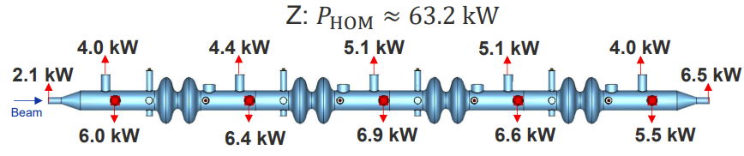
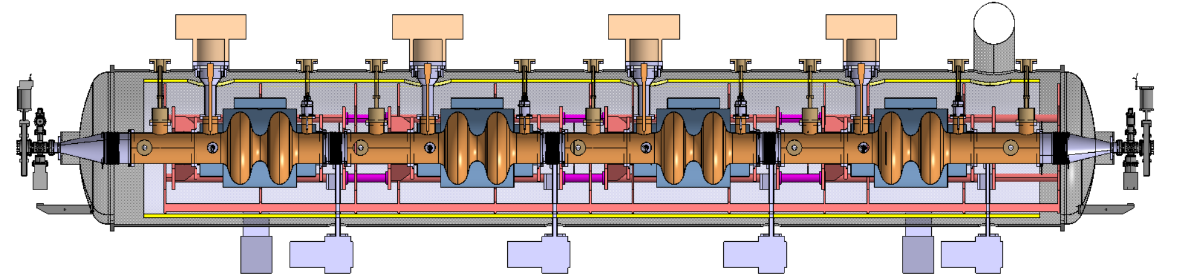
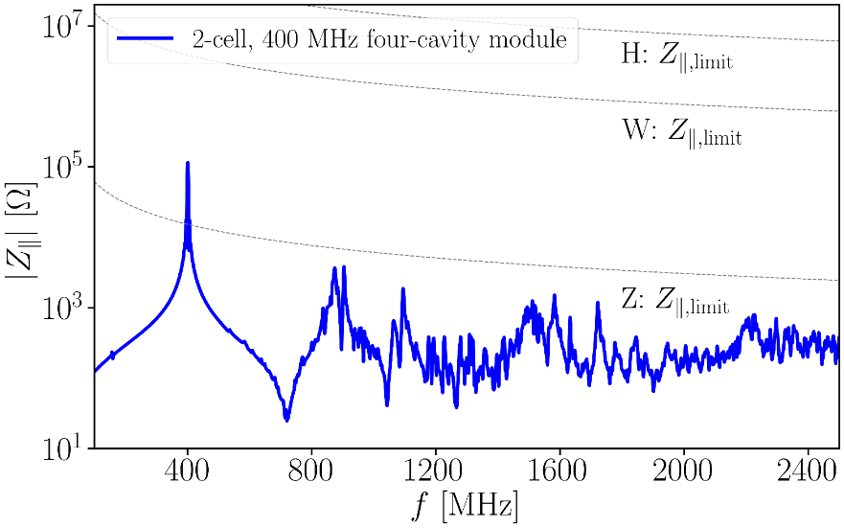
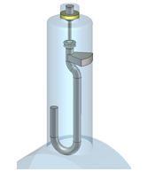
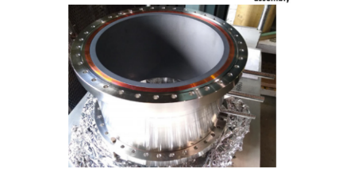
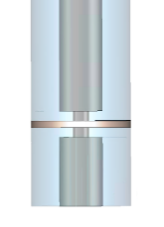
HOM Damping of FCC-ee 400 MHz Cavities
Two hook-type coaxial couplers per cavity used for trapped dipole mode damping. Total numbers: 8×66=528
Two coaxial lines between cavities for high-power HOM extraction. Total numbers: 10×66=660
(possibility of reducing this number should be checked)
BLA between modules to absorb power propagating from modules out. Total numbers=66+1=67
HOM power of all 8 hook-type HOM couplers combined is around 0.7 kW (not shown in the figure above)
CEPC has higher HOM power due to smaller cavity.
BS bunch length control critical to limit HOM power.
Water cooled BLA between modules
Coaxial lines terminated by water-cooled absorbers
Window to separate air and vacuum compromises broadband transmission (design study ongoing)
EIC BLA
Shahnam Gorgi Zadeh, FCC Week 2025

Slide 8
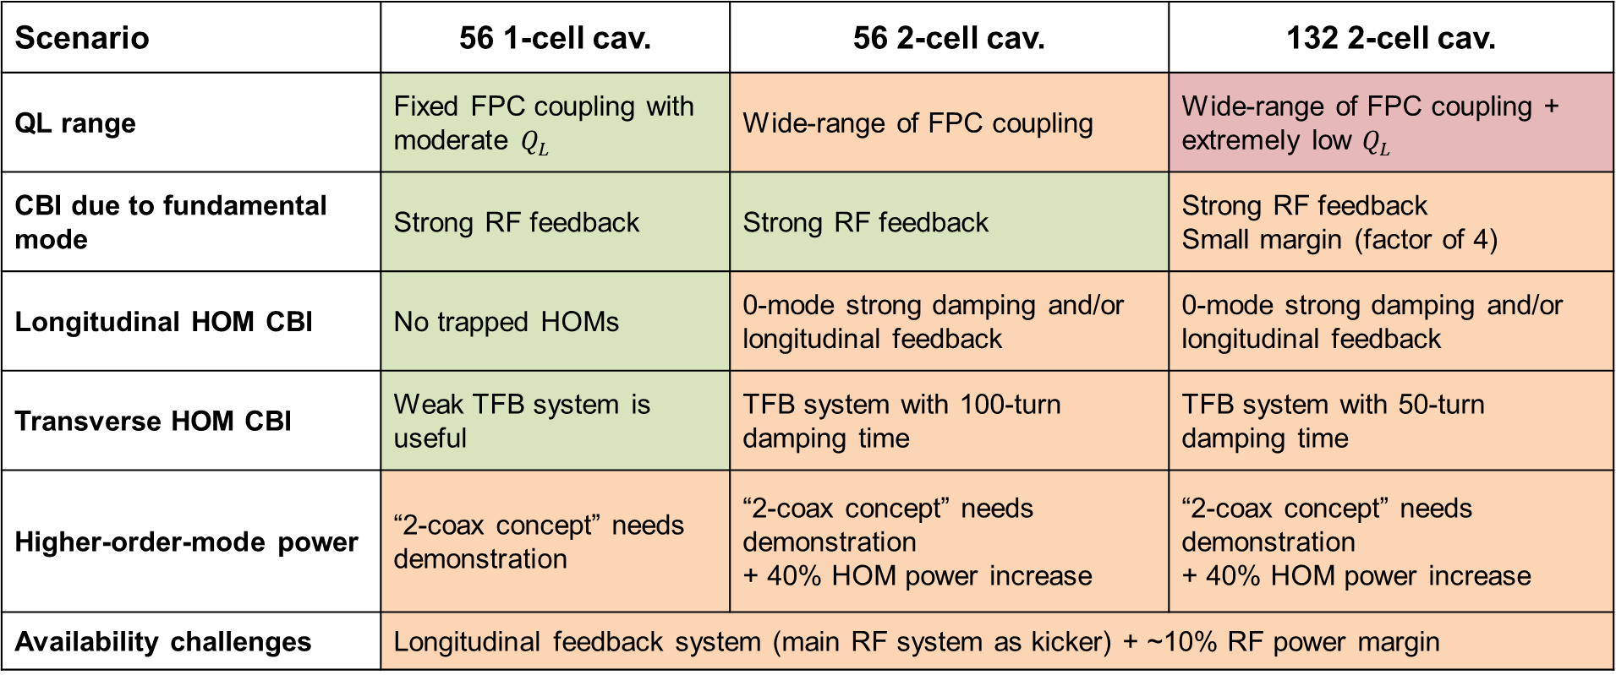
Z 2-cell vs 1-cell (FCC-ee)
Scenario | 56 1-cell cav. | 56 2-cell cav. | 132 2-cell cav.
QL range | Fixed FPC coupling with moderate $Q_{L}$ | Wide-range of FPC coupling | Wide-range of FPC coupling + extremely low $Q_{L}$
CBI due to fundamental mode | Strong RF feedback | Strong RF feedback | Strong RF feedback Small margin (factor of 4)
Longitudinal HOM CBI | No trapped HOMs | 0-mode strong damping and/or longitudinal feedback | 0-mode strong damping and/or longitudinal feedback
Transverse HOM CBI | Weak TFB system is useful | TFB system with 100-turn damping time | TFB system with 50-turn damping time
Higher-order-mode power | “2-coax concept” needs demonstration | “2-coax concept” needs demonstration + 40% HOM power increase | “2-coax concept” needs demonstration + 40% HOM power increase
Availability challenges | Longitudinal feedback system (main RF system as kicker) + ~10% RF power margin
Ivan Karpov

Slide 9
Content
CEPC SRF EDR Design
CEPC SRF R&D Progress
Summary

Slide 10
EDR Plan of CEPC SRF System
EDR major goal is to prepare for the first stage construction of the CEPC SRF system (30 MW H/W & low-lumi Z):
Complete engineering design of the Collider 650 MHz and Booster 1.3 GHz cryomodule for Higgs 30/50 MW & Z 10 MW (3.8×10³⁵ cm⁻²s⁻¹).
Complete Higgs 650 MHz full-scale cryomodule prototyping to achieve TDR specification.
High Q high gradient cavity and high power RF components R&D.
Collider Higgs 650 MHz Cryomodule Parameters | Spec.
Module operating temperature | 2 K
Cavity vertical test gradient | 28 MV/m
Cavity vertical test Q₀ at 25 MV/m | 3.3E10
Module RF voltage (six 2-cell cavities) | 70 MV
Module average cavity gradient | 25 MV/m
Module average cavity Q₀ at 25 MV/m | 3.0E10
Module total 2 K heat load at 70 MV | 160 W
Input coupler conditioning power | 300 kW
Input coupler Q_{e} adjusting range | 1E5 ~ 1E7
HOM coupler power (cryogenic test) | 1 kW
HOM absorber power (test stand) | 5 kW
CEPC SRF EDR | Preliminary Design | Engineering Design | Full-scale Prototyping | Industrial Preparation
Collider H/W/LL-Z (high Q / G 650 M) |  | √ | √ | √
Collider HL-Z (high current 650 M) | √
Collider ttbar (high G / Q 650 M) | √
Booster H/W/ttbar (high Q / G 1.3 G) |  | √ | CW/pulse FEL | CW FEL
Booster Z (high current 1.3 G) | √ | ERL | ERL

Slide 11
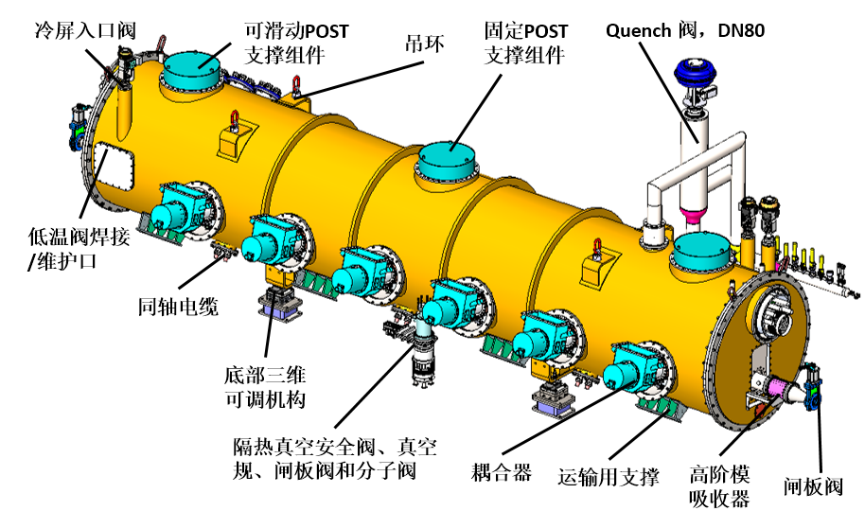
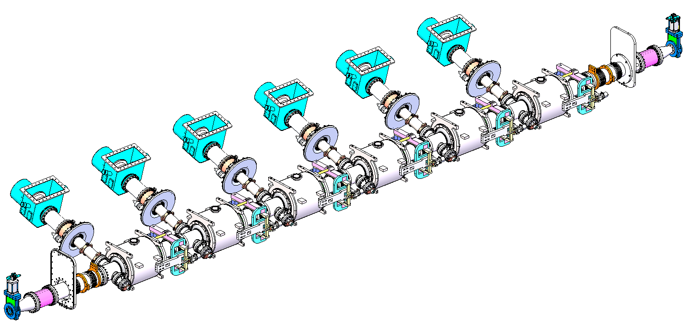
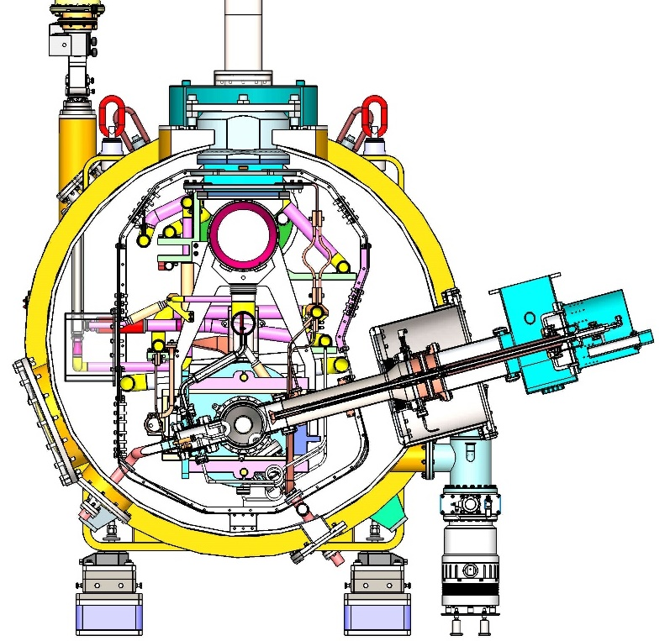
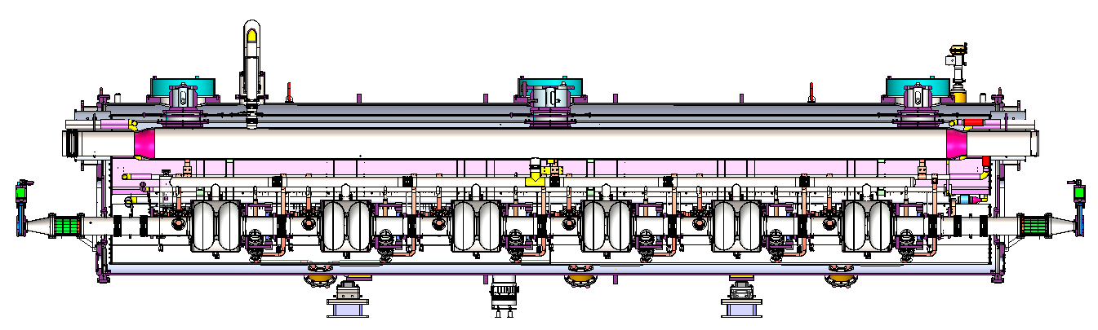
CEPC 650 MHz Full-Scale Prototype Cryomodule

Slide 12
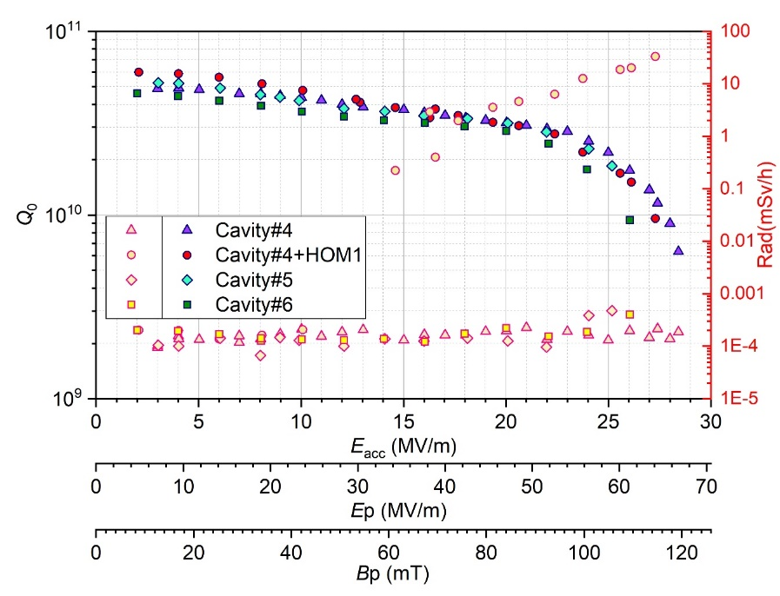
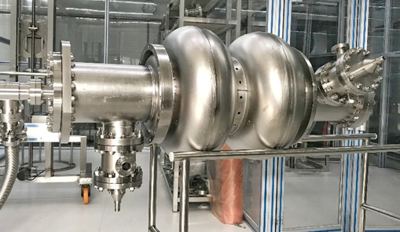
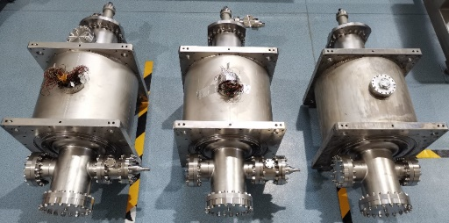
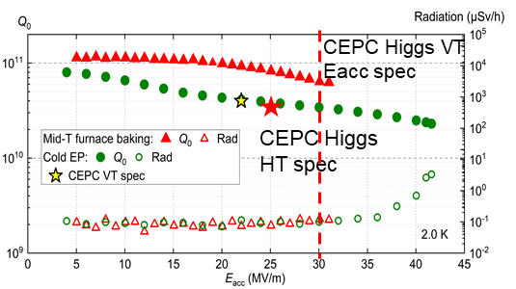
High Gradient and High Q 650 MHz Cavity
CEPC 650 MHz CM |  | EDR Specification
650 MHz 2-cell cavity vertical test | E_{acc.max} | 30 MV/m
 | Q₀ | 3.6E10 @ 25 MV/m
Module horizontal test acceptance | E_{acc.max} | 28 MV/m
 | Q₀ | 3.3E10 @ 25 MV/m
Module long term operation | E_{acc.max} | 28 MV/m
 | Q₀ | 3.0E10 @ 25 MV/m
650 MHz 2-cell BCP
20 % margin from vertical test to operation spec.
BCP dressed 2-cell VT: 2E10 @ 25 MV/m, max ~ 26.5 MV/m
BCP 2-cell module test: 2E10 @ 8 MV/m (coupler cooling limited?)
EP + mid-T 1-cell VT: 8E10 @ 25 MV/m, max 31.5 MV/m
Apply 1-cell recipe to 2-cell
650 MHz 1-cell EP mid-T
12

Slide 13
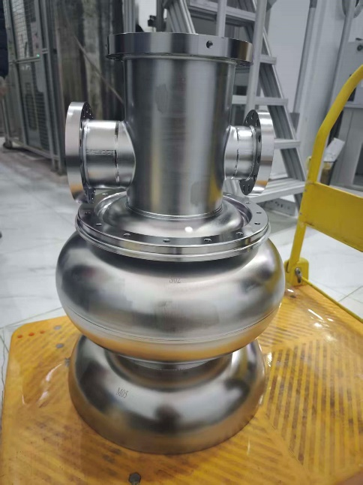
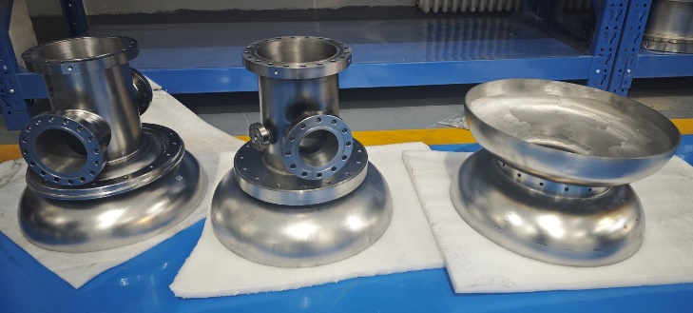
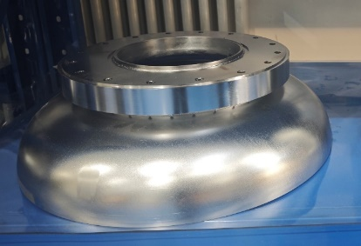
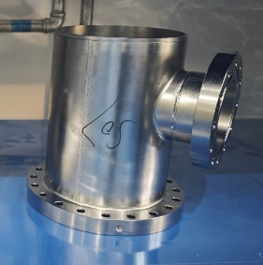
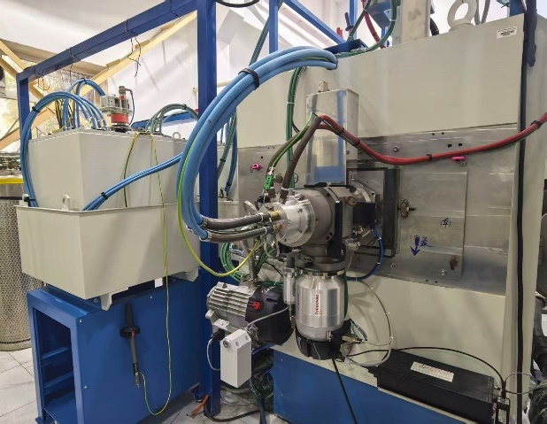
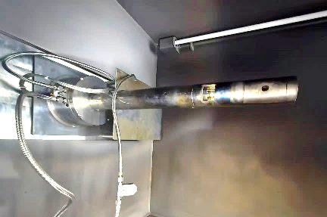
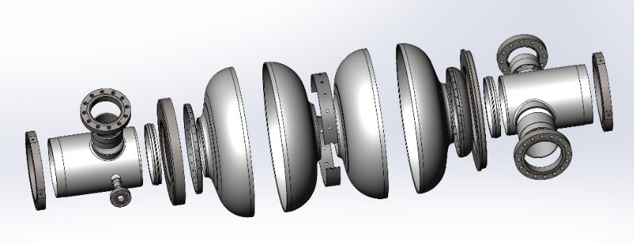
650 MHz 2-cell Cavity Fabrication
Will complete EBW of two 2-cell cavities in January and other six cavities later.
Processing (EP + improved mid-T) and vertical test to start soon.
Inside EBW system installed and in commissioning
Advantages:
still cylindrical and homogeneous beam after bending
extremely smooth weld seam for high performance cavity
welding of unreachable seam for design flexibility
Equator welding:
outside back-forming
two-side (now)
inside (next step)

Slide 14
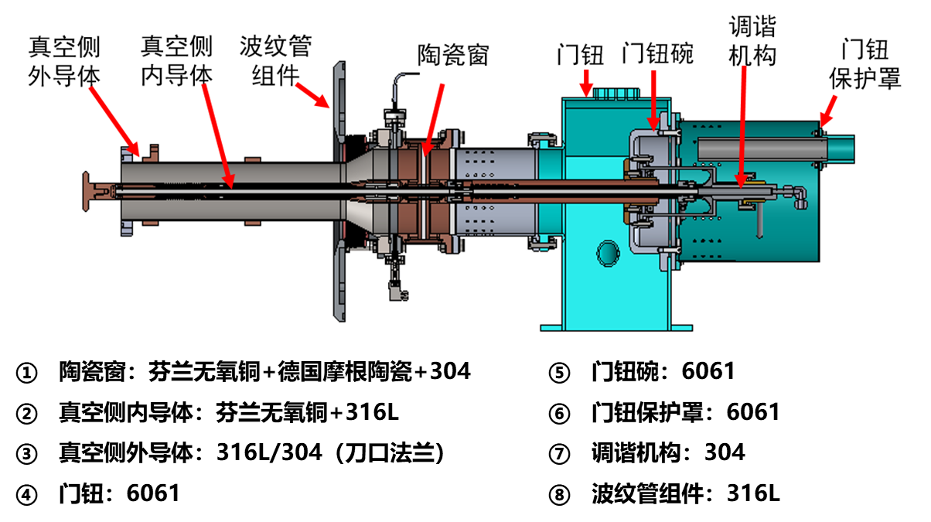
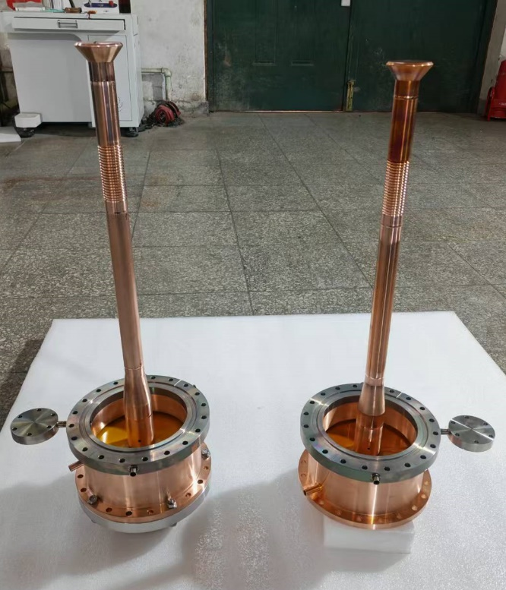
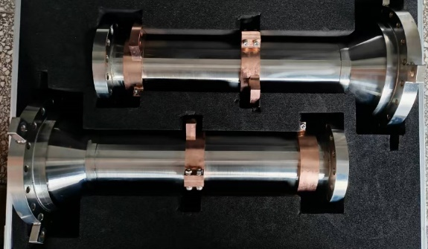
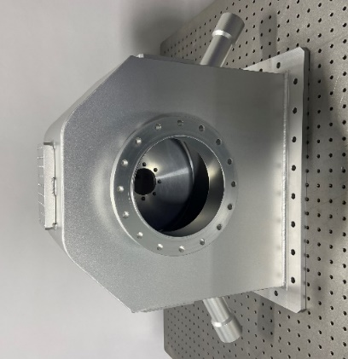
650 MHz Variable High Power Input Coupler
Six variable 300 kW CW 650 MHz input couplers for the full-size module. In TDR phase, both fixed and variable couplers are tested to CW TW 150 kW (SSA power limit), SW 100 kW. Two fixed couplers in test cryomodule.
Two variable couplers will be delivered in January (now outer conductor copper plating and ceramic TiN coating)
High power tested (> 300 kW) with 800 kW CW klystron
The other four variable couplers in fabrication

Slide 15
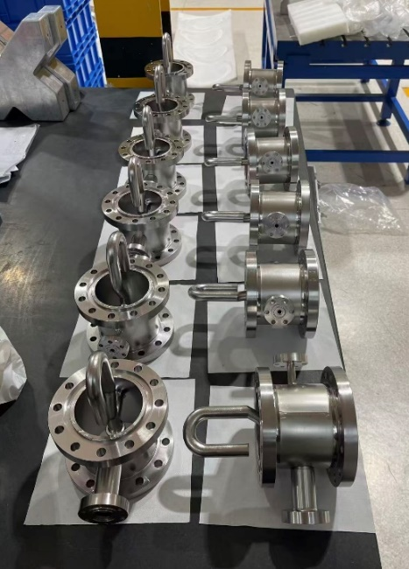
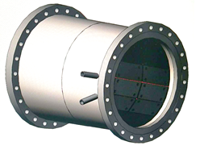
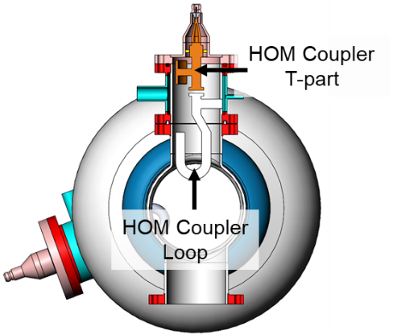
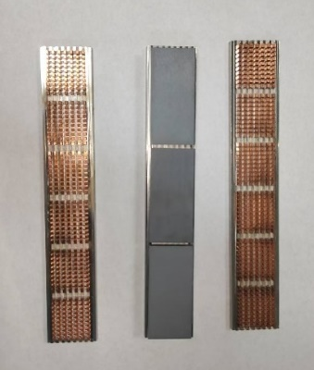
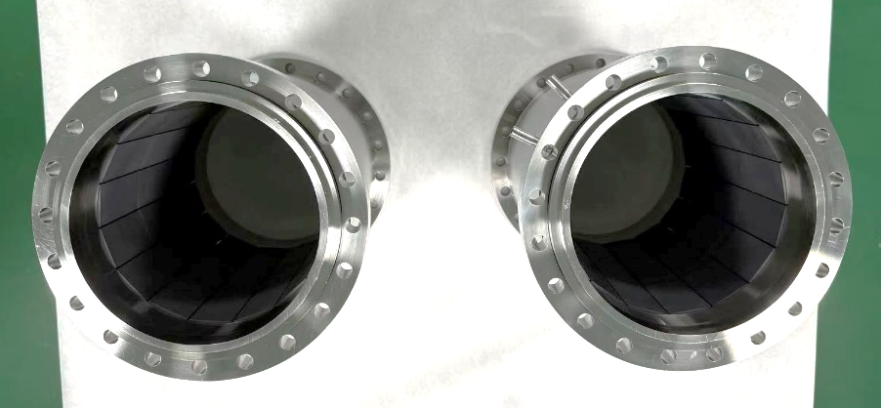
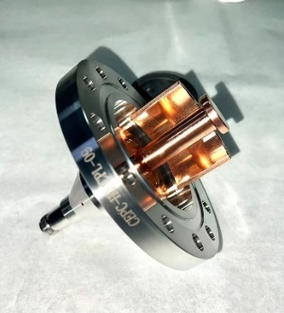
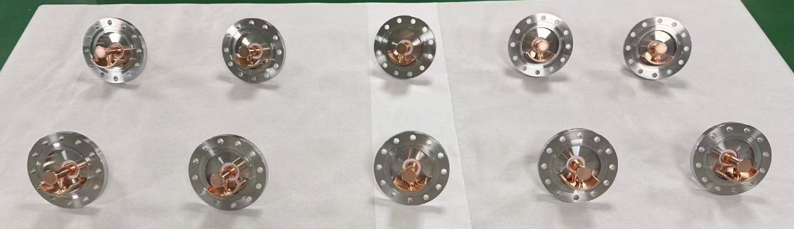
650 MHz HOM Coupler and Absorber
12 HOM couplers and two HOM absorbers fabrication completed. Processing and testing soon.
HOM absorber with
SiC + AlN material
1 kW HOM coupler
Free of notch-tuning

Slide 16
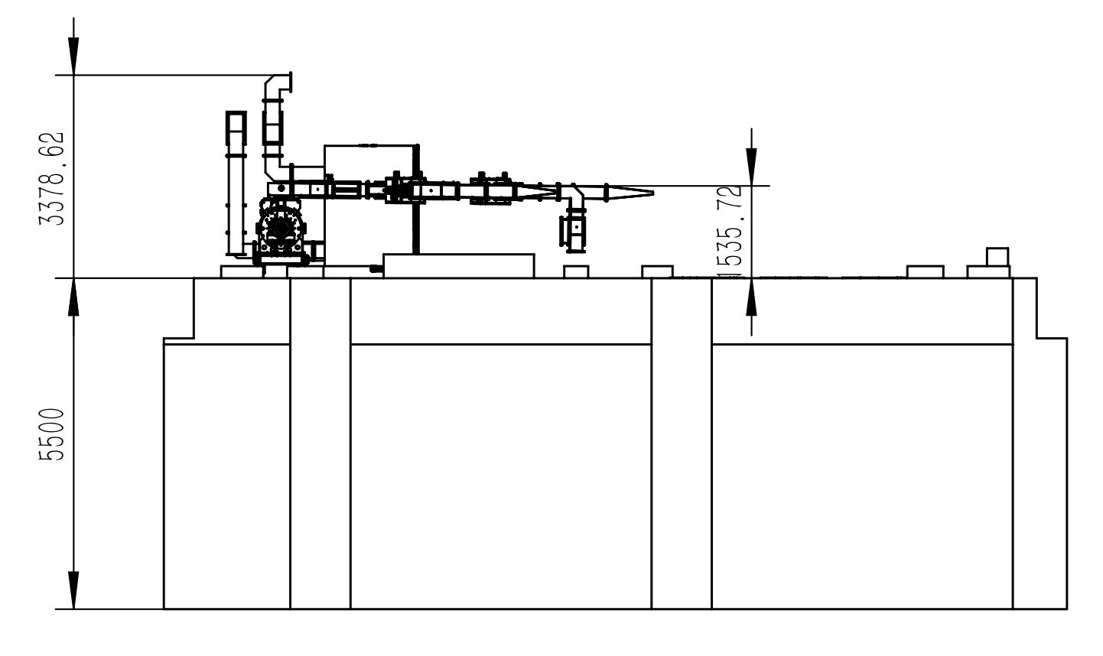
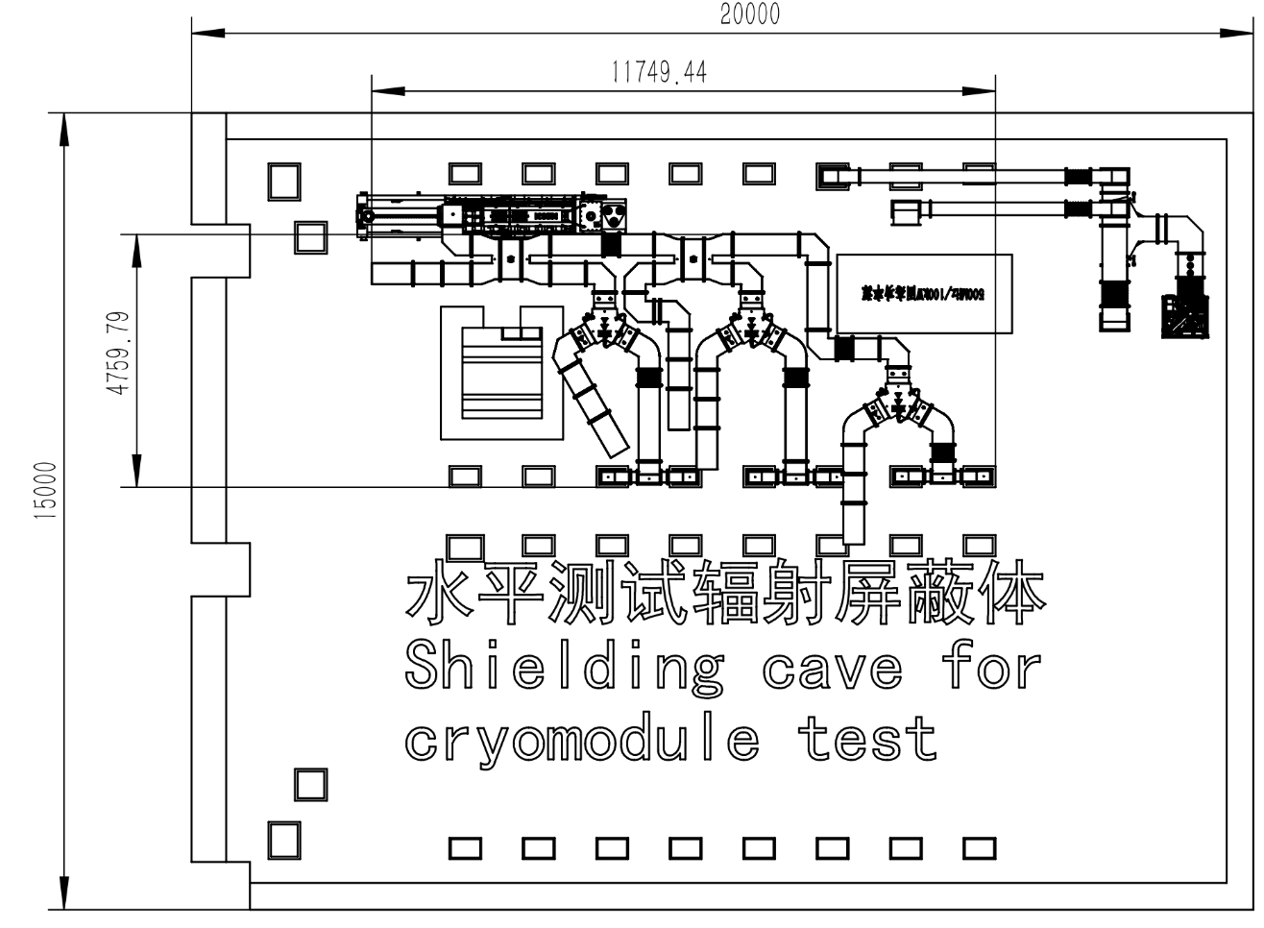
HLRF System for 650 MHz Module Test
Zusheng Zhou
CEPC 800 kW high efficiency 650 MHz klystron to feed six 2-cell cavities (150 kW SSA as backup).
RF distribution under design for the six 2-cell cavities.

Slide 17
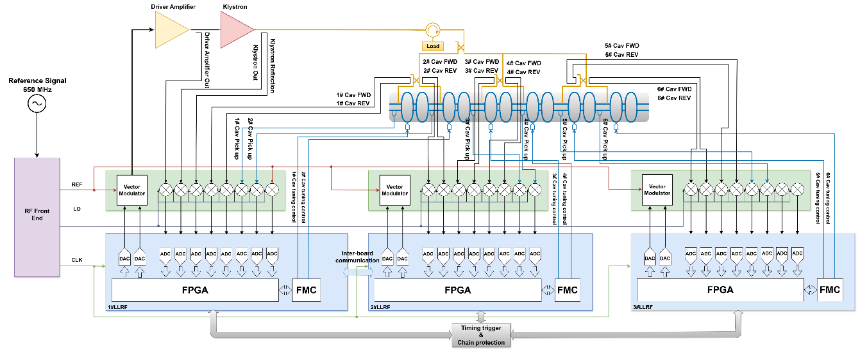
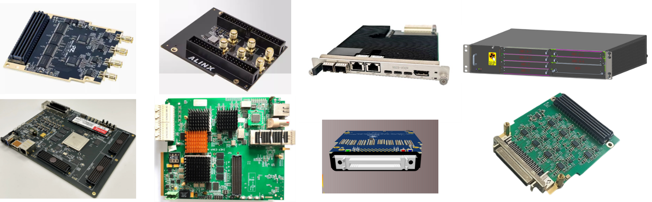
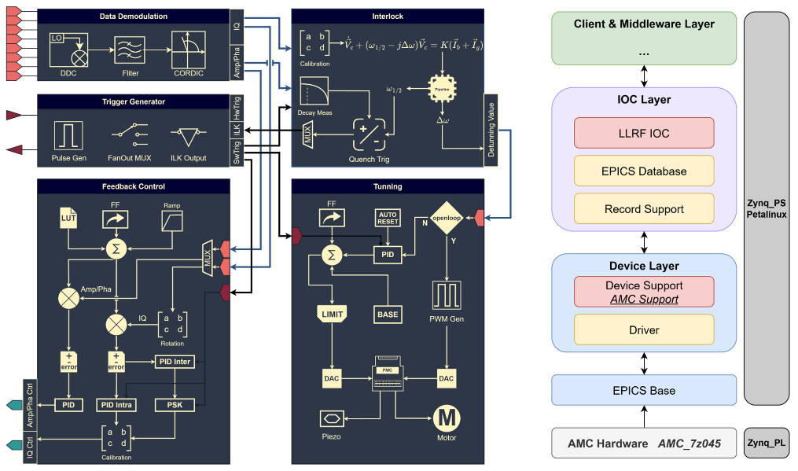
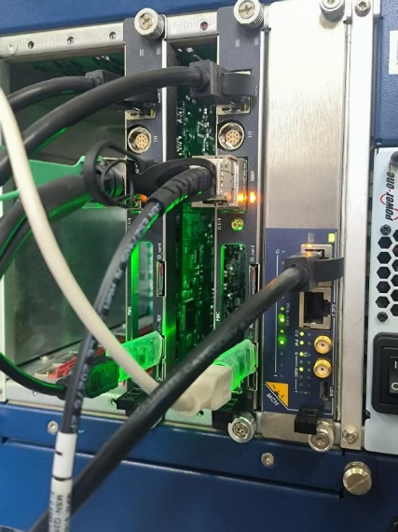
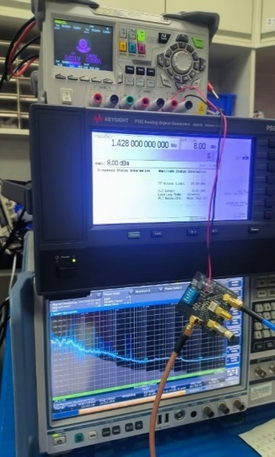
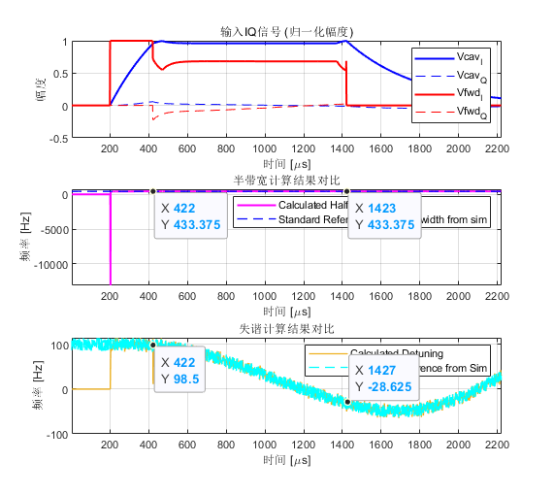
LLRF System for 650 MHz Module Test
Wenbin Gao
Nan Gan
Zusheng Zhou
LLRF system design scheme
Control boards and other hardware (domestic MicroTCA platform)
FPGA firmware and EPICS software architecture
Integration and testing

Slide 18
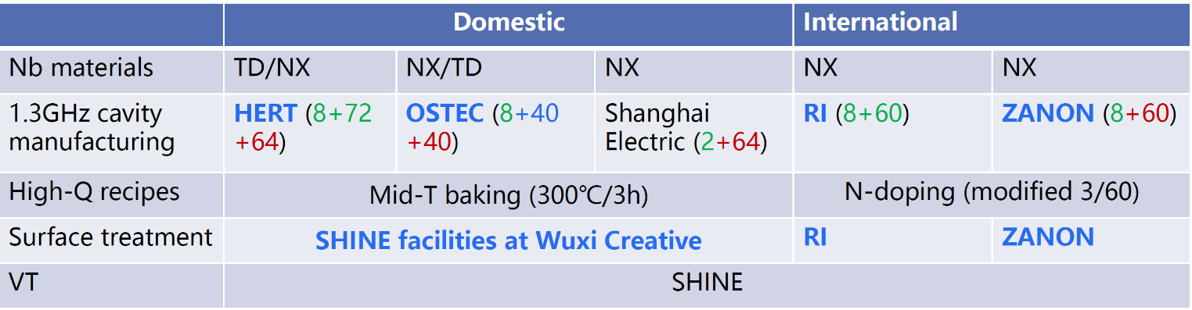
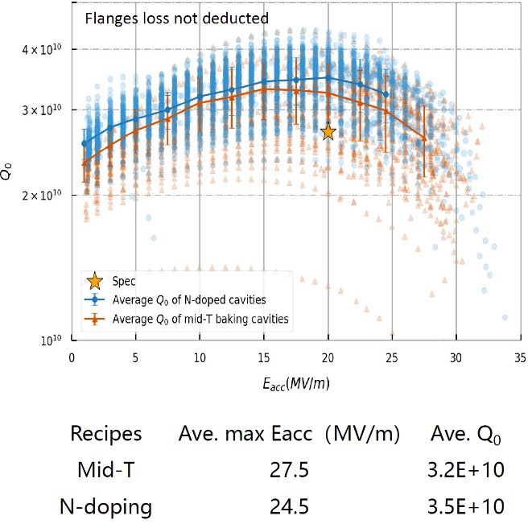
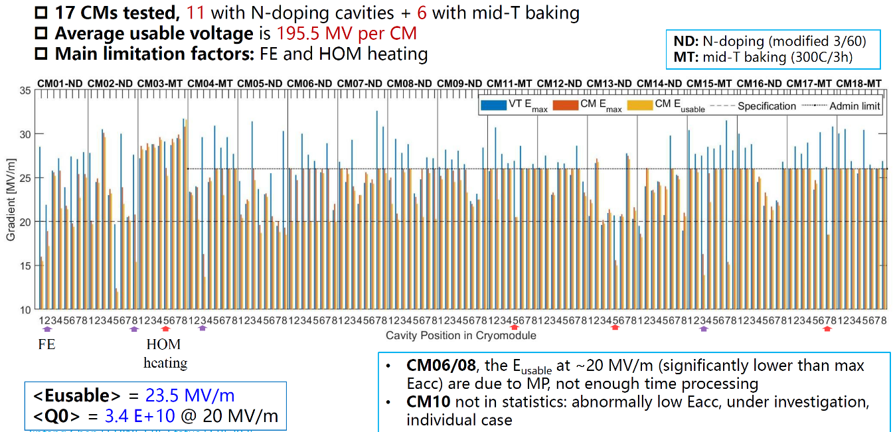
1.3 GHz High Q Cavity and Module
IHEP and SARI significantly advanced high Q mid-T bake application [PRAB 27, 092003 (2024) & NST 36,25 (2025)]
SHINE mass production of high Q cavity / module (as of Sept. 2025) : 126 mid-T cavities and 6 mid-T modules tested
HERT (IHEP) 1/3 of the total 432 cavities (54 CMs) for SHINE
Jinfang Chen, Hongtao Hou, SRF2025

Slide 19
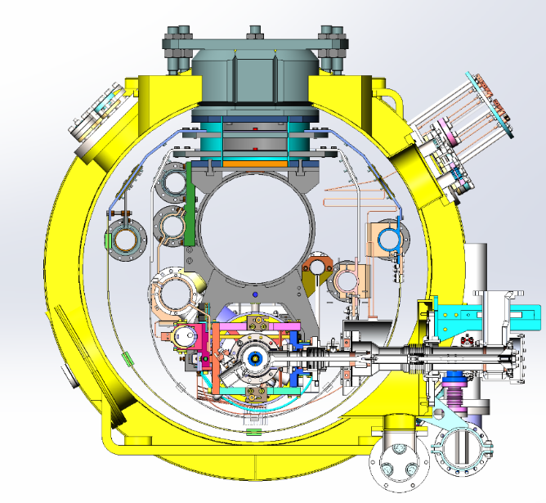
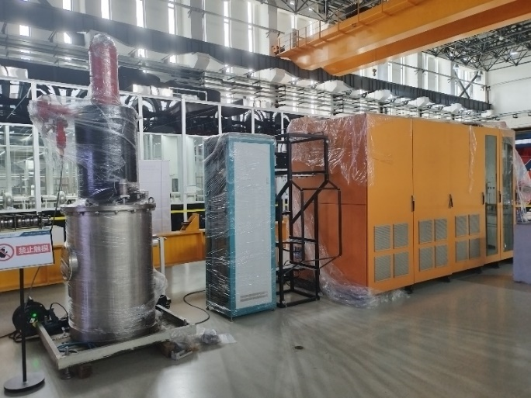


1.3 GHz High Gradient Module
1.3 GHz high gradient cavity and cryomodule R&D, aiming for 40 MV/m operation (pulsed). Module to be assembled and tested in 2026.
Module structure similar to TESLA/XFEL/ILC:
Two layers of thermal shields (add 5 K shield).
No JT and CD valves on the module, one helium vessel pre-cooling inlet (no fast cool down requirement)
1.3 GHz 5 MW klystron and power distribution system to feed 8 cavities
Lorentz force detuning compensation for eight cavities operation

Slide 20



1.3 GHz High Gradient Cavity
Established China’s first EP system and demonstrated high gradient 1-cell and 9-cell results in 2019-2020
Troubleshooting with field emission to recover and improve performance (1-cell OK, now 9-cell)
Developing T-mapping and second sound system for defect diagnostics
1.3 GHz 9-cell (2020)

Slide 21










1.3 GHz High Gradient Module Components

Slide 22
Summary and Outlook
CEPC SRF EDR R&D is focused on a full-size Higgs 650 MHz cryomodule, targeting high Q, high gradient, and high-power handling. This prototype can also be used for future advanced test facilities.
CEPC 1.3 GHz R&D to leverage synergies: ttbar booster 1.3 GHz high-gradient module aligns with national pulsed XFEL R&D, Z booster 1.3 GHz high-current module is with the planned ERL facility.
Optimize CEPC RF configuration to a more compact and efficient system —— integrate high-luminosity Z operation into Higgs by using uniform 2-cell or 1-cell cavities (RPO, large HOM power extraction, high gradient high Q cavity…)

