Slide 1

Perspective of Superconducting RF cavities on high-Q and high-G
CNRS/IN2P3/IJCLab
Akira Miyazaki

Slide 2
My personal bias
Perspective of Superconducting RF cavities on high-Q and high-G
CNRS/IN2P3/IJCLab
Akira Miyazaki
QED, axion,
Superconductivity,
Physics via RF

Slide 3
Outline
Introduction
Why do we need high-Q / high-G cavities?
State-of-the-art bulk niobium cavities
How to understand & optimize high-Q / high-G cavities?
Theory & engineering
Alternative materials
Nb₃Sn/Nb
MgB₂ & HTS
Practicalities
Conclusion

Slide 4
Outline
Introduction
Why do we need high-Q / high-G cavities?
State-of-the-art bulk niobium cavities
How to understand & optimize high-Q / high-G cavities?
Theory & engineering
Alternative materials
Nb₃Sn/Nb
MgB₂ & HTS
Practicalities
Conclusion

Slide 5
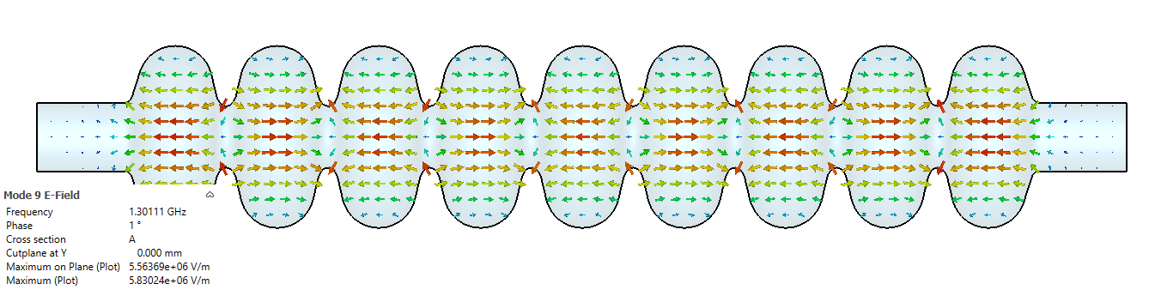
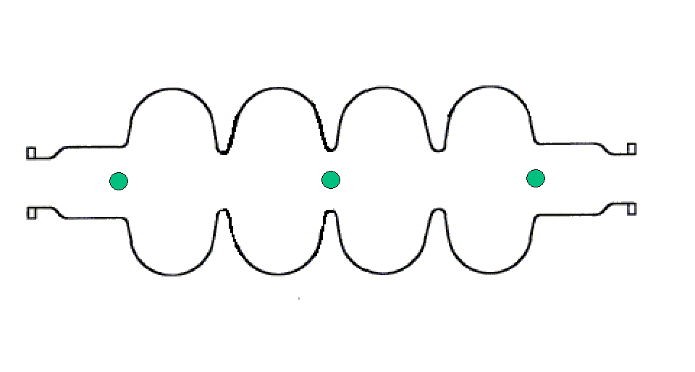
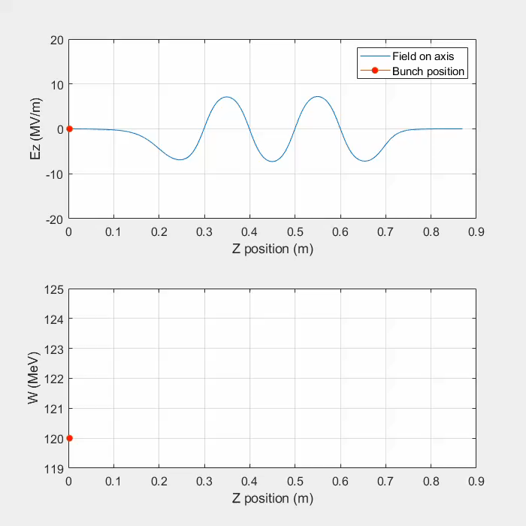

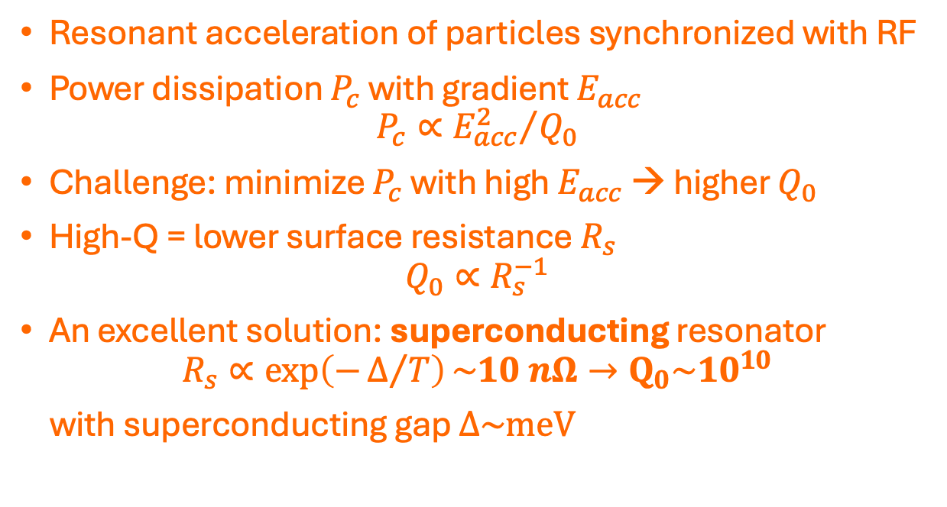
Superconducting RF (SRF) cavities for particle accelerators
Electric fields: $E_{acc}$ along the beam axis
Courtesy: F. Bouly
Resonant acceleration of particles synchronized with RF
Power dissipation $P_{c}$ with gradient $E_{acc}$
$$P_{c}∝{E_{acc}^{2}}/{Q_{0}}$$
Challenge: minimize $P_{c}$ with high $E_{acc}$ → higher $Q_{0}$
High-Q = lower surface resistance $R_{s}$
$$Q_{0}∝R_{s}^{−1}$$
An excellent solution: superconducting resonator
$$R_{s}∝\exp\left(−Δ/T\right)\sim 10 nΩ→Q_{0}\sim 10^{10}$$
with superconducting gap $Δ\sim meV$

Slide 6
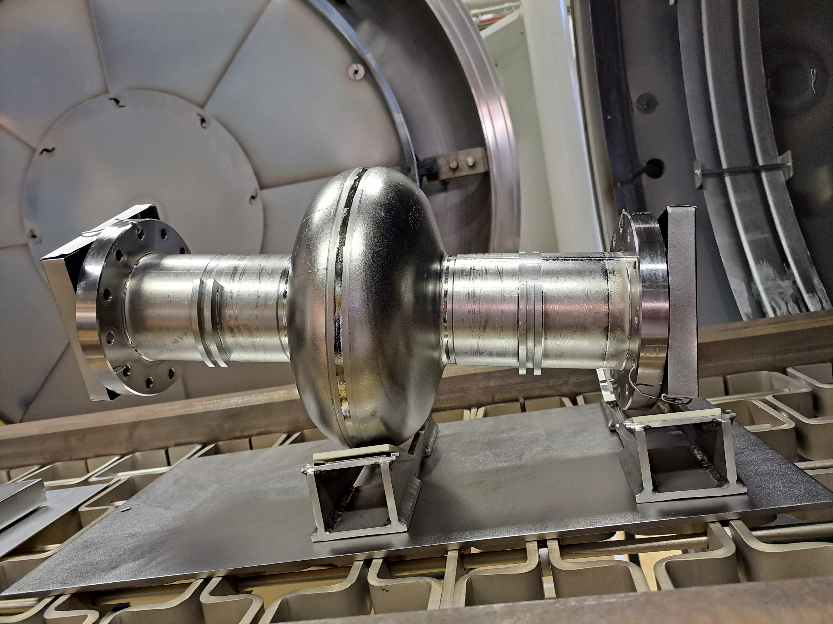
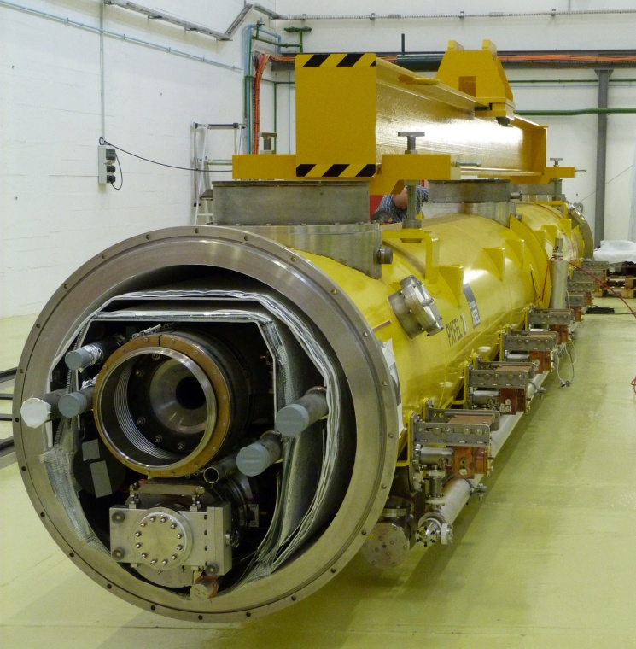
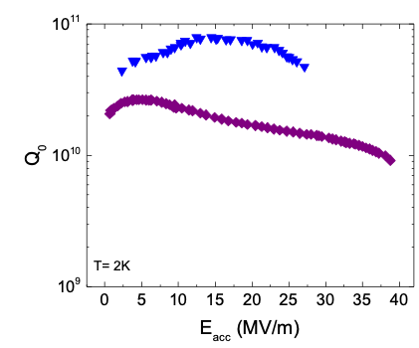
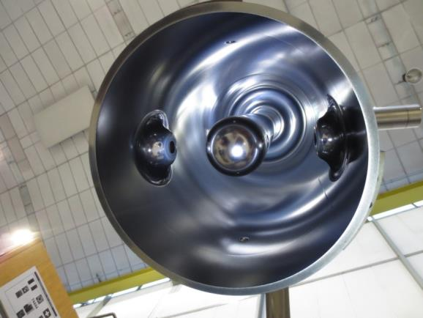
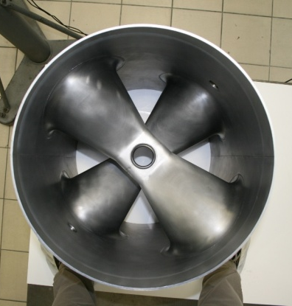
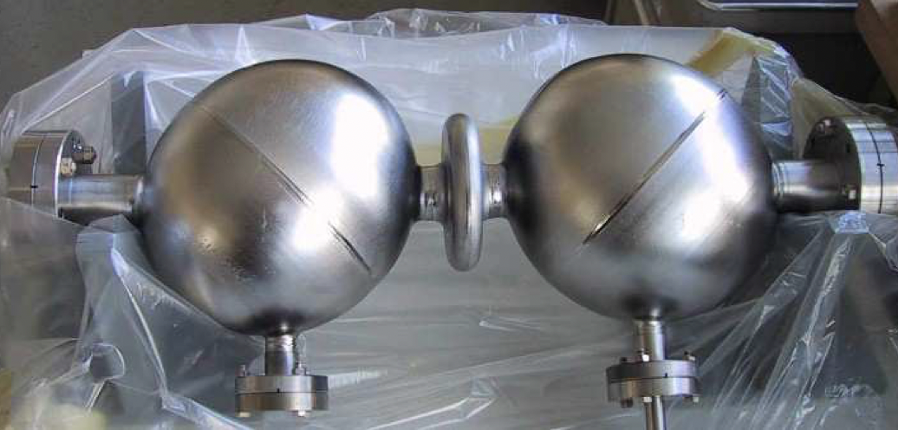
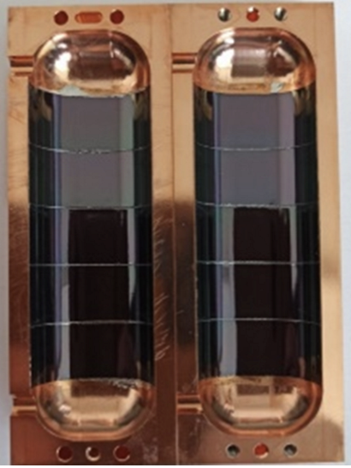
SRF is useful and interesting but NOT a magic wand…
1.3 GHz ILC
Nitrogen doping
800 MHz FCCee
1.3 GHz EuXFEL
standard ILC treatment
Courtesy of
S. Belomestnykh
100 MHz HIE-ISOLDE
1.3 GHz
352 MHz
ESS
400 MHz HL-LHC
Pros: versatile for various needs with basically the identical technology
Cons: somewhat limited in gradient, more crucially lacking sustainability (LHe, pure Nb)
But extremely interesting in fundamental science
Nonequilibrium superconductivity has not been fully understood!
A lot of applications in other fields: photon sensors, qubits, DM & GW searches
2 GHz
MAGO
8.8 GHz
RADES

Slide 7
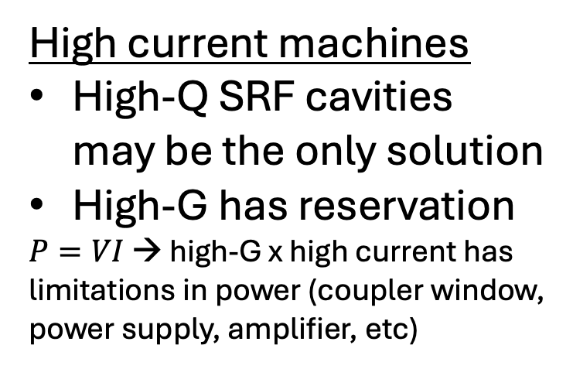
Where do we need high-Q/high-G SRF cavities?
- Energy frontier storage ring (CW, high current)
→ SuperKEKB, LEP2, LHC, FCCee, CEPC, FCChh
High current machines
High-Q SRF cavities may be the only solution
High-G has reservation
$P=VI$ → high-G x high current has limitations in power (coupler window, power supply, amplifier, etc)
- Electron linac (long pulse / CW, high current)
→ EuXFEL, LCLSII, SHINE, etc
- Proton linac (long pulse / CW, high current)
→ ESS, MYRRHA, PIPII, MuCol injector
- Heavy ion linac (CW, low-high current)
→ Srial2, SRILAC, HIE-ISOLDE, RAON, FRIB, ANL-ATLAS, etc
- Energy frontier e+/e– linear collider (long pulse / short pulse)
→ High-G is absolute must → CLIC/C³/plasma is better wrt gradient
Decision making depends on various things: aperture, cryogenic infrastructure, high-power RF, overall technical readiness, …

Slide 8
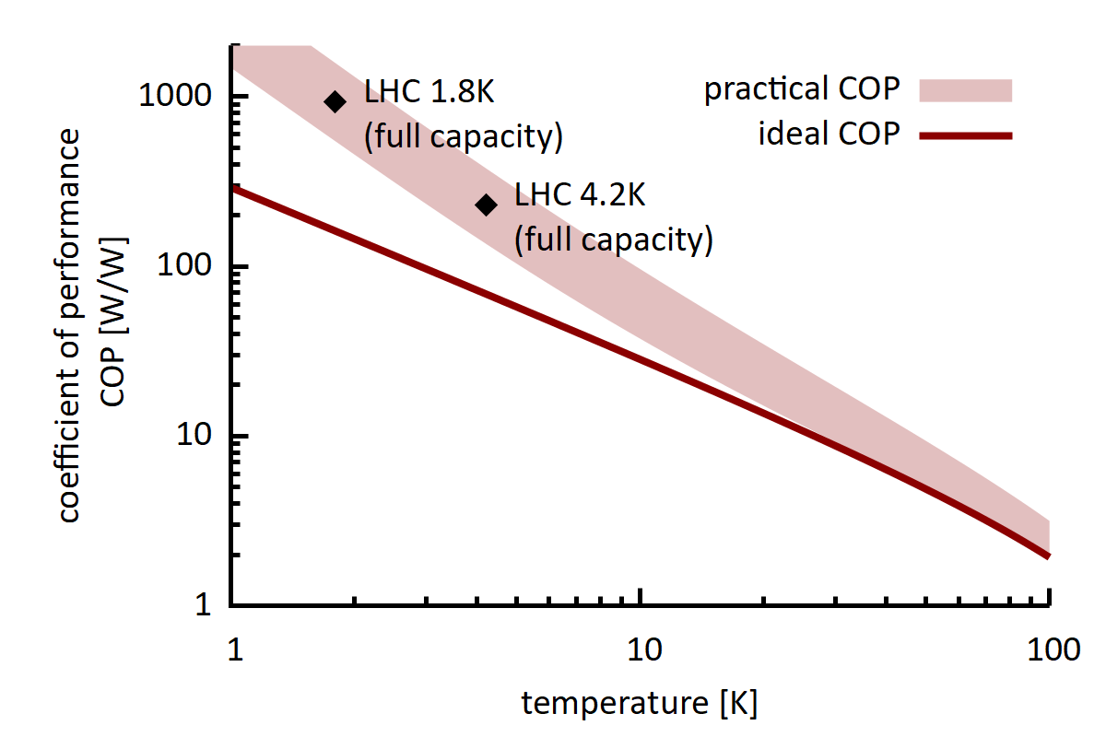
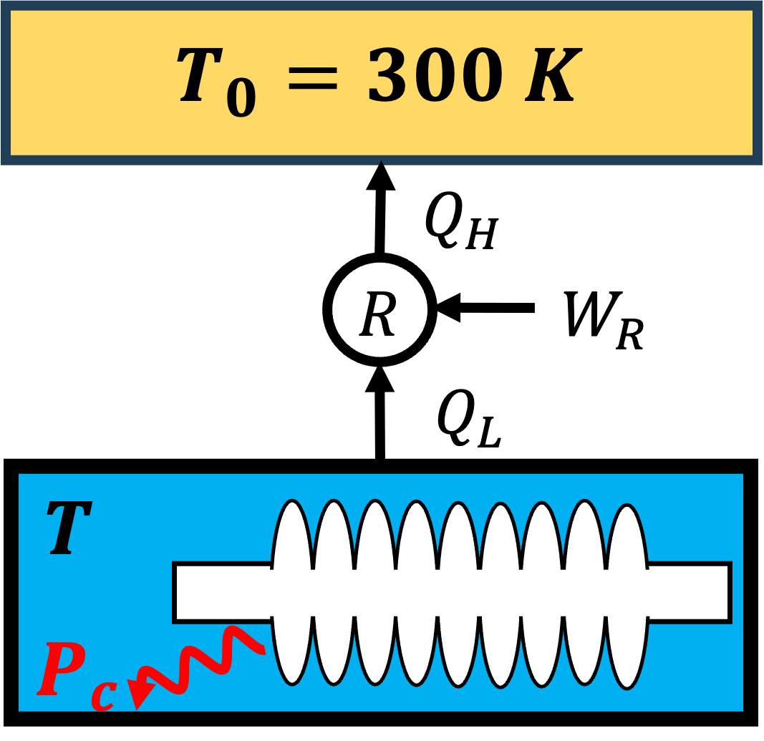
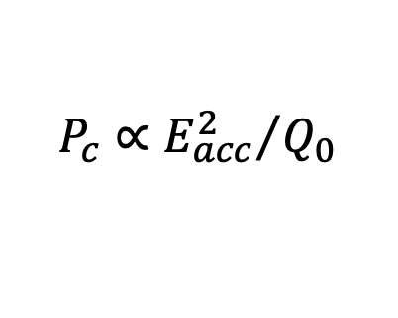
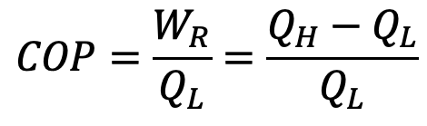
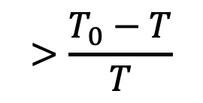
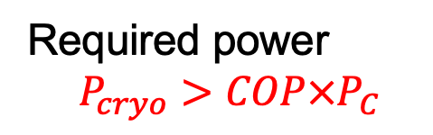
R&D toward high-Q/high-G…in the modern context
Impact of power dissipation $P_{c}$ depends on the operation temperature
$$COP=\frac{W_{R}}{Q_{L}}=\frac{Q_{H}−Q_{L}}{Q_{L}}$$
(Carnot cycle)
M. Seidel iSAS workshop 2023
S.Claudet et al, CERN 2013
Carnot’s theorem
$$>\frac{T_{0}−T}{T}$$
Required power
$$P_{cryo}>COP×P_{C}$$
$$P_{c}∝{E_{acc}^{2}}/{Q_{0}}$$
1 W evacuation: 1 kW from 2 K vs 200 W from 4 K (vs <10 W from 70 K)
Simpler cryogenic system (2K needs 30 mbar pumping) is an advantage
Reasonable-Q at higher T can be a competitive option → new SC materials!

Slide 9
Outline
Introduction
Why do we need high-Q / high-G cavities?
State-of-the-art bulk niobium cavities
How to understand & optimize high-Q / high-G cavities?
Theory & engineering
Alternative materials
Nb₃Sn/Nb
MgB₂ & HTS
Practicalities
Conclusion

Slide 10
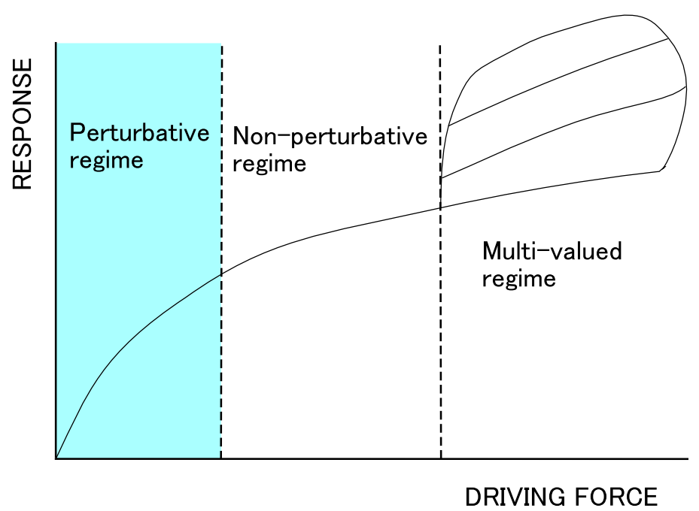
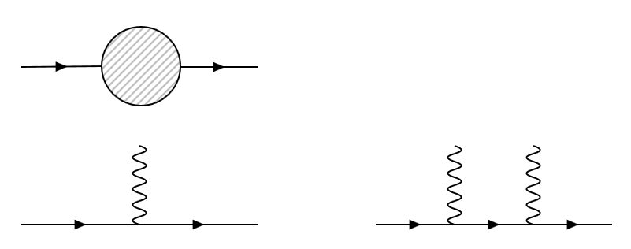
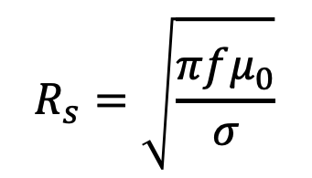
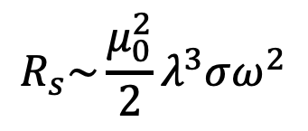
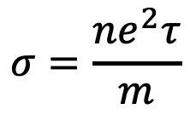

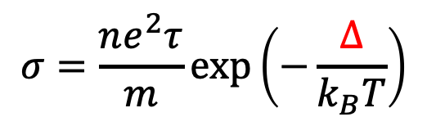
Linear response of condensed matter against classical RF
$$ℋ=ℋ_{0}+ℋ_{RF}(t)$$
If the RF field is “small”
(Suspicious in our case…)
First order perturbation
Higher order terms ignored
equilibrium
equilibrium
=
+
+ …
A. Shimizu, UTokyo
The responding current is given by the equilibrium state (fluctuation-dissipation theorem)
$ℋ_{0}$ : Fermi Liquid → Ohm’s law $ℋ_{0}$ : BCS → Mattis Bardeen
R. Kubo, J. Phys. Soc. Jpn. 12, pp. 570-586 (1957)
Mattis & Bardeen Phys Rev 111 412 (1958)
$$R_{s}=\sqrt{\frac{πfμ_{0}}{σ}}$$
$$σ=\frac{ne^{2}τ}{m}$$
$$R_{s}\sim \frac{μ_{0}^{2}}{2}λ^{3}σω^{2}$$
$$σ=\frac{ne^{2}τ}{m}exp\left(−\frac{Δ}{k_{B}T}\right)$$

Slide 11
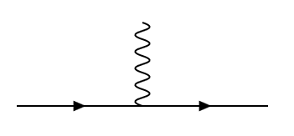

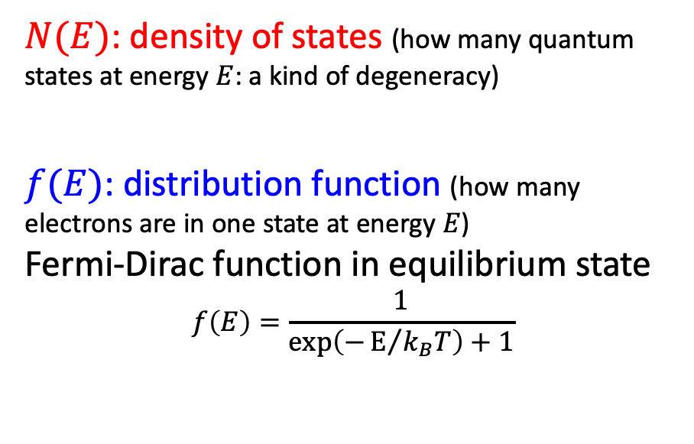
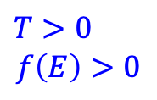


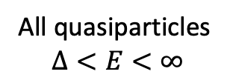





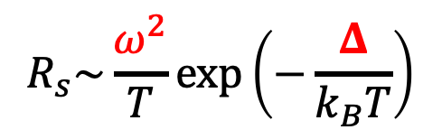



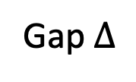
Linear response theory can be approximated by Fermi’s Golden rule
2
Z. Physik 266 p.209 (1974)
$$R_{s}∝P≅Σ_{p, p^{′},h\vec{k}}$$
$$∝$$
(photon energy) x (net # of absorbed photons)
$$E+ℏω$$
$$ℏω$$
$$=ℏω\left(n_{+}−n_{−}\right)=ℏω\int_{Δ}^{∞}{dE \left[f\left(E\right)−f\left(E+ℏω\right)\right]×N\left(E\right)N\left(E+ℏω\right)}$$
$$E$$
$$E+ℏω$$
$N(E)$: density of states (how many quantum states at energy $E$: a kind of degeneracy)
$f(E)$: distribution function (how many electrons are in one state at energy $E$)
Fermi-Dirac function in equilibrium state
$$f\left(E\right)=\frac{1}{\exp\left(−E/{k_{B}T}\right)+1}$$
$$ℏω$$
$$E$$
All quasiparticles
$$Δ<E<∞$$
Gap $Δ$
$$T=0$$
$T>0$
$$f\left(E\right)>0$$
$$R_{s}\sim \frac{ω^{2}}{T}\exp\left(−\frac{Δ}{k_{B}T}\right)$$
$$T>0$$
$$R_{s}\left(T=0\right)=0$$

Slide 12
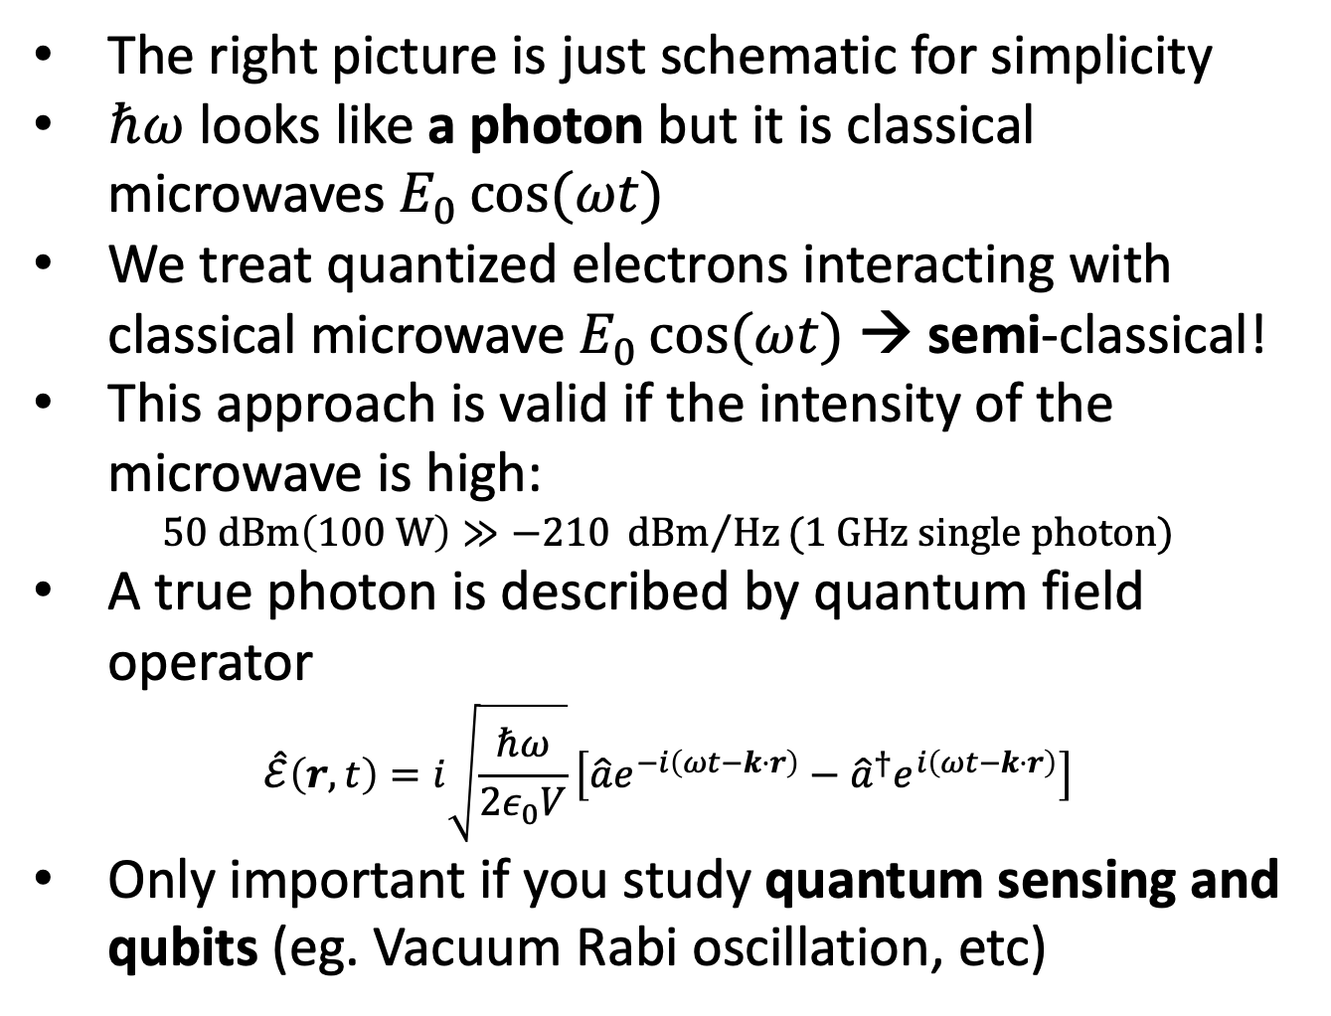
Remark: SRF is semi-classical
The right picture is just schematic for simplicity
$ℏω$ looks like a photon but it is classical microwaves $E_{0}\cos{(ωt)}$
We treat quantized electrons interacting with classical microwave $E_{0}\cos{(ωt)}$ → semi-classical!
This approach is valid if the intensity of the microwave is high:
$$50 dBm\left(100 W\right)≫−210 {dBm}/{Hz}(1 GHz single photon)$$
A true photon is described by quantum field operator
$$\hat{ℰ}\left(r, t\right)=i\sqrt{\frac{ℏω}{2ε_{0}V}}\left[\hat{a}e^{−i\left(ωt−k⋅r\right)}−{\hat{a}}^{†}e^{i\left(ωt−k⋅r\right)}\right]$$
Only important if you study quantum sensing and qubits (eg. Vacuum Rabi oscillation, etc)
Maybe a misleading schematic ☹

Slide 13
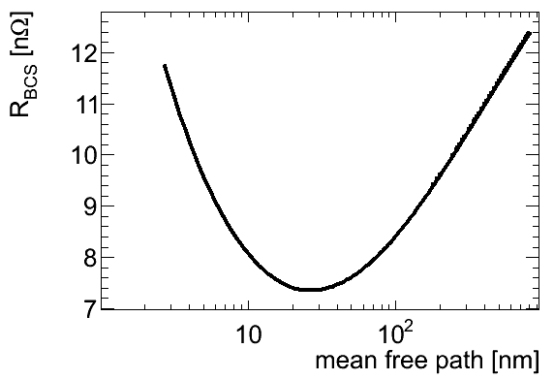
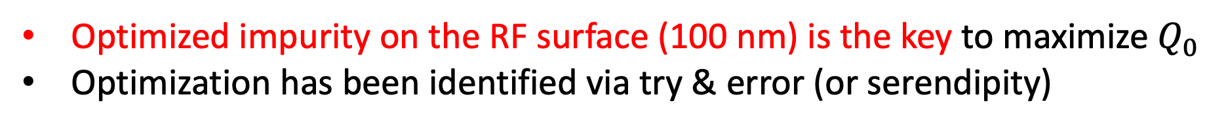
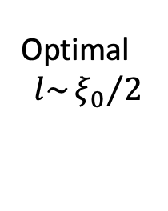
Prediction from the Mattis Bardeen theory (1958)
Bulk niobium
+ surface engineering
BCS-MB for niobium
Halbritter, KFK-Ext.03/70-06 (1970), https://publikationen.bibliothek.kit.edu/270004230
Optimal
$$l\sim {ξ_{0}}/2$$
G. Ciovati PhD thesis
Optimized impurity on the RF surface (100 nm) is the key to maximize $Q_{0}$
Optimization has been identified via try & error (or serendipity)

Slide 14
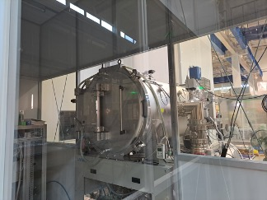
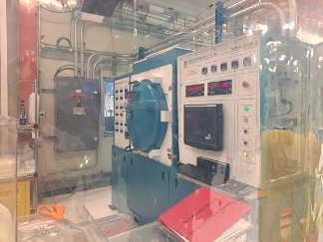
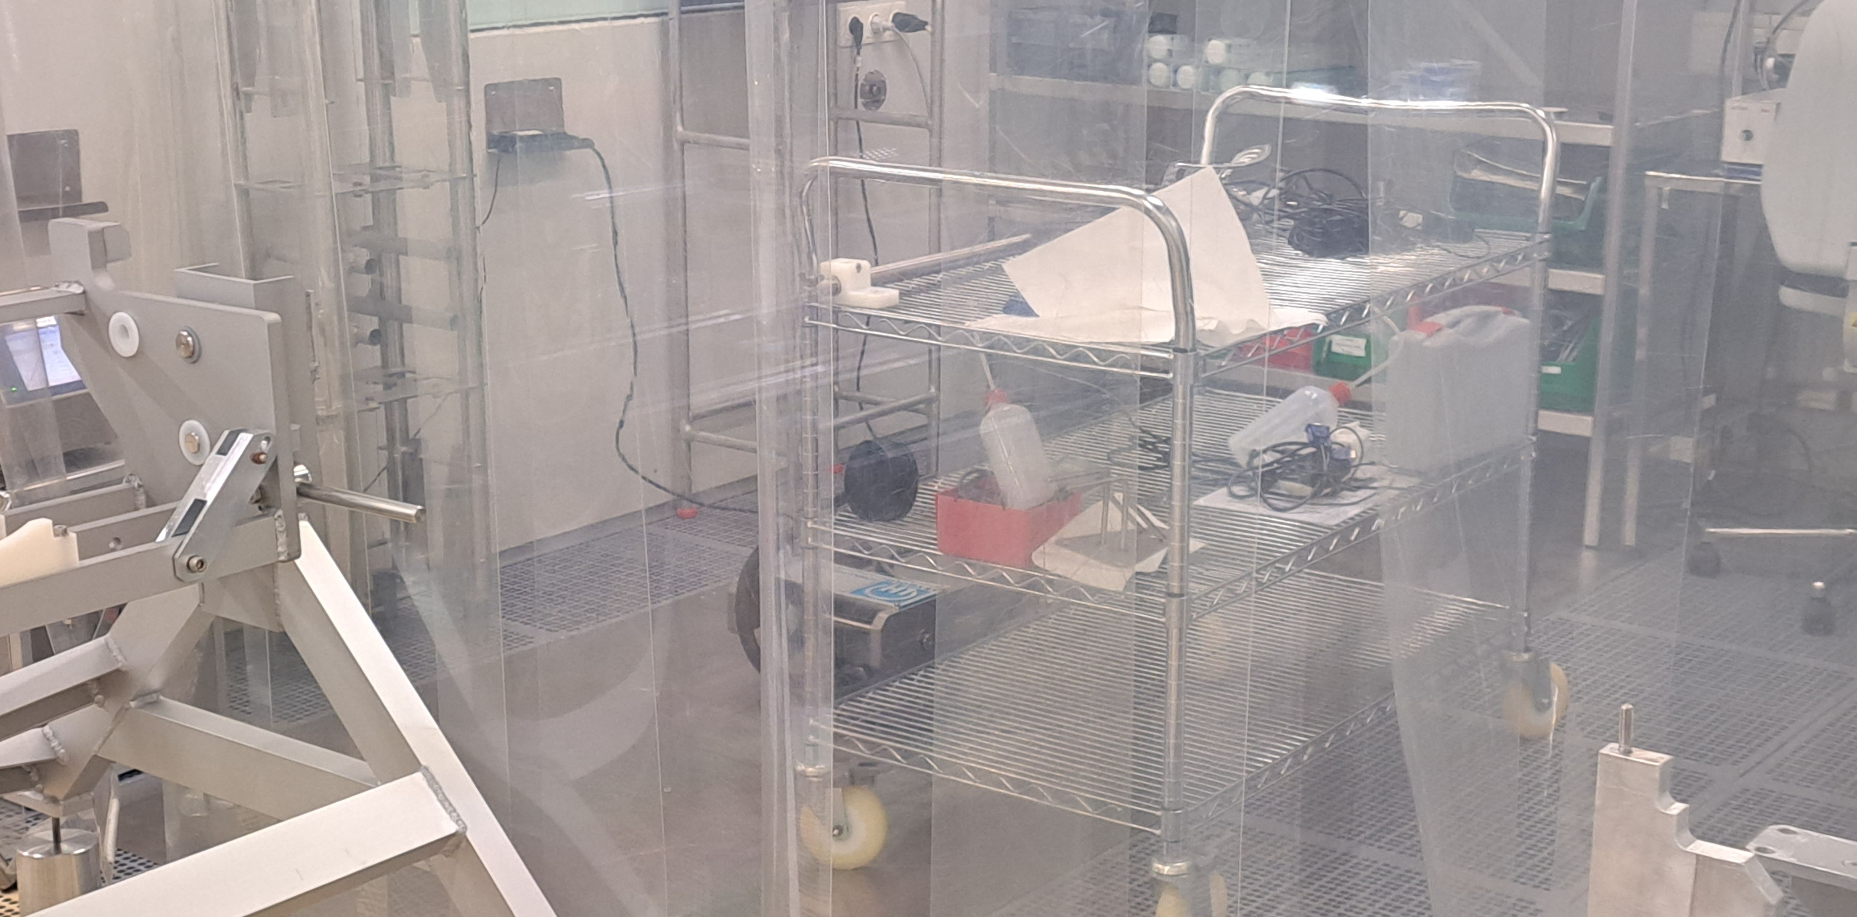
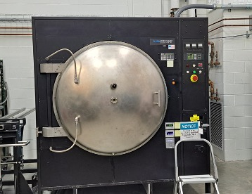
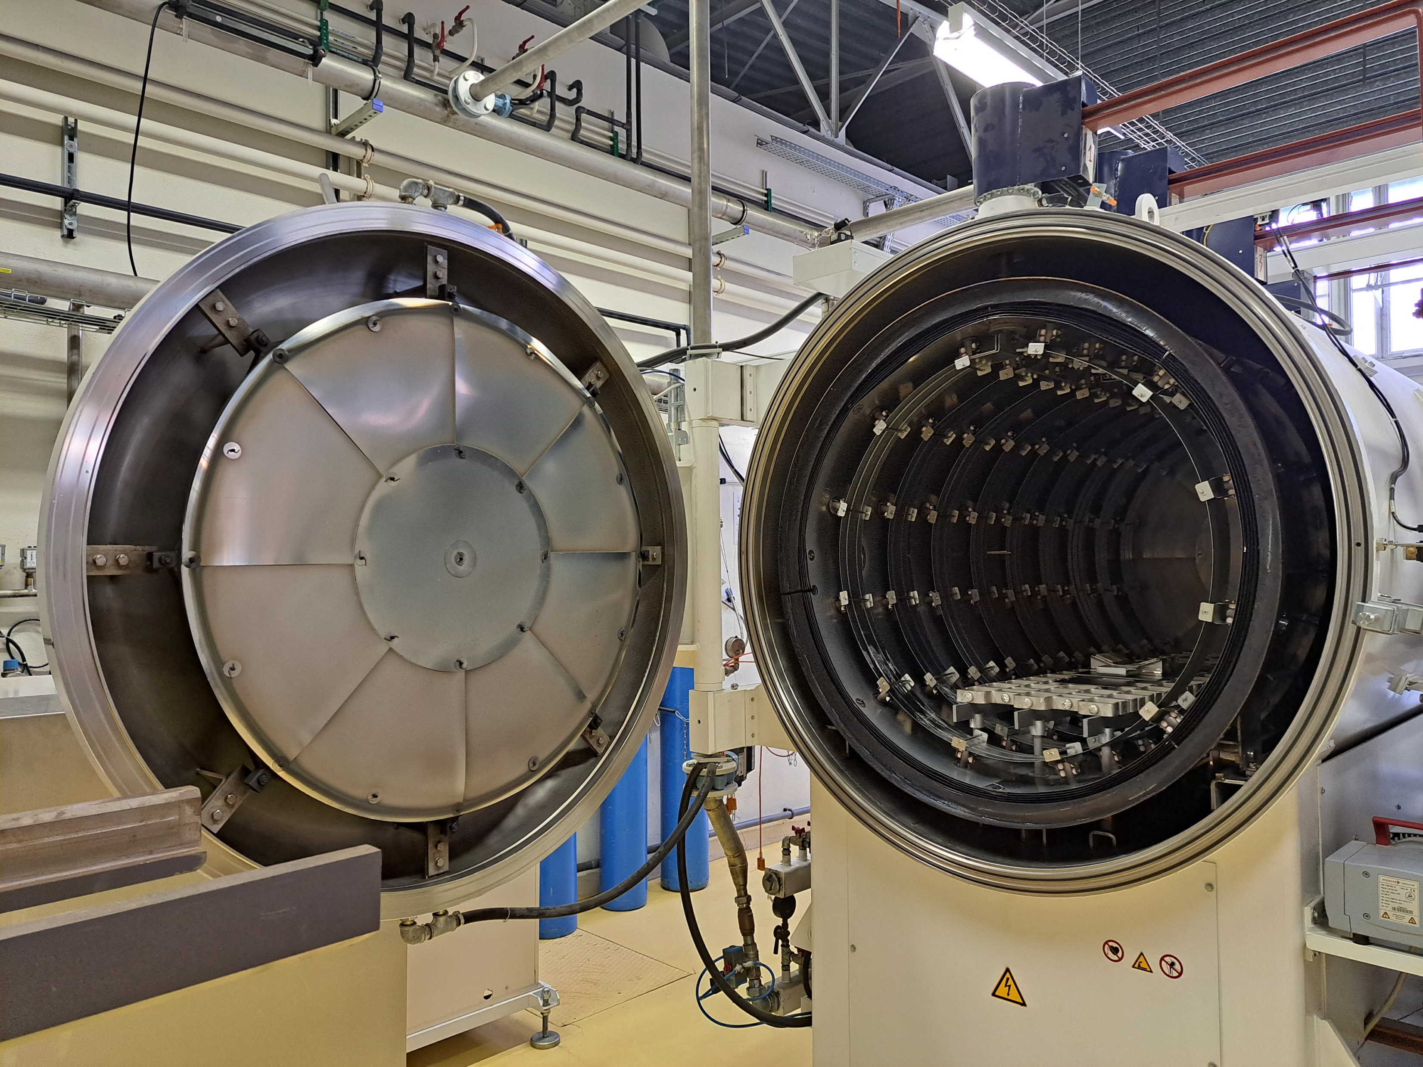
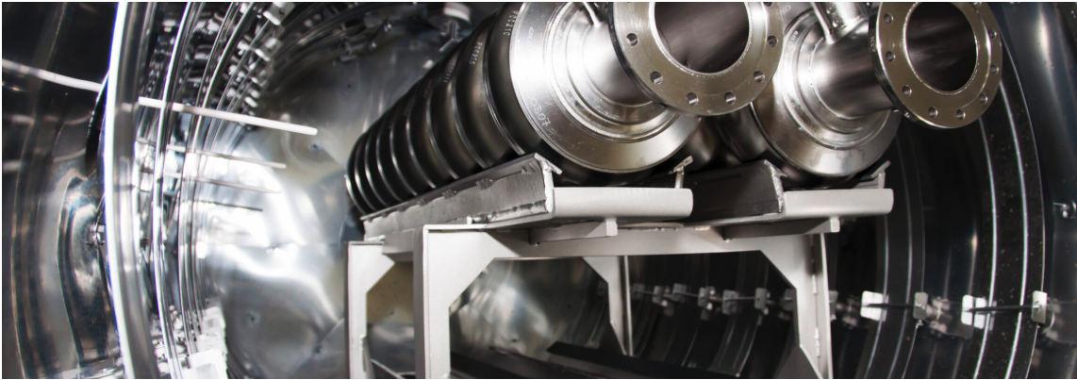
Surface engineering in clean vacuum furnaces
Furnace baking with cryogenic pumps
Oxygen doping, nitrogen doping, etc
Some minor differences among the labs
Systematic studies on different parameters over various laboratories are on-going
KEK
FNAL
DESY
JLAB
IJCLab
ZANON

Slide 15
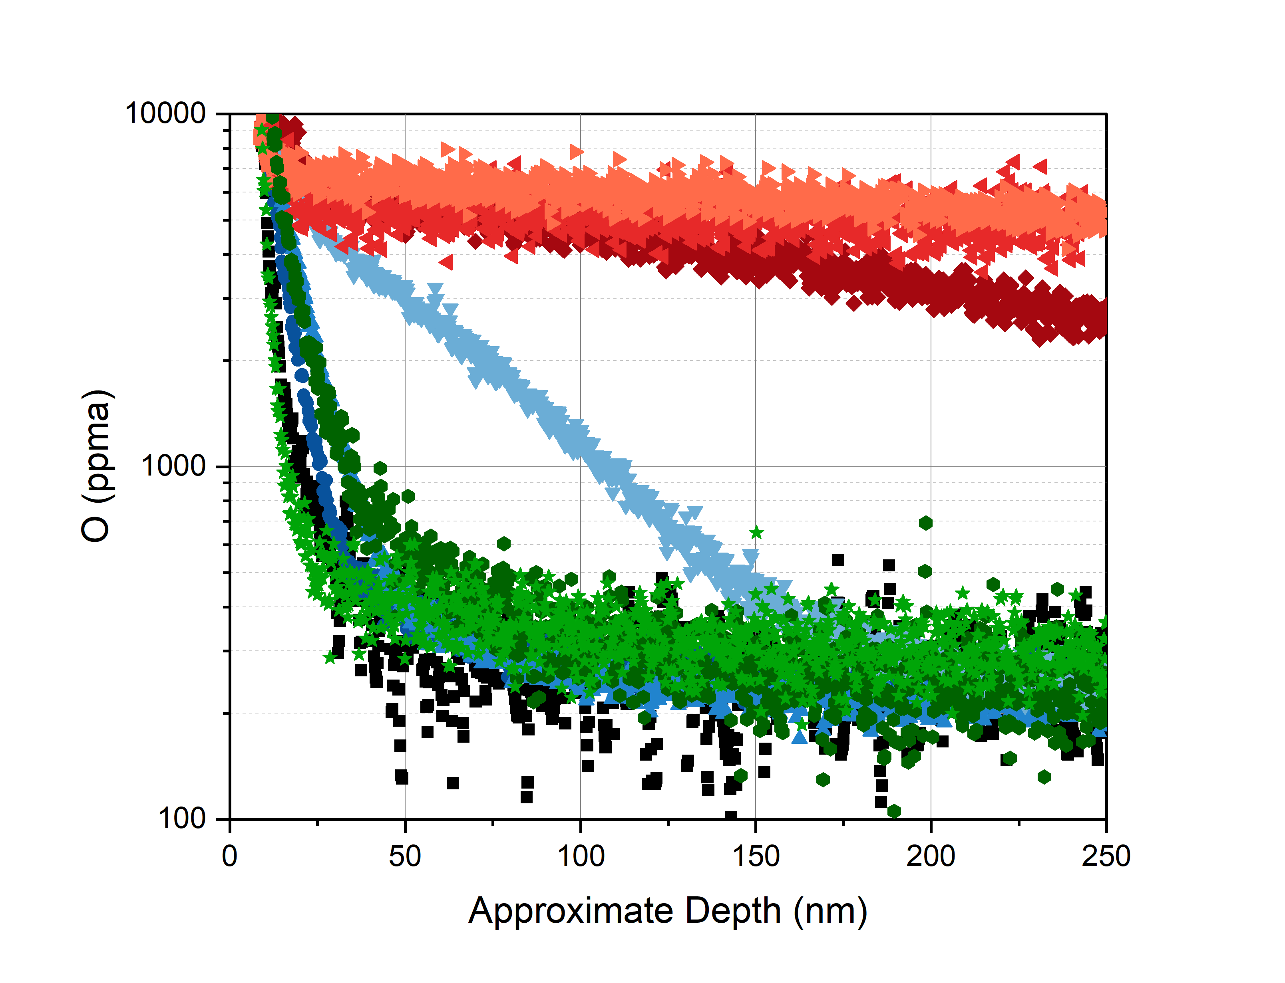
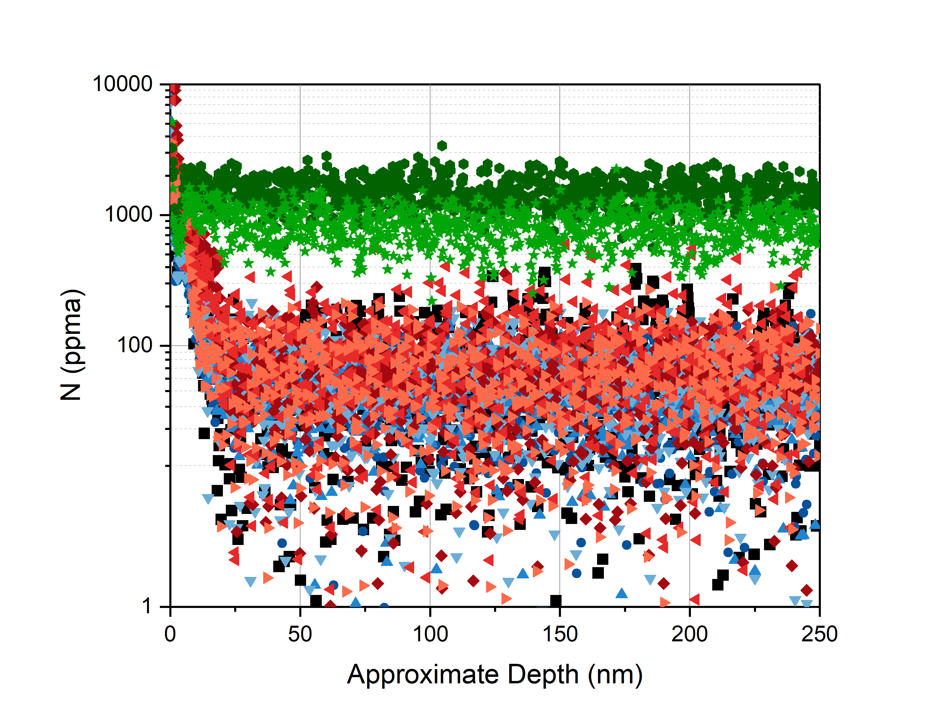
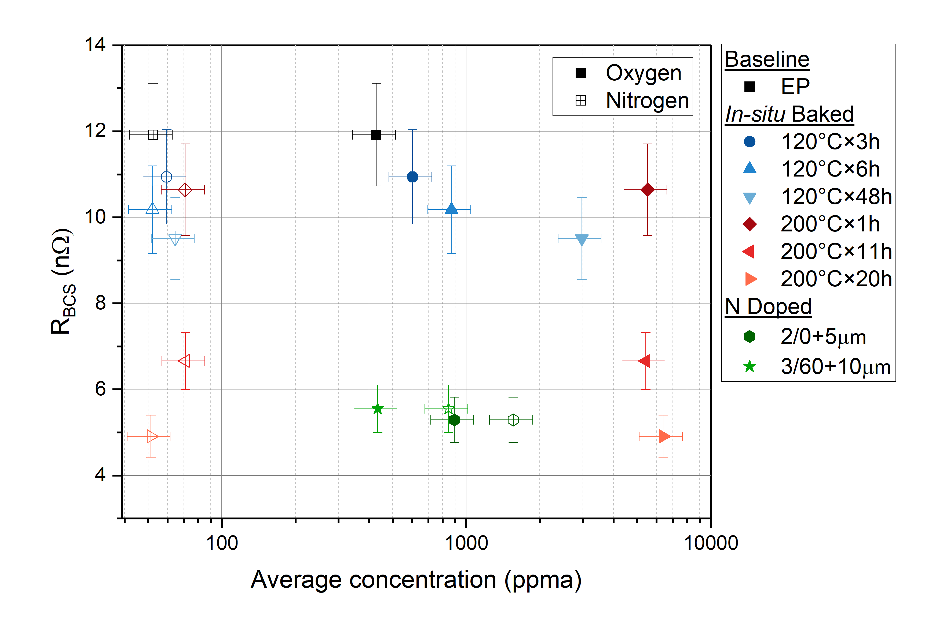
Impurity distribution via Secondary-ion mass spectrometry (SIMS)
Courtesy of Hannah Hu, FNAL
Only 100 nm from the surface contributes to the RF performance (London penetration depth 40 nm)
Mid-T baking (FCC, CEPC, PIPII) / N-doping (LCLSII, PIPII) → homogeneous O- distribution / N- distribution
120C baking (ILC standard) → inhomogeneous O- distribution

Slide 16
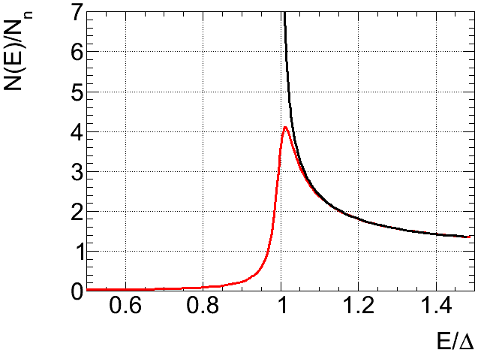
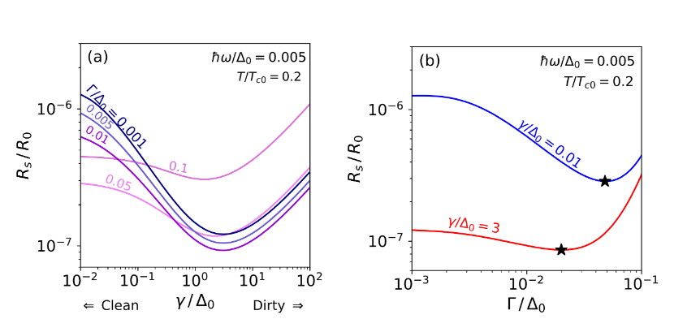
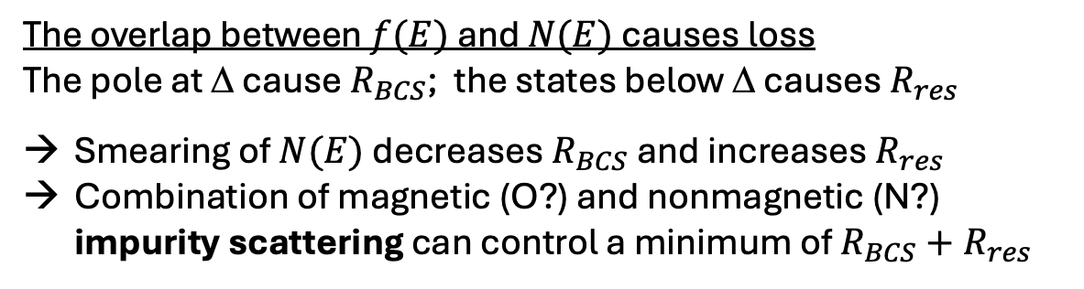
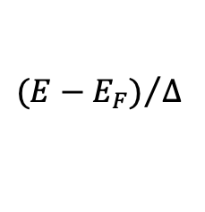
Homogeneous impurity distributions: higher-Q
Less room for excitation!
Magnetic impurity (Dynes)
BCS density of state
Takayuki Kubo, Phys. Rev. Applied 17, 014018, 2022
$${(E−E_{F})}/Δ$$
The overlap between $f(E)$ and $N(E)$ causes loss
The pole at Δ cause $R_{BCS}$; the states below Δ causes $R_{res}$
Smearing of $N(E)$ decreases $R_{BCS}$ and increases $R_{res}$
Combination of magnetic (O?) and nonmagnetic (N?) impurity scattering can control a minimum of $R_{BCS}+R_{res}$
Non-magnetic scattering
Magnetic scattering

Slide 17
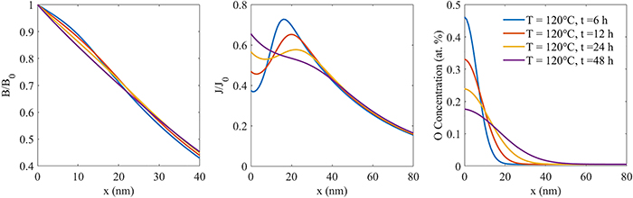
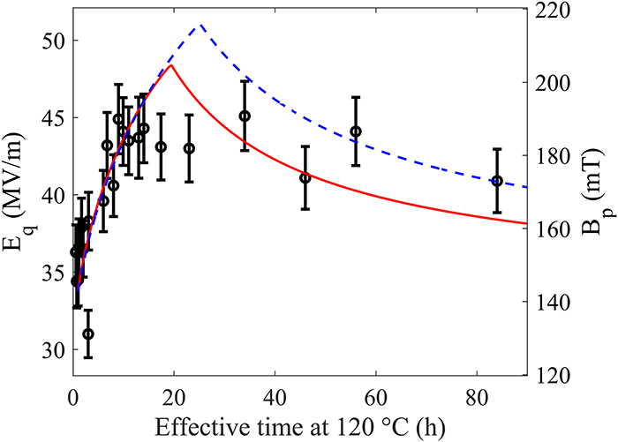


Inhomogeneous disorder: higher-G
SIMS data
Oxygen diffusion model
Current distribution
London equation with spatial inhomogeneity
120C 48h
$$λ{\left(x\right)}^{2}B^{′′}(x)+2λ\left(x\right)λ^{′}\left(x\right)B(x)=B(x)$$
120C 48h
120C 48h
$=0$for uniform case
E. M. Lechner et al J. Appl. Phys. 135, 133902 (2024)
Low-T bake diffuses O from surface oxide and generates gradient in the impurity distribution
Such a distribution leads to the enhancement of the quench field i.e. higher-G
Microscopic model [V. Ngampruetikorn and J. A. Sauls Phys. Rev. Research 1, 012015(R) 2019] also suggests the similar results under the inhomogeneous disorder
Enhancement in Bean-Livingston barrier

Slide 18





New research trends from 2012: nonequilibrium dynamics
$$R_{s}\sim ℏω\int_{Δ}^{∞}{dE \left[f\left(E\right)−f\left(E+ℏω\right)\right]×N\left(E\right)N\left(E+ℏω\right)}$$
Field-dependent $R_{s}\left(E\right)$
Non-equilibrium $f\left(E\right)$
Dynamic $N\left(E\right)$
Antonio Bianchi, SRF2025
Publication in preparation
A. Gurevich PRL 113 087001 (2014)
Depending on the surface impurity and RF frequency, the surface resistance depends on fields
Beyond the simple linear response (1st order perturbation i.e. no field dependence)
Crucial for the understanding of hyper high-Q SRF cavities for high-current machines (FCC & CEPC)

Slide 19
Outline
Introduction
Why do we need high-Q / high-G cavities?
State-of-the-art bulk niobium cavities
How to understand & optimize high-Q / high-G cavities?
Theory & engineering
Alternative materials
Nb₃Sn/Nb
MgB₂ & HTS
Practicalities
Conclusion

Slide 20



Non niobium superconductors
The main cause of the surface resistance is the thermally excited quasi-particles (NC electrons)
It can be suppressed by the gap (s-wave for BCS)
$$R_{s}∝\exp\left(−\frac{Δ}{k_{B}T}\right)$$
Larger gap → lower loss and /or same loss at higher T
Courtesy S. Posen
Nb has the largest gap out of the pure elements
Alloys have higher gap and higher critical temperature $T_{c}$
Non BCS superconductors (?)

Slide 21



Nb₃Sn thin film: 4 K operation equivalent to 2K Nb
Sn-vapor deposition
1.3 GHz
Nb₃Sn 4.4 K
Nb₃Sn 2 K
Nb bulk 2 K
S Posen et al 2021 SUST 34 025007
Nb₃Sn/Nb: previous barrier at 16 MV/m was due to thermal instability
→ Still limited < 25 MV/m, but 1st implication up to 100 MV/m [N. Verboncoeur SRF2025]
1100C required for the Nb₃Sn formation (Nb gets soften…)
→ 4 K cryocooler with 10 MV/m is the recent trend (non-high-G applications)
Nb₃Sn/Cu to save Nb material: initiative for FCC; still preliminary stage

Slide 22










Even more fancy materials?
MgB₂
YBCO
Iron-based SC
Two band s-wave
d-wave→gapless
s+/s- wave (?) gap full
$$R_{s}∝\exp\left(−\frac{Δ_{π}}{k_{B}T}\right)$$
$$R_{s}∝T^{α}$$
$$R_{s}∝\exp\left(−\frac{Δ_{β_{1}}}{k_{B}T}\right)$$
$$Q\left(Cu\right)<Q_{0}<Q(Nb)$$
DC measurement by Z. Lin et al SUST 24 015991 (2021)
$R_{S}$ calculation by AM, IEEE Trans Appl Super 10601306
As handling is tricky → FeSe to start with
Short pulse & T >> 4 K?
REBCO tape available
11 GHz
22
Ke Chen TFSRF2024
http://arxiv.org/abs/2509.13668

Slide 23
Outline
Introduction
Why do we need high-Q / high-G cavities?
State-of-the-art bulk niobium cavities
How to understand & optimize high-Q / high-G cavities?
Theory & engineering
Alternative materials
Nb₃Sn/Nb
MgB₂ & HTS
Practicalities
Conclusion

Slide 24








Do not forget reality for the real large machines!
Fabrication
Surface etching
Robotics
hydroforming@KEK+CERN
BM@CERN
cEP@FNAL
VEP@CEA
Assembly@CEA
Internal EBW
@CERN
EuXFEL
statistics
Ultimate RF performance cannot be achieved if FE occurs!
Quality control is crucial for production yield WITH the beam
Cost reduction & faster process & standardization (industrialization!)
HPR@IJCLab

Slide 25
Outline
Introduction
Why do we need high-Q / high-G cavities?
State-of-the-art bulk niobium cavities
How to understand & optimize high-Q / high-G cavities?
Theory & engineering
Alternative materials
Nb₃Sn/Nb
MgB₂ & HTS
Practicalities
Conclusion

Slide 26
Conclusion: my perspective in SRF cavities
SRF cavities are versatile for various particle accelerators while its ultimate gradient is not as high as normal conducting cavities and plasma accelerators
Decision making is compromised of many aspects! (Higgsino-like LSP 500GeV → multi-TeV e+/e-)
For high-current / high-energy (above cyclotrons), SRF is (probably) the only option (FCC / CEPC)
SRF have been mainly studied by RF engineers and particle physicists (→ yes, it’s me!) but the truly important research may be in the condensed matter physics / material science
Fundamental understandings of nonequilibrium superconductivity is an outstanding challenge
Exploring alternative materials to niobium is crucial for the sustainability of SRF!
Fundamental research is fascinating, but a one-off ultra-cavity is useless for accelerators
We should not forget that accelerators are tool for something important (science, industry, etc)
Industrialization through quality control and cost reduction is essential for the real machine!
The scope of (S)RF technology is not limited to accelerator applications
Light dark matter (axions, dark photons) and high-frequency GW is without our reach
Emerging research field as qubit and photon sensor applications is our neighbor
Interdisciplinary logistics: why not expand our field to more global science community?

Slide 27
backup

Slide 28



Present & future market
For circular & high current linac
Future circular machines & high current linac
Duty cycle >> 1%
Extremely high-Q at relatively high gradient in large cavities
For linear collider
P. Dhakal “Nitrogen doping and infusion in SRF cavities: A review” Phys Open 5 100034 2020
Duty cycle <1%
Extremely high gradient with relatively high-Q in a large # of cavities

Slide 29

Three different families of superconductors
Copper oxide cuprate d-wave
Iron Arsenide pnictide s±-wave
Conventional BCS s-wave

