Slide 1

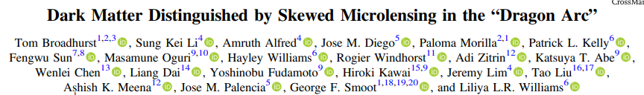
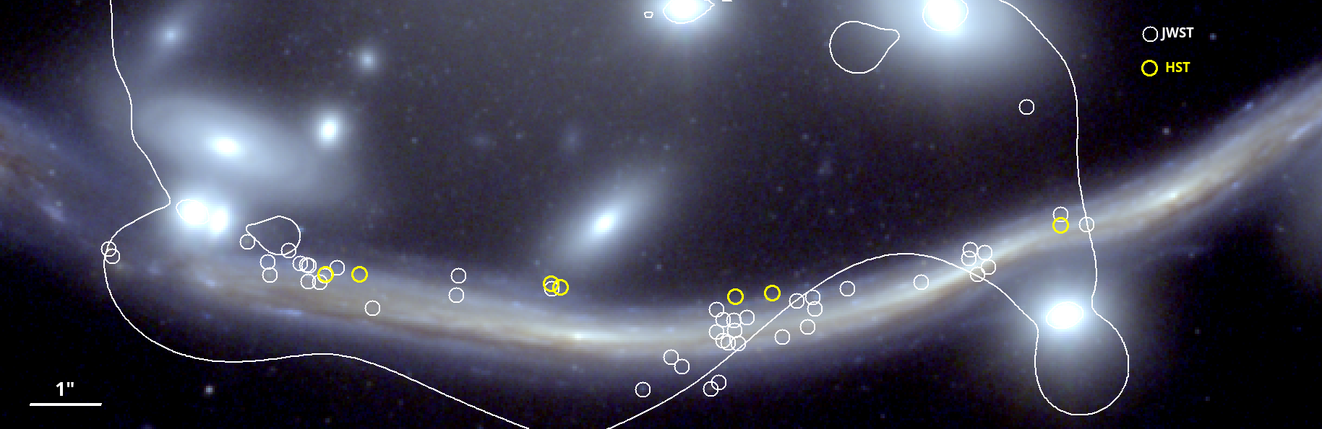
Mapping the nature of dark matter with extremely magnified stars Sung Kei ``Keith’’ Li, Ph.D. Candidate @The University of Hong Kong, HKIAA IAS FP 2026
-ve
-ve
+ve
+ve
Critical curve
1
Broadhurst, Li, Amruth + 24
Grant No.: RGC/GRF 17312122
Notes:
Talks over the last 3 days have demonstrated different strategies and techinques in probing he nature of DM via gravitational lensing.
Here today, I shall introduce one of the latest and arguably the cleanest strategy in investigating DM, with another branch under lensing – cluster microlensing events.
Last two talks of pat and adi gave a nice introduction…… in this talk I shall make use of this image – the dragon arc – to first: demonstrate the technique in deriving transient detection rate; and 2nd, show you how do we confront the nature of DM using the transients.
In this RGB image, we have overlaid white and yellow dots – detection from the Flashlights survey introduced by pat earlier; and the latest discovery using CANUCS+ MAGNIF JWST observation in the nature of Yoshinobu.
The white curve – our familiar old friend, the critical curve predicted by one of the lens models; with green line the \pm 100 macro-magnification.
Apparently, inside of this cruve is the negative parity – supercritical mass; contrast; outside, subcritical density.
IF this lens model is correct – most of the transients are located in the negative parity – what does that mean?
We shall show later in this talk that WIMPS subhalo predict skewness towards the positive parity; density modulation predicted under waveDM paradigm predict skewness towards the negative parity
Remove the green curves
Let me draw your attention to only the white curve – from our lens model.
3 things:
1) most of the transient do not fall on the CC;
2) More transients on the –ve than +ve
Then the rest is how do we explain this?
In my talk I am gonna show you that this skewness can be explained if DM comprises ultra-light particles.
If DM comprises ultra massive particles, this would predict more transients on the positive parity than negative parity

Slide 2
Mapping the nature of dark matter with extremely magnified stars Sung Kei ``Keith’’ Li, Ph.D. Candidate @The University of Hong Kong, HKIAA IAS FP 2026
Transient along Critical Curve
More on the negative parity
-ve
-ve
+ve
+ve
Critical curve
1
Broadhurst, Li, Amruth + 24
Grant No.: RGC/GRF 17312122
Notes:
Talks over the last 3 days have demonstrated different strategies and techinques in probing he nature of DM via gravitational lensing.
Here today, I shall introduce one of the latest and arguably the cleanest strategy in investigating DM, with another branch under lensing – cluster microlensing events.
Last two talks of pat and adi gave a nice introduction…… in this talk I shall make use of this image – the dragon arc – to first: demonstrate the technique in deriving transient detection rate; and 2nd, show you how do we confront the nature of DM using the transients.
In this RGB image, we have overlaid white and yellow dots – detection from the Flashlights survey introduced by pat earlier; and the latest discovery using CANUCS+ MAGNIF JWST observation in the nature of Yoshinobu.
The white curve – our familiar old friend, the critical curve predicted by one of the lens models; with green line the \pm 100 macro-magnification.
Apparently, inside of this cruve is the negative parity – supercritical mass; contrast; outside, subcritical density.
IF this lens model is correct – most of the transients are located in the negative parity – what does that mean?
We shall show later in this talk that WIMPS subhalo predict skewness towards the positive parity; density modulation predicted under waveDM paradigm predict skewness towards the negative parity
Remove the green curves
Let me draw your attention to only the white curve – from our lens model.
3 things:
1) most of the transient do not fall on the CC;
2) More transients on the –ve than +ve
Then the rest is how do we explain this?
In my talk I am gonna show you that this skewness can be explained if DM comprises ultra-light particles.
If DM comprises ultra massive particles, this would predict more transients on the positive parity than negative parity

Slide 3
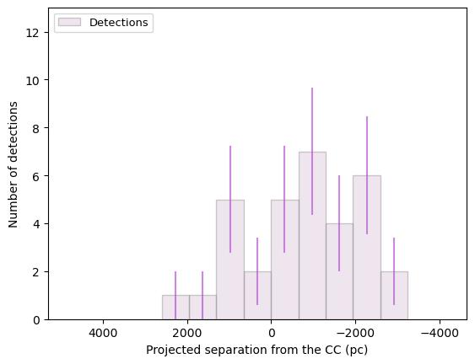
Mapping the nature of dark matter with extremely magnified stars Sung Kei ``Keith’’ Li, Ph.D. Candidate @The University of Hong Kong, HKIAA IAS FP 2026
+ve
-ve
Transient along Critical Curve
More on the negative parity
-ve
-ve
-ve
+ve
+ve
Critical curve
1
Broadhurst, Li, Amruth + 24
Grant No.: RGC/GRF 17312122
Notes:
Talks over the last 3 days have demonstrated different strategies and techinques in probing he nature of DM via gravitational lensing.
Here today, I shall introduce one of the latest and arguably the cleanest strategy in investigating DM, with another branch under lensing – cluster microlensing events.
Last two talks of pat and adi gave a nice introduction…… in this talk I shall make use of this image – the dragon arc – to first: demonstrate the technique in deriving transient detection rate; and 2nd, show you how do we confront the nature of DM using the transients.
In this RGB image, we have overlaid white and yellow dots – detection from the Flashlights survey introduced by pat earlier; and the latest discovery using CANUCS+ MAGNIF JWST observation in the nature of Yoshinobu.
The white curve – our familiar old friend, the critical curve predicted by one of the lens models; with green line the \pm 100 macro-magnification.
Apparently, inside of this cruve is the negative parity – supercritical mass; contrast; outside, subcritical density.
IF this lens model is correct – most of the transients are located in the negative parity – what does that mean?
We shall show later in this talk that WIMPS subhalo predict skewness towards the positive parity; density modulation predicted under waveDM paradigm predict skewness towards the negative parity
Remove the green curves
Let me draw your attention to only the white curve – from our lens model.
3 things:
1) most of the transient do not fall on the CC;
2) More transients on the –ve than +ve
Then the rest is how do we explain this?
In my talk I am gonna show you that this skewness can be explained if DM comprises ultra-light particles.
If DM comprises ultra massive particles, this would predict more transients on the positive parity than negative parity

Slide 4
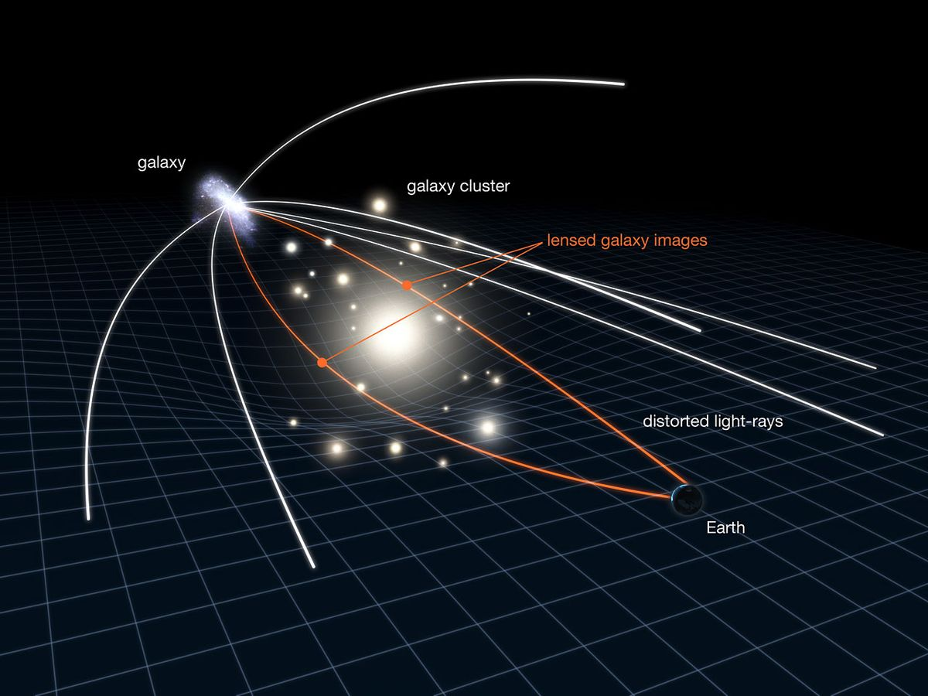
Scientific Background – Strong Lensing
Credit: NASA, ESA & L Calcada
Notes:
As some of you might know, lensing can be divided into multiple regimes.
Those that are relevant to our context today are strong lensing, in particular, from a galaxy cluster; and microlensing from stars such as intracluster stars.
Here I show a classic schematic of a strong lensing scenario from a galaxy cluster….

Slide 5
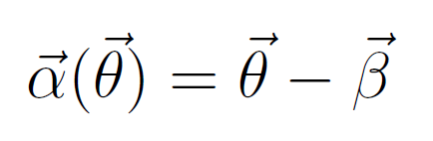
Scientific Background – Strong Lensing
Deflection described by the lens equation:
Credit: NASA, ESA & L Calcada
Notes:
The light ray from a background galaxy is multiply-deflected.
Since light travel in straight path, we don’t actually see the deflected rays.
Instead, we see the image of the same background galaxy in two different positions in the sky!
The angle of the deflection is known as the deflection angle, which depends on the lensing potential and the therefore amount of mass in the lens.

Slide 6
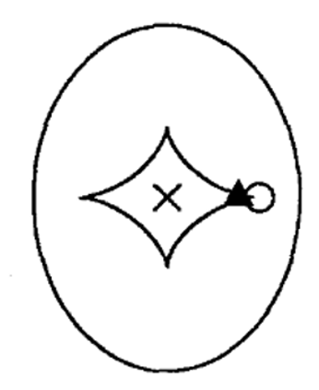
Scientific Background – Strong Lensing
Source Plane: Caustics
Deflection described by the lens equation:
3 different images:
X, Δ, O
Credit: NASA, ESA & L Calcada
Notes:
This whole lensing process can be often described by these diagrams.
What I am showing here is known as the caustic map in the source plane.
There are 3 different markers, x triangle and a circle, representing a source placing at 3 different positions in the source plane w.r.t. to the lens.
The inner diamond shape line is the tangential caustic; and the elliptical line is the radial caustic. These lines represent the maximum lensing magnification – when a source is located on these lines, it means it attain a maximum tangential magnification/radial magnification

Slide 7
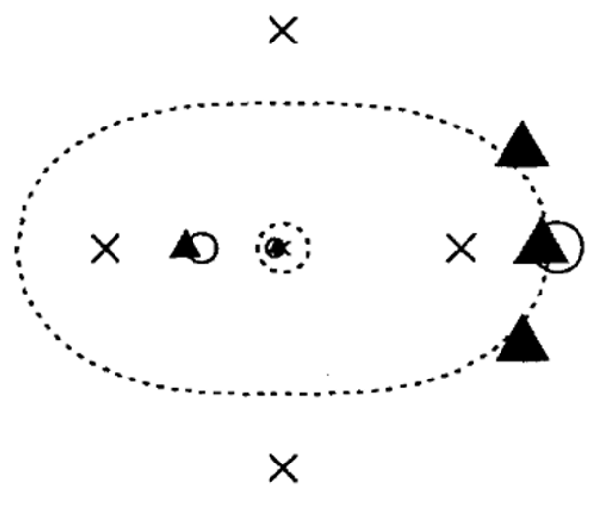
Scientific Background – Strong Lensing
Source Plane: Caustics
Image Plane:
Critical Curve
Deflection described by the lens equation:
3 different sources:
X, Δ, O
Credit: Narayan+92
Negative Parity (Super-Critical surface mass density)
Marker size represents magnification:
Background Images get magnified!
Positive Parity
(Sub-Critical surface mass density)
Credit: NASA, ESA & L Calcada
Notes:
But the source plane is often not what we see.
What we see is known as the image plane.
Now, the inner dotted line is the radial critical curve – where the radial caustic is projected into the image plane via the lens equation.
Similarly, the outer dotted ellipse is the tangential critical curve, of which the result of the tangential caustic being projected in the image plane.
Inside of the tangential critical curve is what we call the negative parity region. It refers to the region where the surface mass density is super-critical;
Outside is the positive parity, which has a sub-critical surface mass density. In otherwords, the CC marks also the position where the surface mass density changes from sub-critical to super-critical, aprat from the maximum lensing magnification.
You can see the same old 3 markers in this plot. But now they represent the image position to be observed of these 3 different sources.
For example, the cross that was in the middle on the caustic now forms an ``einstein’’ cross, as it is perfectly aligned with the lens and us the observer; Similar thing happens for the 2 other markers forming different lensing geometry.
Another key feature is that, the lensed images are magnified – with the surface brightness conserved by lensing.
You can see that, for example, the triangle markers are larger in near the CC, which represents them having a larger magnification.

Slide 8
Scientific Background – Strong Lensing
Source Plane: Caustics
Image Plane:
Critical Curve
Deflection described by the lens equation:
3 different sources:
X, Δ, O
Credit: Narayan+92
Negative Parity (Super-Critical surface mass density)
Marker size represents magnification:
Background Images get magnified!
Positive Parity
(Sub-Critical surface mass density)
Broadhurst, Li, Amruth + 24
Credit: NASA, ESA & L Calcada
Notes:
But the source plane is often not what we see.
What we see is known as the image plane.
Now, the inner dotted line is the radial critical curve – where the radial caustic is projected into the image plane via the lens equation.
Similarly, the outer dotted ellipse is the tangential critical curve, of which the result of the tangential caustic being projected in the image plane.
Inside of the tangential critical curve is what we call the negative parity region. It refers to the region where the surface mass density is super-critical;
Outside is the positive parity, which has a sub-critical surface mass density. In otherwords, the CC marks also the position where the surface mass density changes from sub-critical to super-critical, aprat from the maximum lensing magnification.
You can see the same old 3 markers in this plot. But now they represent the image position to be observed of these 3 different sources.
For example, the cross that was in the middle on the caustic now forms an ``einstein’’ cross, as it is perfectly aligned with the lens and us the observer; Similar thing happens for the 2 other markers forming different lensing geometry.
Another key feature is that, the lensed images are magnified – with the surface brightness conserved by lensing.
You can see that, for example, the triangle markers are larger in near the CC, which represents them having a larger magnification.

Slide 9
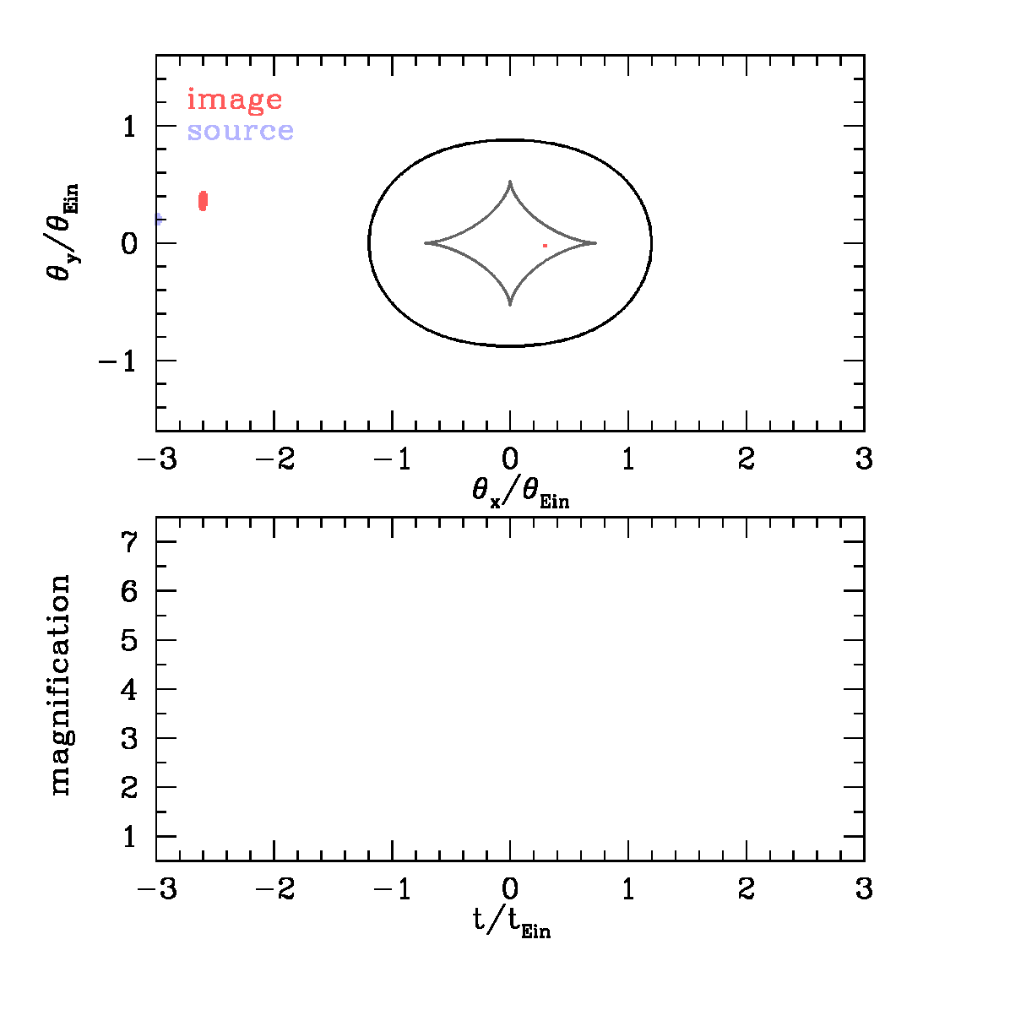
Scientific Background – Microlensing/Caustic Crossing
Caustic Crossing of a Microlens
Critical Curve
(Image Plane)
Caustic (source Plane)
Credit: M. Oguri
Notes:
What I shown was in the scale of strong lensing – where the time-scale of everything is well beyond human time scale.
However, this is not necessarily true for the case of microlensing.
This time, we have a micro-deflector, for example, a star. It forms the caustic and critical curve similarly as the strong lens.
If we have a background source, for example, another star in blue, that moves relatively between the 3 bodies, then we would see a net movement like this in the gif.
The lens originally mildly deflect the image of the star into the red patch – as the blue star move closer and closer to the lensing star, multiple images of the background star is formed as shown in red.
The angular scale of this whole event, however, is very small (micro-arcsec scale) and this is why its called microlensing.
What this mean is that, we cannot see the multiply-deflected images.
Instead, we see the total change in brightness of the event – a light curve as shown below

Slide 10
Scientific Background – Microlensing/Caustic Crossing
Caustic Crossing of a Microlens
Critical Curve
(Image Plane)
Caustic (source Plane)
Credit: M. Oguri
Notes:
Get a better mind on the caustics
Here I show you a simulation that you might be familiar with,
Showing what happens when a background star move pass a foreground stars (dragon arc and the cluster)
The bkg star multiplied, no resolve…

Slide 11
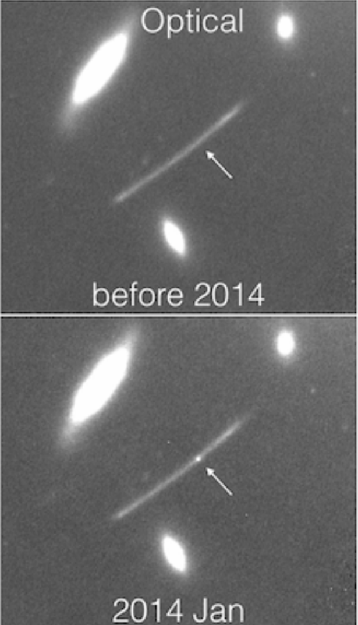
Scientific Background – Microlensing/Caustic Crossing
Caustic Crossing of a Microlens
Obs 1
Critical Curve
(Image Plane)
Caustic (source Plane)
Obs 1
Credit: M. Oguri
Rodney+18
Notes:
In fact, this Is how the transient event happens.
For example, we are observing the star in the 1st window (in orange), where it doesn’t attain much magnification.
Then if we are lucky enough, we would capture the brightening in the 2nd window (in dark blue) thus detecting the star as a transient event.

Slide 12
Scientific Background – Microlensing/Caustic Crossing
Caustic Crossing of a Microlens
Obs 1
Critical Curve
(Image Plane)
Caustic (source Plane)
Obs 1
Obs 2
Obs 2
Credit: M. Oguri
Rodney+18
Notes:
In fact, this Is how the transient event happens.
For example, we are observing the star in the 1st window (in orange), where it doesn’t attain much magnification.
Then if we are lucky enough, we would capture the brightening in the 2nd window (in dark blue) thus detecting the star as a transient event.

Slide 13
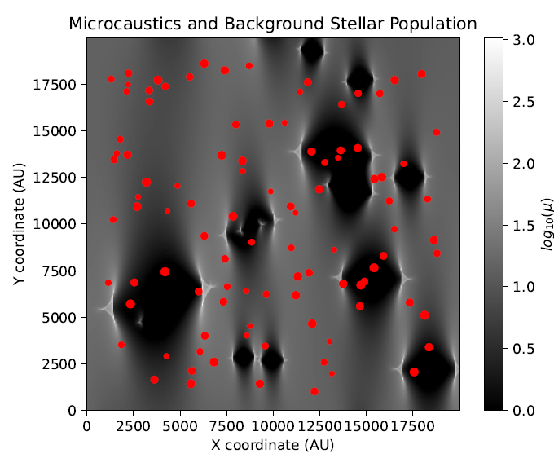
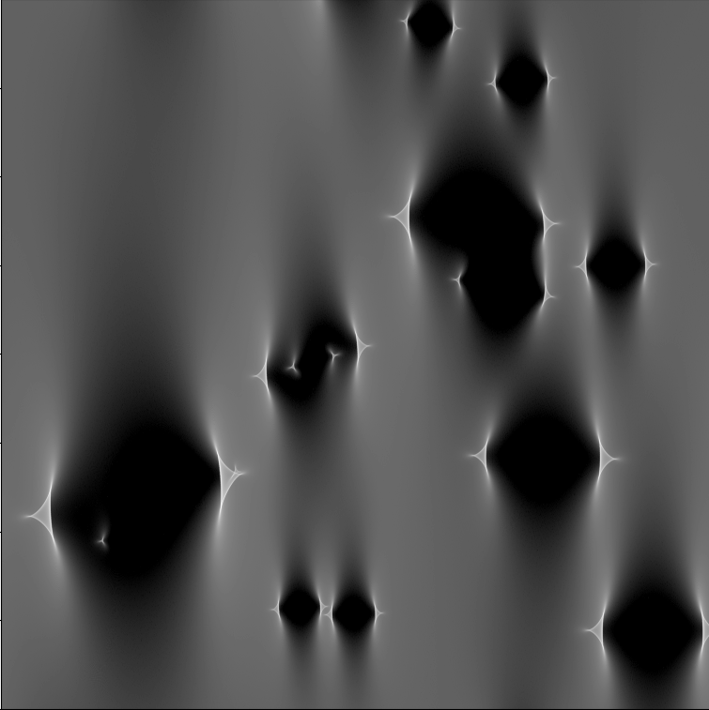
Scientific Background – Microlensing/Caustic Crossing
Stars 1yr ago
Obs 1
Obs 2
Rodney+18
Modified from Li+24
Notes:
In fact, this Is how the transient event happens.
For example, we are observing the star in the 1st window (in orange), where it doesn’t attain much magnification.
Then if we are lucky enough, we would capture the brightening in the 2nd window (in dark blue) thus detecting the star as a transient event.

Slide 14
Scientific Background – Microlensing/Caustic Crossing
Stars 1yr ago
Obs 1
Obs 2
Rodney+18
Modified from Li+24
Notes:
In fact, this Is how the transient event happens.
For example, we are observing the star in the 1st window (in orange), where it doesn’t attain much magnification.
Then if we are lucky enough, we would capture the brightening in the 2nd window (in dark blue) thus detecting the star as a transient event.

Slide 15
Scientific Background – Microlensing/Caustic Crossing
Stars 1yr ago
Obs 1
Obs 2
Rodney+18
Modified from Li+24
Notes:
Make the stars smaller

Slide 16
Scientific Background – Microlensing/Caustic Crossing
Stars 1yr ago
Obs 1
Motion
Obs 2
Rodney+18
Modified from Li+24
Notes:
In fact, this Is how the transient event happens.
For example, we are observing the star in the 1st window (in orange), where it doesn’t attain much magnification.
Then if we are lucky enough, we would capture the brightening in the 2nd window (in dark blue) thus detecting the star as a transient event.

Slide 17
Scientific Background – Microlensing/Caustic Crossing
Stars 1yr ago
Obs 1
Motion
Obs 2
Rodney+18
Modified from Li+24
Notes:
In fact, this Is how the transient event happens.
For example, we are observing the star in the 1st window (in orange), where it doesn’t attain much magnification.
Then if we are lucky enough, we would capture the brightening in the 2nd window (in dark blue) thus detecting the star as a transient event.

Slide 18

Main Methodology
Critical Curve
+ve parity
-ve parity
-ve
-ve
+ve
+ve
Critical curve
Broadhurst, Li, Amruth + 24
Notes:
To address the effect of stellar microlensing, I have adopted the semi-analytical approximation done by my collaborator Jose maria Palencia.
These approximation allow us to calculate the probability of having any magnification a star could have at any moment, given a certain strong lesnign effect (macro-magnifiaciton) and abundance of stellar microlenses.
For example, here I show a PDF by assuming some surface mass density, with a macro-magnification of ~+200.
As you can see, the pdf peaks at approximately where the macro-magnification originally is and form a log-normal distribution
Microlensing create extra magnification – on the otherhand taking magnification from some region and causes demagnification.

Slide 19
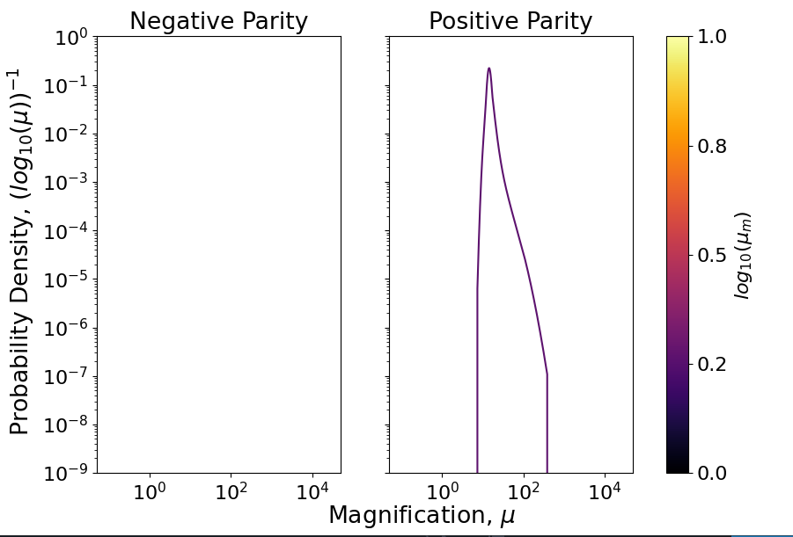
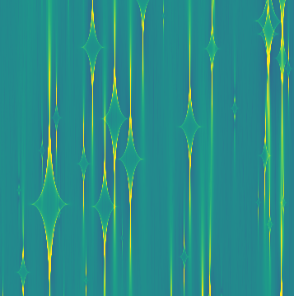
Main Methodology
Critical Curve
μ ~ +10
+ve parity
-ve parity
Snapshot from Palencia+25 simulation
μ ~ +10
Notes:
To address the effect of stellar microlensing, I have adopted the semi-analytical approximation done by my collaborator Jose maria Palencia.
These approximation allow us to calculate the probability of having any magnification a star could have at any moment, given a certain strong lesnign effect (macro-magnifiaciton) and abundance of stellar microlenses.
For example, here I show a PDF by assuming some surface mass density, with a macro-magnification of ~+200.
As you can see, the pdf peaks at approximately where the macro-magnification originally is and form a log-normal distribution
Microlensing create extra magnification – on the otherhand taking magnification from some region and causes demagnification.

Slide 20
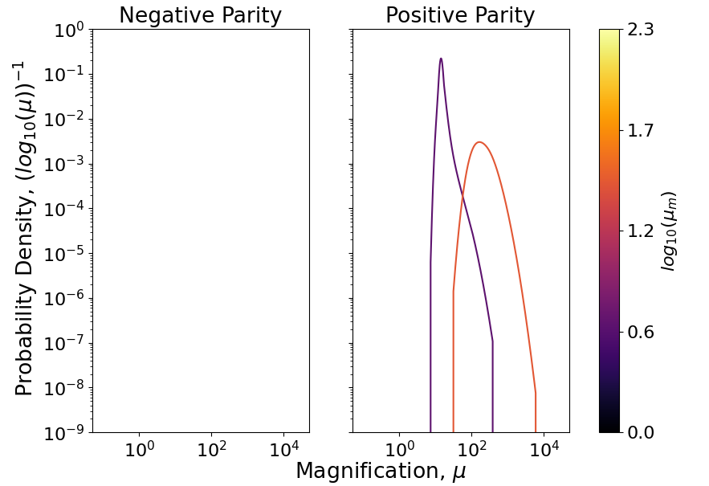
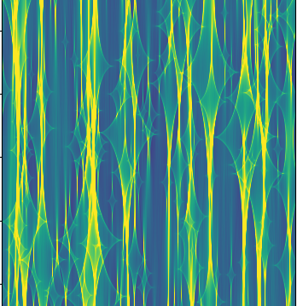
Main Methodology
Critical Curve
μ ~ +100
+ve parity
-ve parity
Snapshot from Palencia+25 simulation
μ ~ +100
Notes:
To address the effect of stellar microlensing, I have adopted the semi-analytical approximation done by my collaborator Jose maria Palencia.
These approximation allow us to calculate the probability of having any magnification a star could have at any moment, given a certain strong lesnign effect (macro-magnifiaciton) and abundance of stellar microlenses.
For example, here I show a PDF by assuming some surface mass density, with a macro-magnification of ~+200.
As you can see, the pdf peaks at approximately where the macro-magnification originally is and form a log-normal distribution
Microlensing create extra magnification – on the otherhand taking magnification from some region and causes demagnification.

Slide 21
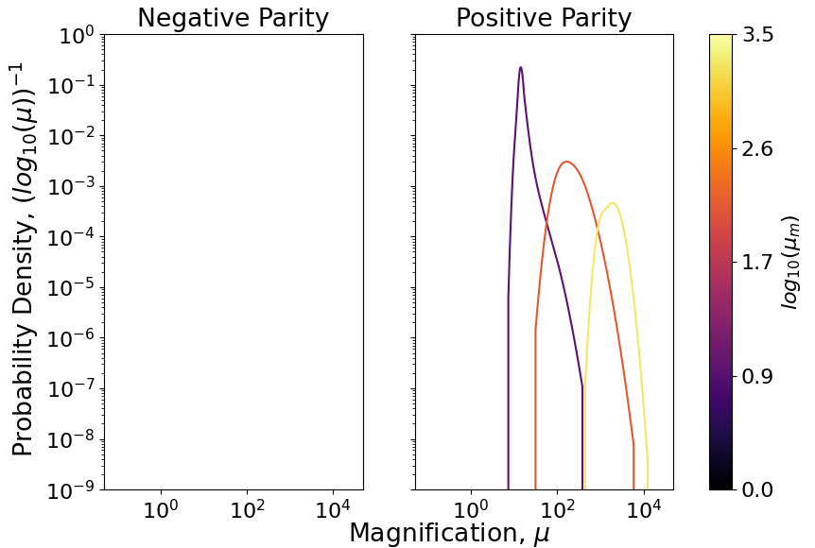
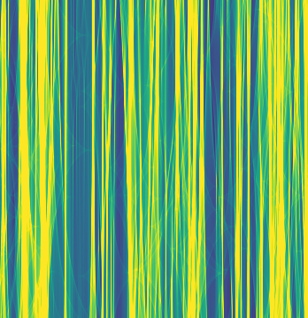
Main Methodology
Critical Curve
μ ~ +1000
+ve parity
-ve parity
Snapshot from Palencia+25 simulation
μ ~ +1000
Notes:
To address the effect of stellar microlensing, I have adopted the semi-analytical approximation done by my collaborator Jose maria Palencia.
These approximation allow us to calculate the probability of having any magnification a star could have at any moment, given a certain strong lesnign effect (macro-magnifiaciton) and abundance of stellar microlenses.
For example, here I show a PDF by assuming some surface mass density, with a macro-magnification of ~+200.
As you can see, the pdf peaks at approximately where the macro-magnification originally is and form a log-normal distribution
Microlensing create extra magnification – on the otherhand taking magnification from some region and causes demagnification.

Slide 22
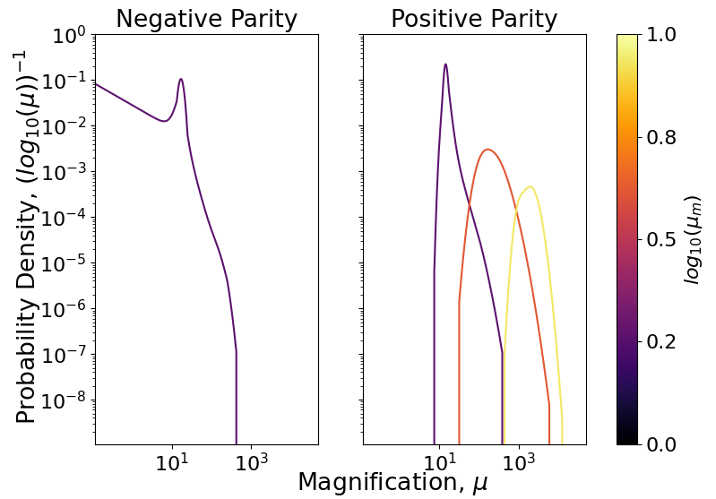
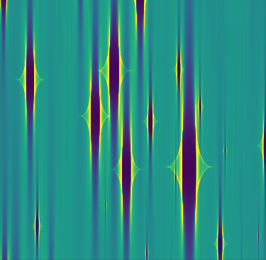
Main Methodology
Critical Curve
μ ~ -10
+ve parity
-ve parity
Snapshot from Palencia+25 simulation
μ ~ -10
Notes:
To address the effect of stellar microlensing, I have adopted the semi-analytical approximation done by my collaborator Jose maria Palencia.
These approximation allow us to calculate the probability of having any magnification a star could have at any moment, given a certain strong lesnign effect (macro-magnifiaciton) and abundance of stellar microlenses.
For example, here I show a PDF by assuming some surface mass density, with a macro-magnification of ~+200.
As you can see, the pdf peaks at approximately where the macro-magnification originally is and form a log-normal distribution
Microlensing create extra magnification – on the otherhand taking magnification from some region and causes demagnification.

Slide 23
Main Methodology
Critical Curve
μ ~ -10
+ve parity
-ve parity
Snapshot from Palencia+25 simulation
μ ~ -10
Notes:
To address the effect of stellar microlensing, I have adopted the semi-analytical approximation done by my collaborator Jose maria Palencia.
These approximation allow us to calculate the probability of having any magnification a star could have at any moment, given a certain strong lesnign effect (macro-magnifiaciton) and abundance of stellar microlenses.
For example, here I show a PDF by assuming some surface mass density, with a macro-magnification of ~+200.
As you can see, the pdf peaks at approximately where the macro-magnification originally is and form a log-normal distribution
Microlensing create extra magnification – on the otherhand taking magnification from some region and causes demagnification.

Slide 24
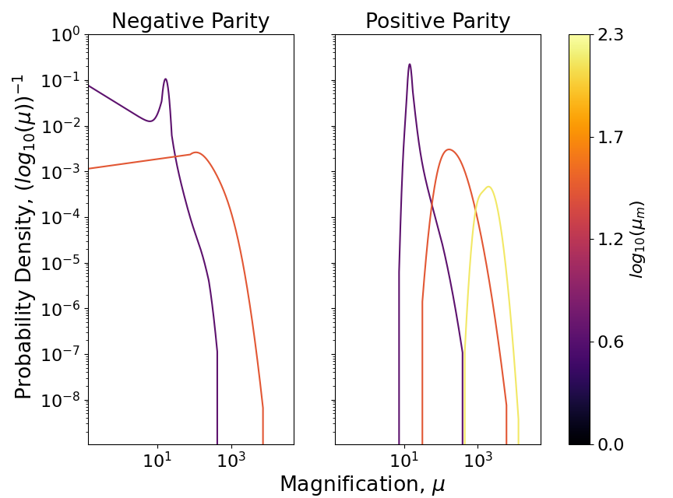
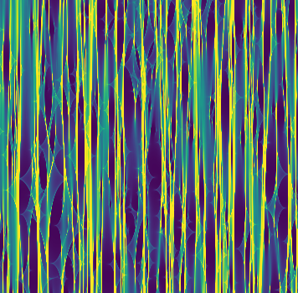
Main Methodology
Critical Curve
μ ~ -100
+ve parity
-ve parity
Snapshot from Palencia+25 simulation
μ ~ -100
Notes:
To address the effect of stellar microlensing, I have adopted the semi-analytical approximation done by my collaborator Jose maria Palencia.
These approximation allow us to calculate the probability of having any magnification a star could have at any moment, given a certain strong lesnign effect (macro-magnifiaciton) and abundance of stellar microlenses.
For example, here I show a PDF by assuming some surface mass density, with a macro-magnification of ~+200.
As you can see, the pdf peaks at approximately where the macro-magnification originally is and form a log-normal distribution
Microlensing create extra magnification – on the otherhand taking magnification from some region and causes demagnification.

Slide 25
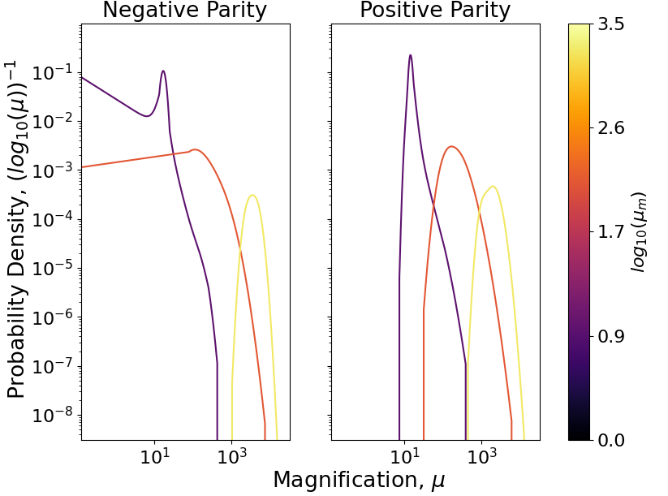
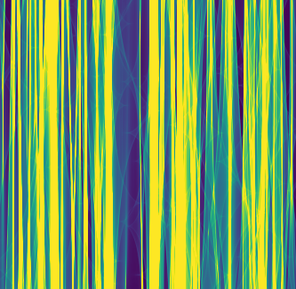
Main Methodology
Critical Curve
μ ~ -1000
+ve parity
-ve parity
Snapshot from Palencia+25 simulation
μ ~ -1000
Notes:
To address the effect of stellar microlensing, I have adopted the semi-analytical approximation done by my collaborator Jose maria Palencia.
These approximation allow us to calculate the probability of having any magnification a star could have at any moment, given a certain strong lesnign effect (macro-magnifiaciton) and abundance of stellar microlenses.
For example, here I show a PDF by assuming some surface mass density, with a macro-magnification of ~+200.
As you can see, the pdf peaks at approximately where the macro-magnification originally is and form a log-normal distribution
Microlensing create extra magnification – on the otherhand taking magnification from some region and causes demagnification.

Slide 26
Main Methodology
Critical Curve
+ve parity
-ve parity
Notes:
To address the effect of stellar microlensing, I have adopted the semi-analytical approximation done by my collaborator Jose maria Palencia.
These approximation allow us to calculate the probability of having any magnification a star could have at any moment, given a certain strong lesnign effect (macro-magnifiaciton) and abundance of stellar microlenses.
For example, here I show a PDF by assuming some surface mass density, with a macro-magnification of ~+200.
As you can see, the pdf peaks at approximately where the macro-magnification originally is and form a log-normal distribution
Microlensing create extra magnification – on the otherhand taking magnification from some region and causes demagnification.

Slide 27
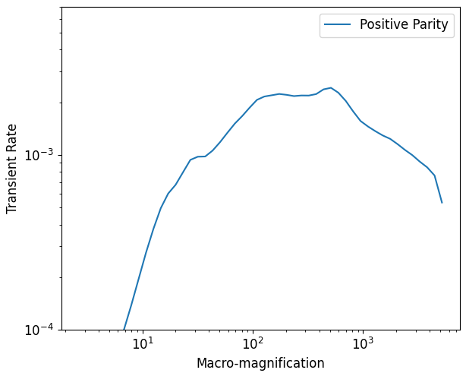
Main Methodology
Critical Curve
+ve parity
-ve parity
Li+25a, Palencia+25, see also Li+25b
Mod. from Li+25a with Palencia+23
Notes:
To address the effect of stellar microlensing, I have adopted the semi-analytical approximation done by my collaborator Jose maria Palencia.
These approximation allow us to calculate the probability of having any magnification a star could have at any moment, given a certain strong lesnign effect (macro-magnifiaciton) and abundance of stellar microlenses.
For example, here I show a PDF by assuming some surface mass density, with a macro-magnification of ~+200.
As you can see, the pdf peaks at approximately where the macro-magnification originally is and form a log-normal distribution
Microlensing create extra magnification – on the otherhand taking magnification from some region and causes demagnification.

Slide 28
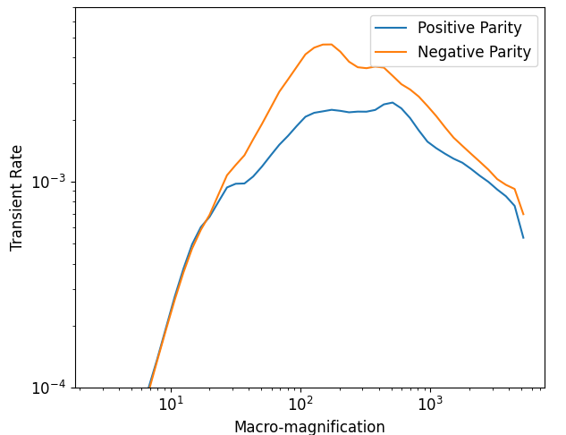
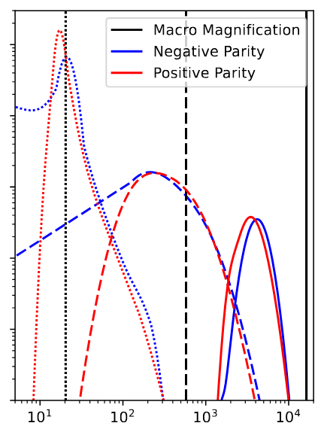
Main Methodology
Critical Curve
+ve parity
-ve parity
Neg Parity > Pos Parity
Li+25a, Palencia+25, see also Li+25b
Mod. from Li+25a with Palencia+23
Notes:
To address the effect of stellar microlensing, I have adopted the semi-analytical approximation done by my collaborator Jose maria Palencia.
These approximation allow us to calculate the probability of having any magnification a star could have at any moment, given a certain strong lesnign effect (macro-magnifiaciton) and abundance of stellar microlenses.
For example, here I show a PDF by assuming some surface mass density, with a macro-magnification of ~+200.
As you can see, the pdf peaks at approximately where the macro-magnification originally is and form a log-normal distribution
Microlensing create extra magnification – on the otherhand taking magnification from some region and causes demagnification.

Slide 29
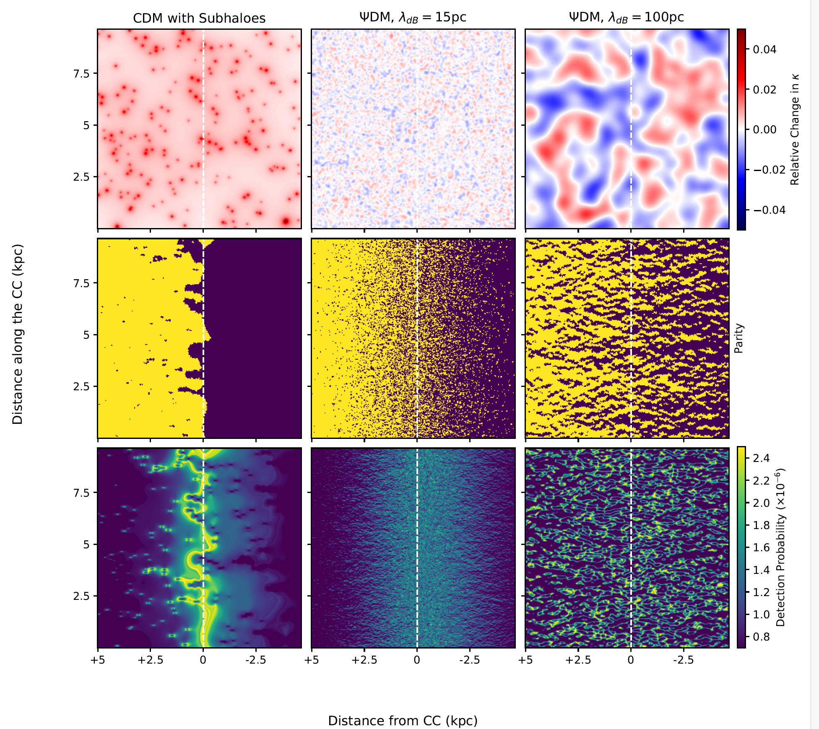

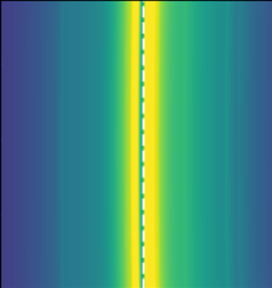
Density Modulations + microlenses
Subhaloes + microlenses
Density Modulations
Subhaloes
Smooth Model + microlenses
Smooth Model
Change in Surface Mass Density
Smooth Model Net change = 0
Parity
-ve
+ve
Smooth Critical Curve
+ve & -ve
Transient Detection Rate
Modified from Broadhurst, Li, Amruth + 24
Notes:
To begin with, we generate a smooth model with lensing potential following a lens model.
Here we used my lens model I generated during my Mphil, specifically fine-tuned around the dragon arc.
So with this smooth lens model, we can predict the CC. as shown in the middle panel.
Since its smooth, the CC is very straight and pass through directly.
We apply the F200W transient detection rate curve to the magnification map generated with the smooth model, and acquired the distribution in the middle – a slight negative skewness while almost all of the transient locate in the close vicinity of the CC.

Slide 30
Density Modulations + microlenses
Subhaloes + microlenses
Density Modulations
Subhaloes
Smooth Model + microlenses
Smooth Model
Change in Surface Mass Density
Smooth Model Net change = 0
Parity
-ve
+ve
Smooth Critical Curve
+ve & -ve
Transient Detection Rate
Slight negative skewness
Modified from Broadhurst, Li, Amruth + 24
Notes:
To begin with, we generate a smooth model with lensing potential following a lens model.
Here we used my lens model I generated during my Mphil, specifically fine-tuned around the dragon arc.
So with this smooth lens model, we can predict the CC. as shown in the middle panel.
Since its smooth, the CC is very straight and pass through directly.
We apply the F200W transient detection rate curve to the magnification map generated with the smooth model, and acquired the distribution in the middle – a slight negative skewness while almost all of the transient locate in the close vicinity of the CC.

Slide 31
Results
Broadhurst, Li, Amruth + 24
Notes:
Ask paloma to redo the figure, only wimps + one waveDM

Slide 32
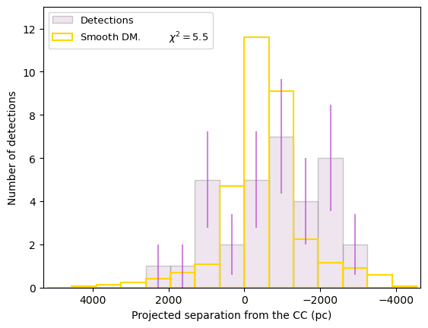
Results
Critical Curve
+ve parity
-ve parity
Notes:
To address the effect of stellar microlensing, I have adopted the semi-analytical approximation done by my collaborator Jose maria Palencia.
These approximation allow us to calculate the probability of having any magnification a star could have at any moment, given a certain strong lesnign effect (macro-magnifiaciton) and abundance of stellar microlenses.
For example, here I show a PDF by assuming some surface mass density, with a macro-magnification of ~+200.
As you can see, the pdf peaks at approximately where the macro-magnification originally is and form a log-normal distribution
Microlensing create extra magnification – on the otherhand taking magnification from some region and causes demagnification.

Slide 33
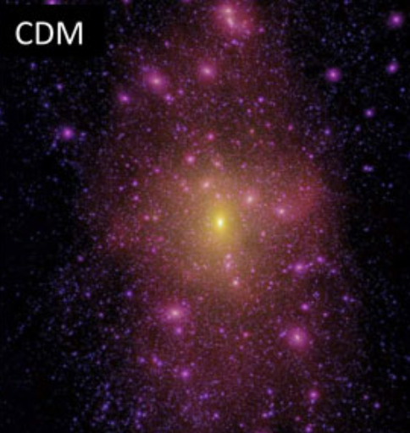


Subhaloes
Density Modulations
Subhaloes + microlenses
Smooth Model + microlenses
Density Modulations + microlenses
Smooth Model
Change in Surface Mass Density
Subhaloes Positive Mass
Dai+20
Parity
-ve
+ve
Transient Detection Rate
Lovell+14
Modified from Broadhurst, Li, Amruth + 24
Notes:
First talk about negative

Slide 34
Subhaloes
Density Modulations
Subhaloes + microlenses
Smooth Model + microlenses
Density Modulations + microlenses
Smooth Model
Change in Surface Mass Density
Subhaloes Positive Mass
Dai+20
Parity
-ve
+ve
sub-critical (+ve)
super-critical (-ve)
Critical Curve
+ve
Transient Detection Rate
Lovell+14
Modified from Broadhurst, Li, Amruth + 24
Notes:
To begin with, we generate a smooth model with lensing potential following a lens model.
Here we used my lens model I generated during my Mphil, specifically fine-tuned around the dragon arc.
So with this smooth lens model, we can predict the CC. as shown in the middle panel.
Since its smooth, the CC is very straight and pass through directly.
We apply the F200W transient detection rate curve to the magnification map generated with the smooth model, and acquired the distribution in the middle – a slight negative skewness while almost all of the transient locate in the close vicinity of the CC.

Slide 35
Subhaloes
Density Modulations
Subhaloes + microlenses
Smooth Model + microlenses
Density Modulations + microlenses
Smooth Model
Change in Surface Mass Density
Subhaloes Positive Mass
Dai+20
Parity
-ve
+ve
sub-critical (+ve)
super-critical (-ve)
Critical Curve
+ve
Transient Detection Rate
Positive skewness
(Also found in Williams+24)
Lovell+14
Modified from Broadhurst, Li, Amruth + 24
Notes:
To begin with, we generate a smooth model with lensing potential following a lens model.
Here we used my lens model I generated during my Mphil, specifically fine-tuned around the dragon arc.
So with this smooth lens model, we can predict the CC. as shown in the middle panel.
Since its smooth, the CC is very straight and pass through directly.
We apply the F200W transient detection rate curve to the magnification map generated with the smooth model, and acquired the distribution in the middle – a slight negative skewness while almost all of the transient locate in the close vicinity of the CC.

Slide 36
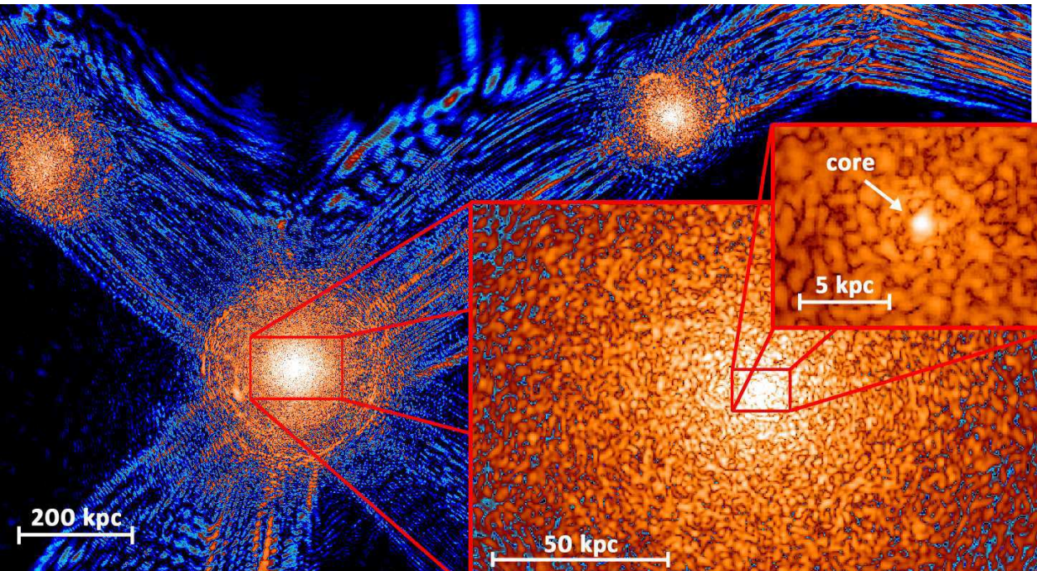
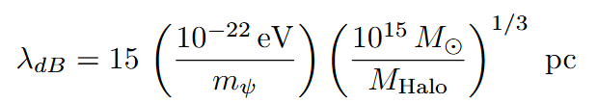
Subhaloes
Density Modulations
Subhaloes + microlenses
Smooth Model + microlenses
Density Modulations + microlenses
Smooth Model
Change in Surface Mass Density
Density Modulation Positive & Negative Mass
Parity
-ve
+ve
Transient Detection Rate
Schive+14
Modified from Broadhurst, Li, Amruth + 24
Notes:
To begin with, we generate a smooth model with lensing potential following a lens model.
Here we used my lens model I generated during my Mphil, specifically fine-tuned around the dragon arc.
So with this smooth lens model, we can predict the CC. as shown in the middle panel.
Since its smooth, the CC is very straight and pass through directly.
We apply the F200W transient detection rate curve to the magnification map generated with the smooth model, and acquired the distribution in the middle – a slight negative skewness while almost all of the transient locate in the close vicinity of the CC.

Slide 37
Subhaloes
Density Modulations
Subhaloes + microlenses
Smooth Model + microlenses
Density Modulations + microlenses
Smooth Model
Change in Surface Mass Density
Density Modulation Positive & Negative Mass
Parity
-ve
+ve
sub-critical (+ve)
super-critical (-ve)
Critical Curve
+ve -ve
Transient Detection Rate
Modified from Broadhurst, Li, Amruth + 24
Notes:
To contrast the waveDM vs subhalo case

Slide 38
Subhaloes
Density Modulations
Subhaloes + microlenses
Smooth Model + microlenses
Density Modulations + microlenses
Smooth Model
Change in Surface Mass Density
Density Modulation Positive & Negative Mass
Parity
-ve
+ve
sub-critical (+ve)
super-critical (-ve)
Critical Curve
+ve -ve
Transient Detection Rate
Negative skewness
Modified from Broadhurst, Li, Amruth + 24
Notes:
To begin with, we generate a smooth model with lensing potential following a lens model.
Here we used my lens model I generated during my Mphil, specifically fine-tuned around the dragon arc.
So with this smooth lens model, we can predict the CC. as shown in the middle panel.
Since its smooth, the CC is very straight and pass through directly.
We apply the F200W transient detection rate curve to the magnification map generated with the smooth model, and acquired the distribution in the middle – a slight negative skewness while almost all of the transient locate in the close vicinity of the CC.

Slide 39
Results
Broadhurst, Li, Amruth + 24
Notes:
Ask paloma to redo the figure, only wimps + one waveDM

Slide 40
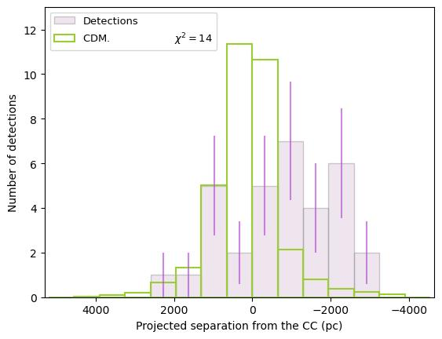
Results
Subhaloes
Broadhurst, Li, Amruth + 24
Notes:
Ask paloma to redo the figure, only wimps + one waveDM

Slide 41

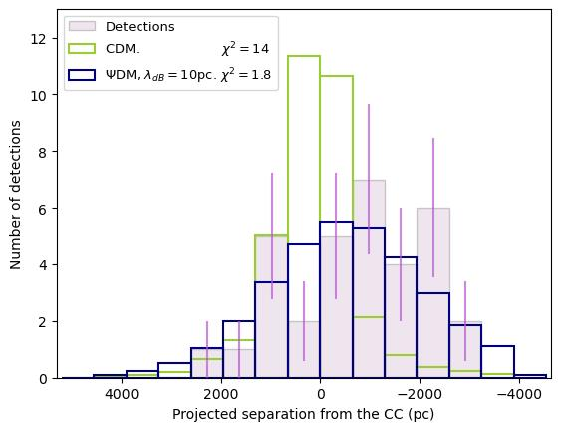

Results
Axion mass of 1e-22 eV
Cluster halo mass ~ 10^15 pc
lambda_dB ~10 pc!
Subhaloes
Subhaloes
Broadhurst, Li, Amruth + 24
Notes:
Ask paloma to redo the figure, only wimps + one waveDM

Slide 42
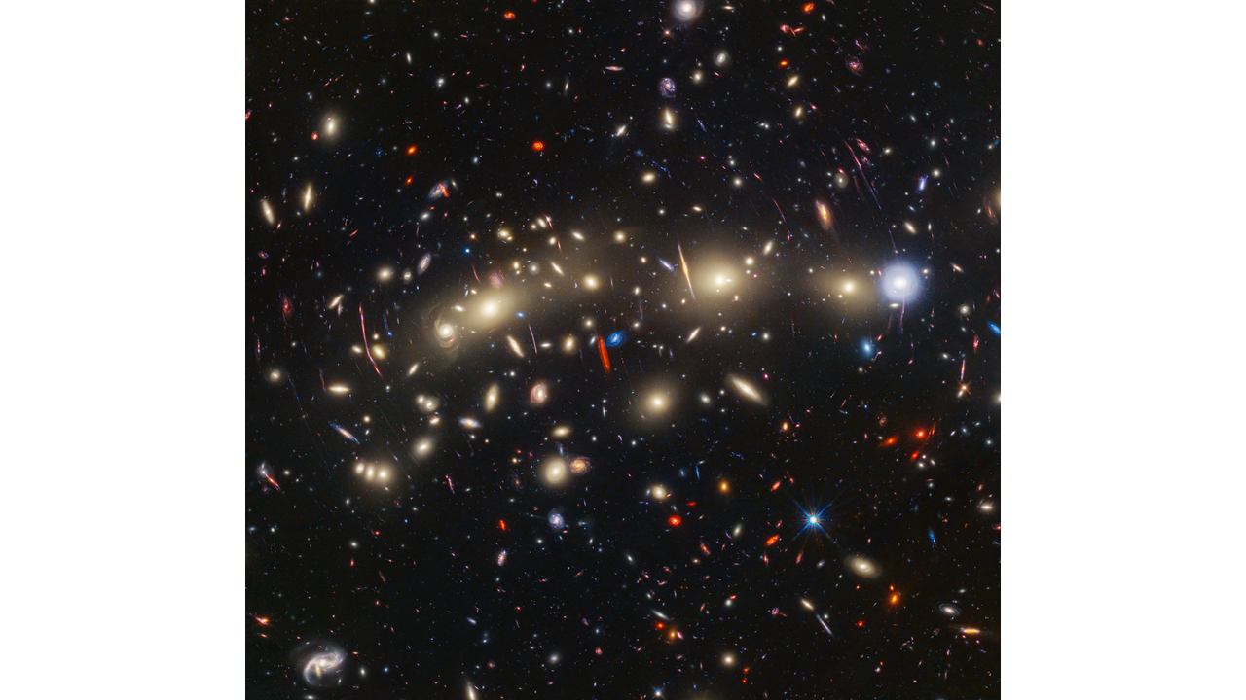
Beyond the Dragon
Credit NASA, ESA, CSA, STScI
Notes:
So we take the above calculation a bit further – we collapse the calculation in the y-axis plane (along the CC), and obtain the number density curve as a function of the projected separation from the CC.
Here, we show the observation in pink histogram; CDM in green and waveDM in blue.
You can see that, waveDM better fits the observed trend. Overall, a simple chi2 test say that waveDM is favoured over CDM.
An interesting fact is that if you assume an axion mass of 10-22 eV (which is common), and a typical velocity dispersion of a cluster, then the DB wavelength of a cluster would be ~10-15pc, which is the best fit simulation in our case.

Slide 43
Beyond the Dragon
Credit NASA, ESA, CSA, STScI
Notes:
So we take the above calculation a bit further – we collapse the calculation in the y-axis plane (along the CC), and obtain the number density curve as a function of the projected separation from the CC.
Here, we show the observation in pink histogram; CDM in green and waveDM in blue.
You can see that, waveDM better fits the observed trend. Overall, a simple chi2 test say that waveDM is favoured over CDM.
An interesting fact is that if you assume an axion mass of 10-22 eV (which is common), and a typical velocity dispersion of a cluster, then the DB wavelength of a cluster would be ~10-15pc, which is the best fit simulation in our case.

Slide 44
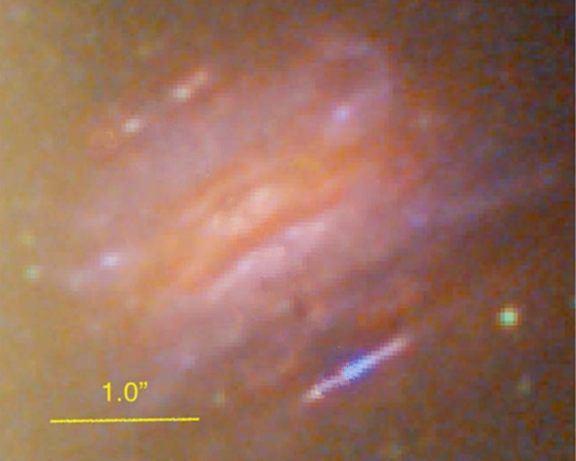
Beyond the Dragon
Broadhurst, Li, Amruth + 24
Credit NASA, ESA, CSA, STScI
Notes:
So we take the above calculation a bit further – we collapse the calculation in the y-axis plane (along the CC), and obtain the number density curve as a function of the projected separation from the CC.
Here, we show the observation in pink histogram; CDM in green and waveDM in blue.
You can see that, waveDM better fits the observed trend. Overall, a simple chi2 test say that waveDM is favoured over CDM.
An interesting fact is that if you assume an axion mass of 10-22 eV (which is common), and a typical velocity dispersion of a cluster, then the DB wavelength of a cluster would be ~10-15pc, which is the best fit simulation in our case.

Slide 45
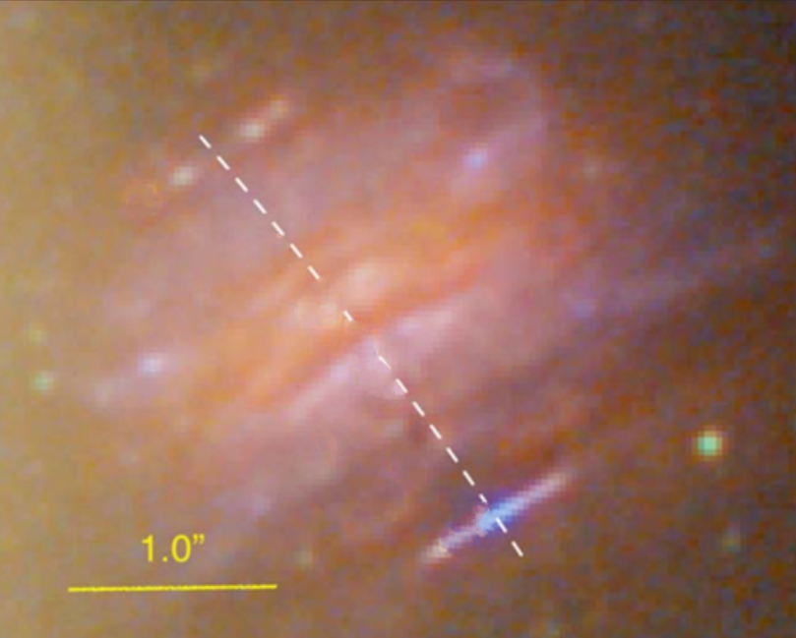
Beyond the Dragon
+ve
-ve
Broadhurst, Li, Amruth + 24
Credit NASA, ESA, CSA, STScI
Notes:
So we take the above calculation a bit further – we collapse the calculation in the y-axis plane (along the CC), and obtain the number density curve as a function of the projected separation from the CC.
Here, we show the observation in pink histogram; CDM in green and waveDM in blue.
You can see that, waveDM better fits the observed trend. Overall, a simple chi2 test say that waveDM is favoured over CDM.
An interesting fact is that if you assume an axion mass of 10-22 eV (which is common), and a typical velocity dispersion of a cluster, then the DB wavelength of a cluster would be ~10-15pc, which is the best fit simulation in our case.

Slide 46
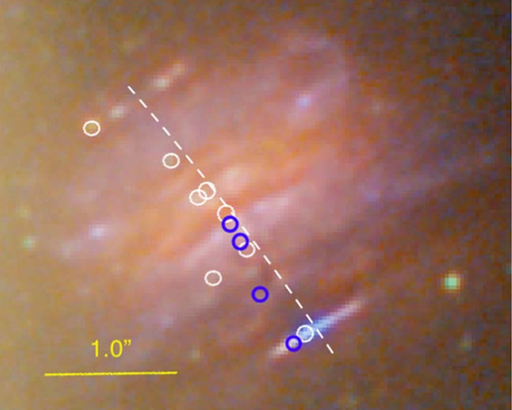
Beyond the Dragon
+ve
-ve
Broadhurst, Li, Amruth + 24
Credit NASA, ESA, CSA, STScI
Notes:
So we take the above calculation a bit further – we collapse the calculation in the y-axis plane (along the CC), and obtain the number density curve as a function of the projected separation from the CC.
Here, we show the observation in pink histogram; CDM in green and waveDM in blue.
You can see that, waveDM better fits the observed trend. Overall, a simple chi2 test say that waveDM is favoured over CDM.
An interesting fact is that if you assume an axion mass of 10-22 eV (which is common), and a typical velocity dispersion of a cluster, then the DB wavelength of a cluster would be ~10-15pc, which is the best fit simulation in our case.

Slide 47
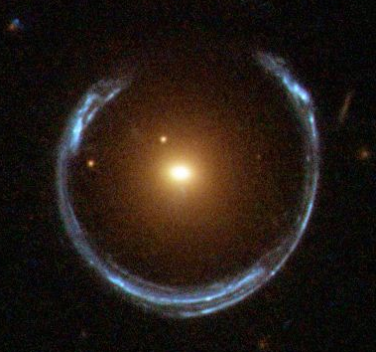
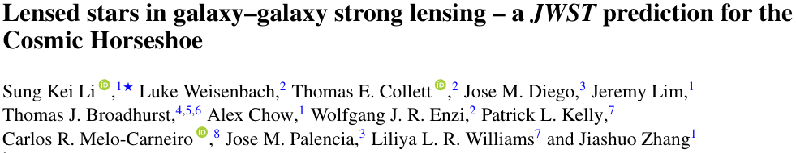
A new frontier – Galaxy-galaxy strong lensing
Credit ESA/Hubble, NASA
All lensed stars are only found in clusters so far, leaving behind a huge population of GGSLs
Credit NASA, ESA, CSA, STScI
Notes:
So we take the above calculation a bit further – we collapse the calculation in the y-axis plane (along the CC), and obtain the number density curve as a function of the projected separation from the CC.
Here, we show the observation in pink histogram; CDM in green and waveDM in blue.
You can see that, waveDM better fits the observed trend. Overall, a simple chi2 test say that waveDM is favoured over CDM.
An interesting fact is that if you assume an axion mass of 10-22 eV (which is common), and a typical velocity dispersion of a cluster, then the DB wavelength of a cluster would be ~10-15pc, which is the best fit simulation in our case.

Slide 48
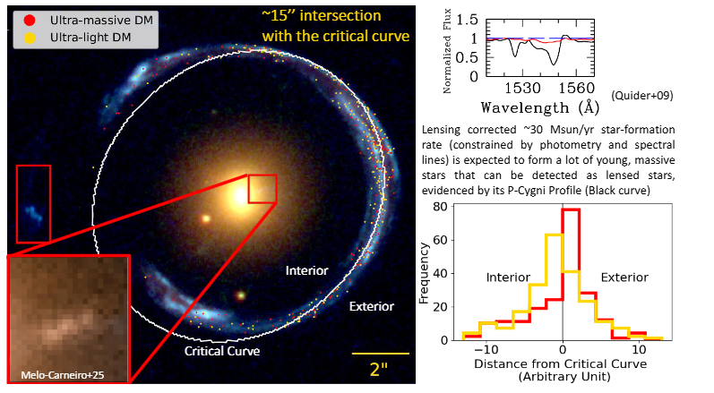
A new frontier – Galaxy-galaxy strong lensing
Resolved stellar kinematics + double source plane
= confident lens model
Modified from Li+25c
Notes:
So we take the above calculation a bit further – we collapse the calculation in the y-axis plane (along the CC), and obtain the number density curve as a function of the projected separation from the CC.
Here, we show the observation in pink histogram; CDM in green and waveDM in blue.
You can see that, waveDM better fits the observed trend. Overall, a simple chi2 test say that waveDM is favoured over CDM.
An interesting fact is that if you assume an axion mass of 10-22 eV (which is common), and a typical velocity dispersion of a cluster, then the DB wavelength of a cluster would be ~10-15pc, which is the best fit simulation in our case.

Slide 49
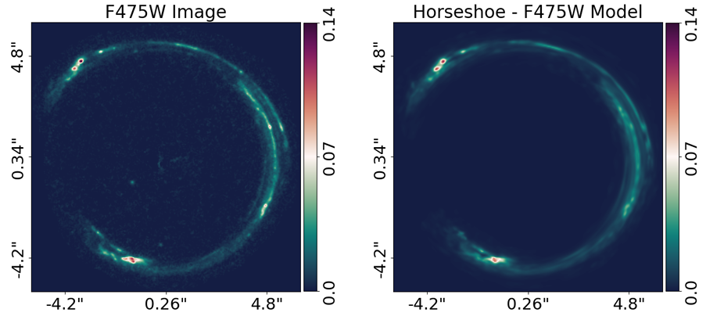
A new frontier – Galaxy-galaxy strong lensing
Resolved stellar kinematics + double source plane
= confident lens model
Modified from Li+25c
Notes:
So we take the above calculation a bit further – we collapse the calculation in the y-axis plane (along the CC), and obtain the number density curve as a function of the projected separation from the CC.
Here, we show the observation in pink histogram; CDM in green and waveDM in blue.
You can see that, waveDM better fits the observed trend. Overall, a simple chi2 test say that waveDM is favoured over CDM.
An interesting fact is that if you assume an axion mass of 10-22 eV (which is common), and a typical velocity dispersion of a cluster, then the DB wavelength of a cluster would be ~10-15pc, which is the best fit simulation in our case.

Slide 50

A new frontier – Galaxy-galaxy strong lensing
Resolved stellar kinematics + double source plane
= confident lens model
Lower halo mass
= longer dB wavelength
= broader lensed star dist.
Modified from Li+25c
Notes:
So we take the above calculation a bit further – we collapse the calculation in the y-axis plane (along the CC), and obtain the number density curve as a function of the projected separation from the CC.
Here, we show the observation in pink histogram; CDM in green and waveDM in blue.
You can see that, waveDM better fits the observed trend. Overall, a simple chi2 test say that waveDM is favoured over CDM.
An interesting fact is that if you assume an axion mass of 10-22 eV (which is common), and a typical velocity dispersion of a cluster, then the DB wavelength of a cluster would be ~10-15pc, which is the best fit simulation in our case.

Slide 51
A new frontier – Galaxy-galaxy strong lensing
Resolved stellar kinematics + double source plane
= confident lens model
Lower halo mass
= longer dB wavelength
= broader lensed star dist.
Modified from Li+25c
Notes:
So we take the above calculation a bit further – we collapse the calculation in the y-axis plane (along the CC), and obtain the number density curve as a function of the projected separation from the CC.
Here, we show the observation in pink histogram; CDM in green and waveDM in blue.
You can see that, waveDM better fits the observed trend. Overall, a simple chi2 test say that waveDM is favoured over CDM.
An interesting fact is that if you assume an axion mass of 10-22 eV (which is common), and a typical velocity dispersion of a cluster, then the DB wavelength of a cluster would be ~10-15pc, which is the best fit simulation in our case.

Slide 52
A new frontier – Galaxy-galaxy strong lensing
Whether same axion mass explain obs. in GGSL & cluster provide a stringent test of nature of DM
Modified from Li+25c
Notes:
So we take the above calculation a bit further – we collapse the calculation in the y-axis plane (along the CC), and obtain the number density curve as a function of the projected separation from the CC.
Here, we show the observation in pink histogram; CDM in green and waveDM in blue.
You can see that, waveDM better fits the observed trend. Overall, a simple chi2 test say that waveDM is favoured over CDM.
An interesting fact is that if you assume an axion mass of 10-22 eV (which is common), and a typical velocity dispersion of a cluster, then the DB wavelength of a cluster would be ~10-15pc, which is the best fit simulation in our case.

Slide 53
Dummy slides

