Slide 1


A Hybrid Asymmetic Linear Higgs Factory
Brian Foster (Oxford/DESY)

Slide 2
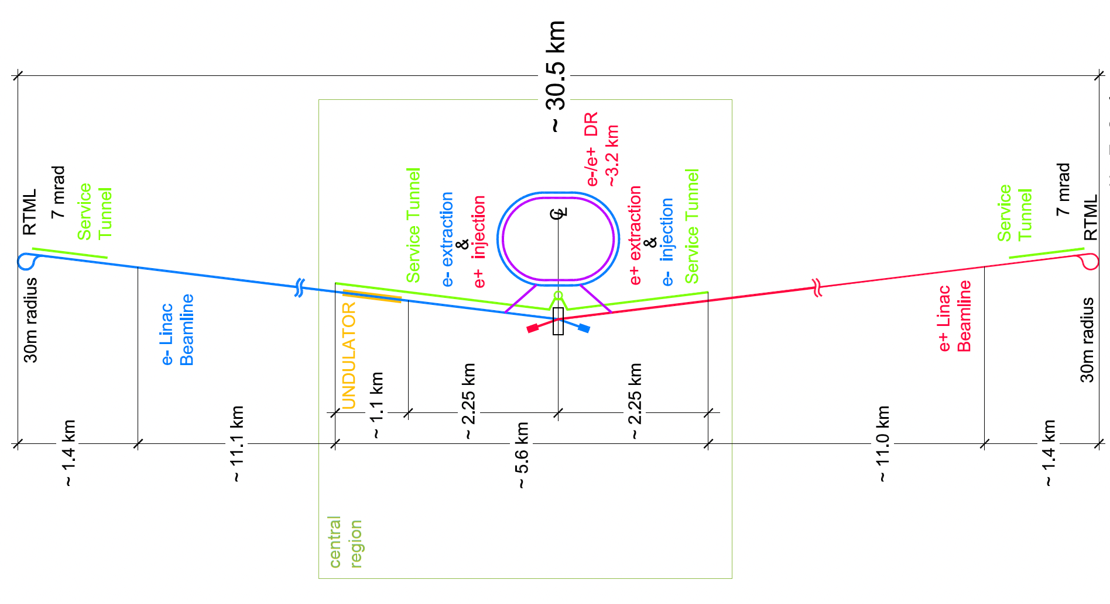
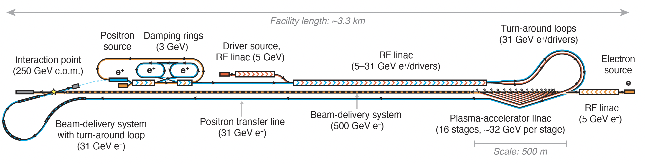
Hybrid Asymmetric Linear Higgs
Factory (HALHF)
ILC
CEPC
https://arxiv.org/2303.10150

Slide 3
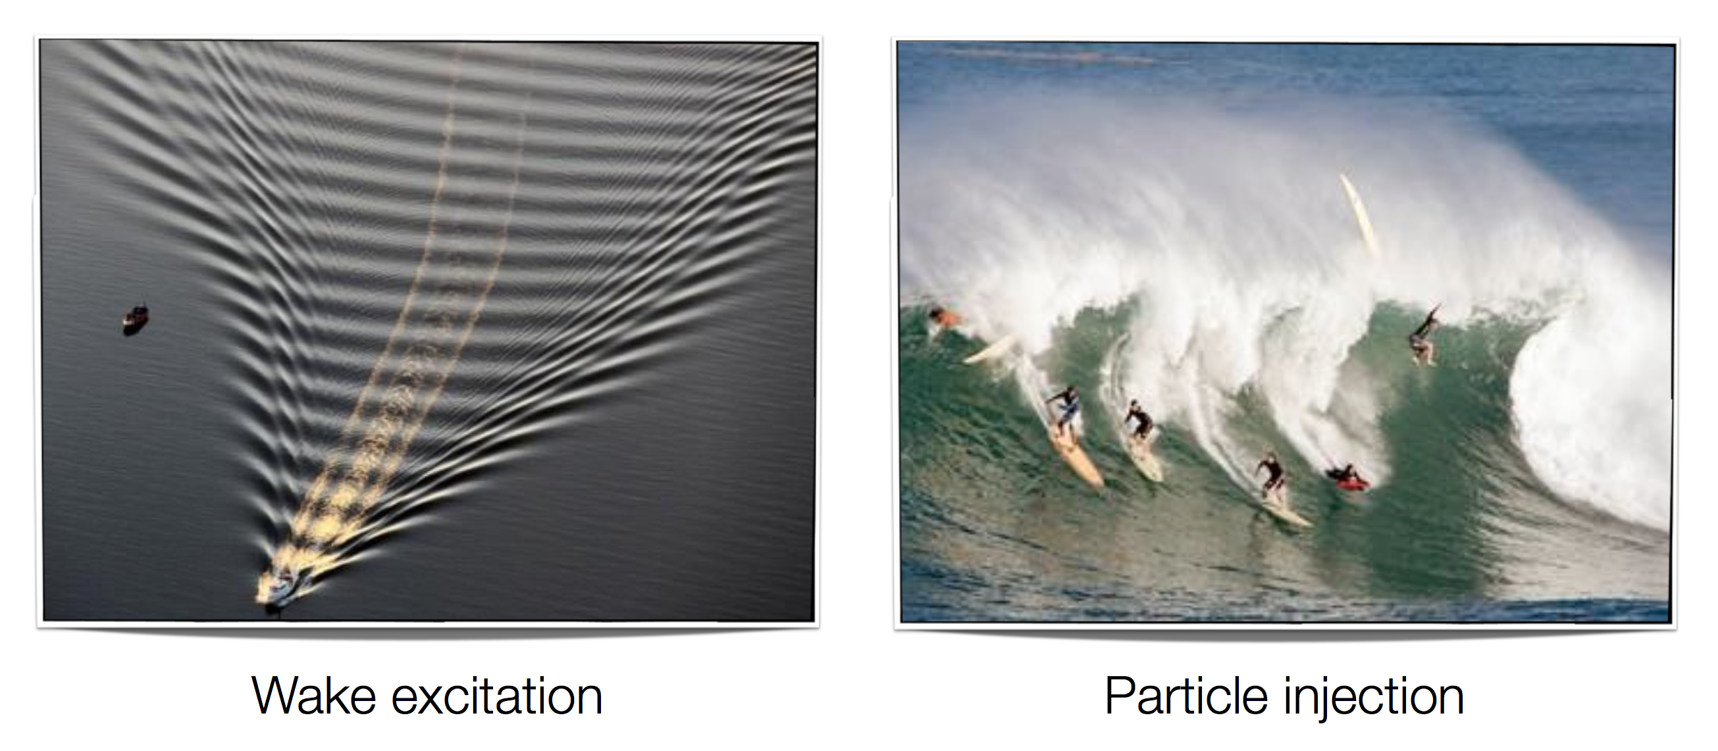

Plasma Wave Acceleration

Slide 4
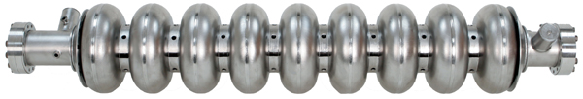
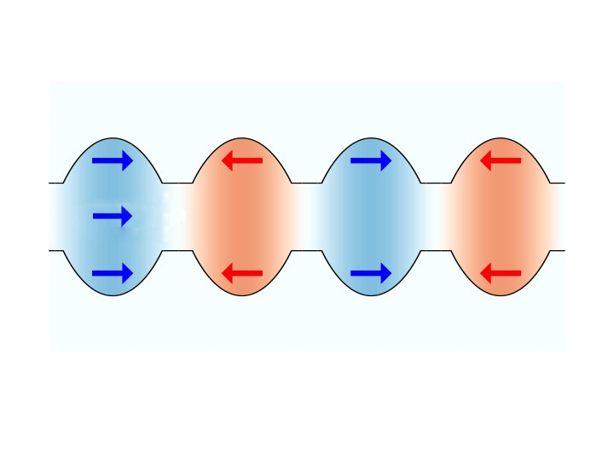
Plasma vs SCRF Cavities
SCRF Cavity
Plasma
wakefield

Slide 5
Plasma vs SCRF Cavities
SCRF Cavity
Plasma
wakefield
5

Slide 6
Plasma vs SCRF Cavities
SCRF Cavity
Plasma
wakefield

Slide 7
Setting the scale
Notes:
Contrast with conventional cavities….
Work at Lawrence Berkeley Laboratory. 40 TW laser pulse (3 * 10 18 W/cm2) – 1 GeV in 3.3 cm
produced 33 GV/m fields. Beam quality lousy! Florian is at forefront of this table top infra-red FELs.

Slide 8
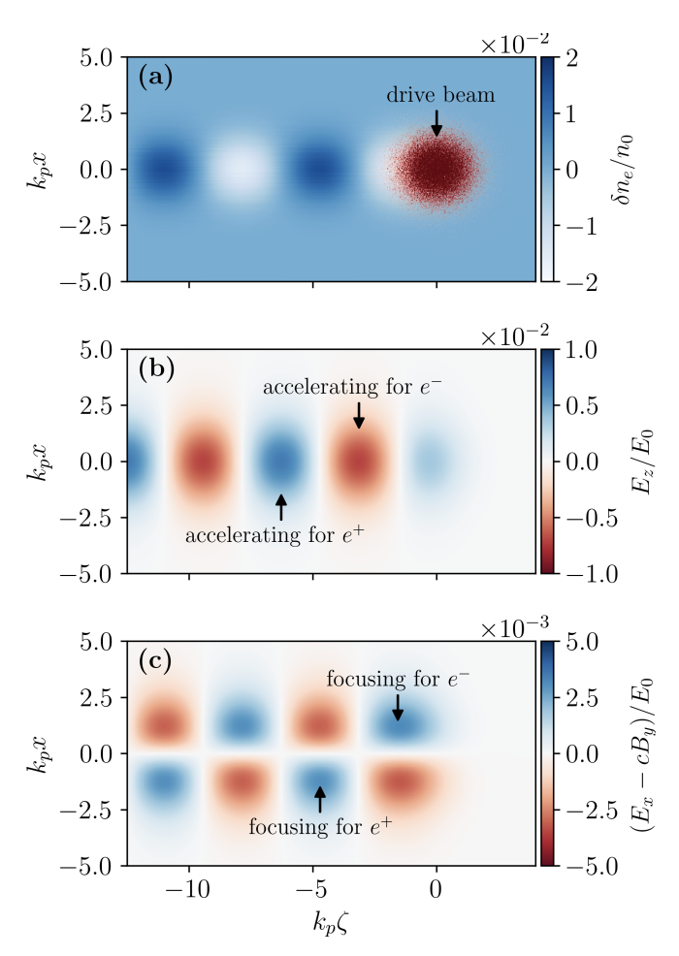
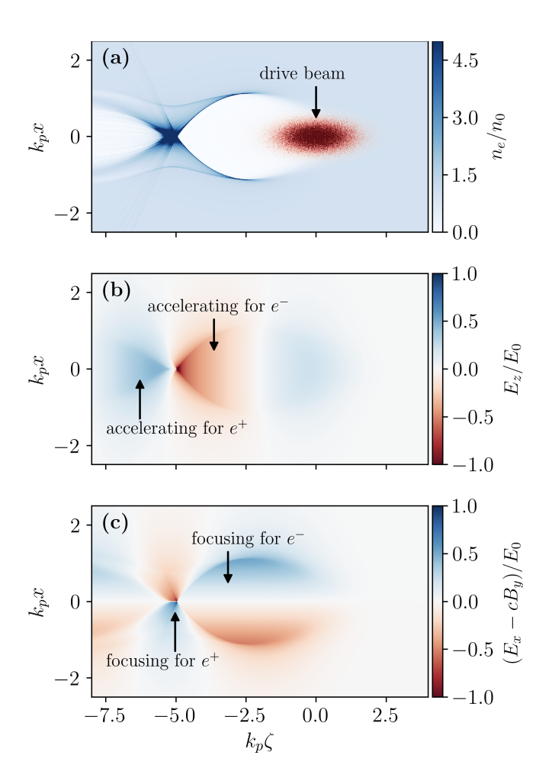
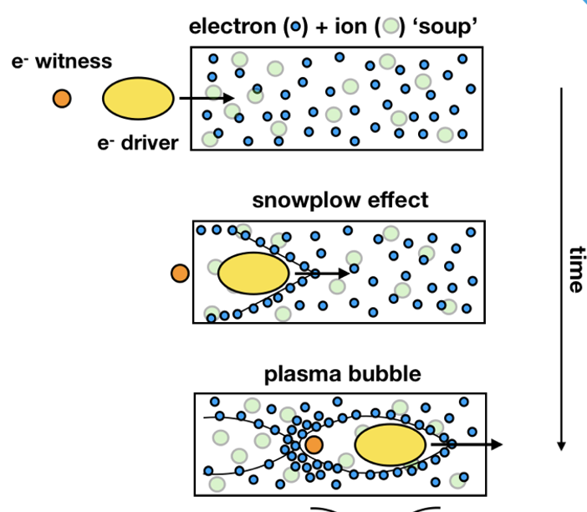
Plasma Acceleration 101
Linear Regime
(n_{b}/n₀ << 1)
Non-linear (“Blow-out”)
Regime (n_{b}/n₀ >>1)
Non-linear (“Blow-out”)
Regime (n_{b}/n₀ >>1)
Ack. For next 3 slides: S. Deiderichs:
https://ediss.sub.uni-hamburg.de/bitstream/ediss/10403/1/SDiederichs-PhD-Thesis.pdf

Slide 9
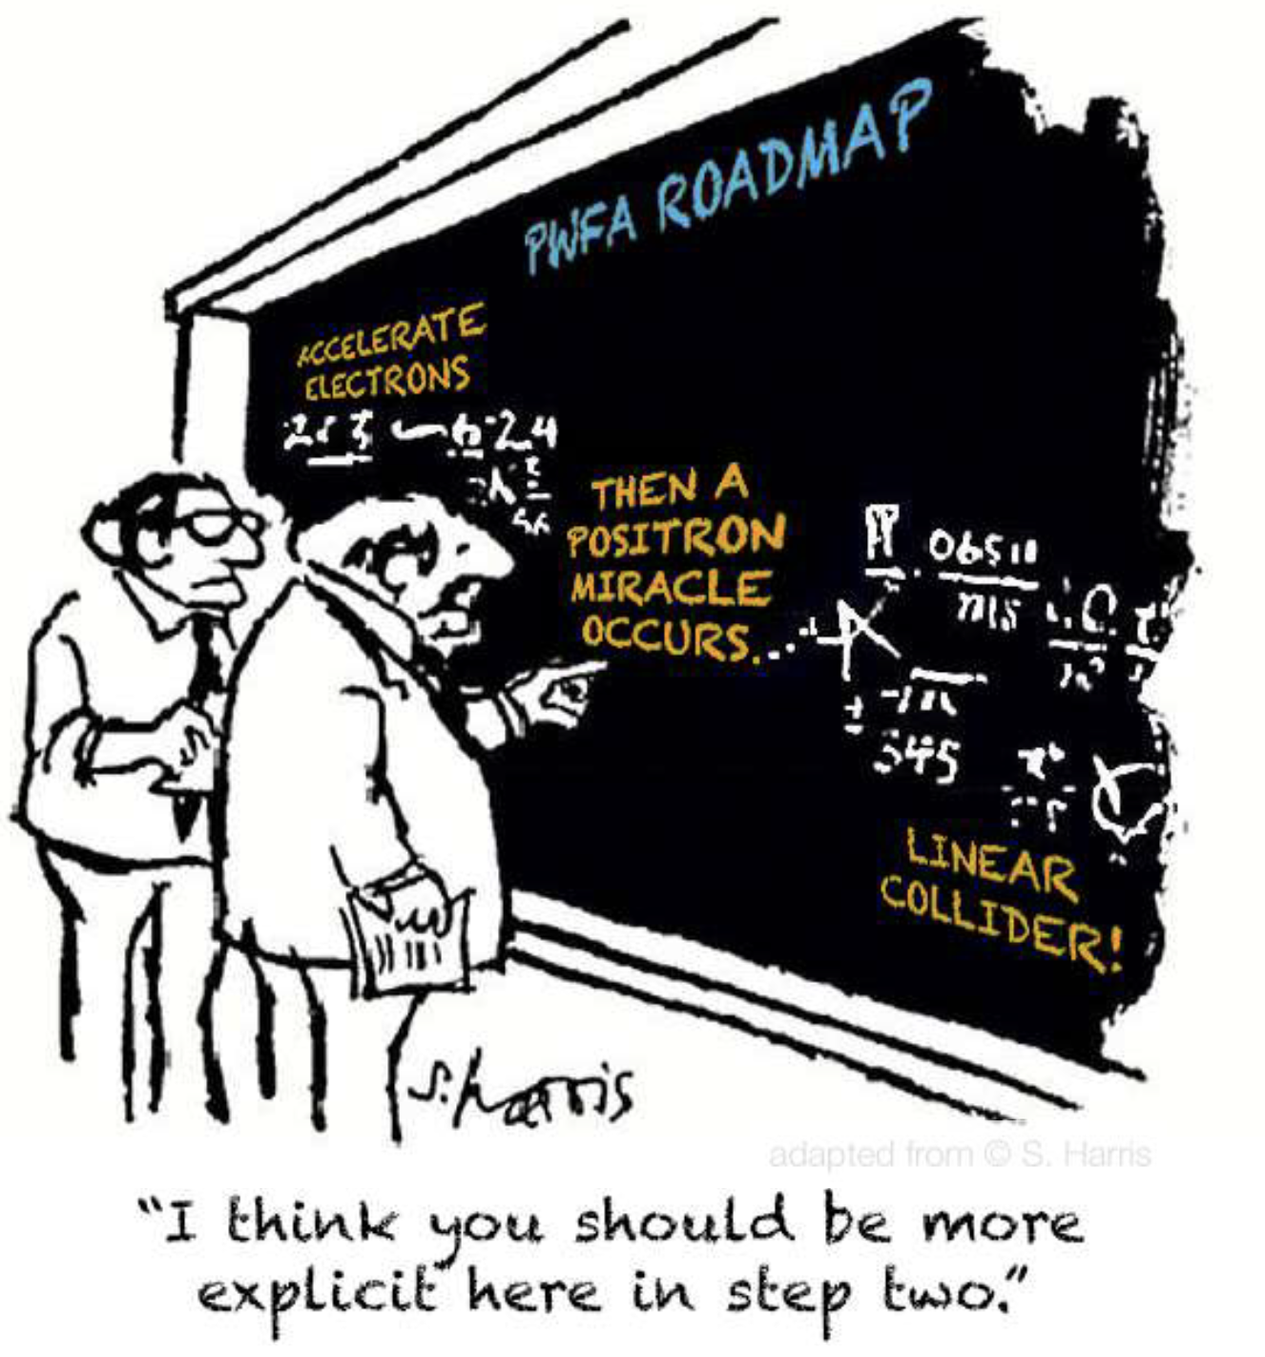
The problem with positrons

Slide 10
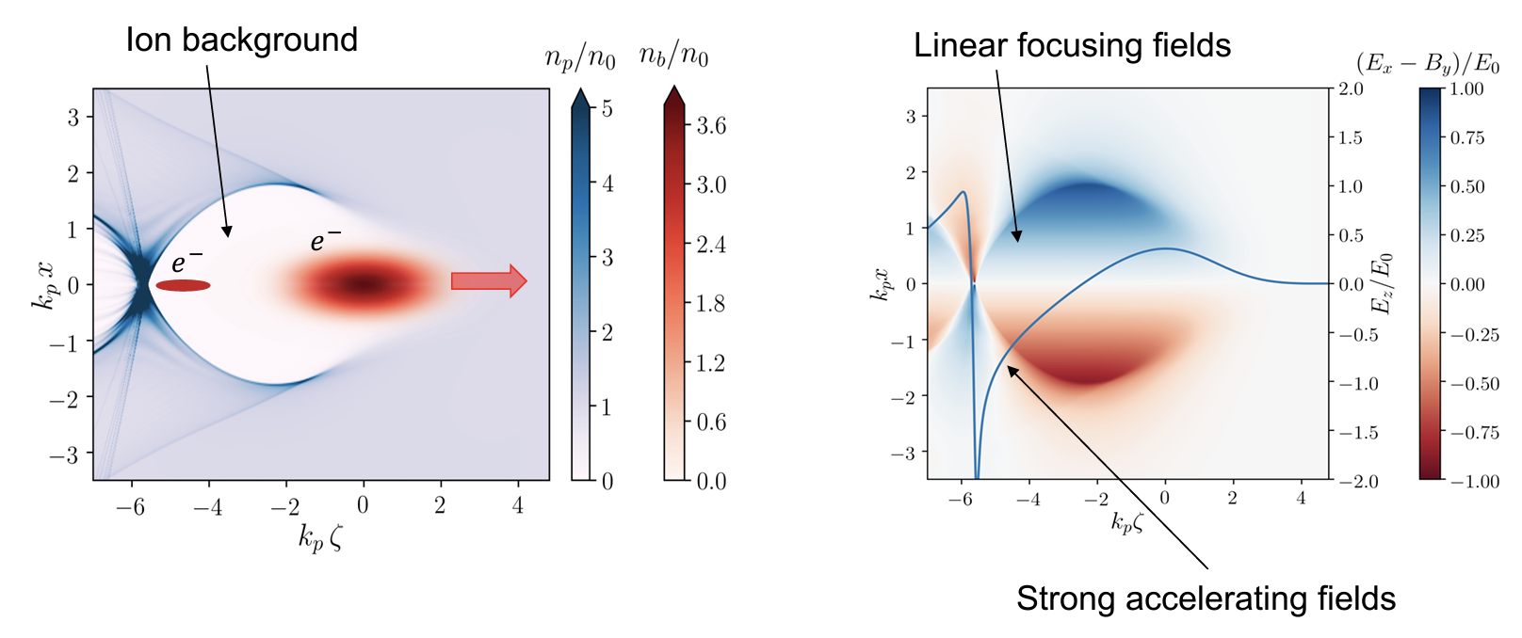
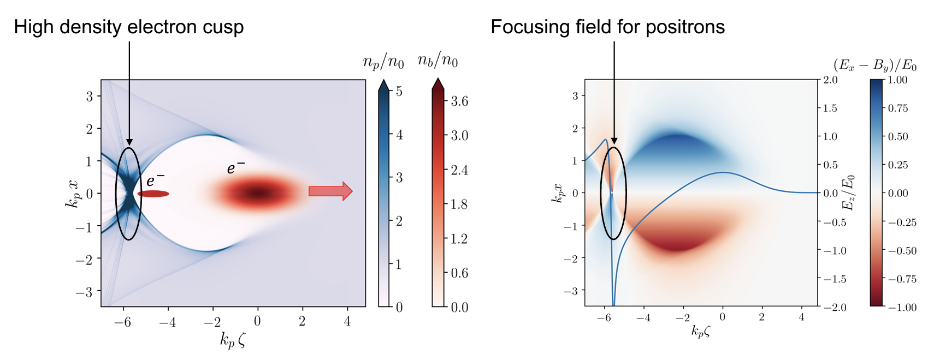
Positron acceleration
e⁻
e⁺

Slide 11
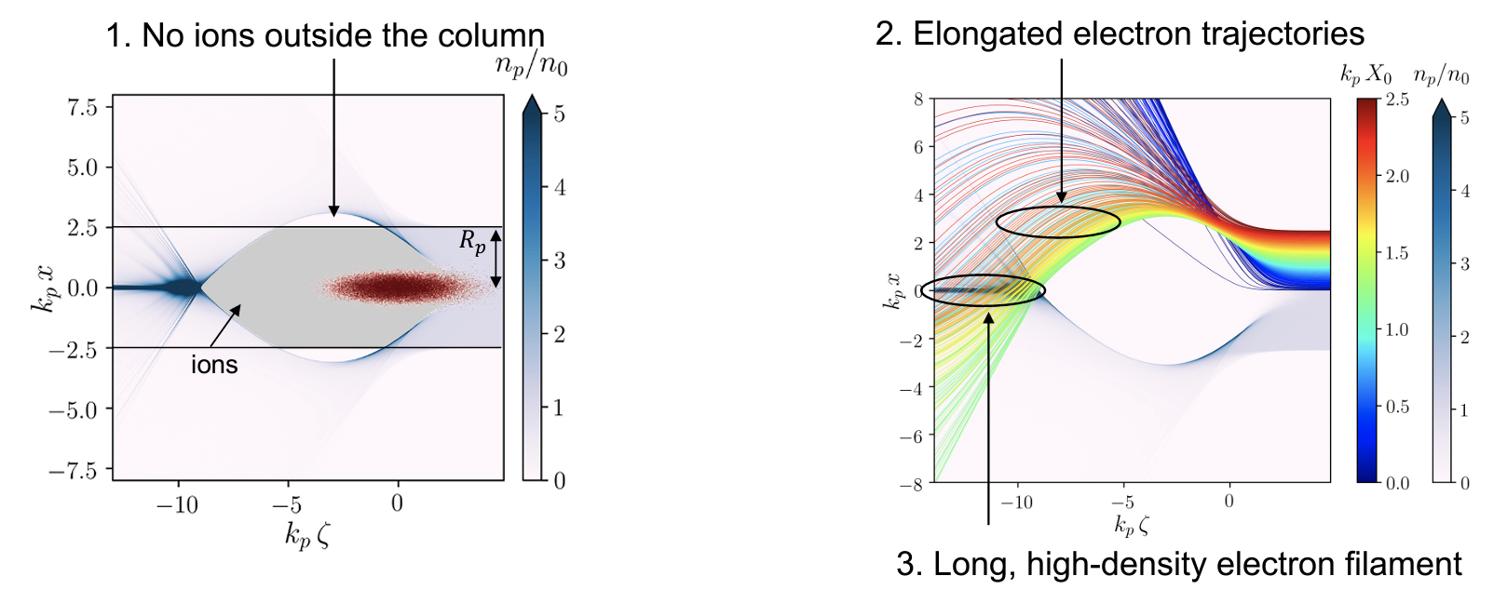
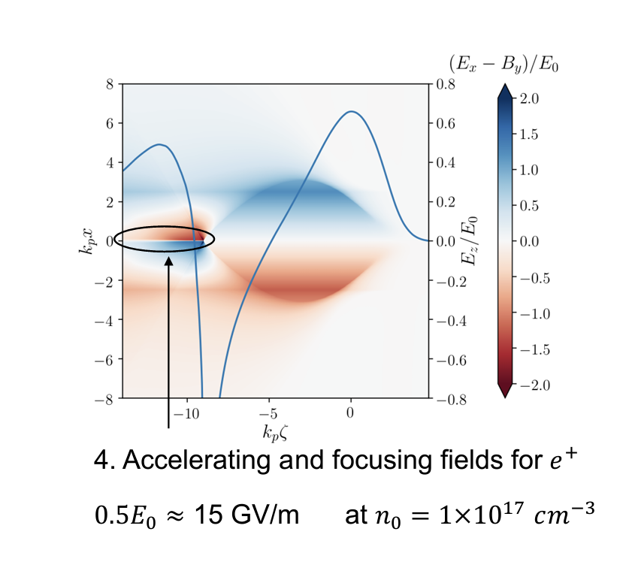
Positron acceleration
There are many
schemes for e+
acceleration – but
currently, none can
be tested
experimentally.
Most involve some
sort of shaping or
truncation of
plasma to inhibit
return flow of
electrons from
blowout.

Slide 12
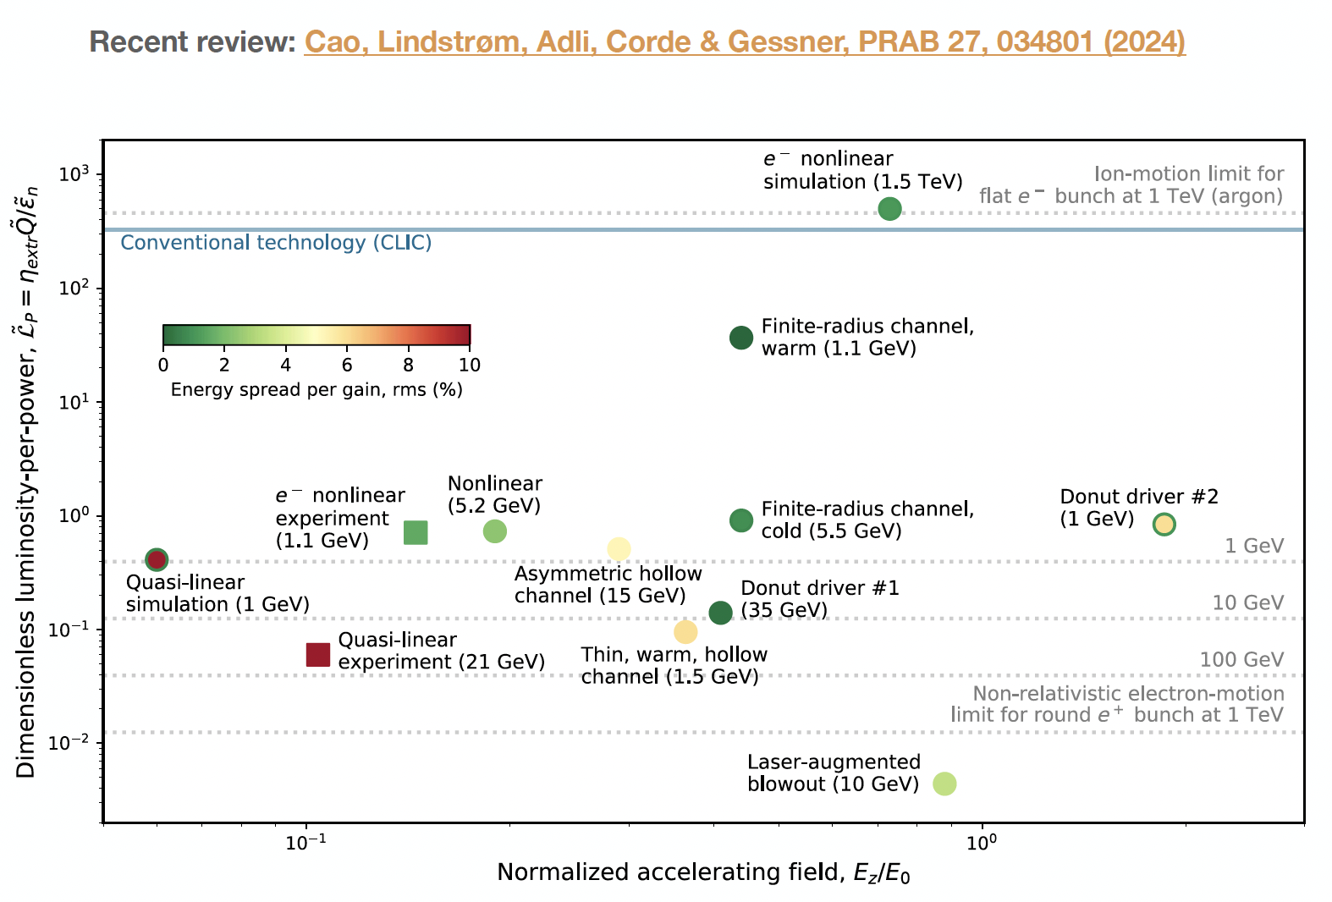
Positron Acceleration
Even if one of these schemes proves to work reliably and reproducibly, they are
generally not close to
collider regime.

Slide 13
Origin of HALHF
The basic idea is – there are enough problems with a PWFA e⁻ accelerator; e⁺ is even more difficult. Bypass this for e⁺e⁻ collider by using conventional linac for e⁺.
For this to be attractive financially, conventional linac must be low energy => asymmetric energy machine.
This requirement led to (at least for us) unexpected directions – the more asymmetric the machine became, the better!

Slide 14
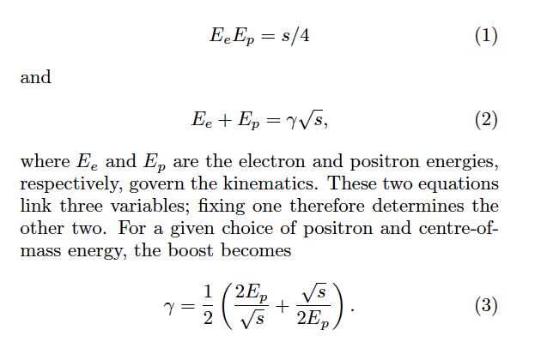
Relativistic Refresher
We thought that the optimum (see later) for E_{cm} = 250 GeV is to pick E_{e} = 500 GeV, E_{p}= 31 GeV, which gives a boost in the electron direction of γ ~ 2.13.

Slide 15
Power Efficiency
Asymmetric machines less energy efficient than symmetric – energy lost “in accelerating the C.o.M.” For equal bunch charges => 2.5 times more power required for same C.o.M. energy.
Can be reduced by introducing asymmetry into beam charges – increase charge of low-energy beam and decrease high-energy s.t. N² = N_{e}N_{p} constant => L conserved.
P/P₀ = (N_{e}E_{e}+N_{p}E_{p})/(N*sqrt(s))
Optimum is to scale e⁺ charge by sqrt(s)/(2E_{p}), i.e. factor ~ 4.
Producing so many e⁺ problematic – compromise by scaling by factor 2 (2*e⁺, ½* e⁻).
Reduces power increase to 1.25. Also reduces bunch charge in PWFA arm.

Slide 16
Emittance reduction
Geometric emittance of bunch scales with 1/E .
Lower-energy e⁺ beam must have smaller β function at I.P. – use β_{x} /β_{y} = 3.3/0.1 mm c.f. CLIC 4.0/0.1 mm.
In contrast, high-energy e⁻ beam - β function can be increased, which could reduce complexity of BDS.
More interesting is to increase the e⁻ emittance AND reduce the β function => normalized emittance can be 16 times higher for the same L => increased tolerances in PWFA arm.
Beam-beam focusing effect on L must be simulated with Guinea Pig.

Slide 17
HALHF Layout
e-
e+
e+ BDS
e- BDS

Slide 18
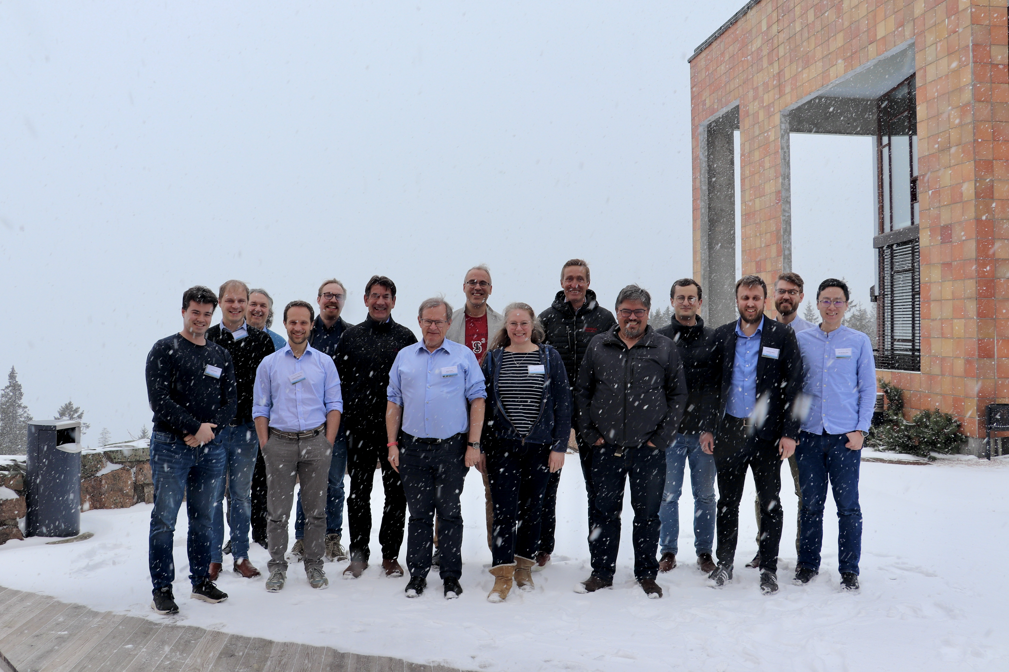
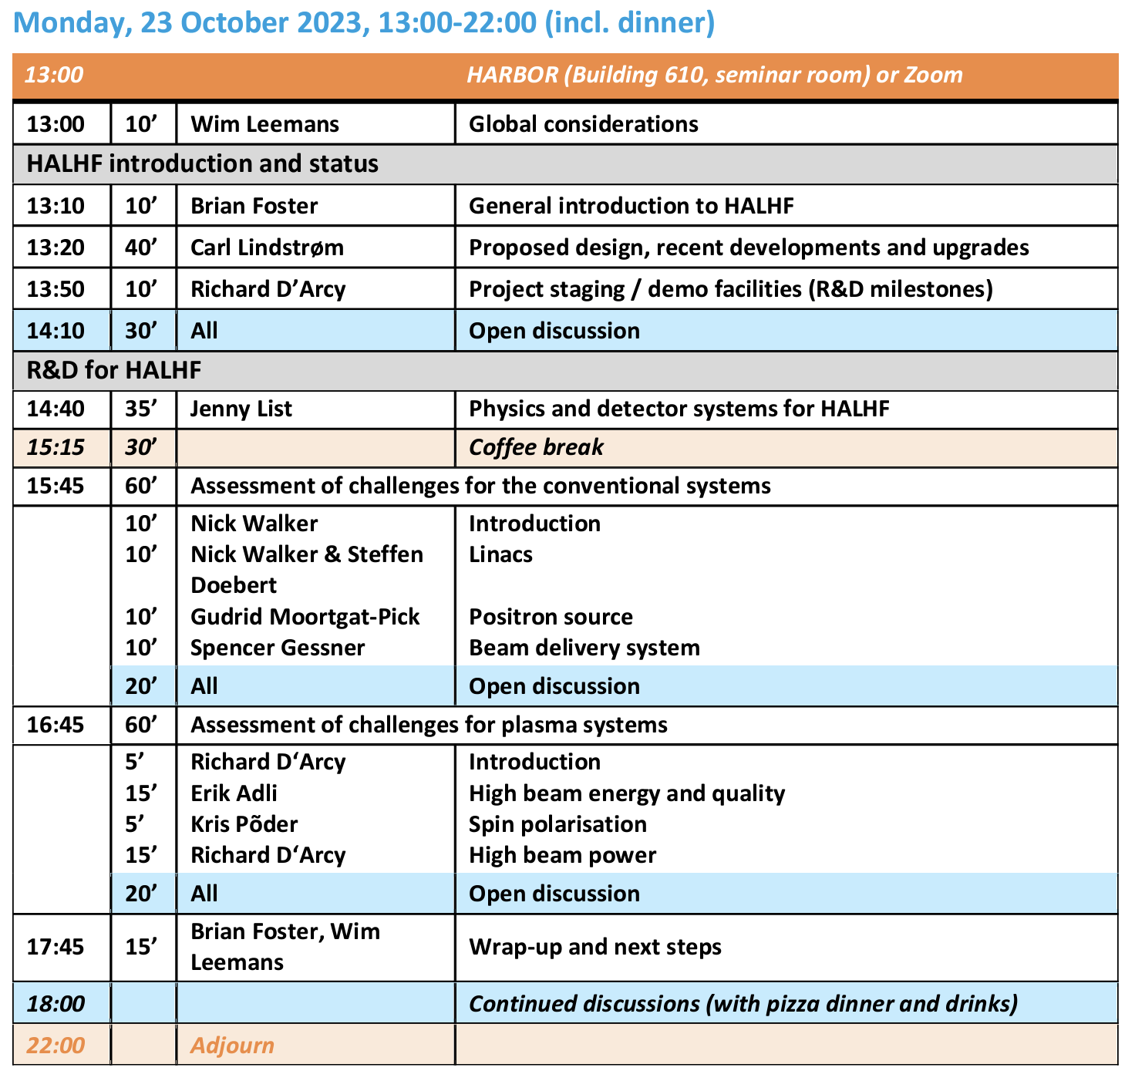
But hang on…..
HALHF Collaboration
“kick-off” meeting
@ DESY 23/10/23.
Attendance ~ 50.
HALHF Workshop
@ Oslo 4-5/4/24.
Attendance ~ 30 (physical+ Zoom).
https://indico.cern.ch/event/1370201/

Slide 19
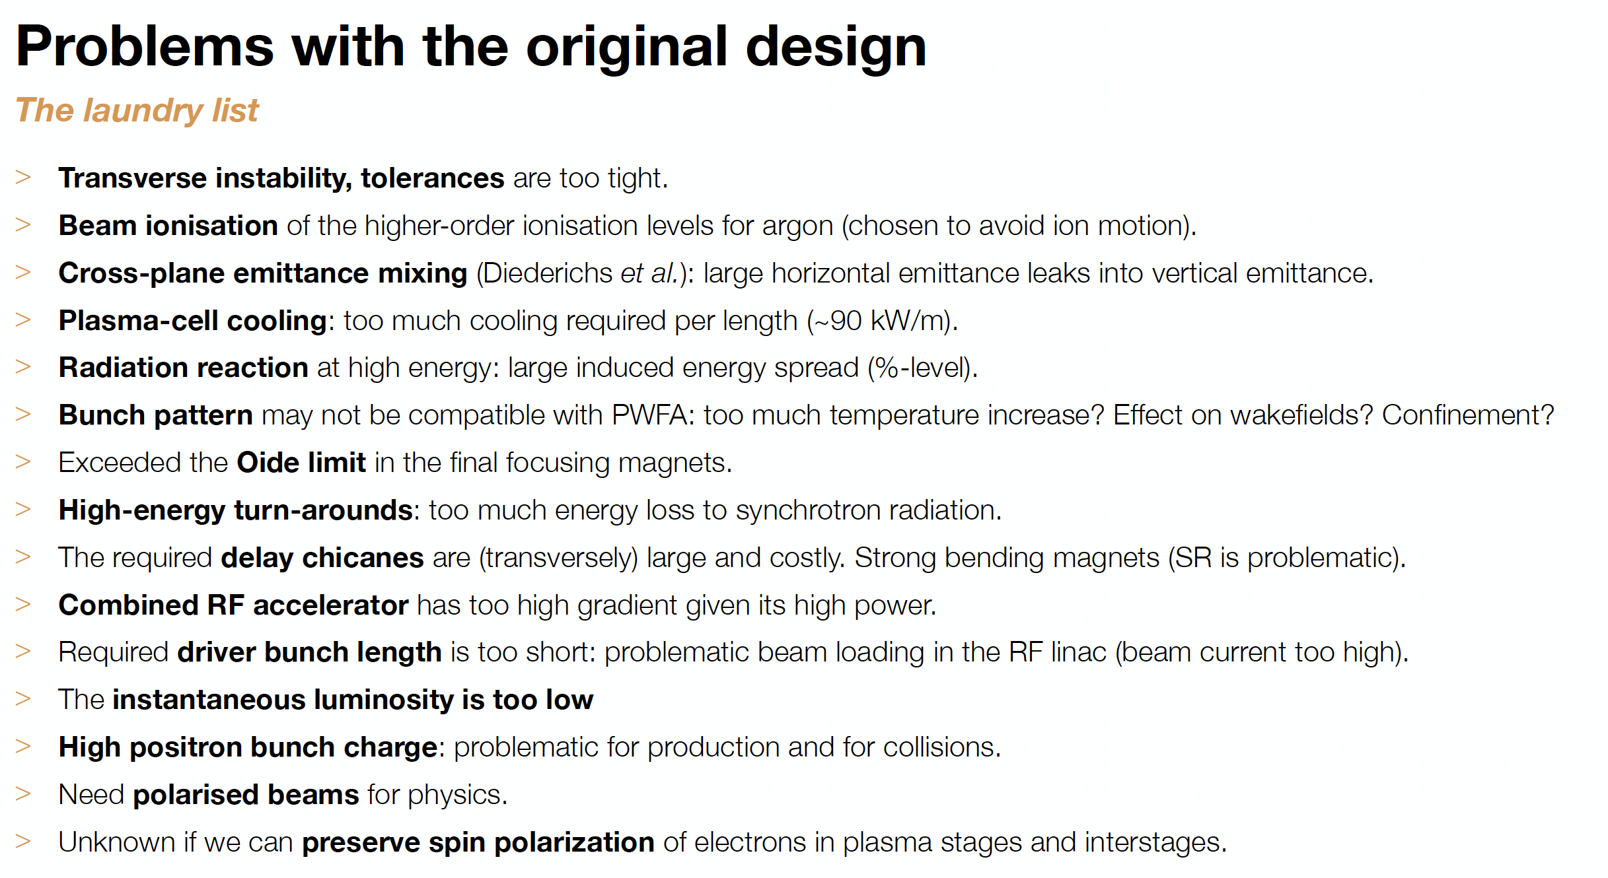
Second thoughts

Slide 20
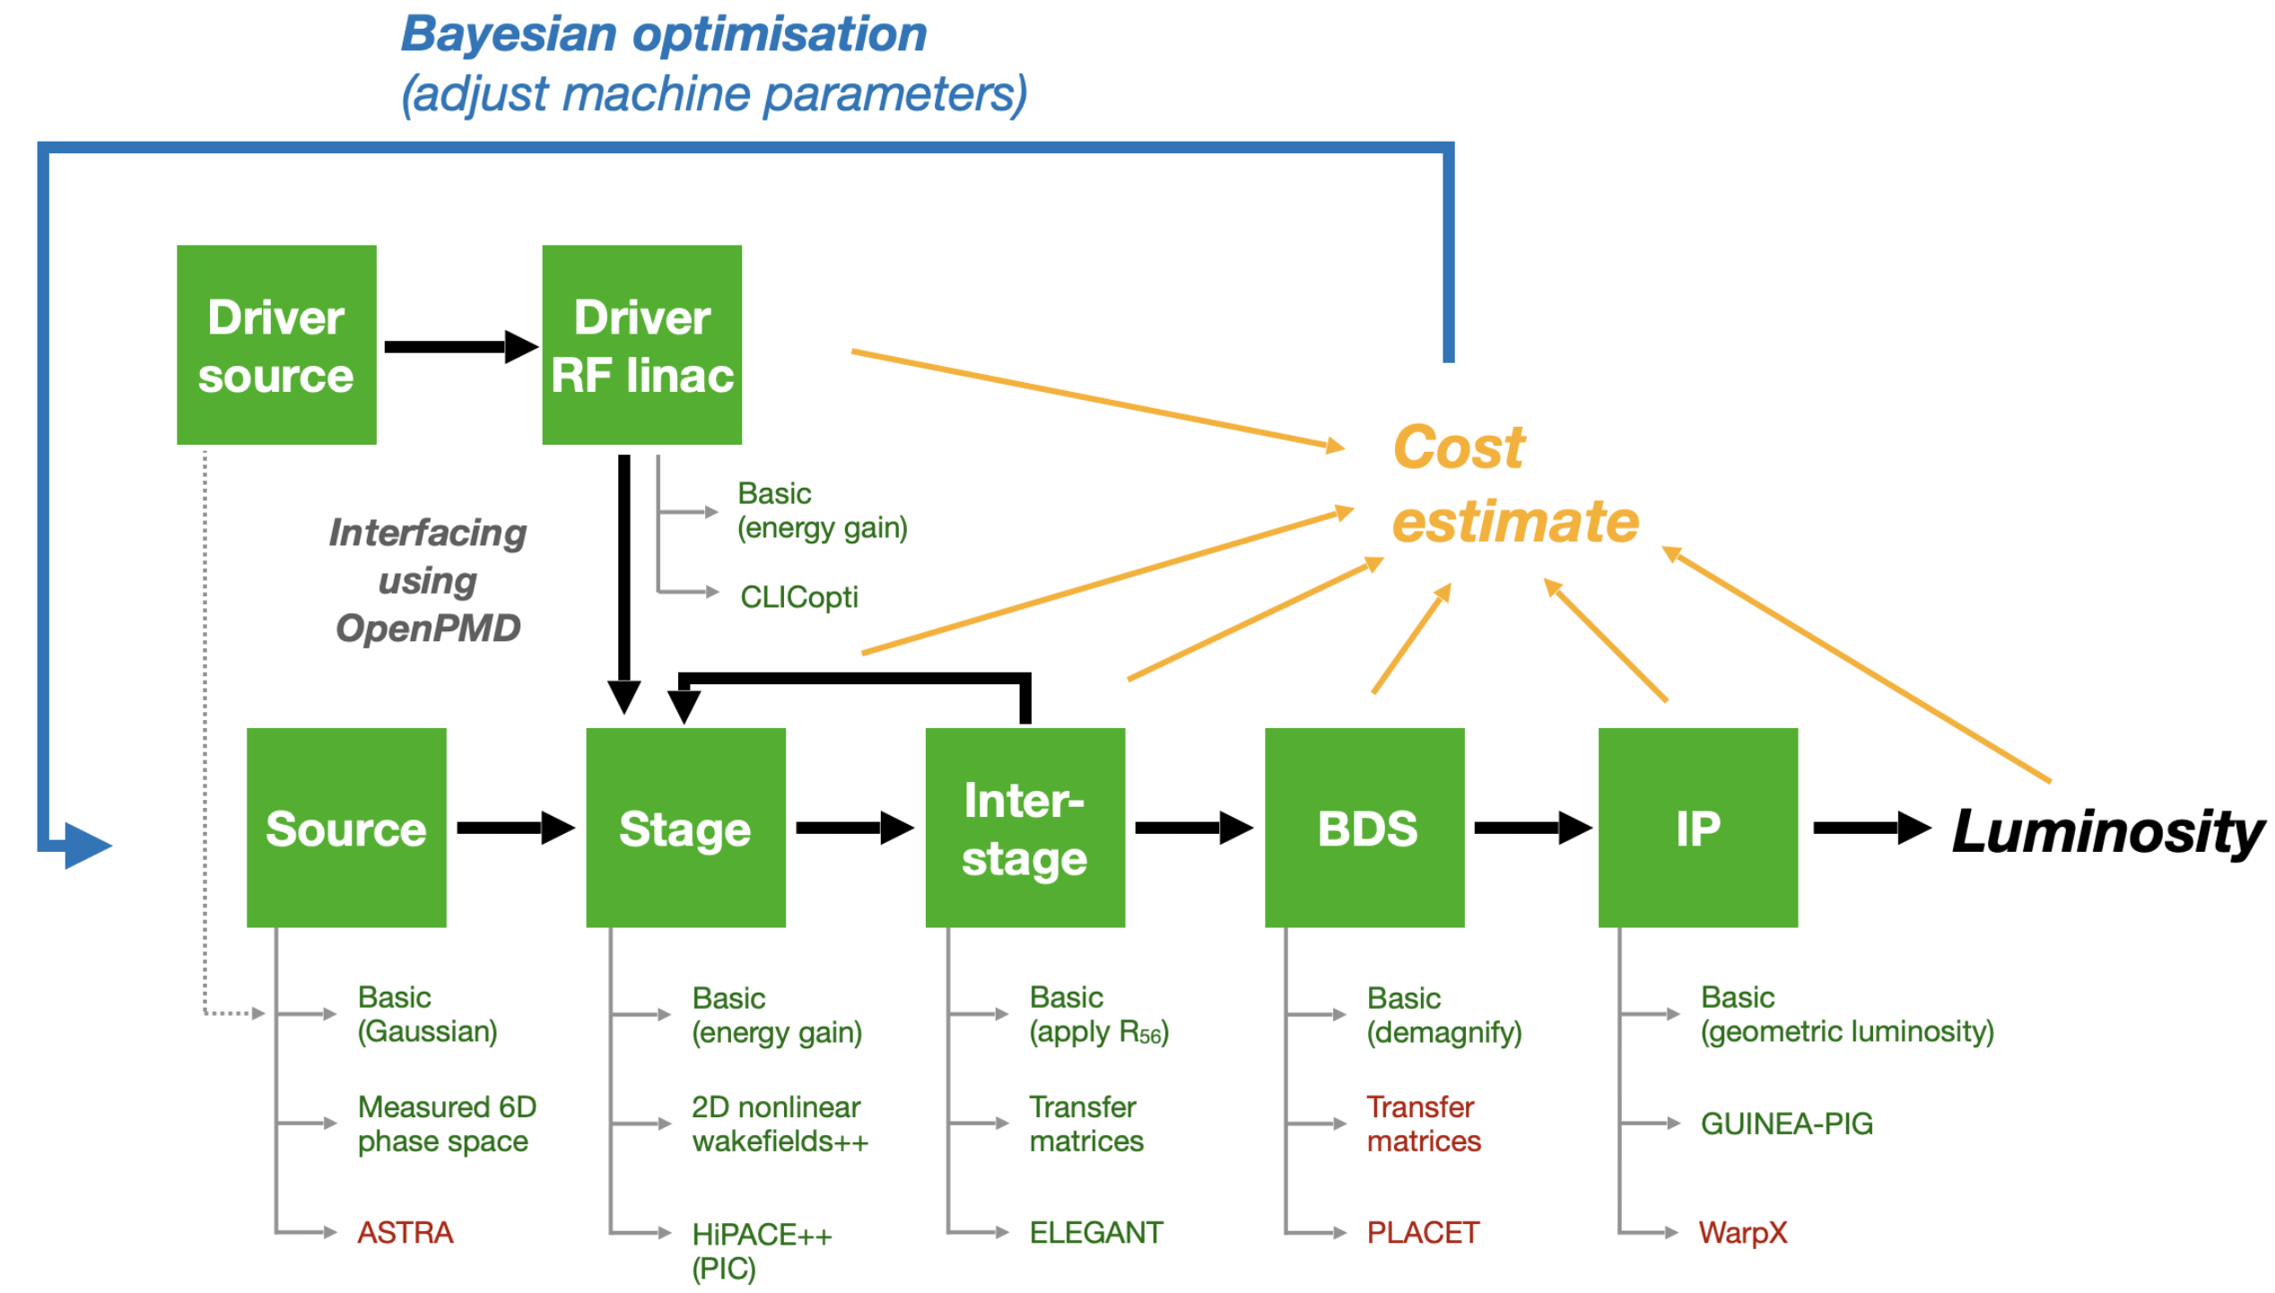
ABEL: The Adaptable Beginning-to-End Linac simulation framework
Facility Optimisation
A start-to-end simulation framework, using OpenPMD
Adaptable implementations
— choose fidelity versus speed for each subsystem
Running other codes via wrappers (also submits HPC jobs etc.)
— HiPACE++, WakeT, ImpactX, GUINEAPIG, ELEGANT, CLICopti
Run simulations as experiments
— run simulations with multiple shots, incl. random jitter
— perform automated scans (one-liner)
— perform parameter optimisations
“System code” (term borrowed from e.g. fusion)
— integrated cost modelling
— machine layouts
Chen et al., TUPS012, IPAC’25
Now released as open source - Repository: https://github.com/abel-framework/ABEL

Slide 21
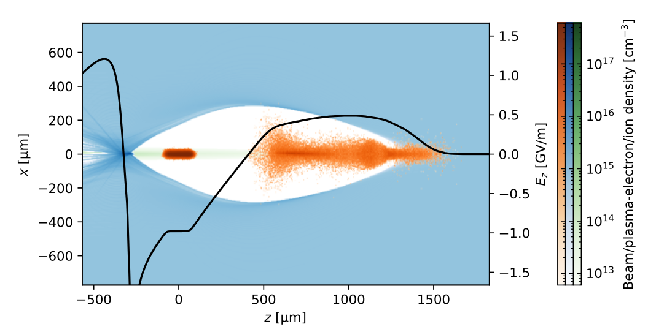
Blow-out simulation
PIC simulation with HiPACE++, He @ 6 × 10¹⁴ cm⁻³ ; driver and main beam (orange) 8 & 1.6 nC. Excess ion density
on axis (green)

Slide 22
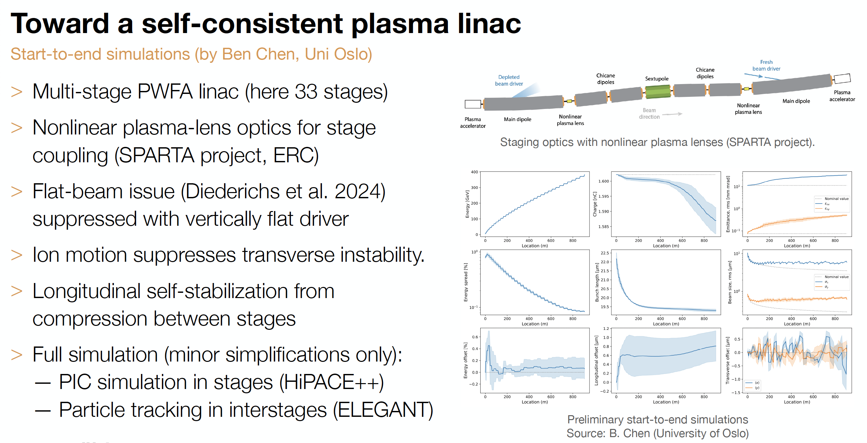
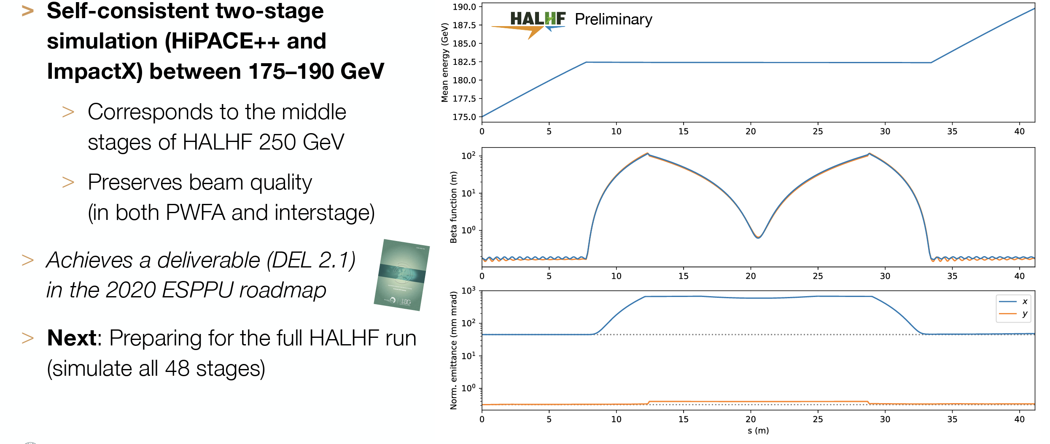
Two-stage simulation

Slide 23
ABEL: The Adaptable Beginning-to-End Linac simulation framework
Towards Full Simulation

Slide 24
ABEL: The Adaptable Beginning-to-End Linac simulation framework
Facility Optimisation

Slide 25
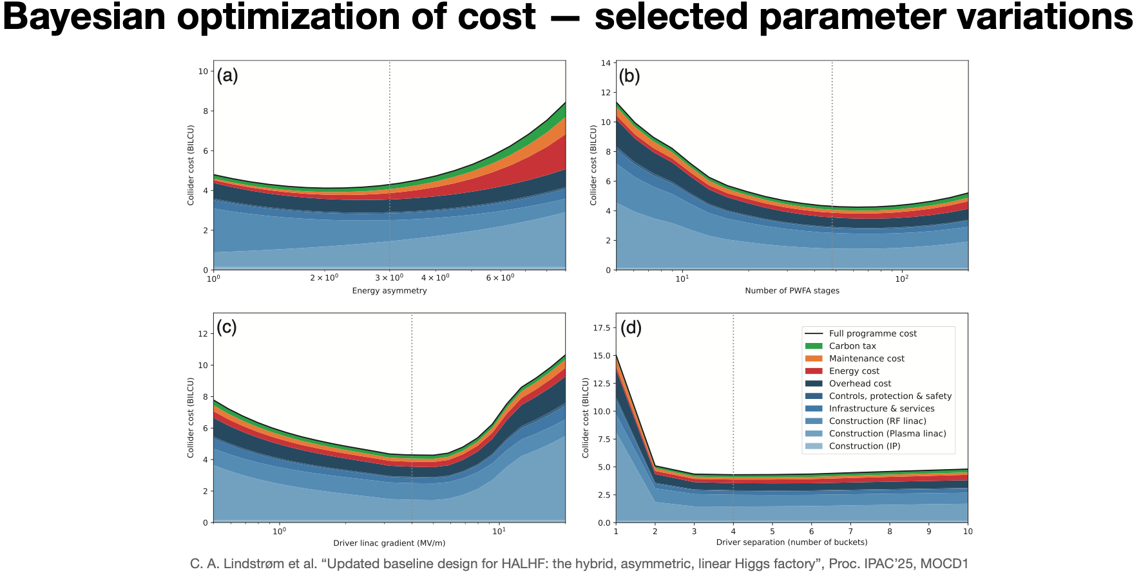
ABEL: The Adaptable Beginning-to-End Linac simulation framework
Facility Optimisation

Slide 26
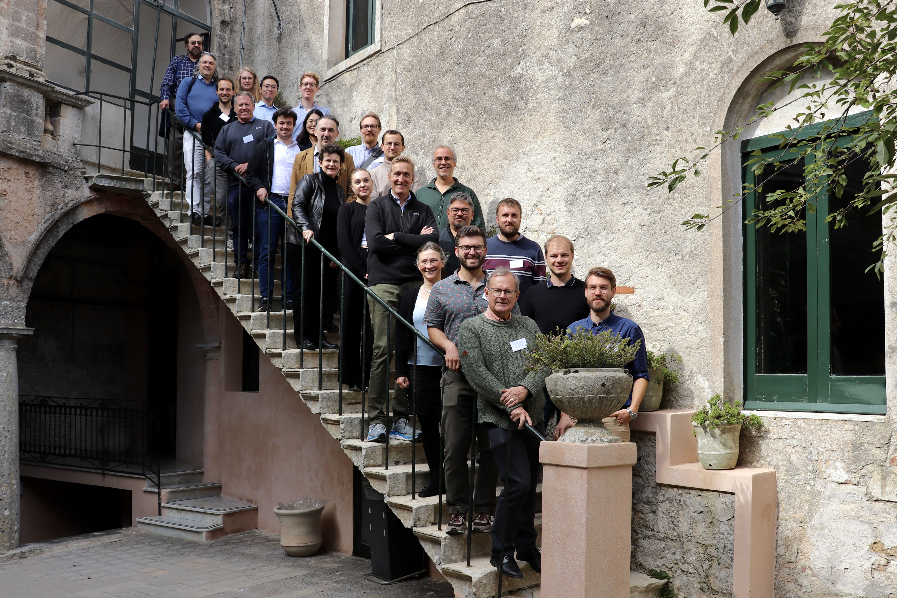
Second HALHF workshop
Facility Optimisation
2nd HALHF
Workshop,
Erice,
3-8 October,
2024

Slide 27
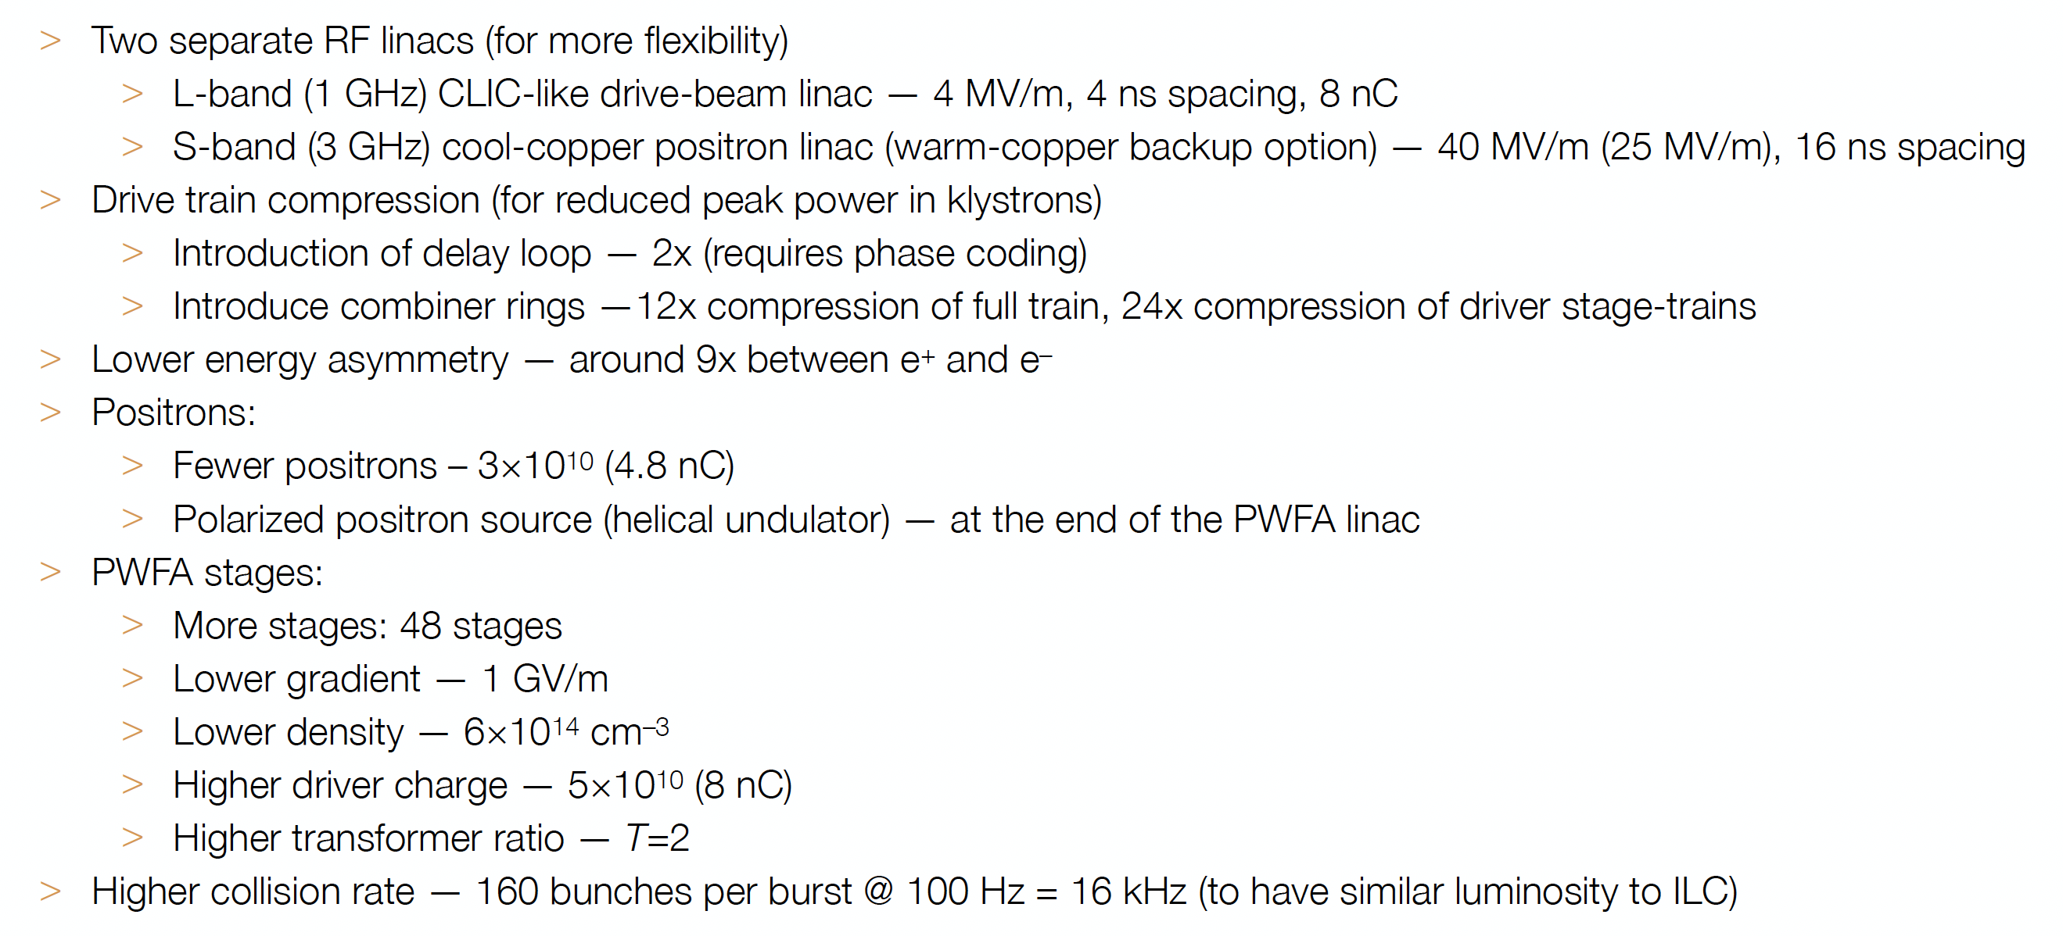
HALHF New Baseline
Foster et al., Phys. Open 23, 100261 (2025)

Slide 28

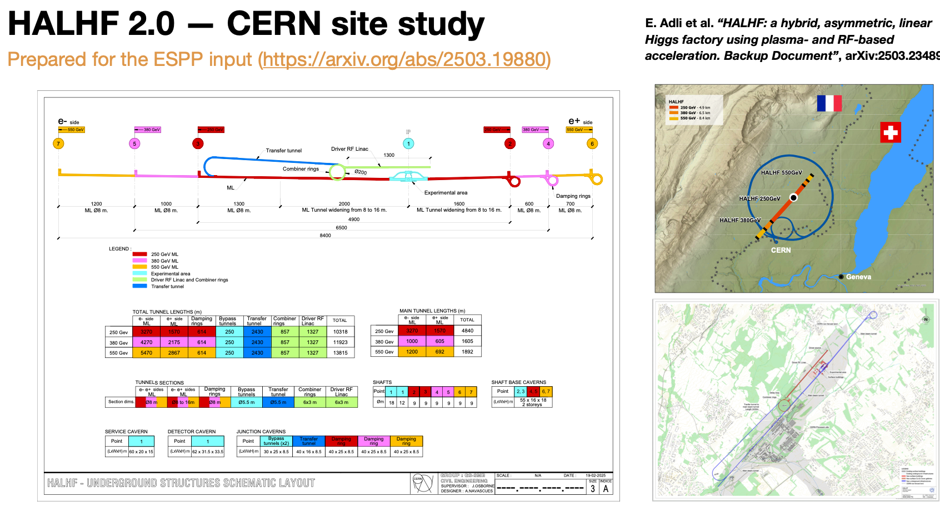
HALHF @ CERN

Slide 29
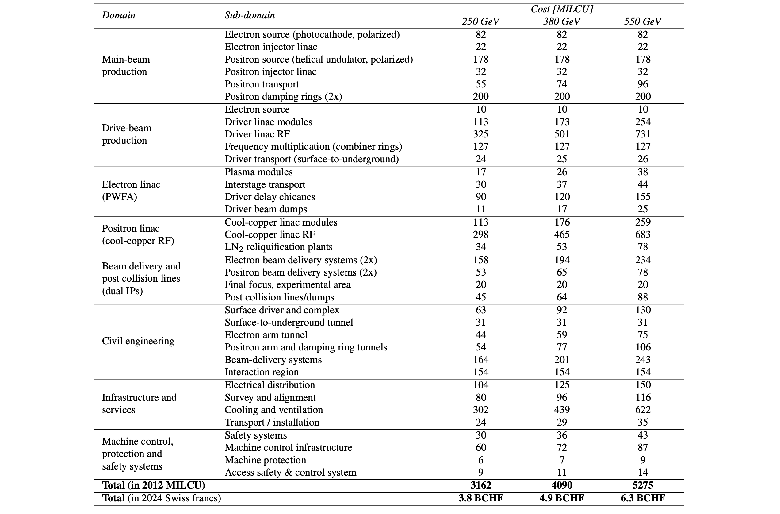
HALHF New Baseline
Cost estimates for HALHF 2.0
E. Adli et al. “HALHF: a hybrid, asymmetric, linear Higgs factory using plasma- and RF-based acceleration”, arXiv:2503.19880
Based scaling from ILC and CLIC
Driver RF linac is a major cost driver
for the machine (~30%; 50% incl. e⁺ linac)
    Drivers: ~22 CHF/watt beam power
    Positrons: ~167 CHF/watt beam power
PWFA linac is not a cost driver (~7%)
    Driver distribution is the cost driver
BDS and IP (~13%) adds
Civil engineering adds ~25% to the machine cost, other overheads ~30%
    Cooling and ventilation is expensive (~3.6 CHF/watt wall-plug power)

Slide 30
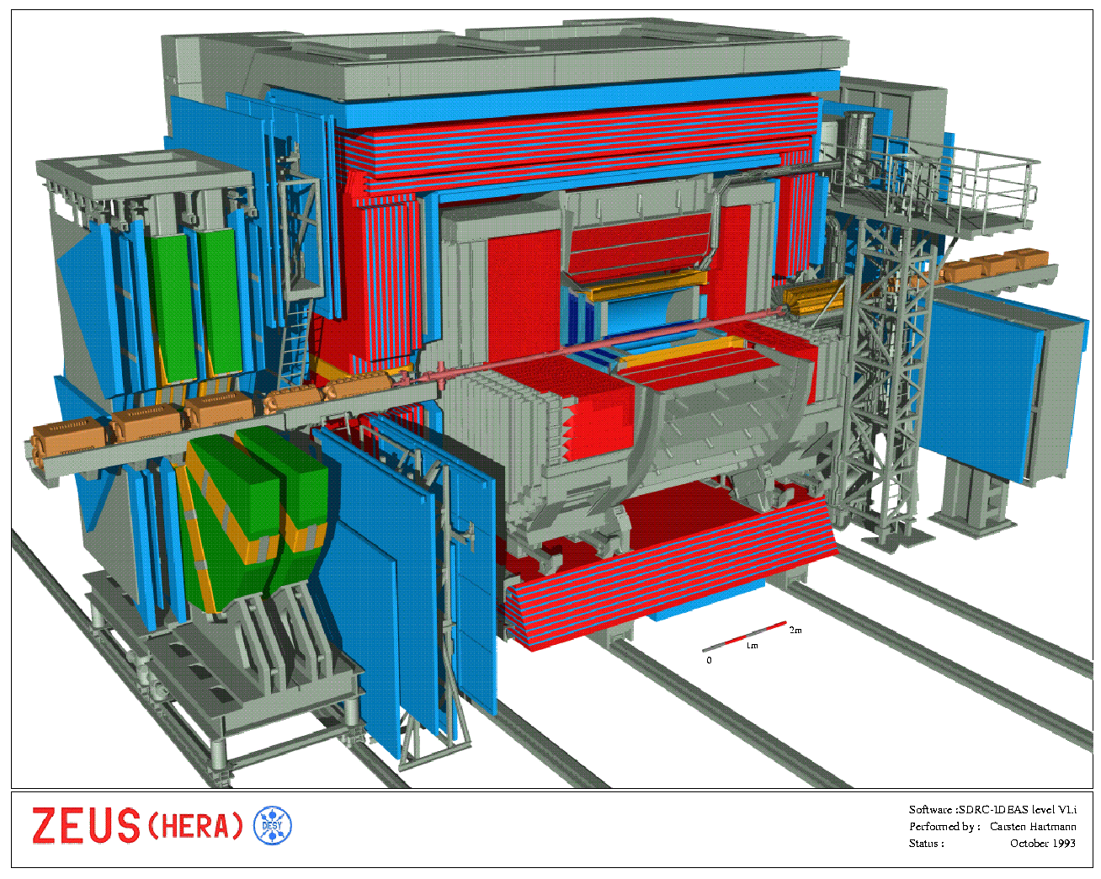
Experimentation at HALHF
Boost is smaller than
HERA - HERA detectors
very similar to those at
symmetric machines.
Also H & Z heavy, so
anyway more
homogeneous.
Measurement of L via
Bhabha (e⁺e⁻ -> e⁺e⁻)
- rate reduced by
1/(θγ)² & e⁺ scattered
into barrel – but not a
problem. Singles rate
good for machine
optimisation

Slide 31
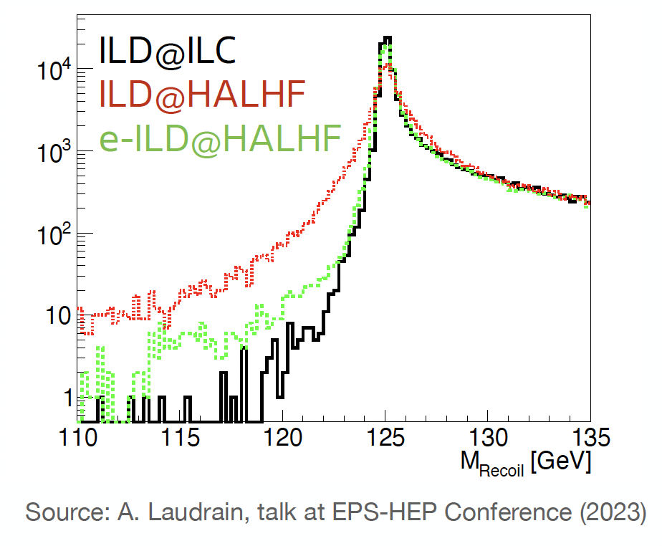
Experimentation at HALHF
Simulation by
M. Berggren,
A. Laudrain (DESY)
– extend ILC Barrel
as proxy for forward
detector;
“Proper” simulation
needed and
under discussion.

Slide 32
Preparation for pre-CDR
Despite ~ 0 project funding (only a few FTEs from JAI general programme, DESY & CERN), HALHF is making rapid progress;
New baseline & costing carried out;
HALHF input to European Strategy:
10pager:https://arxiv.org/abs/2503.19880
Backup: https://arxiv.org/abs/2503.23489
~ 15 year R&D programme before approval
Regular monthly HALHF meetings;
Longer-term goal: pre-CDR this year; & funding to start R&D programme;
Contribute to 10 TeV design

Slide 33
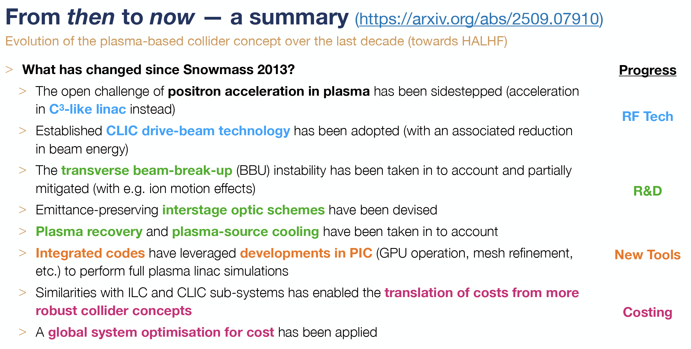
The march of progress
NB – many of these issues, particularly
transverse tolerances and instability
mitigation are still work in progress!

Slide 34
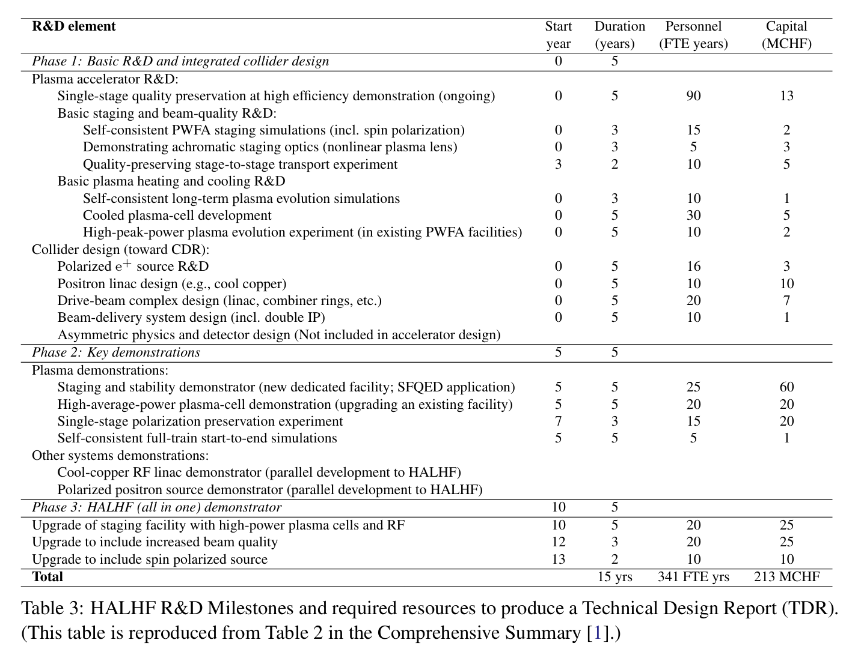
Path to construction
https://indico.cern.ch/event/1439855/contributions/6461458/attachments/3045828/5381747/HALHF_Input_ESPP_2025_Backup_submitted.pdf

Slide 35
10 TeV Wakefield Collider
Challenges
Inefficient acceleration of positrons in plasma
  Proposed solution: Take advantage of large VBF cross-section and utilize gamma-gamma or e⁻e⁻ collisions instead.
Extreme beamstrahlung at high collision energies and beam densities
  Proposed solution: 1) Collide ultrashort bunches to mitigate beamstrahlung and 2) Embrace the broad luminosity spectrum so long as significant fraction of the colliding particles are close to 10 TeV CM.
Detector design and background modeling for high energy collisions
  Proposed solution: Development of new Particle-in-Cell codes, benchmarked against GUINEA-PIG and CAIN, to accurately model backgrounds for high-energy gamma-gamma, e⁻e⁻, and e⁻e⁺ collisions.
10 TeV Design Study sign up @ https://docs.google.com/forms/d/e/1FAIpQLScffLXDxF_8-TUYaWLznL7jAWUGfYOTEzBu4YrOnr8nRS-JQw/viewform

Slide 37
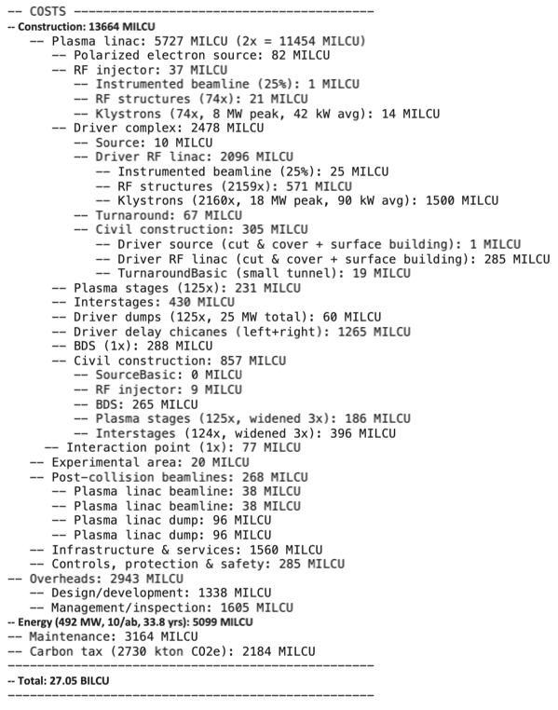
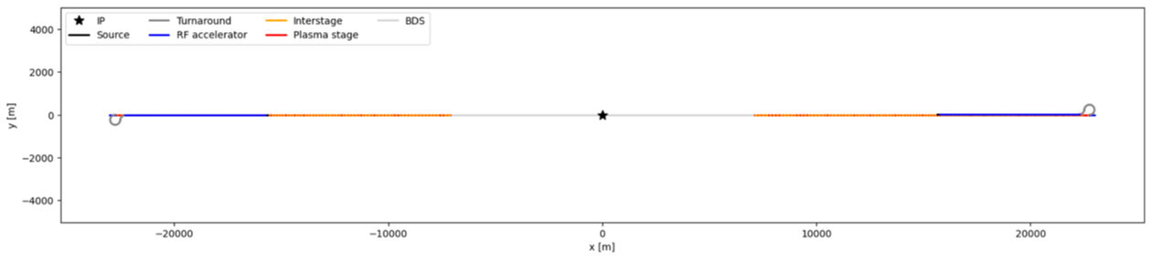
10 TeV Wakefield Collider
Simplified 10 TeV γ–γ collider with “two HALHFs”

Slide 38
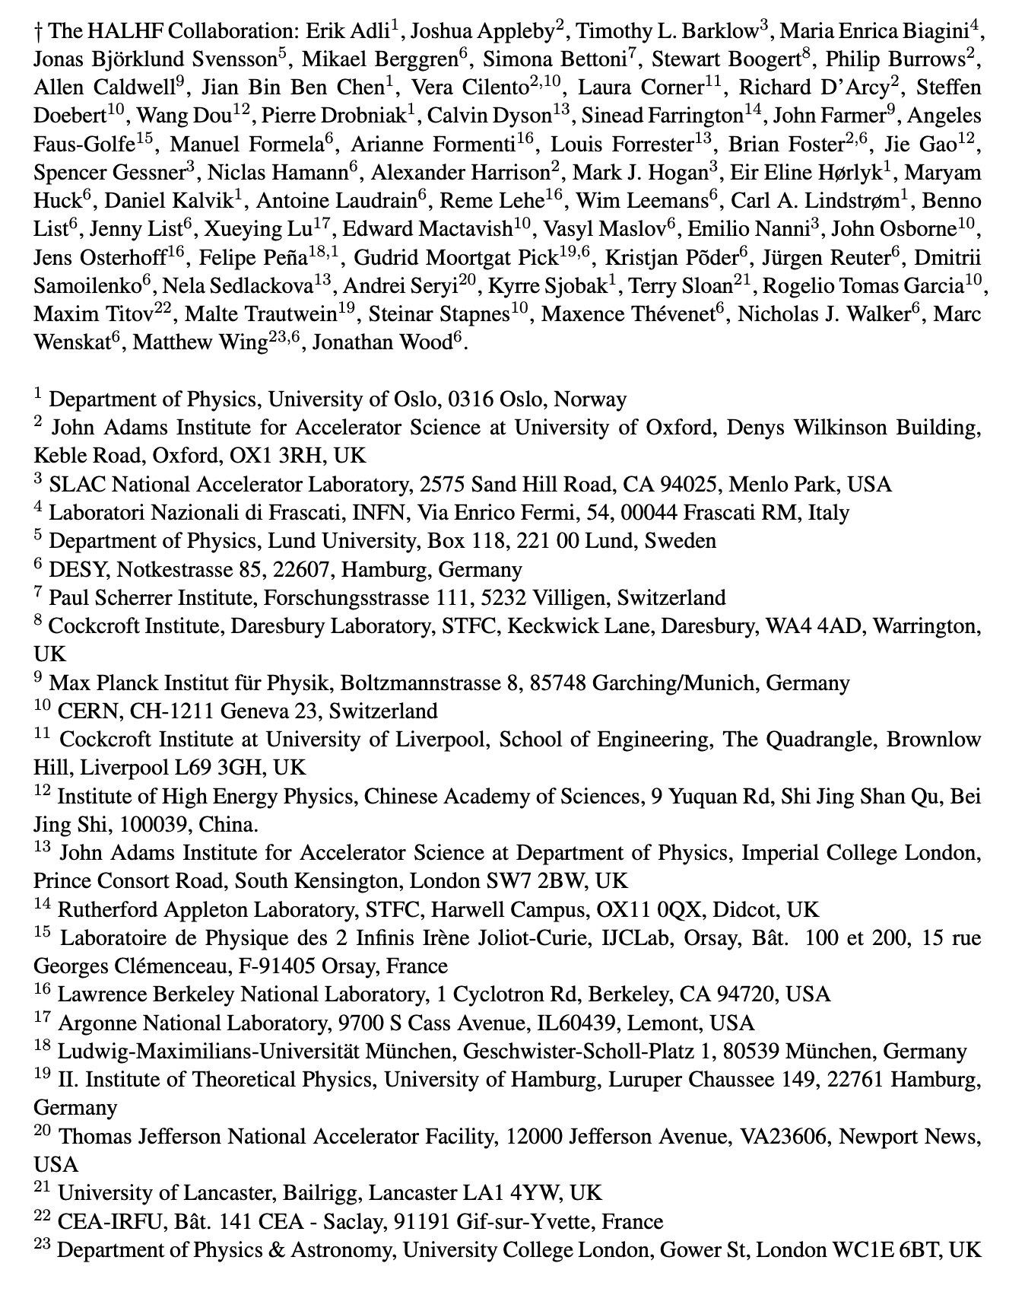
Summary
(April 2025)

Slide 39
Summary & Outlook
Despite ~ 0 funding, HALHF is making rapid progress;
New baseline & costing carried out;
HALHF input to European Strategy: 10pager:https://arxiv.org/abs/2503.19880
Backup: https://arxiv.org/abs/2503.23489 - ~ 15 year R&D programme before approval
Regular monthly HALHF accelerator meetings;
Medium-term goal: pre-CDR in 2026 & funding to start R&D programme;
Contribute to 10 TeV design.
  PLEASE JOIN US: https://adams-institute.ac.uk/halhf

Slide 40
Backup slides

Slide 41
Running Costs
Dominated by power to produce drive beams.
(100*16*4.3nC + 6.4nC)*100 => 47.5 MW@50% eff.
Damping rings: 2*10 MW.
Cooling – assume similar to CLIC => 50% of RF power (corresponds to 20 kW/m).
For magnets and other conventional sources assume ~9 MW.
Gives total power requirement ~ 100 MW – somewhat smaller than other proposals.

Slide 46
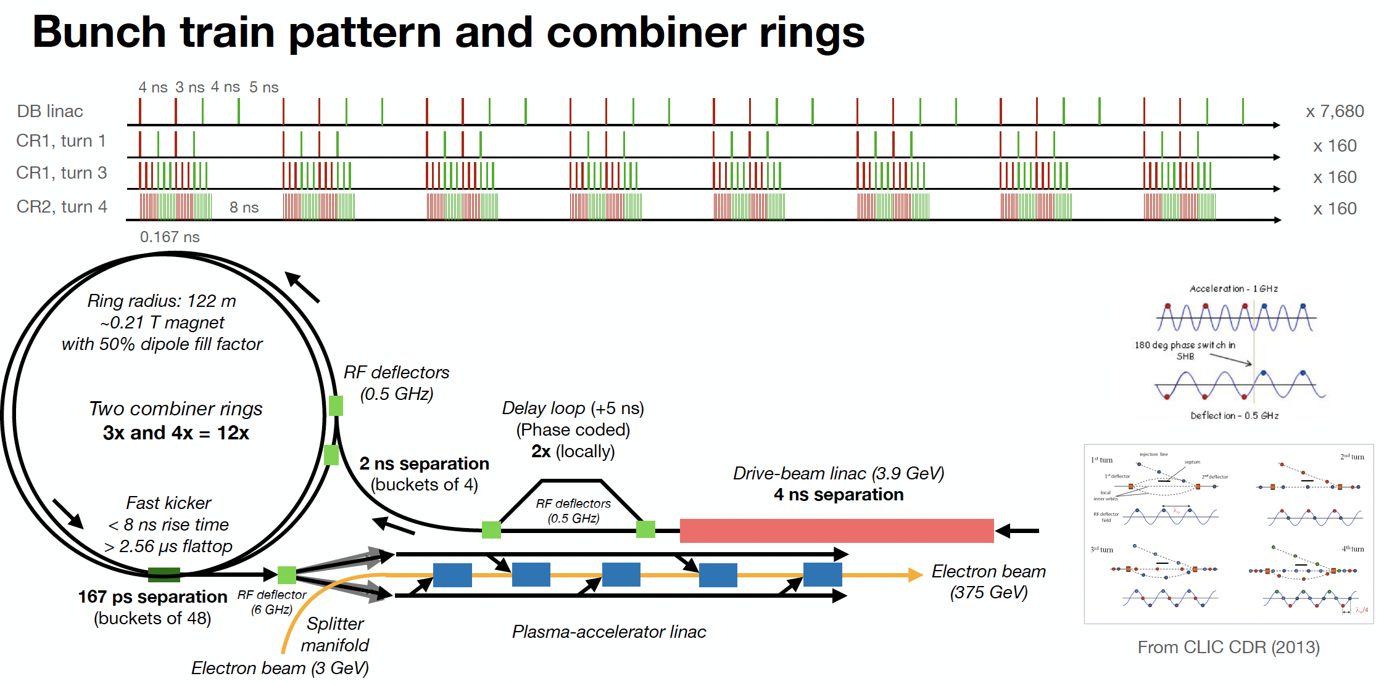
Bunch pattern

Slide 47
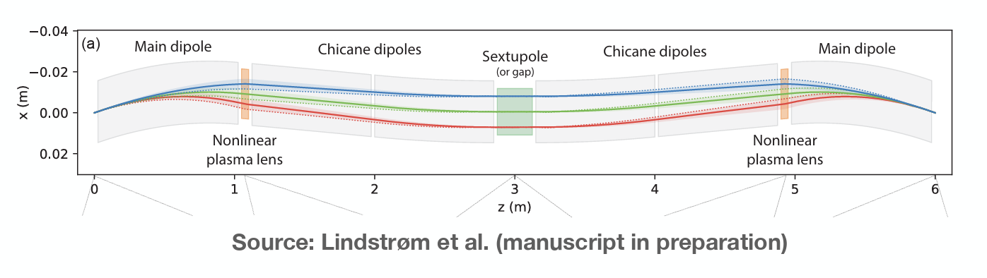
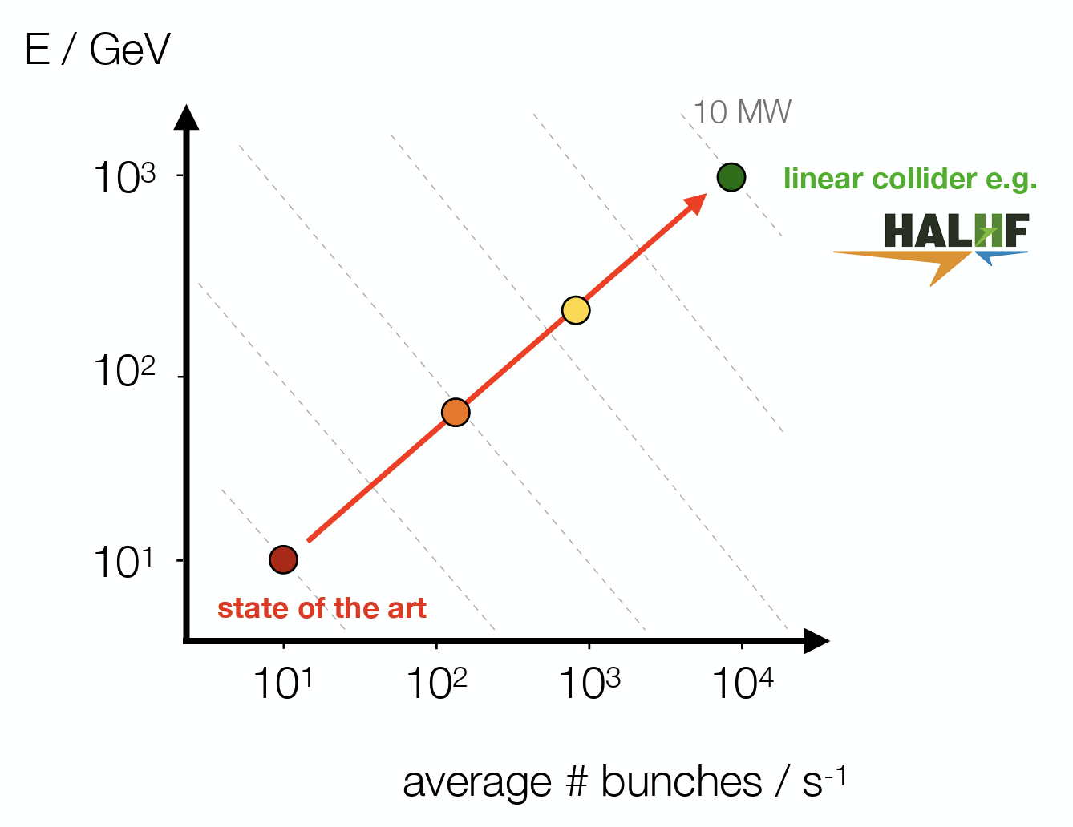
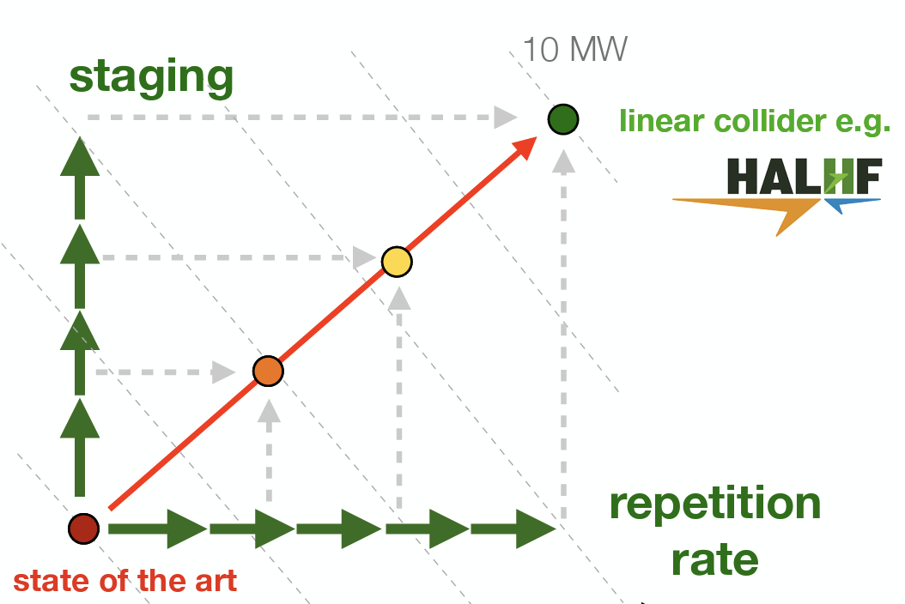
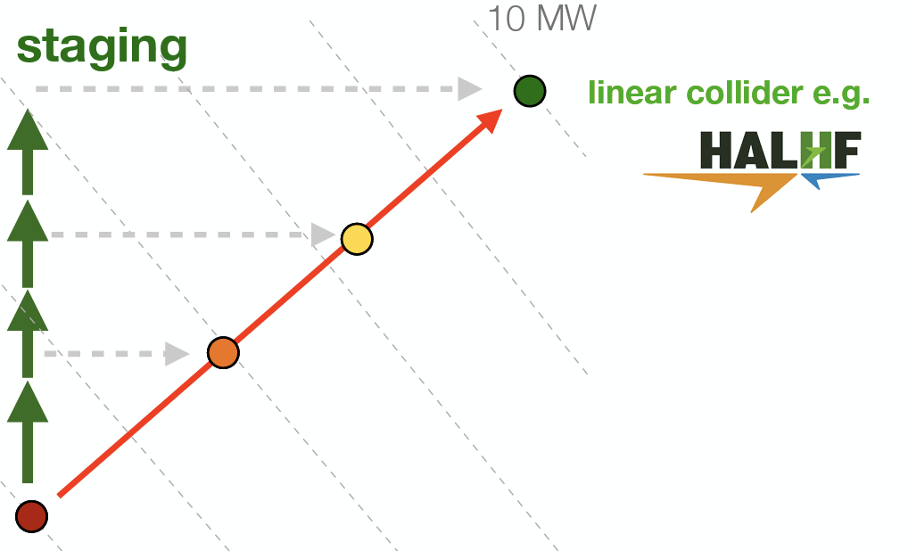
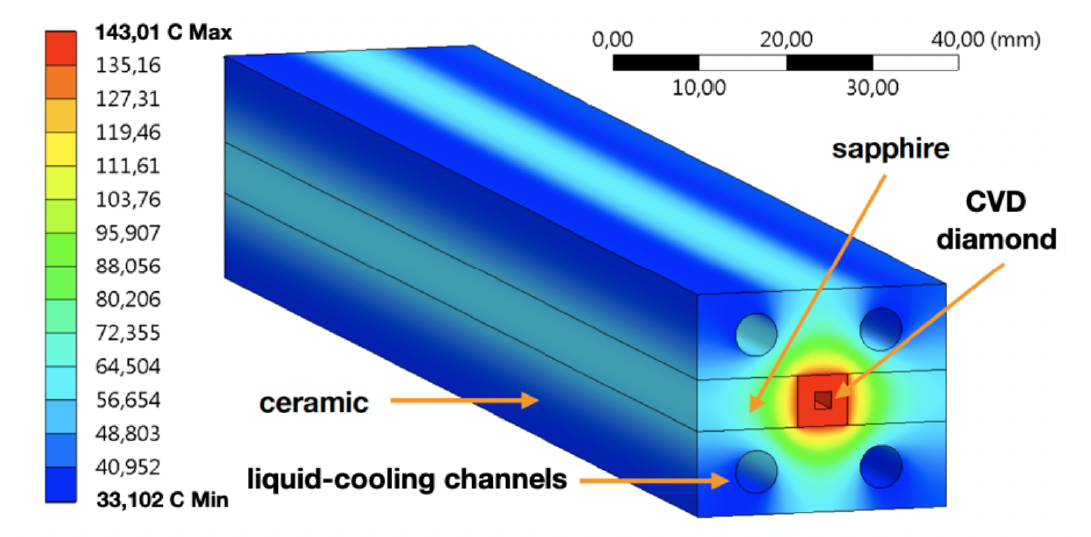
R&D Topics

Slide 48
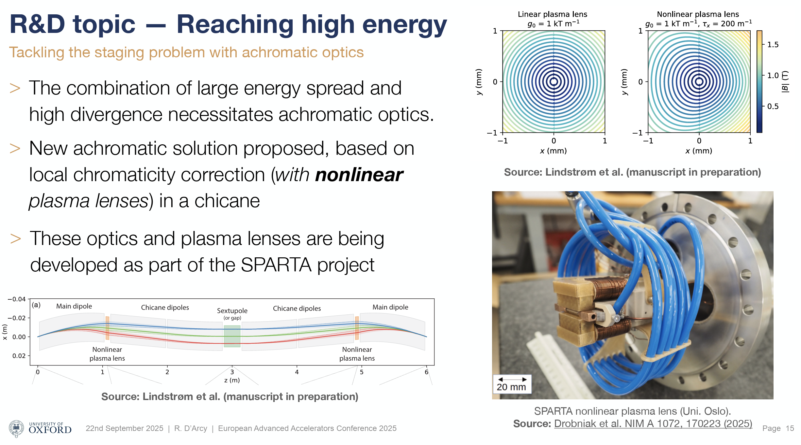
R&D Topics - Staging

Slide 49
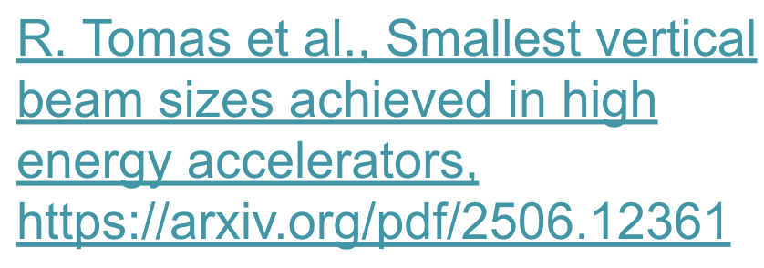
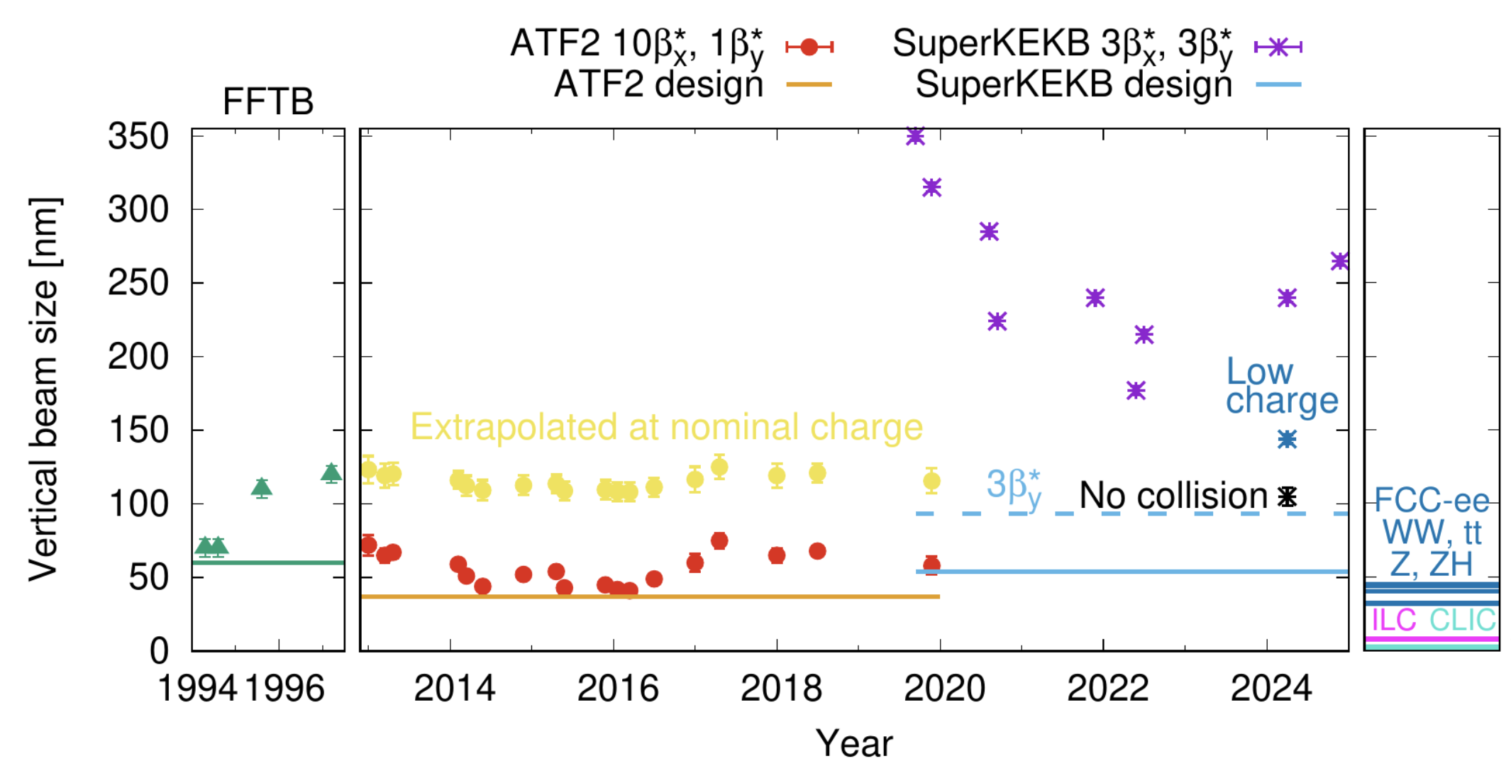
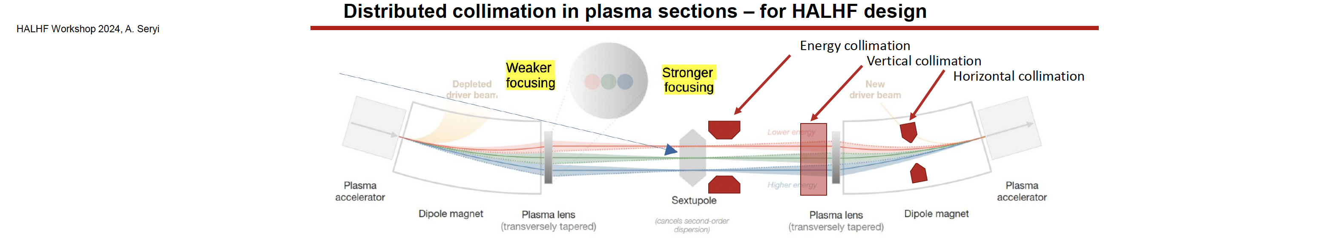
R&D Topics - Beam-Delivery
Challenges:
Emittances: Factor 10-100
larger than in previous designs;
𝜷_{x} : Factor 2-4 smaller
=> Longer than current design
beyond 250 GeV
See. R. Thomas talk
@ LCWS25

Slide 50
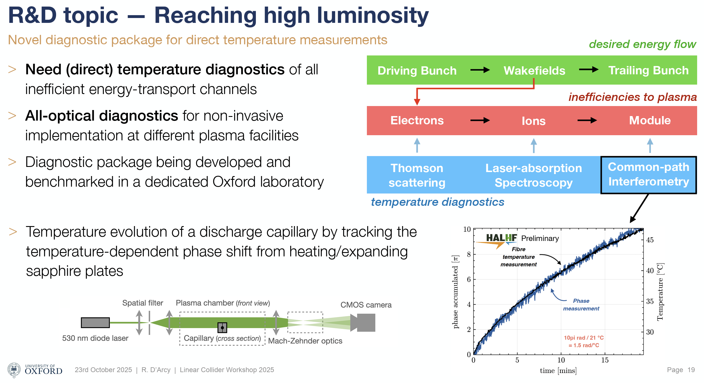
R&D Topics - Plasma Cell

Slide 51
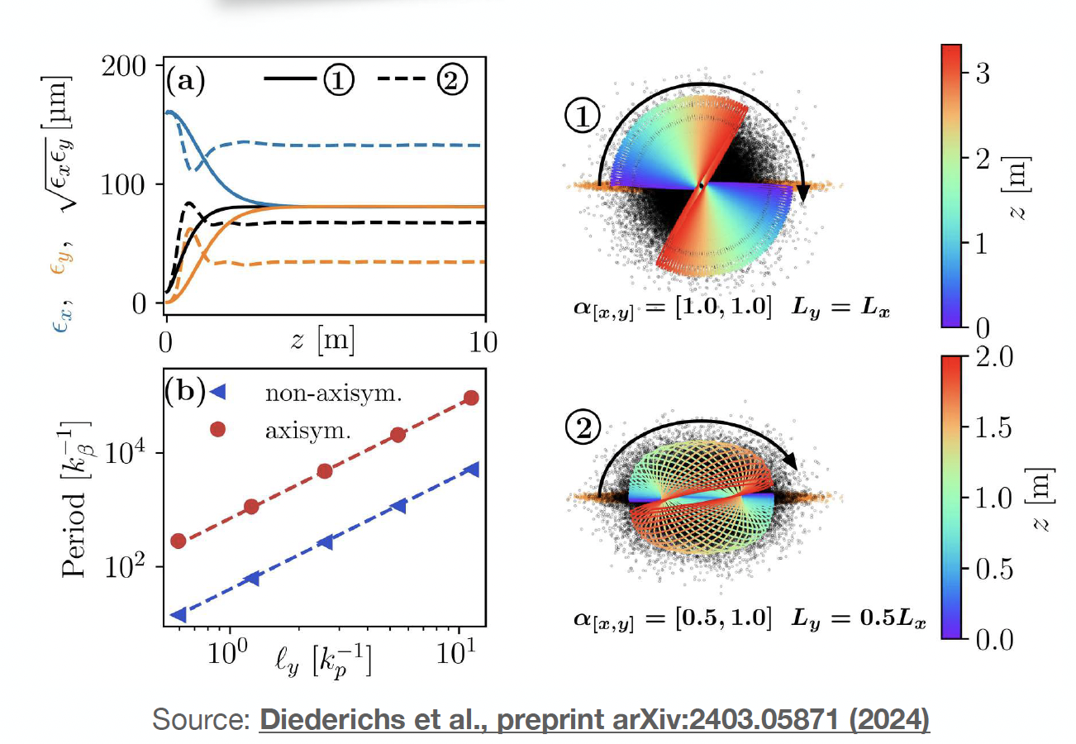
Selected Updates
PWFA arm:
  Flat beams (essential to get required lumi at IP while minimising beamsstrahlung)
    “Resonant emittance mixing of flat beams in plasma accelerators”
    S. Diederichs et al., arXiv:2403:05871
    Issue: when ion motion present,
    non-linear focusing mixes planes
    => Flat beams don’t stay flat
    Possible solution: flat drive beams
    Seems to work – but need to
    evaluate ion-motion from witness
    beam

Slide 52
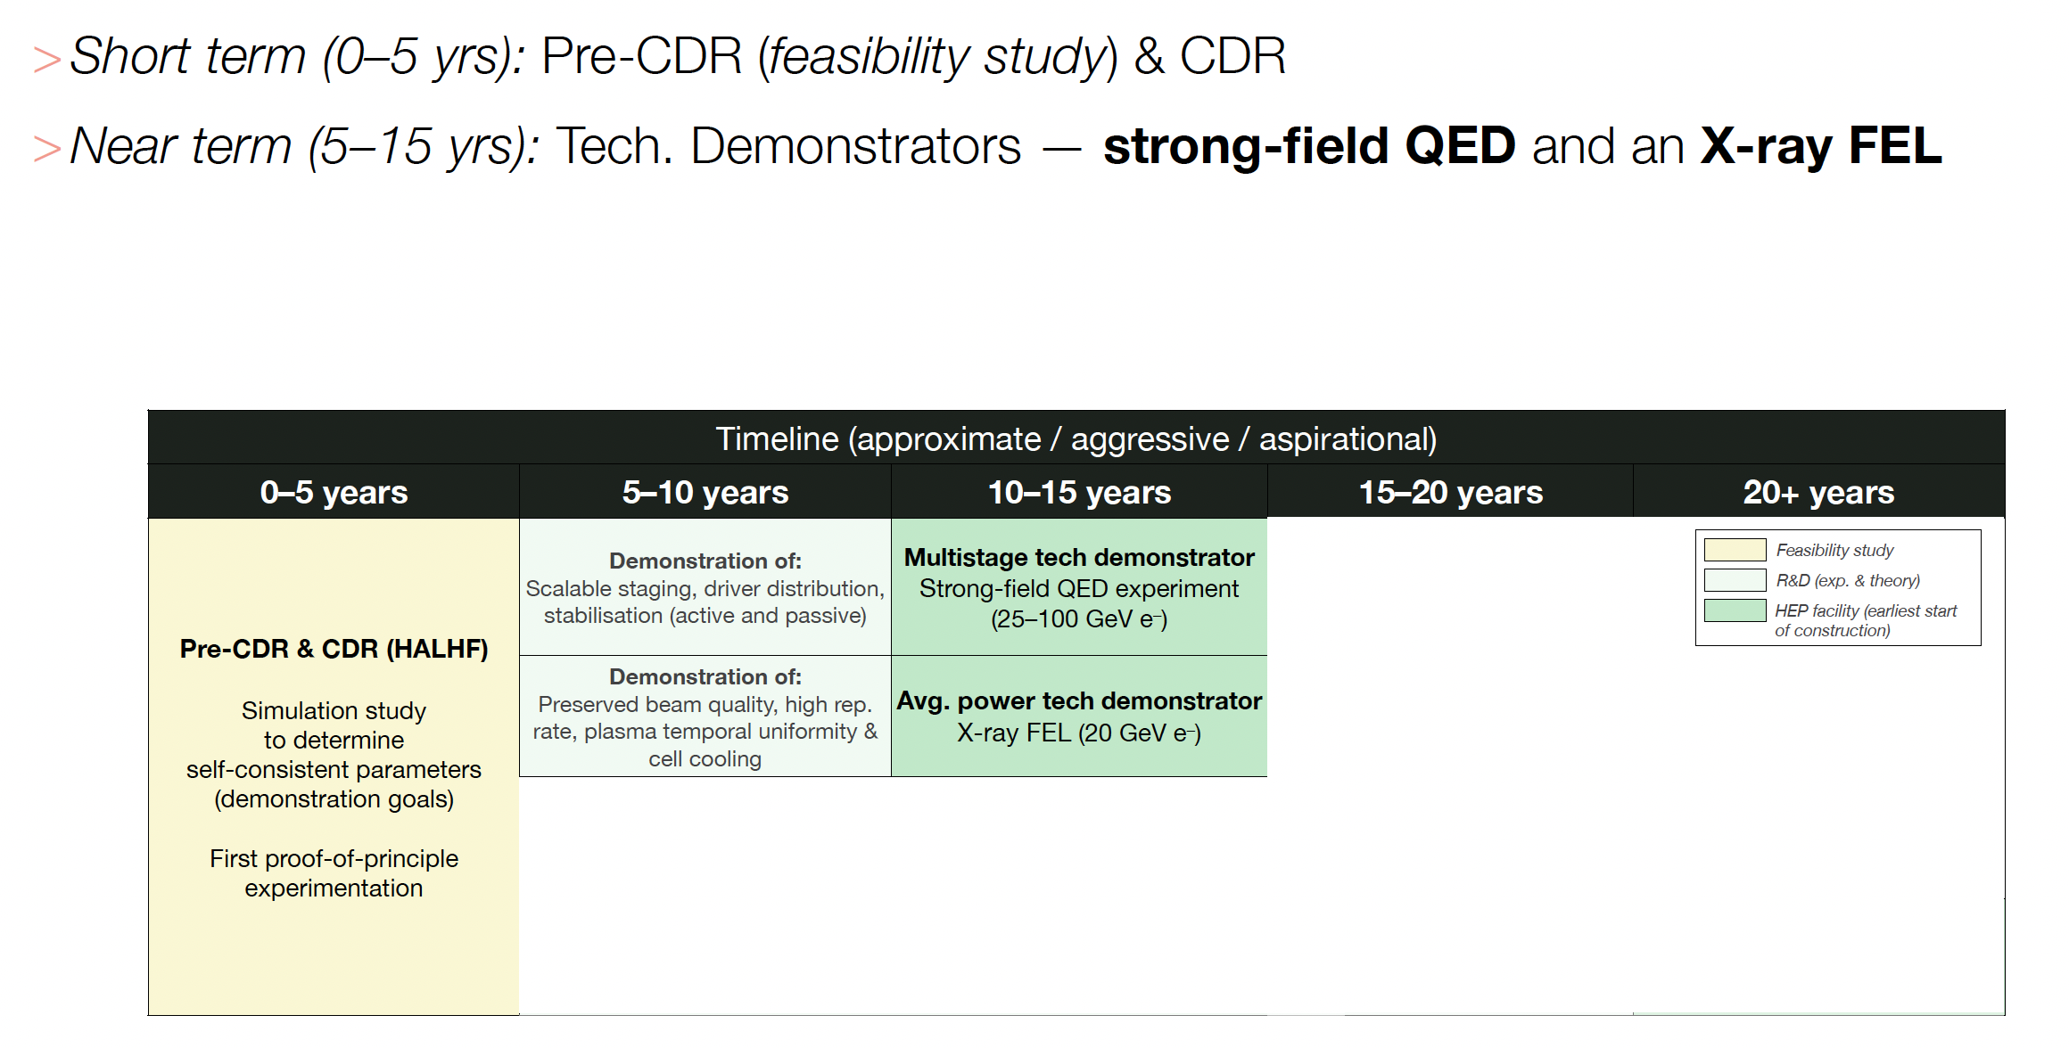
Path to construction

Slide 53
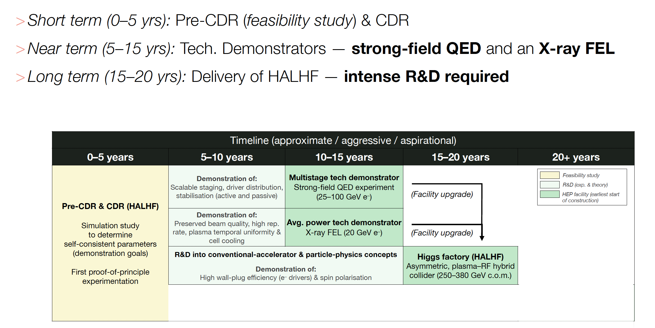
Path to construction

Slide 54
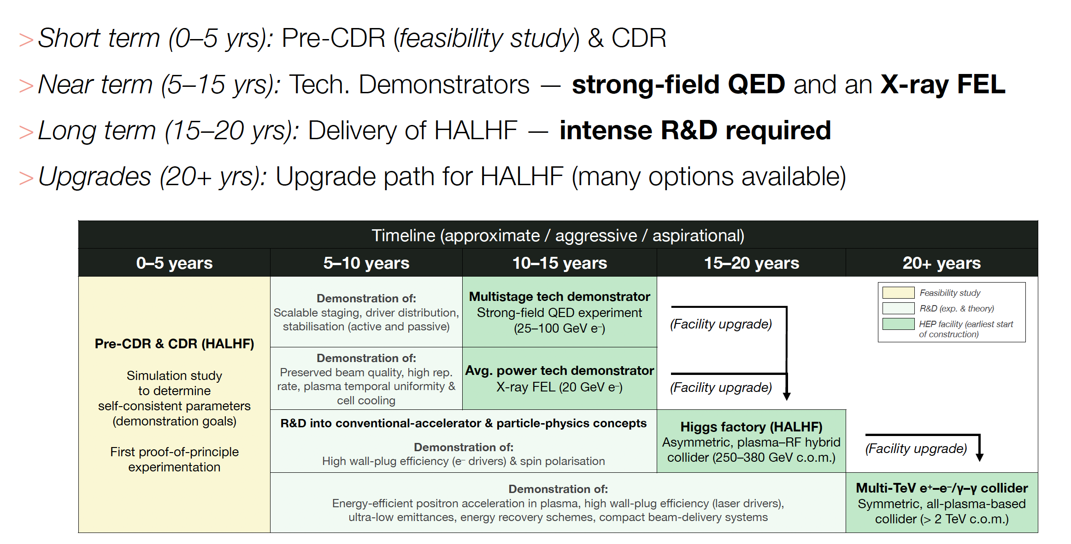
Path to construction

Slide 55
Upgrade Existing LC
Technology being developed for HALHF could also enhance a “conventional” LC design – part of “LCVision”:
Assume: ILC has been built,
-> 2x125GeV linacs available
Goal: upgrade electron arm to 500GeV with plasma
-> 125x500GeV -> 500GeV COM; γ ~ 1.2
-> upgrade a Higgs factory to a tth / Zhh factory
Use electron linac for drive and witness beam:
run a lower gradient but higher current, upgrade RF on electron arm
Use space for undulator source between electron ML and BDS to install plasma booster
Feed boosted electrons into existing BDS (laid out for 500GeV)
Space for
plasma booster
(B. List)

Slide 56

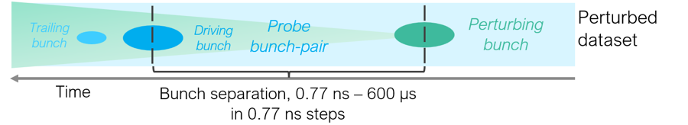




Rate limits in Plasma
Demonstrates >10 MHz repetition
Rate in Ar – lighter gases faster.
3
1
63 ns
Trailing bunch
Driver
Accelerated bunch on the energy spectrometer
Diagram and image courtesy: F. Pena, J. Beinortaitė
[1] R. D’Arcy, BF, et al., Nature 603, 58-62 (2022)
Notes:
In principle, the plasma recovers quickly enough to enable MHz acceleration. However, there are also other mechanisms in play, such as cell heating and gas expulsion.
BRIDGE: Now we want to actually do acceleration at MHz
56

Slide 57

HALHF results
At the end of the HALHF linac:
E. Adli, IPAC’25
Preliminary results for HALHF (simplified interstage, driver guiding assumed): With no ion motion, the BBU is large. With ion motion, the BBU is efficiently mitigated up 10⁻² nm rad drive-beam jitter-emittance – “state of the art” FLASH@DESY - position jitter of ~30 nm. A halo of large amplitude particles has formed, driving up the rms emittance, while the 90%-percentile emittance is better preserved.

Slide 58


Importance of driver guiding
Mitigation: guiding driver with an external magnetic field,
here simulated in HiPACE++ (radially focusing field).
Driver injection angle:
may lead to large main beam offset
Centre of cell
Centre of drive beam
Without magnetic guiding-field
Main beam trajectory
Driver guiding has been assumed in the following ABEL simulations
With magnetic guiding-field

Slide 59
Positron Source
“Conventional” e⁺ sources are not trivial – that for ILC, which has relaxed requirements wrt HALHF, still under development.
e⁻ accelerated to 5 GeV and then collide with target to produce e+ which are accumulated, bunched and accelerated to 3 GeV and then damped in 2 rings (~identical to CLIC but bigger e⁺ bunch charge (4*10¹⁰ e⁺).
May be possible to use spent e⁺ bunch after collision rather than dedicated e⁻ bunch, with cost savings.

Slide 60



Polarized e⁺
Produce e⁺ polarization via ILC-like scheme - ideas exist for E(e⁻) 500 GeV; wiggler probably longer and more expensive. Cost ~ 300 MILCU minus conventional source cost.

