Slide 1
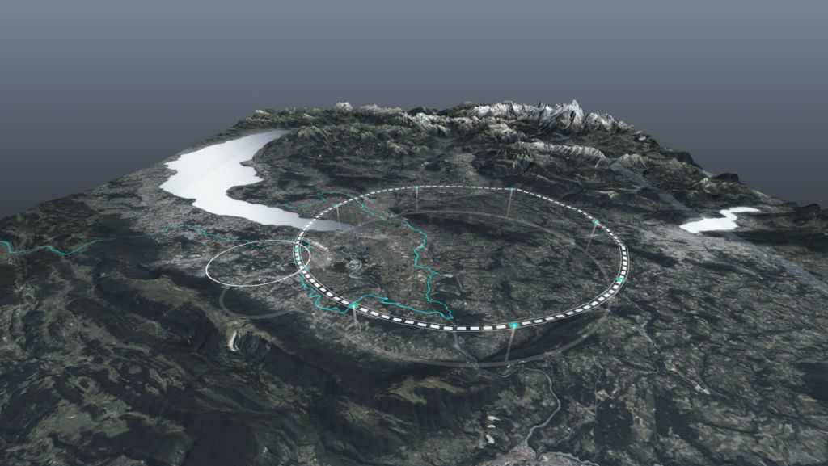









Key Results of the FCC Feasibility Study and
Steps Towards Implementation
Michael Benedikt and Frank Zimmermann
on behalf of the FCC collaboration
HKUST IAS FP 2026
15 January 2026
http://cern.ch/fcc
Work supported by the European Commission under the HORIZON 2020 projects EuroCirCol, grant agreement 654305; EASITrain, grant agreement no. 764879; iFAST, grant agreement 101004730, FCCIS, grant agreement 951754; E-JADE, contract no. 645479; EAJADE, contract number 101086276; and by the Swiss CHART program
photo: J. Wenninger

Slide 2
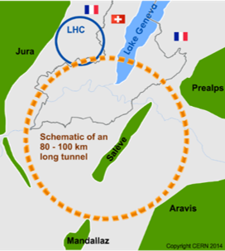
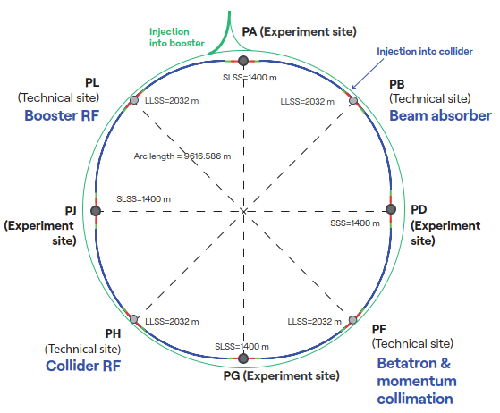
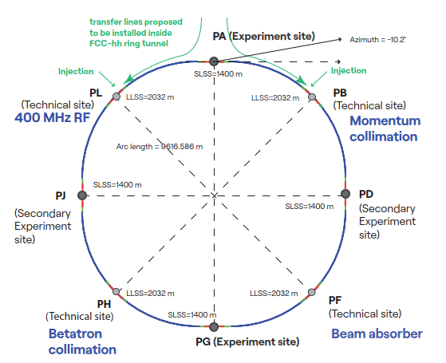
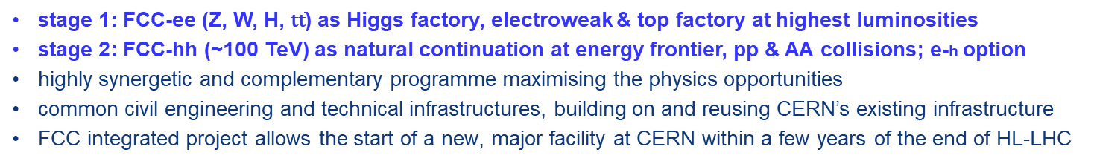
Future Circular Collider integrated program – scope
stage 1: FCC-ee (Z, W, H, $\text{t}\overline{\text{t}}$) as Higgs factory, electroweak & top factory at highest luminosities
stage 2: FCC-hh (~100 TeV) as natural continuation at energy frontier, pp & AA collisions; e-h option
highly synergetic and complementary programme maximising the physics opportunities
common civil engineering and technical infrastructures, building on and reusing CERN’s existing infrastructure
FCC integrated project allows the start of a new, major facility at CERN within a few years of the end of HL-LHC
FCC-ee
FCC-hh
2020 - 2045
2048 - 2062
~2075 - ~2100

Slide 3
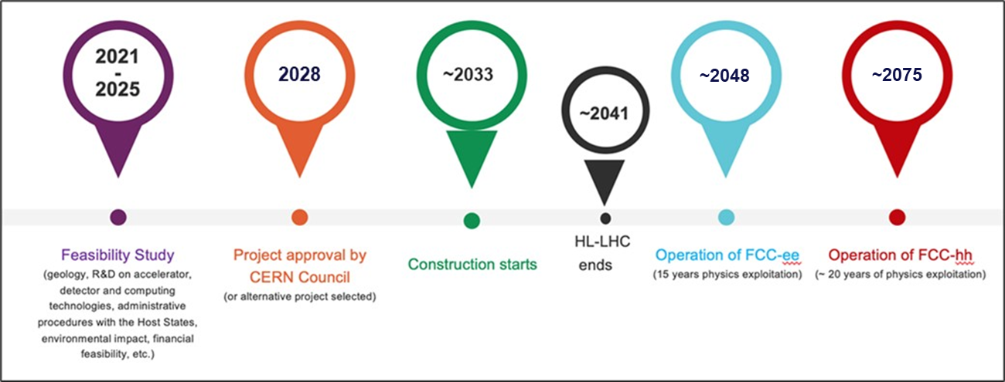
FCC integrated program – timeline
Ambitious schedule taking into account:
past experience in building colliders at CERN
approval timeline: European Strategy for Particle Physics Update, CERN Council decision
that HL-LHC will run until 2041
constraints imposed by present assumptions in funding model
project preparatory phase with adequate resources immediately after Feasibility Study

Slide 4
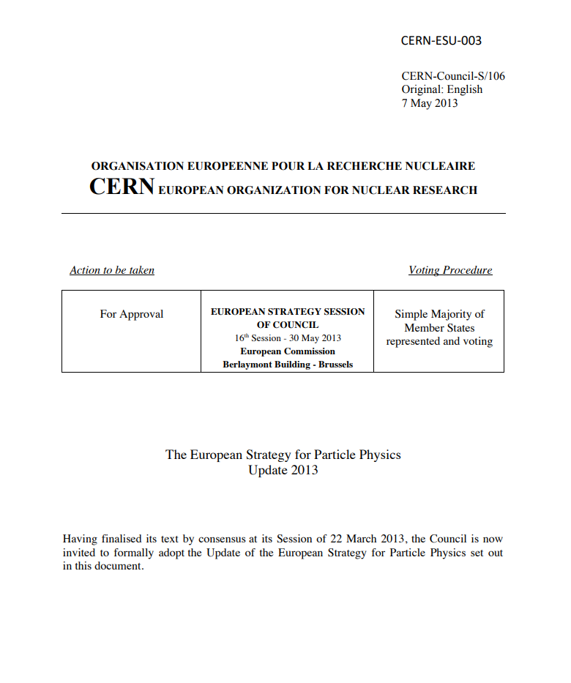

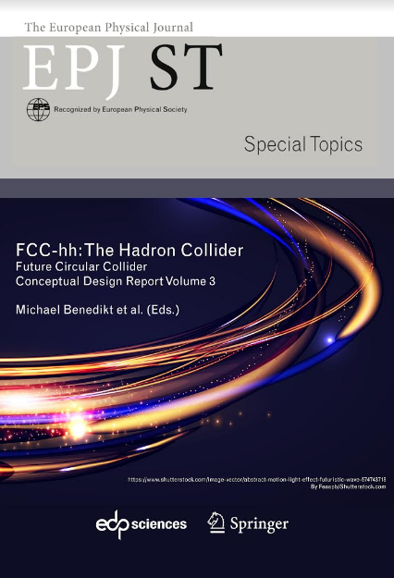
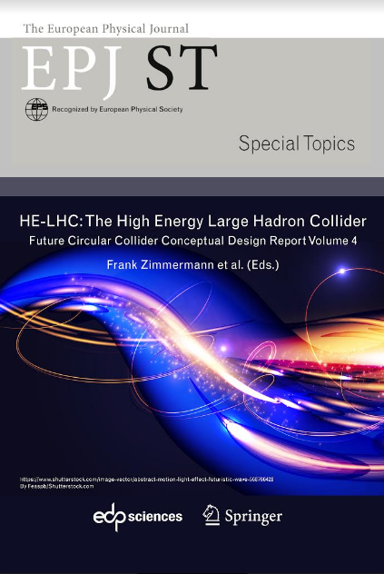
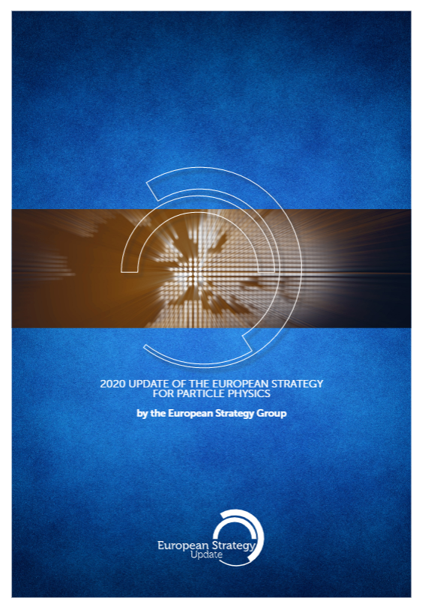
Start and evolution of FCC
2013 Update of European Strategy for Particle Physics:
“CERN should undertake design studies for accelerator projects in a global context, with emphasis on proton-proton and electron-positron high-energy frontier machines.”
FCC Collaboration delivered 4 volumes Conceptual Design Reports as input to ESPPU 2019/20
  Vol 1 Physics, Vol 2 FCC-ee, Vol 3 FCC-hh, Vol 4 HE-LHC
  CDRs published in European Physical Journal C (Vol 1) and ST (Vol 2 – 4)
  EPJ C 79, 6 (2019) 474 , EPJ ST 228, 2 (2019) 261-623 ,
  EPJ ST 228, 4 (2019) 755-1107 , EPJ ST 228, 5 (2019) 1109-1382
2020 Update of European Strategy for Particle Physics:
“Europe, together with its international partners, should investigate the technical and financial feasibility of a future hadron collider at CERN with a centre-of-mass energy of at least 100 TeV and with an electron-positron Higgs and electroweak factory as a possible first stage.”
➔ Launch of the FCC Feasibility Study mid 2021 by CERN Council

Slide 5





Feasibility Study Report completed on 31 March 2025
Vol. 1: Physics, Experiments & Detectors
Vol. 2: Accelerators,Technical Infrastructures, Safety Concepts
Vol. 3: Civil Engineering, Implementation & Sustainability
https://doi.org/10.1140/epjc/s10052-025-15077-x
https://doi.org/10.1140/epjs/s11734-025-01967-4
https://doi.org/10.1140/epjs/s11734-025-01958-5
These+other FCC input to ‘25/26 ESPPU posted at https://indico.cern.ch/event/1534205/
Input for 2025/26 Update of European Strategy for Particle Physics
prepared with Overleaf & published by EPJ (Springer-Nature) – FCCIS members

Slide 6
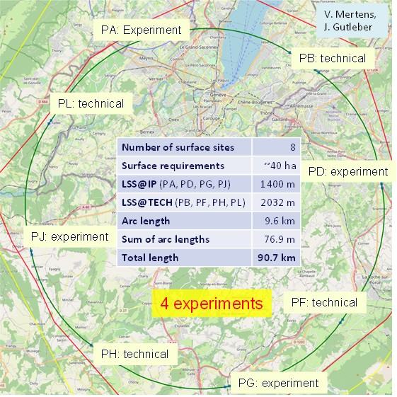
Reference layout and implementation:PA31 - 90.7 km
Layout chosen out of ~ 100 initial variants, based on several criterias:
geology,
surface constraints (land availability, urbanistic, etc.),
environment (protected zones),
infrastructure (electricity, transport),
machine performance
“Avoid-reduce-compensate” principle of EU and French regulations.
Overall lowest-risk baseline:
90.7 km ring, 8 surface points,
4-fold superperiodicity & symmetry

Slide 7
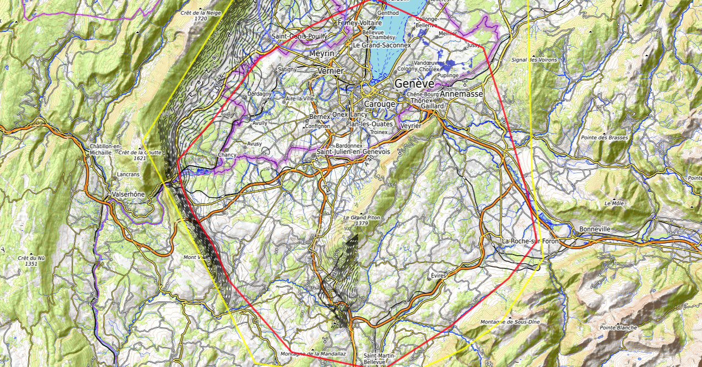
Discouraged due
to likely oppositions
Densely urbanized
and agriculture/nature
Strict landscape protection
and re-naturalization areas
Jura limestone
Protected forest
Densely urbanized
and emerging areas
Densely urbanized
Clustered residential
areas and farm areas
Terrain difficult to
access and water
reservoirs
Known water reservoirs and
protected nature in CH
(legal + technical reasons)
Water protection and
natural zones without
developed access
Densely urbanized
and emerging areas
(some spots possible)
Water protection zones,
landscape protection zones,
altitudes
High mountains (900 m)
north of Fillière river valley
Vuache limestone
and faults
Likely major opposition:
local urbanistic planning
for traffic calming &
nature protection
High altitudes
Densely populated
J. Gutleber, V. Mertens

Slide 8
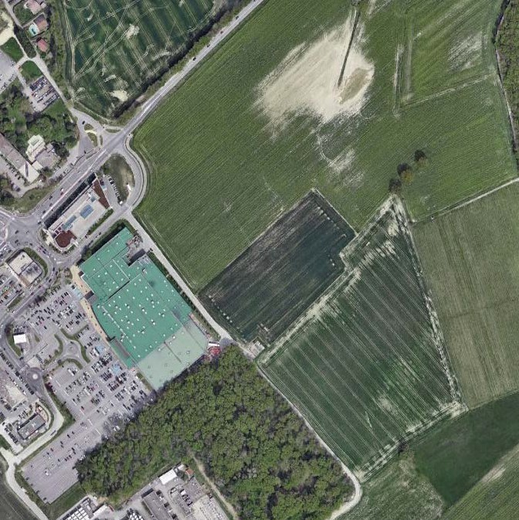
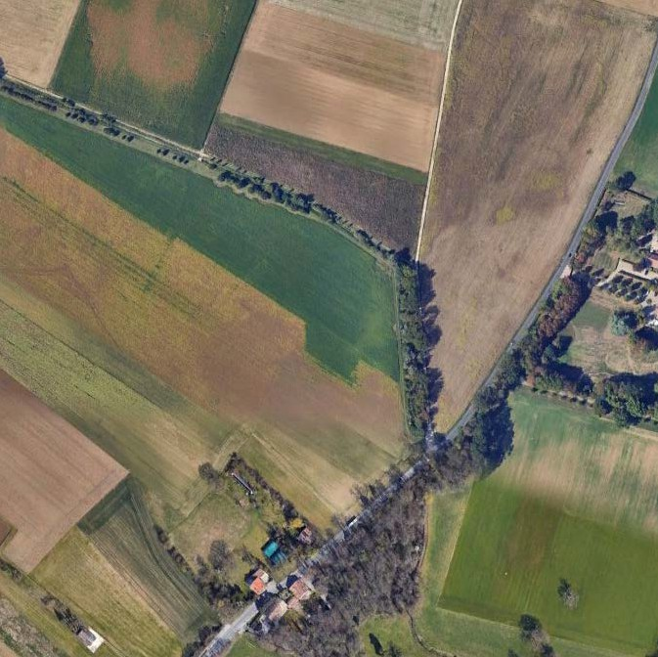
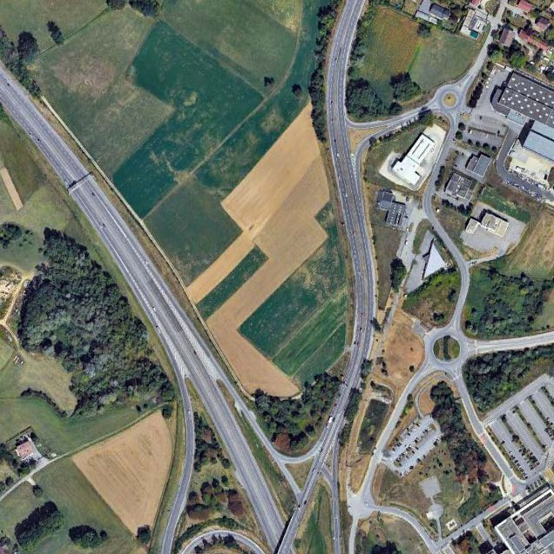
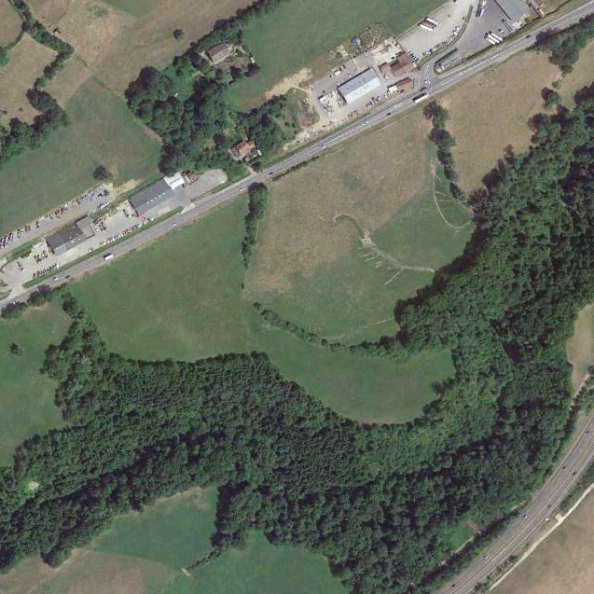
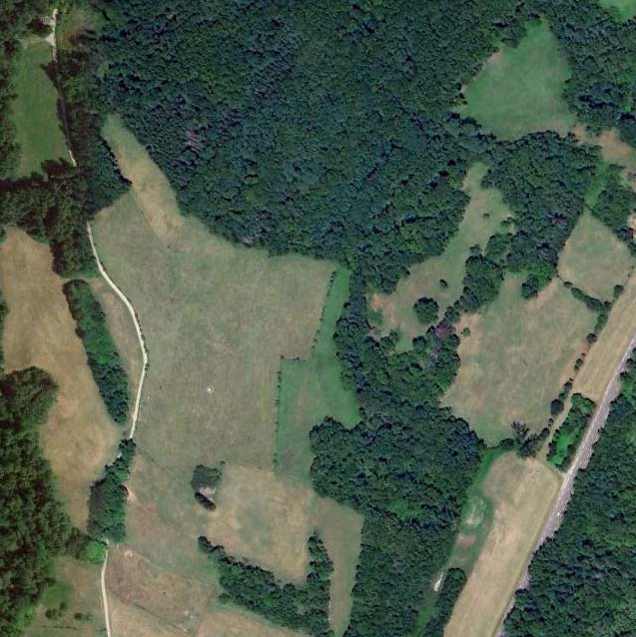
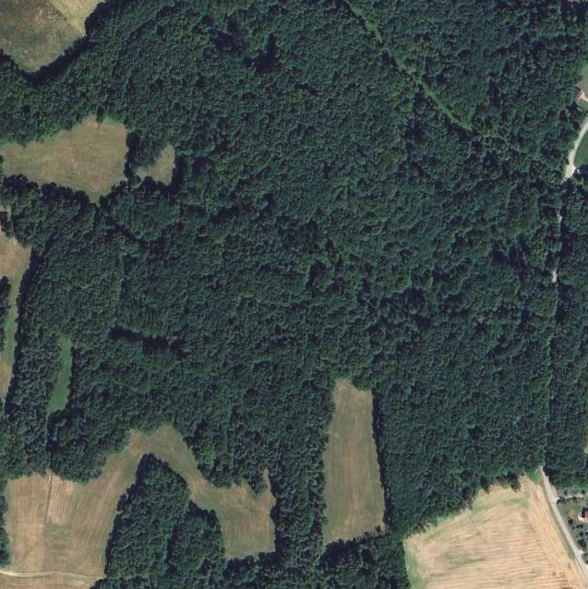
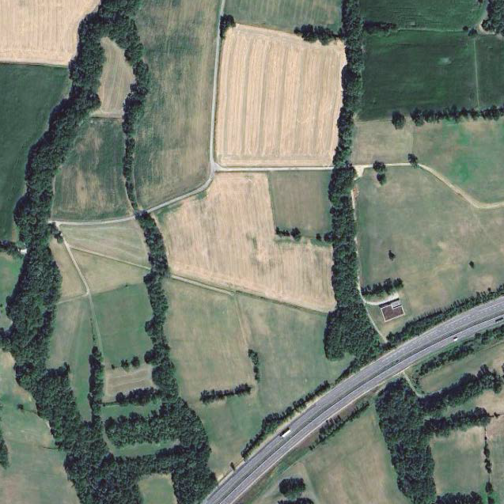
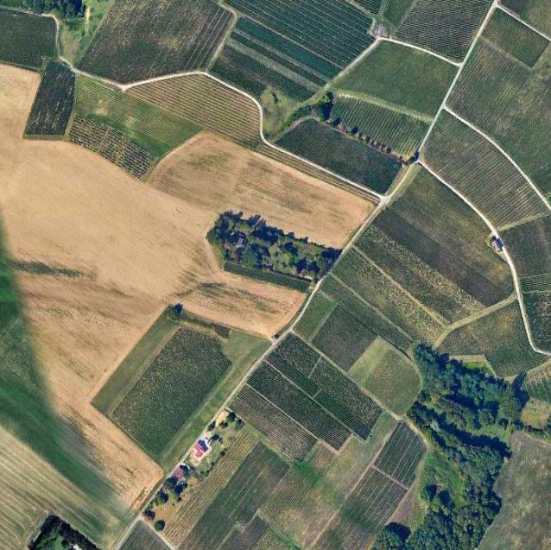
Surface site locations 7 in France and 1 in Switzerland
Optimisation done together with municipalities and region
PA
PB
PD
PF
PG
PH
PJ
PL
land plot needs communicated to Host States in view of protecting the required areas
process in FR: «prise en consideration», landplot in CH owned by Canton of Geneva

Slide 9
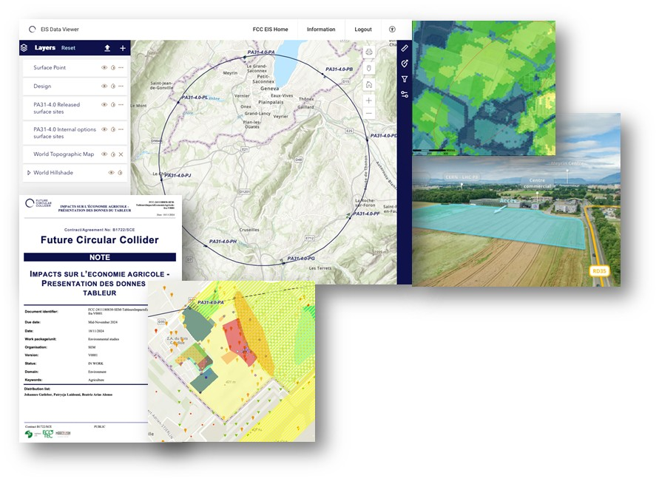
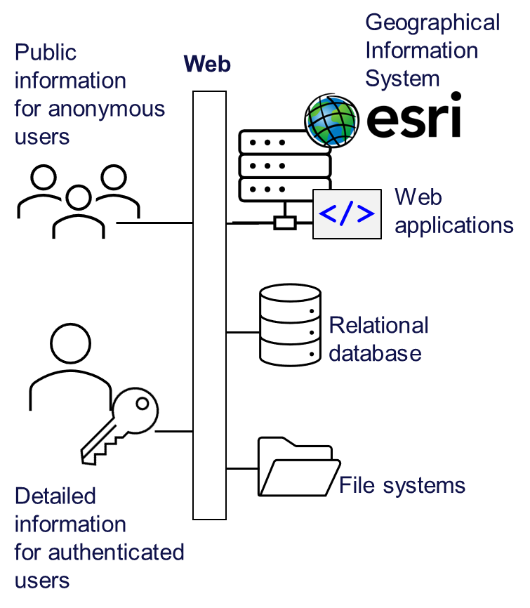
Environmental initial state analysis
Environmental information system
  The environmental initial state analysis at the eight surface site locations (~600 ha covered) did not reveal principal showstoppers for the project.
  Basis for detailed optimisation of surface sites.
  Reference for the environmental impact assessment.

Slide 10

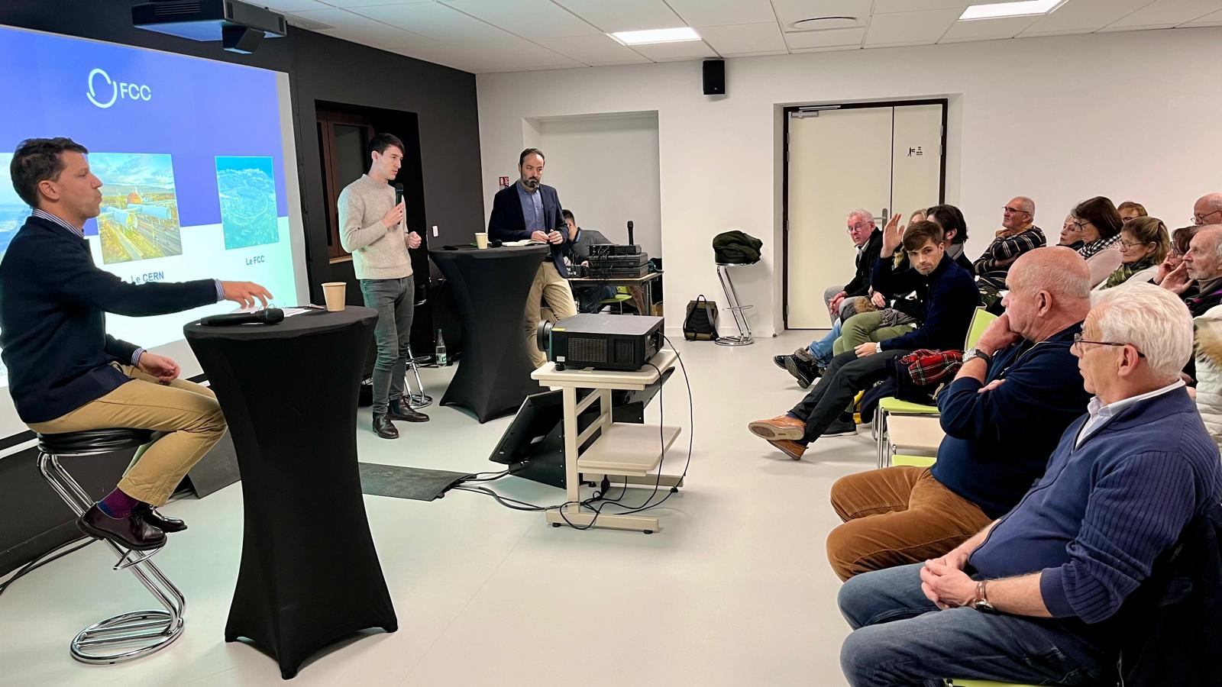
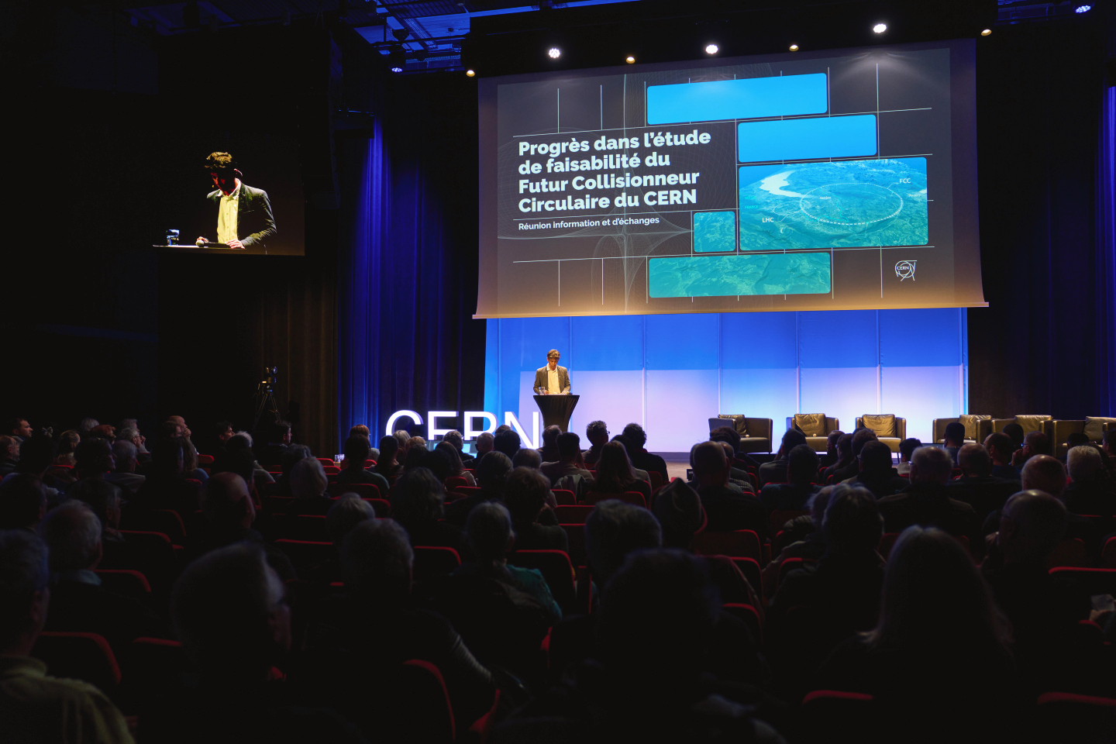
Territorial dialogue and public participation
First cycle of public information meetings completed (April 2024 – March 2025)
11 sessions reached over 1,500 people in France & Switzerland
During 2025:
Second cycle of public information meetings.
Presence days in municipalities affected by surface sites to enable discussion with habitants.
Meetings with stakeholders of the territory.
Dialogue
Website
During 2026:
Formal public participation process planned in France (Debat Public) and Switzerland (public concertation).

Slide 11
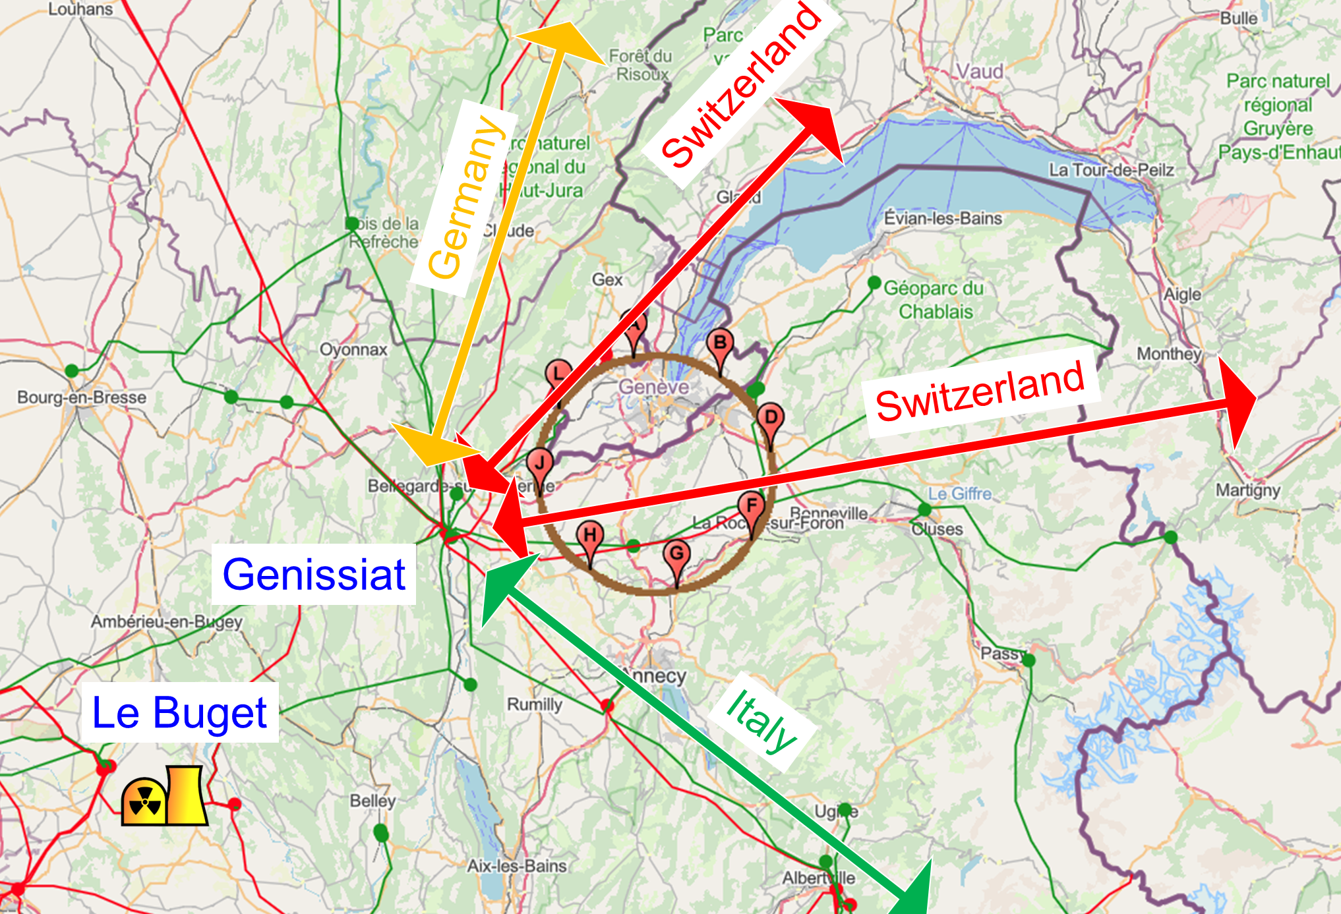
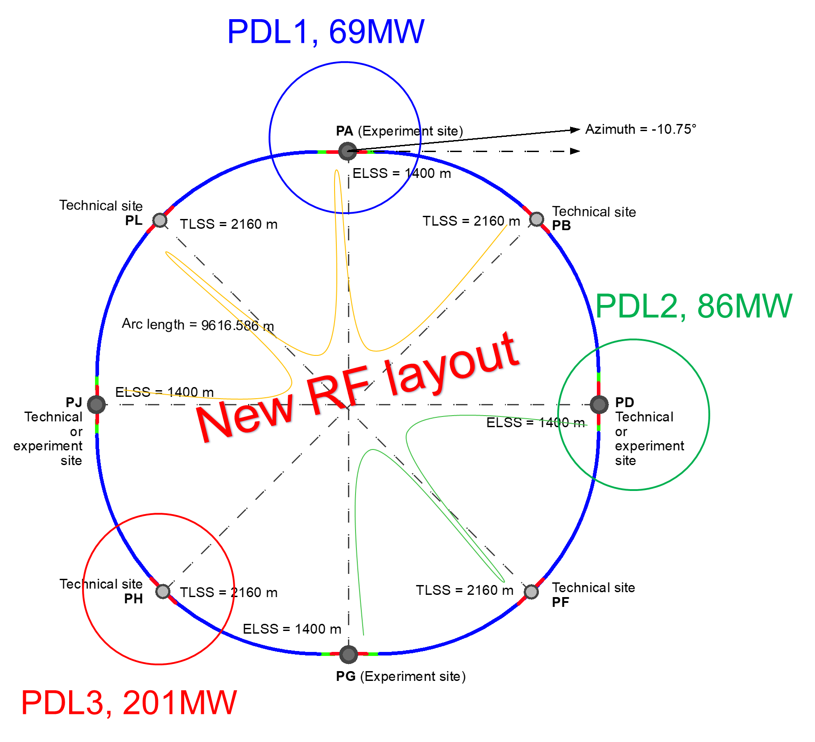
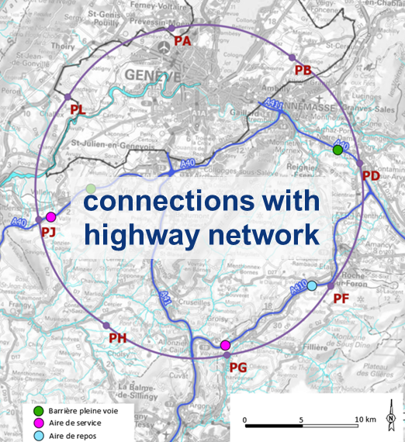
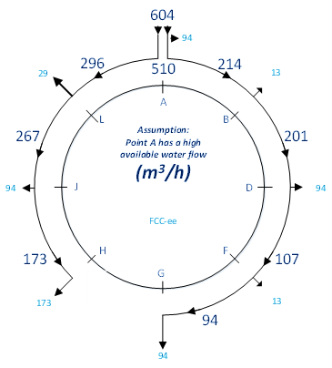
Resource needs & connections to regional infrastructure
Electricity consumption 1.1 – 1.8 TWh/year
Three supply points, also for redundancy
- Two new substations from existing HV grid
- Reuse of present CERN station
Feasibility confirmed with RTE (FR operator)
Road access developed for all 8 surface sites
Four highway connections to existing access areas
Less than 4 km of new roads required
Raw water need:
1 – 3 million m³/year
Water supply from lake Geneva via existing SIG supply to CERN
Distribution via tunnel

Slide 12
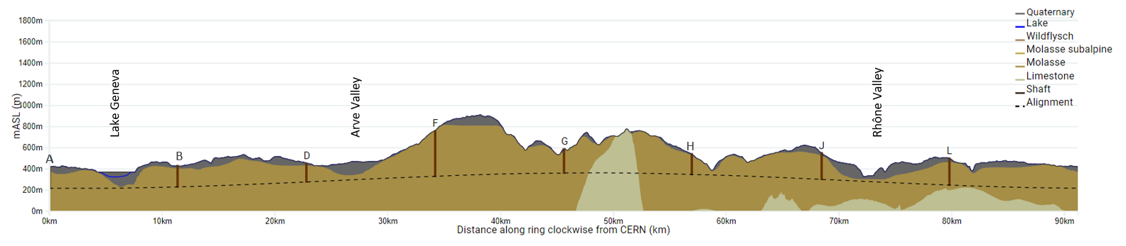
Optimum placement of FCC tunnel and geology
  Tunneling mainly in molasse layer (soft rock), well suited for fast, low-risk TBM construction.
  6,25 million m³ excavated volume → ~8.5 million m³ excavation material on surface (expanded)
  CE Designs of all underground structures developed
  Average shaft depths ~240 m
  To fix the vertical position of the tunnel, interfaces between geological layers have to be known

Slide 13
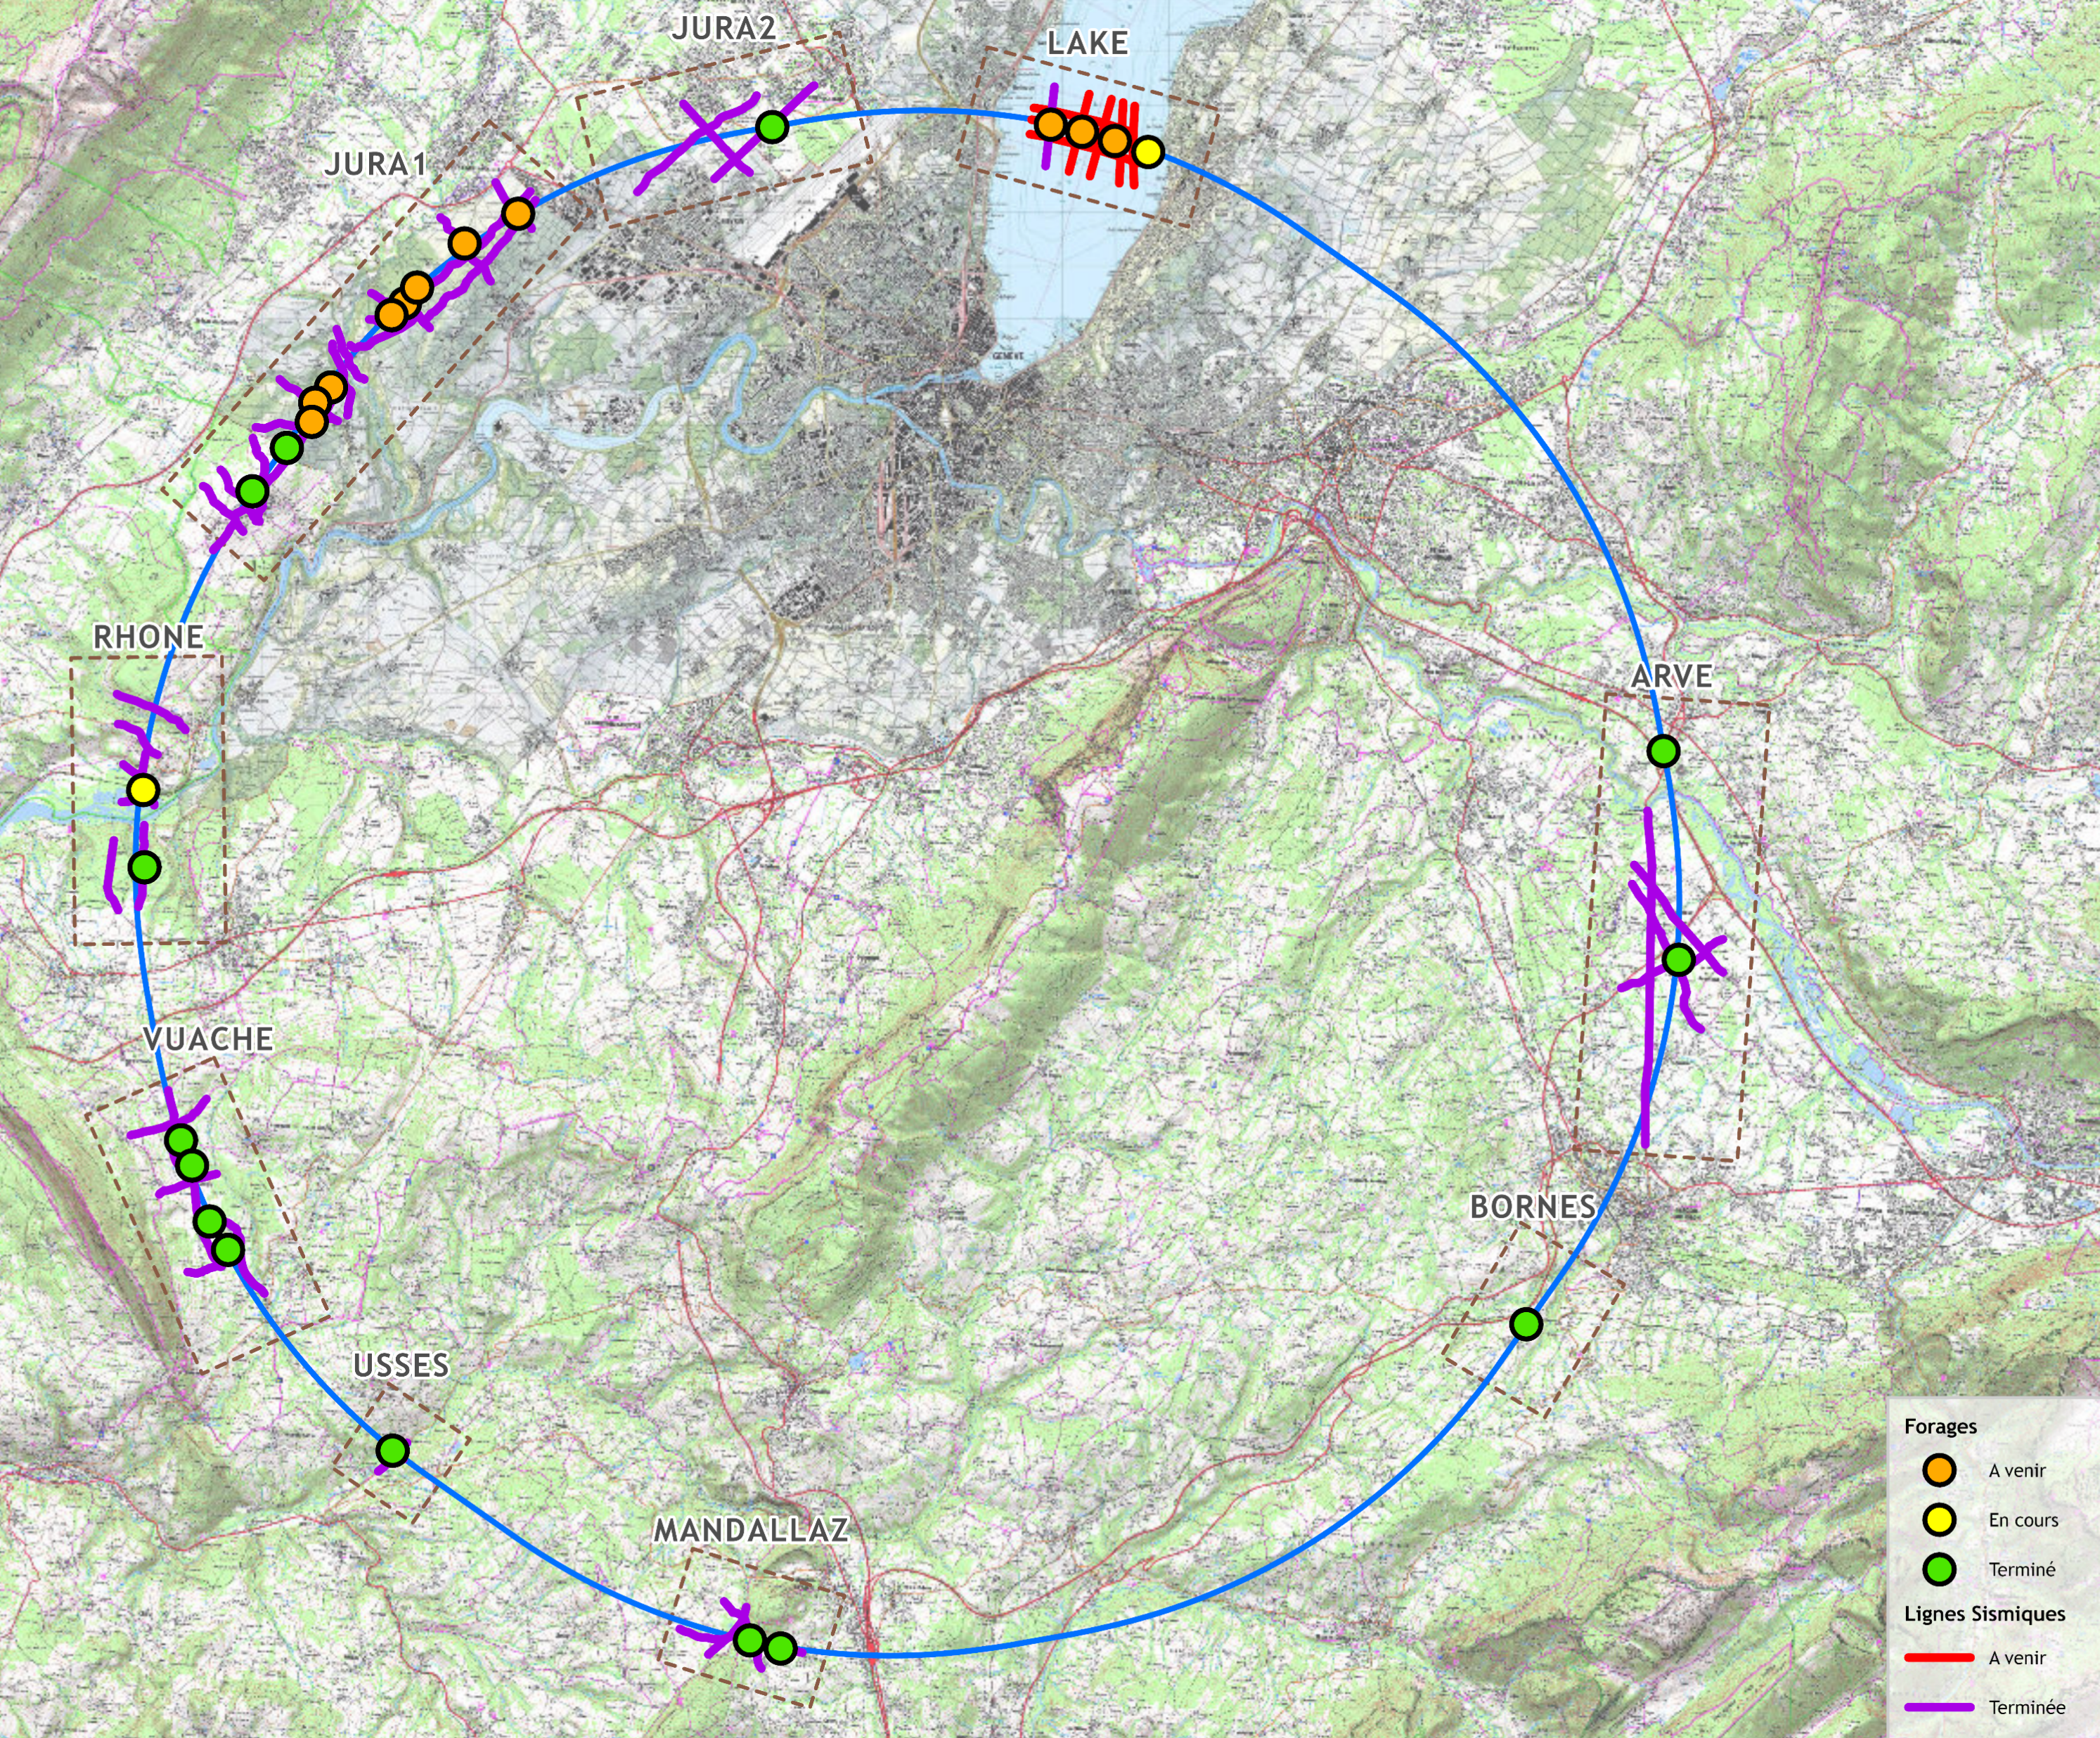
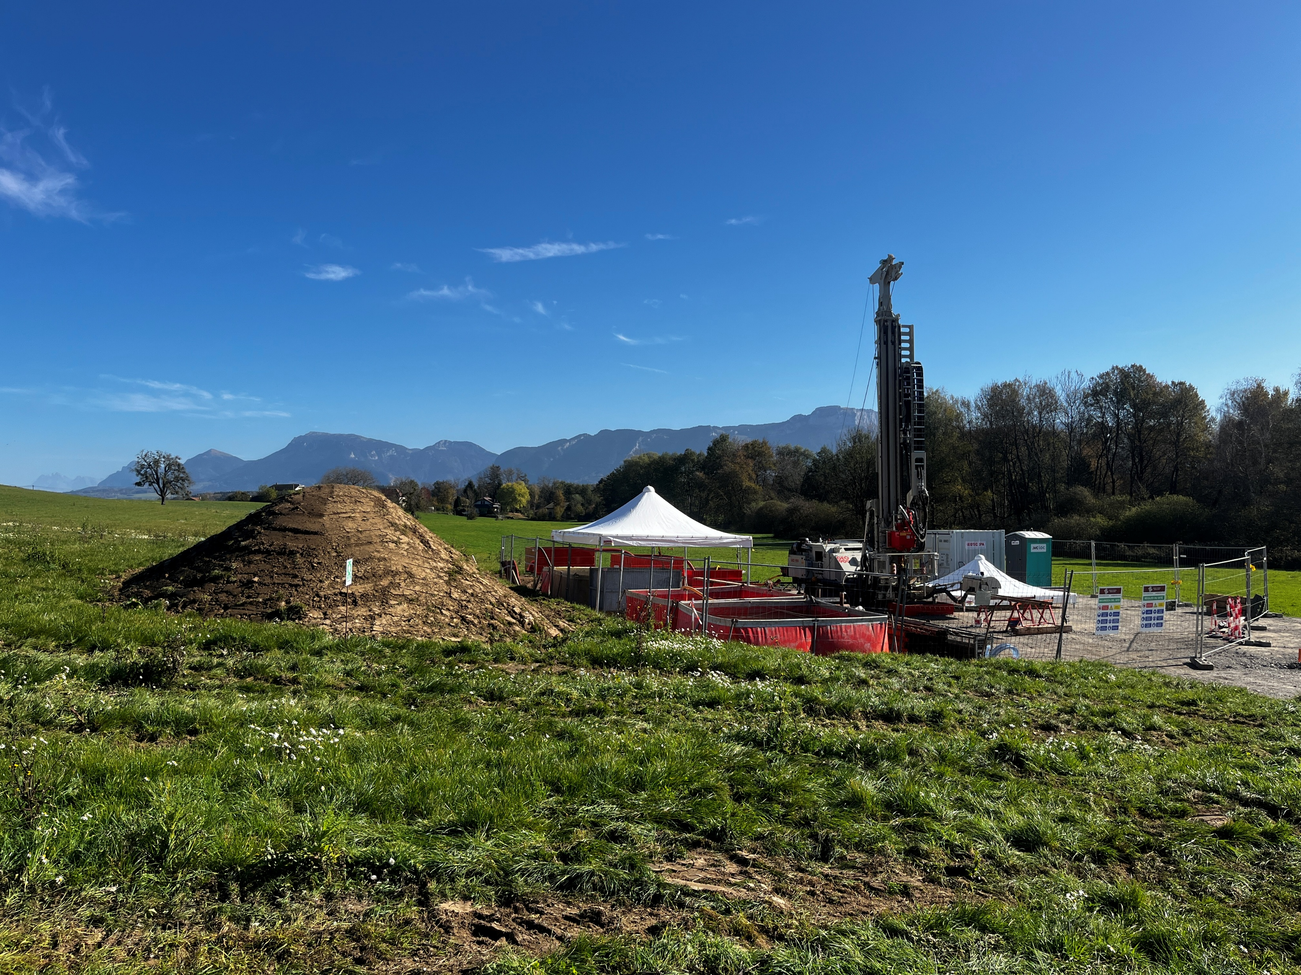
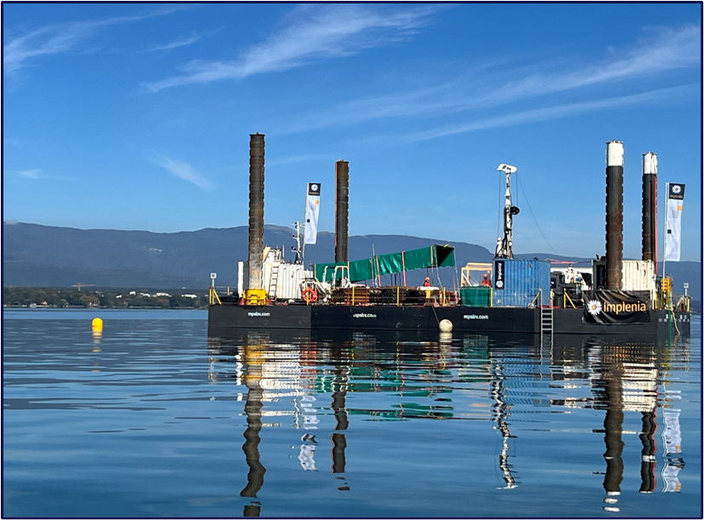
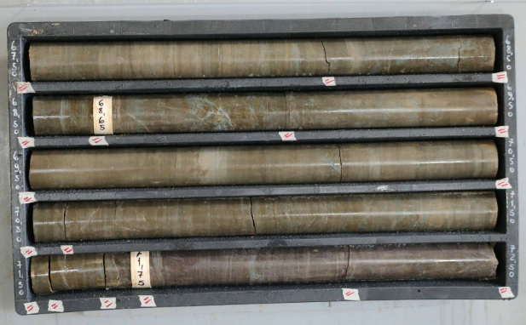
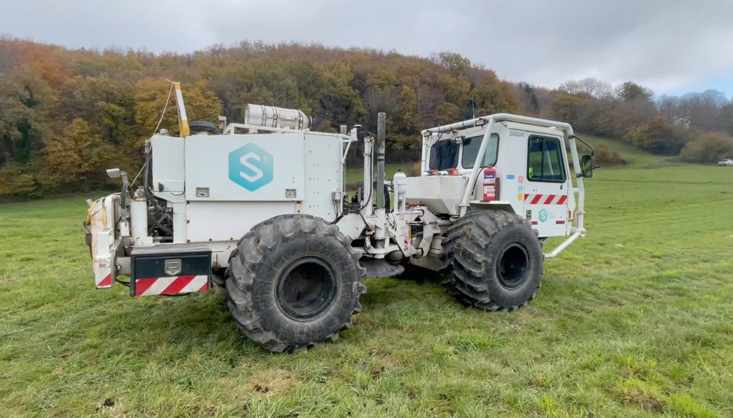
Geological investigations
Focused on 8 zones to improve prêcision of geological model and identify the intercased moraine – molasse and molasse – limestone.
86 km of seismic investigations completed
15 of 27 bore holes completed
1st lake bore hole completed
Completion of all bore holes ~June 2026
Results so far confirm geological model
Lake Geneva –
November 2025

Slide 14
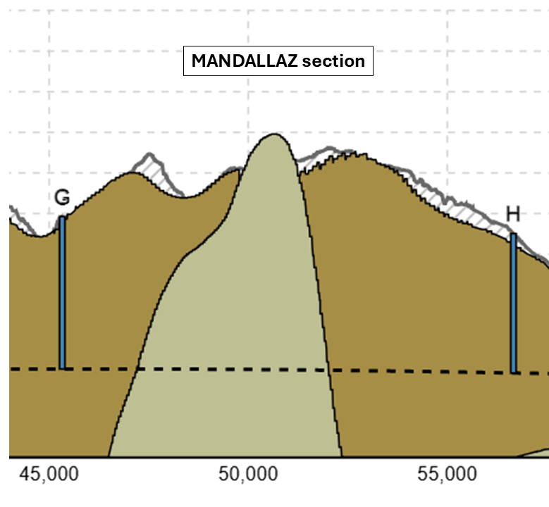
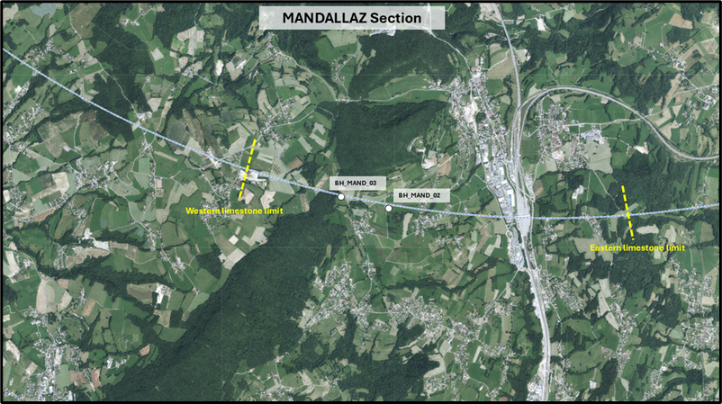
MANDALLAZ Boreholes
Likely Eastern limit
Two boreholes in the Mandallaz region have enabled a more accurate assessment of the limestone profile in this area.
It is now considered the limestone interface is steeper than originally thought thus reducing the estimate length of tunnelling from 4.7 km (black trace) down to less than 3km (red trace).

Slide 15
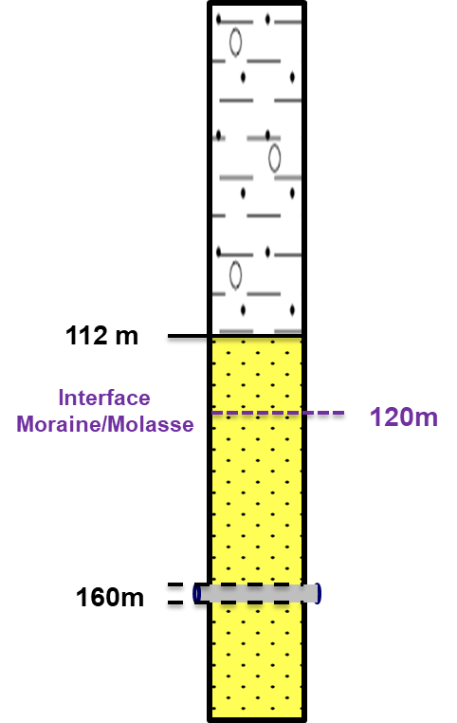
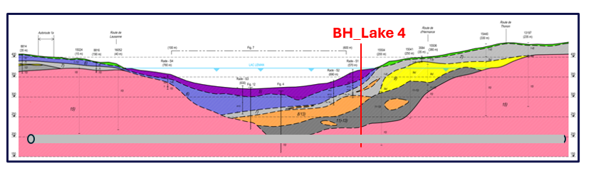
Bore Hole Lake_04
First lake borehole is positive with molasse commencing at a slightly shallower depth than assumed in baseline.
If this is also the case for the other boreholes, it may be possible to make the tunnel shallower by several metres under the lake.
It will also mean the Tunnel Boring Machine will remain in the molasse rock rather than going into the overlying moraine thus avoiding a more complex machine.

Slide 16
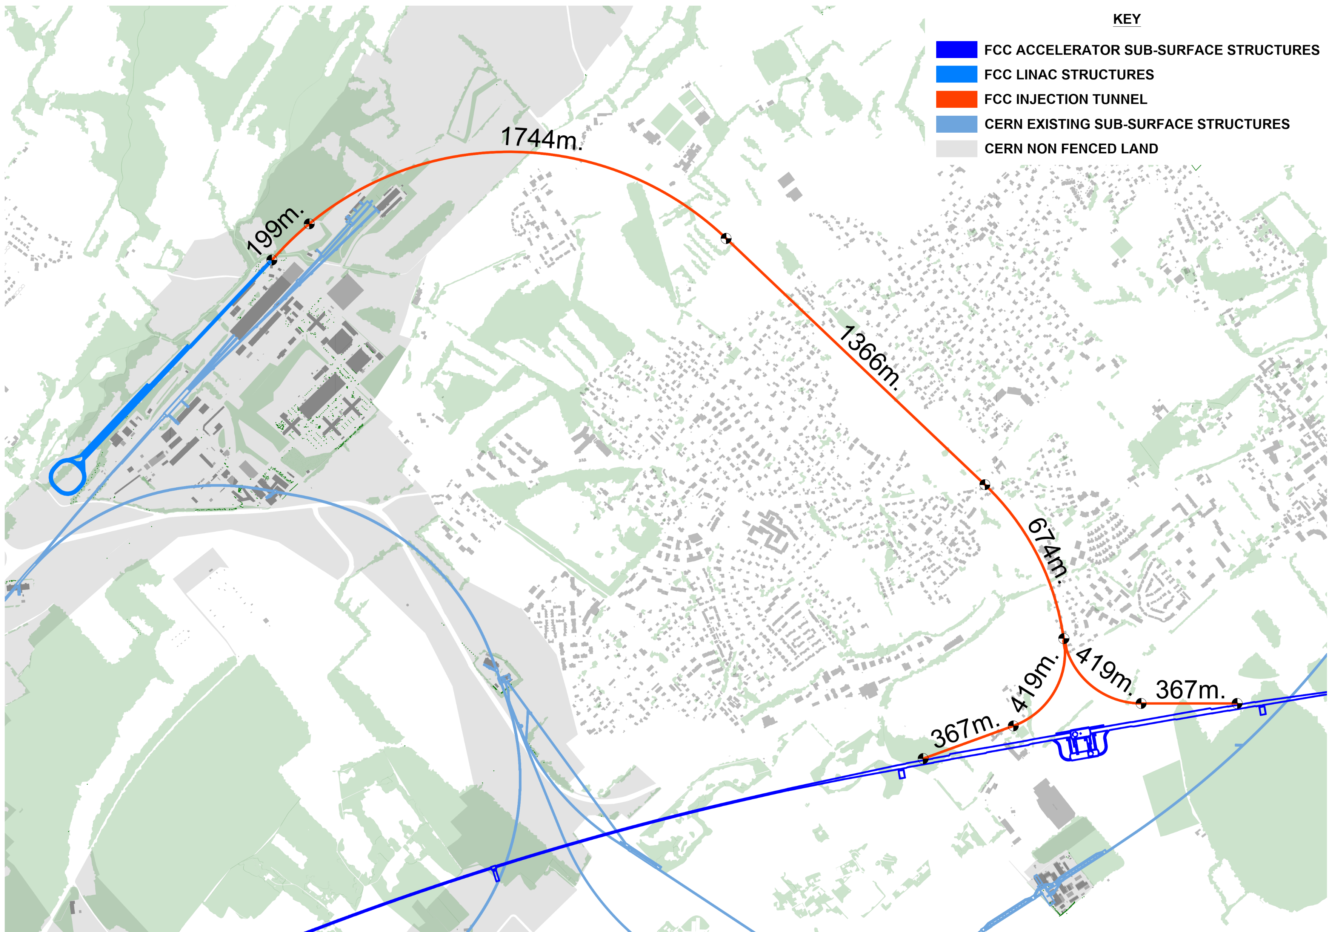
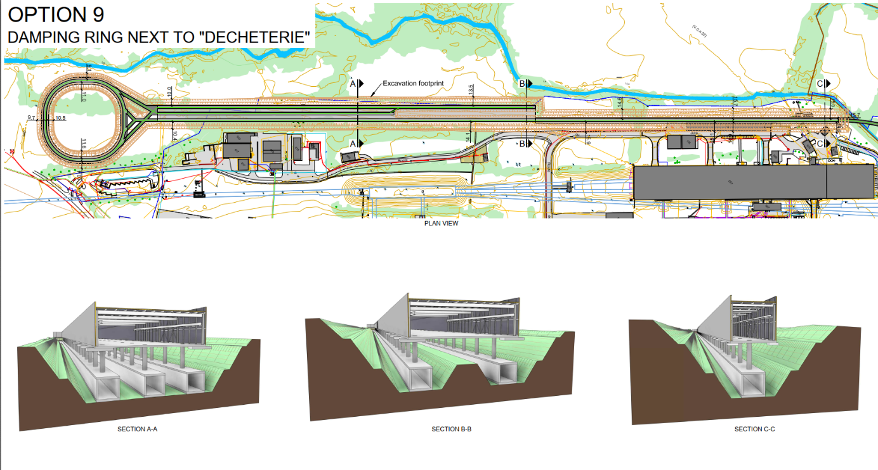
FCC-ee injector implementation
Located on CERN Prévessin site
possible connection to North Area to enable non-collider physics
transfer line to FCC PA (LHC P8)
“cut and cover” construction

Slide 17
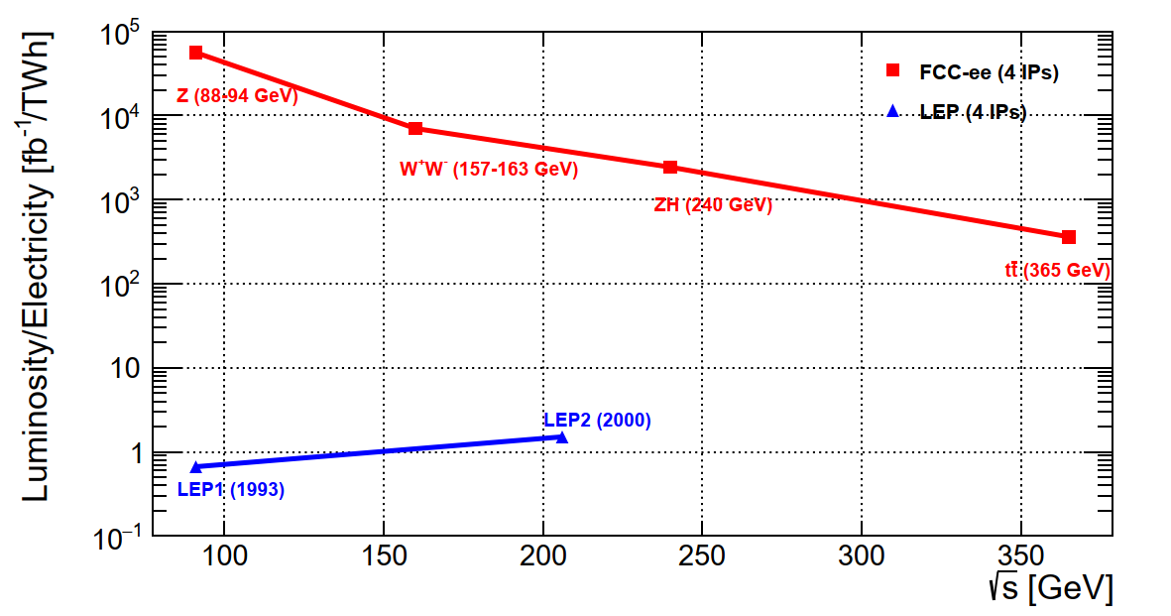
FCC-ee basic design choices and performance
Combining concepts from past and present lepton colliders and using high-efficiency SRF system results in a giant step in efficiency:
Double ring e⁺e⁻ collider, allowing many bunches, high current, like LHC and B factories, different from LEP
Synchrotron radiation power 50 MW/beam at all beam energies. Energy loss ΔE per turn:
ΔE ~ γ⁴/ρ = (E/m₀)⁴/ρ
Asymmetric IR layout and optics to limit synchrotron radiation towards the detector and to provide large horizontal crossing angle 30 mrad for crab-waist collision optics, demonstrated at DAFNE (Italy) and SuperKEKB (Japan)
Top-up injection scheme as at modern light sources (APS, SLS,…) and as at recent e⁺e⁻ colliders, PEP-II (USA), KEKB & SuperKEKB (Japan), BEPCII (China), requires booster synchrotron in collider tunnel
→10⁴–10⁵x luminosity/el.energy of LEP
→ sustainable physics
Notes:
In situ , not in- place

Slide 18
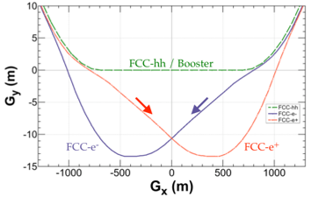
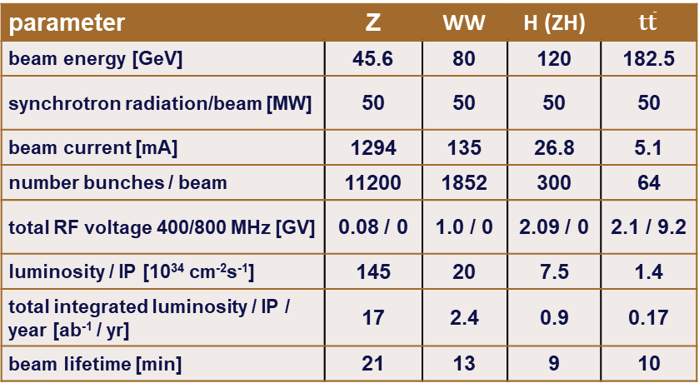
Stage 1: e⁺e⁻ collider FCC-ee
FCC-ee functional layout
Consolidated main parameters
parameter | Z | WW | H (ZH) | $$\text{t}\overline{\text{t}}$$
beam energy [GeV] | 45.6 | 80 | 120 | 182.5
synchrotron radiation/beam [MW] | 50 | 50 | 50 | 50
beam current [mA] | 1294 | 135 | 26.8 | 5.1
number bunches / beam | 11200 | 1852 | 300 | 64
total RF voltage 400/800 MHz [GV] | 0.08 / 0 | 1.0 / 0 | 2.09 / 0 | 2.1 / 9.2
luminosity / IP [10³⁴ cm⁻²s⁻¹] | 145 | 20 | 7.5 | 1.4
total integrated luminosity / IP / year [ab⁻¹ / yr] | 17 | 2.4 | 0.9 | 0.17
beam lifetime [min] | 21 | 13 | 9 | 10
4 years
6 x 10¹² Z
LEP x 10⁵
2 years
> 10⁸ WW
LEP x 10⁴
3 years
> 2x10⁶ H
5 years
2 x 10⁶ tt pairs

Slide 19
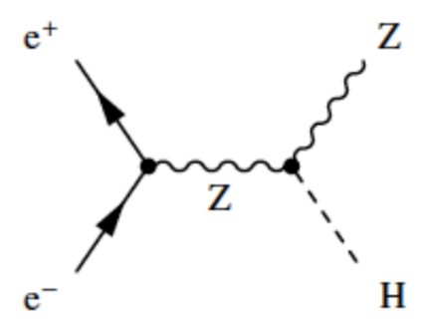
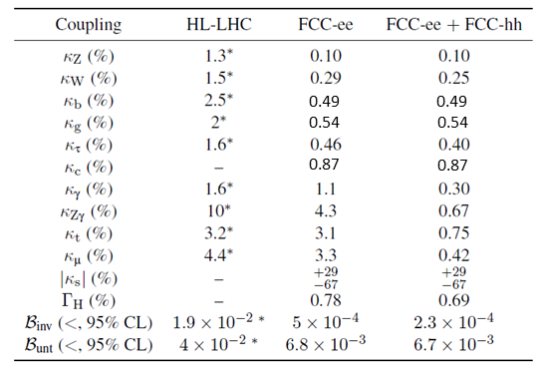
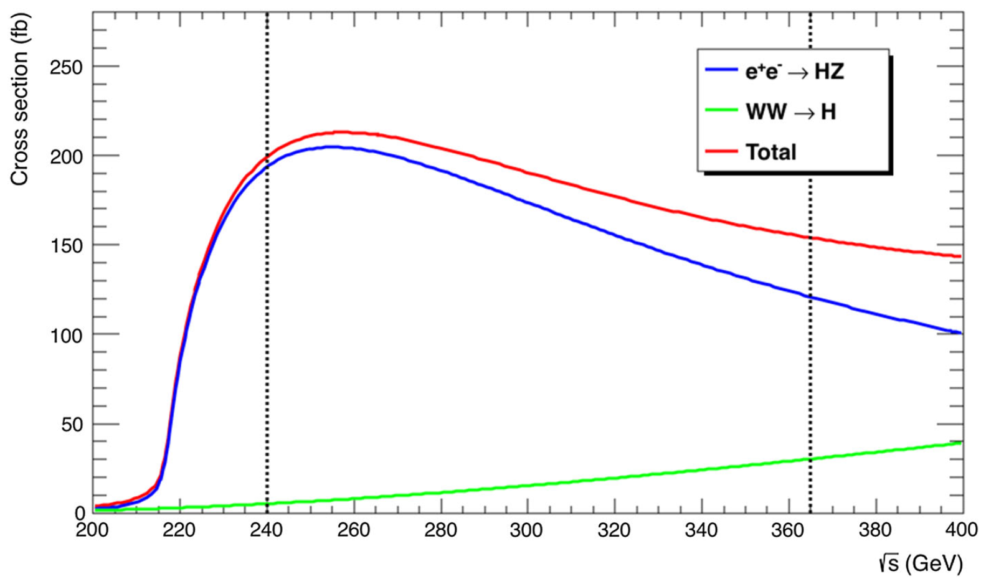
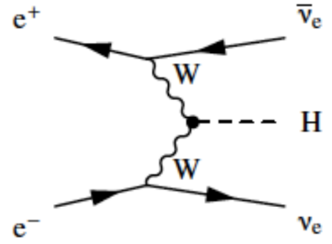
Higgs physics at FCC-ee (and -hh)
FCC-ee provides model-independent and precise measurement of many Higgs properties, far beyond HL-LHC’s reach
Achieved through operation at two energy points: 240 GeV and 350-365 GeV
Precision on κ parameters (ratio of measured / SM couplings)
10.8 ab⁻¹ at 240 GeV
2.2 x 10⁶ ZH events
65k WW→H events
~3 ab⁻¹ at 350-365 GeV
370k ZH events
92k WW→H events
* next to HL-LHC numbers → not model independent
FCC-ee permits model-independent measurement of Higgs width (Γ_{H}), not possible at HL-LHC…
…and sub-percent precision on many of the most interesting coupling modifiers, e.g. HZZ (κ_{Z}) to 0.1% …
…and probes for the first time coupling to second generation quarks, e.g. charm, with Hcc (κ_{c}) to 0.9%
Extensions to baseline plan, e.g. H-pole run at 125 GeV, to measure Higgs coupling to electrons, under evaluation

Slide 20
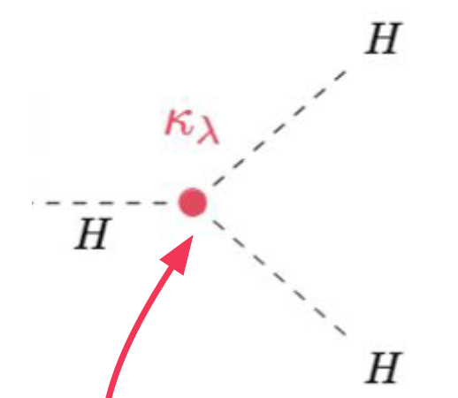
Higgs physics at FCC-ee (and -hh)
FCC-ee provides model-independent and precise measurement of many Higgs properties, far beyond HL-LHC’s reach
Achieved through operation at two energy points: 240 GeV and 350-365 GeV
Precision on κ parameters (ratio of measured / SM couplings)
10.8 ab⁻¹ at 240 GeV
2.2 x 10⁶ ZH events
65k WW→H events
~3 ab⁻¹ at 350-365 GeV
370k ZH events
92k WW→H events
* next to HL-LHC numbers → not model independent
FCC-hh completes the job !
Dataset of 20 billion Higgs bosons allows for precise measurement of rare decay modes
Great synergy and complementarity between -ee and -hh
Dataset of 30 million Higgs pairs allows critical self-coupling parameter κ_{λ} to be measured to ~3%
κ_{λ}

Slide 21
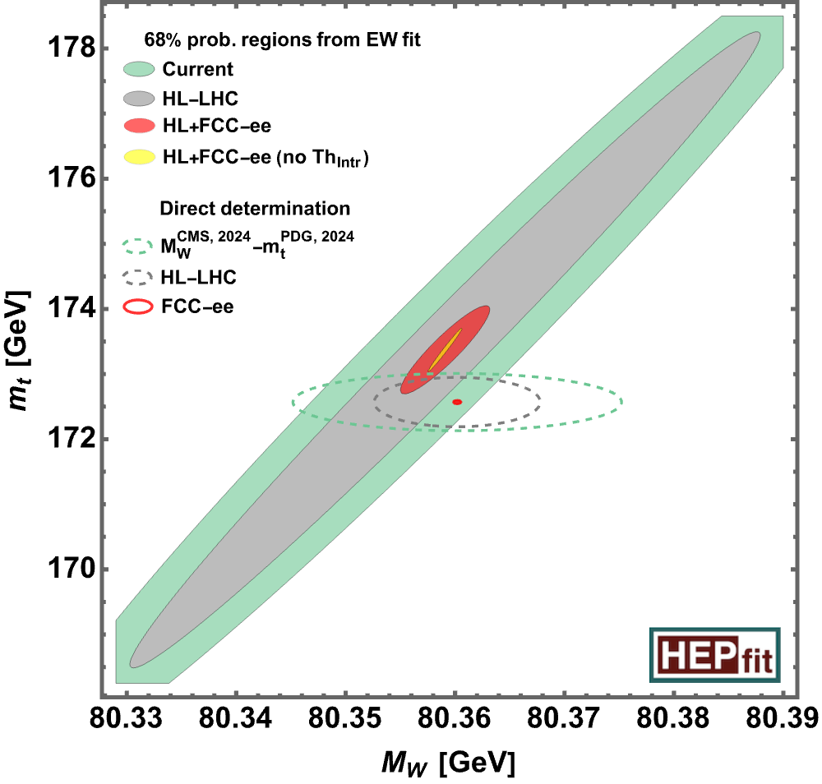
Precision electroweak physics at FCC-ee
FCC-ee allows for ultra-precise studies of electroweak sector → highly sensitive indirect probe of New Physics !
Tera-Z: 6 x 10¹² Z from 205 ab⁻¹ taken on-peak and off
Similarly big improvements at higher energies from
W mass and top-quark mass measurements
Execute LEP-style measurements, e.g. Z scan to determine
mass and width, but with 10⁵ increase in sample size
LEP Z lineshape
now
post FCC-ee
Standard Model
‘closure test’
Compare direct measurements with expectations
from Standard Model deriving from measurements at Z peak

Slide 22
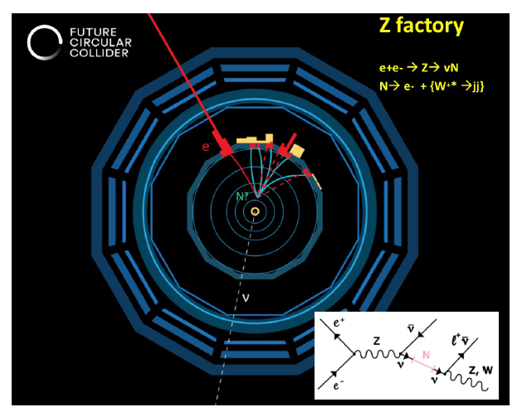


Heavy flavour and direct search physics at FCC-ee
Huge sample of 6 x 10¹² Z provide excellent opportunities in heavy flavour and search physics
Flavour: FCC-ee matches the key advantages
of HL-LHC (very large samples of b, c and τ decays)
with those of Belle II (very clean environment)
Searches for new feebly-coupled
particles, e.g. heavy neutral leptons:
sensitivity in key regions of parameter
space inaccessible by SHiP and LHC
e.g. lepton universality tests with taus

Slide 23



Detector developments
Work progressing to understand detector requirements for full programme (not just Higgs!).
Four ‘detector concepts’ have already emerged, as test beds for possible solutions.
…these are NOT yet collaborations or locked-in designs. Full participation of community, and close collaboration with DRD collaborations, needed to progress in next phase.
CLD IDEA ALLEGRO ILD
Ultra-light drift chamber
Crystal ECAL
Dual readout fibre calo
In early design phase
Noble liquid (Ar) ECAL
Full Si tracker
CALICE-like calorimeter
Ported from ILC
Large volume TPC

Slide 24


FCC-ee operation sequence and SRF concept
400 MHz RF layout and beam switching
Flexible sequence Z – W - H
Z, WW operation
ZH operation
2-cell 400 MHz SRF system for Z, W and ZH, entire system installed at operation start
  flexibility for switching between Z, WW, ZH operation
  reverse phase operation at Z allows constant cavity coupling
  suppression of the single-cell 400 MHz system
  reduced R&D, installation, commissioning, etc…
6-cell 800 MHz SRF system for collider ttbar operation and booster at all energies

Slide 25



FCC-ee different running modes
Reverse phase operation (RPO) mode allows increasing RF cavity voltage (Y. Morita et al., SRF, 2009)
Experimentally verified with high beam loading in KEKB (Y. Morita et al., IPAC, 2010)
Baseline solution for EIC ESR (e.g., J. Guo et al., IPAC, 2022)
 | Energy (GeV) | Current (mA) | RF voltage (GV)
Z | 45.6 | 1294 | 0.079
W | 80 | 135 | 1.05
H | 120 | 26.7 | 2.1
$$t\overline{t}$$ | 182.5 | 5 | 11.3
RF reverse phase operation
at the Z pole → enables one RF system from Z to ZH
RPO at Z
I. Karpov

Slide 26



400 MHz system – collider Z, W, ZH
X 264
X 66
X 264
Superconducting elliptical cavity
400 MHz, 2-cell
1.5 m. long
Electropolished and seamless RF surface
Niobium thin film with HiPIMS
Cryomodule
Segmented design, 4 cavities
Vertical FPC, HOM damping and extraction
Frequency tuning system
Thermal and magnetic shielding
Multibeam Tristron
400 MHz
46 kV
500 kW, CW
~ 90% efficiency
I. Syratchev

Slide 27





800 MHz system – for $t\overline{\text{t}}$collider and booster
Multibeam Tristron
800 MHz
250 kW, CW
X (408 + 448)
X (102 + 112)
X 408
Superconducting elliptical cavity
800 MHz, 6-cell
Nb₃Sn if R&D is successful
Cryomodule
Segmented design, 4 cavities, 2 K
Operation at 4.5 K if R&D successful
Solid State Amplifier (SSA)
800 MHz
10-15 kW pulsed
X 448
A. Butterworth

Slide 28








FCC-ee optics baseline GHC alternative LCC
K. Oide et al.
P. Raimondi, S. Liuzzo, et al.
arc
$$t\overline{t}$$
ZH & $t\overline{t}$
Z & WW
experimental straight
$$t\overline{t}$$
Z & WW
ZH & $t\overline{t}$
PRAB 19, 111005 (2016)
PRAB 28, 021002 (2025)

Slide 29



FCC design with Xsuite
+ SuperKEKB benchmarks
G. Broggi, J. Salvesen, G. Iadarola, H. Sugimoto, K. Oide
  Touschek & beam-gas scattering for different collimator settings, including collimator-matter interaction
  Xsuite-simulated response of Belle-II diamond detector:
G. Iadarola
tutorials in form of Jupyter notebooks
G. Broggi

Slide 30









Design of arc magnets, girders, cavities, prototypes, mock-ups
Arc half-cell =
the most repeated region of mechanical hardware in the tunnel: → 77 km over 90 km are arc cells
Booster dipole
low-field cycling magnet
F. Carra & A. Piccini
A. Milanese
800 MHz bulk Nb 5-cell cavity
Prototype fulfilling FCC specs
JLAB, F. Marhauser
Twin-dipole design with 2× power saving 16 MW
(at 175 GeV)
Vibration studies with girder on PSI jacks

Slide 31


Shielding concept: limiting cumulative dose ($t\overline{\text{t}}$)
Synchrotron radiations absorbers and additional shielding aiming factor ~100 dose reduction in arcs
A. Lechner

Slide 32




Machine-Detector Interface
Q1 prototype tested at cold in SM18 (CERN), October ‘23
Key topics:
SC IR magnet system & cryostat design
3D integration
IR mock-up at INFN-LNF
J. Seeman, A. Novokhatski, SLAC
B. Parker, Vikas Teotia, BNL
P. Tavares, CERN
M. Koratzinos, PSI
M. Boscolo, F. Palla, INFN

Slide 33



FCC-ee booster
full energy booster, ramping from 20 GeV to 46 GeV – 182.5 GeV;
injection $\sim$several times per minute to keep collider beam currents constant;
booster intensity ~1% of collider; full RF voltage as in collider
Booster
Collider

Slide 34






FCC-ee injector design
Main linac 20 GeV S-band, based on SwissFEL structures.
  new accelerating structures with higher shunt impedance;
  gradient 22.5/20.5 MV/m; repetition rate 100 Hz
  80 MW S-band klystron, great interest in KEK R&D
Novel positron source
  HTS solenoid (15 T on axis, tested 18 T @ 12 K)
  proof-of-principle beam tests at PSI SwissFEL from 2026

Slide 35

other FCC-ee science opportunities
large circumference, high energy, abundant positron production, low-emittance beams, high-power beamstrahlung, injector complex → FCC-ee offers unique opportunities for various other fields of physics and science
Examples:
production of true muonium
creation of a Bose-Einstein condensate of positronium
high(est)-energy photons, Compton imaging, nuclear research etc.
spatially coherent photon beams, possibly down to 0.1 Å wavelengths
higher average and peak brightness than any existing or planned light source
radioactive isotope production
neutron source
CERN-FCC-ACC-2025-0005,
doi: 10.17181/CERN.BSP4.H8ED
submitted to EPJ Plus

Slide 36


FCC-ee booster as unique ultimate photon source
36
S. Casalbuoni

Slide 37
Stage 2: hadron collider FCC-hh
Parameter optimization to lower electricity consumption (~max. consumption of FCC-ee)
Magnetic field considered realistic with today’s technologies (Nb₃Sn, ~14T, 1.9 K)
Main parameters FSR 2025
FCC-hh functional layout
parameter | FCC-hh | FCC-hh CDR | HL-LHC
collision energy cms [TeV] | 85 | 100 | 14
dipole field [T] | 14 | 16 | 8.33
circumference [km] | 90.7 | 97.8 | 26.7
beam current [A] | 0.5 | 0.5 | 1.1
synchr. rad. per ring [kW] | 1200 | 2400 | 7.3
peak luminos. [10³⁴ cm⁻²s⁻¹] | 30 | 30 | 5 (lev.)
integr. luminosity / IP [fb⁻¹] | 20000 | 20000 | 3000
For Nb₃Sn @ 1.9 K: 355 MW el, consumption and 2.3 TWh/y
For Nb₃Sn @ 4.5 K potential to reduce to ~1.8 TWh/y as for FCC-ee.

Slide 38


FCC-hh beam optics perfectionated for highest energy !
regular arc cell
~275m
 | CDR cell 12-dipole | 12-dipole | 16-dipole
# dipoles | 4668 | 4288 | 4464
Cell length [m] | 213.030 | 213.030 | 275.792
Circumference [km] | 97.75 | 90.657 | 90.657
CM energy @14T [TeV] | 88.477 | 81.275 | 84.611
Short Straight Section
M. Giovannozzi, G. Perez Segurana, T. Risselada, E. Todesco

Slide 39








FCC-hh High-Field Magnet Nb₃Sn and HTS R&D
Nb₃Sn:
12- and 14-T short demonstrators
Different coil geometries
tests scheduled for 2026
HTS R&D in various domains:
REBCO and IBS Conductor R&D
Racetrack coil developments
B. Auchmann, E. Todesco
Down selection of technology by 2035-2040

Slide 40



Status of the FCC Global Collaboration
Increasing international collaboration is a prerequisite for success:
→links with science, research & development and high-tech industry will be essential to further advance and prepare the implementation of the FCC
→Next step is preparation of a plan with national laboratories for in-kind contributions to the project
38 Participating Countries
Austria – Belgium – Brazil – Canada – Chile – Colombia – Czech Republic – Denmark – Estonia – Finland – France – Georgia – Germany – Greece – Hungary – India – Iran – Italy – Japan – Latvia – Malta – Mexico – Netherlands – Norway – Pakistan – Poland – Portugal – Republic of Korea – Romania – Serbia – Spain – Sweden – Switzerland – Thailand – Türkiye – Ukraine – United Kingdom – United States of America
162 Institutes
38 Countries
+
CERN

Slide 41

Next FCC collaboration meeting is the FCC WEEK 2026,
8 – 12 June in Helsinki, Finland
Entire community is invited and welcome to participate!

Slide 42



Progress and support towards funding
Strong support from European Union expressed in the recent EU Competitiveness Report stating inter alia that
“One of CERN’s most promising current projects, with significant scientific potential, is the construction of the Future Circular Collider… ...Refinancing CERN and ensuring its continued global leadership in frontier research should be regarded as a top EU priority”
Statements of intent to collaborate with CERN on construction and exploitation of FCC-ee, signed with US and with Canada.
26 April 2024
White House Office of Science and Technology Policy Principal Deputy U.S. Chief Technology Officer Deirdre Mulligan signed for the United States while Director-General Fabiola Gianotti signed for CERN.
9 April 2025
CERN Director-General, Fabiola Gianotti, and His Excellency Mr Patrick Wittmann, Ambassador of Canada to Switzerland and Liechtenstein, exchanging signed copies of the joint Statement of Intent between CERN and Canada.
“I am proud that we have financed the feasibility study for CERN’s Future Circular Collider (FCC)...”
Ursula von der Leyen, President of the European Commission,
during CERN 70 anniversary celebrations
For 2028-2034 budget plan, a 3 BEuro budget line for FCC is proposed by the European Commission, to be approved by European Parliament in 2027.

Slide 43




Slide 44


ESG recommendation for preferred option for next flagship collider at CERN
The electron–positron Future Circular Collider (FCC-ee) is recommended as the preferred option for the next flagship collider at CERN.
A descoped FCC-ee is the preferred alternative option for the next flagship collider at CERN.
Fabiola Gianotti

Slide 45
CERN Council review of the FCC Feasibility Study
7-9 July 2025: Final reviews by the FCC Feasibility Study Scientific Advisory Committee (SAC), chaired by A. Parker (Cambridge U.), and by the FCC Cost Review Panel (CRP), chaired by N. Holtkamp (Stanford)
8-10 September 2025: Reviews by CERN Finance Committee (FC) and Scientific Policy Committee (SPC)
6-7 November 2025: CERN Council dedicated session on FCC Feasibility Study, Conclusions:
The Council, being committed to maintaining CERN as a world leader in science and technology:
…. congratulates the CERN Management and all the personnel involved in the FCC Feasibility Study….
….. considers that the FCC would provide the platform for a visionary physics programme addressing many of the open questions in particle physics,... and concludes that:
a. the FCC Feasibility Study provides the basis for the FCC studies to continue and
b. the funding scenarios presented and the financial pledges obtained so far provide the basis for the continuation …towards securing the full financial commitments required for approval of the FCC project.

Slide 46
Recent CERN press releases
The European Strategy for Particle Physics reaches an important milestone
Geneva, 12 December 2025. At its 225th session, the CERN Council received the recommendations for the update of the European Strategy for Particle Physics, the aim of which is to develop a common vision for the future of the field. The recommendations will be reviewed by the Council in the coming months. A final decision is expected at a dedicated Council Session in Budapest in May 2026.
For the 2026 update of the ESPP, the CERN Council requested that the Strategy update should include the preferred option for the next collider at CERN and prioritised alternative options to be pursued if the chosen preferred plan turns out not to be feasible or competitive. ….
The electron–positron Future Circular Collider (FCC-ee) is recommended as the preferred option for the next flagship collider at CERN….
The ESG presents a descoped FCC-ee as the preferred alternative option for the next flagship collider at CERN.
A decision by the CERN Council on the possible construction of the FCC is expected around 2028.
Private donors pledge 860 million euros for CERN’s Future Circular Collider
Geneva, 18 December 2025. For the first time in CERN’s history, private donors (individuals and philanthropic foundations) have agreed to support a CERN flagship research project. Recently, a group of friends of CERN, including the Breakthrough Prize Foundation, The Eric and Wendy Schmidt Fund for Strategic Innovation, and the entrepreneurs John Elkann and Xavier Niel, have pledged significant funds towards the construction of the Future Circular Collider (FCC), the potential successor of the Large Hadron Collider (LHC). These potential contributions, totalling some 860 million euros and corresponding to 1 billion US dollars, would represent a major private sector investment in the advancement of research in fundamental physics.

Slide 47
FCC considerations on organisation
Mark Thomson
The key points from the European Strategy Group report regarding FCC:
Strong endorsement of the physics and strategic case for FCC-ee as the next flagship collider for CERN
  Near consensus on this point within the particle physics communities in CERN’s Member States
A descoped/staged FCC is preferred to other options as an alternative
The further development of FCC-ee will be CERN’s clear second highest scientific priority for 2026-2030 after HL-LHC
The goal remains to take FCC-ee to CERN Council in 2028, hopefully for a positive decision
FCC Organisation 2026-2030
We will establish a new compact FCC Project Office to coordinate the FCC-ee activities
Reporting directly to the D-G
The delivery of the FCC activities within CERN will be embedded in CERN’s sectors in a traditional “CERN matrixed” project structure
With the overall project being defined and coordinated through the FCC Project Office

Slide 48

FCC project structure
Mark Thomson

Slide 49
Conclusions
The technical part of the FCC Feasibility Study has been concluded with the submission of the Feasibility Study Report to the ESPP end March 2025
A coherent baseline design for the FCC integrated programme has been developed, including a well-advanced territorial implementation scenario, in line with desired CE construction start by 2033.
In December 2025, FCC FS successfully passed CERN Council review, and ESG recommended FCC-ee as the preferred option for the next flagship collider at CERN.
FCC-ee design level enables moving towards technical design and prototyping phase, well aligned with overall schedule and towards preparing input for potential project decision by 2028.

Slide 50
spare slides

Slide 51

Key features of the Underground Civil Engineering Baseline
Tunnel Circumference: 90.7 km
Excavated volume: 6.25 Mm³ (in-situ)
Access shafts: 12
Construction shafts: 1
Large experiment sites: 2
Small experiment sites: 2
Technical sites: 4
Deepest shaft: 400m
Average shaft depth: 243m
Total concrete volume: 2 M m³
Schematic of FCC-ee Baseline Underground Civil Engineering

Slide 52
Preliminary Results SSI1 Campaign Results
Section JURA
Top of the limestone has not been encountered in 3 of the 11 boreholes that have so far been completed. Remaining boreholes will be completed by September 2026.
Section MANDALLAZ
Characterisation of the limestone on and above the tunnel alignment in the Mandallaz area. A few karsts were found but none where very large nor water-bearing.
Section USSES
Top of molasse found slightly higher than originally modelled in zones where tunnel is closest to the surface
Section RHONE
Section LAKE
Top of the molasse in first borehole found at around the modelled depth. Results pending other 3 boreholes in 2026
Section ARVE
Top of the molasse found slightly higher the modelled depth
Section VUACHE
Limestone was not encountered and the molasse extends deeper than originally modelled
It is expected that it will be possible to maintain the tunnel in the Molasse other than in the Mandallaz area. However last Lake and Jura boreholes needed to confirm this and to allow a final refinement of the tunnel elevation and tilt.

Slide 53
FCC-ee: detailed machine parameters
Parameter | Z | WW | H (ZH) | ttbar
beam energy [GeV] | 45.6 | 80 | 120 | 182.5
beam current [mA] | 1270 | 137 | 26.7 | 4.9
number bunches/beam | 11200 | 1780 | 440 | 60
bunch intensity [10¹¹] | 2.14 | 1.45 | 1.15 | 1.55
SR energy loss / turn [GeV] | 0.0394 | 0.374 | 1.89 | 10.4
total RF voltage 400/800 MHz [GV] | 0.120/0 | 1.0/0 | 2.1/0 | 2.1/9.4
long. damping time [turns] | 1158 | 215 | 64 | 18
horizontal beta* [m] | 0.11 | 0.2 | 0.24 | 1.0
vertical beta* [mm] | 0.7 | 1.0 | 1.0 | 1.6
horizontal geometric emittance [nm] | 0.71 | 2.17 | 0.71 | 1.59
vertical geom. emittance [pm] | 1.9 | 2.2 | 1.4 | 1.6
horizontal rms IP spot size [μm] | 9 | 21 | 13 | 40
vertical rms IP spot size [nm] | 36 | 47 | 40 | 51
beam-beam parameter ξ_{x} / ξ_{y} | 0.002/0.0973 | 0.013/0.128 | 0.010/0.088 | 0.073/0.134
rms bunch length with SR / BS [mm] | 5.6 / 15.5 | 3.5 / 5.4 | 3.4 / 4.7 | 1.8 / 2.2
luminosity per IP [10³⁴ cm⁻²s⁻¹] | 140 | 20 | 5.0 | 1.25
total integrated luminosity / IP / year [ab⁻¹/yr] | 17 | 2.4 | 0.6 | 0.15
beam lifetime rad Bhabha + BS [min] | 15 | 12 | 12 | 11
F. Gianotti
4 years
5 x 10¹² Z
LEP x 10⁵
2 years
> 10⁸ WW
LEP x 10⁴
3 years
2 x 10⁶ H
5 years
2 x 10⁶ tt pairs
x 10-50 improvements on all EW observables
up to x 10 improvement on Higgs coupling (model-indep.) measurements over HL-LHC
x10 Belle II statistics for b, c, τ
indirect discovery potential up to ~ 70 TeV
direct discovery potential for feebly-interacting particles over 5-100 GeV mass range
Up to 4 interaction points → robustness,
statistics, possibility of specialised detectors
to maximise physics output

Slide 54
FCC-hh injector options
 | unit | scSPS | modif. LHC | 4 T LHC
circumference | km | 6.8 | 26.7 | 26.7
#apertures |  | 1 | 2 | 1
injection energy | GeV | 26 | 450 | 450
extraction energy | TeV | 1.3 | 3.3 | 3.3
injection field | T | 0.12 | 0.6 | 0.6
maximum field | T | 6 | 6 | 6
energy/field swing |  | 50 | 7 | 7
#dipoles |  | 372 | 1232 | 1232
#bunches |  | 640 | 2600 | 2600
stored energy | MJ | 15 | 167 | 167
collider filling time | min | 37 | 46 | 39
superconducting machine in the SPS tunnel (scSPS)
modified faster-ramping LHC
new 4 T machine in the LHC tunnel
2 T superferric machine in the LHC tunnel (1.75 TeV, not shown in the table)

Slide 55

ESG Summary Table, Dec 2026
Karl Jakobs

Slide 56

FCC-ee construction schedule
2028 assumed project approval by CERN Council
01/2033 – 06/2041 CE construction work
07/2039 – 12/2043 technical infrastructure installation
07/2041 – 06/2045 accelerator installation
07/2046 start of beam commissioning and operation
01/2048 nominal beam operation

Slide 57

Operation modes for RF
Physics at 4 different energy points:
  Z⁰, W⁺W⁻, Higgs (ZH), t-tbar production
Same SR power for all 4 modes
  P_{SR}= 50 MW per beam
Lowest energy:
Low RF voltage
High beam current
Few cavities
Low voltage per cavity
High power per cavity
Significant HOM power
Instabilities
1- or 2-cell cavities at low
RF frequency (400MHz)
Highest energy:
High RF voltage
Low beam current
Many cavities
High voltage per cavity
Low power per cavity
Low HOM power
High SR damping
Multi-cell cavities at higher
RF frequency (800MHz)

Slide 58






examples of other FCC-ee optics and beam dynamics activities
spin tracking
:
collaboration with BNL EIC project
beam-beam interaction & sextupole alignment → dynamic aperture and beam lifetime - correlation
H. Kiel, J. Wenninger
benchmarking case of LEP1 with orbit bumps to compensate precession in the experimental solenoids; good agreement with classical SLIM simulations
L. Van Riesen-Haupt
top-up
on-axis & off-axis
injection studies
top-up hybrid
injection studies
cavity trip in RPO scheme
Y. Dutheil,
S. Yue,
T. Mori
I. Karpov

Slide 59




FCC-hh: highest collision energies
order of magnitude performance increase in both energy & luminosity
20 ab-1 per experiment collected over 25 years of operation (vs 3 ab⁻¹ for LHC)
similar performance increase as from Tevatron to LHC
key technology: high-field magnets
from
LHC technology
8.3 T NbTi dipole
via
HL-LHC technology
12 T Nb₃Sn quadrupole
FNAL dipole demonstrator
4-layer cosϑ
14.5 T Nb₃Sn in 2019

Slide 60




SuperKEKB as FCC-ee demonstrator
an ultralow $β_{y}^{∗}\sim$0.8–1.0 mm†,
the virtual crab waist collision scheme,
electron and positron beam currents exceeding 1.3 A
challenges encountered:
sudden beam loss (being addressed)
stored beam vertical emittance (~10x design)
injected vertical beam emittance (~1000x the design stored beam emittance)
injection efficiency (large inj. emittance & physical+dynamics aperture)
interaction region (highly complex source of IP aberrations)
IP beta $β_{y}^{∗}$ (limited by injected beam emittance, IR aperture, DA)
specific luminosity (linear & chromatic coupling, design lattice, optics errors, space charge, impedance, feedback/noise,…)
limited number of experts

Slide 61





SuperKEKB injected beam emittance
N. Iida
emittance growth in the beam transport lines of the SuperKEKB injector measured in 2024
γε= 100 μm $↔$ ε=13 nm
γε= 100 μm $↔$ ε=7 nm
N. van Gils
both horizontal and vertical emittance growth in BTe reproduced in Xsuite simulations with 100 μm rms random quad misalignments
possible mitigations? → survey & realignment, dispersion-free steering

Slide 62




producing true muonium
– a world’s first !?!
Bose-Einstein condensate
of Ps – also world’s first
A positronium density of ${10}^{15}{\text{mm}}^{−3}$is necessary for forming a BEC. Current e+ sources cannot reach that !
assuming ∆E ∼ 44 MeV, one can expect to produce around 1 TM atom per 4.4 × 10¹³ positrons.
PRL 104 (2010) 243401
PRL 132 (2024) 083402
Simplified layout of the experimental set-up
with estimated rates the properties of the bound state could be studied
When a Ps-BEC annihilates, a coherent burst of gamma rays is emitted.
A proposed way to build a 511 keV gamma ray laser!
P. Crivelli
B. Rienäcker, M. Pölker

Slide 63
FCC-ee cost estimate (FSR 2025)
Capital cost (2024 CHF) for construction of the FCC-ee is summarised below. This cost includes construction of the entire new infrastructure and all equipment for operation at the Z, WW and ZH working points.
Domain | Cost [MCHF]
Civil engineering | 6,160
Technical infrastructures | 2,840
Injectors and transfer lines | 590
Booster and collider | 4,140
CERN contribution to four experiments | 290
FCC-ee total | 14,020
+ four experiments (non-CERN part) | 1,300
FCC-ee total incl. four experiments | 15,320
Note: Upgrade of SRF (800 MHz) & cryogenics for $\text{t}\overline{\text{t}}$ operation corresponds to additional cost of 1,260 MCHF.

