Slide 1





Muon Collider
D. Schulte
Funded by the European Union (EU). Views and opinions expressed are however those of the author(s) only and do not necessarily reflect those of the EU or European Research Executive Agency (REA). Neither the EU nor the REA can be held responsible for them.
IAS, HKUST, January, 2026

Slide 2
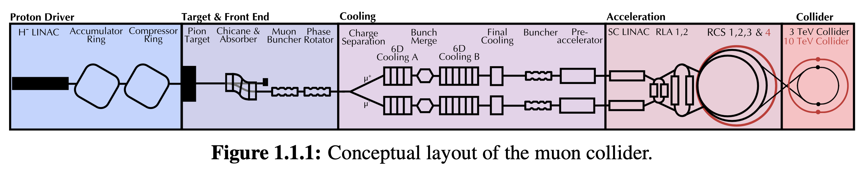
Muon Collider Concept
The main challenge is the short muon lifetime τ = γ x 2.2 μs
Up to 100 ms at collision energy
Protons produce pions which decay into muons which are captured
Ionisation cooling of muon in matter
Acceleration to collision energy
Short, intense proton bunch
Collision
2

Slide 3


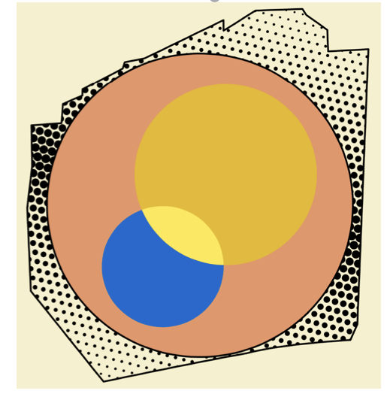
IMCC International Muon Collider Collaboration
Collaboration formed 2022, currently hosted by CERN
61 formal member institutions, still growing
Currently centred in Europe, strong US contribution
R&D progamme developed with global community
In response to strategic requests:
Last ESPPU demanded integration into European Accelerator R&D Roadmap
EU is co-funding design study MuCol since 2023
Different US recommendations: Snowmass, P5 and National Academy of Science
Goal is 10 TeV collider (green field) with potential initial stage
And implementations at specific sites, e.g. CERN and FNAL
Difference to most other projects: there could be competition for the site
3

Slide 4
IMCC Partners
IEIO | CERN
FR | CEA-IRFU
 | CNRS-LNCMI
 | Ecoles des Mines St-Etienne
DE | DESY
 | Technical University of Darmstadt
 | University of Rostock
 | KIT
UK | RAL
 | UK Research and Innovation
 | University of Lancaster
 | University of Southampton
 | University of Strathclyde
 | University of Sussex
 | Imperial College London
 | Royal Holloway
 | University of Huddersfield
 | University of Oxford
 | University of Warwick
 | University of Durham
 | University of Birmingham
 | University of Cambridge
NL | University of Twente
IT | INFN
 | INFN, Univ., Polit. Torino
 | INFN, LASA, Univ. Milano
 | INFN, Univ. Padova
 | INFN, Univ. Pavia
 | INFN, Univ. Bologna
 | INFN Trieste
 | INFN, Univ. Bari
 | INFN, Univ. Roma 1
 | ENEA
 | INFN Frascati
 | INFN, Univ. Ferrara
 | INFN, Univ. Roma 3
 | INFN Legnaro
 | INFN, Univ. Milano Bicocca
 | INFN Genova
 | INFN Laboratori del Sud
 | INFN Napoli
Mal | Univ. of Malta
EST | Tartu University
PT | LIP
SE | ESS
 | University of Uppsala
FI | Tampere University
 | HIP, University of Helsinki
LAT | Riga Technical University
CH | PSI
 | University of Geneva
 | EPFL
 | HEIA-FR
BE | Univ. Louvain
AU | HEPHY
 | TU Wien
ES | I3M
 | IFIC/CSIC
 | ICMAB
China | Sun Yat-sen University
 | IHEP
 | Peking University
 | Inst. Of Mod. Physics, CAS
 | University of CAS
KO | Kyungpook National University
 | Yonsei University
 | Seoul National University
India | CHEP
CA | Université Laval
US | Iowa State University
 | University of Iowa
 | Wisconsin-Madison
 | University of Pittsburgh
 | Old Dominion
 | Chicago University
 | Florida State University
 | RICE University
 | Tennessee University
 | MIT Plasma science center
 | Pittsburgh PAC
 | Yale
 | Princeton
 | Stony Brook
 | Stanford/SLAC
 | …
DoE labs | FNAL
 | LBNL
 | JLAB
 | BNL
Brazil | CNPEM
4
Signed MoC (61), requested MoC, contributor

Slide 5
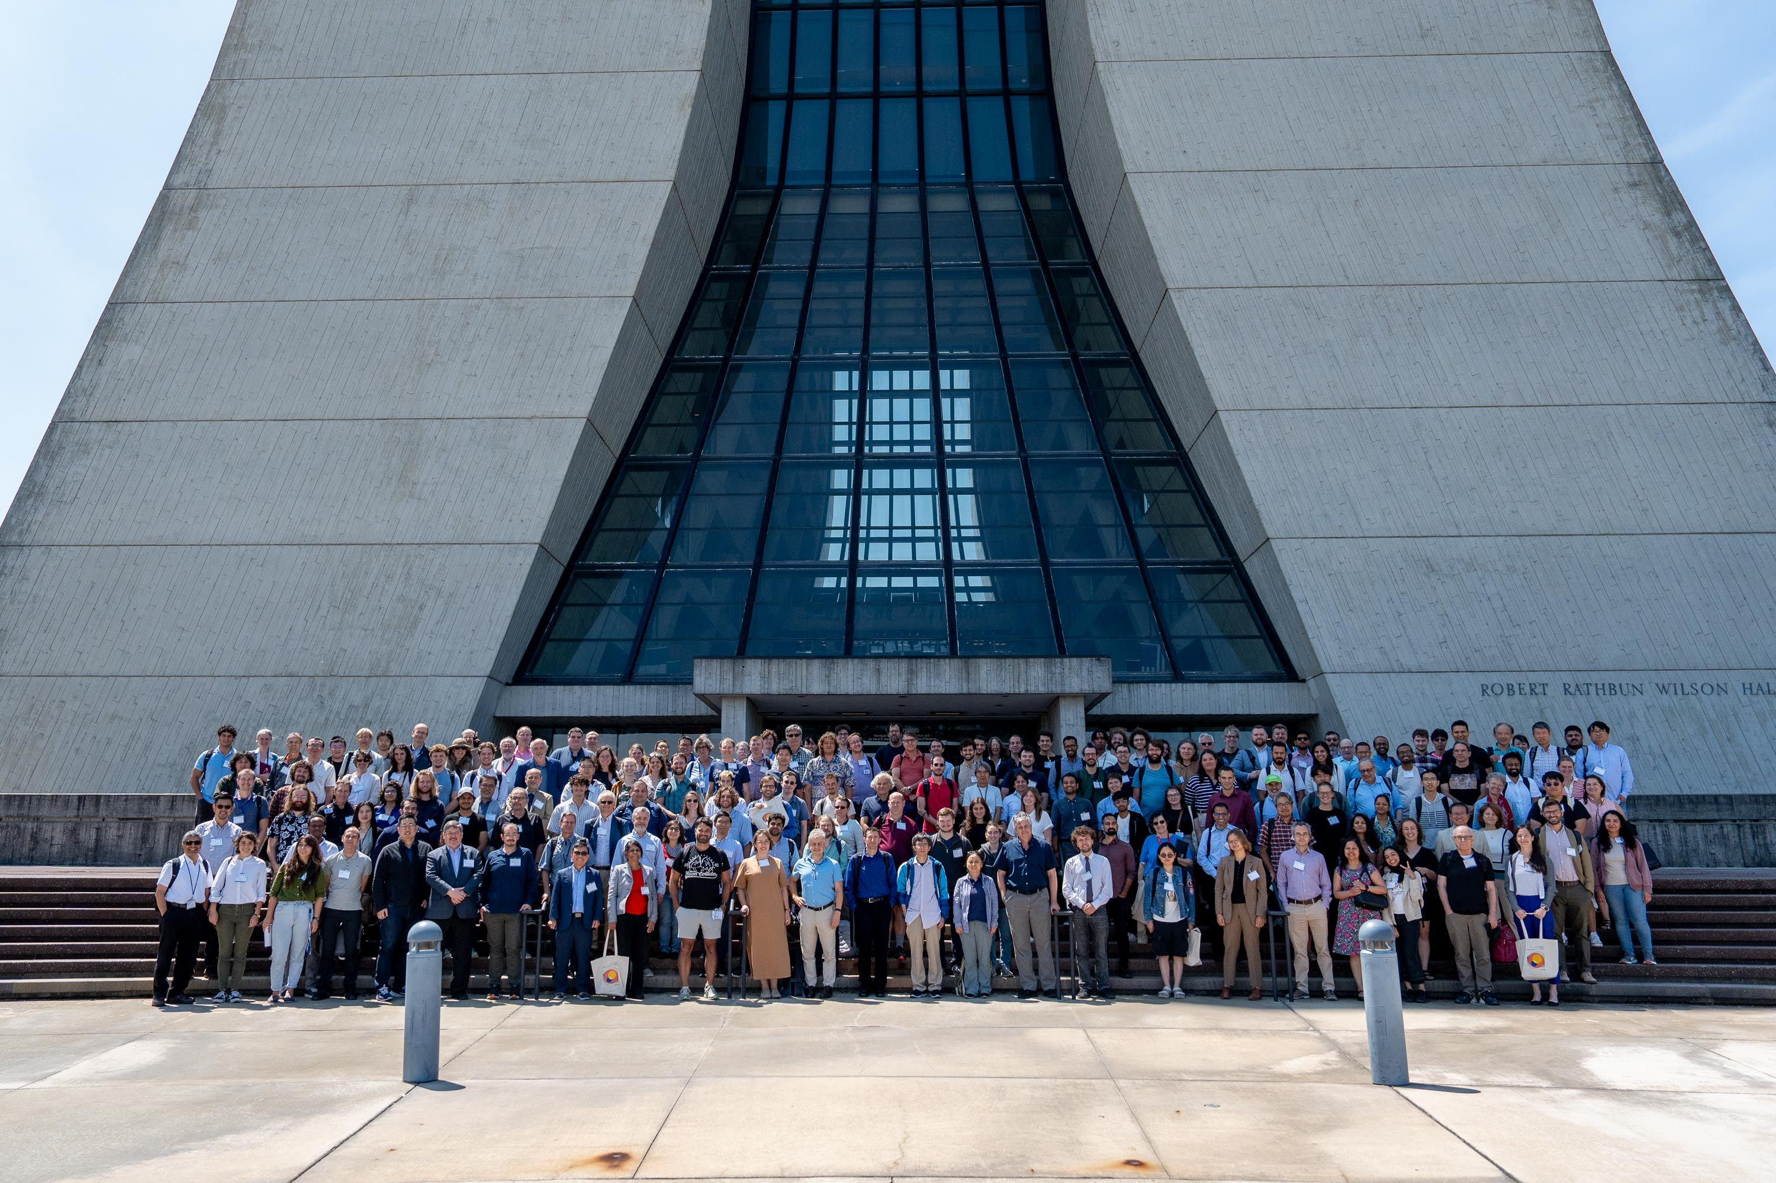
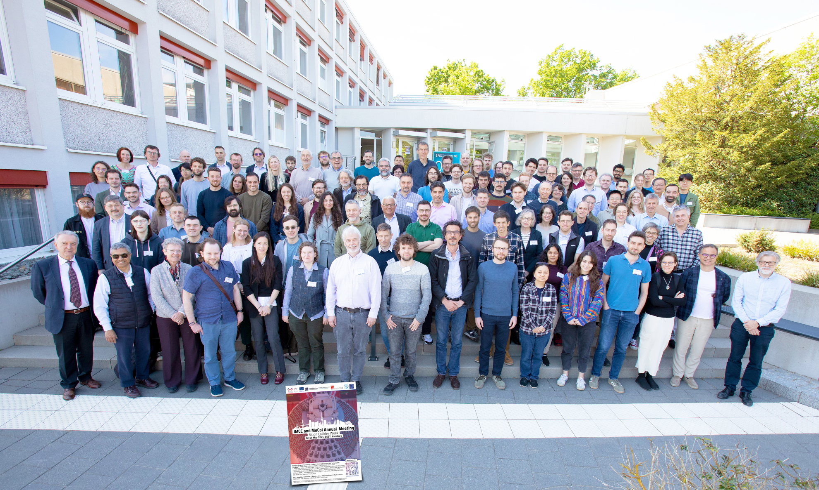
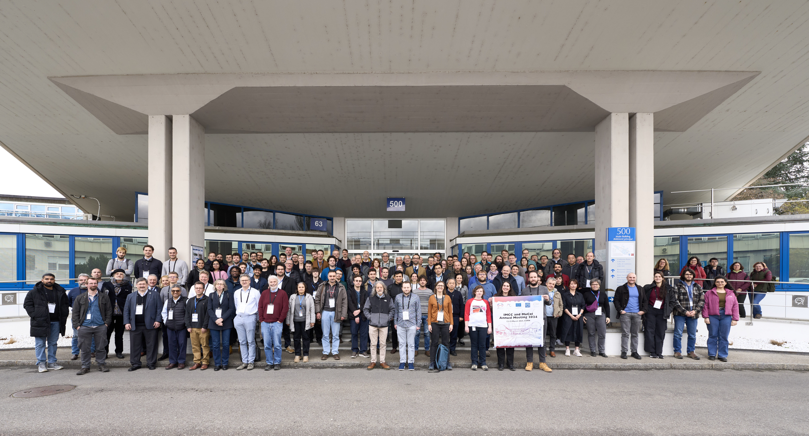
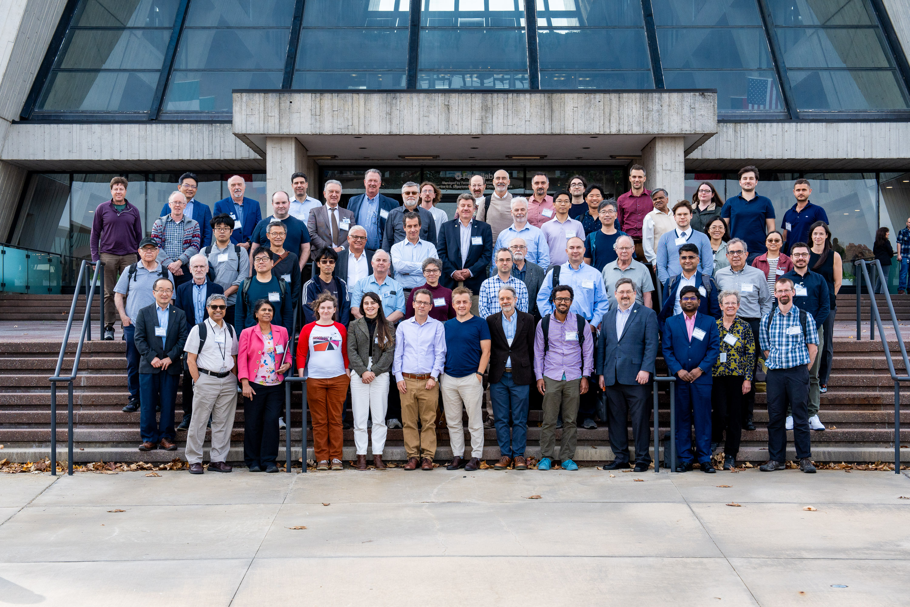
IMCC International Muon Collider Collaboration
5

Slide 6
ESPPU Submission Content
Muon Collider Assessment
Present physics case and green field designs and technologies
Parameters, lattice and component designs, beam dynamics, cost, …
Aim for 10 TeV with 10 ab⁻¹
Aim for initial stage around 2050 (e.g. with 3 TeV and 1 ab⁻¹)
Back-up document (406p, 450 signatories)
R&D plan
The main timeline driver
Accelerator design, detector development, magnets, muon cooling technology, …
Implementation Considerations
Currently for CERN and for FNAL
Scaling from green field design, detailed lattice designs after ESPPU
Technically limited schedule
Cost and power consumption scales
6

Slide 7
Physics Case for 10 TeV
Strong physics case for 10 TeV parton-parton centre-of-mass collider, in particular muon collider:
Muon collider impact on precision physics and BSM has been studied extensively and should be presented in all relevant sessions
So you can form your own opinion
Strong physics case complementary to FCC-ee + FCC-hh exists, see for example Snowmass and NAS report
National Academy of Science Recommendation:
M. Spiropulu (Co-Chair), M. S. Turner (Co-Chair), N. Arkani-Hamed, B. C. Barish, J. F. Beacom, PH. H. Bucksbaum, M. Carena, B. Fleming, F. Gianotti, D. J. Gross, S. Habib, Y.-K. Kim, P. J. Oddone, J. R. Patterson, F. Pilat, C. Prescod-Weinstein, N. Roe, T. M.P. Tait,
Staff: T. Konchady, D. Nagasawa, L. Walker, D. Wise, C. N. Hartman, A. Mozhi
A collider with approximately 10 times the energy of the Large Hadron Collider (LHC) is crucial for addressing the big questions of particle physics and making discoveries.
A 10-TeV muon collider on the Fermi National Accelerator Laboratory (Fermilab) site would have similar discovery reach as a 100-TeV proton collider.
A muon collider combines the physics advantages of an electron-positron and a proton-proton collider, with a much smaller size.

Slide 8
Muon Collider Promises
Higher gradients could constrain length of linear collider
Constant technology scaling:
Luminosity is proportional to beam power at different energies
Could reduce vertical emittance, but tried hard for decades
Could shorten bunch to reduce beamstrahlung, but trident cascade process will set in
8

Slide 9
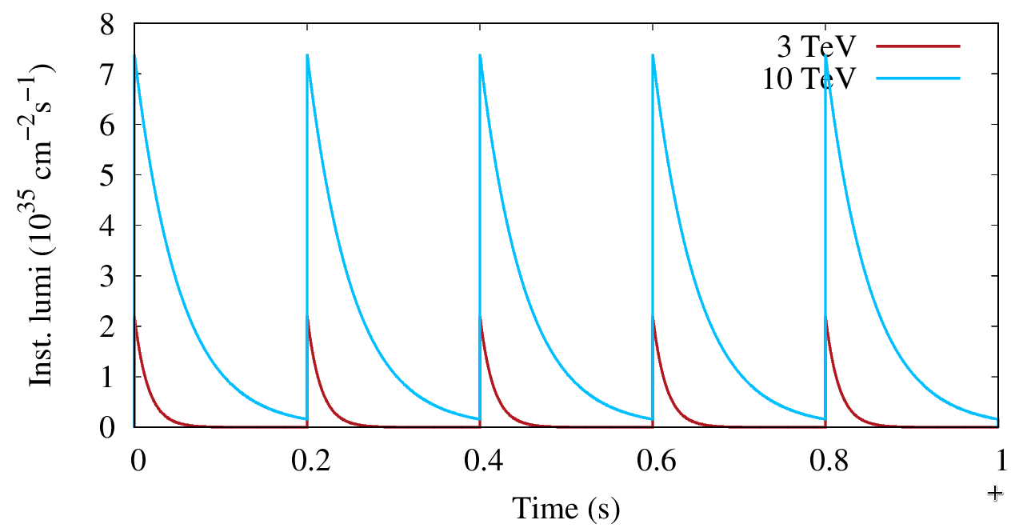
Muon Collider Luminosity Scaling
Fundamental limitation
Requires emittance preservation and advanced lattice design
Applies to MAP scheme
High field in collider ring
Large energy acceptance
High beam power
High energy
Dense beam
Luminosity per power increases with energy
Provided technologies can be made available
Constant current for required luminosity scaling

Slide 10
Key Parameters
Param. | Unit | Site independent |  | CERN 2 tunnels |  | CERN 1 tunnel
Sqrt(s) | TeV | 3 | 10 | 3.2 | 7.6 | 3.2 | 7.6
N | 10¹² | 2.2 | 1.8 | 2.2 | 1.8 | 2.2 | 1.8
ε | μm | 25 | 25 | 25 | 25 | 25 | 25
σ_{z}=β∗ | mm | 5 | 1.5 | 4.7 | 2 | 4.7 | 2
L/IP | 10³⁴ cm⁻²s⁻¹ | 1.8 | 17.5 | 2 | 10 | 0.9 | 7.9
Int L | ab⁻¹ | 1 | 10 | 1 | 10 | 1 | 10
Acc. time | years | 2+2.8 | 2+2.9 | 2+2.5 | 2+5 | 2+5.6 | 2+6.3
C | km | 4.5 | 11.4 | 4.8 | 8.7 | 11 | 11
B_{dipole} | T | 11 | 14 | 11 | 14 | 4.8 | 11
Collider dipole technology |  | Nb3Sn | HTS | Nb3Sn | HTS | NbTi | Nb3Sn or HTS
10

Slide 11
Luminosity Drivers
The beam emittances result from design, physics and technology of the cooling system
Aim for limited emittance increase downstream
The total number of muons per bunch is given by the proton pulses in the target
The total beam power is given by the high energy complex power consumption, cost, neutrinos
Important decay of muons afterwards
11

Slide 12
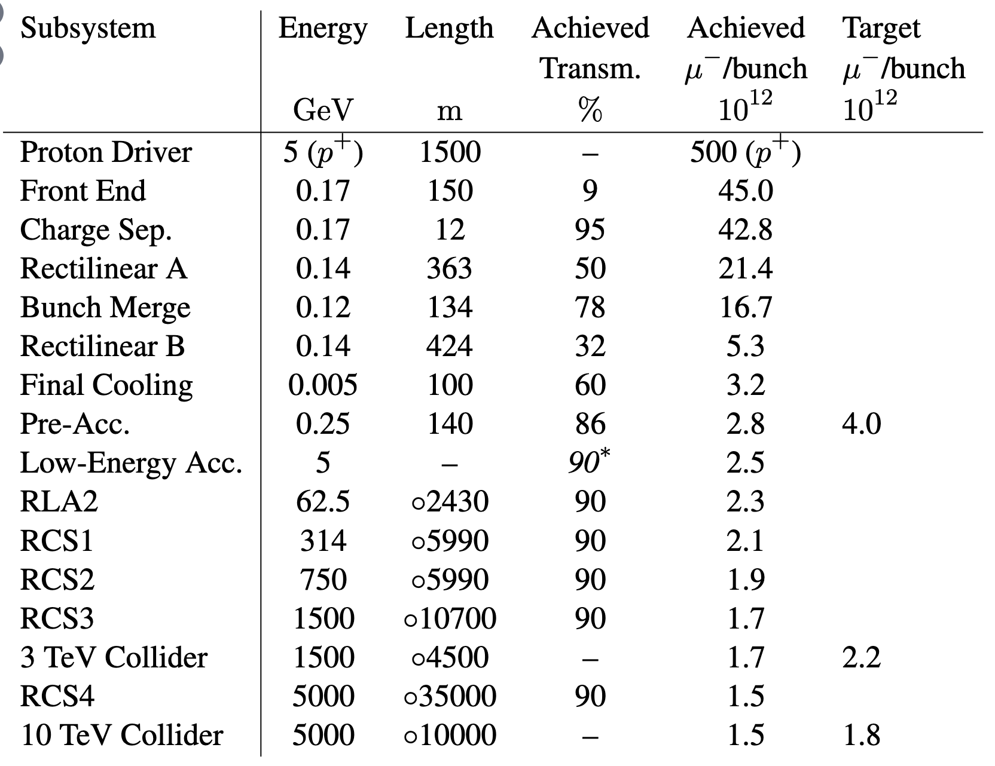
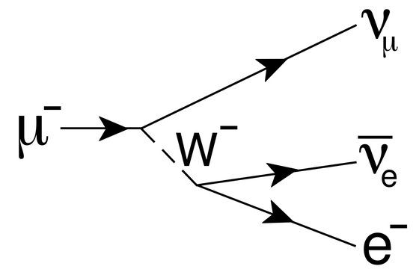
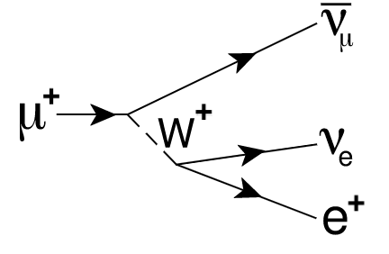
Muon Beam Production and Transmission
Need to produce many muons
Efficient muon transport is key to the luminosity
Need to have compact cooling system
Need fast acceleration
Note: 1.67 TeV to produce muons for one pair at collision point, compared to 10 TeV muon pair energy
Need some improvement in muon production or in transport
Being studied
Note: μ⁺ can be 30% higher
12

Slide 13
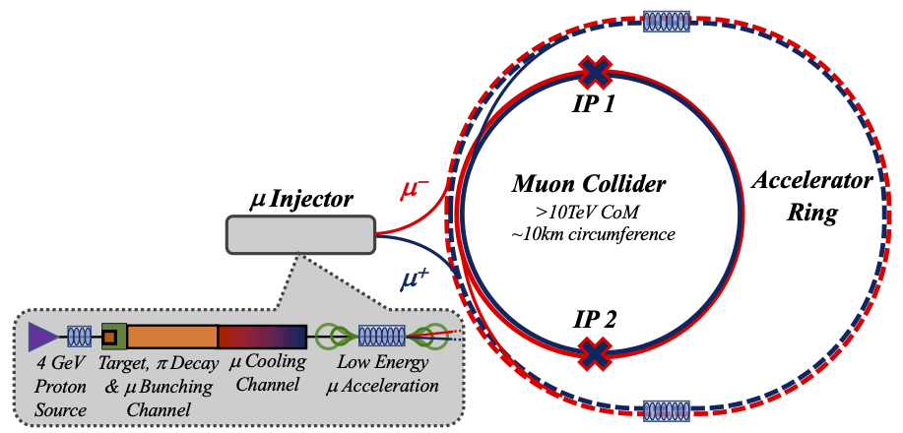
Key Challenges
0) Physics case
4) Drives the beam quality
MAP put much effort in design
optimise as much as possible
2) Beam-induced background
1) Dense neutrino flux
mitigated by mover system and site selection
3) Cost and power consumption limit energy reach
e.g. 35 km accelerator for 10 TeV, 10 km collider ring
Also impacts beam quality
13

Slide 14
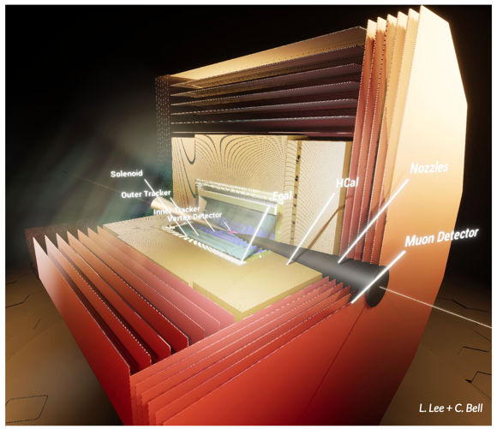
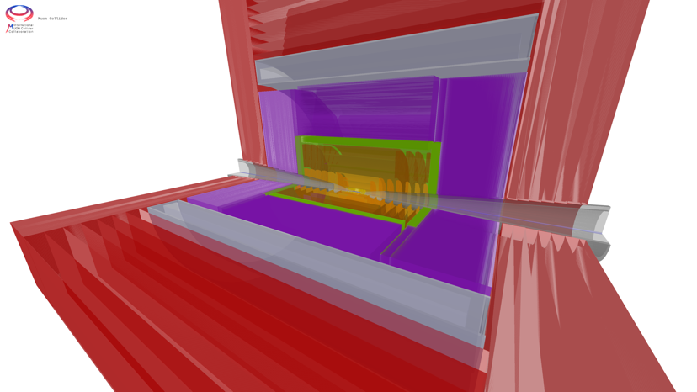
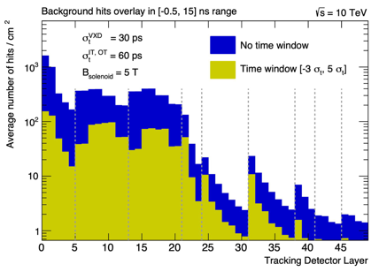
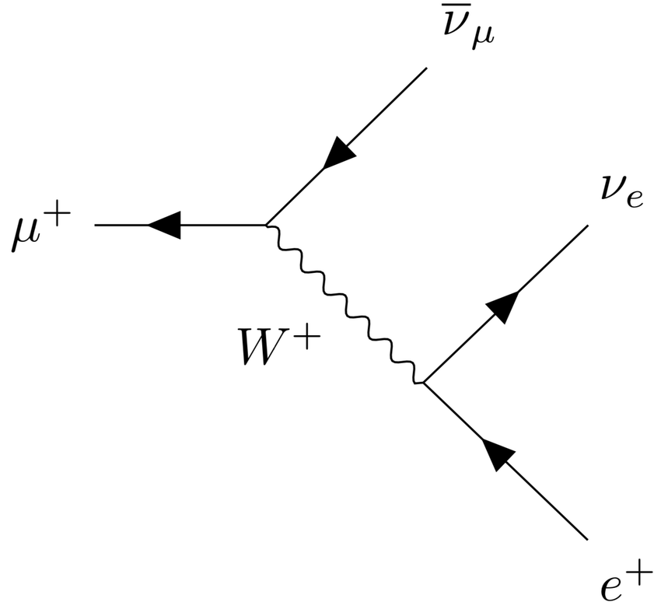
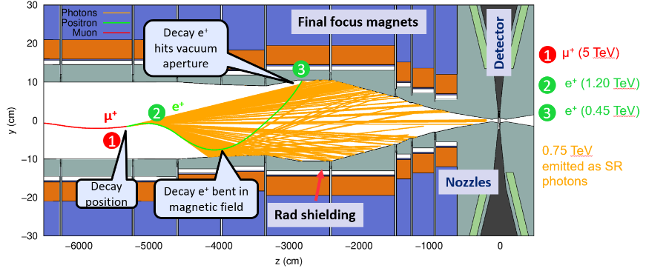
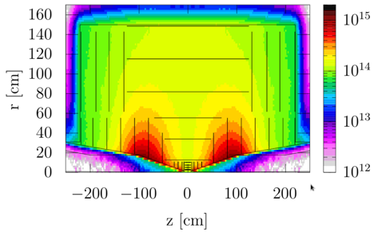
Physics and Detector Concepts
MUSIC
(MUon System for Interesting Collisions)
MAIA
(Muon Accelerator Instrumented Aperatus)
Challenges:
High-energy lepton detector requirements
Background from muon decay and beam-beam effects (BiB)
Achievements
Two detector concepts are being developed
Performance studies with GEANT
Detailed design and simulations of MDI and background suppression
Key conclusions:
Full simulations show good physics performance with near-term technology in spite of BiB
But important improvements are possible
Need strong R&D for optimization and integration
Proper investment crucial to enable exploitation of full muon collider potential in available time using new technologies, AI, and ML

Slide 15
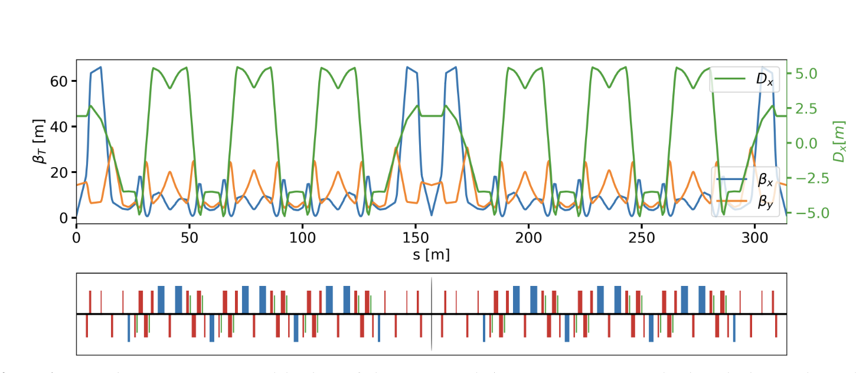
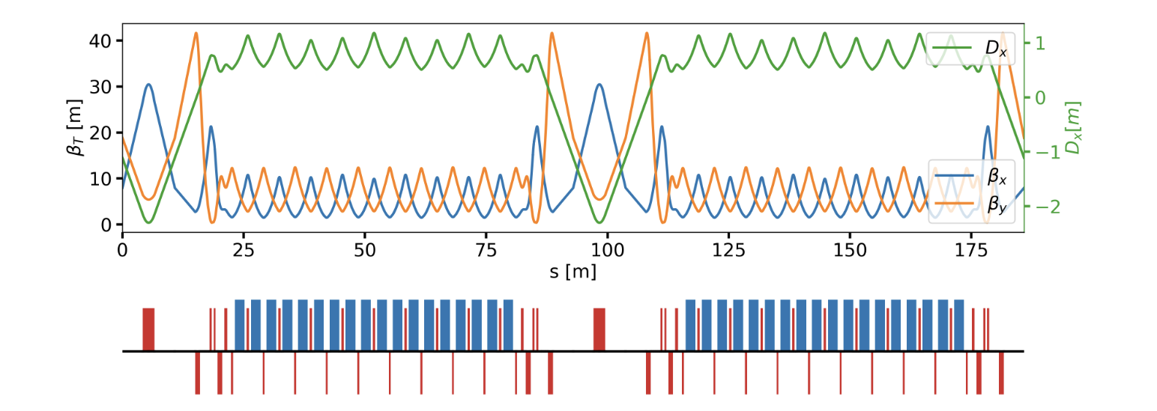
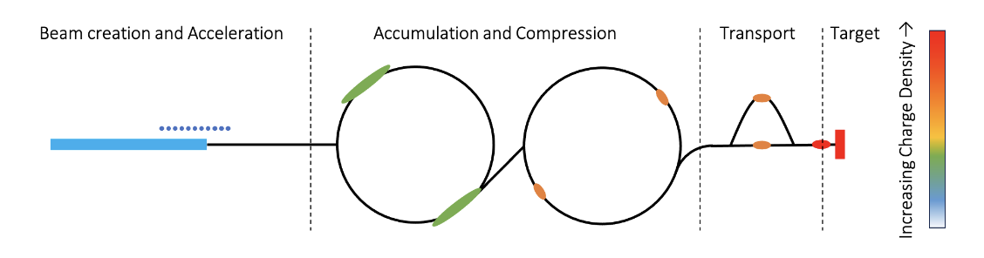
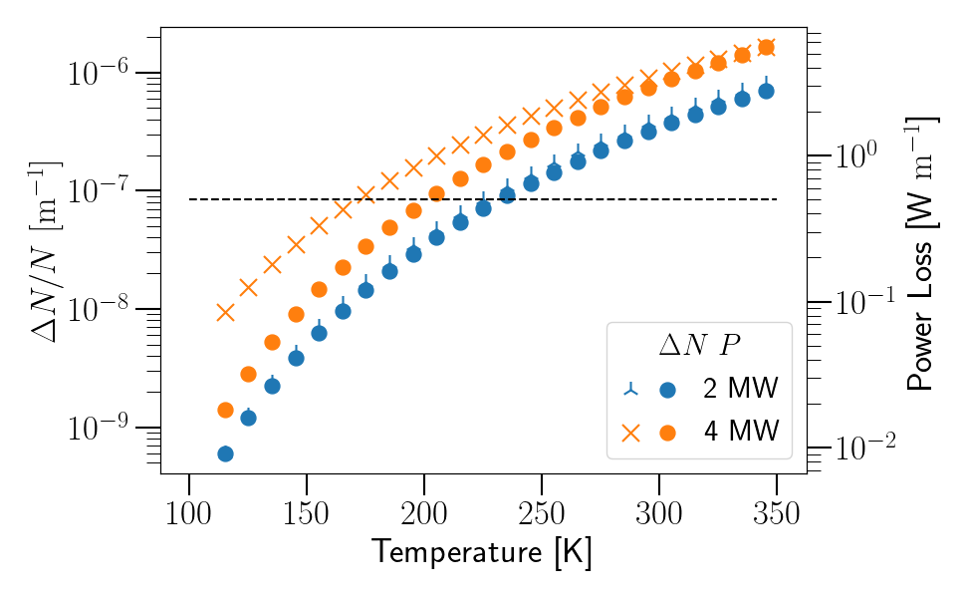
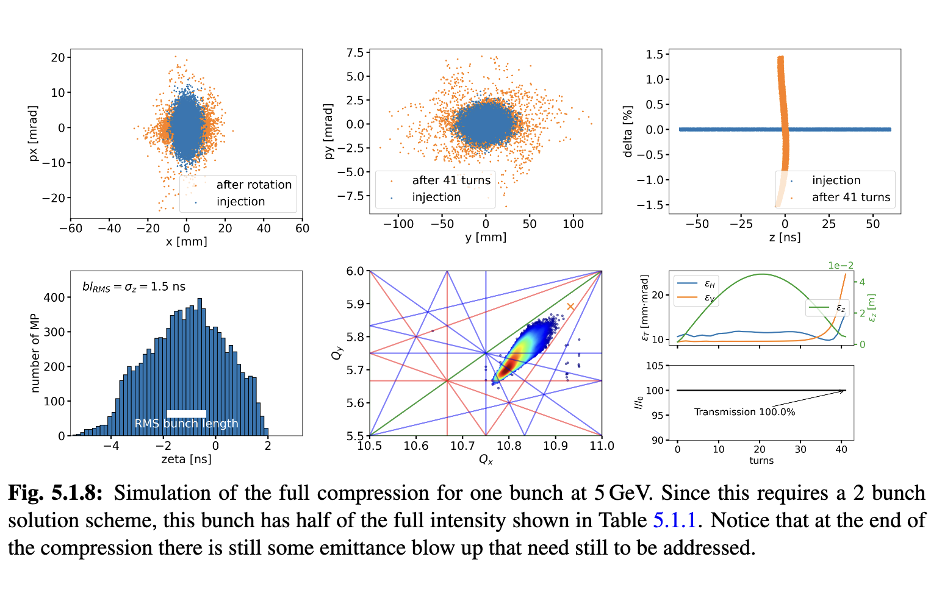
Proton Complex
Challenge:
2 MW, 5 GeV, 5 Hz,
5 x 10¹⁴ protons/pulse
Proton pulse accumulator and compressor rings
Achieved:
Accumulator and combiner ring lattices
First collective effects studies promising
One or two bunches in compressor, to be decided
H- beam
Key conclusions:
Can compress 2 MW, 5 GeV proton beam to two 2 ns bunches, then merge them
Optimisation in compressor ring for collective effects ongoing
For 4 MW need 10 GeV beam
Cool beamline to avoid ion loss from black body radiation

Slide 16
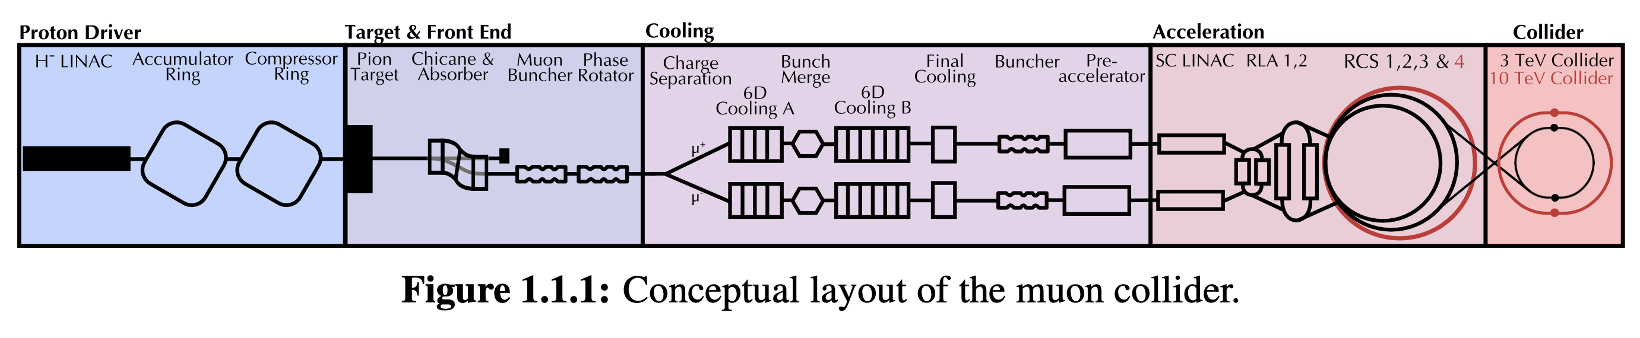
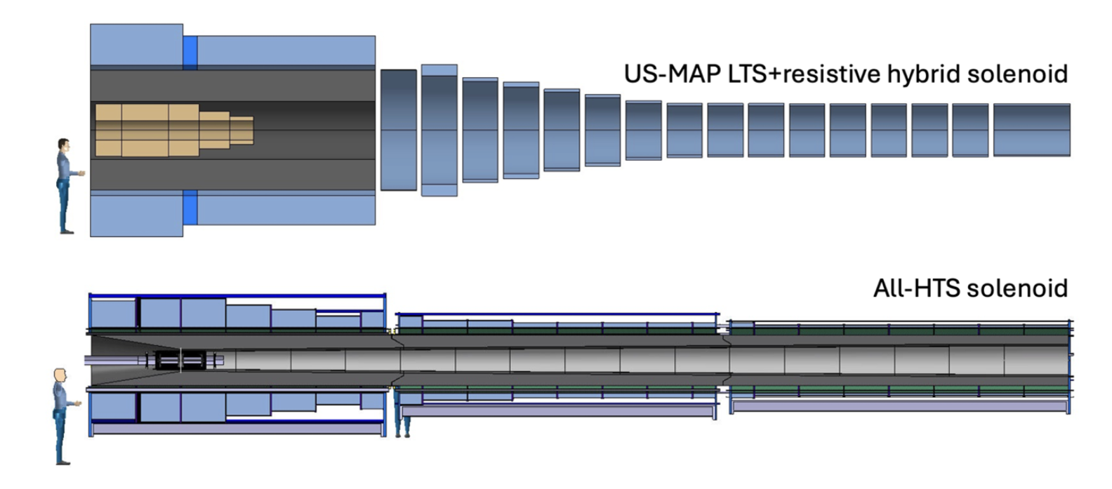
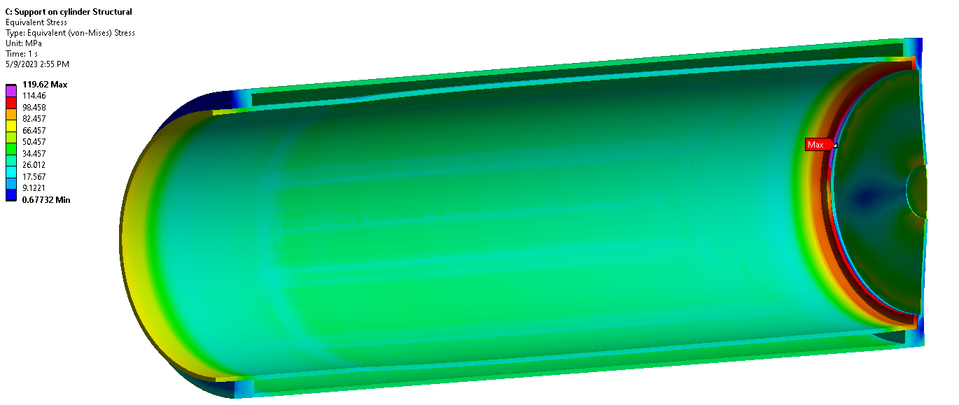
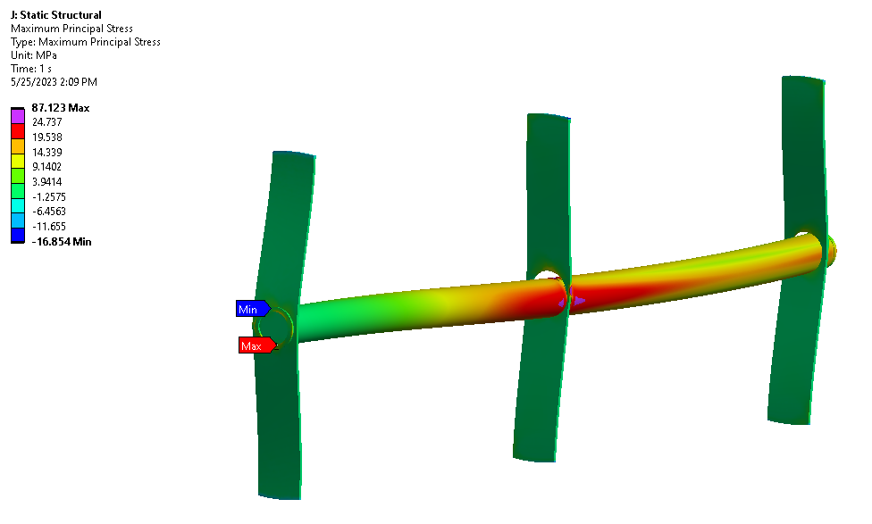
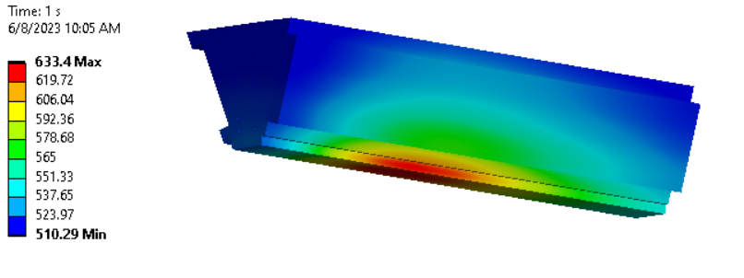
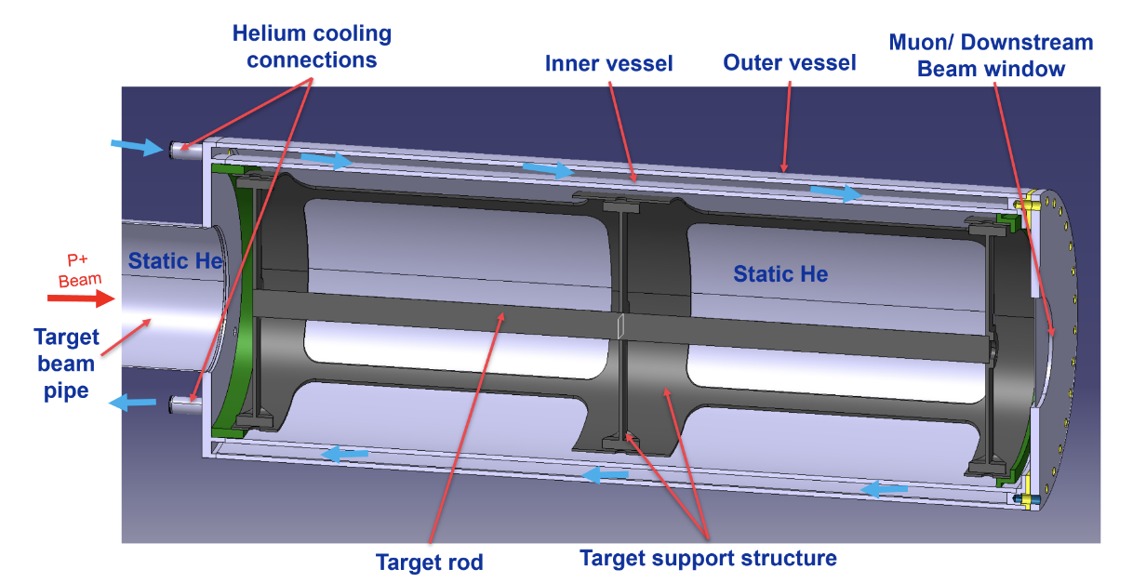
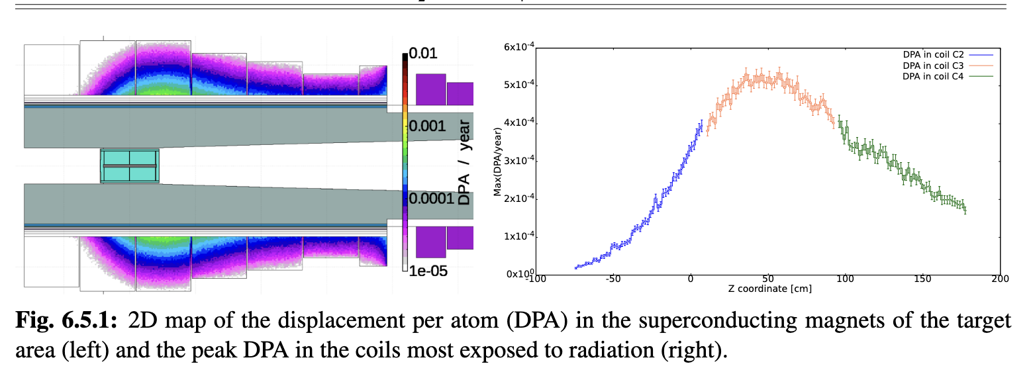
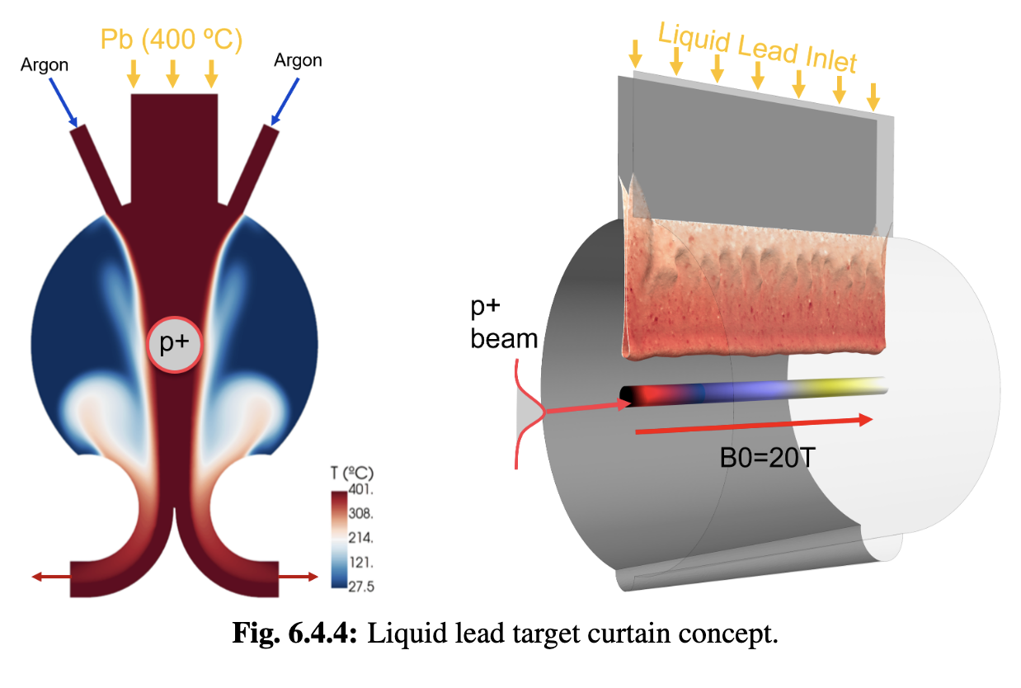
Target
Challenges:
2 MW, 5 Hz, 400 MJ/pulse target
Can we replace mercury with graphite?
protons
pions
muons
Achieved:
Initial 2 MW graphite target conceptual design, pion yield optimised
HTS solenoid and shielding concept developed
Study of proton removal ongoing
Key conclusions:
Yield, magnet shielding, target stress, cooling, radiation are OK
Components survive 2 MW beam
Higher power alternatives to study:
Graphite
Liquid metal

Slide 17

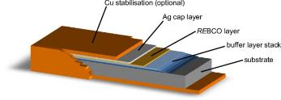
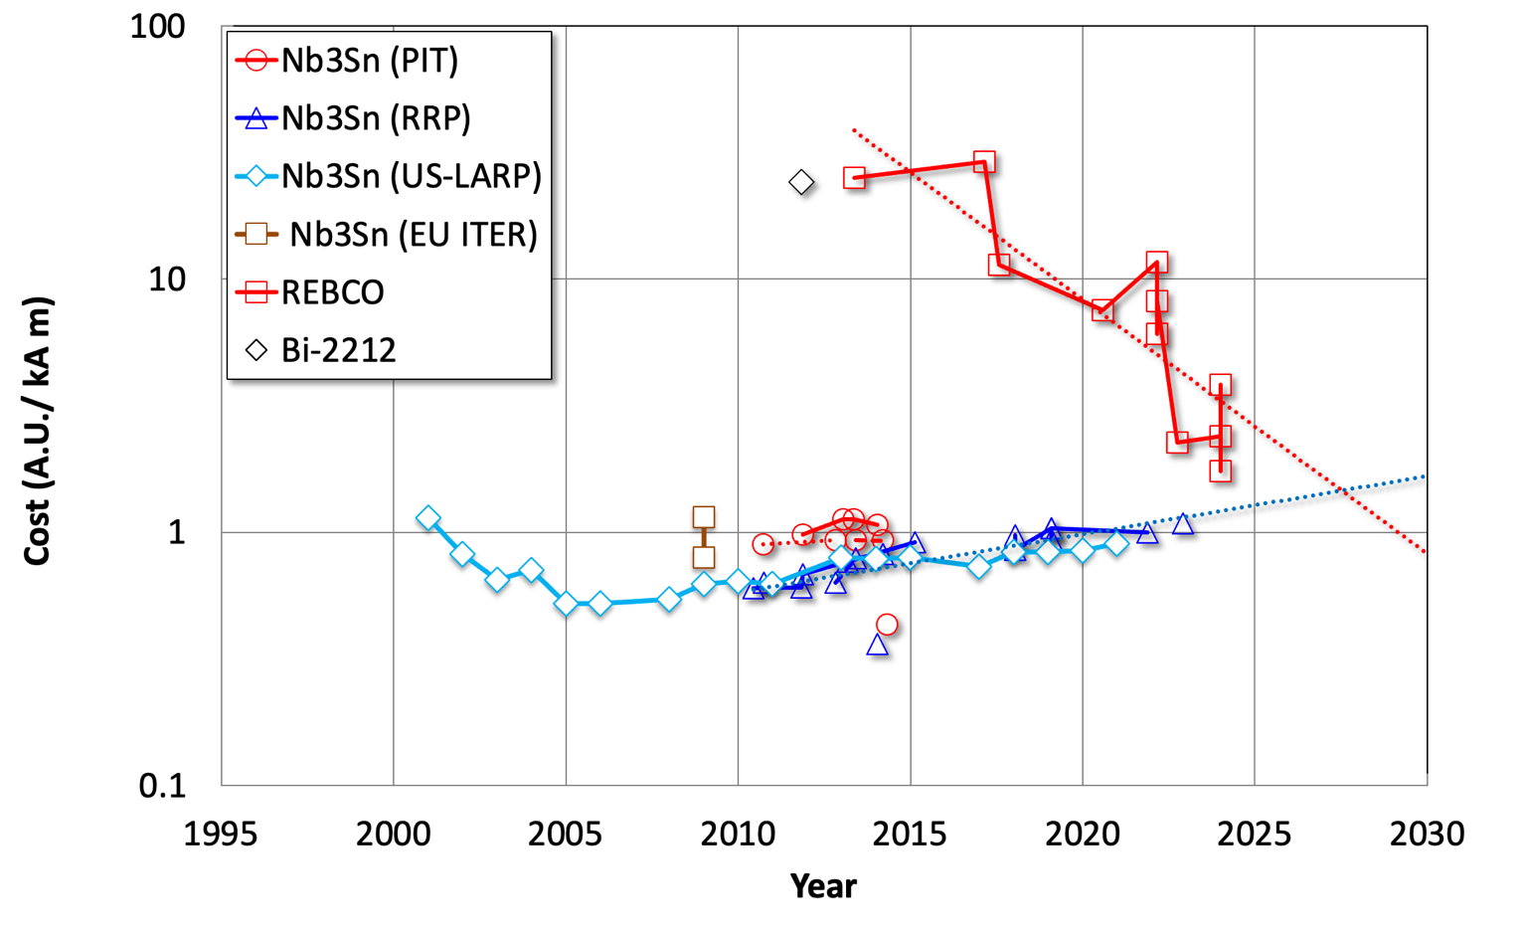
Note: High-field Magnet Technology
NbTi (niob-titanium, operating at 2-4 k)
is standard, used in LHC
Expect 5 T in MC
Nb₃Sn (niobium-tin, operating at 2-4 K)
Expect O(11 T) in MC
Stil not mature
Used in some points for HL-LHC
Foreseen for FCC-hh also in arcs
HTS (high-temperature superconductor, operating up to 20 K)
Different options exist, e.g. REBCO
In solenoids > 30 T demonstrated
Still expensive and technology challenges
Applications in other fields, e.g. medical, fusion reactors, power generators for wind energy, engines, …
REBCO Tape
HTS cost is coming down
How much depends on the overall use of HTS
Nb3Sn cost slowly increasing
We may be the only users
Industry would have to ramp up just for us

Slide 18
Muon Cooling Concept
High field solenoids minimise beta-function and impact of multiple scattering
Energy loss = cooling
Multiple scattering = heating
18

Slide 19
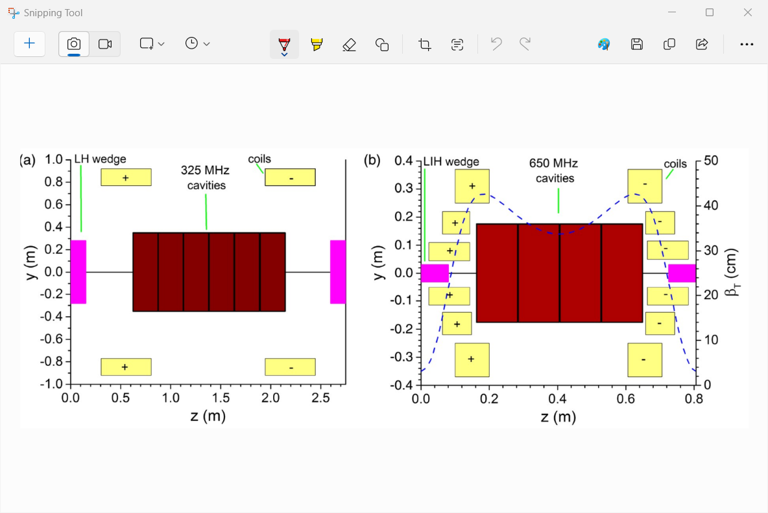
Layout
Total length O(1 km)
18 sequencies with one cell design each
Apertures decrease toward end
Beam emittance shrinks
Fields increase
To reduce equilibrium emittance
Here we pack the short train of bunches into one with large emittances
Final cooling has O(10) stages/cells
RF+low-field solenoids
Absorber in high-field solenoids
Solenoids act as focusing lenses
RF, absorbers and solenoids are highly integrated
Absorbers are in constant solenoid field
RF is more separated and has less focusing

Slide 20
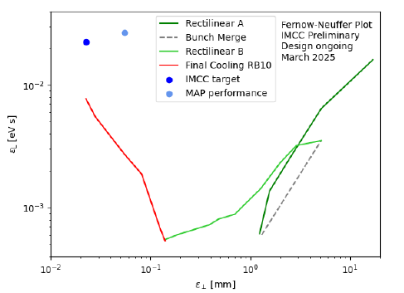
Muon Cooling Lattice Design
Challenge:
Novel, complex lattice with cavities and absorbers in solenoids
Previous design (MAP)
Goal
Achieved
better
Achieved:
Much improved lattice design
Improved simulation tools: BDSIM and RFtrack
Key conclusions:
Can in principle reach or exceed performance target
Much improved longitudinal, may be useful for collider ring
Study of collective effects important
better

Slide 21
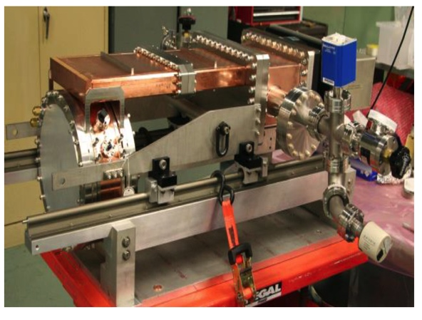
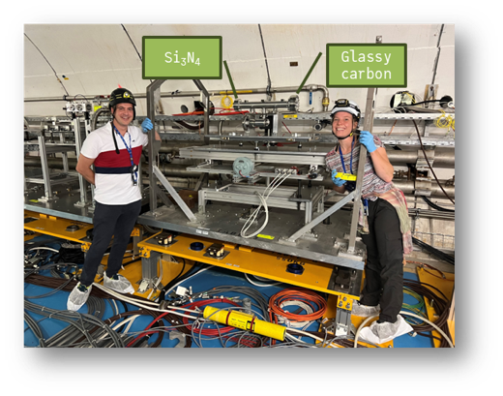
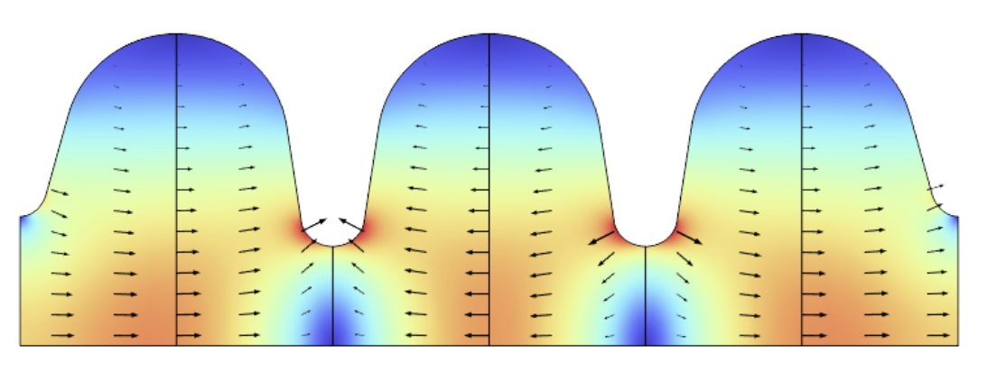
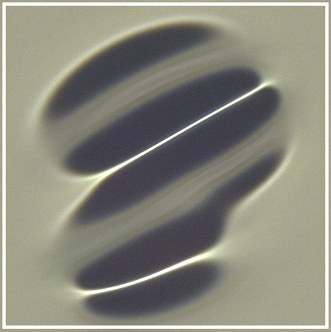
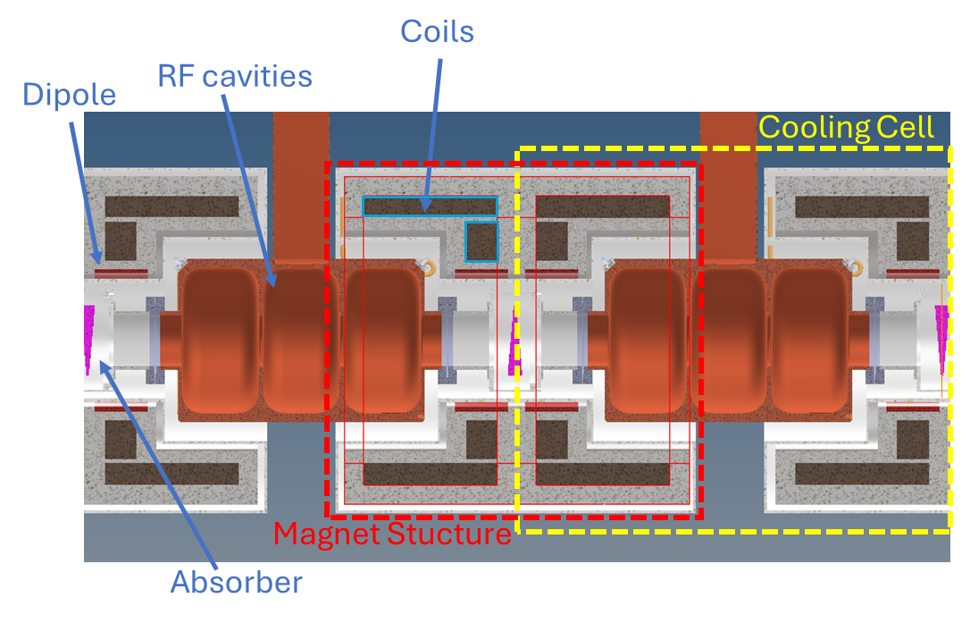
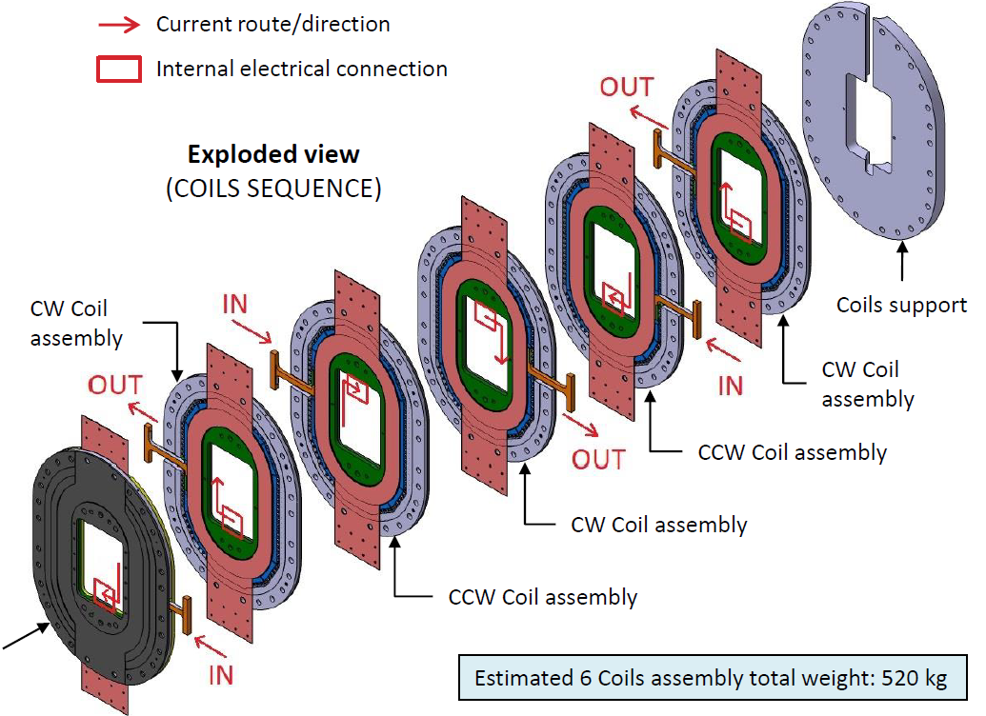
Muon Cooling Technology
Challenges:
NC RF cavities in magnetic field (30 MV/m)
HTS magnets (up to 40 T in final cooling)
Bright beam hard on absorbers and windows
Can evaporise liquid hydrogen
MuCool demonstrated >50 MV/m in 5 T
H2-filled copper
Be end caps
MAP proved gradient
Initial RF designs
More RF design ongoing to optimise beamloading
First window tests performed with protons
Use of H2 gas in final absorbers
Key conclusions:
Ready to ramp-up effort, in particular prototyping and experimental work, also beamdynamics
Need RF test stands for experimental optimization
6D cooling cell engineering design almost ready

Slide 22
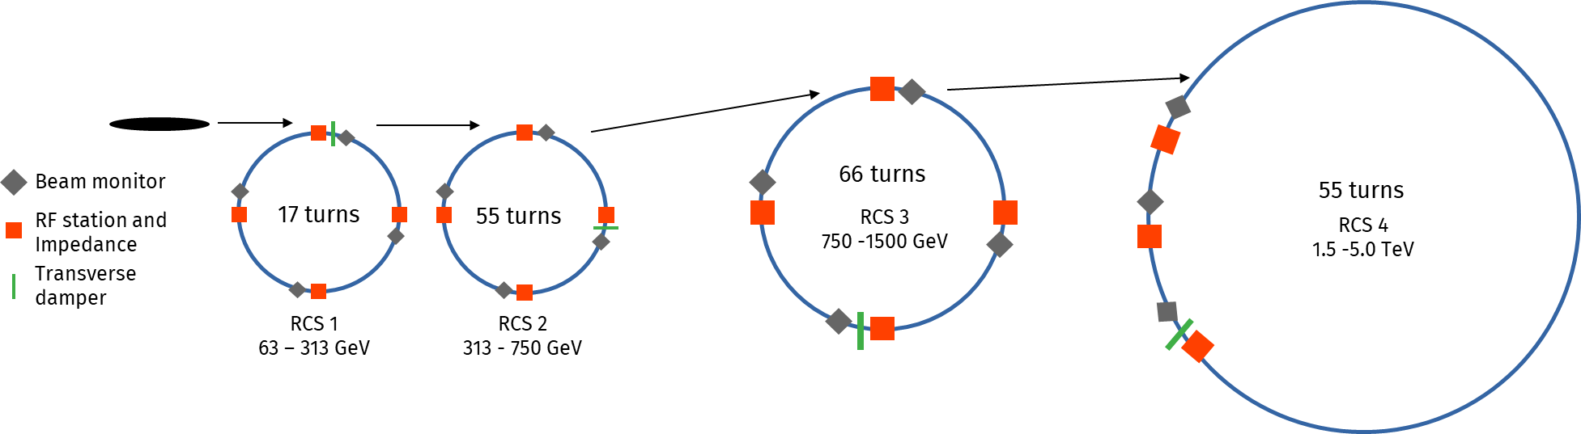
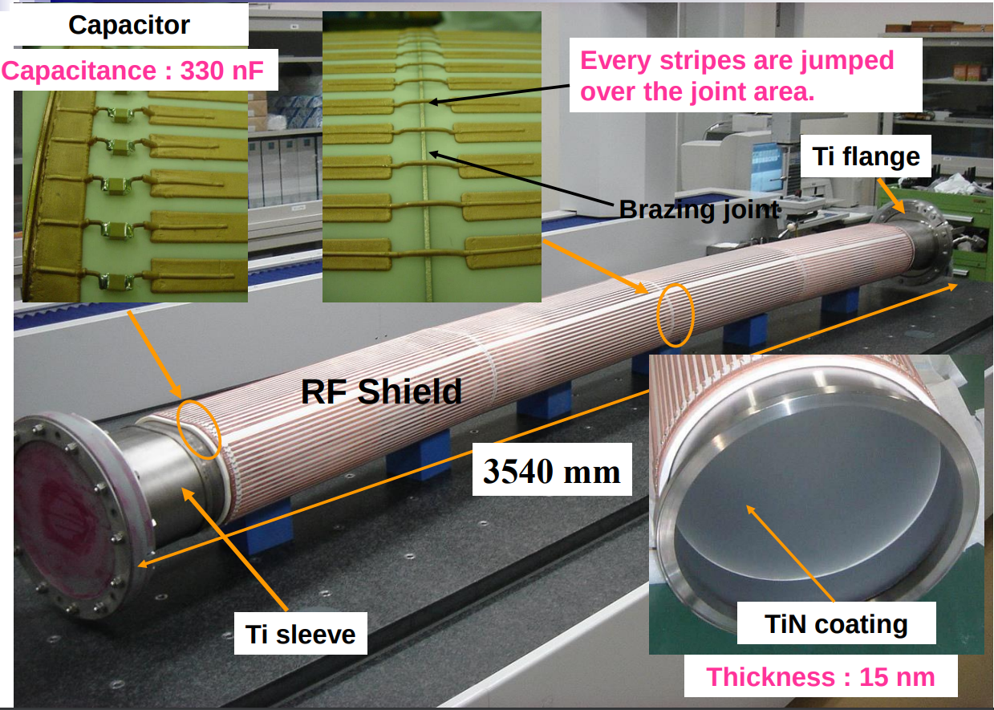
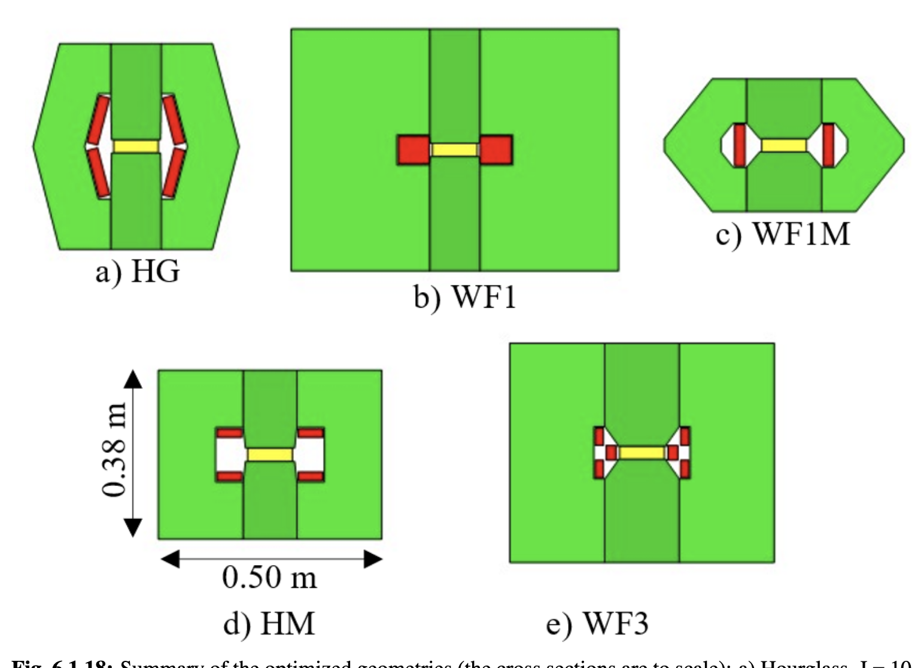
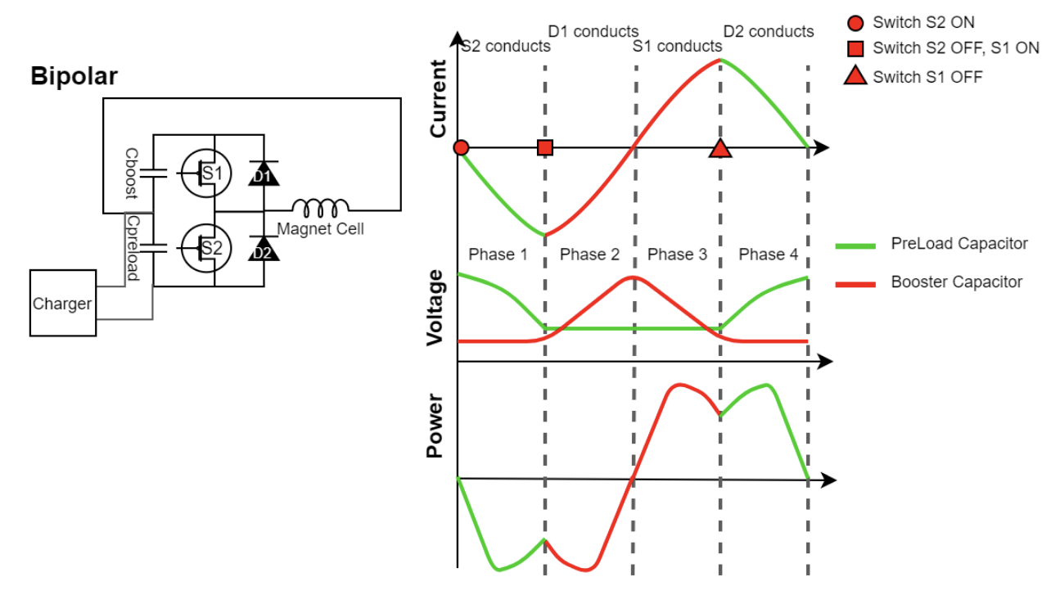
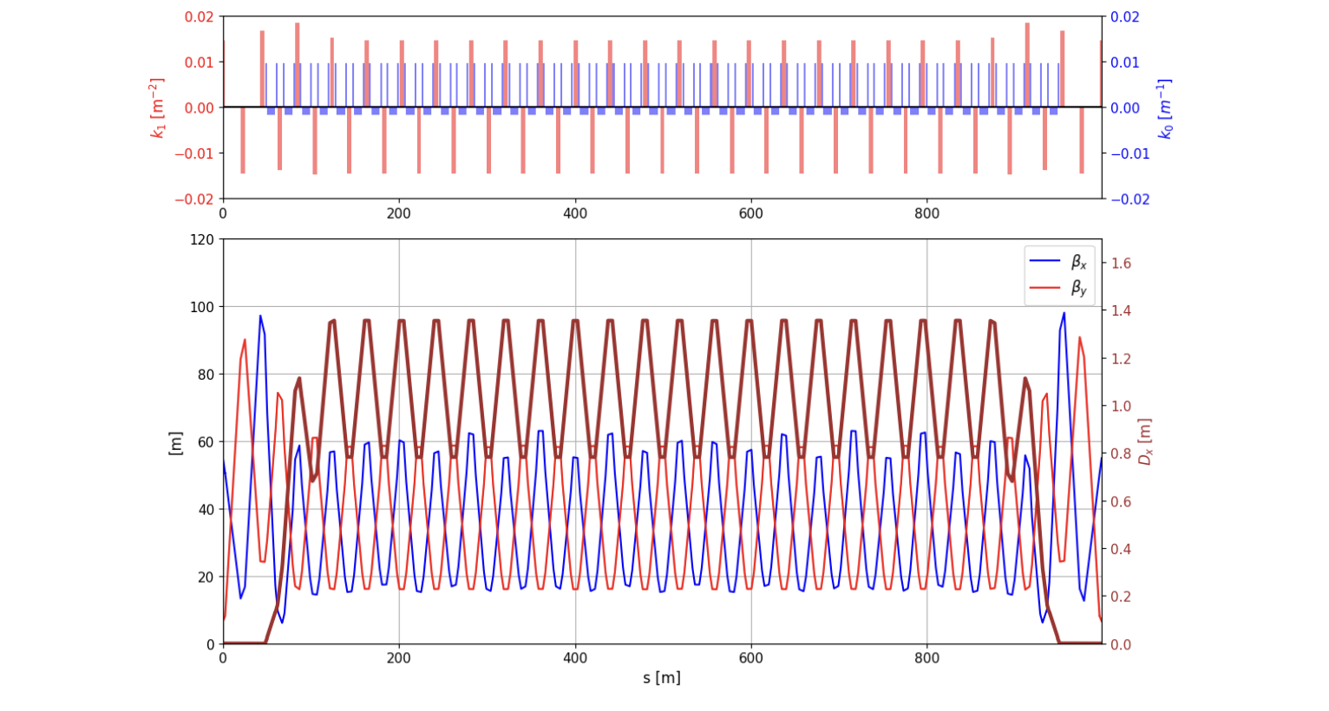
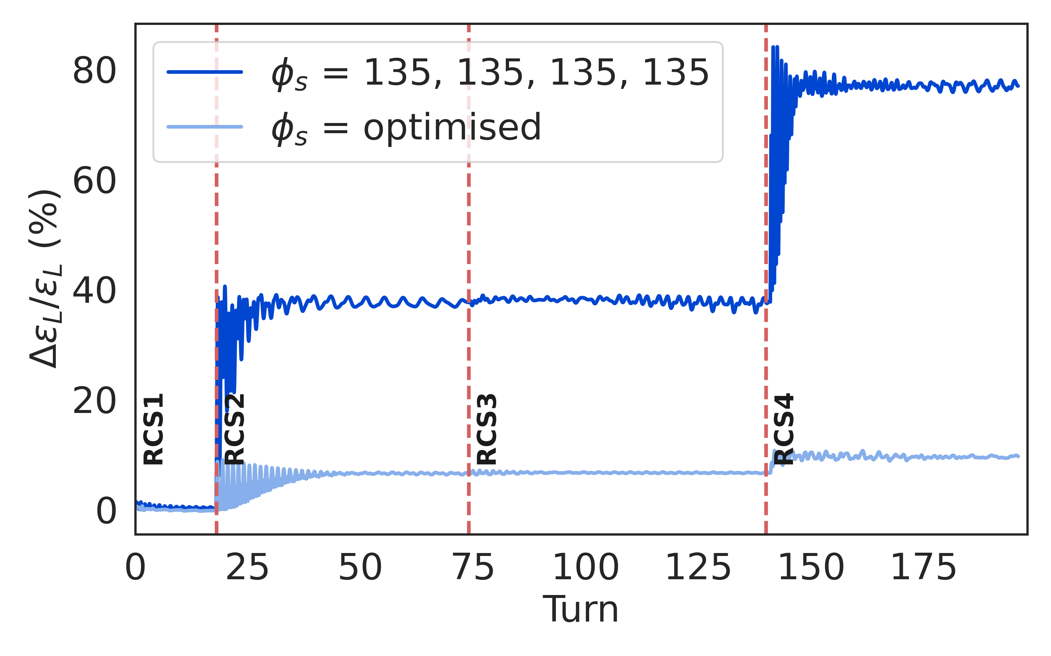
RCS Designs
Challenge:
Uses fast-pulsed normal magnets
5 Hz pulses of O(1-10ms)
6-35 km circumference
Cost
Recover energy from magnetic field
High bunch charge
Maintain beam quality
Achieved:
Lattices for all site independent RCSs
Beam propagation through complex
Conceptual design of magnets and power converters
Optimised design together with RF
RCS | E [J/m] | Loss [%] | P [MW]
SPS 1 | 5447 | 1.1 | 1.9
LHC 1 | 5678 | 1.6 | 12.8
LHC 2 | 5752 | 6.3/2 | 26.6
Key conclusions:
1.3 GHz TESLA-type cavities work
Emittance transport is OK
Cost and power is OK
Need to connect to initial linacs

Slide 23
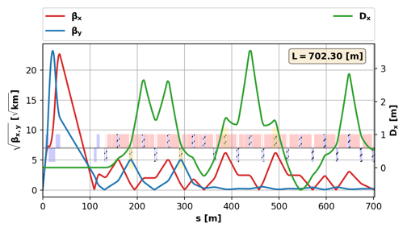
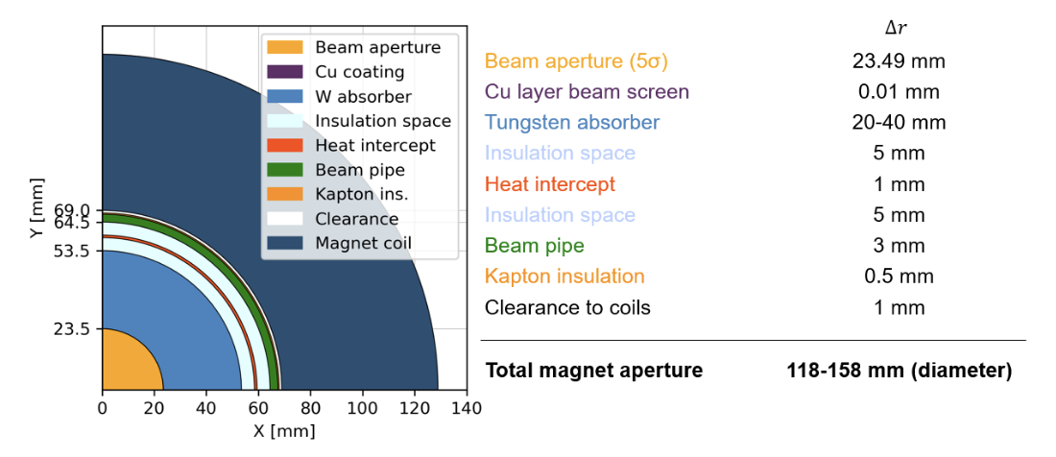
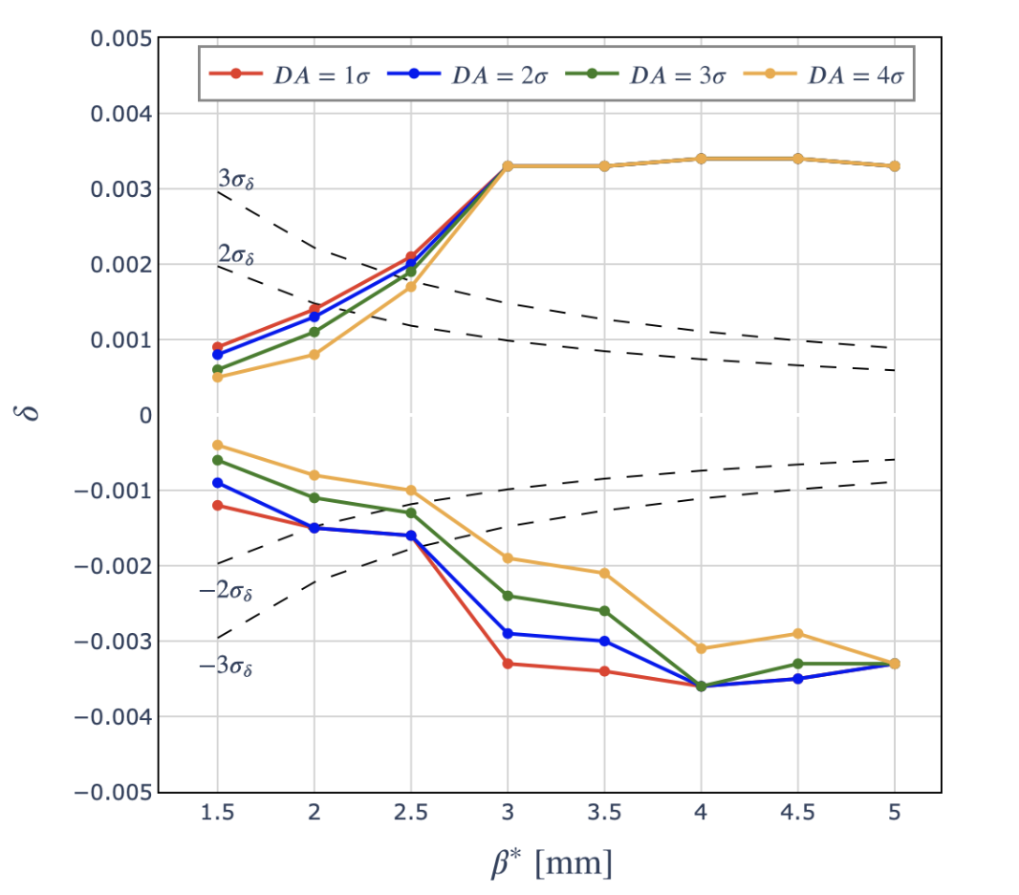
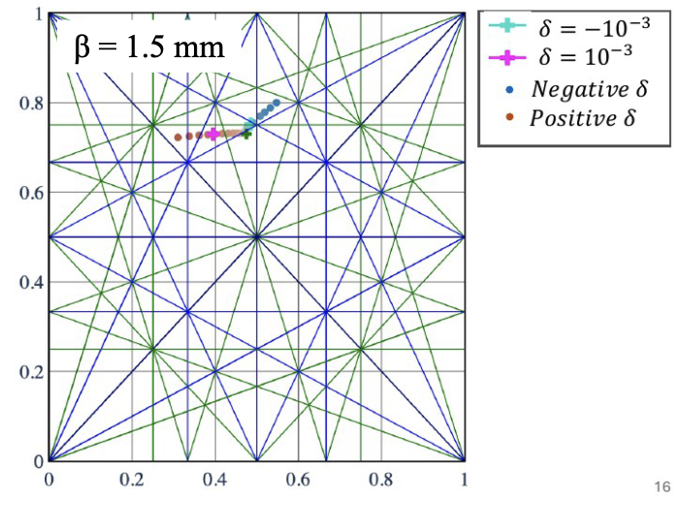





Collider Ring
Challenges:
500 W/m loss, magnet strength, lattice design with beta 1.5-5 mm, 0.1% beam energy spread
Shielding (30-40 mm)
Achieved:
Magnet shielding design
Magnet performance model and conceptual designs
Cryogenics conceptual design
Lattice reaches target beta-functions but not yet full target energy acceptance
First studies of mover system impact on beam
Impedance is OK
Cryogenic loads at different temperatures
Key conclusions:
Further improve energy acceptance, but OK with energy spread predicted in muon cooling
Mover system OK for beam in regular arcs
Address imperfections next
Magnet Designs

Slide 24






Placement
Challenge:
Obtain negligible neutrino flux
Similar impact as LHC
Fermilab site study
Achieved:
Detailed modelling
First good orientation found
Mover system concept
Arc mitigation concept
t₁
Experiment?
t₂
Mover system design
FLUKA and RP studies
Key conclusions:
Close to a solution
Arcs impact similar to current CERN impact
Hottest spot inside fence is like sitting in a plane
More work to be done
Site study at CERN for experimental insertion

Slide 25



Site Specific Designs
Started tentative studies for concrete site at CERN and Fermilab, looks very promising
CERN:
One RCS in SPS and two in LHC
Construct facility on CERN land
Adjusted parameters
(3.2 and 7.6 TeV, 10 TeV maybe possible)
Fermilab:
One RCS in Tevatron tunnel,
Three RCSs in one site-filler tunnel

Slide 26

Summary of cost
The cost range for the single tunnel CERN implementation was evaluated and compared to the Green Field scenario, where a cost for Civil Engineering of 50kCHF/m was assumed in the absence of a detailed study.
Cost is bottom up
Based on existing conceptual designs, e.g. fast-ramping magnets and power converter
Detailed scaling from known components, e.g. ILC main linac modules, FCC-ee, ..
Uncertainties
From components
No optimisation performed
Good agreement with ITF

Slide 27





Cost Drivers
Cost drivers:
RF systems
Superconducting solenoids
Other superconducting magnets
Fast-ramping magnet systems
MCHF
MCHF

Slide 28
Power Drivers
Key power drivers
RCSs
Infrastructure
Proton complex
6D Cooling
RLAs
Collider
Have to add cryogenics to remove beam loss power from RCS cavities
(Estimate included in the ESPPU submission)

Slide 29
R&D Programme
Accelerator design
Complete start-to-end design to validate and optimize performance, cost, power and risk
Muon cooling technology
Implementation in steps important for timeline
Need hardware, in particular RF test stands
New detector technologies useful for instrumentation
Cooling RF requires urgent test infrastructure
Detector
Strong potential for further improve physics potential with technologies, AI and ML
Magnet programme
Have conceptual designs, need hardware
HTS solenoids have important synergy with society (also power converter)
Industry is ready to invest
Must not miss the opportunity
IAC review:
“The committee would like first to congratulate the International Muon Collider Collaboration for the tremendous progress made over the last year on the technical studies, the overall project planning and the organization of the collaboration. The committee welcomes the idea to evaluate the priority setting of these R&D activities, in view of the IMCC activities beyond the European Strategy Process.
In general, all the R&D proposals presented are impressive and complete, and the committee expressed support of this R&D program in the long term. The R&D plan is quite thorough and will provide a valuable foundation for prioritizing R&D plans as the programme matures.
IAC composition:
Permanent members: Ursula Bassler (chair), Mauro Mezetto, Hongwei Zhao, Akira Yamamoto, Maurizio Vretenar, Stewart Boogert, Sarah, Demers, Giorgio Apollinari
Additional experts: Pierre Vedrine, Stephen Gourlay, Lyn Evans, Alessandro Gallo, Barbara Dalena, Pantaleo Raimondi

Slide 30


R&D Plan Deliverables and Resources

Slide 31



Muon Cooling Demonstrator
Launch RF test stands and first module (700 MHz test stand) right away
Important decision in 2028 on sharing of effort and demonstrator location
Two promising demonstrator site studies at CERN
Budget for site Fermilab study approved

Slide 32








Way Forward
Implement the proposed R&D plan, with deliverables and resources estimates for the next 10 years
Prepare sharing of work between partners
Central funding through CERN and other partners is instrumental
Identify additional funding sources
Need strong support of ESPPU
Started a task force to prepare the implementation
Exploit synergy with other particle physics and accelerators
Muons, neutrinos, …
Strong synergy with societal applications exist
HTS magnets for fusion reactors, wind power generators, motors, material science, health applications
Power converter
…
Design of 10 MW HTS wind generator
Collaboration on target solenoid/fusion with F4P, ERUOFusion, GaussFusion, ENI is key example
Have agreements that will lead to resources
An opportunity for particle physics to make an important impact on society
https://indico.cern.ch/event/1439855/contributions/6461515/
Early career experts are very motivated by the required and possible innovations

Slide 33
Global Engagement
National Academy of Science:
Recommendation 1: The United States should host the world’s highest-energy elementary particle collider around the middle of the century. This requires the immediate creation of a national muon collider research and development program to enable the construction of a demonstrator of the key new technologies and their integration.
US ESPPU submission:
Realisation of the plan above relies on sustained and adequate funding in both the US and Europe, and a close collaboration between the two regions, as outlined in the next section . Potential contributions from other regions of the world would further strengthen the program.
[https://arxiv.org/pdf/2503.23695]
IMCC will carry out the R&D together and develop options to host the collider at CERN or at Fermilab and potentially also other sites
Envisage to share leadership between CERN and Fermilab
33

Slide 34
Conclusion
Excellent technical progress has been made, in spite of resource limitations
Supported by review committees from LDG, MuCol, and IAC reviews
Have global R&D programme proposal that needs to be funded
Strong interest in different regions hopefully translates into resources
https://www.facebook.com/cern/videos/the-future-of-particle-physics-david-gross-cern70/509915295164473/
A muon collider is disruptive
It will push beyond the current boundaries
It will be the first of its kind
High-risk, high-benefit
Important innovation is required
Not all issues have been solved
This means uncertainty and risk
But also the potential to be creative and invent
Strong synergy with societal applications
Many thanks to the collaborators for all the work
Our web page: http://muoncollider.web.cern.ch
If you want to join: muon.collider.secretariat@cern.ch

Slide 35
Reserve

Slide 36

Timeline and R&D Programme Proposal
Decision on demonstrator T₀
Initial final demonstrator
Timeline is driven by R&D
Most ambitious example to define R&D programme priorities
Assumes firm commitment to enable the muon collider as next flagship after HL-LHC
R&D is fully successful
No delays due to decision making
Other options
In Europe after a higgs factory
In the US to become leader at the energy frontier
Demonstration Phase 7 years
Project Preparation Phase 5 years
Construction Phase 9 years

