Slide 1

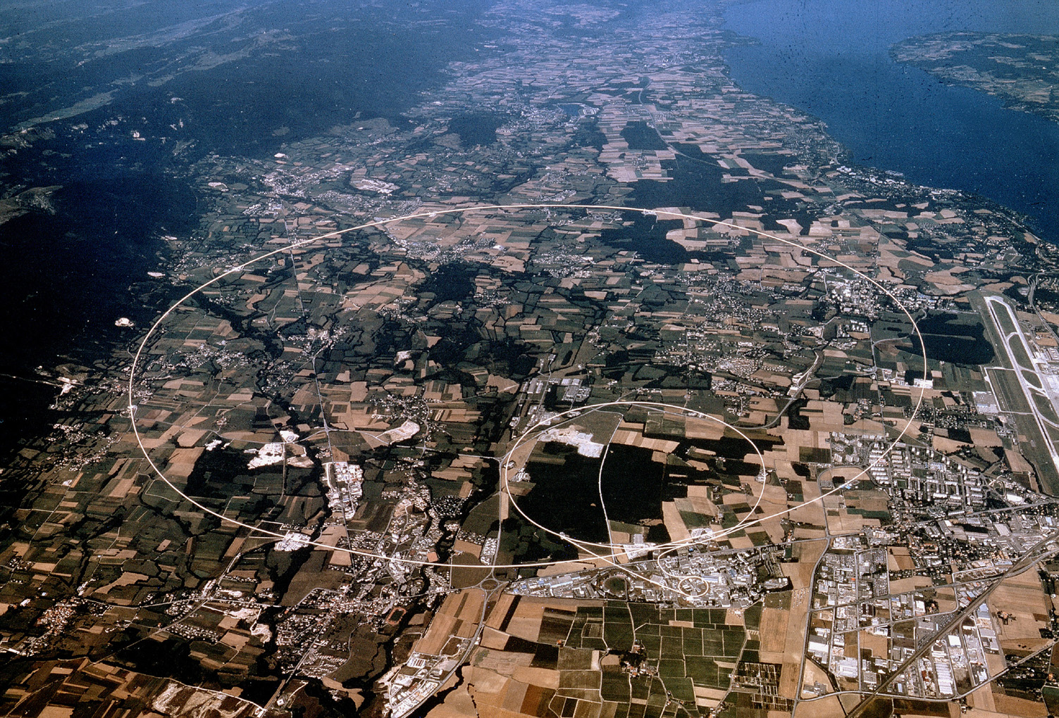
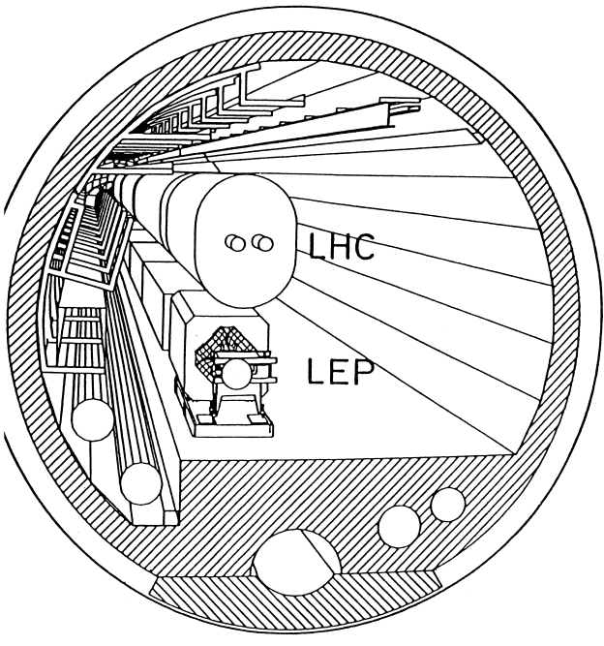

LEP3: Reusing the LEP/LHC Tunnel
T. Camporesi, January 14,
IAS Fundamental Physics
https://arxiv.org/abs/2504.00541

Slide 2
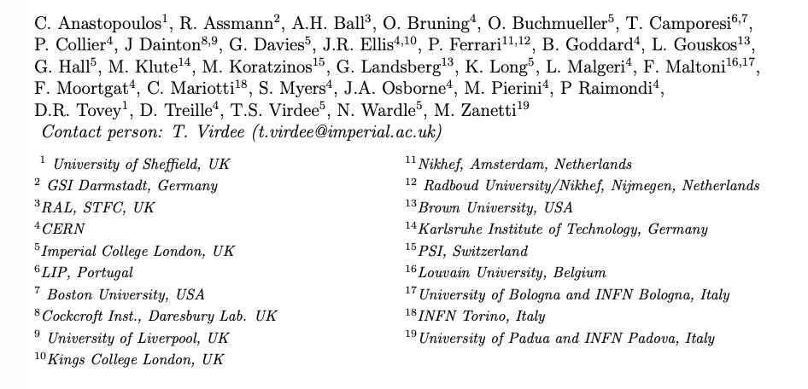
A group of concerned people
We think that a PLAN b (wrt to FCC ee) would need to be a project which can be built within acceptable financial constraints and still address the fundamental questions which had led to recommend a Higgs Factory as the ‘necessary ‘ next step…and a linear collider does not fit this definition ( it is an alternative plan A)

Slide 3
Setting the Scene 1: 2019 ESPP
Recall Recommendations 2019 ESPP
The successful completion of the HL-LHC
Neutrino Platform
An electron-positron Higgs factory is the highest-priority next collider.
R&D effort focused on advanced accelerator technologies, in particular that for high-field superconducting magnets, including high-temperature superconductors
investigate the technical and financial feasibility of a future hadron collider at CERN with √s ~ 100 TeV and with an e⁺e⁻ Higgs and electroweak factory as a possible first stage.
Point e. clearly points to the FCC project, which has been extensively pursued.
Notes:
At the Large Hadron Collider (LHC) at CERN, Geneva we can probe Nature moments after the Big Bang to tackle the questions about the origin, evolution and composition of our universe. These include: What is the origin of mass? What constitutes dark matter? How many dimensions of space and time do we live in? Why is the universe composed of matter and not antimatter? The answers have the potential of altering our perception of how Nature operates at the fundamental level.
The discovery in July 2012 of the Higgs boson at the Large Hadron Collider (LHC), one of the most important of this new century, completes the particle content of the standard model (SM) of particle physics, a theory that describes our visible universe in exquisite detail.
This talk will briefly look into the evolution of our universe from the Big Bang, the fundamental particles and their interactions, the journey to the discovery of the Higgs boson, and look ahead. The CMS experiment is used as an example to briefly recall the physics of the LHC, outline some of the challenges faced during its construction, and major physics results produced so far, including the searches for widely anticipated new physics beyond the SM.

Slide 4
Setting the Scene 2: Request for Alternatives
We support FCC-ee and FCC-hh as the preferred option for CERN’s future
LEP3 is not competitive with FCC-ee.
ESG Guidance
ESG's remit explicitly states that “The Strategy update should include the preferred option for the next collider at CERN and prioritised alternative options to be pursued if the chosen preferred plan turns out not to be feasible or competitive”.
A major objective in Particle Physcs : always to operate an accelerator that allows a leap of a factor of 10 in the constituent centre-of-mass energy with respect to the previous one.
- Today the two possibilities being explored are the FCC-hh operating at √s~100 TeV or a muon collider operating at √s > 10 TeV.

Slide 5
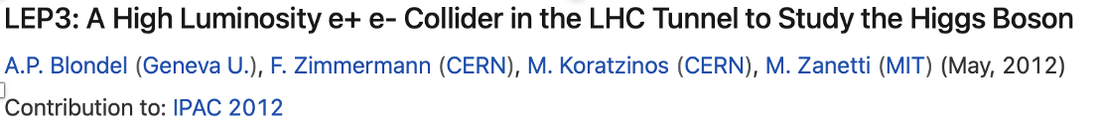
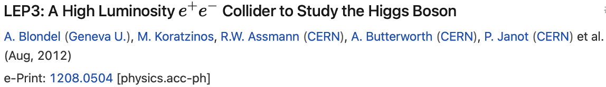
LEP3: why
It is desirable that any back-up to FCC should present fewer technical and/or financial difficulties than those associated with the preferred option, as well as have good physics potential.
To minimise the possibility of such difficulties, the LEP3 strategy is to re-use, as much as possible, the existing infrastructure of CERN, utilise maximally the R&D already carried out for FCCee (needing the same R&D and hardware choices), and keep the required financing within the envelope of the current budget of CERN.
Several others have also discussed such a possibility in the past.
e.g. 2013 ESPP, a Higgs factory (LEP3) was proposed but not pursued any further. [https://cds.cern.ch/record/1471486].

Slide 6
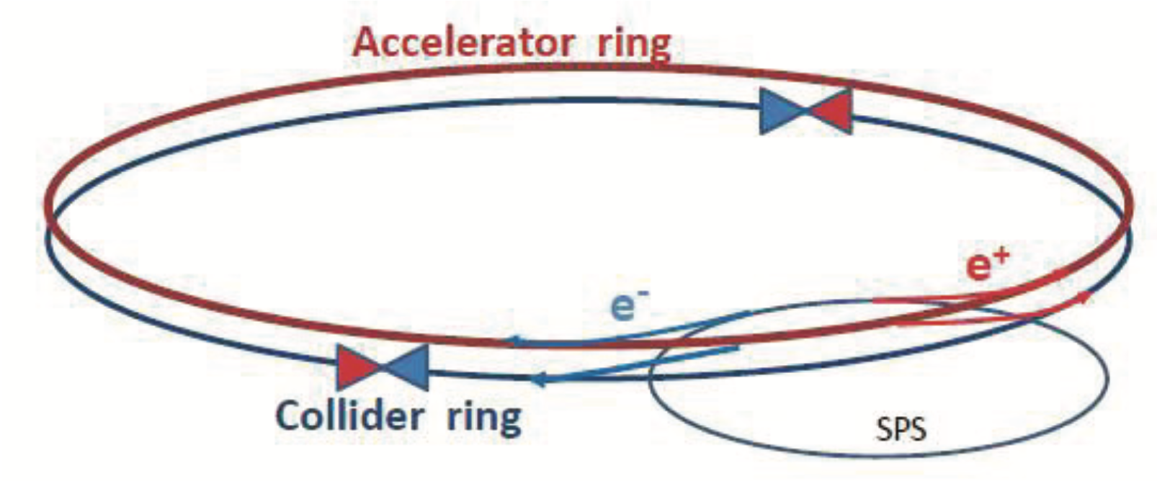
Follow ESPP2013 proposal & FCC(ee) Design
It is not the first time that re-use of the LHC tunnel is proposed
LEP3 installed in the existing LHC/LEP tunnel
Design of LEP3 could follow closely that outlined in FCC Medium Term Report (MTR) and [ESPP 2013: Zimmerman and Blondel (https://cds.cern.ch/record/1471486)].
Separate full energy collider and accelerator (booster) rings, the latter for top-up injection. Electrons and positrons in the collider ring travel in separate beam pipes.
With top-up - beam lifetime ~ 15 minutes (expected to be dominated by loss due radiative Bhabhas) top up ~ few 10¹⁰ electron/s
Earlier work (2013)
Reuse substantial parts of ATLAS and CMS experiments
TLEP(which became FCC later) /LEP3 luminosity ratio of ~5
In our proposal

Slide 7
Note
In this presentation, I will use the configuration presented in the note contributed to the ESPP meeting in Venice, in order to ensure coherence with the physics performance assessments discussed there.
As shown yesterday by Mike Koratzinos, recent work indicates substantial improvements in performance. This suggests that, should we wish to further pursue the exploration of reusing the LHC tunnel, additional effort will be required to fully exploit its potential. ..and we all know how to scale the statistical uncertainties accordingly.
Where technically relevant, I will highlight the impact of these recent developments.

Slide 8
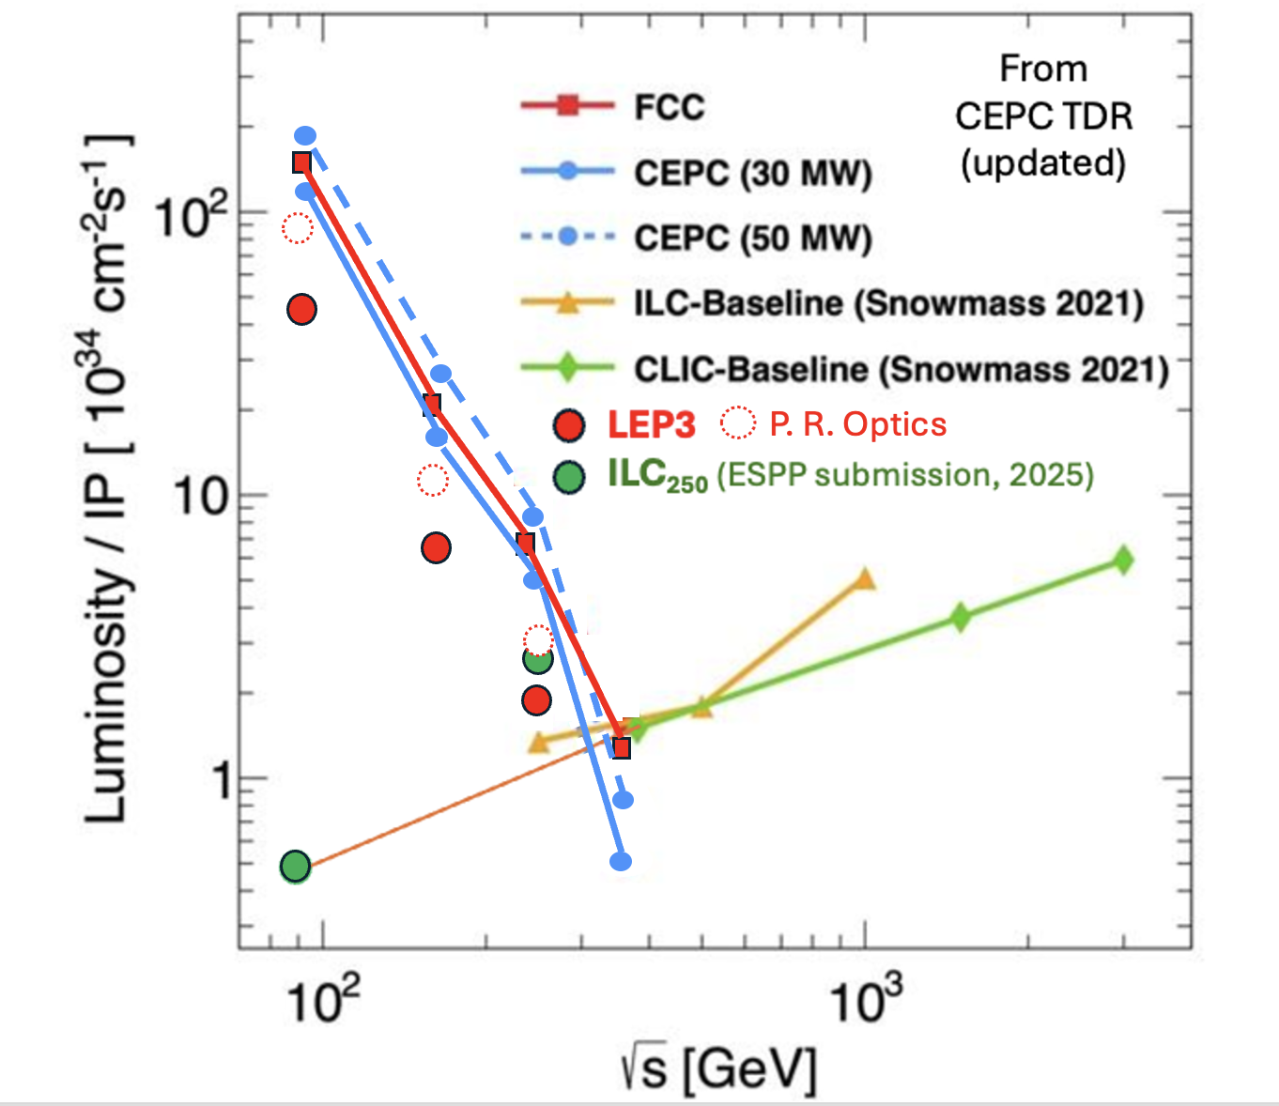
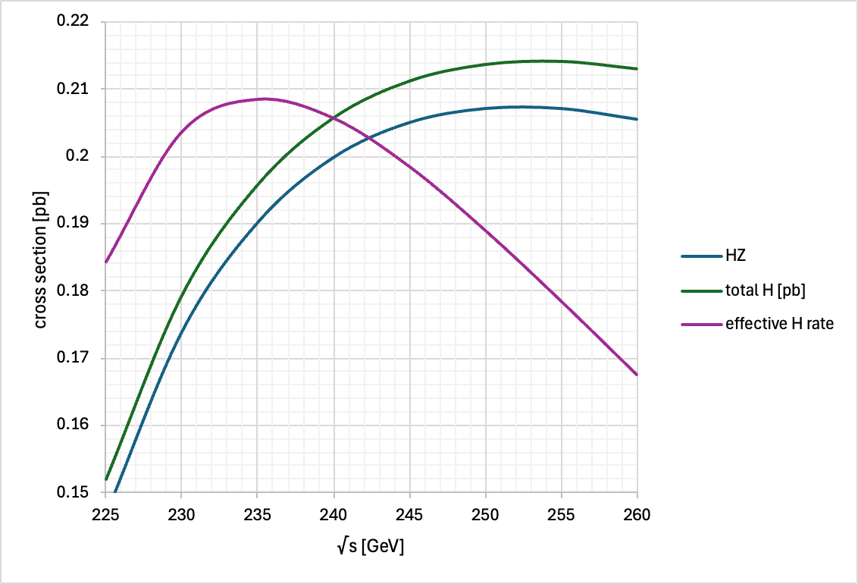
e⁺e⁻ Colliders: Instantaneous Luminosity
In circular e+e- colliders, for the same synchrotron power loss, at a lower energy, more current can be put to increase luminosity.
LEP3
FCC ee
Htot
HZ
Z
WW
effective H rate
HZ
LEP3: Run at √s =230 GeV
Only 10% higher energy than LEP.
18% lower synchrotron power loss at √s=230 GeV compared with 240 GeV.

Slide 9
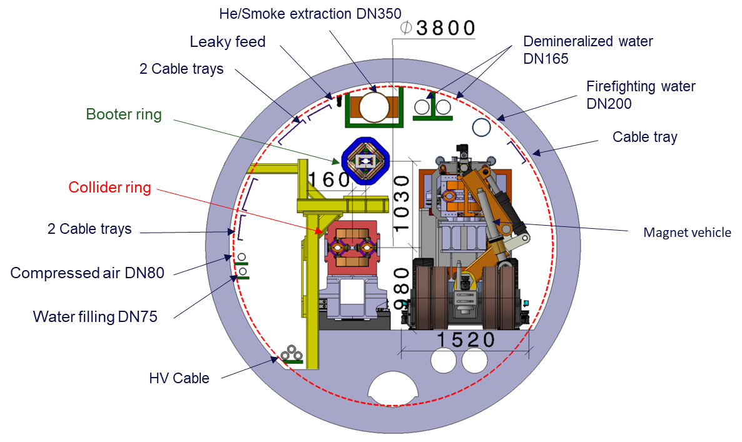
Integration in the tunnel
The LHC has eight arcs and eight long straight sections (LSS). The length of the arcs is ~ 2.45km, and the eight LSS are each~560m long. The inner diameter of the tunnel varies between 3.8m in the arcs and 4.4m in the straight sections (RF would have to be installed in straight sections) .
BOOSTER ring
COLLIDER ring
Integration of the accelerator/booster
and the collider in the arcs.
Note that the booster/accelerator ring
is situated some 1 m above the collider ring.
(courtesy F. Valchkova).

Slide 10
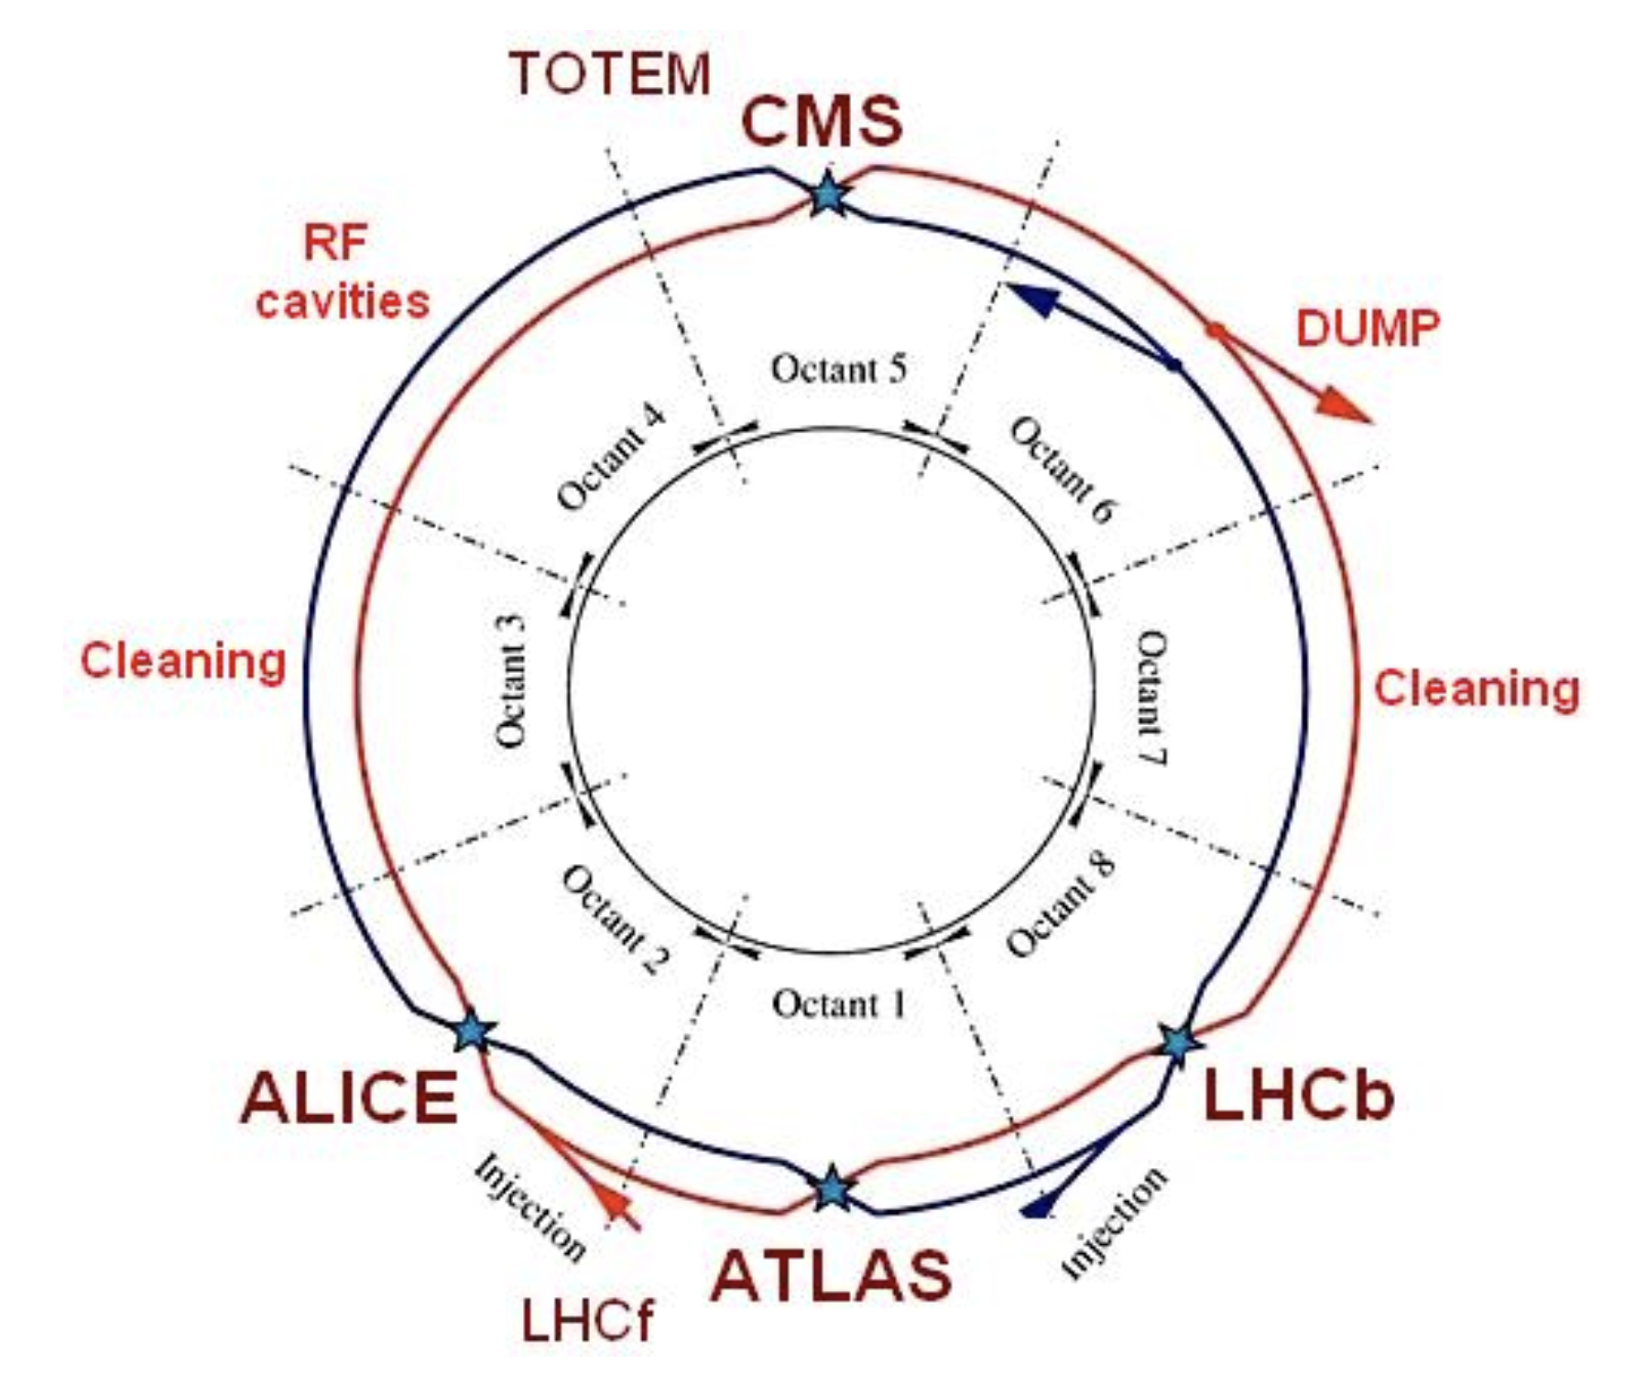
LEP3
The arcs are 2.45-km long, and the straight sections are 545-m long. The inner diameter of the tunnel varies between 3.8m in the arcs and ~ 4.4 m in the straight sections.
Either deploy two new experiment or use re-purposed ATLAS and CMS experiments

Slide 11
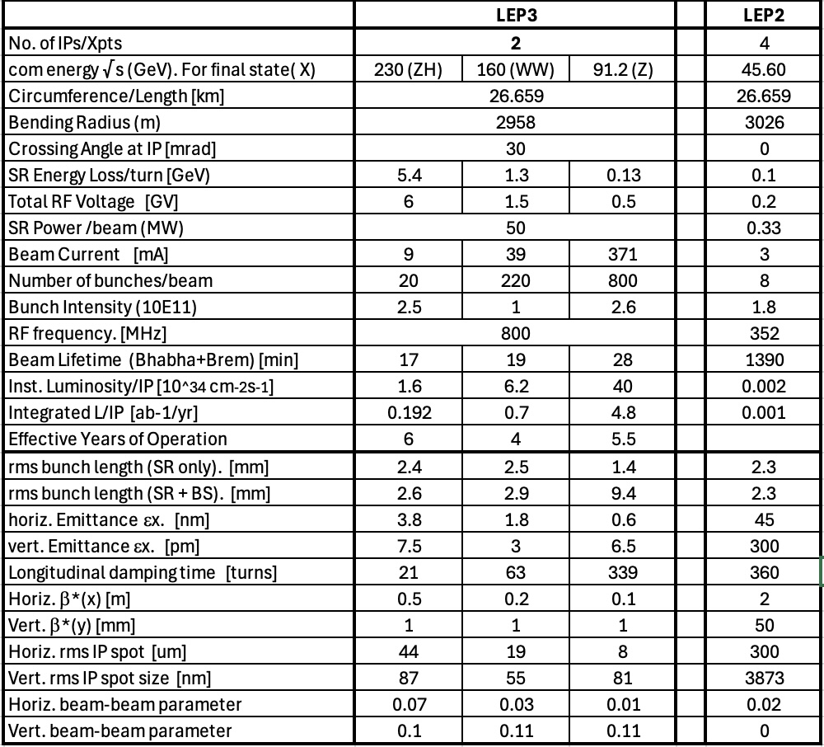
LEP3 Parameters
The predicted lumi is scaled from the FCC present FODO optics
But optimized optics ( see work by P. Raimondi presented in M. Koratzinos talk ) indicate factor ~2 increase possible
ZH | WW | Z
3 | 11.4 | 92

Slide 12
LEP3 Principal Parameters Abstracted
No. of IPs 2
Highest c.o.m. energy 230 GeV
SR power loss Fix at 50 MW (as for FCC ee)
SR energy loss/turn ~ 5.4 GeV
Total rf Voltage ~ 6 GV (800 MHz, 20MV/m SCRF cavities)
Inst Luminosity see previous slide
Crossing angle 30 mrad
Running Scenario ~ 20 years programme
e.g. 6 yrs at 230 GeV, 4 years around WW, 5 years around Z
Est. total no. of Events 4.7x10⁵ H, (cf. 6x10⁵ for ILC₂₅₀ and 22 x10⁵ FCC-ee)
3.7x10⁷ WW at 163 GeV,
1.7x10¹² Z (cf. 0.001x10¹² for ILC₂₅₀ and 6 x10¹² FCC-ee)
Running time: 185 days of operation at 75% efficiency, with top-up running, giving 1.2 10⁷ s/year of running
This is a fundamental parameter
LEP3 can be competitive with alternatives wrt Higgs and E-W physics

Slide 13
Why better than LEP ?
LEP3 orders of magnitude increase of luminosity (at Z peak expect ~10000) are due to making it FCC –like
synchrotron power loss that is increased from 0.315 MW to 50MW leading to an increase in the instantaneous luminosity of factor 160. ( RF power is indeed a key cost item!)
LEP was limited in the number of bunches due to its single beam pipe
β*_{y} is 1mm for LEP3 whilst it was ~40mm for LEP (this increases the instantaneous luminosity by a factor of ~ 40)
On the minus side: hourglass factor of 0.76 for LEP3 whilst it was 0.99 for LEP (decrease in instantaneous luminosity of a factor of 1.3)

Slide 14
Hourglass effect
Hourglass Shape:
The betatron function often exhibits a "hourglass" shape, meaning it's smaller near the IP and larger further away from it. This shape is a result of the focusing and defocusing of the beams as they travel through the accelerator.
Luminosity Reduction:
Because the beam is larger outside the IP, the actual probability of collisions is lower than if the beam remained at its smallest size throughout. This reduced collision probability translates into a lower luminosity.

Slide 15
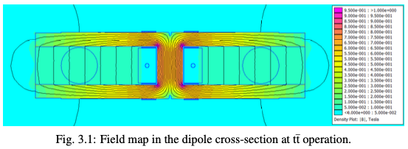
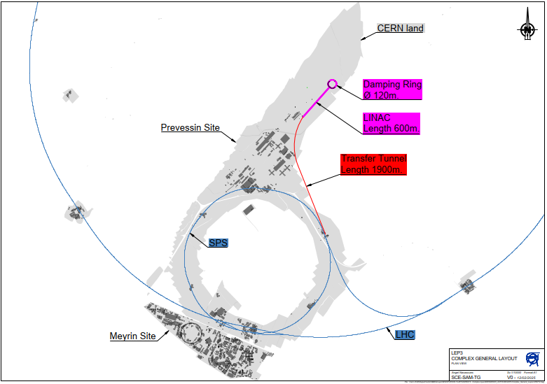
Choice of Components: Dipole Magnets & Injector
Follow FCC(ee) design
Luminosity [CEPC or FCC(ee) / LEP3] ~5; FODO lattice ~ 1.6×10³⁴ cm⁻²s⁻¹ per IP
Low emittance lattice : ~ 3×10³⁴ cm⁻²s⁻¹ per IP
Use FCC designs
for magnets
Dedicated linac injector on Prevessin site;
Injection energy optimized (lowered from 20
to 10 GeV)
(Sensitive to field quality of bending magnets
at injection.) To be studied further
FCC Feasibility Study

Slide 16
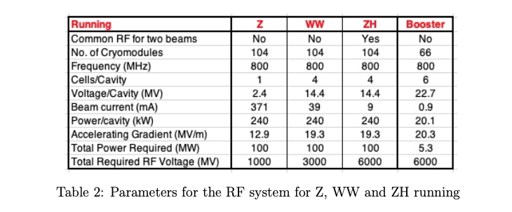
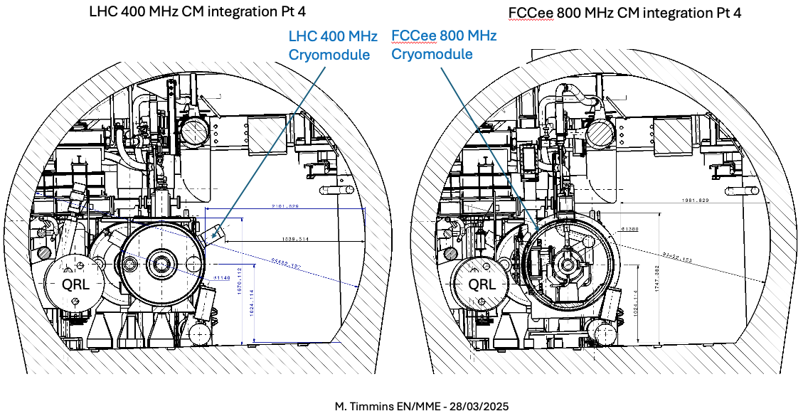
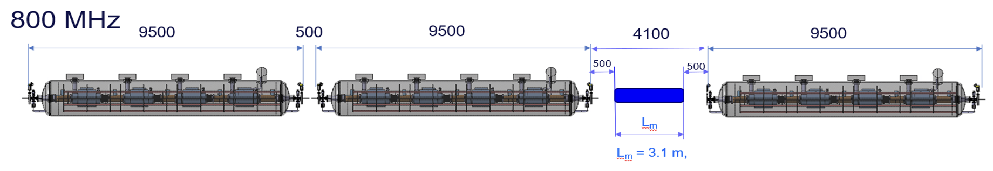
Choice of Components: RF System
RF: Energy loss/turn @ √s=230 GeV: 5.4 GeV.
  A total 6.0 GV to be installed, with the same margin as FCCee
Possible optimization of power coupler to be studied

Slide 17
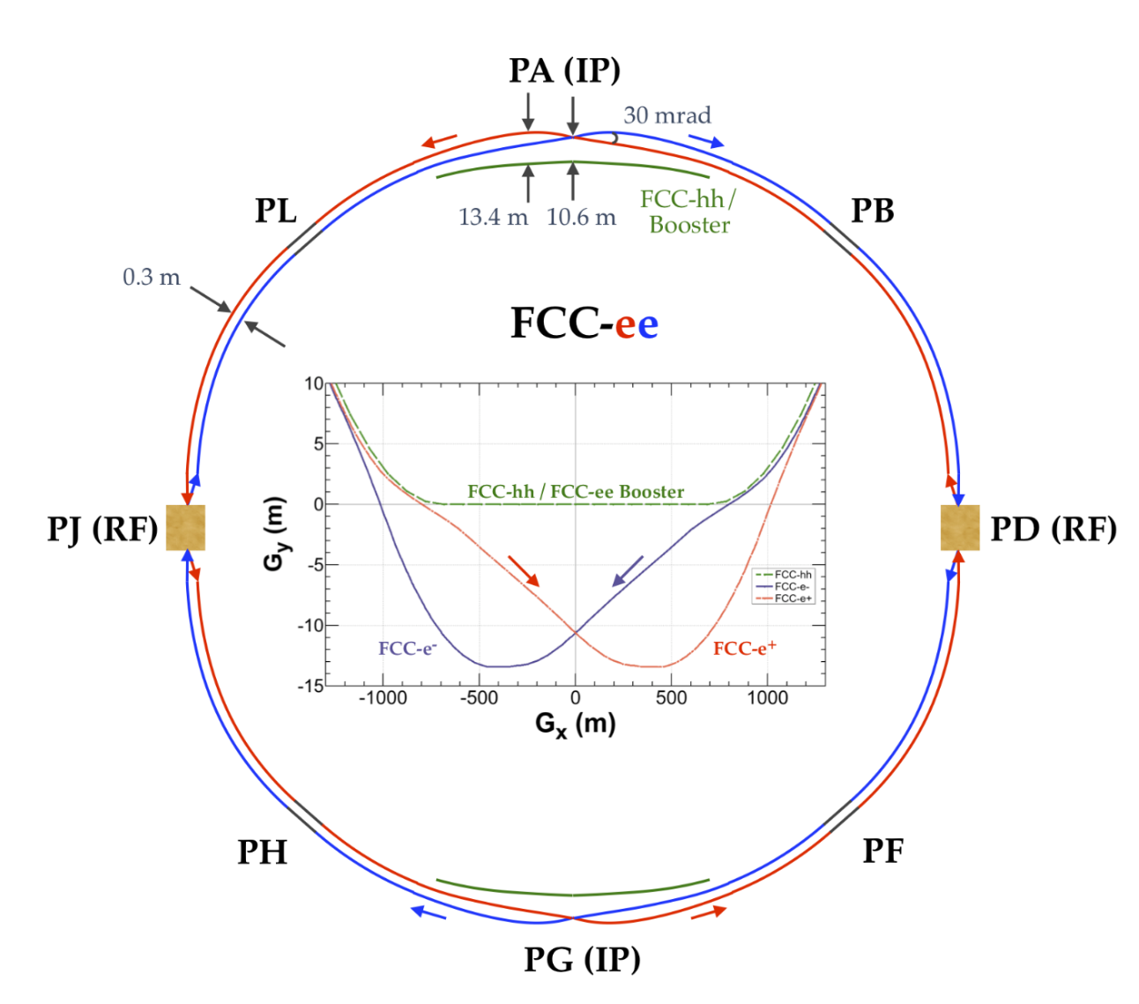
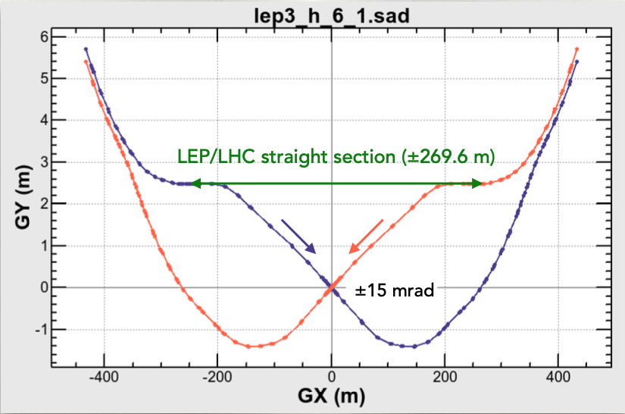
Crabbed waist optics = Large Crossing Angle
As for FCC have large crossing angle to have smaller β* and lower vertical emittances
FCC ->LEP3
Axis of tunnel off by 2m wrt IP in FCC
FCC crossing angle 30 mrad

Slide 18
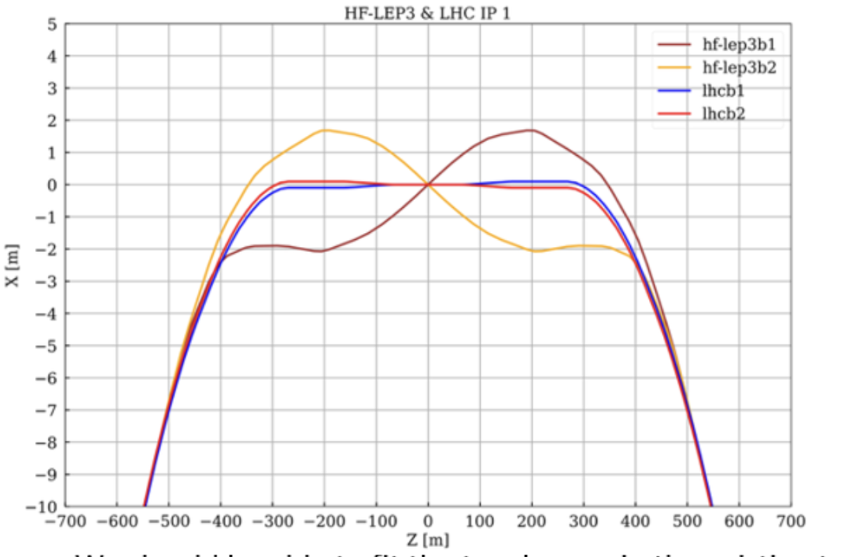
Problem solved
In new optics developed by Pantaleo Raimondi the issue is not present any longer
Straight Section
To be understood:
-how much civil engineering is needed to accommodate le 30 mrad crossing angle .
- Path of booster ring across the IP
Max beam separation <4m

Slide 19
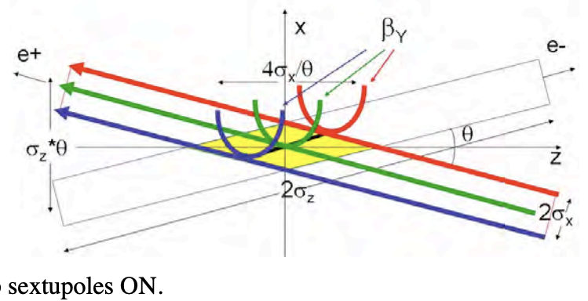
Crabbed waist crossing
The “crabbed waist” collision means that the crossing angle 2θ >> σ_{x}/σ_{z}, in contrast, the “head-on” collision means that 2θ << σ_{x}/σ_{z}.
This allows much lower vertical emittances and β* as it reduces the instabilities due to effect on one beam to the other during the crossing ( beam beam tune shift )
With lower β:
Luminosity increase with the same bunch current.
Possibility of the bunch current increase (if it is limited by ξy), thus farther increasing the luminosity.
Suppression of the vertical synchrobetatron resonances [7].
Moreover an adequate set of sextupoles rotates the ‘waist’ of the β function furter reducing the vertical beta

Slide 20
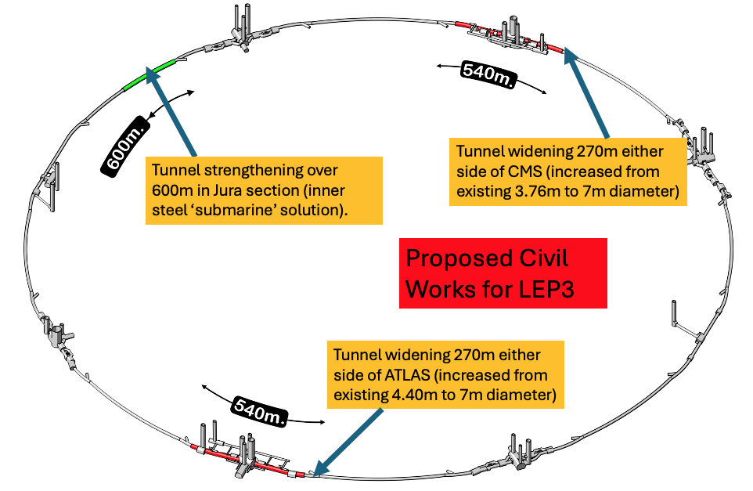
Civil Engineering
  40 years old infrastructure, some parts need maintainance
  High lumi achieved by crab-waist → large xing-angle → need to widen the LSS cross section on either side of the experiments
  possibly need of by-passes (avoidable if booster Beam pipe goes through detector)
  Overall civil engineering cost estimated: 165 MCHF

Slide 21
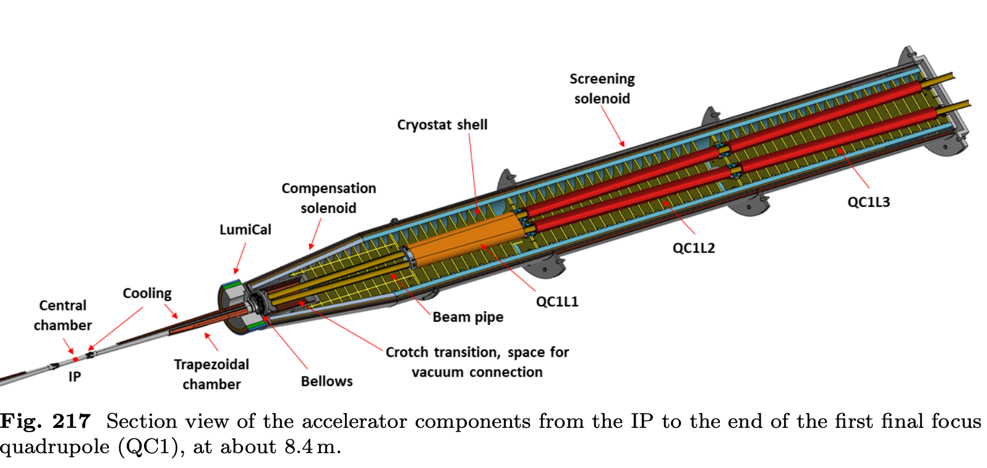
Experiments-Machine Detector Interface
Assume that the ATLAS and CMS experiments can be re-used with suitable modification (rebuilding of the inner trackers and the integration of focusing quadrupoles some 2m from the IP).
Keep magnets but at lower fields. Trackers costing around MCHF 100/per experiment are assumed. (Re-using ATLAS & CMS Should save the community >1BCHF)
Exploit all R&D done for ILC, CLIC and FCC(ee) detectors as well as LHC upgrades.
Baseline: Accelerator(booster) beam passes through tracker. If too much of perturbation then need bypasses.
All of the above need detailed studies.
From FCC MTR: Integration of IR optics. Independent beam pipes ~ 1-2m from IP.

Slide 22
Other aspects
Energy Calibration: For Z running, use the FCC-ee approach ( ie. Having non colliding bunches which allow frequent monitoring of the polarization
For WW running, see if under special running conditions adequate levels of polarization can be achieved at energies close to or at the WW threshold. Failing this, aim is to use the resonant depolarization method at the highest energy possible, and extrapolate to the WW threshold. Needs further study.
Sustainability: We assume that all building permissions/permits for LEP3 should be in place. Environmental impact should be minimal. Allowance probably needed for regulations that may have changed since the time of the construction of LEP. Benefit should be drawn from any relevant studies in these areas carried out for other proposed projects such as FCC-ee or CLIC.
Power Consumption: We estimate that the total power consumption at the highest LEP3 energy will be less than 250MW, similar to that of HL-LHC.

Slide 23
Planned Stages
The LEP3 physics programme would have three phases ( here based on FCC derived FODO optics )
near or on the Z peak (91 GeV), recording 2×10¹² Z decays over six years
near the WW threshold~ 4×10⁷ WW events at and around √s = 163 GeV over four years
near the ZH threshold (at 230 GeV). ~ 4.7×10⁵ e⁺e⁻→ ZH events would be recorded over six years at √s = 230 GeV.
With improved optics/performance can save on operation/construction costs
For comparison with other projects:
Statistical errors scale as √(ratio of no. of events). Systematic errors have to be evaluated on a case by case basis (using similar recipes to FCC) .
Here comparable detector performance is assumed.
LEP3 is competitive with other alternatives and considerably better for EW physics

Slide 24
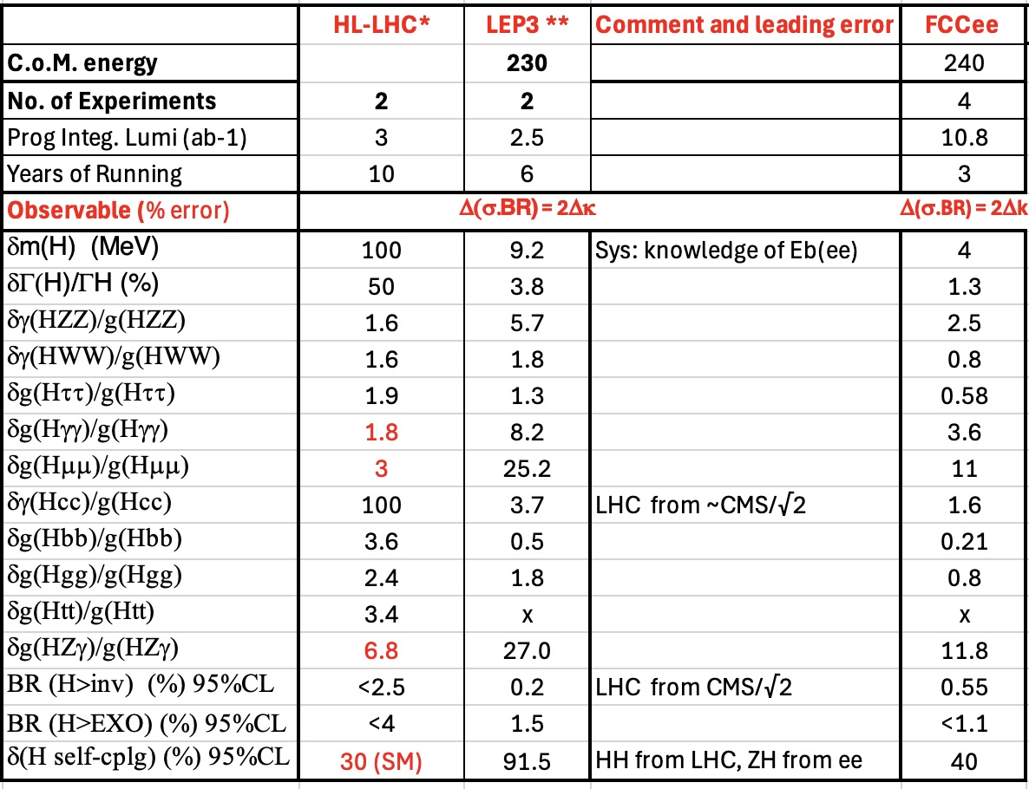
Higgs boson physics
LEP3 can be competitive with other alternatives
LEP3 ~ 4.7x10⁵ H bosons (6 yrs 2 expts) cf FCC(ee) ~2.2 × 10⁶ (3 yrs 4 expts)

Slide 25
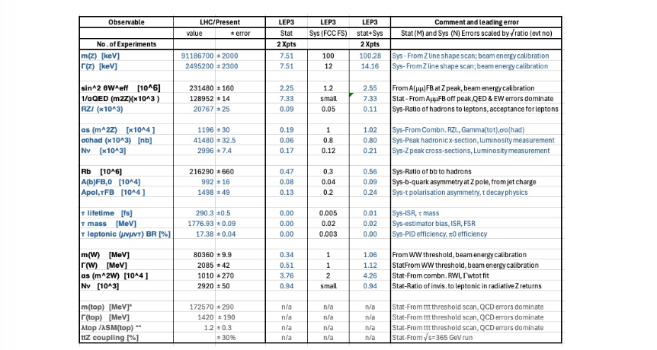
E-W physics
~1.7x10¹² Z bosons (6 yrs at 91.2 GeV), and ~ 4×10⁷ WW pairs (4 eff yrs at √s=163 GeV)
cf FCC(ee) ~6 × 10¹² and ~1.5 × 10⁸ resp.
Estimation of EW measurement precision: stat error scaled square root of lumi ratio and syst derived in similar way to FCC ones

Slide 26
TERA-Z a gateway to explore new physics
Tera-Z factories can discover new elementary particles with couplings to the Z-boson that are orders of magnitude smaller than current bounds.
Indirect signatures. If the mass m of a new elementary particle exceeds the collision energy, it can only leave an indirect trace in observables as a virtual mediator. In this case deviations from the SM can be described in the framework of effective field theories (EFTs) involving SM fields. The huge number of events that can be achieved with NZ ∼ 10¹² permits searches for such deviations through very precise measurements of known processes.
Discovery of new elementary particles. It is possible that new elementary particles with masses m below the LHC collision energy have escaped discovery because they rarely interact with ordinary matter. This can either occur in minimal models featuring isolated SM gauge singlets or in more complex theories in which a hidden or dark sector couples to the SM only through so-called portals

Slide 27
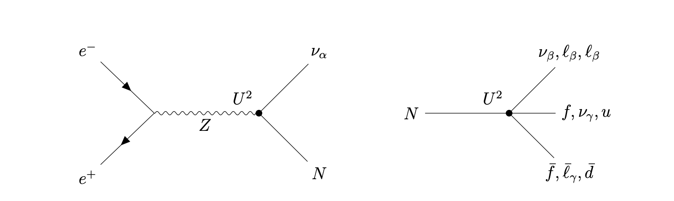
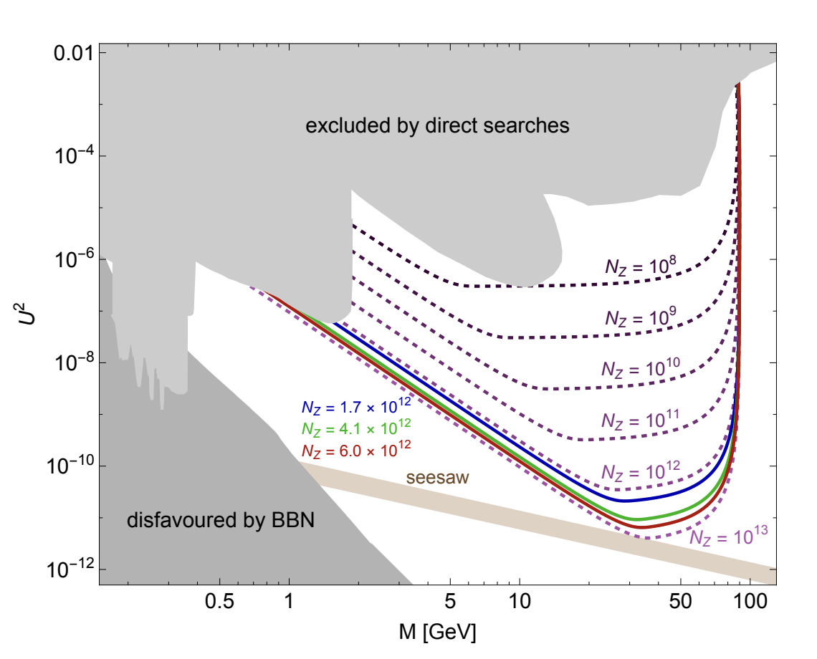
Example :HNL from Z decays
Detector : D=10m, L=9m
Small coupling= long lived
Example Heavy Neutral leptons
HNL production
ILC
LEP3
HNL decay ( 4 fermions )
Yuan-Zhen Li , M. Drewes, J. Klaric, New particles at the z-pole, 2511.23461.
Notes:
heavy right-handed Majorana neutrinos they can explain the light neutrino properties through the seesaw mechanism, generate the matter-antimatter asymmetry of the universe via leptogenesis and are viable Dark Matter candidates

Slide 28
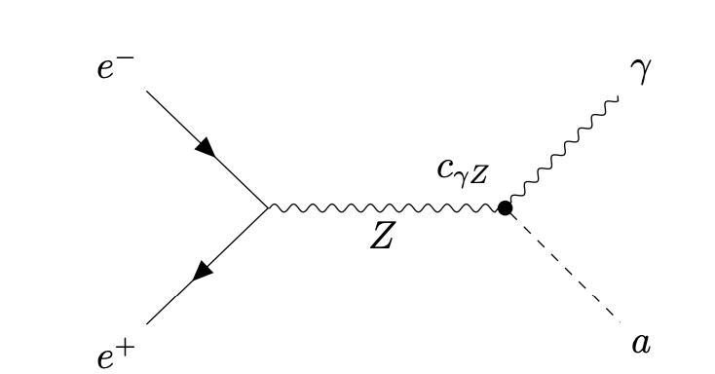
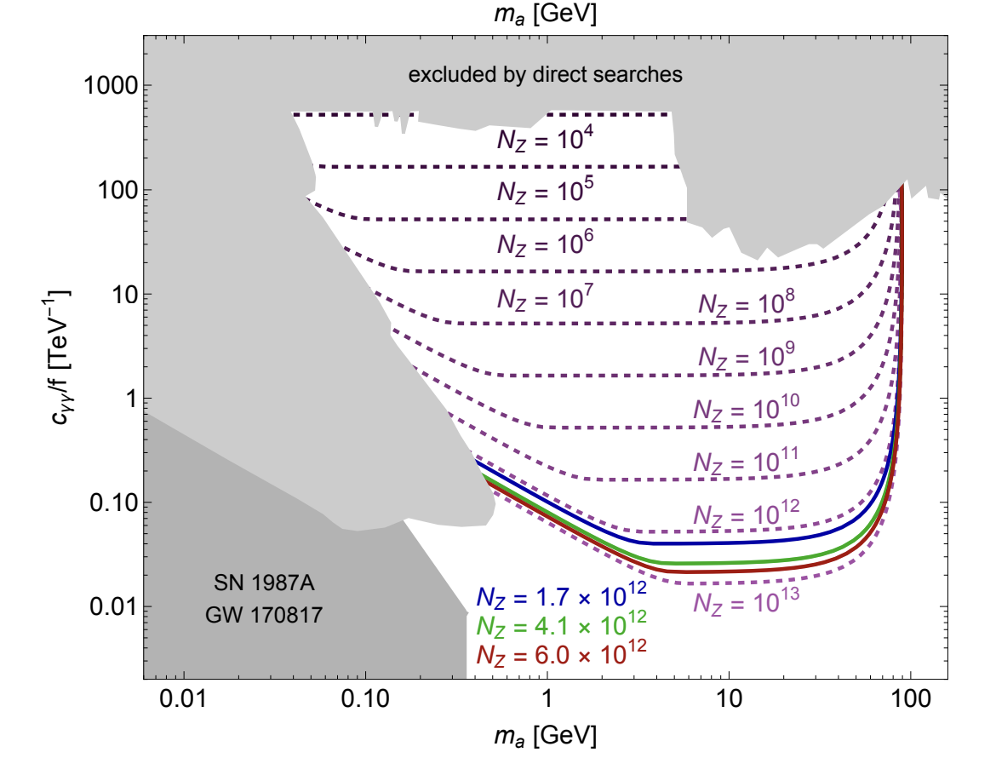
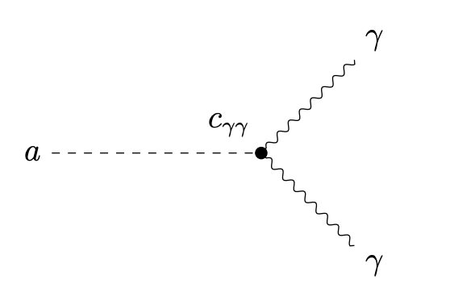
Example: Axions from Z decays
Example Axion coupled to the U(1) hypercharge gauge boson before electroweak symmetry breaking
Axion production
ILC
LEP3
Detection
Yuan-Zhen Li , M. Drewes, J. Klaric, New particles at the z-pole, 2511.23461.

Slide 29
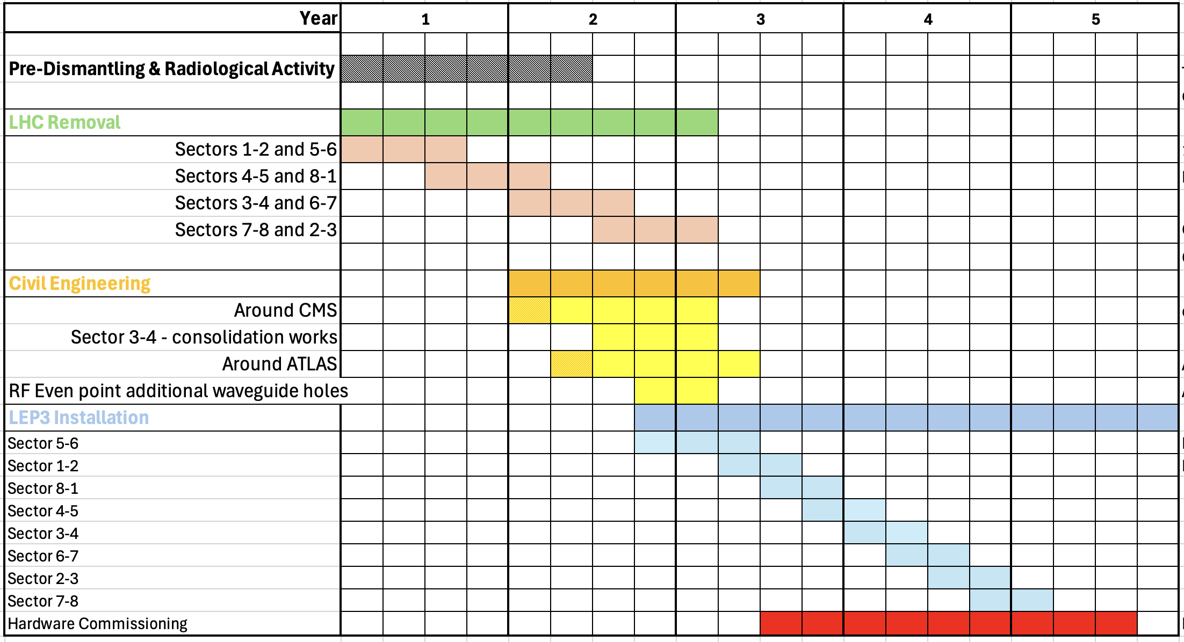
Example: Shutdown Schedule: After LHC stops

Slide 30
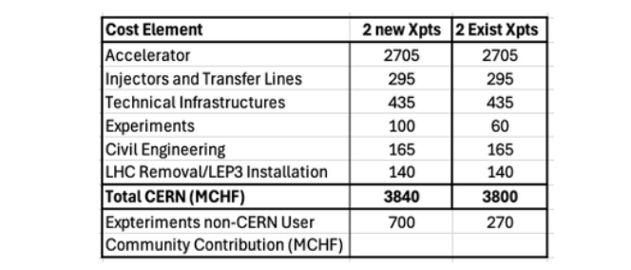
Cost
Use the FCCee costing methodology.
Costs scaled from FCC(ee) MTR costs: scaled according to numbers of components required
With assumed schedule LEP3 cost would be well within the standard CERN budget, allowing pursuit of other future-oriented initiatives [e.g. R&D on rf cavities (high gradient, low power), high-field magnets, muon collider demonstrator]
Cost: assumes careful removal of LHC machine in case it is needed later as an injector.
Funding assumes CBD paid off by 2035; 250 (350) MCHF saved/year when only running HL-LHC (when in shutdown).
Sustainability is an important issue: use ideas/proposals from the other projects

Slide 31
Some performance, cost consideration
The beam pipe assumed in this study has the same diameter as the FCCee : for FCCee one constraitn was the overall impedance of the accelerator . As the the impdedance depends linearly on the circumference of the accelerator and inversely with the third root of the bean pipe diameter. LEP3 beam pipe could have a diameter of 30mm to maintain the same impedance of FCCee. As the cost of the magnet varies with the square of the beam diameter this could result in substantial savings.
The optics used for this study is one derived from FCCee without any optimization for the LEP3 setup. Ongoing work ( Pantaleo Raimondi) indicates that substantial increases in luminosity are possible. Early investigations indicate that the luminosity could increase by a factor 2
Notes:
Possible consequences: possible saving
Can reduce time by factor 2 , can reduce RF , rad shields would also be cheaper

Slide 32
Possibilities: The Future Beyond LEP3
Aim: an accelerator with constituent √s ~10 times higher than LHC (1-2 TeV).
If FCC(ee) is built then a ~100 TeV hadron collider would be the obvious next step.
R&D Goal: Develop high field magnets - followed by the setting up for industrial production to provide solid cost estimates.
If R&D on high field magnets is successfiul and their construction cost and production capacity are known and appear affordable, then a decision could be made to go to a higher energy hadron machine FCC(hh) (~100 TeV).
Another R&D Goal: increase gradient and efficiency of rf cavities and bring down their cost

Slide 33
Summary
We support (FCC-ee + FCC-hh) as the preferred option for CERN’s future
An e⁺e⁻ collider in the LHC tunnel, referred to here as LEP3, is proposed as a backup option for FCC-ee
Compared to the linear e⁺e⁻ colliders proposed, LEP3 provides similar luminosity for ZH production, higher luminosity at lower energies and options for multiple experiments, all at much lower cost.
LEP3 is a reasonable (perhaps the best) backup option
Leaves room (time, budget, resources) for further development of THE machine that can probe directly the energy frontier at a constituent √s ~ 10 times LHC.
No showstoppers have yet been identified, and we consider this proposal to be sufficiently interesting to deserve further study. We have identified important areas that would require deeper investigation before CERN could commit to LEP3.

Slide 34
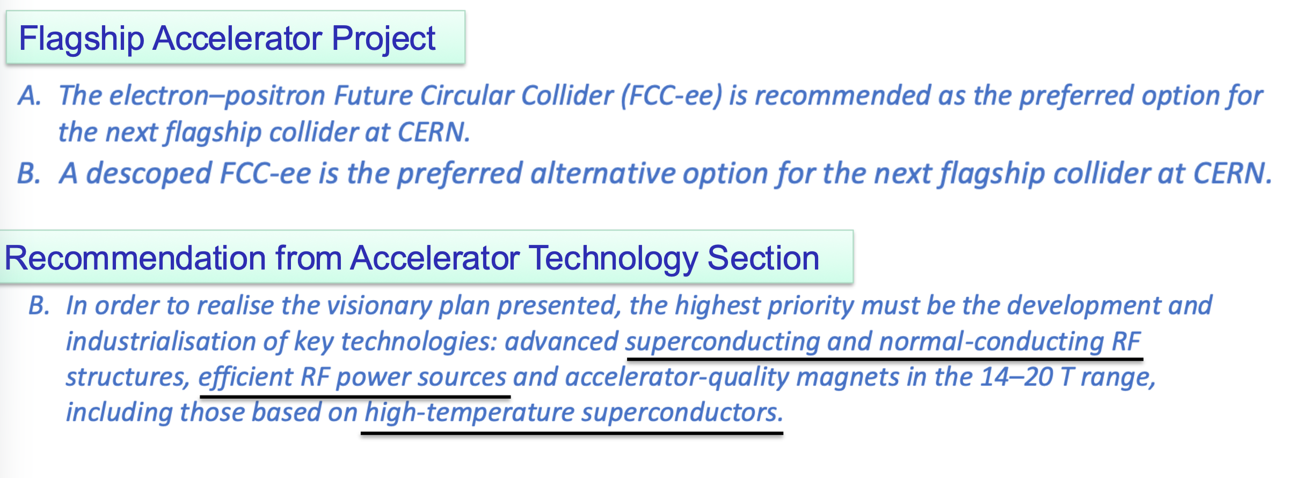
Recommendations from ESPP (Nov.2025)
As we have heard from Karl on Monday :

Slide 35
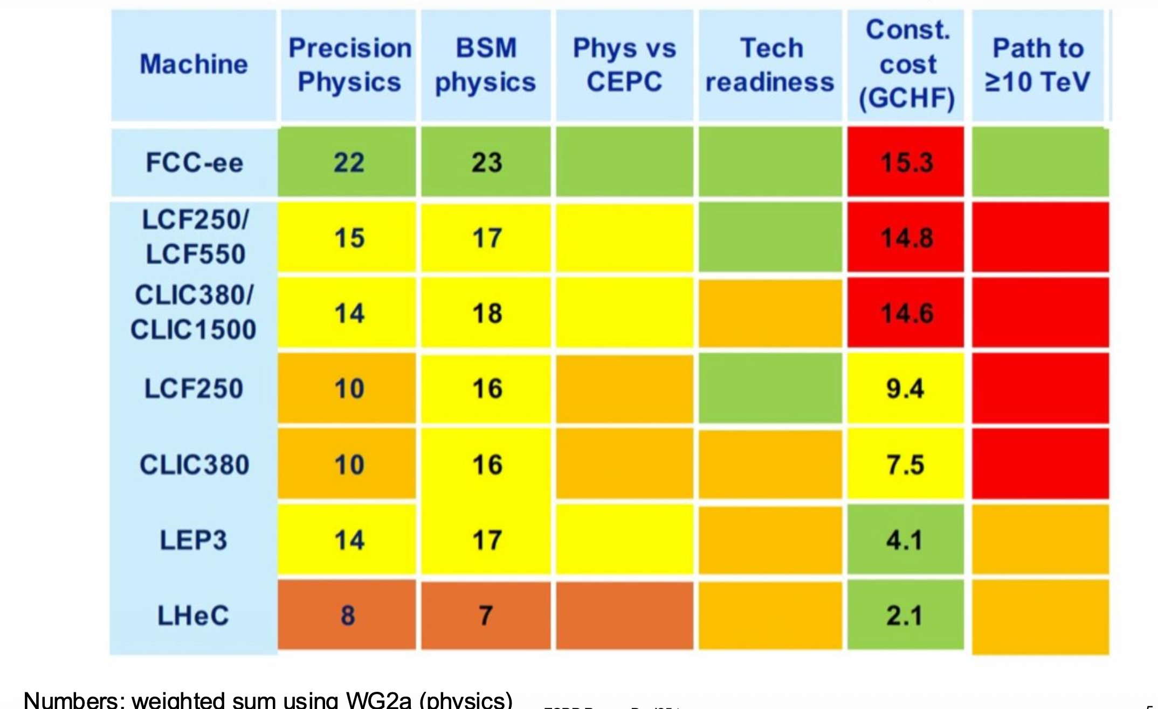
Comparison of various proposals

Slide 36
Some open Questions
What are the implications of a crossing angle of ~ 30 mrad? Over which length does the tunnel need widening?,
What rf cavities are the most appropriate for LEP3? Can such cavities fit into the existing straight sections in the LEP/LHC tunnel?
The tunnel needs enlargement or consolidation in some areas, how easily can it be done? How much time will be needed? Is the cost of civil engineering works reliably estimated?
What procedures/derogations are required for the removal of LHC elements, especially for those elements considered to be significantly activated? Where will these components be stored?
What is the optimal injection energy into the LEP3 accelerator?
Present estimate indicate that the total cost of the whole LEP3 project be kept within CERN’s current budgetary limits: this assumption needs more studies ( RF, Power distribution, magnet design..) .
If one wants to be serious about knowing if LEP3 is a real option some professional work ( read by CERN services) needs to be done over the next 2-3 years . We estimate that the cost of this is below 5 MChf /year with ~45 Fellow.Yrs and 16 Staff FTE.Yrs

Slide 37
Backup

Slide 38
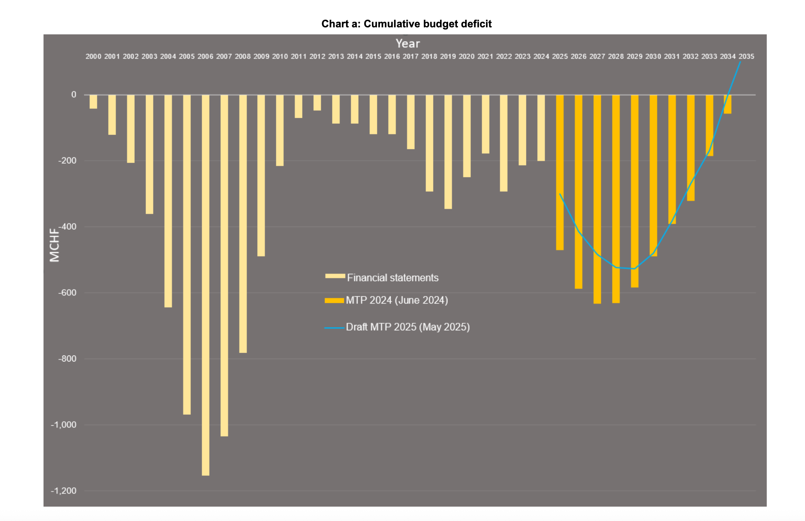
CBD for LHC and HL-LHC
Note: LEP3 cost to CERN would be similar to LHC construction

