Slide 1
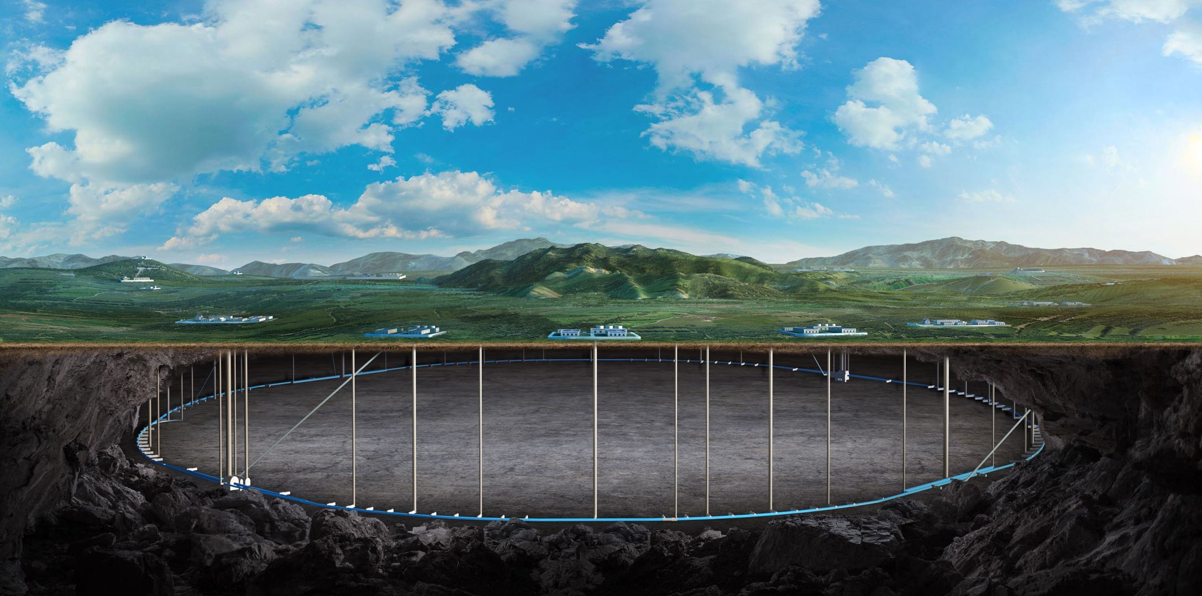



CEPC Booster, Damping Ring and Timing
Dou Wang (IHEP)
on behalf of CEPC AP group
HONG KONG, Jan 12-16, IAS Program on Fundamental Physics HKUST (FP 2026)

Slide 2
Content
EDR progress of CEPC Booster
  Feasibility study of the combined dipole magnets
  Mini-review of the combined dipole magnets
  Simulations of first turn injection commissioning
EDR progress of CEPC positron damping ring
  DR TDR design status
  Polarized DR study
CEPC timing issue and detector performance
Summary

Slide 3
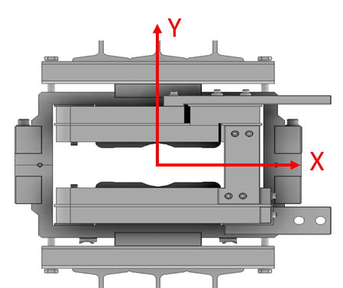
Booster error tolerance study in EDR
The transverse offset error of the combined dipoles were scanned with100um (RMS), 300um (RMS), 400um (RMS) and 500um (RMS) to see the tolerance from the view of beam dynamics, while all the other errors keep same as TDR error table.
The combined dipole magnets were shifted Integrally without inner distortion.
Both dynamic aperture and emittance growth are checked after error correction.
Assume the error is Gaussian distribution, and are truncated at 3σ.
Dynamic aperture was tracked by SAD.
Emittance was calculated by both SAD and AT.

Slide 4
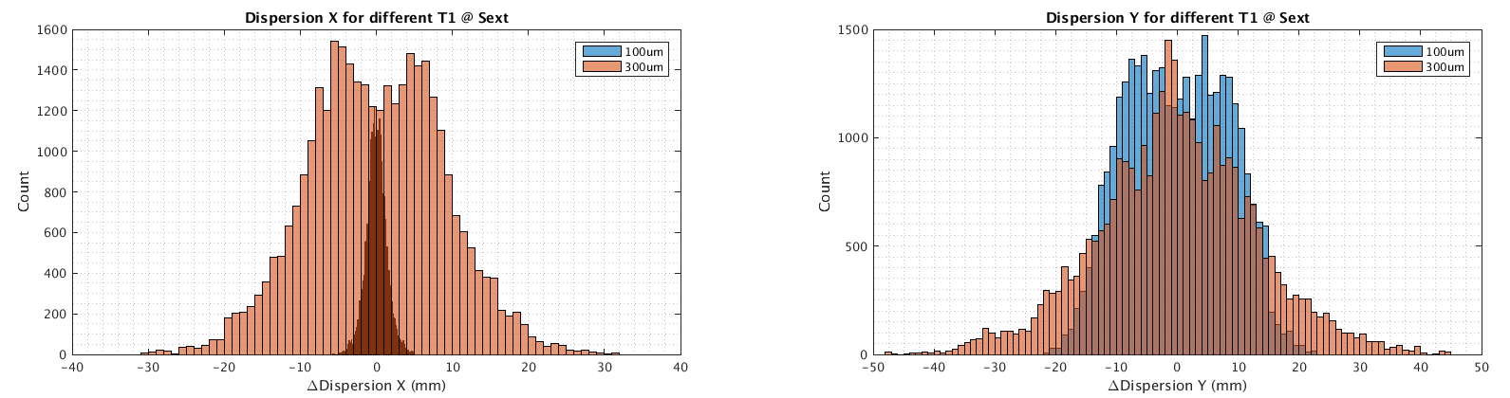
Error correction process
Daheng Ji
Orbit Correction + Horizontal dispersion
  Response Matrix(RM) Method：links corrector to beam orbit at BPM
  2-level iteration：
  1st Loop: 20%~100% Corrector
  2nd Loop：30%~80% Singular Value
  Dispersion correction
  Energy adjustment by corrector
Optics correction
  RM + LOCO
  Based on 30GeV & 120GeV simulation
  All quadrupole independent
  Dispersion correction included
RMS@120GeV | 100um | 300um | 400um | 500um
Orbit (mm) | 0.142/0.075 | 0.130/0.073 | 0.179/0.104 | 0.169/0.110
Betabeating(%) | 0.67/0.17 | 0.98/0.64 | 2.571/1.442 | 4.862/2.663
Δdispersion (mm) | 1.3/8.3 | 8.8/13.332 | 19.267/11.42 | 23.445/13.05
Emittance(nm) | 1.233/0.0086 | 1.241/0.0103 | 1.271/0.0114 | 1.280/0.0158
Coupling | 0.599 | 0.57 | 0.899 | 1.1
Coupling and vertical
dispersion correction
  8 skew quadrupole skew quadrupole magnets are arranged in the dispersion free section to correct coupling
  the coupling control target being better than 1%

Slide 5
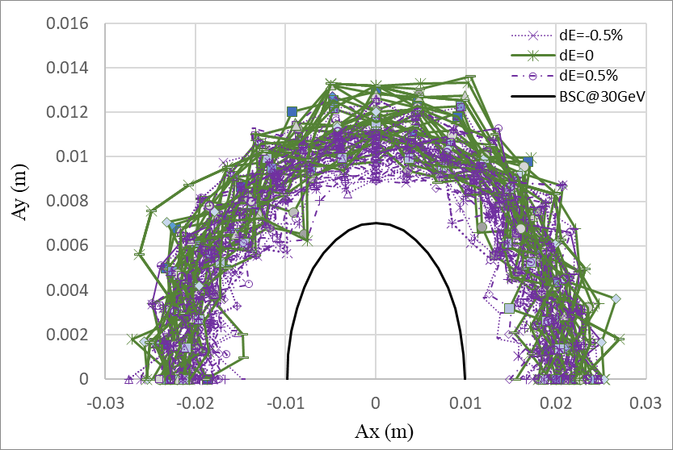
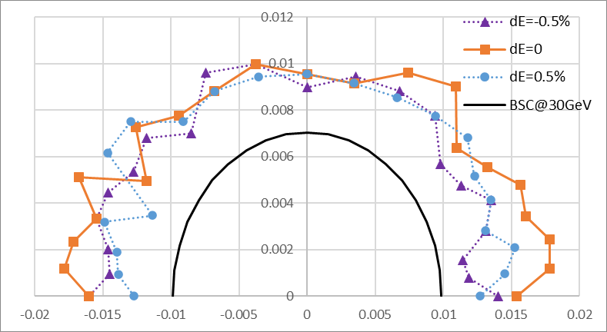
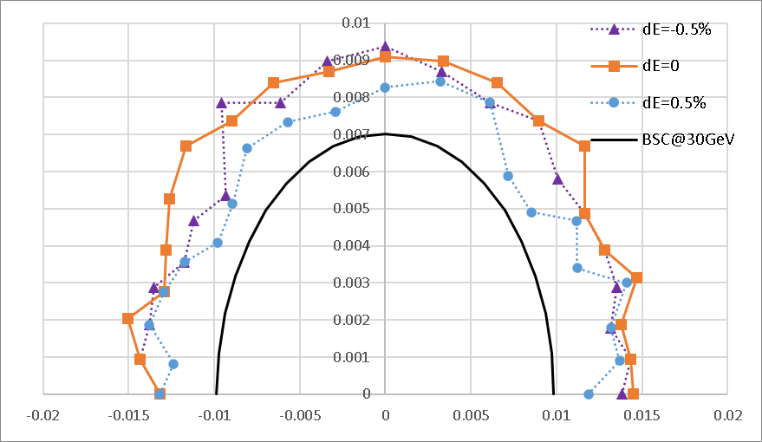
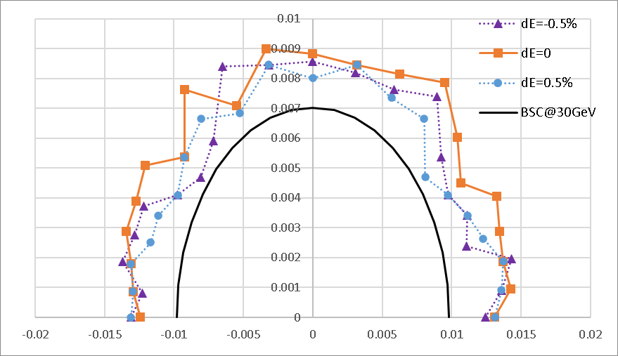
Booster DA results@30GeV
30 GeV is the most critical energy among other energy modes according to TDR study.
D. Wang, Daheng Ji
100um
300um
400um
500um
Maximum integral transverse offset of whole magnet: 1.5mm (rms: 500um)

Slide 6
Emittance growth @120GeV
D. Wang, Daheng Ji
Emittance growth at extraction energy should be controlled to make sure the injection efficiency to collider ring.
Horizontal emittance growth is very small.
Vertical emittance growth can be controlled by 8 skew quadrupoles and vertical dispersion correction.
- Coupling design goal: ≤ 1%
Trans. offset of com. Dipole (RMS) |  | 100um | 300um | 400um | 500um
Hor. Emit. growth (%) |  | <0.5 | <0.8 | <1.5 | <2
Coupling (%) | w/o coupling correction | 0.59 | 0.98 | 1.24 | 1.30
Coupling (%) | w coupling correction |  | 0.57 | 0.89 | 1.08

Slide 7
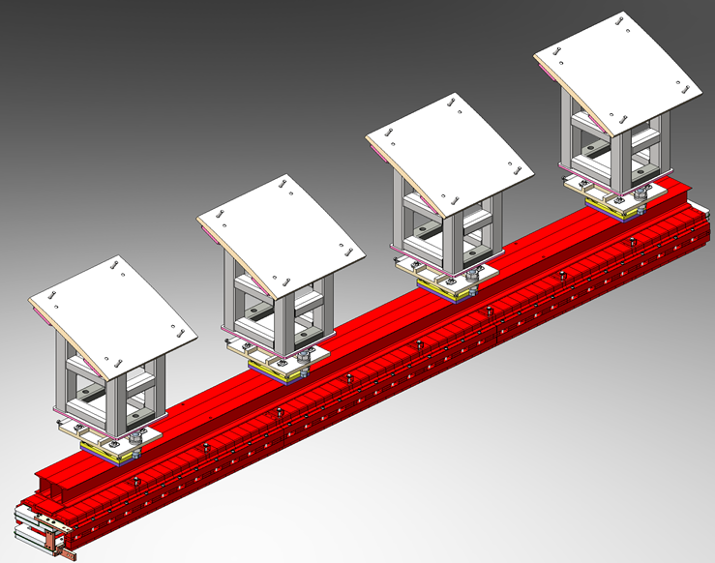
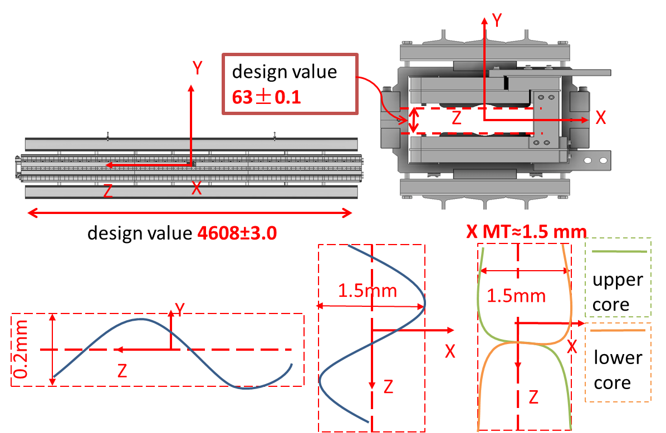
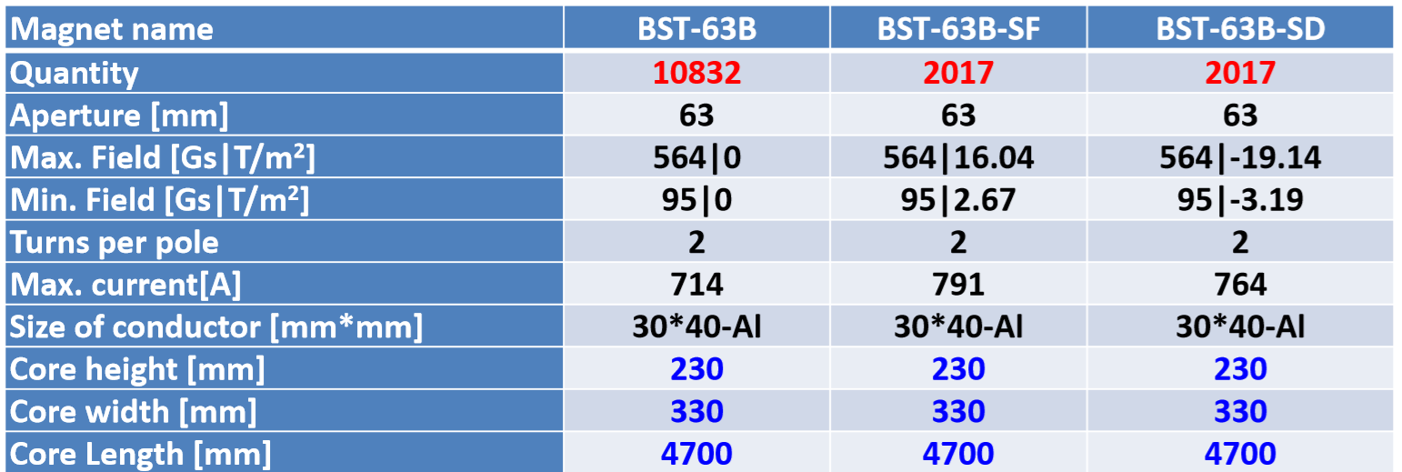
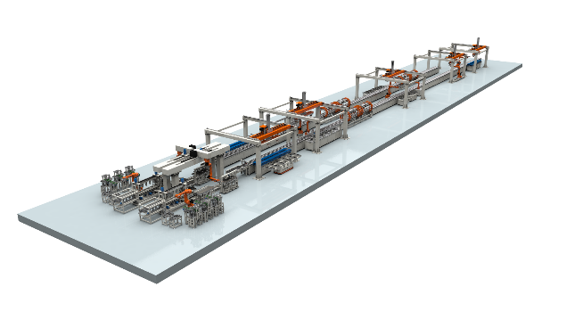
Booster dipole mass production preparation in EDR
All the booster dipole magnets including the combined dipoles will be produced by the automatic fabrication lines in order to reduce the cost.
Three fabrication lines will be required to produce the required 15,000 dipole magnets within 5 years (4 dipole magnets per day).
Production error: combining machining error, assembly error,
welding deformation, lifting deformation
Wen Kang, Zhihui Mu
BST-63B: booster pure dipole; BST-63B-SF: dipole-SF combined magnet; BST-63B-SD: dipole-SD combined magnet.

Slide 8
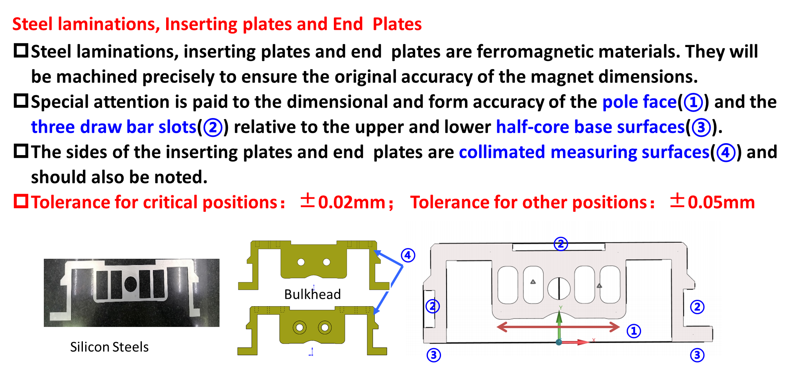
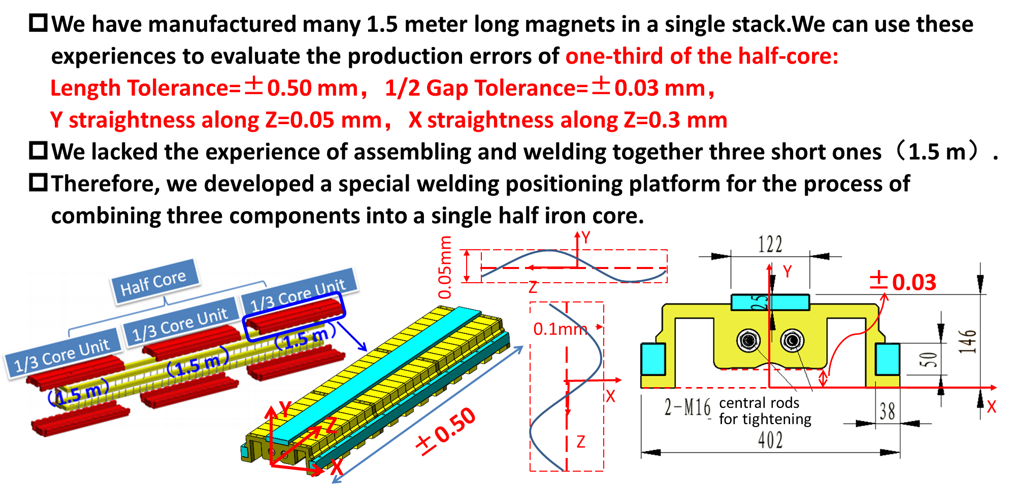
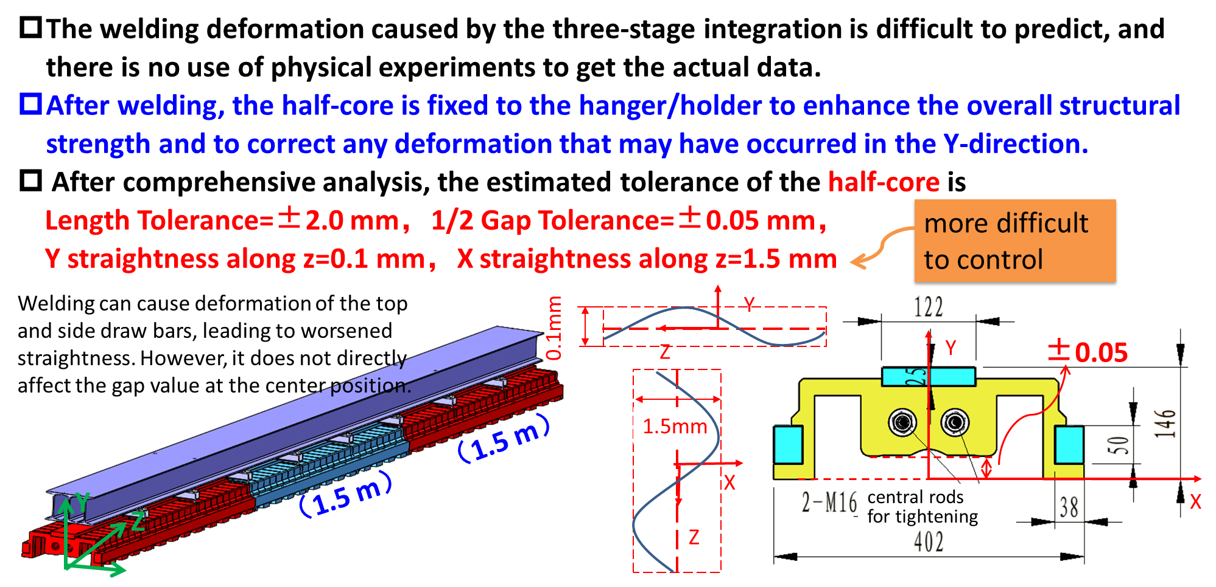
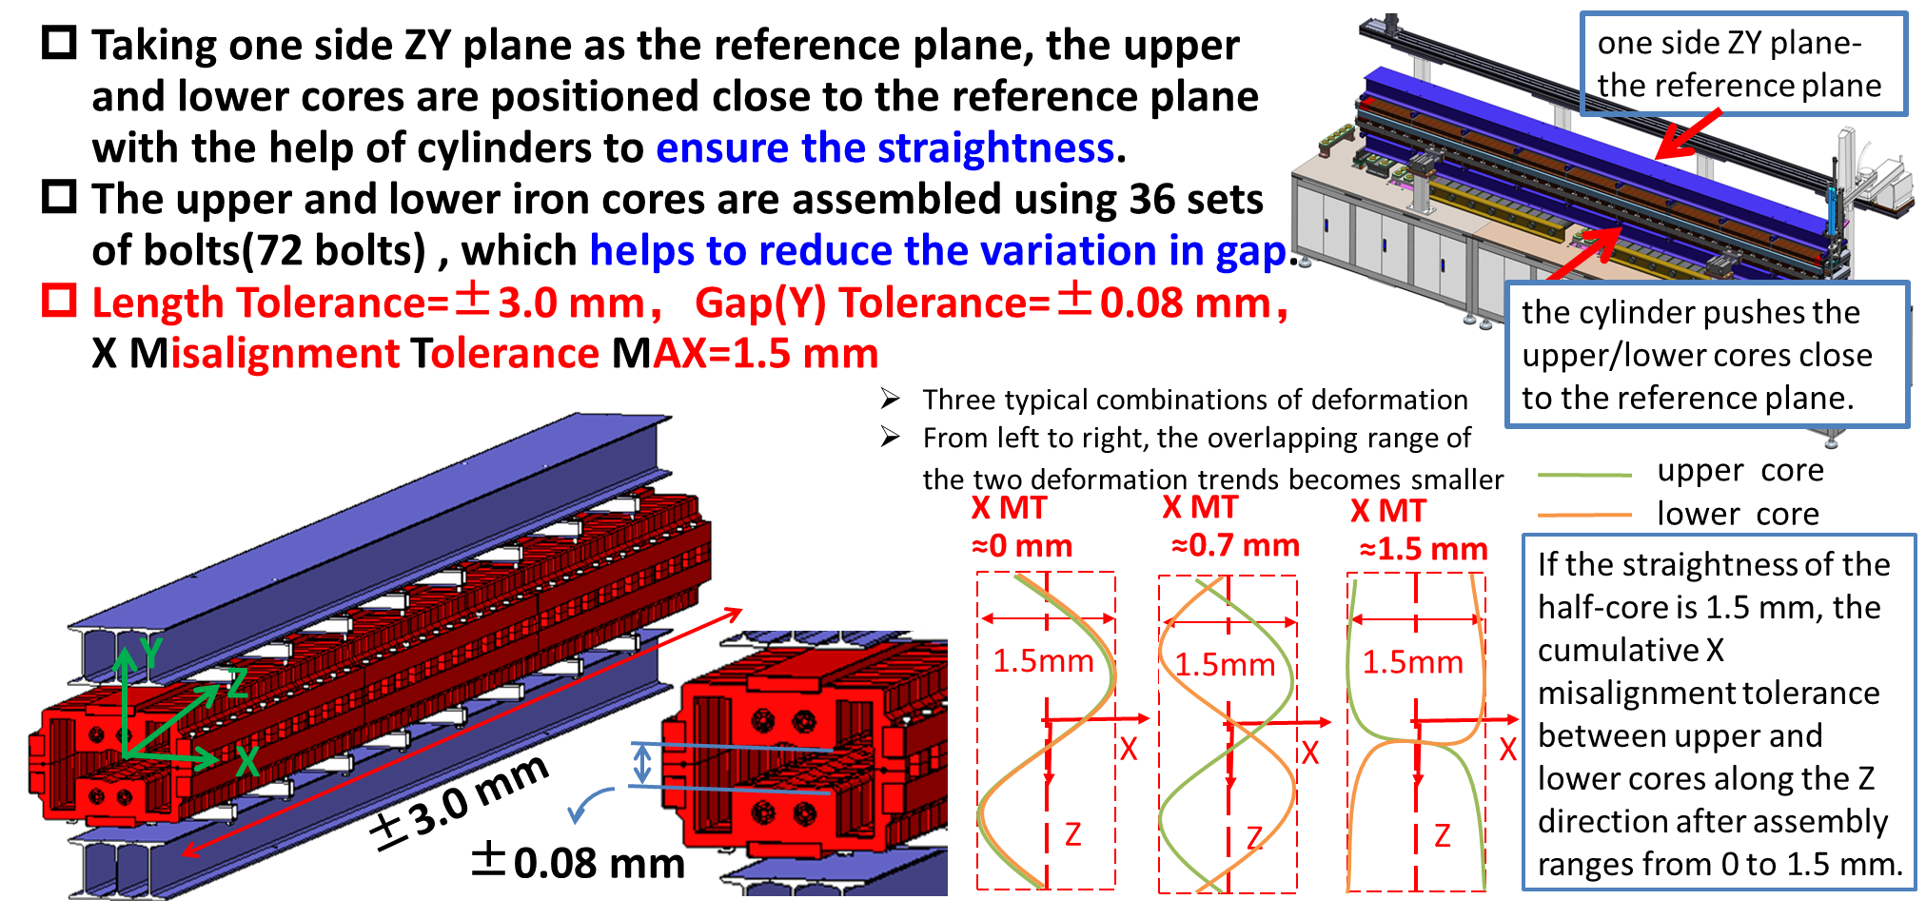
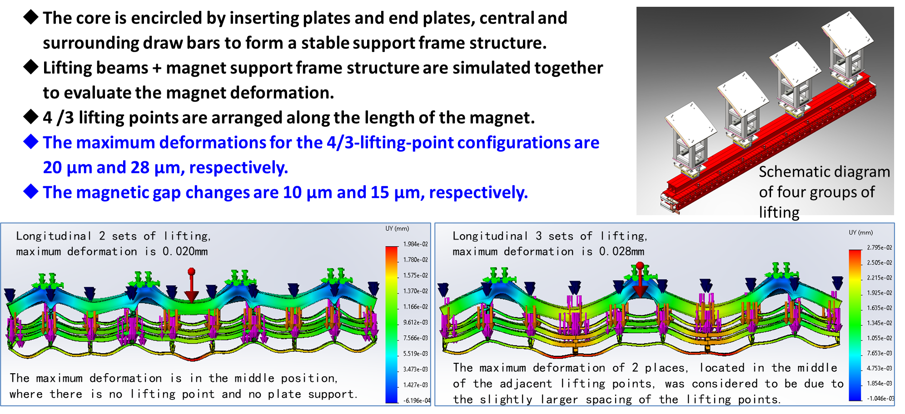
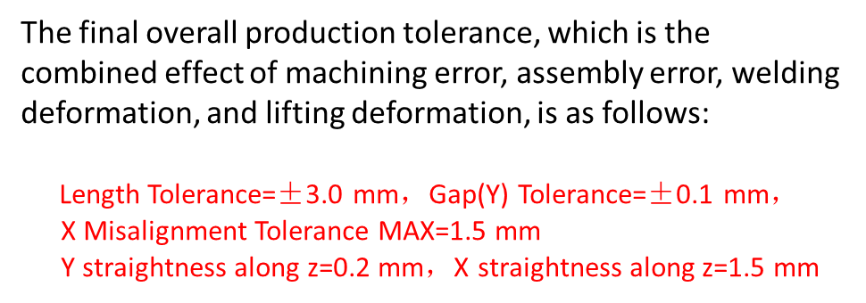
Production error tolerance analysis of combined magnets
Wen Kang, Zhihui Mu
Silicon Steels, Plates
1/3 of the Half-Core
Half-Core
Core
Lifting
Overall

Slide 9
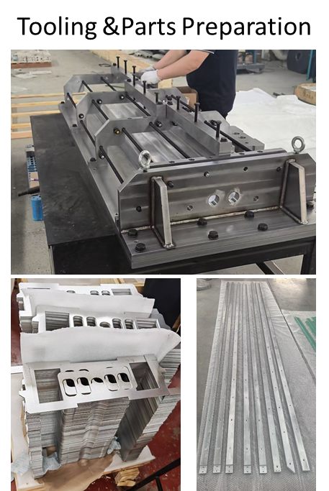
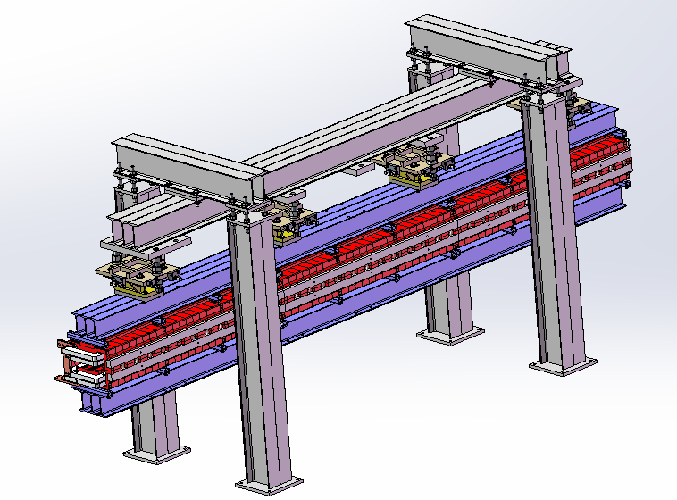
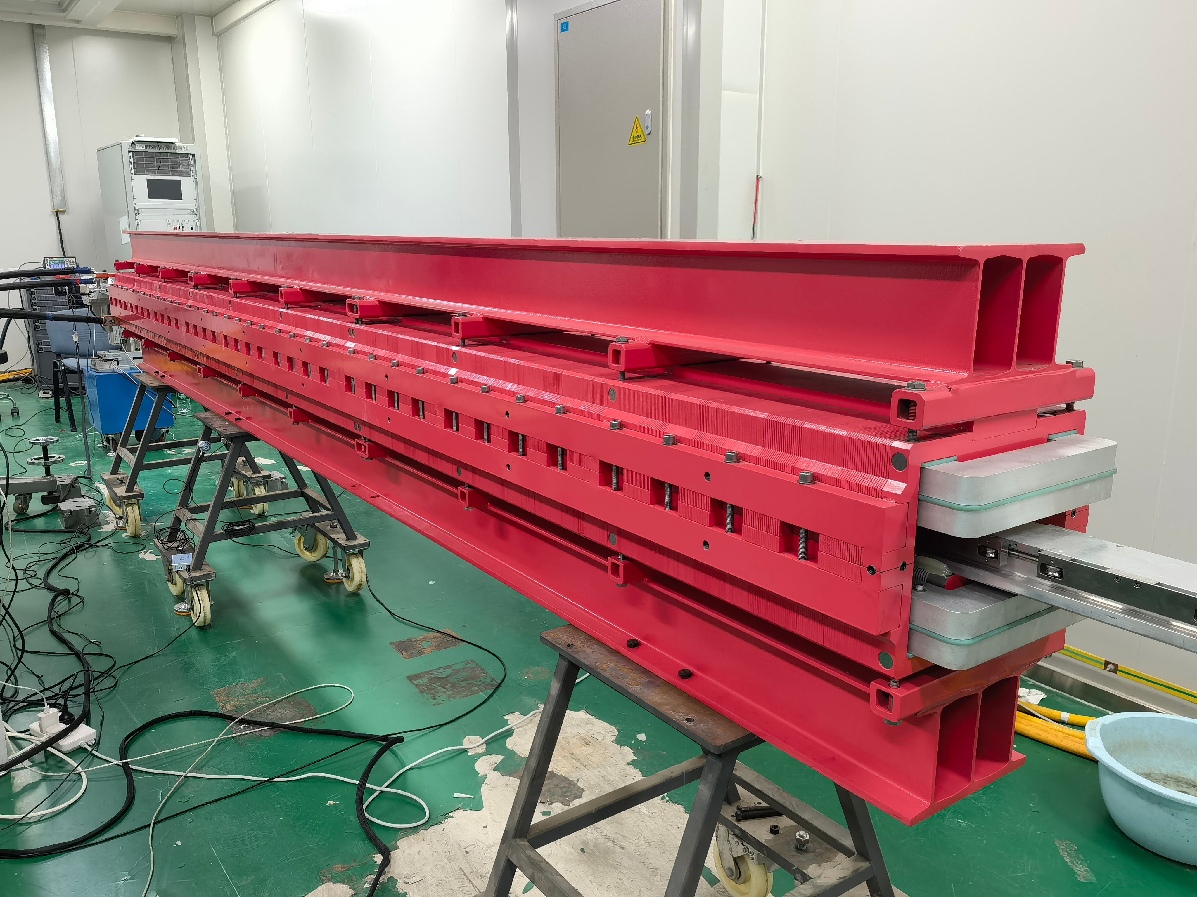
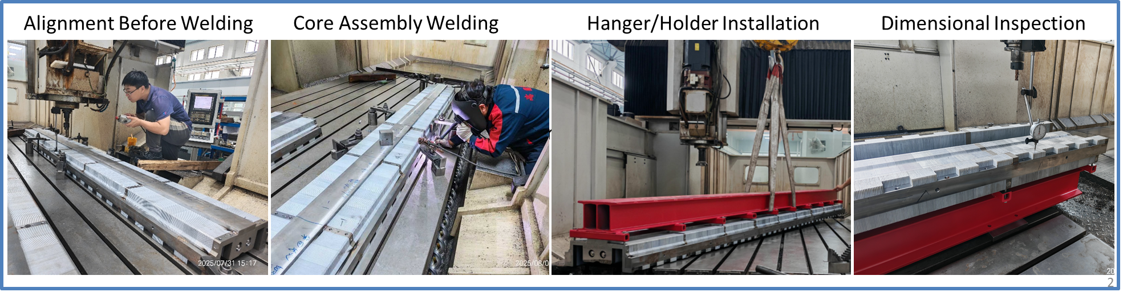
Prototype status of booster combined magnet
A full size combined magnet prototype has been finished last October.
Measurements and experiments were planed based on this prototype.
* Refer to Zhihui Mu’s talk “CEPC Magnets Line, Booster Magnets, etc”.

Slide 10
Summary from magnet system
Wen Kang, Zhihui Mu
Based on the magnetic design and mechanical design as well as material selection, a preliminary analysis of the production tolerance for the CEPC Booster dipole-sextuple combined magnet is presented.
The 4.7-meter-long dipole-sextuple combined magnets had never been fabricated before and its manufacture is extremely difficult.
We are actively working on the prototype of the dipole-sextuple combined magnet to verify the final machining accuracy.
The overall production tolerances evaluation will serve as the performance target for the automatic production line.

Slide 11
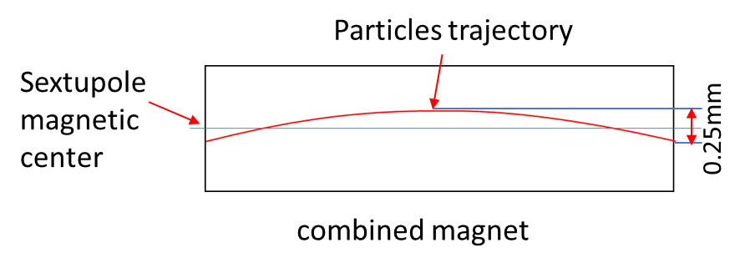
Alignment scheme for the combined dipole in EDR
The booster dipole-sextuple combined magnet alignment will be based on its integrated sextupole center.
Align the combined magnet to the position where the integral of the quatrupole magnetic field along the particle’s trajectory is zero.
The combined magnet final alignment error includes magnet fiducialisation error and magnet installation alignment error.
The alignment scheme based on mechanical center will be adopted.
-- Rotating coil magnetic center measurement error is
estimated to be 0.4mm
-- The mechanical structure of a magnet is highly correlated with
the distribution of its magnetic field
Xiaolong Wang
Arc deviation
The integrated sextupole center is moved to outside of the beam inlet/outlet points (offset: ~180 um).

Slide 12
Summary from alignment system
Fiducialisation error
Xiaolong Wang
 | Transversal X/mm | Vertical Y/mm | Roll θ_{z} /mrad | Pitch θ_{x} /mrad | Yaw θ_{y} /mrad
Based on mechanical center | 0.071 | 0.071 | 0.14 | 0.011 | 0.011
Based on magnetic center | 0.401 | 0.401 | 0.14 | 0.017 | 0.017
Total alignment error
 | Transversal X/mm | Vertical Y/mm | Roll θ_{z} /mrad | Pitch θ_{x} /mrad | Yaw θ_{y} /mrad
Based on mechanical center | 0.1 | 0.102 | 0.29 | 0.019 | 0.019
Based on magnetic center | 0.407 | 0.408 | 0.29 | 0.023 | 0.023

Slide 13
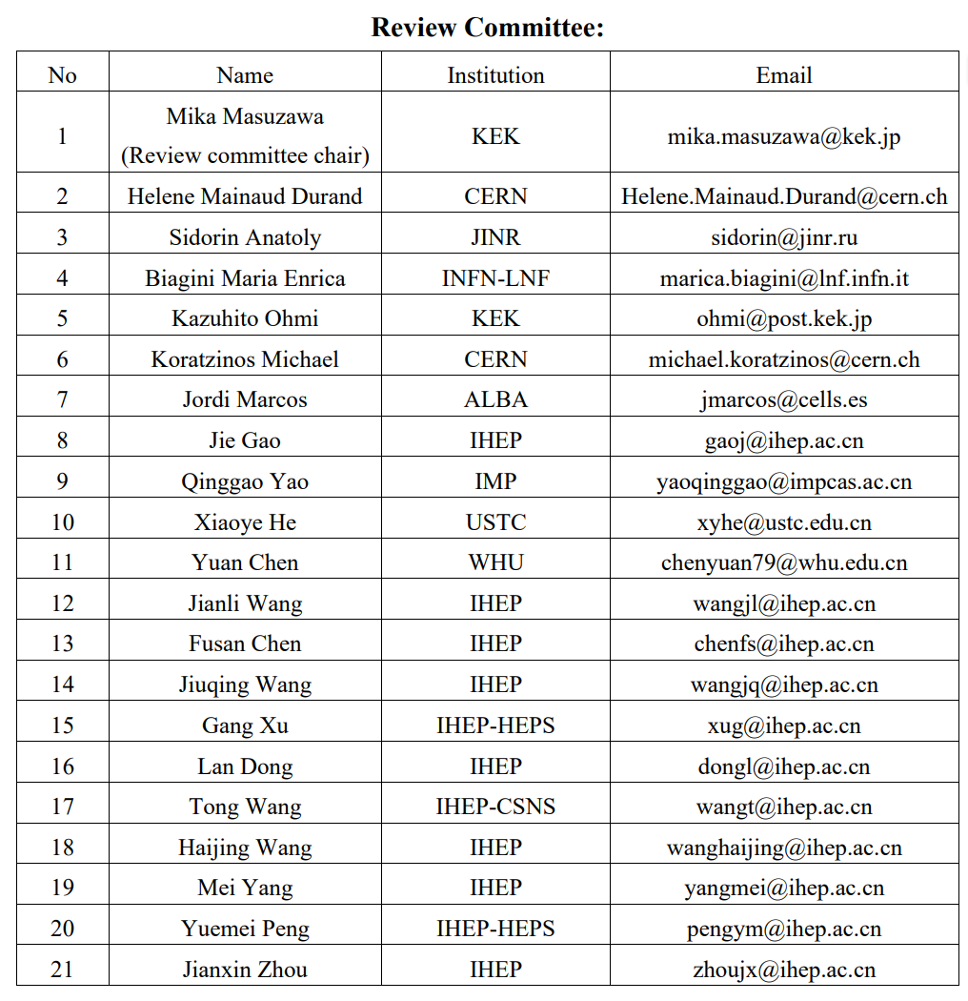

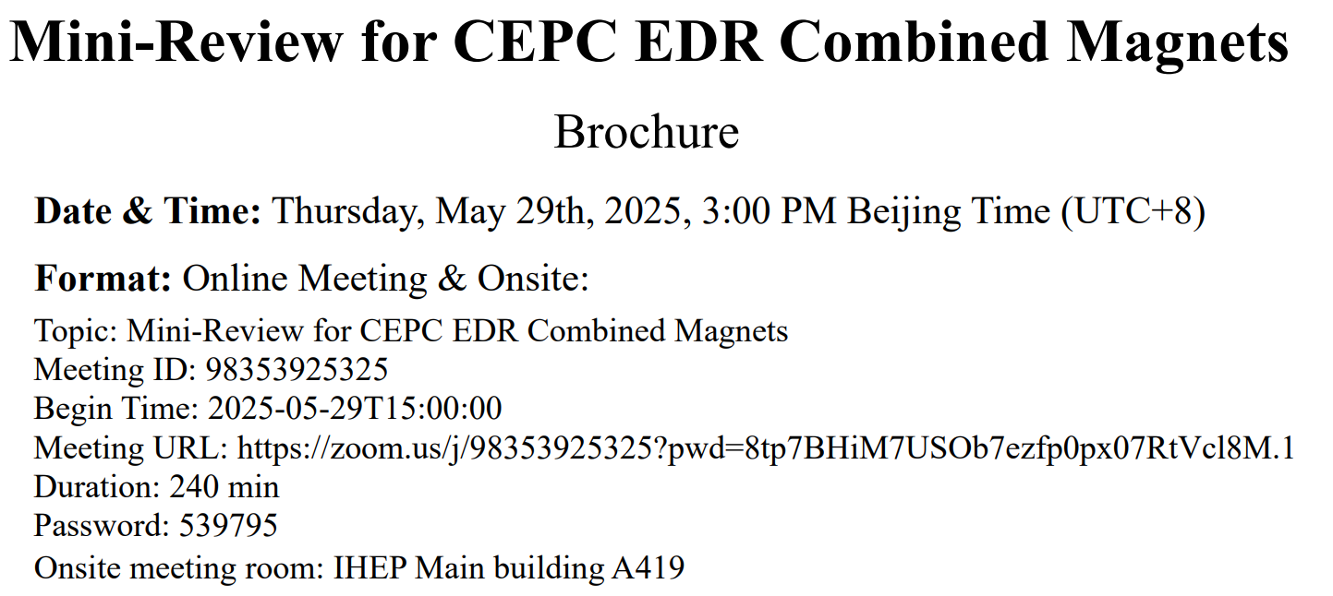
Mini-Review for CEPC EDR Combined Magnets
The booster combined magnets mini-review was held on May 29th of 2025, as requested by the CEPC IARC.
-- 7 foreign reviewers (online)
-- 14 Chinese reviewers (on-site)

Slide 14
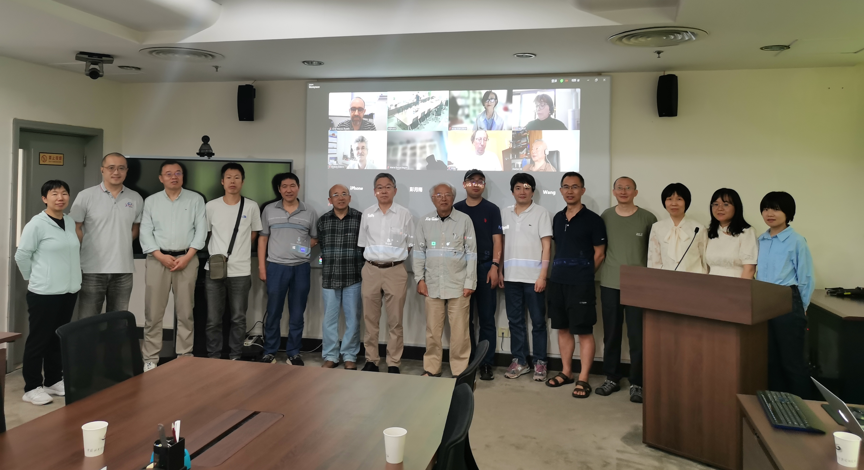

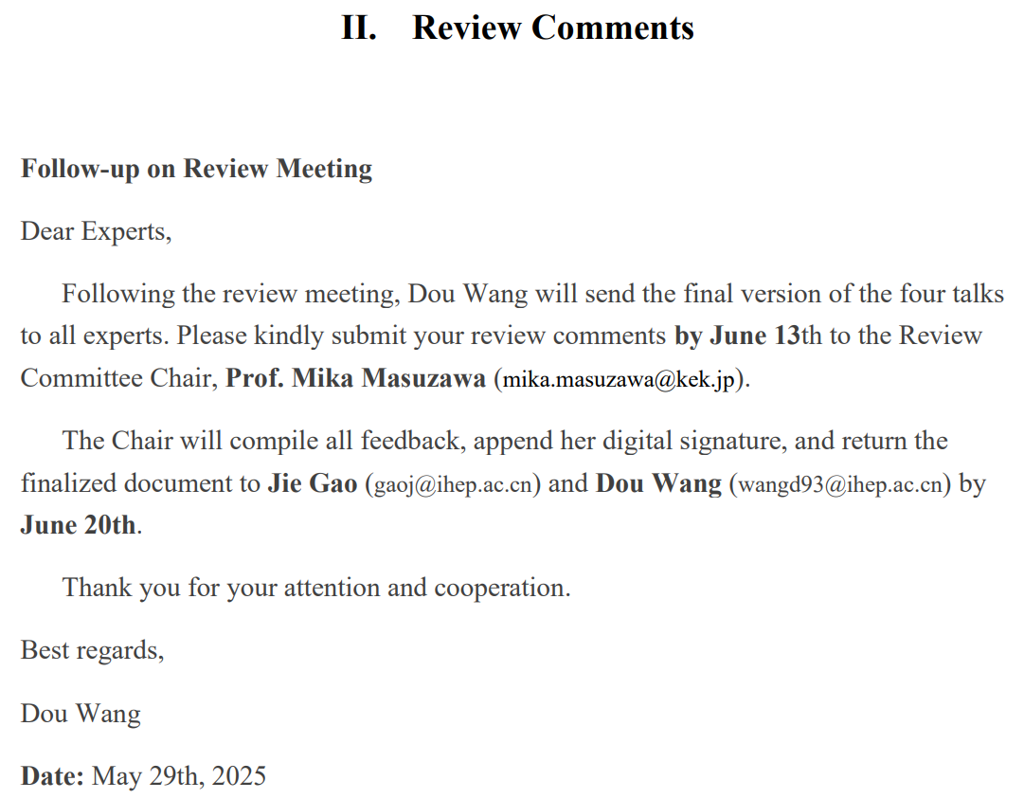
Mini-Review for CEPC EDR Combined Magnets

Slide 15
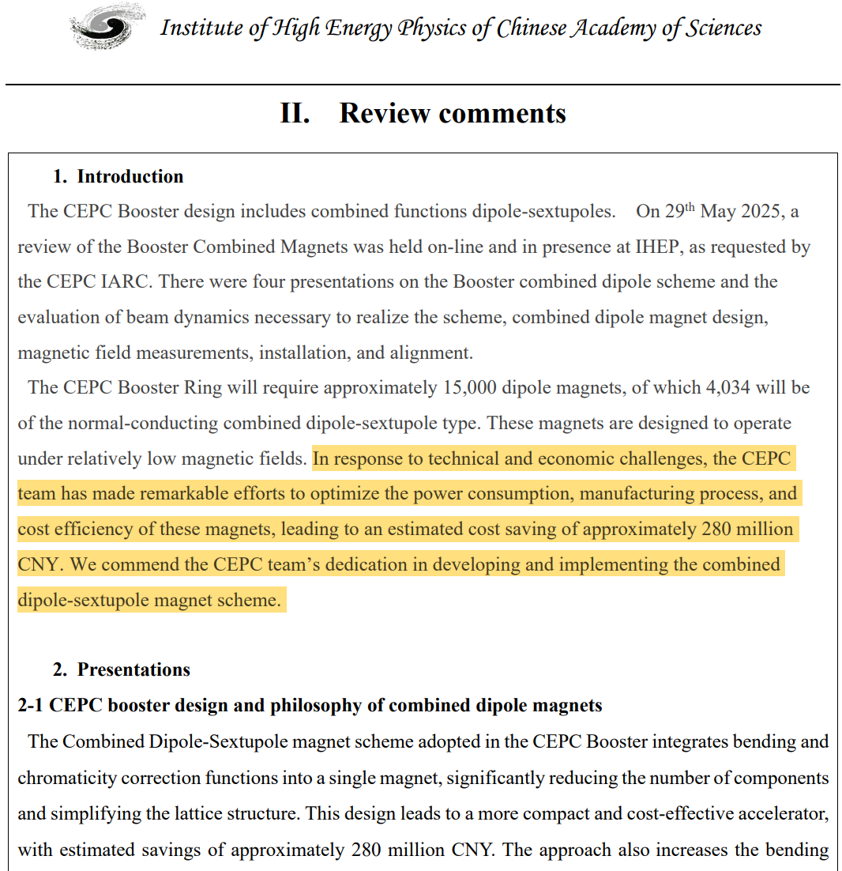
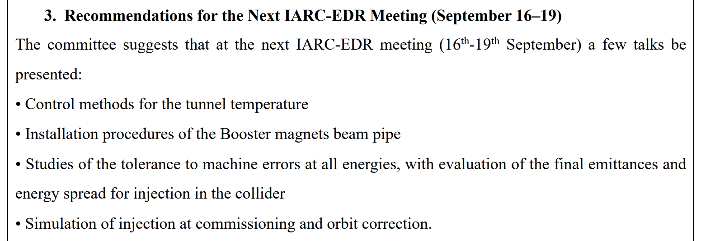
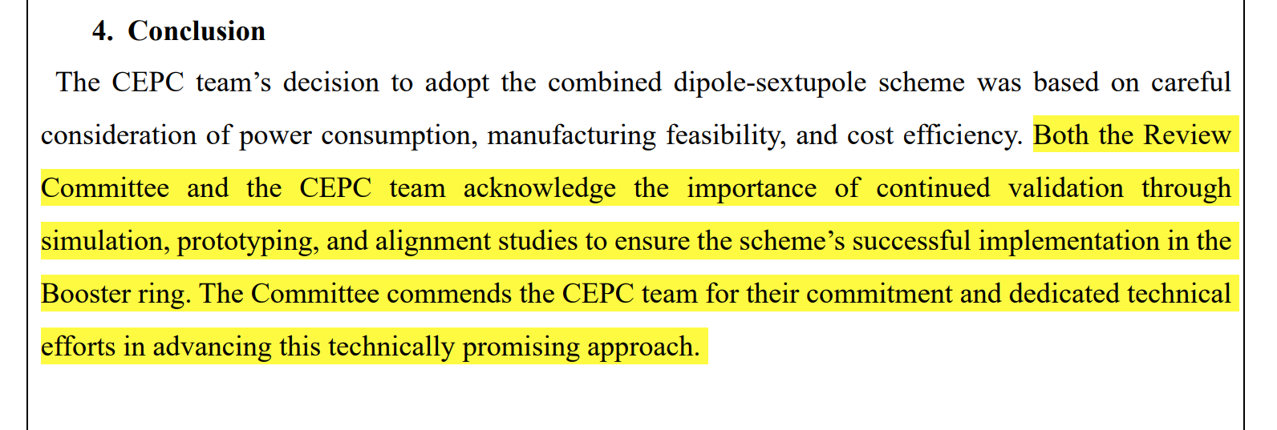
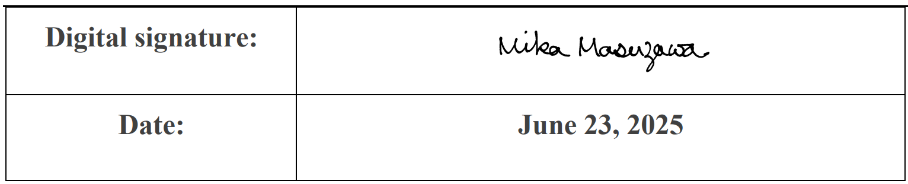
Mini-review report
Quick response was send to the review committee. All the recommendations will be addressed at the next meeting of the IARC.

Slide 16
First turn Injection Commissioning
Daheng Ji
Recent simulation studies have been conducted on the initial beam commissioning of the CEPC Booster
  These studies can also serve as a reference for related research on the CEPC storage ring.
Simulation settings:
  Physical aperture: 56mm
  BPM Accuracy and offset: 300um
  Other error settings are the same as those in ordinary error correction simulations.
  The injection beam jitter and beam distribution are taken into account.
  Based on the AT (Accelerator Toolbox) program.
  Using the response matrices of orbit, trajectory, working point, and injection beam derived from theoretical models.
A similar correction process has already been applied to the HEPS (High Energy Photon Source) booster and storage ring.
  Multi-turn Trajectory Correction, Injection Beam Trajectory Correction
  Single-turn Trajectory Correction
0
10
100
500
1000
10000
stored
RF on
  Tune tuning,
  RF Phase tuning
TBT Optics Correction

Slide 17
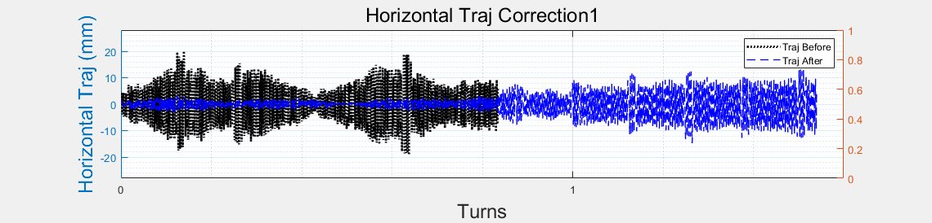
Single-turn and Multi-turn trajectory correction
  Multi-turn Trajectory Correction, Injection Beam Trajectory Correction
Daheng Ji
  Single-turn Trajectory Correction
0
10
100
500
1000
10000
stored
RF on
  Tune tuning,
  RF Phase tuning
TBT Optics Correction
Single-turn trajectory correction: Minimize the trajectory of the beam for the first 5 turns.
Multi-turn trajectory correction: Average the beam trajectory over more than 5 turns to obtain an approximate closed orbit and correct it.
Injection beam trajectory correction: Correct the coordinates of the injection beam at the injection point to reduce the oscillation of the injected beam.
Tune adjustment: Calculate (Phased-CFT) and adjust the working point using the beam over 50 turns.
RF parameters adjustment: Evaluate the beam energy variation with the average of the horizontal trajectory over each turn and adjust the RF parameters to reduce oscillation.
Optics correction: Based on ICA, PCA.

Slide 18
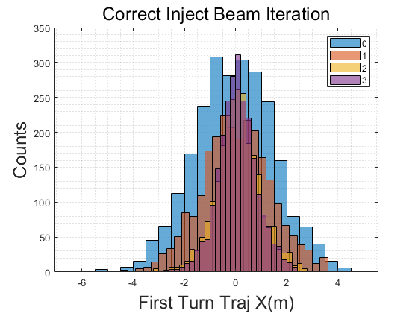
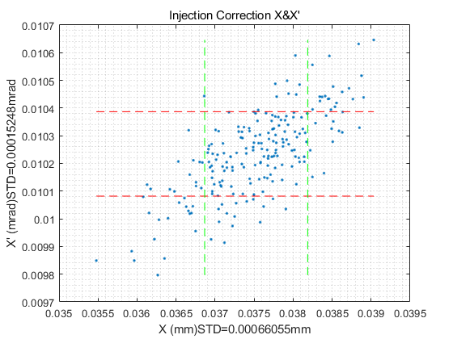
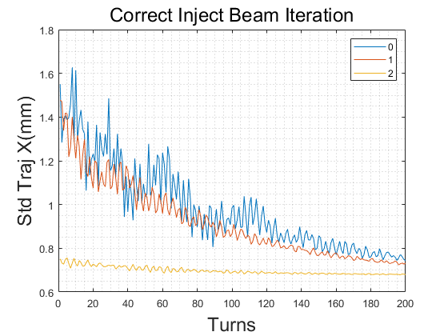
Injection beam trajectory correction
  Multi-turn Trajectory Correction, Injection Beam Trajectory Correction
Daheng Ji
  Single-turn Trajectory Correction
0
10
100
500
1000
10000
stored
RF on
  Tune tuning,
  RF Phase tuning
TBT Optics Correction
Single-turn trajectory correction: Minimize the trajectory of the beam for the first 5 turns.
Multi-turn trajectory correction: Average the beam trajectory over more than 5 turns to obtain an approximate closed orbit and correct it.
Injection beam trajectory correction: Correct the coordinates of the injection beam at the injection point to reduce the oscillation of the injected beam.
Tune adjustment: Calculate (Phased-CFT) and adjust the working point using the beam over 50 turns.
RF parameters adjustment: Evaluate the beam energy variation with the average of the horizontal trajectory over each turn and adjust the RF parameters to reduce oscillation.
Optics correction: Based on ICA, PCA.

Slide 19
Injection beam trajectory correction
  Multi-turn Trajectory Correction, Injection Beam Trajectory Correction
Daheng Ji
  Single-turn Trajectory Correction
0
10
100
500
1000
10000
stored
RF on
  Tune tuning,
  RF Phase tuning
TBT Optics Correction
Single-turn trajectory correction: Minimize the trajectory of the beam for the first 5 turns.
Multi-turn trajectory correction: Average the beam trajectory over more than 5 turns to obtain an approximate closed orbit and correct it.
Injection beam trajectory correction: Correct the coordinates of the injection beam at the injection point to reduce the oscillation of the injected beam.
Tune adjustment: Calculate (Phased-CFT) and adjust the working point using the beam over 10 turns.
RF parameters adjustment: Evaluate the beam energy variation with the average of the horizontal trajectory over each turn and adjust the RF parameters to reduce oscillation.
Optics correction: Based on ICA, PCA.

Slide 20
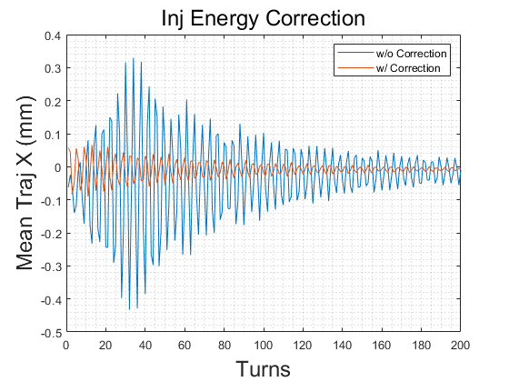
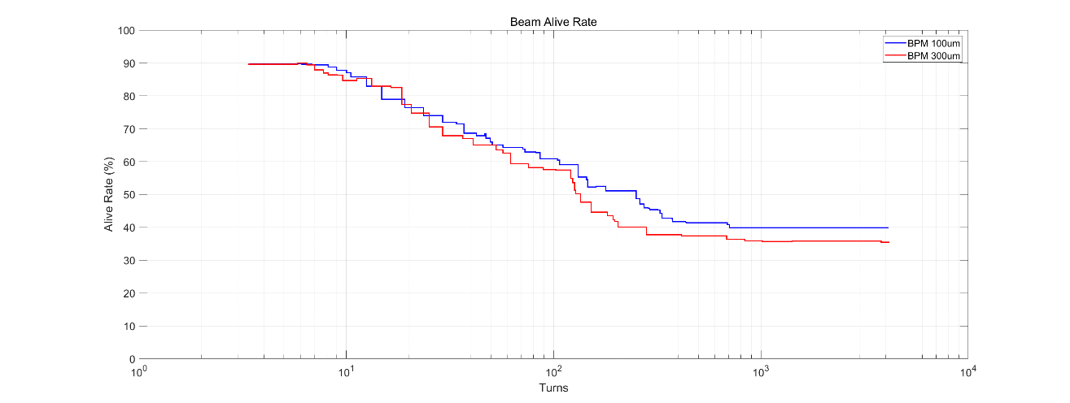
RF parameters adjustment
  Multi-turn Trajectory Correction, Injection Beam Trajectory Correction
Daheng Ji
  Single-turn Trajectory Correction
0
10
100
500
1000
10000
stored
RF on
  Tune tuning,
  RF Phase tuning
TBT Optics Correction
Single-turn trajectory correction: Minimize the trajectory of the beam for the first 5 turns.
Multi-turn trajectory correction: Average the beam trajectory over more than 5 turns to obtain an approximate closed orbit and correct it.
Injection beam trajectory correction: Correct the coordinates of the injection beam at the injection point to reduce the oscillation of the injected beam.
Tune adjustment: Calculate (Phased-CFT) and adjust the working point using the beam over 50 turns.
RF parameters adjustment: Evaluate the beam energy variation with the average of the horizontal trajectory over each turn and adjust the RF parameters to reduce oscillation.
Optics correction: Based on ICA, PCA.

Slide 21
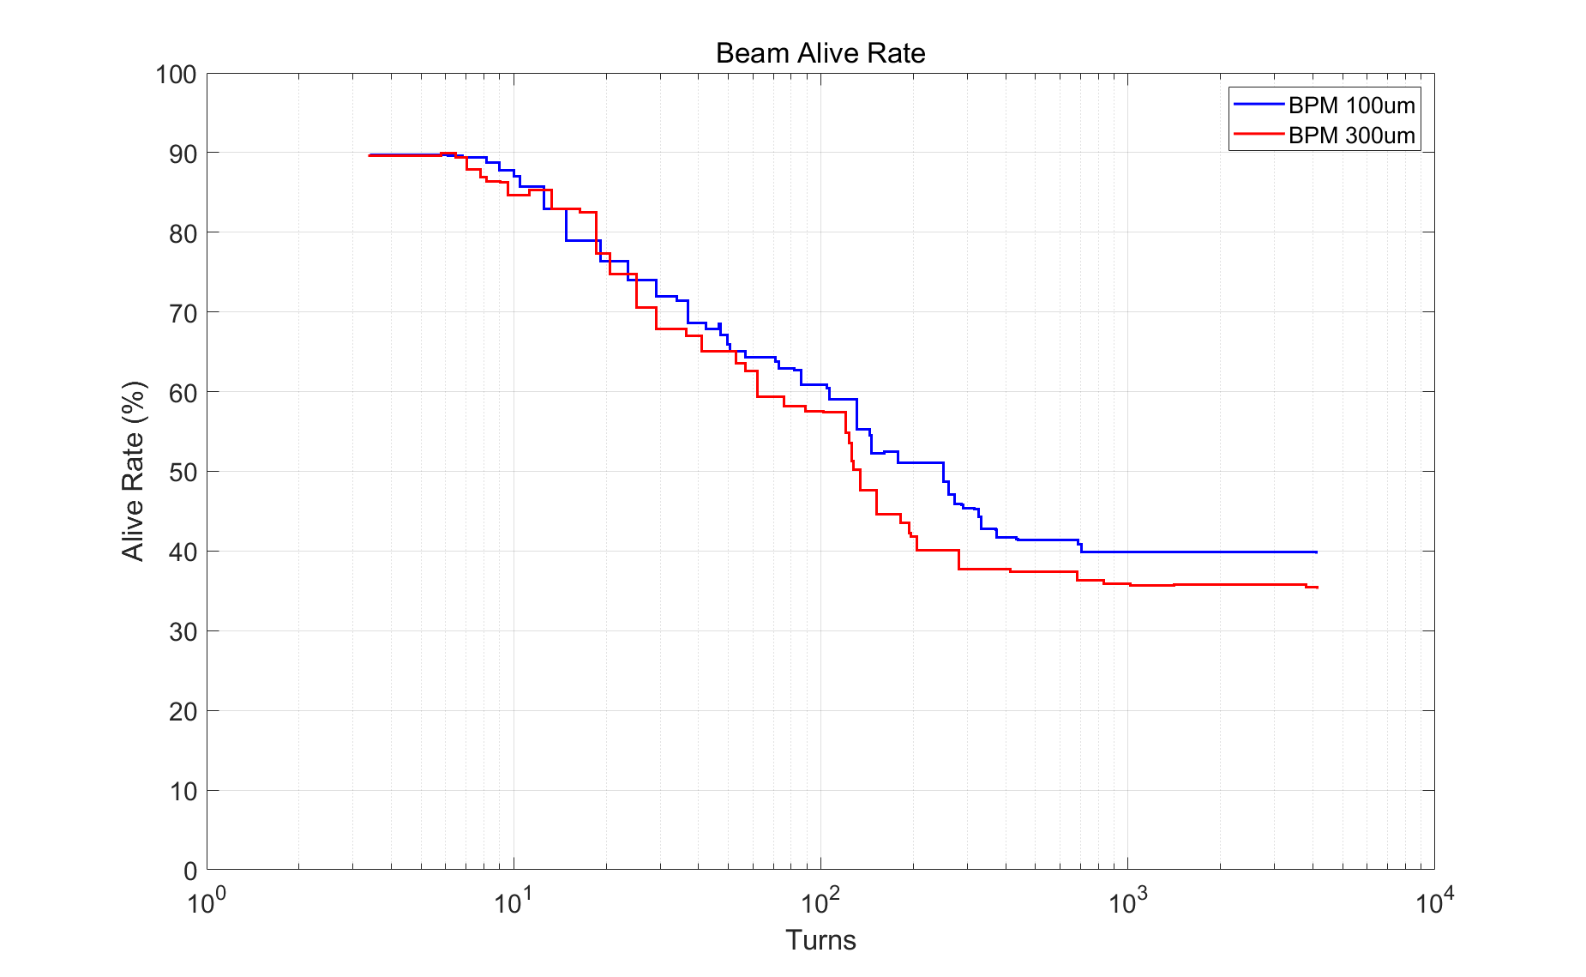
Particles survive rate
  Multi-turn Trajectory Correction, Injection Beam Trajectory Correction
Daheng Ji
  Single-turn Trajectory Correction
0
10
100
500
1000
10000
stored
RF on
  Tune tuning,
  RF Phase tuning
TBT Optics Correction
Results indicate that after correction, approximately 30% of the particles survive for more than 10,000 turns.
  BPM Noise 300 μm and 100 μm has little impact on the results.
  This can meet the needs of subsequent more detailed corrections
  The algorithm is still undergoing optimization.
The research still lacks many details, with some conditions such as more detailed physical apertures being updated and iterated.

Slide 22
Content
EDR progress of CEPC Booster
  Feasibility evaluation of the combined dipole magnets
  Mini-review of the combined dipole magnets
  Simulations of first turn injection commissioning
EDR progress of CEPC positron damping ring
  DR TDR design status
  Polarized DR study
CEPC timing issue and detector performance
Summary

Slide 23
DR parameters in TDR
Damping with reversed bending magnet
4 (max. 8)-bunch storage, storage time:20 (40) ms
Emittance: 2500→ 166/75 (97/3) mm.mrad
Flexibility for extr. emittance
 | DR V3.0
Energy (Gev) | 1.1
Circumference (m) | 147
Number of trains | 2 (4)
Number of bunches/trian | 2
Total current (mA) | 12.4 (24.8)
Bending radius (m) | 2.87
Dipole strength B₀ (T) | 1.28
U₀ (kev/turn) | 94.6
Damping time x/y/z (ms) | 11.4/11.4/5.7
Phase/cell (degree) | 60/60
Momentum compaction | 0.013
Storage time (ms) | 20 (40)
δ₀ (%) | 0.056
ε₀ (mm.mrad) | 94.4
injection σ_{z} (mm) | 4.4
Extract σ_{z} (mm) | 4.4
ε_{inj} (mm.mrad) | 2500
ε_{ext x/y} (mm.mrad) | 166(97)/75(3)
δ_{inj} /δ_{ext} (%) | 0.18 /0.056
Energy acceptance by RF(%) | 1.8
f_{RF} (MHz) | 650
V_{RF} (MV) | 2.5
Longitudinal tune | 0.0387

Slide 24
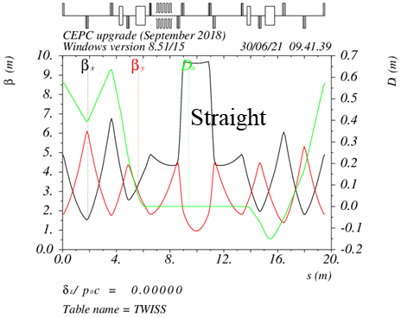
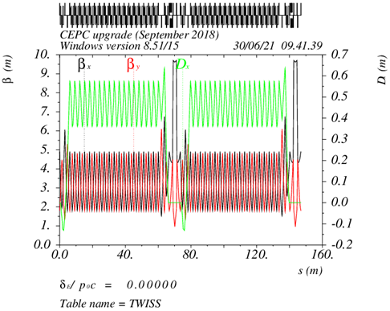
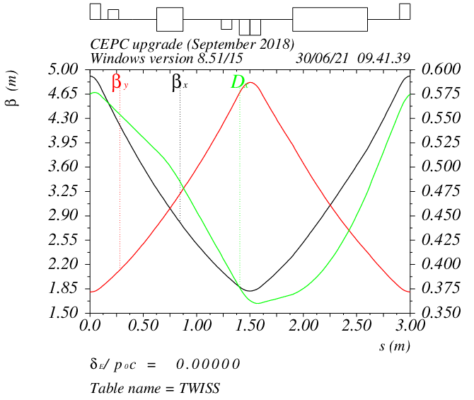
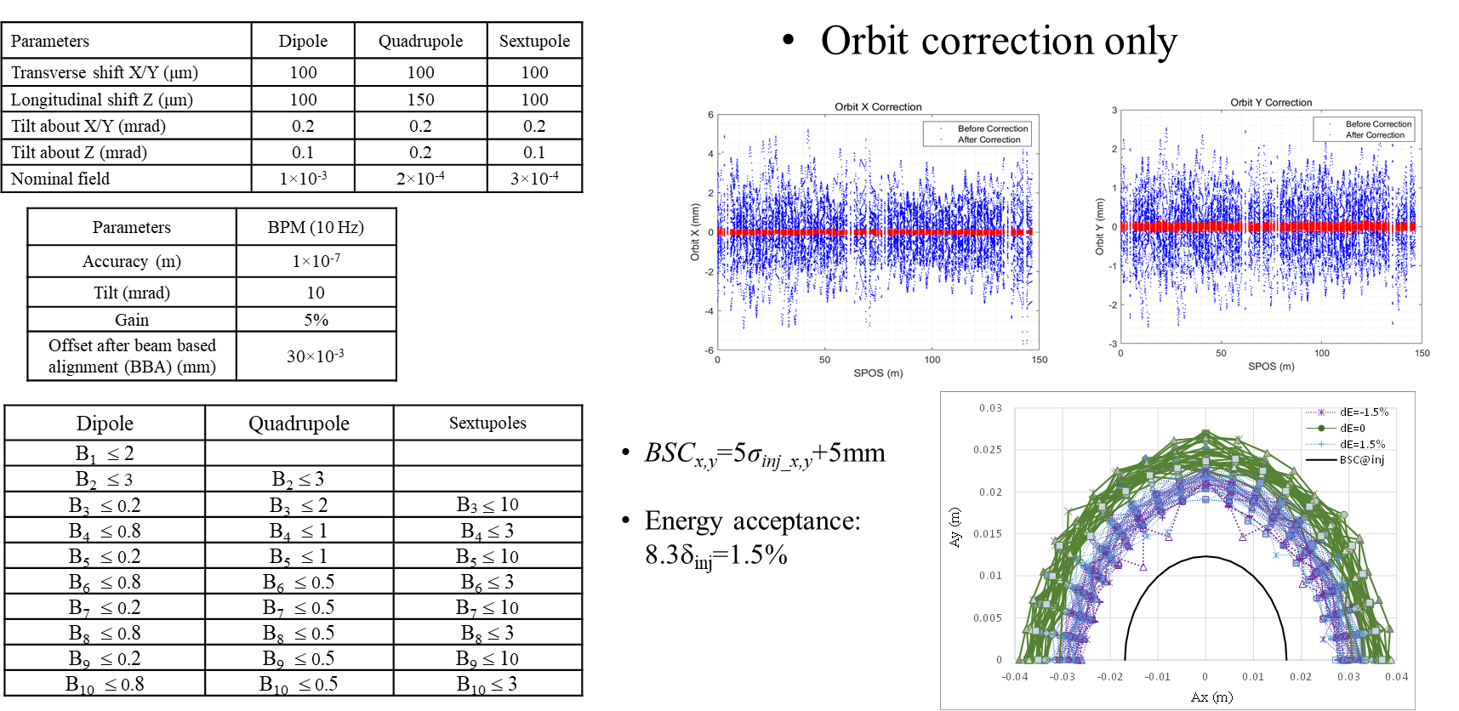
DR optics and error study
Cell length: 3m
B=1.28T
θ_{r} /θ₀=0.355
Phase/cell: 60°/60°
Interleave sextupole scheme
2 sex. families
-θ_{r}
B=1.28T
θ₀
Error study
Arc

Slide 25
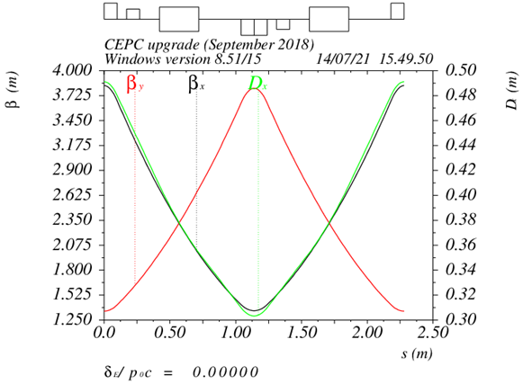
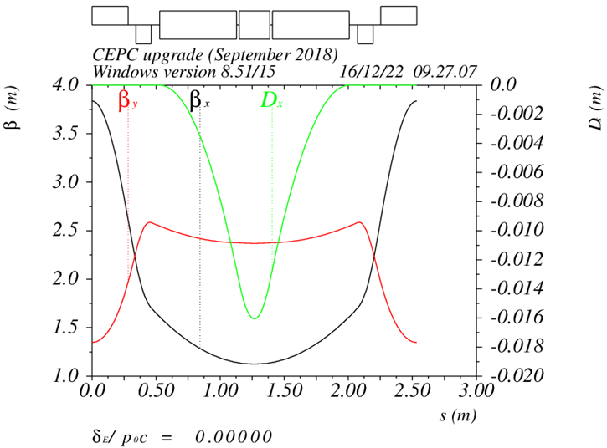
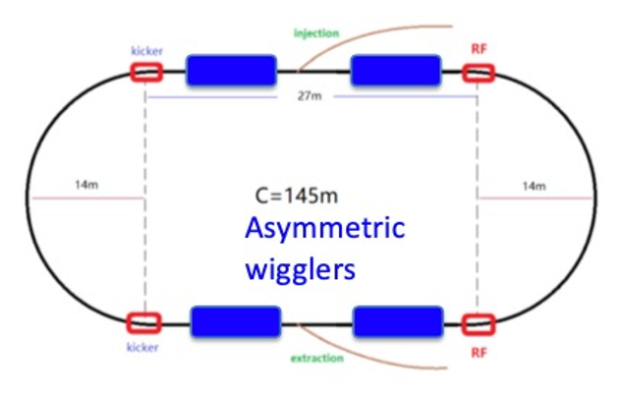
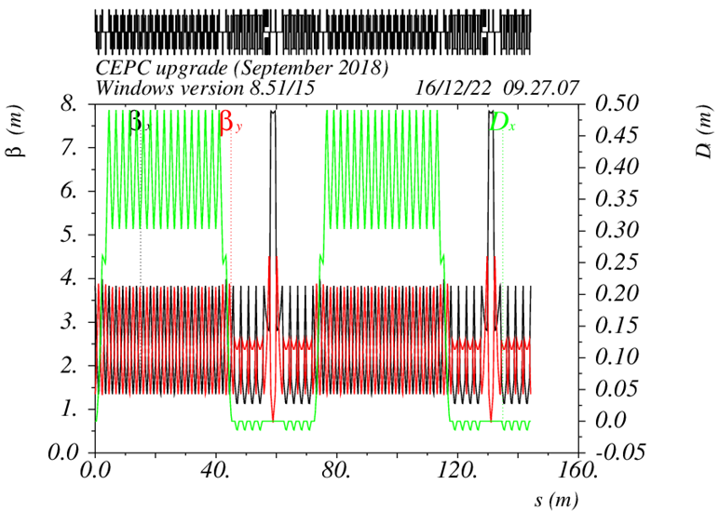
Alternative design for the DR with polarization
Z. Duan, D. Wang
Produce polarized positron beam for the purpose of energy calibration @ Z & W*.
DR V4.0 | unpolarized e+ | polarized e+
Energy (Gev) | 1.542
Circumference (m) | 145
Number of trains | 2(4)
Number of bunches/trian | 1(2)
Total current (mA) | 12.4
Bending radius (m) | 3.44
Dipole strength B₀ (T) | 1.5
Wiggler strength B₊ (T) | 1.8
Wiggler cell length (m) | 1.5
U₀ (kev/turn) | 190.9
Damping time x/y/z (ms) | 7.77/7.77/3.89
Momentum compaction | 0.015
Storage time | 20 ms | 10 min
δ₀ (%) | 0.072
ε₀ (mm.mrad) | 138
injection σ_{z} (mm) | 6
Extract σ_{z} (mm) | 5.7 | 5.6
ε_{inj} (mm.mrad) | 2500
ε_{ext x/y} (mm.mrad) | 150/15 | 138/14
δ_{inj} /δ_{ext} (%) | 0.18 /0.072
RF acceptance (%) | 1.8
f_{RF} (MHz) | 650
V_{RF} (MV) | 3.95
Longitudinal tune | 0.044
10 min storage → ~20% polarization
arc
Compatible with standard top up operation
Asymmetric wigglers
B₊=1.8T=5 B₋
cell length=1.5m
wiggler
Wiedemann, Particle Accelerator Physics, 4 Edition
16 wigglers

Slide 26
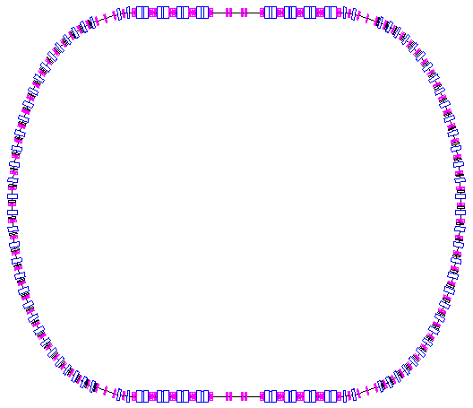
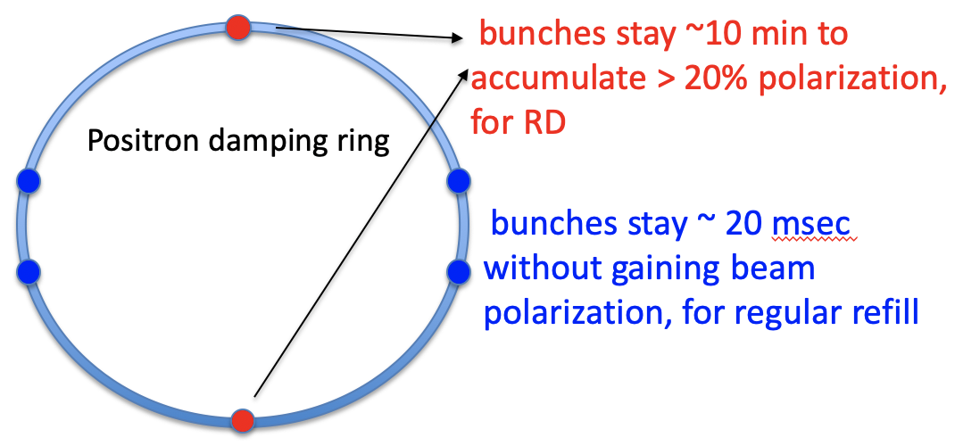
Positron damping/polarizing ring
Optimization of a dual-purpose design
  Bunches stay ~ 20 msec for regular refill
  Bunches stay ~ 10 min to accumulate > 20% polarization for resonant depolarization in the Colliders
Cost and benefit comparison between two schemes
  Higher beam energy without asymmetric wigglers
  Lower beam energy with asymmetric wigglers
Z. Duan
Asymmetric wigglers

Slide 27
Content
EDR progress of CEPC Booster
  Feasibility evaluation of the combined dipole magnets
  Mini-review of the combined dipole magnets
  Simulations of first turn injection commissioning
EDR progress of CEPC positron damping ring
  DR TDR design status
  Polarized DR study
CEPC timing issue and detector performance
Summary

Slide 28
CEPC frequency choice
f (MHz) |  | SHB1 | SHB2 | Linac_S | DR | Linac_C | Booster | Collider
CEPC | Baseline (thermal cathode gun) | 158.89 | 476.76 | 2860 | 650 | 5720 | 1300 | 650
 | Alternative (RF gun) | ⎯ | ⎯ | 2860 | 650 | 5720 | 1300 | 650
CEPC: greatest common divisor=130 MHz
Min bunch spacing @ rings: 7.6923ns
Bunch spacing @ Z: 7.6923×3=23.0769 ns
FCC: greatest common divisor=400 MHz
Min bunch spacing @ rings: 2.5 ns
*D. Wang, et al, “Problems and considerations about the injection philosophy and timing structure for CEPC”, International Journal of Modern Physics A， Vol. 37, (2022) 2246006.

Slide 29
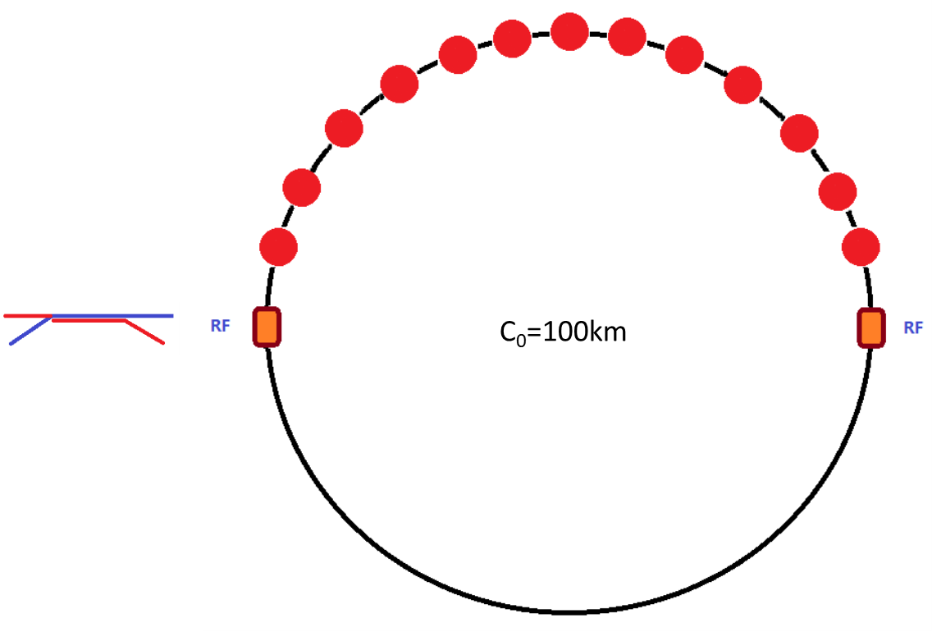
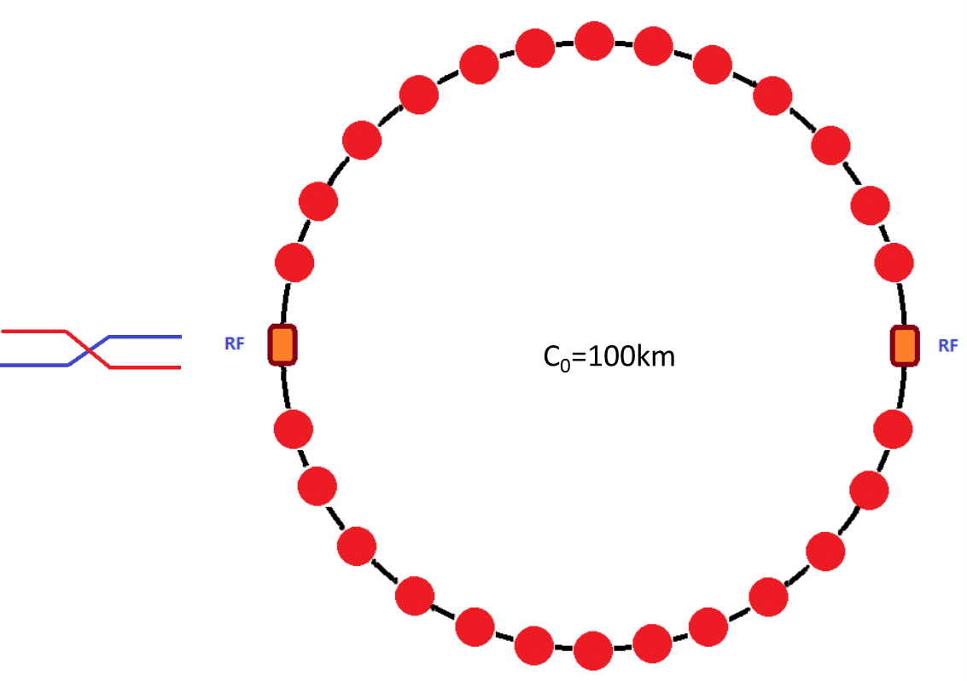
Bunch structure in Booster
tt
H
35 bunches
268 bunches
Train structure @Z
51 train
78 bunch/train
W
Z
1297 bunches
3978 bunches

Slide 30
Bunch structure in Collider
tt
H
35 bunches
268 bunches
Train structure @Z
153 train
78 bunch/train
W
Z
1297 bunches
11934 bunches

Slide 31
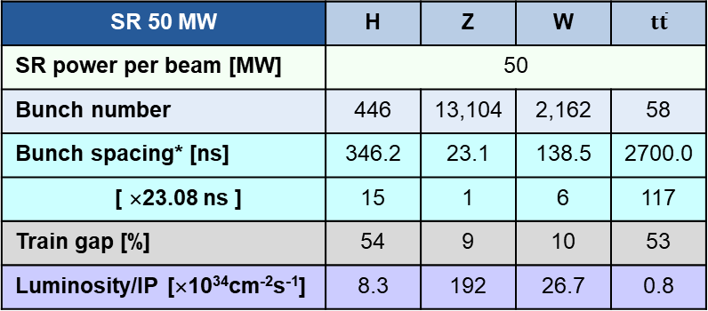

TDR Bunch Structures and Circumference
D. Wang, X. H. Cui, C. Meng, G. Lei, G. Li, J. H. Chen, J. C. Wang, W. Wei…
The spacings between adjacent bunches in any CEPC operation mode are integer numbers of 23.08 ns..
The master CEPC clock will be provided by the accelerator to the detector system(s), synchronous to the beam. The CEPC detector system relies on the clock to sample physics signal at the right time.
It is agreed to have the detector frequency of 43.3 MHz = 130 MHz / 3 = 1 / 23.08 ns, which is reasonably good from the detector point of view.
The CEPC collider ring have possible 14,442 bunch positions (14,442 × 23.0769 ns × c = 99.914 km).
SR 30 / 10 MW | H | Z |  | W | $t\overline{t}$
SR power per beam [MW] | 30 | 30 | 10 | 30 | 30
Bunch number | 268 | 11,934 | 3,978 | 1,297 | 35
Bunch spacing* [ns] | 576.9 | 23.1 | 69.2 | 253.8 | 4523.1
[ × 23.08 ns ] | 25 | 1 | 3 | 11 | 196
Train gap [%] | 54 | 17 | 17 | 1 | 53
Luminosity/IP [×10³⁴cm⁻²s⁻¹] | 5.0 | 115 | 38 | 16 | 0.5
SR 50 MW | H | Z | W | $t\overline{t}$
SR power per beam [MW] | 50
Bunch number | 446 | 13,104 | 2,162 | 58
Bunch spacing* [ns] | 346.2 | 23.1 | 138.5 | 2700.0
[ ×23.08 ns ] | 15 | 1 | 6 | 117
Train gap [%] | 54 | 9 | 10 | 53
Luminosity/IP [×10³⁴cm⁻²s⁻¹] | 8.3 | 192 | 26.7 | 0.8
14,442 = 2 × 3 × 29 × 83
It is important that beam collisions are synchronized with a 43.33 MHz clock.

Slide 32


Circumference finetuning and detector performance improvement
D. Wang, J. Gao, J. C. Wang, X. H. Cui, C. Meng, Y. W. Wang, D. P. Jin, G. Lei, J. H. Chen, Y. H. Li, W. Wei, J. B. Ye, J. Y. Zhai, S. S. Sun, …
CEPC will operate in the Higgs and the LL Z modes in the first 10 years.
The bunch spacing for the LL Z mode is 3×23.08 ns. If the bunching spacing for the Higgs mode is an integer number of 3×23.08 ns, e.g. 24×23.08 ns, the detector system could benefit more.
An estimation of the vertex detector using 65nm CMOS sensor shows that the power consumption per sensor chip is reduced from 310 to 165 mW, about 47% reduction. This significantly reduces the material budget, hence improve the physics performance.
14,448 = 24 × 3 × 7 × 43
$14448×23.08ns×c=99955.418m$
SR 30 / 10 MW | H | Z |  | W | $t\overline{t}$
SR power per beam [MW] | 30 | 30 | 10 | 30 | 30
Bunch number | 268 | 11,934 | 3,978 | 1,297 | 35
Bunch spacing* [ns] | 553.85 | 23.08 | 69.23 | 184.62 | 3969.23
Case 14448 [ × 23.08 ns ] | 24 | 1 | 3 | 8 | 172
SR 50 MW | H | Z | W | $t\overline{t}$
SR power per beam [MW] | 50
Bunch number | 446 | 13,104 | 2,162 | 58
Bunch spacing* [ns] | 276.92 | 23.08 | 138.46 | 2584.62
Case 14448 [ ×23.08 ns ] | 12 | 1 | 6 | 112
*Dou Wang, Jie Gao, Jianchun Wang, et. al., The CEPC Clock Issue and Finetuning of the Circumference, http://arxiv.org/abs/2509.19026

Slide 33
Summary
Feasibility evaluation of the combined dipole magnets has been carried out in EDR. Mini-review finished (May 29th of 2025).
So far, based on the evaluation of production error and misalignment error, the combined dipole scheme can fulfill the requirement of accelerator physics. Experience will be gradually accumulated through the development of prototype.
The simulation work for first injection has been updated. The simulation results show that after correction, a beam survival rate of approximately 30% can be achieved after 10,000 turns, which meets the requirements for subsequent routine correction.
The timing issue of CEPC has been studied between the accelerator team and the detector team. The circumference of CEPC is slightly changed to 99955.418m to improve the detector performance.

Slide 34
Thanks for your attention!
Welcome to suggestions and comments!

Slide 35
Back up

Slide 36

CEPC injector chain
30→180GeV
30GeV
2 RF stations
2 Inj. (Linac to Booster)
2 Inj. (Collider to Booster)
4 Ext. (Booster to Collider)
2 Ext. (Booster to Dump)
100km
30 GeV linac provides electron and positron beams for booster.
Top up injection for collider ring ~ 3% current decay
Booster is in the same tunnel as collider ring, above the collider ring, bypass in IRs (same circumference).
Budget for transfer efficiency 90%: 95% for booster + 95% for transport lines (inj. to collider).
Beam current threshold in booster is limited by RF system.
Feedback systems (Transverse & longitudinal) are need to damp the instability at low energy.

Slide 37
Booster TDR parameters
Injection energy: 10GeV → 20GeV → 30GeV
Max energy: 120GeV → 180GeV
Lower emittance ─ new lattice (TME)
Extraction
Injection
*Diameter of beam pipe is 56mm for re-injection with high single bunch current @120GeV.

Slide 38






Booster TDR optics
D. Wang, C. H. Yu, D. H. Ji, Y. M. Peng, X. H. Cui,…
Arc: TME like structure (cell length=78m)
Interleave sextupole scheme
Emittance@120GeV=1.26nm
Overall idea: uniform distribution for the Q
Combined magnet (B+S) scheme + 100 sextupoles
Phase advance/cell: 100° (H) / 28° (V)
Dispersion sup.
Arc cell
Straight cell
Ref: D. Wang, et al., “Low emittance optics design for CEPC booster”, NIMA, 1062 (2024) 169159.

Slide 39
Main advantage of combined magnets (D+S)
Cost saving (Unit: 10000 CNY)：
280 Million CNY (compared with independent sext. scheme)
-- Magnets : 3026 * 6 =18156
-- Power supply: 10000 ( PS: 2000, cables：8000）
 |  | number | Unit price (CNY)
Independent sextupole |  | 3026 | 60000
Power supply | PS | 64 | 300000
 | Cables | 1280 (km) | 63 /m
8 groups sext. in each 1/8 arc
Increase the filling factor of dipoles to reduce the SR U0 as much as possible
-- Total Length of independent sextupoles : ~1.8 km
Good synchronization for dynamics operation mode
Small saving for the power consumption：0.56~1.1MW

Slide 40


Error Set in Simulation
Simulation based on Accelerator Toolbox(AT) Code.
3σ cutoff | Dipole/Sextupole | Quadrupole
Transverse shift X/Y (μm) | 300(old:100) | 100
Longitudinal shift Z (μm) | 100 | 150
Tilt about X/Y (mrad) | 0.2 | 0.2
Tilt about Z (mrad) | 0.2 | 0.2
Nominal field | 1e-3/3e-4 | 2e-4
 | Accuracy (um) | Tilt (mrad) | Gain | Offset w/ BBA (um)
BPM(10Hz) | 0.1 | 10 | 5% | 30
BPM(TBT@1st Turn) | 300 | 10 | 5% | 300
  #BPM: 2408
  #Corrector: 2000
Dipole | Quadrupole
B1/B0 ≤ 2×10⁻⁴
B2/B0 ≤ 5×10⁻⁴ | B2/B1 ≤ 3×10⁻⁴
B3/B0 ≤ 2×10⁻⁵ | B3/B1 ≤ 2×10⁻⁴
B4/B0 ≤ 8×10⁻⁵ | B4/B1 ≤ 1×10⁻⁴
B5/B0 ≤ 2×10⁻⁵ | B5/B1 ≤ 1×10⁻⁴
B6/B0 ≤ 8×10⁻⁵ | B6/B1 ≤ 5×10⁻⁵
B7/B0 ≤ 2×10⁻⁵ | B7/B1 ≤ 5×10⁻⁵
B8/B0 ≤ 8×10⁻⁵ | B8/B1 ≤ 5×10⁻⁵
B9/B0 ≤ 2×10⁻⁵ | B9/B1 ≤ 5×10⁻⁵
B10/B0 ≤ 8×10⁻⁵ | B10/B1 ≤ 5×10⁻⁵
Simulations show that due to the improved uniformity of quadrupole magnet strength, the sensitivity of the beam to errors in the new design has been significantly optimized.

Slide 41


Mini-Review for CEPC EDR Combined Magnets
First CEPC IARC EDR Review (Sep. 18-20, 2024)
Report of First CEPC IARC EDR Review
CEPC IARC EDR Review Committee
11 October 2024

Slide 42





Fiducialisation error based on magnetic center
Xiaolong Wang
Rotating coil magnetic center measurement error is
estimated to be 0.4mm.( from magnet engineer)
Measurement error of relating the rotation center of the coil to the fiducials of the magnet
  Laser tracker transversal and vertical measurement error 0.03mm
  Laser tracker pitch and yaw measurement error 0.03mm / 5m = 0.006 mrad
The total fiducialisation error based on integral magnetic center
  Integral magnetic center transversal and vertical fiducialisation error
  Roll (θ_{Z}) fiducialisation error 0.02mm/0.142m=0.14 mrad
  Pitch and yaw fiducialisation error
$$\sqrt{{0.4}^{2}+{0.03}^{2}}=0.401mm$$
$$\sqrt{{0.016}^{2}+{0.006}^{2}}=0.017mrad$$

Slide 43



Alignment method based on mechanical center
Xiaolong Wang
Using a laser tracker to perform the measurement. By measuring the lower pole surface and the inserting plate outer surface to determine the mechanical center position.
0.38m
There are 13 inserting plates along the magnet longitudinal direction.
Inserting plate
Using the measurement points best-fit two planes, obtain the intersection line of the two planes.
Move the intersection line to the magnet center according to the design dimensions, obtain the mechanical center.

Slide 44

Fiducialisation error based on mechanical center
Xiaolong Wang
  Taking into account laser tracker measurement error and the inserting plates machining error (0.03mm), we estimate the transversal and vertical measurement error of the mechanical center is about 0.05mm.
  The mechanical structure of a magnet is highly correlated with the distribution of its magnetic field, so we can determine the integral magnetic center by the mechanical center. HEPS: transversal and vertical difference between magnetic center and mechanical center is 0.02mm(1σ). Considering the combined magnet has a more complex magnetic field, longer dimension and a larger aperture than HEPS magnets, we estimate the difference between integral magnetic center and mechanical center in transversal and vertical is about 0.05mm(1σ) for the combined magnet.
  The integral magnetic center fiducialisation error in transversal and vertical include the mechanical center measurement error and the difference between the mechanical center and the integral magnetic center, the total error is about
$$\sqrt{{0.05}^{2}+{0.05}^{2}}=0.071mm$$

Slide 45
Comparison between requirements and achievement
 | Requirements | Achievements
Offset of integrated sextupole center (RMS) | ≤150um (Horizontal) / 150um (Vertical) | 100um (Horizontal) / 102um (Vertical) *
Magnet straightness along z (MAX) | ≤1.5mm (Horizontal) / 1.0mm (Vertical) | 1.5mm (Horizontal) / 0.2mm (Vertical)
* Alignment based on mechanical center measurement

