Slide 1
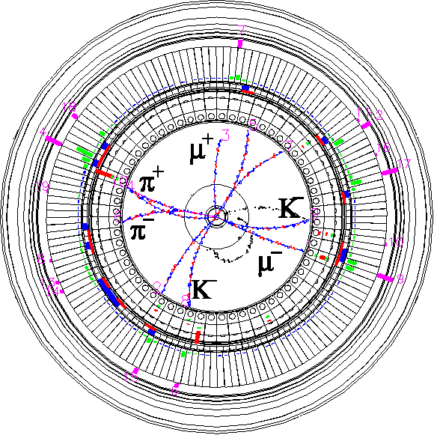


SuperKEKB Accelerator Status
Makoto Tobiyama
KEK Accelerator Laboratory
(on behalf of SuperKEKB Accelerator Team)
Inter-University Research Institute Corporation High Energy Accelerator Research Organization (KEK)
大学共同利用機関法人 高エネルギー加速器研究機構 (KEK)

Slide 2
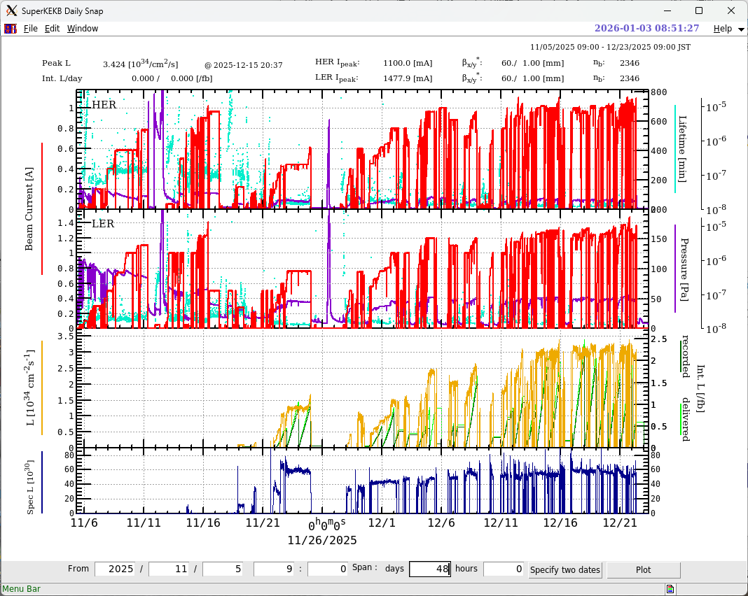
2025C run summary

Slide 3
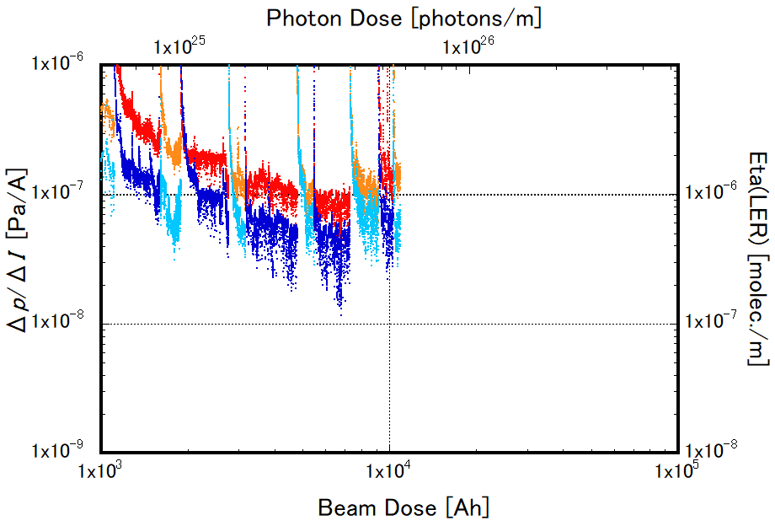
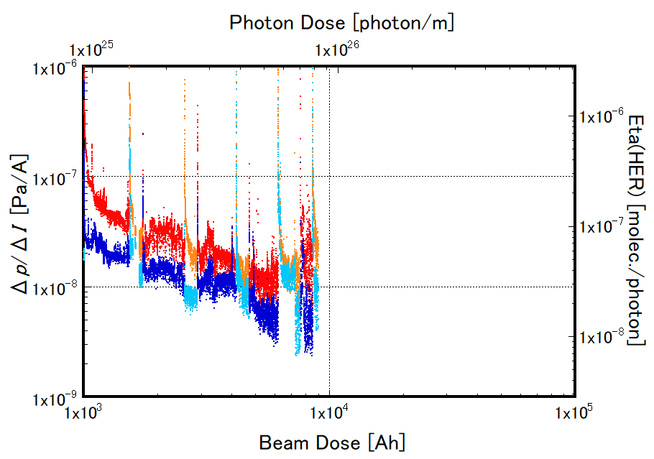
history of dp/dI during Phase-3 operation
LER
LS1
HER
Whole ring
2024ab
Whole ring
Arc sections
(D03, D06, D09, D12)
2024c
2025c
2025c
2024c
Arc sections
(D03, D06, D09, D12)
2022ab
2024ab
2022ab
LS1

Slide 4
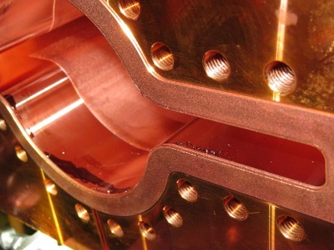
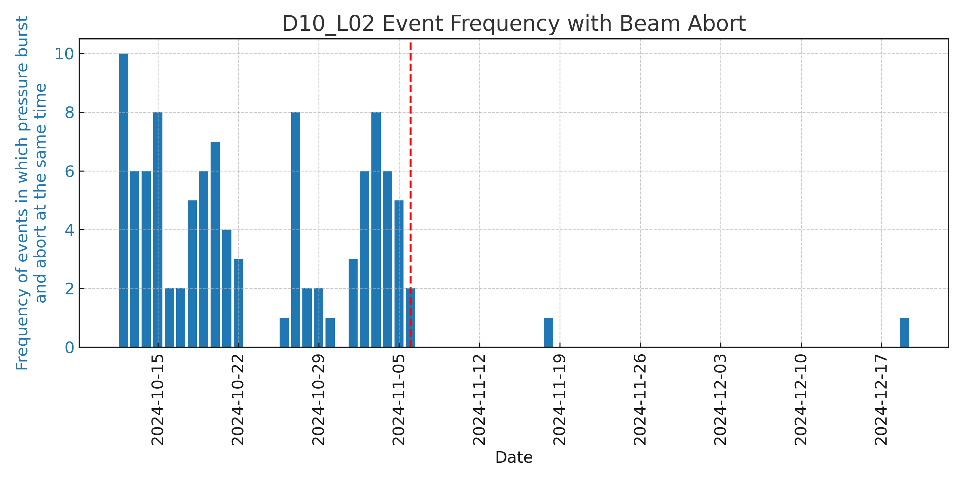
Sudden Beam Loss
Sudden Beam Loss (SBL)
  SBL is the most critical obstacle to achieving stable operation.
    Part of the beam is suddenly lost within a few turns.
    It is difficult to prevent uncontrollable beam from damaging Belle II and collimators.
  Countermeasures
    Removal of VASCEAL contamination
      All MO-type flange connections likely used VACSEAL were checked and fully cleaned during the previous shutdown.
    SBL mitigation effect of VACSEAL removal was confirmed during 2024c run.
  Significant reduction in SBL events
Additional countermeasures
  Collimator relocation
    D06V2 -> D03V4 (to protect IR (Belle II, QCS, D02V1 collimator) from uncontrollable beam)
  Additional beam loss monitors and acoustic sensors
  Faster beam abort system
T. Ishibashi
black stain removal
Number of pressure burst with beam abort
Last shutdown
VACSEAL removal
Tsukuba (Belle II)
D02V1
Interaction region (IR)
D03V4
Last shutdown
Nikko wiggler Sect.
Oho wiggler Sect.
D06V2

Slide 5
However..
Still observed SBL-like events without vacuum bursts in both rings.
SBL events with vacuum bursts (some of them caused the QCS quench), where we have cleaned the chamber completely inside in LER.
  Near Nikko and Oho wiggler section
We have investigated the inside during this shutdown.
  No significant indication of dust (like vacseal).
  Exchanged the bellows chambers with the spares.

Slide 6
Many machine failures
HER synchrotron injection-related failures
  Damage the vacuum chamber wall (and gasket) around the beam dump due to the aborted beam, which resulted in a large vacuum leak after one day of operation.
    The issue was temporarily resolved by re-examining the trajectory of the abort beam and modifying it to maintain sufficient distance from the chamber wall.
  Large bunch leaks to the following buckets.
Failure of the pulsed power supply of the HER beam abort system caused the extreme beam loss by the backup system (weak bending magnet off)
  Damaged the D1V1 collimator heads.
    By tuning the other vertical collimators, we could turn on the Belle II detector, but with a low injection rate.
  Suspected QCS-L vacuum leak at the vacuum insulation vessel.

Slide 7
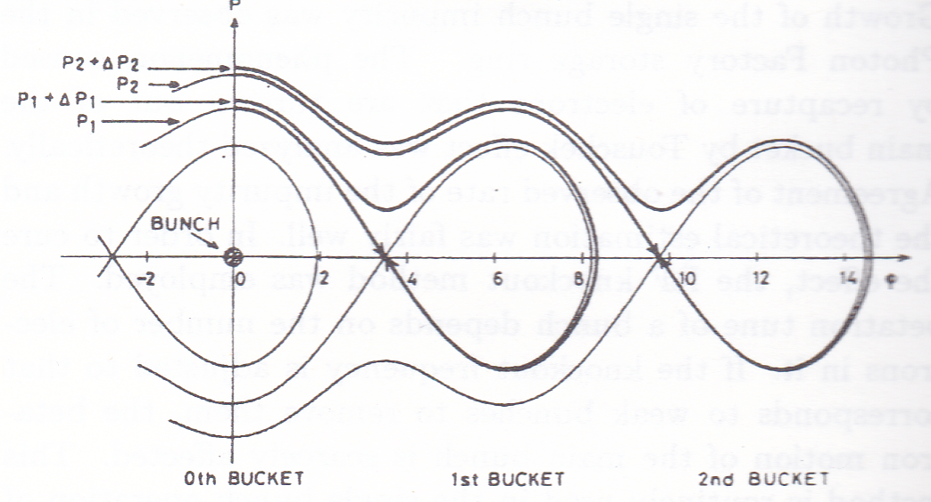
Synchrotron Injection of HER
For the collision optics with by*~8 mm to 1 mm, we have struggled to get a good injection efficiency, but it did not work out for a higher repetition rate of larger than 12.5Hz.
Significant charge leak to the following buckets (~15%).
Given up synchrotron injection and returned to betatron injection.

Slide 8
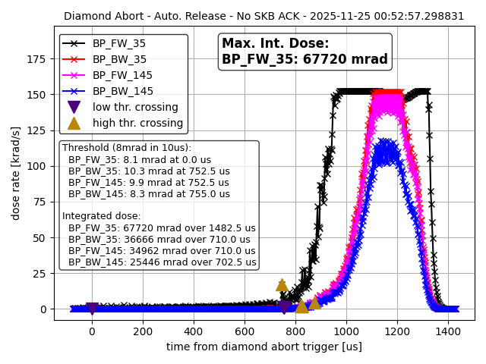
Due to weak-bends cutoff, a large beam orbit primarily in the horizontal direction emerged with a time constant of 0.1 seconds, resulting in catastrophic beam loss.
Simulation suggests more than 80% beam loss in the IR direction.
  Large xy coupling.
  Shrinked RF separatrix.
The QCS on the L side caused a quench in all magnets, taking about 7 hours to restore the liquid level.

Slide 9
(Temporally) countermeasure for both rings
When an abort kicker power supply malfunctions, do not issue an abort request.
  In principle, it will not be strongly needed to abort the beam due to the malfunctioning of the abort kicker PS.
Simultaneously with the power supply issue, we decided to send an HV shutdown request to Belle II, completed signal verification and operational confirmation at Belle II.
During this period, we will attempt to restore the abort kicker power supply. If restored, use the abort kicker to abort the beam correctly. If restoration fails, wait until the current decays sufficiently, then drop the beam via RF off or weak-bends.
Note: Even if the abort power supply is in an abnormal state, kicking is possible if charged. Therefore, changing the interlock logic is also under consideration.

Slide 10
Weak bend and RF OFF are extremely dangerous beam abort methods, so we are considering other approaches
  (A) Control weak bend (and horizontal steering magnets) to direct the beam to a radiator that can be damaged
    Simulation shows the beam will be crossing strong resonance lines such as 3rd slowly after By<90%.
    Considering preparing a horizontal bump at horizontal emergency radiators.
  (B) With RF OFF, direct the beam to a radiator located in a safe area
In either case, we are currently studying the beam trajectory with simulation. After confirming the orbit, we will check the orbit with the real beam (with a tiny beam current).

Slide 11
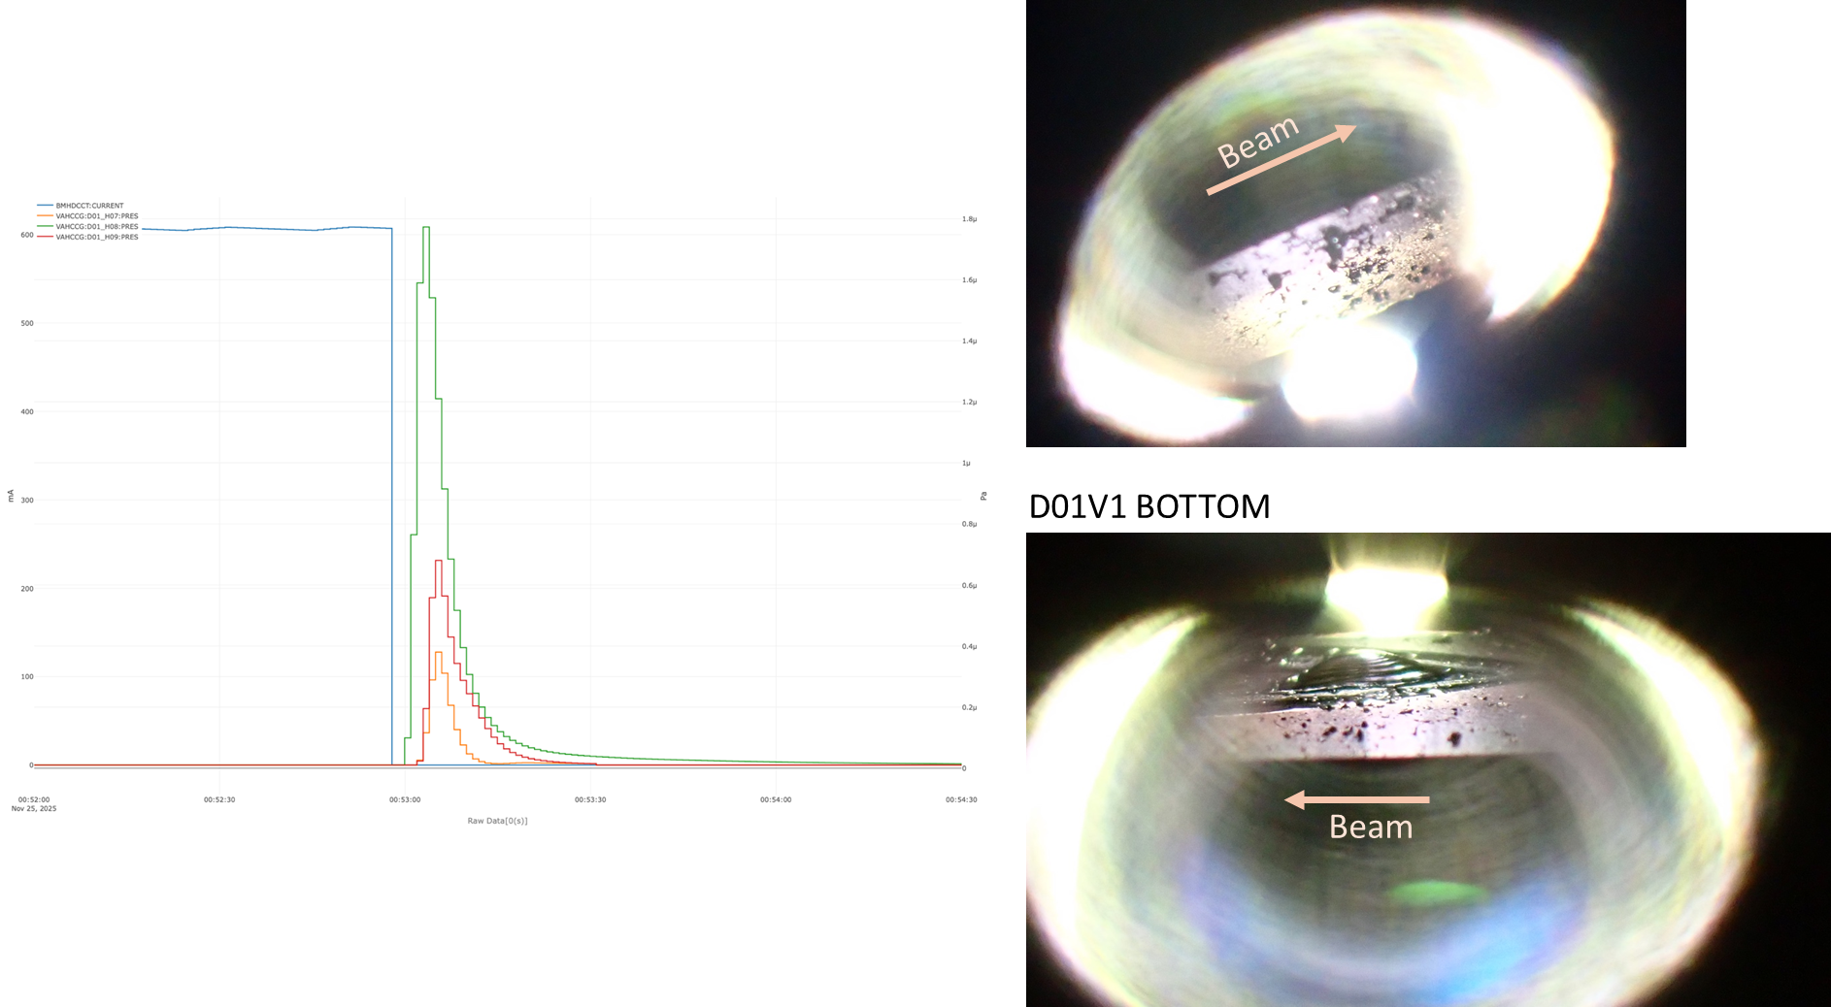
D1V1 collimator head has been damaged

Slide 12
By moving the damaged vertical collimator 1.5 mm horizontally and adjusting the other vertical collimators, we are currently able to continue operation while keeping the background to the Belle II detector within acceptable limits.
However, this situation results in the vertical collimator being significantly narrowed, considerably reducing the HER’s injection efficiency.

Slide 13
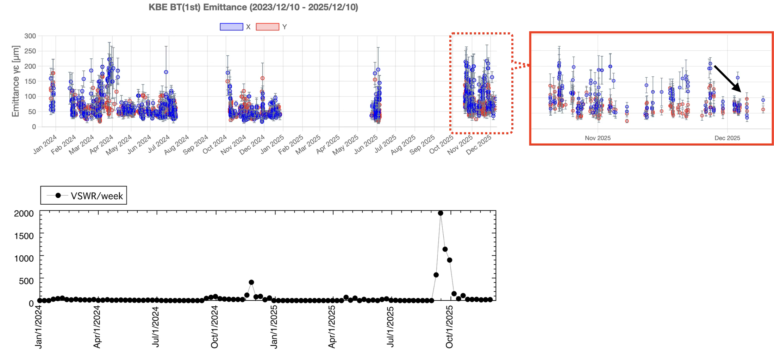
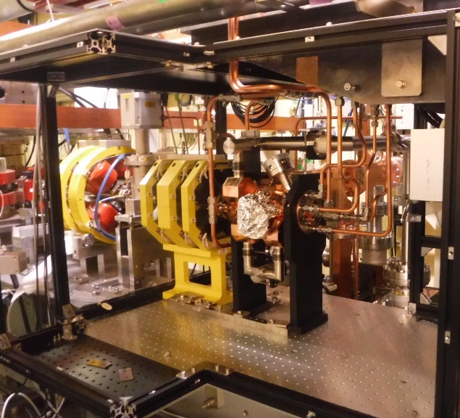
Injector / injection efficiency
New RF gun operation status
Emittance and frequency of VSWR at the same level as before
Installation
↓
2025c operation
RF conditioning
~20 times/week
By M. Yoshida et al.
New RF gun
Notes:
r

Slide 14
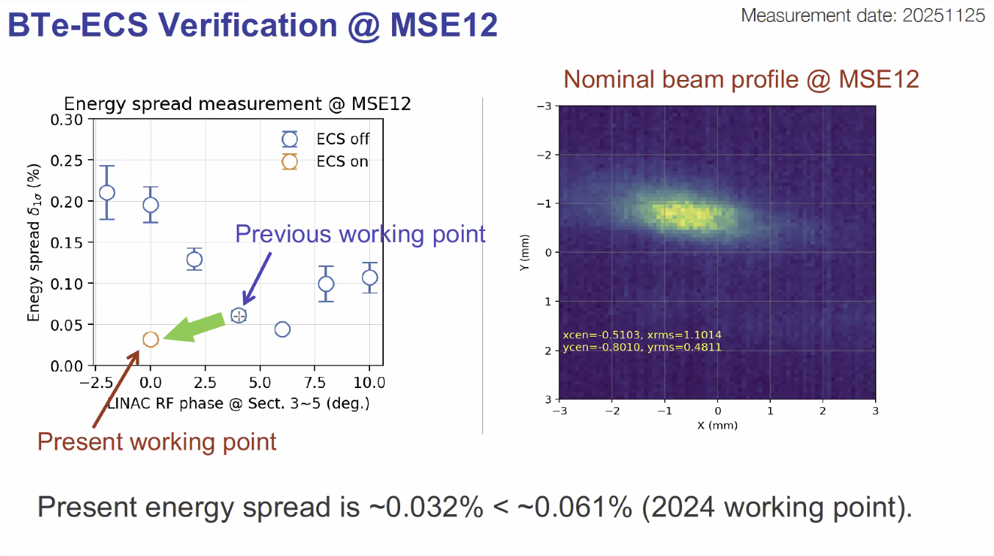
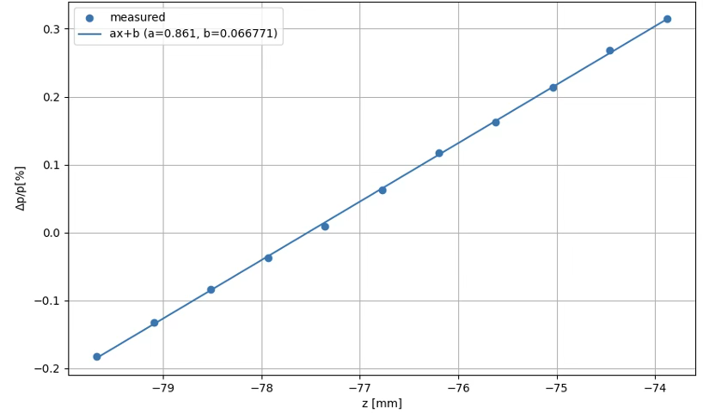
Injector / injection efficiency
Electron ECS operation status
Design V_{c} = 100 MV and R₅₆ = -0.7m attained
Energy compression confirmed
Measured voltage : 100.08 MV
By T. Natsui
By T. Yoshimoto

Slide 15
Injector / injection efficiency
The other studies on BT and DR for injection improvement
BT
  Resolution improvement of BPMs for BTe-ECS by using VME system : 72 → 7.5 μm
  SY3 new precise beam diagnostics line for HER e⁻ beam commissioned
  Tests of new ML beam-optimization and auto-phase tuning in progress
  Test of transverse beam-size minimization by Bayesian and Down-hill optimization with BT beam profiles (Two SR monitors required)
  BTe new energy- and orbit-feedback
  Disappearance of XY-coupling by revised bending magnets in BTp
  BTe and BTp dispersion correction
  Auto phase scanning program for both eECS and pECS
DR
  Successful horizontal orbit correction for only 2nd e⁺ bunch by using new horizontal strip-line kicker in RTL

Slide 16
Obstacles to High beam current storage
Vertical emittance of injection beam.
Beam jitter of the injection beam.
Beam-beam related injection efficiency.
  Increase Bx at injection point, Decrease Bx at collision point
Vacuum burst at ARES cavities
  A cavity that periodically deteriorates the vacuum, such as argon instability(D8).
  ARES cavity experiencing sudden vacuum deterioration, as if due to an internal leak (D5A).

Slide 17
Improvement of injection efficiency
Optical matching between the beam transport line and the ring has significantly improved the HER's injection efficiency.
  The results do not agree well with optical calculations, and a correction method has not yet been established.
Two-bunch injection of LER worked well to double the injection rate.
  The equalization of injection efficiency between Bunch 1 and Bunch 2 resulted from adjusting RTL Strip Line Kicker No. 2 and matching the energy levels of both bunches.

Slide 18
Vertical beam size
In HER, the vertical emittance during single-beam operation has only been achieved at levels equivalent to the previous period (2024c).
  However, there are cases where the effects of synchro-beta resonance lines can be mitigated (this depends heavily on the results of optical correction).
In LER, a smaller vertical emittance than the previous term has been achieved.
For the collision performance, initial concerns were raised about low specific luminosity and significant geometric deviation. However, through continued tuning, the deviation has decreased, and a specific luminosity comparable to that in the previous period has been achieved.

Slide 19
Summary
The SuperKEKB Accelerator resumed operation as scheduled.
We attempted synchrotron injection at HER, but due to difficulties with beam injection during collisions, we reverted to the previous betatron injection method.
Unexpected problems have been occurring frequently, and we have not yet achieved the target performance.
  Synchrotron injection-related troubles
  Numerous failures associated with weak bending magnet off during HER Abort system malfunctions.
  Large vacuum burst (internal leak?) of LER D05A ARES cavity.
  Disruptions caused by the earthquake off the eastern coast of Aomori Prefecture
  Difficulties to keep Liq-He level (solved)

Slide 20
2026a/b runs
Restart ring operation on 26/Jan/2026
Continue operation until (at least) the end of May/2026
  Keep βy*=1mm with (trying to) increase the beam currents
  Belle II data taking has the priority– to achieve the total integrated luminosity of 1 ab⁻¹
Machine development time will be 3 days/month.

Slide 21
Backup

Slide 22
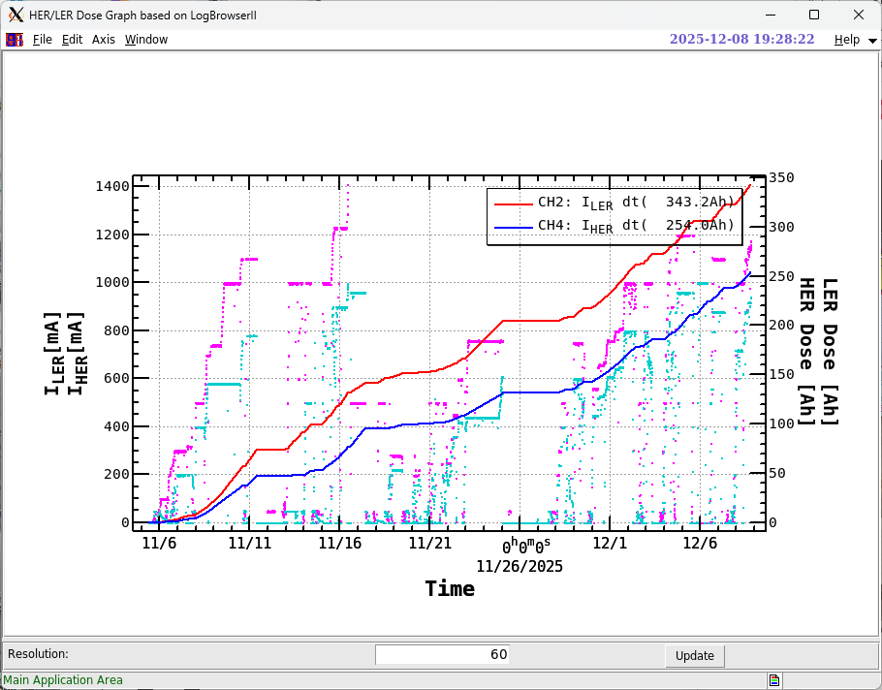
Vacuum scrubbing

Slide 23
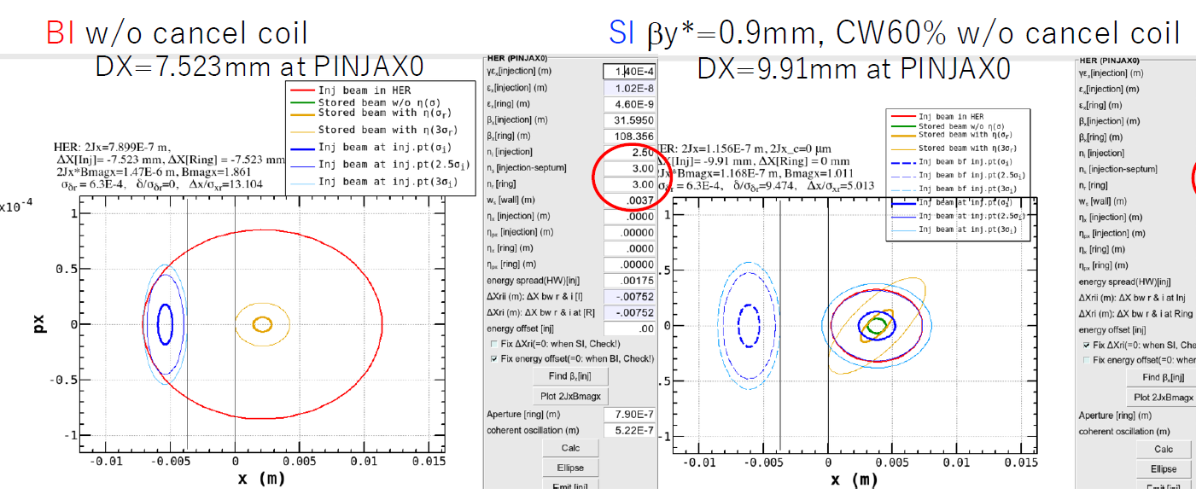
HER: synchrotron injection
N. Iida, https://kds.kek.jp/event/57401/
Betatron injection (BI):
conventional method at SuperKEKB, horizontal distance at the injection region (ΔX) goes to betatron (horizontal) oscillation
Synchrotron injection (SI):
proposed method at SuperKEKB, horizontal distance at the injection region (ΔX) goes to synchrotron oscillation
In synchrotron injection, beam-beam effects can be reduced, then the beam injection efficiency will come improved.

Slide 24
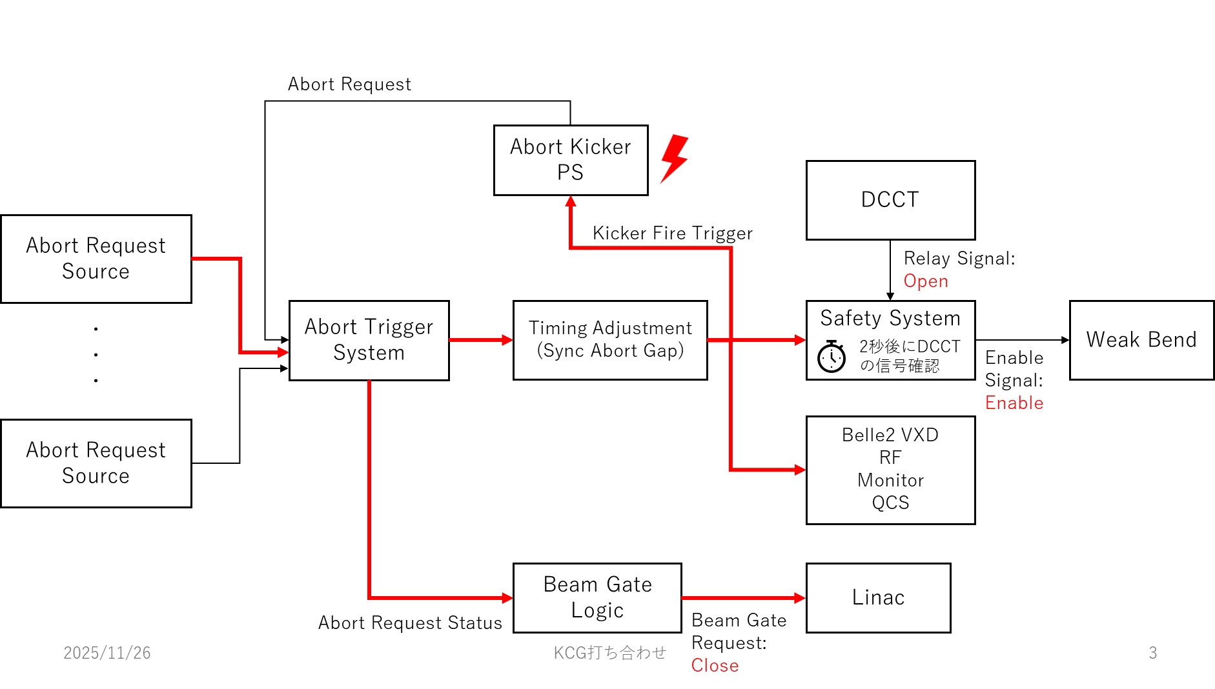
HER beam abort kicker malfunctioning
Normal condition

Slide 25
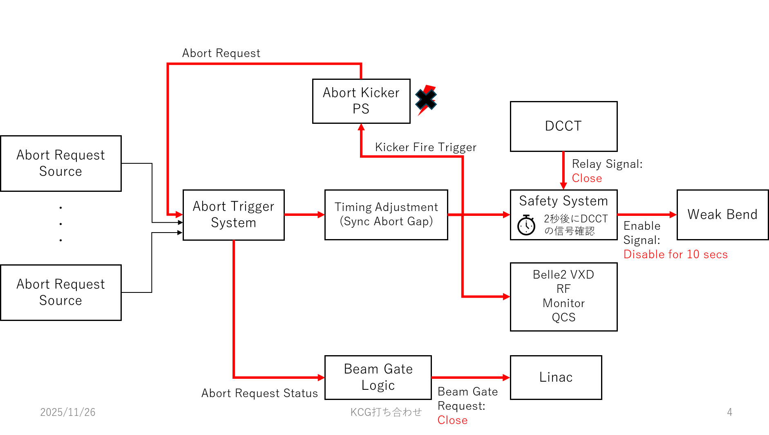
Abort kicker mulfunctioning

Slide 26
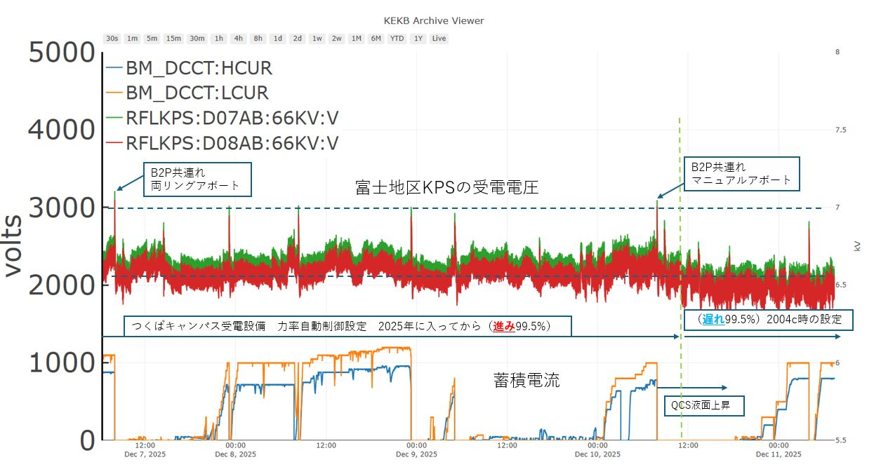
B2P power supply down due to overvoltage of the primary 6.6kV line

Slide 27
The LER bending magnets power supply (B2P) tripped due to a primary voltage (6.6kV) overlimit interlock (occurred twice) caused by the trip of all RF sources of Fuji area due to beam abort.
After investigating the cause with KEK's Facilities Department, it was determined that the settings for the power factor correction capacitors at KEK's power receiving section—intended to improve power efficiency—differed from those used in fiscal year 2024 (having been adjusted toward greater energy savings). These settings were reverted to their original configuration.
  Efforts were also made on the RF side to reduce power consumption in the Fuji area.
  After this, the B2P power supply is not interlocked.

Slide 28
Synchrotron Injection for HER
Successfully with the detuned optics, but
  Damage the vacuum chamber wall (and flange) around the beam dump due to the aborted beam, which resulted in a large vacuum leak after one day of operation.
  The issue was temporarily resolved by re-examining the trajectory of the abort beam and modifying it to maintain sufficient distance from the chamber wall.

Slide 29
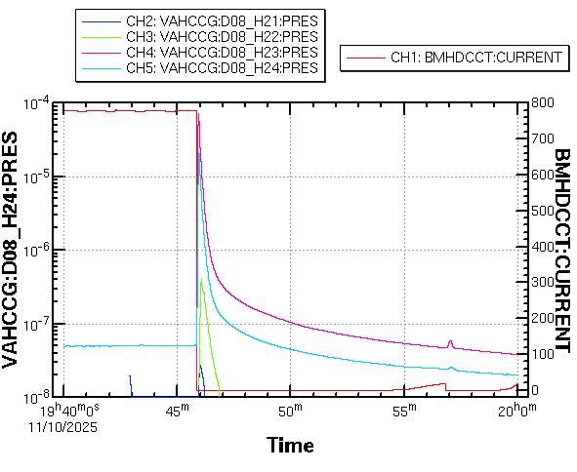
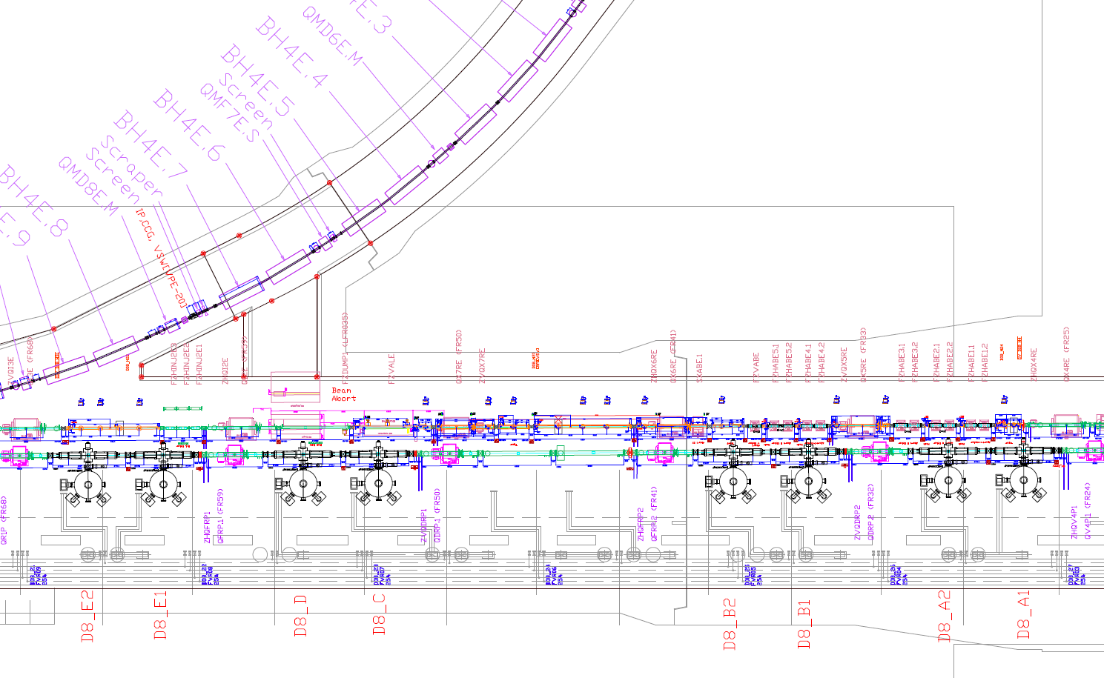
ビームダンプ
ランバートソン
アボートキッカー
リーク箇所

Slide 30
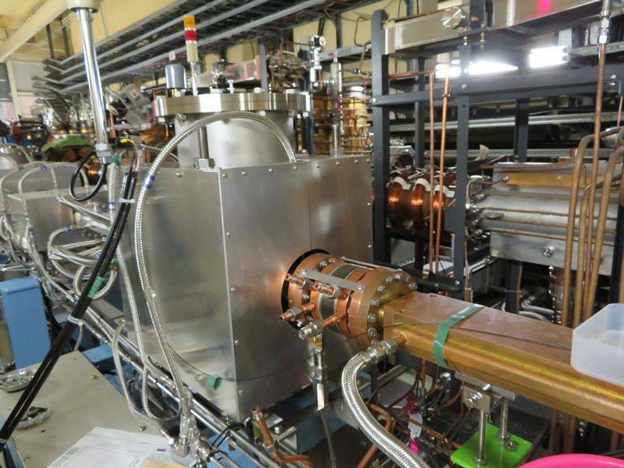
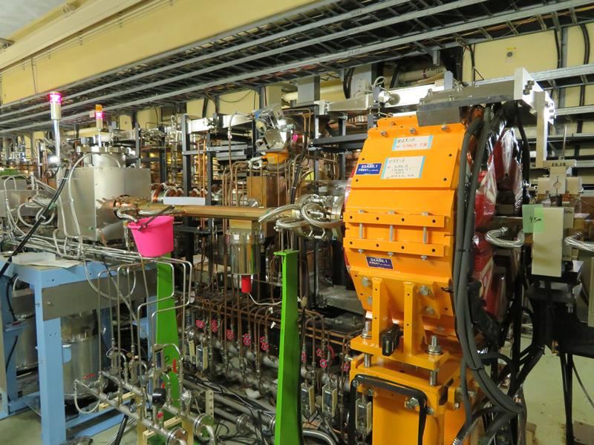
リーク箇所
ベローズ
テーパーチェンバー
このチェンバーでH60 x V40からH104 x V50に変換

Slide 31
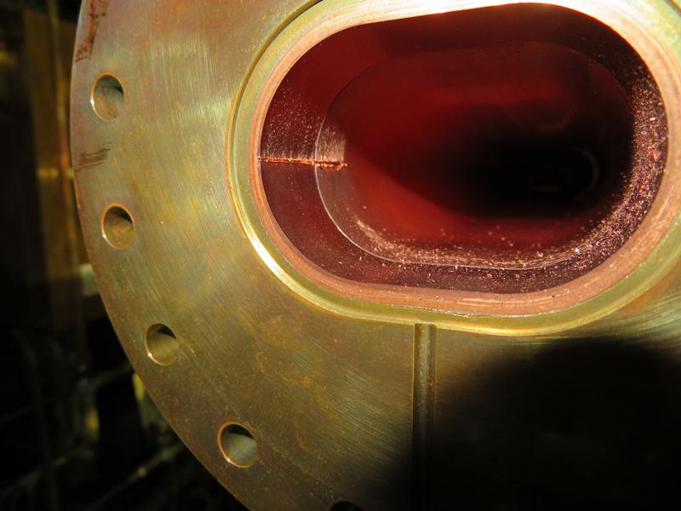
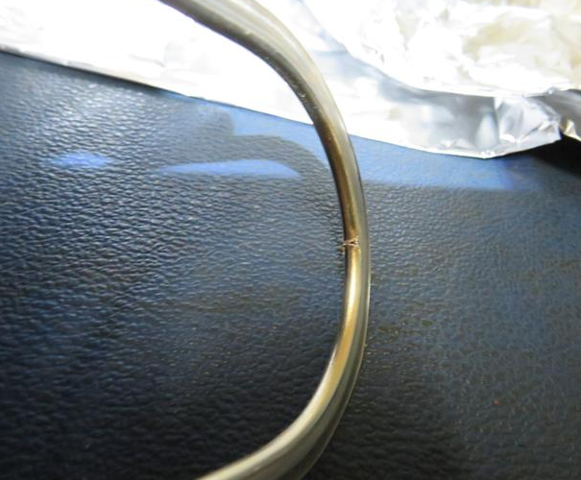
リング外側
リークしたフランジの
ヘリコフレックスガスケット
リークしたフランジ側から見たテーパーチェンバー

Slide 32
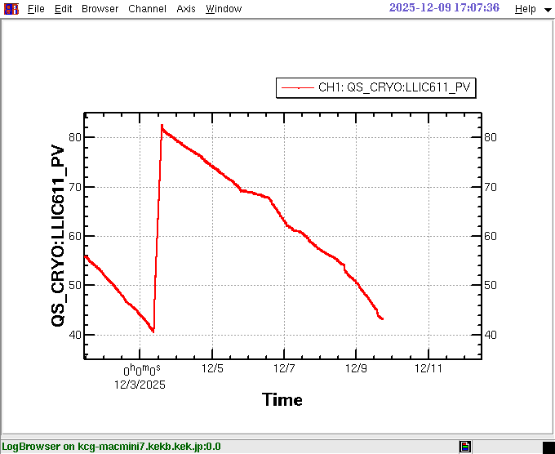

Slide 33
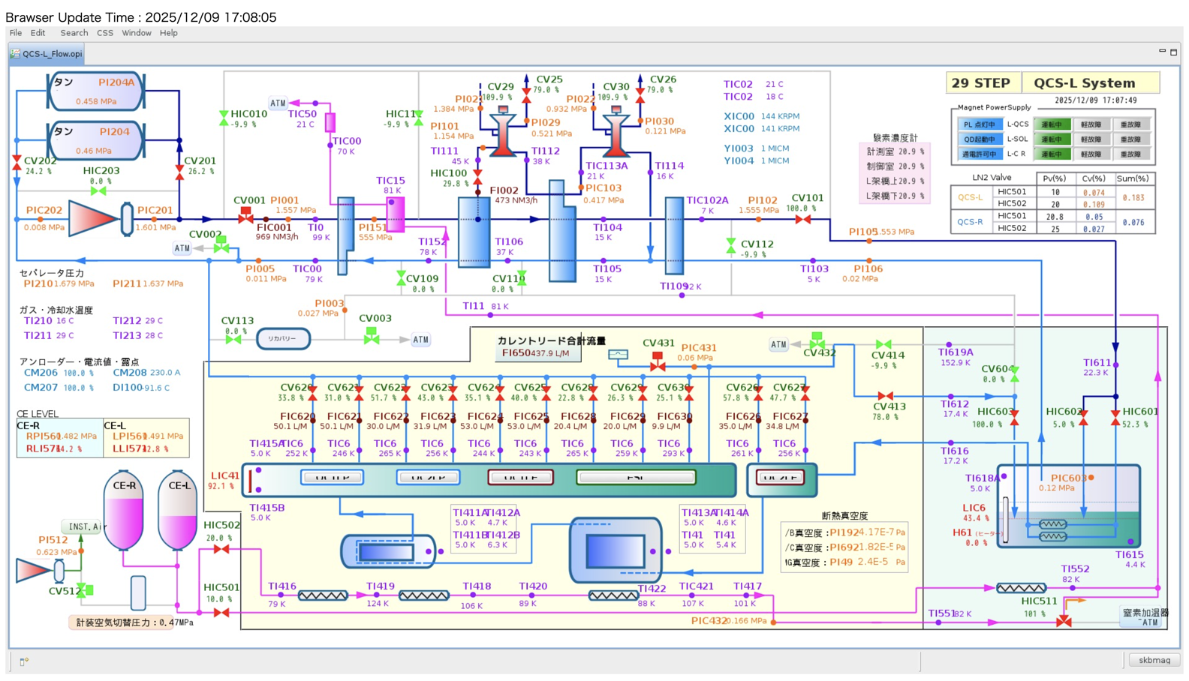

Slide 34
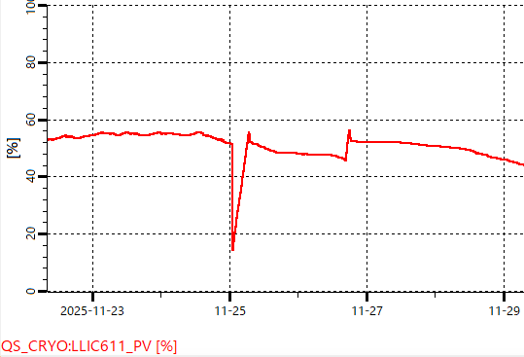
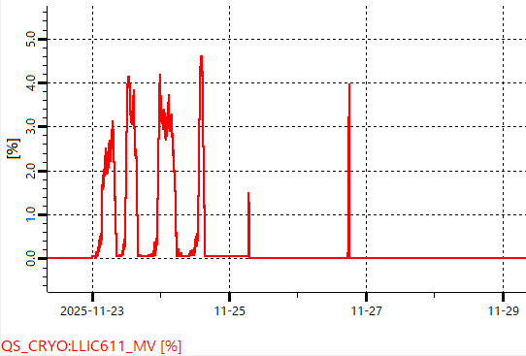
L-Side QCS Li-He reserver level
Liquid helium surface level near atmospheric pressure for producing supercooled liquid helium to cool QCSL superconducting electromagnets
Heater operation status to maintain liquid helium level at 55%
At 00:52 on November 25, QC1LE and ESL were quenched by the HER beam. Due to the ESL quench, all other L-side superconducting electromagnets were shut down.
The liquid level is controlled at 55%.
After system recovery from quench, the liquid level dropped to 46%. Set all QCSL electromagnets to 0A and reduce the helium gas flow for current lead cooling to raise the liquid level. (Reduce the heat load on the cryostat)
During normal operation, when the liquid helium level reaches 55% or higher, the heater inside the liquid helium container activates to maintain the level at 55%.
QCSL electromagnet quench reduced to 15%.

Slide 35
Why can’t we keep the Li-He level?
The heat load of the QCS cryostat has increased.
  Air leak in the thermal vacuum chamber.
  Air leakage may have occurred due to deterioration of the O-ring at the cryostat tip, potentially causing air to condense on the surface of the liquid helium container.

Slide 36
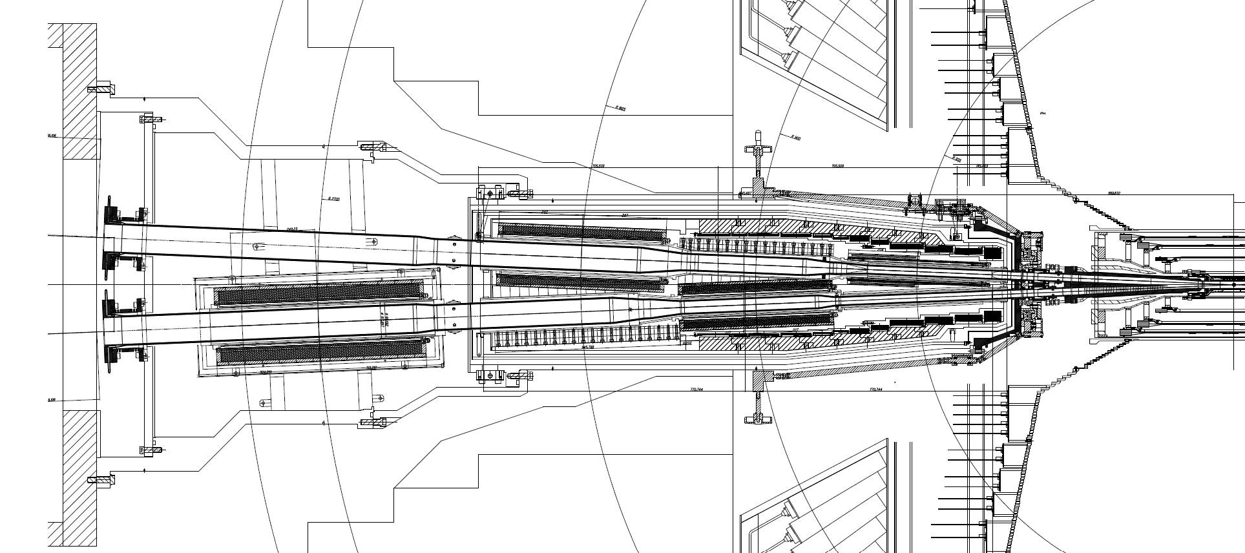
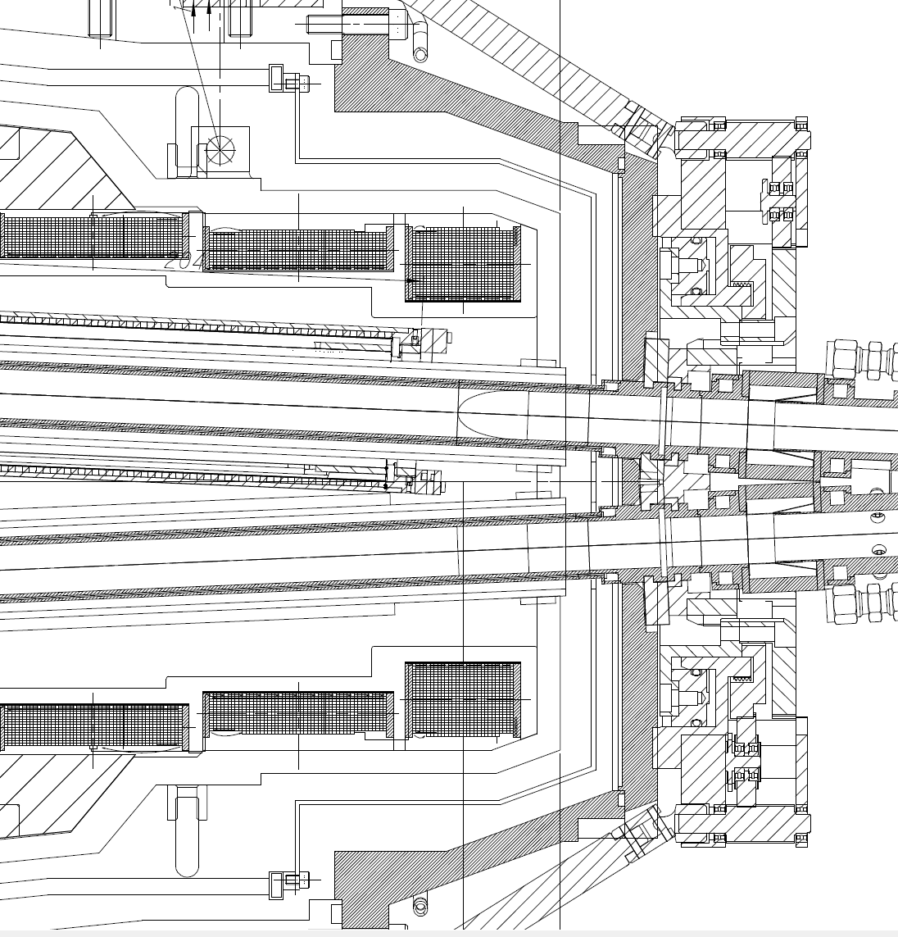
O-ring at the tip of cryostat
QC1LE
EPDM Oリング
QCS-L side cryostat
EPDM O-ring
The vacuum vessel (vacuum layer) of the QCS cryostat is sealed from the atmosphere using the end face of the vacuum vessel and the outer circumference of the beam pipe.

Slide 37
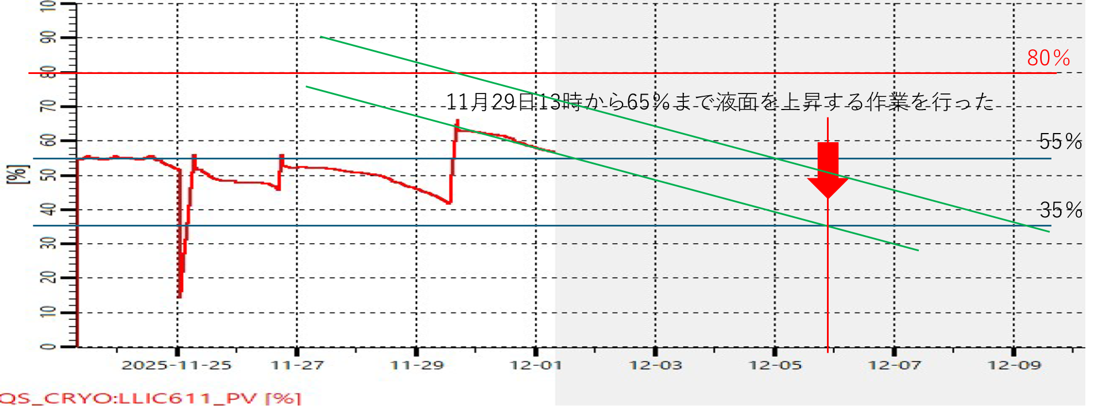
Power off the QCS magnets and raise the liquid He level
Needs roughly 8 hours to increase the Li-He level. After the process, we need to re-do the optics correction (8h)

Slide 38
Following the liquid He level rise operation on December 16, we were able to keep the liquid He Level constant (82%) by tuning the Liquid He refrigerator. Consequently, the nearly weekly shutdowns of operations and the rise in liquid He level operations conducted since early December were no longer necessary.
By the inspection of residual molecular components in the thermal insulation vessel after heating the cryostat, we have confirmed that there were no (additional) vacuum leaks in the thermal vessel.
We will restart the operation as early as possible, starting 26/Jan

