Slide 1


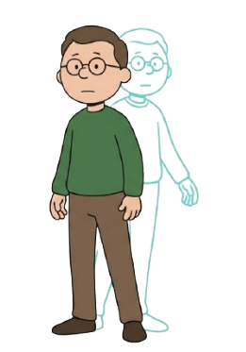

Understanding isospin violation in the X(3872) through molecular isotriplet mixing
Based on: A. Carducci, B. Grinstein, D.G., A.D. Polosa [arXiv:2512.21538 [hep-ph]] (accepted for publication on JHEP)
Davide Germani

Slide 2
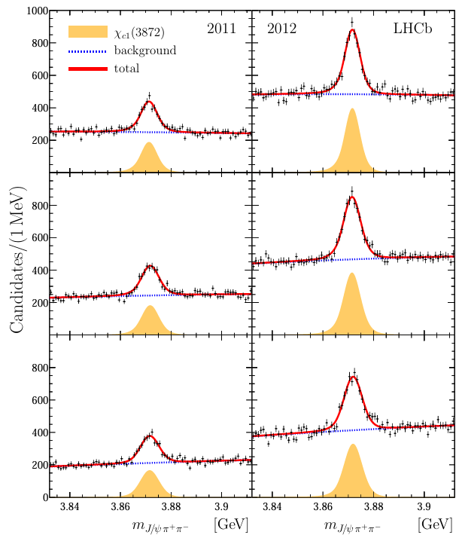
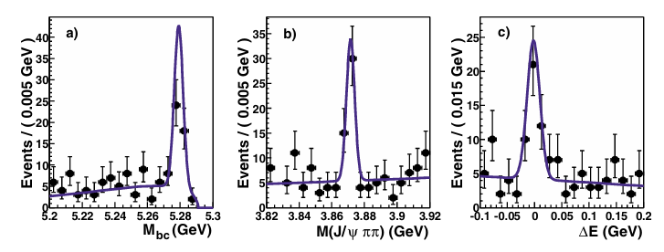





$X\left(3872\right):$Introduction
Quantum numbers: ${I(J}^{PC})=0(1^{++})$
Mass: $3871.64±0.06$ MeV ($m_{th}=3871.69$)
Main decay channels:
$X\left(3872\right)→D^{0}{\overline{D}}^{∗0}→D^{0}{\overline{D}}^{0}π^{0}$
$X\left(3872\right)→J/ψπ^{+}π^{−}$
Belle collaboration, Phys.Rev.Lett.91:262001,2003 [arXiv:hep-ex/0309032]
LHCb collaboration, Phys. Rev. D 102, 092005 (2020) [arXiv:2005.13419 [hep-ex]]

Slide 3



Disclaimer: this list is not exhaustive!
$X\left(3872\right):$Taxonomy
Quark content
$c\overline{c}q\overline{q}$: exotic states
$c\overline{c}$: charmonium
P. Colangelo et al. [arXiv:2501.15888 [hep-ph]], F. De Fazio, Phys.Rev.D 83, 099901 (2011) [arXiv:0812.0716 [hep-ph]].
Internal structure
Compact
Tetraquark
Hadronic
Molecule
A. Esposito et al., Riv. Nuovo Cim. (2025) [arXiv:2502.02505 [hep-ph]
C. Hanhart [arXiv:2508.20694 [hep-ph], T. Ji et al. [arXiv:2502.04458 [hep-ph]]

Slide 4
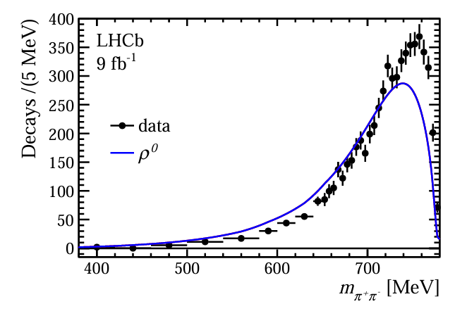
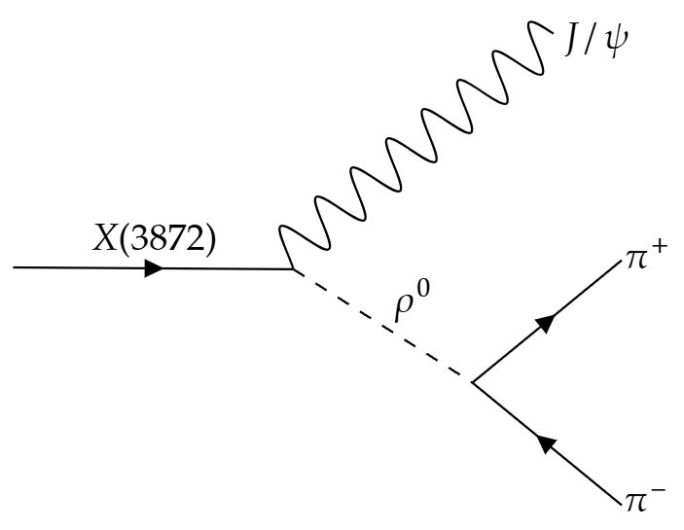



$X\left(3872\right):$Isospin violation
$X\left(3872\right)→J/ψππ$
The pion pairs comes from the decay of a $ρ^{0}$ meson: $ρ^{0}→π^{+}π^{−}$ ($Br∼100\%$).
LHCb collaboration, Phys. Rev. D 131 (2023) L011103 [arXiv:2204.12597 [hep-ex]]
Data cannot be explained considering only
$ρ^{0}$ contribution.

Slide 5
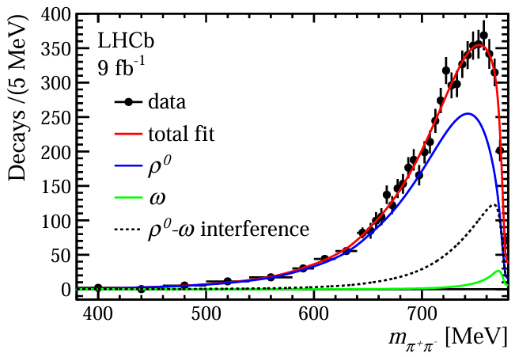
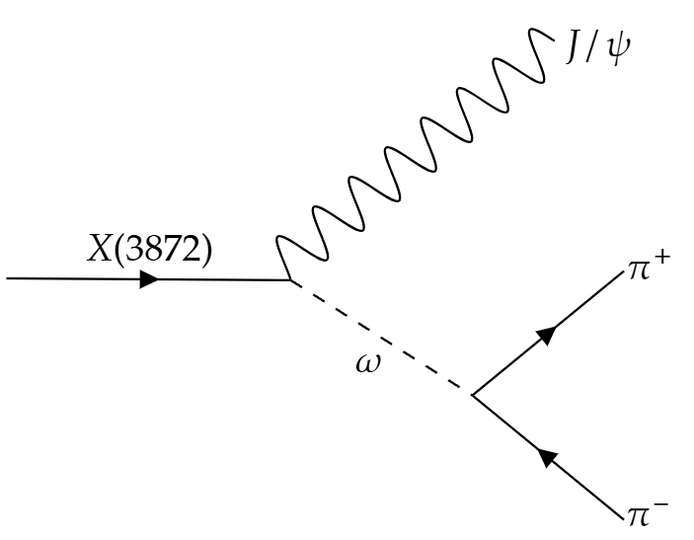


$X\left(3872\right):$Isospin violation
LHCb collaboration, Phys. Rev. D 131 (2023) L011103 [arXiv:2204.12597 [hep-ex]]
$$+$$
Including $ω$ contribution is necessary to align with the experimental data.

Slide 6
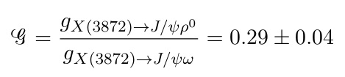
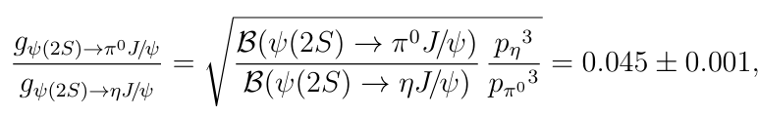

$X\left(3872\right):$Isospin violation
“This value is an order of magnitude larger than expected for pure $c\overline{c}$ states, […], therefore, the $X(3872)$ state cannot be a pure charmonium state.”
LHCb collaboration, Phys. Rev. D 131 (2023) L011103 [arXiv:2204.12597 [hep-ex]]
LHCb collaboration, Phys. Rev. D 131 (2023) L011103 [arXiv:2204.12597 [hep-ex]]
VS

Slide 7
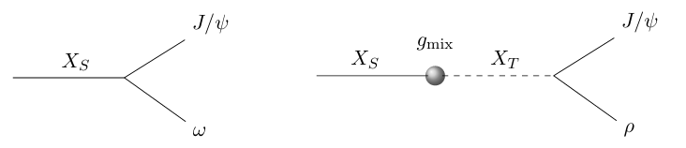
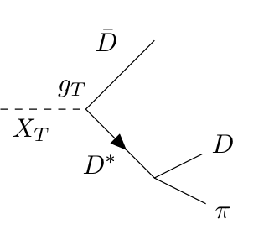
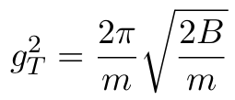


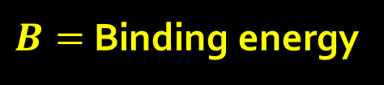

$X\left(3872\right):$Isospin partner
To account for such an isospin violation, we assume the existence of an isosinglet state ( $X_{S}$ ) and a neutral component ( $X_{T}^{0}$ ) of an isotriplet.
$$G_{ω}$$
$$G_{ρ}$$
A. Carducci, B. Grinstein, D.G., A.D. Polosa [arXiv:2512.21538 [hep-ph]] (accepted for publication on JHEP)
Since no charged partners of $X(3872)$ have been observed, we assume that this triplet has a molecular nature.
C. Bignamini et al., Phys.Rev.Lett.103:162001,2009 [arXiv:0906.0882 [hep-ph]], A.L. Guerrieri et al., Phys.Rev.D 90 (2014) 3, 034003, [arXiv:1405.7929 [hep-ph]]
$B=$Binding energy

Slide 8
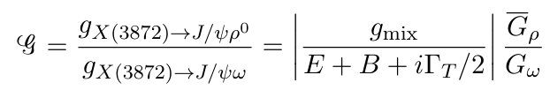

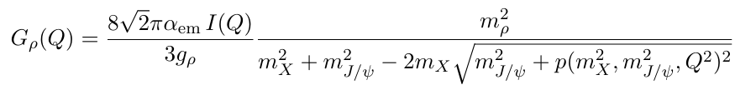



$X\left(3872\right):$Isospin partner
$$Γ_{T}≃Γ_{D^{∗0}}$$
Couplings:
$$G_{ω}:$$
we assume this value is equal to $Γ(X\left(3872\right)→J/ψω)$
$${\overline{G}}_{ρ}:$$
is a function of the virtual photon momentum
We define ${\overline{G}}_{ρ}$ as the constant coupling that lead to the same decay width in $J/ψρ^{0}$ as the one obtained with the formula.

Slide 9
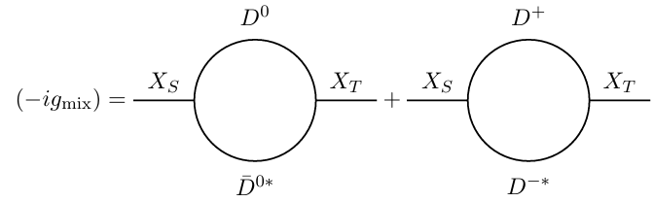


$X\left(3872\right):$Isospin mixing
Loops integral are divergent!
The last piece is the coupling $g_{S}$. No ab initio calculation, so we take LHCb value.
LHCb collaboration, Phys. Rev. D 102, 092005 (2020) [arXiv:2005.13419 [hep-ex]], A. Esposito et al., Riv. Nuovo Cim. (2025) [arXiv:2502.02505 [hep-ph]

Slide 10
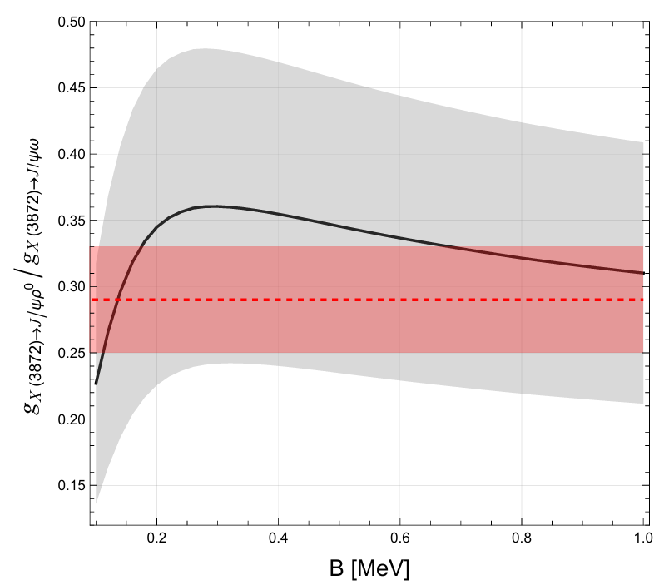
$X\left(3872\right):$Isospin partner

Slide 11
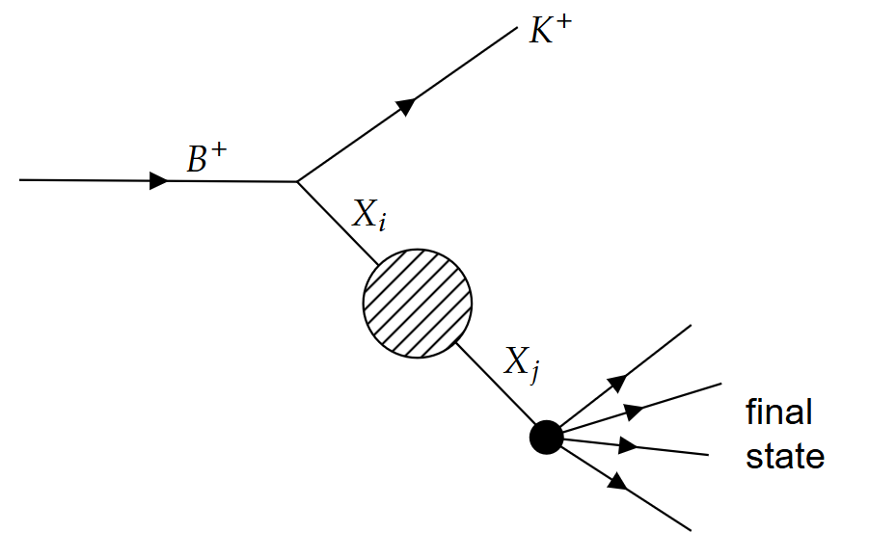

$X\left(3872\right):$What next?

Slide 12
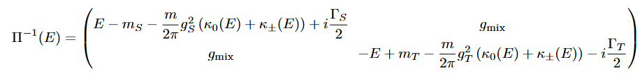
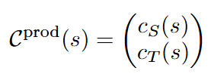
$X\left(3872\right):$What next?
Parametrization of the scattering amplitude

Slide 13
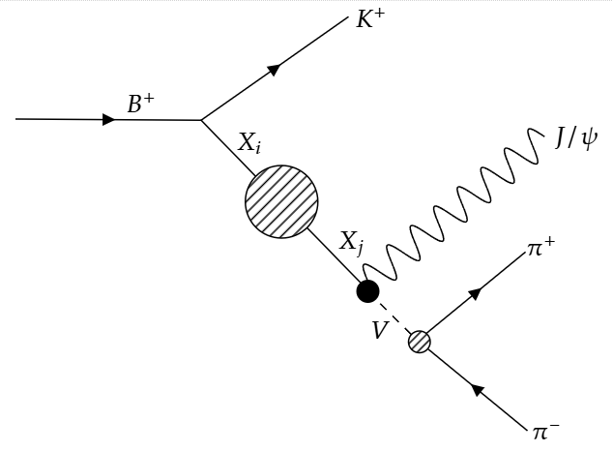
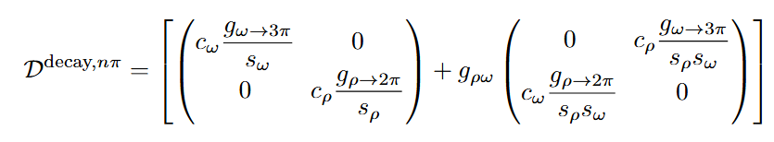
$X\left(3872\right):$What next?
Parametrization of the scattering amplitude

Slide 14


Conclusions & outlook
The strong isospin violation in the decay of $X\left(3872\right)$ may be due to the presence of two neutral states, one isosinglet and one isotriplet, that both contribute to the decay processes.
The observed violation may be enhanced by isospin breaking in the neutral and charged $D(D^{∗})$ mesons. This idea, when applied to the compact $X(3872)$, has in fact already been used several times to explain the same violation in the purely molecular scenario.
N. A. Tornqvist, Phys.Lett.B590:209-215,2004 [arXiv:hep-ph/0402237], Q. Wu et al., Eur.Phys.J.C 81 (2021) 2, 193 [arXiv:2102.08637 [hep-ph]]
If a molecular isotriplet partner is included, the results become consistent with the experimental measurements reported by LHCb.
To build a consistent framework, we need to start from the production mechanism of these states rather than focusing only on their decay.
A comprehensive description that goes beyond the $J/ψ+pions$ decay modes and also accounts for other decay channels originating from $B$ mesons is essential for a consistent experimental analysis.
T. Ji et al. [arXiv:2502.04458 [hep-ph]]

