Slide 1

Neutrino Physics Overview
David Vanegas Forero (D. V. Forero)
dvanegas@udemedellin.edu.co
2nd ConHEP School, Nov 28th 2025

Slide 2
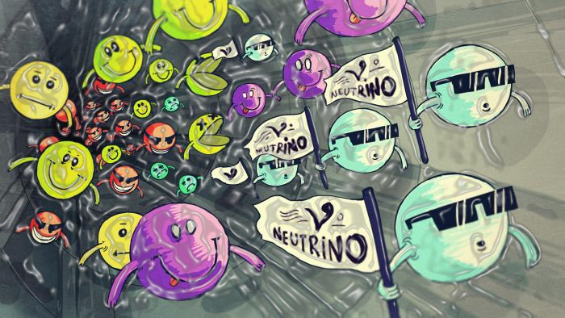
Table of contents
Generalities
Neutrino oscillations (The basics)
The problem of the Neutrino Mass
The problem of the Neutrino Nature
Back to Neutrino Oscillations
Current unknows
BSM searches
Summary

Slide 3
Generalities
Neutrino oscillations (The basics)
The problem of the Neutrino Mass
The problem of the Neutrino Nature
Back to Neutrino Oscillations
Current unknows
Some BSM searches
Summary

Slide 4
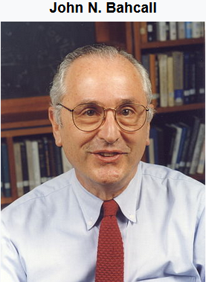

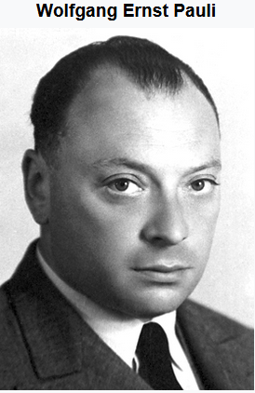
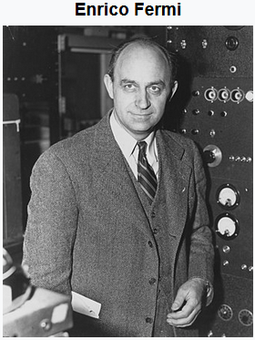

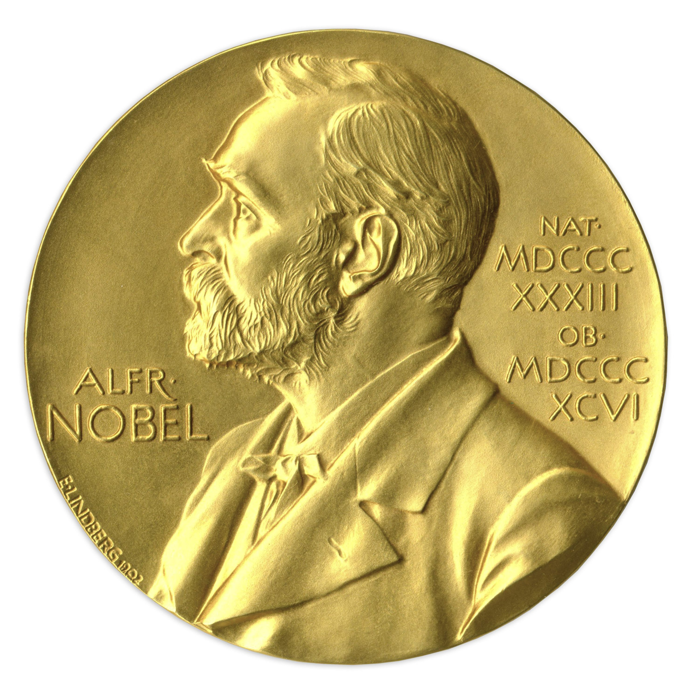
Historical facts
1930 Pauli proposed an “indetectable particle” to explain the
observed beta(β) decay espectrum.
1932 The neutron was discovered (Chadwick). Why its name?
1932 E. Fermi named as neutr-ino (little neutron in italian) the Pauli particle.
More important, he built a theory for beta(β)-decay.
1939 Bethe explains how the Sun “shines” (CNO-cycle, pp-chain).
1956 First antineutrino detection, Cowan & Reines (PNP 1995)
1964 1st calculation of the number of solar neutrinos (Bahcall, Davis)… (Standard Solar Model)
1967 1st theoretical proposal flavor change of (anti)neutrinos (Bruno Pontecorvo)
1968 1st observation solar neutrino deficit (Davis), PNP 2002.

Slide 5

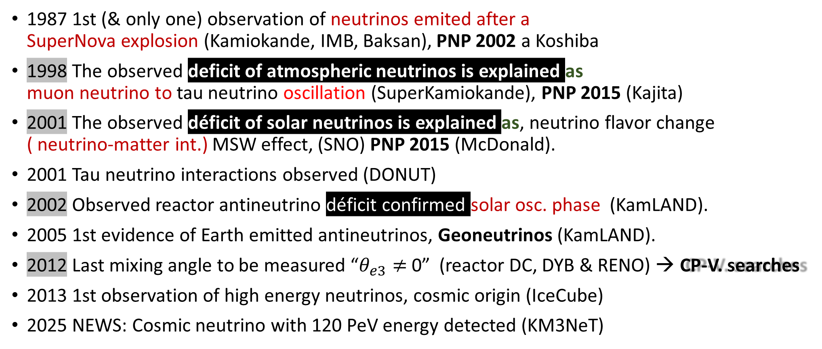
Historical facts
1987 1st (& only one) observation of neutrinos emited after a SuperNova explosion (Kamiokande, IMB, Baksan), PNP 2002 a Koshiba
1998 The observed deficit of atmospheric neutrinos is explained as muon neutrino to tau neutrino oscillation (SuperKamiokande), PNP 2015 (Kajita)
2001 The observed déficit of solar neutrinos is explained as, neutrino flavor change ( neutrino-matter int.) MSW effect, (SNO) PNP 2015 (McDonald).
2001 Tau neutrino interactions observed (DONUT)
2002 Observed reactor antineutrino déficit confirmed solar osc. phase (KamLAND).
2005 1st evidence of Earth emitted antineutrinos, Geoneutrinos (KamLAND).
2012 Last mixing angle to be measured “$θ_{e3}≠$ 0” (reactor DC, DYB & RENO) → CP-V. searches
2013 1st observation of high energy neutrinos, cosmic origin (IceCube)
2025 NEWS: Cosmic neutrino with 120 PeV energy detected (KM3NeT)
Yuver Talk

Slide 6
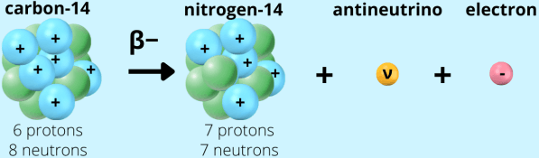
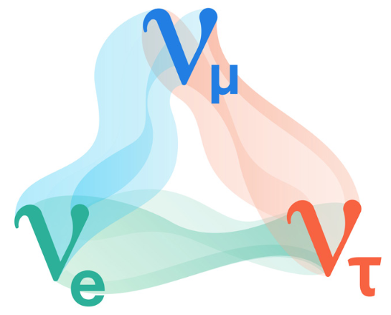
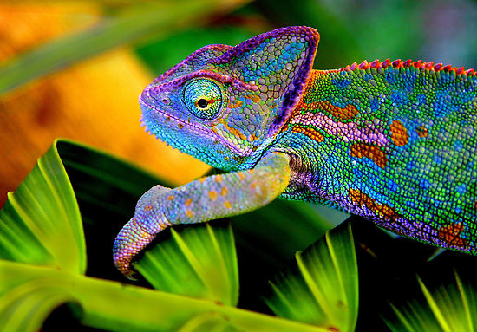
¿What do we know about the neutrino?
It is a fundamental particle, a fermion
Has no electric charge
Interacts mainly through the weak interaction
β-decay (fusion & fision), π-decay (cosmic rays)
Comes in three flavors, associated to each charged lepton (e, μ, τ)
Changes its flavor during propagation
Explained by neutrino oscillations
Mixing and tiny non-zero neutrino masses
Most abundant massive particle in the Universe

Slide 7
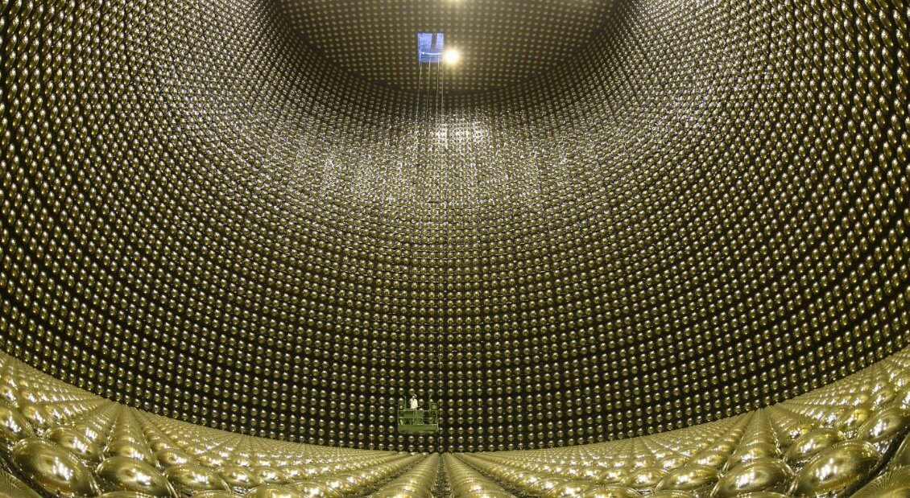

How to “catch” a neutrino?
Neutrinos produced from a powerful “characterized source”
A “giant” massive detector
Properly instrumented to detect neutrinos
Estrategically located & optimized distance from source
The Exp. Has to run for a couple years
Notes:
Neutrino Experiment=Source+Detector, separated the CORRECT baseline

Slide 8





Reactor
Fuentes de neutrinos
Particle accelerator
Neutrino
Sources
Sun
Earth
Cosmos
www.symmetrymagazine.org

Slide 9
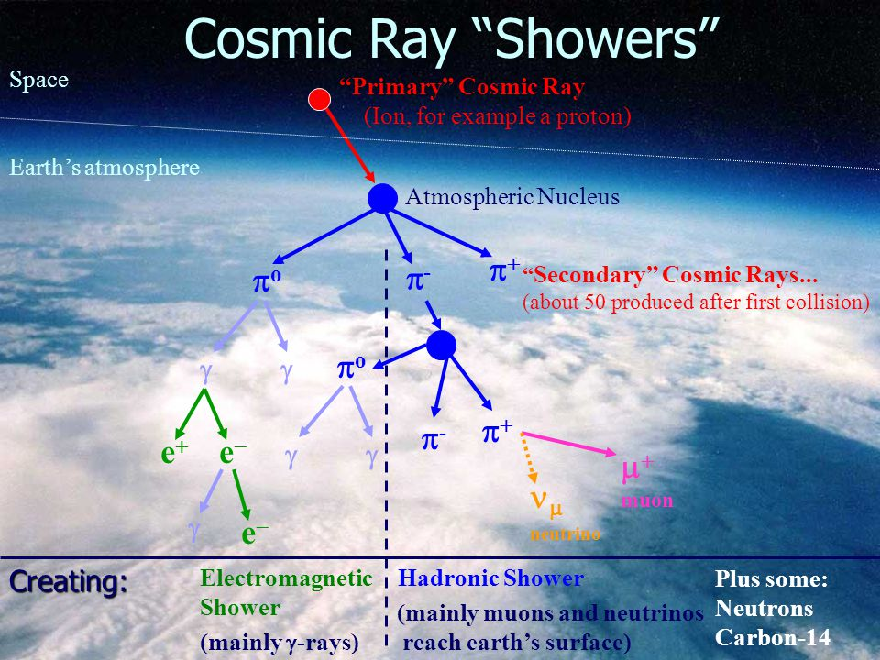
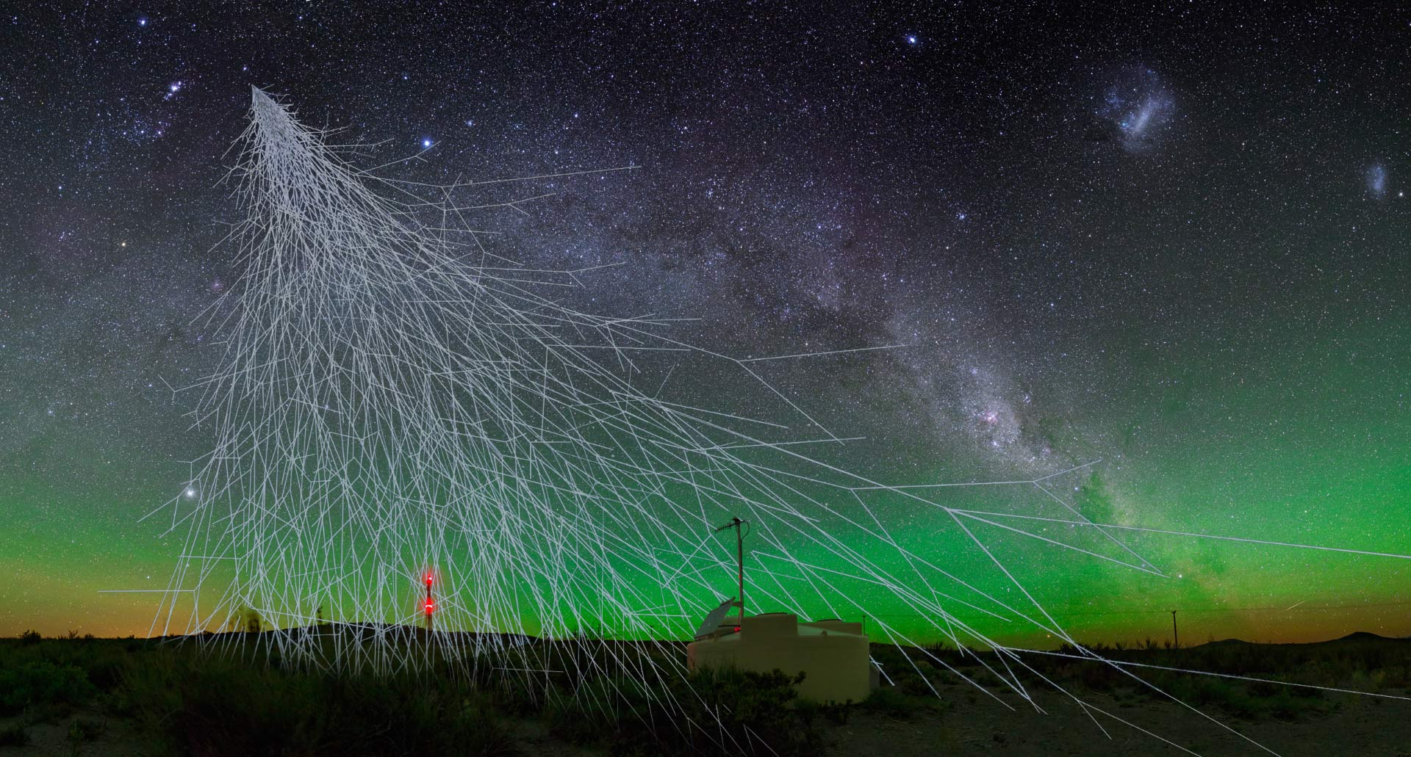
“particle shower” at the Earth surface

Slide 10


Slide 11
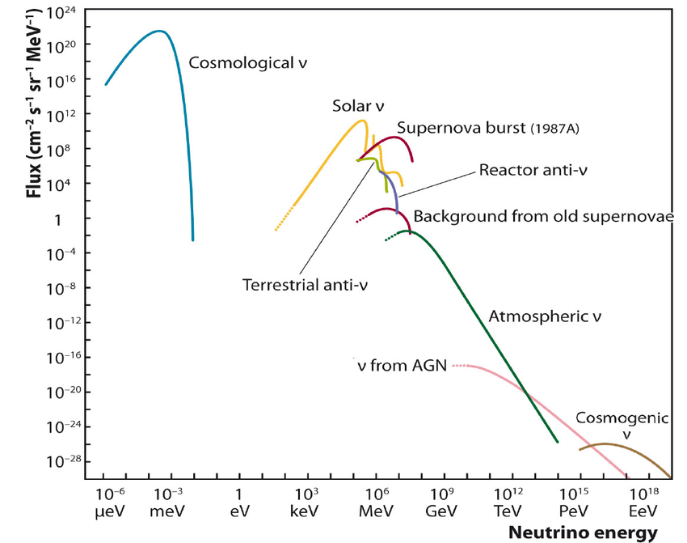

Neutrino Sources Oscillation Energy Window : ~1 MeV -- ~100 GeVs
Oscillation
Window
Natural
Solar
Atmospheric
Man-made
Accelerator (not included)
Reactor

Slide 12
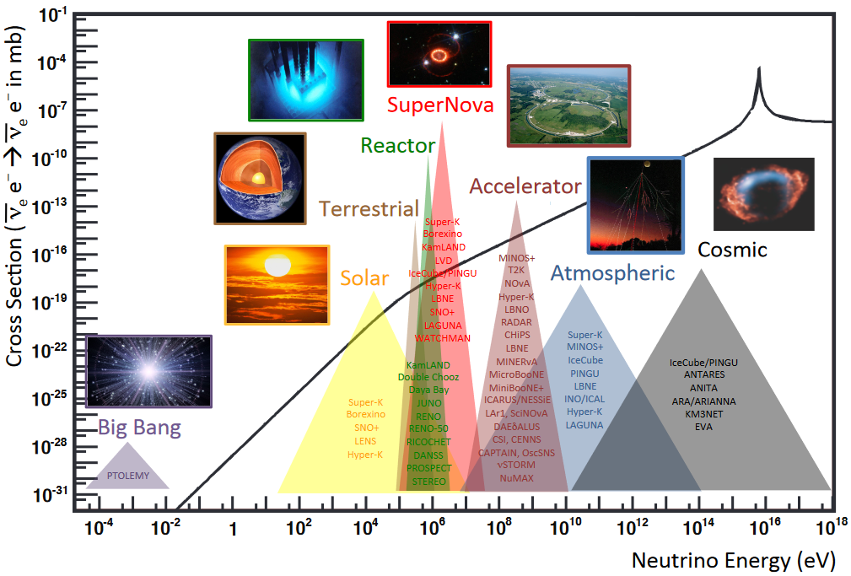


Neutrino Interactions
Oscillation
Window
1b = ${10}^{−28}m^{2}$
$${\sim 10}^{−44}m^{2}$$
Solar
Geoneutrinos
Reactor
SuperNova
Accelerator
Atmospheric
Notes:
Neutrino Energy is a key variable

Slide 13
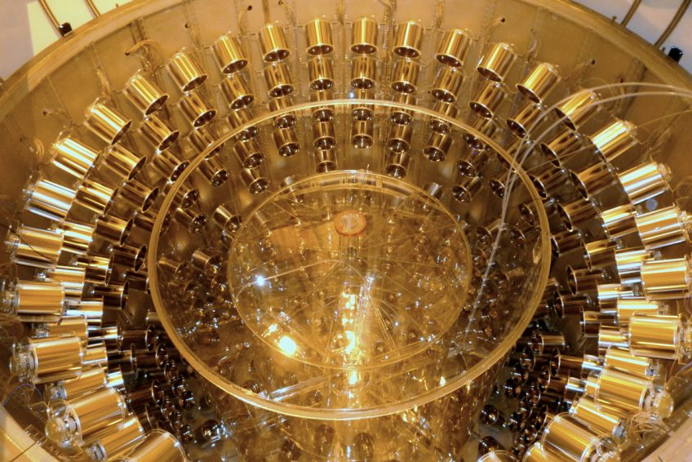
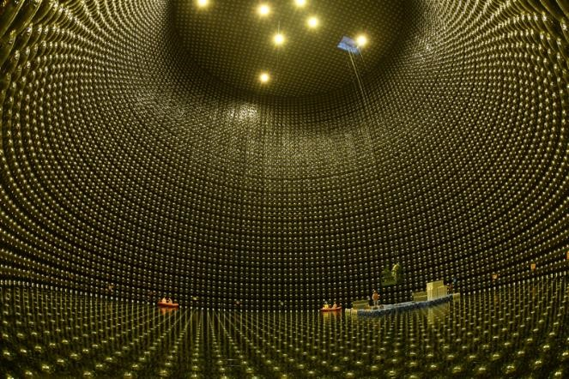
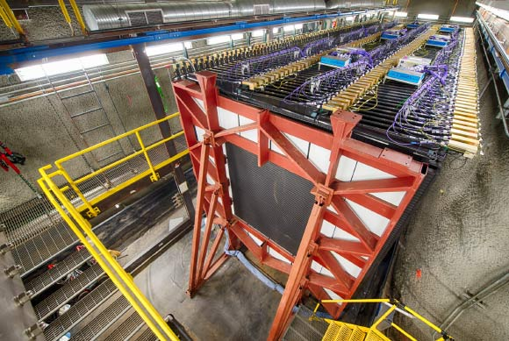





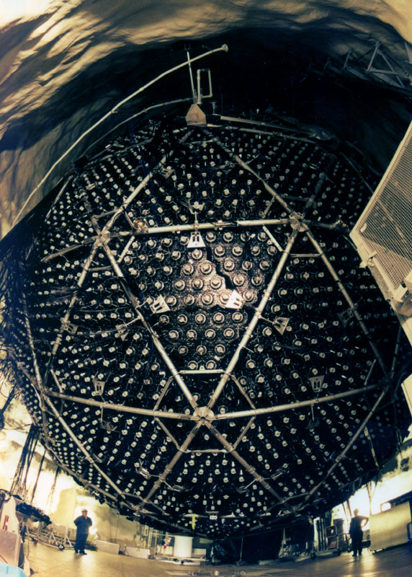
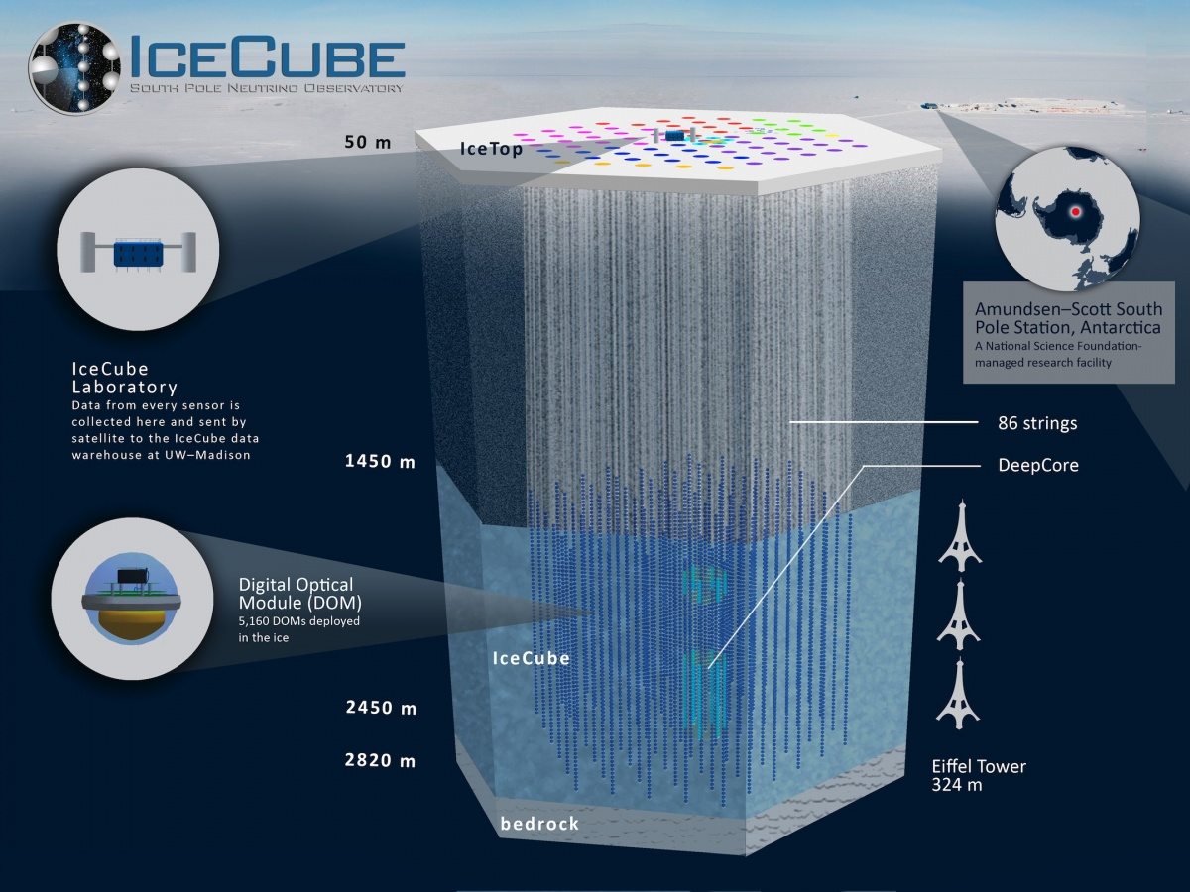
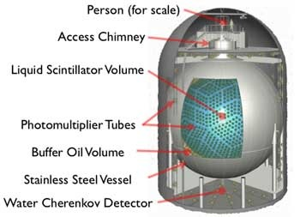

DubleChooz (&DYB & RENO)
SuperKamiokande (& T2K)
NOvA
SNO
Neutrino Detectors
KamLAND
Notes:
Where do neutrinos (from different sources) are detected? Each one with different detector techniques

Slide 14
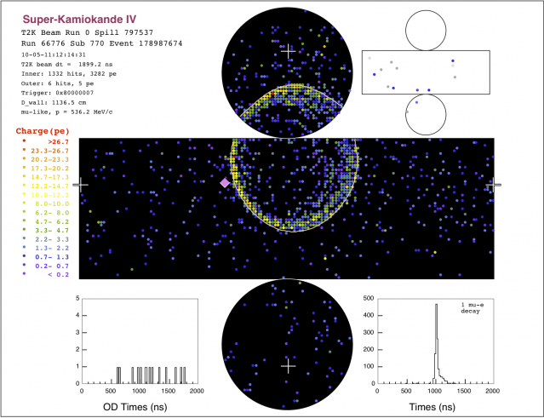
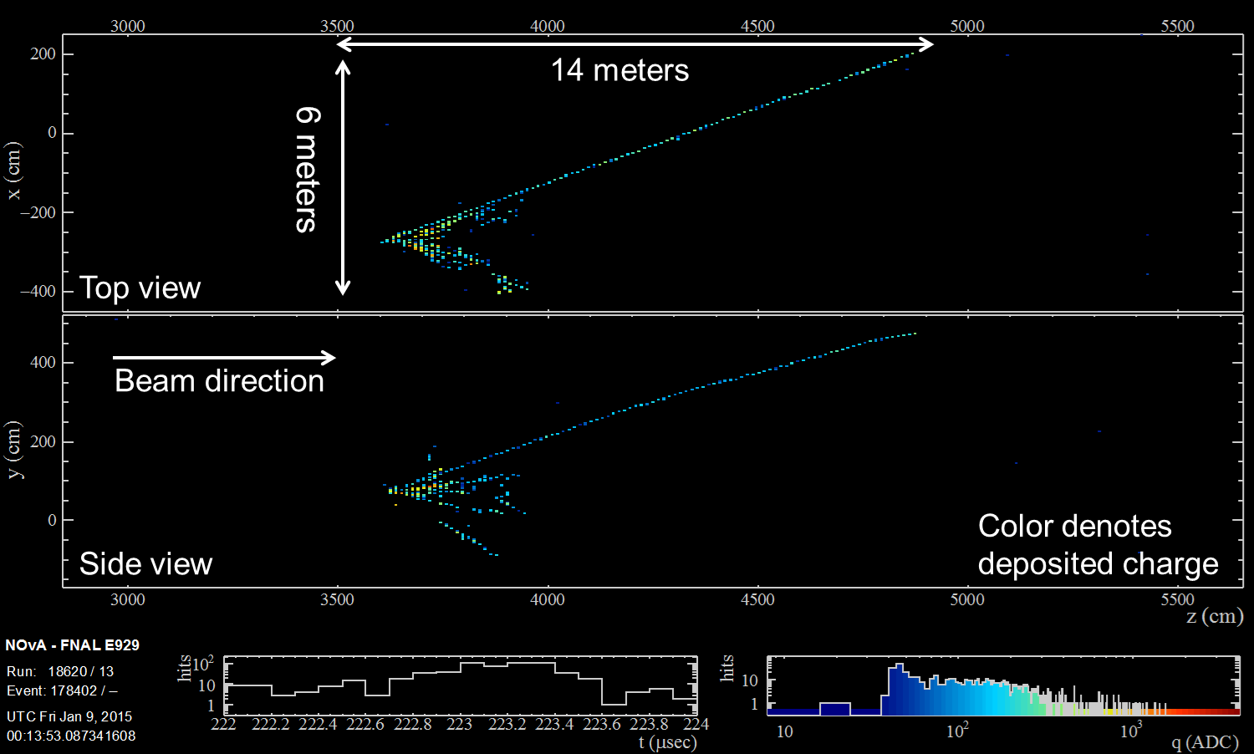
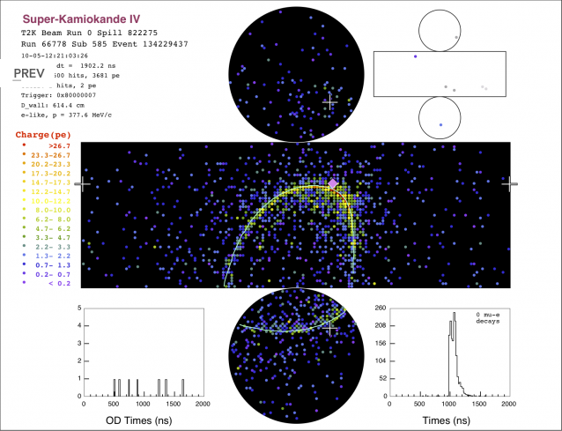
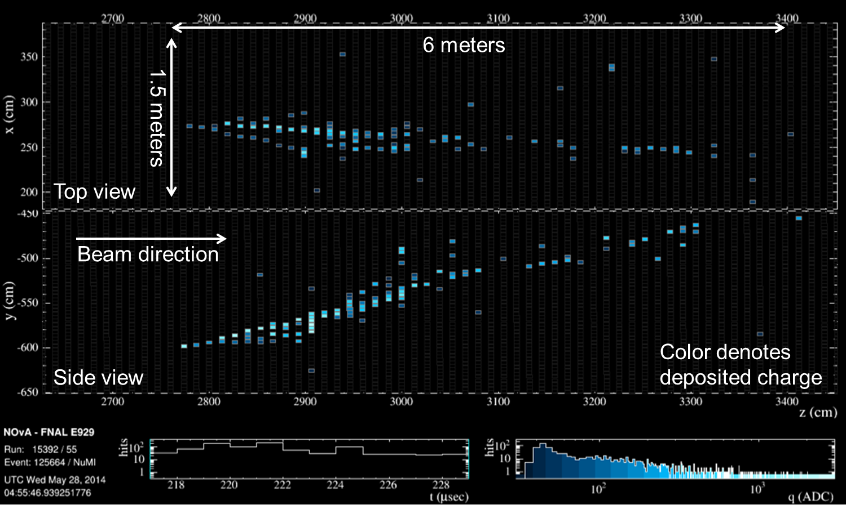
¿How a neutrino is “seen” in a detector?

Slide 15
Generalities
Neutrino oscillations (The basics)
The problem of the Neutrino Mass
The problem of the Neutrino Nature
Back to Neutrino Oscillations
Current unknows
Some BSM searches
Summary

Slide 16
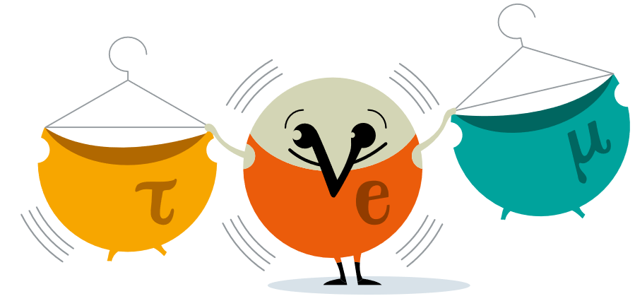

Neutrino oscillation experiment, the concept
An intense neutrino source
A massive (Far) detector
Optimized Baseline
A Near Detector
Let the Exp. Run for several yrs
Notes:
Neutrino Experiment=Source+Detector, separated the CORRECT baseline

Slide 17
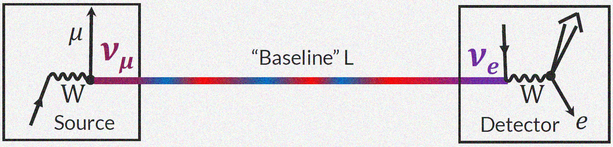
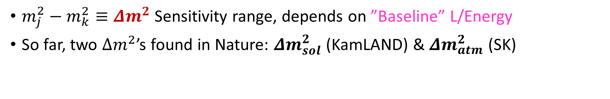
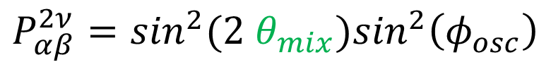
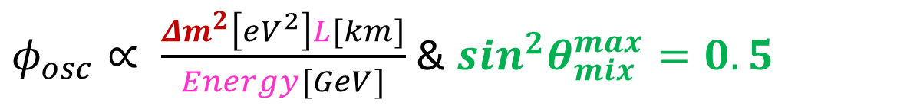
Neutrino oscillations ‘in a Nutshell’
1. production
2. propagation
3. Detection
$φ_{osc}∝ \frac{{Δm}^{2}\left[eV^{2}\right]L[km]}{Energy[GeV]}$ & $\sin^{2}θ_{mix}^{max}=0.5$
$$P_{αβ}^{2ν}=\sin^{2}{(2 θ}_{mix})\sin^{2}\left(φ_{osc}\right)$$
$m_{j}^{2}−m_{k}^{2}≡Δm^{2}$ Sensitivity range, depends on ”Baseline” L/Energy
So far, two $Δm^{2}$’s found in Nature: ${Δm}_{sol}^{2}$ (KamLAND) & ${Δm}_{atm}^{2}$ (SK)
Non-zero neutrino masses, a discovery recognized -> Physics Nobel Prize (2015)
Notes:
Neutrino Experiment=Source+Detector, separated theCORRECT baseline

Slide 18
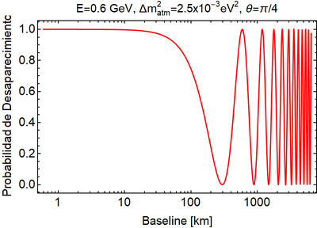
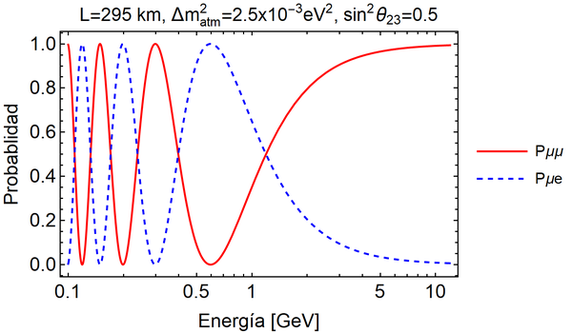
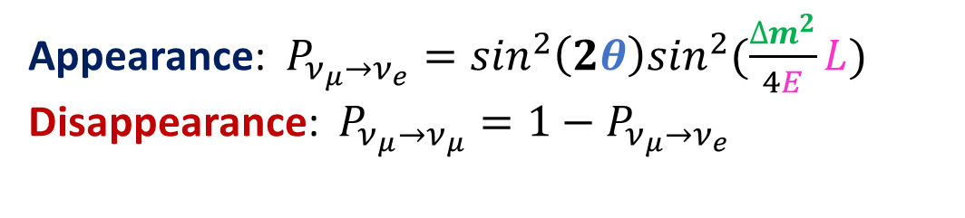
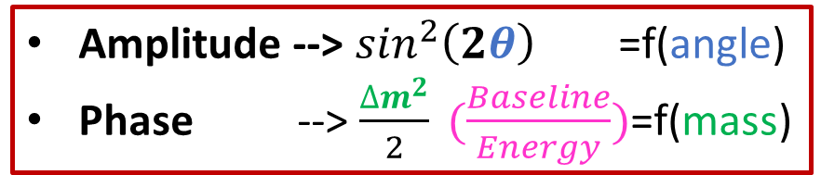
Probabilidad de Oscilación (dos neutrinos en vacío)
Appearance: $P_{ν_{μ}→ν_{e}}=\sin^{2}\left(2θ\right)\sin^{2}(\frac{∆m^{2}}{4E}L)$
Disappearance: $P_{ν_{μ}→ν_{μ}}=1−P_{ν_{μ}→ν_{e}}$
Amplitude --> $\sin^{2}\left(2θ\right)$ =f(angle)
Phase --> $\frac{∆m^{2}}{2} (\frac{Baseline}{Energy})$=f(mass)
T2K
Oscillacion has not
developed yet
Disappearance
Appearance
Notes:
Resultados en UNIDADES NATURALES hbar=c=1

Slide 19






Neutrino Oscill. Experiments (by their source)
Running & past experiments that have seen Neutrino Flavor Transitions
Solar & Reactor (~200km)
Atmospheric
Accelerator (LBL)
Reactor (km)
Homestake, GALLEX/GNO, SAGE, Borexino
SuperKamikande (SK), SNO, SNO+
KamLAND, SNO+ (LBL reactors)
SuperKamiokande (SK)
IceCube DeepCore (DC)
K2K, MINOS
T2K, NOvA
Daya Bay
RENO
$${Δm}_{31}^{2}$$
$${Δm}_{21}^{2}$$
JUNO (52.5km)
Notes:
Neutrino sectors (Data sets) considered in the Global-fit, SNO+ data not included

Slide 20
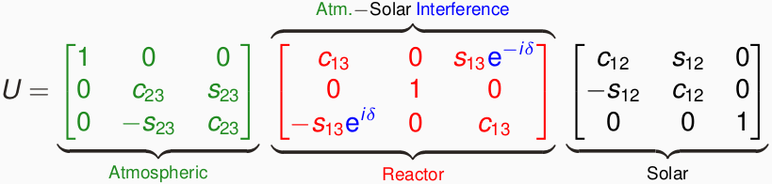
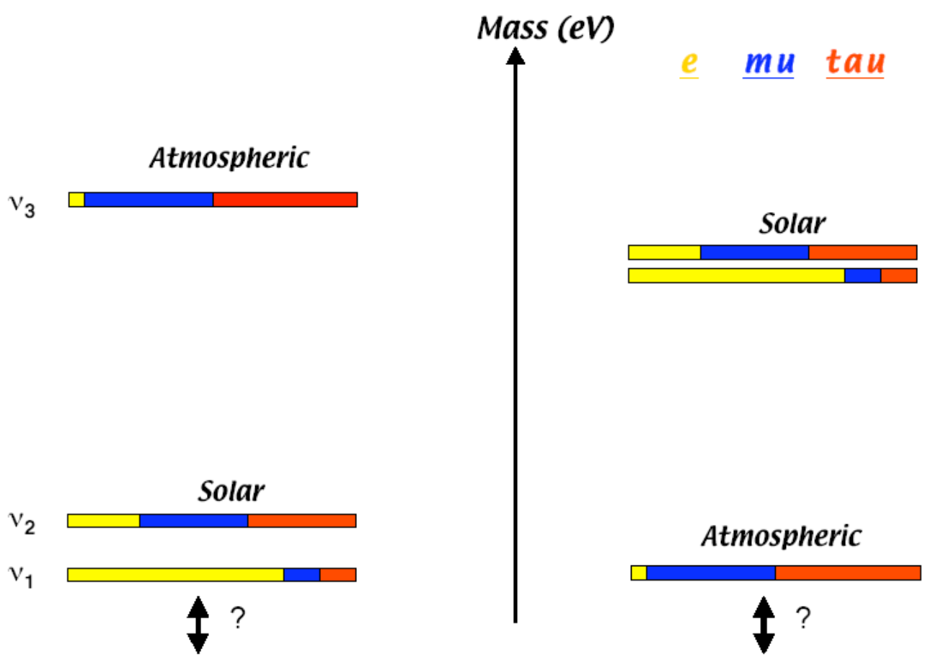
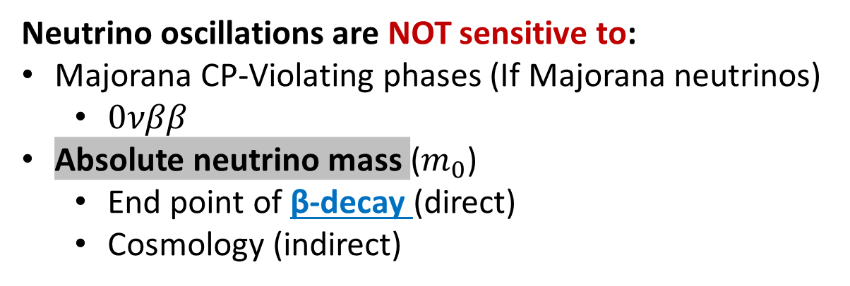
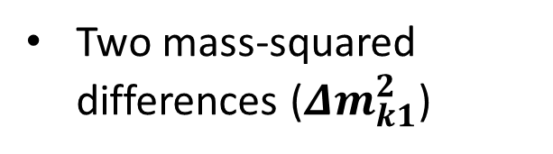
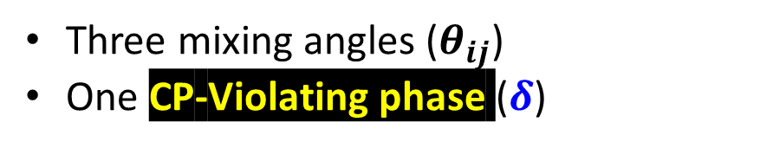
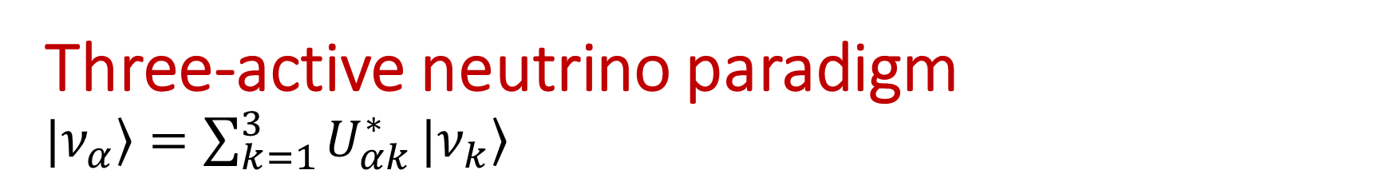
Three-active neutrino paradigm $\left.|ν_{α}\right\rangle =\sum_{k=1}^{3}{U_{αk}^{∗}}|\left.ν_{k}\right\rangle$
Two possible mass orderings
Normal (L), Inverted (R)
Three mixing angles ($θ_{ij}$)
One CP-Violating phase ($δ$)
Two mass-squared differences (${Δm}_{k1}^{2}$)
Neutrino oscillations are NOT sensitive to:
Majorana CP-Violating phases (If Majorana neutrinos)
$0νββ$
Absolute neutrino mass ($m_{0}$)
End point of β-decay (direct)
Cosmology (indirect)
Complementarity with other searches

Slide 21
Generalities & Motivation
Neutrino oscillations (The basics)
The problem of the Neutrino Mass
The problem of the Neutrino Nature
Back to Neutrino Oscillations
Current unknows
Some BSM searches
Summary

Slide 22

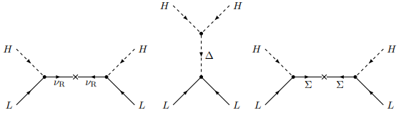
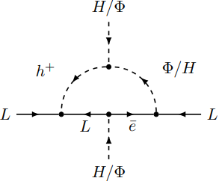
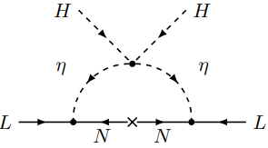
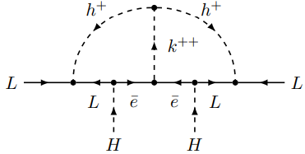
The problem of the Neutrino Mass
arXiv:1706.08524
Neutrino oscillations imply massive neutrinos (at least 2)
The mechanism behind neutrino mass generation is unknown (d=5 WO)
Dirac neutrino mass (like any other SM fermion)
Majorana neutrino Mass (if LNV)
Several (popular) realizations:
Seesaw mechanism (Tree level)
Low-scale seesaw
Radiative (1-loop arXiv:2205.13063, 2-loop,…)
Zee (1-loop), Zee-Babu (2-loop)
Scotogenic models (link to DM)
Seesaw
Radiative
POSTER 1-loop

Slide 23
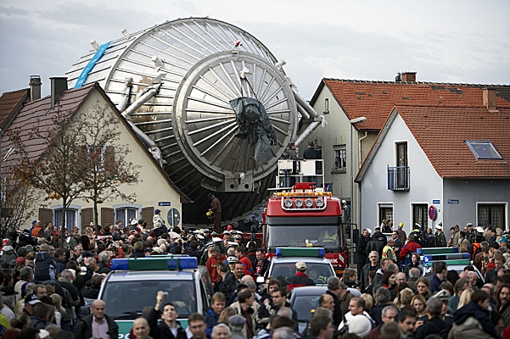
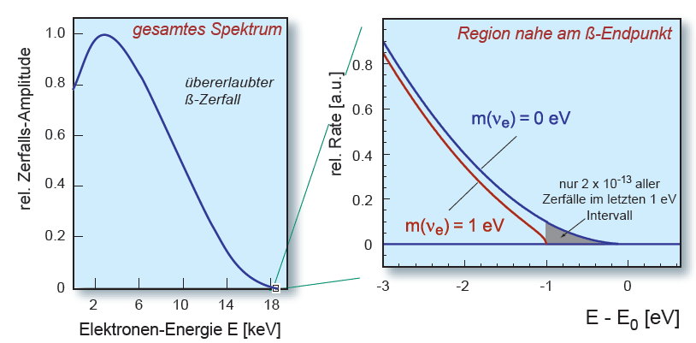


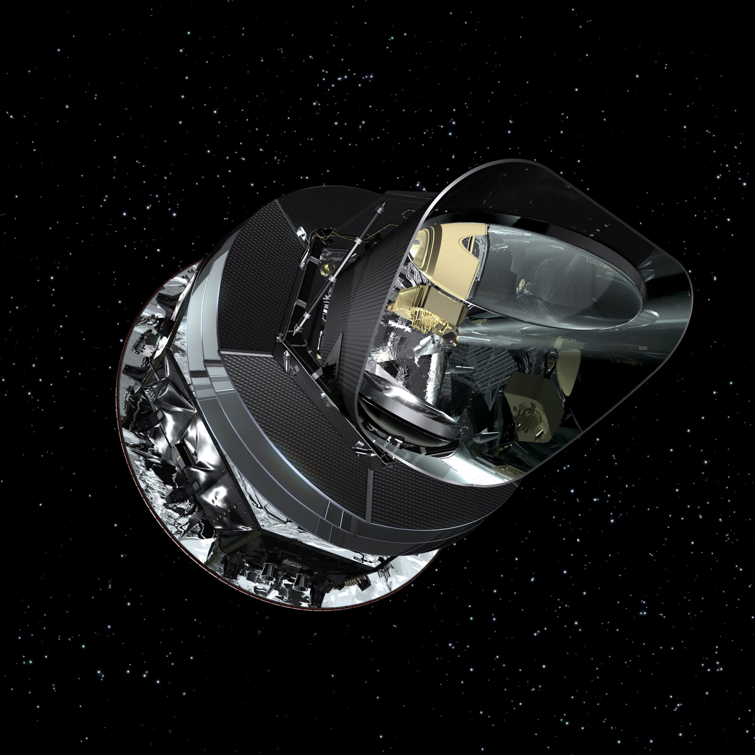
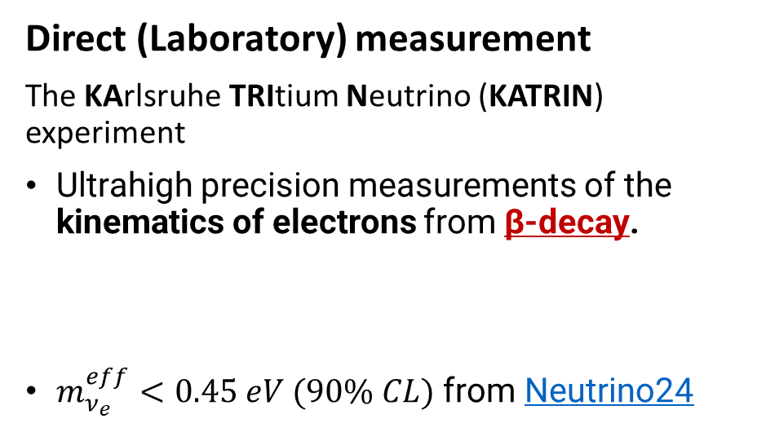
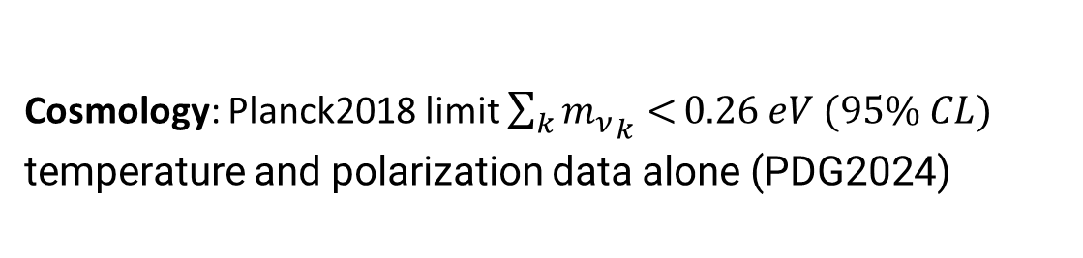
Absolute Neutrino Mass Limits
Direct (Laboratory) measurement
The KArlsruhe TRItium Neutrino (KATRIN) experiment
Ultrahigh precision measurements of the kinematics of electrons from β-decay.
$m_{ν_{e}}^{eff}<0.45 eV (90\% CL)$ from Neutrino24
Indirect measurement
Cosmology: Planck2018 limit $\sum_{k}{{m_{ν}}_{k}<}0.26 eV (95\% CL)$
temperature and polarization data alone (PDG2024)

Slide 24
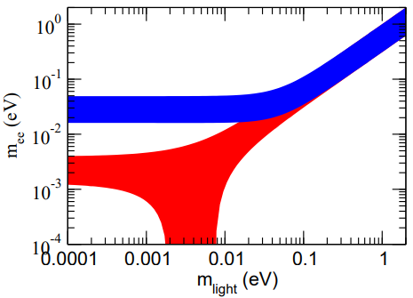
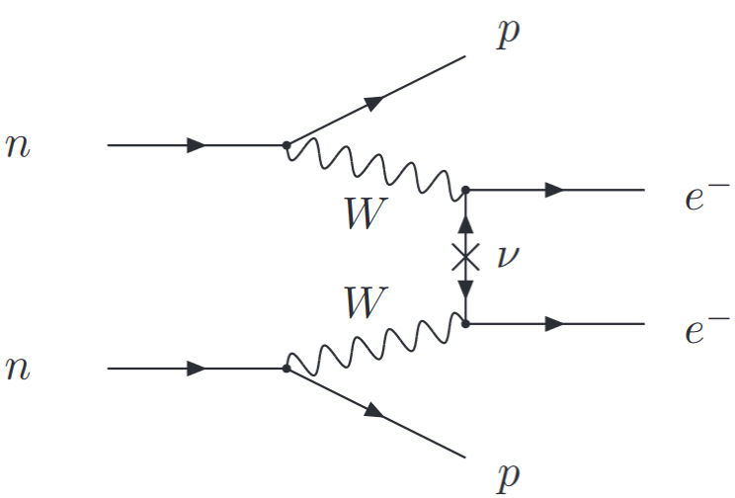






P. Neutrino Nature (related to neutrino mass) The search for $0νββ$
PDG
IO Vs NO
Effective Majorana mass
Theory
Only practical way to demonstrate if neutrinos are their own antiparticles
If observed $↔$ Majorana ν-mass (Black Box Theorem)
Challenges
Unknown mechanism behind the 0νββ (lepton number violation)
Effective operators d=5 (light neutrino exchange)
Effective operators d=7, 9
Calculation of nuclear matrix elements (& uncertainties)
PRD 25 (1982)
Kzen
Gerda
Several, current and future, experimental efforts
arXiv:1706.08524

Slide 25
Generalities & Motivation
Neutrino oscillations (The basics)
The problem of the Neutrino Mass
The problem of the Neutrino Nature
Back to Neutrino Oscillations
Current unknows
Some BSM searches
Summary

Slide 26
Neutrino Osc. Experiments (by their source)
Running & past experiments that have seen Neutrino Flavor Transitions
Solar & Reactor (~200km)
Atmospheric
Accelerator (LBL)
Reactor (km)
Homestake, GALLEX/GNO, SAGE, Borexino
SuperKamikande (SK), SNO, SNO+
KamLAND, SNO+ (LBL reactors)
SuperKamiokande (SK)
IceCube DeepCore (DC)
K2K, MINOS
T2K, NOvA
Daya Bay
RENO
JUNO (52.5km)
Tunable source or that can be well characterized
Multiple detectors (ND, FD)
Notes:
Controlled exeriments for precision studies

Slide 27
Three-active neutrino paradigm $\left.|ν_{α}\right\rangle =\sum_{k=1}^{3}{U_{αk}^{∗}}|\left.ν_{k}\right\rangle$
Two possible mass orderings
Normal (L), Inverted (R)
Three mixing angles ($θ_{ij}$)
One CP-Violating phase ($δ$)
Two mass-squared differences (${Δm}_{k1}^{2}$)

Slide 28



Neutrino Oscillation Channels
Two $Δm^{2}$’s found in Nature: $Δm_{21}^{2}={Δm}_{sol}^{2}$ & $|Δm_{31}^{2}|∝{Δm}_{atm}^{2}$
$${Δm}_{sol}^{2}$$
$${Δm}_{atm}^{2}$$
No single experiment is sensitive to ALL parameters, so we need global-fits:
To find the parameters allowed by MOST of the data taken at Neutrino Oscillation Experiments
To account for correlations between parameters
Notes:
Neutrino sectors (Data sets) considered in the Global-fit

Slide 29






Global-fit results, $Δχ^{2}$-profiles https://globalfit.astroparticles.es/
Update in progress!
~5%
~6%
~3%
3$σ$
$$2.4σ$$
Normal Ordering (NO)
Inverted Ordering (IO)
~3%
~1%
3$σ$
$$2.5σ$$

Slide 30


Global-fit results, lepton mixing
Bfp and $3σ$ Ranges for NO
Could this mixing pattern be a result of some underlying symmetry?
Notes:
Very different mixing pattern in the Quark Sector

Slide 31



Lepton mixing pattern
Before 2012, when reactor mixing angle ($θ_{13}$) was “compatible with zero”
Several possibilities
Based on non-Abelian Discrete Flavor Symmetries:
TBM
BM
Golden-Ratio
Texture zeros
…
After 2012, “large” $θ_{13}≠0$
Some possibilities
Flavor symmetries plus corrections (for instance from Charged sector) needed
Modular symmetry (string Compactification): Ex. Gui-Jun Ding talk at Neutrino24 here
Maybe it is just a result of “luck” (Anarchy):
“random draw from an unbiased distribution of unitary three-by-three matrices”
arXiv:1204.1249

Slide 32

Where we stand so far
CP symmetry (δ): T2K & NOvA combined analysis
MO: NO is preferred over IO with $2.5σ$ significance.
Atmospheric mixing ($θ_{23}$): In the 2nd octant for both MO, LO disfavored $Δχ^{2}≥5.8\left(6.4\right)$ for NO (IO)
Parameter precision: Ranges from ~1% to ~6%
After previous global-fit results, same questions remains
Is there a violation of the CP-Symmetry in the lepton sector: $J_{CP}∝\sin{δ≠0}$?
What is the correct neutrino mass ordering: NO or IO?
Is the atm. mix. angle maximal, if not, what is its octant? $\sin^{2}θ_{23}\left(<,=,>\right)0.5$?
Precise measurements are needed -> FUTURE NEUTRINO EXPS.

Slide 33



MAIN Current &Near Future Neutrino Oscillation Experiments
DUNE
HK

Slide 34
DUNE
Colombian Institutions in DUNE
Universidad Antonio Nariño
Universidad EIA
Universidad del Atlántico
Universidad de Antioquia
Universidad del Magdalena
Universidad de Medellín
Universidad Sergio Arboleda (?)
Jorge POSTER
Also in NOvA

Slide 35
Generalities & Motivation
Neutrino oscillations (The basics)
The problem of the Neutrino Mass
The problem of the Neutrino Nature
Back to Neutrino Oscillations
Current unknows
BSM searches
Summary

Slide 36

Some REMARKS
ALL 3-neutrino osc. parameters (& ordering) are aimed to be measured at future neutrino experiments (given the important improvement in precision):
DUNE/T2HK (LBL): Definitive measurement of δ
JUNO (reactor): Precise measurement of Solar parameters
DUNE/JUNO: Different strategies to establish the correct MO
DUNE: Precise determination of the atm. mix. angle, $θ_{23}$
DUNE/JUNO: Able to detect neutrinos from SN explosion “nearby” (~10kparsec)
JUNO: Measurement of Geoneutrinos
Tau neutrinos still a challenge, but efforts are being pursued
This is not the full story: Massive neutrinos imply BSM physics
Some BSM physics searches have already been performed at Osc. Exps.

Slide 37

Published Papers by Experimental Collaborations (LBL, Reactor) on BSM physics searches 2008-2024

Slide 38
BSM scenarios Impacting neutrino flavor
Motivated both theoretically (viable neutrino mass models) and phenomenologically (anomalies):
The existence of additional (flavor) neutrino states
Sterile neutrinos (low mass-scale)
Sterile neutrinos (high mass-scale) a.k.a Neutral Heavy Leptons
Deviations from the unitarity of the leptonic mixing matrix
Neutrinos in Large Extra Dimensions (LED)
New neutrino interactions a.k.a NSIs
Viable NSI models induced by light mediators (well below the EW scale)
The use of the SMEFT formalism to study low-energy NSI induced by heavy mediators
Neutrino properties: decay, magnetic moment
Test of fundamental laws
Lorentz and CPT symmetries
Quantum decoherence
Any others? Theorist imagination/insight is the limit
Your favorite one here
If impact on production/detection, and/or propagation
then can be tested in neutrino oscillation experiments (Ex: spectral distortion)

Slide 39

New Experiments and “Some” Old Questions
DUNE/HK (LBL): Expected to measure δ.
JUNO (reactor): Precise determination of the solar parameters.
DUNE/JUNO: Different strategies to determine the neutrino mass ordering.
DUNE: Improve the $θ_{23}$ determination.
Tau appearance?
Detection of neutrinos from SN?
Geoneutrinos
Are there additional neutrino (flavor) neutrino states? (at what mass-scale?)
Is the 3x3 lepton mixing matrix unitarity?
Do neutrinos interact in a non-standard form?
Do neutrinos decay?
Could the current lepton mixing pattern be a result of an underlying symmetry?
Standard neutrino program @ near future oscillations exps.

Slide 40


Any Other avenue, besides 3$ν$-oscillations, $0νββ,$ active-Sterile mixing?
cesium iodide neutrino detector
lead shield
“(COHERENT, 2017)observed CEνNS with a 6.7σ confidence by using
a comparatively tiny, 14.6-kg sodium-doped CsI scintillator
exposed to neutrinos from a spallation neutron facility ”

Slide 41


Slide 42


Slide 43
Generalities
Neutrino oscillations (The basics)
The problem of the Neutrino Mass
The problem of the Neutrino Nature
Back to Neutrino Oscillations
Current unknows
Some BSM searches
Summary

Slide 44
10 Reasons Why to Study Neutrinos, By ChatGPT
1. Beyond the Standard Model
Neutrino mass = new physics
6. Majorana Mystery
Are neutrinos their own antiparticles?
2. Quantum Flavor Oscillations
Lepton mixing & PMNS matrix
7. Cosmic Abundance
Trillions pass through us every second
3. Matter–Antimatter Asymmetry
Leptogenesis & CP violation
8. Technological Innovation
Detectors, imaging, and cross-disciplinary tools
Martinez talk
4. Early Universe Probes
Cosmic neutrino background
9. Portal to New Physics
Sterile neutrinos, dark matter connections
5. Astrophysics & Cosmology Link
Role in stars, supernovae, structure formation
10. Multidisciplinary Frontier
Bridges particle physics, astrophysics, cosmology

Slide 45



What neutrinos are good for?
Direct aplication
Monitor Nuclear Reactor to avoid Uranio enrichment (non-ploriferation weapons), measuring the emited Antineutrinos
Provides a unique window
To “see” the interior of:
The Earth:
measuring Geoneutrinos
Neutrino tomography
The Sun, measuring Solar Neutrinos
To know more about the SuperNovae gravitational collapse and explosion: 99% of its energy released in the form of (anti)neutrinos
Science fiction
Interestelar communication

Slide 46
Conclusions & Final remarks
DATA DRIVEN FIELD: Lots of neutrino exps: Osc. (SBL, LBL),m0,0nuBB, CEvNS & The need to BUILD REALISTIC MODELS (pheno. implications)
Neutrino Mass, DM & BAU
A TOOL FOR DISCOVERY
In parallel to the (funded) standard physics program, several BSM physics searches can be pursued at near future neutrino osc. experiments:
Sterile, NSI, LED, NHLs… (your favorite HERE)
CEvNS: Promising tool for BSM physics searches
Either new physics is hidden in the error bars, so it is a matter of precision... or is a completely new stuff that can show up, so detectors triggers have to be careful designed to see non-standard signals
PART OF SEVERAL OPEN QUESTIONS ACROSS “DIFFERENT” AREAS
Neutrinos impact particle physics, astrophysics & cosmology: It is always a good time to start studying neutrinos

Slide 47


Slide 48
BACK UP

Slide 49





Comparing Global-fit results: BFPs and 3$σ$ ranges
De Salas et. al arXiv:2006.11237 (VLC) Esteban et. al arXiv: 2007.14792 (nu-fit) Capozzi et. al arXiv: 2003.08511 (Bari)
Notes:
All agree with a small preference for 2nd Octant

Slide 50


Comparing Global-fit results: BFPs and 3$σ$ ranges
De Salas et. al arXiv:2006.11237 (VLC) Esteban et. al arXiv: 2007.14792 (nu-fit) Capozzi et. al arXiv: 2003.08511 (Bari)
Notes:
All agree with a preference for 2nd Octant

Slide 51


Three and only three active neutrinos: 2.984±0.008
Extra flavor neutrino states have to be sterile!
SBL anomalies motivate light sterile neutrino(s) with $Δm^{2} \sim 1 eV^{2}$
One economical extension is to introduce one extra sterile neutrino, 3+1 framework.
Right-handed neutrinos (singlets under SM gauge group) can propagate in hypothesized extra space-time dimensions.
In a ‘vanilla’ LED model, similar phenomenology to that of light sterile neutrinos results.
Exp side: Dedicated SBL neutrino program at FNAL (& Several others)

