Slide 1
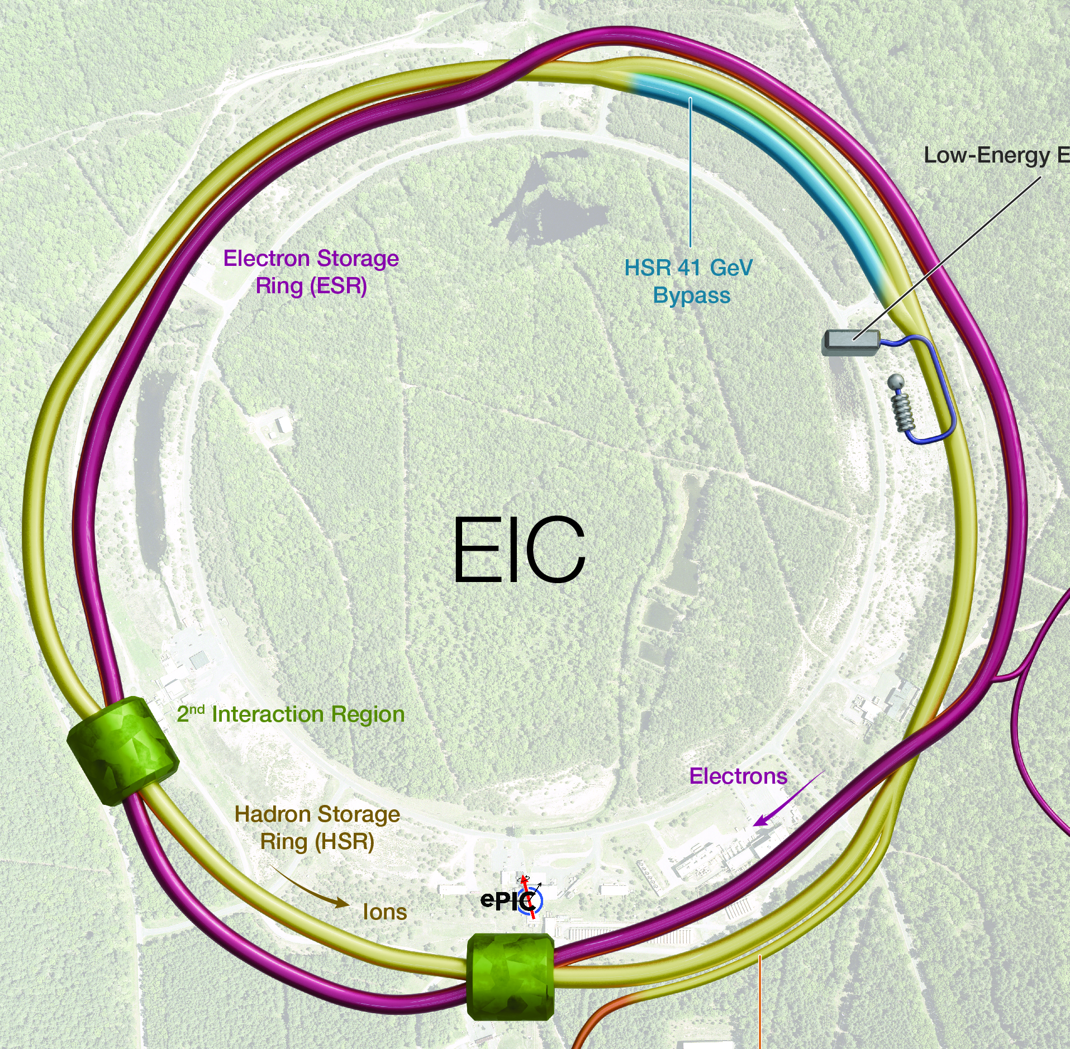
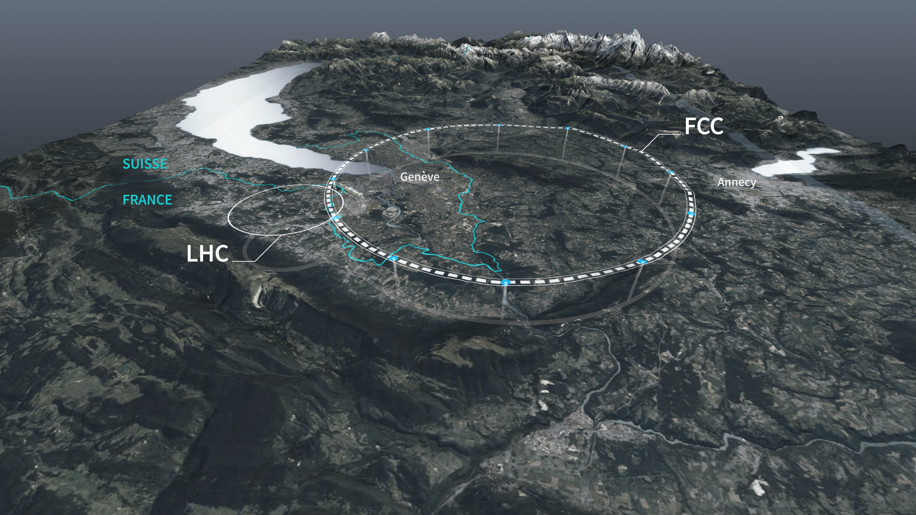
FCC-EIC Synergies
Frank Zimmermann, CERN
NAPAC’25, Sacramento, 12 August 2025

Slide 2


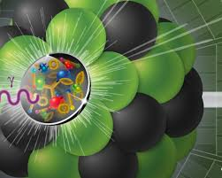

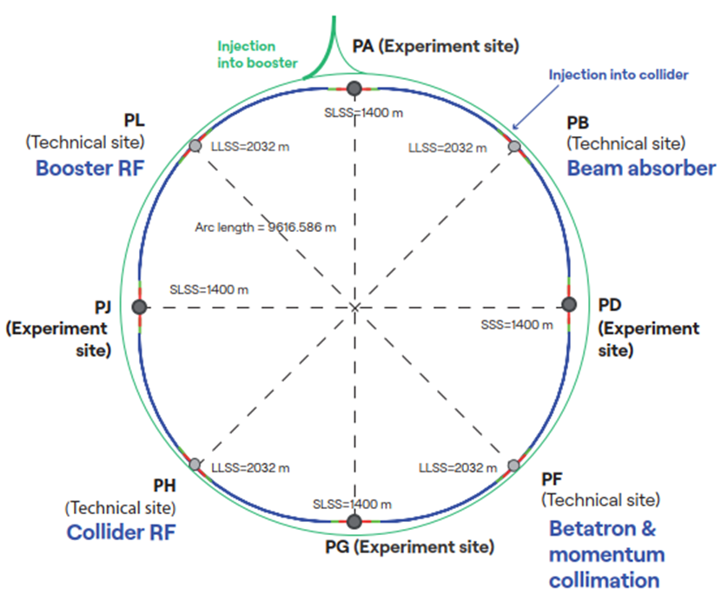
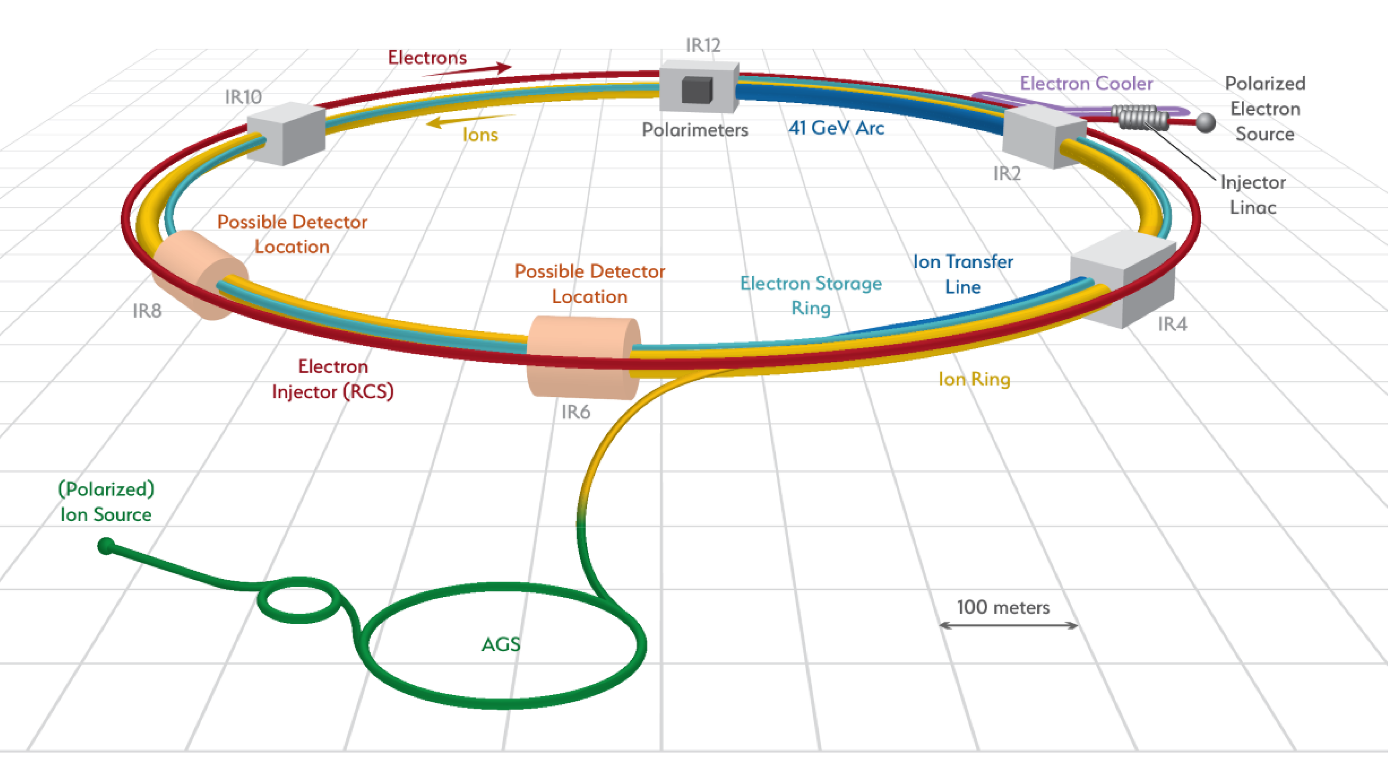
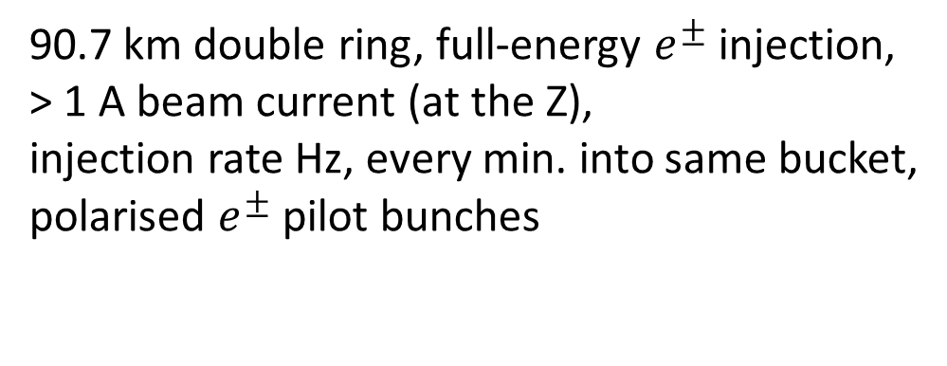
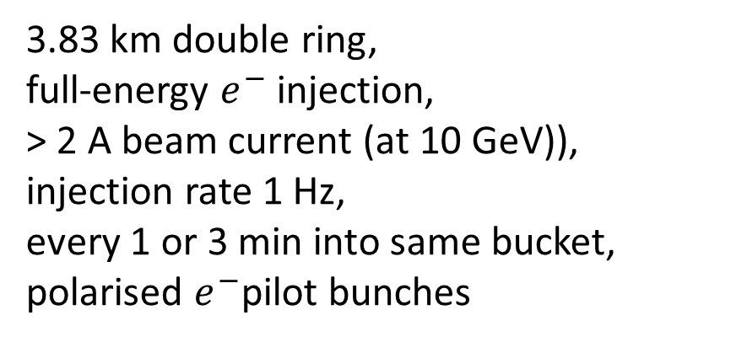
FCC & EIC similarities
FCC-ee
EIC
3.83 km double ring,
full-energy $e^{−}$ injection,
> 2 A beam current (at 10 GeV)),
injection rate 1 Hz,
every 1 or 3 min into same bucket,
polarised $e^{−}$pilot bunches
90.7 km double ring, full-energy $e^{±}$injection,
> 1 A beam current (at the Z),
injection rate Hz, every min. into same bucket,
polarised $e^{±}$pilot bunches

Slide 3
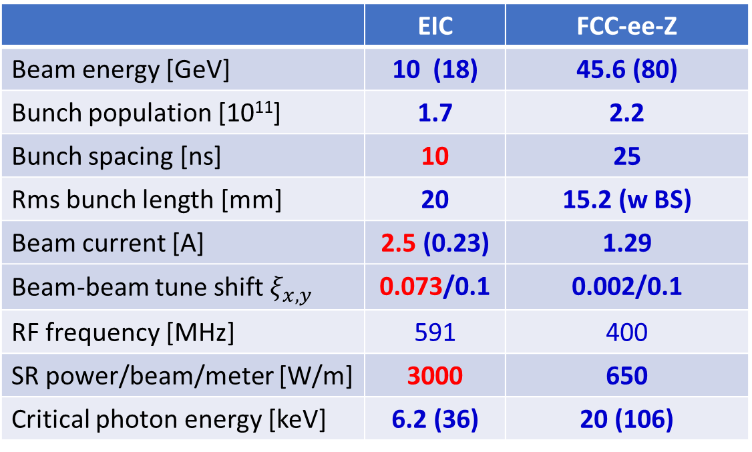
Electron Ion Collider (EIC)
US EIC Electron Storage Ring similar to, but more challenging than, FCC-ee
beam parameters almost identical, but twice the maximum electron beam current, or half the bunch spacing, and lower beam energy
 | EIC | FCC-ee-Z
Beam energy [GeV] | 10 (18) | 45.6 (80)
Bunch population [10¹¹] | 1.7 | 2.2
Bunch spacing [ns] | 10 | 25
Rms bunch length [mm] | 20 | 15.2 (w BS)
Beam current [A] | 2.5 (0.23) | 1.29
Beam-beam tune shift $ξ_{x,y}$ | 0.073/0.1 | 0.002/0.1
RF frequency [MHz] | 591 | 400
SR power/beam/meter [W/m] | 3000 | 650
Critical photon energy [keV] | 6.2 (36) | 20 (106)
>10 areas of common interest identified by the FCC and EIC design teams, which had been meant to be addressed through joint EIC-FCC working groups – mostly not really active
EIC will start beam operation about a decade prior to FCC-ee
The EIC will provide another invaluable opportunity to train next generation of accelerator physicists on an operating collider, to test hardware prototypes, beam control schemes, etc.

Slide 4
CERN FCC – EIC collaboration, contact persons - to be updated
Domain | CERN/FCC contacts | BNL/EIC contacts | JLAB/EIC contacts | Other contacts FCC | Other contacts EIC
impedance model, instabilities, HOM, ion instability | Mauro Migliorati (INFN), Ivan Karpov (CERN) | Mike Blaskiewicz, Alexei Blednykh, Silvia Verdu (?) | Todd Satogata | Alexander Novokhatski (SLAC)
polarization | Jorg Wenninger (CERN), Jacqueline Keintzel (CERN) | Vadim Ptitsyn | Todd Satogata | Eliana Gianfelice (FNAL), Guy Wilkinson (Oxford)
beam instrumentation, SR monitors (BPMs) | Thibaut Levefre (CERN), Manfred Wendt (CERN) | David Gassner, Dany Padrazo | Todd Satogata | Anke Susanne Mueller (KIT)
beam feedback systems | Wolfgang Hofle (CERN) | Mike Blaskiewicz (BNL), Another ? | Todd Satogata | John Fox (SU)
vacuum system | Roberto Kersevan, Cedric Garion (CERN) | Charles Hetzel | Mark Wiseman
final focus quadrupoles |  | Brett Parker, Holger Witte | Walter Wittmer | Mike Koratzinos (MIT, PSI)
SRF | Erk Jensen, Frank Gerigk, (CERN) | Kevin Smith | Robert Rimmer
MDI, IR shielding, handling equipment associat’d w IR | Manuela Boscolo (INFN), Helmut Burkhardt (CERN) | Holger Witte | Walter Wittmer | Mike Sullivan (SLAC), John Seeman (SLAC)
Collimation – beam tails | ­Andrey Abramov (CERN), Roderik Bruce (CERN) |  |  | Dmitry Shatilov (BINP, NIU)
Beam-beam interactions (limits with multiple IPs) | Xavier Buffat (CERN) |  |  | Dmitry Shatilov (BINP, NIU)
to be updated

Slide 5
FCC-EIC Joint Working Meetings
1st working meeting EIC-FCC on polarized beam operation
CERN, 19-23 September 2022, in conjunction with the 2nd FCC EPOL workshop https://indico.cern.ch/event/1181966/
2nd FCC-EIC joint working meeting on beam dynamics, stability, impedances, feedback, vacuum and MDI
CERN, 17-21 October 2022, in conjunction with the FCC-ee MDI working meeting https://indico.cern.ch/event/1186798/
2nd FCC Polarisation workshop
CERN, 19-30 Sept. 2022, https://indico.cern.ch/event/1181966
V. Ranjbar: EIC e-Injector Polarization; E. Gianfelice: EIC esr Polarization; M. Signorelli: EIC ESR Tracking Studies;
V. Ptitsin: Physics with polarized beams at the EIC; F. Zimmermann, V. Ptitsin: Synergies EIC-FCC
3rd FCC-FNAL-US joint working meeting on SRF
FNAL, 29-30 March 2023 800 MHz RF cavities, SRF Cryomodules, SSA, HOMs

Slide 6
topics of common interest
simulation code development
collaboration on Xsuite
code benchmarking
MDI concepts & simulations
IR optics, IR magnet design
mechanical integration
beam losses and SR in the MDI
collimation, detector backgrounds
tuning, mechanical stabilization
impedance, heat load evaluation
det. solenoid compensation scheme
polarisation
simulation & code development
suppressing spin resonance
  lattice design
  knobs: harmonic spin matching
  polarisation transport thru booster
  resonant depolarisation & spin flip
  coherent spin precession as tool
  beam-beam effect on polarisation
  polarimetry
    integration, detector, bkgd, laser
accelerator design & beam dynamics
DA, tolerances, machine learning
mechanical alignment & BBA
impedance, collective effects, e-cloud
sudden beam loss events as in SKEKB
machine protection

Slide 7
more topics of common interest
injector
S-band linac & S-band rf structures
(FCC/PSI, EIC)
polarised e- source
MDI hardware
final quadrupole technology
  & production, cryostat design
choice of IR cryogenic temperature
SRF
    RF cavities (2-cell?)
    RF power source
      tristron R&D
vacuum systems
automated production & NEG coating
beam-intercepting devices
primary, secondary & tertiary collimators – design & materials
collision debris collimators
protection devices, beam dumps
beam diagnostics
    BPMs
    BLM system
    emittance measurements, halo
    bunch length measurement
    polarimeters & lasers
training
working visits of young scientists

Slide 8

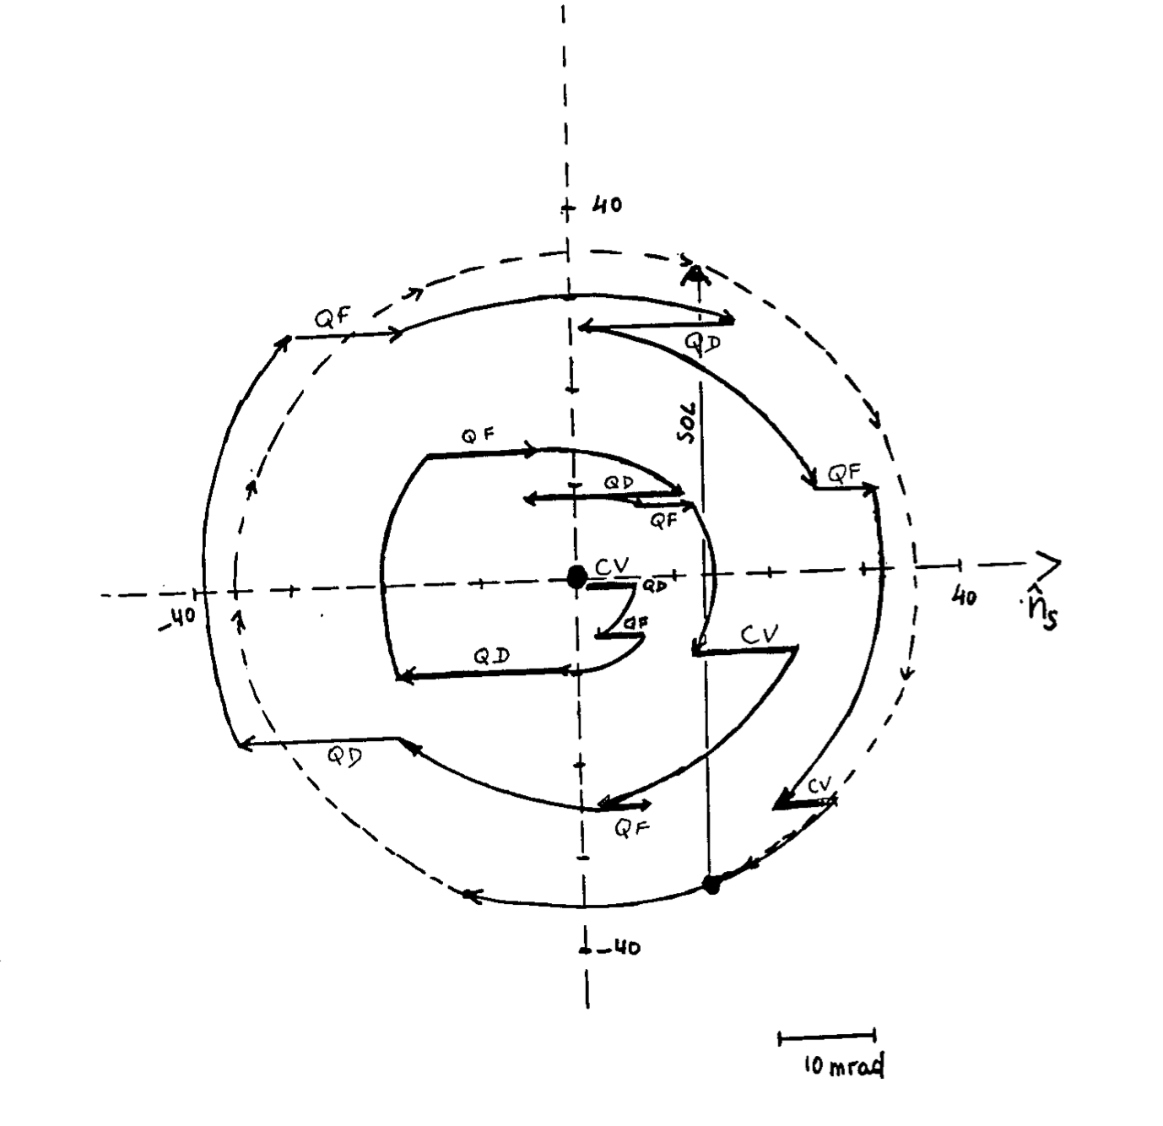
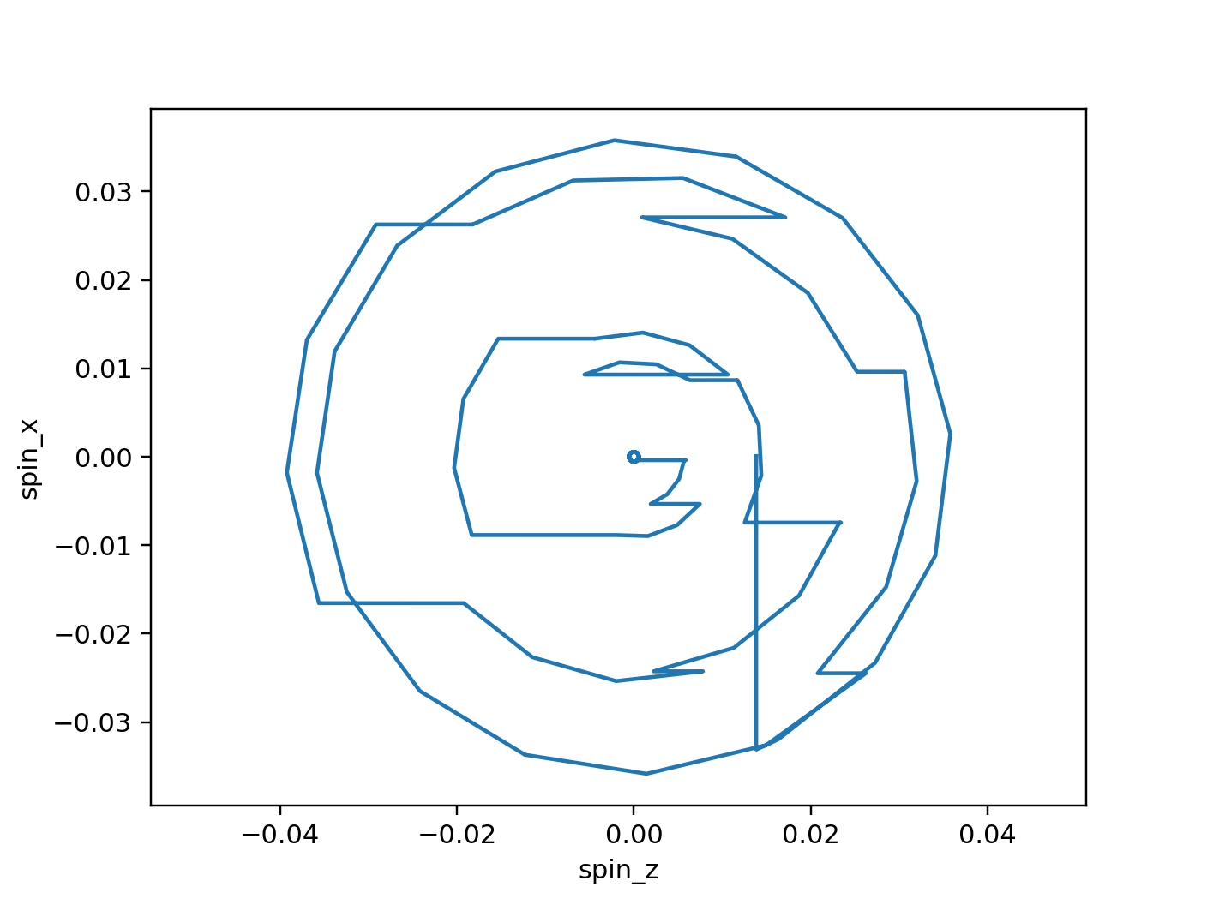
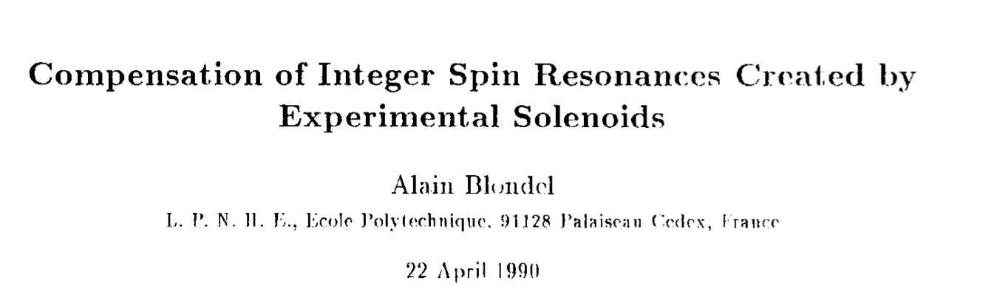
spin tracking: a success story
spin tracking newly implemented in Xsuite !
Benchmarking case of LEP1 with orbit bumps to compensate precession in the experimental solenoids → good agreement found against SLIM simulations
tests, benchmarking,
and first simulation studies ongoing
Xsuite 2025
SLIM 1990
G. Iadarola,
K. Hock,
Y. Wu,
J. Keintzel,
T. Pieloni,
J. Wenninger
8

Slide 9
conclusions & outlook
a lot of FCC-EIC synergies in many areas & mutual interest to collaborate
so far formal agreement between CERN and DOE/NP proved elusive
CERN/FCC has agreement for HEP and with DOE Office of Science
may common successful work on Xsuite usher in a new era ?
suggest continuing joint effort on polarisation and adding themes:
- S-band linac
- collimator design
- beam-beam studies
- electron-cloud studies
- MDI ?
- mechanical alignment ?
Next ECLOUD workshop
in Mérida / Yucatán,
March 2027 !

