Slide 1
EIC Accelerator Collaboration
Tatiana Pieloni, École Polytechnique Fédérale de Lausanne, Switzerland
Andrei Seryi, Jefferson Lab, USA
co-chairs of
EIC Accelerator Collaboration
NAPAC 2025 Sacramento
13th August 2025

Slide 2
EIC Accelerator Collaboration
The EIC design, construction, and future upgrades offer exciting scientific and technical challenges, creating opportunities for closely connected worldwide accelerator R&D
The EIC Accelerator Collaboration will help realize the full potential of these opportunities
This will benefit the EIC project, collaboration partners, and the wider accelerator community. It will also help maximize the ultimate performance of the EIC facility on the long-term and serve as a bridge toward next-generation accelerators.

Slide 3
EIC Accelerator Collaboration
EIC Accelerator Collaboration missions:
  Provide a discussion forum and a collaboration vehicle for the EIC accelerator-related working groups and topics;
  Identify and create opportunities for US institutions to contribute to the EIC construction project;
  Identify and create opportunities for In-Kind contributions to the EIC project and to future upgrades;
  Identify and develop future EIC facility upgrades;
  Identify and provide accelerator research and development topics and opportunities;
  Communicate to EIC stakeholders on behalf of the accelerator R&D community;
  Communicate to various long-range planning panels.
The EIC Accelerator Collaboration will enhance the long-term evolution and performance of the EIC, and should also help us construct the EIC more efficiently.

Slide 4
Institutional Collaboration Board
Lin Liu | LNLS | Brazil
Oliver Kester | TRIUMF | Canada
Guillaume Olry | IJCLab | France
Pierre Vedrine | CEA Saclay | France
Qing Qin | ESRF | France
Ralph Assmann | GSI/FAIR | Germany
Lucio Rossi | INFN Milano | Italy
Roberto Cimino | INFN-LNF | Italy
Moses Chung | Pohang Accelerator Lab | South Korea
Jose Miguel Jimenez | CERN | Switzerland
Graeme Burt | Lancaster University | UK
Carsten Welsch | University of Liverpool | UK
Nik Templeton | STFC | UK
Phil Burrows | John Adams Institute | UK
Stewart Boogert | Cockcroft Institute | UK
Georg Hoffstaetter | Cornell University | United States
Jean Delayen | Old Dominion University | United States
John Power | ANL | United States
Mei Bai | SLAC | United States
Sam Posen | Fermilab | United States
Sarah Cousineau | ORNL | United States
Soren Prestemon | LBNL | United States
Young-Kee Kim | University of Chicago | United States
Yue Hao | FRIB | United States
Established the Institutional Collaboration Board: 24 members, 24 Institutes, 9 countries.
Planning to:
  Continue expanding the ICB
  Organizing the first meeting

Slide 5
EIC-AC Events
IPAC 2024 Kick off Event
  Present the Accelerator Collaboration
  Collect community and experts inputs for WGs formation
  Formed the ICB
IPAC 2025 Taiwan ~ 80 people
  Agenda available with presentations: link
  Strong interest from both the accelerator community and industrial partners present, with a clear willingness to get involved!
  Several point of contacts for in-kind contributions
NAPAC 2025 → EIC-FCC discussion

Slide 6
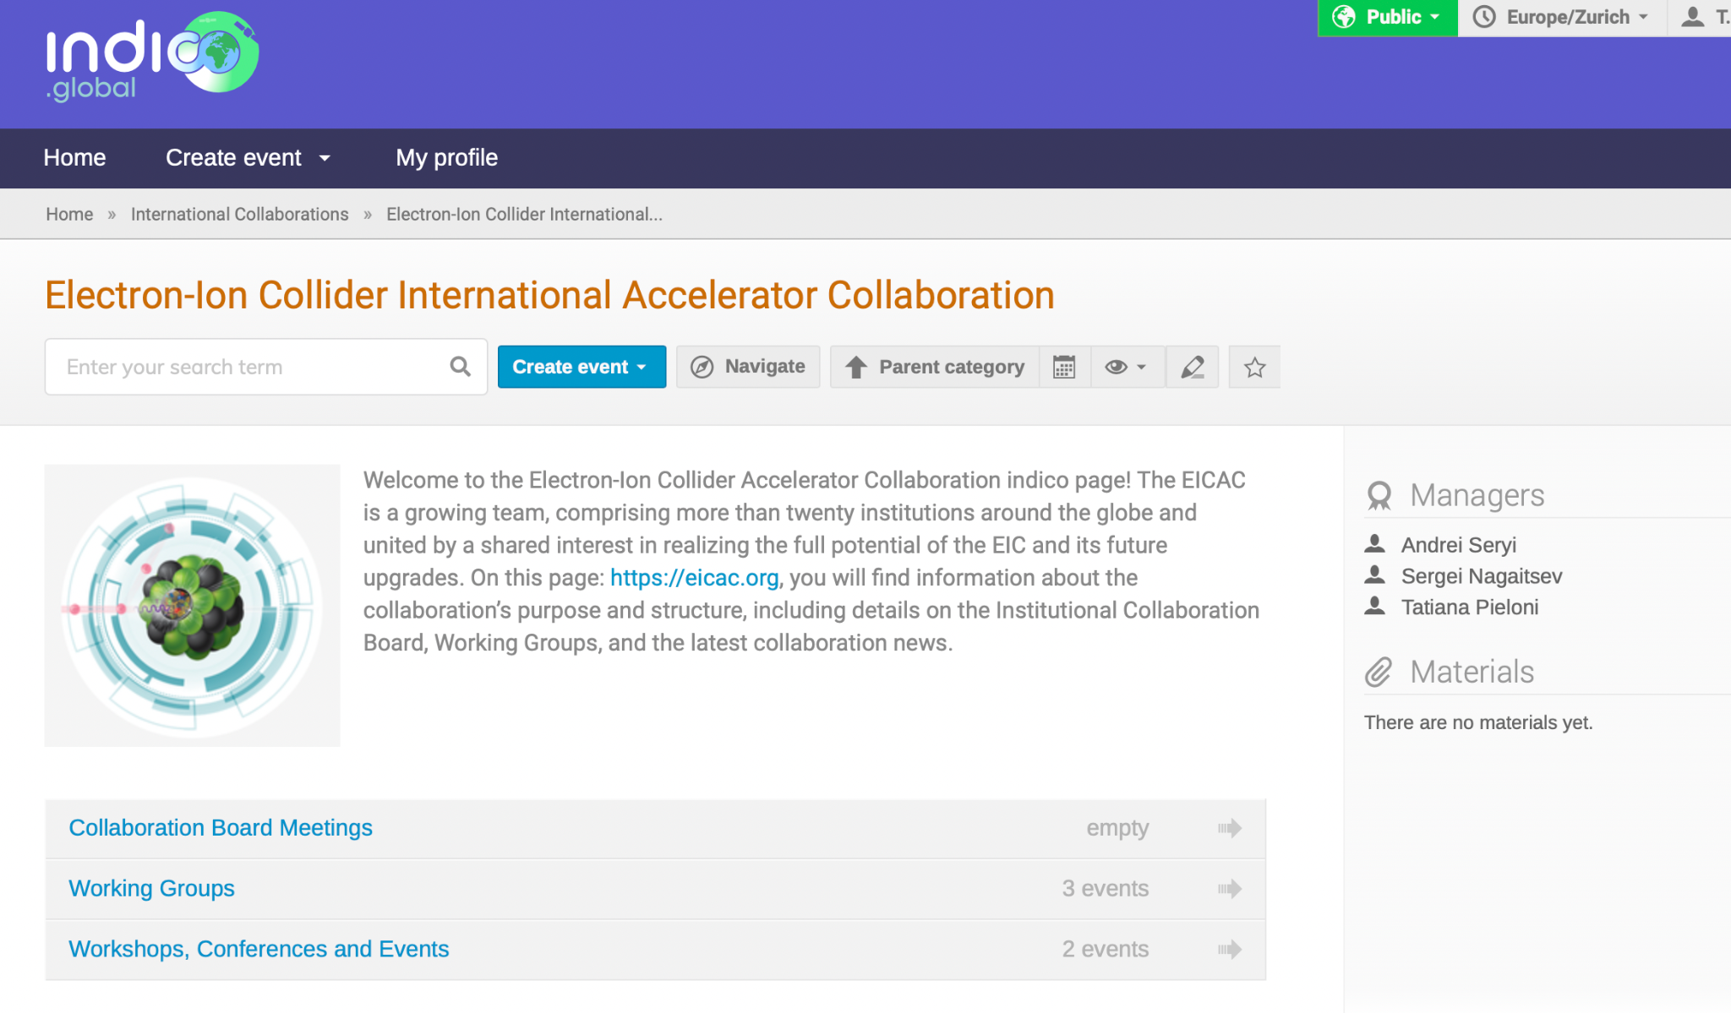
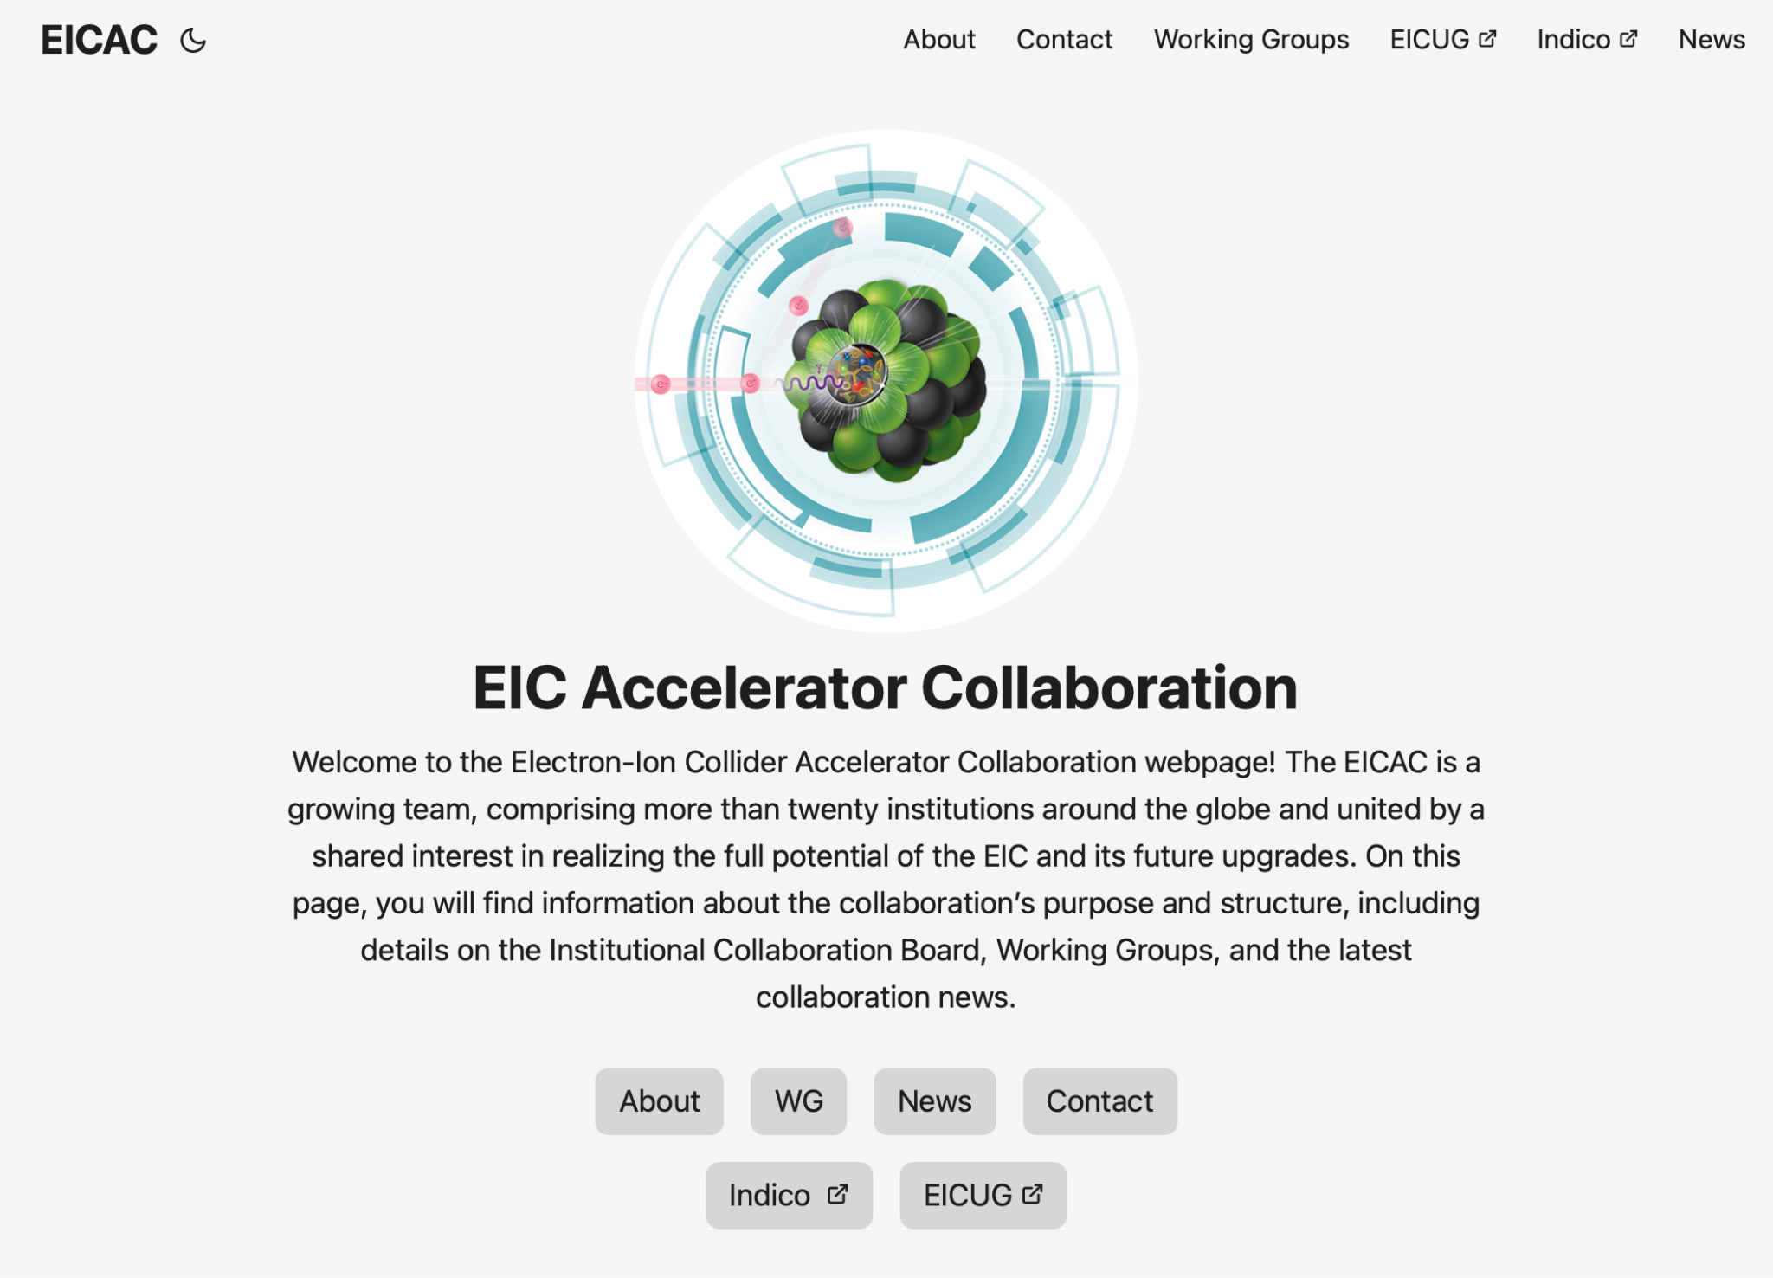
Information flow and Material Sharing
Official Webpage EICAC.org
All WG meetings and material migrated soon to: CERN Global Indico

Slide 7
Working Groups on key challenges
Beam-beam effects C. Montag (BNL), X. Buffat (CERN)
Polarized Beams and Polarimetry F. Rathmann (BNL), G. Hoffstaetter(Cornell)
EIC commissioning Tools Y. Hao (MSU/BNL), J.L. Vay (LBNL) and tbc (CERN)
Collimation, Machine protection and MDI – A. Natochii (BNL) and tbc S. Redaelli (CERN)
Injection and sources R&D – tbc P. Craievich (PSI)
Impedance and Collective effects - tbc S. Antipov (DESY)
Second Interaction Region recruiting co-chairs
High Energy Beam Cooling recruiting co-chairs
Forum on EIC Synergies with Current and Future Projects - recruiting co-chairs
More WGs to come → Feel free to propose topics and technologies of interest

Slide 8
Polarized Beam and Polarimetry WG
Coordinators: Georg Hoffstaetter de Torqua and Frank Rathmann
Focus on important EIC-specific and general topics of polarized beams such as:
- Theory of spin dynamics in storage rings, including radiative depolarization, spin diffusion, and beam-beam forces.
- Spin simulation tools for polarized beams.
- Polarized beam manipulation and optimization techniques.
- Polarized hadron and atomic beam sources for protons, deuterons and Helios.
- Theory and technology of polarimetry, based on pp, dd and 3He-3He scattering.
- Polarized electron sources.
- Electron polarimetry based on Compton scattering.
Registered group members: 24 members from 8 institutions
Purpose:
Identify topics for polarized EIC beams that can receive significant attention from outside BNL.
Identify and form groups that attend to pertinent topics.
Identify funding sources (especially outside BNL).
Identify potential and help in manpower development.
Maintain contact to respective BNL groups and experts for polarized beams.

Slide 9
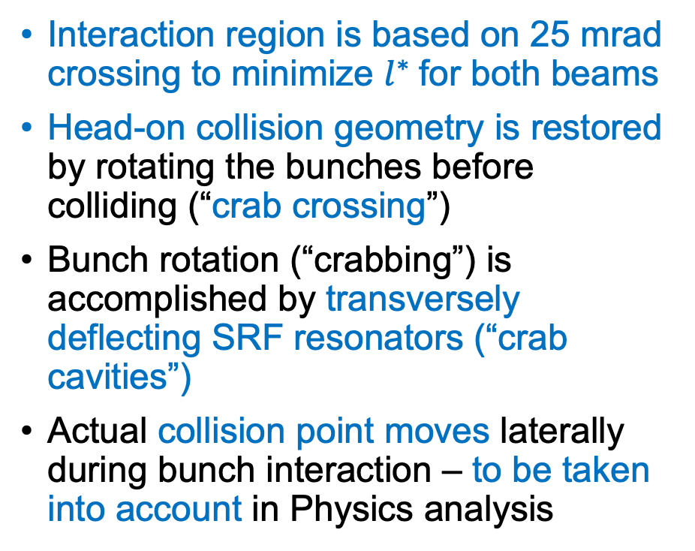
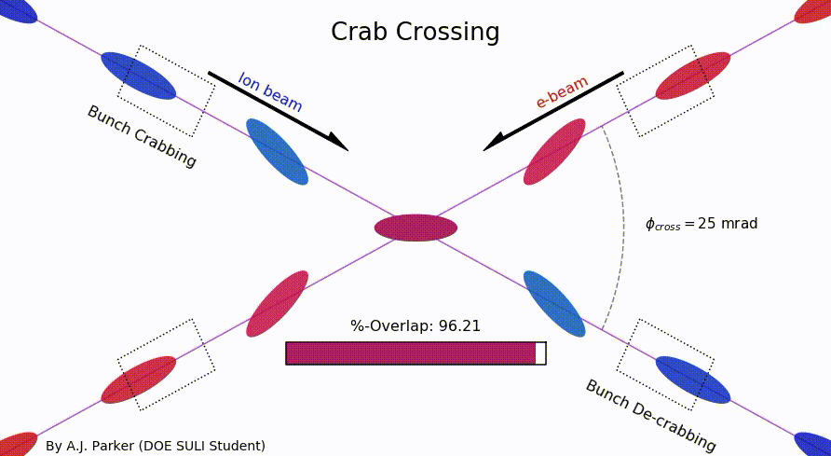
Beam-Beam WG
Coordinators: C. Montag, X. Buffat
Beam-beam parameter;
x=0.01 for protons and 0.1 for electrons

Slide 10
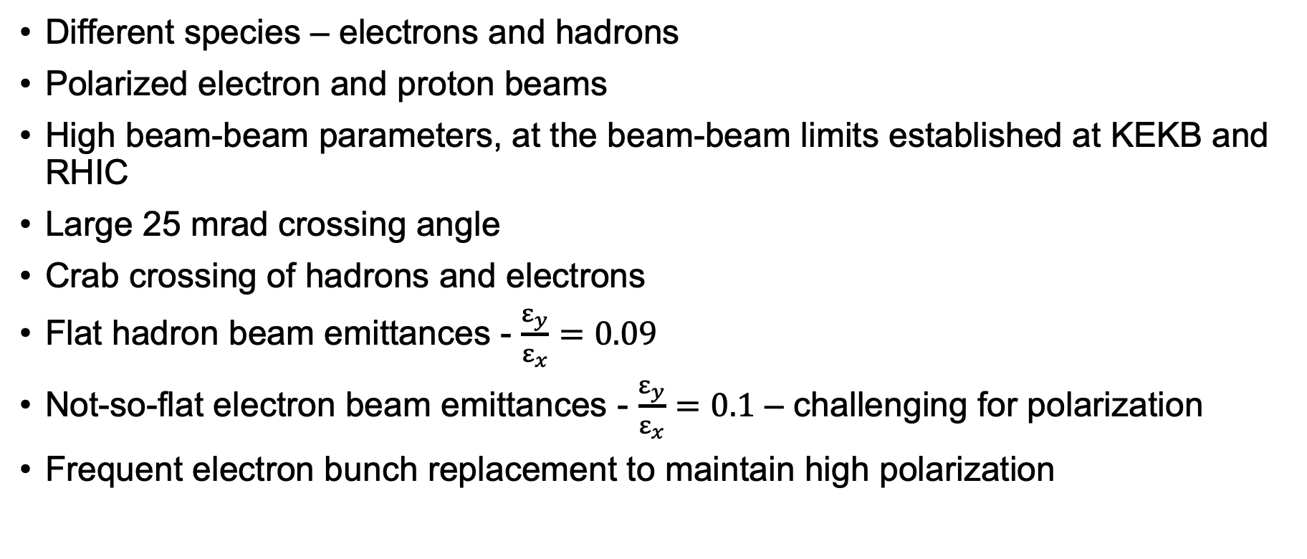
Beam-Beam Challenges in EIC

Slide 11
WGs next
Not a review, nor a workshop → Knowledge transfer and maximize performances
Cluster subjects that are closely related from a physics perspective and also from an operational perspective. Focus on preparing for a real machine.
i.e. Beam-Beam + Collective Effects
Build a critical mass of expertise, Maintain high-level, frequent scientific discussions creating an ongoing forum for dialogue among different experts
Working groups under review to foster a more efficient and productive environment!

Slide 12
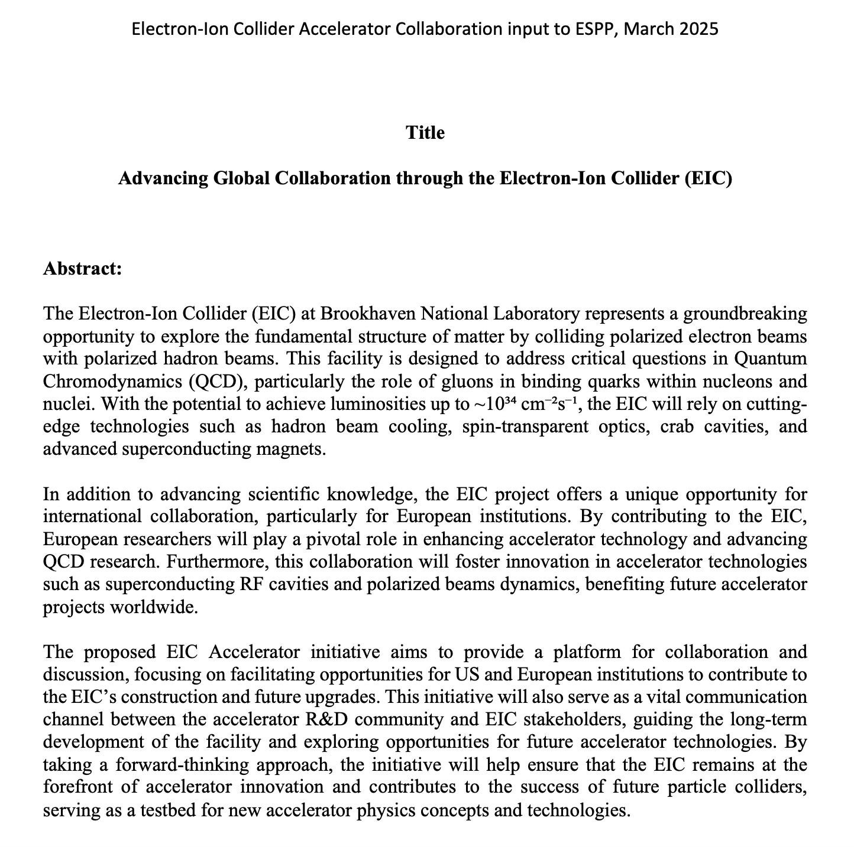

Input to European Strategy for Particle Physics
Drafted document as EIC input
  Scientific Research
  Accelerator Technology
  Educational Exchanges
Register to endorse
https://indico.global/event/14314/
Endorsing can be done any time until European Strategy conclusions converge!
Full Document

Slide 13
Input to European Strategy for Particle Physics
We have a unique opportunity to actively shape a new facility by integrating concepts and technologies that align with the goals of the EIC and even extend them in a longer term.
This facility can become a powerful platform for advancing beam dynamics and diagnostics concepts already at the conceptual level
EIC could serve as a dedicated test bench for technology development and exploration relevant to future machines.
Valuable environment for the education and training of the next generation of operators, engineers, and physicists in both hadron and lepton operations—bridging the gap to future colliders/accelerators
This facility will not only support technical innovation but also play a crucial role in developing talent and expertise for the future of accelerator science.

Slide 14
Conclusions and future plans
Collaboration keeps growing → first CB meeting to be prepared for this summer
ESPP input submitted → evident synergies with European studies (i.e. FCC)
IPAC 25 event was successful
WGs are kicking off with activities and exchanges → re-optimization ongoing
IKC – work in progress and keep increasing
Need to establish a framework for funding EIC AC activities to foster research activities among collaborators (EIC/CERN exchange fellowship program). Ideas are under discussion and feedback is needed.

Slide 15
Thank you!

Slide 16
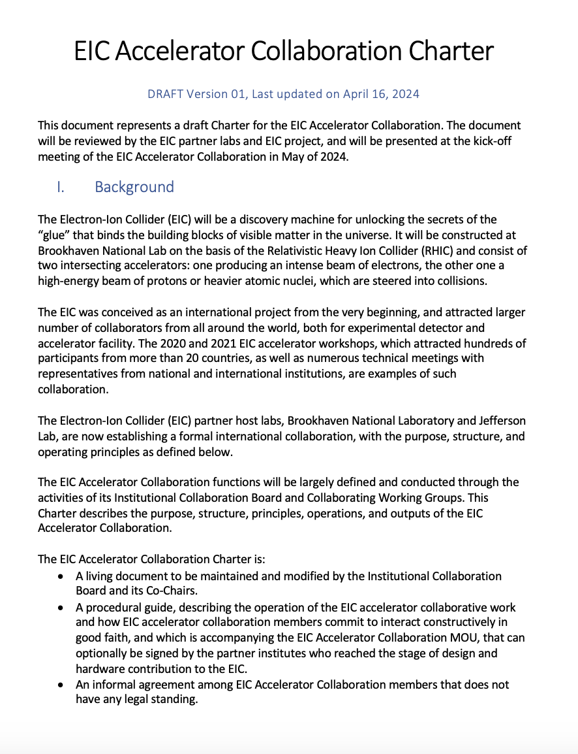
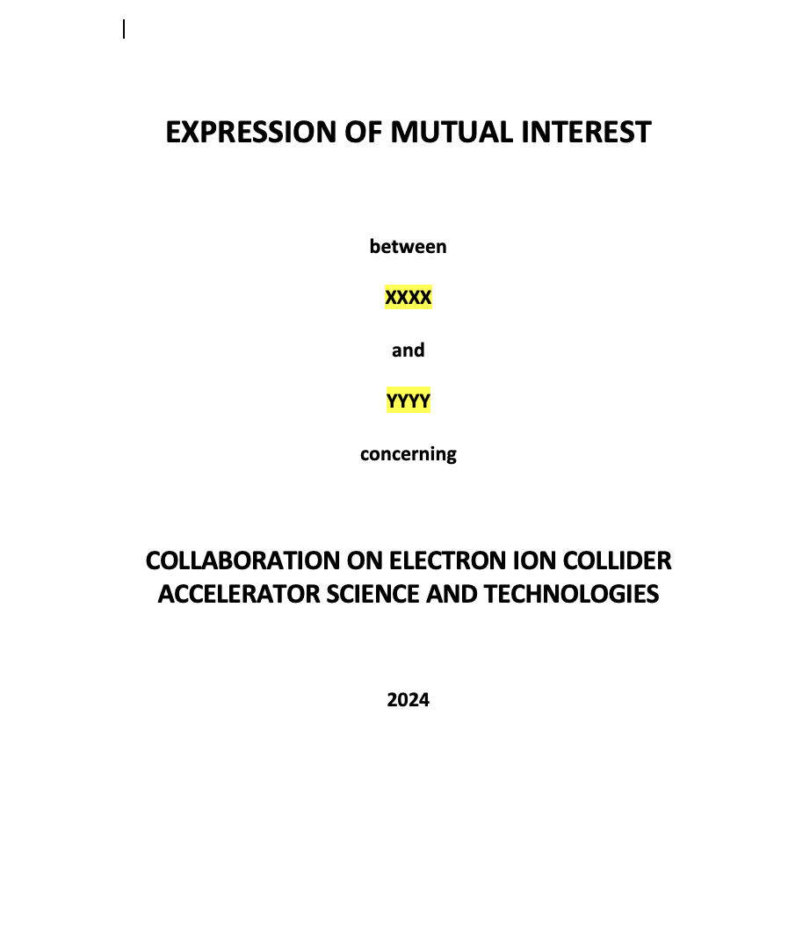
Collaboration Charter and EIC/MOU
Coll Charter
MoU/EoI doc

