Slide 1
Electron-Ion Collider Accelerator Collaboration: status and opportunities
Sergei Nagaitsev
EIC Technical Director
Aug 12, 2025
NAPAC 2025

Slide 2
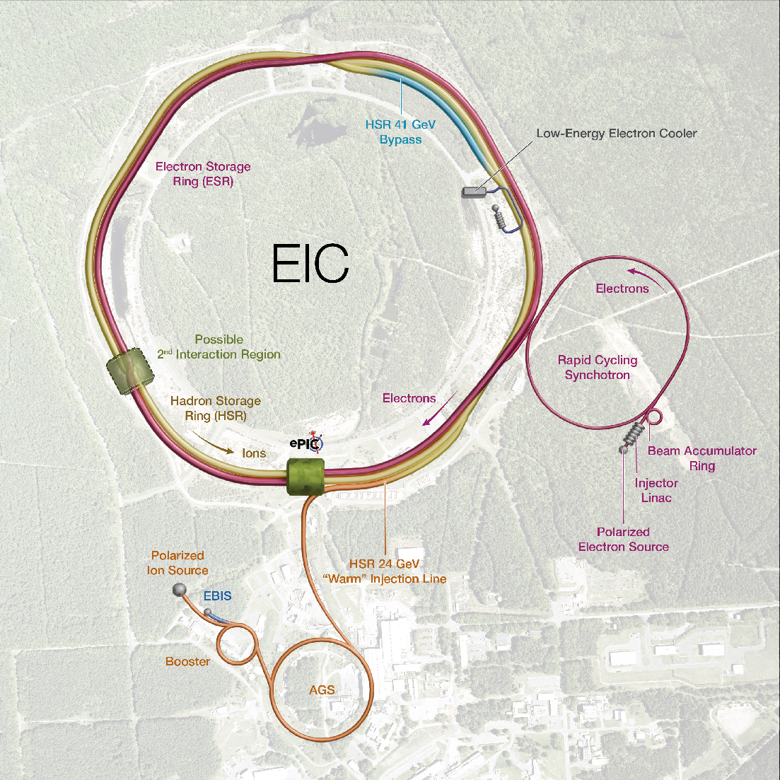
EIC concept
Construction timeline for planning
purposes:
Mid-2026 → 2035
We will have several sub-projects:
Collider rings
IR
Detector
Electron Injector
…

Slide 3
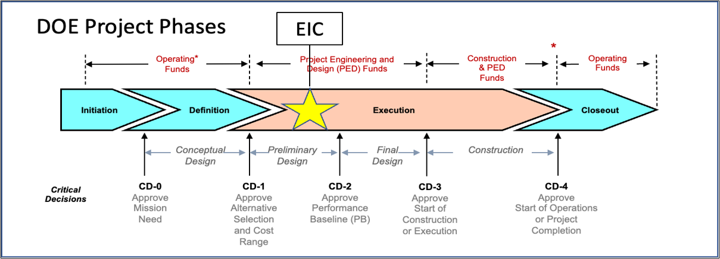
EIC Project: Critical Decisions and Plans
2019
2021
CD-2 and CD-3 in Preparation
CD-4 EF = 2034
CD-3A, Long-Lead Procurement, approved March 2024. Excellent use of IRA funding.
CD-3B, Long-Lead Procurement, approval planned for 2025.

Slide 4
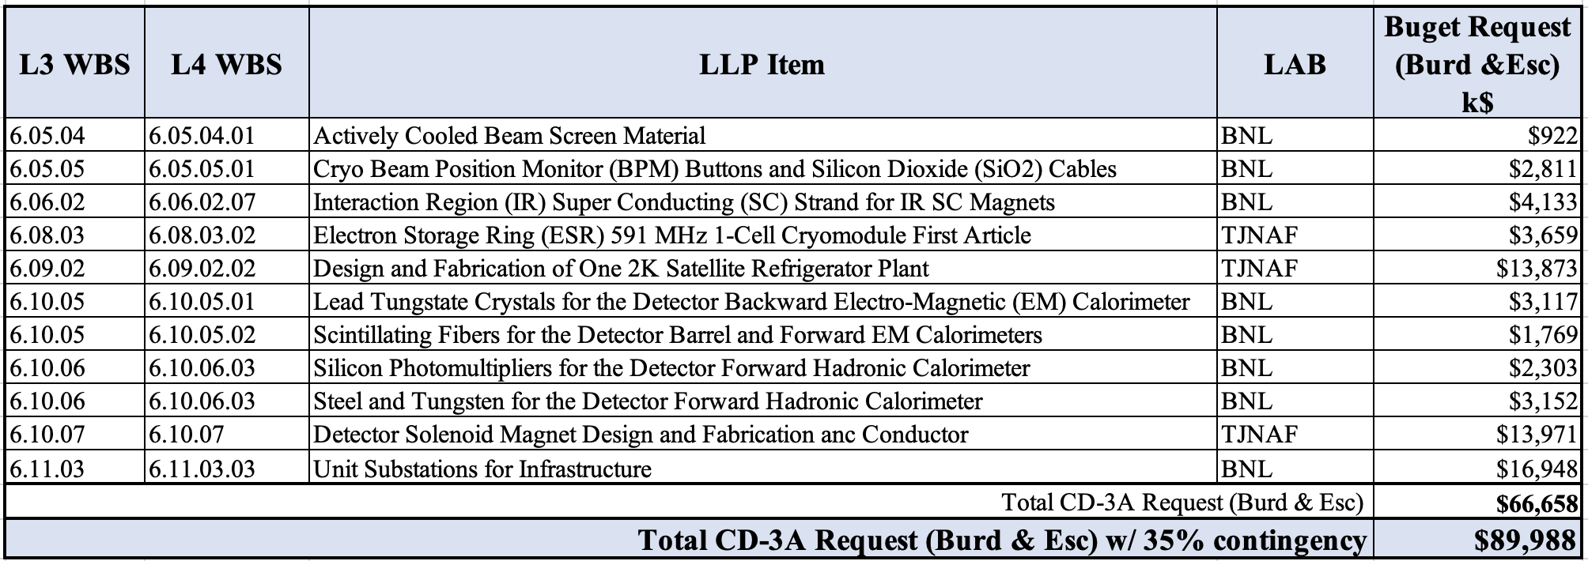
CD-3A Long-Lead Procurements (Approved)
and
The Beam Screen material now includes roll-forming which increases the cost by 4.4M.

Slide 5
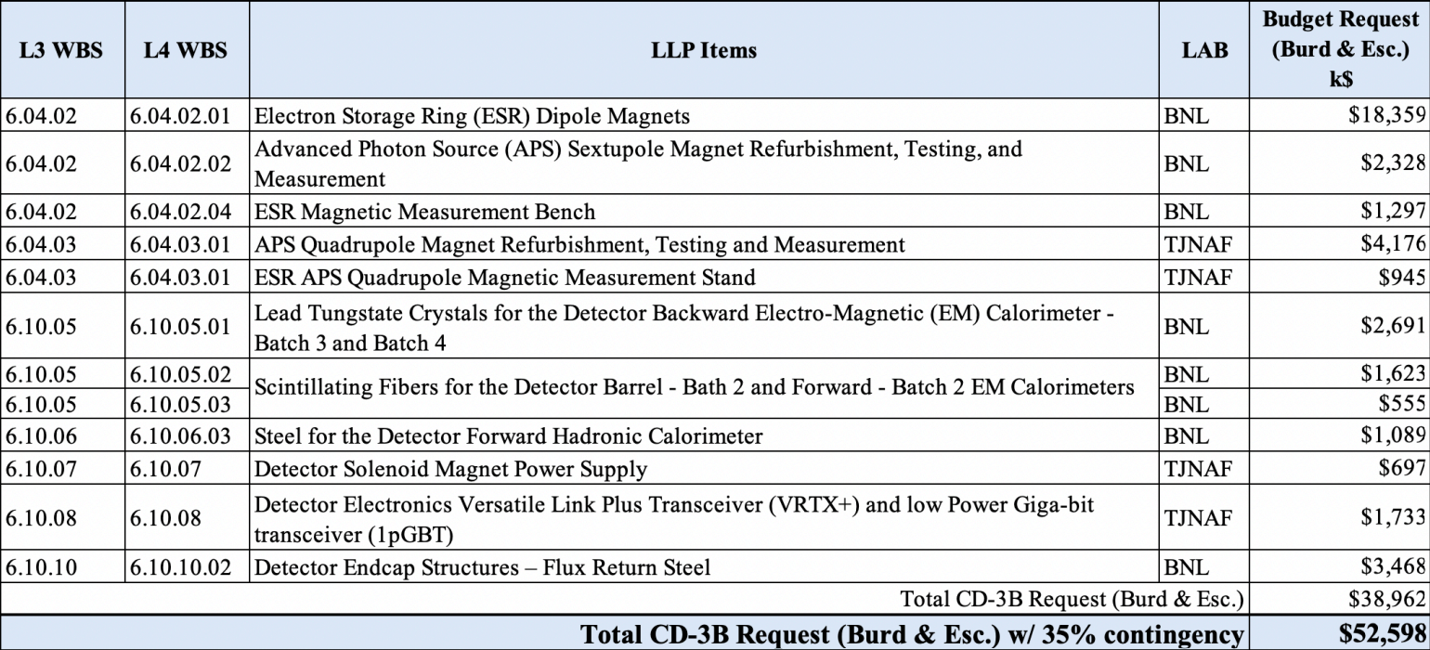
CD-3B Request

Slide 6
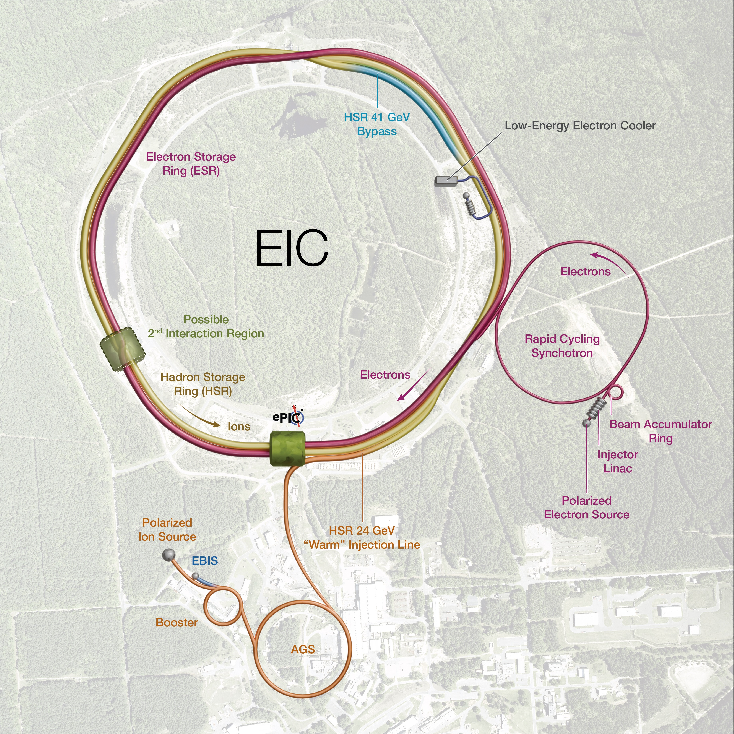
Subproject Strategy (recent development)
Subproject strategy follows the maturity status
Accelerator Storage Rings (lowest risk)
Detector
IR
Electron Injector
              Start Science Program
Energy and Luminosity Ramp-up
Integrated Project Office and Global Commissioning
Subprojects minimize dependencies, create well-defined interfaces, and well-defined physical boundaries.
The roll-up of subproject scope progressively elaborate a complete EIC facility.
CM
CM
CM
Cryoplant & Bldg

Slide 7
Proposal for EIC Science Program in the First Years
Year - 1
Year - 2
Year - 3
Year - 4
Year - 5
Start EIC Science
New Capability:
Commission electron polarization in parallel
Collider:
10 GeV electrons on 115 GeV/u heavy ion beams (Ag or Nb)
+Long. electron polarization
New Capability:
Commission proton polarization in parallel
Collider (base goal):
10 GeV long. polarized electrons on 130 GeV/u Deuterium
Collider (stretch goal):
Last weeks: 10 GeV long. polarized electrons and 130 GeV polarized protons
+Long. electron polarization
+ Proton polarization
New Capability:
Commission hadron spin rotators
Collider (base goal):
10 GeV long. polarized electrons on 130 GeV transverse-polarized protons
Collider (stretch goal):
Last weeks switch to longitudinal proton polarization
+ Long. electron polarization
+ Proton polarization
+ Hadron spin rotators
New Capability:
Commission hadron accelerator to operate with off-center orbits
Collider (base goal):
10 GeV long. polarized electrons on 100 GeV Au
Collider (stretch goal):
10 GeV long. polarized electrons on 250 GeV transverse and longitudinal polarized protons
+ Long. electron polarization
+ Proton polarization
+ Hadron spin rotators
+ Hadron beams with off-center orbits
Collider (base goal):
10 GeV long. polarized electrons on 100 GeV Au
Collider (stretch goal):
10 GeV long. polarized electrons on 166 GeV transverse and longitudinal polarized He-3
Time to construct the ELR subproject

Slide 8
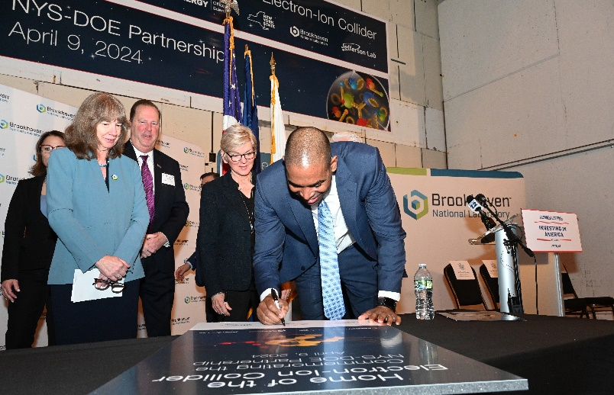
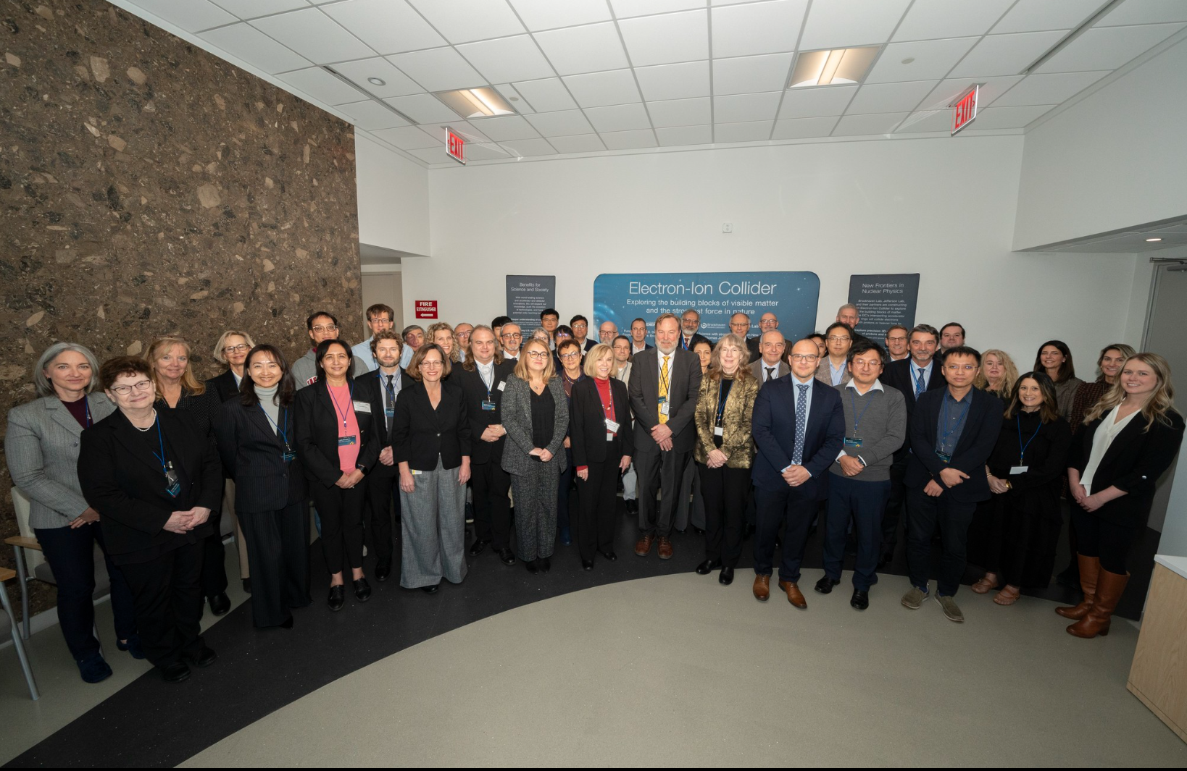

Strong Support from Partners & Collaborators
New York State committed $100M toward construction of EIC buildings and infrastructure.
EIC Accelerator Collaboration kicked off at IPAC’24 with over 150 participants expressing interest in contributing to the global EIC effort.
UK announced £58 million ($75M) for the EIC.
EIC Resource Review Board Meetings in Rome in May 2024 and at BNL in Oct. 2024. Strong participation from Canada, Czech Republic, France, India, Israel, Italy, Japan, Poland, South Korea, United Kingdom, and Taiwan. Recent meeting held in Prague in June 2025.
In-kind contribution goals represent ~30% of the Detector and ~5% of the Accelerator
8
8
8

Slide 9
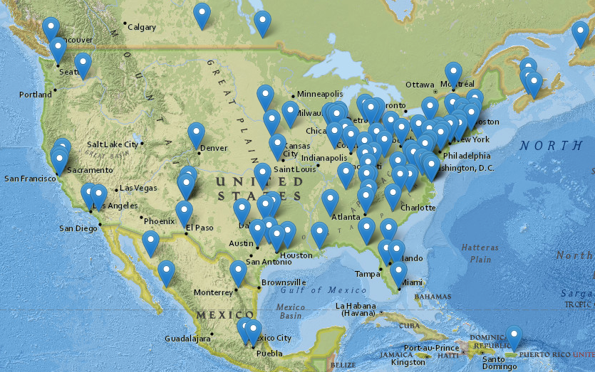
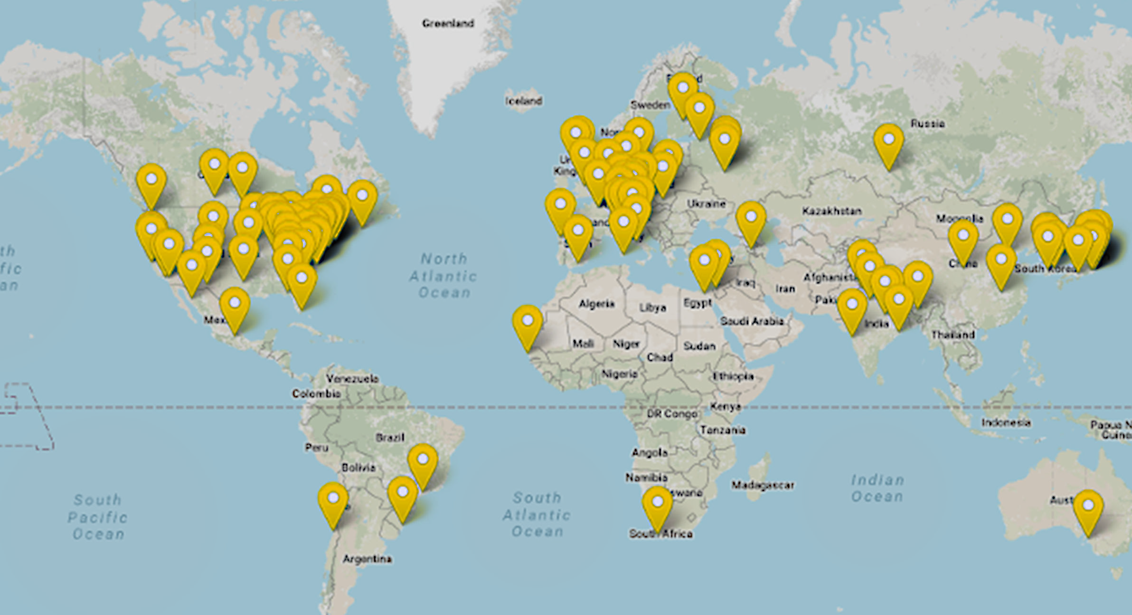
The EIC Users Group – a vibrant community
Nine national labs and 99 U.S. universities and institutions, as well as 139 international partners, will participate in the EIC.
The EIC Users Group has been growing rapidly—more than 1,400 scientists from more than 296 institutions in 40 countries around the world.
www.eicug.org

Slide 10
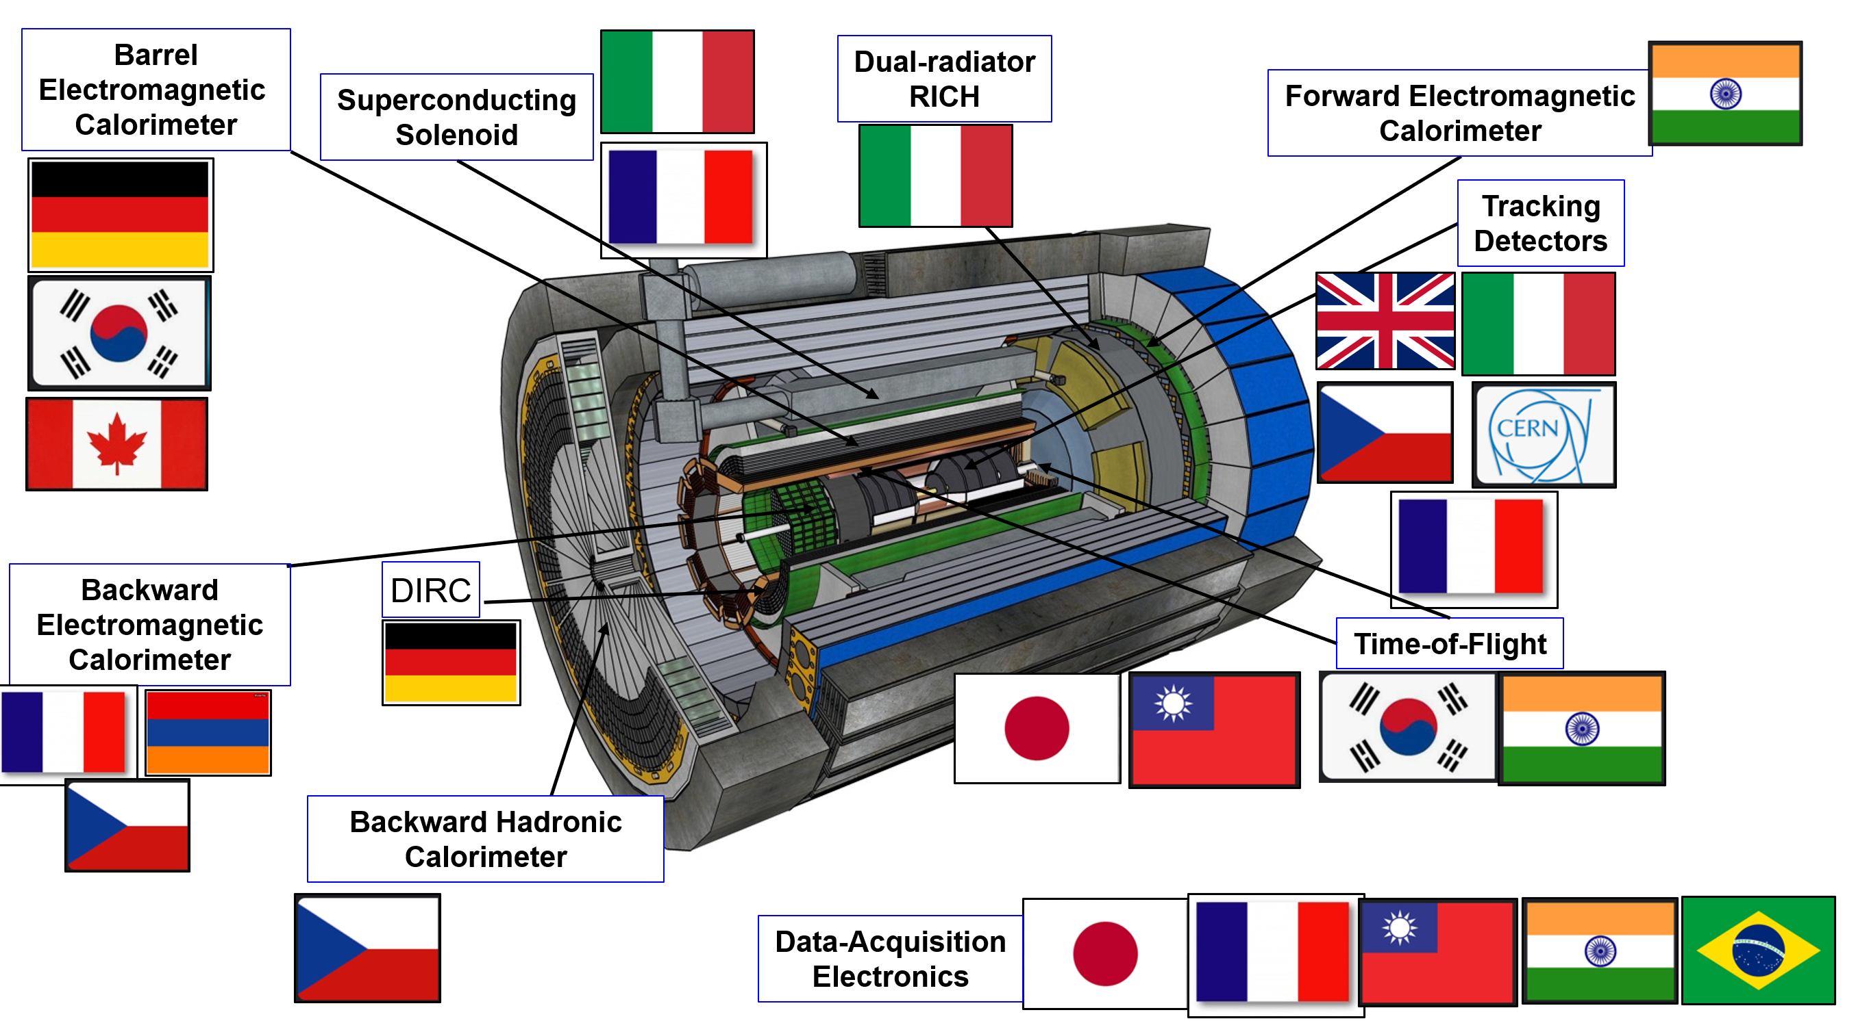
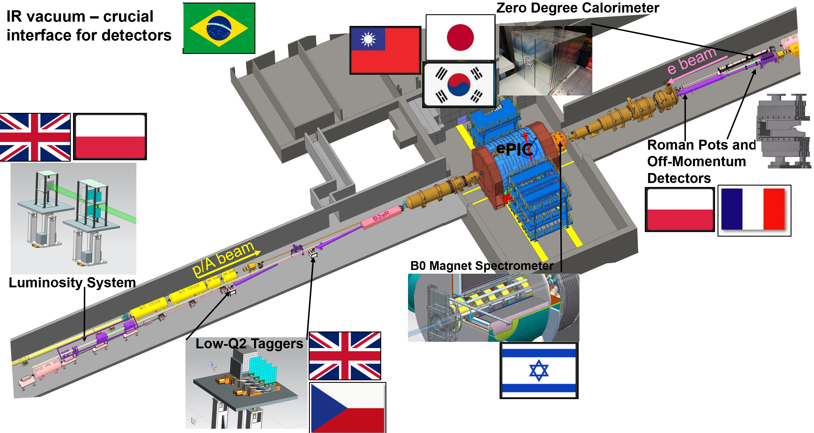
Overview of IKC for the ePIC Detector
Italy and France IKCs for the Detector Solenoid magnet, procurement and design respectively.
UK, Italy, France, Korea, Canada, and Japan have identified scope for IKCs in several Detector areas.
Other IKCs are being discussed with India, Israel, Taiwan and potentially others could follow.
10

Slide 11
Can we organize the EIC Accelerator Collaboration in a similar manner?

Slide 12
EIC Accelerator Collaboration?
EIC Accelerator Science and Technology Space
EIC Construction Project (funded by the DOE)
EIC Upgrades
In-kind contributions
Accelerator Science and Technology
Industry Partnerships
AST Education and Training

Slide 13
Funding scenarios
US Nat Labs and universities
  On-project and off-project – different approaches
  LDRDs, DOE ECA grants, FOAs
Non-US partners
CERN
Industrial partners
Every case is going to be unique. Every conversation should start with science and technology impacts, not with funding.

Slide 14

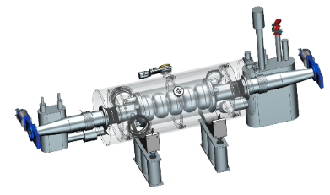
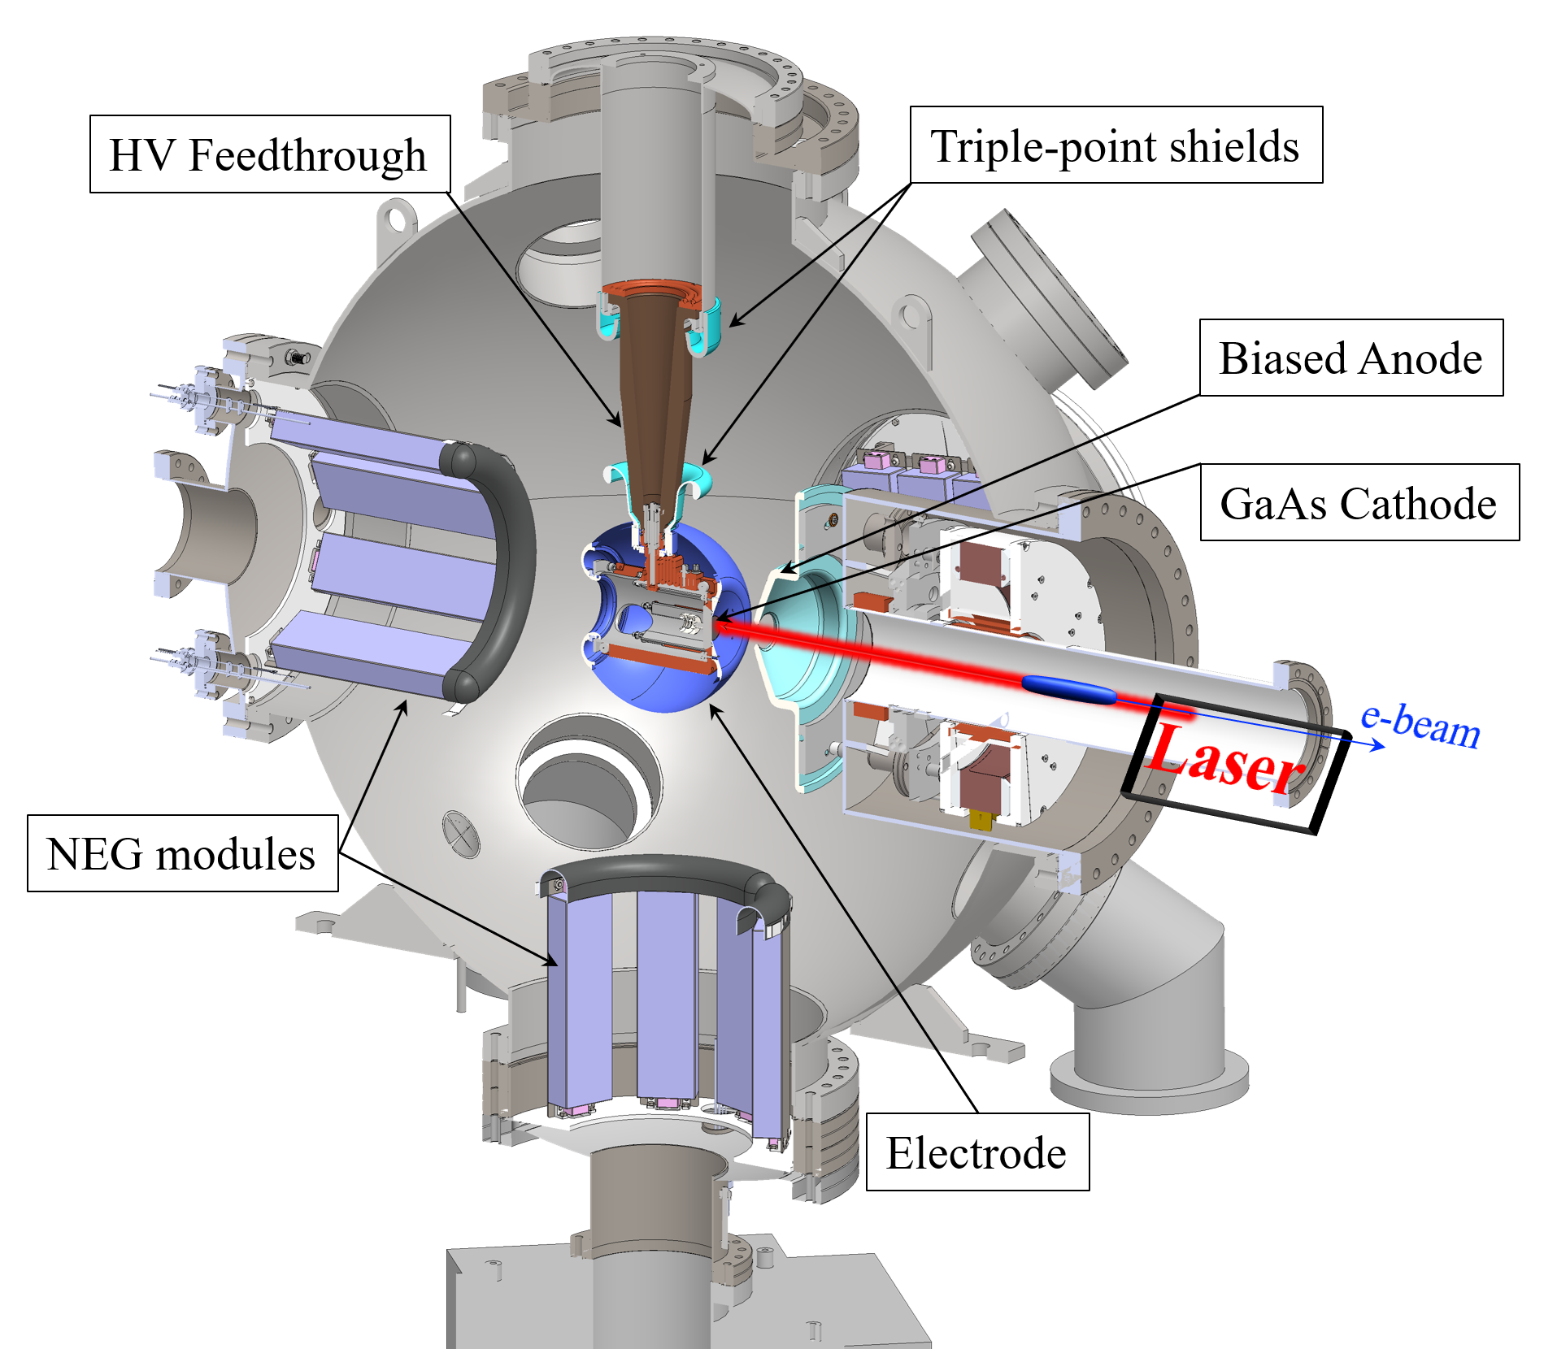
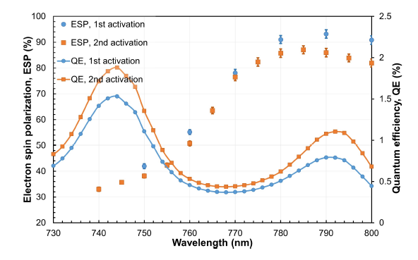

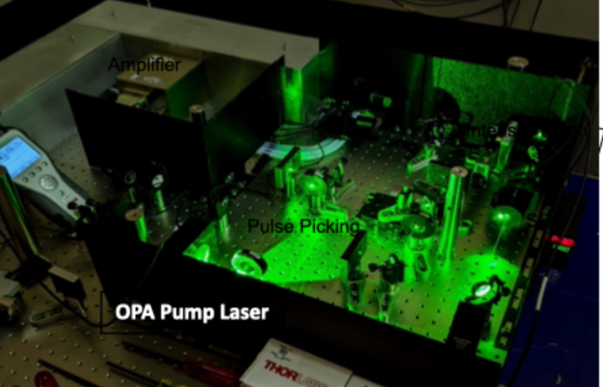
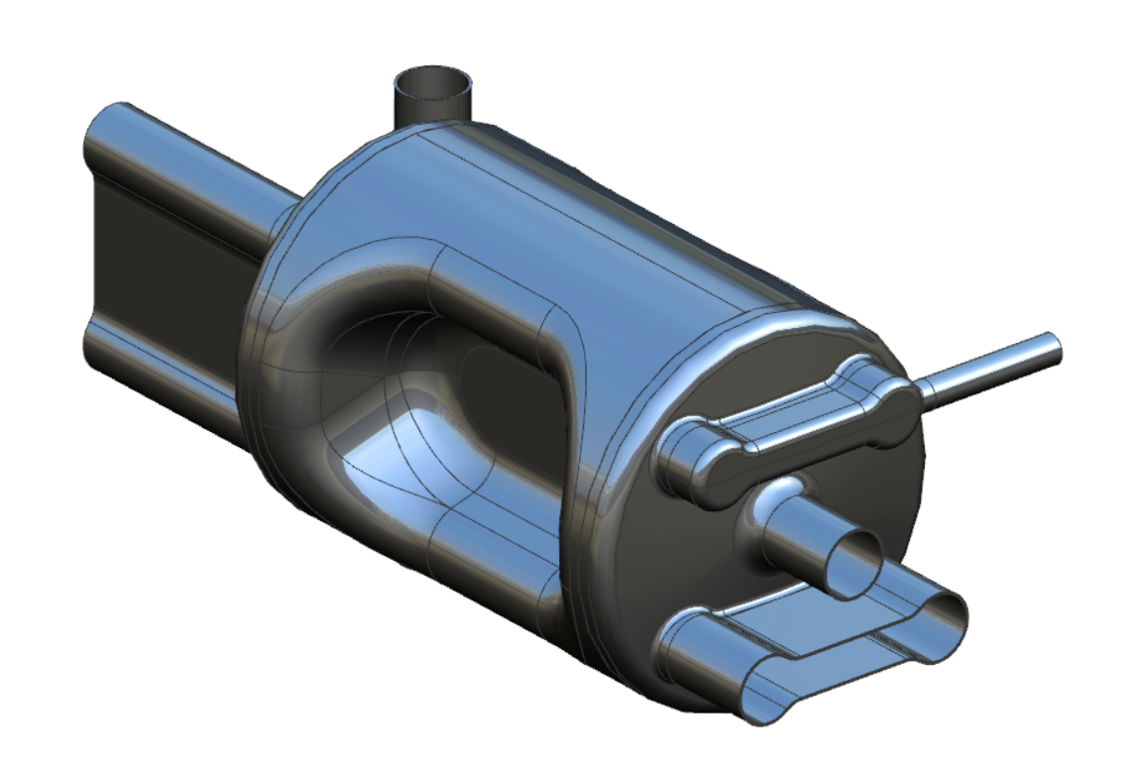
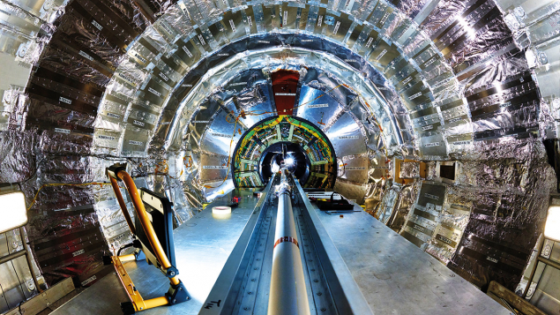



Overview of Accelerator IKC under discussions
591 MHz 5-cell CM for RCS,
2 CMs + cryo box
Laser for the Electron Source of EIC,
1 + 1 hot spare
394 MHz Crab CMs,
Be beam pipe, 200 MHz NC cavities, …
14

Slide 15
Early discussions / opportunities
Korea – NC linac or BAR
Taiwan – ESR swap-out kickers
UK – RCS beam diagnostics and beam-based alignment

Slide 16
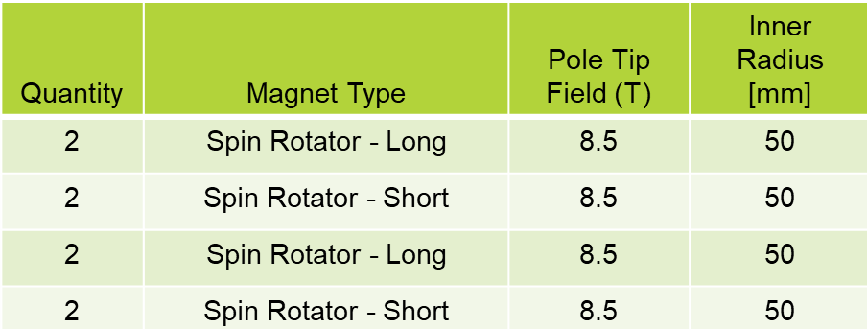
Other potential IKC opportunities
SC spin rotators (high-field solenoids)
ESR swap-out injection kickers
  High-power water-cooled strip-line
  Qty: 8 + 2 spares
ESR kicker pulsers:
  25-30 kV, 10 ns FW, 1 Hz
HSR transverse instability dampers at injection (25 GeV)
Diagnostics (various items)
RCS beam-based alignment during ramp (polarization preservation)
IR SC magnets
Collimation systems

Slide 17
What is still ‘at play’ in the EIC project and upgrades?
Understanding of beam-beam interactions (ξ_{e}=0.1, ξ_{p} =0.015)
Full understanding of a 25-mrad crossing angle, compensated by crab cavities
Highly polarized electron and hadron beams, including novel polarized He3+ beams
Hadron cooling at collisions to maintain hadron beam brightness
Various feed-forwards and feed-backs
Maintaining an option for the 2nd IR
Swap-out injection
Modern control system and instrumentation

Slide 18
New working groups
Hadron beam cooling
  COOL25 workshop at Stony Brook, Oct 27-31, 2025
2nd IR
FCC-EIC forum
Collimation and machine protection
EIC upgrades
Optics
Collective effects

