Slide 1


PhD Funding options
PhD as an employment / paid position
  In several countries PhD candidates are often employed by the university or research institute
  This means you get a salary (or stipend that is treated like a salary) + employee benefits
  This model is like a research job, not just a student scholarship
Scholarship / Grant-Based PhD
  These are more traditional “scholarships”: money is given to you to support your PhD, but you’re not necessarily an employee
  Funding might cover a stipend (living costs), tuition (if there is any), travel, research expenses, etc
Doctoral Networks / Consortia
  Programs to fund doctoral networks: these are usually structured PhD programs
  involving multiple institutions or sectors
  These are very competitive but often provide excellent support (salary, mobility,
  training, research costs)
National Funding Bodies
  Many countries have their own national research funding organizations
  Also, non-governmental foundations may provide PhD scholarships

Slide 2




Major European-Wide / EU Funding
(i) Marie Skłodowska-Curie Actions (MSCA)
  Very important program for PhD-level funding
  Covers things like living allowance, mobility, family, research/training costs
  Many Doctoral Networks funded via MSCA are open for PhD candidates
https://www.eeas.europa.eu/sites/default/files/msca_brochure_en.pdf?utm
(ii) EURAXESS
  A portal by the European Commission focused on researcher careers. You can find PhD job listings, funding calls, and researcher resources
  Very helpful to track funded PhD scholarships
https://education.ec.europa.eu/es/study-in-europe/planning-your-studies/scholarships-and-funding?utm
(iii) European Research Council (ERC)
  Though more known for postdocs / advanced research grants
  ERC funding tends to be for high-level researchers, but it’s good to be aware of their programs for later
https://erc.europa.eu/sites/default/files/2023-02/boost%20your%20research%20career-NC0822310ENN.pdf?utm

Slide 3

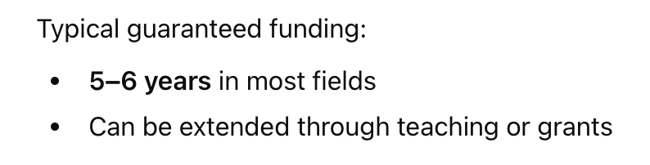


Major USA PhD Funding Options
(i) University Funding
  Teaching Assistantships (TA)
  Research Assistantships (RA)
  Fellowships (university-wide or departmental)
  → These usually require 10–20 hours/week of teaching or research
(ii) External Fellowships
  Fulbright
https://fulbright.es/programas-y-becas/convocatorias/u-s-scholar-awards/2026/1933/
  Ford Foundation
  Hertz Fellowship (STEM)
https://www.hertzfoundation.org/hertz-fellowship/
  NDSEG (US citizens, defense-related research)
  International fellowships (various countries sponsor overseas study)
(iii) Government or Home-Country Funding (for international students)
  National scholarships (e.g., CSC, DAAD, Fulbright Foreign Student Program)
  Sponsor programs (e.g., Saudi Aramco, Kuwait Cultural Office)

Slide 4


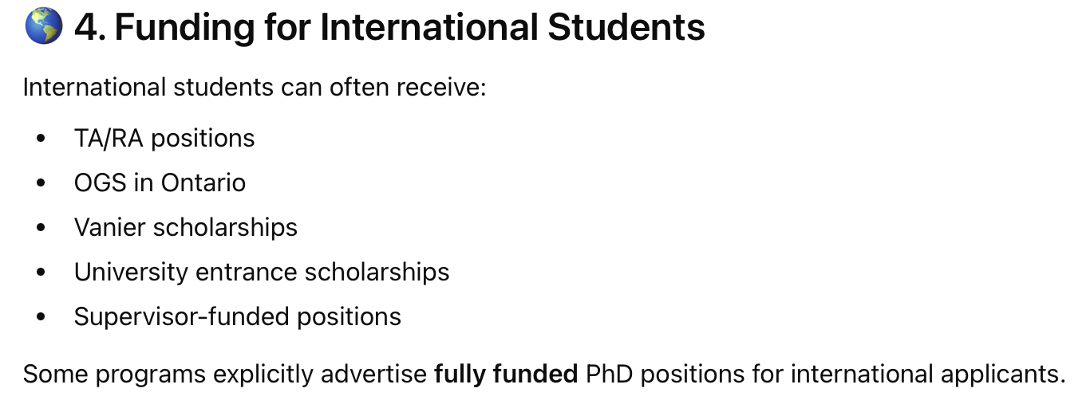
Major Canadian PhD Funding Options
(i) Major National Scholarships (Canada-Wide)
  Vanier Canada Graduate Scholarships
https://vanier.gc.ca/en/home-accueil.html
(ii) Provincial Funding Programs
  Ontario Graduate Scholarship (OGS)
  Quebec: FRQNT, FRQSC, FRQS (depending on discipline).
  Alberta Graduate Excellence Scholarship (AGES)

Slide 5




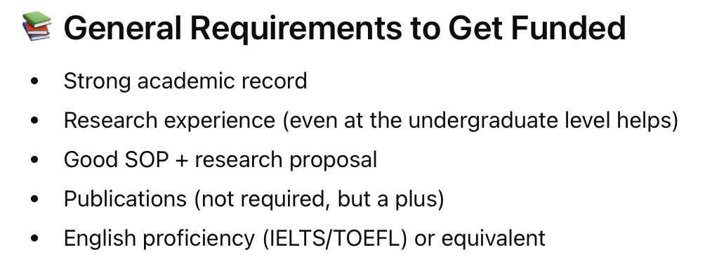



Major ASIA PhD Funding Options
(i) China is one of the largest providers of fully funded PhD spots to international students
  CSC Scholarship (China Government Scholarship)
  University scholarships
(ii) Japan offers highly prestigious government-funded PhD scholarships
  MEXT Scholarship
  University-funded RA/TA positions
(iii) South Korea increasingly funds international doctoral students, especially in science and engineering
  KGSP (Global Korea Scholarship)
  University research assistantships
(iv) Singapore is one of the best-funded PhD environments in Asia, with salaries similar to Western countries
  SINGA Scholarship
  MOE-funded Research Assistantships
(v) Hong Kong is competitive, prestigious, and well-funded opportunities
  HKPFS (Hong Kong PhD Fellowship Scheme)
  Available at HKU, HKUST, CUHK, CityU
(vi) India has become more internationalized, especially in STEM
  ICCR Scholarships
  UGC-JRF/NET fellowships
(vii) Malaysia attractive for international students with English-language programs
  MyBrain Scholarship
  UM Graduate Fellowship (University of Malaya), UTM, USM university scholarships

Slide 6

Practical Tips to Find PhD Funding
1. Use specific websites
  Regularly check it for PhD job listings and funding calls
  Filter for “PhD funding” / “Doctoral” / “First‐Stage Researcher.”
2. Network & Contact Professors
  Find potential supervisors whose research aligns with yours. Email them with a research proposal and ask about funded PhD positions — many funded positions are tied to a specific research grant/project
  Sometimes funding is not publicly advertised — contacting PIs can reveal hidden opportunities
3. Apply to Doctoral Networks / Programmes
  Look for MSCA Doctoral Networks, as they often have open PhD calls
  Also check for “European Joint PhD Programmes” which can provide funding + structured training
4. Look for National Scholarships
  Search for the national research funding agency of the country where you want to do your PhD
  Check university websites: many have dedicated PhD funding pages
5. Prepare a Strong Application
  Research proposal: Clear, well-justified, with a good plan
  CV + academic transcripts
  Recommendation letters
  Possibly a motivation letter explaining why you want to do a PhD in that specific program
6. Be Aware of Deadlines
  Funding calls have deadlines that vary widely by country and programme
  Start your search at least 6–12 months before you want to begin your PhD

Slide 7

Things to Consider / Challenges
1. Competition is High:
  Fully funded PhD positions are competitive, especially for prestigious programmes
2. Living Costs:
  Even when funded, the stipend/salary must be enough for you to live in the country
3. Tax and Employment Status:
  If you are employed, the PhD funding might be taxed; understand what
  “salary” vs “scholarship” means in your host country
4. Visa and Immigration:
  As an international student, check visa requirements
https://education.ec.europa.eu/news/research-opportunities-in-europe?utm (For the EU)
5. Duration:
  PhD programs in Europe vary in length — some are 3 years, others longer (especially in the UK, but many continental European PhDs are ~3–4 years)

