Slide 1
IEEE-NPSS School on
Nuclear Instrumentation and Applications for Society
– Mexico City 2025 –
Positron Emission Tomography Simulation using GATE/GEANT4
Hoang Thi Kieu Trang
Department of Nuclear Physics, Nuclear Engineering and Medical Physics
University of Science, VNU-HCM, Vietnam
Dec 3rd – 5th, 2025, Mexico City, Mexico

Slide 2

Hoang Thi Kieu Trang (Trang HOANG)
University of Science, VNU-HCM, Vietnam
Education
1998: Bachelor in Nuclear Physics, University of Science, Vietnam National University, Vietnam
2003: Master in Nuclear Physics, University of Science, Vietnam National University, Vietnam
2012: Ph.D. in Experimental High Energy Physics, Florida State University, USA
Professional Experience
1998 – 2005: Teaching Assistant, University of Sciences HCMC, Vietnam
2005 – 2007: Ph.D. Student, Teaching Assistant, Florida State University, USA
2007 – 2012: Ph.D. Student, Research Assistant based at Fermilab, Florida State University, USA
2013 – Present: Lecturer, University of Science, Vietnam National University Ho Chi Minh City
2022 – 2024: Project Manager, NuVirLab - Virtual Laboratory for Nuclear and Medical Physics
2026 – 2028: Software developer, EducomPet project
Research Interests
Medical Image Processing, AI in image processing
Nuclear Medicine
Monte Carlo Simulation
Software Development (C++, python, web app)
Courses Taught
Medical Image Processing
Nuclear Medicine
Radiation Physics
Quantum Mechanics
Modern Physics
Networking
2002 – Present: Member of the Vietnam Nuclear Science and Technology Association
2014 – Present: Member of the Vietnam Society for Medical Physics
2022 – Present: Member of IEEE - Nuclear and Plasma Sciences Society

Slide 3
Outline
What is Monte Carlo Simulation?
How do you track particles in the Monte Carlo simulation?
How does the PET system work?
How do you simulate a PET imaging system?
How do you reconstruct a PET image?
Hands-on exercise:
  PET simulation and
  Image reconstruction

Slide 4
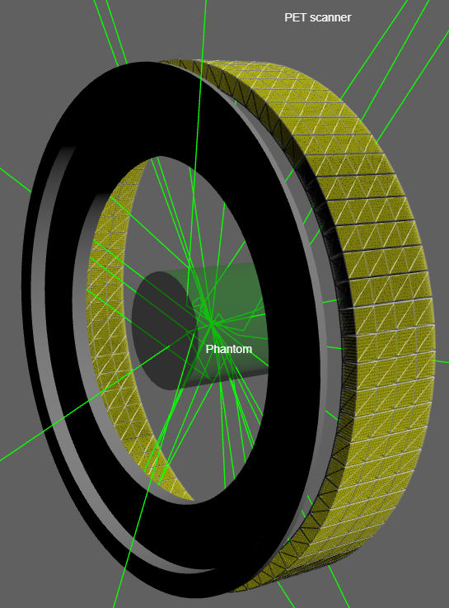
Introduction to Monte Carlo Simulation
What is Monte Carlo Simulation?
Monte Carlo simulation is a computational technique used to model and analyze complex systems through random sampling
Simulation Capabilities
  Modeling System Geometry
  Simulating Particle Interaction Processes

Slide 5
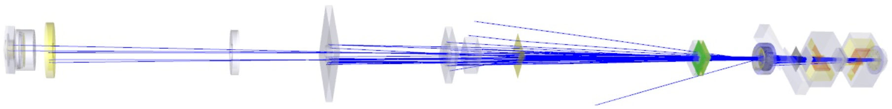
Introduction to Monte Carlo Simulation
What is needed to simulate an experimental system?
Popular Monte Carlo Simulation Codes:
GEANT4: Widely used in high energy physics, astrophysics, and medical physics
MCNP(X): Effective for simulating the transport of neutron, electrons and positrons
EGSnrc: Focused on radiation transport and dosimetry in medical physics
PENELOPE: Used for simulating the transport of photons and electrons, particularly in medical applications
FLUKA, PHITS, etc.

Slide 6
Introduction to Monte Carlo Simulation
What is needed to simulate an experimental system?
Popular Monte Carlo Simulation Codes:
GEANT4 simulates the passage of particles through matter, is primarily written in C++.
several initiatives and tools exist to enable interaction with Geant4 functionalities using Python
Requirements for Using GEANT4:
Solid understanding of physics
Strong programming skills
Access to adequate computing power
Using Python with Geant4:
Python's scripting capabilities can simplify configuring complex Geant4 simulations
Enhanced analysis with Python's powerful data analysis libraries and visualization tools.
Use shells and notebooks to explore functionalities and test configs

Slide 7
Introduction to Monte Carlo Simulation
What is needed to simulate an experimental system?
Custom Application Using Geant4 in Medical Physics
  Geant4-DNA - Geant4-DNA project
  G4MED - Geant4 Medical Physics in Japan
  G4NAMU - Geant4 North American Medical User Organization
  GAMOS - Geant4-based Architecture for Medicine-Oriented Simulations
  GATE - Geant4 Application for Tomographic Emission
  GHOST - Human Oncology Simulation Tool
  TOPAS - Geant4 Monte Carlo Platform for Medical Application

Slide 8
Introduction to Monte Carlo Simulation
What is GATE?
GATE (Geant4 Application for Tomographic Emission) is a Monte Carlo simulation platform built on top of the Geant4 toolkit.
GATE - Geant4 Application for Tomographic Emission
2001 - 2004: first public release
Written in C++
GATE encapsulates GEANT4 libraries
GATE 9.4 (Geant4 11.2)
  Does not require C++ programming
  Control Monte Carlo simulations using macro language
GATE 10 (Geant4 11.3) utilizes a python-based interface
GATE can simulate time dependent phenomena:
System movements: SPECT, PET or CT detector (rotation/translation)
Source decay kinetics
User Layer
Application Layer
Core Layer
Geant4

Slide 9
Introduction to Monte Carlo Simulation
What are the applications of GATE in medical physics?
GATE’s applications in medical physics are generally divided into two main domains: Diagnostic Imaging and Radiation Therapy
Diagnostic Imaging:
Emission Tomography
  Positron Emission Tomography (PET),
  Single Photon Emission Computed Tomography (SPECT)
Computed Tomography (CT),
Optical Imaging (Bioluminescence and Fluorescence)
Radiation Therapy:
GATE is used to calculate radiation dose distributions in External Beam Radiotherapy
Hadrontherapy (Proton & Ion Therapy):
  Gate handles complex proton & ion fragmentation physics
  In-beam PET monitoring
Internal Dosimetry: Determines dose to tumors and Organs at Risk (OARs) over time

Slide 10
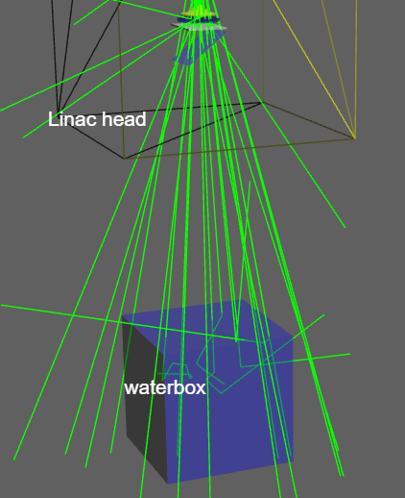
Introduction to Monte Carlo Simulation
How do you track particles in the Monte Carlo simulation?

Slide 11
Introduction to Monte Carlo Simulation
How do you track particles in the Monte Carlo simulation?
Step 1: Initialization
Define the simulation environment
  Geometry
  Materials
  Initial conditions for the particles (e.g., photon, energy, beam shape, direction, etc).

Slide 12
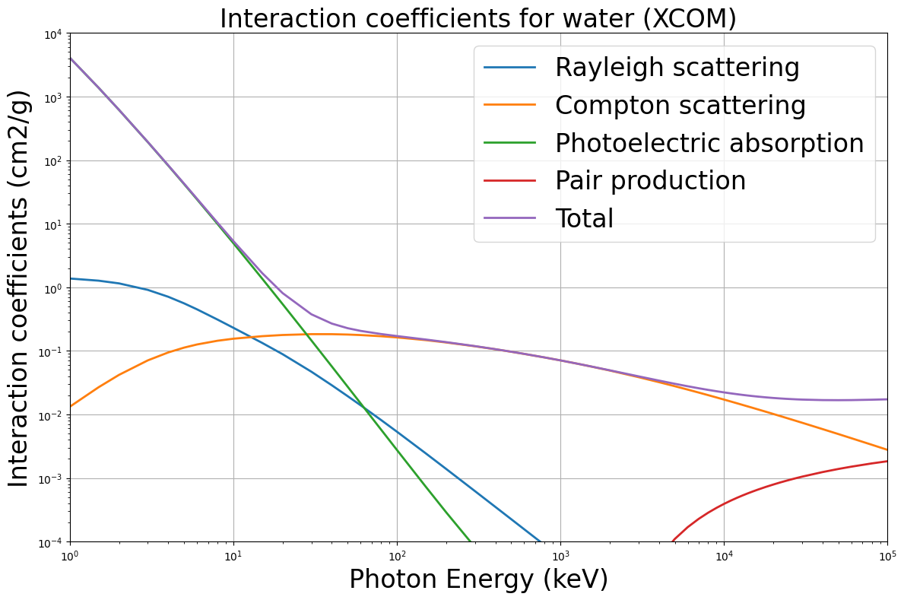
Introduction to Monte Carlo Simulation
How do you track particles in the Monte Carlo simulation?
Step 1: Initialization
Select Interaction Modeling based on physical laws.
Main processes of interaction of photons with matter:
  Photoelectric absorption,
  Compton scattering,
  Rayleigh scattering,
  Pair production

Slide 13
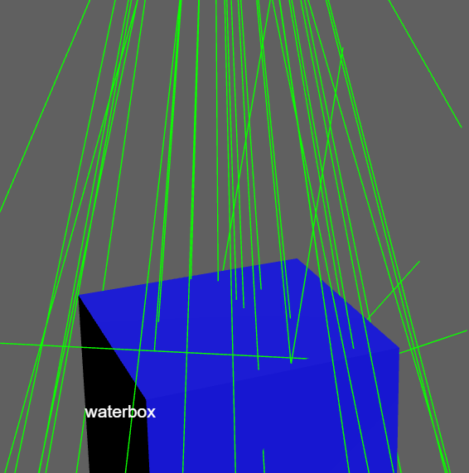
Introduction to Monte Carlo Simulation
How do you track particles in the Monte Carlo simulation?
Step 2: Particle Generation
Create initial particles based on the defined parameters.
This can include random sampling of positions and energies.

Slide 14
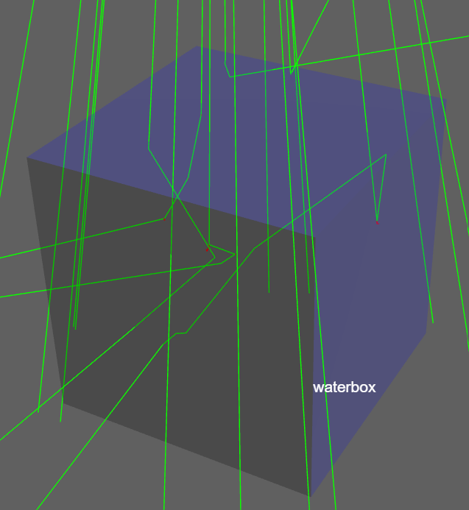
Introduction to Monte Carlo Simulation
How do you track particles in the Monte Carlo simulation?
Step 3: Step-by-Step Tracking
Calculate Step Length: Determine how far the particle will travel before an interaction occurs.
Update Position: Move the particle based on its velocity and the calculated step length.
Handle Interactions: If an interaction occurs, update the particle's properties (e.g., energy loss, direction change) and possibly generate new secondary particles.
Boundary Conditions: Check if the particle exits the defined geometry or interacts with a boundary. If it exits, you may record data (such as energy deposition) or terminate its simulation.

Slide 15
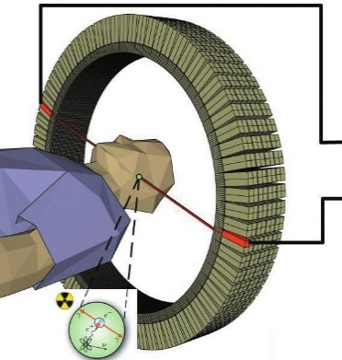
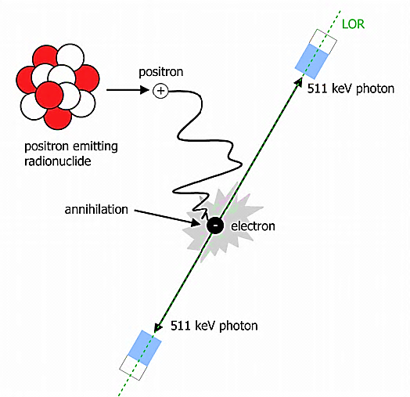
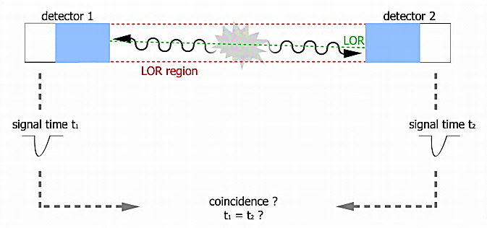
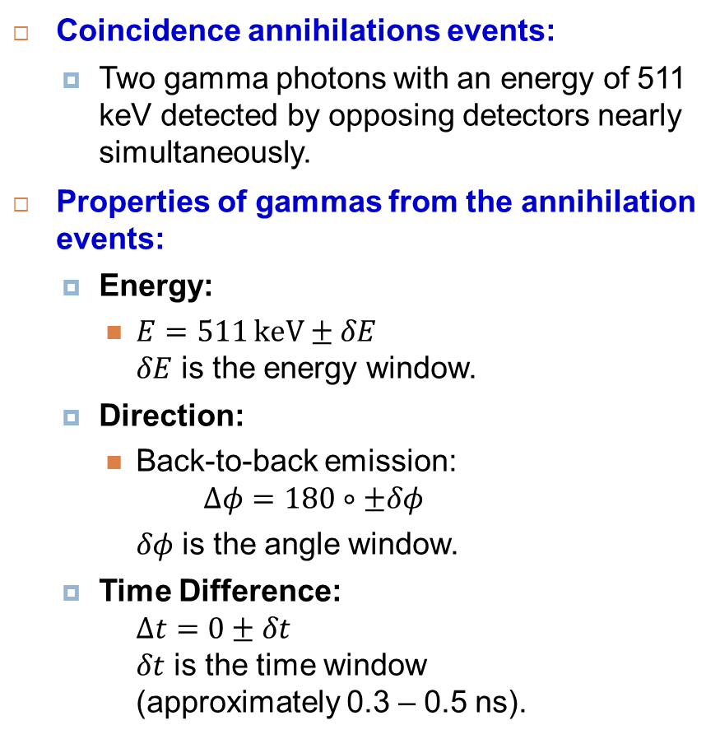
Positron Emission Tomography
How does the PET system work?
Coincidence annihilations events:
  Two gamma photons with an energy of 511 keV detected by opposing detectors nearly simultaneously.
Properties of gammas from the annihilation events:
  Energy:
    $E=511 keV±δE$
    $δE$ is the energy window.
  Direction:
    Back-to-back emission:
    $$Δφ=180∘±δφ$$
    $δφ$ is the angle window.
  Time Difference:
  $Δt=0±δt$
  $δt$ is the time window (approximately 0.3 – 0.5 ns).

Slide 16
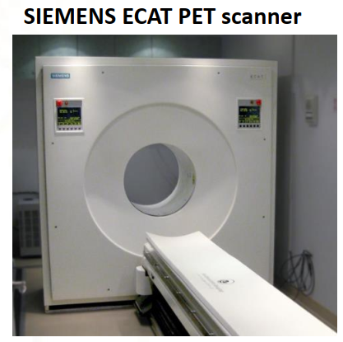
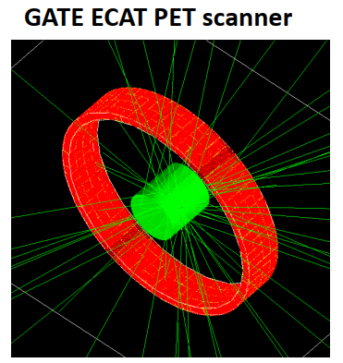
Positron Emission Tomography
How do you simulate a PET imaging system?
ECAT PET scanner
ECAT uses block detector, consisting in an array of 8 x 8 crystals, read by 4 photomultipliers.
The blocks are organized along an annular geometry to yield multi-ring detectors.
OpenGate Collaboration – Documentation – Ecat scanner

Slide 17
Positron Emission Tomography
How do you simulate a PET imaging system?
Step 1: Initialization
Define the simulation environment
Step 2: Particle Generation
Step 3: Step-by-Step Tracking
Select Interaction Modeling
Create initial particles
Define Digitizer and Readout

Slide 18
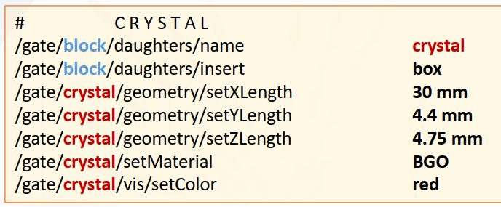
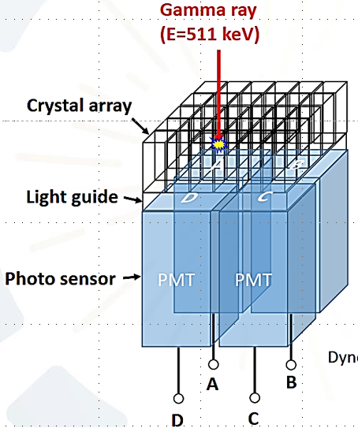
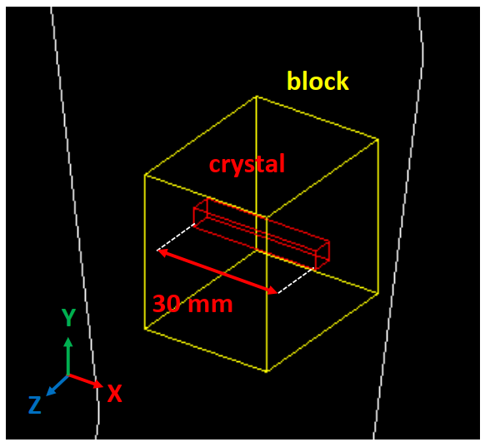
Positron Emission Tomography Simulation
Simulating a PET Scanner Using GATE
Define the PET geometry
Geometry and material
Scanner
Phantom
Source
ECAT PET scanner
ECAT uses block detector, consisting in an array of 8 x 8 crystals, read by 4 photomultipliers.

Slide 19
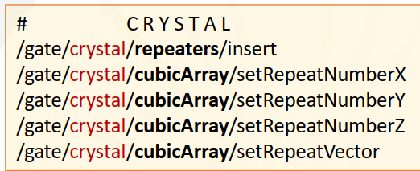
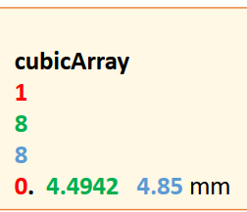
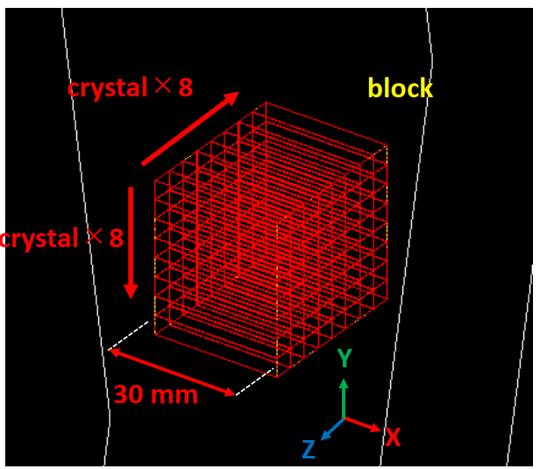
Positron Emission Tomography Simulation
Simulating a PET Scanner Using GATE
Define the PET geometry
Geometry and material
Scanner
Phantom
Source
ECAT PET scanner
ECAT uses block detector, consisting in an array of 8 x 8 crystals, read by 4 photomultipliers.

Slide 20
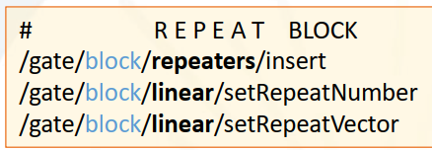
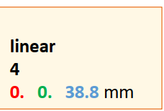
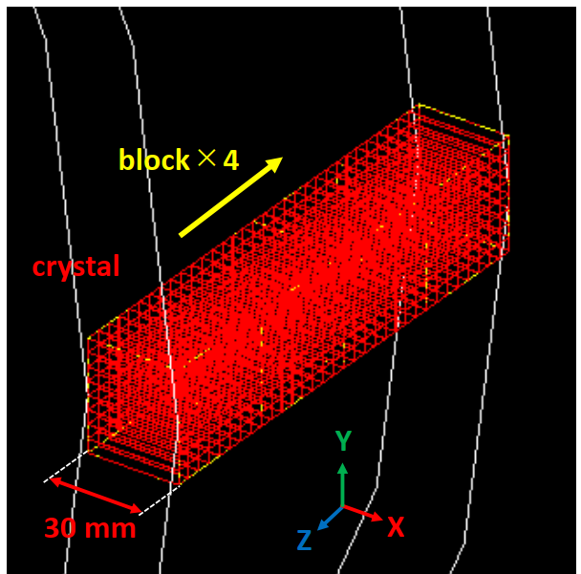
Positron Emission Tomography Simulation
Simulating a PET Scanner Using GATE
Define the PET geometry
Geometry and material
Scanner
Phantom
Source
ECAT PET scanner
The blocks are organized along an annular geometry to yield multi-ring detectors.

Slide 21
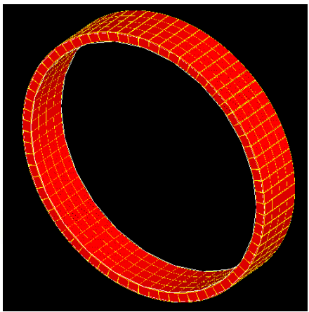
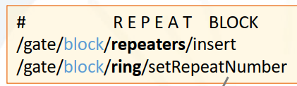
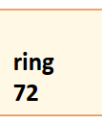
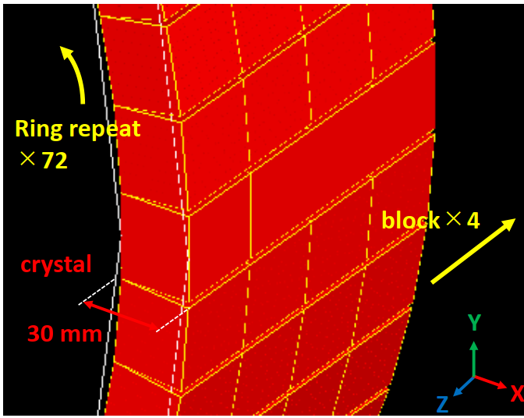
Positron Emission Tomography Simulation
Simulating a PET Scanner Using GATE
Define the PET geometry
Geometry and material
Scanner
Phantom
Source
ECAT PET scanner
The blocks are organized along an annular geometry to yield multi-ring detectors.
The scanner is equipped with 18,432 crystals organized into 288 blocks.

Slide 22
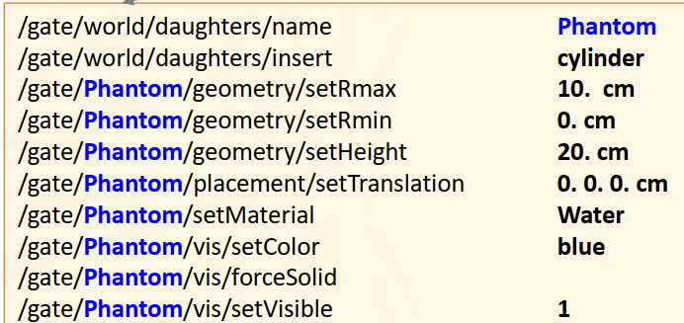
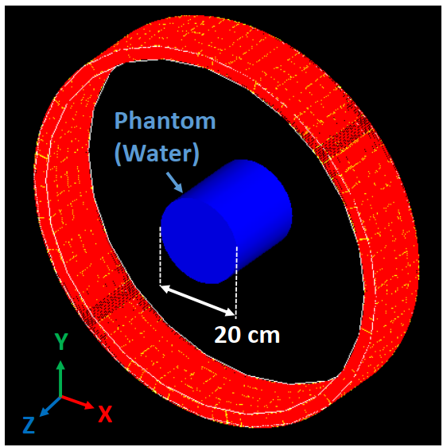
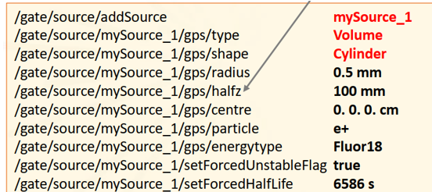
Positron Emission Tomography Simulation
Simulating a PET Scanner Using GATE
Define a phantom containing a source
Geometry and material
Scanner
Phantom
Source
Water cylinder phantom with a cylinder F-18 source at the center of the phantom

Slide 23
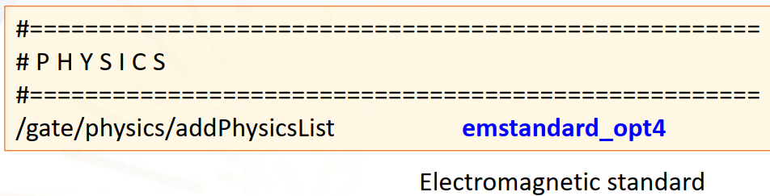
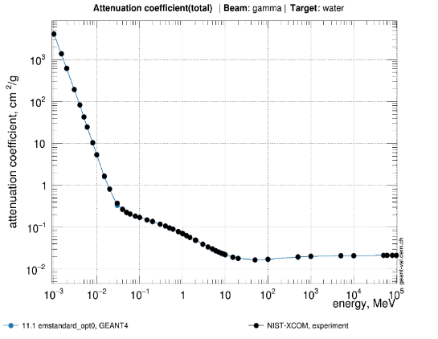
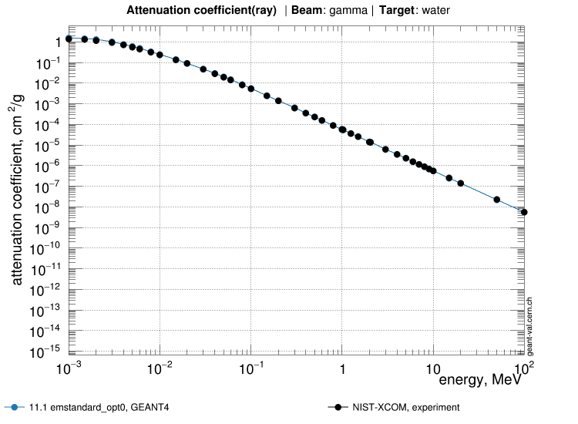
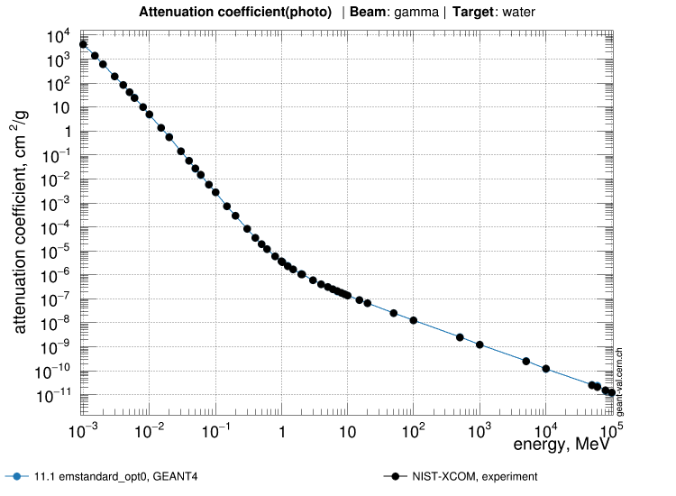
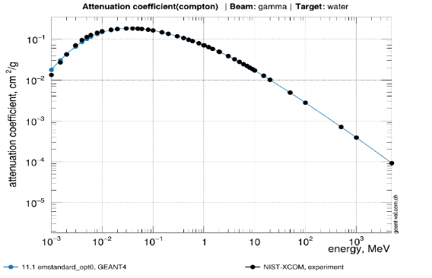
Positron Emission Tomography Simulation
Simulating a PET Scanner Using GATE
Select the Physics Model
Electromagnetic Processes:
Rayleigh scattering, photoelectric effect,
Compton scattering
Bremsstrahlung (charged particle)
Attenuation of photon in water - GEANT4 emstandard_opt4 (line) vs. NIST-Xcom (dot)
Total
Photoelectric effect
Rayleigh scattering
Compton scattering
Geant4 Validation Portal – Gamma Attenuation

Slide 24
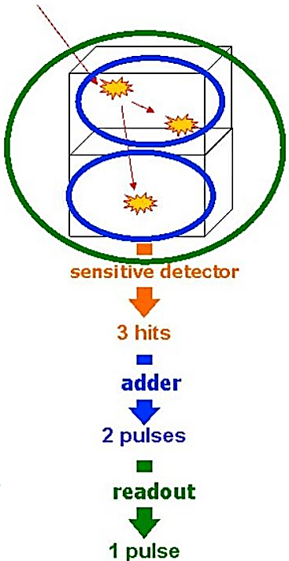
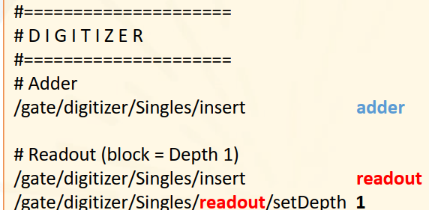
Positron Emission Tomography Simulation
Simulating a PET Scanner Using GATE
Defind Digitizer and Readout
Digitizer collects the hits inside the Sensitive Detector
Hits are added to
form a pulse per volume
The pulses are added to
form a “Singles” event

Slide 25
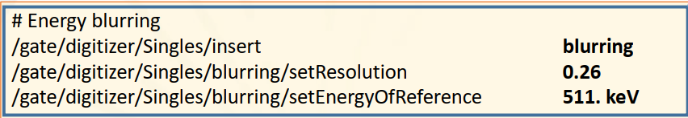
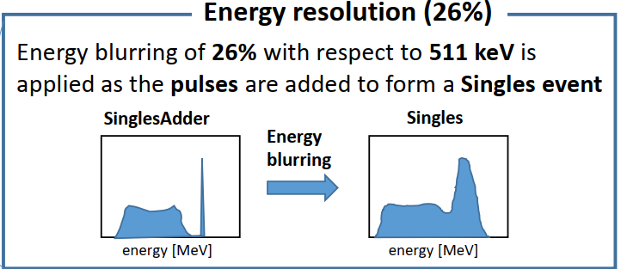
Positron Emission Tomography Simulation
Simulating a PET Scanner Using GATE
Defind Digitizer and Readout

Slide 26
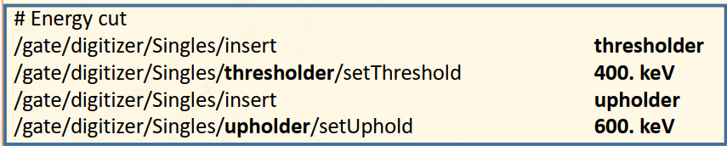
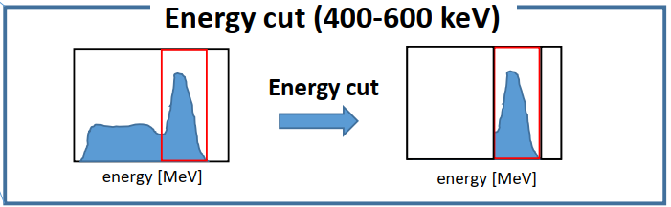
Positron Emission Tomography Simulation
Simulating a PET Scanner Using GATE
Defind Digitizer and Readout

Slide 27
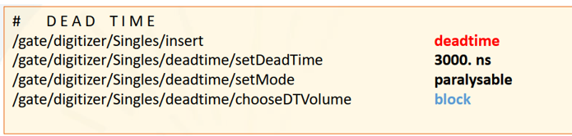
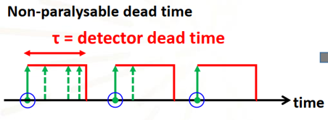
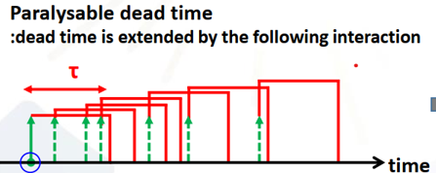
Positron Emission Tomography Simulation
Simulating a PET Scanner Using GATE
Defind Digitizer and Readout
Number of incomming photons: 7
Number of signals: 3
Number of incomming photons: 7
Number of signals: 1

Slide 28
Positron Emission Tomography Simulation
Simulating a PET Scanner Using GATE
Defind Digitizer and Readout
Number of incomming photons: 7
Number of signals: 3
Number of incomming photons: 7
Number of signals: 1

Slide 29
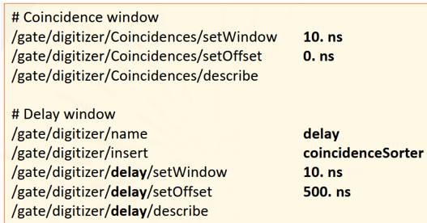
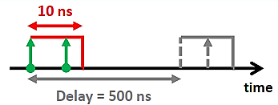
Positron Emission Tomography Simulation
Simulating a PET Scanner Using GATE
Defind Digitizer and Readout
The delay coincidence sorters are used for:
Simulate realistic data: To replicate the exact data structure and "Prompts minus Delays" correction method used by physical scanners.
Noise estimation: To providing a statistical way to measure and subtract random coincidences (noise) during image reconstruction.

Slide 30
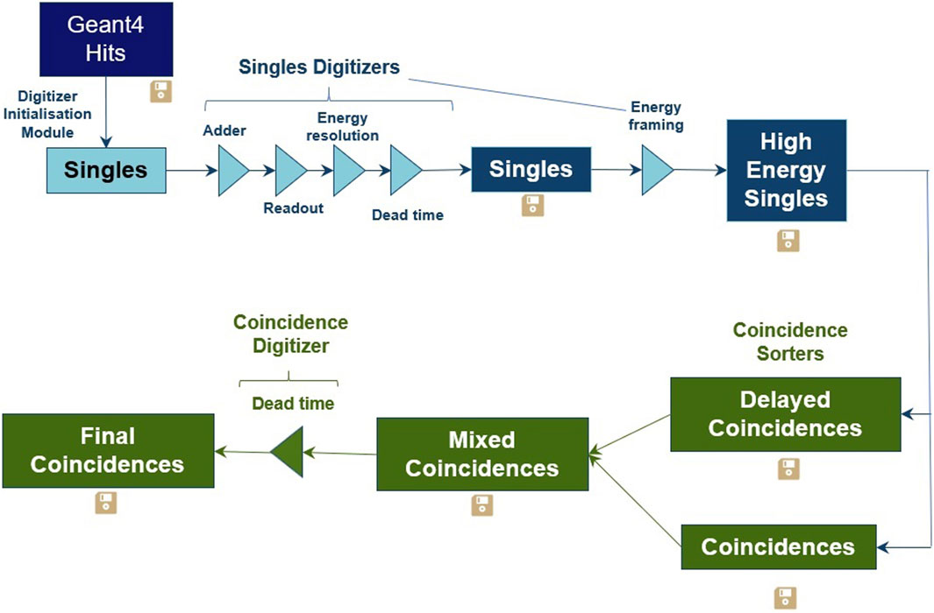
Typical data flow diagram for a PET simulation
https://doi.org/10.3389/fphy.2024.1294916

Slide 31
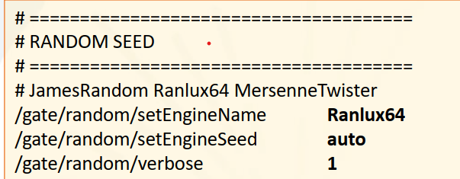
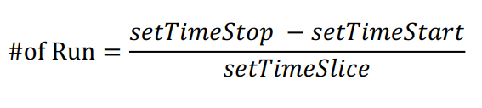
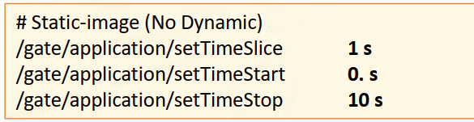
Positron Emission Tomography
Simulating a PET Scanner Using GATE
Step 1: Initialization
Define the simulation environment
Step 2: Particle Generation
Step 3: Step-by-Step Tracking
Select Interaction Modeling
Create initial particles
Define Digitizer and Readout

Slide 32
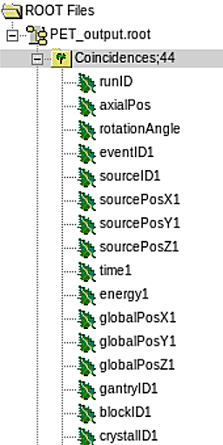
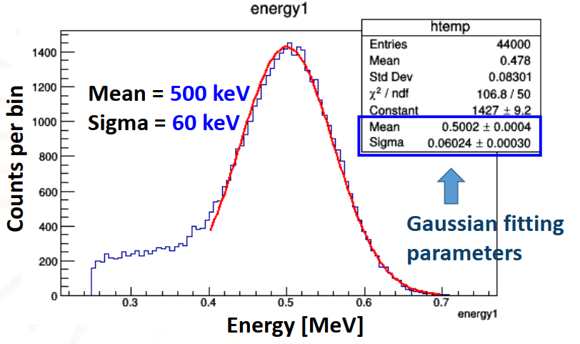
Positron Emission Tomography
How do you simulate a PET imaging system?
Step 1: Initialization
Step 2: Particle Generation
Step 3: Step-by-Step Tracking
Step 4: Data Analysis
Simulation output is saved in the root file (list mode)
Energy, position, time,

Slide 33




Positron Emission Tomography
How do you reconstruct a PET image?
Hough transform:
$$r=x\cos{θ}+y\sin{θ}$$
Sinogram: the angle specific histogram store detected events.
Every event is sorted using the angle and offset characteristic to its detection.
Each LOR has a corresponding angle and offset to indicate its location in the sinogram.

Slide 34

Positron Emission Tomography
How do you reconstruct a PET image?
Back Projection is the simplest method to turn measured / simulated data back into an image.
Back Projection:
The image is constructed from the sum of all projections
Simple back projection creates the 1/r blurring effect - The image is recognizable, but mathematically incorrect and too blurry for medical diagnosis

Slide 35



Positron Emission Tomography
How do you reconstruct a PET image?
Ramp filter:
A high-pass filter,
Enhance edges and sharp details in the image, while suppressing the low-frequency blurring.
Filtered back projection: The sinogram data are filtered and then back-projected to recover an accurate image

Slide 36



Hands-on exercise
PET simulation
Ubuntu 24.04.3
Gate 10.0.3
Exercise 1 and 2
Image Reconstruction
Python and essential libraries
Jupiter notebook

Slide 37



Exercise 1: Time window vs. coincidences
Change the coincidence time window
Results file:
> Simulation_data/ EasyPET_sim_Activities/Activities/easyPET.root
Image reconstruction parameters
  Coincidence window: change $δt$ from 0.01 ns to 100000 ns
Analysis: Check the number of coincidences and image quality
Activity (uCi) | $δt$ (ns) | Coincidences
 | 0.01
 | 1
 | 10
 | 100
 | 1000
 | 10000
 | 100000

Slide 38
Exercise 2: Spatial Resolution
Change the source activities
Results file:
> Simulation_data/ EasyPET_sim_Activities/Activities/easyPET.root
Image reconstruction parameters
  Find the spatial resolution of the image - estimate the full-width-at-half-maximum (FWHM) along the principal directions.
Analysis: Compare the spatial resolutions for different source activities
Activity (uCi) | FWHM (mm)
5
10
20
30
40

Slide 39
Summary
Monte Carlo simulation is a computational technique used to model and analyze complex systems through random sampling
GATE is a Geant4-based simulation platform for medical physics
  design of new medical imaging devices,
  optimize of acquisition protocols,
  develop / assess image reconstruction algorithms and correction techniques,
  dosimetry
Simulation workflow
  Setup scanner (geometry, materials, physics, sensitive detector)
  Simulation: generating and tracking optical photons
Image reconstruction
  The image is constructed from the sum of all projections (back-projection)
  Corrections: absorption, decay time

Slide 40
Literatures
Cherry S.R., Dahlbom M. (2006) PET: Physics, Instrumentation, and Scanners. In: Phelps M.E. (eds) PET. Springer, New York, NY
IAEA, Nuclear Medicine Physics: A Handbook for Teachers and Students, 2014, chương 12-15
IAEA, Human Health Campus, 3D image reconstruction
https://humanhealth.iaea.org/HHW/MedicalPhysics/NuclearMedicine/ImageAnalysis/3Dimagereconstruction/index.html
Adam Kesner and Ida Häggström (2019), Kesner-Häggström Fundamentals of Medical Image Reconstruction Explained with Animations Lecture
Rafael C. Gonzalez, Digital image processing, 2008
ECSE-4540 Intro to Digital Image Processing Rich Radke, Rensselaer Polytechnic Institute
  DIP Lecture 18: Reconstruction from parallel projections and the Radon transform
https://www.youtube.com/watch?v=ZgcD4C-4u0Q&list=PLuh62Q4Sv7BUf60vkjePfcOQc8sHxmnDX&index=21

Slide 41

IEEE-NPSS School on
Nuclear Instrumentation and Applications for Society
– Mexico City 2025 –
Thank you for your attention
Medical Physics is not only involved in medicine and physics, but it also includes mathematics, biology, chemistry, computer science, and arts

