Slide 1



Radiation facts introduction Introduction to Nuclear MEDICINE
Patrick Le Dû
PhD
patrickledu@me.com
NPSS EDUCOM UNAM SCHOOL

Slide 2
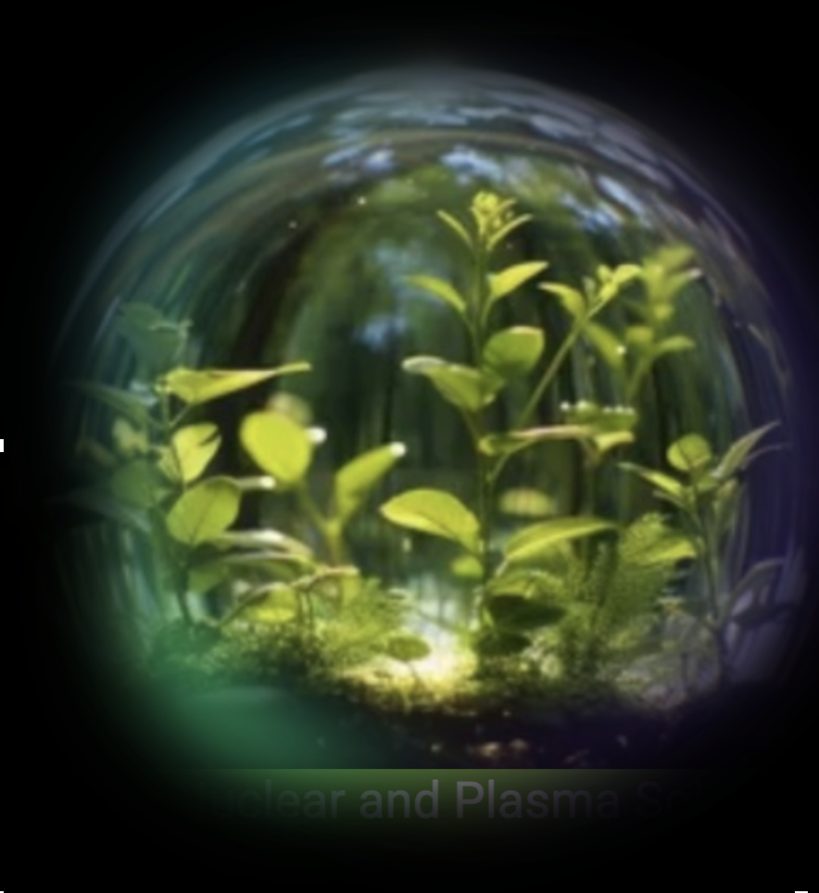
The NPSS BOOKLET
Edited by IEEE NPSS
Authors
  Cinzia Davia
    Manchester Univ UK)
  Patrick Le Dû
    Retired CEA Saclay (F)
  Richard Kouzes (Nuclear Energy)
    PNL US
  Simon Cherry (Medical Imaging)
    UC Davis US
https://ieee-npss.org
Menu Item PUBLICATIONS

Slide 3
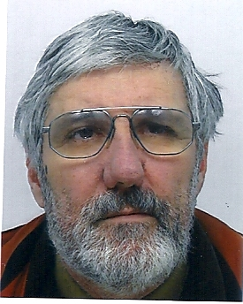
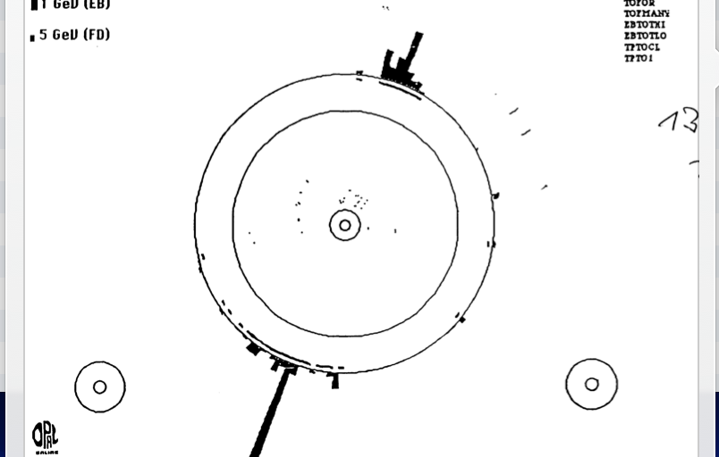
Who I am ? -50 years in Physics
NA3 @ CERN (Di-Muon Drell Yan) : 1974-1980
  Large MWPC (4x4 m2)
  Trigger & DAQ
LEP - OPAL @ CERN (1980-1990)
  TOF system
  Trigger & DAQ → First Z⁰
SSC- SDC @ Dallas/LBL Berkeley (1990-1994)
  Trigger L2
  Shower Max Detector electronics (APD & SCA)
LHC- ATLAS @ CERN (1994-2000)
  L2 trigger & LARG calorimeter Read Out electronics (SCA)
D0 @ FNAL (1996-2005)
  L1 Calormeter trigger and L2 trigger.
ILC study group (1996-2008)
  Trigger & DAQ convener → Software triigeer
2000→Technology transfer advisor for medical application (PET & Particle therapy)
Ultra fast (picosecond) timing and TOF
Experimental Physicist
PHD in 1973
  CEA Saclay (1969-2008)
  IN2P3-IPN Lyon (2009 ..)

Slide 4
Goals of this lecture
This presentation intend to be a VERY simple overview of so called ‘radiation’ and its use. Its main purpose is just for information and education.
I will present mainly the radiation instrumentation aspect around the nuclear medicine and its perspectives
Might be a bit too naive for some and too simple sometime BUT give a broad overview of the medical nuclear domain see by a long time Physicist
Notes:
This overview interdisciplinary talk has the main purpose to present how HEP developments and evolution of front end deadtimeless low noise electronics, parallel read-out , real time selection of events (trigger), terabit data networking (DAQ) and on-line processing farms can be use to improve drastically the performances and efficiency of medical imaging devices like the Positron Emission Tomograph (PET) of next genration. The first part of the presentation will introduce the generic architectural model of future large colliding experiments like the future Colliders (ILC/CLIC) and its main features like the software trigger concept. An example of possible implementation will be shown using the new Advance Telecom Computing Architecture (ATCA) standard. Then, it will be discussed how these innovative ideas, tools and techniques of modern architectural concept in data acquisition can be applied in two particular applications of the future: the whole body Time Of Flight Positron Emission Tomography (TOF-TEP) for tumour diagnostic and the Hadrontherapy In-Beam PET for cancer treatment.

Slide 5

Objectives
Historical context and discoveries
Basic type of Radiation – a refleshing introdudtion
Radiology
AND Introduction to nuclear medicine
Radioactive tracers for diagnosis and treatment
Short survey of Imaging tools and techniques from diagnostic to therapy and their future

Slide 6
Objective
Thie introduction intend to be a simple overview of so called ‘radiation’ and its use. Its main purpose is just for information and education.
First OUR WORLD IS BATHED IN RADIATION
Human has been exposed to radiation since his first appearance on Earth. For example, we are exposed to visible radiation coming from the Sun and from space.This is known as cosmic radiation or cosmic rays.
As well as visible light, this includes invisible radiation known as ultraviolet and infrared. Both kinds of radiation are electromagnetic waves, as are radio waves, X-rays and gamma

Slide 7
Historical Context and Discover
The discovery of nuclear radiation dates back to the late 19th century. Short history will be presented from the radioactivity to many technologies (Tracer principle, Invention of the Cyclotron, artificial radioactivity to vision and first graphite miller)
Importance of Nuclear Radiation in Modern Society with applications spanning various fields will be presented.

Slide 8
Basics types of Radiation :an Introduction
2.2 Measuring and Detecting Radiation Radiation Units is the way to measure and quantify the degree of radiation a short description of Curie, Becquerel, Gray, Seivert
•2.3 Example of Sources of Radiation over the world
•2.3.1 Example of Natural Sources -
Cosmic rays variation of natural radioactivity
•2.4 .Exposure for radiological X ray exposure examples
Then I will be describe the application of the common exam : the radiography X

Slide 9
OUR WORLD IS BATHED IN RADIATION
Nuclear & industry
1 %
Earth has been radioactive ever since its formation into a solid mass over 4½ billion years ago. However, we have only known about radiation and radioactivity for just over one hundred years...
Water Food
6 %
soils
11 %
radon
34%%
Medical
exposure
41 %
Cosmic rays
7 %

Slide 10
Some history
.. how the development of radiation instrumentation has been crucial for fundamental scientific discoveries
and for the improvement of human life...
More in ‘back up slides’

Slide 11
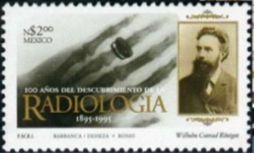
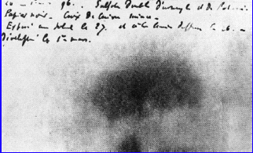
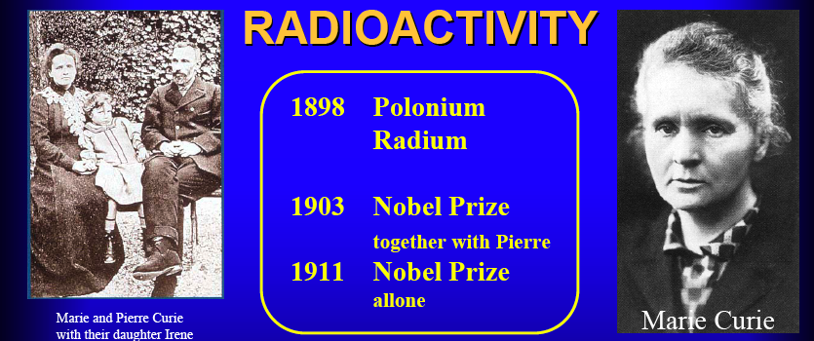
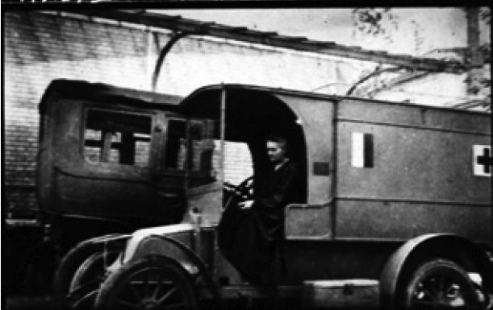
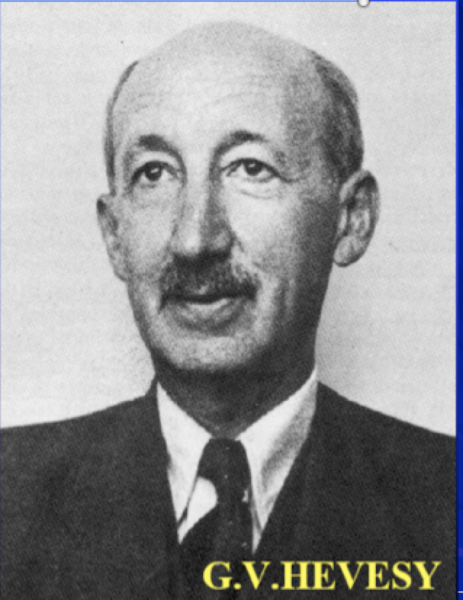
How physics discoveries have impacted our life (1)
1895
W.C. Rontgen
Discovery of X Ray
1896 - Discovery of natural radioactivity by H. Becquerel
1897 – J.J. Thomson – electron
1899 – E. Rutherford : Alpha & Beta
1900 – U. Vilars – the Gamma
First image of
potassium uranyl disulfide
1898
Pierre and Marie Curie
the Radioactivity
Polonium,Radium
1923 - The Tracer principle
`G.V.Hevesy- the father of
nuclear medicine
1910
X Ray
Radiography

Slide 12
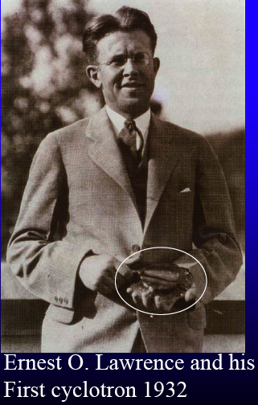
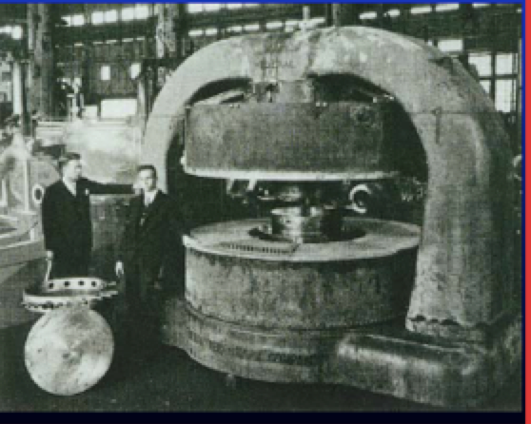
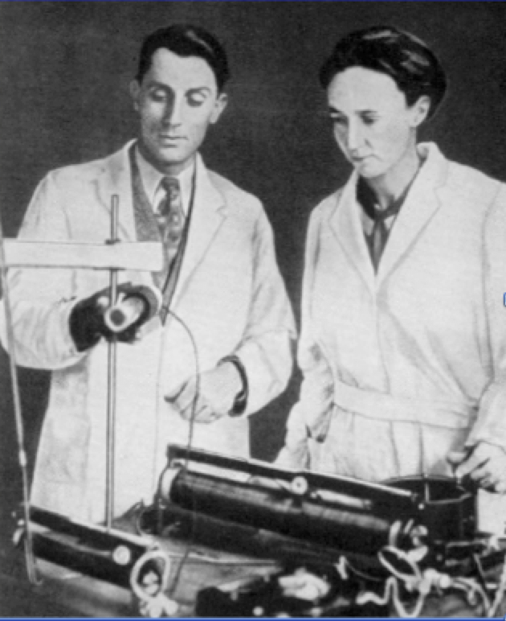
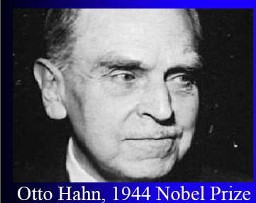
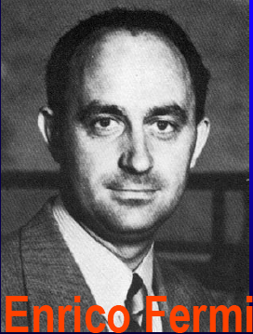
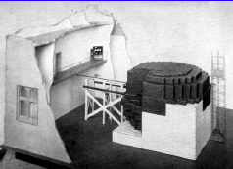
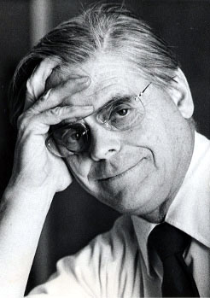
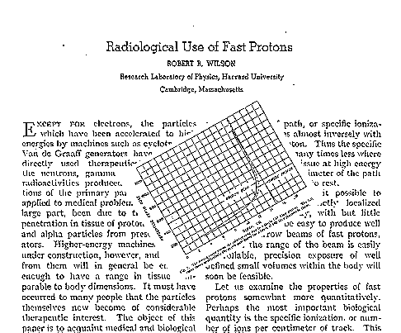
How physics discoveries impact our life (2)
1932 - The Invention of the cyclotron
Production of radioisotopes
1934 - Artificial radioactivity
Irène and Fréderic Jolio Curie
in combination with the cyclotron open the door to the production of useful radio indicators.
1938-1942 Fission of Uranium
From discovery to first
graphite miler in Chicago
To the Production of long lived
radio-isotopes and nuclear energyproduction
O.Hahn
E. Fermi
1946 – R.R.Wilson The origin of particle therapy
Using the Bragg peak discovery (1903)

Slide 13
Effects of radiation
on human body
What is a Curie,Bequerel, Seivert?
From Prof. Aurengo - Hopital de la Salpetriere - Paris

Slide 14
The Units - a bit of definition!
Activity = Number of decays per second
  Becquerel Bq : 1 decay / second
  Curie Ci : 37 x 10⁹ Bq (37 GBq)
Dose : GRAY = amount of radiation absorbed in any material = absorbed energy / mass unit
  Gy : 1 joule / kilogram = 100 Rad
Effective dose : SEIVERT Sv = estimates biological effect from the absorbed radiation
→ indication of global risc
  = absorbed dose x WR* x WT**
    Particle → WR*= 1 pour RX, beta and gamma, p=5, α=20
    Organ → WT** = 0.05 for thyroïd, 0.01 for skin

Slide 15
Effective dose values
10.000 mSv : high irradiation / rapid death
1.000 mSv : moderate irradiation / clinical visible signs (burn… )
5 mSv : annual irradiation in Clermont-Ferrand (volcanic soil)
2,5 mSv : annual irradiation in Paris
1 mSv : legal limit irradiation in France
1 mSv : average annual medical irradiation in France
1 Sv = 1 J/kg equivalent 1 Sv = 100 rem

Slide 16

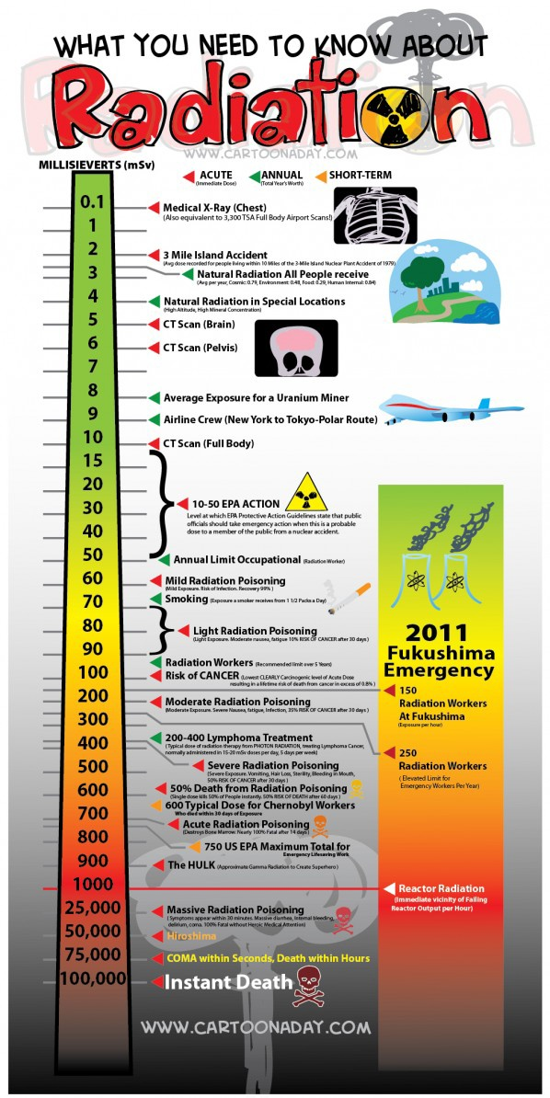
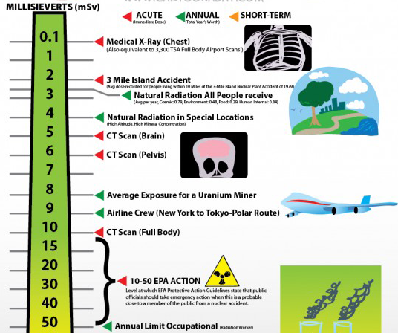
16

Slide 17
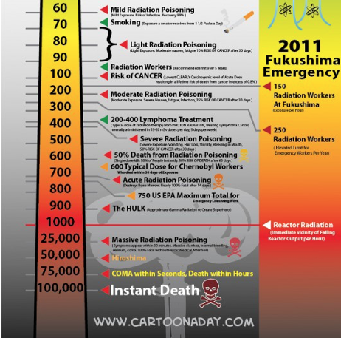

Slide 18
Some simple exemple
a ‘standard’ Scintigraphy exam
W_{R} W_{T} %
RX : 100 mGy / 50 cm² skin 1 0,01 30 %
¹³¹I : 10 mGy / thyroïde 1 0,05 100 %
Effective dose = (100 x 1 x 0,01 x 0,30) + (10 x 1 x 0,05 x 1)
= 0,8 mSv
Mammogram : 2 view x 2 breasts
X ray with Q factor WR = 1
Tissue weighting factor = 0,12
Absorbed dose: 4 x 1 = 4 mSv
Effective dose: 4 x 0.12 ≈ 0.5 mSv
Mammogram exposure equivalent to whole-body dose of 0.5 mSv

Slide 19
Variation of natural radioactivity
Cosmic rays
  sea level 0,25 mSv / year
  Mexico (2240 m) 0,80 mSv / year
  La Paz (3900 m) 2,00 mSv / year
External exposure due to earth exposure
  average 0,9 mSv / year
  Espirito Santo (Bresil) 35 mSv / year
  Maximum (Iran) 100 mSv / year
  Marseille (France) 0,20 mSv / year
  Limousin (France) 1,20 mSv / year
Internal exposure due to water
  Evian water 0,03 mSv / year
  St Alban water 1,25 mSv / year

Slide 20
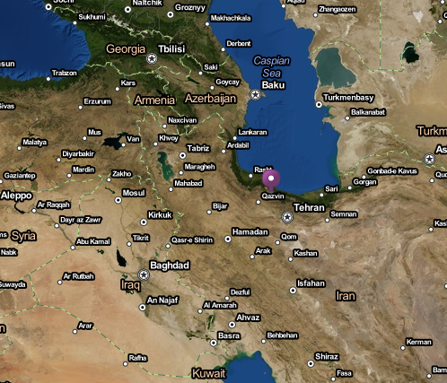
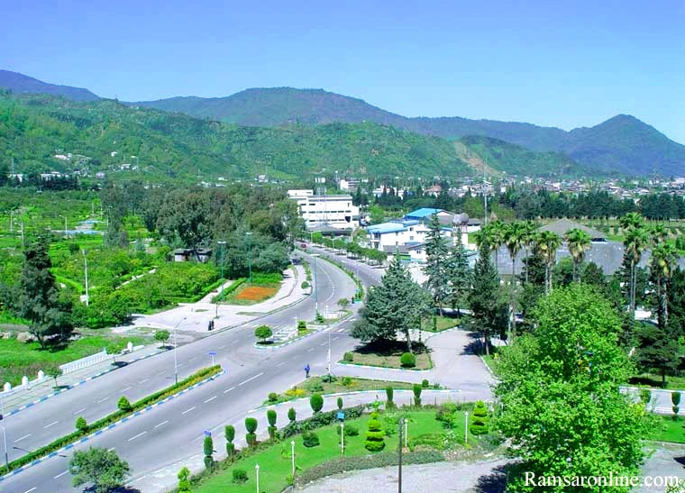
Most radioactive place in the world: Ramsar, Iran
Background radiation: 100- mSv / year due to ²²⁶Radium
No epidemiological evidence of adverse affects
Residents demonstrate a marked increase in DNA repair capacity
Proposal: to relocate the inhabitants (2000) to a lower radioactive area!
20

Slide 21
Conclusion & question ?
Sv= Unit well adapted to radioprotection
However : why this official’ limit of 1 mSV/ year is so low ?
  No sanitary argument : industrial irradiation :10 -15 µSv
  Interpretation of the ‘low’ absolute value might be controversial!
Do not take into account debit and age ..an personal sensitivity, instant vs integrates
The total radiation accumulates along the full life
  At 70’s I have received certainly accumulated 500 mSr ?

Slide 22
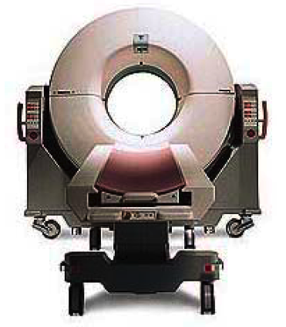
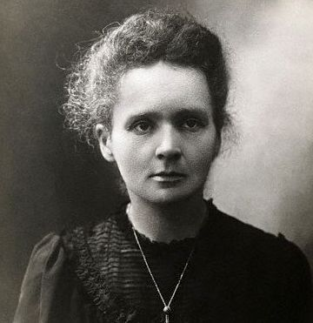
2010
1910
Some words about Radiology X
Common tools & techniques

Slide 23
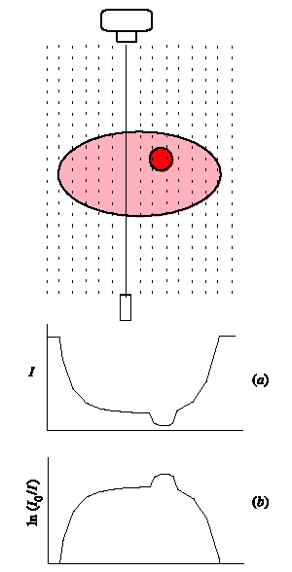
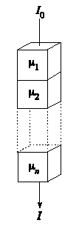


Radiology principle
The most common exam
Transmission of X rays through tissue

Slide 24
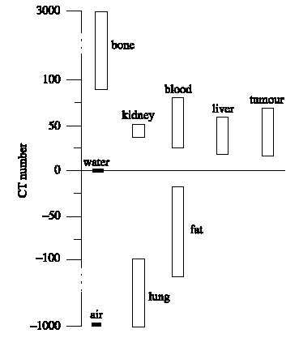
Radiology problem = contrast
black
How to get the best contrast?
white

Slide 25
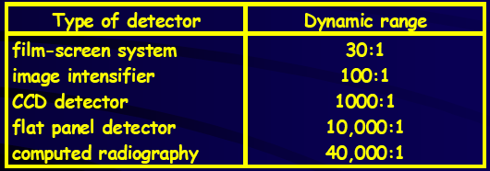
Detection techniques
The standard : film scren system
How to replace the film
  More sensitive --> better contrast
  Less dose
  Affordable ?

Slide 26
Exposure for radiological exams
Some examples
organ dose skin effective dose
mGy mSv
Thorax, face 0,2 - 0,5 0,015 - 0,15
Lumbar region 4 - 28 1,5
Urography 40 - 60 3
Brain scan 7 - 78 1
Whole Body scan 30 - 60 4 - 10
Mammography 7 - 25 0,5 - 1

Slide 27
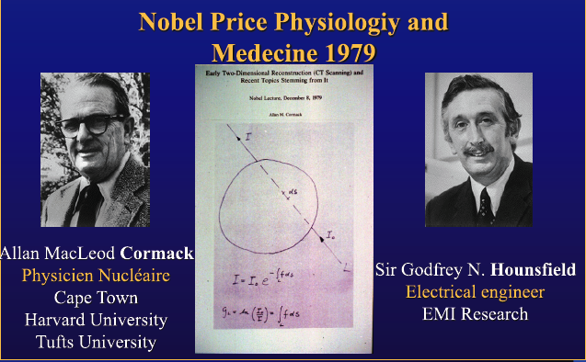
State of the art :Computed Tomography (CT)

Slide 28
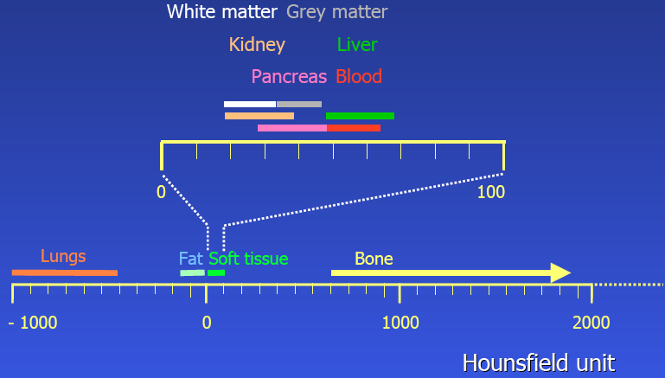
Contrast (Houndsfield) units

Slide 29
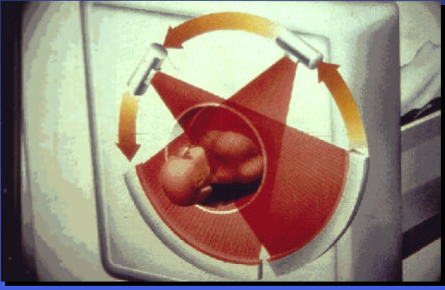
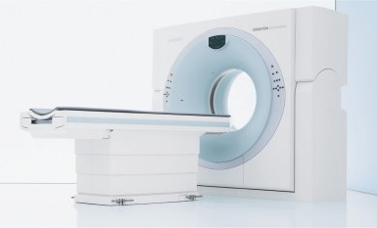
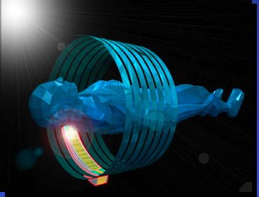
CT Scaner principle
Spatial resolution and speed
  64 … 320 detector rows
  Slice thickness 0.33 … 0.6 mm
  Tube rotation time 0.3 s
    Organ in a sec
    Whole body < 10 sec
  dual source (180° → 90°)
  Volume coverage with one rotation: 4 … 16 cm

Slide 30
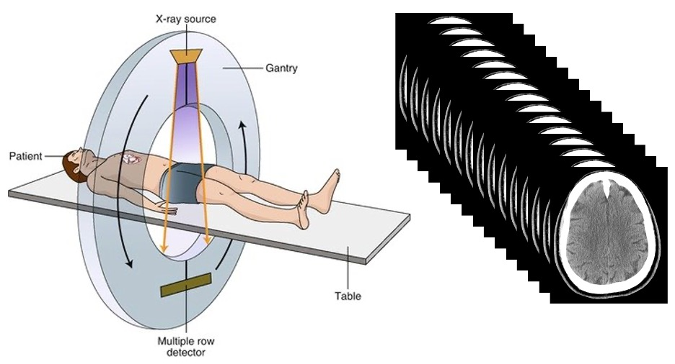
CT Scanner principle (2)

Slide 31
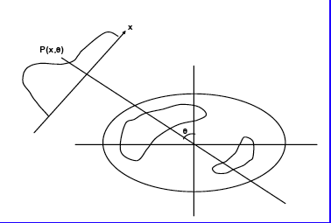
Computed Tomography
Basic method of Image reconstruction
Take 1D profiles or 2D projection at discrete angle around the object
Assume that each measured point = sum of actvity elements along the Line of Response (LOR)
Raw data can be displayed as a ‘sinogram’

Slide 32
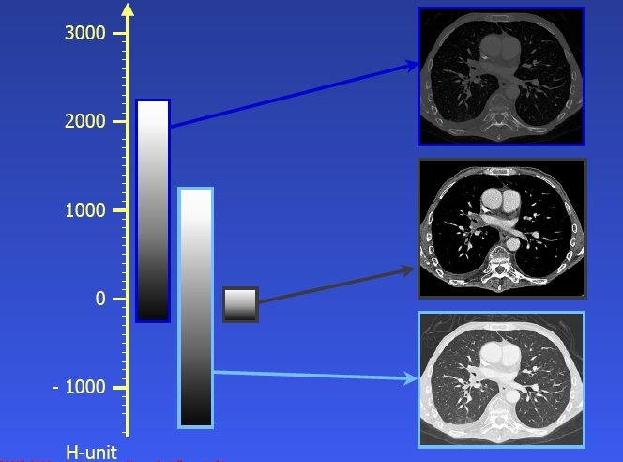
From Hounfield units to image

Slide 33
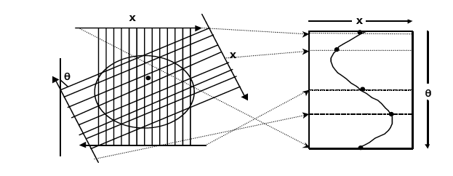
Computed Tomography
Basic method of Image reconstruction
Projection
Sinogram
Raw data can be displayed as a ‘sinogram’
Then a lot of corrections …..

Slide 34
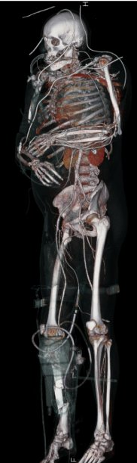
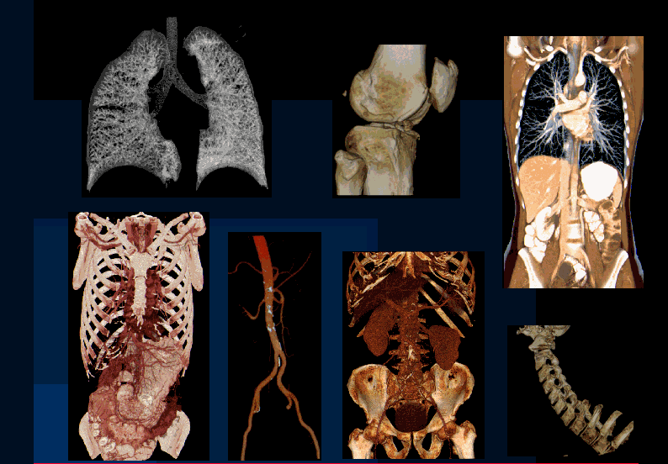
Computed Tomography scaner (CT)
The best device widely used for precise exam
  Whole body
  Cardiology
Still a lot of radiation full body CT = 4-10 mSv (depending organ)
  Standard radiography = 0.1 mSv

Slide 35
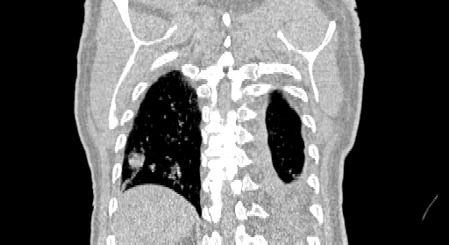
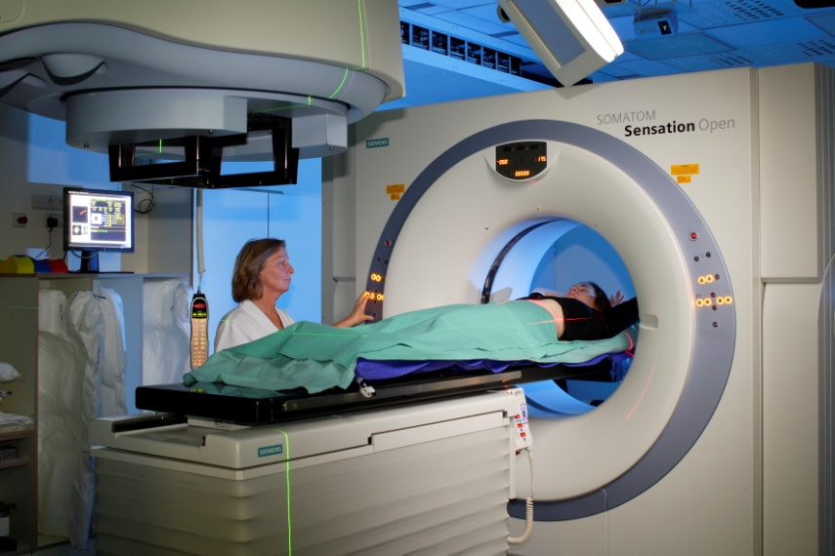
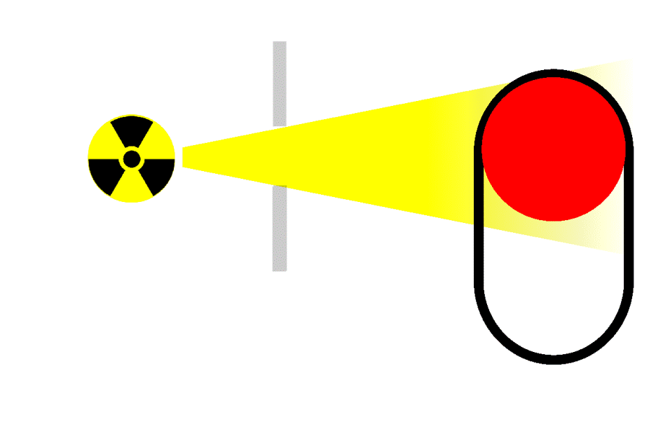
State o the art : 4D CT
Position influenced by the
breathing motion

Slide 36
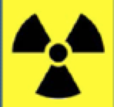

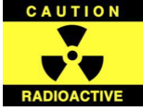
Patient Radiation Dose is Limited!
Image Noise Is Limited by Counting Statistics
Cannot Increase too much Source Strength
See the BU slides about how to decrease the dose using gaseous detetors

Slide 37
Deacreasing the dose
with HEP Gazeous detector

Slide 38
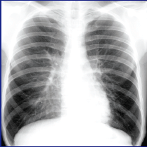
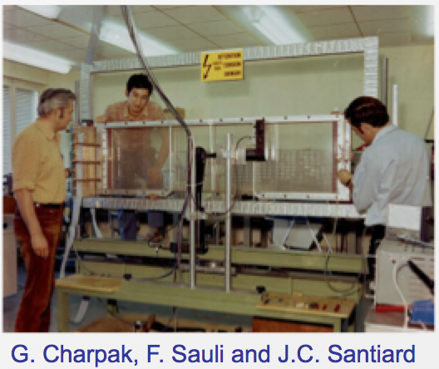
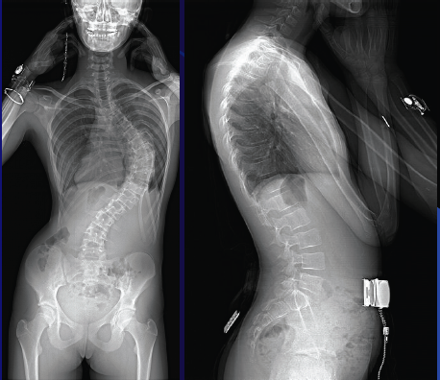
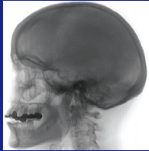
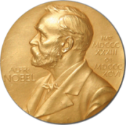
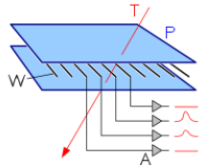
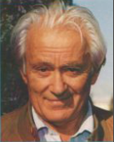
The 1970’s dream : Digital radiography with MWPC
A tribute to George Charpak
With 10 time less dose
1992
Multiwire Proportional Chamber
Georges Charpak
1924 - 2010
1968

Slide 39
More detailed presentations during this school
DIAGNOSTIC IMAGING
TREATMENT THERAPY
See Andrea talk on medical imaging and PET
Particle therapy
See Martin presentations
And Gate Simulation by Trang

Slide 40
What is Nuclear medicine ? Definition
Use in vivo of radioactive elements (tracers) injected to the patient orally or by blood injection to image the function of the body
Functional and metabolic (scintigraphy)
In vivo biochemistry
Study of a radioactive molecule in a living organism
  Images are Static 2D/3D (x,y,z)
  Or 4D (+time) --> dynamic
  Or 5D (+ Energy) --> Multisotopes /multitracers

Slide 41
Few words about Radiotherapy X

Slide 42

About Cancer
France→around 230 000 new cases per year
→ Cure (35-40 %)
  Health budget = 130 Billions Euros
  CANCER = 10 Billions Euros
Targeting 2030 → Cure > 50 %
First step →
Improve diagnostics tools (imaging)
Future → screening possibility ?
US statistics

Slide 43
Fight again cancer – Radiotherapy
Local irradiation to kill tumour → 100 Gy = 90 % of sterilization
Frequent treatment (2/3 of cases).
Efficient treatment: cure → 40 to 50% of recovery
Allow good quality of life and tolerance
non invasive, itinerant and without important physical effects.
Cheap (< 10%) of the cancer budget (France)
Essentially X rays
  (Linear accelerators) & photons (curietherapy)
Chimiotherapy
New Hormoniotherapy
Radioutherapy
Surgery
Treatments

Slide 44
Radiatherapy X
No substitute for RT in the near future
Number of patient increasing
Present limitation of RT→ 30 % of patients recurs
Why Radiotherapy X is NOT 100 % efficient?
  Complication < 5 %
  Tolerance of saine tissue is the limiting factor
    Close to Organ at Risk
  Failures due to radioresistant tumors!
  Second cancer 30 years after Radio Therapy (from recent statistics)
    Adult : 1.1
    Chidren : 6
Particle therapy
Around 25% of the case
Martin lecture

Slide 45

Therapy with radioelements
Origin ; The tracer concept 1923)

Slide 46

Isotopes in medicine

Slide 47




Common DiagnosisTracers
Application
Requirement
Isotope
MTR = Material Testing Reactors
There are different solutions available worldwide to produce artificial radioisotope, i.e. by accelerators, nuclear reactors or research reactors such as the JHR Material Test Reactor.
Cyclotrons

Slide 48

EU tracer production situation
Very worry about the future this why we are building the RJH

Slide 49
RJH Producing radioisotope for nuclear medicine
The JHR Material Test Reactor (70MWh) has been designed to produce artificial radioisotope by way of fission or neutron capture, The need for artificial radioisotope has been increasing year after year, especially for nuclear medicine where radioisotopes are used for examinations (diagnostics) and cancer treatment (therapy).
Producing between 25% (representing about 2 millions patients diagnosed) and 50% of European yearly requirements
Diagnostic radioelement
    ⁹⁹Mo/^{99m}Tc • ¹²⁵I ¹³¹I• ¹³³Xe produced by ²³⁵U fission
Therapeutic radioelement
    ⁸⁹Tc, ⁹⁰Y, ¹⁵³Sm, ¹⁶⁶Ho, ¹⁶⁹Er, ¹⁷⁷Lu, ¹⁸⁶Re, ¹⁹²Ir, ¹⁰³Pd, ¹²⁵I
    ¹⁹²Ir, ⁶⁰Co, ⁷⁵Se ….

Slide 50

The Jules Horowitz MTR Reactor
Cadarache France
2025?
WEB site: https://jhrreactor.com/

Slide 51



Curietherapy/Brachytherapy
1910
Today
Principle →Local (contact) deposit of the dose by needles or implants

Slide 52


First cancer cure by brachy (ulcus rodens, basal cell carcinoma): Goldberg and
London in Moscow, 1903

Slide 53


First brachy treatment, any disease, generally credited to be Danlos:
Henri Alexandre Danlos,
Parisian dermatologist,
exhibiting a woman who he
successfully treated for
lupus vulgaris of the
face. Pierre Curie loaned
him the source and he
treated her in 1901.

Slide 54
BRT (typically 10-20% of patients)
Radiation sources placed in the tumor, ergo less toxicity
Dose homogeneity in the target not an issue
Conformal treatment without complicated technological
tools
4) Generally invasive (except intracavitary)
5) In BRT timing is critical
6) Overall risk of a second cancer is claimed to be lower for
brachy
The actual dose delivered can be precisely known and monitored (precise dosimetry)
Operator-independent treatment)
Ideal for focal therapy (radiobiology not needed)

Slide 55
Modern imaging
If I have time !

Slide 56
The various types (modalities) of imaging
Organ
Function
Cell
Anatomy Physiology Metabolism Molecular
PET,SPECT
NMR/MRI*
X ray (CT)
Ultrasounds
Optical
Complementary !
Depends on what you want to see
MRI/MMR* = Magnetic resonnance

Slide 57




Medical Imaging Modalities exemples
X-ray radiology
X-ray Radiography
Computed Tomography (CT)
Emission tomography
Tomo-Densitometry (DXA)
Single Photon Emission Computerized
Tomography (SPECT)
Positron Emission Tomography (PET)
Magnetic Resonance (MR)
Magnetic Resonance Imaging (MRI)
Ultrasonic imaging
Magnetic Resonance Spectroscopy (MRS)
Functionnal MRI (fMRI)

Slide 58







Historical Evolution of PET
C-PET Philips
1977
First Steps
Townsend & Jeavons
1997
First mouse imaging with ¹⁸F
2007
Biograph PET + X ray-CT

Slide 59






From Today ---> Tomorrow Challenge
2017
no TOF
~600 ps TOF
TDM/PET-TOF (250 psec)
2022
Sucima PET-MRI EU project
~200-ps TOF PET Siemens Biograph Vision 600

Slide 60


From Today ---> Tomorrow Challenge
CRT = Laboratory 30ps
→ 10 to 1 psec 3 min scan
SNR, Direct imaging Multi-photon imaging, Positronium imaging
Scintillation, Cerenkov, Metascintillators, Photonics
AI vs TOF, Cost?
2022
2027 ?
Iseult Project: 11.7T Whole-Body MRI
Explorer total body project

Slide 61


Radiograph of a phantom
Uwe Schneider PhD thesis (1978,PSI)
Another dream
The Proton CT
A tribute to G.Charpak

Slide 62
Basics of particle imaging
The particle (proton/ion) go through the patient at high energy
Advantages:
  Decrease the uncertainties → better dose accuracy
  Reduce the dose delivered to the patient
Challenge → the data reconstruction
  correctly reconstruct the path of the proton
Proton CT:
1) replaces X-ray absorption with proton energy loss
2) reconstruct mass density distribution instead of electron distribution
Radiograph of a phantom
Uwe Schneider PhD thesis (1978,PSI)
A tribute to G.Charpak

Slide 63
Thank you for your attention
Questions?
Or send me an email
patrickledu@me.com

Slide 64


Few words about Radiation Detectors
Radiation
Instrumentation
THE Book
Glenn Knoll

Slide 65
Instrumentation schools References
IRSTS 14 Osaka
http://rt2014.rcnp.osaka-u.ac.jp/rt2014-school/index.html
IRTS 16 HoChiMinh City
http://ntlab.hcmus.edu.vn/en/rt2016-school/
Le Cap South Africa.18
https://indico.cern.ch/event/661919/overview
ICISE July 19
https://indico.in2p3.fr/event/19513/
IRSTS Kuala Lumpur (Malaysia) Nov 2019 https://indico.cern.ch/event/854879/surveys/1178
IEEE NPSS Workshop on Radiation Instrumentation – Dec 2021
Dakar Senegal
https://indico.cern.ch/event/954194/
IEEE NPSS Workshop on Radiation Instrumentation – Nov 2020
Jakarta Indonesia
Thank you
for your attention
https://indico.cern.ch/event/954199/

Slide 66
Thanks to
C. DaVia (Manchester U. ).
D.Townsend (U. Singuapor)
H. Frisch ( U. Chicago)
P. Lecoq ( CERN)
R. Lecomte (Sherbrook)
W. Moses ( LBL)
S. Cherry (Davis)
K. Parodi (HIT)
Pr. J.N. Talbot (Hopital Tenon - Paris)
… and many others
Thank you
for your attention

Slide 67
May be
Interest you
Back up & extra slides

Slide 68

18 Nov, 1895 W.C. Rontgen discovers Xrays

Slide 69

1996 - Discovery of the natural radioactivity by Henri Becquerel
First image of potassium uranyl disulfide

Slide 70


1898 the Radioactivity

Slide 71

1923 - The Tracer principle

Slide 72

1934 - Artificial radioactivity
Irène & Frederic Joliot-Curie

Slide 73

1932 - The Invention of the cyclotron

Slide 74

Radiology survey of electronically readable detectors

Slide 75

Radiology: Flat panel direct detection
Xray ---> electron --> electric signal
Selenium

Slide 76

Radiology :Flat panel indirect detection
Xray -->Light--> electron ---> electronic signal

Slide 77

Multi Wires Proportional chambers MWPC
MODERN GASEOUS DETECTORS:
POWERFUL TOOLS FOR RADIATION DETECTION
AND LOCALIZATION IN PARTICLE PHYSICS,
BASED ON THE MULTIWIRE PROPORTIONAL CHAMBER
(Georges Charpak, 1967)
CATHODE
-V
TWO-DIMENSIONAL MWPC READOUT CATHODE
INDUCED CHARGE (Charpak and Sauli, 1973)
CONVERSION
S ~ 1 mm
CHARGE COLLECTION
ANODE WIRES
AVALANCHE MULTIPLICATION
+V
Spatial resolution determined by: Signal / Noise Ratio
Typical (i.e. ‘very good’) values: S ~ 20000 e: noise ~ 1000e
Space resolution < 100 μm
-V
CATHODE
E. Gatti et al, Optimum geometry for strip cathodes … , Nucl. Instr. and Meth. 163(1979)83

Slide 78

TWO-DIMENSIONAL LOCALIZATION
TWO-DIMENSIONAL LOCALIZATION FROM SIGNALS INDUCED ON CATHODE PLANES (Charpak & Fabio Sauli, ~1973)
CATHODE STRIPS
ANODE WIRES
CATHODE STRIPS
LOW-DOSE DIGITAL RADIOGRAPHY WITH MWPC:
CHARPAK’S HAND (2002):

Slide 79




From MWPC’s to MGPD’s
MGPD
Drift Chamber
MWPC
1970 - 1990
PS- ISR- SPS- LEP
1975 - 1995
UA2-LEP
1990 -
Multiwire Proportional Chamber
Georges Charpak 1968
GEM F.Sauli)
Micromegas Y. Giomataris

Slide 80




MPGD
From 1988-1998 Micro-technologies and etching techniques allowed development of Micro Patter Gaseous Detectors
MICROMEsh GAseous Structure
  Thin gap Parallel Plate Chamber: micromesh stretched over readout electrode.
Gas Electron Multiplier
  Thin, metal-coated polymer foil with high density of holes, each hole acting as an individual proportional counter.

Slide 81



X Ray imaging
GEM for 2D Imaging:
Using the lower GEM signal, the readout can be self-triggered with energy discrimination:
Wire Chamber Radiography:
9 keV absorption radiography of a
small mammal
(image size ~ 60 x 30 mm²)
Position resolution ~ 250 μm
A. Bressan et al, Nucl. Instr. and Meth. A 425(1999)254
F. Sauli, Nucl. Instr. and Meth.A 461(2001)47
G. Charpak, Eur. Phys. J. C 34, 77-83 (2004)
F. Sauli, http://www.cern.ch/GDD
Position resolution ~ 100 μm
(limited by photoelectron range in the gas)

Slide 82



Exemple with GEM Detector
Thin, metal-clad polymer foil, chemically pierced by a high density of holes (70-80 μm diameter).
On application of a difference of potential between the two electrodes, electrons released by radiation in the gas on one side of the structure drift into the holes, multiply and transfer to a collection region.
Cascading several foils results in high multiplication factors.
70 µm
F.Sauli & al.
Notes:
Another approach could be given by the GEM detector, where a charge amplification is obtained through tiny holes chemically pierced in a thin metal-clad polymer foil

Slide 83



Next → INGRID
InGrid :integrate the Micromegas/GEM concept on top of a MediPix pixel CMOS chip ( Timepix)
    pixel size: 55 x 55 μm²
    per pixel: preamp – shaper – 2 discr. –
    Thresh. DAQ - 14 bit counter
metalized foil
~100 μm ~1mm
Use → Large Trackers & Calorimeters

Slide 84


Timepix Hybrid detector
On the way of photon counting
Medipix is a Silicon pixel-based detector technology AND signal processing that can be employed to measure charged particles,photons, and neutrons.
It is based on a read-out chip that embeds the electronics for each pixel within the pixel’s footprint!
Detector and electronics readout are optimized separately
developed for use in the CERN LHC Central Trackers
Medipix 3/TimePix This technology is an extension of designs originally
  Integrate a TDC ….
Pixelated 300 μm silicon sensor
(256 x 256 pixels)
14 mm
TU Prague - J. Jakubec
NSS-MIC 2013 Seoul J4-3
Timepix readout ASIC
Detector bias voltage

Slide 85


The Future ?: New Si detector and signal processing
On the way to photon counting?
Medipix3
- 8 simultaneous energies
- 55 µm isometric resolution
- Excellent energy resolution
- 10⁸ photons per second per mm²
Jacubek & al. Prague University
Xray source
Medipix
See presentation of Stanislav Pospisil about Timepix

