Slide 1




DRD1 overview:
Toward the Global South
Marcello Abbrescia
on behalf of the DRD1 collaboration
RPC2026 - XVIII Conference on Resistive Plate Chambers and related detectors
Rio de Janeiro (Brasil)
Sept. 14-18 2026

Slide 2
Detectors for all seasons
Phasing out of gaseous detectors has been predicted many times:
Many times this prediction was proved to be wrong!
Thanks to their versatility, their possibility to provide sub-mm spatial resolution, and tens of ps timing resolution over surfaces of the several hundred of square meters and more, they are an essential component of the present of future particle physics experiments.
Thanks to their simplicity, they also feature important applications beyond HEP
Since the beginning of 2000s, a we assisted to a real boost in new types, applications, materials, and technologies of gaseous detectors.
Marcello Abbrescia
RPC 2026
2

Slide 3
The Renaissance of Gaseous Detectors
DRD1 was born during the «Renaissance» of Gaseous Detectors: when many experiments were planning and building the upgrade for the HL-LHC phase.
Gaseous detectors will play a major role in HL-LHC:
enhancing Muon Tracking and Triggering with MPGDs, iRPC
new Generation TPCs with MPGDBased, Readouts@ALICE/T2K
Marcello Abbrescia
RPC 2026
3

Slide 4
DRD1 collaboration act of birth
DRD1 was born with the spirit of creating an environment where gaseous detector experts from different communities could share knowledge and tools.
First draft submitted to DRDC on
July 31st 2023
It brings together experts in:
Micro-Patter Gasesous Detector (MPGDs)
Resistive Plate Chambers (RPCs)
Time Projection Chambers (TPCs)
Wire Chambers, and so on...
From accelerator experiments to cosmic rays experiments, and beyond.
«Preliminary» phase
https://cernbox.cern.ch/s/BKQsu6oiuhPWDaa
Marcello Abbrescia
RPC 2026
4

Slide 5
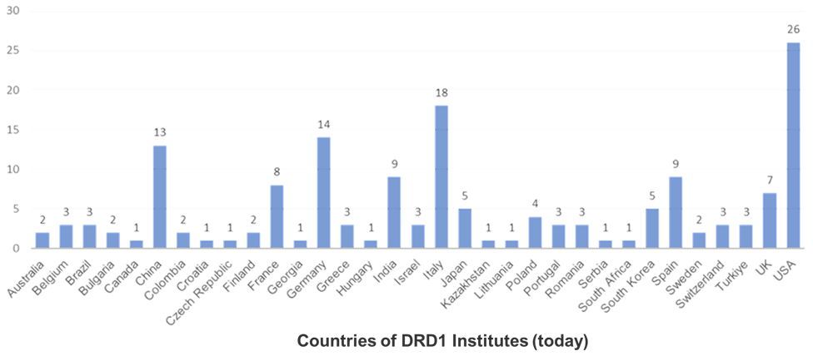
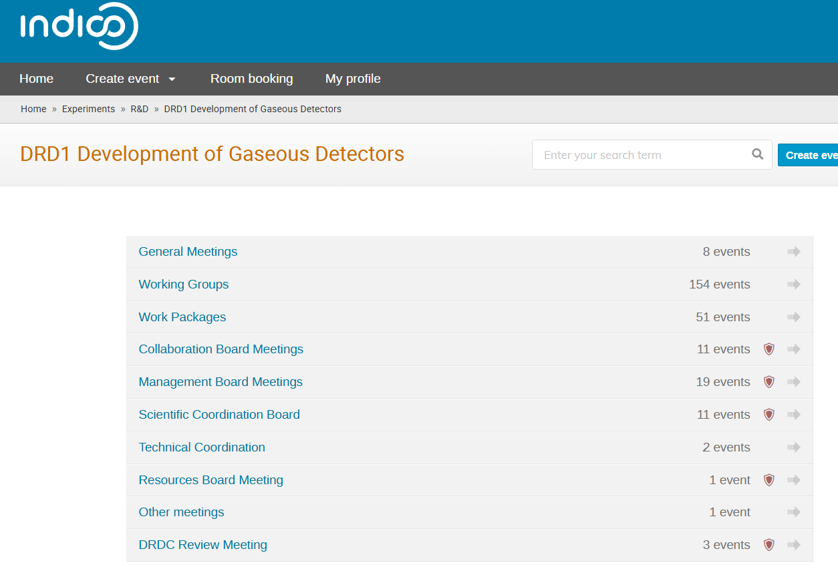
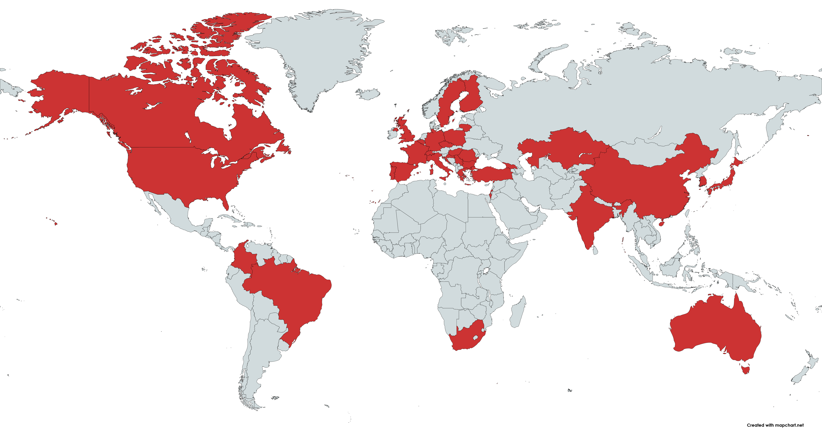
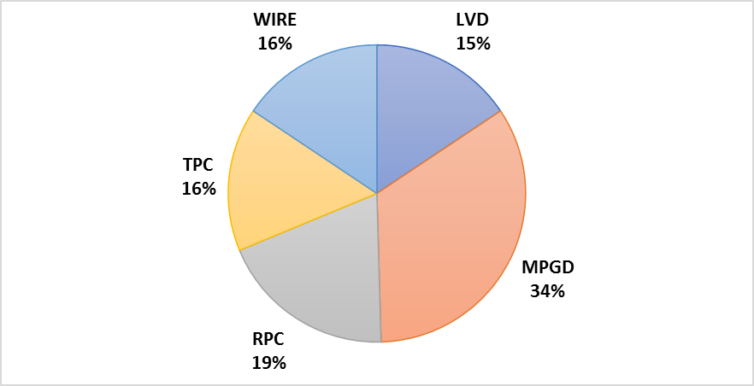
DRD1: a large and diversified community
133 Institutes (DRD1 MoU Annexes 1 & 2)
More than 30 Countries,
More than 700 members
DRD1 website: https://drd1.web.cern.ch
https://indico.cern.ch/category/17841/
https://indico.cern.ch/category/17385/
(in 2023)
DRD1 Collaboration Meetings in 2024 – 2026:
& WG and WP DRD1 Scientific
Activities :
Marcello Abbrescia
RPC 2026
5

Slide 6
DRD1 scientific organization
ECFA Scientfic Goals
Working Groups (WGs)
Working Packages
Marcello Abbrescia
RPC 2026
6

Slide 7
Strategic R&D=Work Packages
Group together institutes research interests around Applications with a focus on a
specific task(s) devoted to a specific challenge (Detector R&D theme ), typically related to specific Detector Technologies and to the development of specific tool or infrastructure
Work Package
WPs are structured in strategic Tasks
Most WPs are ready for endorsement or preparing for endorsement: interested institutes are drafting documents with detailed information about milestones, deliverables over the years and available/needed resources for the R&D program accomplishment.
Marcello Abbrescia
RPC 2026
7

Slide 8
DRD1 Work
Packages
First 9 DRD1 WPs established at the time of the DRD1 proposal approval
• 2024-2025: scientific activities organized within a WP framework
– WP meetings
– Workshops
• Resource planning
– Existing resources used for the ongoing activities
– Application for resources
• Endorsement procedure
– Preparation of the WP endorsement procedure within WPs
– First endorsements started!
Marcello Abbrescia
RPC 2026
8

Slide 9
WP1 Tasks
Just an example from the nine WPs
8 tasks define the WP1. From the proposal up to now, an update of the task activities has occurred to include new feedback from institutes during the WP1 workshops.
– 1st DRD1—WP1 Workshop, March 7, 2024
– 2nd DRD1—WP1 Workshop, November 14, 2024
– 3rd DRD1—WP1 Workshop, September 25, 2025
New RPC and TGC structures
New Resistive MPGD Structures
New Front-End Electronics
Optimization of Scalable Readout System
Eco-friendly gases
Manufacturing
Longevity on large detector area
New Detector Structures
Many WP1 contributions in DRD1 WG sessions
Marcello Abbrescia
RPC 2026
9

Slide 10
WP1 activities: RPC and TGC structures
Marcello Abbrescia
RPC 2026
10

Slide 11
WP2: Drift chambers
WP2 Tasks
DRD1 does not prioritize technologies!
Development of a front-end ASIC for cluster counting
Development of a scalable multichannel DAQ board
Mechanics: new wiring procedures and new endplate concepts
Increase rate capability and granularity
Consolidation of new wire materials and wire metal coating
Study ageing phenomena for new wire types
Optimisation of gas mixing, purification, and recirculation systems
Marcello Abbrescia
RPC 2026
11

Slide 12
…and so ON!
Literally hundreds of presentations on the work DONE!
WP7 timing detectors
Selected WP highligths
WP3: Straw and Drift Tube Technologies
WP5: Gaseous Calorimeters
WP9: beyond HEP
Marcello Abbrescia
12

Slide 13
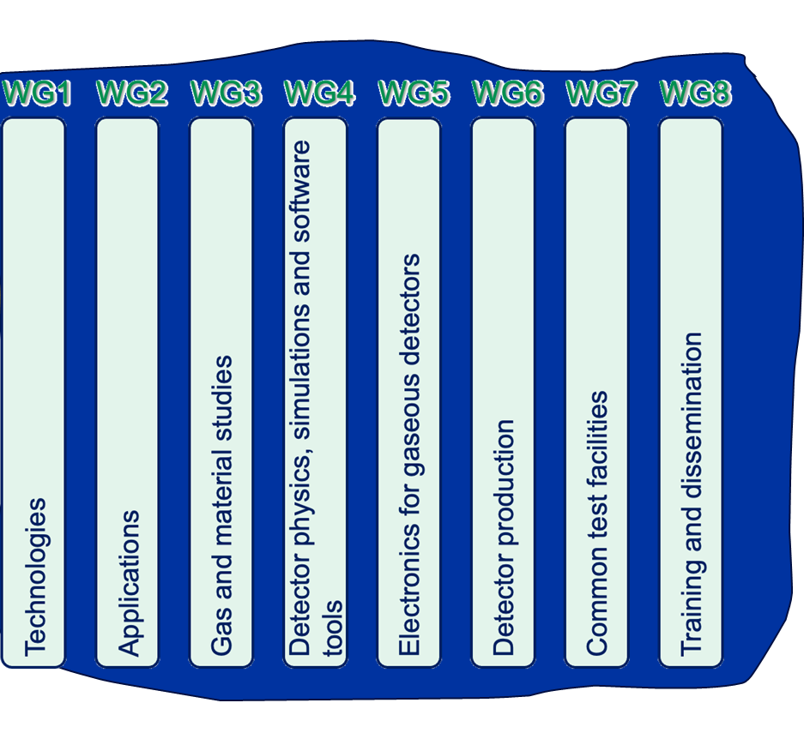
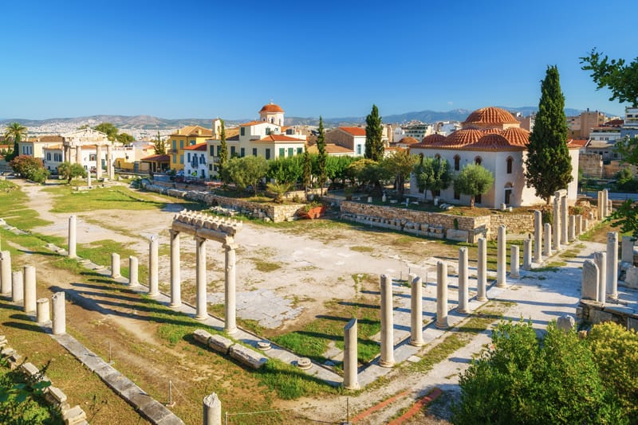
DRD1 structure: Working Groups
DRD1 is a community-driven collaboration: the idea is to share common infrastructures (labs, workshops), common R&D tools (software and electronics ), and to create the right environment for cross-exchange of knowledge and techniques on gaseous detectors.
DRD1 Is also organized in eight Working Groups (WGs): they provide the framework for sharing knowledge, expertise, and efforts, and support strategic detector R&Ds, facilitating the establishment of joint projects between institutes.
DRD1 WGs are the «agora» of modern particle detector physics
Marcello Abbrescia
RPC 2026
13

Slide 14
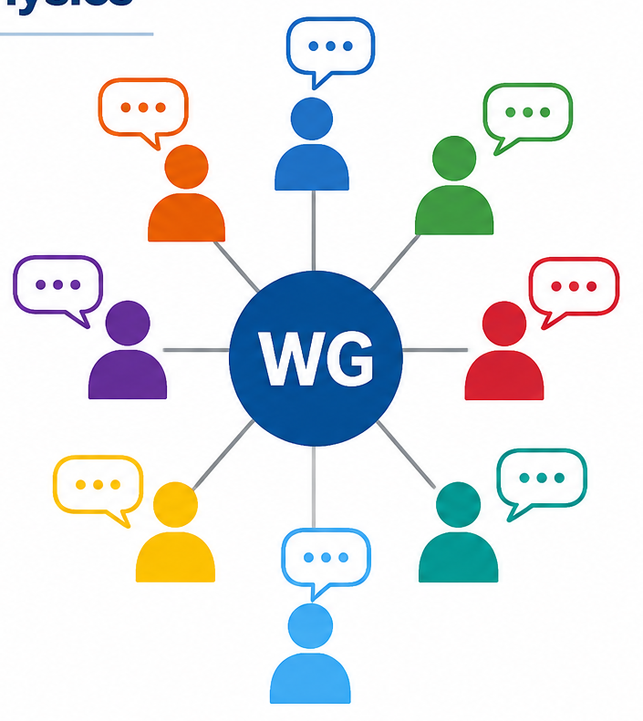
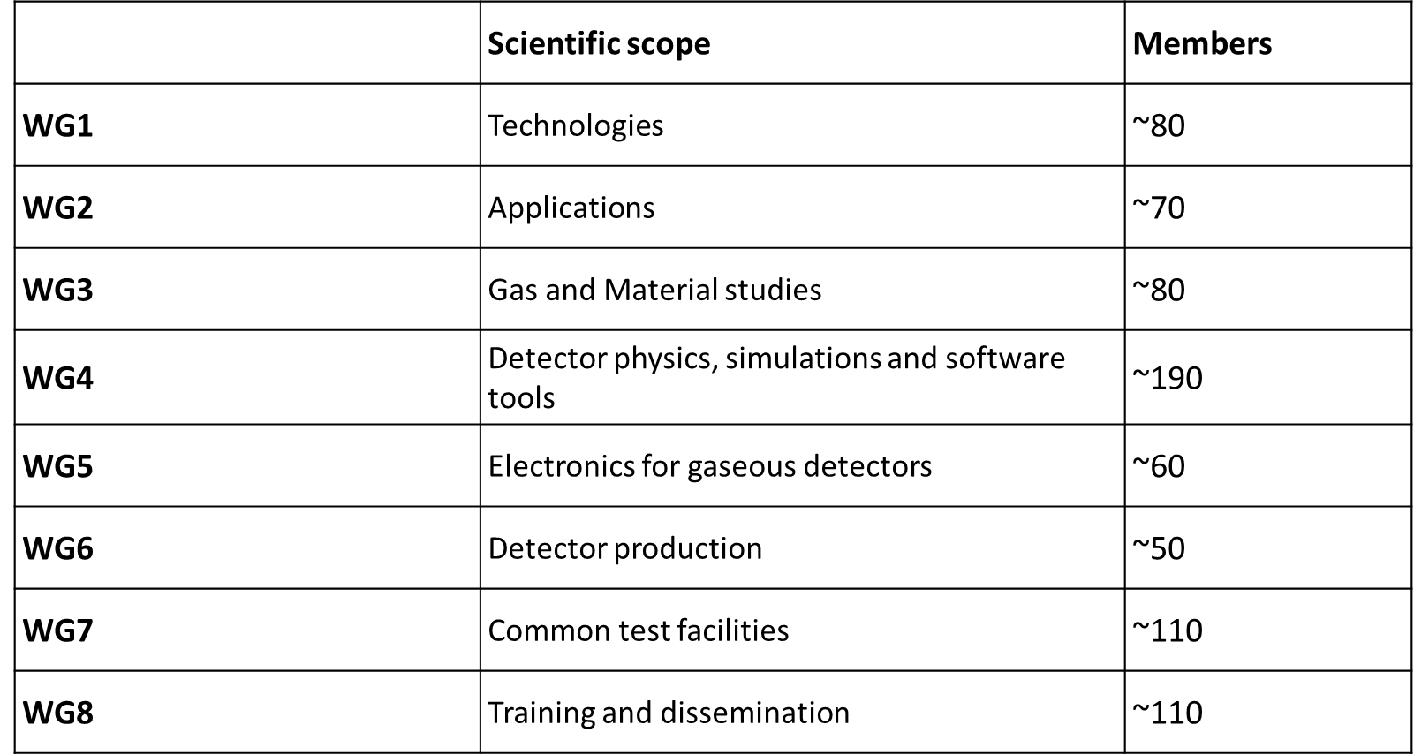
DRD1 structure: Working Groups
Each of the eight Working Groups is guided by 3-5 conveners from different gaseous detector technologies:
New challenge for the community
New opportunity for the community
Open and filled with cross-fertilization among different technologies
Approximate number of components
Typically 2-4 meeting per year/per WG
Presentation of the activities to the collaboration at large during Collaboration Meetings
Different ideas. Common progress.
Marcello Abbrescia
RPC 2026
14

Slide 15
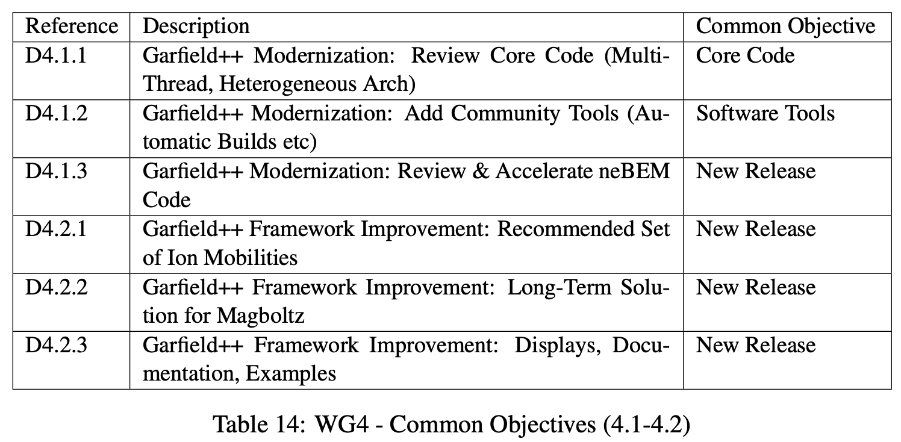
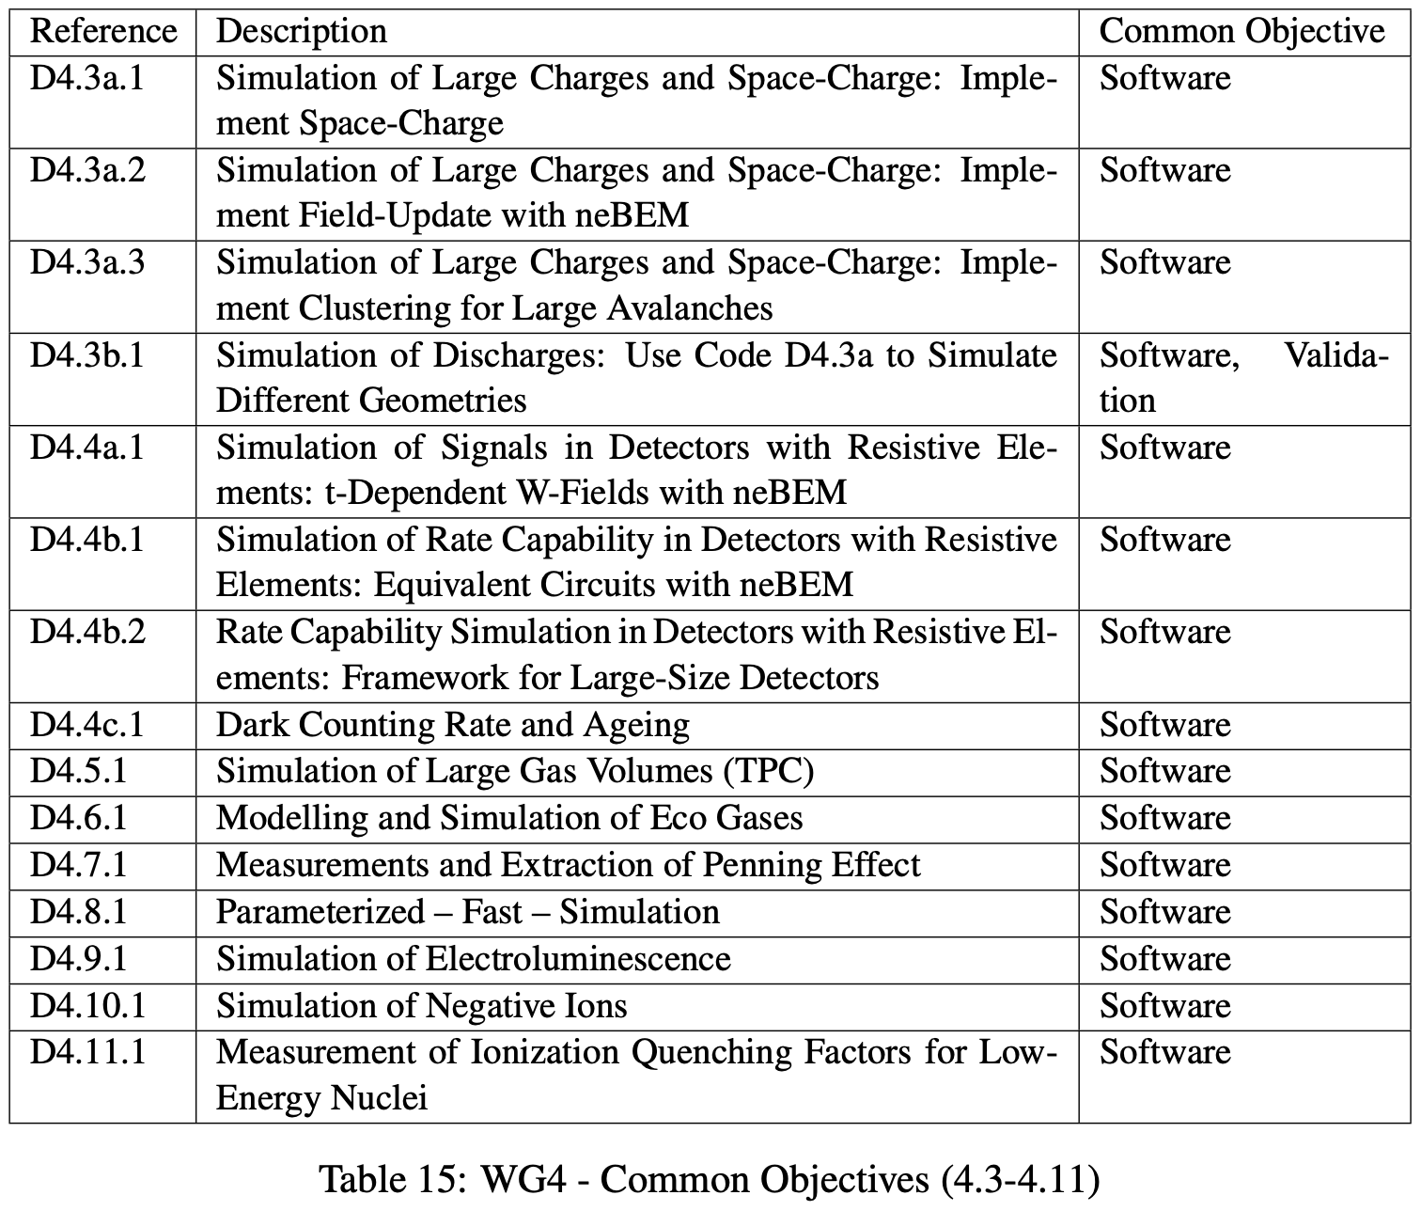
WG methodology: common goals
Activity of the WGs develops around common goals, agreed after consulting the community.
Example from WG4
spice
Garfield++ is a community built & maintained tool
Inherited from Wires & MPGD community
Interfaced with other community built tools such as neBEM, Magboltz, Degrad, Heed
Not the only code one can / should use to simulate!
Disclaimer: being co-convener of WG4 the presenter is particularly fond of these topics (and expert in the activities of WG4).
Marcello Abbrescia
RPC 2026
15

Slide 16
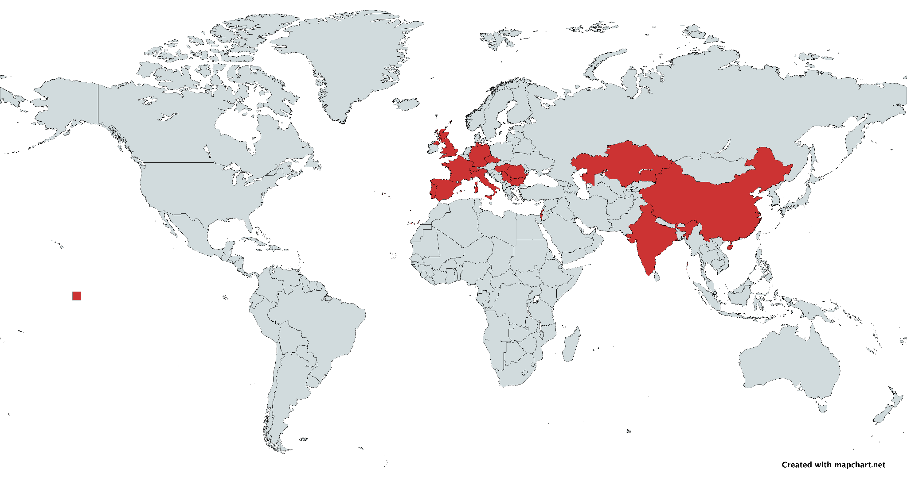
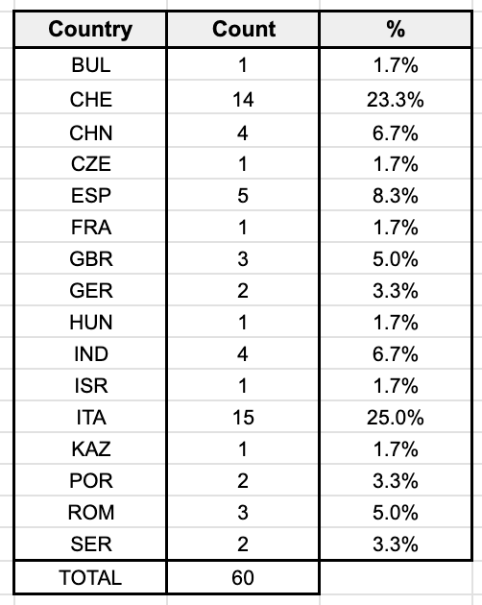
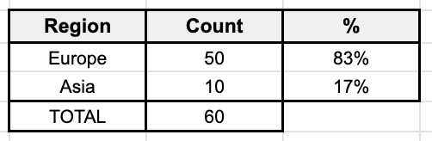
Talks in WG4
60 Talks given in WG4 sessions of 7 collaboration meetings + WG4 Working meetings
While we have contributions from Europe and Asia, we do not have them from the America.
There is plenty of room for contributions from the Global South!
Marcello Abbrescia
RPC 2026
16

Slide 17
WG5: Topical Workshop on electronics for gaseous detectors
18 contributions covering different electronics topics
https://indico.cern.ch/event/1413681/sessions/546964/#20240619
Example from WG5
Marcello Abbrescia
RPC 2026
17

Slide 18
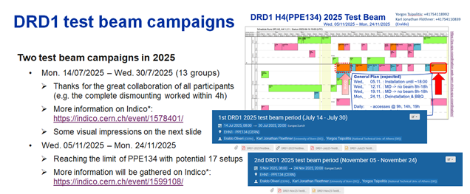
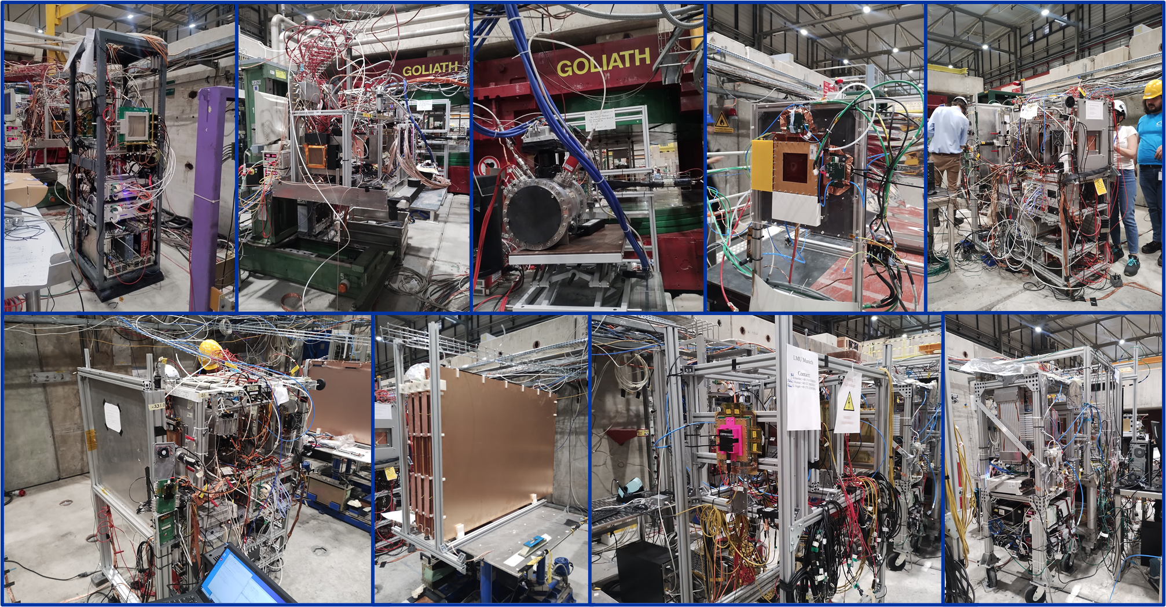
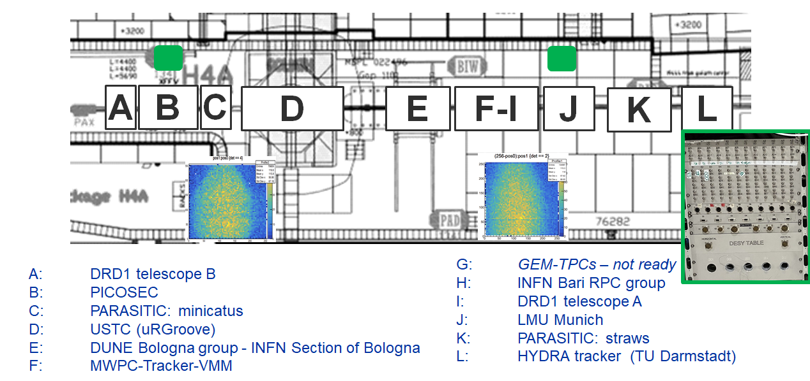
WG7: common test facilities
Common Laboratory: GDD (CERN, EP-DT-DD)
Common DRD1 Test Beam campaigns at EHN1/SPS Semi-permanent installation (H4):
2024: 3 DRD1 test-beam campaigns (8/8/5 setups)
2025: 2 DRD1 test-beam campaigns (13 /17 setups)
2026: 2 DRD1 test-beam campaigns (May & July)
Marcello Abbrescia
RPC 2026
18

Slide 19


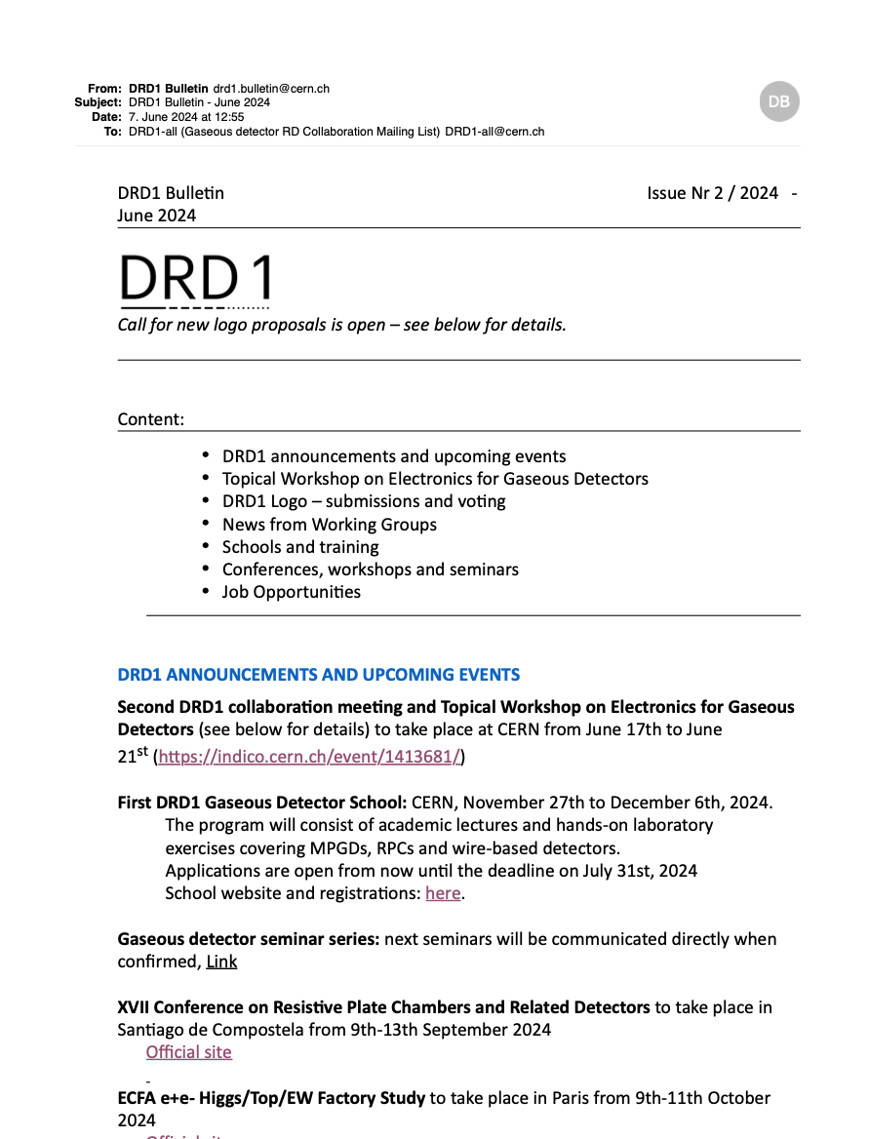
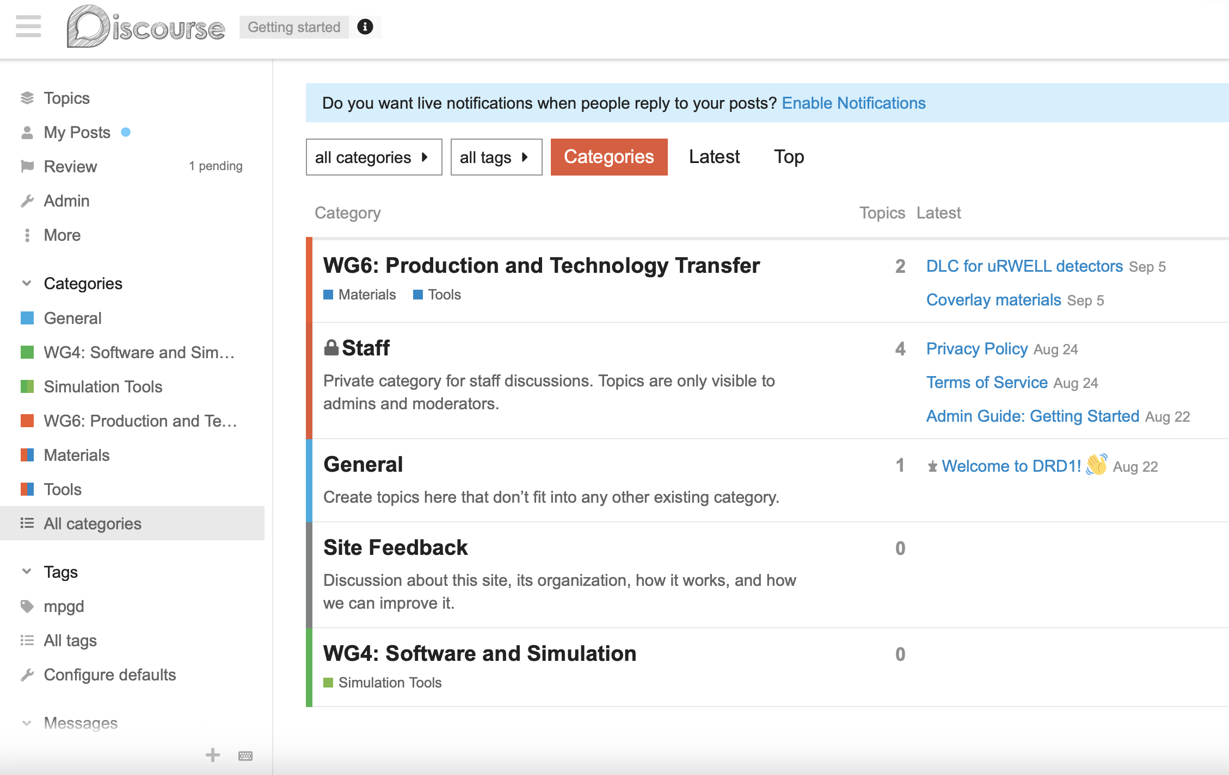

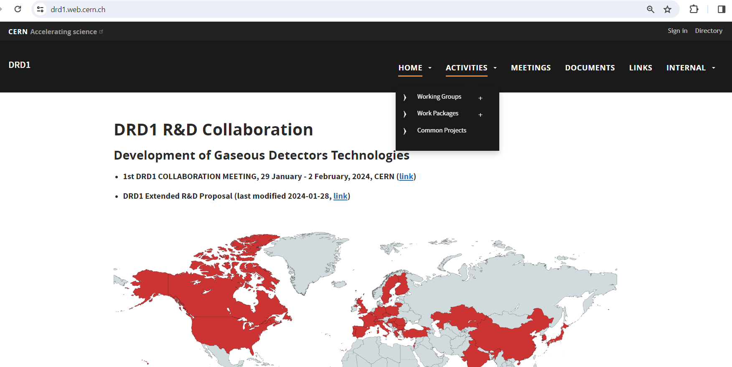
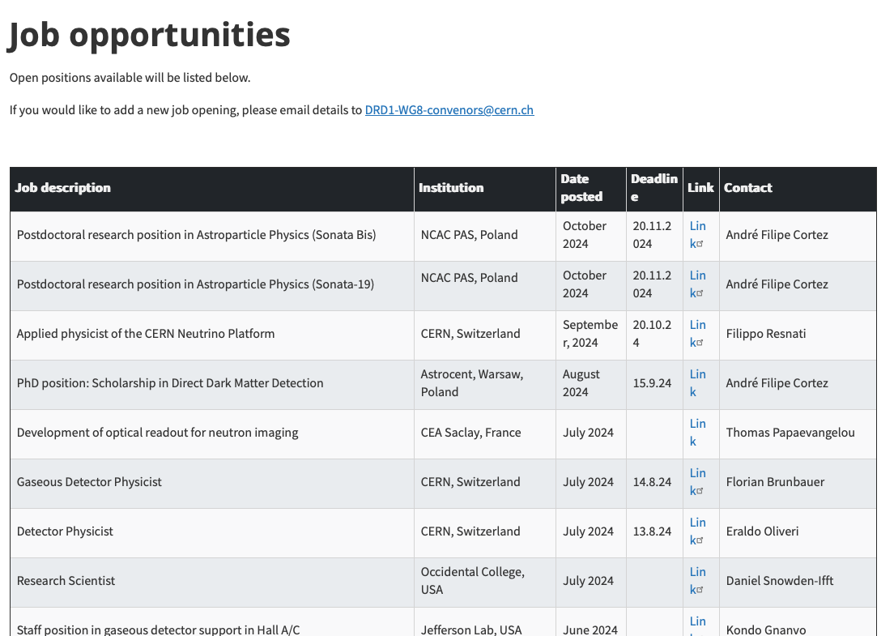
WG8: DRD1 Communication resources
DRD1 Bulletin
Regular newsletter containing announcements, upcoming events, communications from WGs, job opportunities, etc.
DRD1 Forum
https://drd1-forum.web.cern.ch
Exchange about common questions, used by multiple WGs e.g. for test beam preparation, simulation activities.
DRD1 Website
https://drd1.web.cern.ch
Updated lists of collaboration events, WG/WP descriptions and contacts, job opportunities in DRD1 institutes, training opportunities.
19

Slide 20
DRD1 Scientific Coordination Board
The SCB serves as a cross-coordination board within DRD1. It plays a pivotal role in overseeing the execution of DRD1's scientific programs as outlined by the CB:
Foster collaboration between DRD1
Working Groups (WG) and Work Packages (WP)
SCB Composition:
    Discussion of WG activities
  Overview of the program and people participating
  How the activities are organised
  Status of the activities
  Common objectives
  Synergies between WGs and WPs
    WP feedback to WGs
  How WPs see cooperation with different WGs
  Support the WPs expect from WGs
  What is the support the WP can provide to foster WG activities
Working Groups Coordinator
Work Packages Coordinator
WG Conveners
WP Leaders
WP Project Leaders
Spokespersons
Technical Coordinator and Deputy
Resource Coordinator
Linkpersons to the other DRDs
CB Chair/Deputy
MB/SCB secretary (tbd)
multiple SCB meeting every year
Marcello Abbrescia
RPC 2026
20

Slide 21
DRD1 Common Activities: 2025/26
Highlighted activities supported by available common resources in 2025
Common Developments
Gas and Material Studies | Gas and material properties studies. Eco-friendly mixtures. Outgassing and ageing studies.
Gas systems control and monitoring | Development of gas mixers, monitoring and calibration units for laboratory use.
Modelling and simulations | Training, measurements of gas parameters relevant for simulation (in synergy with WG3), access to computing hardware, services and software licenses
Electronics | Common developments on FE ASICs, DAQ and Instrumentation
Common Facilities
Detector Manufacturing and Workshop | Common equipment, test new manufacturing techniques, training and transfer to industry
Common Laboratory and Test Beam | Common Test Beams (semi-permanent installation at CERN/SPS), support for common test and characterization (in synergy with WG3) laboratories.
Common Projects
Blue-sky and Generic R&D | Project involving at least three DRD1 members in areas of common interest to the DRD1 community
Detector physics R&D
Novel Applications
Technology R&D
Industry Technology Transfer
Scientific Network
Collaboration Meetings and Topical Workshops | Three collaboration meetings per year, with one of them held outside CERN. Ad-hoc topical workshops extended to other communities.
Conferences and awards | Support to gas detector conferences and workshops.
Schools and training | DRD1 Gaseous Detector School, knowledge and training dissemination initiatives.
Marcello Abbrescia
RPC 2026
21

Slide 22
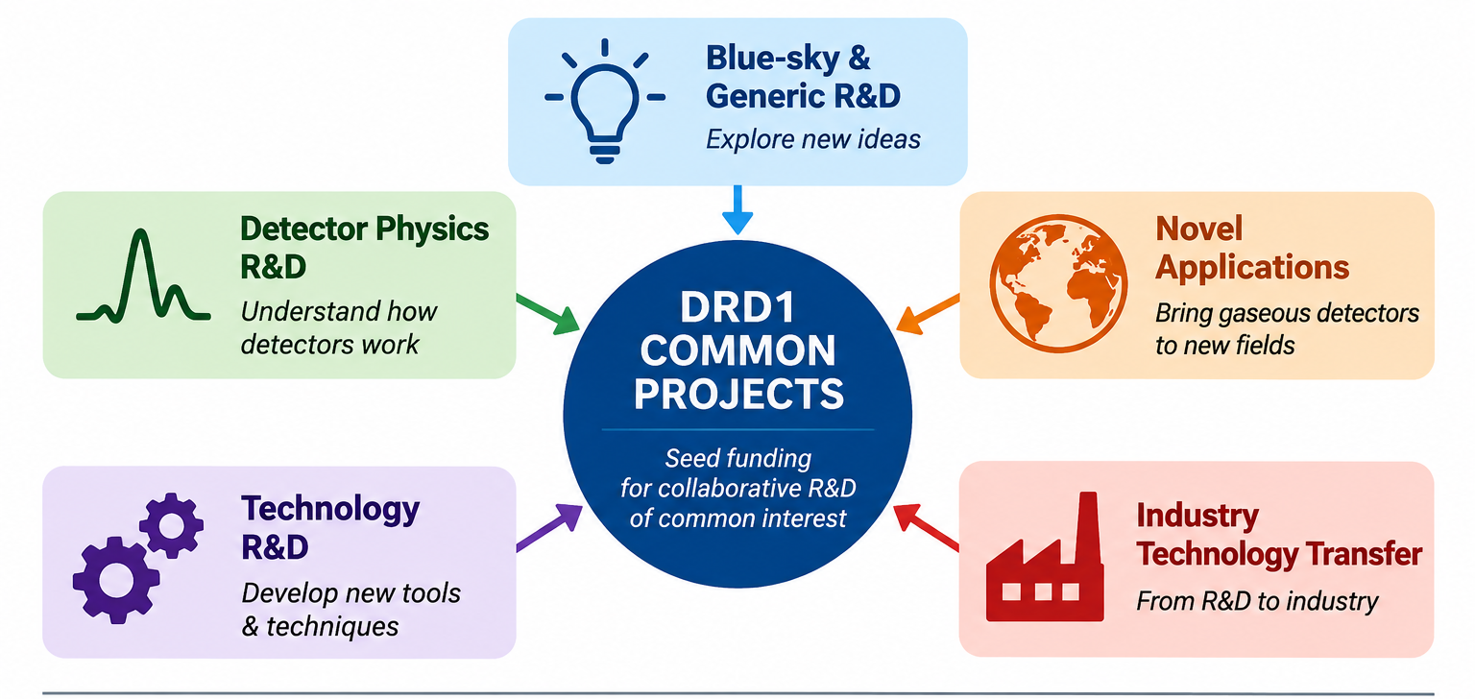
DRD1 common projects
The DRD1 Common Project Funding is designed to support project costs in areas of
shared interest within the DRD1 community, in five main fields.
The DRD1 Common Projects are not meant to cover R&D activities where other funding
schemes are better suited, such as:
- Strategic R&D (covered by the Work Package activities)
- Project-driven R&D (covered by the projects or experiments)
Marcello Abbrescia
RPC 2026
22

Slide 23
First DRD1 commond project funded
Prepreg (pre-impregnated composite fiber): The resin can include additives (e.g., carbon black, CNTs, graphene, or metal particles) to impart controlled electrical conductivity or static dissipation.
Marcello Abbrescia
RPC 2026
23

Slide 24

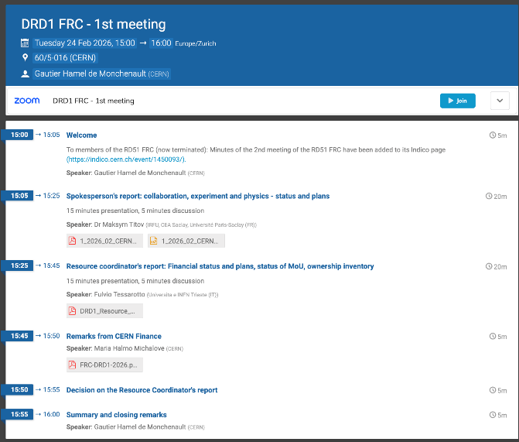
DRD1 collaboration meetings
Baseline: Three DRD1 Meetings per year
1st Collaboration Meeting (CERN), Jan. 29-Feb. 2, 2024: https://indico.cern.ch/event/1360282/
2nd Collaboration Meeting & Topical workshop of Electronics for Gaseous detectors (CERN), Jun. 17-21, 2024: https://indico.cern.ch/event/1413681/
3rd Collaboration Meeting (CERN), Dec. 9-13, 2024: https://indico.cern.ch/event/1442324/
4th Collaboration Meeting & Topical workshop on Detector Manufacturing and Production (CERN), Feb, 24-28, 2025, https://indico.cern.ch/event/1489983/
5th DRD1 Collaboration Meeting and Topical Workshop Towards Sustainable Gas Mixtures for Future Detectors (CERN), Jun. 16-28, 2025, https://indico.cern.ch/event/1543925/
^{7th} DRD1 Collaboration Meeting (CERN), Feb. 23-27, 2025, https://indico.cern.ch/event/1632132/
Marcello Abbrescia
RPC 2026
24

Slide 25
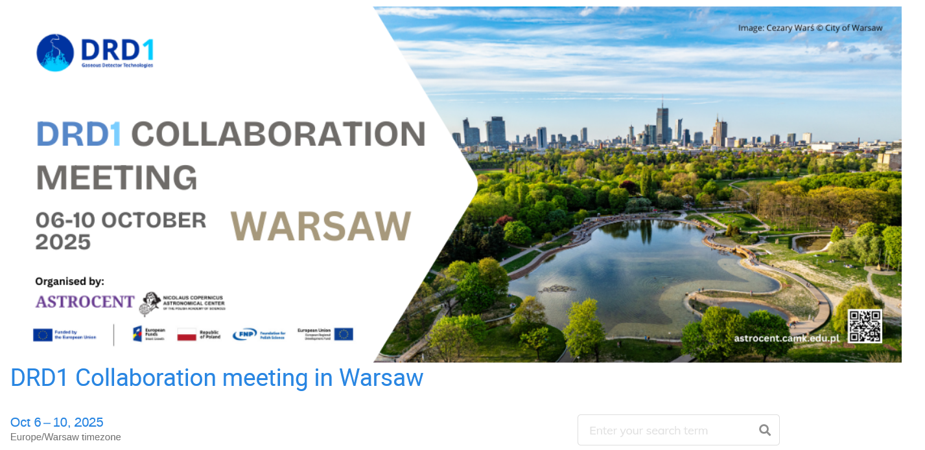
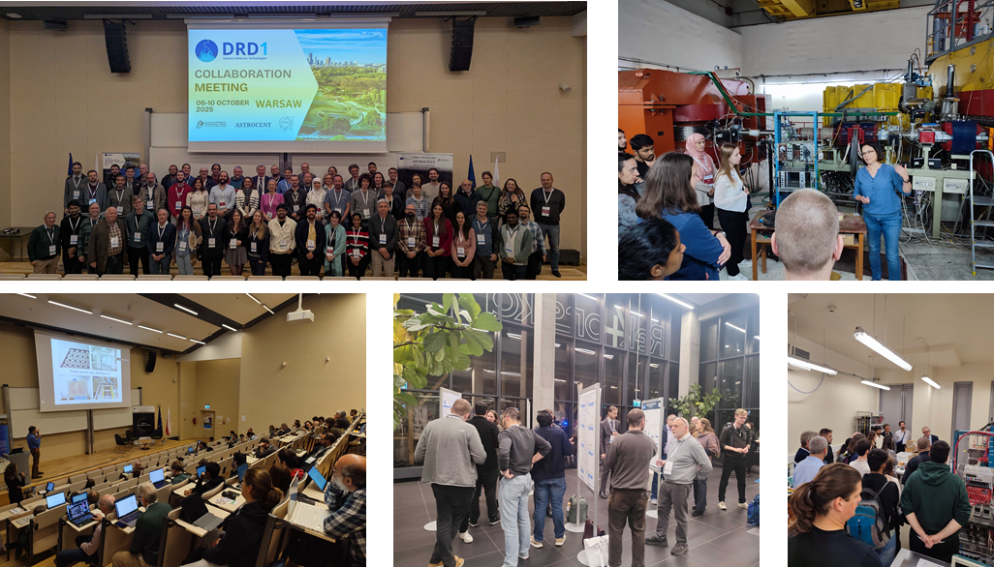
DRD1 collaboration meetings outside CERN
First DRD1 Collaboration Meeting outside of CERN:
Oct. 6-10, 2025: Astrocent & Nicolaus Copernicus Astronomical Center, Polish Academy of Sciences, Warsaw
One out of the three yearly collaboration meetings is outside CERN
Expanding DRD1 Scientific Network:
community of experts exchanging knowledge, providing critical peer review, inspiring each other, and sparking new collaborations, exploring new solutions or other ways
Support to DRD1 Local Institute:
https://events.camk.edu.pl/event/124/
Marcello Abbrescia
RPC 2026
25

Slide 26
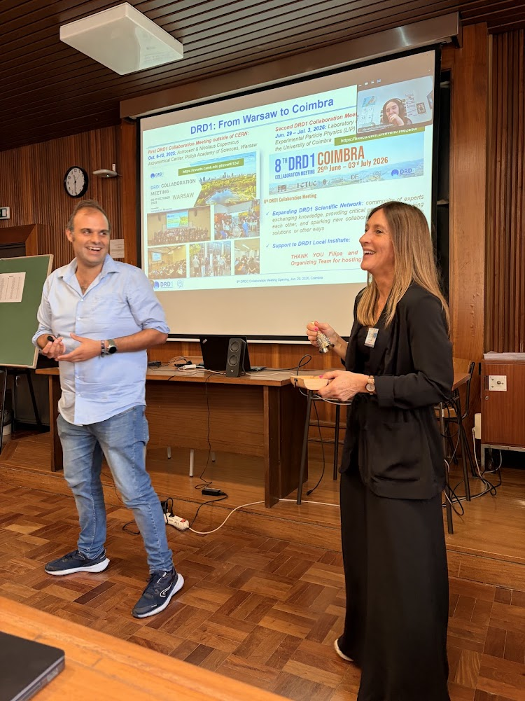

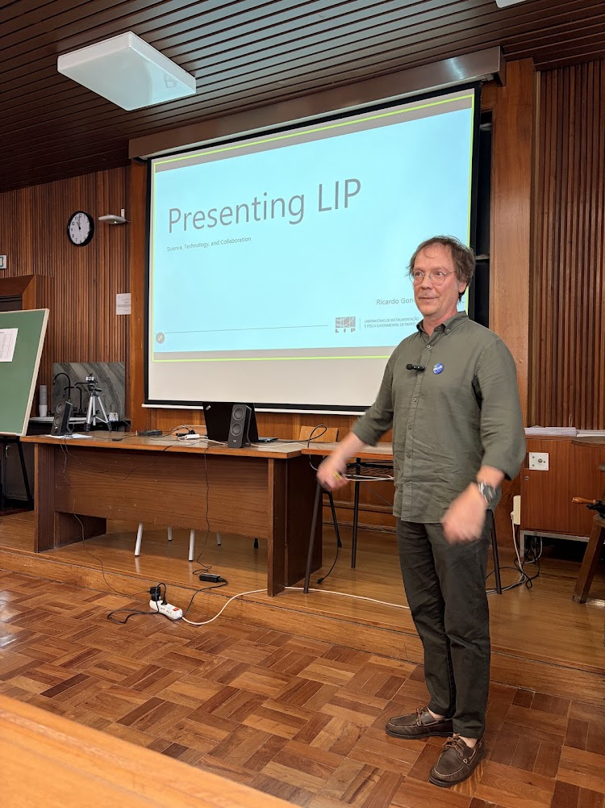
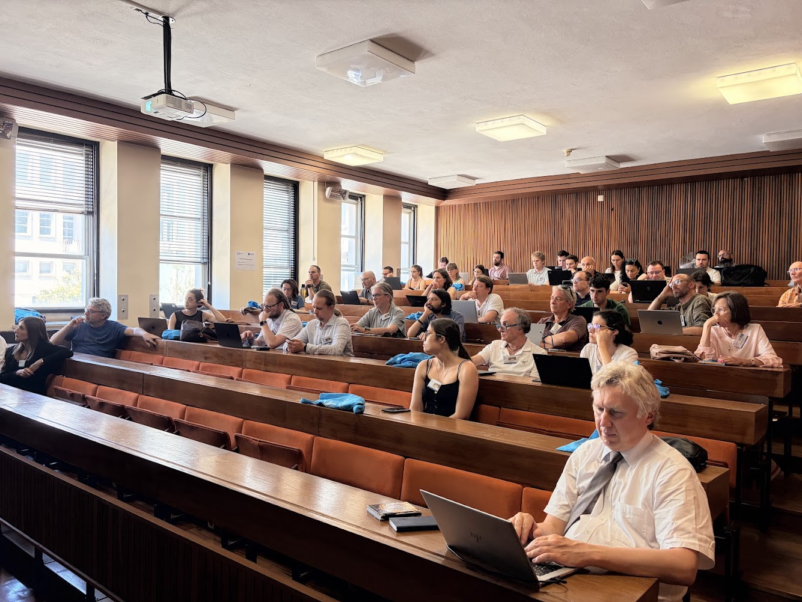
DRD1 collaboration meetings outside CERN
Second DRD1 Collaboration Meeting outside of CERN:
Jun. 29 – Jul. 3, 2026: Laboratory of Instrumentation and Experimental Particle Physics (LIP) and Physics Department of the University of Coimbra
https://indico.cern.ch/event/1662850/
165 partecipants
66 contributions
ALL sessions broadcast on ZOOM
LOTS of exciting scientific discussions
Marcello Abbrescia
RPC 2026
26

Slide 27
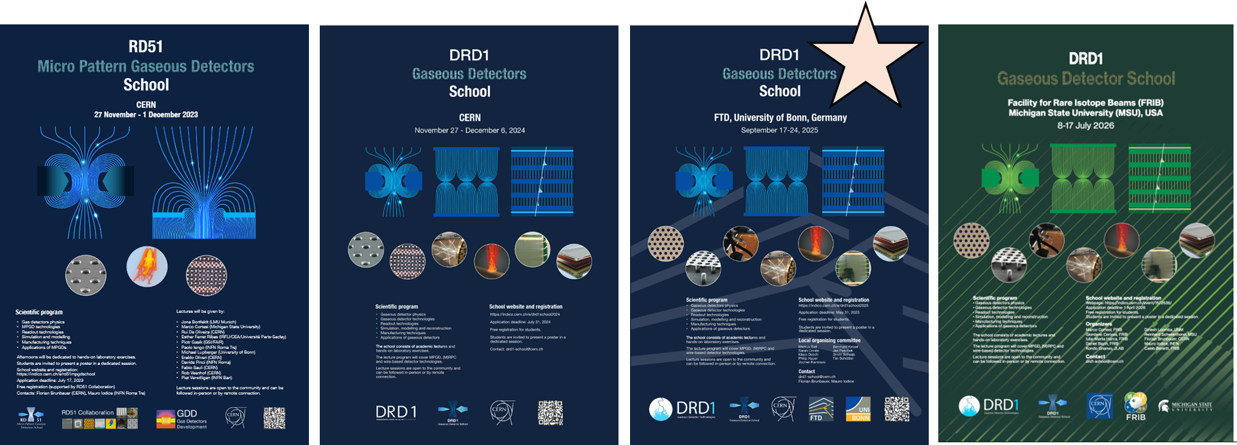
Fostering young researchers: DRD1 schools
Organized in the framework of the WG8 activities, with the help of local organizing committes:
2026: 3rd DRD1 School, FRIB facility, US, July 8-17:
https://indico.cern.ch/event/1572535/ → first DRD1 School in the US
2026: DRD1 Topical School “Gaseous Detector Simulation”,
Bari, Italy, May 18-22: https://indico.cern.ch/event/1606443/overview
2025: 2nd DRD1 School, FTD, Univ. Bonn, Germany, Sep. 17-24, 2025:
https://indico.cern.ch/event/1384298 → first DRD1 School outside CERN
2024: 1st DRD1 School, CERN, Nov. 27 – Dec. 6: https://indico.cern.ch/event/1384298
2023: RD51 MPGD School CERN, Nov. 27 – Dec. 1: https://indico.cern.ch/event/1239595
DRD1 goal was to move the schools outside CERN
Marcello Abbrescia
RPC 2026
27

Slide 28
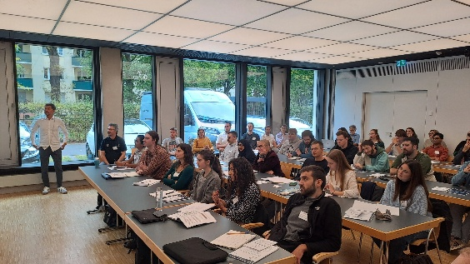
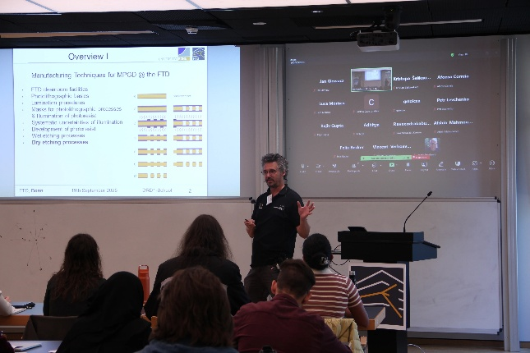
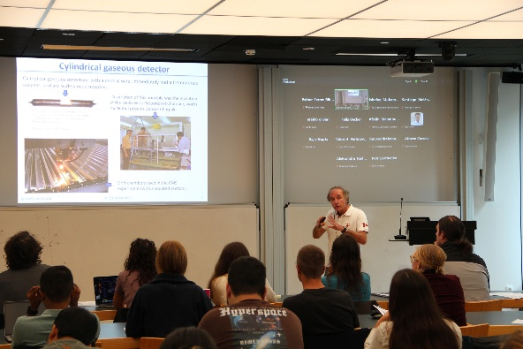
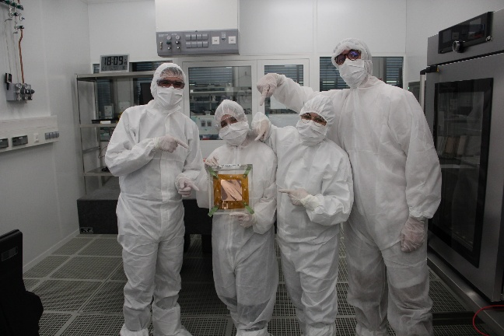
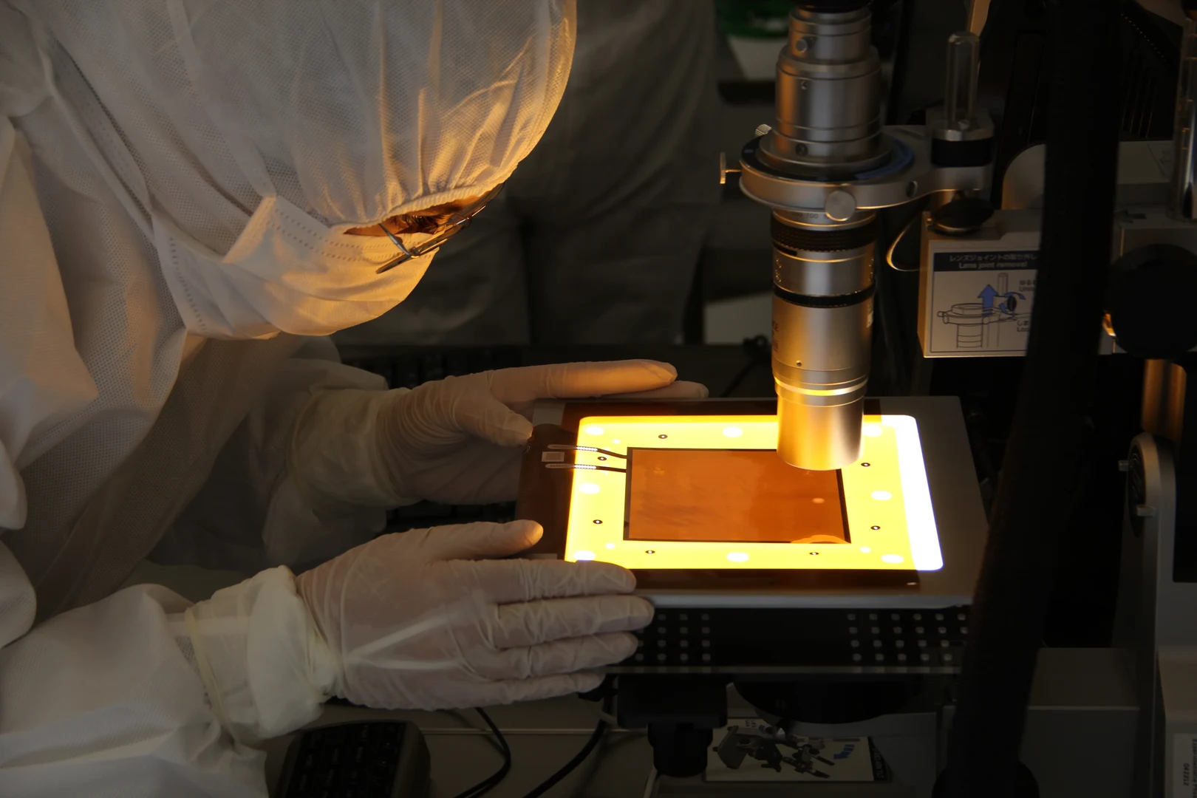
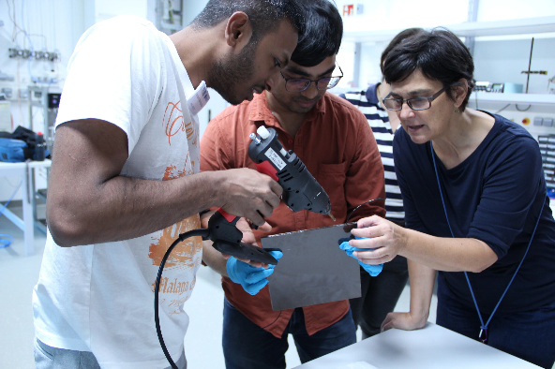
2025 DRD1 Detector school@FTD
DRD1 Detector Schools are structured in:
Morning lectures by world experts in the field offering an overview on gas detectors physics, technologies, simulation and modelling, readout approaches, manufacturing techniques and applications,
Hands-on exercises on various technologies in the afternoons, with an emphasis on methodologies.
The target audience are PhD students and young scientists working on gaseous detectors.
Marcello Abbrescia
RPC 2026
28

Slide 29
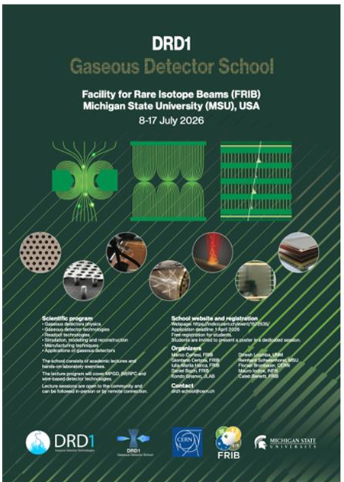
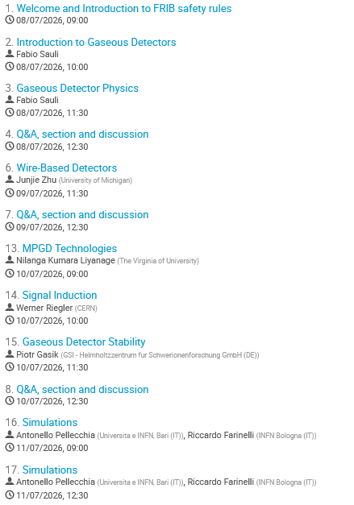
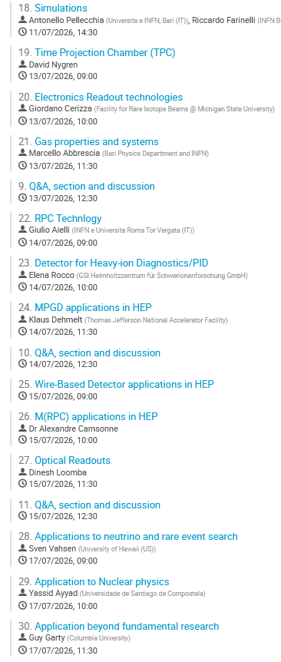
2026 DRD1 Detector school@FRIB
8–17 Jul 2026 https://indico.cern.ch/event/1572535/
Facility for Rare Isotope Beams (FRIB), Michigan State University (MSU)
Marcello Abbrescia
RPC 2026
29

Slide 30

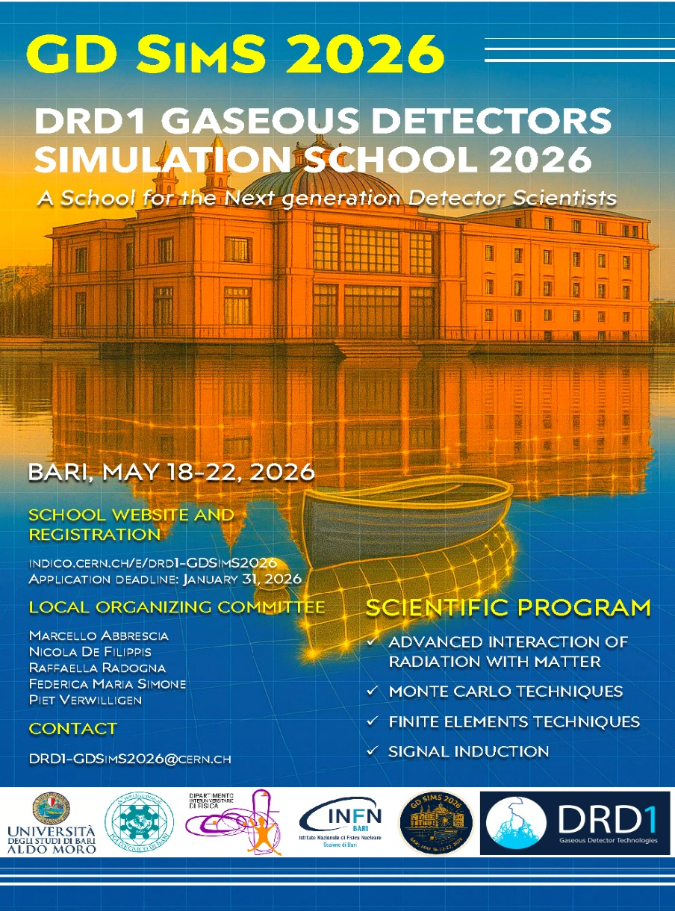
2026 DRD1 Simulation school
School focused on simulation of state-of-the-art gaseous detector technologies: MPGD, (M)RPC, TPC, Wire-based dets.
Provide understanding of fundamental principles underlying the simulation of GD
42 Students & Post-Docs who already followed the DRD1 Detector School
Lectures:
Physics Modelling & MC Methods
Interaction of Radiation w. Matter
Finite Element Method
Electron Transport in Gases
Signal Induction & Processing
Exercises:
Physics Modelling & MC Methods
Finite Element Method
LXCAT & Magboltz
Signal Induction
Full Detector Exercise with GARFIELD++
  MPGD, RPC, TPC, Wire detectors
Marcello Abbrescia
RPC 2026
30

Slide 31
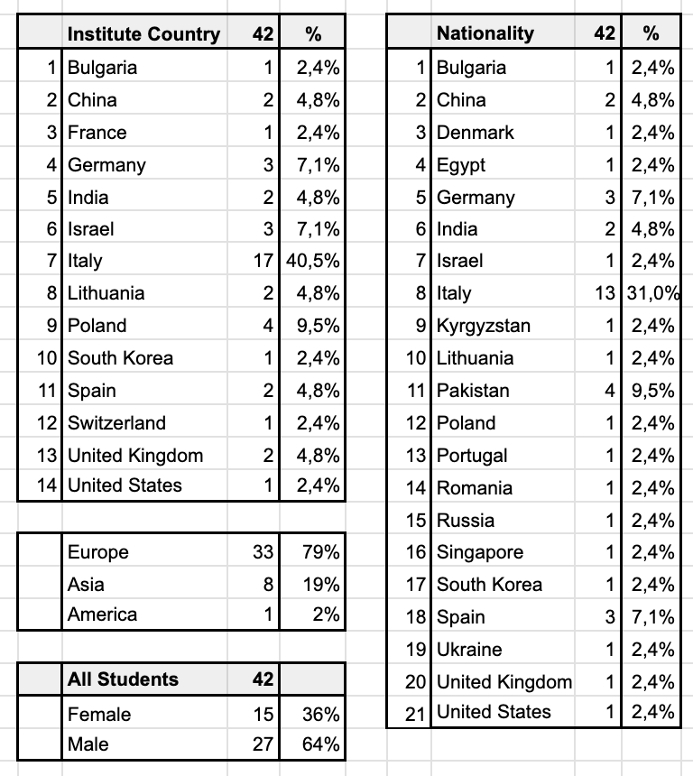
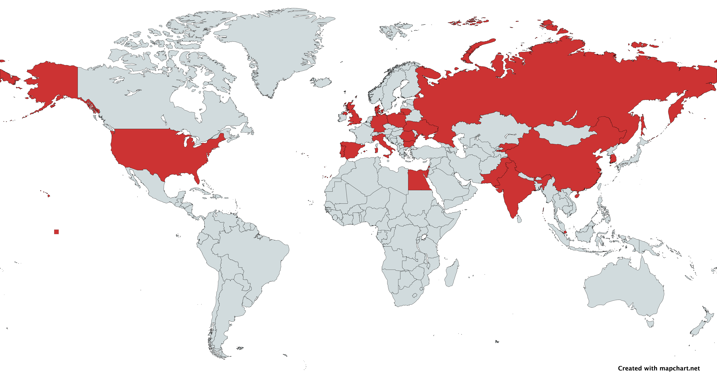
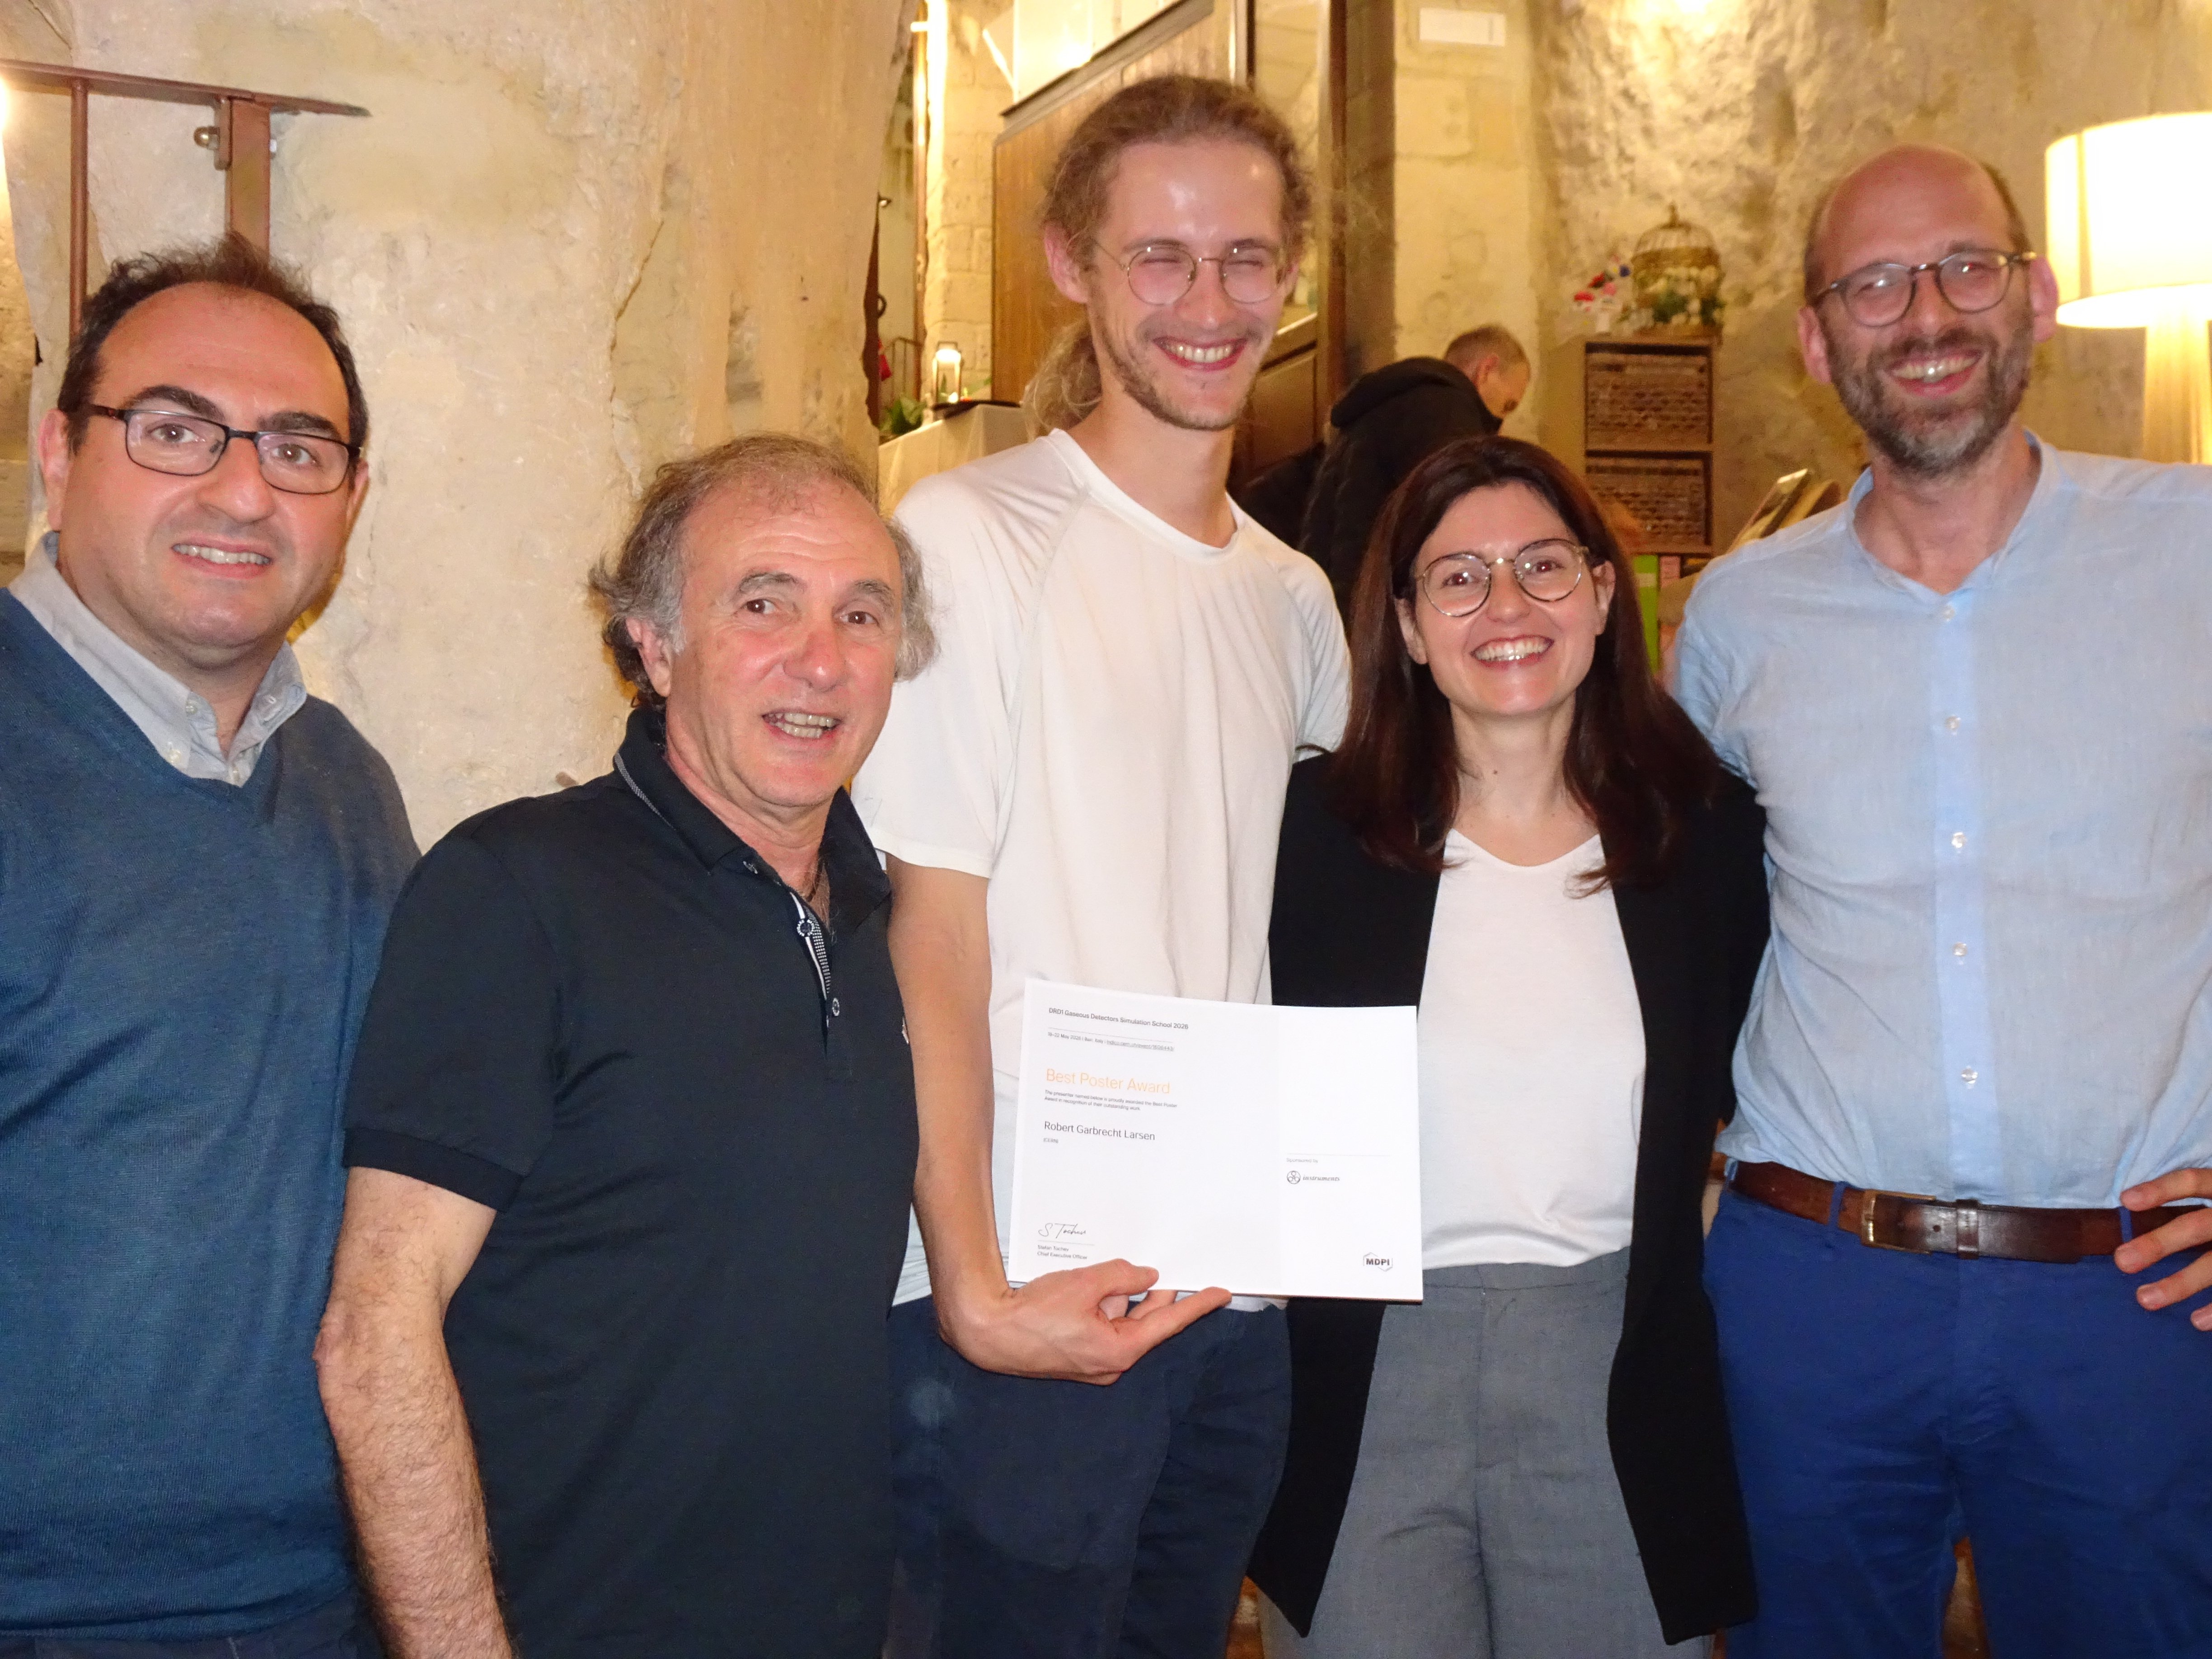
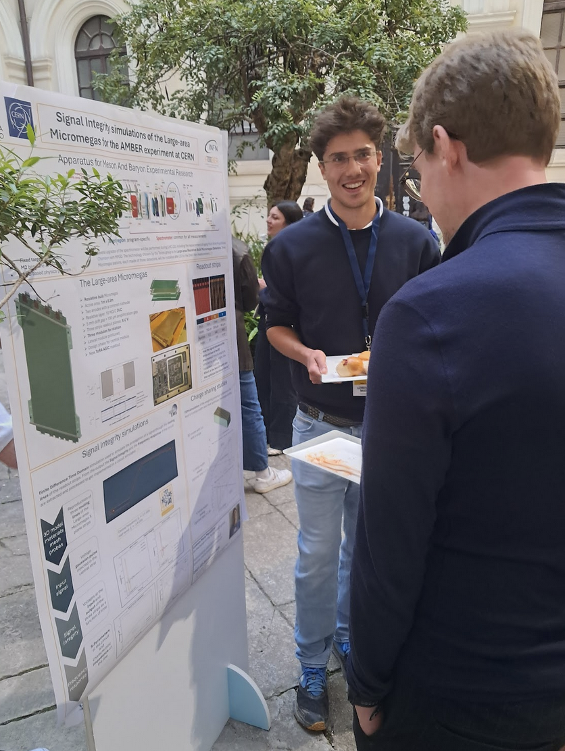
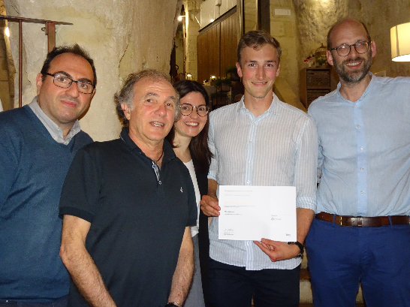

GDSimS2026: students
42 registrations – 36% women & 64% man – 60% EU 30% Asia
Best Poster Awards was published on the website of the journal "Instruments", by MDPI:
https://www.mdpi.com/journal/instruments/announcements/16681
Marcello Abbrescia
RPC 2026
31

Slide 32
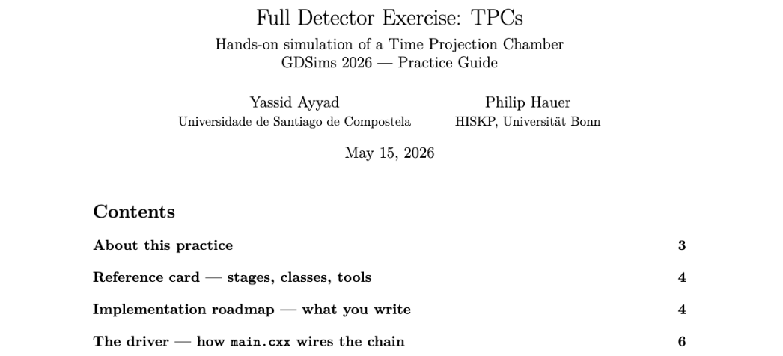
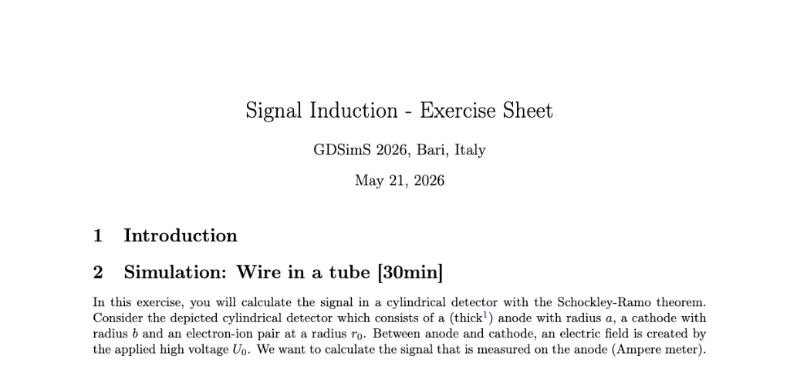
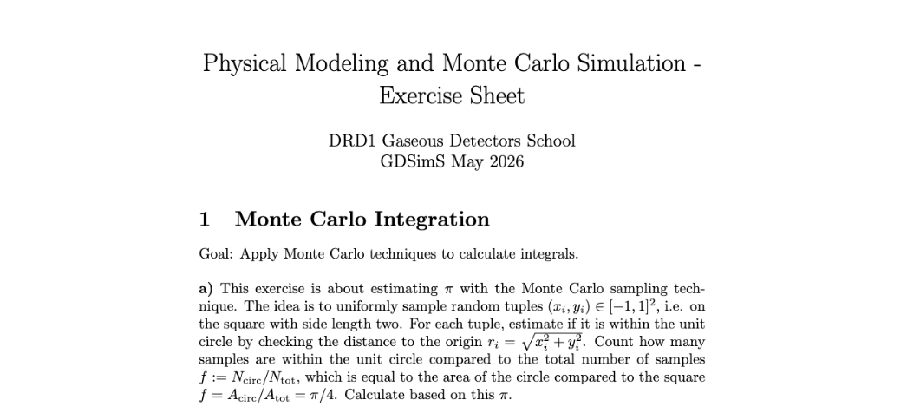
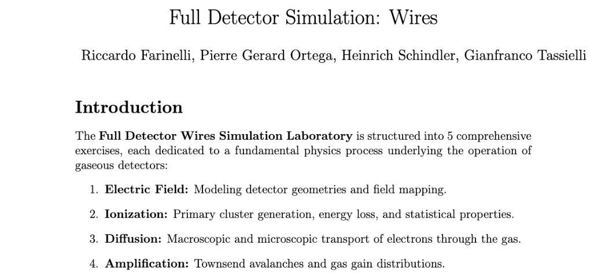
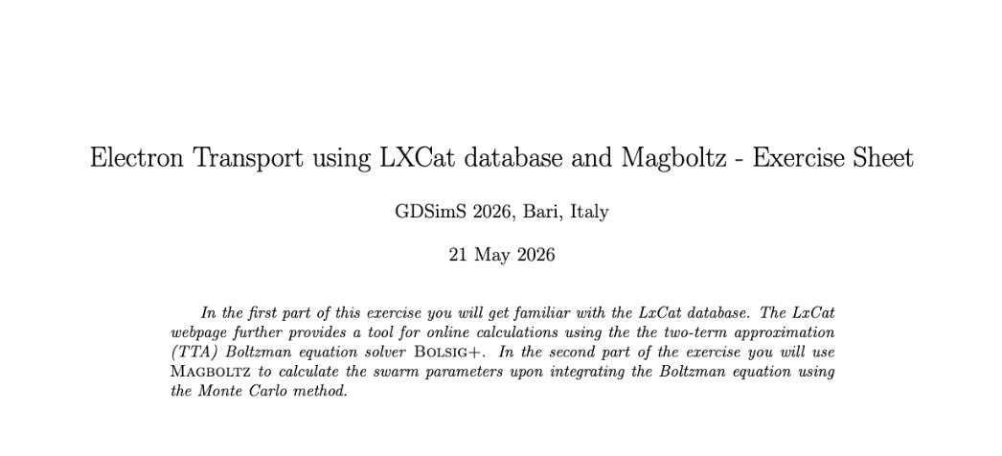
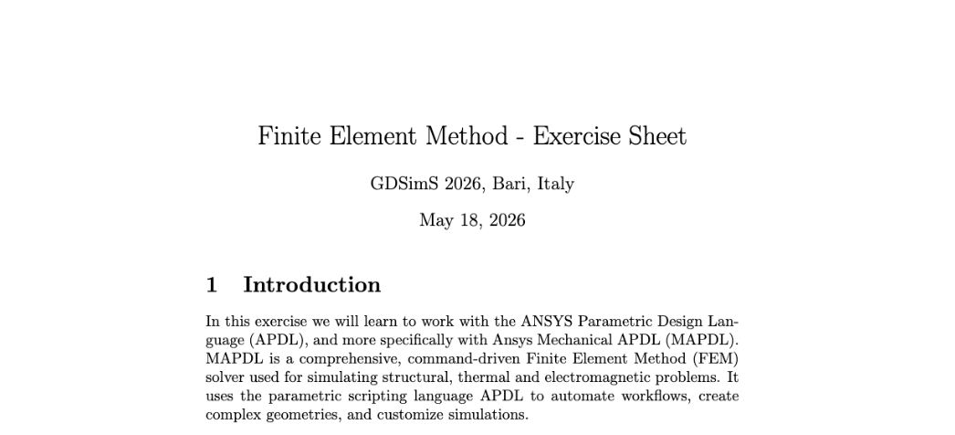
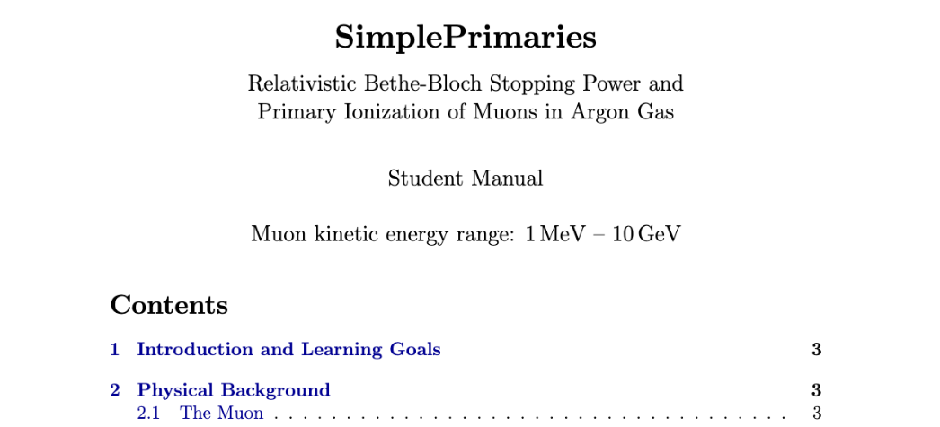



> 100 exercize sheets
https://indico.cern.ch/event/1606443
Marcello Abbrescia
RPC 2026
32

Slide 33





A collaborative effort: DRD1 spirit
Again: being one co-organizer of the school, I am bit biased on it!
Marcello Abbrescia
RPC 2026
33

Slide 34



DRD1 Awards 2026
This program aims to support, foster and provide larger visibility to R&D and “blue-sky” researchers in the field of gaseous detector for particle physics, and beyond. DRD1 is an equal opportunity community that values diversity and promote inclusion, and for these reasons we strongly encourage applications from underrepresented groups in the field.
PhD Thesis Award
For exceptional contributions to developments in the field of gaseous detectors. The PhD must have been completed within 2 years of the time of the closing of the call and have already been defended.
Early Career Scientist Award
For outstanding scientific developments in the field of gaseous detectors. The PhD of the nominee must have been completed within the last 7 years (excluding demonstrated career interruptions) at the time of the closing of the call
Exceptional Contributions to the DRD1 Collaboration Award
Selected based on contributions to DRD1 goals and missions, by the committee (not by nomination). There is no constraint on the career stage for this category.
Alexandra Kallitsopoulou
Natsuki Tomida
Alessandro Rocchi
Marcello Abbrescia
RPC 2026
34

Slide 35

Conclusions and outlook
Partecipation of Institutions to the DRD1 activities is:
an opportunity for the Institutions
a resource for DRD1
DRD1 does NOT prioritizes technologies:
The blue sky R&D of today can be the main stream of tomorrow
R&D on experiments at accelerators, for cosmic rays, and beyond
Maximum flexibility:
Institutes can contribute in the topic they prefer
Institutes are encouraged to actively contribute
There is no «strategic» direction on the single Institutes
Thank You!
Marcello Abbrescia
RPC 2026
35

