Slide 1
Detector Physics-Driven Concepts for Future RPC systems
G. Aielli and R. Cardarelli
University and INFN Roma Tor Vergata
Acknowledgments: The authors are indebt with the ATLAS RPC performance team (In particular S. Simsek, Z. Uysal and E. Ersoy), for the strong support and for making us preliminarily available very recent and yet unpublished results crucial to support this presentation.

Slide 2
RPC technology beyond the LHC era
Versatile and successful across the LHC era
POST-LHC EXPERIMENTAL HORIZON
New experiments are being studied in three main areas:
01
Later stages of the HL-LHC
RPC technology has demonstrated reliable performance in demanding large-scale experiments.
Extensions of the current experiments, including searches for long-lived particles.
02
Future colliders
Simple
WHY RPCs WORK
New detector concepts for FCC-ee and FCC-hh.
CONSTRUCTION
Robust
OPERATION
Low per unit area
Space-based experiments
03
COST
A new application domain for gaseous detectors.
High efficiency and very good timing
PERFORMANCE
THE NEXT CHALLENGE
Gaseous detectors, and RPCs in particular, must meet new requirements. For the first time, they will also compete directly with solid-state technologies already prominent in FCC proposals.

Slide 3
Muon-system features (1): physics → functions
Narrative: FCC-ee is primarily tracker-driven; outer-radius information becomes PID, background rejection and exotic-signature acceptance.
physics drivers
1
Precision EW
& Higgs
High-efficiency μ ID
ε×acceptance >98%; low fake rate
prompt isolated μ
Z/H recoil; BES
Punch-through veto
2
Heavy flavour
at Z pole
MUON
SYSTEM
π/K/p mis-ID as μ is the key figure of merit
soft μ inside jets
π/K decay rejection
LLP signature layer
3
BSM / LLP
far vertices, disappearing tracks, delayed decays
far vertices
delayed/slow particles
large radius × timing × hermeticity
Timing layer
4
Detector-level
reconstruction
ns-class for matching/BX; <100 ps when ToF drives PID
PF, tail catcher
cosmic rejection
Consequence: low occupancy relaxes rate constraints, but rare signatures make efficiency, fake rejection, timing and volume the real optimization axes.
Luca Moleri - 16/06/26 - DRD1 FCC-ee workshop
8

Slide 4
Muon-system features (2): detector-design consequences
TIME
SPACE
PURITY
VOL.
resolution
segmentation
rejection
coverage
BX / matching: 1–10 ns
LLP ToF: ≥200 ps, target 50 ps
1–5 mm for matching
0.1 mm bending coordinate
0.05 mm mechanical stability
ε×A > 98%
π/K/p punch-through + decay-in-flight rejection
maximize sensitive volume
hermeticity + PF/tail catcher
continuous DAQ or special trigger
Boundary conditions from FCC-ee running
triggerless / software event selection under study
rates are modest: chamber design driven more by physics than rate capability
integration matters: HCAL granularity, magnetic field, material budget, mechanics
Design question: choose the detector mix that preserves standard μ identification while adding timing and volume for LLP/exotic signatures.
Luca Moleri - 16/06/26 - DRD1 FCC-ee workshop
9

Slide 5
RPC design

Slide 6
RPC-specific design challenges
Efficiency
Gas mixture
TARGET
Maximize single-detector efficiency while exploiting the sensor and optimizing readout cost.
TARGET
Minimize cost, environmental, and detector impact while maintaining high performance.
LEVERS
Gaseous target · electron-avalanche physics · front-end electronics sensitivity.
LEVERS
Electron-avalanche physics · front-end electronics sensitivity.
Gas-mixture constraints · rate capability · longevity · time resolution.
COMPETING
REQUIREMENTS
Efficiency · longevity.
COMPETING
REQUIREMENTS
Time resolution
Low cost per unit area
Sub-nanosecond timing, down to <100 ps.
TARGET
TARGET
Build simple, low-cost modules larger than 1 m² while retaining the current advantage over competing technologies.
LEVERS
Gaseous-target segmentation · faster mixture · front-end electronics sensitivity.
LEVERS
Efficient design · gas mixture · front-end electronics sensitivity.
COMPETING
REQUIREMENTS
Single-gap efficiency · simplicity · robustness · low cost.
High time resolution and spatial resolution.
COMPETING
REQUIREMENTS

Slide 7
The gas-mixture challenge
1
Initial motivation — control ageing
Outcome versus the standard mixture
Adding CO₂ to the RPC gas mixture was first studied to moderate the ageing effects of HFO-based replacements for R134a.
The CO₂-rich mixture outperformed the standard mixture across the evaluated criteria:
2
Since 2022 — a pragmatic ATLAS programme [*]
✓
Strong reduction in ageing
ATLAS launched a long-term study to partially replace R134a with CO₂ and enable an immediate, practical transition.
✓
25% improvement in time resolution
✓
Lower global-warming potential and operating cost
3
2024–2026 — replacement of the standard mixture
✓
Same efficiency
64.5% R134a · 30% CO₂ · 5% i-C₄H₁₀ · 0.5% SF₆
✓
Lower operating voltage
WHY NOT FROM THE START?
OPEN QUESTION
The standard mixture was performing well, so there was no immediate pressure to change.
How far can this substitution path go?
[*] See on Sinem’s slides in this conference

Slide 8
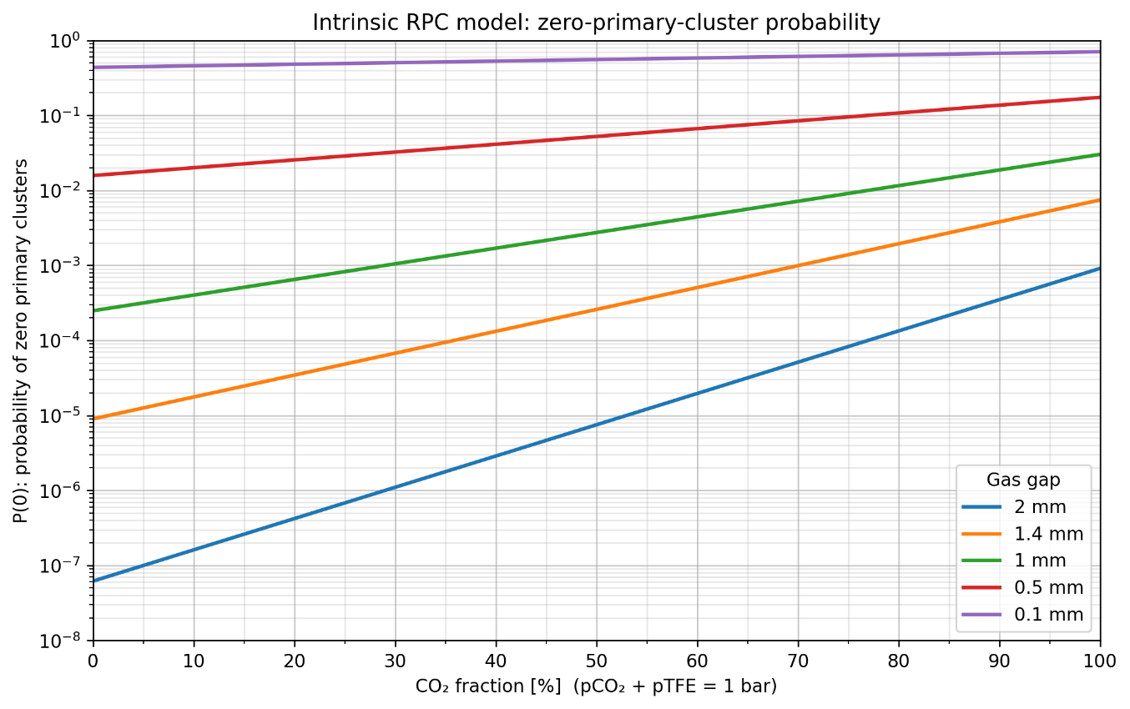
Primary Poisson probability and the useful gas gap
The total gaseous target sets P(0); only ionizations inside the useful region can generate a detectable avalanche.
PRIMARY-CLUSTER POISSON LIMIT
USEFUL GAP
Useful gap
gas gap
Useful gap
gas gap
The useful gap is empirical: it is the region where an ionization can develop into an avalanche large enough to be detected.
P(0) depends mainly on the total gaseous target: the gap thickness and the mixture density.
Consequence: Poisson P(0) is smaller than the observed inefficiency because not every primary ionization lies inside the useful gap.

Slide 9
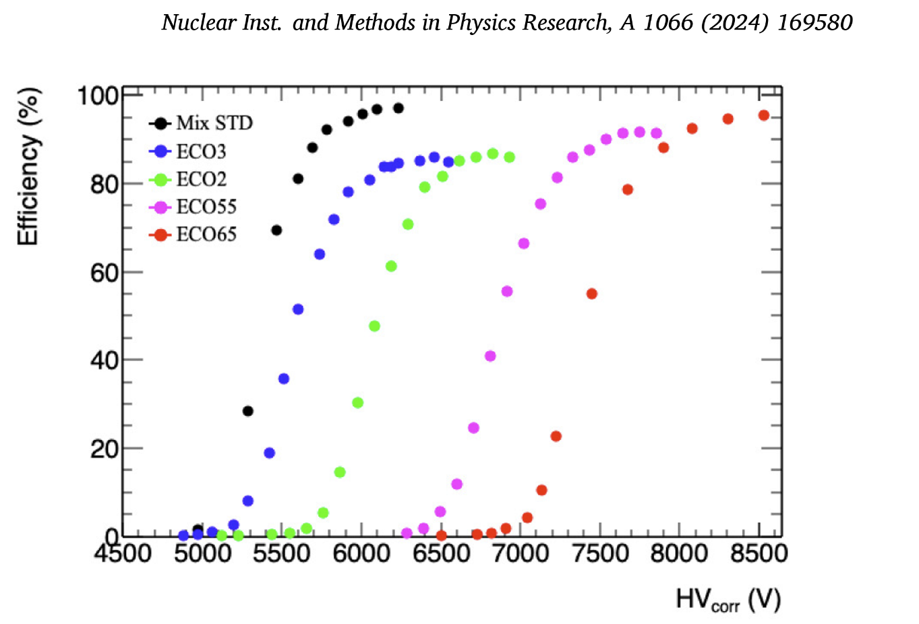
Maximum efficiency measurements
1 mm gas gap (BIS7 test 2021)
2 mm gas gap (test 2025-26)
DOI:10.5281/zenodo.22809853
preliminary

Slide 10
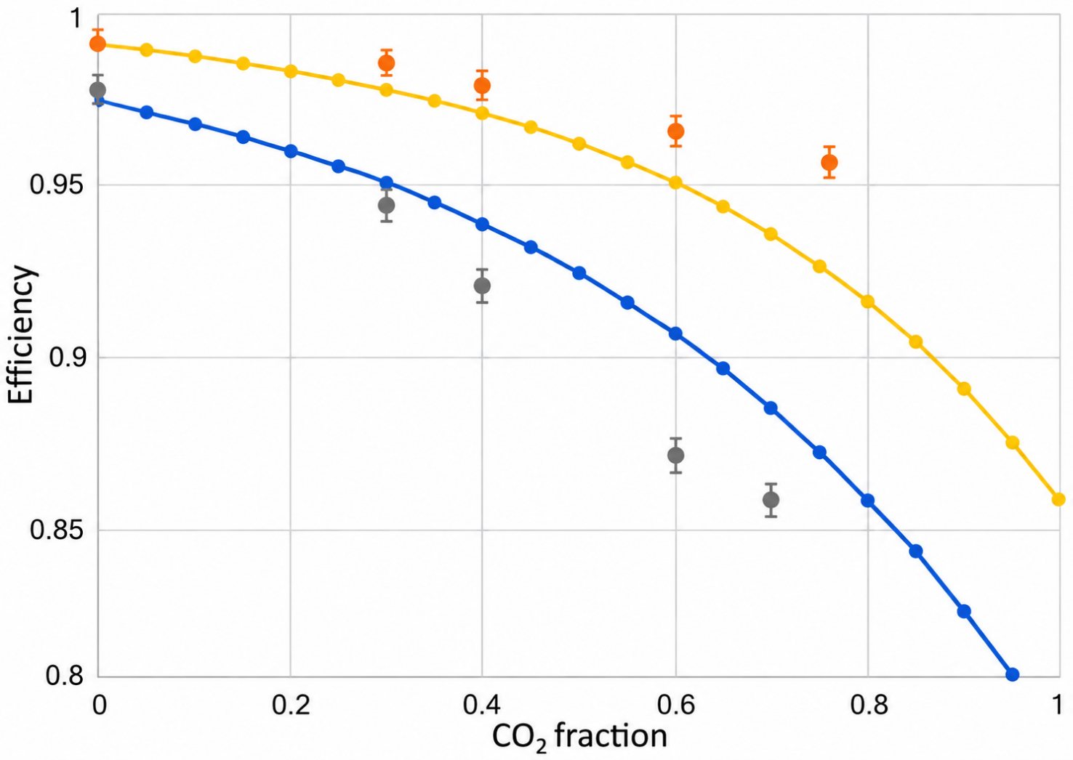
Effective maximum efficiency and constrained Poisson
1. Effective maximum efficiency
An empirical working value rather than a rigorous limit. Efficiency may still increase with HV, but at increasing operating cost.
2. Constrained Poisson prediction
The Poisson maximum from primary-cluster statistics versus gas composition, normalized to the Standard-mixture measured efficiency and assuming 100% acceptance.
3. Direct comparison
The Poisson curve follows the decrease approximately, but shows a growing quantitative difference and a different functional shape.
Equation placeholder: constrained Poisson normalization
Takeaway: the primary Poisson constraint is a baseline; detector-dependent response is required to describe the measured effective plateau.

Slide 11
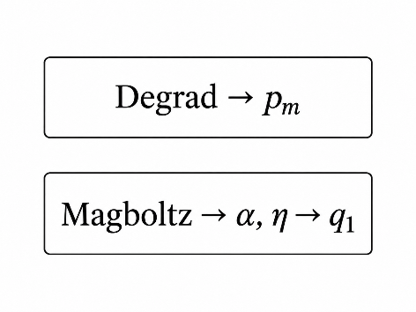
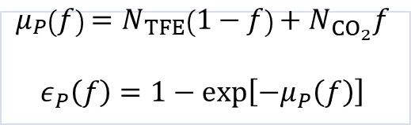
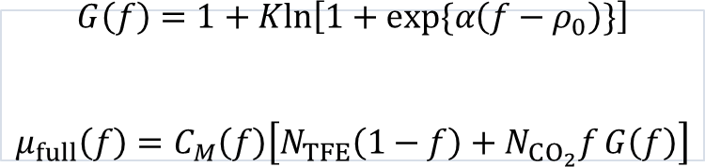
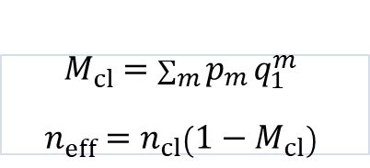
Model structure used
Primary clusters
Cluster mortality
Surviving clusters
Effective response
nclus before extinction
lineage extinction
effective nclus
logistic closure
$$μ_{P}\left(f\right)=N_{TFE}\left(1−f\right)+N_{CO_{2}}f$$
$$ε_{P}\left(f\right)=1−exp\left[−μ_{P}\left(f\right)\right]$$
$M_{cl}=\sum_{m}^{​}{p_{m}}q_{1}^{m}$
$$n_{eff}=n_{cl}\left(1−M_{cl}\right)$$
$$G\left(f\right)=1+Kln​\left[1+exp\{α\left(f−ρ_{0}\right)\}\right]$$
$$μ_{full}\left(f\right)=C_{M}\left(f\right)\left[N_{TFE}\left(1−f\right)+N_{CO_{2}}f G\left(f\right)\right]$$
Interpretive rule
Current simplification
Attachment-induced complete cluster extinction is kept separate from the detector-dependent effective useful response.
Thinning / RQ constrains charge cost and working point; it is not used as a direct plateau-loss term in this closure.

Slide 12
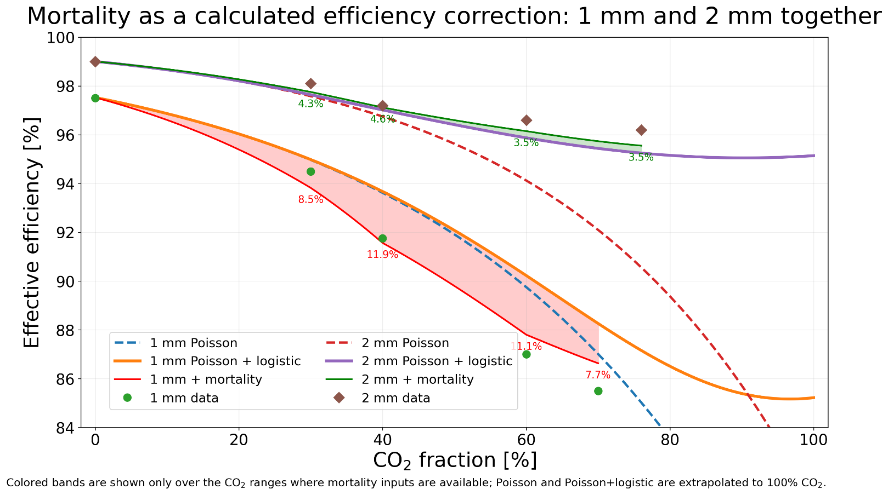
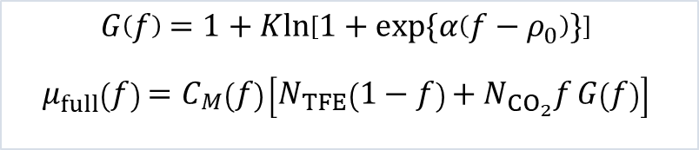
Realistic efficiency model
1. Common ionization constraint
nclus for TFE is imposed for the STD mixture, we dont have a strong constraint for the CO2 nclus.
he same CO₂/TFE primary-ionization ratio as the 2 mm case.
2. Mortality fills most of the gap
Relative to the STD point, the HFO/SF₆ mixtures have much larger cluster extinction: Mcl rises from about 1.7% to roughly 8.5–12%.
3. Logistic term is residual
After mortality is applied to nclus, the calibrated logistic response only absorbs the remaining effective-response evolution.
$$G\left(f\right)=1+Kln​\left[1+exp\{α\left(f−ρ_{0}\right)\}\right]$$
$$μ_{full}\left(f\right)=C_{M}\left(f\right)\left[N_{TFE}\left(1−f\right)+N_{CO_{2}}f G\left(f\right)\right]$$
The cluster mortality plays an important role, especially for the 1mm gas gap and for very electronegative gases such as HFO
No error bars shown for 1 mm points, as requested. Logistic fit is regularized to avoid an artificial elbow.

Slide 13
Front-end electronics sensitivity test
TEST CONFIGURATION
Chamber: ATLAS-like layout [*]
Geometry: 2 mm gas-gap doublet with one test chamber and one monitoring chamber
Test readout: vertical strips equipped with ATLAS electronics
Reference readout: horizontal strips equipped with a high-sensitivity analog preamplifier, the baseline for the Phase-1 and Phase-2 upgrades
GIF++ EXPOSURE AND MEASUREMENTS
Beam and source exposure
Efficiency under irradiation
V–A curve
EXAMPLE GAS MIXTURE
0% R134a 88% CO₂ 10% i-C₄H₁₀ 2% R1233zd
Flammable and freon-free. Example only, not (yet) an official proposal.
OBJECTIVE Compare the two amplifiers event by event on the same avalanche signal.
Both electronics record each avalanche simultaneously.
[*] INSPIRE-HEP 2955768

Slide 14
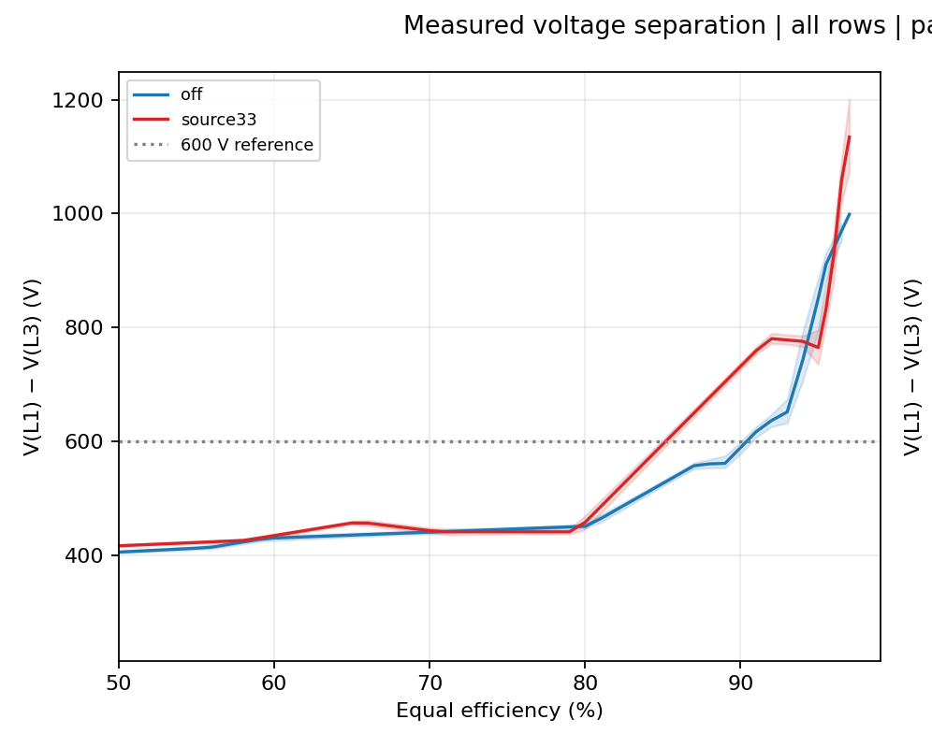
Voltage separation new vs. standard FE
Preliminary
DOI:10.5281/zenodo.22809853
800 V
We observe that
this freon free mixture, is unsuitable for a standard ATLAS chamber working at Efficiency > 90%
The sensitivity of the new electronics allows to catch very small signals lowering by more of 600V the working point → the mixture becomes fully workable in saturated avalanche regime

Slide 15
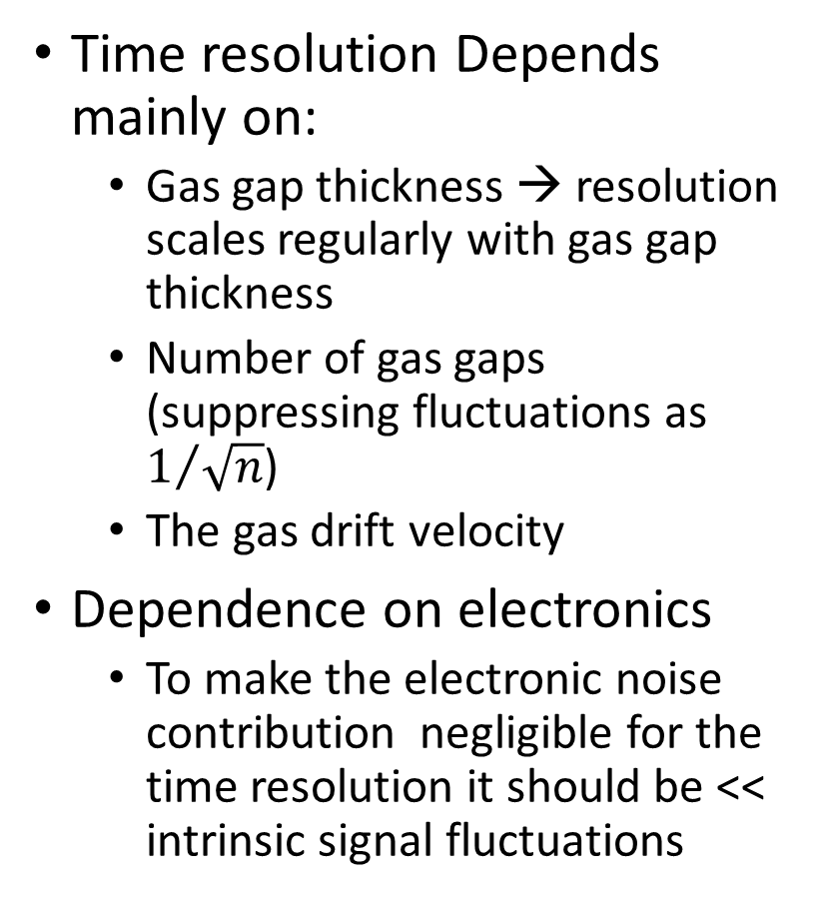
RPC design – time resolution
Time resolution taken for single gas gap and scaled for the number of gas gaps
The yellow line il for total gas gap = 2 mm
Time resolution Depends mainly on:
  Gas gap thickness → resolution scales regularly with gas gap thickness
  Number of gas gaps (suppressing fluctuations as $1/{\sqrt{n}}$)
  The gas drift velocity
Dependence on electronics
  To make the electronic noise contribution negligible for the time resolution it should be << intrinsic signal fluctuations

Slide 16
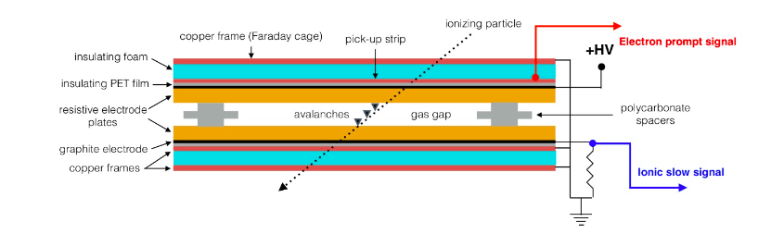
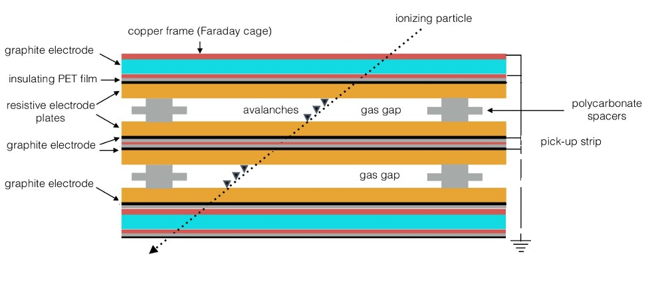
Detector design from performance targets
FIXED DESIGN TARGETS
1
Target efficiency
99%
2
CO₂ fraction
> 90%
3
Gas thickness required per efficient unit
2 mm
TIME RESOLUTION SETS THE GAP ARCHITECTURE
TARGET | GAP LAYOUT | ASSESSMENT
1 ns | Single 2 mm gap | Simple, robust and low cost
400 ps | 1.4 + 1.4 mm bi-gap | CMS Phase-2 geometry Resolution to be verified
200 ps | 1 + 1 mm bi-gap | ATLAS Phase-2 geometry Resolution to be verified
80 ps | 2 × (0.5 + 0.5 mm) bi-gaps | Critical Dedicated R&D required Scaling to be verified

Slide 17
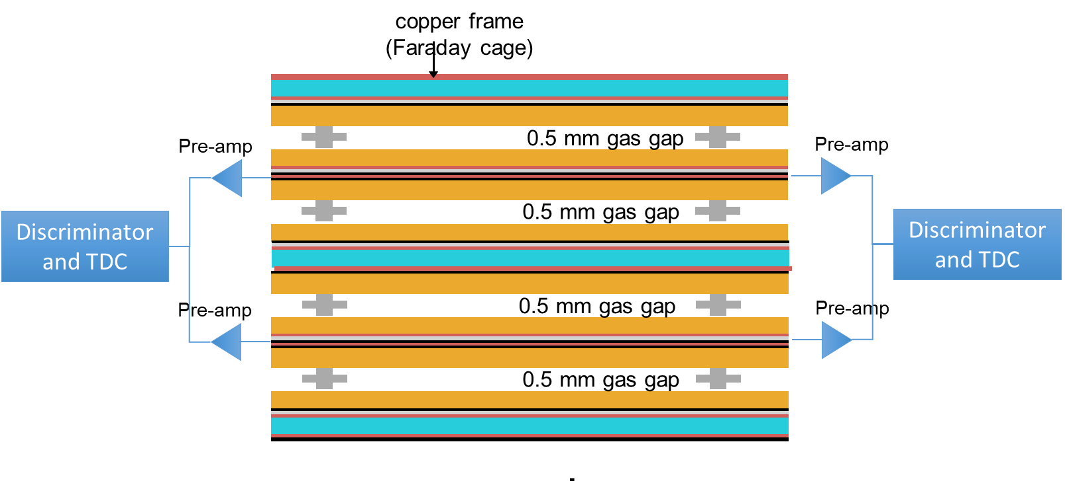
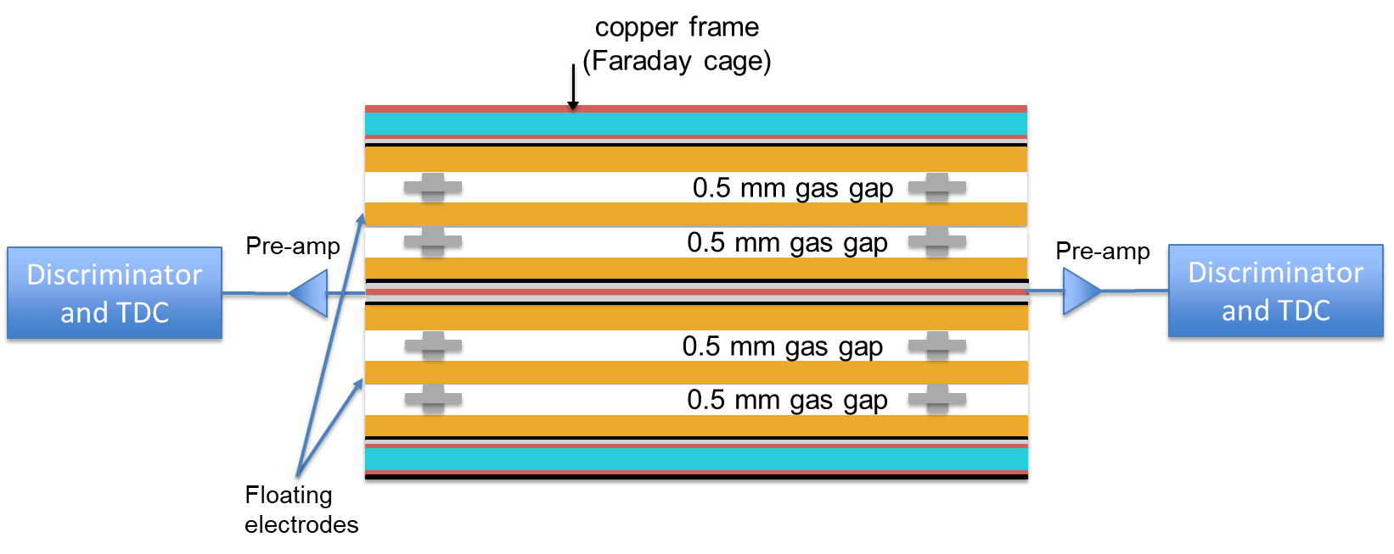
Multiple-gap detector layout options
OPTION 1
Four individual gaps in two double-gaps
Readout: at the center of each double-gap
Signal chain: preamplifiers at both strip ends. A wired-OR combines the two double-gaps before the discriminator and TDC
Advantage: simpler chamber construction with no floating electrodes
Trade-off: greater complexity in the front-end electronics
OPTION 2
Two bi-gaps in a double-gap configuration
Readout: at the center of the double-gap
Signal chain: preamplifier and digital stage integrated at both ends of each readout strip
Advantage: simpler interface to the front-end electronics
Trade-off: more delicate chamber construction with floating electrodes
In both cases the second coordinate is obtained from time difference

Slide 18
If this is not enough...
innovative proposals: SHARP and RCC
SHARP: A Schottky-enhanced Hybrid Avalanche Resistive Photodetector for ps timing and high-rate large-area detection
RCC: Resistive cylindrical chamber

Slide 19
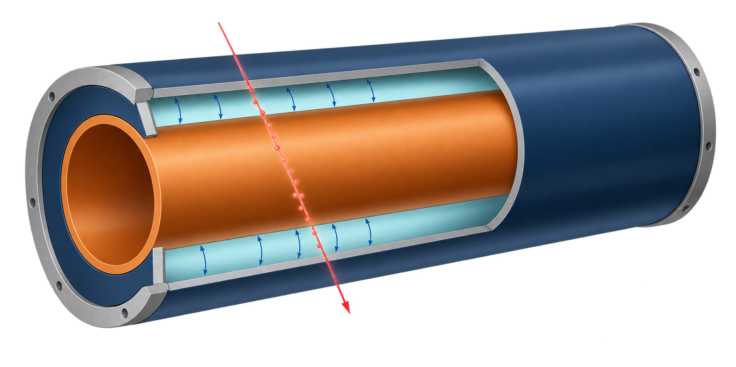
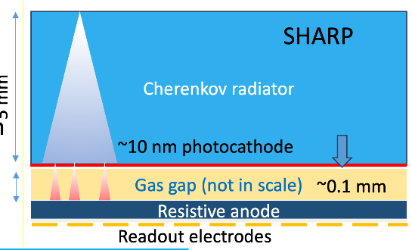
RCC and SHARP as alternatives to complex RPCs
For FCC, both concepts become relevant when timing, rate or integration requirements make the RPC architecture too elaborate.
WHY CONSIDER THEM
Preserve gaseous-detector scalability while changing one fundamental lever: RCC reshapes the field geometry, SHARP separates signal creation from charge amplification.
RCC
Resistive Cylindrical Chamber
SHARP
Schottky-enhanced Hybrid Avalanche Resistive Photodetector
Coaxial resistive electrodes with a thin radial gas gap
Photocathode conversion followed by RPC-like microgap gain
FEATURES
Coaxial resistive electrodes, thin annular gap, radial nonuniform field. Can be pressurized
FEATURES
Cherenkov radiator, nanometric photocathode, about 0.1 mm gas gap, resistive anode.
PROS
• New freedom for field shaping
• Compact cylindrical integration with resistive discharge protection
Ideal for space applications
Can work without fluorinated gases
PROS
• Targets <50 ps timing and high rate over large areas
• May avoid multigap stacks and reduce charge fluctuations
Intrinsically fluorinated gas free
CONS
• Photocathode lifetime and uniformity are critical
• Surface control and very low noise electronics are demanding
CONS
• Polarity-dependent response and nonuniform field
• Readout, mechanics and scalability remain open
SELECTION LOGIC
RCC changes the field geometry. SHARP changes how the first electron is produced. Both are justified when a conventional RPC loses its main advantage: simplicity.
Notes:
Sources: RCC description adapted from M. Abbrescia et al., ‘A standalone simulation program for resistive cylindrical chamber (RCC)’, European Physical Journal C 86, 351 (2026), https://doi.org/10.1140/epjc/s10052-026-15576-5. SHARP schematic and concept adapted from G. Aielli, ‘Initial design of a fast hybrid photodetector’, RPC 2024, and the supplied deck ‘EOI su RPC in FCC’. SHARP performance values are R&D targets, not demonstrated detector results. The RCC cutaway is a conceptual illustration based on the coaxial geometry described in the cited source.

Slide 20
Conclusion and EOI proposal
Basing on the analysis above we are convinced that RPC can play a crucial role in the far future
It would be appropriate to propose in any of the FCC muon systems such a modular detector based on these elements
CMS proposal based on 0.5 mm bi-gaps foresees to use floating glass electrodes our proposal is based on referenced HPL electrodes. But this is a technical detail so our EOI can reinforce and generalize CMS one.
The R&D has as a target to demonstrate the system scalability:
  Studying the gas gap configurations
  Defining the gas candidates
  Electronics and faraday cage integration
RPC based proposals are very few at the moment and this should change

Slide 21
backup

Slide 22
State of the art R&D and EOI
State of the art
  This concept has been applied in PICOSEC based on a MMGAS
  The concept is good but MMGAS have a strong constraint of Gain
  The proof of principle is achieved by the PICOSEC studies
  RPCs have a free gain and this concept can work much better on the same proof of principle
R&D proposal
  Basing on the Proof of principle studies we can aim directly at a reduced number of prototypes:
    DLC cathode
    Zr cathode
  Scope: demonstrate the scalability of the principle, substantially impossible with PICOSEC but possible with SHARP
  Request 5000 Euro for a reduced set of prototypes 10x10 cm 5mm quartz plates finished with a nanometric coating of photocathode. The anode can be glas or HPL as for a normal RPC
EOI
  This detector, if prooven can feature 20 ps, 100 kHz/cm^2 and since it is based on a rigid quarts plate it han reach a very good mechanical precision, providing the bending coordinate at 0.1 mm level amd becoming a stand alone self triggering muon technology
  Given its features it can support particle flow calorimetry and provide excellent ToF features in the calorimeter too, providing the function of timing wrap as well.
We have until 2028 to provide a clear demonstration of scalable performance

Slide 23
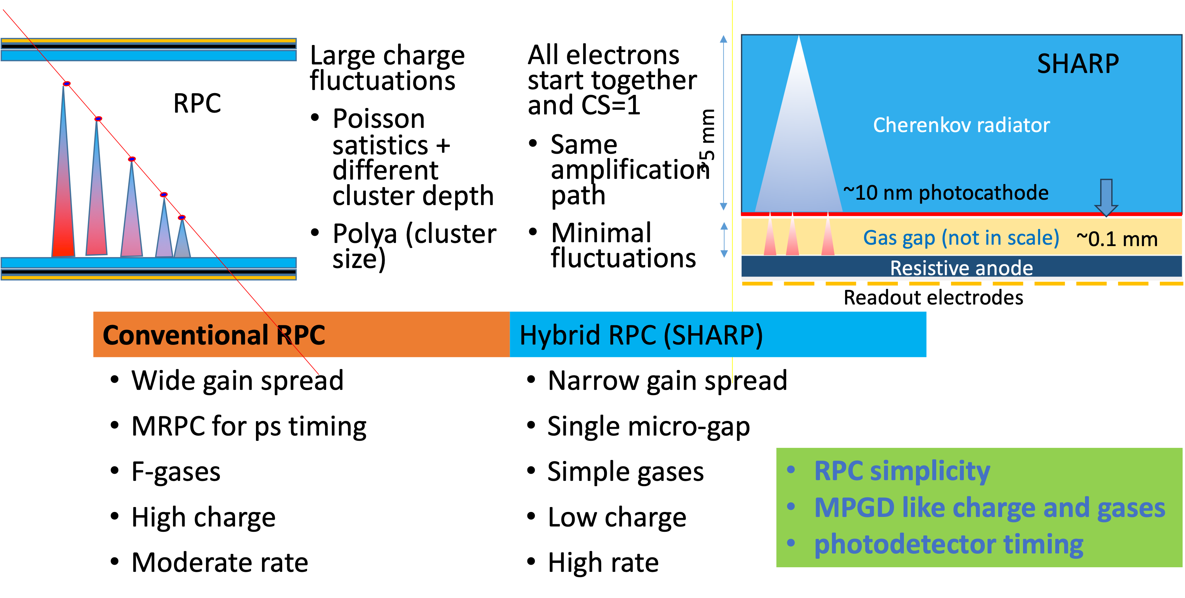
Hybrid RPC: suppress the charge fluctuations

Slide 24
Effective maximum efficiency vs. Poisson
effective maximum efficiency VS. constrained Poisson prediction
The effective maximum efficiency is not a rigorous definition since in principle the efficiency still can increase HV, but with increasing cost function which sets an effective value.
The constrained Poisson function is the maximum efficiency predicted by the Poisson primary cluster statistics, as a function of the gas composition, but constraining the effective number of clusters to the Standard mixture measured efficiency, assuming 100% acceptance.
A direct comparison shows that the Poisson function approximately follows the data for increasing fraction of CO2
  Quantitatively diverging
  Different functional shape

Slide 25
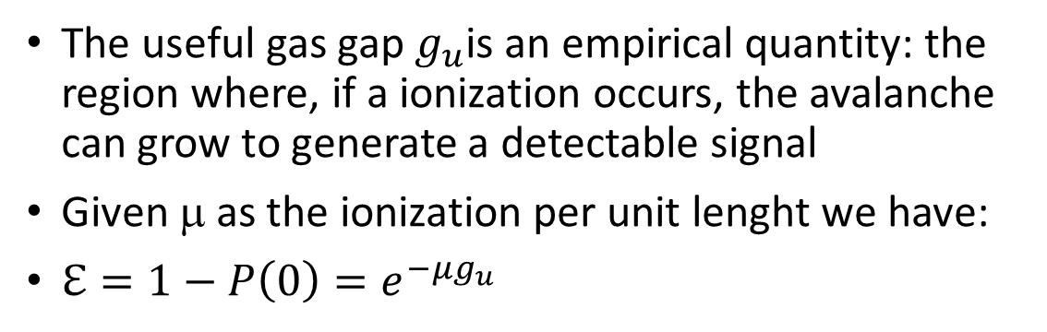
P(0) vs. the useful gap
Depends primarily on the total gaseous target
  Total thickness
  Mixture density
Poisson P(0) < expected inefficiency.
The useful gas gap $g_{u}$is an empirical quantity: the region where, if a ionization occurs, the avalanche can grow to generate a detectable signal
Given μ as the ionization per unit lenght we have:
$ℇ=1−P\left(0\right)=e^{−μg_{u}}$
Useful gap
gas gap
Useful gap
gas gap

Slide 26
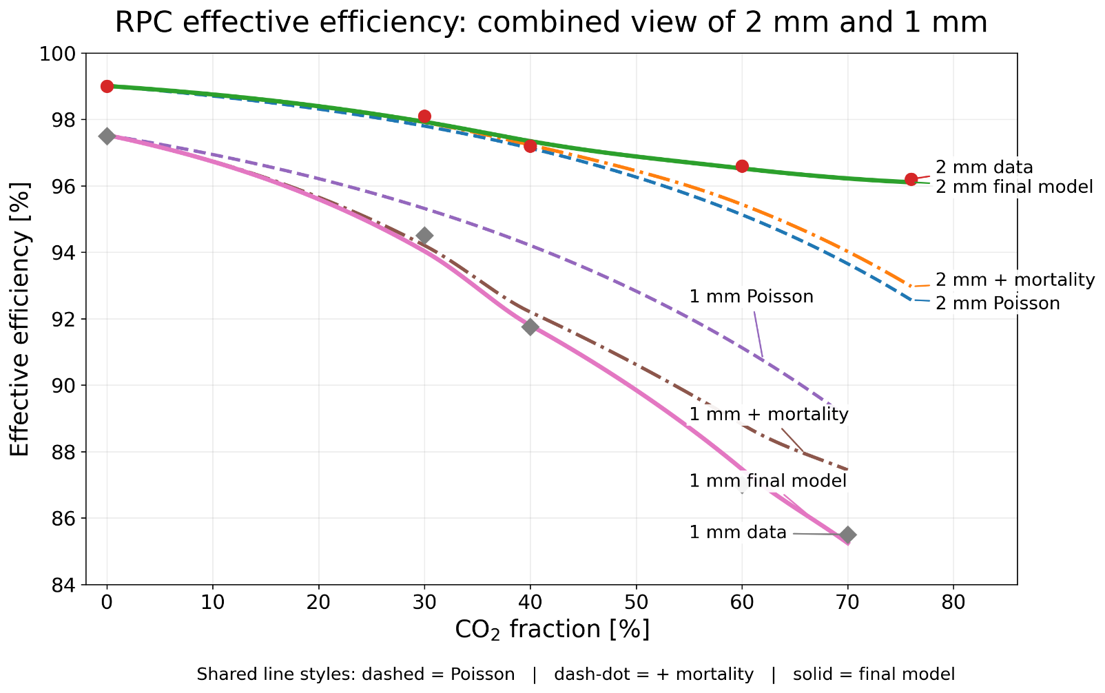
Realistic efficiency
Real efficiency vs. poisson constrained efficiency
Effect of the electronic sensitivity → g_u
Cluster mortality
Saturation effect on Qtot/Qprompt signal vs. gain

Slide 27
Definition of the RPC specific challenges
Efficiency
  Target: Maximum efficiency of the single detector → exploit the sensor and optimize the cost of readout
  Lever arms: gaseous target, electron avalanche physics, front end electronics sensitivity
  Competing requirements: gas mixture constraints, rate capability, longevity, time resolution
Gas mixture
  Target: Low impact (cost, environmental, detector), high performance
  Lever arms: electron avalanche physics, front end electronics sensitivity
  Competing requirements: efficiency, longevity
Time resolution
  Target: sub ns, down to < 100 ps+
  Lever arm: gaseous target segmentation, faster mixture, front end electronics sensitivity
  Competing requirements: efficiency of a single gap, simplicity robustness and low cost
Low cost per unit area
  Target: low cost and simple > m^2 module, holding the present margin with respect to other technologies
  Lever arm: efficient design, gas mixture, FE electronics sensitivity
  Competing requirements: high time resolution (and space)

Slide 28
The gas mix challenge
Adding CO2 to the RPC gas mixture was initially studied to moderate the ageing effects of HFO as R134a replacement → cite ECOGAS
ATLAS studied a pragmatic strategy to do something immediately and since 2022 performed a long study to partially replace R134a with CO2 → (see Sinem’s slides)
In 2024-2026 ATLAS replaced the standard gas mixture with:
  64.5% R134a, 30% CO2, 5% i-C4H10, 0.5% SF6
The results was that this new mixture outperformed the standard one under any aspect: strong reduction of ageing, increase of time resolution by 30%, reduction of GWP and operation cost, same efficiency and lower operating voltage →link Sinem
Why this was not done from the beginning? STD was working well, so there was no pressure to change…
Now it comes spontaneous to wonder: how far one can go on this path…?

Slide 29
The effect of the FE electronics sensitivity
To test the effect of the FE electronic sensitivity we performed a comparative test
The chamber is an ATLAS-like layout chamber [*]
2mm gas gap doublet one test and one monitoring chamber
  One side of the test chamber (vertical strips) is equipped with ATLAS electronics
  The other side (horizontal strips) is equipped with a high sensitivity analog pre-amp (baseline for Phase1 and Phase2 upgrade)
Each avalanche is seen AT THE SAME TIME by both electronics!
Exposed to GIF++ beam and source to measure:
  Efficiency under irradiation
  V-A curve
Mixture used:
  Zero R134a
  88% CO2
  10% i-C4H10
  2% 1233-ZD
It is flammable but freon free
It is not meant as an official proposal but as an example
The purpose is to compare event by event the response of the two amplifiers looking exactly at the same signal to compare the performance in an objective way
[*] https://inspirehep.net/literature/2955768

