Slide 1

University of Science and Technology of China
RPC2026
Study of Rate Effects in a Photo-RPC
with Different Bulk-Resistivity Electrodes
Based on Stochastic Local Voltage-Drop Modeling
Yiding Zhao
Dongdong Hu, Ming Shao
University of Science and Technology of China
RPC2026, September 2026
Notes:
Good afternoon, everyone. My name is Yiding Zhao, from the University of Science and Technology of China. Today I will present our study of rate effects in a Photo-RPC with different Bulk-Resistivity Electrodes.

Slide 2
Outline
1
Background and motivation
2
Photo-RPC setup and rate measurements
3
Stochastic local voltage-drop model
4
Model validation
5
Conclusions
2
Notes:
I will begin with the motivation and the role of resistive electrodes. Then I will introduce the Photo-RPC setup and the rate measurements. The next two parts describe the voltage-drop model and its comparison with data, using waveform resampling and Garfield. I will finish with the conclusions.

Slide 3
Resistive electrodes and rate capability
Local charging and field recovery
Discharge protection
Photocathode (0 V)
Resistive electrodes limit
the discharge current.
Local field reduction
helps quench a discharge.
Nominal field
Gas gap
Reduced
local field
Deposited
electrons
Resistive
anode
Field recovery
Recharge current
Conventional direction
Deposited charge reduces
the gap field locally.
Charge leakage restores
the field over time.
HV contact (+HV)
Simplified Photo-RPC cross-section, not to scale
How does electrode resistivity affect gain and timing at high rates?
3
Notes:
The schematic on the left shows the local charging and recovery process. The photocathode is grounded, and positive high voltage is applied through the resistive anode. Avalanche electrons reach the anode surface and leave a local charge. This charge reduces the electric field in the gas gap.
Resistive electrodes limit the discharge current, and the local field reduction helps quench a discharge. The field then recovers as charge leaks through the electrode. The blue arrows represent the electric field, while the green arrows indicate conventional recharge current.
This recovery takes time. If another event occurs in the same region before recovery is complete, it sees a reduced field. We therefore want to understand how electrode resistivity affects gain and timing as the rate increases.

Slide 4
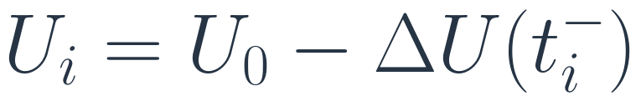
Rate effects from incomplete field recovery
Effective gap voltage
Voltage before each event
Low rate
Voltage seen by an event
U
0
$$U_{i}=U_{0}−ΔU\left(t_{i}^{−}\right)$$
Gain
Time
The local field largely recovers before the next event.
Lower effective voltage
reduces the mean gain.
High rate
Residual drop
U
0
Timing
Reduced and fluctuating
fields can broaden the
time distribution.
Time
Events arrive before full recovery.
Schematic: same local region, recovery time and axis scales.
4
Notes:
These schematic curves compare low and high rates in the same local region, using the same recovery time and axis scales. Each event produces a voltage drop, followed by recovery toward the applied voltage.
At low rate, the voltage almost recovers before the next event. At high rate, the intervals are shorter, so residual voltage drops accumulate. Differences in the intervals and deposited charges also make the voltage vary from event to event. The markers show the voltage just before each event.
The equation on the right says that the voltage seen by event i is the applied voltage, U zero, minus the residual drop immediately before that event. A lower effective voltage reduces the mean gain. A reduced and fluctuating field can also broaden the time distribution. Both effects need to be considered when interpreting the rate measurements.

Slide 5
Outline
1
Background and motivation
2
Photo-RPC setup and rate measurements
3
Stochastic local voltage-drop model
4
Model validation
5
Conclusions
5
Notes:
With this recovery picture in mind, I will now introduce the experimental setup and the measurements used to study gain and timing at different rates.

Slide 6
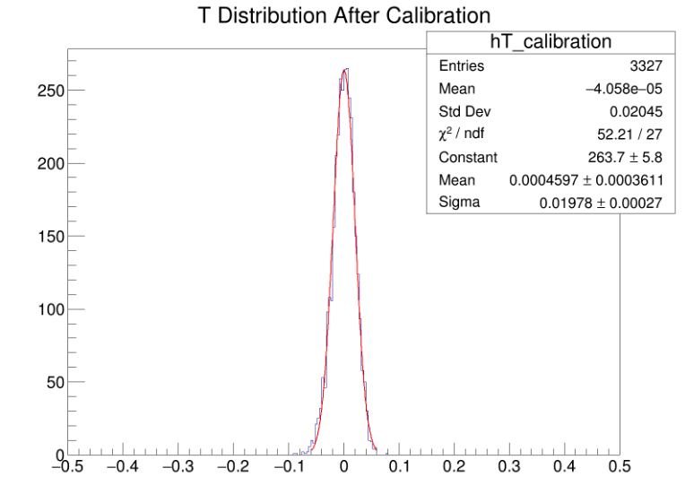
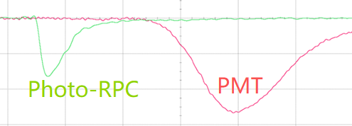
Photo-RPC experimental setup
Photoelectron emission and avalanche
Single-photoelectron operation
355 nm laser
R134a / SF₆ / i-C₄H₁₀ = 90 / 5 / 5
Photocathode
(0 V)
Gas gap: 215 μm
e⁻
355 nm femtosecond laser
Gas gap
215 μm
Electron
avalanche
Adjustable repetition rate
Resistive
electrode
Low-rate timing
+HV
2500 V, after time-walk correction
σ = 19.78 ps
Signal readout
RPC signal
PMT reference
Oscilloscope
Pulse charge and relative time
ρ = 1.4 × 10¹⁰ Ω·cm
6
Notes:
We operate the Photo-RPC in single-photoelectron mode. A three-hundred-and-fifty-five-nanometre femtosecond laser illuminates the photocathode, and the emitted electron initiates an avalanche in a two-hundred-and-fifteen-micrometre gas gap. The gas mixture is R one three four a, sulfur hexafluoride, and isobutane, in a ratio of ninety to five to five. The laser repetition rate is adjustable.
The oscilloscope records the RPC signal together with a photomultiplier reference signal. From these paired signals, we extract the pulse charge and relative arrival time.
The distribution on the right is a low-rate timing example at twenty-five hundred volts, after time-walk correction. Its fitted width is nineteen point seven eight picoseconds, or approximately twenty picoseconds. The electrode in this example has a resistivity of one point five times ten to the tenth ohm centimetres. This measurement illustrates the low-rate timing performance of the setup.

Slide 7
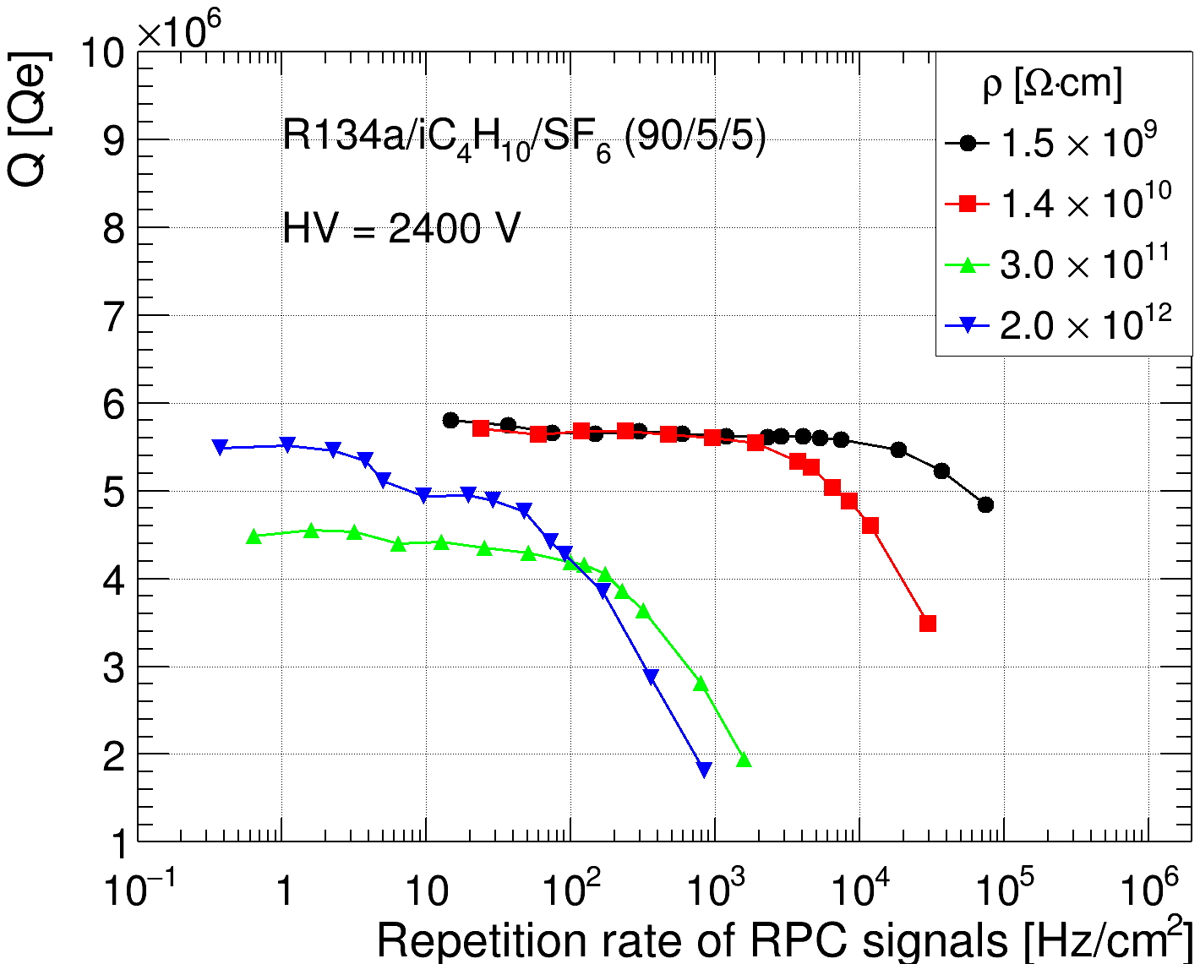
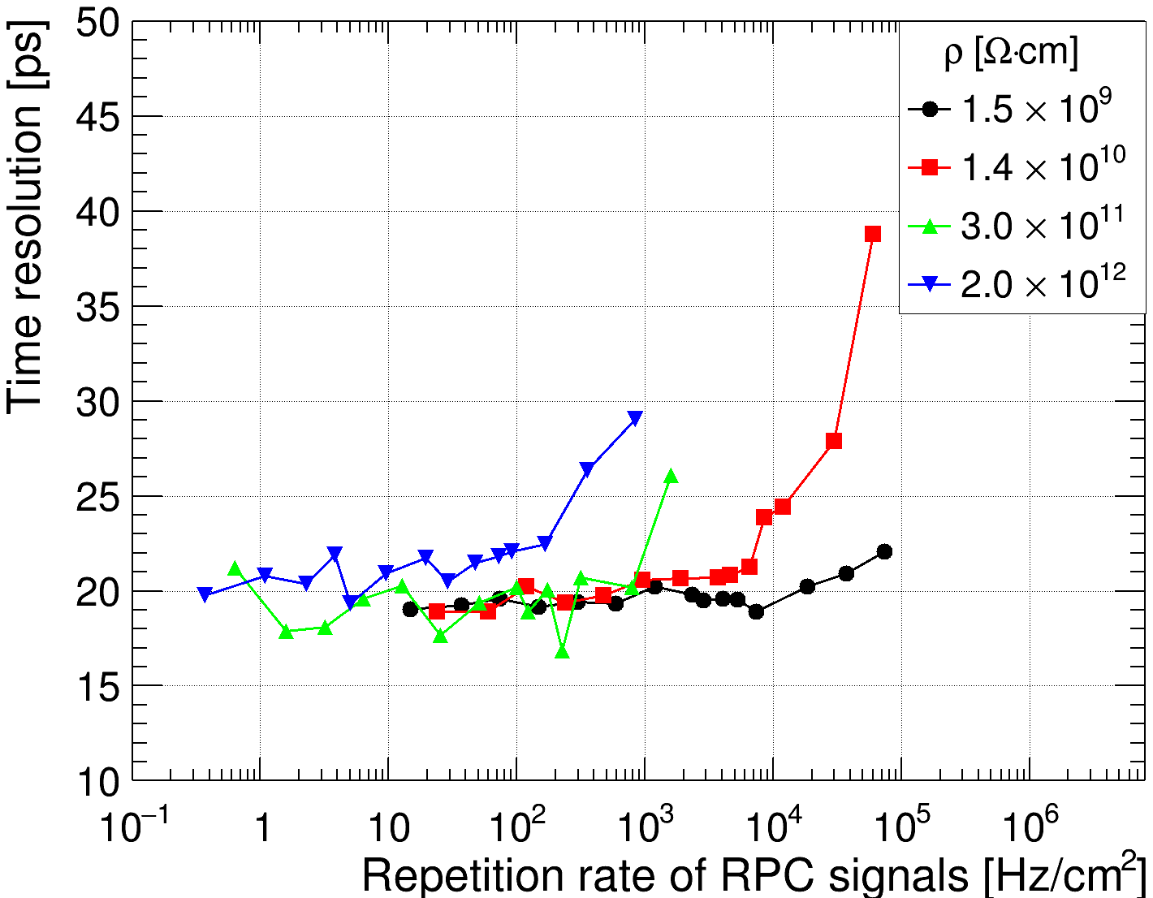
Lower resistivity extends the rate capability
Single-photoelectron measurements at 2400 V
Mean integrated charge
Time resolution
Lower resistivity shifts gain loss and timing degradation to higher rates.
7
Notes:
Here we compare four electrode materials in single-photoelectron operation at twenty-four hundred volts. Their resistivities are one point five times ten to the ninth, one point four times ten to the tenth, three times ten to the eleventh, and two times ten to the twelfth ohm centimetres. They are shown by black circles, red squares, green upward triangles, and blue downward triangles, respectively. The highest-resistivity sample is quartz.
The left plot shows mean signal charge against rate density. We use this charge as a proxy for mean gain under the same readout conditions. The right plot shows time resolution in picoseconds. The horizontal axes are logarithmic, with rate density in hertz per square centimetre.
For the higher-resistivity materials, the mean charge starts to fall and the timing starts to deteriorate at lower rates. Lower resistivity moves both changes to higher rates, consistent with faster field recovery.

Slide 8
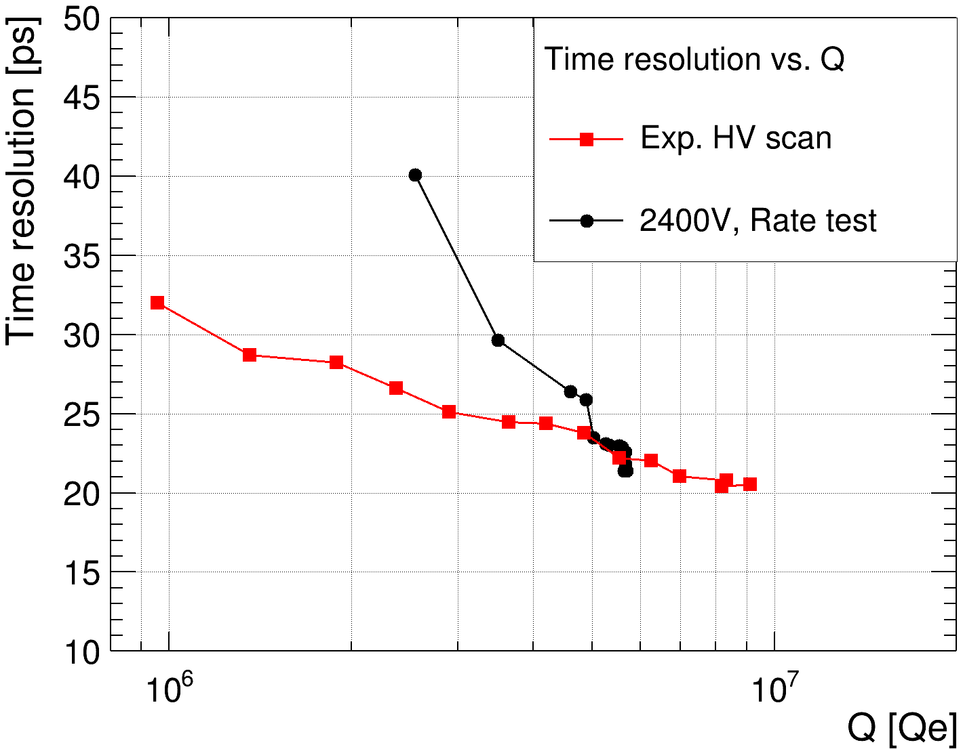



Timing at the same mean gain
Measurement | Fixed | Scan
Rate scan | 2400 V | Rate
HV scan | Low rate | Voltage
$$4×{10}^{4} Hz/cm^{2}$$
2000V
$$2×{10}^{4} Hz/cm^{2}$$
2050V
2100V
$${10}^{4} Hz/cm^{2}$$
At the same mean gain,
high-rate timing is worse
than low-rate timing at
reduced voltage.
2400V
2650V
Can local field fluctuations account for the additional timing spread?
8
Notes:
To separate the effect of mean gain from other rate effects, we compare two scans. In the rate scan, the applied voltage stays at twenty-four hundred volts while the rate changes. In the voltage scan, the rate stays low while the applied voltage changes. The measurement and analysis methods are otherwise the same.
The plot shows time resolution against mean signal charge. The black circles are the high-rate scan, and the red squares are the low-rate voltage scan. Comparing points at the same horizontal position means comparing approximately the same mean gain.
Over the measured range, the high-rate data have worse timing, even at the same mean gain. Therefore, matching the mean charge does not remove the timing difference. We investigate whether fluctuations of the local field can contribute to this additional spread.

Slide 9
Outline
1
Background and motivation
2
Photo-RPC setup and rate measurements
3
Stochastic local voltage-drop model
4
Model validation
5
Conclusions
9
Notes:
I will now describe how local voltage variations affect the time distribution, and then derive the periodic baseline used to fit the rate dependence of the mean charge.

Slide 10
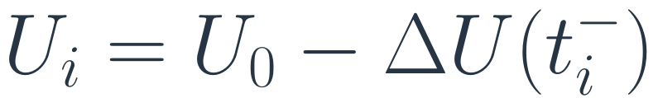
Local voltage fluctuations and timing response
Incomplete field recovery
Probability density
The residual voltage depends on
the charge and timing of
previous avalanches.
Fixed voltages
0.4
p(t | U₁)
p(t | U₂)
p(t | U₃)
0.2
$$U_{i}=U_{0}−ΔU\left(t_{i}^{−}\right)$$
Combined response
p(t)
0
Equal weights: 1/3 each
The local voltage can change
both the mean time and
the intrinsic timing width.
−4
−2
0
2
4
Each curve has unit area.
Time residual [a.u.]
Schematic, arbitrary units
$$Var\left(t\right)=𝔼\left[Var\left(t∣U\right)\right]+Var\left(𝔼\left[t∣U\right]\right)$$
Spread at fixed voltage
Shift of the mean time
10
Notes:
The residual voltage depends on the charge and timing of earlier avalanches. Each new event therefore samples an effective voltage, equal to the applied voltage minus the residual drop.
On the right, the three thin curves illustrate time distributions at three different voltages. Their mean times and widths can both differ. The dark curve is their weighted mixture. This is a schematic in arbitrary units, with equal event fractions for illustration.
The equation below is the law of total variance. In words, the total time variance is the average variance at fixed voltage, plus the variance of the voltage-dependent mean time. The first term includes the intrinsic timing fluctuations already present at low rate. The second term describes the spread caused by shifting the centre of the time distribution.
This explains how voltage fluctuations can add timing spread. The identity refers to the full variance; a Gaussian fit to a mixture does not necessarily give the standard deviation of the full distribution.

Slide 11


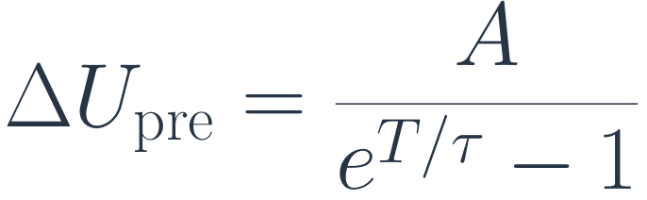

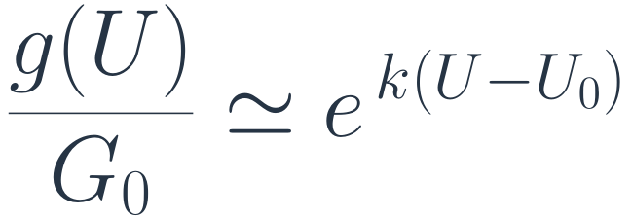
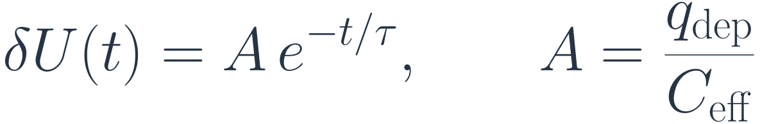
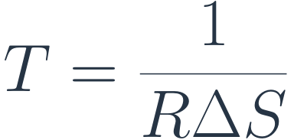

Periodic baseline for rate-dependent gain
Fixed event interval T, fixed deposited charge, exponential recovery
Periodic steady state
1
Single-event recovery
$$δU\left(t\right)=A e^{−t/τ}, A=\frac{q_{dep}}{C_{eff}}$$
U₀
ΔU
pre
2
Accumulation of previous events
A
$$ΔU_{pre}=A​\left(e^{−T/τ}+e^{−2T/τ}+⋯\right)$$
$$ΔU_{pre}=\frac{A}{e^{T/τ}−1}$$
Time
T
Same voltage before each event
3
Gain response at low rate
$$\frac{g\left(U\right)}{G_{0}}≃e^{ k\left(U−U_{0}\right)}$$
k from the low-rate HV scan
$$U_{eff}=U_{0}−ΔU_{pre}$$
Mean charge ∝ mean gain
Normalized mean charge for the rate fit
Fit parameter
$$Q_{norm}\left(R\right)=\frac{\overline{Q}\left(R\right)}{{\overline{Q}}_{0}}≃exp​\left[−\frac{c_{2}}{exp​\left[1/\left(τRΔS\right)\right]−1}\right]$$
$$c_{2}=kA$$
$$T=\frac{1}{RΔS}$$
R: rate density ΔS: effective local area τ: effective recovery time
11
Notes:
We first use a simple baseline: a fixed event interval T, a fixed deposited charge, and exponential recovery with time constant tau. In the periodic steady state shown on the left, every event sees the same voltage just before it arrives.
For one event, the initial voltage drop is A, equal to the deposited charge divided by the effective capacitance. After a time t, the remaining drop is A times the exponential of minus t over tau.
Immediately before the next event, we add the remaining drops from all earlier events. Their ages are T, two T, three T, and so on. This gives a geometric series. The numerator of its sum is A; the denominator is the exponential of T over tau, minus one. Subtracting this residual drop from U zero gives the effective voltage.
We then approximate the low-rate mean gain by an exponential voltage response. The gain relative to its value at U zero is the exponential of k times the voltage change. Here k is the slope to be obtained from the low-rate voltage scan.
The local rate is the rate density R times the effective area, delta S, so T is the reciprocal of that product. Substitution gives the normalized mean-charge formula at the bottom. In its exponent, the numerator is minus c two. The denominator is the exponential of one over the product tau R delta S, minus one. Here c two equals k times A.
This formula links field recovery to the rate fit. It is a fixed-charge, periodic baseline; random arrivals and voltage-dependent deposited charge require further treatment.

Slide 12
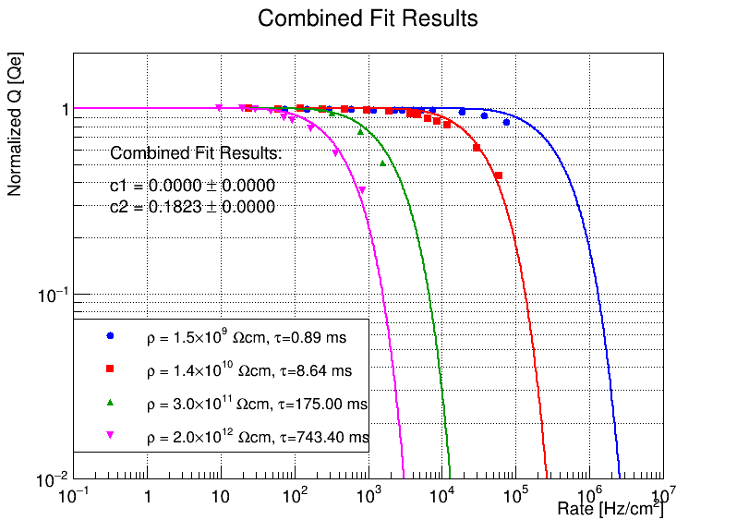


Fits to the rate-dependent mean charge
Four electrode materials at 2400 V
Material parameters
ρ [Ω·cm] | εᵣ | τ [ms]
1.5 × 10⁹ | 6.682 | 0.887
1.4 × 10¹⁰ | 6.973 | 8.64
3 × 10¹¹ | 6.589 | 175
2 × 10¹²* | 4.2 | 743.4
* Fused quartz
$$τ≃ε_{0}ε_{r}ρ$$
Bulk relaxation-time estimate
$$Q_{norm}\left(R\right)≃exp​\left[−\frac{c_{2}}{exp\left[1/\left(τRΔS\right)\right]−1}\right]$$
c₂ = kA = 0.1823
ΔS = π(0.06 cm)²
12
Notes:
Here the periodic expression is compared with the normalized mean-charge measurements for the four electrode materials at twenty-four hundred volts. Normalization makes it easier to compare where gain loss begins.
The table lists the bulk resistivity, relative permittivity, and estimated relaxation time. The three lower-resistivity samples have relative permittivities close to six point six to seven, while the quartz value is four point two. In order of increasing resistivity, the estimated times are zero point eight eight seven, eight point six four, one hundred and seventy-five, and seven hundred and forty-three point four milliseconds.
These times use the bulk estimate tau approximately equal to vacuum permittivity times relative permittivity times resistivity, with consistent units. An effective recovery time can also depend on geometry. The local area used here is the laser-spot area, pi times the square of a radius of zero point zero six centimetres.
The displayed fit parameter is c two equal to zero point one eight two three. The fit constrains the product k times A. An independently measured voltage-response slope is needed to interpret A as a physical voltage jump. The comparison shows how longer recovery shifts the onset of charge loss to lower rates.

Slide 13
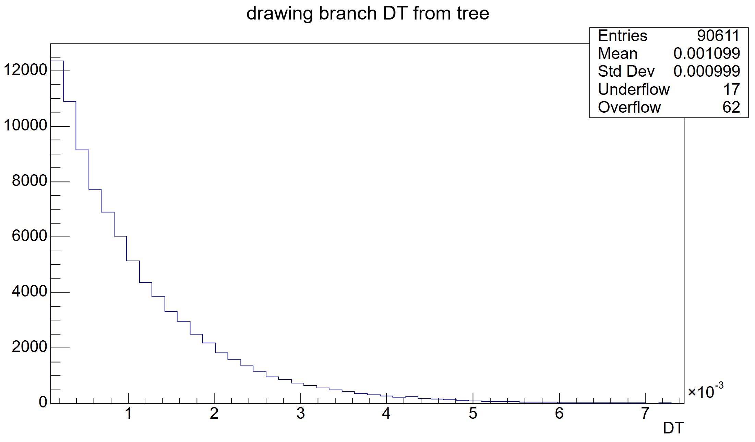
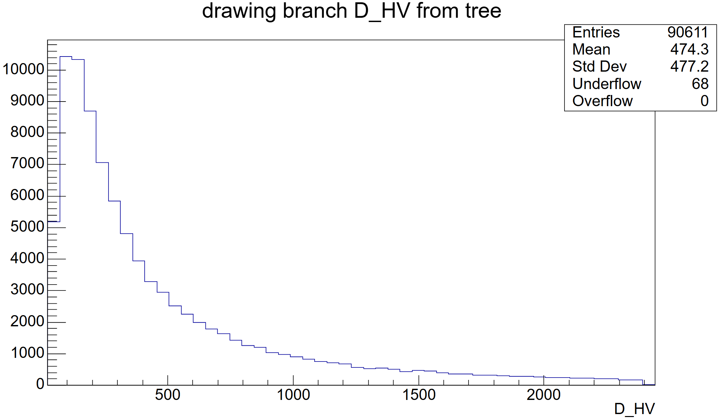
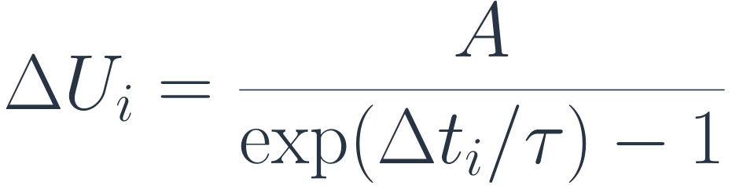
Random event intervals and voltage-drop sampling
Poisson arrival approximation
Sampling prescription used here
$$p\left(Δt\right)=f e^{−fΔt}, f=RΔS$$
$$ΔU_{i}=\frac{A}{exp\left(Δt_{i}/τ\right)−1}$$
Example: f = 1000 Hz, A = 28.155 V, τ = 8.64 ms
f [Hz] | ⟨ΔU⟩ [V]
1 | 1
50 | 48
100 | 87
500 | 299
1000 | 474
2000 | 708
Inter-event interval
Sampled voltage drop
The current sampler evaluates the periodic expression at each sampled interval.
13
Notes:
For the current numerical study, we approximate event arrivals by a Poisson process. The waiting time then has an exponential distribution: its probability density is f times the exponential of minus f delta t. The mean interval is one over f, where f is the local rate, R times delta S.
The present sampler inserts each sampled interval into the periodic expression. For the assigned voltage drop, the numerator is A and the denominator is the exponential of delta t over tau, minus one. This is an approximation for sampling voltages; it does not propagate the complete charging history.
The example uses one thousand hertz, A equal to twenty-eight point one five five volts, and tau equal to eight point six four milliseconds. The left histogram shows the sampled intervals, and the right shows the corresponding broad voltage-drop distribution.
The table summarizes the displayed samples. As the rate increases from one to fifty, one hundred, five hundred, one thousand, and two thousand hertz, their listed mean drops increase from one to forty-eight, eighty-seven, two hundred and ninety-nine, four hundred and seventy-four, and seven hundred and eight volts.
These are finite-sample summaries. Very short intervals make this mapping singular, so the numerical means depend on cutoff and selection handling. They should not be interpreted as exact Poisson charging predictions. This qualification also applies to the comparisons that follow.

Slide 14
Outline
1
Background and motivation
2
Photo-RPC setup and rate measurements
3
Stochastic local voltage-drop model
4
Model validation
5
Conclusions
14
Notes:
Next, I will use the sampled voltages to calculate charge and timing responses, and compare those responses with the high-rate measurements.

Slide 15

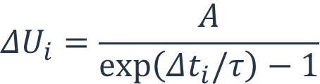
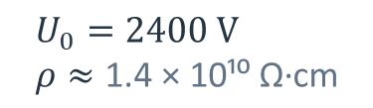
Model validation
$$U_{0}=2400 V \\ ρ≈\text{1.4 × 10¹⁰ }\text{Ω}\text{·}\text{cm}$$
Stochastic local voltage model
$$ΔU_{i}=\frac{A}{exp\left(Δt_{i}/τ\right)−1}$$
$$U_{i}=U_{0}−ΔU_{i}$$
Waveform resampling
Garfield++ simulation
Select measured waveforms
at the effective voltage.
Simulate avalanches
at the effective voltage.
Compare mean charge and time resolution with high-rate data
15
Notes:
The diagram shows two ways to obtain the detector response. Both start from the same prescribed local voltage distribution. For each event, the effective voltage is the applied voltage minus its assigned voltage drop.
The left branch uses waveform resampling. We select a measured low-rate waveform at the corresponding voltage, so the response is taken from data. The right branch uses Garfield plus plus to calculate an avalanche response at that voltage.
The two branches then lead to the same comparison: mean charge and time resolution against the high-rate data. They provide complementary checks of the response calculation. Since the Garfield mean-charge response is also calibrated to measurements, these are not fully independent tests of every model component.

Slide 16
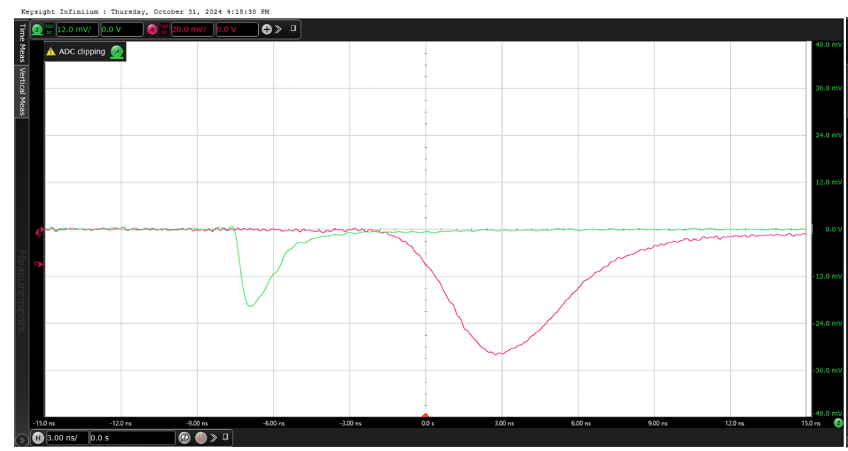
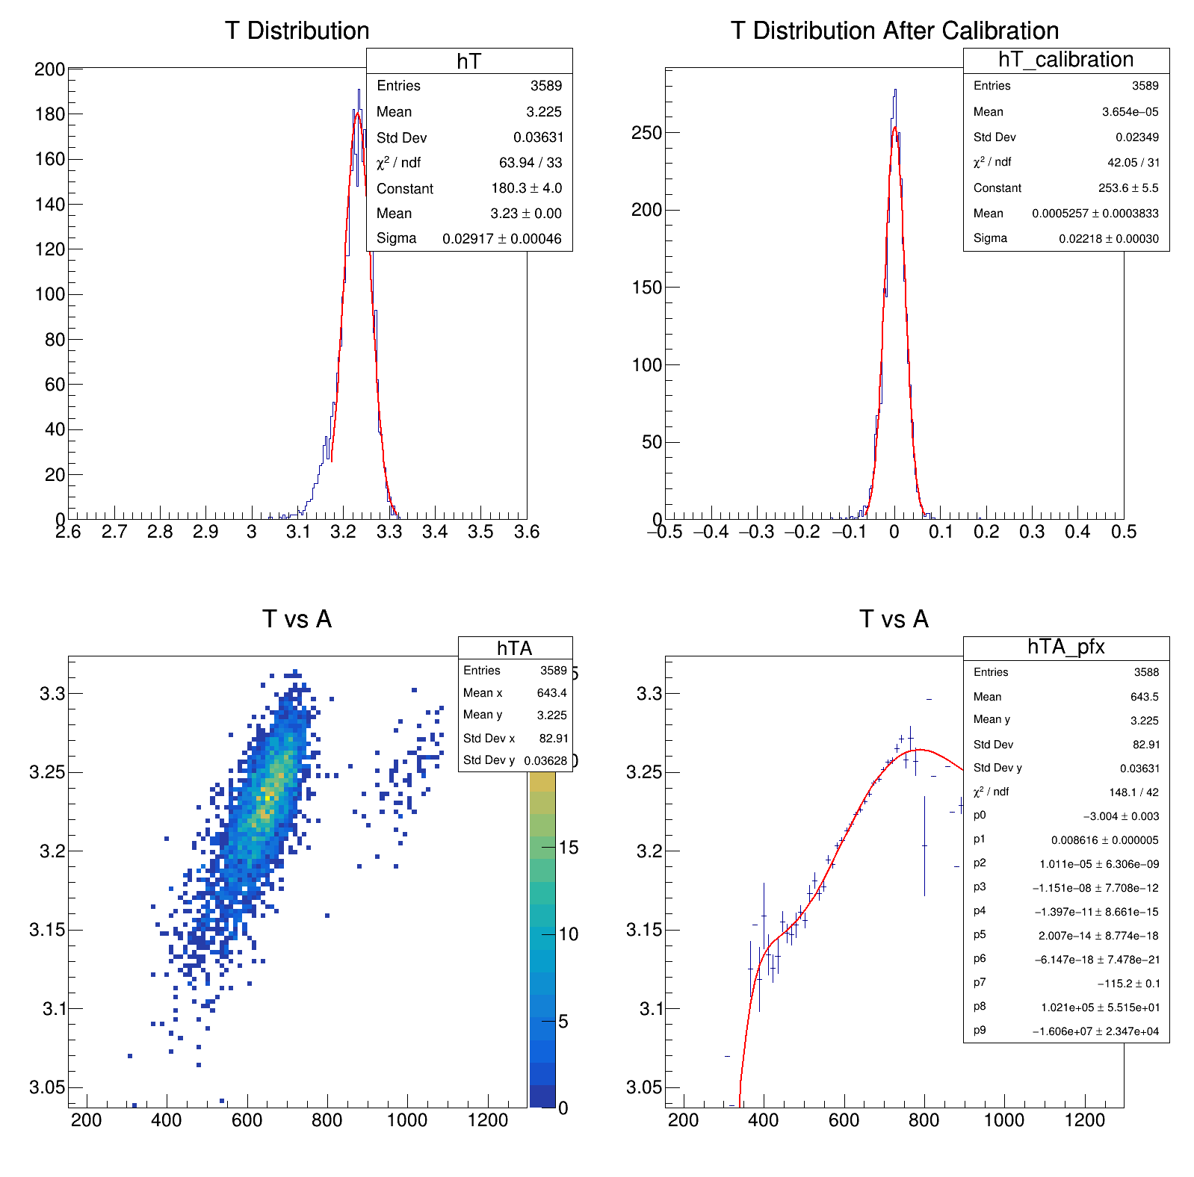
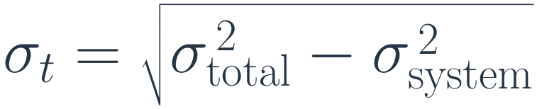
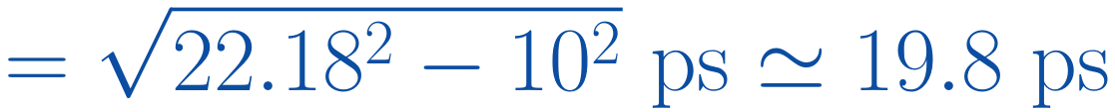

Low-rate waveform library
2000–2650 V in 50 V steps
CFD fraction: 20%
4,000 recorded waveforms per voltage
Time-walk correction and Gaussian fit
Before: 29.17 ps
After: 22.18 ps
RPC signal: green PMT reference: red
$$σ_{t}=\sqrt{σ_{total}^{ 2}−σ_{system}^{ 2}}$$
$$Δt=t_{PMT}−t_{RPC}$$
$$=\sqrt{{22.18}^{2}−{10}^{2}} ps≃19.8 ps$$
16
Notes:
The waveform library was recorded at low rate, from nineteen hundred to twenty-six hundred and fifty volts in fifty-volt steps, with four thousand recorded waveforms at each voltage.
The oscilloscope example shows the RPC signal in green and the photomultiplier reference in red. We define the relative time as the reference time minus the RPC time. The timing analysis uses a constant-fraction level of twenty percent, followed by time-walk correction and a Gaussian fit.
The two histograms show the effect of that correction. The fitted width decreases from twenty-nine point one seven to twenty-two point one eight picoseconds. Using a ten-picosecond estimate for an independent system contribution, we subtract the variances. The square root of twenty-two point one eight squared minus ten squared is approximately nineteen point eight picoseconds.
The library provides the measured charge and timing response at each voltage, including event-to-event fluctuations. Keeping the RPC and reference traces paired also preserves their common timing reference and the measured charge-time correlations.

Slide 17
Waveform resampling method
Input: mean local signal rate f
1
Sample an event interval
Exponential waiting time with mean 1/f
2
Calculate the effective voltage
Apply the current voltage-drop prescription
Repeat
8,000 times
per rate
3
Select a measured waveform
Randomly sample at the nearest measured voltage
4
Extract charge and time
Use the same event analysis as for the data
Time-walk correction and Gaussian fit of the resampled ensemble
17
Notes:
For each input local rate f, we follow the four steps shown here. First, we draw an exponential waiting time with mean one over f. Second, we calculate an effective voltage using the current voltage-drop prescription.
Third, we find the nearest measured voltage in the library and randomly select a recorded waveform event at that voltage. Fourth, we extract its charge and relative time using the same event analysis as for the data.
We repeat this sampling procedure eight thousand times per rate. We then apply time-walk correction and fit the time distribution of the resampled ensemble with a Gaussian.
Random selection from the measured library retains the intrinsic fluctuations at a given voltage. Sampling across voltages adds the effect of the prescribed voltage distribution. The result therefore depends on both the voltage sampler and the range covered by the waveform library.

Slide 18
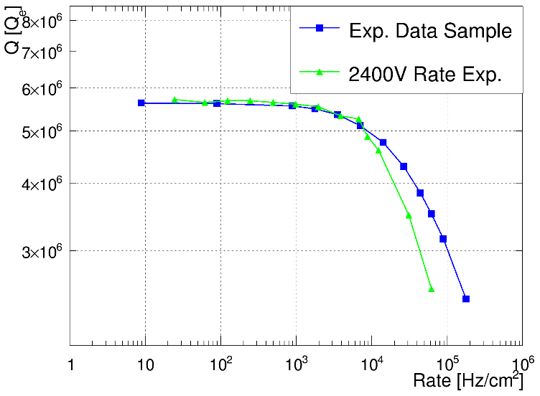
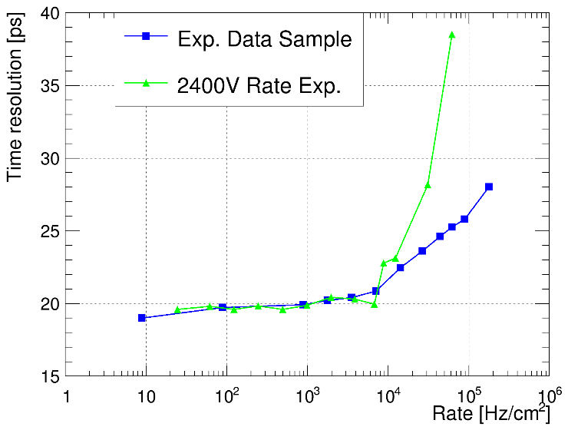
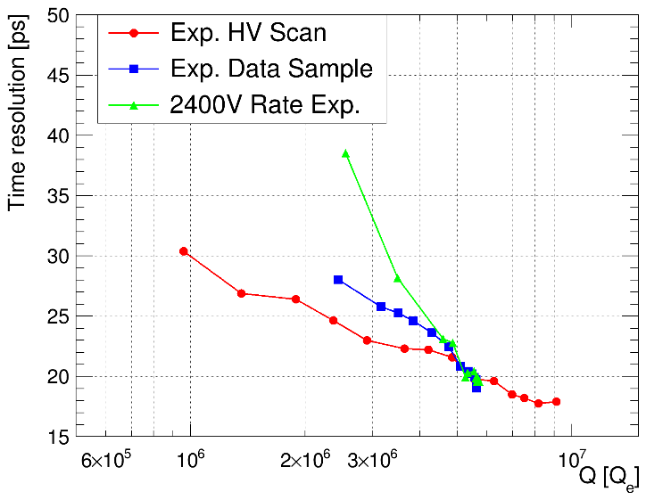
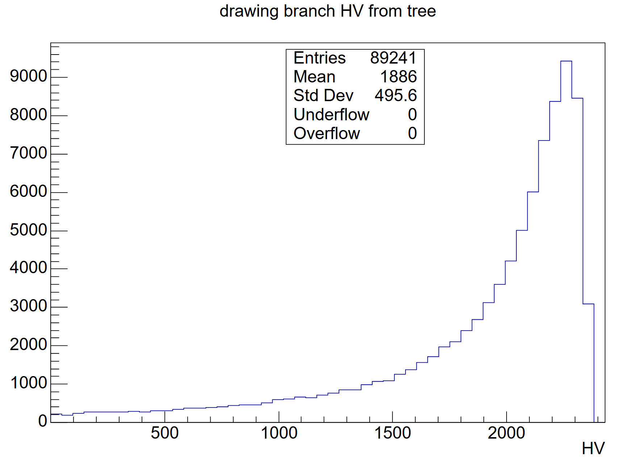
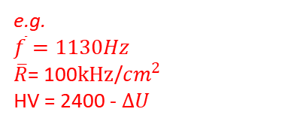
Waveform resampling results
Mean charge
Time resolution
Timing at the same gain
Effective-voltage coverage
e.g.
$\overline{f}=1130Hz$
$\overline{R}$= 100$kHz$/$cm^{2}$
HV = 2400 - $ΔU$
Resampling describes the overall measured trends.
Limited voltage coverage can bias the predicted
charge and timing distributions.
18
Notes:
The three upper plots compare waveform resampling with measurements. From left to right, they show mean charge versus rate, time resolution versus rate, and time resolution versus mean charge. Blue squares represent resampling and green points represent the high-rate data. The right-hand plot also includes the low-rate voltage scan in red.
Resampling describes the overall decrease in mean charge and deterioration in timing. At comparable mean charge, it also gives a timing difference from the low-rate scan. Quantitative discrepancies remain, especially toward the higher rates.
The lower-left histogram shows a sampled effective-voltage distribution. Part of the voltage range can fall outside the available measured response. If those events are excluded or represented incompletely, both the predicted charge and timing distributions can be biased. Limited voltage coverage is therefore a constraint on this comparison, although it has not been established as the sole cause of the disagreement.

Slide 19

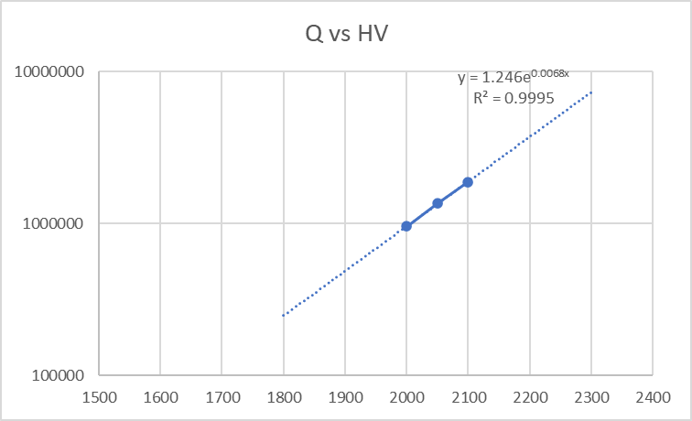

Garfield++ response model
Uniform electric field within each simulated event
Calibrate the effective Townsend coefficient from the measured mean charge.
$$Q\left(U\right)=exp\left[α_{eff}\left(U\right)d\right]$$
Other transport parameters: gas file
Fit to the measured response
Exponential continuation
Polynomial fit above 2100 V
Exponential extrapolation below 2100 V
19
Notes:
The second response calculation uses Garfield plus plus. Within each simulated event, we assume a uniform electric field corresponding to the sampled effective voltage.
We calibrate an effective Townsend coefficient from the measured mean charge. The adopted relation says that Q is the exponential of alpha effective times the gap thickness d. Equivalently, alpha effective is the natural logarithm of Q divided by d. Here Q is used in the adopted gain normalization. Other transport parameters are taken from the gas file.
The left panel shows the measured charge response. The prescription uses a polynomial fit above twenty-one hundred volts. The right panel shows an exponential continuation, used for extrapolation below twenty-one hundred volts. This low-voltage continuation is a modeling assumption beyond the directly constrained response.
The calculation provides a complementary way to obtain timing and charge at a specified field. Because its mean-charge response is calibrated to data, agreement in mean charge alone is not an independent prediction of gain

Slide 20
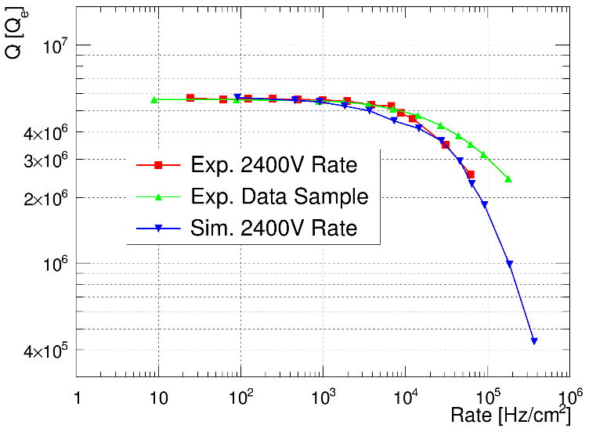
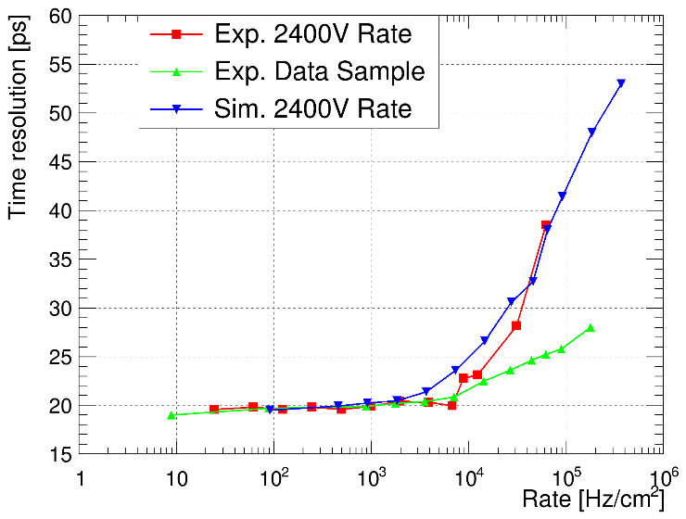
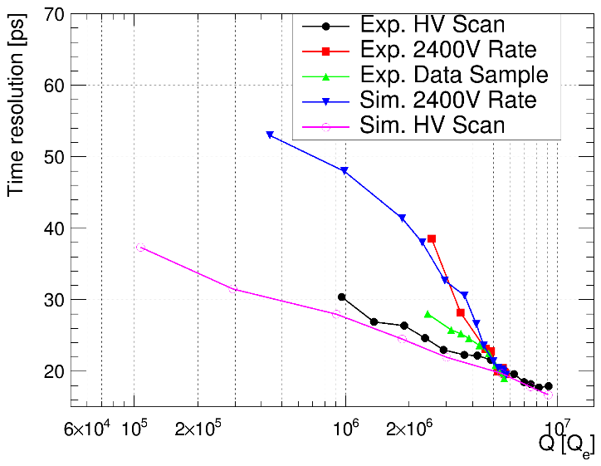
Comparison with high-rate measurements
Mean charge
Time resolution
Timing at the same gain
Both approaches describe the main trends.
At comparable mean gain, the high-rate distributions show worse timing.
20
Notes:
This slide brings the measurements and both response calculations together. The left panel shows mean charge versus rate, the middle panel shows time resolution versus rate, and the right panel compares timing at similar mean gain.
In these plots, the high-rate measurements are red, waveform resampling is green, and Garfield plus plus is blue. The right panel also includes the low-rate voltage-scan measurement in black and its simulation in magenta.
Both approaches describe the main trends: charge decreases with rate, timing becomes worse, and the high-rate response has a larger timing width at comparable mean gain. The agreement is not exact, particularly toward the highest rates.
These comparisons support local voltage fluctuations as a contributor to the additional timing spread. The accuracy of the prediction still depends on the arrival-time approximation, the charge-response calibration, and the treatment of low-voltage events. The plots do not establish that voltage fluctuations explain the entire measured excess.

Slide 21
Outline
1
Background and motivation
2
Photo-RPC setup and rate measurements
3
Stochastic local voltage-drop model
4
Model validation
5
Conclusions
21
Notes:
I will finish by summarizing what we learn from the measurements and what the present model comparisons can establish.

Slide 22
Conclusions
Electrode resistivity
Lower bulk resistivity shifts gain loss to higher rates.
Timing at matched mean gain
High-rate timing is worse much than low-rate timing at reduced HV.
Local voltage fluctuations
The model comparisons support a contribution to the extra timing spread.
Validation
Experimental-data resampling and Garfield++ reproduce the measured gain loss
and timing degradation.
22
Notes:
Lower electrode resistivity shifts the onset of gain loss to higher rates. This is consistent with faster recovery of the local electric field.
At the same mean gain, the high-rate measurements show worse timing than the low-rate measurements at reduced voltage. The timing change therefore cannot be described by the mean gain alone over the measured range.
The waveform-resampling and Garfield comparisons support a contribution from local voltage fluctuations to this additional spread. The present predictions remain limited by the low-voltage response and the assumptions used to sample the voltage.
Before making precise predictions, we need to check the voltage calibration and the sampling of short intervals. The measurements already help us compare electrode materials for high-rate timing.
The model supports resistive-electrode optimization and high-rate performance prediction for resistive gaseous detectors.
Thank you for your attention. I would be happy to take questions.

Slide 23
Appendix
Backup material
Rate scans and detector details
23
Notes:
Backup slides for discussion.

Slide 24
Rate scans across electrode materials
Single-photoelectron measurements at 2400 V
ρ = 1.5 × 10⁹, 1.4 × 10¹⁰, 3 × 10¹¹ and 2 × 10¹² Ω·cm
Mean charge
Time resolution
Timing at the same gain
DOI: 10.1088/1748-0221/20/10/C10001
The highest-resistivity sample is quartz.
24
Notes:
This slide collects the original experimental comparisons in one place. The material table identifies the 2e12 ohm cm sample as quartz, so the collective wording is electrode materials.

Slide 25
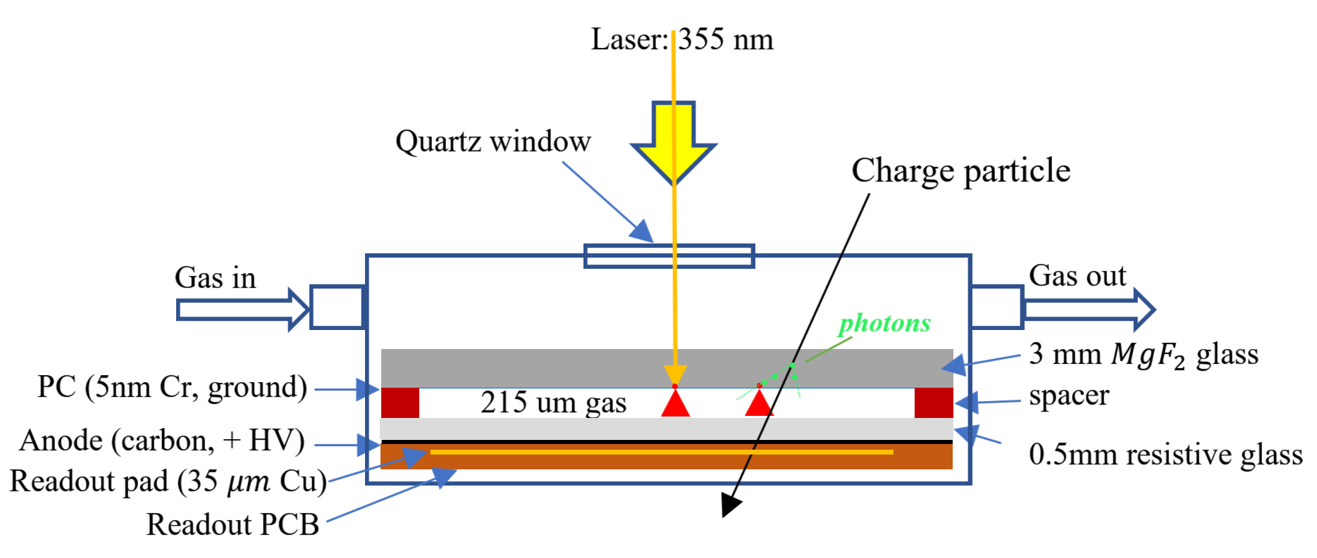
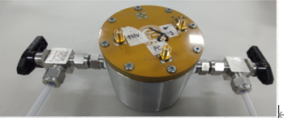
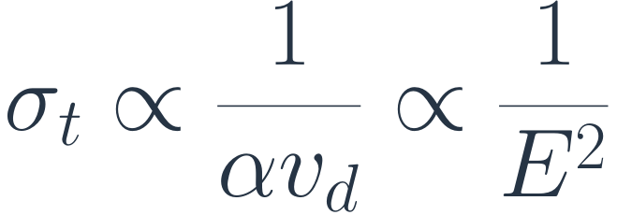
Photo-RPC detector and timing
Photoelectrons originate at the photocathode plane.
215 μm gap, R134a / SF₆ / i-C₄H₁₀ = 90 / 5 / 5
2500 V
σ = 19.78 ps
$$σ_{t}∝\frac{1}{αv_{d}}∝\frac{1}{E^{2}}$$
DOI: 10.1016/j.nima.2025.170593
After time-walk correction
Qualitative scaling estimate
25
Notes:
Detector photograph and cross-section are from the supplied deck. The photocathode localizes the initial photoelectron emission plane, reducing primary-position fluctuations. The quoted fit width is 19.78 ps at 2500 V. The proportionality sigma_t ∝ 1/(alpha*v_d) ∝ 1/E^2 is a qualitative scaling from the original slide, not a universal transport law. The second proportionality requires suitable approximate field dependences of the coefficients over the operating range. Actual transport and avalanche fluctuations depend on gas, field, attachment and signal formation.

Slide 26
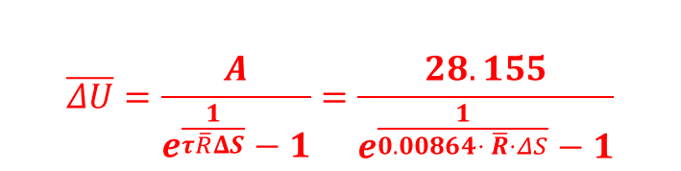
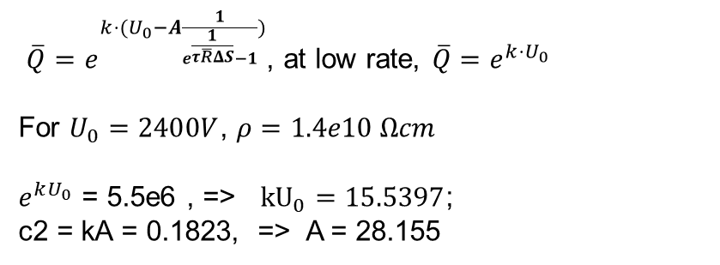
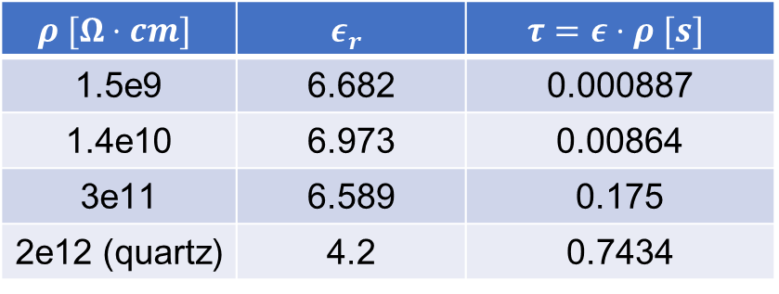
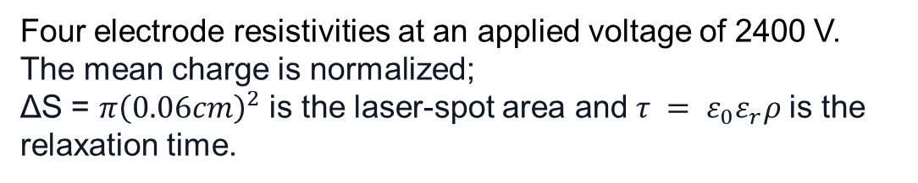
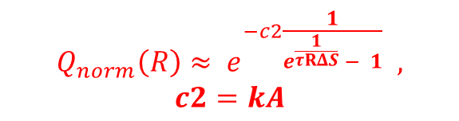
Fits to the rate-dependent mean charge
Four electrode resistivities at an applied voltage of 2400 V.
The mean charge is normalized;
ΔS = $π{\left(0.06cm\right)}^{2}$ is the laser-spot area and $τ = ε_{0}ε_{r}ρ$is the relaxation time.
$$ρ [Ω⋅cm]$$ | $$ε_{r}$$ | $$τ=ε⋅ρ [s]$$
1.5e9 | 6.682 | 0.000887
1.4e10 | 6.973 | 0.00864
3e11 | 6.589 | 0.175
2e12 (quartz) | 4.2 | 0.7434
$$Q_{norm}\left(R\right)≈ e^{−c2\frac{1}{e^{\frac{1}{τRΔS}} − 1}} ,$$
$$c2=kA$$
$\overline{Q}=e^{k⋅(U_{0}−A\frac{1}{e^{\frac{1}{τ\overline{R}ΔS}}−1})}$, at low rate, $\overline{Q}=e^{k⋅U_{0}}$
For $U_{0}=2400V$, $ρ=1.4e10 Ωcm$
$e^{kU_{0}}$ = 5.5e6 , => ${kU}_{0}=15.5397$;
c2 = kA = 0.1823, => A = 28.155
$$\overline{ΔU}=\frac{A}{e^{\frac{1}{τ\overline{R}ΔS}}−1}=\frac{28.155}{e^{\frac{1}{0.00864⋅ \overline{R}⋅ΔS}}−1}$$
Recovery time: estimated from material properties
Fit parameter: c2 ​=kA
Notes:
We next examine how fluctuations in event timing and deposited charge affect the voltage distribution.

Slide 27
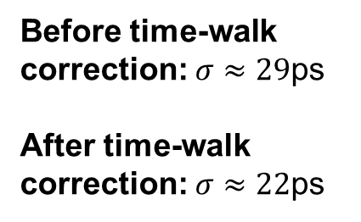

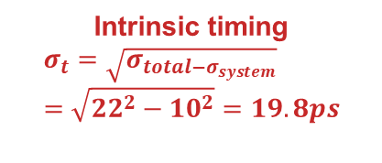
Data analysis
HV scan: 1900–2650 V in 50 V steps
Recorded waveforms: 4000 per voltage
CFD timing with a fraction of 20%, followed by time-walk correction.
Gas: R134a/SF6/i-C4H10 = 90/5/5
Before time-walk correction: $σ≈29$ps
After time-walk correction: $σ≈22$ps
29ps -> 22ps
Oscilloscope traces: RPC signal in green; PMT reference in red.
Intrinsic timing
$$σ_{t}=\sqrt{σ_{total−σ_{system}}}=\sqrt{22^{2}−10^{2}}=19.8ps$$
$$Δt=t_{PMT}​−t_{RPC}​$$

Slide 28
Waveform resampling with the voltage mode
Signal sampling and time-resolution analysis
Set the mean signal rate <f>
Sample a time interval dt
from an exponential distribution with mean 1/<f>
Calculate ΔU using the fitted formula
Repeat
8000
times
The voltage model selects the operating point for each sampled event.
Calculate the actual voltage: U = U₀ − ΔU
Randomly select a test signal
at the measured voltage closest to U
Extract charge and time
Apply TA correction and a Gaussian fit
to obtain the time resolution σₜ

