Slide 1



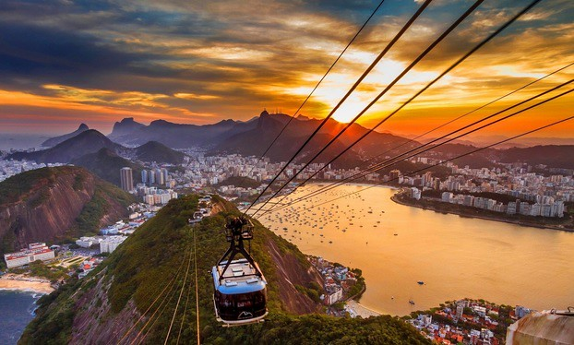
Eco-friendly gas mixtures for RPCs: results from a long-term ageing study at CERN GIF++
Marcello Abbrescia
on behalf of the RPC EcoGas @ GIF++ collaboration
RPC2026 - XVIII Conference on Resistive Plate Chambers and related detectors
Rio de Janeiro (Brasil)
Sept. 14-18 2026

Slide 2
Use of Greenhouse gases in HEP
GHGs are used in several gaseous particle detectors due to their characteristics suitable for optimal detector performance AND long term operation
Micro Pattern Gaseous Detectors (MPGD)
30 years ago we had to get rid of Ozone Depletion gases
At the time there was not the same feeling about GHGs → many detectors were designed from the beginning to be used with GHGs
Marcello Abbrescia
RPC 2026
2

Slide 3
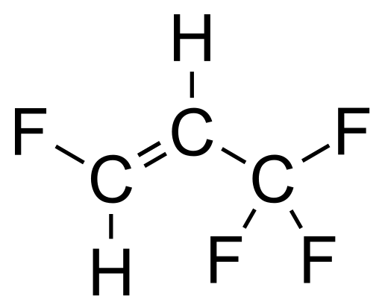
The importance of collaborative effort
All high energy experiments (ALICE, ATLAS, CMS, LHCb, etc.) and the CERN gas group (CERN EP-DT) started, already several years ago, an intense R&D program to find suitable gas mixtures.
Practically all research trendlines concentrate around the idea of replacing:
C₂H₂F₄ (GWP=1430)→ C₃H₂F₄ze (GWP=4)
+ CO₂ (GWP=1) or He
EEE
10.1088/1748-0221/19/11/P11003
C₃H₂F₄ (here indicated as HFO for short) is the molecule most similar to TFE but with low GWP
CO₂ (or He) are essentially added to reduce the operating voltage.
The RPC EcoGas@GIF++ is a Collaboration transversal to ALICE, ATLAS, CERN EP-DT, CMS, and LHCb willing to put together expertise and resources in order to test potential candidates of eco-friendly gas mixtures with different detectors and electronics.
Marcello Abbrescia
RPC 2026
3

Slide 4
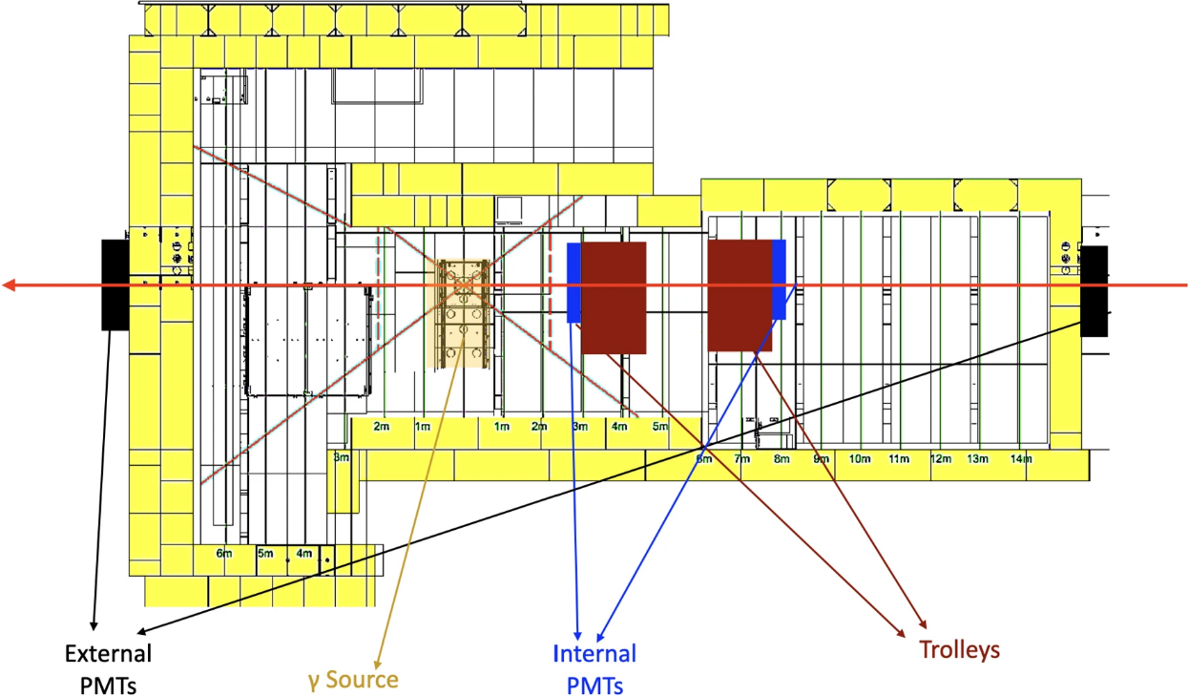
Experimental set-up @GIF++
Two eco-friendly gas mixtures identified in home laboratories tests, with various concentrations of HFO and CO₂.
Irradiation campaign started in 2022 by the EcoGas@GIF++ collaboration at the GIF++:
12.5 TBq 137Cs source
to generate background (high rate)
to accelerate aging processes
100 GeV muon beam
to measure detector performance
RPC 2026
Marcello Abbrescia
RPC 2026
4

Slide 5
Detectors @ GIF++
Various detectors, mounted on two trolleys, equipped with various electronics.
Help in disentagling common observed effect from effects specific of ONE detector
Irradiation was performed using ECO2, tests with ALL gas mixtures mentioned.
Trolley 3
Trolley 1
Marcello Abbrescia
RPC 2026
5

Slide 6
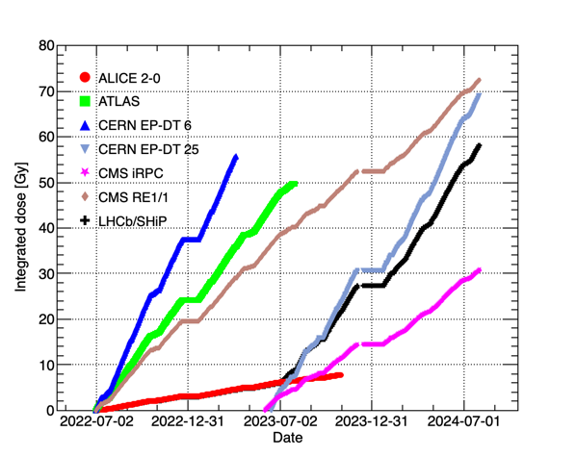
Integrated dose
RPC EcoGas@GIF++ preliminary
Doses integrated by the chambers under test during the irradiation campaign, and until the end of July 2024. The overall systematic uncertainty of the estimation procedure is around 20%.
The integrated dose was measured by the PMINA dosimeters (fixed and movable) and rescaled for the distance and material shielding.
Results presented here are up to the end of July 2024. Tests performed after this date are being analyzed.
Marcello Abbrescia
RPC 2026
6

Slide 7
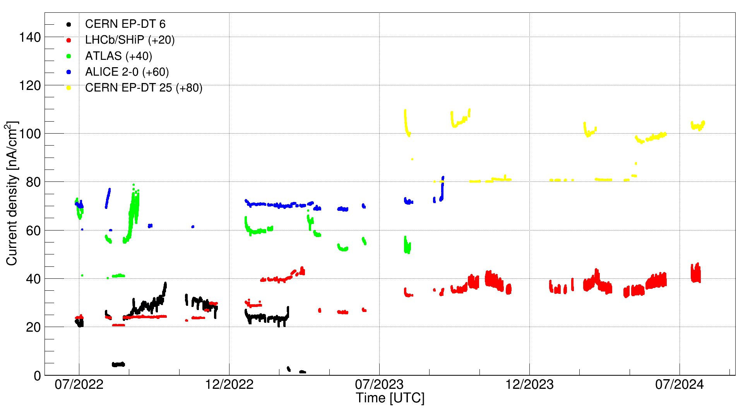
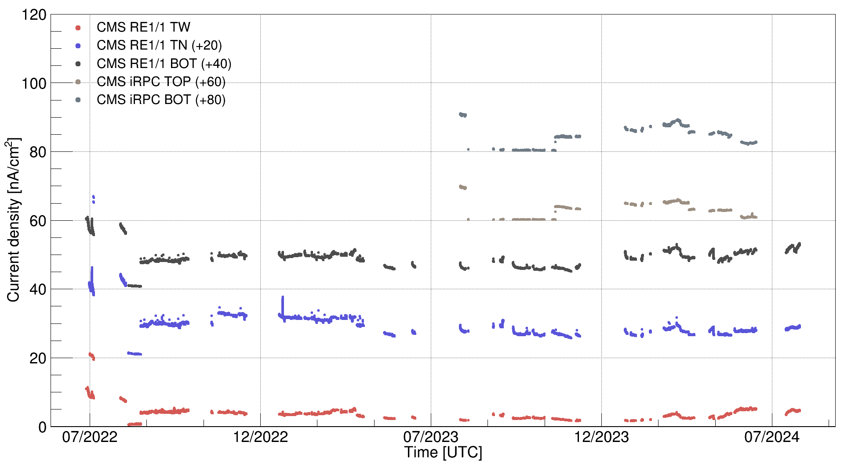
Current densities during irradiation
RPC EcoGas@GIF++ preliminary
Current densities measured during irradiation at ABS = 2.2 for the chambers under test.
The data points are vertically shifted with gap-dependent factors (indicated in the legend as +20, +40, …) to improve readability.
RPC EcoGas@GIF++ preliminary
Currents remain basically stable during the irradidation period.
Marcello Abbrescia
RPC 2026
7

Slide 8
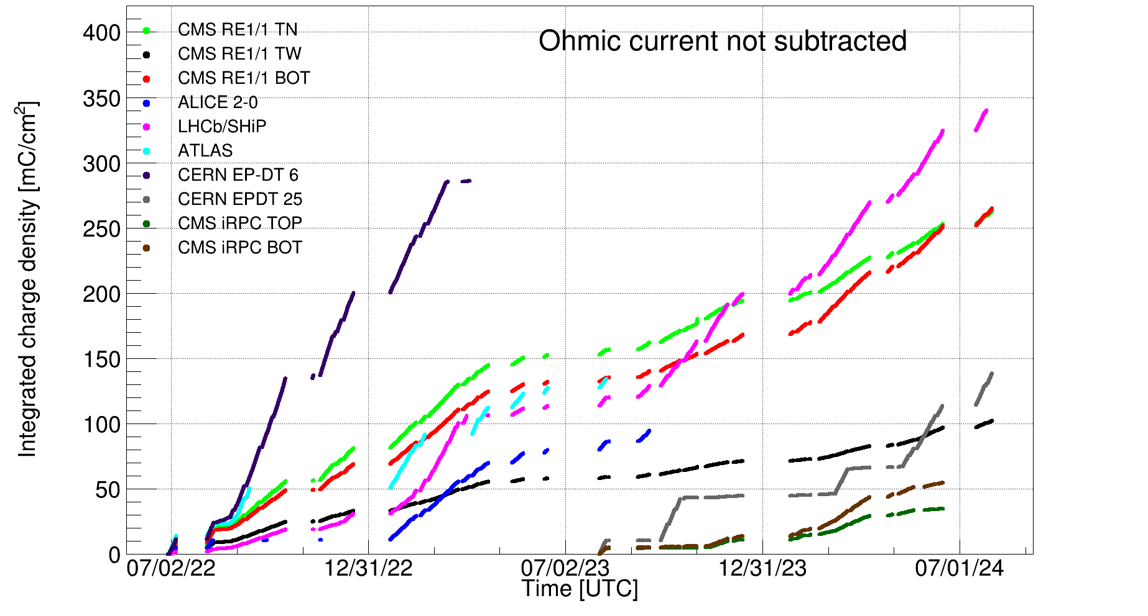
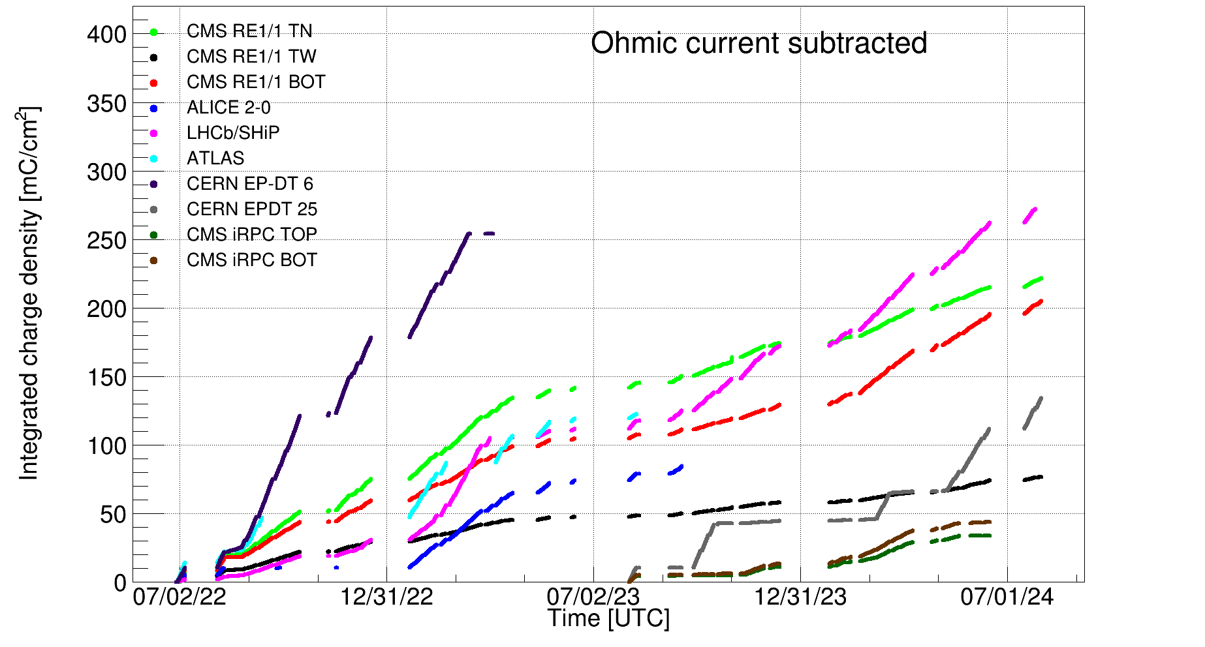
Charge integrated during irradiation
Integrated charge per unit area accumulated by the RPC chambers during the tests.
The interruptions visible at the end of each year correspond to the GIF++ technical stops, when the detectors were powered off.
Integrated charge is another important evaluator for aging processes in gaseous detectors.
Both integrated dose and integrated charge are a significant fraction of the total during HL-LHC,exact fraction depending on the experiment.
Marcello Abbrescia
RPC 2026
8

Slide 9
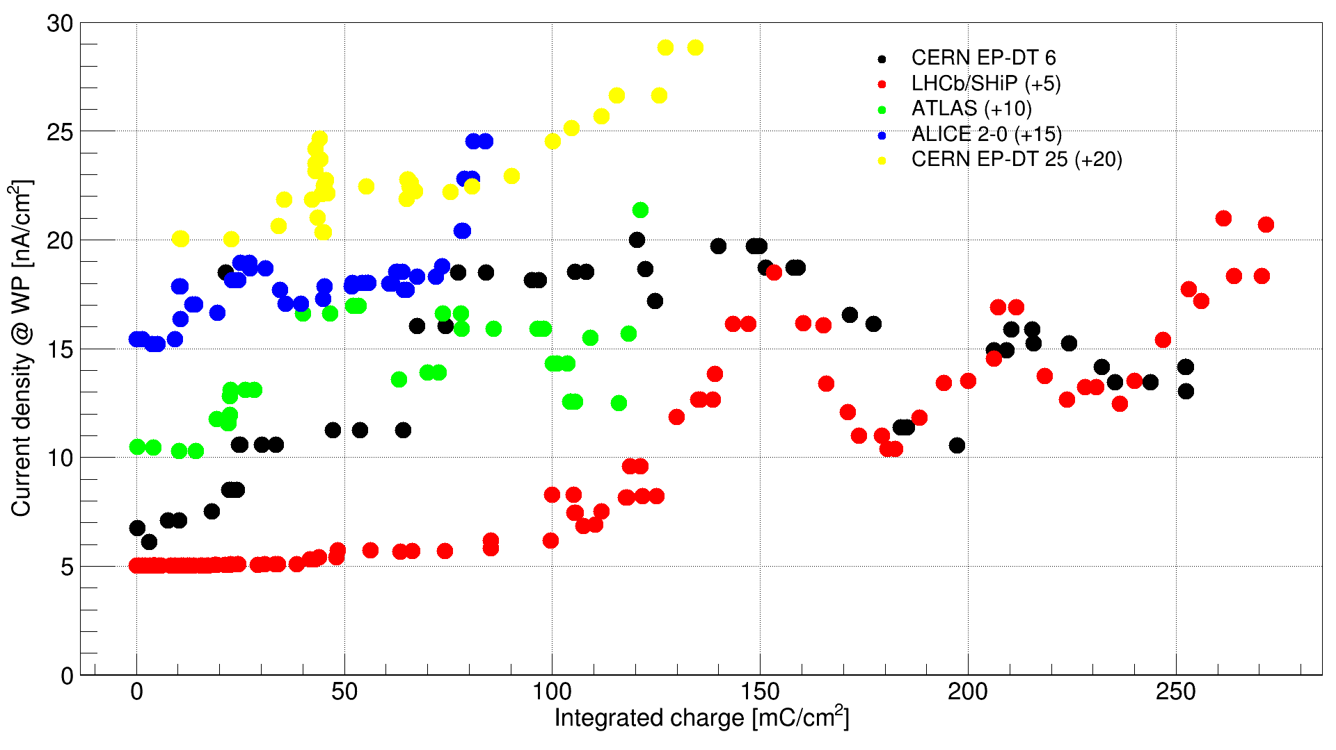
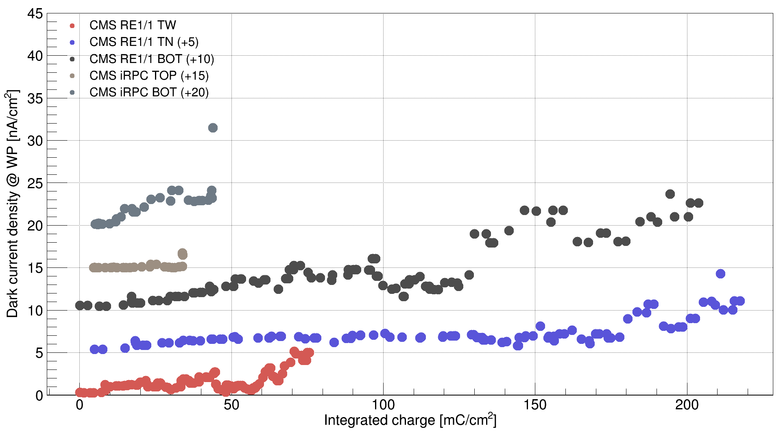
Dark (without irradiation) current
Total dark current density at Working Point (WP) as a function of the total integrated charge.
Obtained from HV scans performed without irradiation.
The data points are vertically shifted with gap-dependent factors (indicated in the legend as +20, +40, …) to improve readability.
RPC EcoGas@GIF++ preliminary
RPC EcoGas@GIF++ preliminary
Currents slowly increase and, in some cases, show oscillations.
Marcello Abbrescia
RPC 2026
9

Slide 10
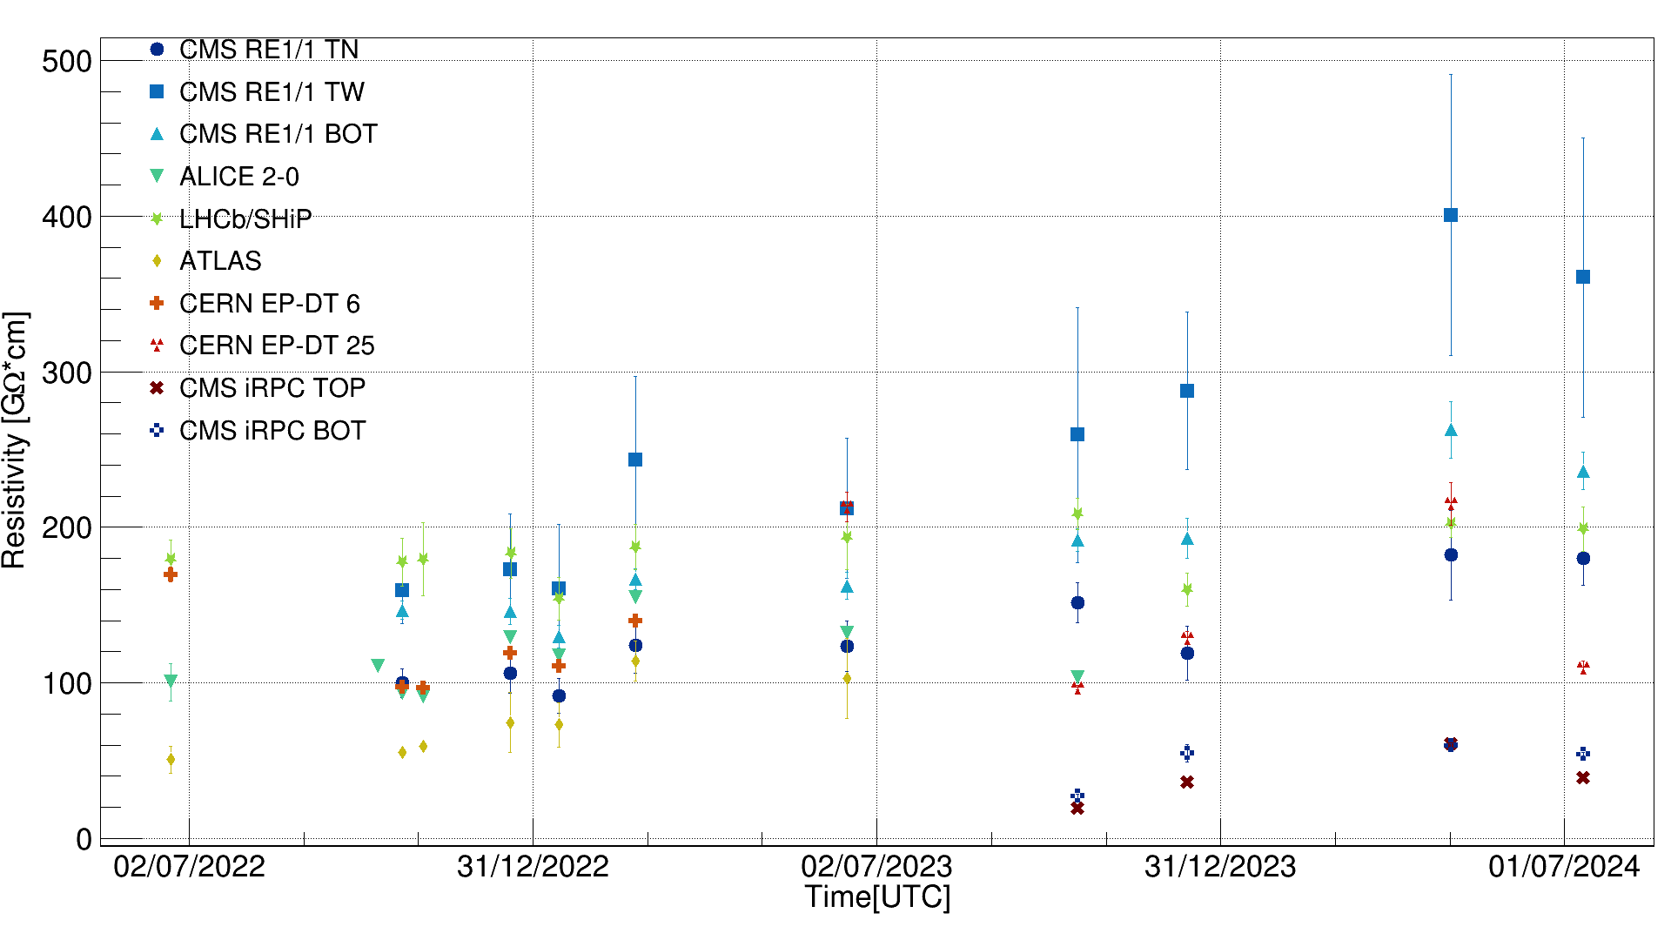
Resistivity vs. time
RPC EcoGas@GIF++ preliminary
Time evolution of the electrode plates resistivity for the RPC chambers under test vs. time. It was determined by filling the chambers with Argon and extracting the slope of the current–voltage curves in the linear region.
Most chambers show stable or slowly increasing values, with the TW gap of the CMS RE1/1 chamber exhibiting the most significant variation.
Marcello Abbrescia
RPC 2026
10

Slide 11
Efficiency at low rate
RPC EcoGas@GIF++ preliminary
Efficiency and dark current density for the ALICE 2-0 and CERN EP-DT 5 chambers with STD, ECO2 and ECO3 mixtures, comparing data taken before and after (2024) the aging campaign, with the source off. Pressure and temperature effects were corrected.
Plateau efficiency basically stable
Shift of the efficiency curves toward higher voltages
Increased current density
Marcello Abbrescia
RPC 2026
11

Slide 12
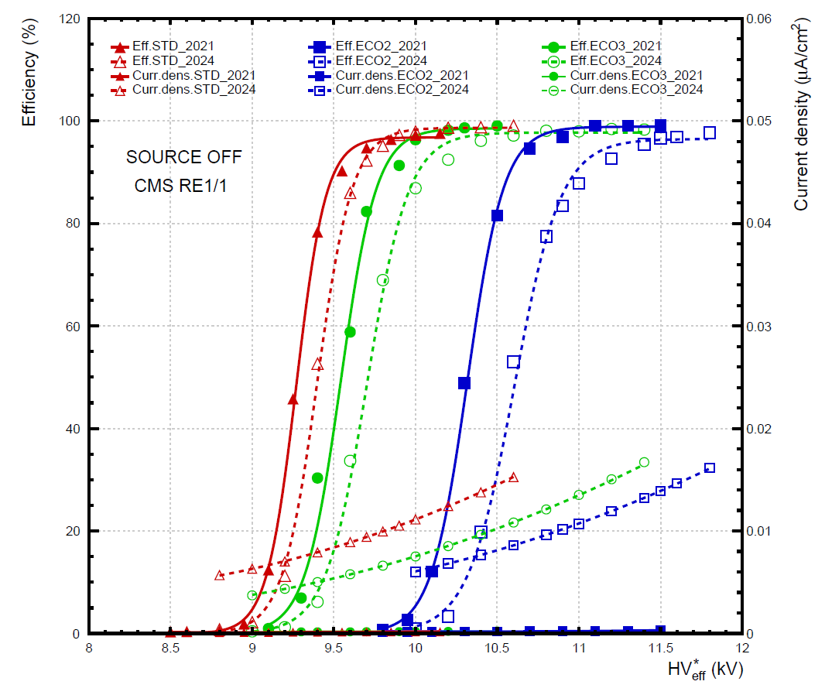
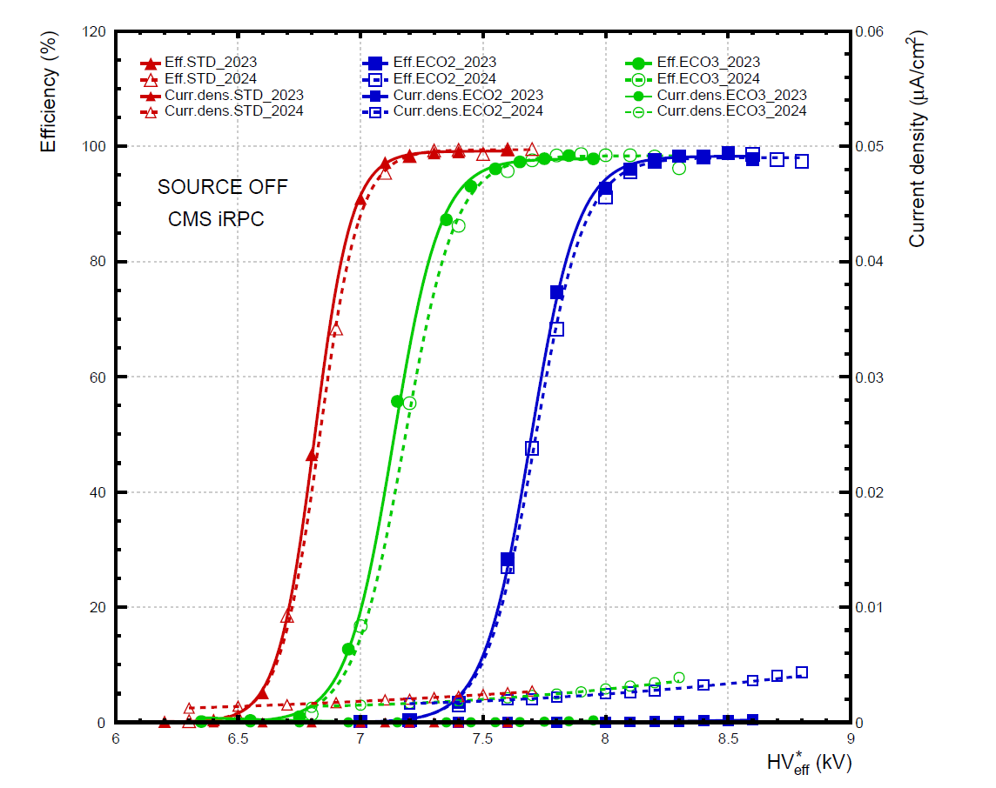
Efficiency at low rate
RPC EcoGas@GIF++ preliminary
Basically the same behaviour for all chambers:
CMS iRPC the chamber been exposed for the shorter time to irradiation
CMS RE 1/1 and more than 10 years old chamber, with a gap only partially operating since the beginning.
Marcello Abbrescia
RPC 2026
12

Slide 13
Plateau efficiency at low rate
vs. integrated charge
RPC EcoGas@GIF++ preliminary
vs. integrated dose
RPC EcoGas@GIF++ preliminary
Most chambers show stable or slightly decreasing plateau efficiency, more evident with ECO2 and ECO3 gas mixtures.
Marcello Abbrescia
RPC 2026
13

Slide 14
Electric field at HV₅₀
vs. integrated charge
RPC EcoGas@GIF++ preliminary
vs. integrated dose
RPC EcoGas@GIF++ preliminary
All chambers feature a shift toward the right of the efficiency curves, whose amount looks quite comparable to each other.
Marcello Abbrescia
RPC 2026
14

Slide 15
Efficiency at high rate
RPC EcoGas@GIF++ preliminary
Efficiency and current density versus for ALICE 2-0 and CERN ET-DT 5 chambers with STD, ECO2 and ECO3 mixtures, comparing data taken before and after the irradiation campaign.
Source was ON.
The ABS were chosen so that the instantaneous dose before and after irradiation was as similar as possible (taking into account the decay of the source activity).
Marcello Abbrescia
RPC 2026
15

Slide 16
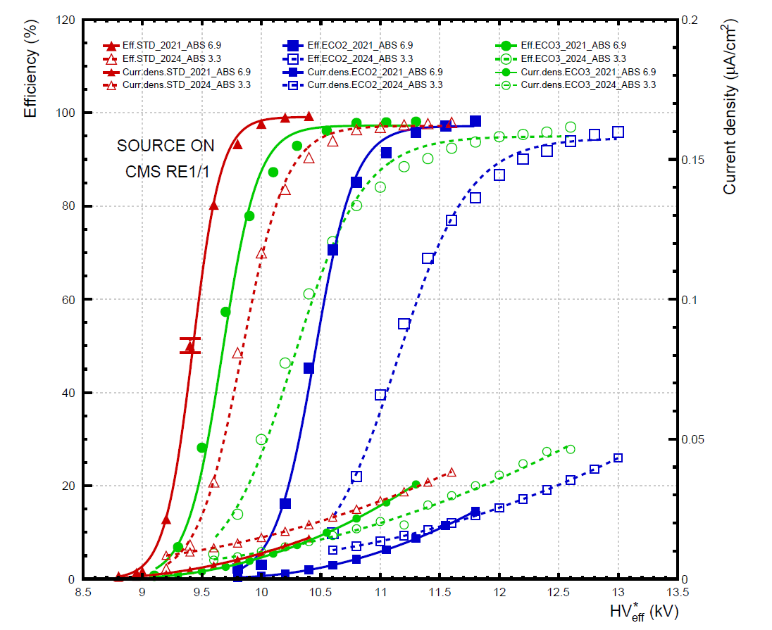
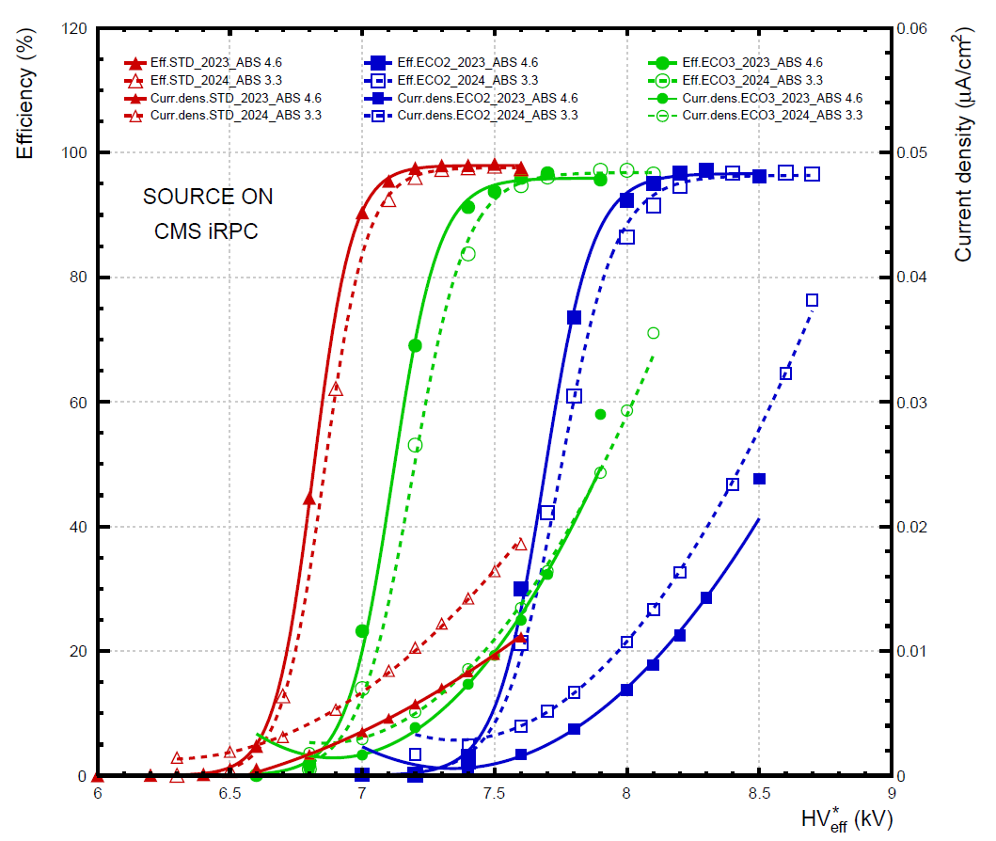
Efficiency at high rate
RPC EcoGas@GIF++ preliminary
Basically the same behaviour observed at low rate:
Efficiency stable or slightly decreasing.
Shift of the efficiency curves.
Increase of the current density.
Effects slightly more evident at high rate wrt. low rate.
Marcello Abbrescia
RPC 2026
16

Slide 17
Plateau efficiency at high rate
vs. integrated charge
RPC EcoGas@GIF++ preliminary
vs. integrated dose
RPC EcoGas@GIF++ preliminary
Marcello Abbrescia
RPC 2026
17

Slide 18
Electric field at HV_{50 at} at high rate
vs. integrated charge
RPC EcoGas@GIF++ preliminary
RPC EcoGas@GIF++ preliminary
vs. integrated dose
RPC EcoGas@GIF++ preliminary
Marcello Abbrescia
RPC 2026
18

Slide 19
Current density at WP at high rate
RPC EcoGas@GIF++ preliminary
Current density measured at the Working Point (WP) as a function of the integrated dose for the chambers considered in this study.
Increase of the current density observed.
Might be correlated to the shift of the efficiency curves.
Tried to make a prediction of the shift of the efficiency curves, but with not quantitative agreement.
Marcello Abbrescia
RPC 2026
19

Slide 20

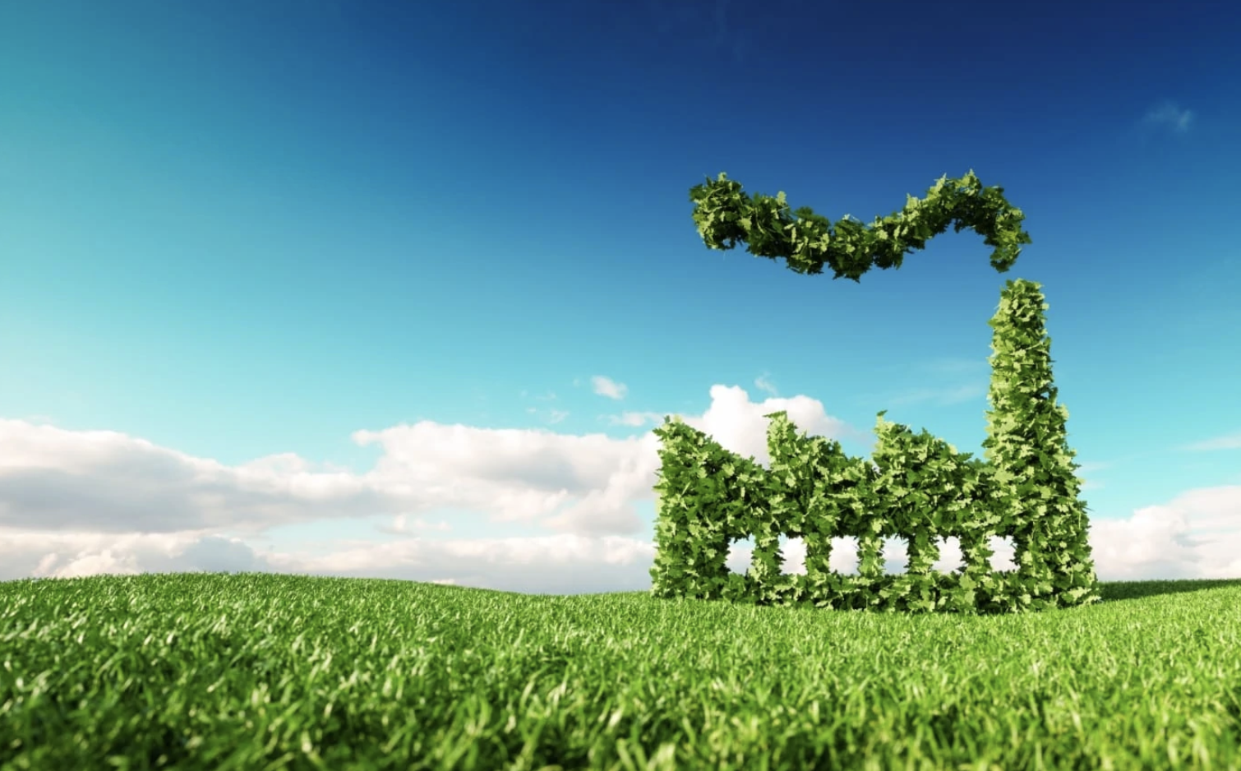
Conclusions and outlook
No evident showstopper in using HFO in place of TFE found: at the macroscopic level the performance before and after the irradiation campaign is basically similar.
After the end of July 2024 some chambers were brought off the GIF++ and opened for material studies: (see L. Quaglia later today on and https://indico.global/event/16058/contributions/154198/)
General comment: disentangle effects due to HFO wrt. the ones due TFE not trivial: more studies needed on this topic.
The RPC detector community is on the eve of its ecological transition

