Slide 1
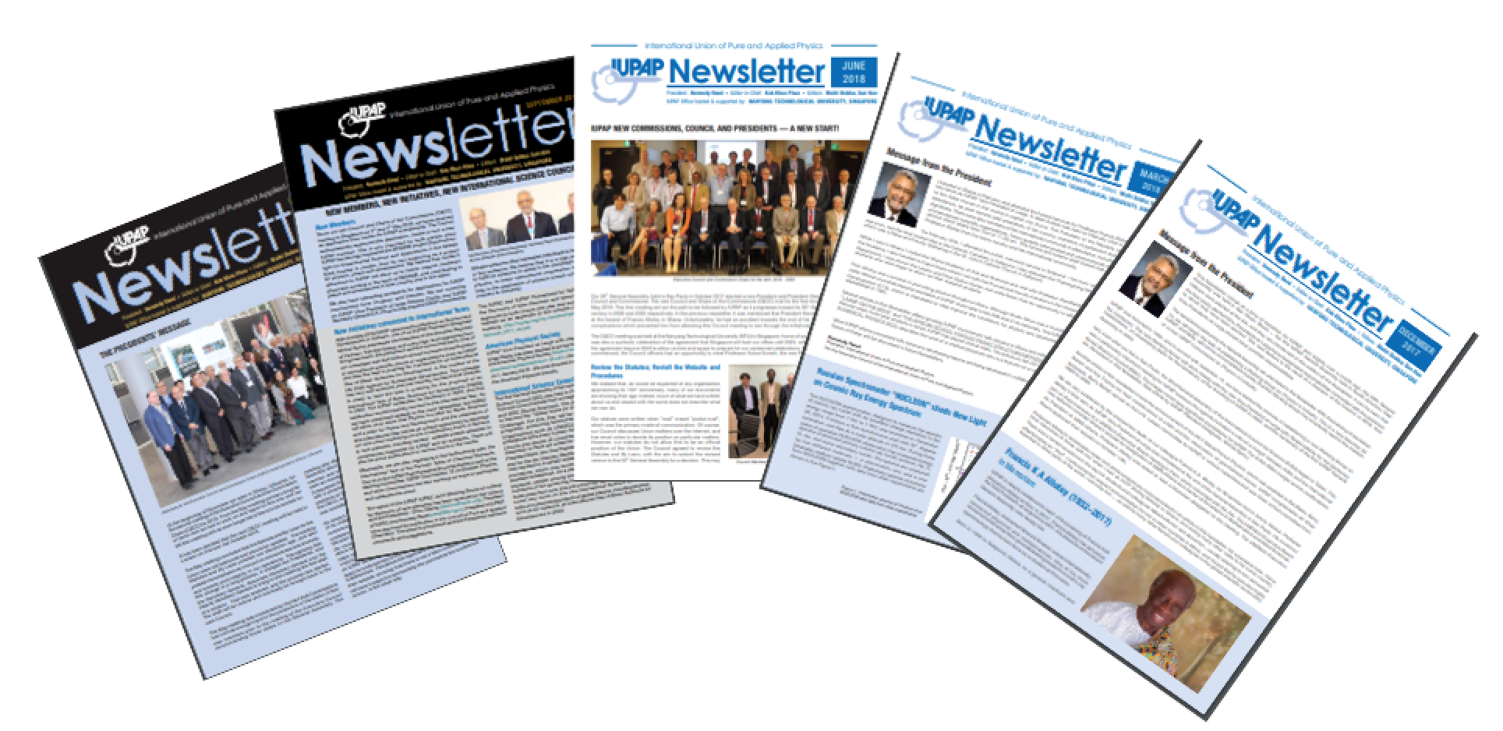
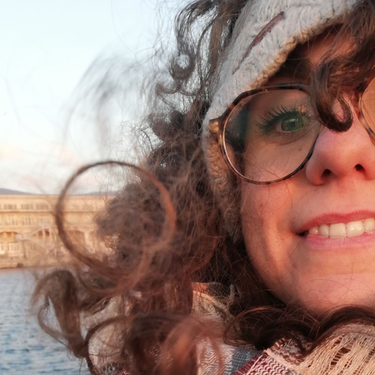
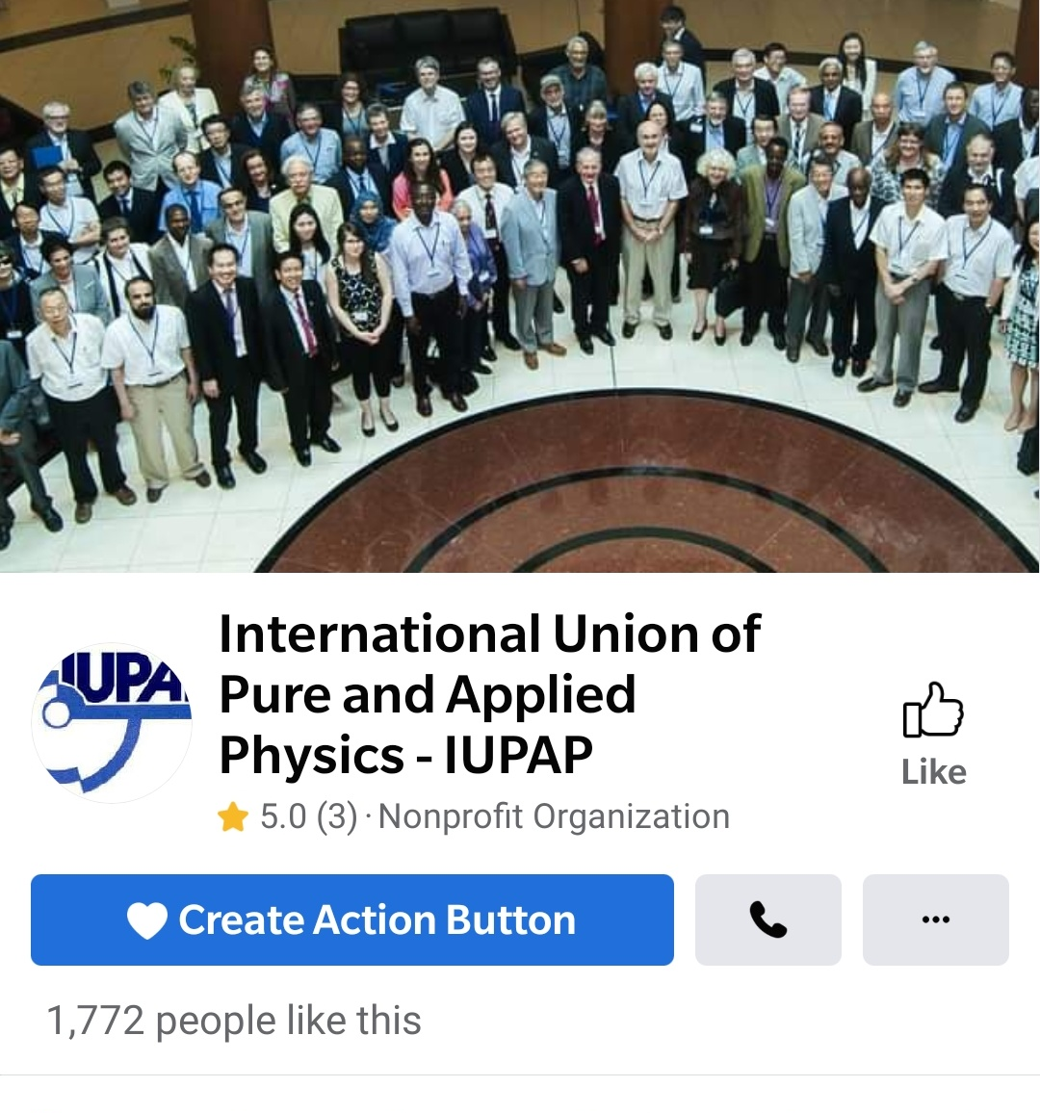
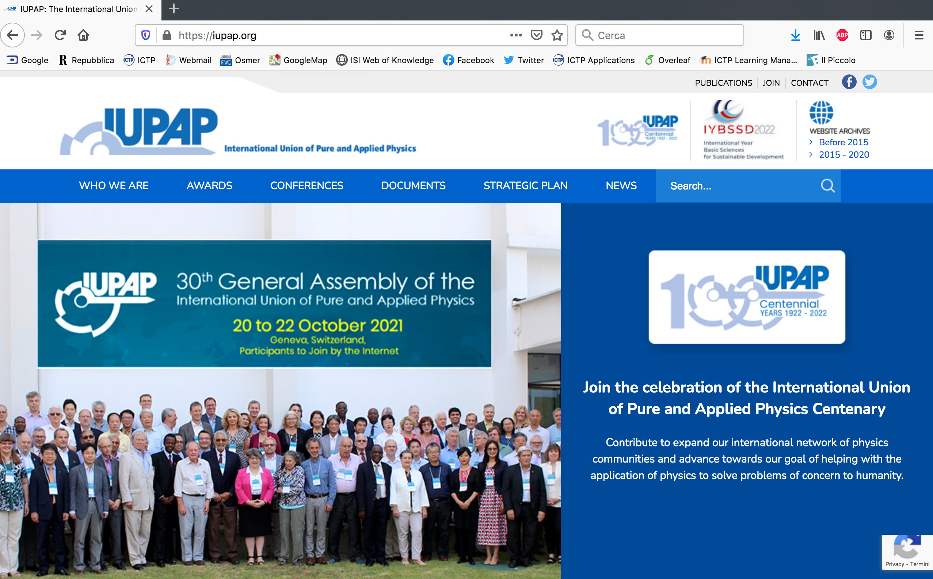




IUPAP Communication EC&CC October 2025
Francesca Zavino
communication@iupap.org

Slide 2
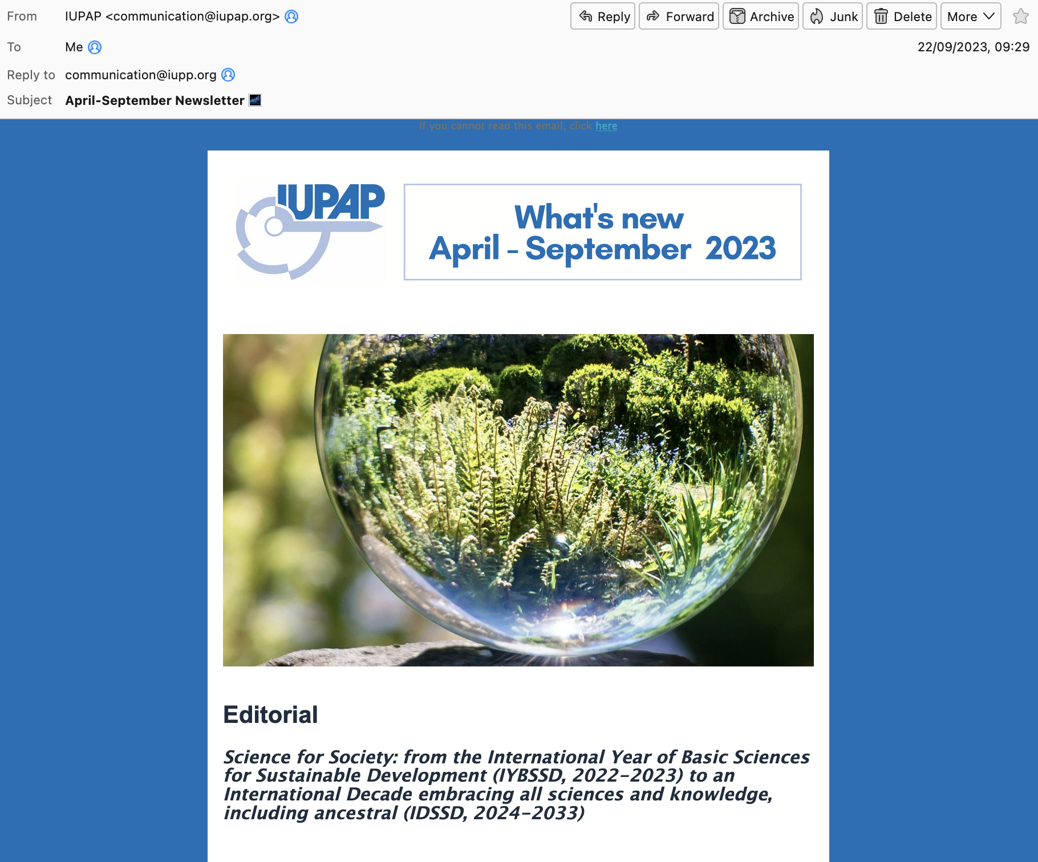
IUPAP Communication
e-Newsletter
e-newsletter
(almost) quarterly
pdf posted on website
2,434 contacts
(+1,304 from 2024!!)

Slide 3
IUPAP Communication
e-Newsletter contents
April - 2025
Editorial
The third ISC General Assembly and the Muscat Global Knowledge Dialogue
International Year of Quantum Science and Technology
Meet Our Team (Rudzani Nemutudi)
Early Career Scientist Prizes
August – 2025
Editorial
IYQ2025 Events
Stellar
29th STATPHYS
First StatPhys Satellite Event Held in Rwanda
Early Career Scientist Prizes

Slide 4
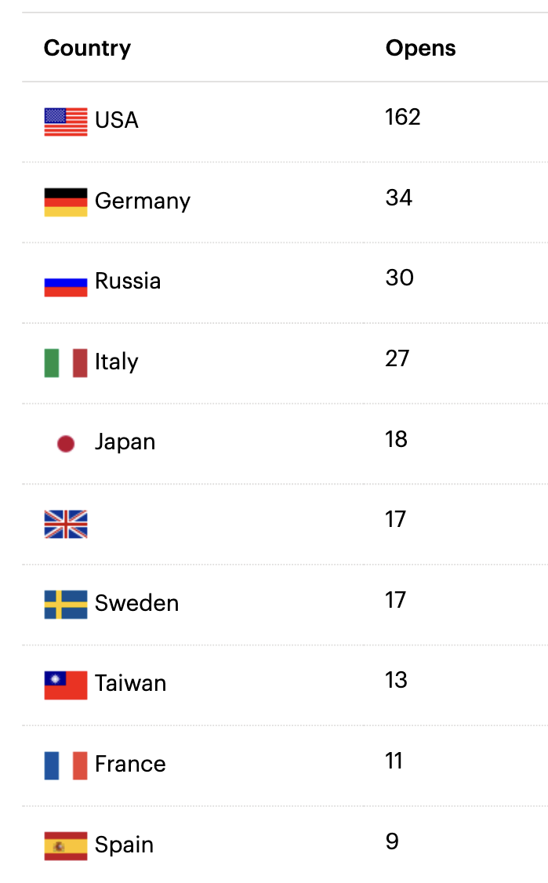
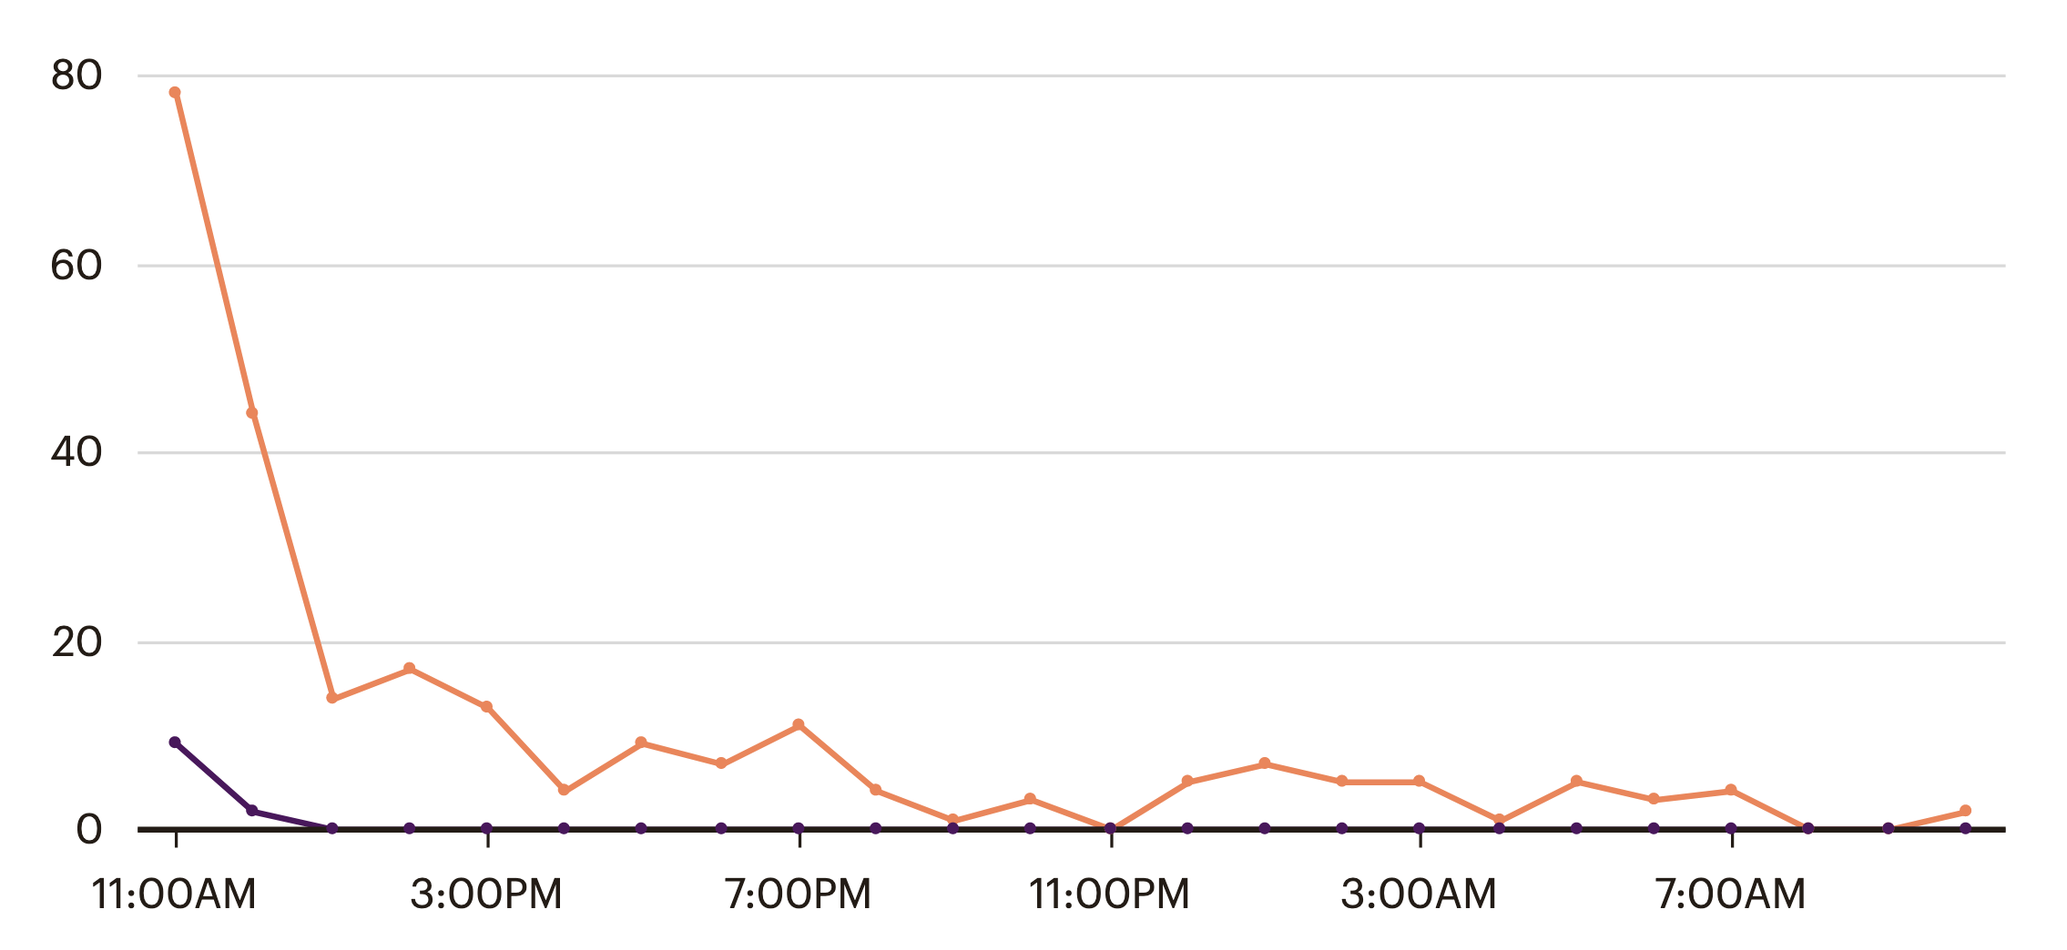
IUPAP Communication
e-Newsletter
2434 email addresses
. 54% read (opened) the message
. 19% clicked on link
Opened
Clicked
24 hours

Slide 5
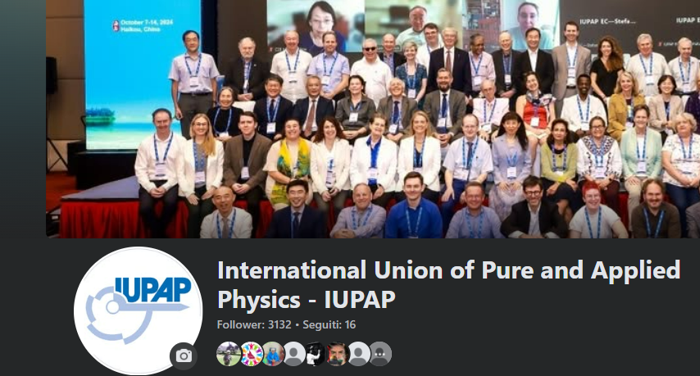
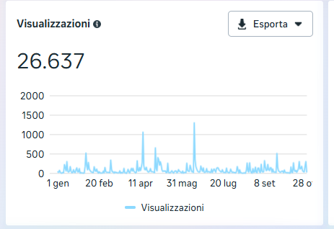
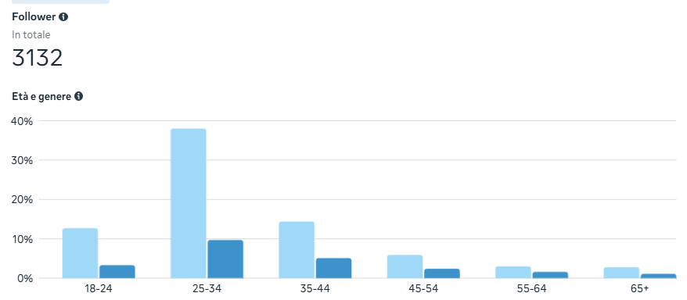
IUPAP Communication
Facebook page
Regular Facebook posts (1-2/week)
Reach
Followers

Slide 6

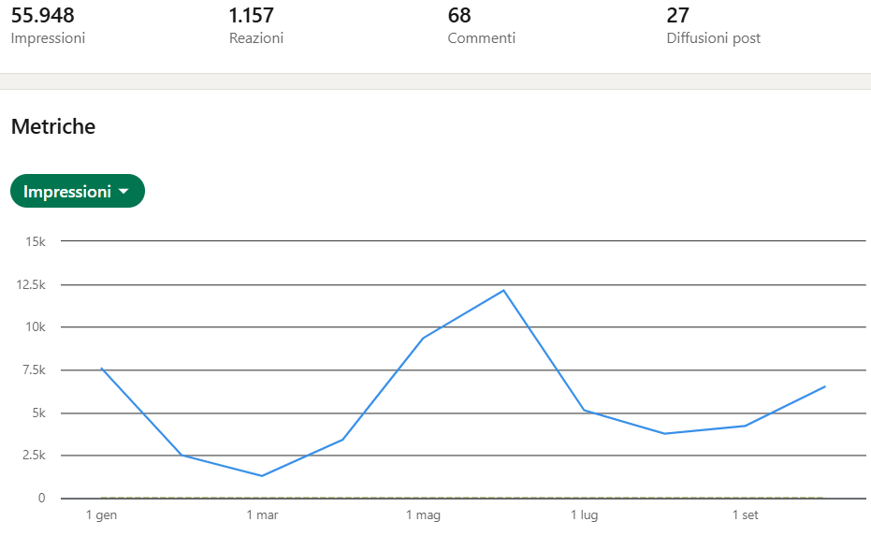
IUPAP Communication
Social media
Facebook: followers: 3132 (+159 from Jan 2025)
LinkedIn (2330 followers)
Impressions: 55.948 (2025)
Collaboration with communication teams at other organizations (ICTP, CERN, IYBSSD, other Unions, UNESCO, etc) for post re-sharing

Slide 7

IUPAP Communication
Website
Updated by communication team
Commissions/AC/WG are responsible for their content on website
-> please send your content/updates to communication@iupap.org
Francesca
Hari
Silvina

Slide 8

IUPAP Communication
Homework for you (especially Chairs)
Please send us (to communication@iupap.org):
  Content updates for website from Commissions / AC / WG
  Newsworthy updates (e.g. conferences, events) - send pics & brief text
  Early Career Scientist Prize winner information (and other awards)
  Commissions will be contacted for rotating «feature» in newsletter
  Any other suggestions to improve the communication
Please help us sharing news on social media and involving local communication officers when relevant (please tag @iupap in your posts!!)

Slide 9
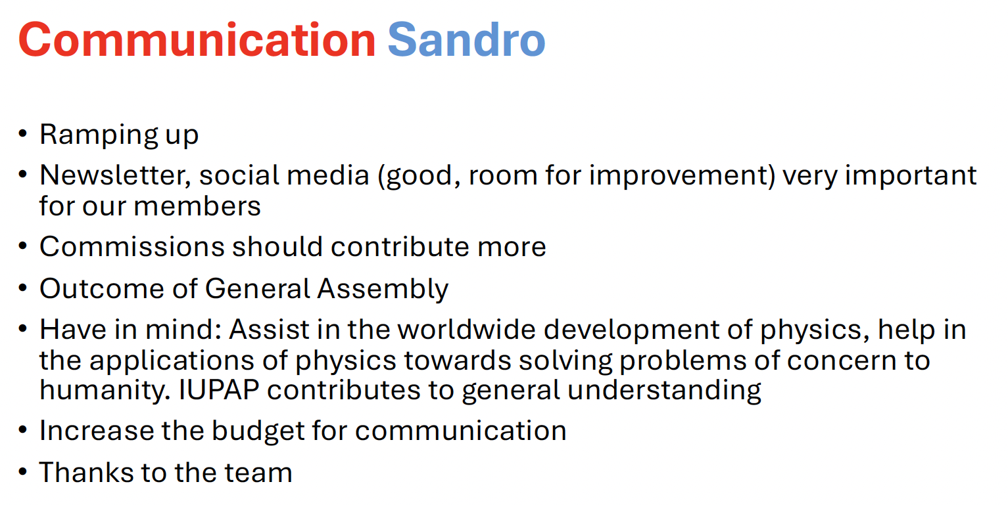
IUPAP Communication
Recommendations from EC&CC October 2024
From Michel’s EC&CC 2024 summary slides

Slide 10
IUPAP Communication
Who’s who
Francesca Zavino
A special thanks to Hari Haran (GRAPES-3 experiment, Tata Institute of Fundamental Research) for help with web site
communication@iupap.org: News and web items
[managed by Francesca Zavino]
secretariat@iupap.org: All types of «business» messages
[managed by Gabriella Marra, read by entire EC]

