Slide 1

WG 20: Open Science
Alex Hansen
PoreLab, Department of Physics
Norwegian University of Science and Technology

Slide 2

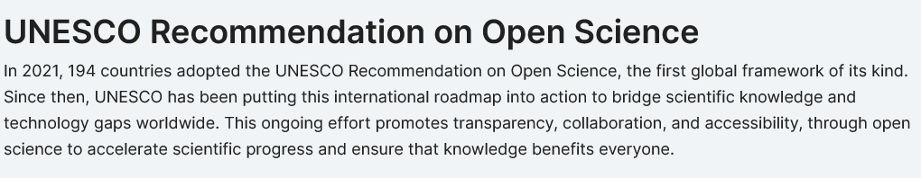

Slide 3
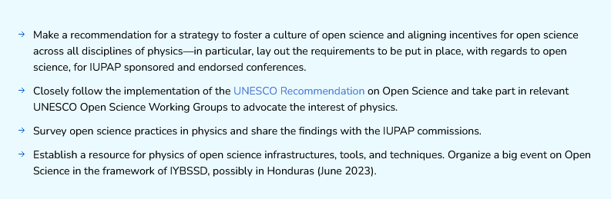

WG20 – Working Group on Open Science

Slide 4

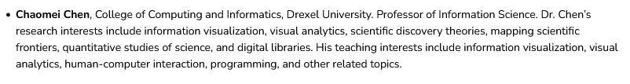
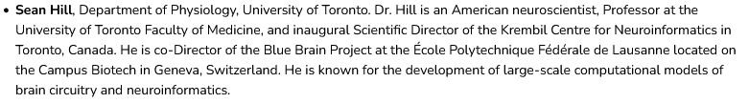

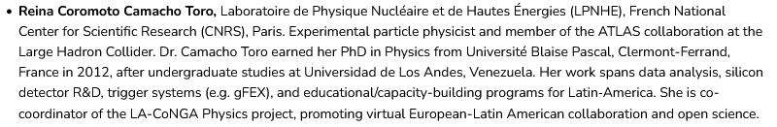
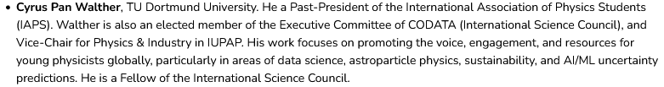

Slide 5

Scientific publications
Research data
Educational resources
Software and source code
Hardware
WG20: Place the UNESCO recommendations in a physics context

Slide 6
Scientific Publication: Open access
Revolution in scientific publishing
As big as the Gutenberg revolution in the 15th century.
Part of a bigger revolution:
The information revolution
Traditional subscription-based publishing
Business model that was made for publication on paper.
Truth is no longer a yes/no question.
Not compatible with on-line publishing.
Giving the ownership of scientific work to the publisher in perpetuity.
Printing press one of several reasons behind the European 30-year war.

Slide 7
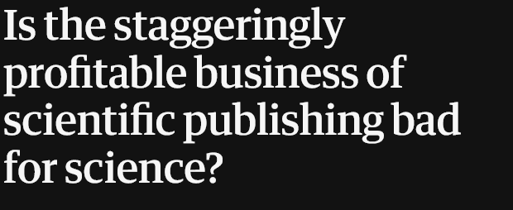
Scientific Publication: Open access
Revolution in scientific publishing
As big as the Gutenberg revolution in the 15th century.
How scientific publishing became big business.
Traditional subscription-based publishing
The Guardian:
June 27, 2017
Giving the ownership of scientific work to the publisher in perpetuity.

Slide 8
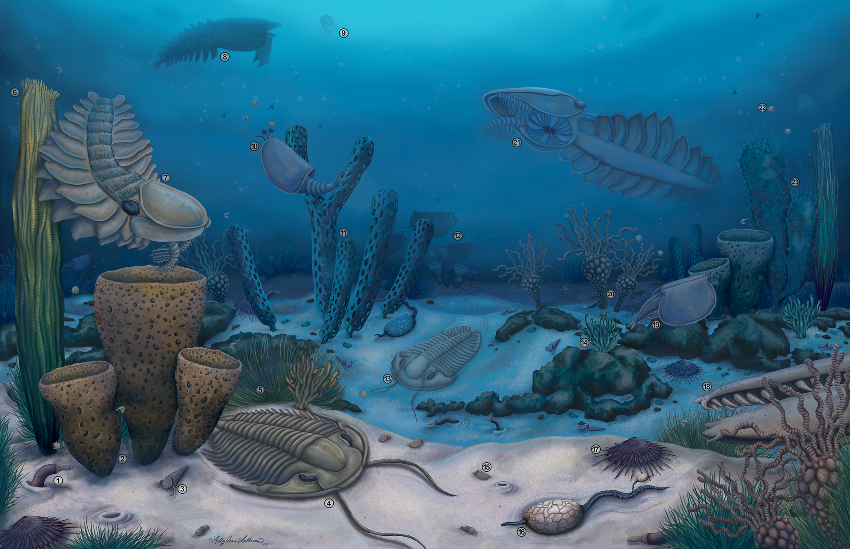
Scientific Publication: Open access
The scientific publication revolution:
Single cell organisms to multiple cell organisms.
Cambrian explosion
No rules: All sorts of creatures developed.
Darwinean selection starts, only the well adapted survive.
Scientific publishing: Same revolution.
Predatory journals.
They will disappear.
New business model:
Gold open access: Shifting the cost of publication from reader to author.

Slide 9
Scientific Publication: Open access
Gold open access
Shifting the cost of publication from reader to author.
Publishing is part of the expense in doing science.
Trend: National agreements between publishers and libraries.
Problem: What about poor nations? How do they get to publish under this paradigm?
My solution: All publishers are mandated to create a publication fund.

Slide 10
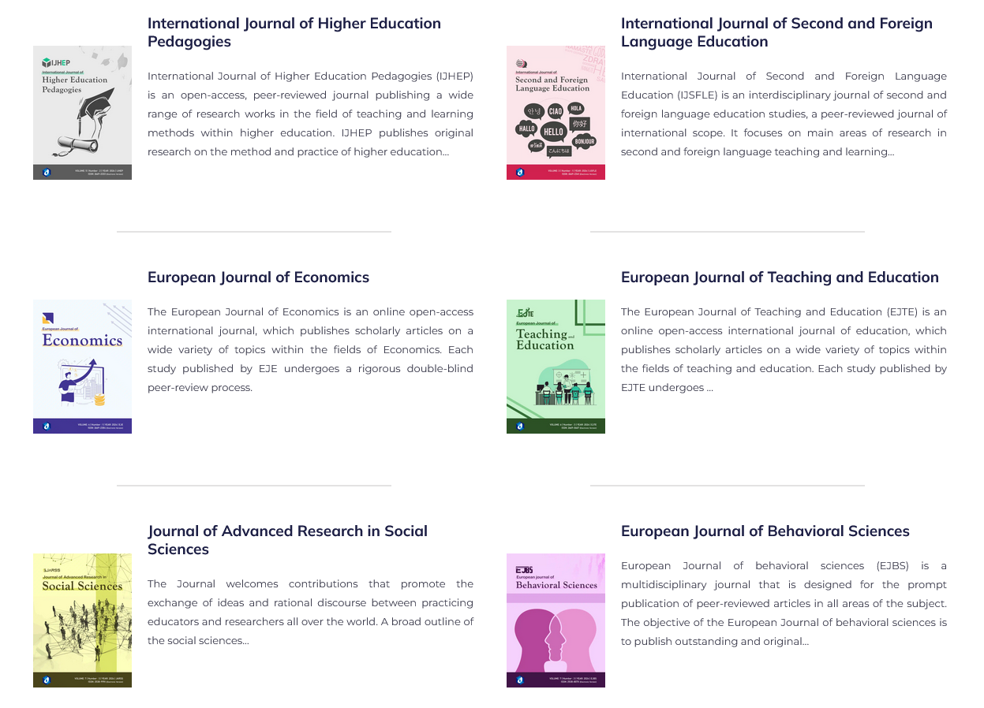
Scientific Publication: Open access
Diamond open access

Slide 11
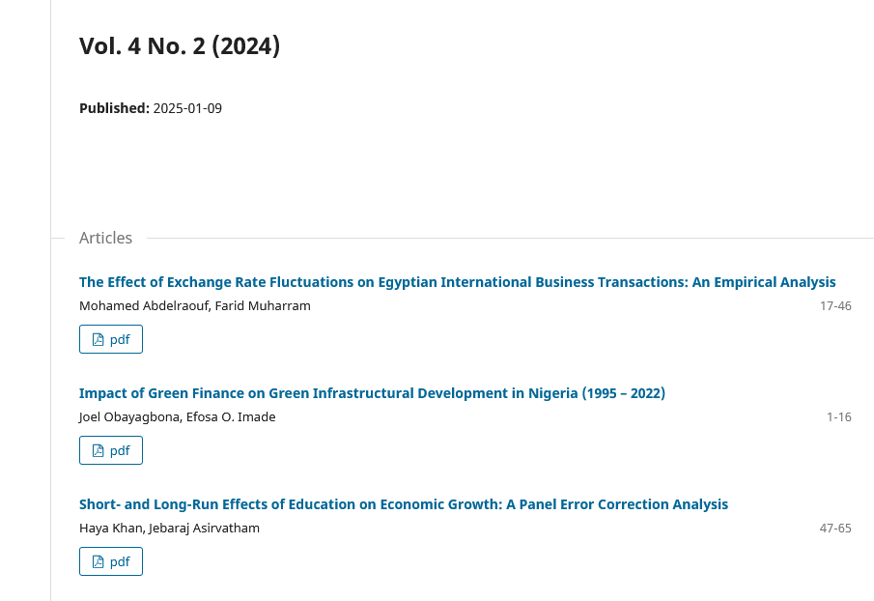
Scientific Publication: Open access
Small journals with limited resources.
Typically based within a university department.

Slide 12
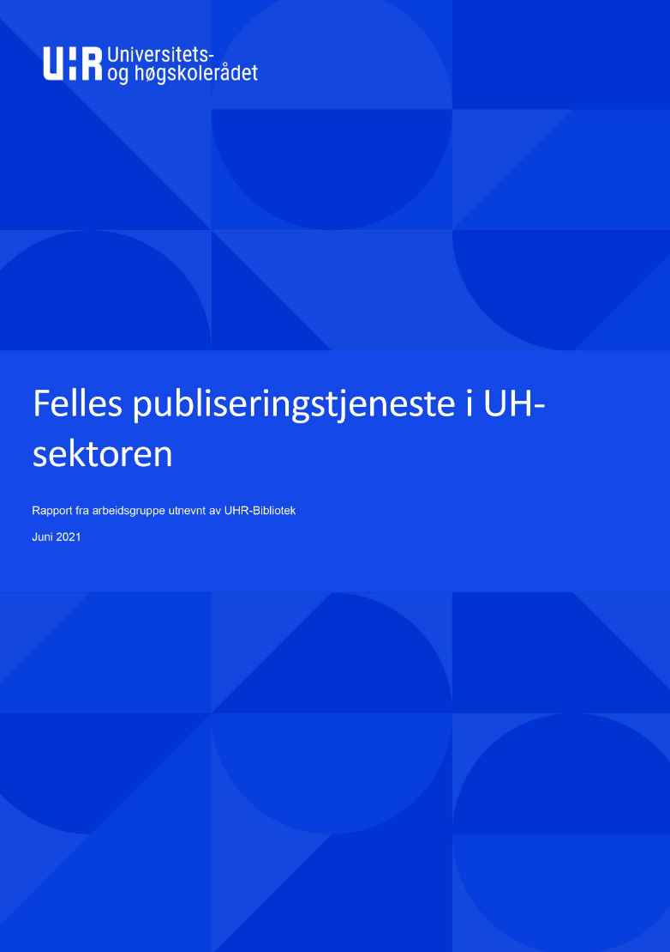
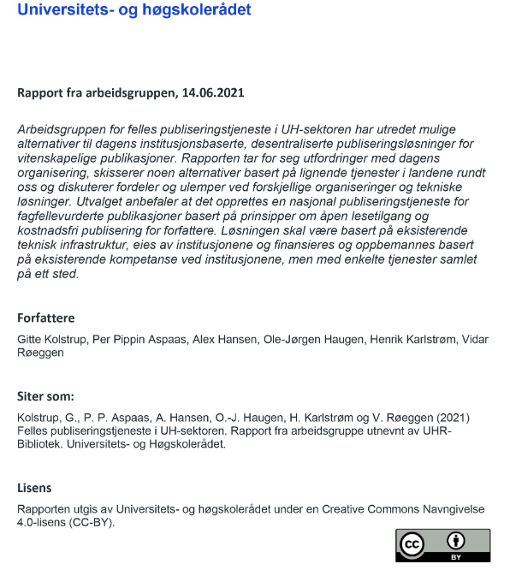


Scientific Publication: Open access
The group recommends the creation of a national publication service for reviewed publications based on principles of open access and free publication for authors.

Slide 13
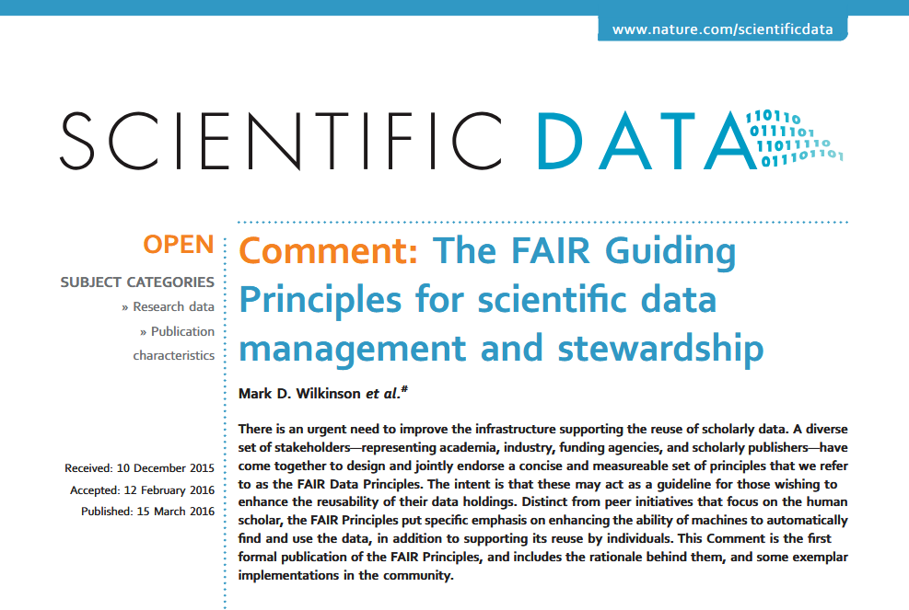
Research Data: Preservation and Open Access

Slide 14
Research Data: Preservation and Open Access
Findable
Accessible
Interoperable
Reusable
FAIR

Slide 15
Research Data: Preservation and Open Access
Sean Hill:
100 data sets generated
80 data sets are lost
20 data sets are made available
4 data sets are reused
2 data sets are fully FAIR compatible
1 data set is shared and cited.

Slide 16
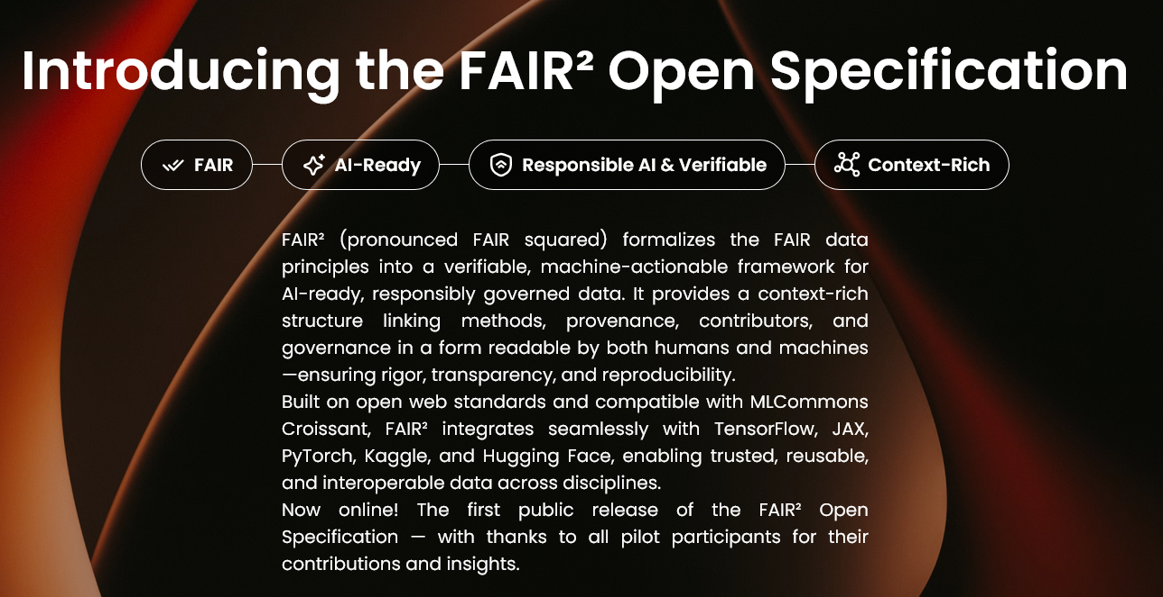
Research Data: Preservation and Open Access

Slide 17
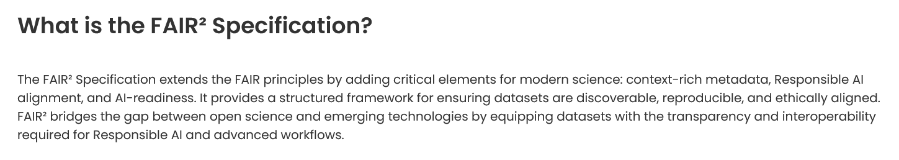


Research Data: Preservation and Open Access
New type of publication (Senscience): AI-written data article describing and
containing the data making them FAIR-compatible.

Slide 18
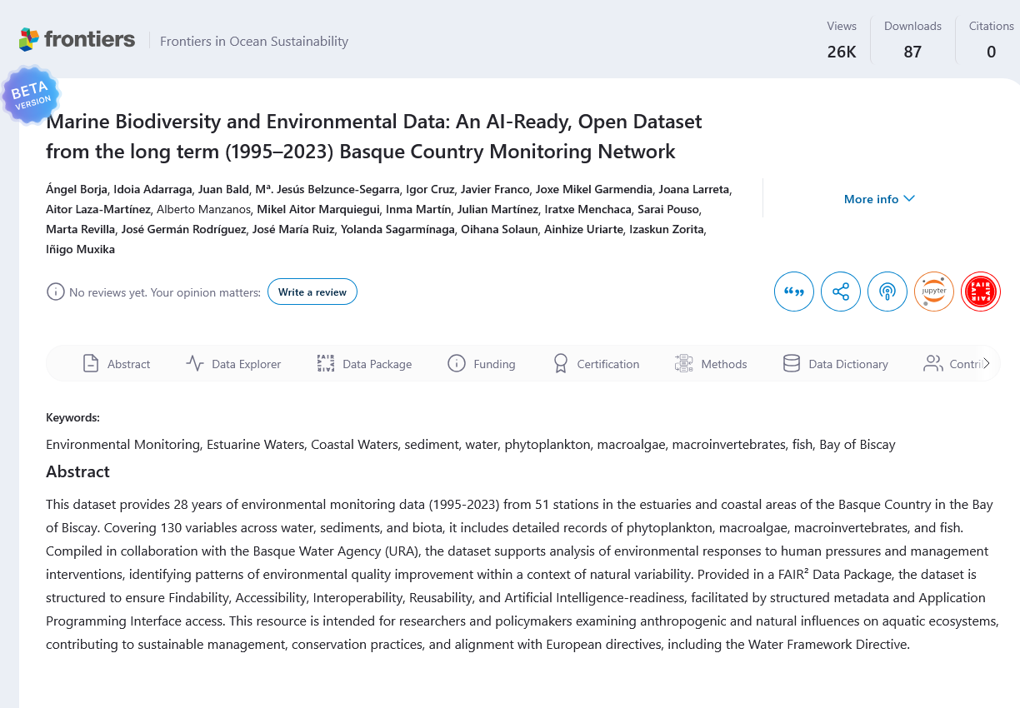
Research Data: Preservation and Open Access
https://sen.science/doi/10.71728/r1rj-f947/dashboard

Slide 19



IUPAP: Cyrus Walther member of ExCom.

Slide 20
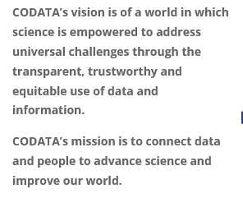

Slide 21

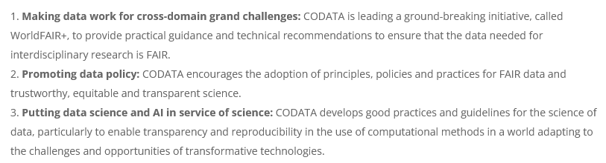

Slide 22
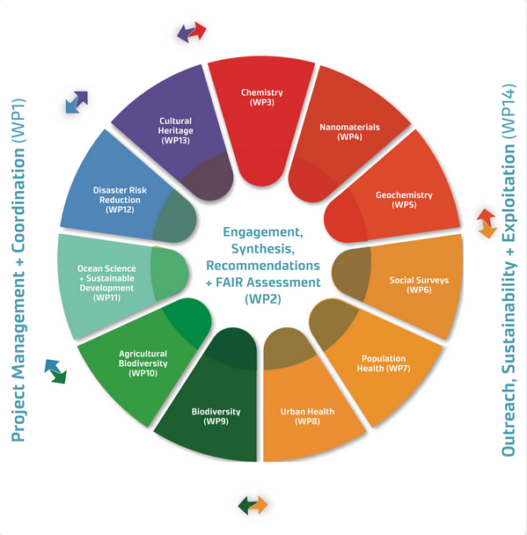
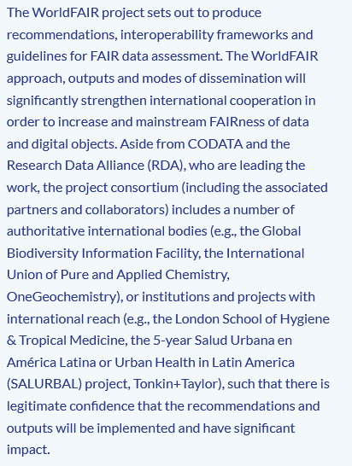


FAIR and transdisciplinarity

Slide 23

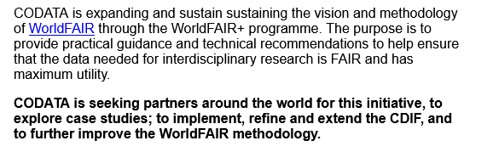
CDIF: Cross-Domain Interoperability Framework

Slide 24


Slide 25
WG20: Place the UNESCO recommendations in a physics context
Scientific Publications
Research Data
Educational Resources
Software and Source Code
Final report in time for IUPAP GA 2027.
Hardware

