Slide 1
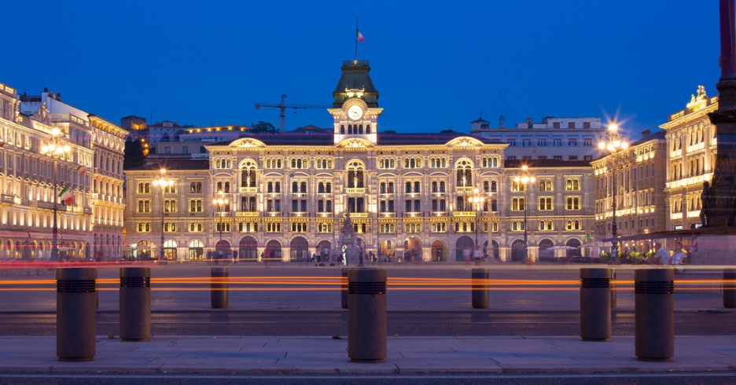


Welcome to Trieste
Stefano Fantoni
(IUPAP Secretary General for Administrative Affairs, FIT President)

Slide 2
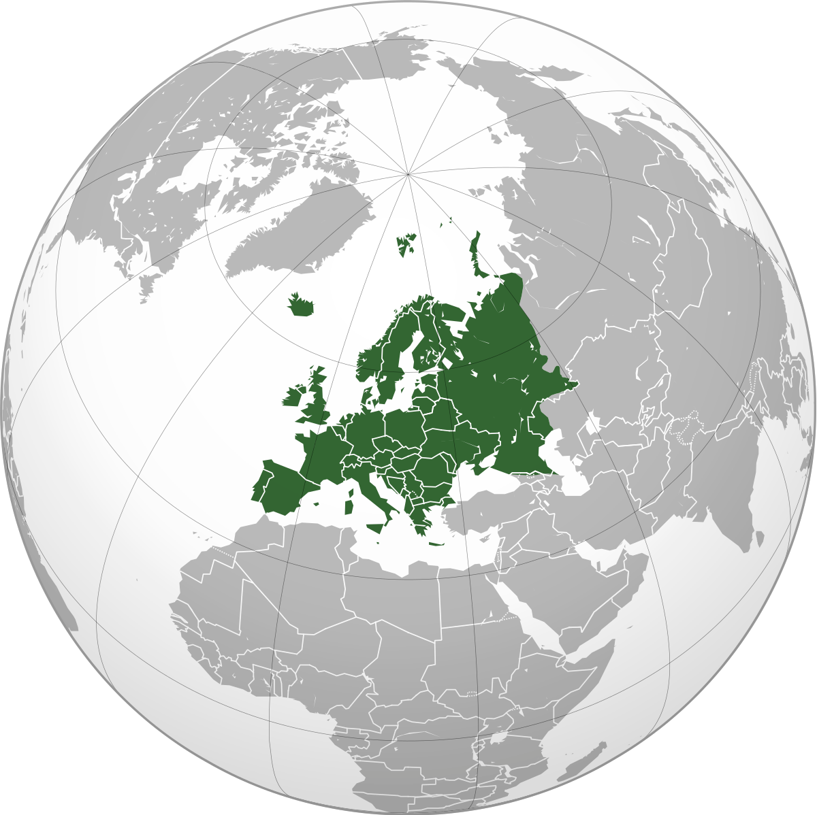
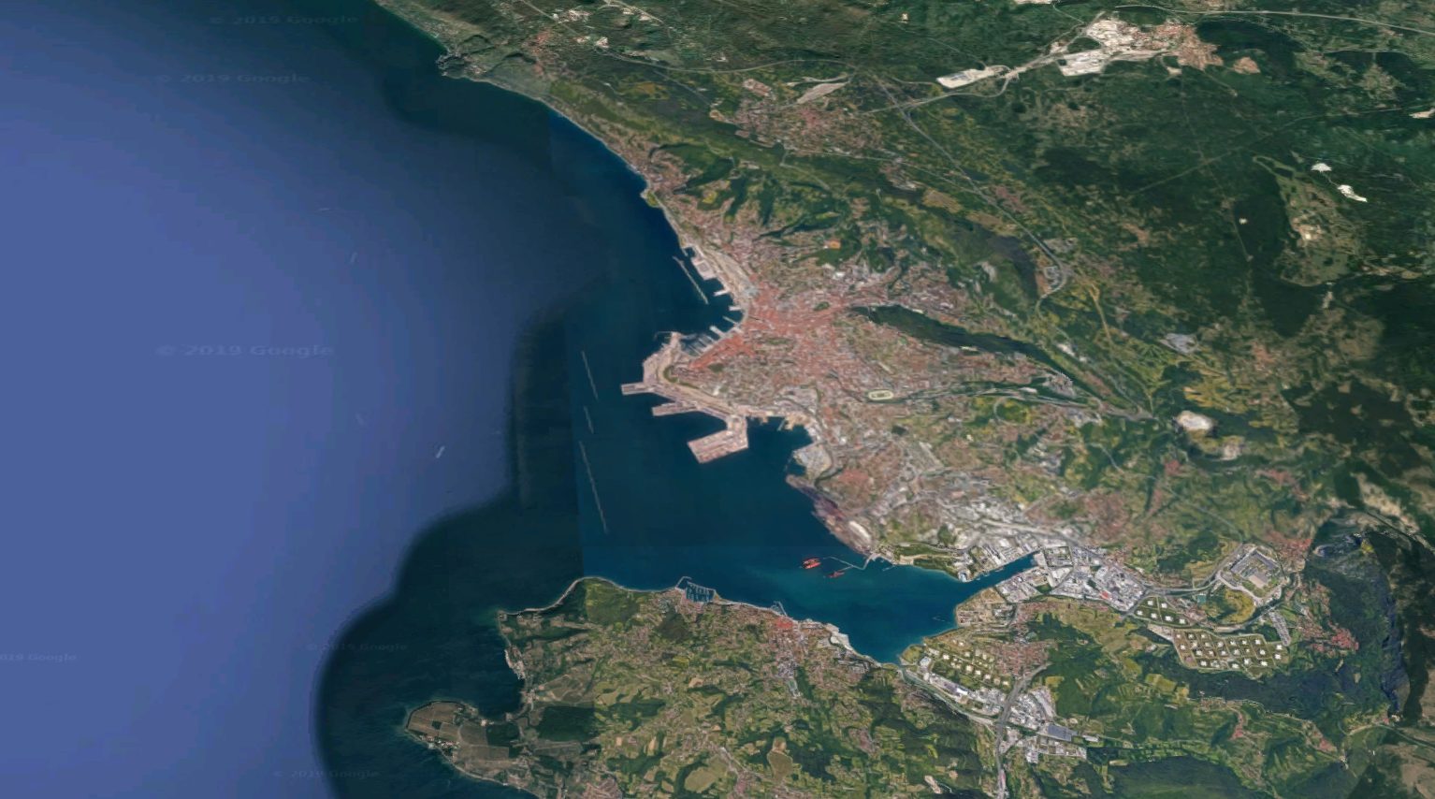
The “Trieste Science System”
TWAS
OGS
ICTP
More than 150,000 physicists have visited ICTP from all over the world
Trieste is the city with the highest density of researchers in Europe
Trieste was the European City of Science 2020
Hosts the National synchrotron radiation facility (Elettra)
The largest national Science Park
SISSA
Univ of
Trieste
Area Science Park
ICGEB
CNR
Elettra

Slide 3
The Trieste International Foundation for the Progress and Freedom of Science (FIT)
Created in 1980 by Abdus Salam and Paolo Budinich to promote and support the development, freedom and dissemination of science, and its peaceful applications.
FIT is a private-law entity regulated by statute and bylaws. Its legal status is recognized by the Italian Ministry of Education (with no restriction on any country ).
FIT members: most Trieste-based scientific institutions, including ICTP, SISSA, TWAS, University of Trieste, University of Udine, OGS, the “Elettra” synchrotron radiation facility.
FIT has organized ESOF2020, Trieste European City of Science, and is actually in charge of a Laboratory on quantitative sustainability (TLQS).
FIT has signed on 2021 a MoU with IUPAP, extended up to 2026 for its administrative secretary

Slide 4
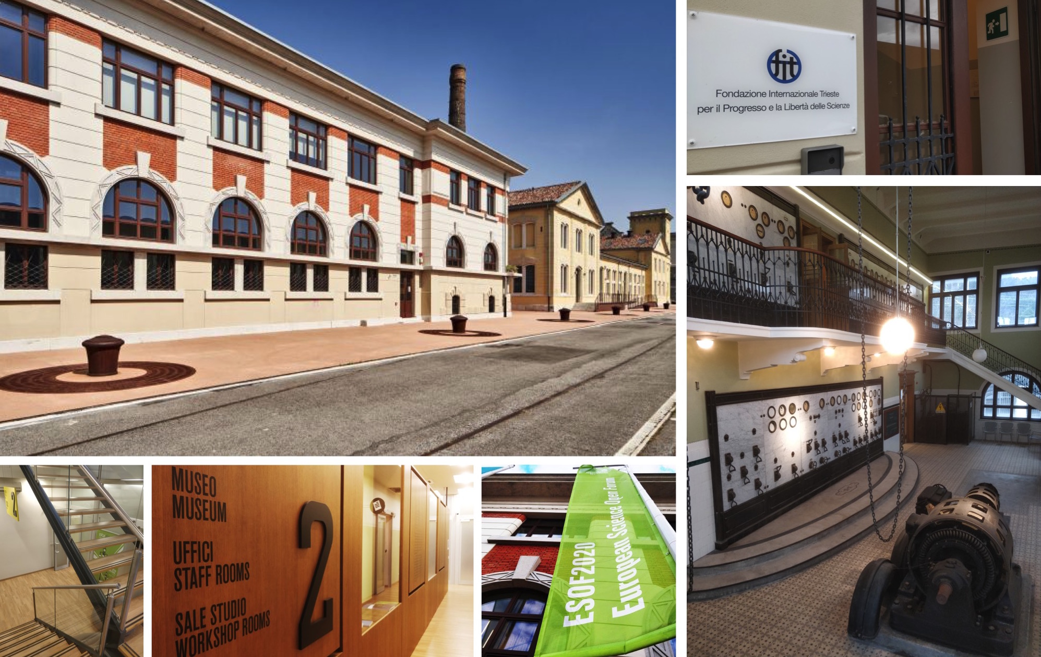
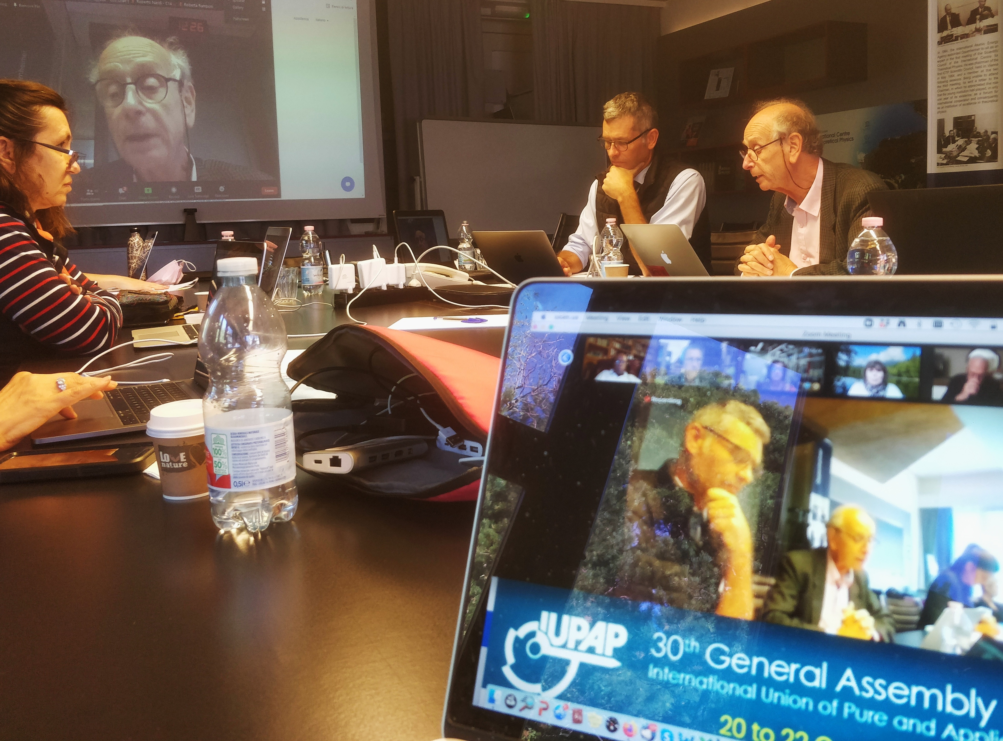
Where we are
In 2024 the IUPAP headquarters moved its administrative offices at the original location: the first floor of SottoStazione Elettrica (SSE) building of Trieste Porto Vecchio.
IUPAP events held in Trieste:
2021: General Assembly
2022: IUPAP Centenary (with EC&CC and GA)

Slide 5
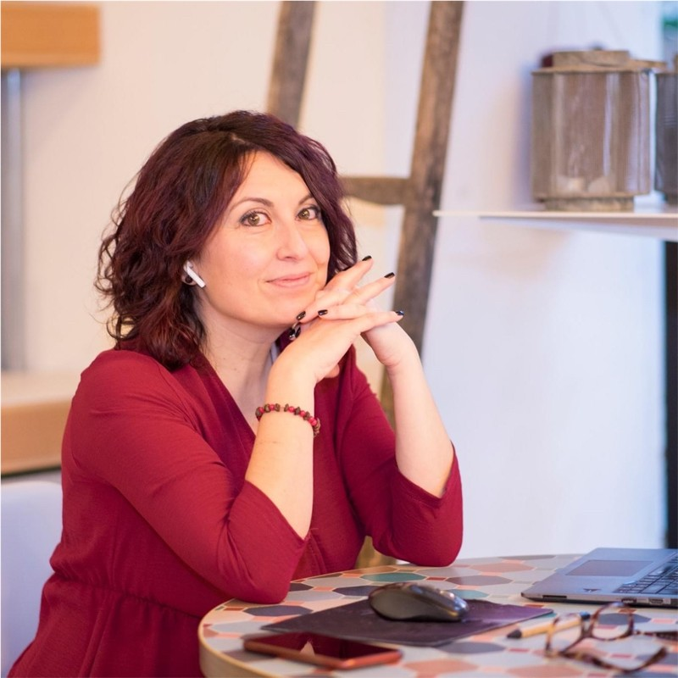
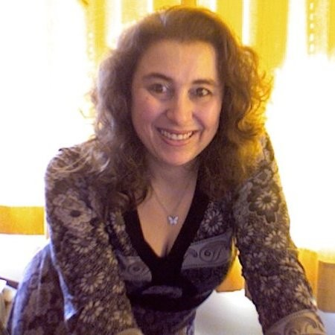

IUPAP team in Trieste
Stefano Fantoni Secretary General for Admin Affairs
Sandro Scandolo Deputy Secretary General
Gabriella Marra IUPAP Secretary
Ariella Kranjek FIT Secretary
Francesca Zavino IUPAP Communication
Contacts:
secretariat@iupap.org (all administrative matters)
communication@iupap.org (Web updates, newsletter, etc.)

Slide 6
Main activities on 2025
• Operational coordination: drafting minutes and supporting the preparation of general assemblies and periodic meetings of the governing bodies (approximately 15);
• Administrative and financial collaboration with the Geneva headquarters: supporting accounting procedures and financial interactions between the Secretariat, member countries, and external institutions, ensuring a smooth flow of information and paperwork (60 member countries, 250 people including commission members, working groups, and the Executive Committee, external bodies where IUPAP is represented, and other bodies);
• International communication: updating the IUPAP website and information channels, disseminating news, promoting events and conferences, and supporting the visibility of scientific activities (Sandro Scandolo with the help of Francesca Zavino);
• Conference support: assisting in the selection, financing, and management of the international conferences sponsored by the Union (about 40);
• Membership and awards management; updating member records, managing applications, and supporting the assignment of scientific awards – (20 awards).

Slide 7
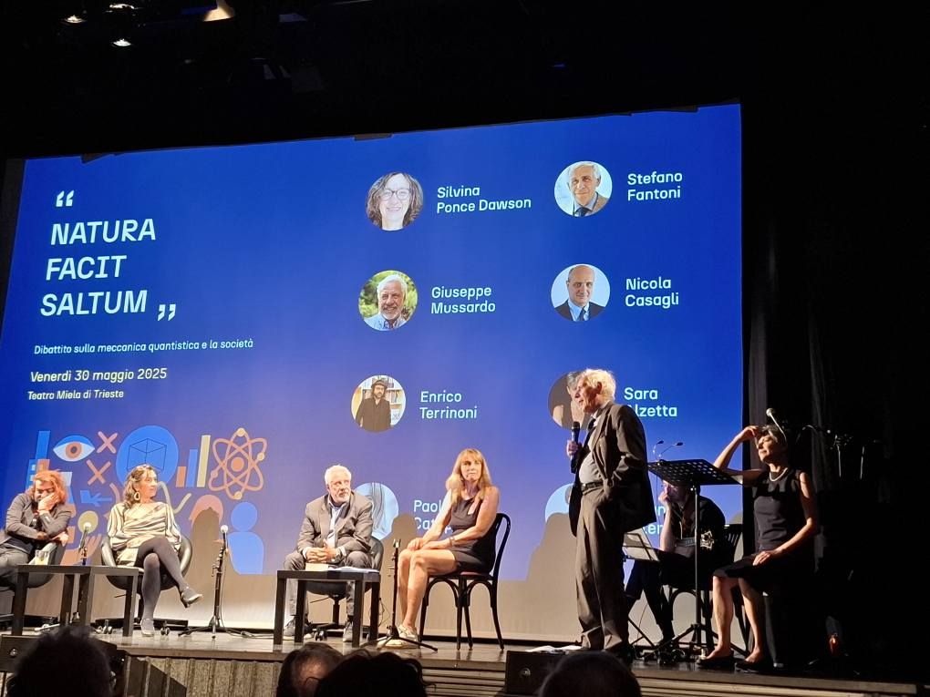
International Year of Quantum Science and Technology (IYQ2025)
A public event organized by FIT and ICTP on May 30, 2025, for IYQ2025

Slide 8
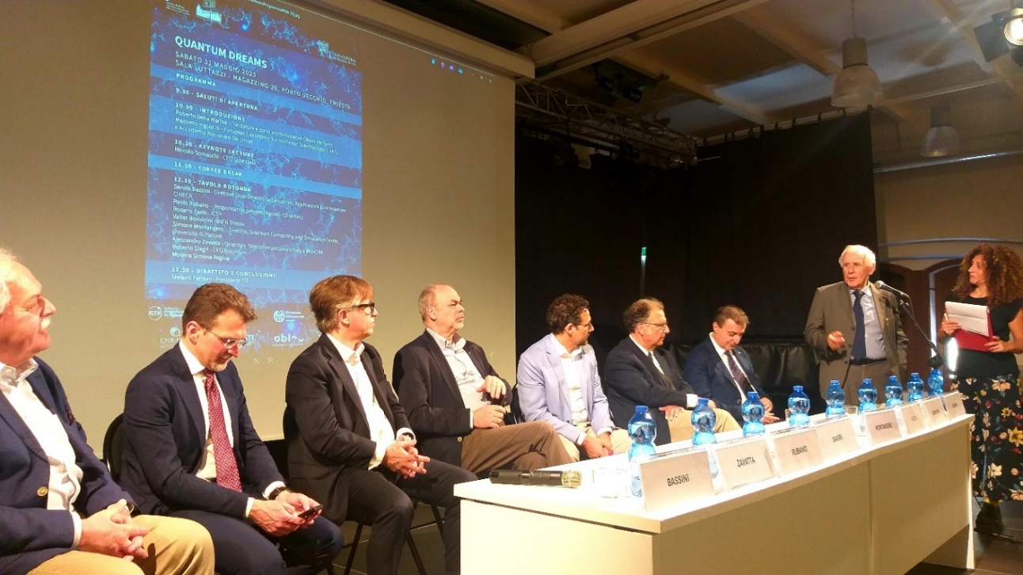
Quantum Dreams
Workshop organized by FIT and ICTP on how scientists, interpreneurs,
venture capitalists and policy makers see the future of quantum Technologies

Slide 9
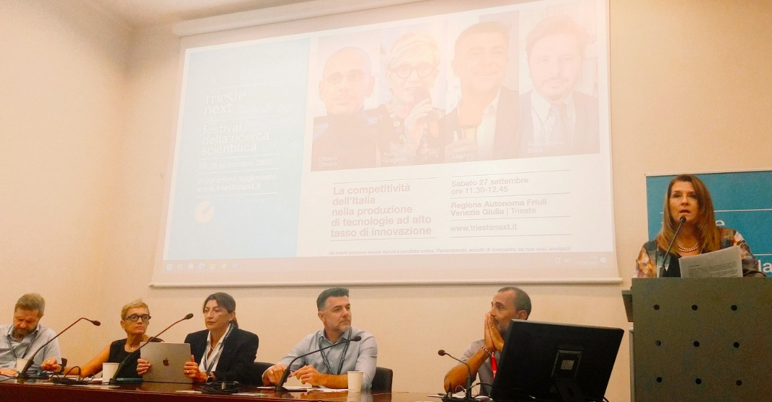
On the production of highly innovative technology
FIT meeting at the Trieste science festival NEXT 2025

Slide 10
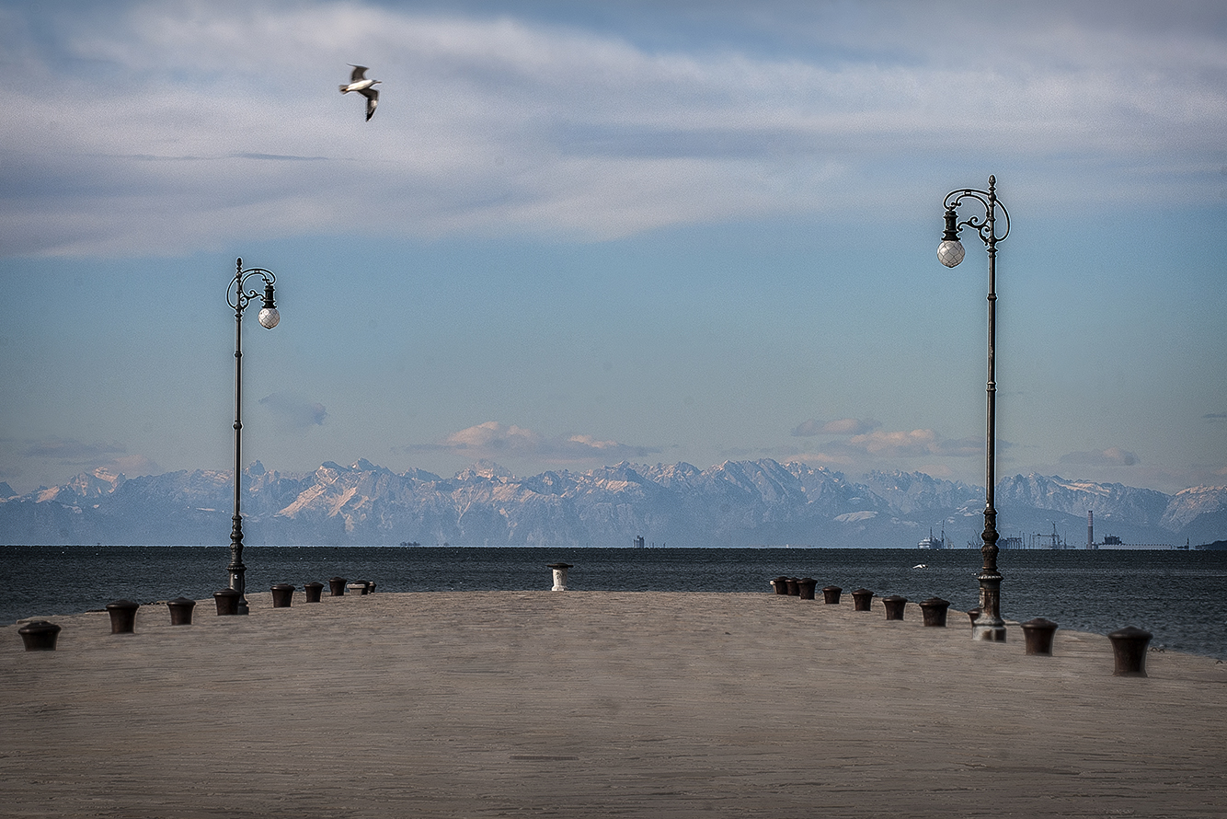
Thank You
…… looking towards the infinity of knowledge

