Slide 1
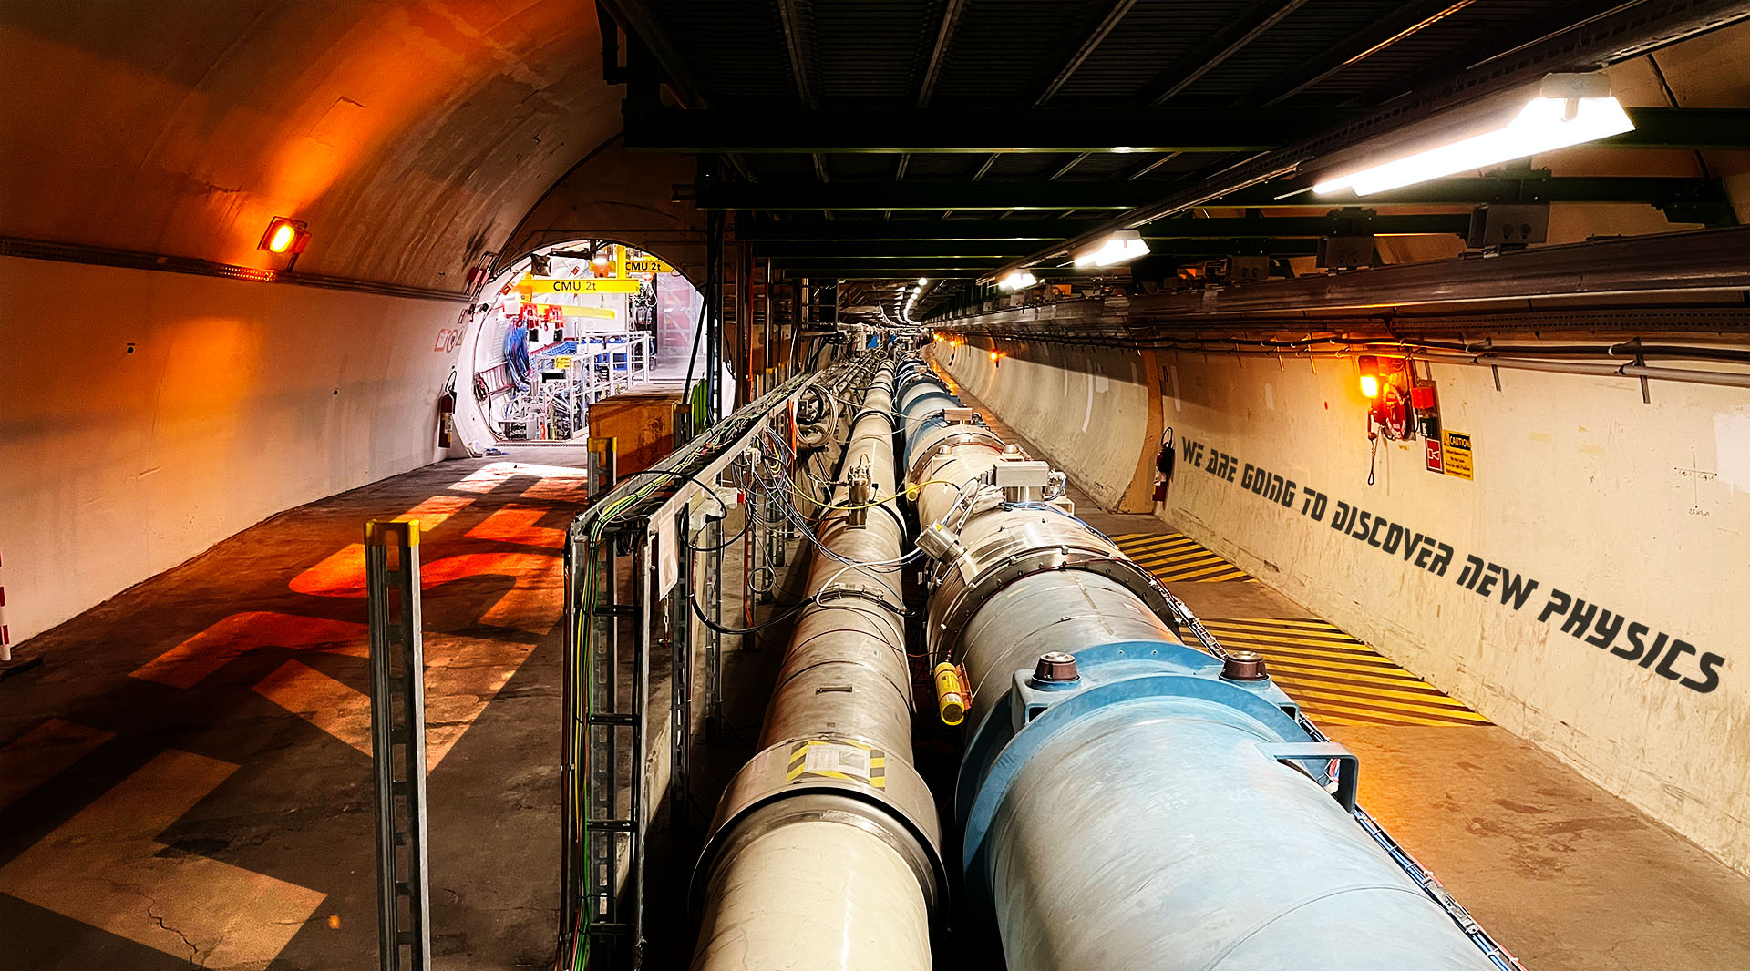









FASER and FPF
Akitaka Ariga
University of Bern
On behalf of the FASER Collaboration

Slide 2

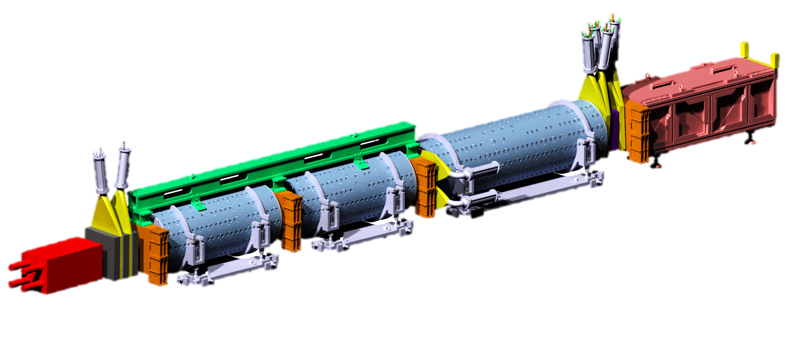


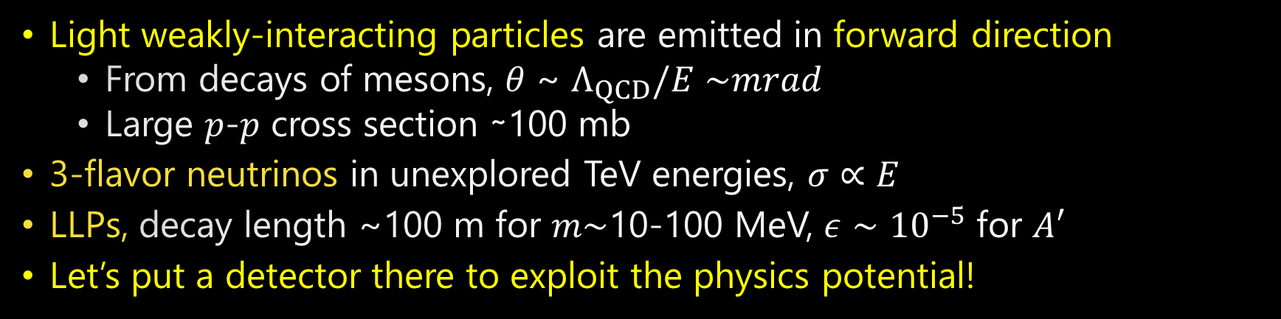






Physics concept of “forward” beam at the LHC
Light weakly-interacting particles
14TeV $p$-$p$ collisions
$$ALPs$$
$$A′$$
$$ν_{μ}$$
$$ν_{e}$$
$$ν_{τ}$$
$p$-$p$ collision axis
Strongly interacting massive particles
Light weakly-interacting particles are emitted in forward direction
  From decays of mesons, 𝜃 ~ $Λ_{QCD}/E∼$𝑚𝑟𝑎𝑑
  Large 𝑝-𝑝 cross section ∼100 mb
3-flavor neutrinos in unexplored TeV energies, $σ∝E$
LLPs, decay length ~100 m for 𝑚$∼$10-100 MeV, $ε∼{10}^{−5}$ for $A′$
Let’s put a detector there to exploit the physics potential!

Slide 3


The FASER experiment
FASER TP arXiv:1812.09139,
FASER$ν$ Eur. Phys. J. C (2020) 80: 61
FASER web page: https://faser.web.cern.ch/
FORWARD SEARCH EXPERIMENT AT THE LHC
Targets long-lived BSM particles (e.g. A’, ALPs) and SM neutrinos (and $μ)$
Located 480 m downstream of ATLAS interaction point
First experiment to utilize “collider neutrinos”
p-p collision at ATLAS
LHC tunnel
Charged particles
Neutrinos and LLPs
FASER
Neutral hadrons
LHC magnets
100 m of rock
Service tunnel
480 m

Slide 4
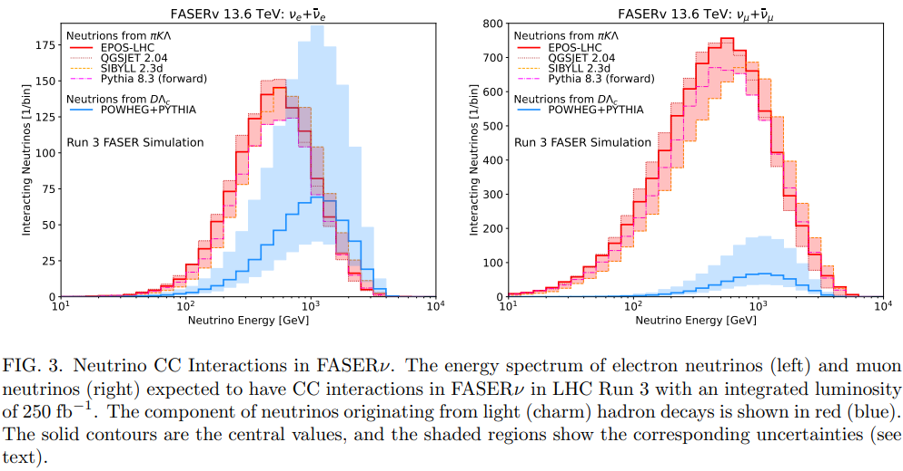
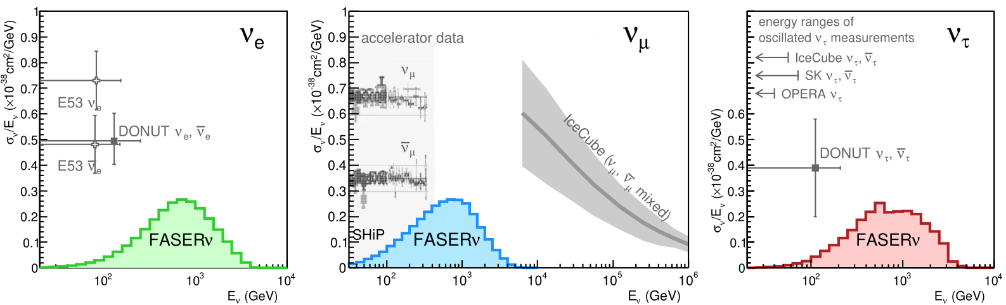
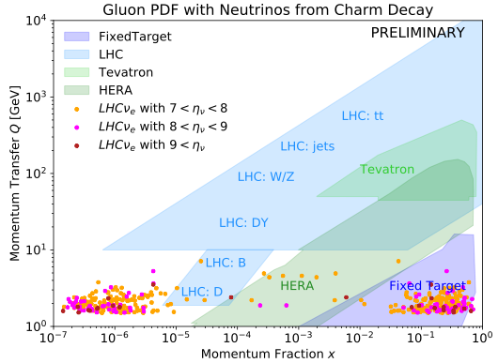

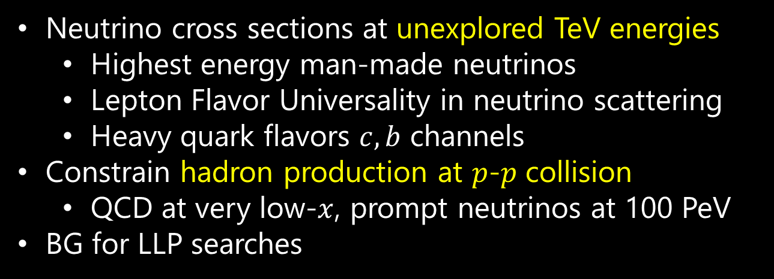

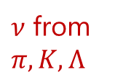
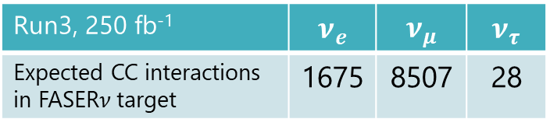
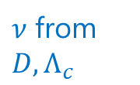
Neutrino studies in FASER
$ν_{e}$ flux uncertainty
$ν$ from $D, Λ_{c}$
$ν$ from $π,K,Λ$
Neutrino cross sections at unexplored TeV energies
  Highest energy man-made neutrinos
  Lepton Flavor Universality in neutrino scattering
  Heavy quark flavors $c, b$ channels
Constrain hadron production at $p$-$p$ collision
  QCD at very low-$x$, prompt neutrinos at 100 PeV
BG for LLP searches
$$x∼{10}^{−6}$$
Run3, 250 fb⁻¹ | $$ν_{e}$$ | $$ν_{μ}$$ | $$ν_{τ}$$
Expected CC interactions in FASER$ν$ target | 1675 | 8507 | 28
2402.13318
Notes:
Arxiv

Slide 5











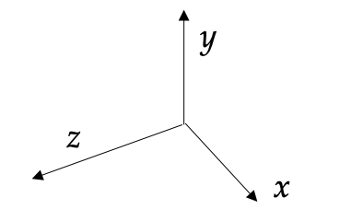
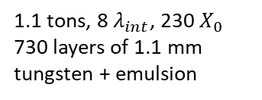
FASER detector
(ariXiv:2207.11427)
Small, inexpensive detector
  10 cm radius
  7 m long
2 x 20 mm thick
35 x 30 cm area
3 x 3 layers of ATLAS SCT strip modules
3 x 20 mm thick
30 x 30 cm area
4 LHCb Outer
ECAL modules
1.1 tons, 8 $λ_{int}$, 230 $X_{0}$
730 layers of 1.1 mm tungsten + emulsion
10mm thick + dual PMT readout (σ = 400 ps)
Air-core magnets
0.57 T Dipoles
1.5 m decay volume

Slide 6
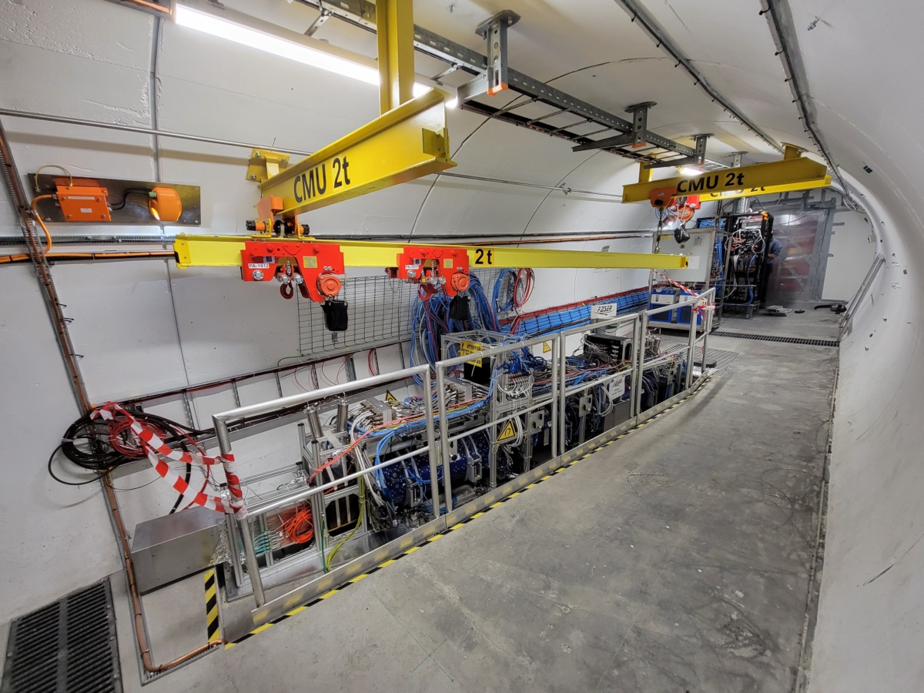
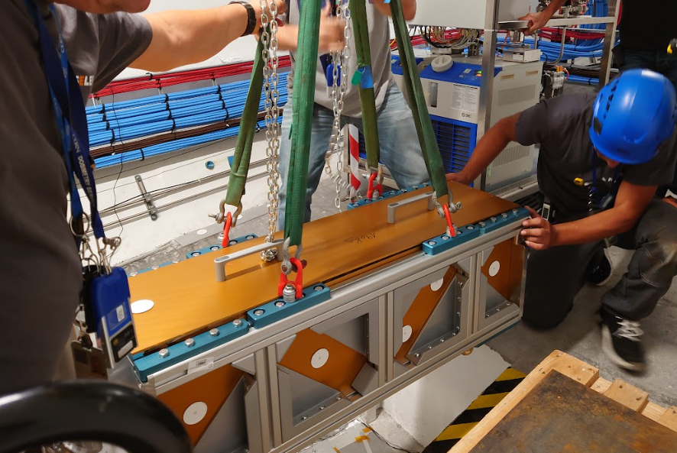


FASER$ν$
IFT
Veto
Decay volume
Tracking spectrometer
Calorimeter
Pre-shower
FASER$ν$ installation
3 times / year

Slide 7
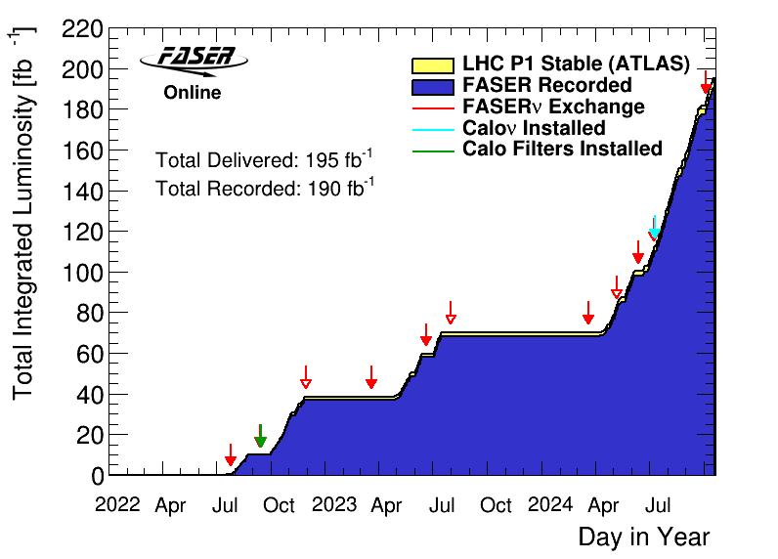
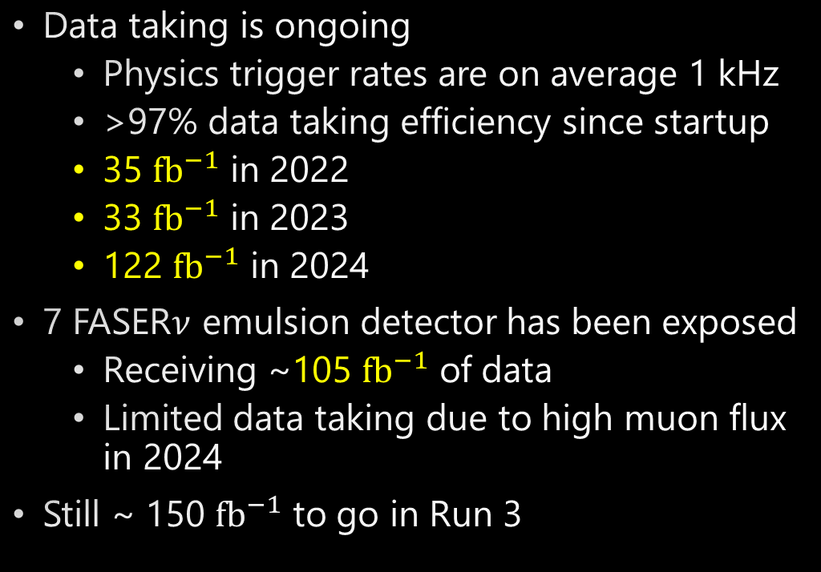

Data taking in LHC-Run 3
Data taking is ongoing
  Physics trigger rates are on average 1 kHz
  >97% data taking efficiency since startup
  35 $fb^{−1}$ in 2022
  33 $fb^{−1}$ in 2023
  122 $fb^{−1}$ in 2024
7 FASER$ν$ emulsion detector has been exposed
  Receiving ~105 $fb^{−1}$ of data
  Limited data taking due to high muon flux in 2024
Still ~ 150 $fb^{−1}$ to go in Run 3
(1 fb⁻¹ = 10¹⁴ $p$-$p$ collisions)

Slide 8
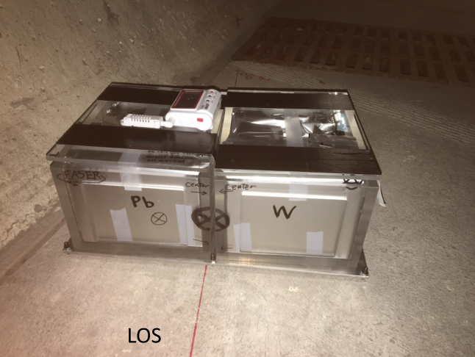
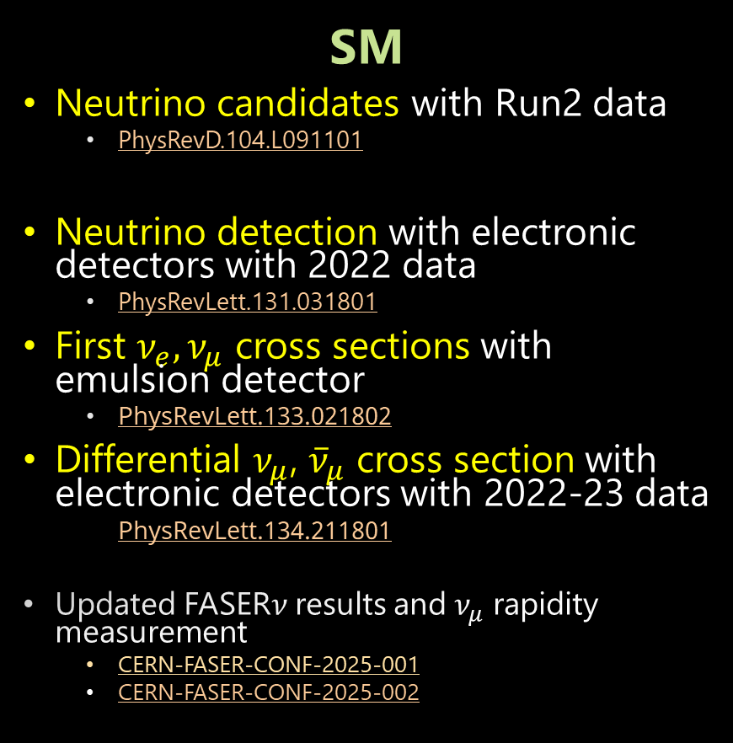
Results from the FASER experiment
SM
Neutrino candidates with Run2 data
  PhysRevD.104.L091101
Neutrino detection with electronic detectors with 2022 data
  PhysRevLett.131.031801
First $ν_{e}, ν_{μ}$ cross sections with emulsion detector
  PhysRevLett.133.021802
Differential $ν_{μ}$, ${\overline{ν}}_{μ}$ cross section with electronic detectors with 2022-23 data
  PhysRevLett.134.211801
Updated FASER$ν$ results and $ν_{μ}$ rapidity measurement
  CERN-FASER-CONF-2025-001
  CERN-FASER-CONF-2025-002
2018
2019
2020
2021
2022
2023
2024
2025
Run 2
Run 3
BSM
Dark photon with 2022 data
  j.physletb.2023.138378
Axion-Like-Particles (ALPs) with 2022, 2023 data
  JHEP01(2025)199
See FASER BSM searches in EPS-HEP by X. Ai
https://indico.in2p3.fr/event/33627/contributions/154654/
Notes:
Arxiv-> paper

Slide 9
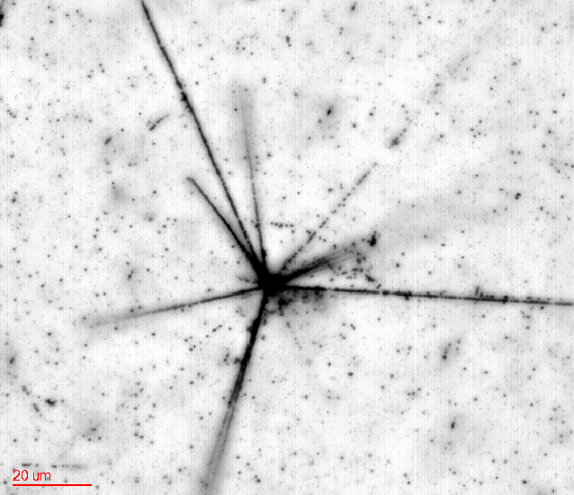
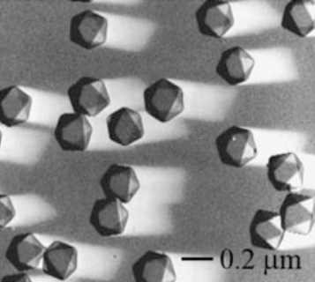
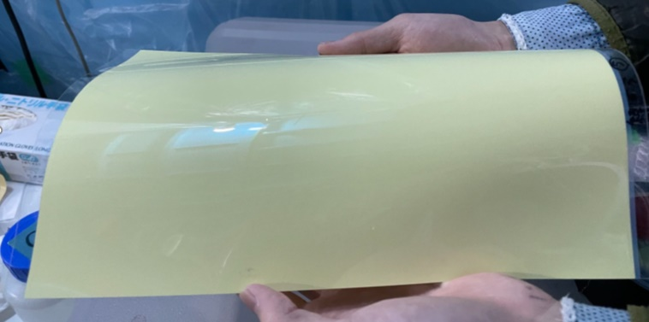


Emulsion tracker
Nuclear Emulsions:
https://link.springer.com/chapter/10.1007/978-3-030-35318-6_9
Silver bromide crystals ~ 200 nm, quantum sensors for charged particles
Super large number of detection channels ~ $8×{10}^{14}$ detection channels / film (30 x 25 cm² in FASER$ν$)
3D tracking device with 50 nm intrinsic resolution
Anti-proton annihilation
Silver bromide crystals
Emulsion films produced in Japan
$$20 μm$$

Slide 10
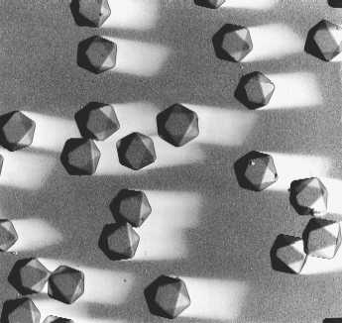
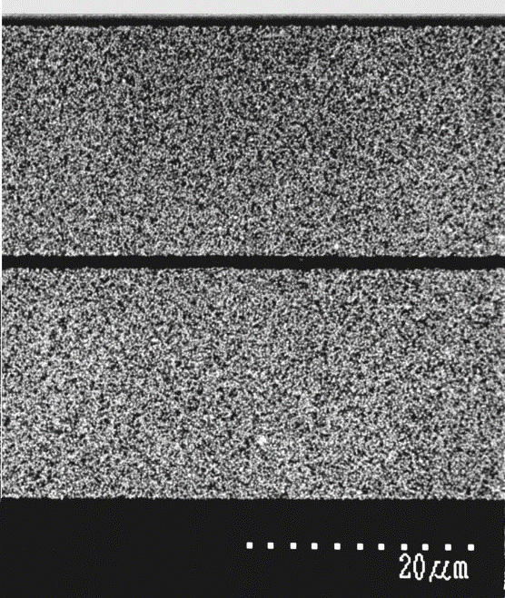


The OPERA Film
A minimal detector:
Silverbromide (AgBr) Cristal
diameter = 200 nm
core-shell structure
detection eff. = 0.16/crystal
noise rate = 0.5x10⁻⁴/crystal
volume occupancy = 30%
10¹⁴ crystals in a film
Shell AgBr (+Fe)
Core
AgBrI
Core-shell structure
Zoom
Protection Coat
（1μm）
12.5 cm x 10 cm
Emulsion layer
（21μm）
Emulsion layer （44μm）
Color negative film
TAC base（200μm）
Emulsion layer
（21μm）
TAC Base
Emulsion layer （44μm）
Nucl. Instrum. Methods A 556 80 (2006)

Slide 11
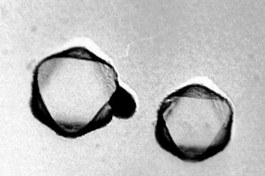
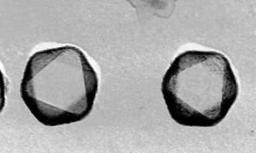
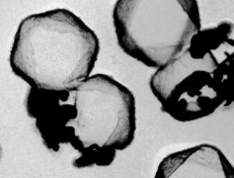

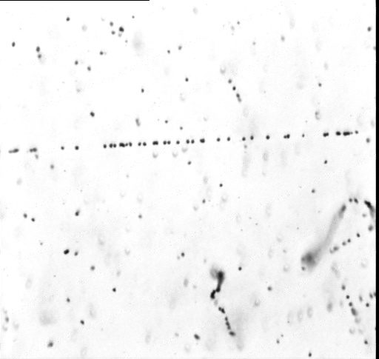
Detection principle of emulsions
Ionization by a particle
  band gap of 2.5 eV
Electrons trapped in a lattice defect on the surface of crystal
  Attract interstitial silver ions
  Making a “latent image” = Ag_{n}
  n>=4, developable
Amplification of signal chemically
  Development → silver filaments
  Gain 10⁷ - 10⁸
Resolve crystal
Ready to observe under optical microscopes
AgBr crystal
+ -
- +
- +
+-
-+
-
-
Silver filament
-
-
~200 nm
-
Ag+
-
Ag+
-
Ag+
-
Ag_{n}
-
Ag+
-
Lattice defect
Latent image
high energy pion
Dot (or Grain) under microscope
20μm

Slide 12
Intrinsic resolution of OPERA film
Precision measurement of hits (5nm)
Deviation of grains from a fit line
Resolution was found to be 50 nm
  0.35 mrad angular resolution
44 μm
CERN 10 GeV π
σ = 50 nm

Slide 13
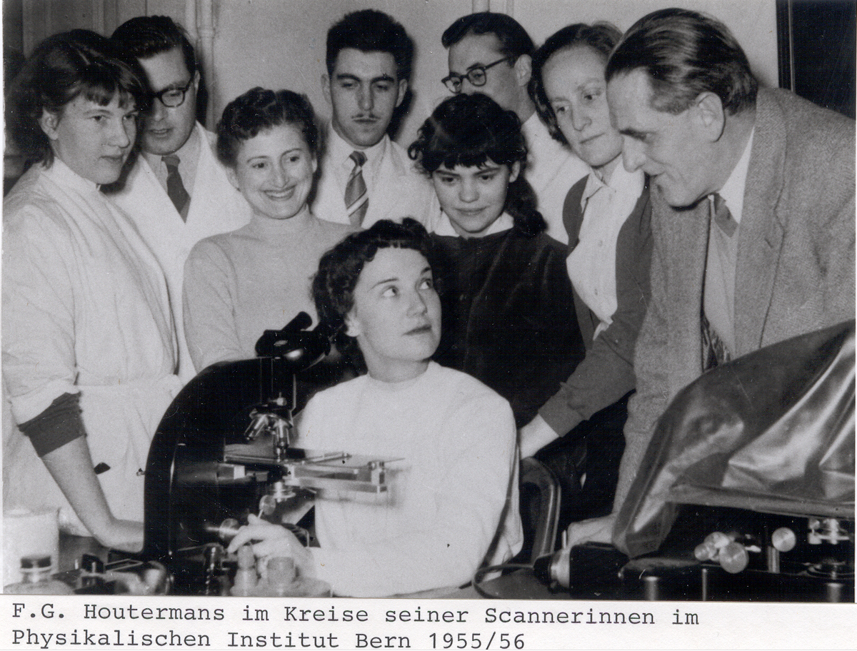

Scanning in Bern some time ago

Slide 14
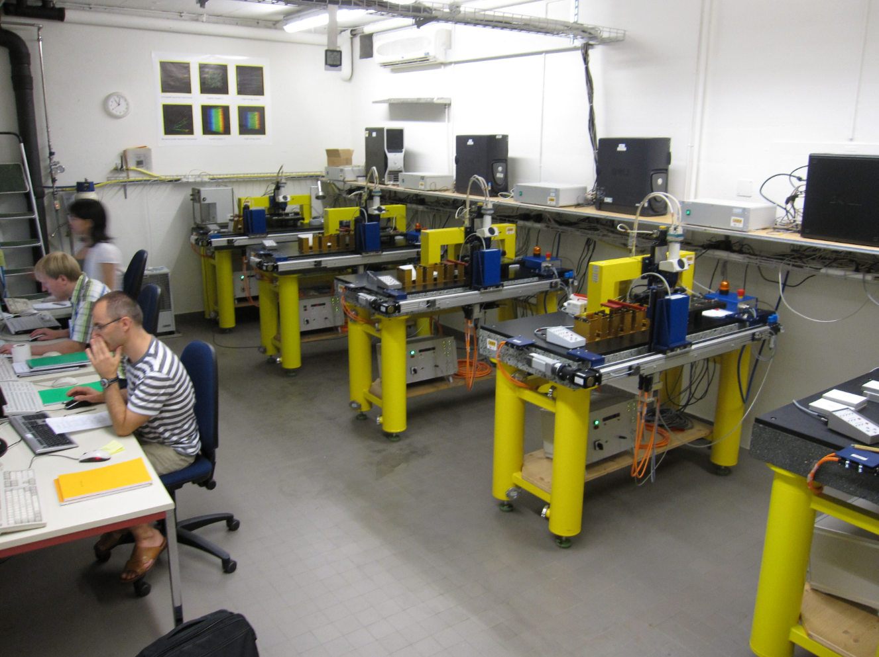
Bern scanning station (2008-)

Slide 15
Is it Quantum sensor?
Yasin said yes ☺
Emulsions can be quantum sensors
  Quantum-Level Detection
  Discrete Quantum States
  Binary Quantum Information Storage
(Similarly, “Imaging Plate” used in X-ray imaging can also be called quantum sensors)

Slide 16
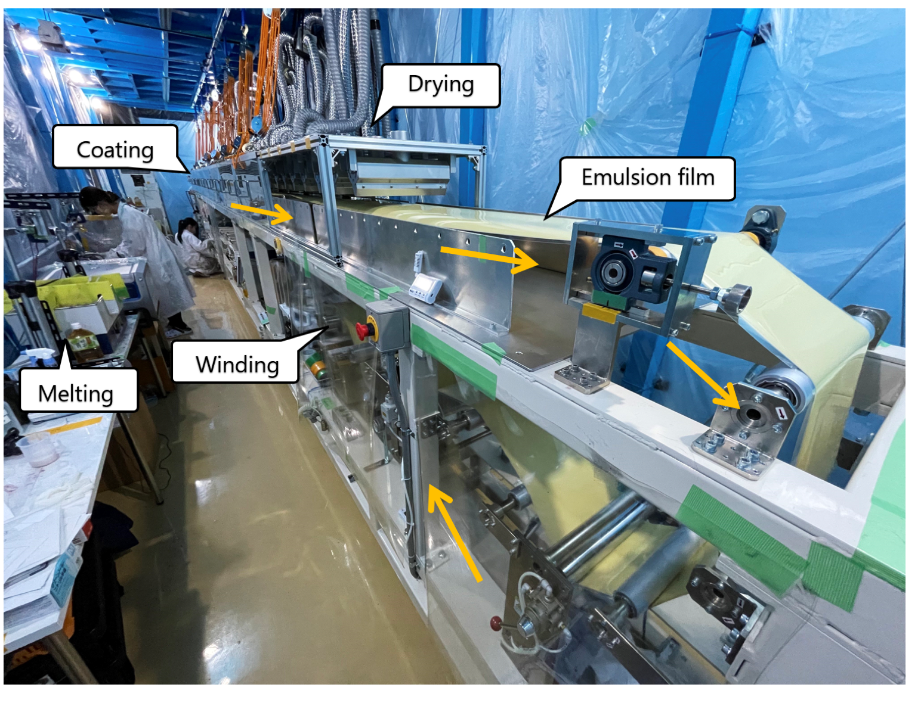
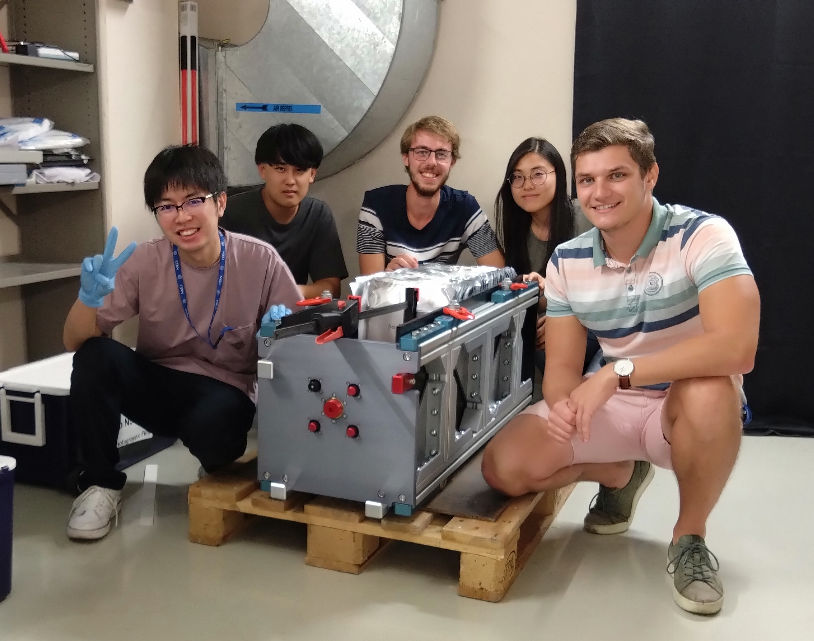
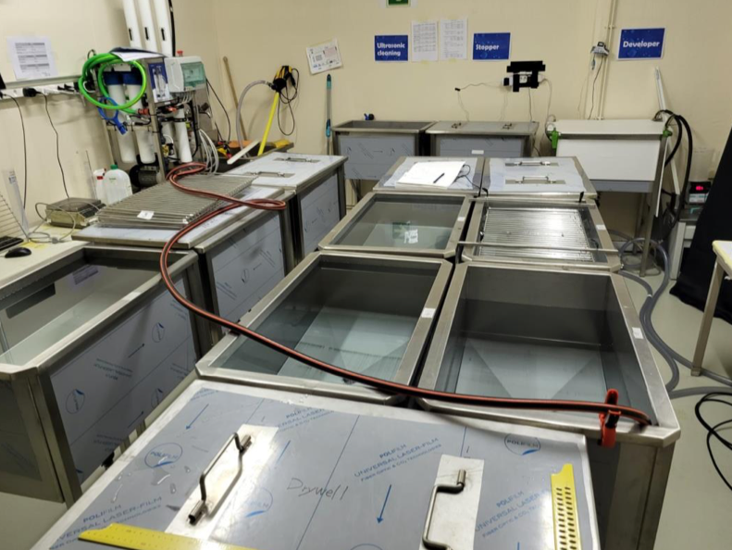
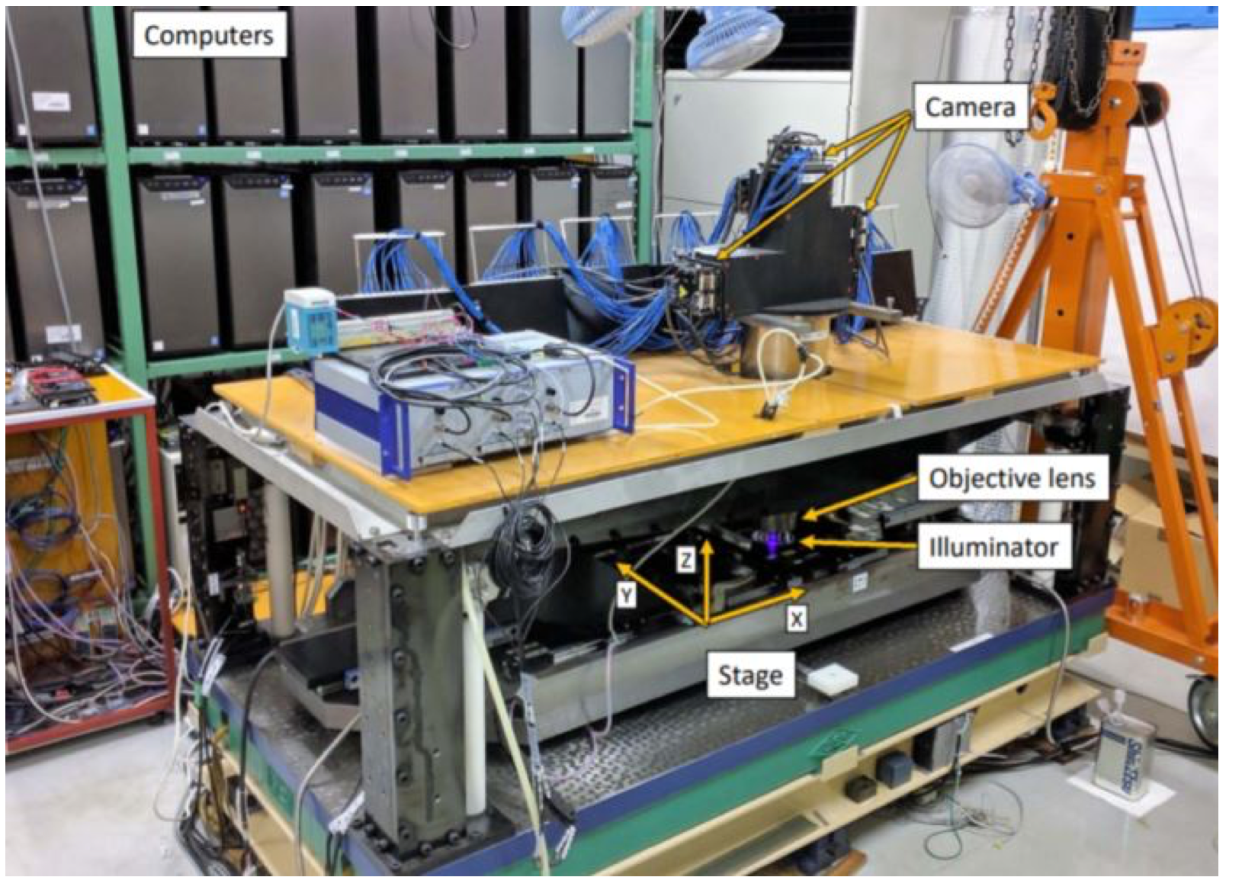
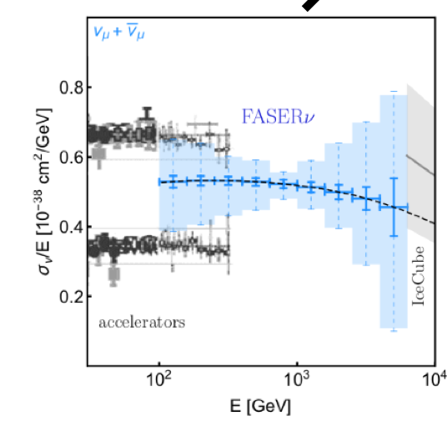
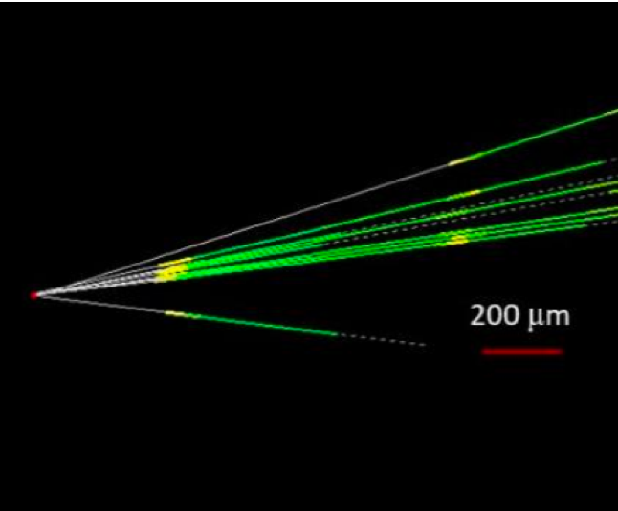
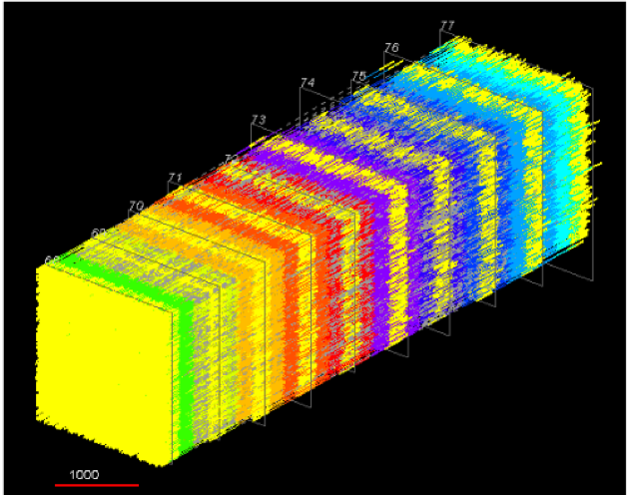
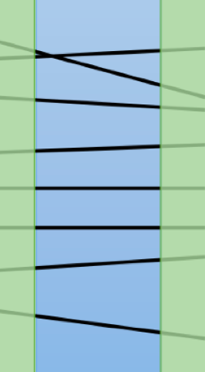

FASER$ν$ steps, 3 detectors per year
Reconstruction paper: 2504.13008
Japan
CERN
Japan
Film production
Assembly
Exposure
Disassembling
Development
Readout
Offline analysis
Physics analysis
$e, μ$ ID
$τ$ decay search
charge ID
E$ν$ reco
charm/beauty
etc.
Vertex reconstruction
Track reconstruction
Alignment
16

Slide 17
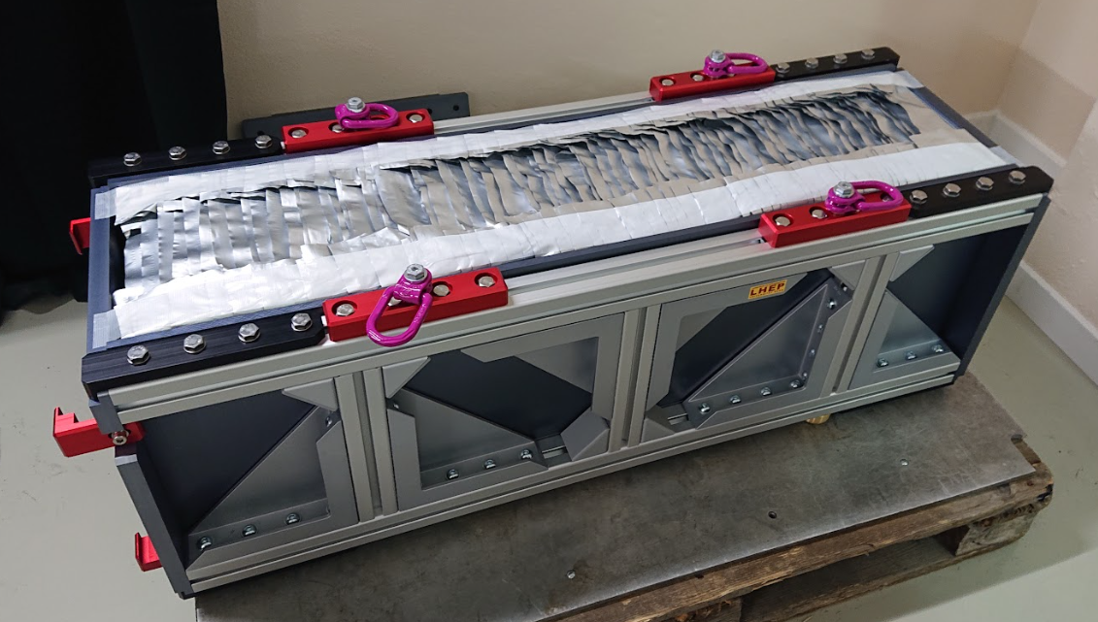
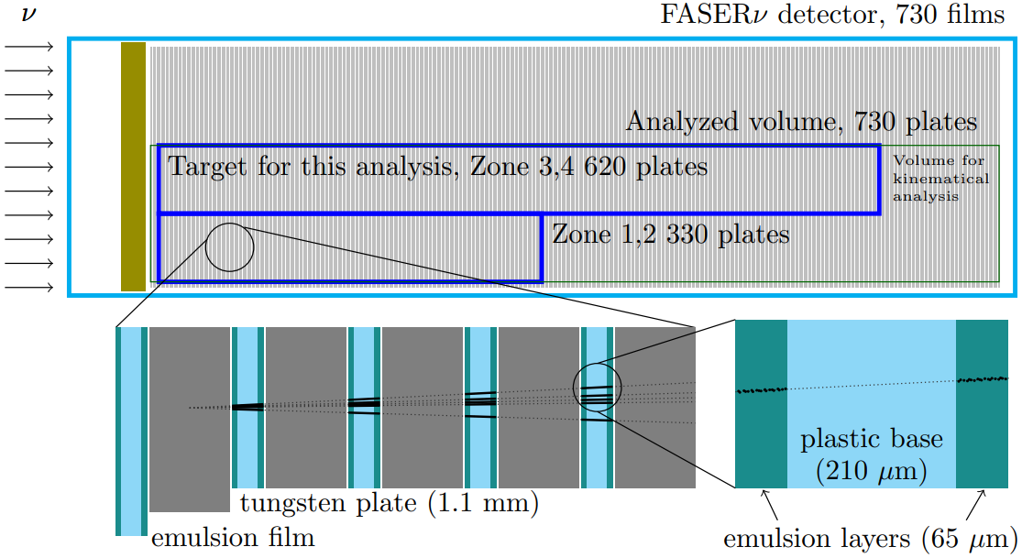
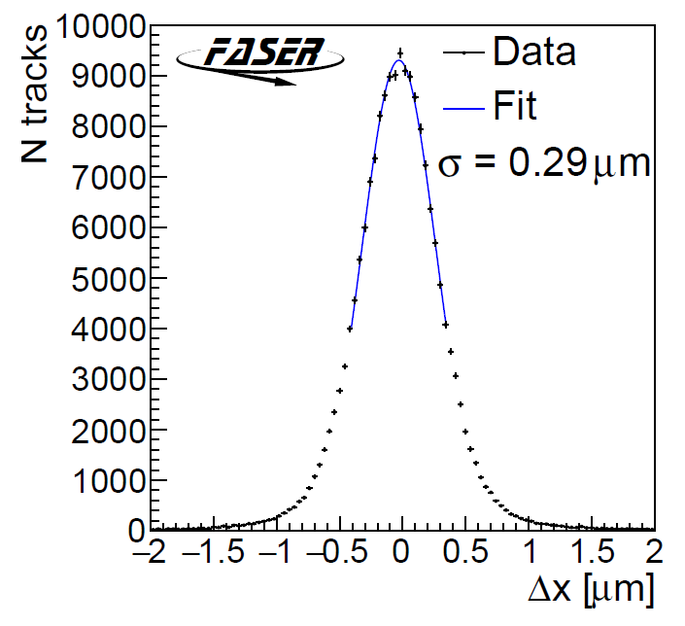
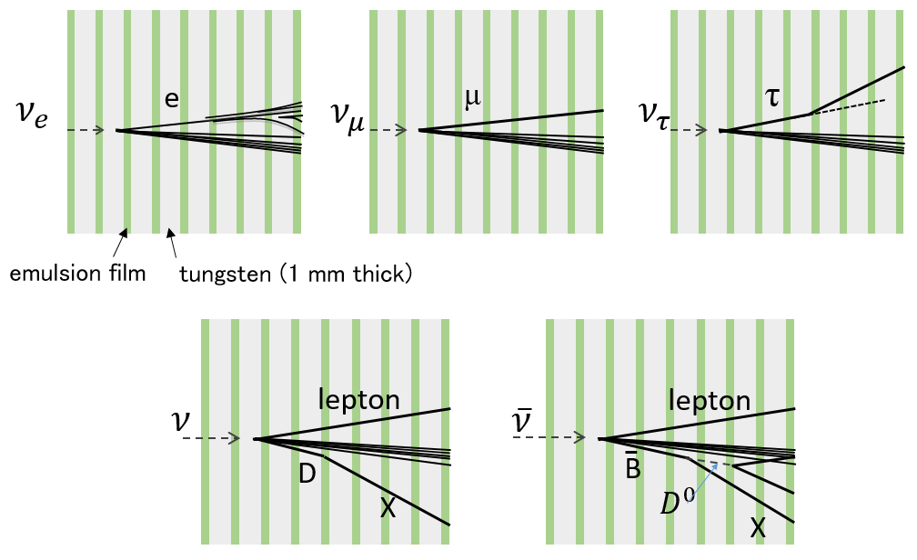
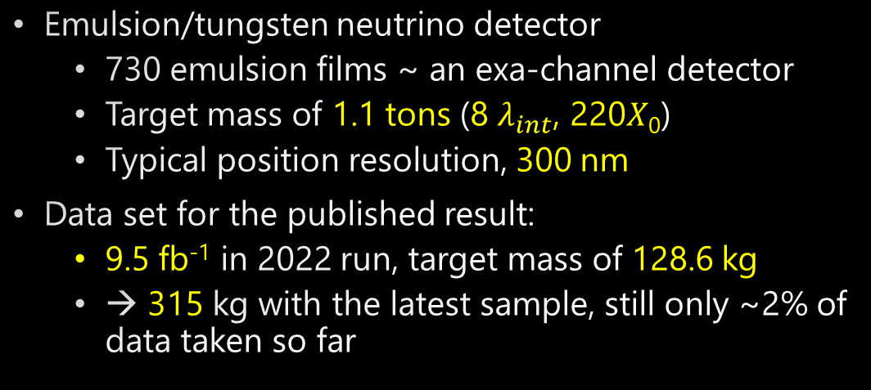

FASER$ν$ and current sample
Emulsion/tungsten neutrino detector
  730 emulsion films ~ an exa-channel detector
  Target mass of 1.1 tons (8 $λ_{int}$, 220𝑋₀)
  Typical position resolution, 300 nm
Data set for the published result:
  9.5 fb⁻¹ in 2022 run, target mass of 128.6 kg
  → 315 kg with the latest sample, still only ~2% of data taken so far
1.3 m

Slide 18
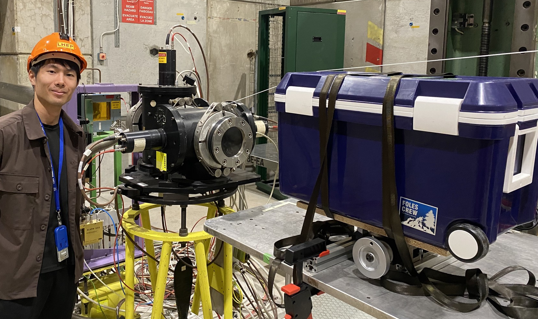
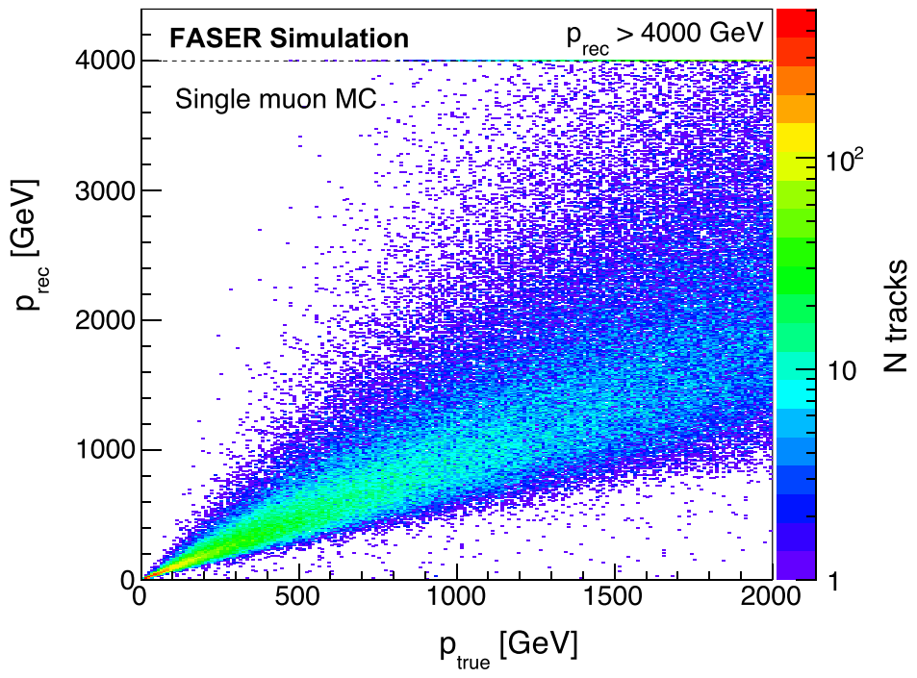
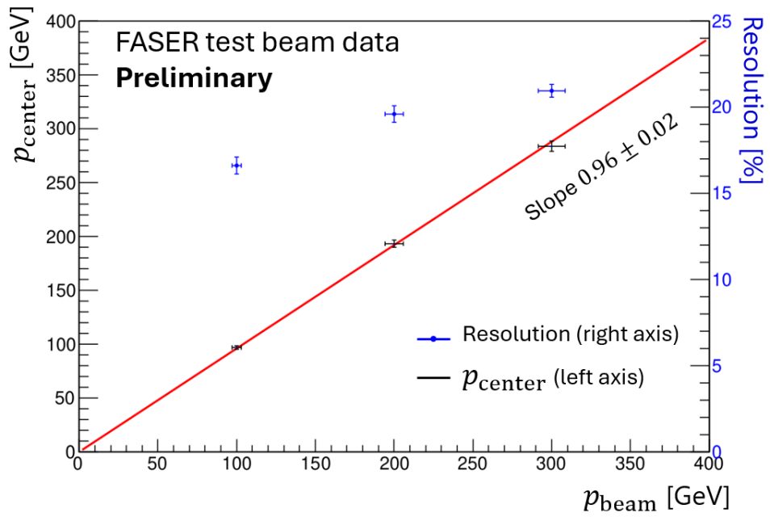
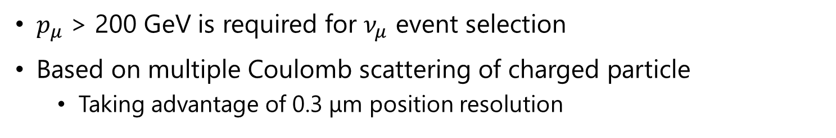
Kinematical tools: Muon momentum measurement
$p_{μ}$ > 200 GeV is required for $ν_{μ}$ event selection
Based on multiple Coulomb scattering of charged particle
  Taking advantage of 0.3 μm position resolution
Good linearity even above 1 TeV
Test beam at SPS(H8 beamline) in 2024
Method was validated at 100, 200, and 300 GeV
~20% resolution at 200 GeV
Notes:
I’ll talk about muon momentum measurement.
To select the good neutrino candidate, it is important to do kinematical measurement.
Currently, we are applying 200 GeV momentum cut for numu event selection.
The method is only based on MCS, because no magnetic field applied to emulsion detector, but taking advantage of high positional resolutions, we can measure the momentum.

Slide 19
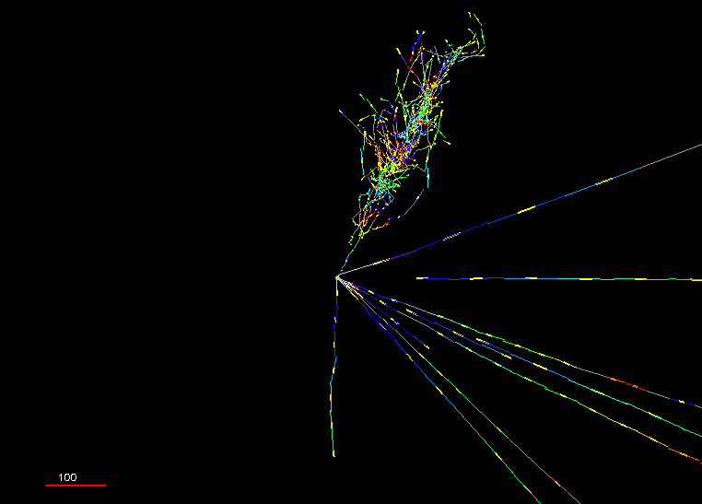




Animated event display of Pika-$ν$ event
$ν_{e}$ candidate
Try an interactive display! http://physics.s.chiba-u.ac.jp/lepp/pika-nu.html
Beam view
Side view
Vertex with 11 tracks
  615 µm inside tungsten
e-like track from vertex
  Single track for 2X₀
  Shower max @ 7.8Χ₀
  θ_{e} = 11 mrad to beam
Back-to-back topology
  175° between e & rest
100 $μm$

Slide 20




Electron neutrino observation in FASERν
  $ν_{e}$ CC event, “Pika-$ν“$ event
Side View
$E_{e}=1.5$ TeV
Vertex with 11 tracks
  615 µm inside tungsten
e-like track from vertex
  Single track for 2X₀
  Shower max @ 7.8Χ₀
  θ_{e} = 11 mrad to beam
Back-to-back topology
  175° between e & rest
Beam View

Slide 21

First cross section measurements at TeV energies
4 $ν_{e}$ and 8 $ν_{μ}$ observed events with negligible BG, both above 5 $σ$
PhysRevLett.133.021802
Relative measurement wrt theoretical curve.
L=9.5 fb⁻¹, m=128.6 kg

Slide 22





Neutrino event selections and results
CERN-FASER-CONF-2025-002
Neutrino detection efficiency as a function of neutrino energy
Strategy
  Search for neutral vertex
Signal: Neutrino interaction
Background: Neutral hadron interaction
→ Suppressed by topological and kinematical selections
Preliminary results with ~300 kg x 9.5 fb⁻¹ data
Note: $E_{e}$ ~25% resolution at 200 GeV
from the simulation

Slide 23



Results with Electronic detectors
Detection of high energy muons emerging from the FASER$ν$ target
First detection of neutrinos at the LHC was done by electronic detectors
$ν_{μ}$ measurement as a function of energy in 2024, using data set of 2022-2023 (65.6 ${fb}^{−1}$)
  PhysRevLett.131.031801
  PhysRevLett.134.211801
Spectrometer: 0.55 T magnets with silicon strip trackers
Request a high energy particle > 100 GeV in spectrometer
FASER$ν$ as target 1.1 t, 8 $λ_{int}$
Extrapolation of the particle should be within r<12 cm at the VETO
Request no VETO hits

Slide 24


Observed events and kinematics
362 observed, 322$±$51 $ν_{μ}$CC expected + 24 non-$ν_{μ}$CC BG
Muon momentum is unfolded into neutrino energy

Slide 25



Interpretations of $ν_{μ}$ interaction rate
FASER’s result = interaction rates
neutrino cross section
Cross section
uncertainty
FASER’s result can be interpreted in two ways
  Neutrino cross sections
  Flux measurement → hadron production model study
Neutrino flux
Analysis in $π/K$ production ratio at $p$-$p$ collisions

Slide 26






Neutrino rapidity measurement
CERN-FASER-CONF-2025-001
To study the characterization of forward hadron production at the LHC
  Define five rapidity bins (annular regions) around line of sight (black cross)
  Rapidity from transverse position of reconstructed $μ$, then unfolded to $ν$ rapidity
Rapidity $y=−\ln{\tan\left(θ/2\right)}$
$y_{pos}$ [mm]
# Neutrino interactions/cm²
$x_{pos}$ [mm]
Neutrino rapidity

Slide 27

LHC continues collecting data
LHC is the biggest investment in particle physics
LHC takes data in Run 3 till 2026, collecting only ~15% of luminosity, still on its long way to the completion
HL-LHC will start 2030, last till 2041 or later
How can we exploit the physics potential of the LHC?
FASER has been a path-finder experiment
  Provide timely results in a cost-efficient way, despite of many constraints
  We had a strategy to open a new field with FASER and enlarge later
Today
Forward Physics Facility!

Slide 28




Forward Physics Facility at the HL-LHC
HL-LHC provides x20 proton collisions
Extending sensitivities for new particle searches and neutrino physics by 2 to 4 orders of magnitude
See more detail in the talk in EPS-HEP
The Forward Physics Facility at the LHC
UJ18
ATLAS
UJ12
LHC
LOS
New shaft and hall
FASER2
FASER$ν$2 20 tons
FLArE
Nominal beam axis
FORMOSA
CERN GIS

Slide 29

Physics objectives and experiments
Neutrino physics at TeV energies
Neutrino precision physics
FPF as neutrino-ion collider
Unique probe of small-x QCD
Impact for Astroparticle Physics
Dark matter and mediators
Millicharged particles
Other opportunities for new particle searches
See FPF’s input to ESPPU!

Slide 30

Physics objectives and experiments
Neutrino physics at TeV energies
Neutrino precision physics
FPF as neutrino-ion collider
Unique probe of small-x QCD
Impact for Astroparticle Physics
Dark matter and mediators
Millicharged particles
Other opportunities for new particle searches
See FPF’s input to ESPPU!
FPF experiments have discovery potential in every one of the PBC benchmark scenarios!

Slide 31






Neutrino physics, and QCD with $ν$ as a probe
TeV Energy Neutrino Interaction
$$ℓ$$
intrinsic
charm
neutrino DIS at TeV scale
large x PDFs: x~1
charm
fragmentation
Lepton flavour Universality
g,q
$$ν$$
p
Non-Standard Interaction
D
Sterile $ν$ oscillation
cc
hadronization in nuclear medium
BFKL dynamics
forward charm
¹⁸⁴W
q
p
g,q
color transparency
ultra low-x
PDFs: x~10⁻⁷
color glass condensate
strangeness
nuclear PDFs
shadowing
EMC effect
Forward Particle Production

Slide 32

Neutrinos at FPF

Slide 33

QCD and enhancing HL-LHC discovery potential
FPF measures the gluon probability
(PDF) at low momentum fractions
Improves predictions of Higgs- and weak gauge- boson cross sections at the HL-LHC

Slide 34

LLPs searches at the FPF
From FPF’s input to ESPPU

Slide 35

LLPs with unusual propagation patterns
From FPF’s input to ESPPU

Slide 36




Tailored detectors at the FPF
FASER2: tracking spectrometer for LLP searches and muon charge ID
FASER$ν$2: emulsion detector for neutrinos
FLArE: LAr TPC for neutrino detection
FORMOSA: plastic scintillator array for mCPs

Slide 37







FASER$ν$2
20-ton tungsten-emulsion detector
  Tungsten target: 64 cm x 25 cm x 2 mm ｘ3300 plates
  Sensitivity to $ν_{e}, ν_{μ}, ν_{τ}$
  $μ^{±}$ charge ID with FASER2
Performance proven by FASER$ν$
High statistics $ν_{τ}$ studies and test lepton flavor universality
$ν$ int. rate estimated based on Sibyll 2.3d
Reconstructed MC event with FASER$ν2$ configuration
 |  |  | $ν_{e}$+$\overline{ν_{e}}$ CC | $ν_{μ}$+$\overline{ν_{μ}}$ CC | $ν_{τ}$+$\overline{ν_{τ}}$ CC
FASER$ν$ (1.1 tons, 150 fb⁻¹) | $ν$ int. |  | 0.9k | 4.8k | 15
 | $ν$ int. with charm |  | $\sim$0.1k | $\sim$0.5k | $\sim$2
 | $ν$ int. with beauty |  | - | $\sim$0.05 | -
FASER$ν$2 (20 tons, 3 ab⁻¹) | $ν$ int. |  | 178k | 943k | 2.3k
 | $ν$ int. with charm |  | $\sim$20k | $\sim$90k | $\sim$0.2k
 | $ν$ int. with beauty |  | $\sim$2 | $\sim$10 | $\sim$0.02
$ν_{τ}$ CC
int.

Slide 38





FASER$ν2$ detector structure
Prototype design, T-shirt shape iron plates on a rail, pushed by compressed-air pressure
Assembling a 20-ton detector in dark is technically challenging → Assembling in FPF
  Light-tight-packed emulsion film
The scheme was tested in test beam at SPS-H8 in 2024
Prototype design
Test at SPS-H8

Slide 39


FASER2
Decay volume:
10 m long decay volume
Tracker:
Based on LHCb's SciFi tracker
SiPM and scintillating fiber design
Detector resolution: ~ 100 µm
m
Magnet:
Large aperture
s
3m wide X 1m gap (*)
Superconducting technology
Magnetic Field : 2 Tm
m
Based on the SAMURAI magnet
Calorimeter:
Based on dual-readout calorimetery
Spatial resolution: 1-10 mm
m
All possible with existing
detector technologies

Slide 40





FLArE
Inspired by the DUNE near detector concept
(photo in Bern)
Liquid Argon neutrino detector
  Based on DUNE near detector concept
  3 x 7 = 21 TPCs
  30 tons active volume, 10 tons fiducial volume
LAr works as precision tracker and calorimeter
Particle ID, energy measurements from MeV – O(100) GeV
Study $ν_{e}$, $ν_{μ}$, $ν_{τ}$ (statistically)
$μ^{±}$ charge ID with FASER2
LHEP can play a leading role here! With high precision readout

Slide 41




FORMOSA
2024
PMT
80cm
scintillator
$$⟨E⟩∝{\left(\frac{Q}{e}\right)}^{2}l_{scint}$$
~440cm
L.O.S.
40cm
Direct millicharged particle (mCP) searches at the LHC
Core concept: Use array of efficient long scintillator bars + PMTs to detect ionization from mCPs.
Small scale prototype in 2025:
  16 scintillator bars
  Front+back muon panels
20cm
FORMOSA demonstrator as of 2025
~4 m long

Slide 42







BG muon measures
FASER$ν$ with 10 ${fb}^{−1}$ in
$2 mm×2 mm×10 films$
Background muon limits sensitivities
  Impacts FASER$ν2$, FLArE, FORMOSA
  Estimated to be O(1) Hz/cm²
Reducing muon background would be beneficial for the FPF experiments (particularly FASERnu2)
→Investigating the feasibility of implementing a Sweeper magnet
Track density
~$3×{10}^{5} tracks/cm^{2}$
$μ^{+}$ fluence expected in FPF ~O(1) Hz/cm²
Charged particles
muons produced after D1
$ν$ and LLPs
FPF
$$ν$$
D1 magnet
Neutral hadrons
LHC tunnel

Slide 43




BG muon measures
FASER$ν$ with 10 ${fb}^{−1}$ in
$2 mm×2 mm×10 films$
Background muon limits sensitivities
  Impacts FASER$ν2$, FLArE, FORMOSA
  Estimated to be O(1) Hz/cm²
Reducing muon background would be beneficial for the FPF experiments (particularly FASERnu2)
→Investigating the feasibility of implementing a Sweeper magnet
Track density
~$3×{10}^{5} tracks/cm^{2}$
$μ^{+}$ fluence expected in FPF ~O(1) Hz/cm²
Sweeper magnet
Simulated muon rates with/without sweeper magnet (preliminary)
Place a permanent magnet along the wall of the LHC tunnel
1 T x 40 m long
$$\frac{1}{5}$$
Charged particles
muons produced after D1
$$ν$$
$ν$ and LLPs
FPF
$$\frac{1}{3}$$
D1 magnet
Neutral hadrons
LHC tunnel

Slide 44




FPF documentation
Photo at FPF8 workshop
FPF workshop series:
FPF1, FPF2, FPF3, FPF4, FPF5, FPF6, FPF7, FPF theory day, FPF8
FPF paper:
2109.10905
~75 pages, ~80 authors
Snowmass Whitepaper:
2203.05090
~450 pages, ~250 authors
Recent Summary:
FPF Update
Technical Documents:
Facility Technical Study
Muon Flux Study
Vibration Study
Geotechnical Report
ESPPU scientific program:
EPJ C: doi.org/10.1140/epjc/s10052-025-14048-6
~25 pages, ~26 authors

Slide 45



Summary
FASER is a pathfinder experiment, opening a new window to utilize “collider neutrinos”
Taking data in LHC-Run 3, collecting 190 $fb^{−1}$ of data by 2024
First neutrino cross section measurements in TeV energy range both by the FASER$ν$ and electronic detectors
Strong physics cases in future programs for future at Forward Physics Facility (FPF)
  FASER$ν2$
  LAr detector

Slide 46















FASER INSTITUTIONS
96 collaborators, 26 institutions, 10 countries
International laboratory covered by a cooperation agreement with CERN

Slide 47
Related talks in EPS-HEP
The Forward Physics Facility at the LHC
  https://indico.in2p3.fr/event/33627/contributions/155270/
  Akitaka Ariga (University of Bern (CH) and Chiba University (JP))
  7TH July 10:15
Neutrino results at the FASER experiment (This talk)
  https://indico.in2p3.fr/event/33627/contributions/154587/
  FASER Collaboration, Akitaka Ariga (University of Bern (CH) and Chiba University (JP))
  8th July 08:50
Long lived particle searches at FASER
  https://indico.in2p3.fr/event/33627/contributions/154654/
  FASER Collaboration, Xiaocong Ai (Zhengzhou University)
  11th July 09:10

Slide 48
Backup

Slide 49

The layout of the LHC neutrino experiments

Slide 50



















$$ν_{e}$$
FASER Preliminary
$$ν_{e}$$
Rotated view
Pika-$ν$ event
Beam view
Pika-$ν$ event
$$e$$
1.5 TeV
$$e$$
500 $μ$m
100 $μ$m
$$ν_{μ}$$
$ν_{μ}$ Rotated view
Beam view
$$μ$$
$$μ$$
360 GeV
1000 $μ$m
200 $μ$m

Slide 51


Neutrino interaction rates in Run 3
arXiv:2501.10078
$$350 fb^{−1}$$

Slide 52


Slide 53


FASER measures $ν_{ℓ}$ interaction rates, and then?
Precise knowledge of flux
Hadron production models
External validation data
FASER’s interaction rate measurements
Neutrino cross section measurements
Test Lepton Flavor Universality
Search for new interactions
FASER’s result = interaction rates
SM neutrino cross section is decent
Neutrino flux measurement
neutrino cross section
Assuming LFU is valid
Study hadron/neutrino production at very high-energy
Prompt neutrinos
QCD at small $x$
Cross section
uncertainty
Neutrino flux
uncertainty
Neutrino flux

Slide 54

BG muon measures
FASER$ν$ with 10 ${fb}^{−1}$ in
$2 mm×2 mm×10 films$
Background muon limits sensitivities, in FASER$ν2$ and others
  Estimated to be O(1) Hz/cm²
Reducing background muons is essential both for cost and physics reach
→ Implementation of a “Sweeper magnet”
Track density
~$3×{10}^{5} tracks/cm^{2}$
$μ^{+}$ fluence expected in FPF ~O(1) Hz/cm²
Sweeper magnet
Simulated muon rates with/without sweeper magnet
Place a permanent magnet along the wall of the LHC tunnel
1 T x 40 m long
$$\frac{1}{5}$$
Charged particles
muons produced after D1
$$ν$$
$ν$ and LLPs
FPF
$$\frac{1}{3}$$
D1 magnet
Neutral hadrons
LHC tunnel

Slide 55

4 proposed FPF experiments, diverse detectors for a broad physics program
FASER2
FASER$ν$2
FLArE
Nominal beam axis
FORMOSA

Slide 56

Systematic uncertainties

Slide 57








FASER$ν$ performances
BG muon angular distribution (Data)
Angular spread of muon peaks
$$∼0.4 mrad$$
Position resolution ~$300 nm$
20 mrad
FASER Preliminary
Electron energy reconstruction
$$\frac{ΔE}{E}∼0.25 @ 200 GeV$$
Muon momentum measurement
$$\frac{ΔP^{RMS}}{P}∼0.3 @ 200 GeV$$

Slide 58




Axion-like Particles (ALPs) search
production
FASER is sensitive to axion-like particles (ALPs) coupling to SU(2)_{L} gauge bosons, mainly produced in $B$ meson decays
Signal: $a→γγ$ appearing from ‘nothing’ with ~TeV of energy
  Can decay anywhere in FASER spectrometer volume
decay
4-m-long decay volume
Selection
No signal in 5 veto counters and timing scintillators
Evidence of EM shower in pre-shower counters
> 1.5 TeV in calorimeter
In time with LHC collision
Notes:
Magnetic volume, 4 m long decay volume

Slide 59




Background for ALPs
Dominant BG: Neutrino interactions → simulated to be $0.4±0.4$ events
Negligible BG from others: neutral hadrons, large-angle muons, non-collision / cosmics
BG validated by control regions: ex) “Neutrino interaction in calorimeter”-like
(Large EM in calo, but little in pre-shower)
Simulated interaction or decay position of $a, ν_{e}, ν_{μ}$ in control sample
Neutrino control region

Slide 60



ALPs results
Public documentation to be released soon
Expect 0.4 $±$ 0.4 from $ν$ interactions in 58 fb⁻¹
1 observed event after unblinding
Exclude uncovered parameter space significantly
Notes:
Significant
300 events at the edge of previous limits.

Slide 61

Event display of 1 selected event: “ALPtrino” event
Pre-shower
Calorimeter
1.6 TeV
No signal in veto and timing scintillators
Waveforms of PMTs (ns-mV)

Slide 62





Direct observation of $ν_{μ}$ interactions at the LHC by the FASER electronic detectors
Shown in Moriond 2023, now published in Phys. Rev. Lett. 131, 031801 (2023)
Selection: No veto, P>100 GeV, $r_{veto}$<12cm
Unblinded results:
153 events in the signal region with 35.4 fb⁻¹
(significance of 16$σ$)
First direct observation of $ν_{μ}$ interactions at the LHC
Spectrometer to measure particle momenta
FASER$ν$ as passive target

Slide 63

FASER$ν$ steps, 3 detectors per year
Japan
CERN
Japan
Film production
Assembly
Exposure
Disassembling
Development
Readout
Offline analysis
Physics analysis
$e, μ$ ID
$τ$ decay search
charge ID
E$ν$ reco
charm/beauty
etc.
Vertex reconstruction
Track reconstruction
Alignment
63

Slide 64











CERN Emulsion Facility
Dark room at CERN established in 80s → Obsolete
Emulsion experiments are increasing: NA65/DsTau, FASER$ν$, SND@LHC, SHiP, test beams…
Refurbished recently, big thanks for supports from CERN!
Experiments share installation and equipment
Temperature controlled developer bath
Film drying
Dark room operation
Assembling of FASER$ν$ and SND@LHC
Development timer
Microscope
Asbestos floor removed, new shiny floor, modern climate control, card lock system…
Disposal
Development room
13 x 100L tanks
Easy disposal system

Slide 65


Emulsion readout systems
Total emulsion film surface in FASER$ν$2: $∼$530 m²/year
  $∼$2400 h/year with HTS
  or $∼$420 h/year with HTS2
HTS-1
 | Field of view (mm²) | Readout speed (m²/h/layer)
S-UTS | 0.04 | 0.0072
HTS-1 | 25 | 0.45
HTS-2 | 50 | 2.5
HTS-3 | ? | ?

Slide 66





Muons at FASER site
Angular distribution (Data)
Muons brings rich info to validate beamline simulation
Eventually we could validate hadron production models at $p$-$p$ collisions
From IP
From backward
0.5 fb⁻¹
FASER preliminary
10 fb⁻¹
$±$20 mrad

Slide 67












Event selection
FASER$ν$ analysis
Selection criteria
Vertex reconstruction ($N_{track}≥5$, $N_{track}$(tan$θ≤$0.1)$≥$4)
$E_{e}$ or $p_{μ}$>200 GeV
tan$θ_{e}$ or tan$θ_{μ}$>0.005
$φ$>90°
$$θ$$
$$e$$
$$ν_{e}$$
$←$ $p$ high
neutral
hadron
$←$ $p$ high,
$θ$ small
$$φ$$
$$e$$
$ν$ beam

Slide 68








First detection of $ν_{e}$ and $ν_{μ}$ with FASER$ν$ detector
arXiv: 2403.12520
High purity selection
Vertex reconstruction ($N_{track}≥5$, $N_{track}$(tan$θ≤$0.1)$≥$4)
$E_{e}$ or $p_{μ}$>200 GeV
tan$θ_{e}$ or tan$θ_{μ}$>0.005
$φ$>90°
 | Expected background | Expected signal | Observed | Significance
$ν_{e}$ CC | 0.025^{+0.015}_{-0.010} | 1.1-3.3 | 4 | 5.2$σ$
$ν_{μ}$ CC | 0.22^{+0.09}_{-0.07} | 6.5-12.4 | 8 | 5.7$σ$
First detection of $ν_{e}$ at the LHC!
Electron angle
Electron energy
$$φ$$
$$e$$
$$ν$$

Slide 69




Neutrino event characteristics
CERN-FASER-CONF-2025-002
$ν_{e}$
$ν_{μ}$
Characteristics of the observed 𝜈 interactions are in good agreement with MC

Slide 70


Neutrino flux and expected number of interactions
https://arxiv.org/abs/2402.13318
Expected number of CC interactions in FASER$ν$ with 250 fb⁻¹

Slide 71











Neutrinos = proxy of forward hadron production
Pion, Kaon, charm contribute to different part of energy spectra and flavor
FASER$ν$ provides important inputs to validate/improve generators → Muon excess, prompt neutrinos
$$K$$
$$D$$
$$π$$
$$ν_{e}$$
$$ν_{μ}$$
$$K$$
$$D$$
$$D_{s}$$
$$ν_{τ}$$

Slide 72













Heavy-flavor-associated channels
Measure charm production channels
  Large rate ~ 10% $ν$ CC events, $𝒪(1000)$ events
  First measurement of $ν_{e}$ induced charm prod.
Search for Beauty production channels
  Expected SM events ($ν_{μ} CC b$ production) are $𝒪(0.1)$ events in Run 3, due to CKM suppression, $V_{ub}^{2}≃{10}^{−5}$
$$ν_{τ}$$
$$τ$$
$$W^{±}$$
$$ℓ=e, μ$$
$$d$$
$$V_{cd}$$
$$c$$
$$\overline{ν}N→ℓ\overline{B}X$$
$$νN→ℓBDX$$

Slide 73





Sterile neutrino oscillation
Due to unique energy and baseline ($L/E\sim {10}^{−3}$ m/MeV), FASER$ν$ is sensitive to large $Δm^{2}\sim {10}^{3}$ eV².
Neutrino spectrum deformation
Competitive in disappearance channels.
$ν_{e}$ disappearance
$ν_{μ}$ disappearance

Slide 74







Expected neutrino spectra
Expected CC interactions with 150 fb⁻¹
$$⟨E_{ν_{μ}}⟩∼900 GeV$$
 | FASER$ν$ | SND@LHC
Target mass | 1100 kg | 800 kg
Location | On axis | Off axis
Features | High energy & high statistics | More neutrinos from charm decay
$$⟨E_{ν_{μ}}⟩∼500 GeV$$
10.1103/PhysRevD.104.113008
$$η=$$

Slide 75

FASER AND FASERν TIMELINE
In-situ BG measurement
Pilot neutrino detector
LOI submitted to CERN LHCC
ERC awarded for FASERν
FASER fully constructed and installed
FASERν fully constructed and installed
Technical Proposal submitted to CERN LHCC
FASER approved as 8th LHC detector by CERN
Concept paper: Feng, Galon, Kling, Trojanowski
FASERν approved as 9th LHC detector by CERN
FASER and FASERν announce first physics results
FASER and FASERν begin collecting data in Run 3
Funding from Heising-Simons and Simons Foundations
FASER and FASERν announce more physics results
Spare detector parts from ATLAS and LHCb Collaborations

Slide 76


Forward Physics Facility (FPF) at the HL-LHC
FPF White Paper (2022/3)
http://arxiv.org/abs/2203.05090
FPF 5th workshop (2022/11)
https://indico.cern.ch/event/1196506/
FPF Facility studies (2023/3)
https://cds.cern.ch/record/2851822
BSM particles can be detected in various ways
Giving access to wide range of models
Neutrinos can be used to search for BSM effects
Production
Propagation
Interaction

