Slide 1



Workshop
Exotic atoms: fundamental aspects, applications and advances in radiation detectors
Zagreb, 03.-05. 12. 2025
Supported by the Croatian Science Foundation under the project number HRZZ-IP-2022-10-3878

Slide 2
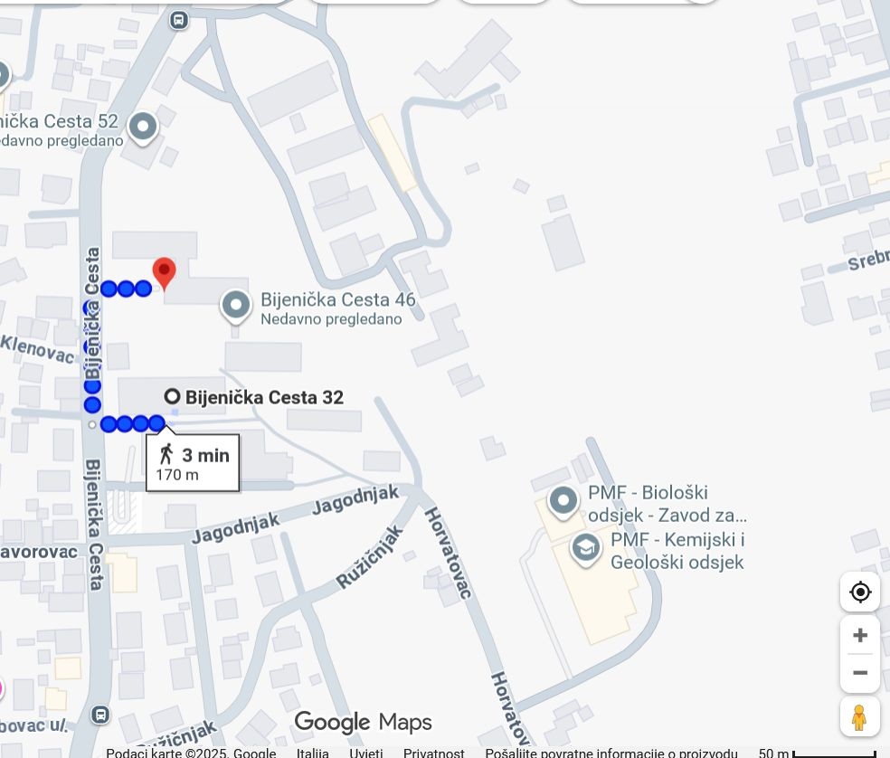
Venue
Wednesday:
Department of Puysics (FIZIKA), Bijenička 32
Thursday, Friday:
Institute of Physics, Bijenička 46

Slide 3
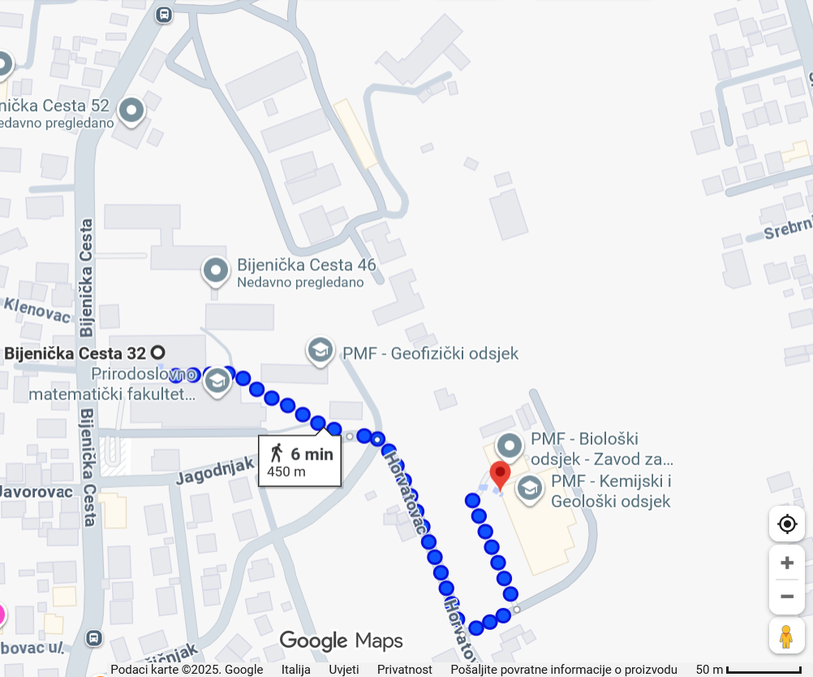
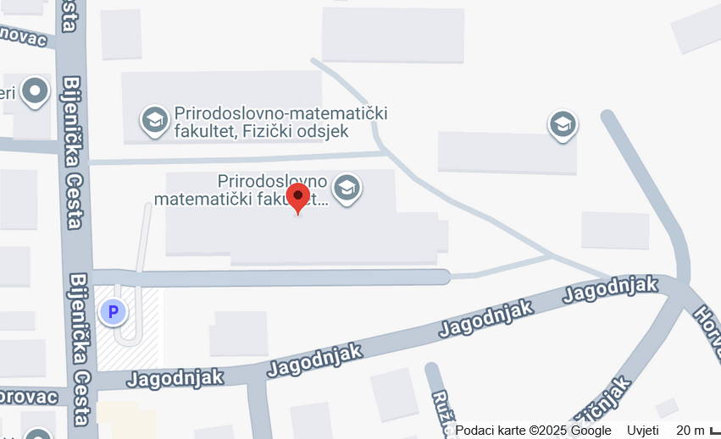
Lunch
2) Coffee shop –
Department of Mathematics
sandwiches and snacks
Student canteen –
Department of Chemistry
FIZIKA
Department of Mathematics
Use the „priority” line

Slide 4
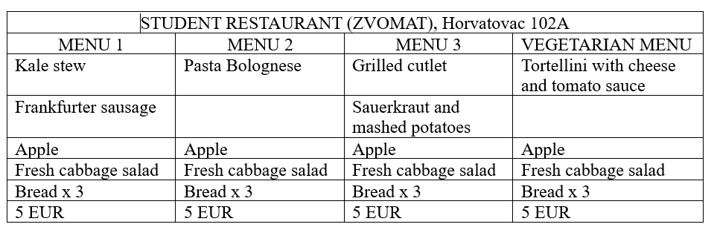

Student canteen -lunch menu: Wednesday

Slide 5
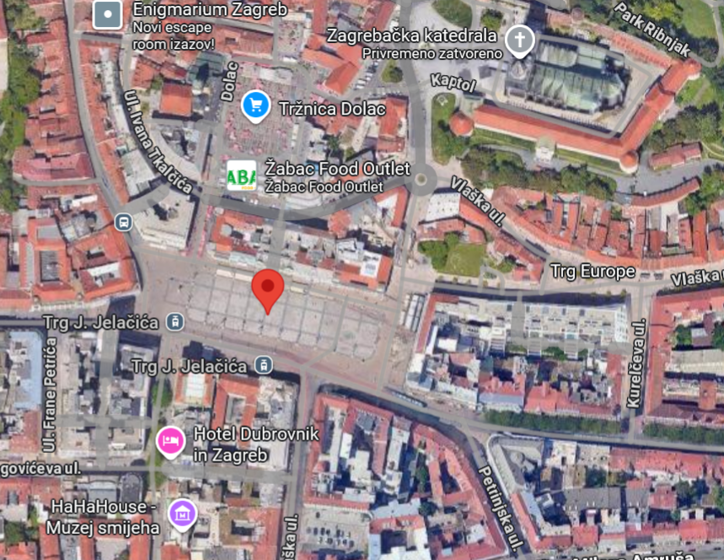
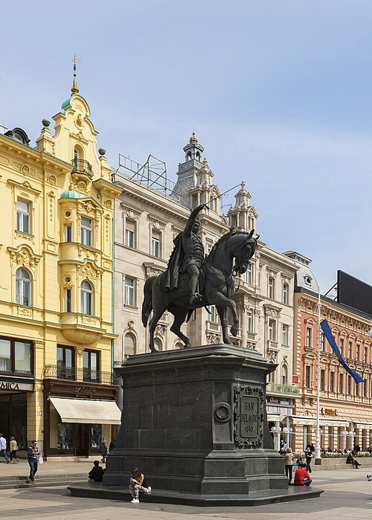
Zagreb guided tour
Thursday 17-19h, start Trg bana J. Jelacic (near the horse)

Slide 6
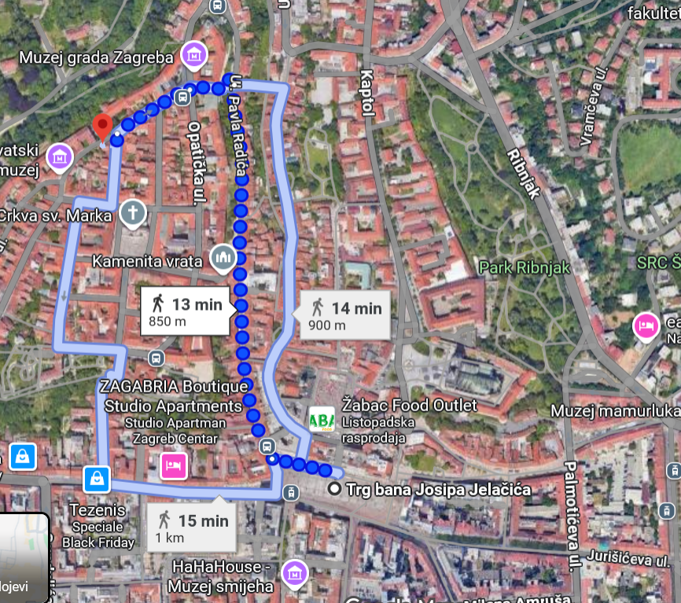
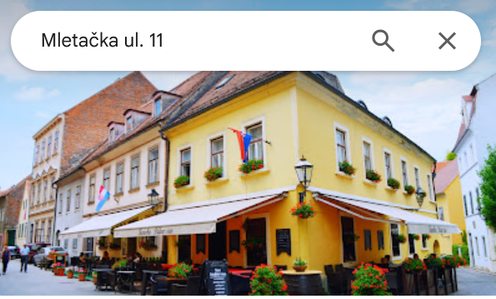
Dinner – Thursday 19h
Restaurant „Didov san” Mletacka 11

Slide 7
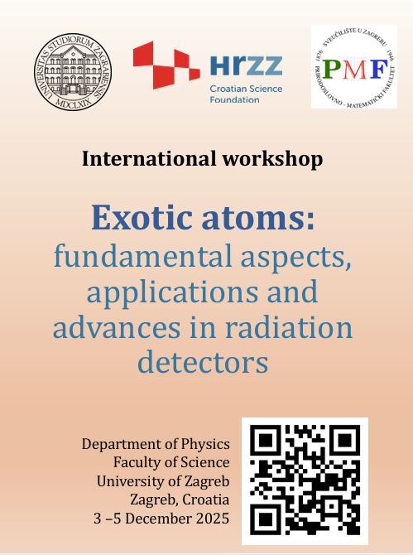
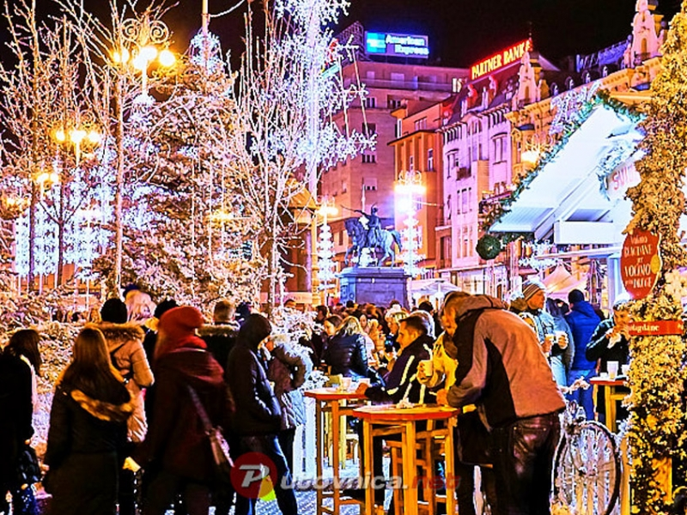
Enjoy the workshop
and Zagreb Advent !

