Slide 1



Positron emission tomography imaging harnessing polarization correlations Mihael Makek¹ T. Bokulić¹, D. Grošev², A. M. Kožuljević³, S. Parashari⁴, L. Pavelić³, M. Žuvić² ¹Department of Physics, Faculty of Science, University of Zagreb, Croatia ²University Hospital Centre Zagreb, Croatia ³Institute for Medical Research and Occupational Health, Zagreb, Croatia ⁴Instituto de Física Corpuscular (IFIC), Valencia, Spain
Exotic atoms: fundamental aspects, applications and advances in radiation detectors Zagreb, Croatia, Dec 3-5 2025

Slide 2
Standard PET detector
Injection and metabolisation of positron labeled radiopharmaceutical
Positron annihilation:
e⁺e⁻ -> γ γ
The pair of γs identified based on:
coincidence time
Energy of each 511 keV
Back-to-back geometry assumed
RING OF DETECTORS
Positron annihilation in tissue
e⁺+e⁻ -> γ+γ
Positron-labeled radiopharmaceutical
M. Makek

Slide 3
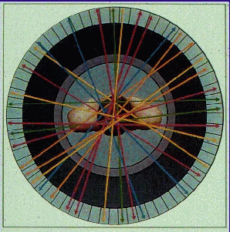
Standard PET detector
Injection and metabolisation of positron labeled radiopharmaceutical
Positron annihilation:
e⁺e⁻ -> γ γ
The pair of γs identified based on:
coincidence time
Energy of each 511 keV
Back-to-back geometry assumed
LORs --> reconstructed image
RING OF DETECTORS
M. Makek

Slide 4
Background in PET
Backgrounds mostly due to:
Compton scatter in patient's body
Scatter
γ’
γ
M. Makek

Slide 5
Background in PET
Backgrounds mostly due to:
Compton scatter in patient's body
Random coincidence
-> reduced image contrast
Random coincidence
M. Makek

Slide 6
Additional information available: Polarization of annihilation quanta
M. Makek

Slide 7
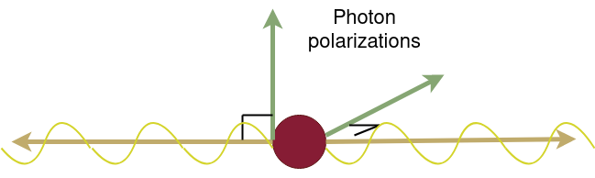
Polarization of annihilation quanta
In positron annihilation back-to-back gammas generated
They are quantum-entangled and polarized in orthogonal directions [P. Dirac, Proc. Camb. Philos. Soc. 26 (1930) 361; R. Hanna, Nature 162 (1948) 332]
How to measure polarization correlations?
Use of polarization correlations in PET imaging?
Cost-efficient implementation?
γ (511 keV)
γ (511 keV)
M. Makek

Slide 8



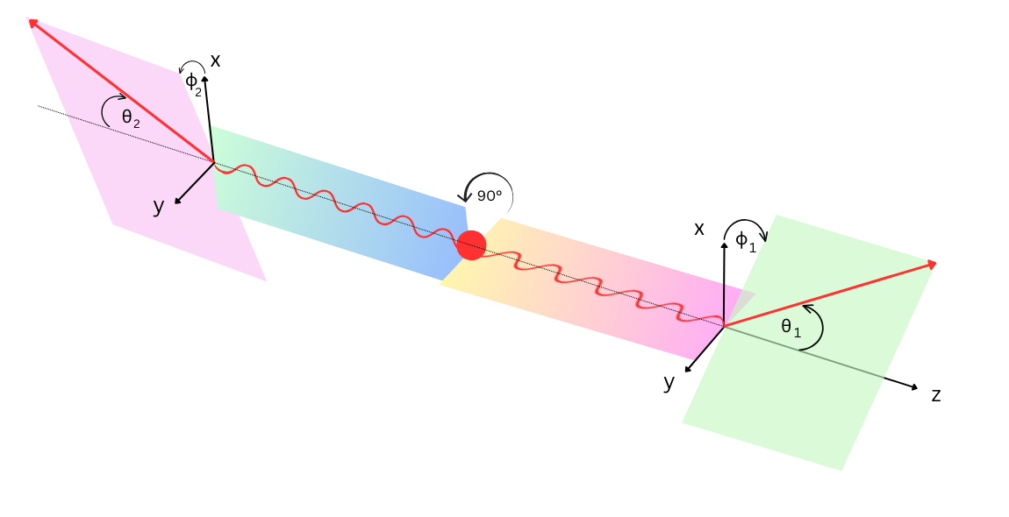

How to measure polarization correlations
When both linarly polarized annihilation photons undergo Compton scattering:
Polarimeric modulation:
with:
[Pryce and Ward, Nature 160 435; Snyder, Pasternak, Hornbostel, Phys. Rev. 73 (1948) 440-8]
M. Makek

Slide 9
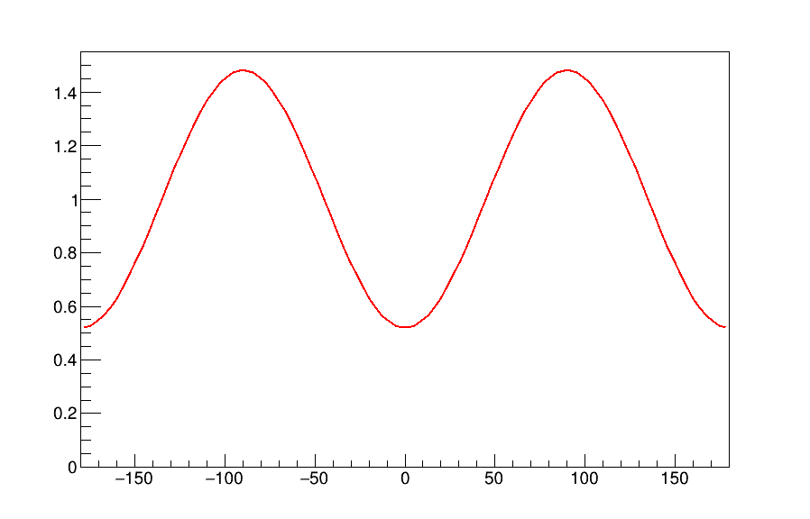
How to measure polarization correlations
When both linarly polarized annihilation photons undergo Compton scattering:
Polarimeric modulation:
with:
[Pryce and Ward, Nature 160 435; Snyder, Pasternak, Hornbostel, Phys. Rev. 73 (1948) 440-8]
a.u.
Δφ (deg)
M. Makek

Slide 10
Polarization correlations in PET
Potential of polarization correlations for S/B improvement in PET?
The polarization correlations are expected only for signal pairs
Discriminate true coincidences from randoms
Standard event ID in PET: - back to back, coincidence
- 511 keV
Scatter
Additional event ID in PET:
γ
γ
a.u.
Random conicidences
γ
γ
[Kuncic et al., NIM A648 (2011), McNamara et al., Phys. Med. Biol 59 (2014), M. Toghyani et al., Phys. Med. Biol 61 5803(2016)]
Δφ (deg)
M. Makek

Slide 11
How to measure gamma polarization in PET?
Modern PET detectors: - highly segmented, - large axial coverage
Typical Compton polarimeters:
2 sensitive layers: 1st for measuring the recoil electron, 2nd for the scattered gamma
A PET system based on 2-layer detectors would dramaticaly increase the cost of the apparatus
-> Measurement of polarization viable only using single-layer detectors​
M. Makek

Slide 12
Development of PET demonstrator with polarization measurement capability
M. Makek

Slide 13
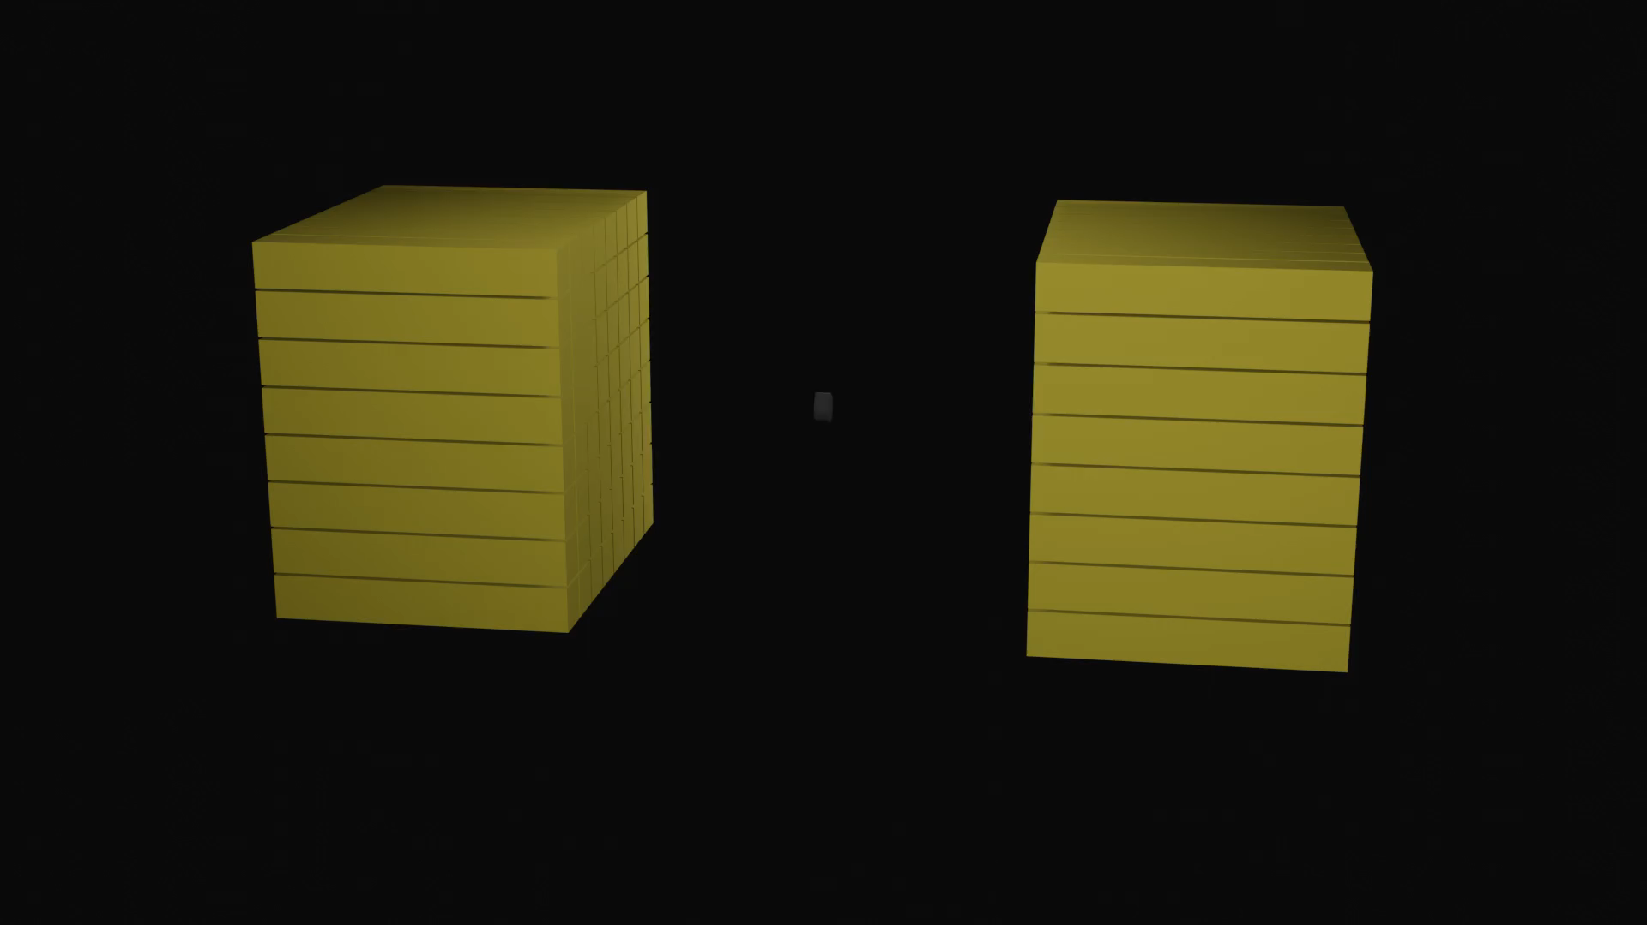
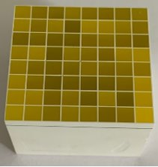
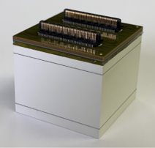
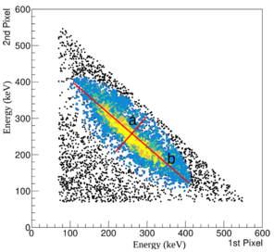

Detector modules: single-layer polarimeters
GAGG matrix (2.9x2.9x20 mm³) Single-sided readout by SiPM!
Animation by E. Piškorić
Compton event ID
2 pixels fired
S. Parashari et al. (2022), NIMA, 1040:167186
M. Makek

Slide 14
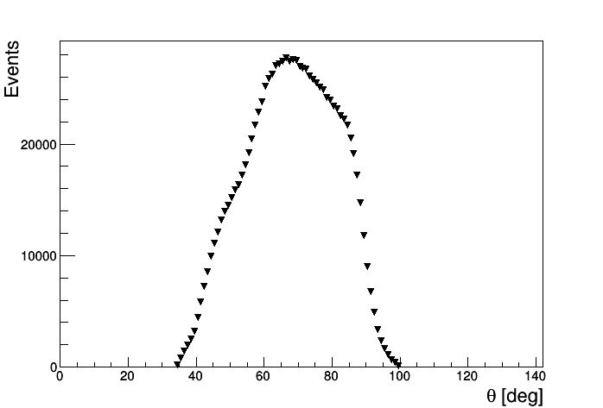
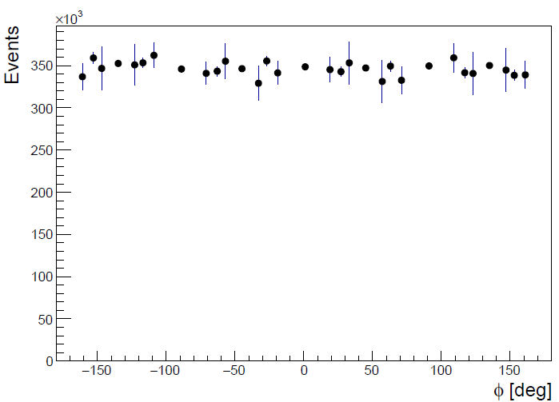
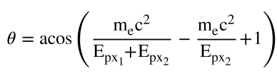

Detector modules: single-layer polarimeters
GAGG matrix (2.9x2.9x20 mm³) Single-sided readout by SiPM!
Compton event ID
2 pixels fired
S. Parashari et al. (2022), NIMA, 1040:167186
M. Makek

Slide 15
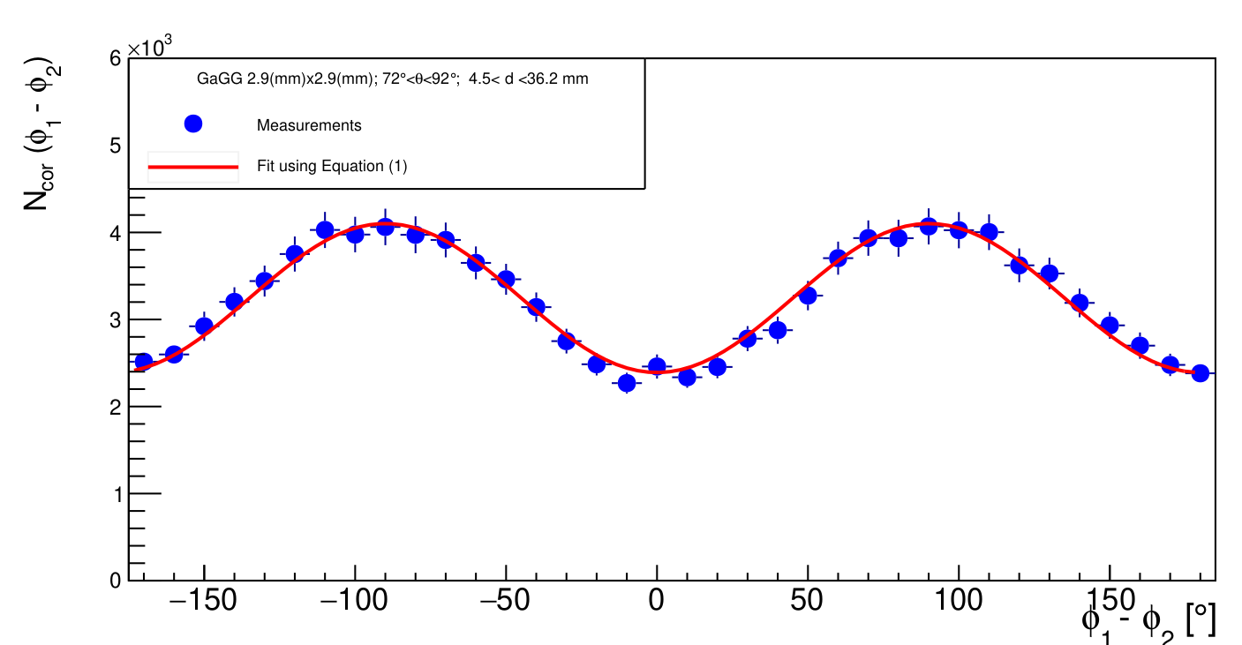
Detector modules: single-layer polarimeters
GAGG matrix (2.9x2.9x20 mm³) Single-sided readout by SiPM!
S. Parashari et al. (2022), NIMA, 1040:167186
M. Makek

Slide 16
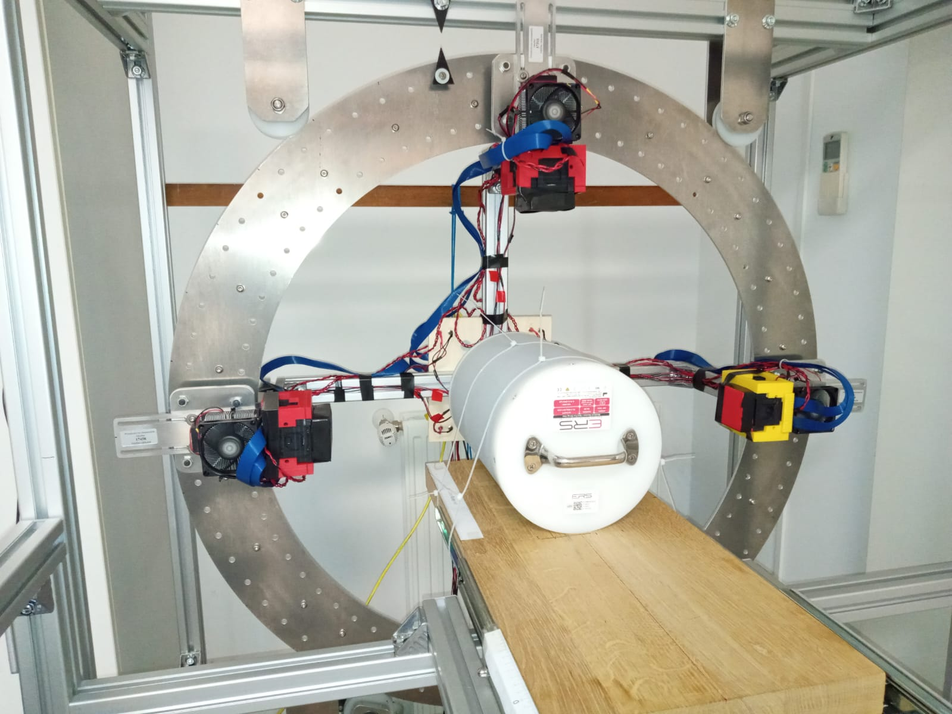
The PET demonstrator
Four modules with 16 x 16 scintillator pixels
2 modules 3.2 mm pitch, GAGG
2 modules 2.2 mm pitch, LYSO
Readout by TOFPET2
Annular structure allowing diameters 420 – 700 mm
Rotation around the scanner axis to emulate the full ring
Tests with high activity sourced at University Hospital Centre Zagreb
M. Makek
EXOTIC ATOMS ZAGREB 2025

Slide 17
PET imaging with polarization-correlated events
M. Makek

Slide 18
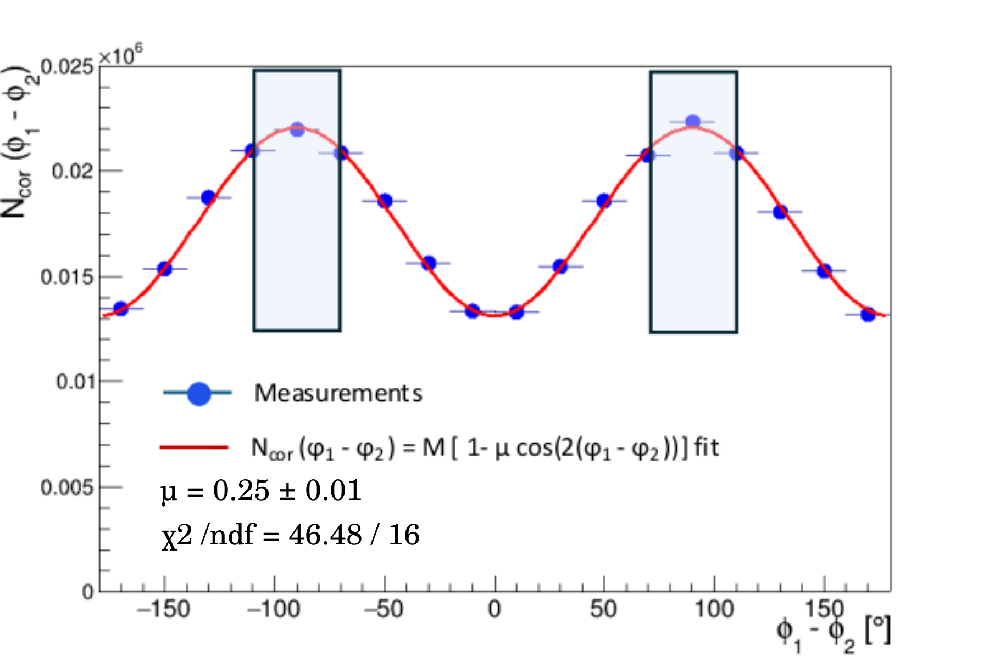
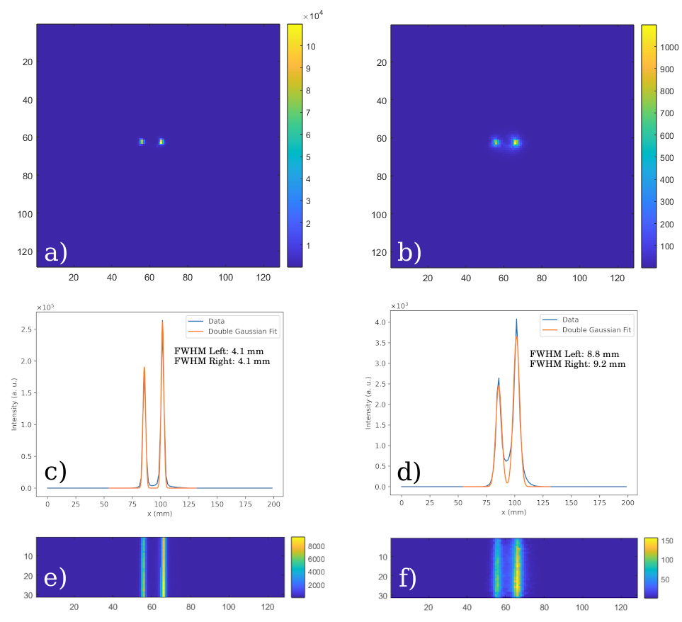
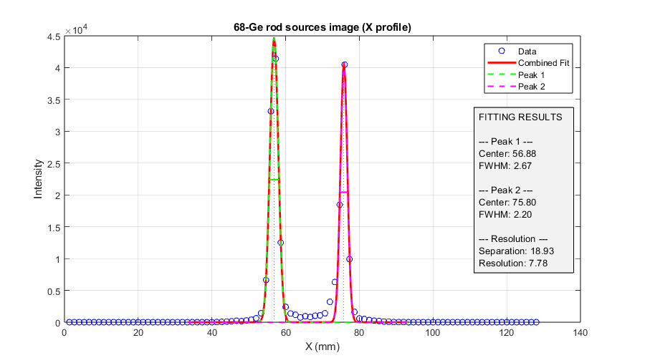
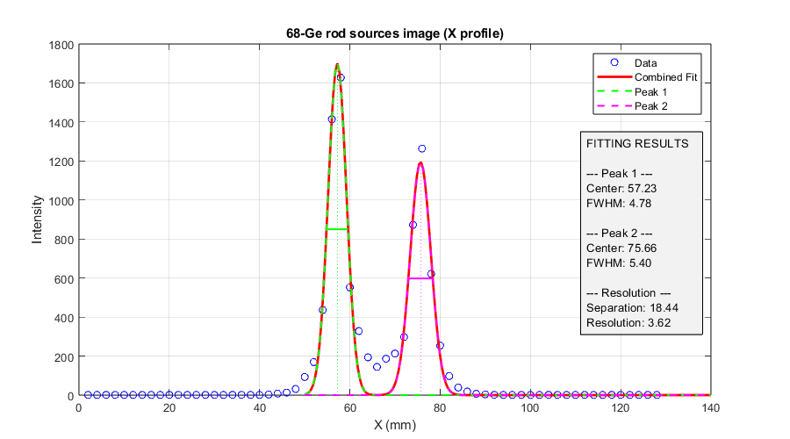
The spatial resolution
1 pixel events, E_{px}=511 keV
Pol.-cor. Events, |φ₁−φ₂|=90°±20°
FWHM ~2.5 mm
FWHM ~5.1 mm
Line sources Ge-68 ~45 MBq each, in epoxy phantom, 2 cm distance
Ring diameter: 430 mm; GAGG-3mm modules
M. Makek

Slide 19
The spatial resolution
1 pixel events, E_{px}=511 keV
Pol.-cor. Events, |φ₁−φ₂|=90°±20°
FWHM ~2.5 mm
FWHM ~5.1 mm
LOR ambiguity
Line sources Ge-68 ~45 MBq each, in epoxy phantom, 2 cm distance
Ring diameter: 430 mm; GAGG-3mm modules
M. Makek

Slide 20
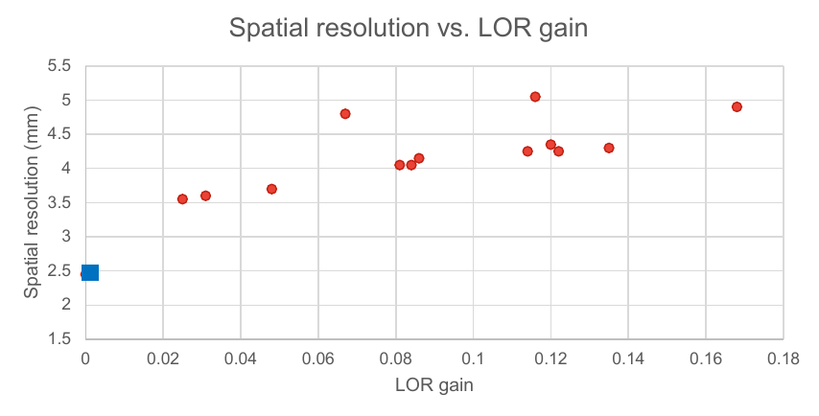
The spatial resolution
1 pixel events, E_{px}=511 keV
Pol.-cor. Events, |φ₁−φ₂|=90°±20°
Spatial resolution vs. LOR gain
FWHM ~5.1 mm
LOR ambiguity
Pol-cor events
Line sources Ge-68 ~45 MBq each, in epoxy phantom, 2 cm distance
1-px events
Ring diameter: 430 mm; GAGG-3mm modules
M. Makek

Slide 21
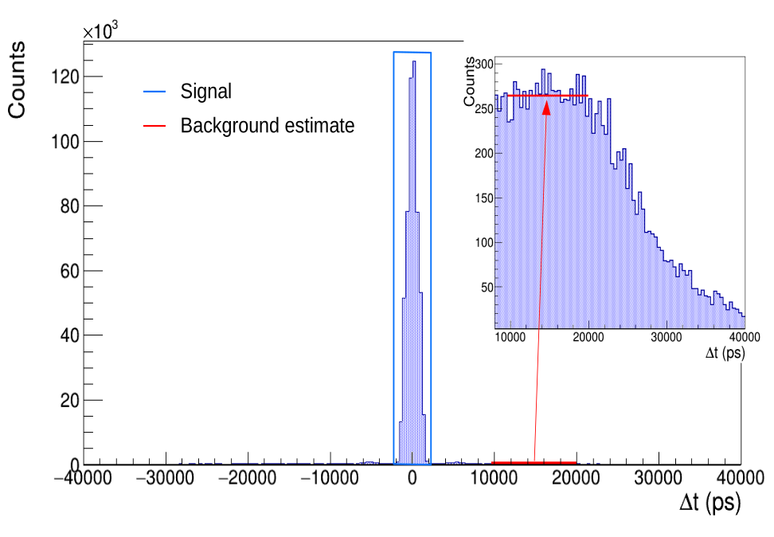
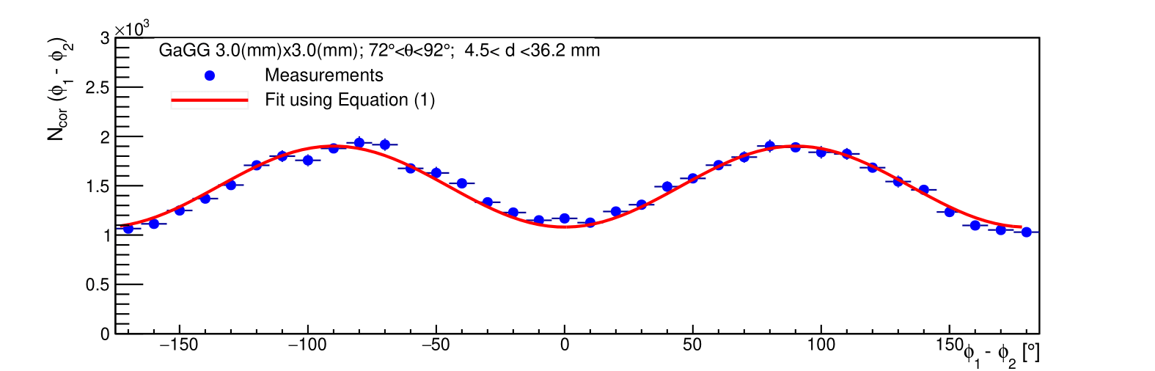
Random background rejection
S/B_{rand} from coincidence time spectrum, 5 ns window
Single pixel events
Pol-cor events, 72°<θ<90°, 70°<|Δφ|<110°
Pol-cor events, 72°<θ<90°, -20°<|Δφ|<20°
A. M. Kožuljević, PhD Thesis, University of Zagreb, 2025
M. Makek
EXOTIC ATOMS ZAGREB 2025

Slide 22
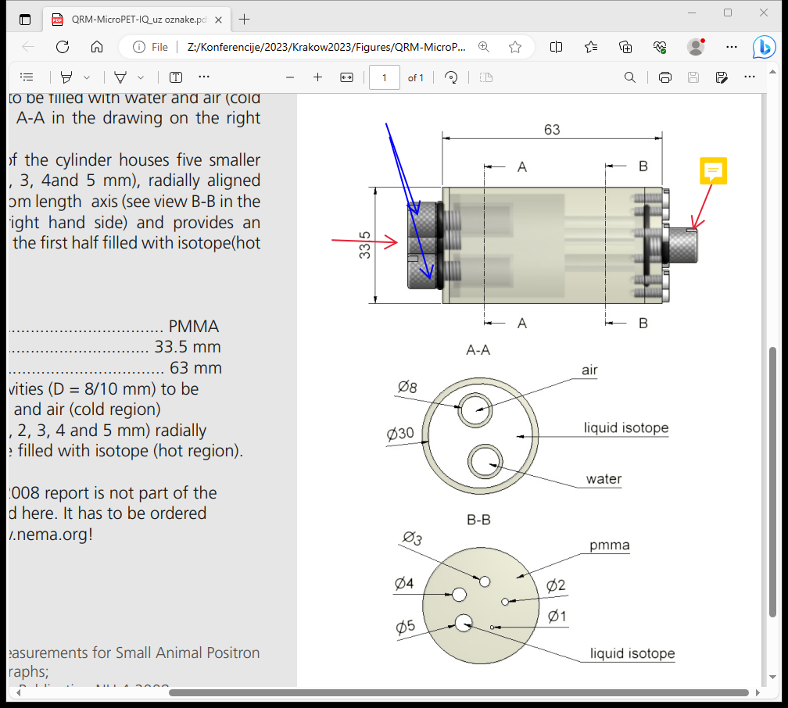
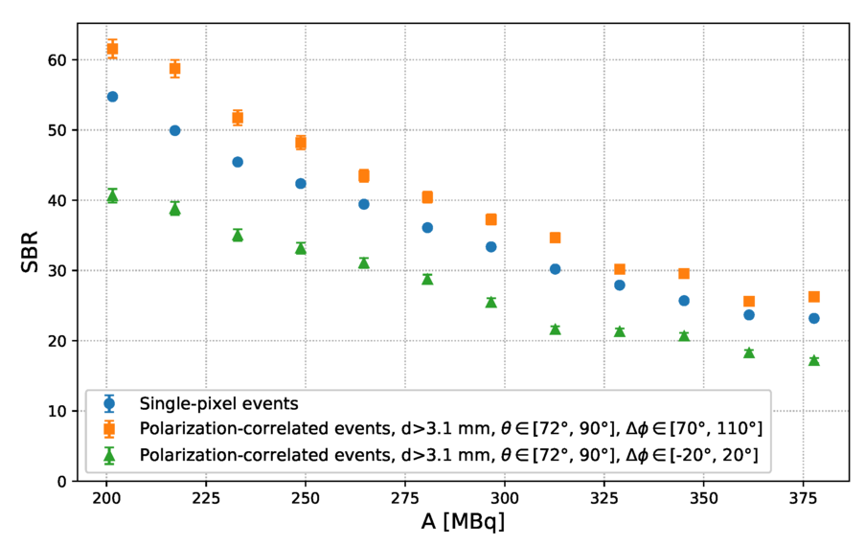
Random background rejection
NEMA-NU4, Ga-68, 400 MBq initial activity
Single pixel events
Pol-cor events, 72°<θ<90°, 70°<|Δφ|<110°
SBR improvement up to 20% for Pol.-Cor. events
Pol-cor events, 72°<θ<90°, -20°<|Δφ|<20°
Pol.cor events |Δφ|=90°±20° Single pixel events Pol.cor events |Δφ|=0°±20°
[ArXiv: 2510.11504]
M. Makek
EXOTIC ATOMS ZAGREB 2025

Slide 23
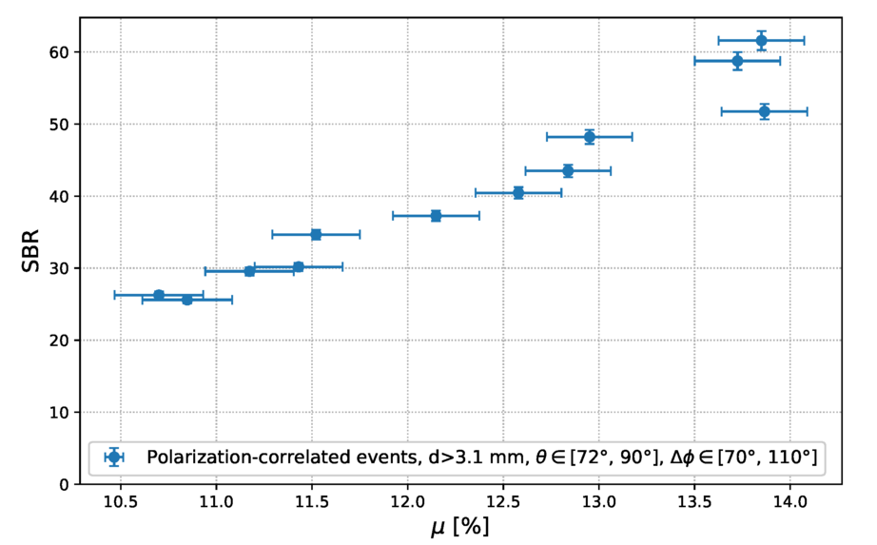
Random background rejection
NEMA-NU4, Ga-68, 400 MBq initial activity
SBR improvement up to 20% for Pol.-Cor. events
[ArXiv: 2510.11504]
Pol.cor events |Δφ|=90°±20° Single pixel events Pol.cor events |Δφ|=0°±20°
Azimuthal modulation (μ) - SBR estimator
[ArXiv: 2510.11504]
M. Makek
EXOTIC ATOMS ZAGREB 2025

Slide 24
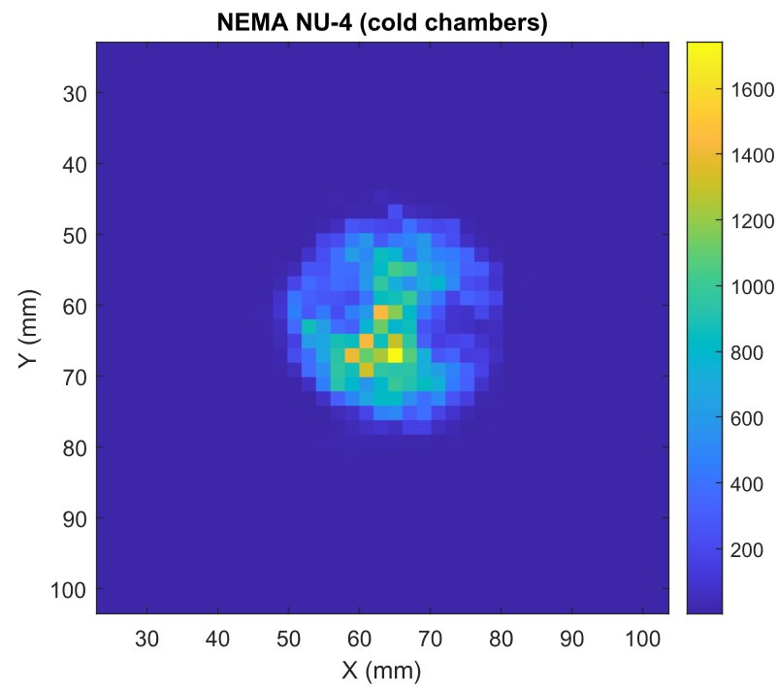
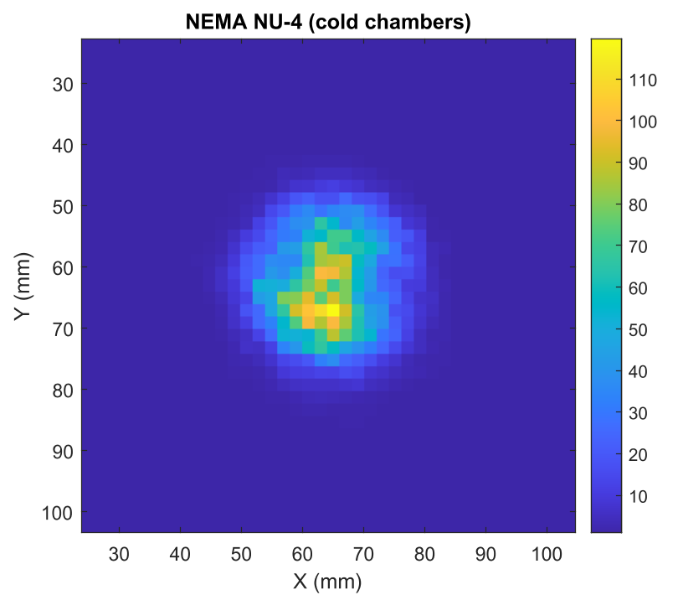
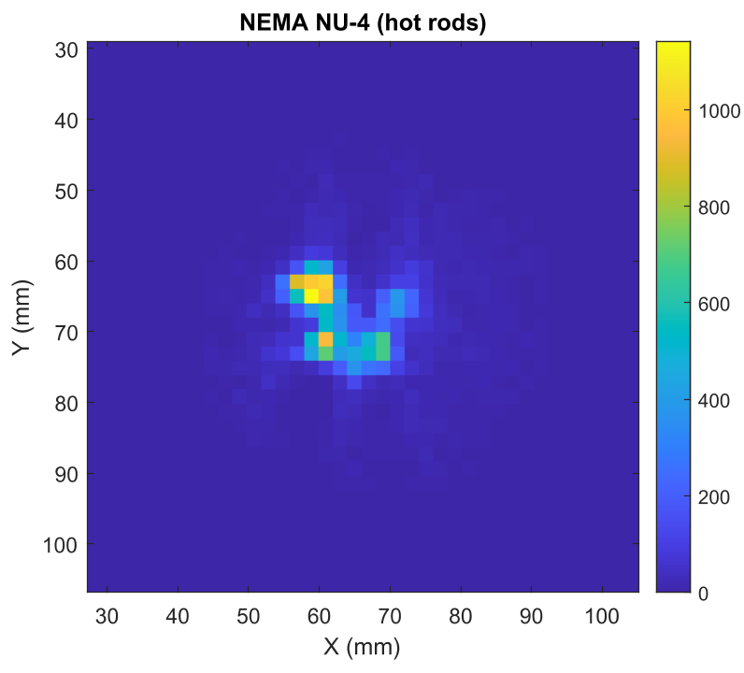
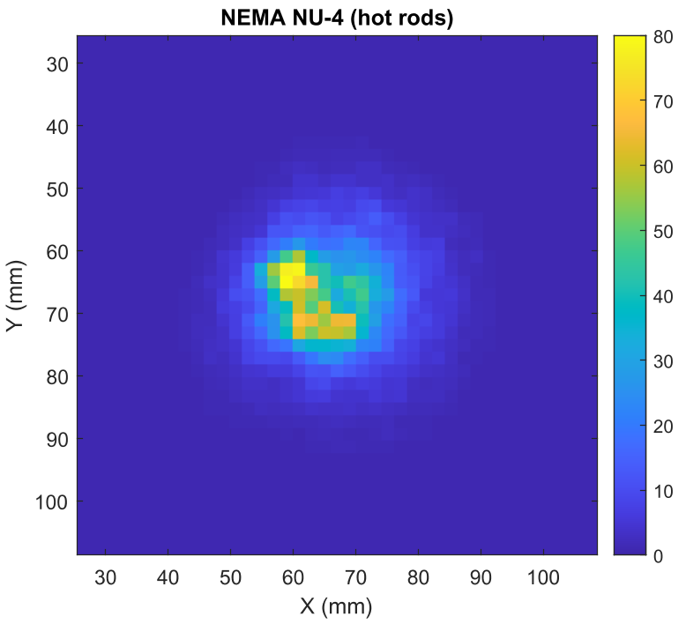
Standard vs. Pol-Cor Image
Ga-68
400 MBq
1-Pixel events
Pol. correl. events
Ring diameter: 420 mm; GAGG-3mm modules
M. Makek
EXOTIC ATOMS ZAGREB 2025

Slide 25
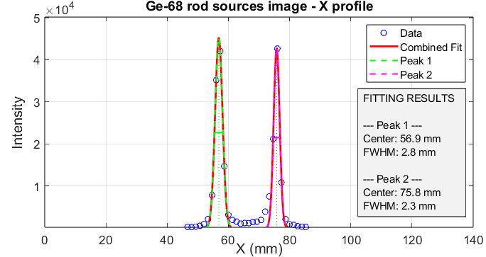
Standard and Pol-Cor PET synergy
Single-pixel (standard) + Pol-Cor(~10% extra) data
Spatial resolution
M. Makek
EXOTIC ATOMS ZAGREB 2025

Slide 26
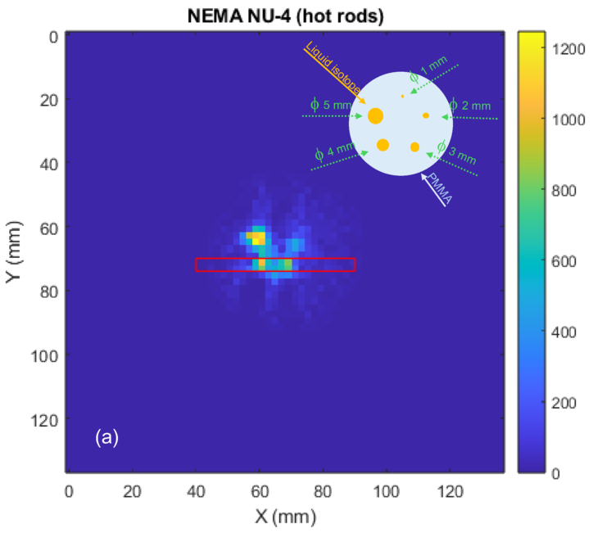
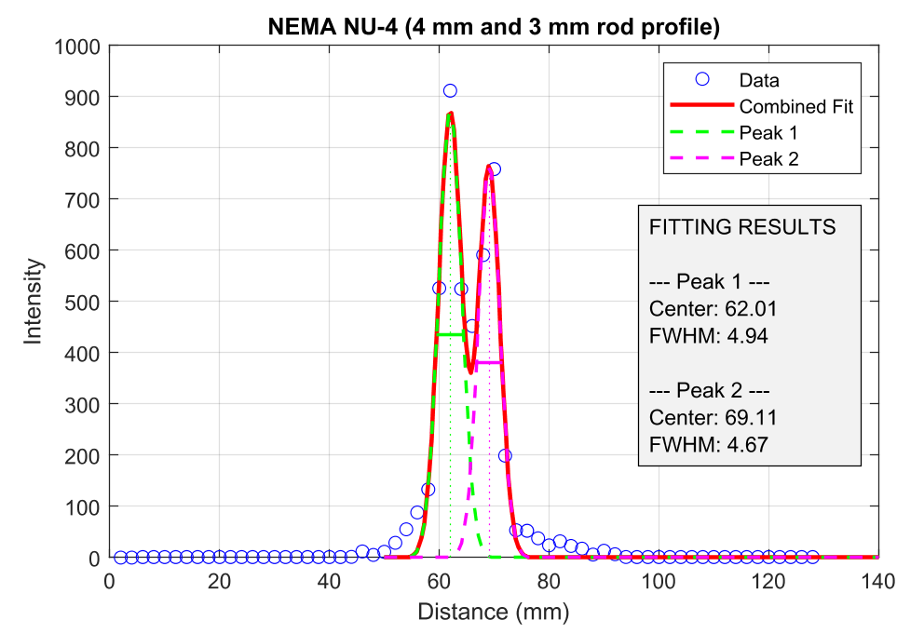
Standard and Pol-Cor PET synergy
Single-pixel (standard) + Pol-Cor(10% extra) data
NEMA NU-4 Phantom
10% data increase, resolution and image quality preserved
M. Makek
EXOTIC ATOMS ZAGREB 2025

Slide 27
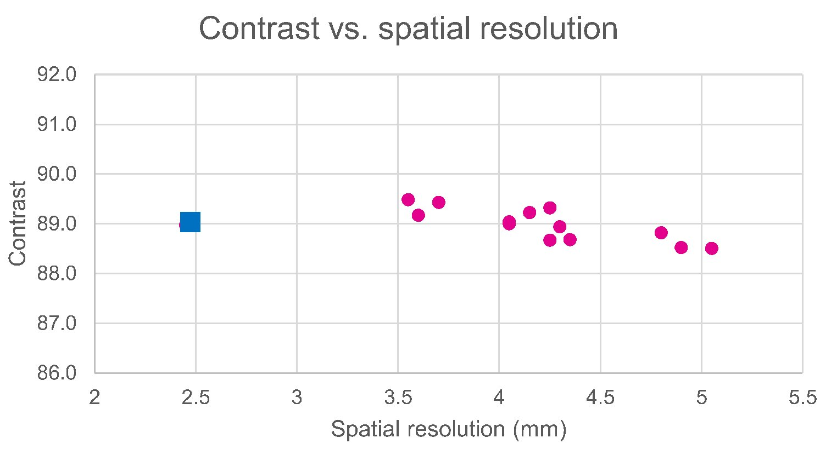
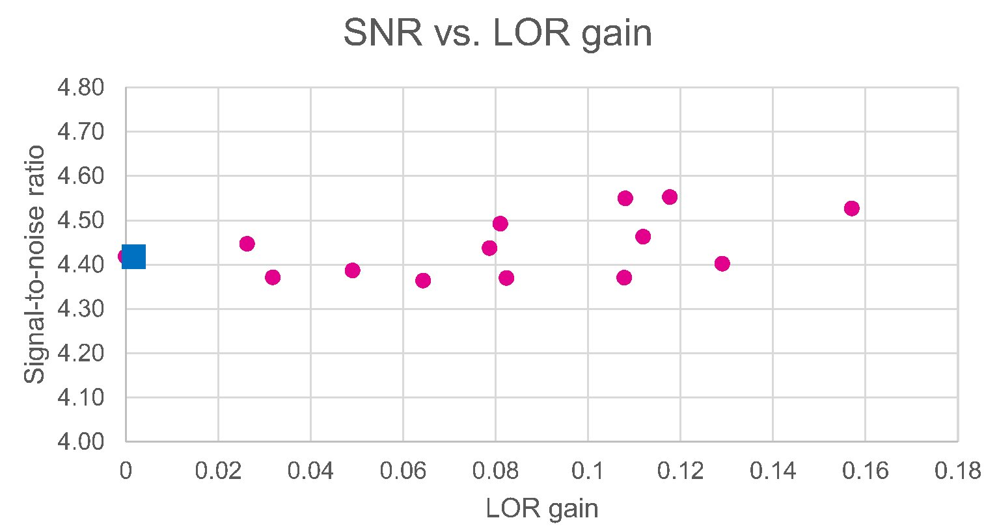
Further image improvement?
Merged image contrast vs. pol-cor. image resolution
Merged image SNR vs. LOR gain
Pol-cor events
1-px events
1-px events
Pol-cor events
Contrast improvement observed with polarization -correlated event resolutions < 4 mm
SNR improvement observed with LOR gain > 8%
-> Fine-balance between contrast and sensitivity with current methods
M. Makek
EXOTIC ATOMS ZAGREB 2025

Slide 28
Conclusions
PET using polarization-correlated events
First imaging with clinically relevant activities
Improved random suppression
Additional signal to improve sensitivity
Balance contrast vs. sensitivity
M. Makek

Slide 29

ACKNOWLEDGEMENTS
This work was supported by Croatian Science Foundation under the project IP-2022-10-3878 and in part by the “Research Cooperability” Program of the Croatian Science Foundation, funded by the European Union from the European Social Fund under the Operational Programme Efficient Human Resources 2014–2020, grant number PZS-2019-02-5829

