Slide 1



Linear coupling and beam-beam biases to luminosity calibration measurements in the Large Hadron Collider
Anne-Clémence Piveteau
Supervision : Prof. Mike Seidel, Dr. Tatiana Pieloni
Notes:
pursued work of Lia lammert and Chenying Zhang

Slide 2
Outline of the presentation
Introduction on beam-beam and linear coupling
  Tune shift analysis for Gaussian beams
Observables : single beam distribution, transverse luminosity distribution…
Beam distributions in the LHC : Gaussian and q-Gaussian
Effects on beam dynamics
  influence of linear coupling and impact of beam-beam interactions
Consequences for keys observables in van der Meer (vdM) scans
  impact on single beam imaging and modifications of the transverse luminosity distribution
  role and influence of coupling terms
  evaluation of luminosity biases
  changes in σ_{vis}
Flat q-Gaussian beam
Linear coupling and beam-beam biases to luminosity calibration measurements in the Large Hadron Collider

Slide 3
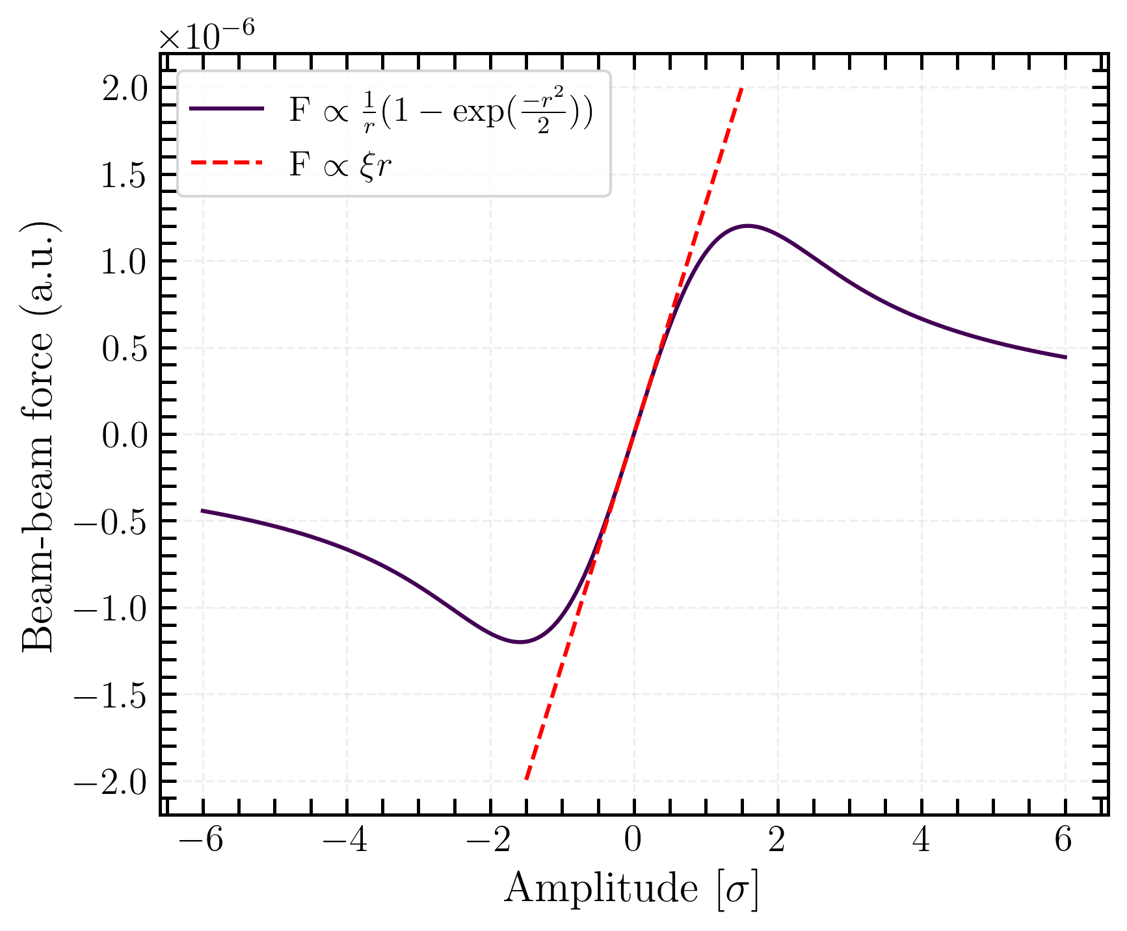
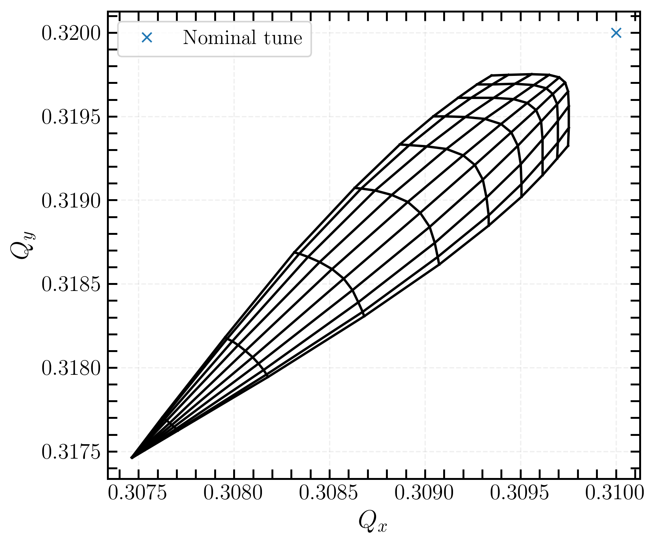
Beam-beam effect
Beam-beam force : non-linear EM force between particles in colliding beams [2], which can lead to x-y correlation.
Beam-beam force for round beams
Tune footprint for head-on collision
→ non-linear dependence of the force with amplitude for large displacements
→ tune spread caused by beam-beam force
Linear coupling and beam-beam biases to luminosity calibration measurements in the Large Hadron Collider
Notes:
• The beam–beam force leads to tune spread and potential x–y coupling.

Slide 4
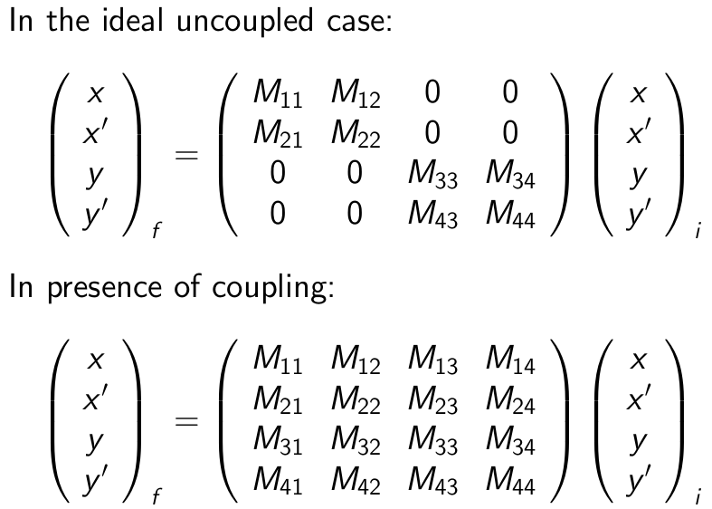
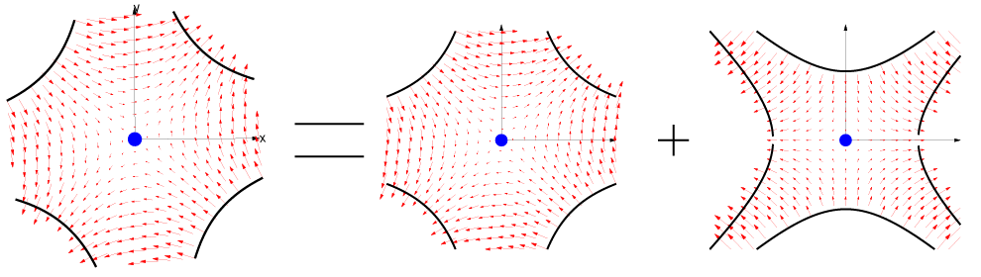
Linear coupling
In linear motion :
Source : tilted quadrupoles and tilted sextupoles
Interdependency between x-y motion
tilted quadrupole = normal quadrupole + skew quadrupole [1]
Local coupling → change in local parameters
Global coupling → change in global parameters
Linear coupling and beam-beam biases to luminosity calibration measurements in the Large Hadron Collider
Notes:
linear coupling : describes the interaction between the motion of particles in the horizontal and
vertical planes, leading to a situation where the motion in one plane influences the motion in
the other. In an ideal accelerator, the transverse motion of particles in the x and y planes is
independent.
linear coupling could be one of the sources of non-factorization interplay with beam-beam effects
xy and phases 2by 2 diagonal matrix
horizontal and vertical planes are fully decoupled
in presence of coupling no longer diagonal
sources of coupling are tilted quadrupoles
effect depends on the strength of this tilted quadrupole and also where your beams are sitting in terms of the frequency
for non-linear motion way more complicated
two types of linear coupling

Slide 5
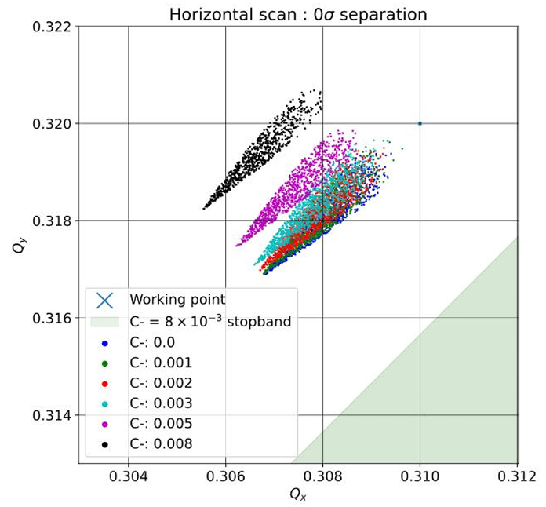
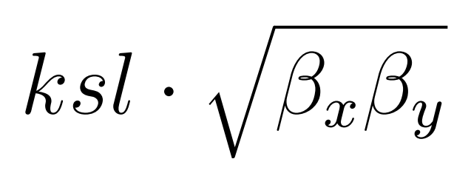
Linear local coupling
Linear global coupling
Due to tilted quadrupoles in the IR and cancels out of the IR
No impact on global parameters (i.e tunes)
Impact to local beam properties (beam sizes) along the IR
Proved to be a problem in physics fills and corrected (first correction in 2022 [2])
Scaling as
Changes global parameters (i.e. tunes, tune spread)
Quantified with C⁻ coupling term
[3]
Linear coupling and beam-beam biases to luminosity calibration measurements in the Large Hadron Collider
Notes:
linear coupling : occurs due to tilted quadrupoles in the IR ans it cancels out of the IR, no impact to global parameters (i.e. tunes) but impact to the local beam properties (beam sizes) along the IR

Slide 6
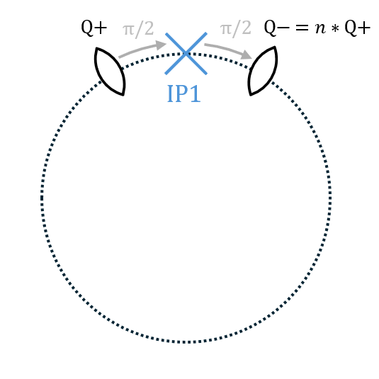
Simulation setup
Xsuite beam dynamics framework (Python modules)
Simplified LHC lattice, with 1IP and 2 skew quadrupoles (Q+ and Q-)
When the strength of Q+ and Q- is the same
→ local coupling
Strength of the second quadrupole can be reduced
→ local+global coupling
Local coupling strength varying over 10⁻⁴ to 10⁻³ m⁻²
typical vdM parameters (ξ_{bb}= 3.24 x 10⁻³)
Linear coupling and beam-beam biases to luminosity calibration measurements in the Large Hadron Collider

Slide 7
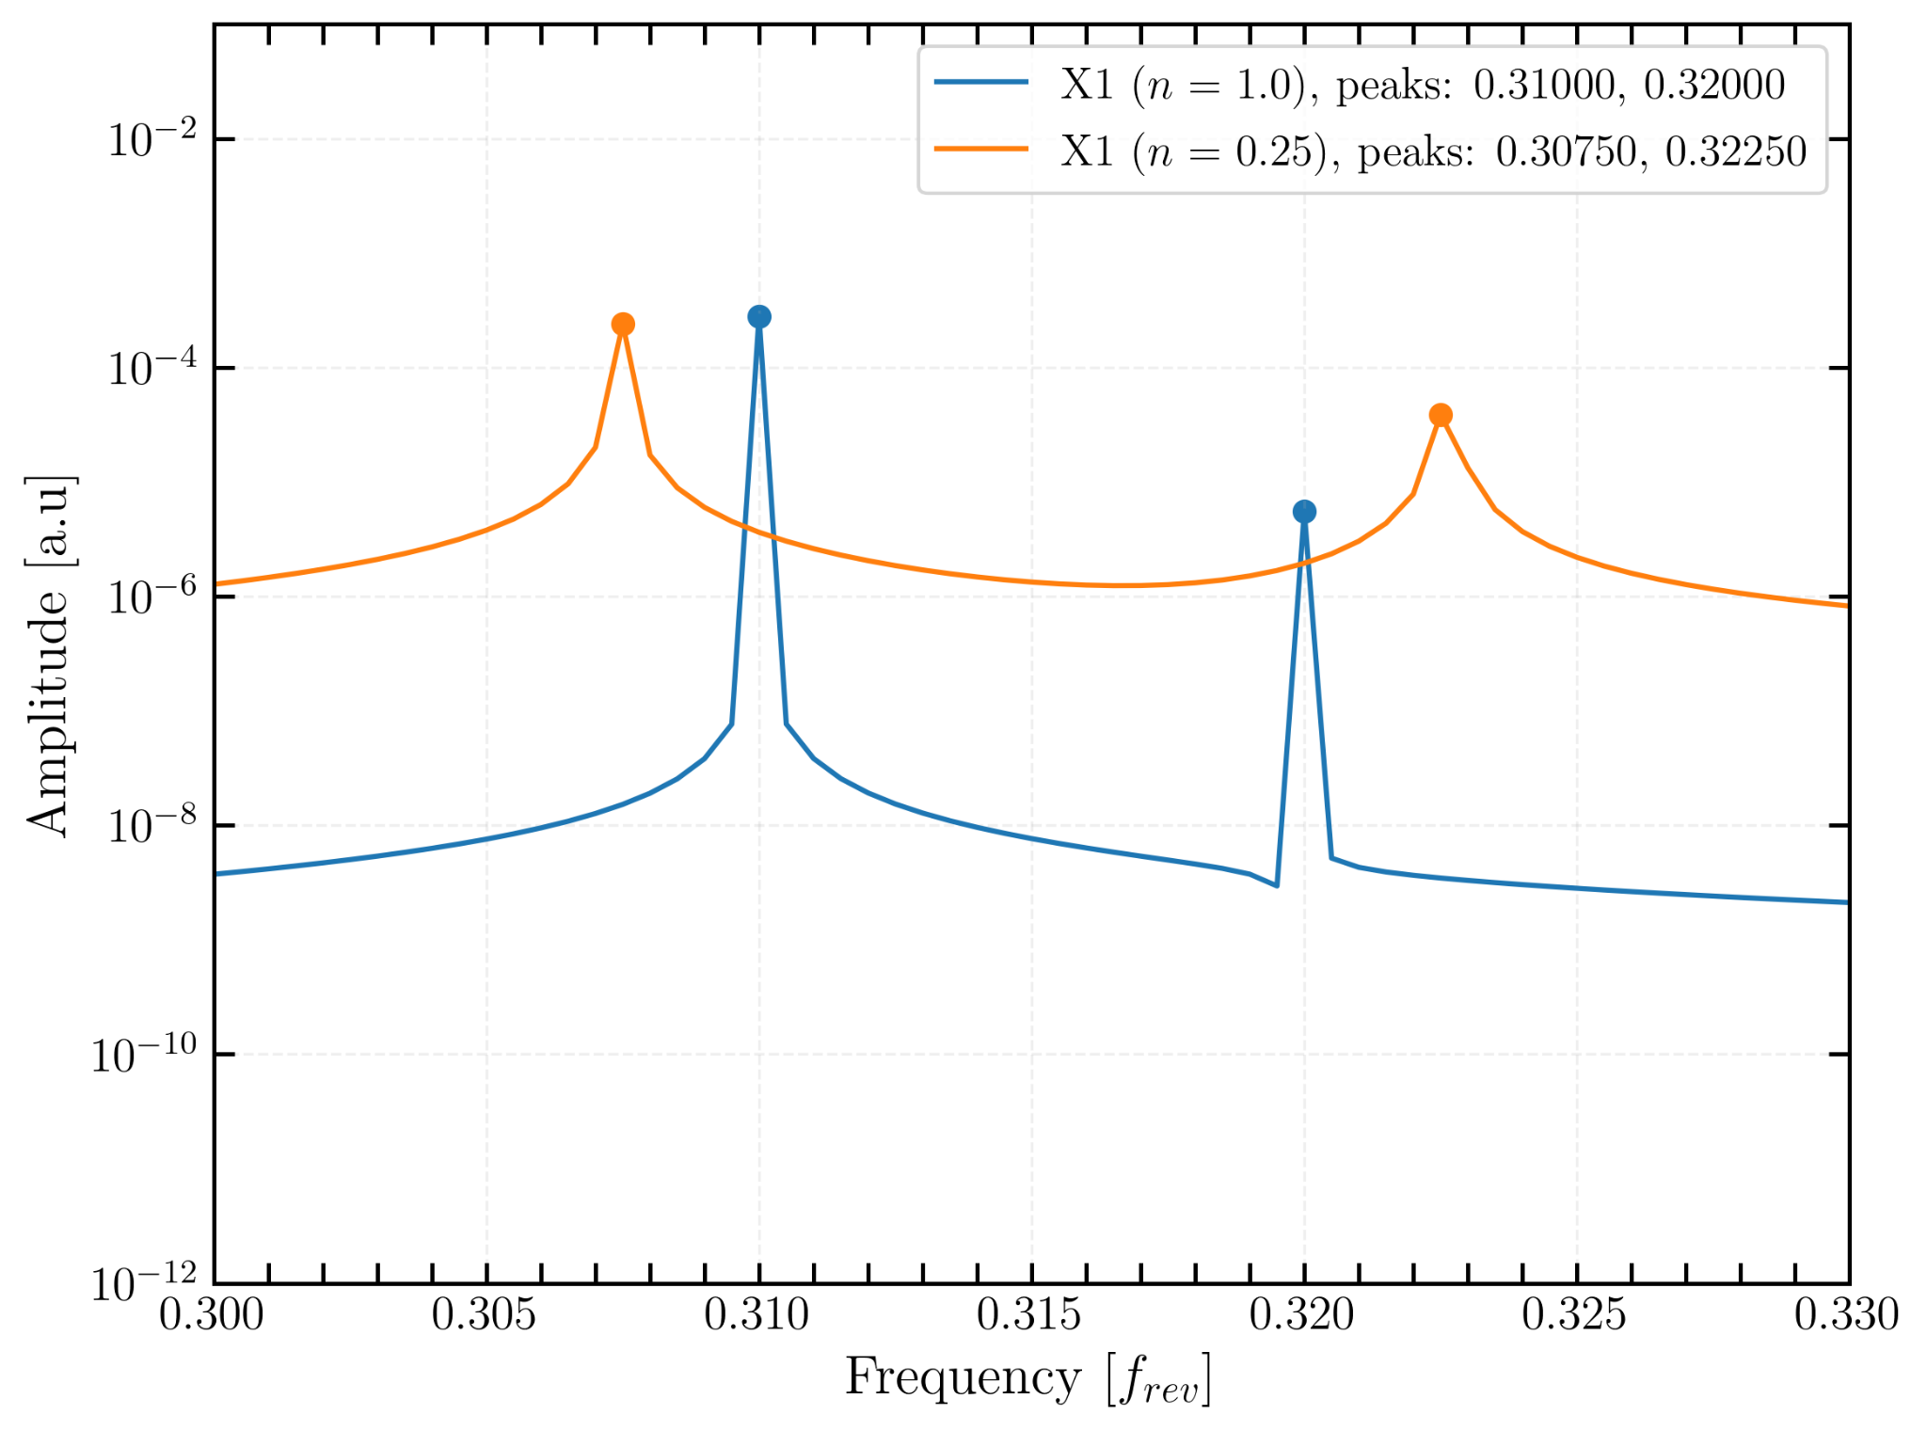
Tune shift analysis for Gaussian beams (I)
tune shift
Tune shift induced by coupling
Detectable tune shifts typically require changes of ≥ 0.0002 [7]
fully corrected (n=1)
Linear coupling and beam-beam biases to luminosity calibration measurements in the Large Hadron Collider
Notes:
frequency spectra

Slide 8
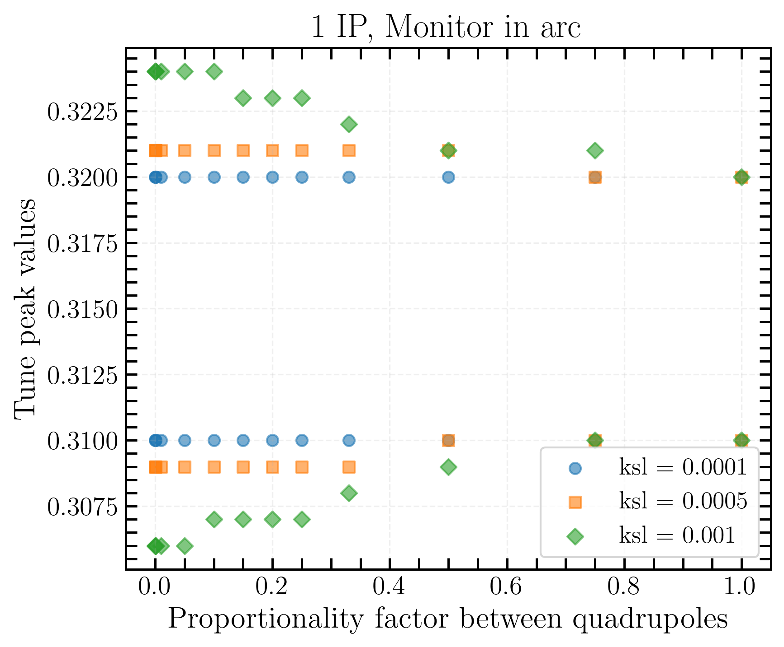
Tune shift analysis for Gaussian beams (II)
3 quadrupole coupling strengths
ksl = [0.0001, 0.0005, 0.001].
With ksl = 0.0001, no measurable tune shift is observed.
The maximum tune shift, as n→0 is only 0.0038.
Even strong sources of local-global coupling may go unnoticed during vdM scan due to the small magnitude of the associated tune shift.
Linear coupling and beam-beam biases to luminosity calibration measurements in the Large Hadron Collider

Slide 9
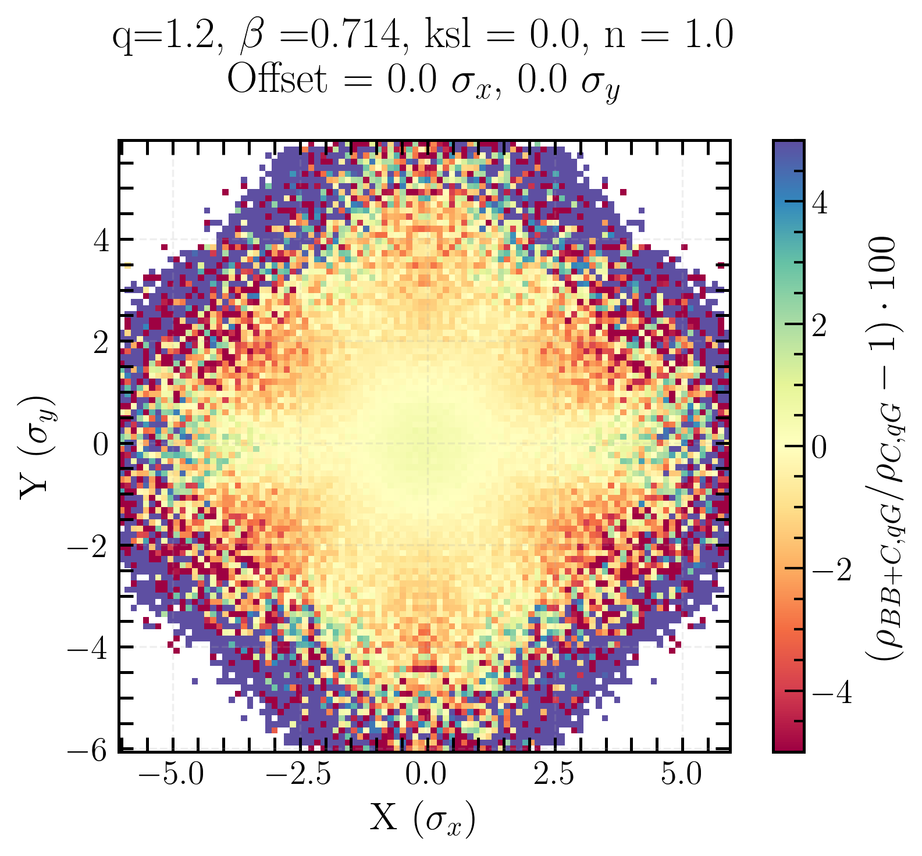
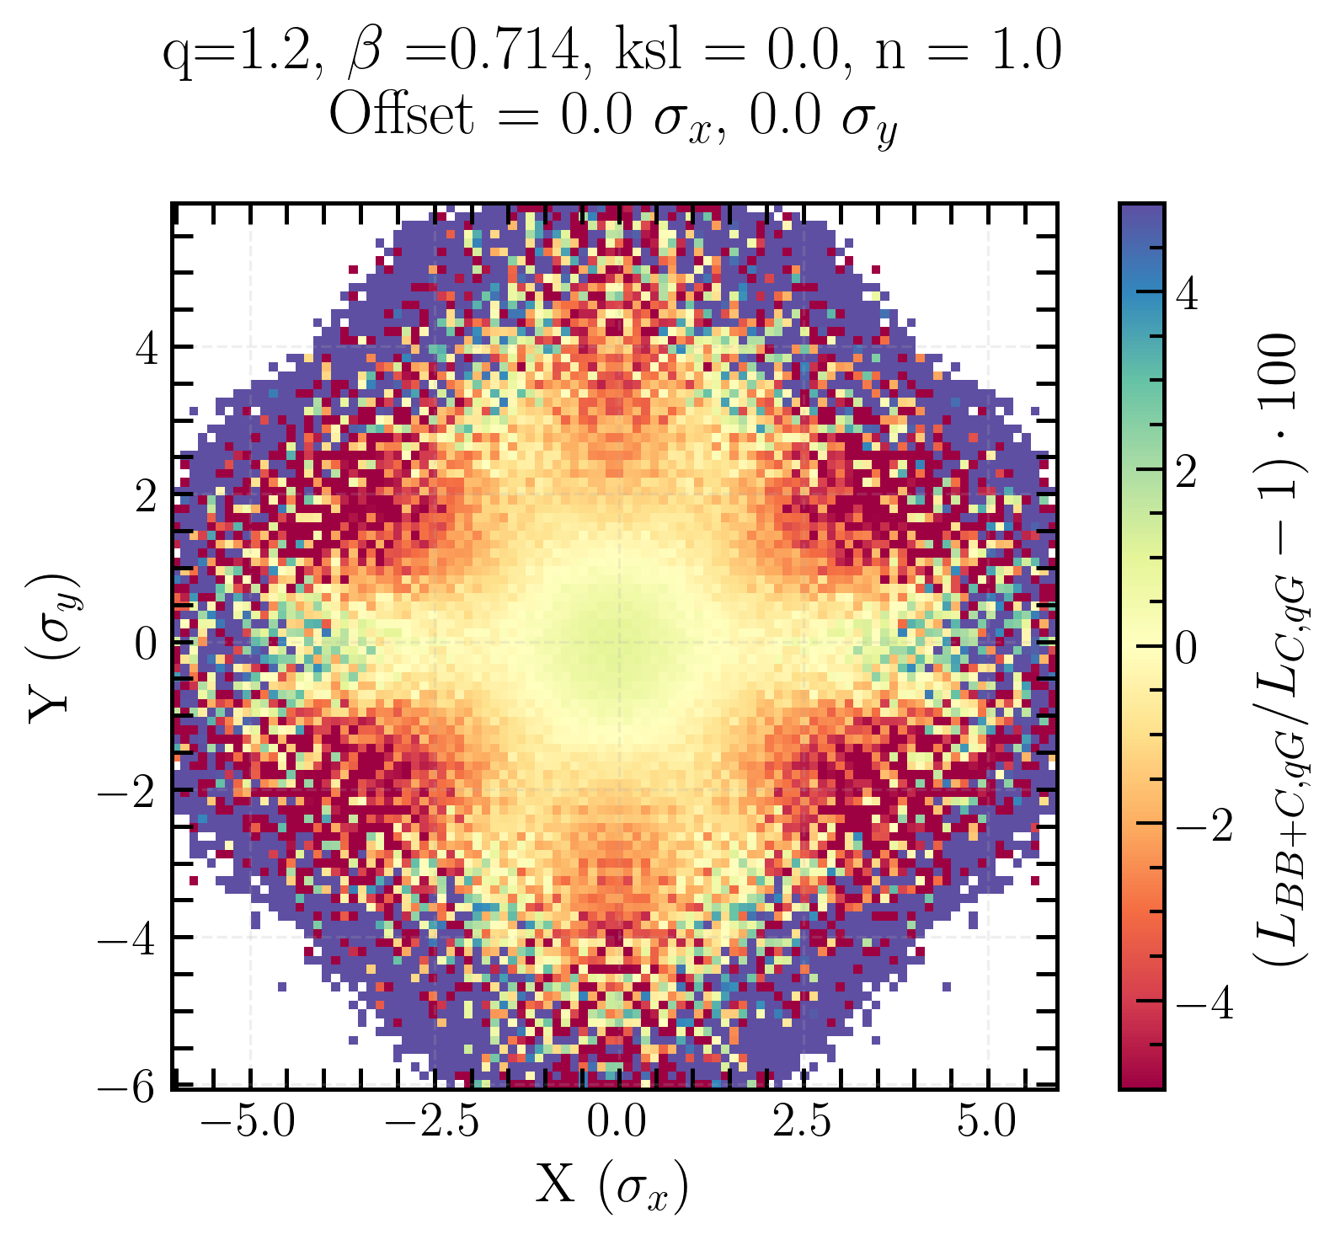
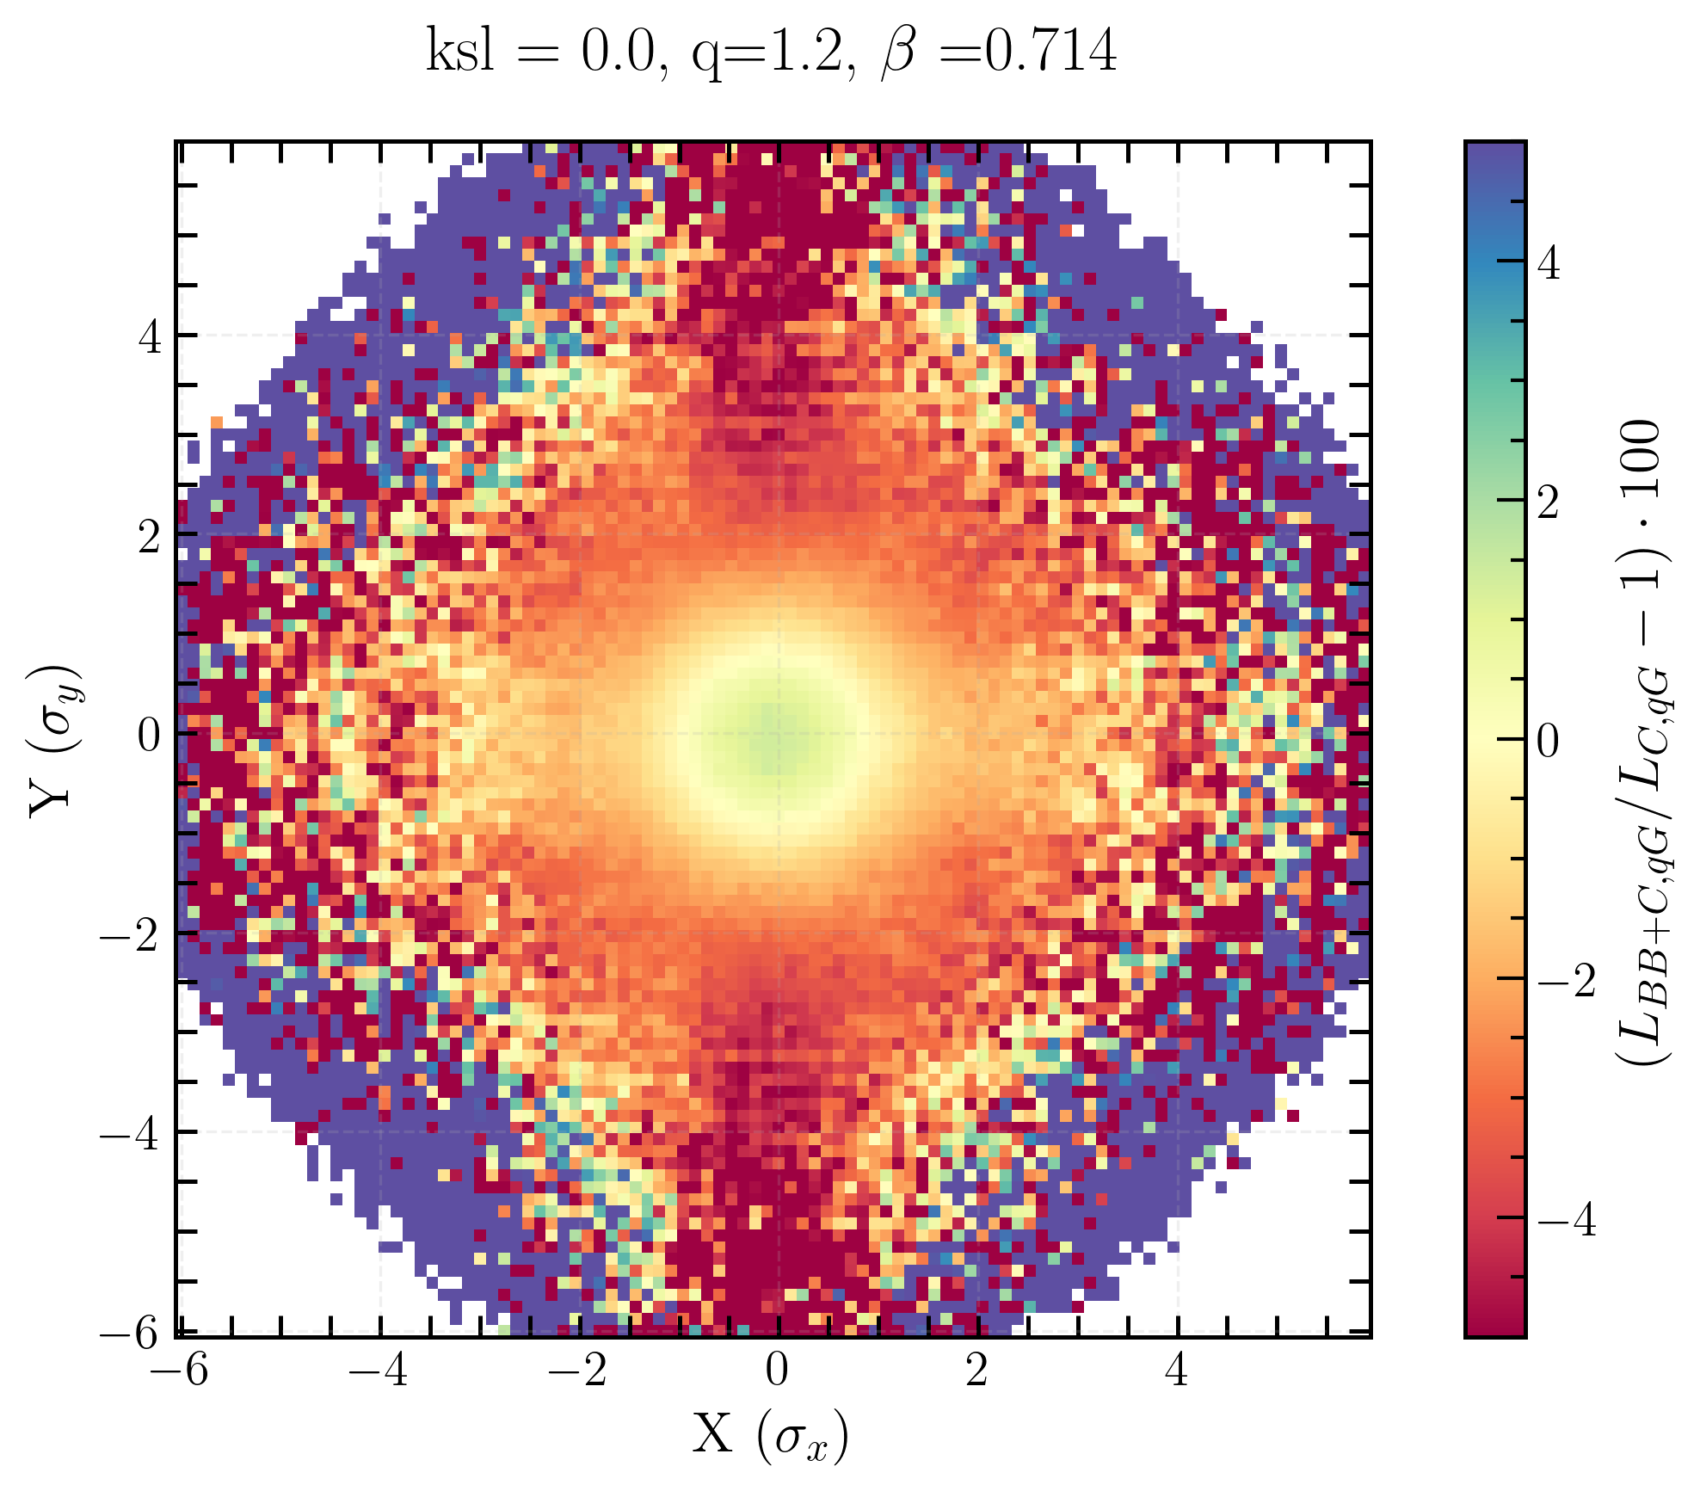
Observables
Single beam xy-distribution : charge density ρ for a single beam for one beam separation
Transverse luminosity distribution : point-by-point multiplication of charge density map of the two beams over the entire grid, for a fixed beam separation
(single) Beam imaging : (single beam xy-distribution) transverse luminosity distribution overlap of all beam separations from 0σ to 5σ
Plot of the charge density or transverse luminosity distribution biases.
single beam xy-distribution
transverse luminosity distribution
beam imaging
Linear coupling and beam-beam biases to luminosity calibration measurements in the Large Hadron Collider
Notes:
All of these are constructed
using a two-dimensional grid of size N × N, applied to either one or both beams.
Each point of the grid is assigned a charge density, it’s the representation of the distribution of particles
in transverse space.

Slide 10
Nomenclature used in the following slides
L_{BB} is the overlap of the charge density maps of both beams with only beam-beam.
L_{C} is the overlap of the charge density maps of both beams with only coupling.
L_{BB+C} is the overlap of the charge density maps of both beams with beam-beam and coupling.
L₀ is the overlap of the charge density maps of both beams with neither beam-beam nor coupling.
L_{G} is the is the overlap of the charge density maps of both beams of a Gaussian beam.
L_{qG} is the overlap of the charge density maps of both beams of a q-Gaussian beam.
Same convention used for the charge density ρ, and σ_{vis}
Linear coupling and beam-beam biases to luminosity calibration measurements in the Large Hadron Collider

Slide 11
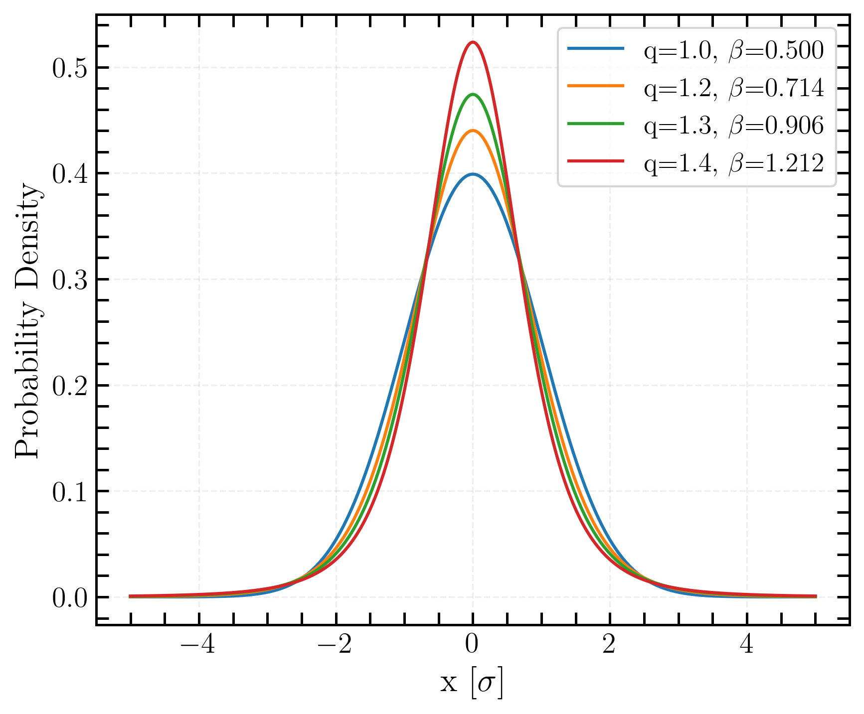
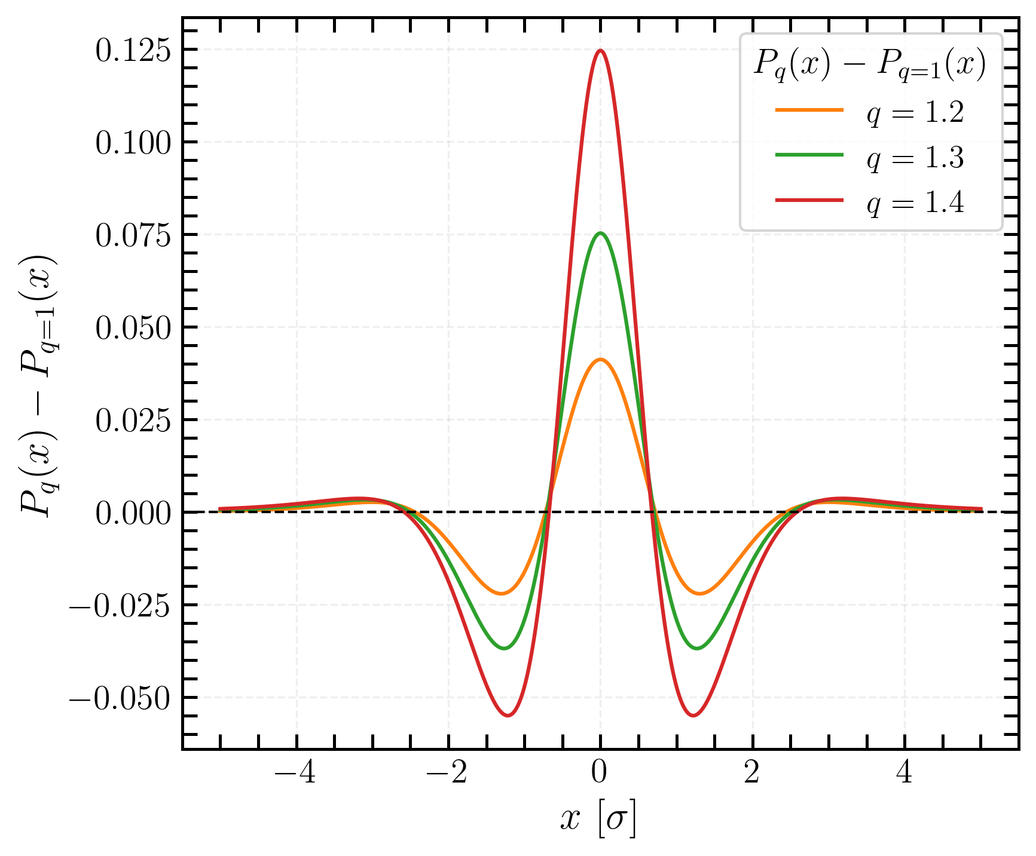
q-Gaussian distributions
Observations that colliding bunches often exhibit non-Gaussian tails [4,5]
Beams with heavy tails
Using simplified definition to artificially get the rms = 1: f(x) = [1-(1-q)βx²]^{1/(1-q)}
q-Gaussian distributions
Difference with standard Gaussian distribution
standard Gaussian
Linear coupling and beam-beam biases to luminosity calibration measurements in the Large Hadron Collider
Notes:
non-Gaussian tails : due to intra beam effects such as intra-beam scattering, synchrotron radiation, and due to the mutual interaction of the two colliding beams, such as beam-beam effect, e-cloud and luminosity burn-off.

Slide 12
Single beam xy-distribution beam-beam bias…
Linear coupling and beam-beam biases to luminosity calibration measurements in the Large Hadron Collider

Slide 13
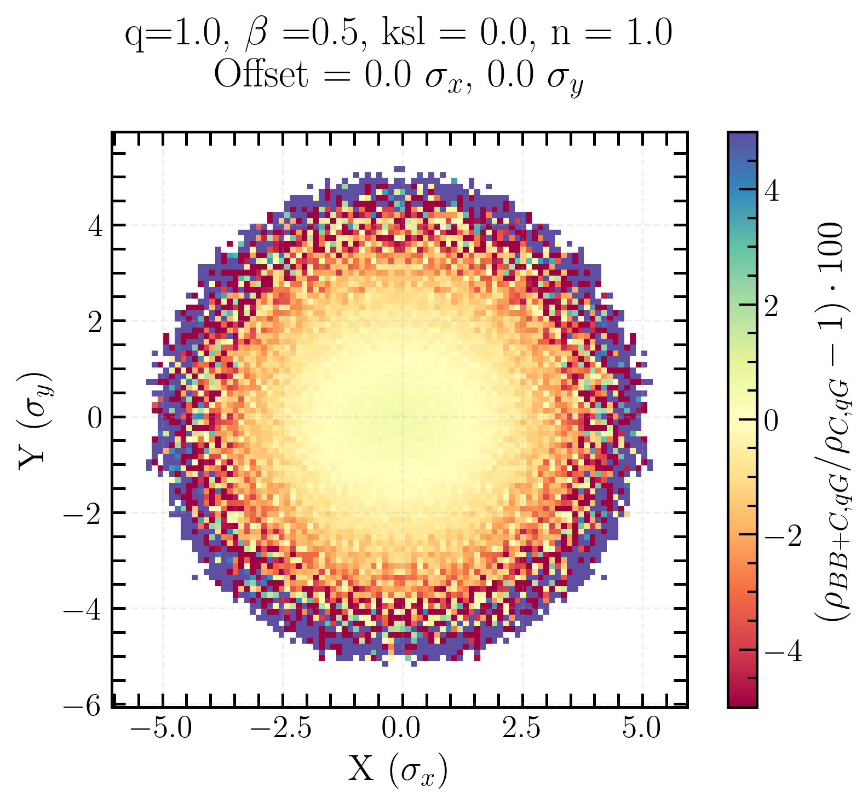
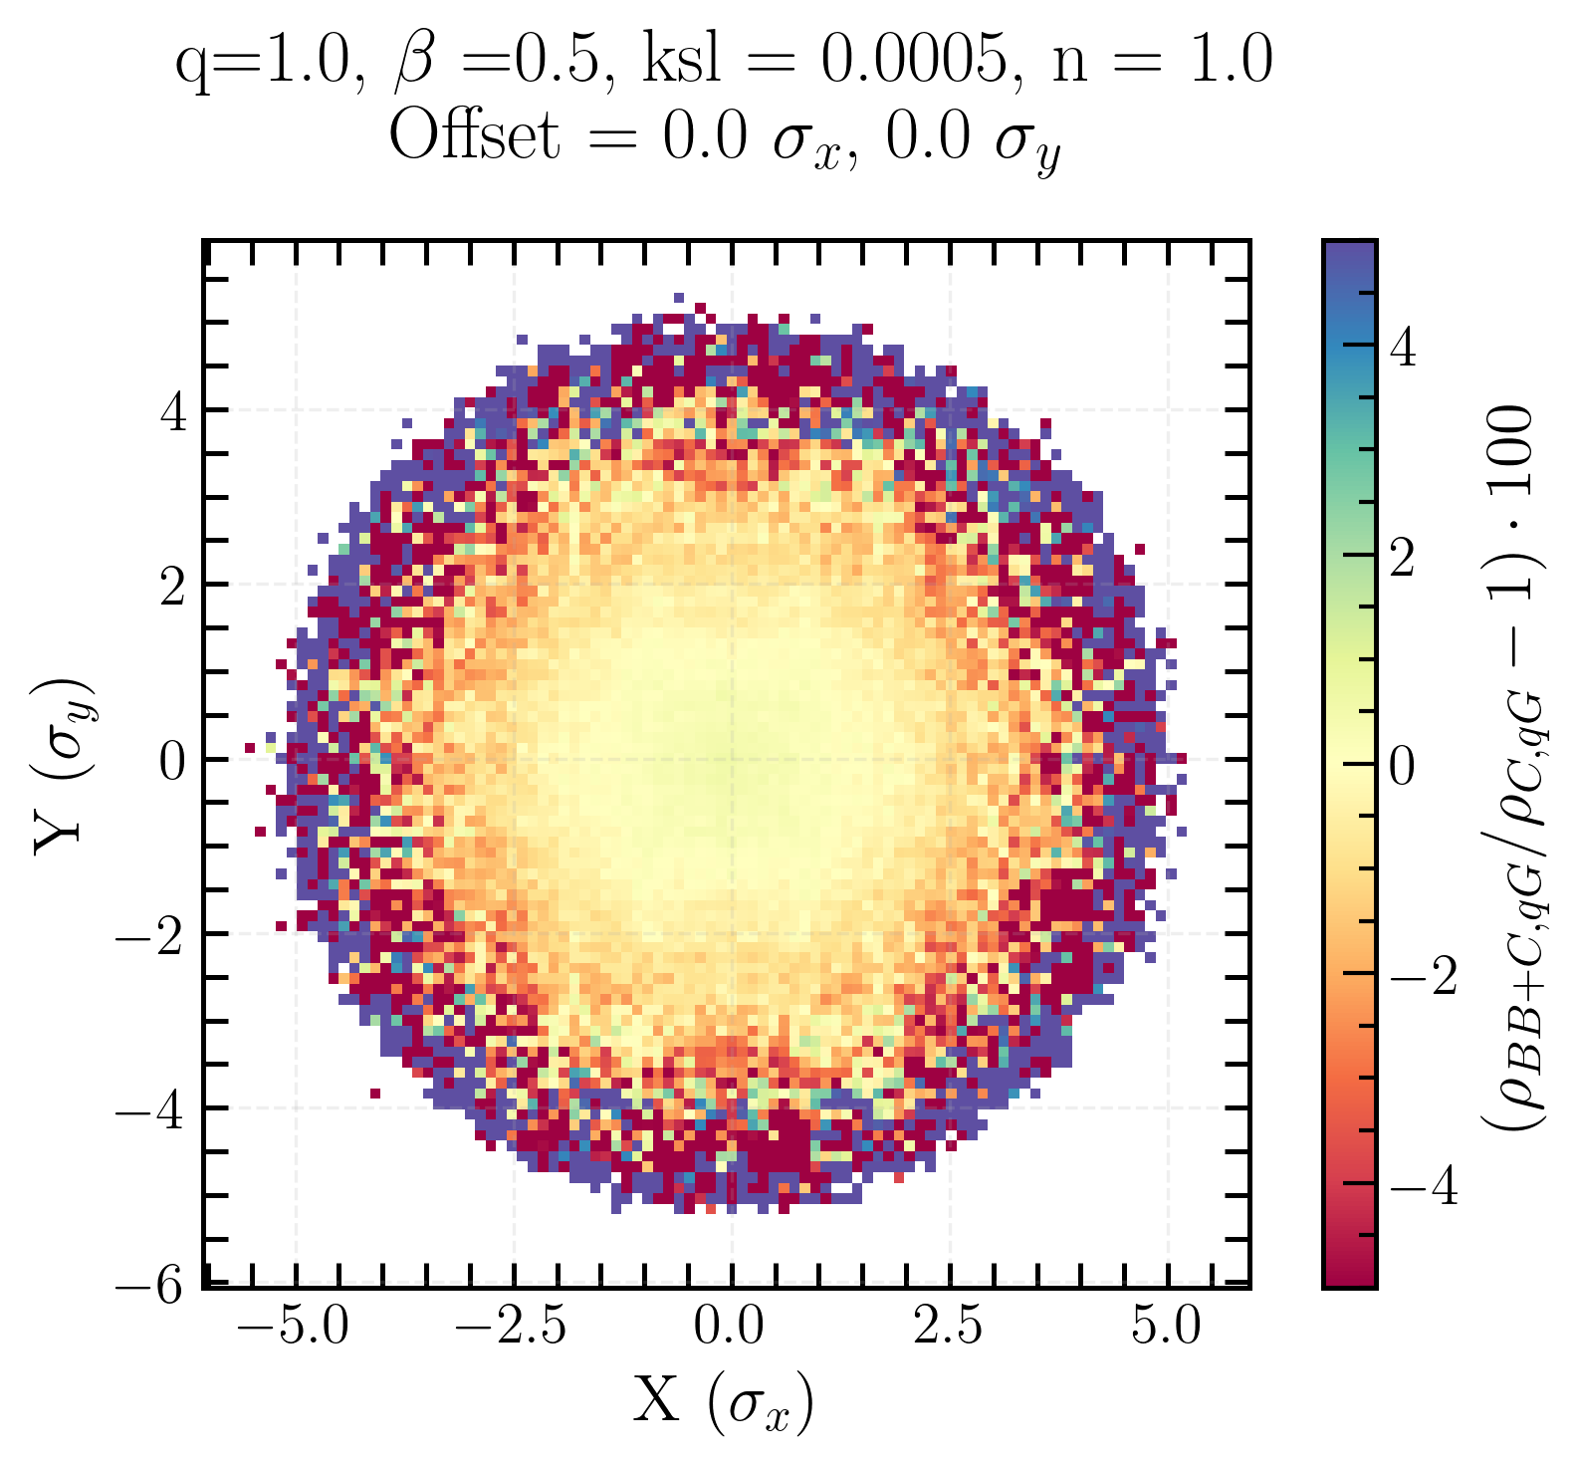
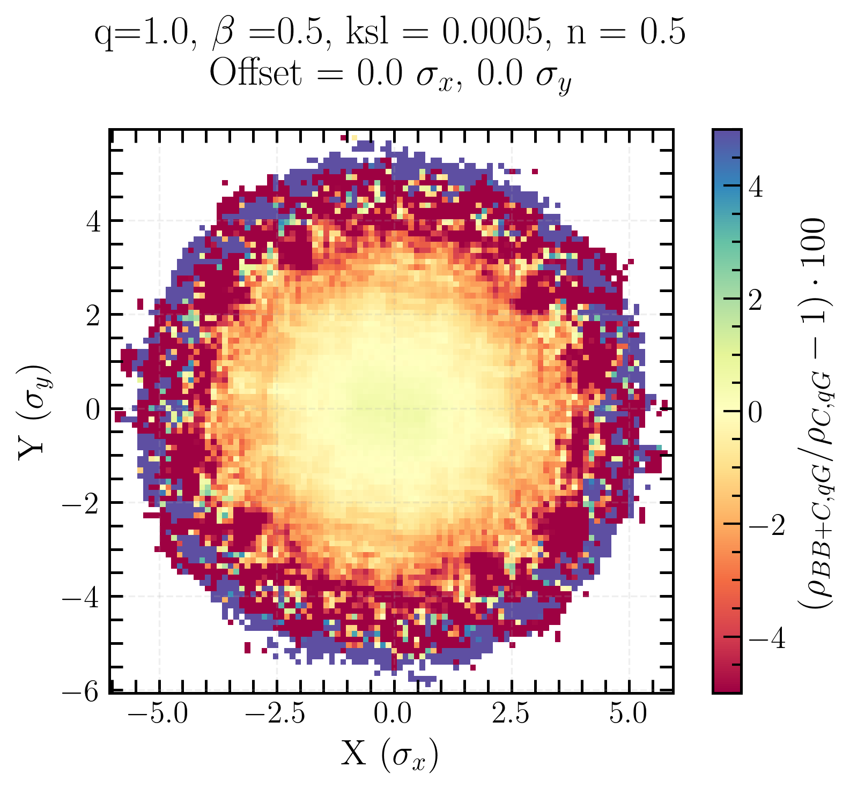
Single beam xy-distribution BB-bias for Gaussian beam
charge density ρ bias due to beam-beam
Positive bias in the center and negative bias around
no coupling
local coupling
local + global coupling
Linear coupling and beam-beam biases to luminosity calibration measurements in the Large Hadron Collider
Notes:
radial symmetry
positive bias in the center and negative bias around -> beam-beam enhances the charge density distribution in the center, drives particles from the tails to the center

Slide 14
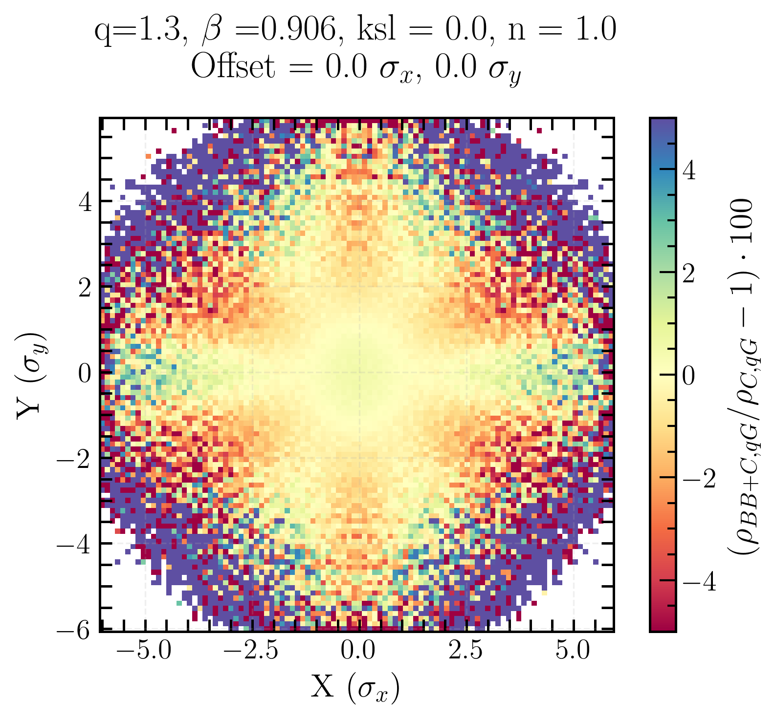
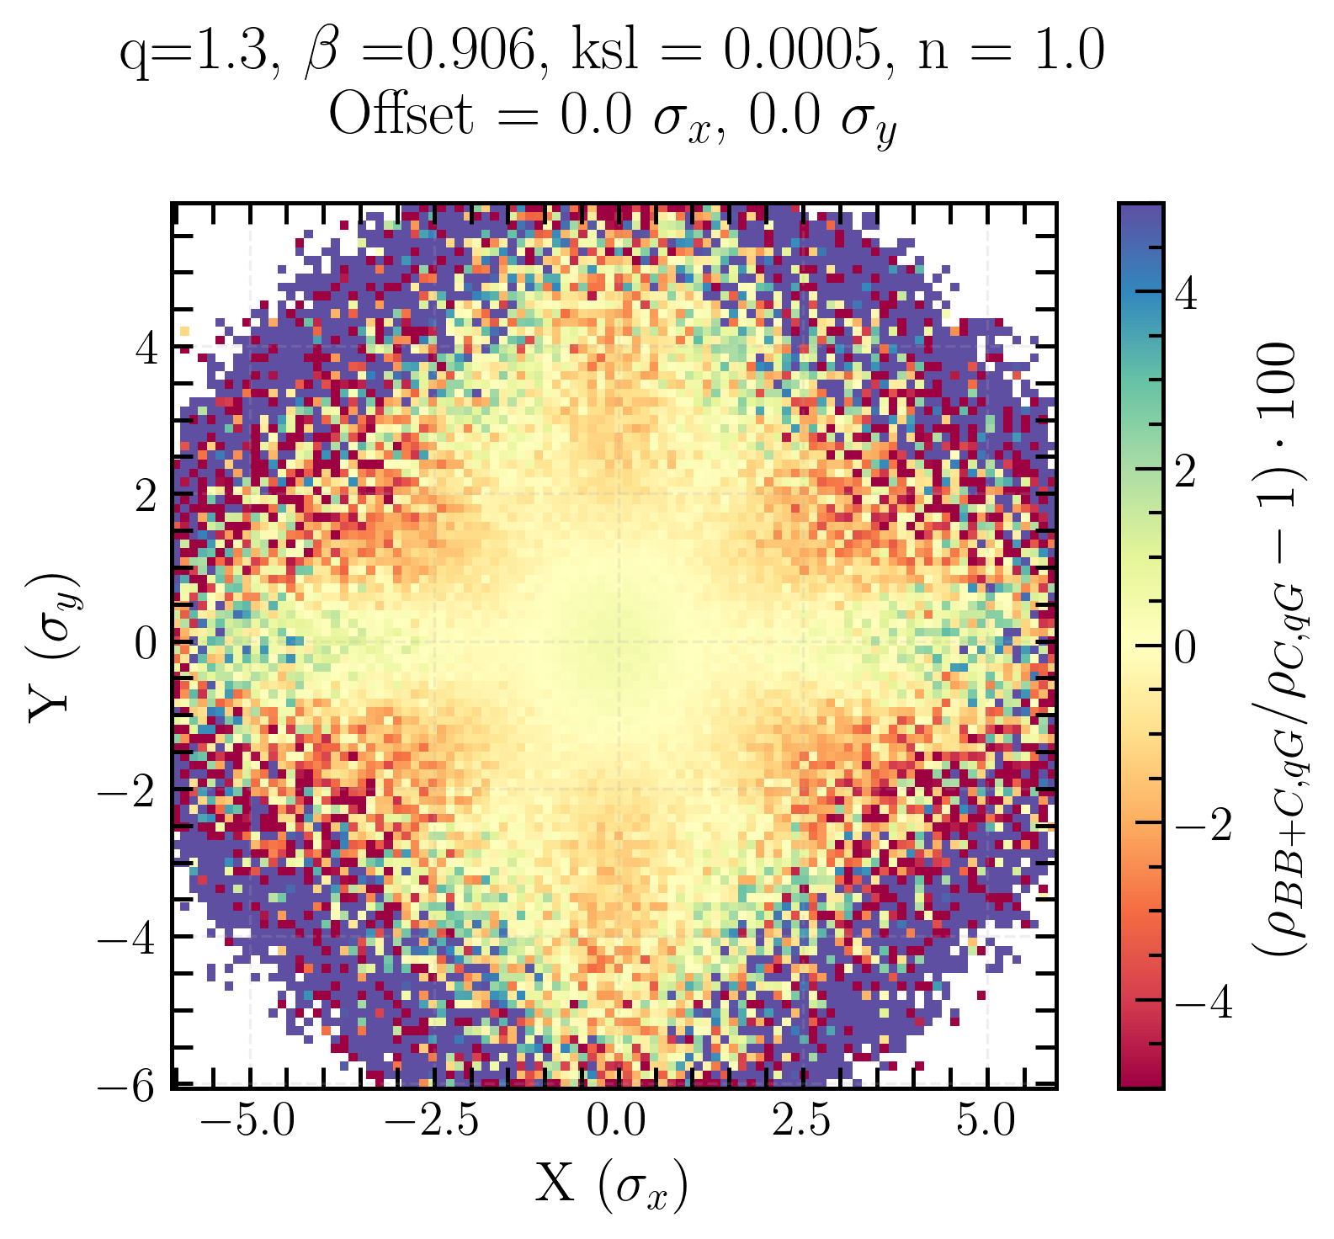
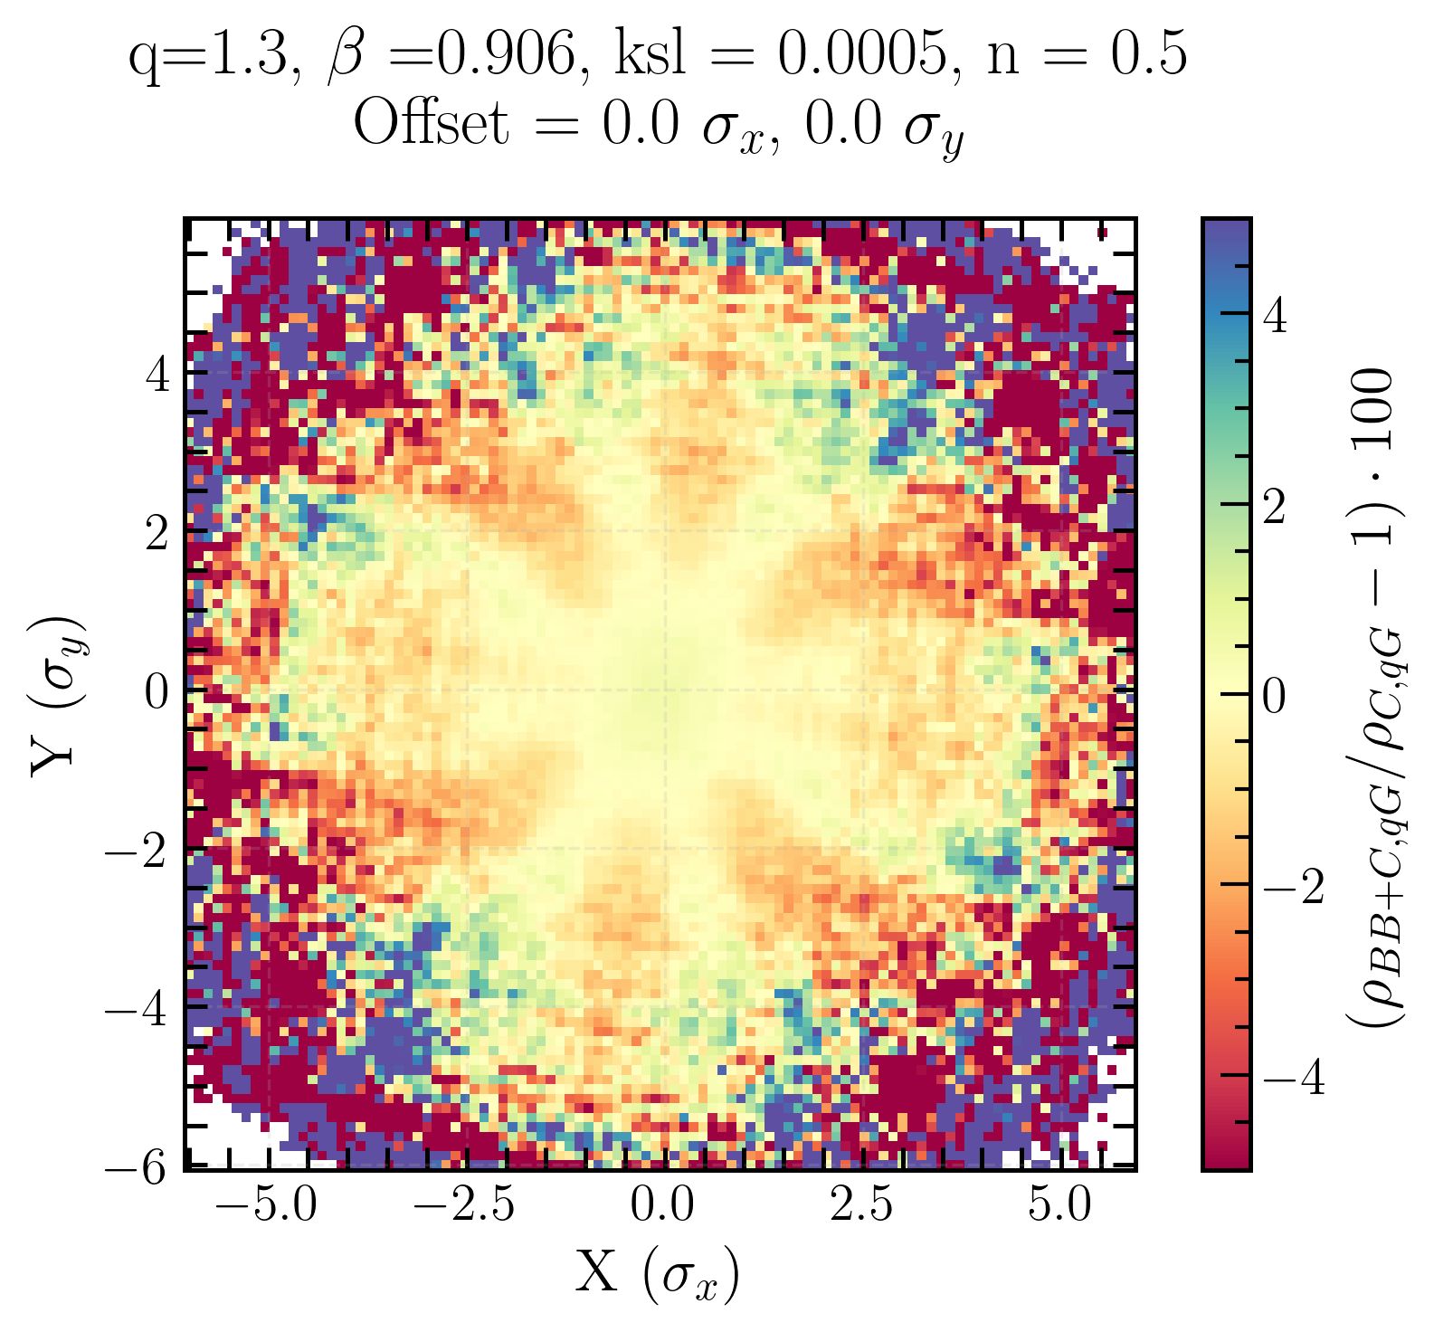
Single beam xy-distribution BB-bias for q-Gaussian beam
Initial beam distribution matters → shapes how beam-beam effects deform the transverse profile
Tilt in the local + global coupling case is now obvious
no coupling
local coupling
local + global coupling
Linear coupling and beam-beam biases to luminosity calibration measurements in the Large Hadron Collider
Notes:
highlight importance of the initial beam distribution for single beam xy-distribution

Slide 15
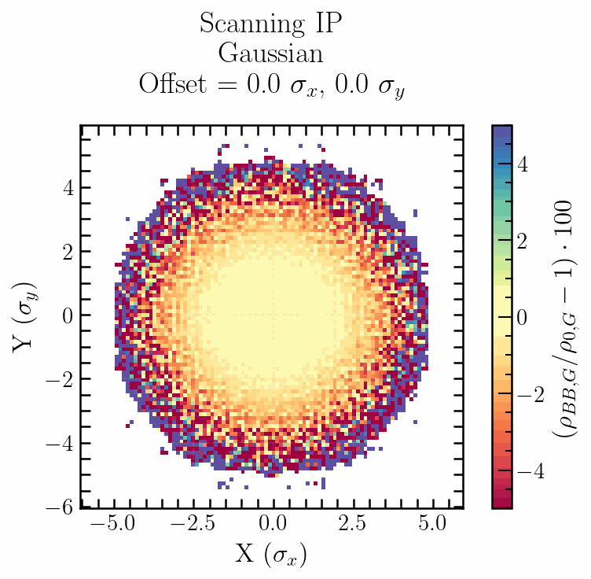
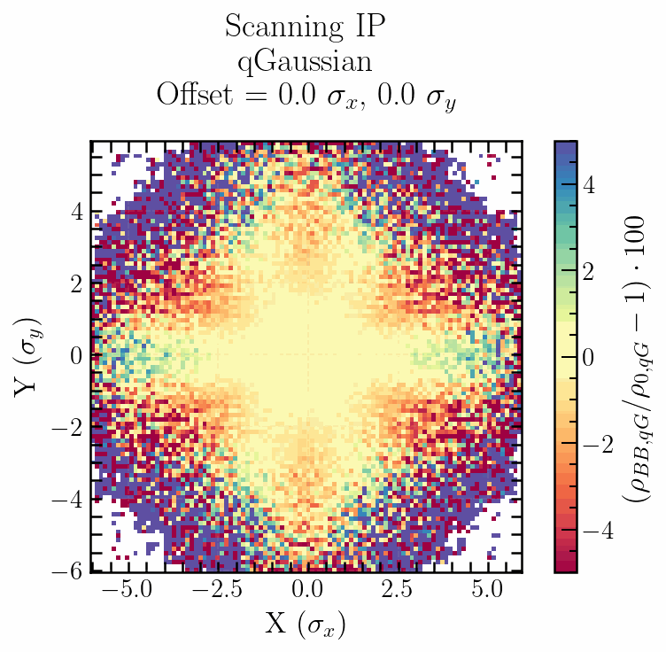
Single beam xy-distribution beam-beam bias
Gaussian
q-Gaussian
Beam-beam bias on single beam xy-distribution for x-axis scans.
Beam-beam interaction perturbs the single beam xy-distribution in a non-linear way that depends on the beam separation.
Linear coupling and beam-beam biases to luminosity calibration measurements in the Large Hadron Collider
Notes:
simulations during vdm scans
Beam-beam interaction perturbs the beam transverse density distributions in non-linear way, that depends on the beams’ separation
This can lead to correlation in x-y

Slide 16
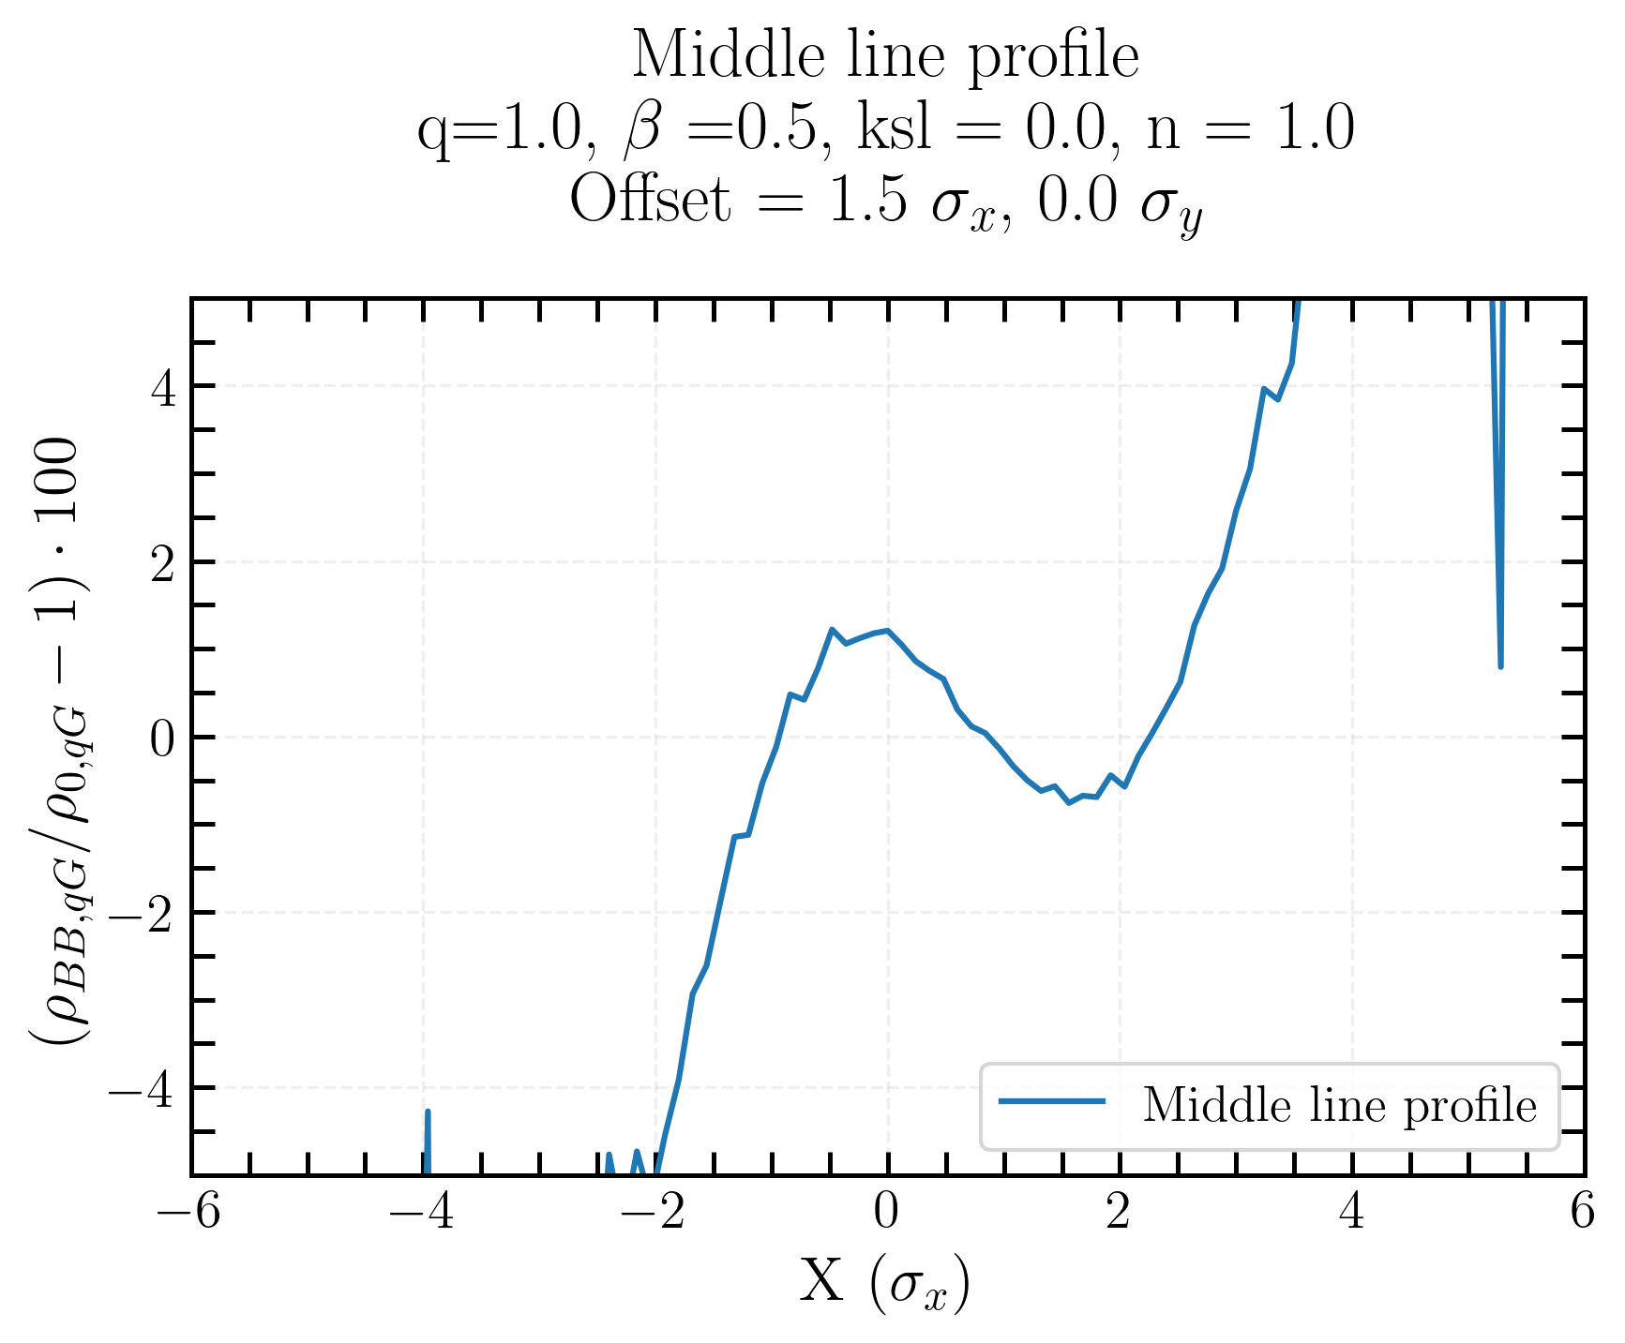
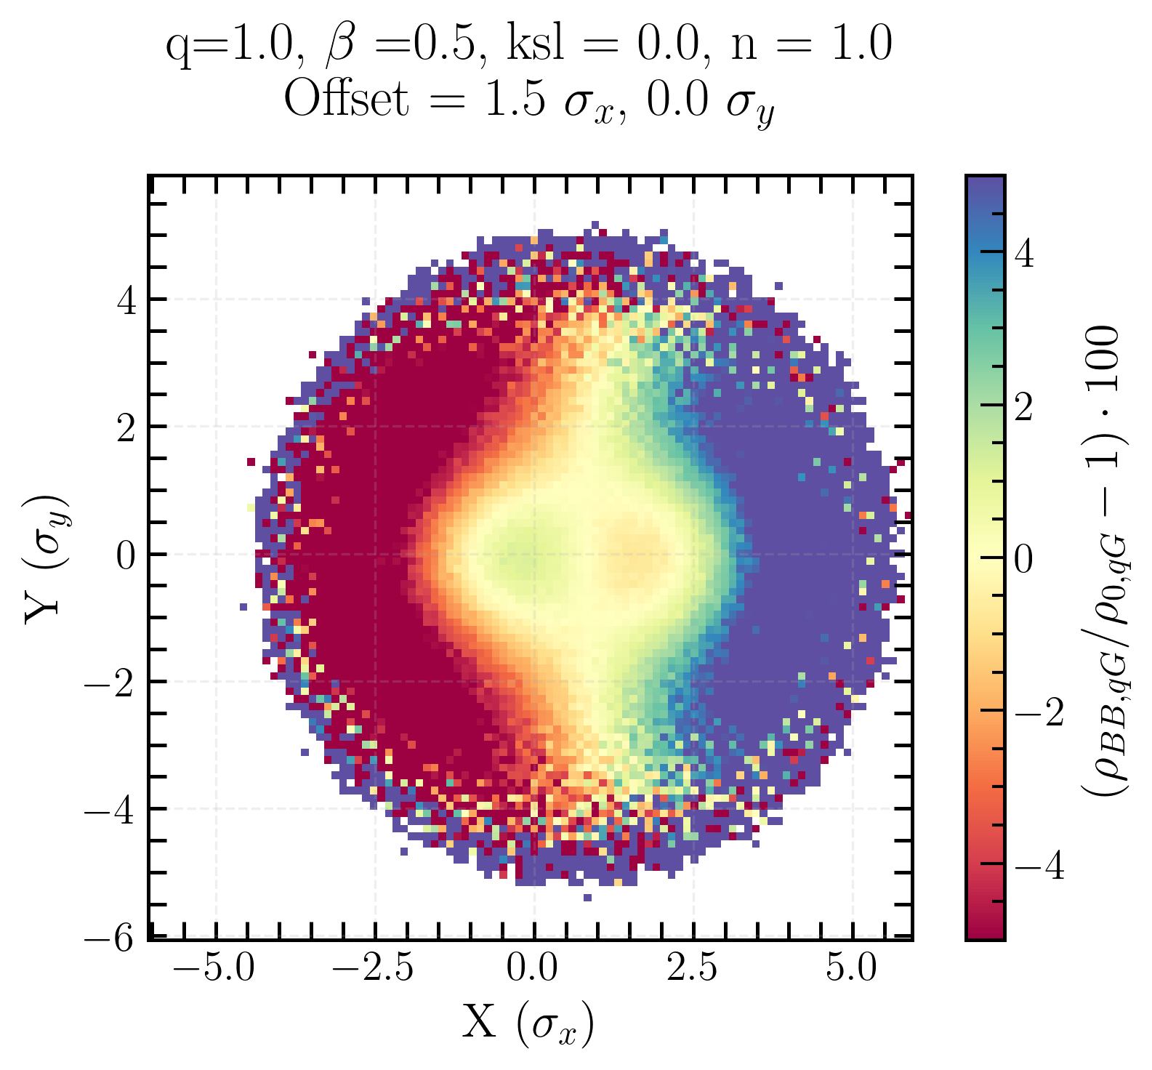
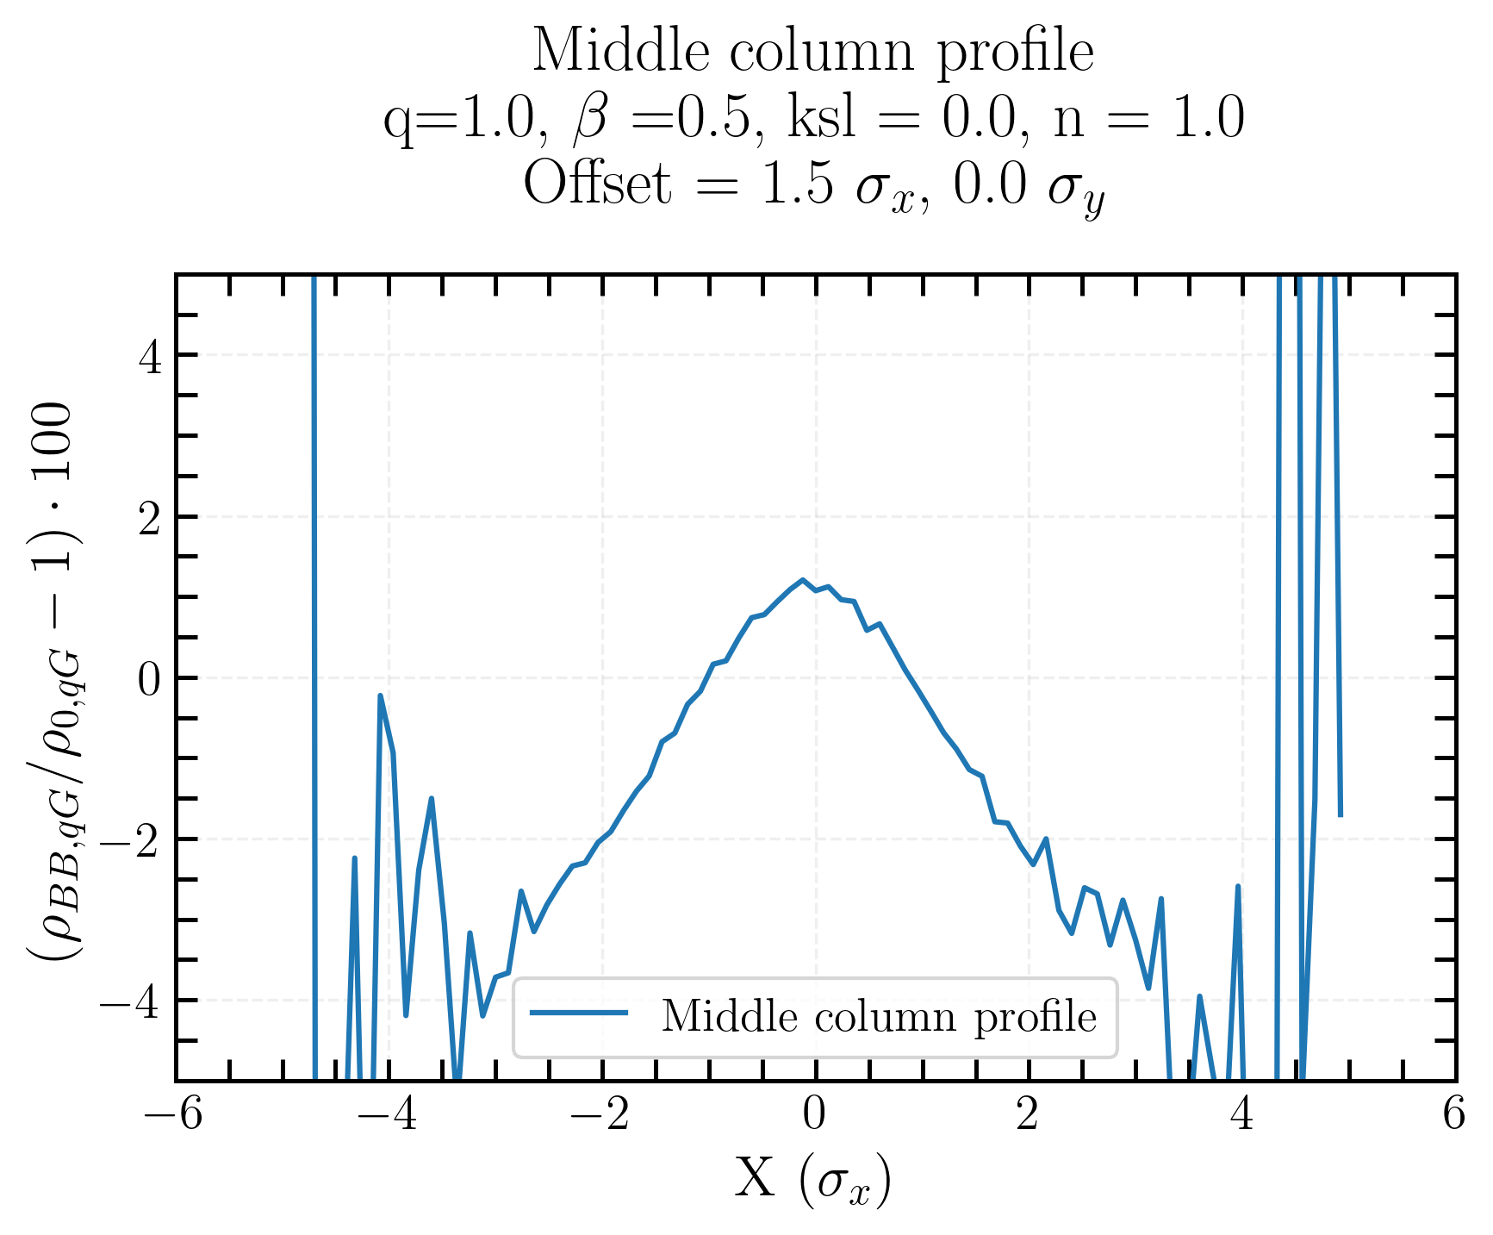
Single Gaussian beam xy-distribution BB bias, with offset
Middle line profile
ρ_{BB, qG}/ρ_{0, qG}
Induced asymmetry in the offset plane
Projection in a plane can lead to a lack of information
Middle line profile
Middle column profile
Linear coupling and beam-beam biases to luminosity calibration measurements in the Large Hadron Collider

Slide 17
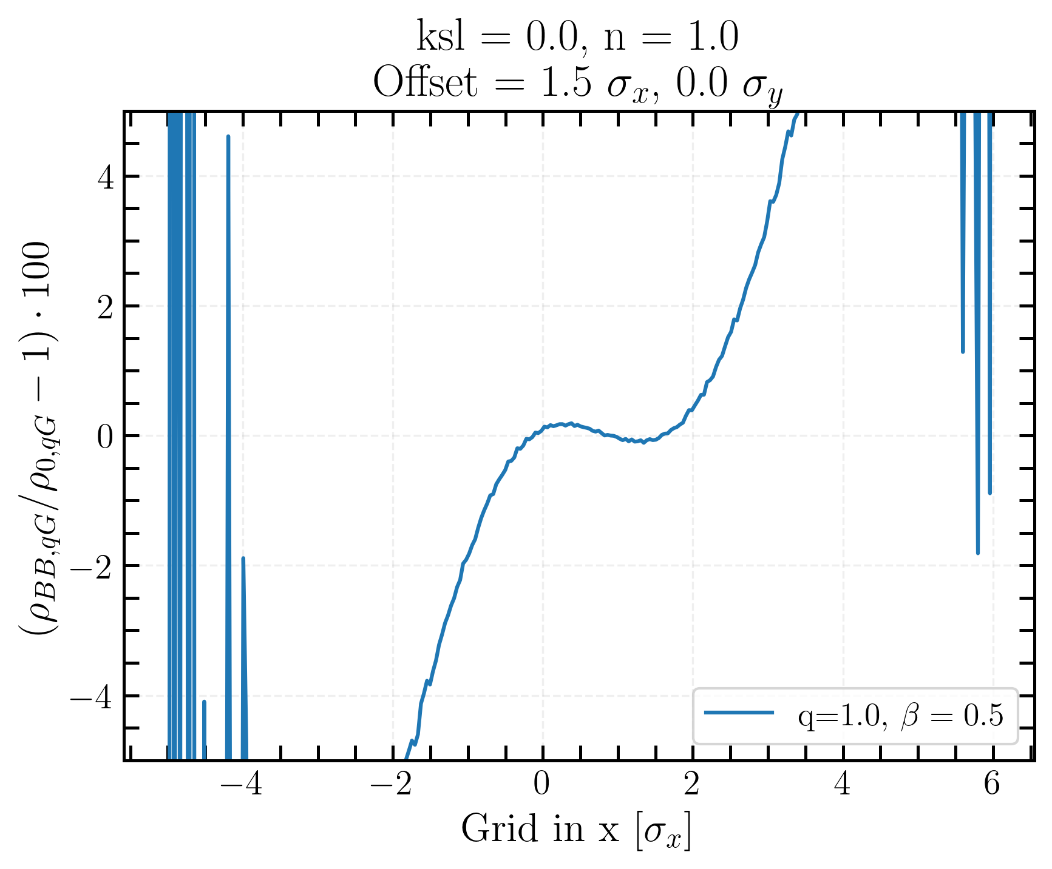
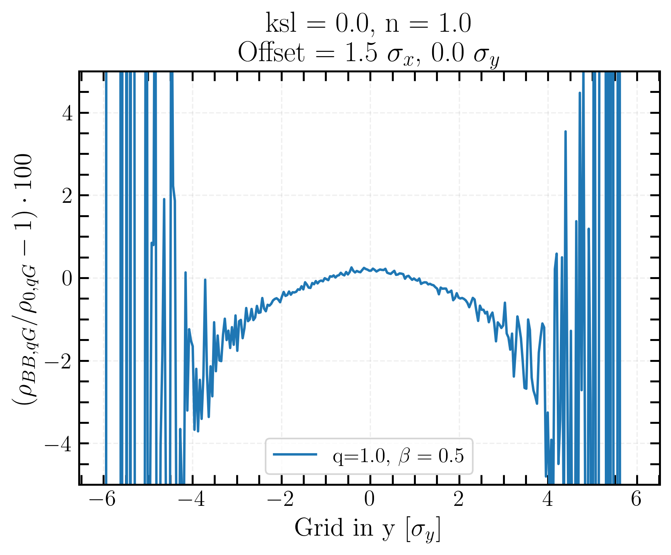
Single Gaussian beam xy-distribution BB bias, with offset
X-axis projection
ρ_{BB, qG}/ρ_{0, qG}
Projection of the charge density ρ bias obtained by summing along all column/lines
Same conclusions as before
Y-axis projection
Linear coupling and beam-beam biases to luminosity calibration measurements in the Large Hadron Collider
Notes:
what is used in this work

Slide 18
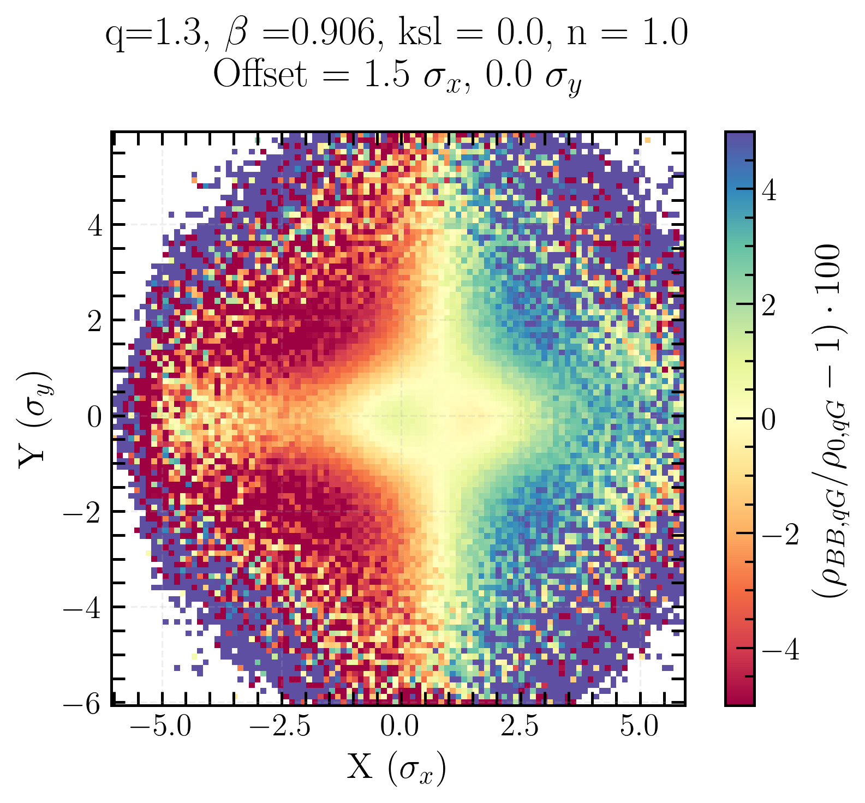
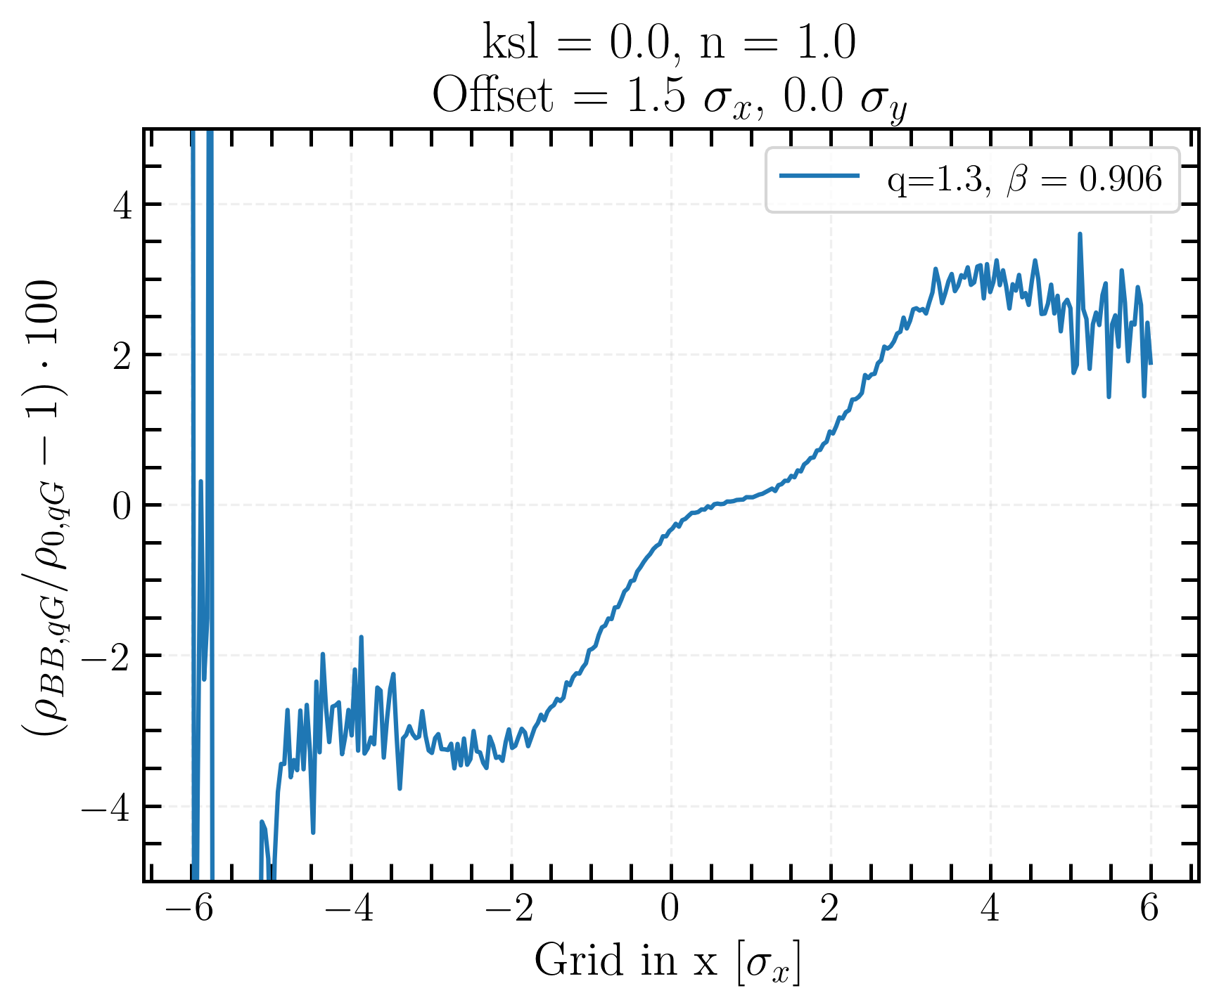
Single q-Gaussian beam xy-distribution bias, with offset
X-axis projection
Projection of the charge density ρ bias, obtained by summing along all lines
Linear coupling and beam-beam biases to luminosity calibration measurements in the Large Hadron Collider
Notes:
completeness

Slide 19
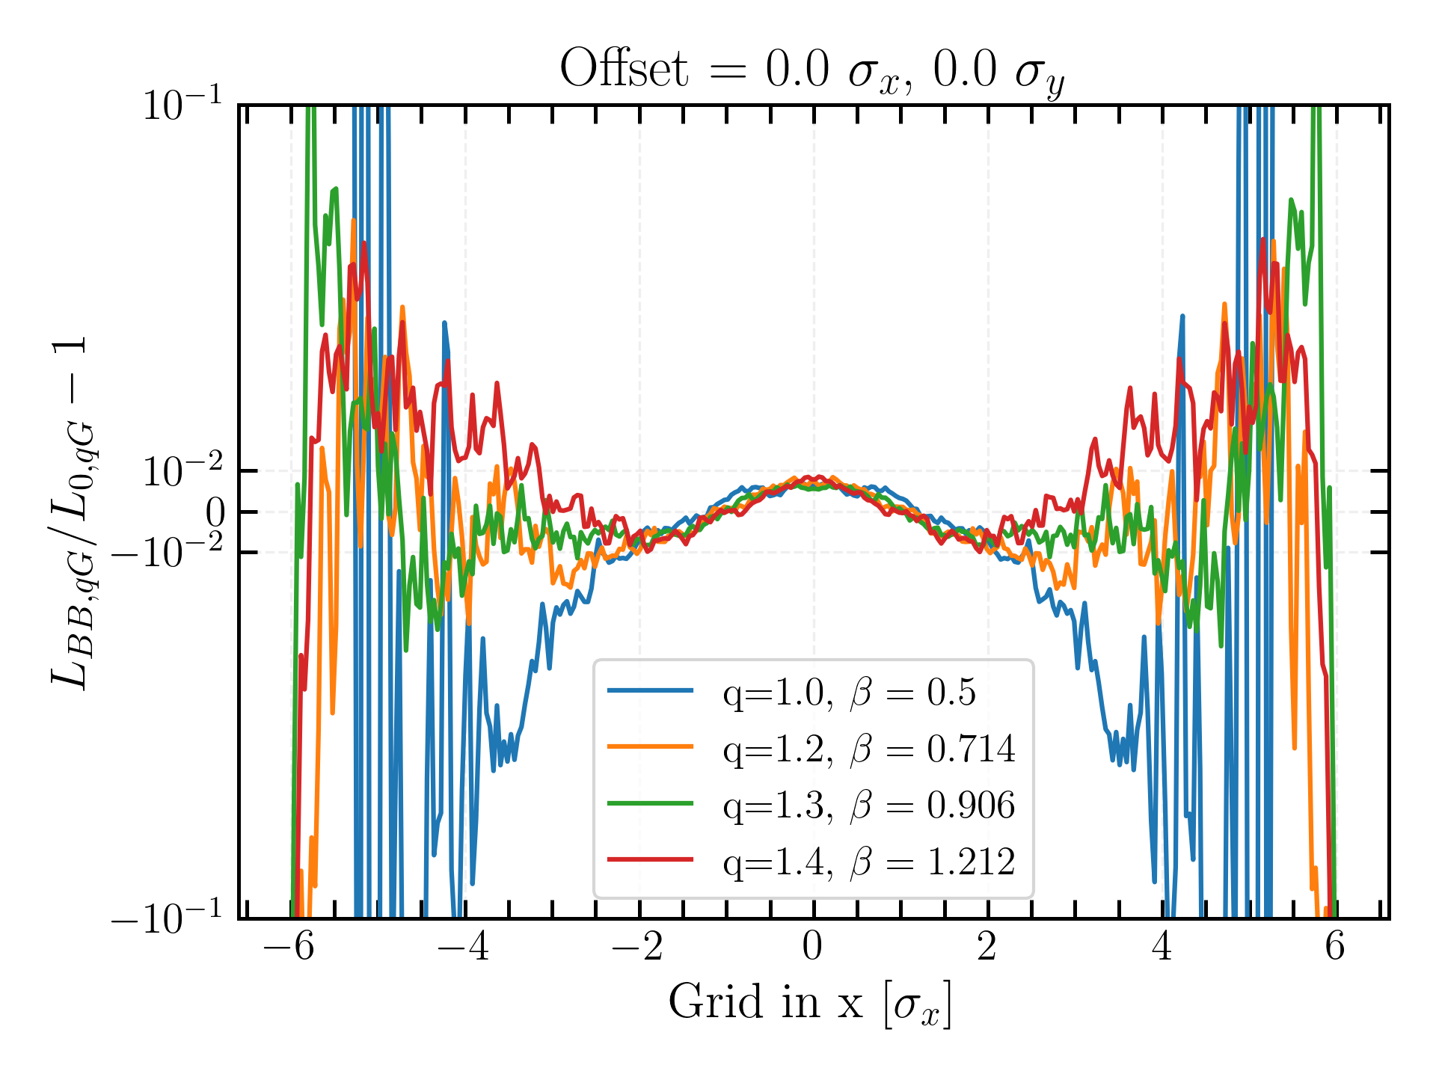
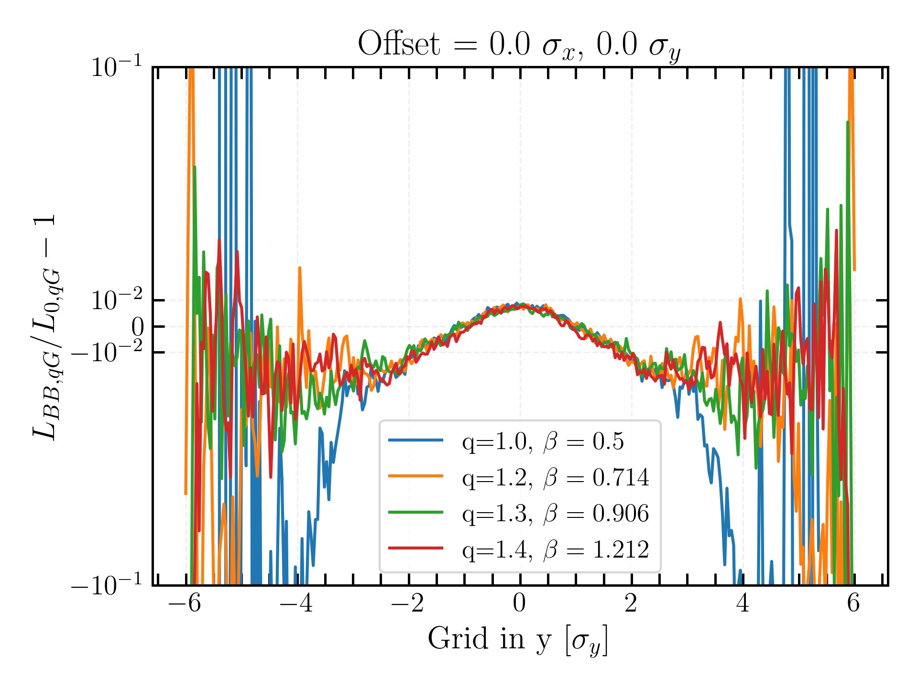
BB bias of projected transverse luminosity distribution for q-Gaussian beams
Here again, x-y asymmetry coming from the different tune values
Beam-beam manifests itself by increasing the luminosity in the center region
Linear coupling and beam-beam biases to luminosity calibration measurements in the Large Hadron Collider

Slide 20
Transverse luminosity distribution…
… beam-beam bias
… coupling bias
… beam-beam + coupling bias
Linear coupling and beam-beam biases to luminosity calibration measurements in the Large Hadron Collider

Slide 21
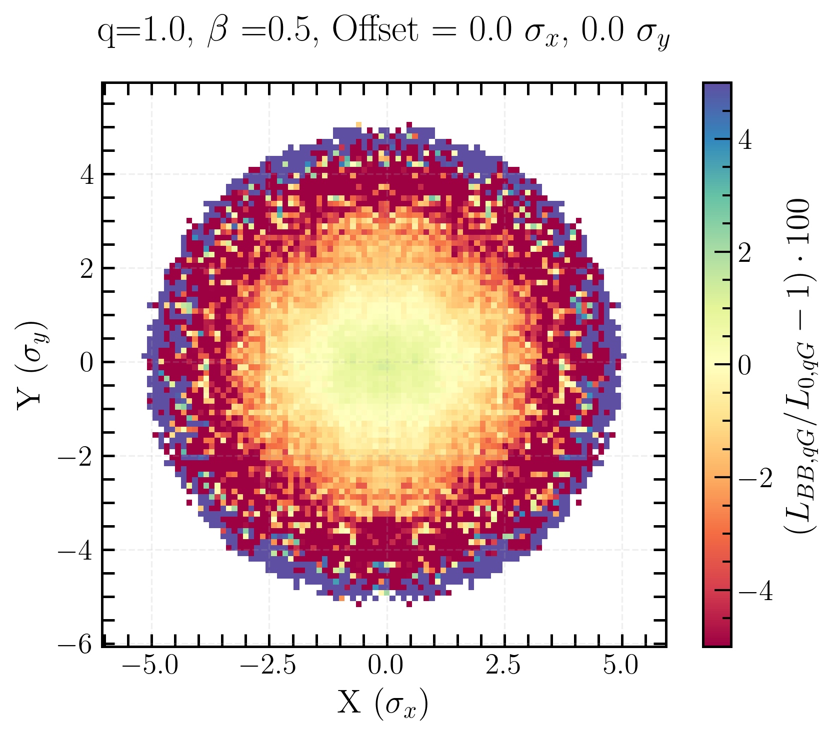
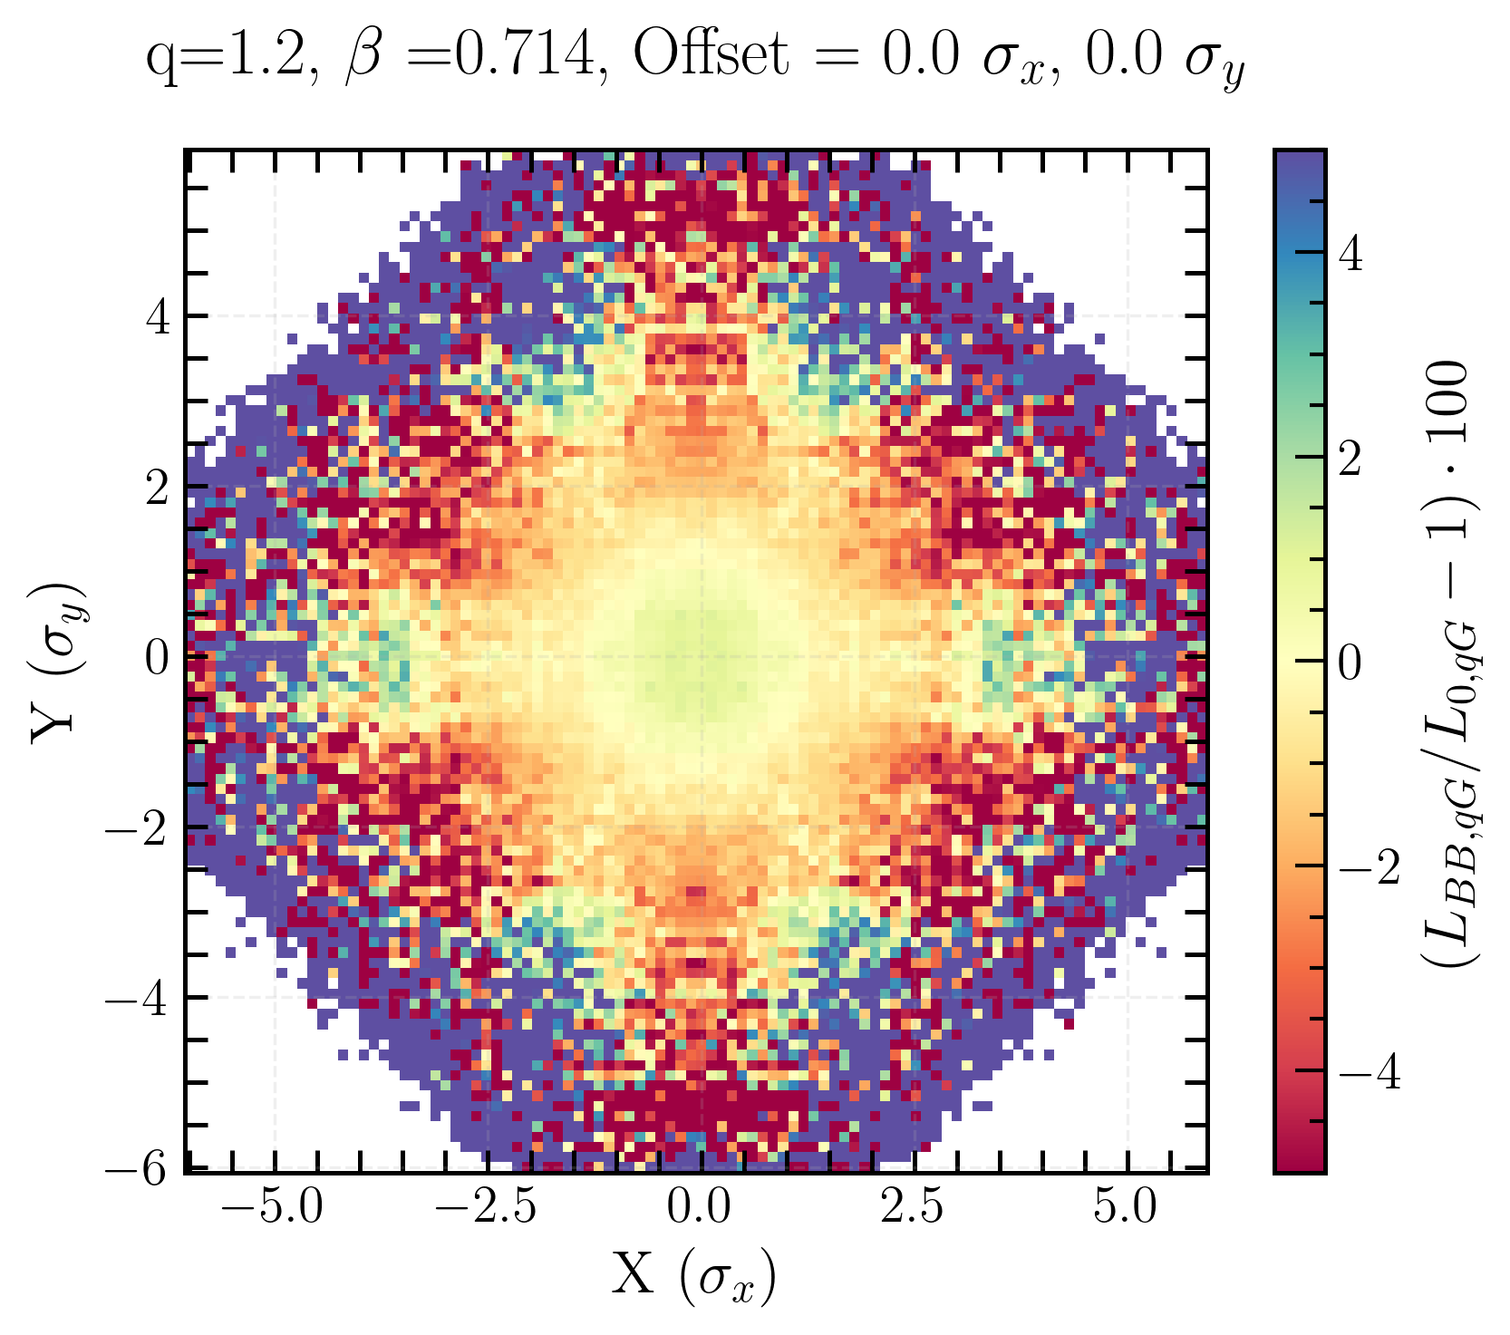
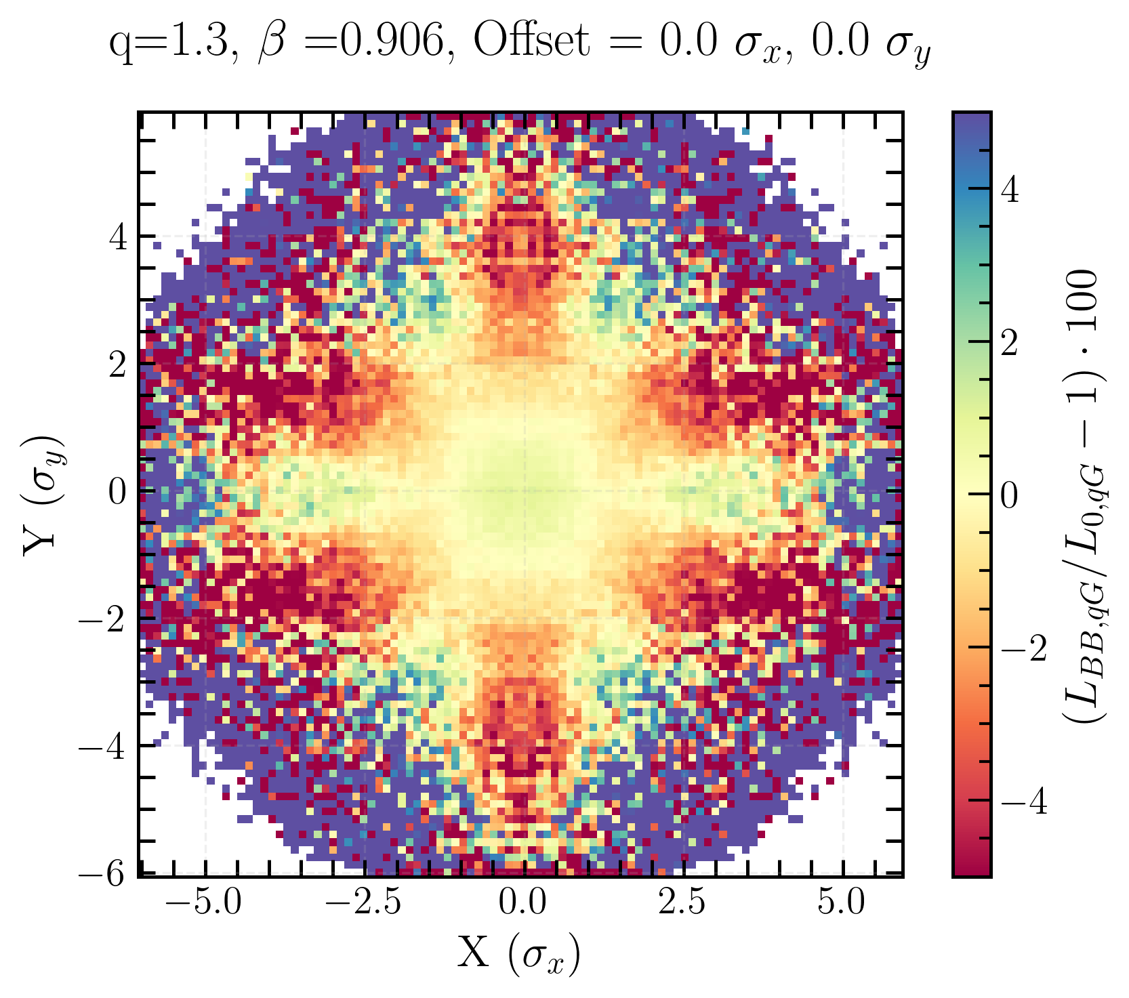
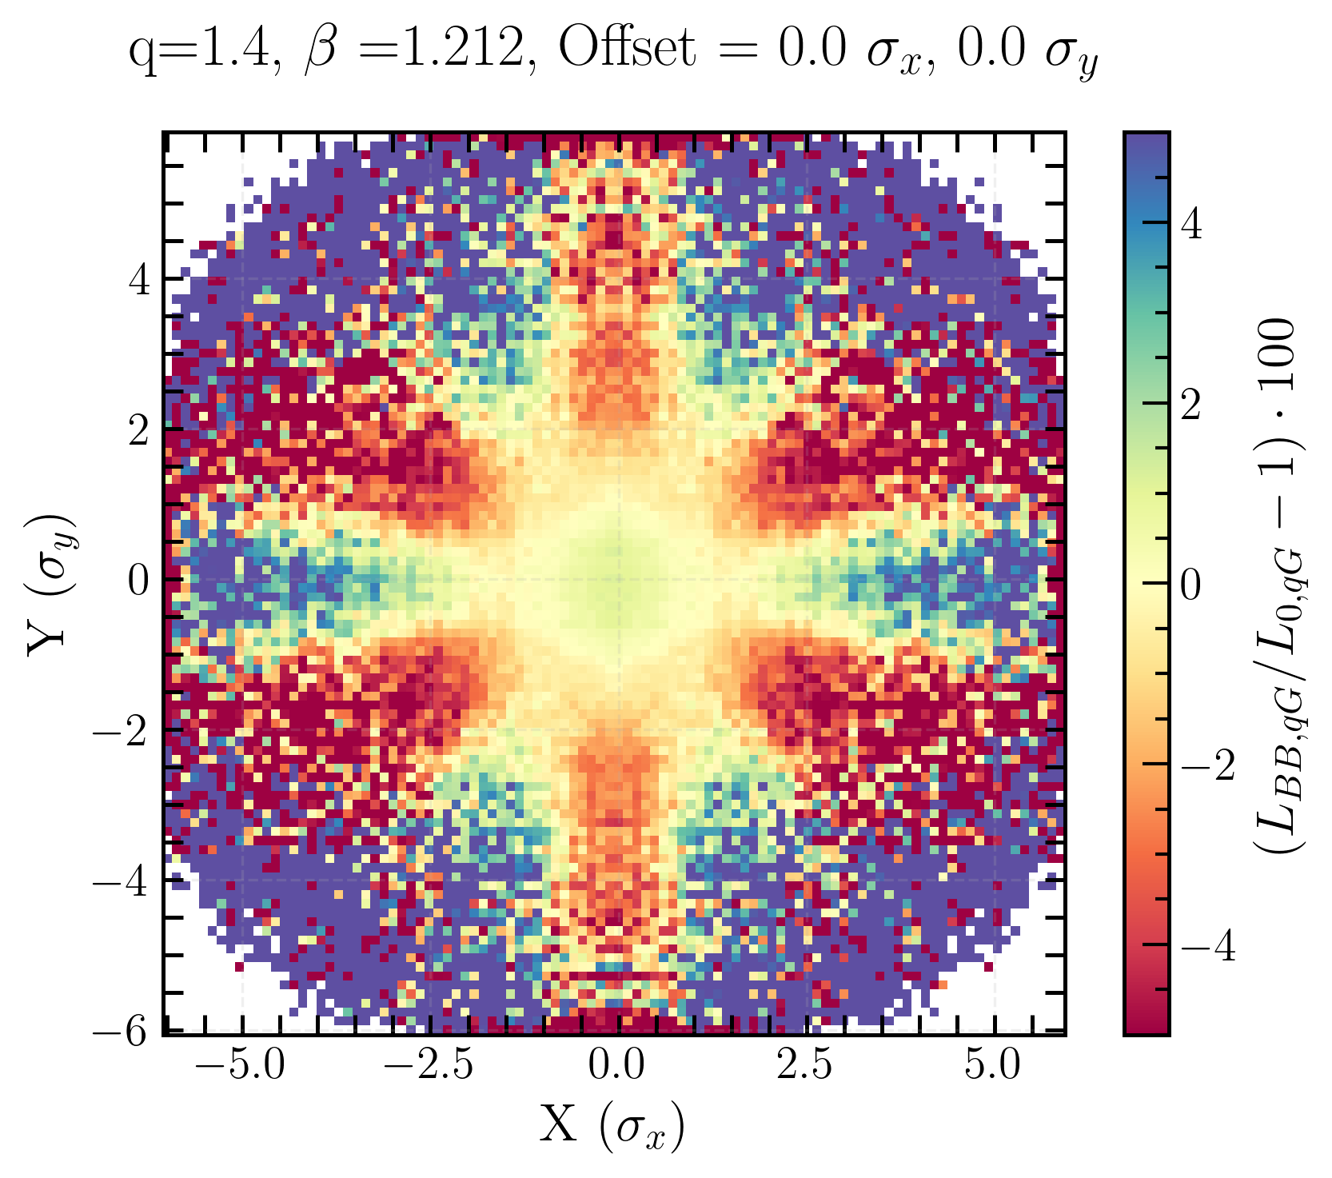
Transverse luminosity distribution for q-Gaussian
beam-beam bias
L_{BB, qG}/L_{0, qG}
x-y asymmetry coming from the different tune values
strong negative bias with an hexagonal shape
The higher the q, the sharper the bias distribution
Linear coupling and beam-beam biases to luminosity calibration measurements in the Large Hadron Collider
Notes:
for Gaussian beams, coherent results with what Lia’s obtained

Slide 22
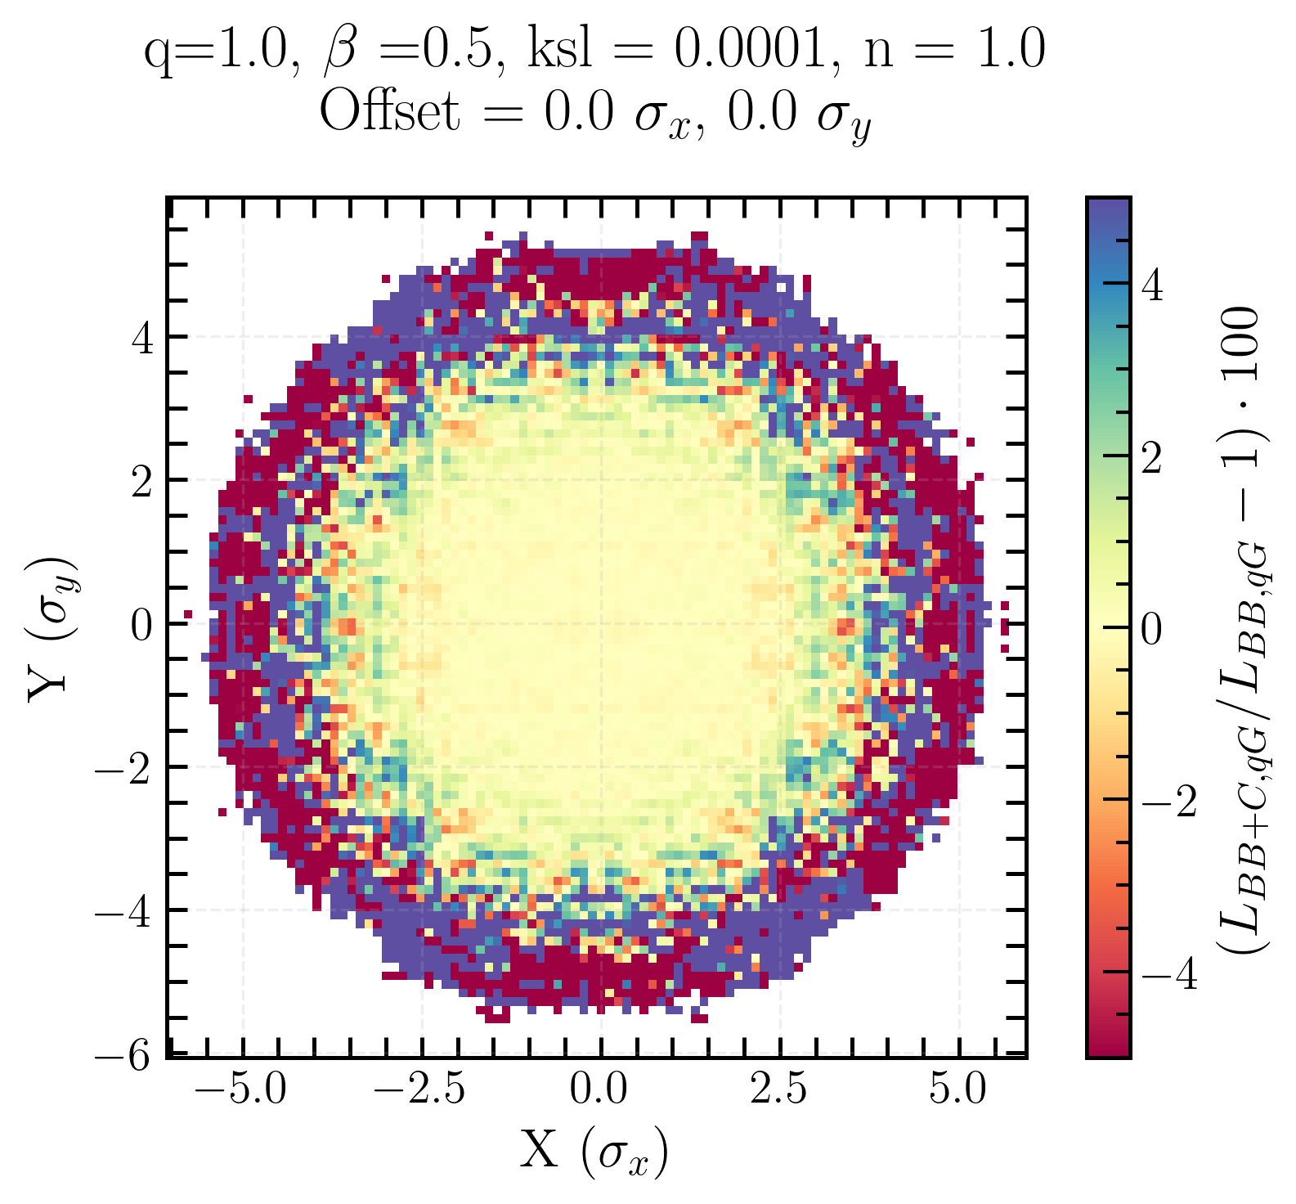
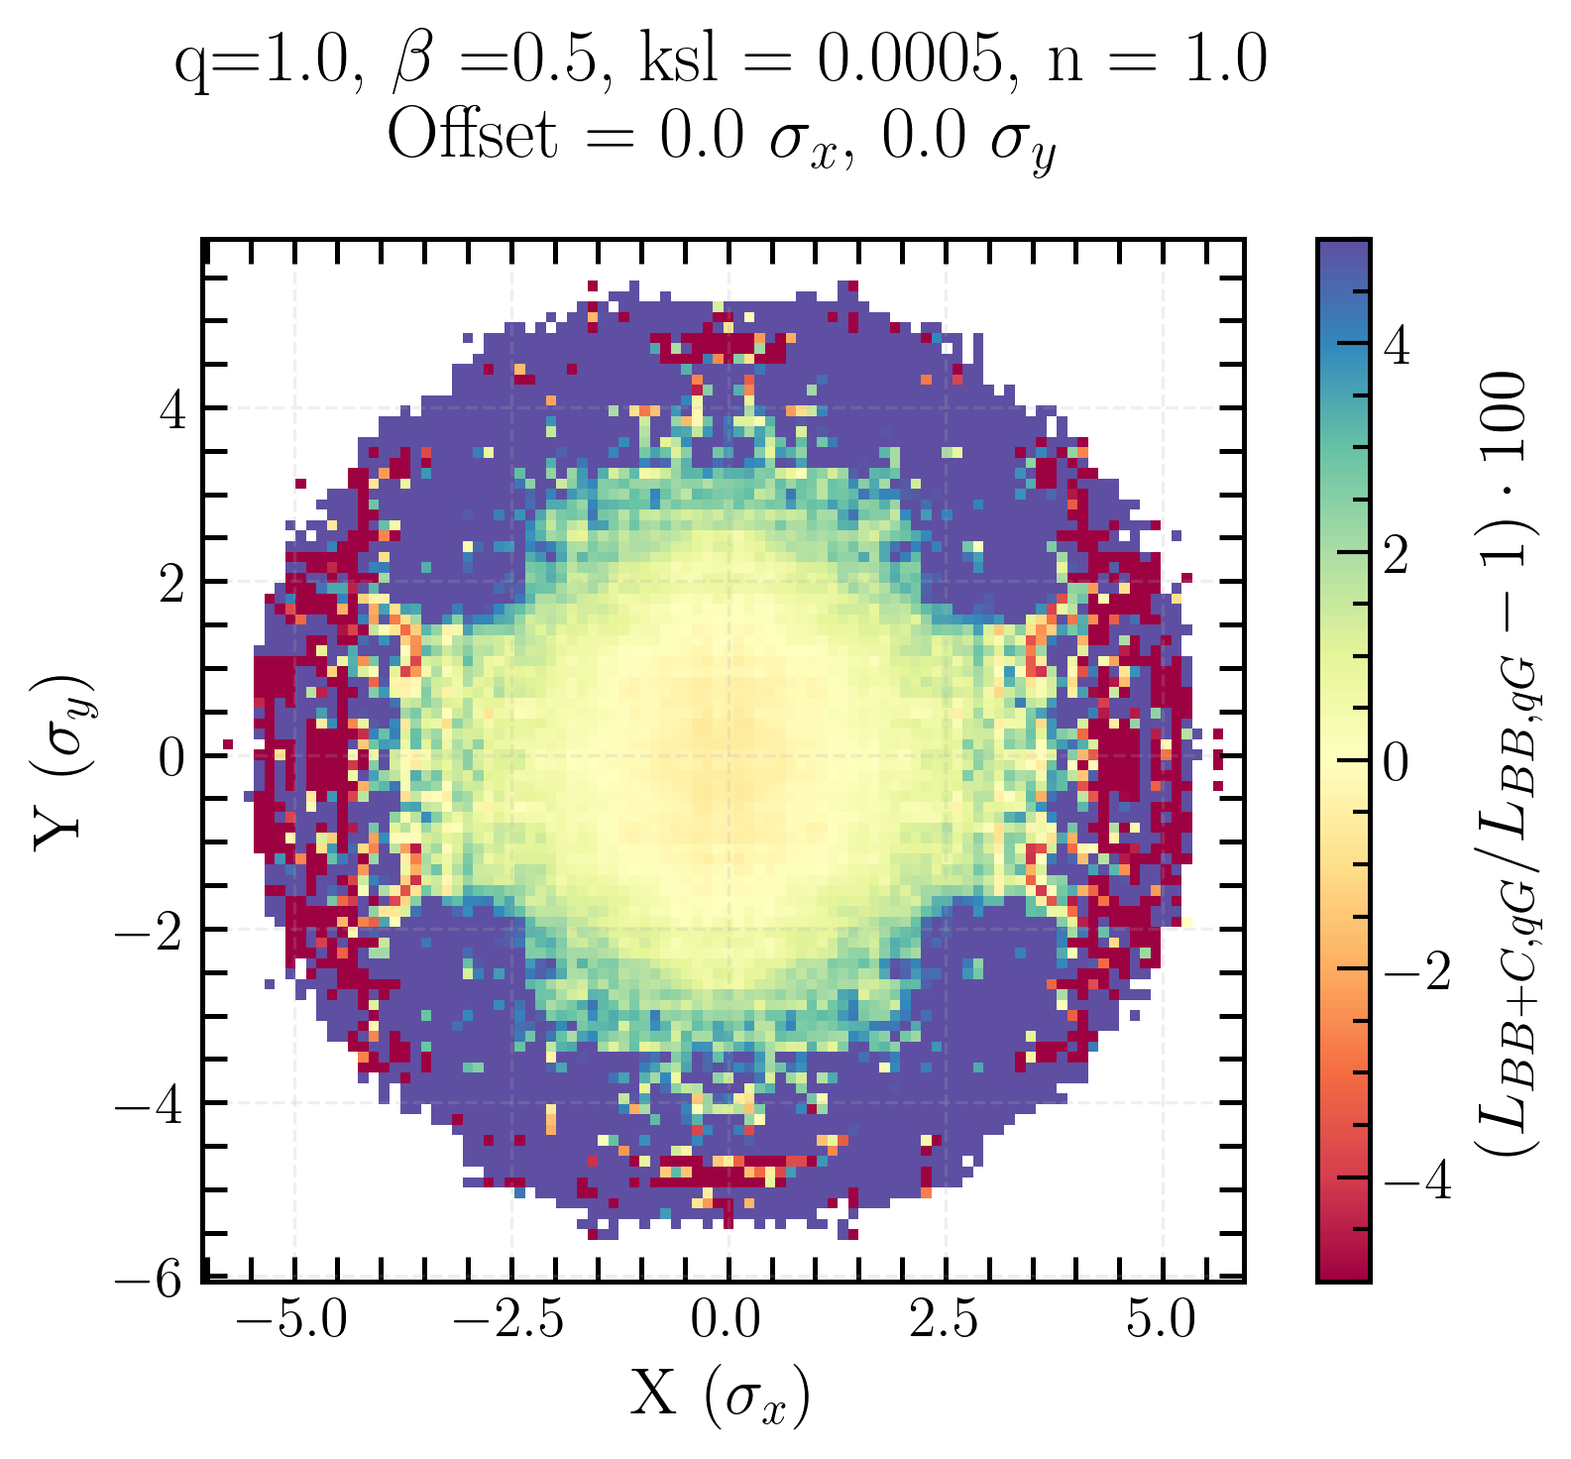
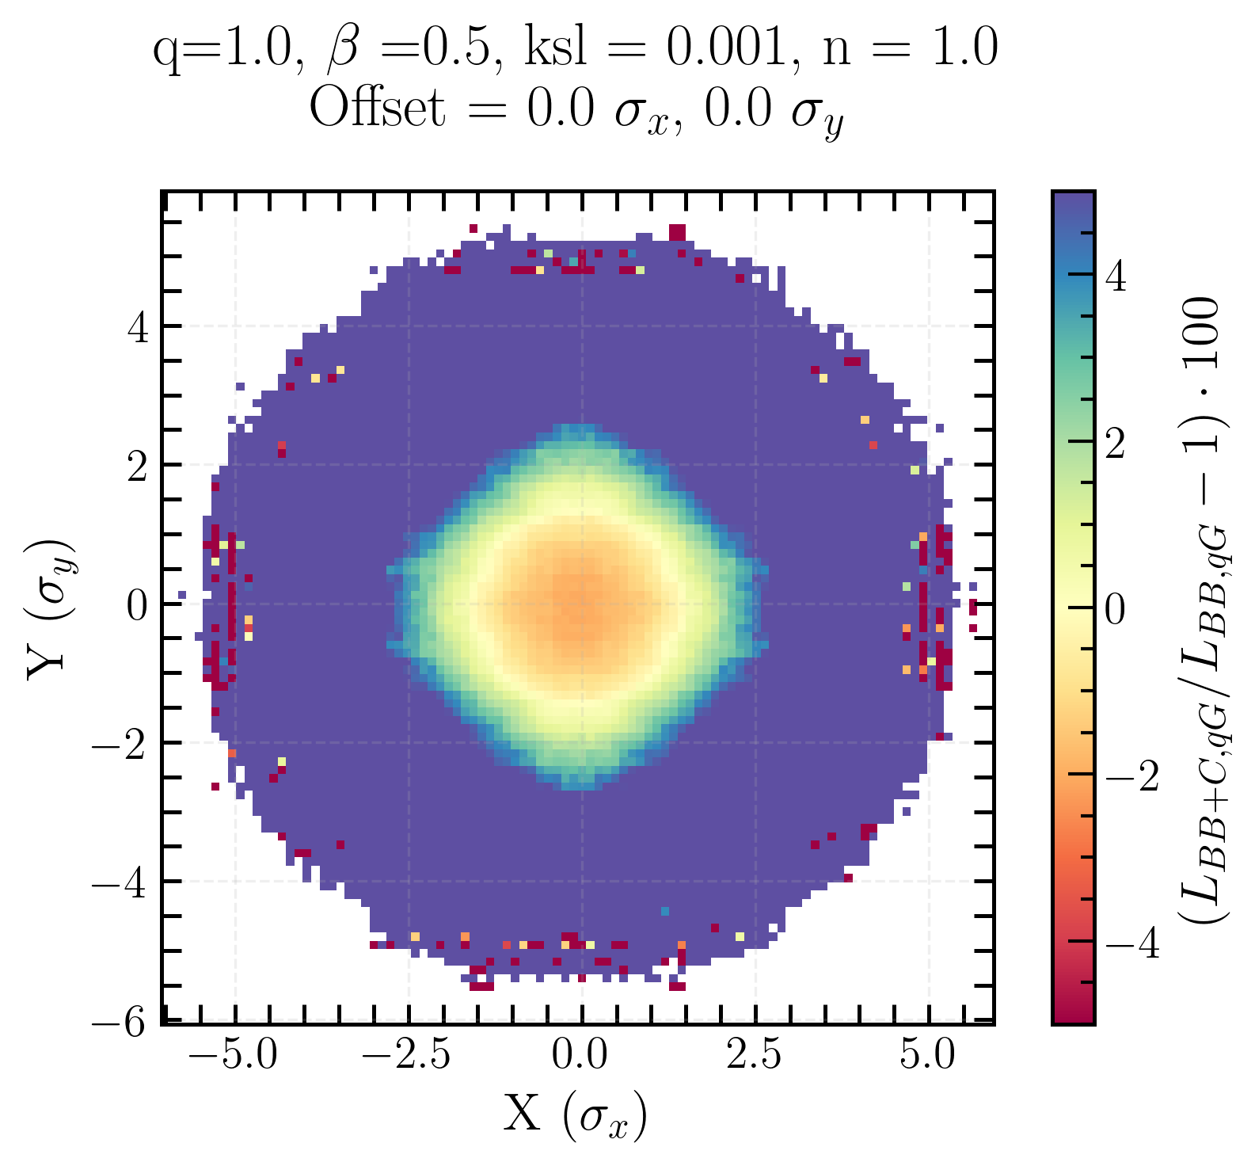
Coupling bias on transverse luminosity distribution for Gaussian beams
With increasing coupling: negative bias in the center and positive bias around
Coupling drives particles out of the center and into the tails
Linear coupling and beam-beam biases to luminosity calibration measurements in the Large Hadron Collider
Notes:
highlight importance of the initial beam distribution for single beam xy-distribution

Slide 23
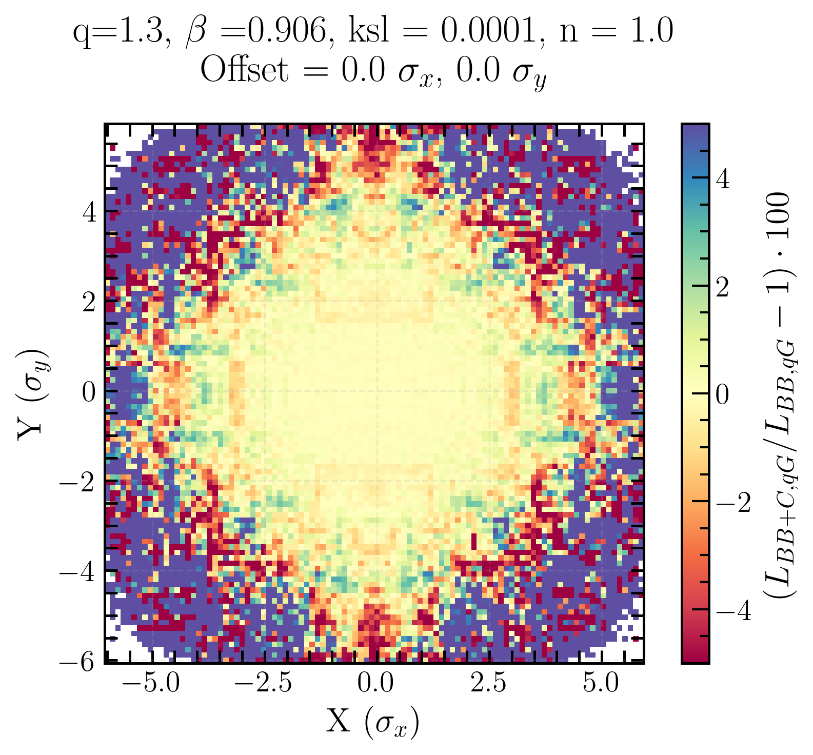
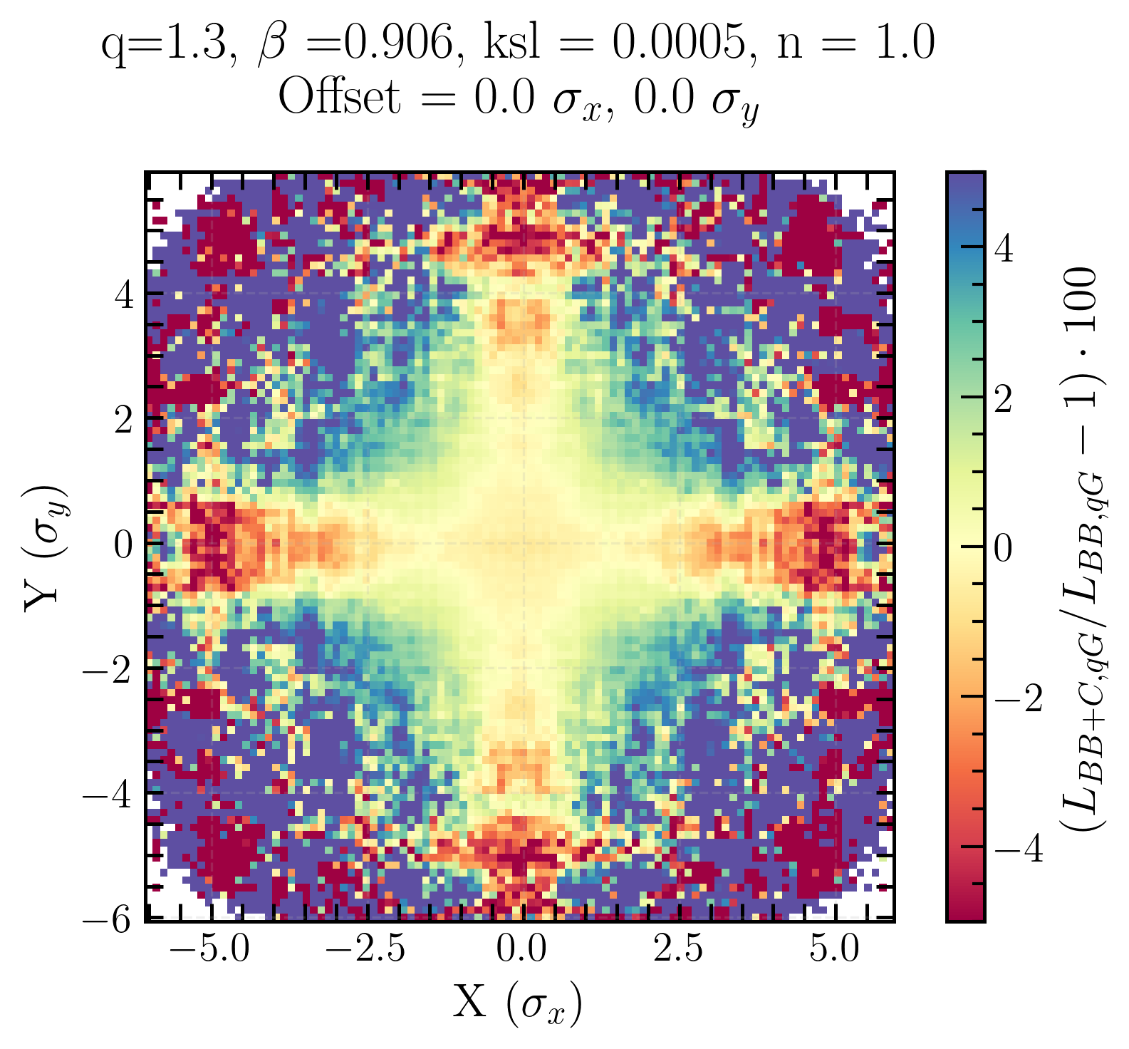
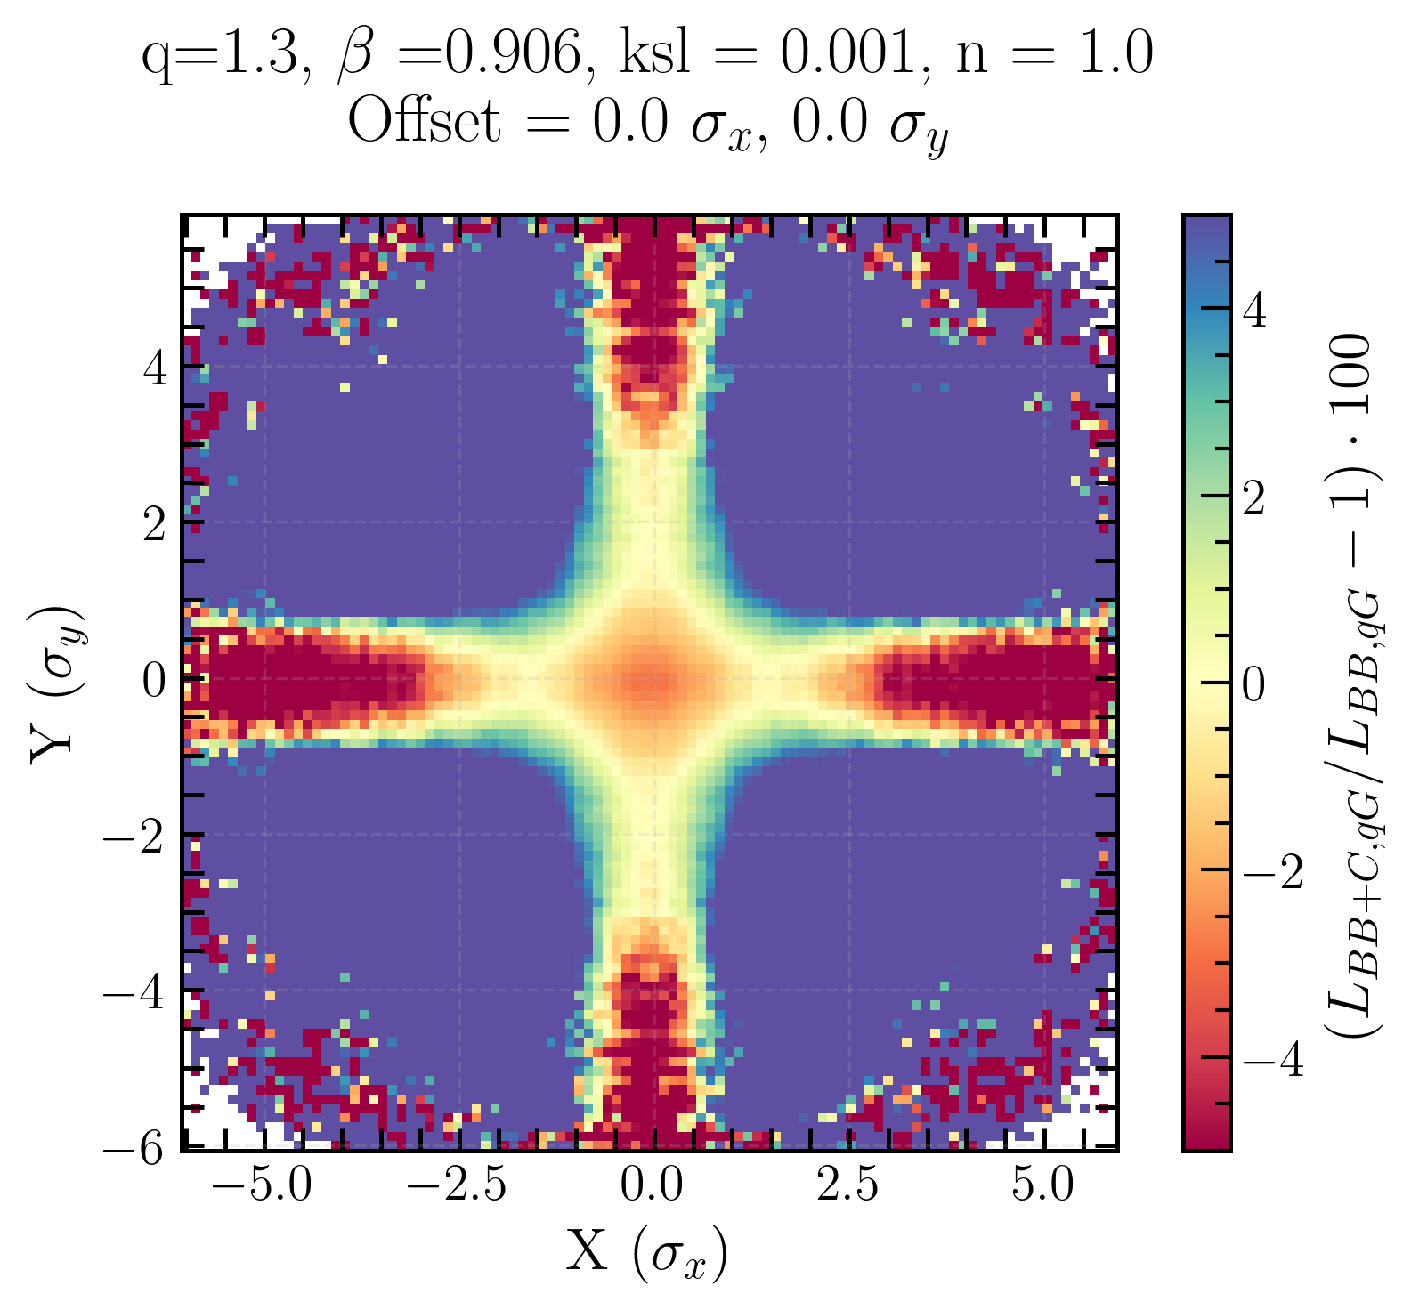
Coupling bias on transverse luminosity distribution for q-Gaussian beams
Initial beam distribution matters → shapes how local coupling deforms the transverse luminosity distribution
Linear coupling and beam-beam biases to luminosity calibration measurements in the Large Hadron Collider

Slide 24
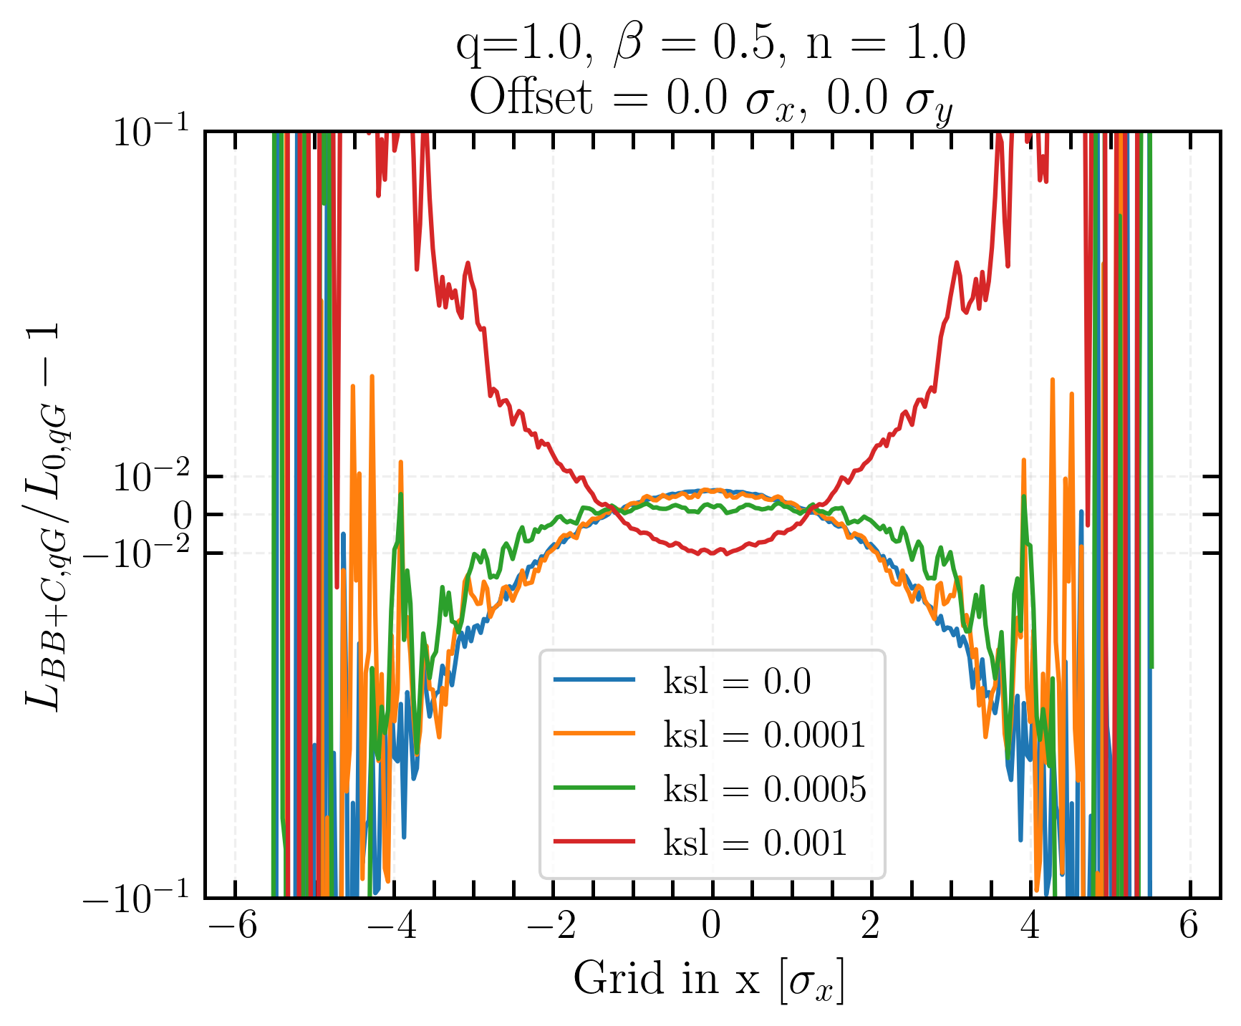
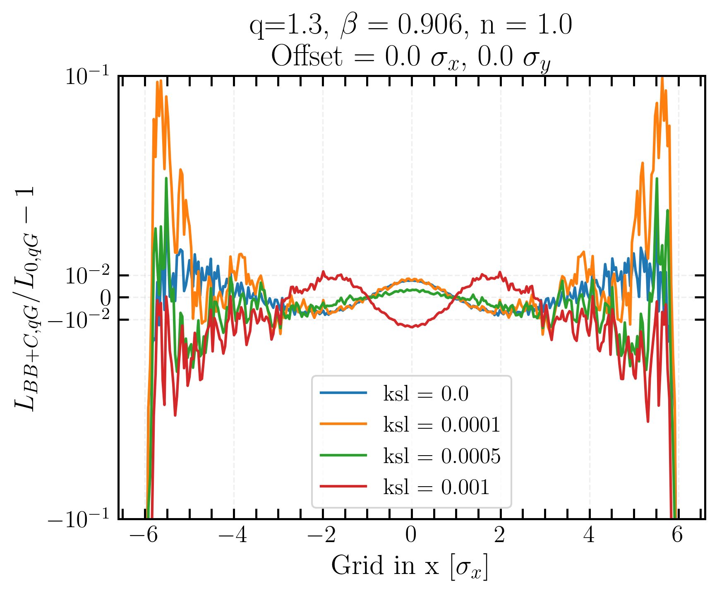
BB and local coupling effects on projected transverse luminosity distribution
BB effect becomes significant for small coupling and increases L in central region
BB and coupling have opposite effects and counteract each other
Gaussian
q-Gaussian
Linear coupling and beam-beam biases to luminosity calibration measurements in the Large Hadron Collider
Notes:
two bumps in the case of q-Gaussian

Slide 25
Luminosity and beam-beam biases on 𝝈vis
Linear coupling and beam-beam biases to luminosity calibration measurements in the Large Hadron Collider

Slide 26
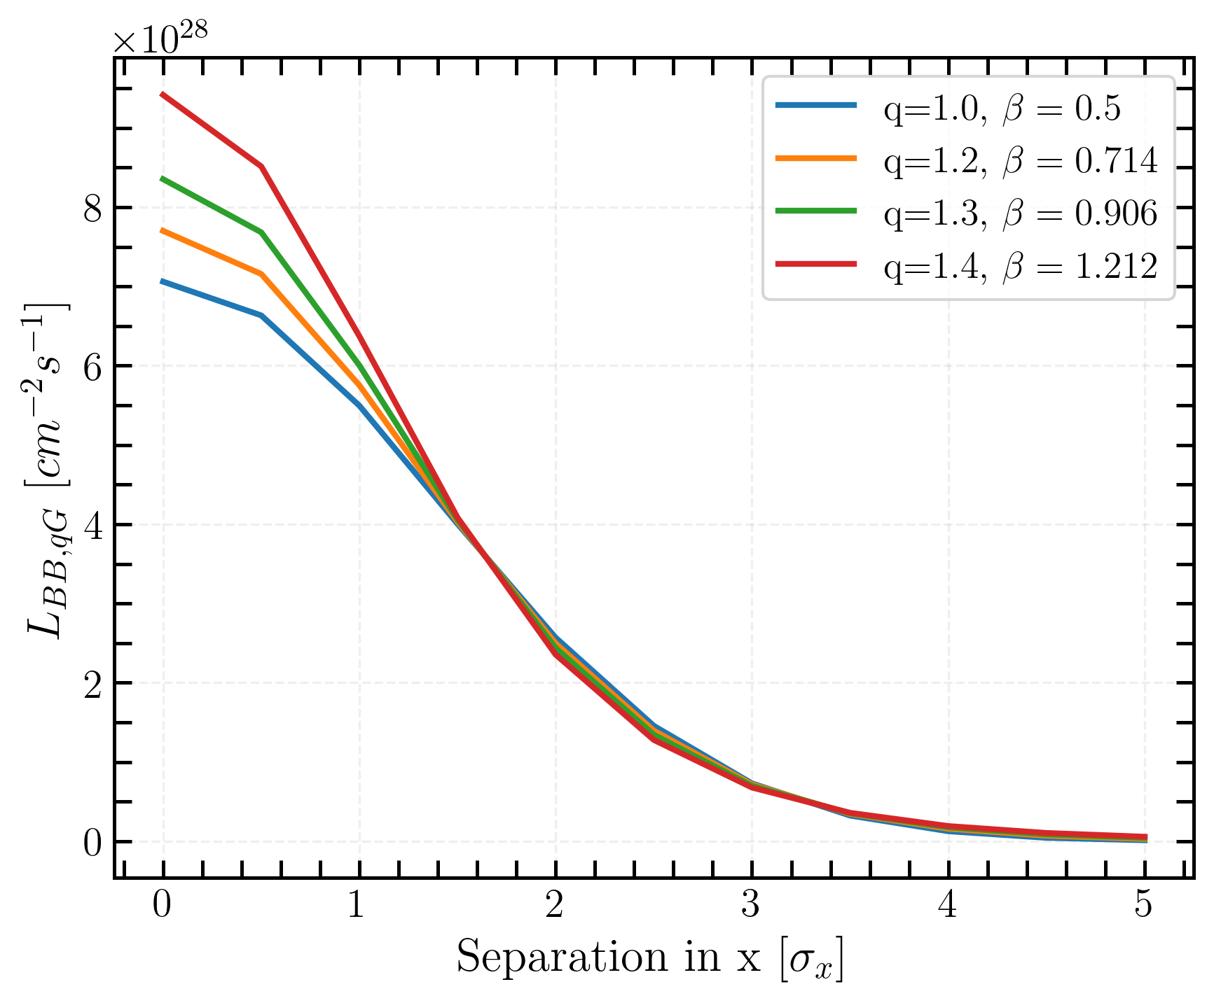
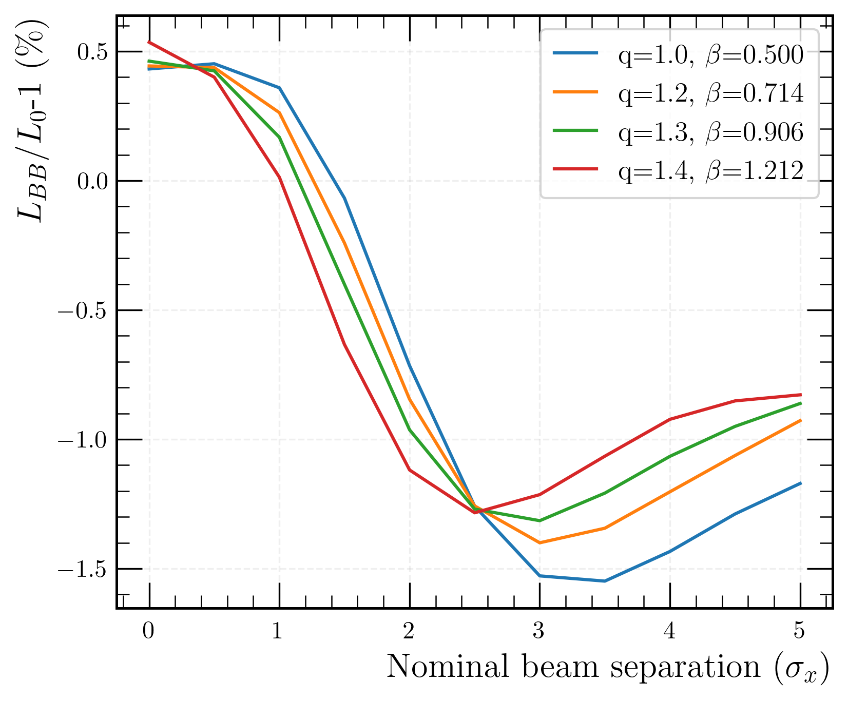
Luminosity for q-Gaussian distribution
beam-beam bias
standard Gaussian
Absolute luminosity with Xsuite numerical integrator for different q-Gaussian distributions
Beam-beam bias of the order of 1%
Negative bias for low separation (under ~ 1.5σ_{x}) and positive bias for high separation
Linear coupling and beam-beam biases to luminosity calibration measurements in the Large Hadron Collider
Notes:
30% in luminosity was measured for two different q-Gaussian distributions when
considering head-on collisions

Slide 27
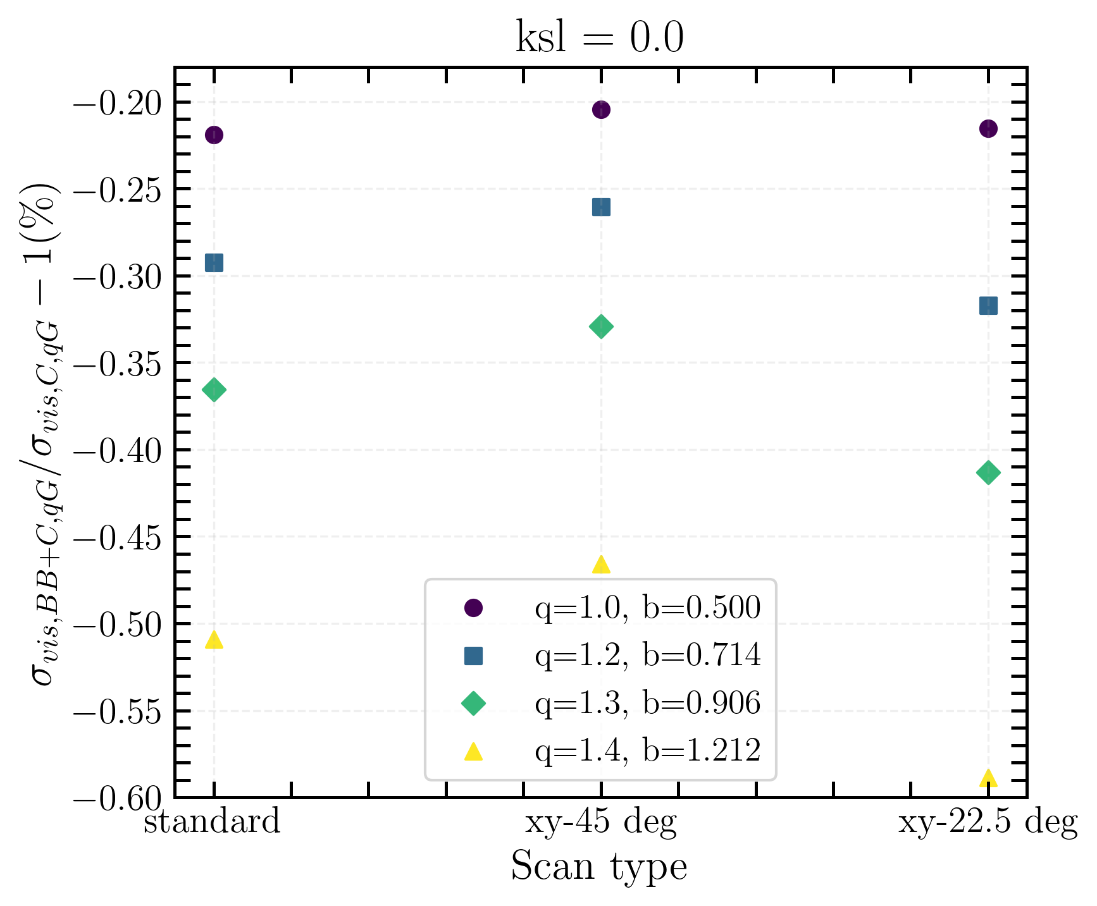
Beam-beam bias on 𝝈_{vis}
standard Gaussian
-0.2 % bias due to beam-beam for Gaussian beams under typical vdM scans
Very little difference between two different types of scan
Biggest impact on the bias comes from the distribution
( -0.6% for q = 1.4, β = 1.212)
Linear coupling and beam-beam biases to luminosity calibration measurements in the Large Hadron Collider

Slide 28
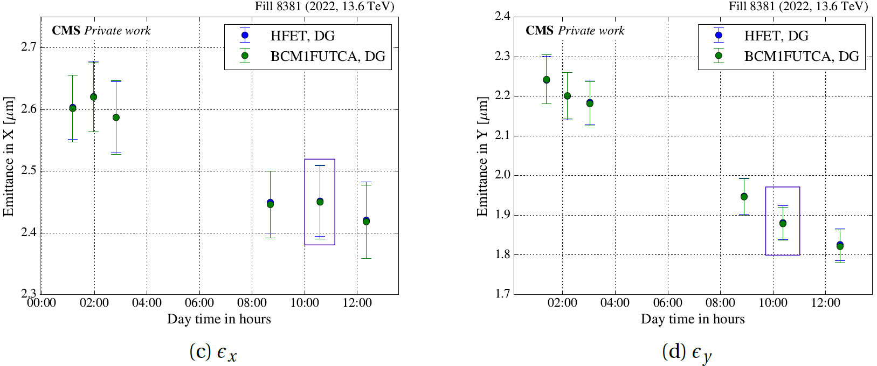
Flat beams
simulated values
Transverse beam emittances during vdM session in fill 8381, as measured by the CMS luminometers [4]
Linear coupling and beam-beam biases to luminosity calibration measurements in the Large Hadron Collider
Notes:
during vdM fills, as time passes, the beam becomes flatter with time due to synchrotron radiation. To better understand the implication of the shrinkage of the emittances, simulations have been conducted.

Slide 29
Towards more realistic conditions…
Linear coupling and beam-beam biases to luminosity calibration measurements in the Large Hadron Collider

Slide 30
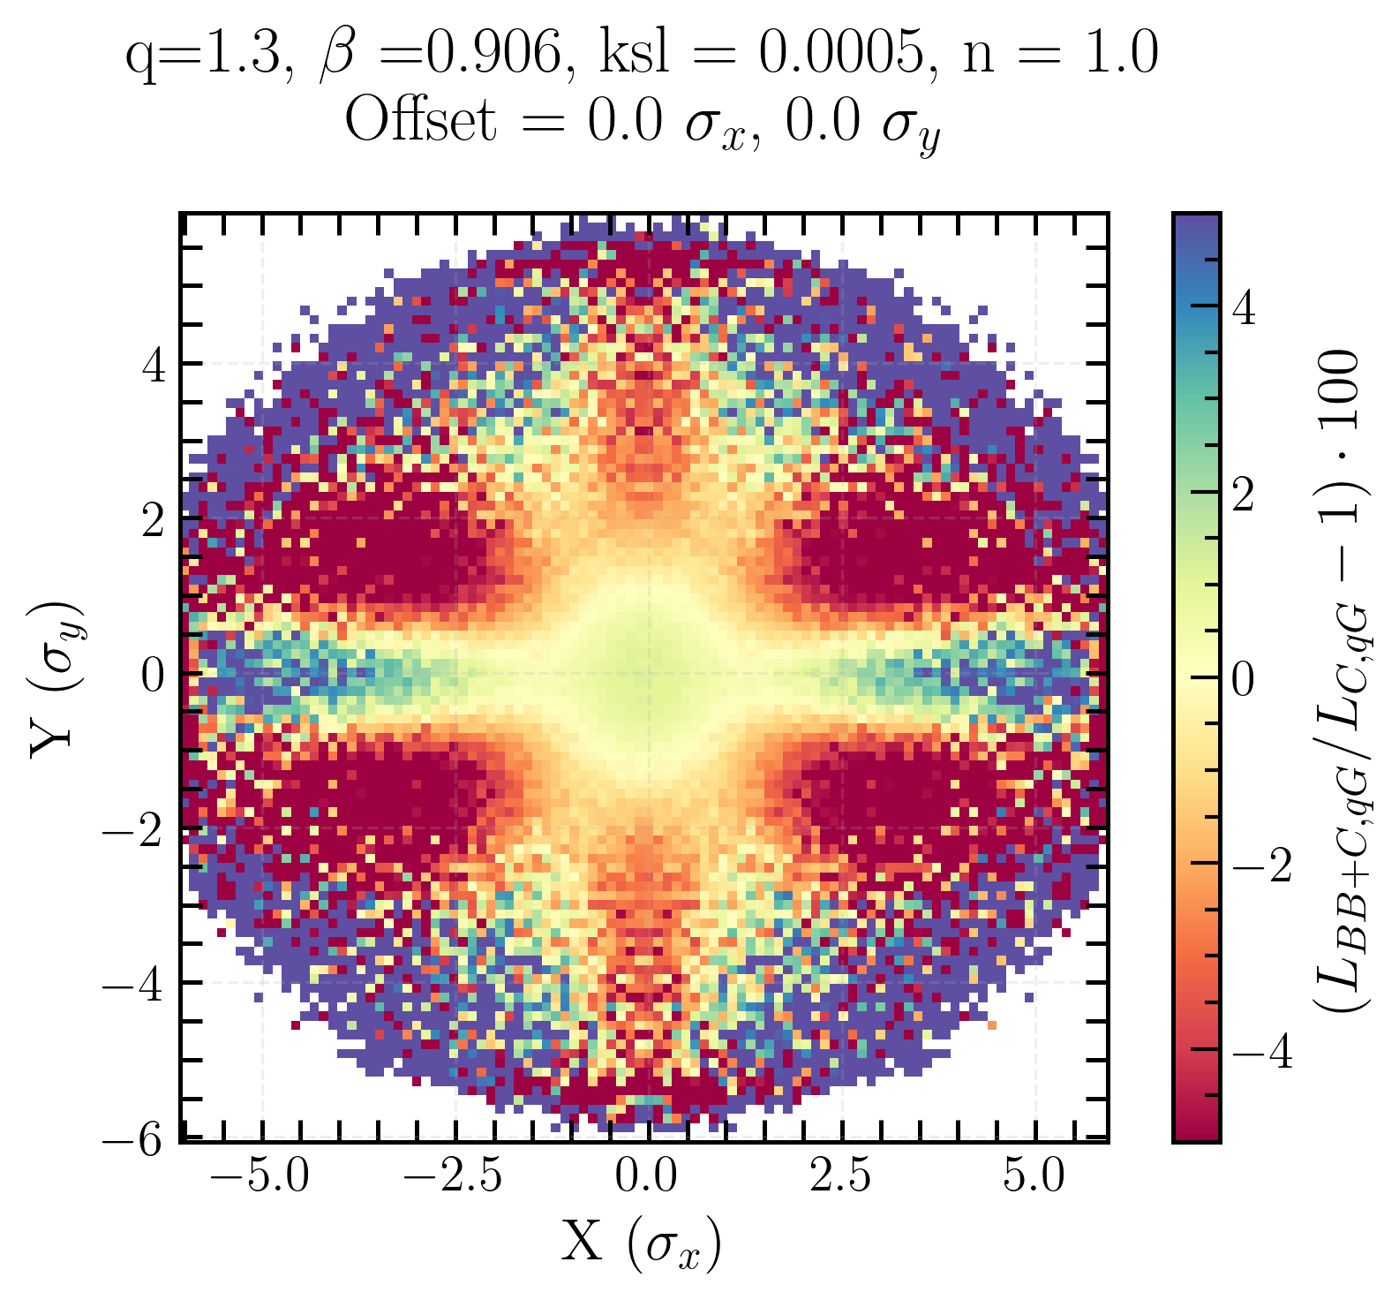
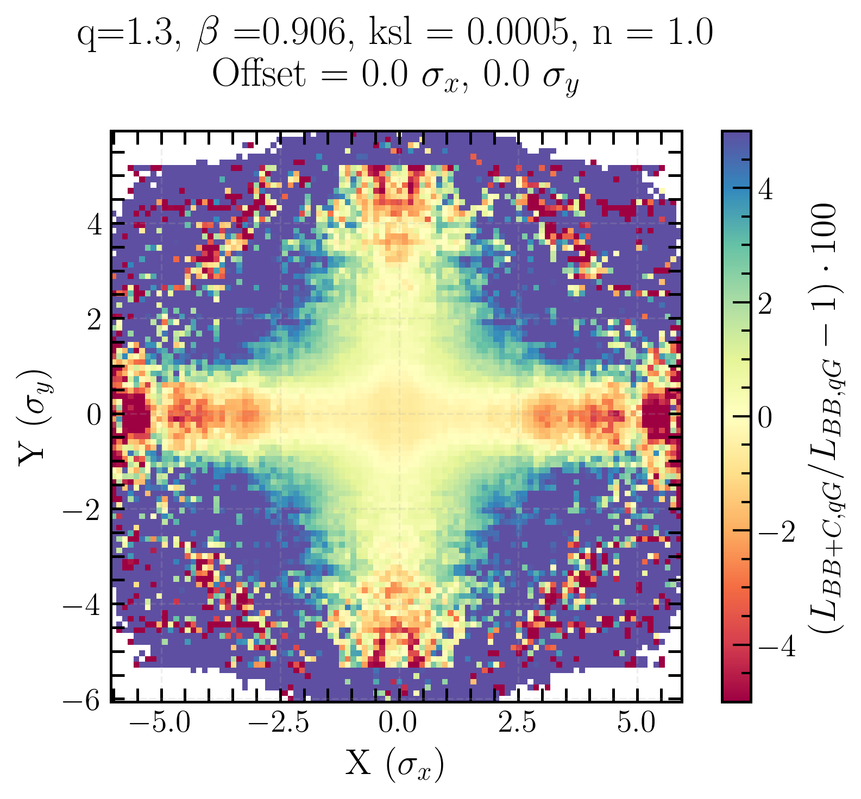
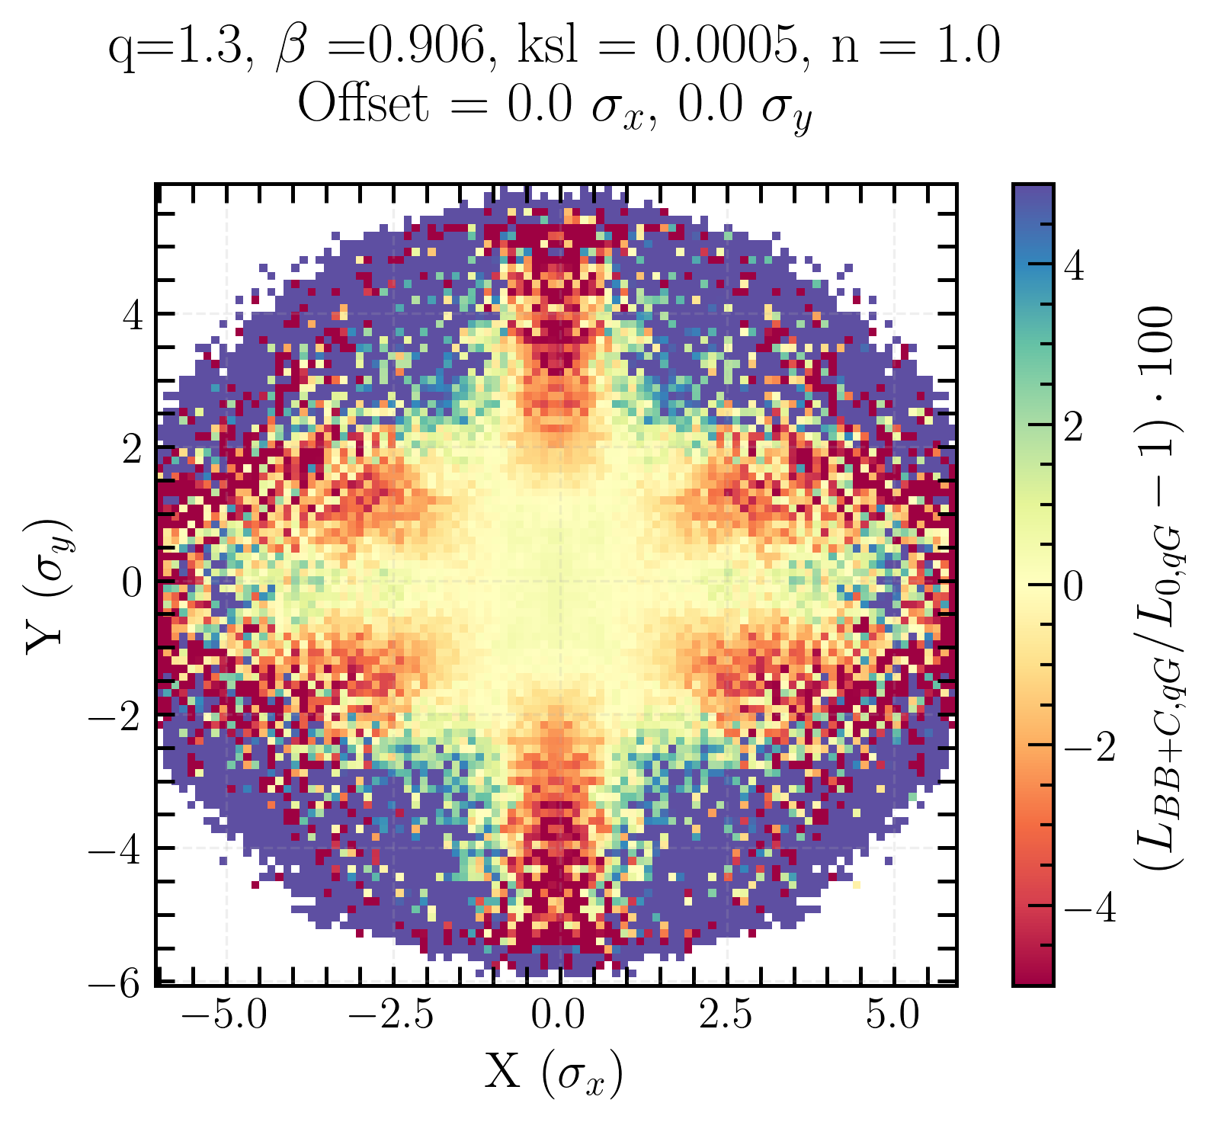
Flat beam transverse luminosity distribution biases for q-Gaussian beams
Beam-beam bias
Local coupling bias
Beam-beam+local coupling bias
Opposing effects of coupling and beam-beam are apparent
Beam-beam has a stronger effect than coupling in central region
Linear coupling and beam-beam biases to luminosity calibration measurements in the Large Hadron Collider
Notes:
in beam-beam + coupling

Slide 31
Conclusion
First characterization of the impact of beam-beam interactions and linear coupling on the transverse luminosity density, luminosity, and σ_{vis}
→ characterize and quantify
Preliminary studies on q-Gaussian distribution effects :
  Initial beam distribution matters → shapes how local coupling and beam-beam deform the transverse luminosity density
Linear coupling preliminary studies :
  Modelling with local and local+global effects, qualitative study on luminosity
  Coupling drives particles out of the center and into the tails
Beam-beam :
  effects of ~1% for Gaussian beams, even smaller for q-Gaussian
  Squeezes particles into the center of the beam
σ_{vis} :
  Beam-beam bias up to -0.2% for Gaussian beams and up to -0.6% for q-Gaussian beams under typical vdM scan conditions
Linear coupling and beam-beam biases to luminosity calibration measurements in the Large Hadron Collider

Slide 32
Outlook…
Beyond soft-Gaussian beam-beam
  Implement self-consistent beam–beam force models
  Compare with Particle-In-Cell (PIC) simulations
  → Validate beam–beam treatment and quantify modeling biases
Modeling the full LHC complexity
  Include all four experiments (CMS, ATLAS, LHCb, ALICE)
  → Account for asymmetric optics, crossing angles, and lattice features
Beam distribution studies
  Extend to light-tailed q-Gaussians (q < 1)
  → Probe the influence of core-dominated beams on luminosity and σ_{vis}
Toward experimental validation
  Propose dedicated vdM scans and coupling configurations
  → Measure impact of non-Gaussian beams and local/global coupling
  → Bridge toward operational tools for luminosity calibration
Linear coupling and beam-beam biases to luminosity calibration measurements in the Large Hadron Collider

Slide 33
References
[1] R. Thomas, “Linear Imperfections”, CAS Lecture, 2016
[2] F. Soubelet et al., “First Interaction Region Local Coupling Corrections in the LHC Run 3,” Proceedings of IPAC2022, Bangkok, Thailand, juin 2022, pp. 1838–1841.
[3] C. Zhang, “Impact of beam-beam effects and linear coupling resonance on the absolute luminosity calibration at the CERN Large Hadron Collider”, Master’s thesis, Imperial College London, 2024.
[4] M. Fitterer et al. “Effect of a Resonant Excitation on the Evolution of the Beam Emittance and Halo Population”. Technical Report CERN-ACC-NOTE-2017-0037. Geneva: CERN, 2017. https://cds.cern.ch/record/2264616.
[5] H. Timko et al. “Operational and Beam Dynamics Aspects of the RF System in 2016”. In: Proceedings of the 7th Evian Workshop on LHC Beam Operation. Evian-les-Bains, 2016, p. 193. https://cds.cern.ch/record/2293532.
[6] J. Wanczyk. “Precision luminosity measurement at hadron colliders”. PhD thesis. EPFL, May 2024.
[7] A. Babaev et al. “Impact of beam-beam effects on absolute luminosity calibrations at the CERN Large Hadron Collider”. The European Physical Journal C 84.1 (Jan. 2024) http://dx.doi.org/10.1140/epjc/s10052-023-12192-5.
Linear coupling and beam-beam biases to luminosity calibration measurements in the Large Hadron Collider

Slide 34
Thank you !

Slide 35
Back-up slides
Linear coupling and beam-beam biases to luminosity calibration measurements in the Large Hadron Collider

Slide 36

x-axis scan with associated resulting change of p_{x} along the x-axis and tune footprint for Gaussian beams
Linear coupling and beam-beam biases to luminosity calibration measurements in the Large Hadron Collider

Slide 37

y-axis scan with associated resulting change of p_{x} along the x-axis and tune footprint for Gaussian beams
Linear coupling and beam-beam biases to luminosity calibration measurements in the Large Hadron Collider

Slide 38

Diagonal scan with associated resulting change of p_{x} along the x-axis and tune footprint for Gaussian beams
Linear coupling and beam-beam biases to luminosity calibration measurements in the Large Hadron Collider

Slide 39

Biases on 𝝈_{vis} for a Gaussian beam
Linear coupling and beam-beam biases to luminosity calibration measurements in the Large Hadron Collider

Slide 40




q =1.3 avec ksl
Linear coupling and beam-beam biases to luminosity calibration measurements in the Large Hadron Collider

