Slide 1



Linear coupling and beam-beam biases to luminosity calibration measurements in the Large Hadron Collider
Anne-Clémence Piveteau
Supervision : Prof. Mike Seidel, Dr. Tatiana Pieloni
Co-supervision : Joanna Wanczyk

Slide 2
Outline of the presentation
Introduction on beam-beam, linear coupling and particle distribution in the LHC
Observables : single beam distribution, transverse luminosity distribution…
Biases for keys observables in van der Meer (vdM) scans coming from :
  Linear coupling, beam-beam and particle distribution
Beam-beam biases on σ_{vis}
Simulation of vdm fill 8381
Linear coupling and beam-beam biases to luminosity calibration measurements in the Large Hadron Collider

Slide 3
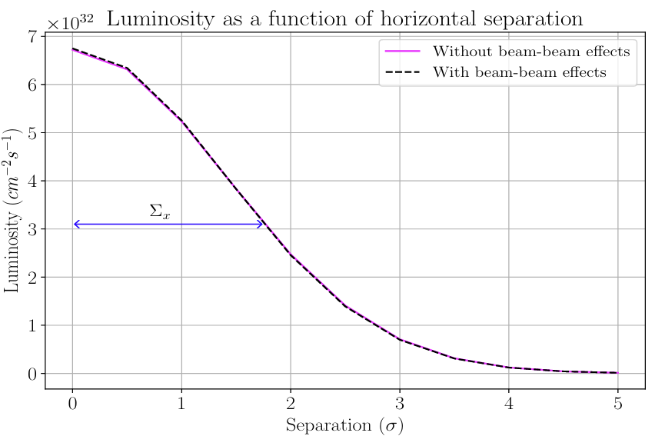
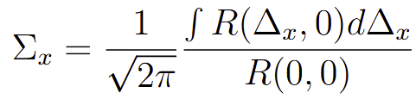
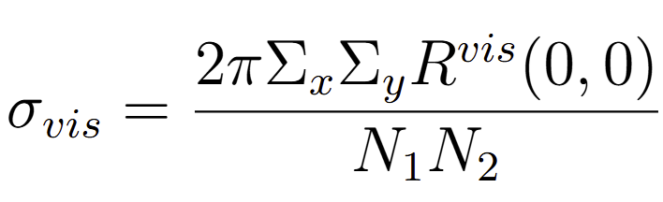
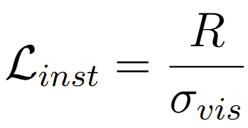
Introduction – Luminosity calibration
Luminosity [cm⁻²s⁻¹] is a proportionality factor between the rate of events detected and production cross section for a given event : R = L_{inst} · σ_{event}
A Van der Meer scan is a luminosity calibration method where the beams are transversely moved with respect to each other to measure their spatial profiles and determine the absolute luminosity .
Rates can be fitted as a function of the separation for an event with a known cross-section :
σ_{vis} is the luminometer-dependant constant used to calibrate the luminosity :
[1]
What can bias the luminosity calibration ?
… particles distribution, beam-beam effects, linear coupling
Linear coupling and beam-beam biases to luminosity calibration measurements in the Large Hadron Collider
Notes:
Lumi : property of accelerator
Convolved transverse beam size

Slide 4
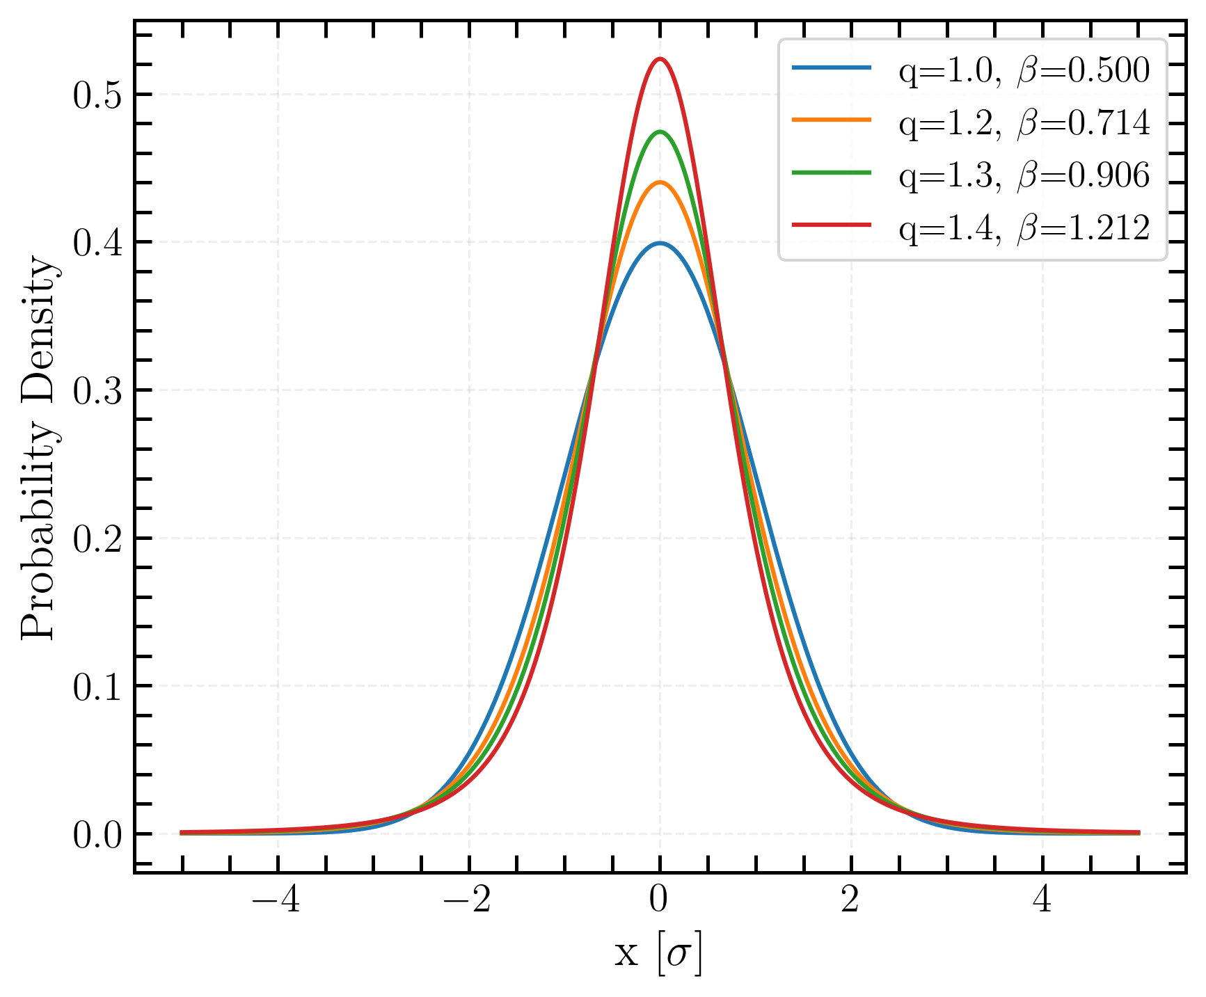
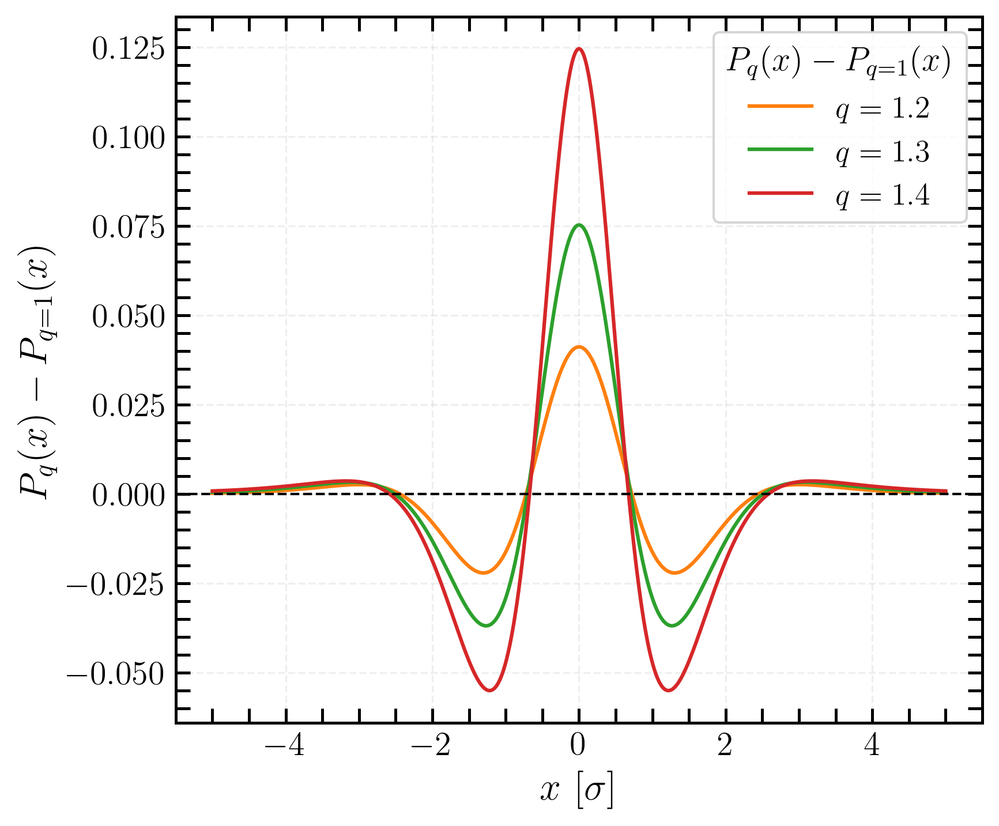
q-Gaussian distributions
Observations that colliding bunches often exhibit non-Gaussian tails [2,3]
Beams with heavy tails
Using simplified definition to artificially get the rms = 1: f(x) = [1-(1-q)βx²]^{1/(1-q)}
q-Gaussian distributions
Difference with standard Gaussian distribution
standard Gaussian
Linear coupling and beam-beam biases to luminosity calibration measurements in the Large Hadron Collider
Notes:
non-Gaussian tails : due to intra beam effects such as intra-beam scattering, synchrotron radiation, and due to the mutual interaction of the two colliding beams, such as beam-beam effect, e-cloud and luminosity burn-off.

Slide 5
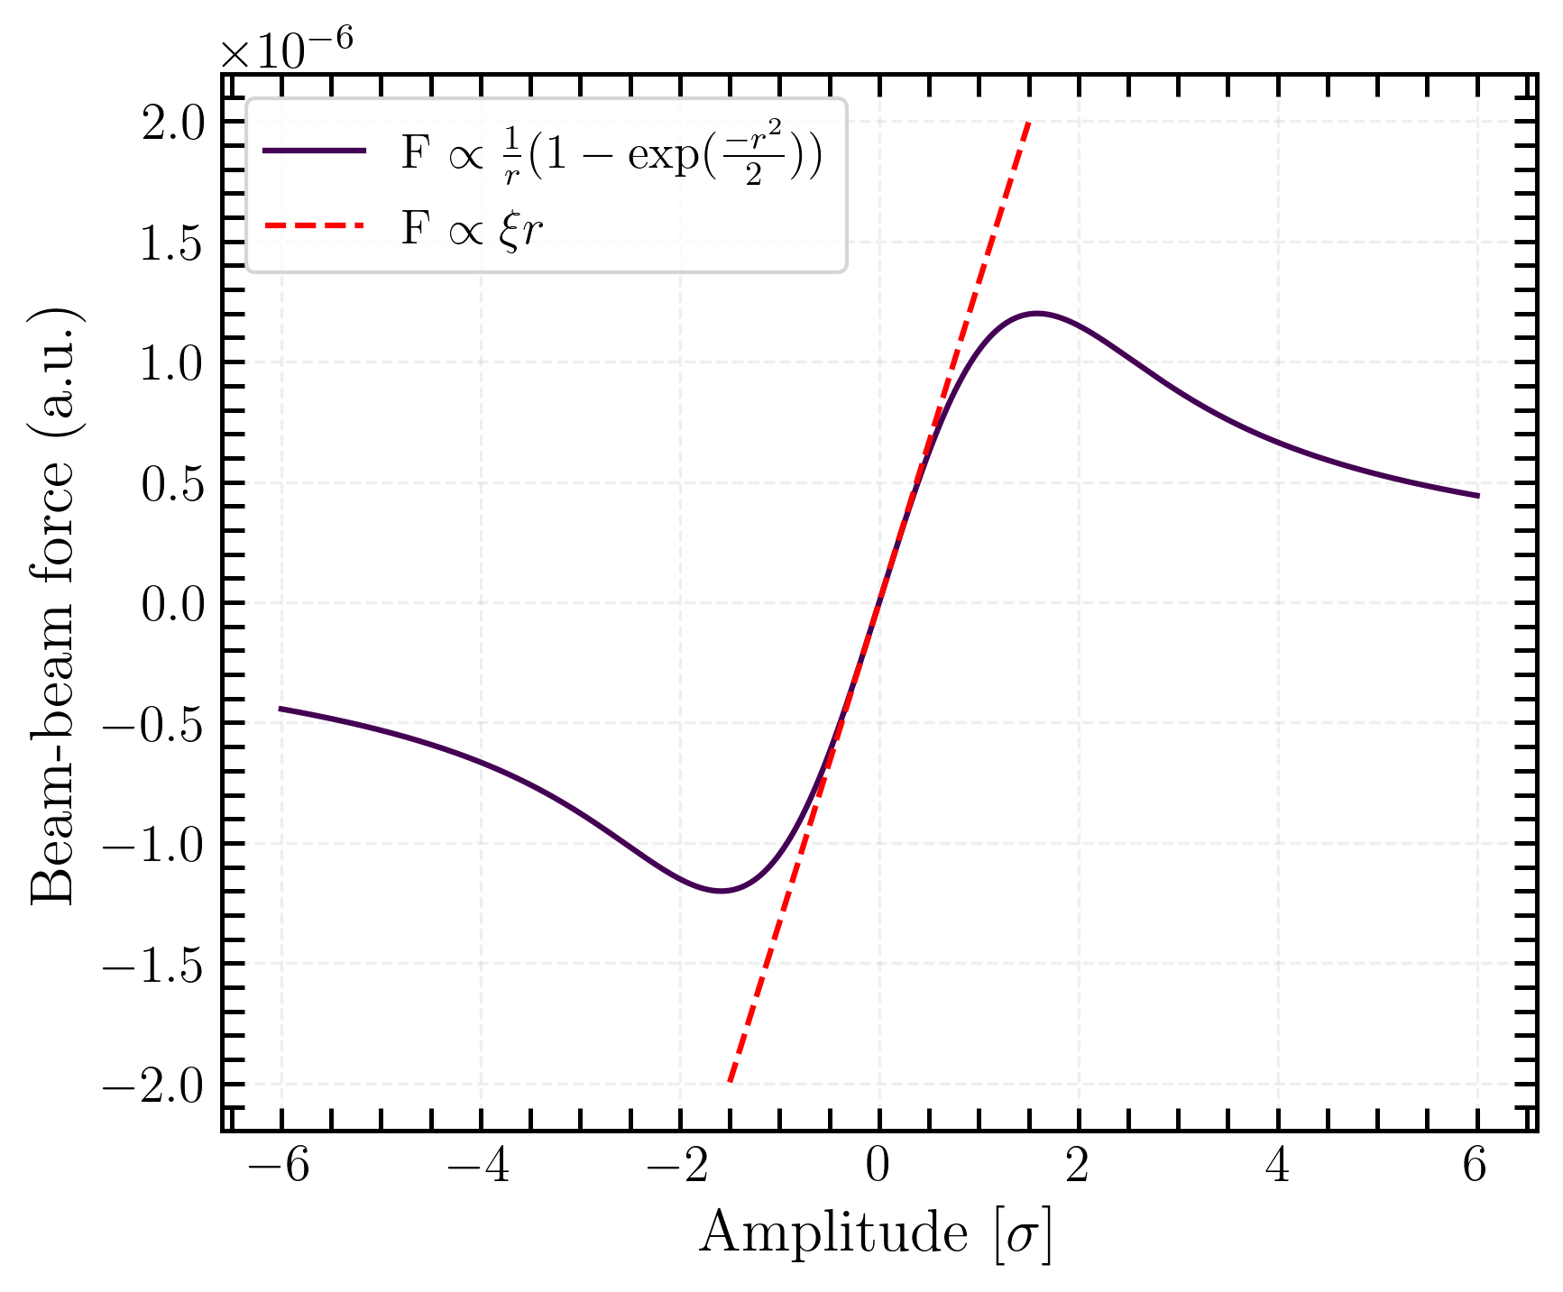
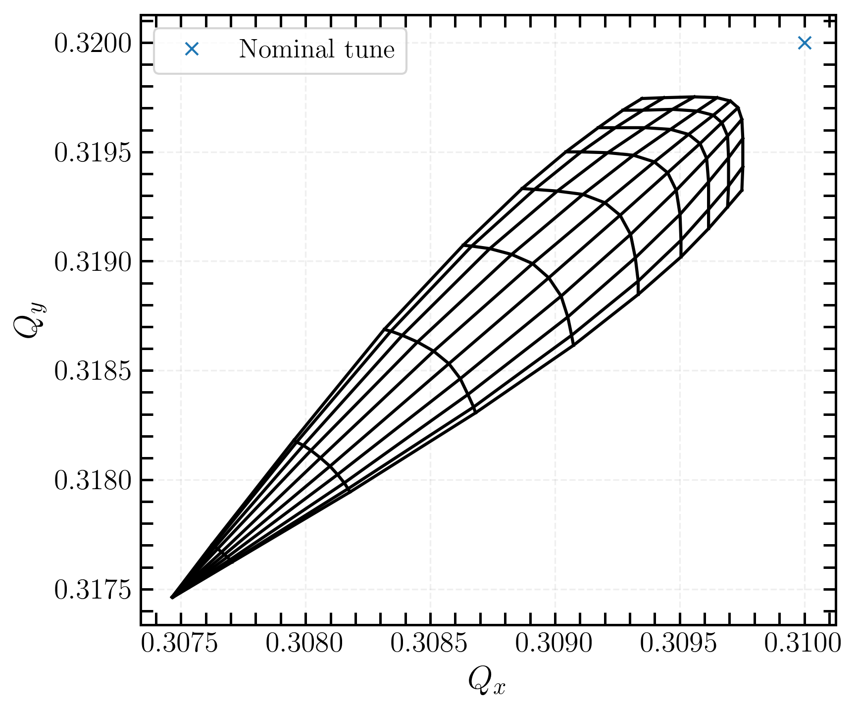
Beam-beam effect
Beam-beam force : non-linear EM force between particles in colliding beams [4], which leads to a tune spread. Particles will behave differently depending on their position with respect to the center of the beam.
Beam-beam force for Gaussian beams
Tune spread for head-on collision
→ non-linear dependence of the force with amplitude for large displacements
→ tune spread caused by beam-beam force
Linear coupling and beam-beam biases to luminosity calibration measurements in the Large Hadron Collider
Notes:
- The beam–beam force leads to tune spread

Slide 6
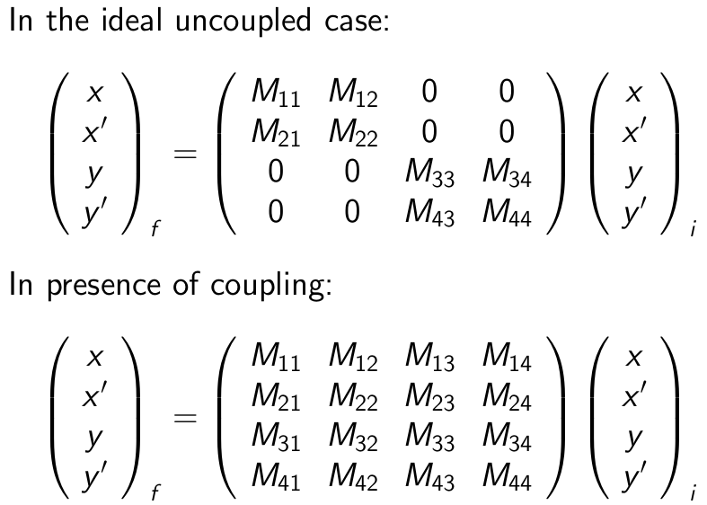
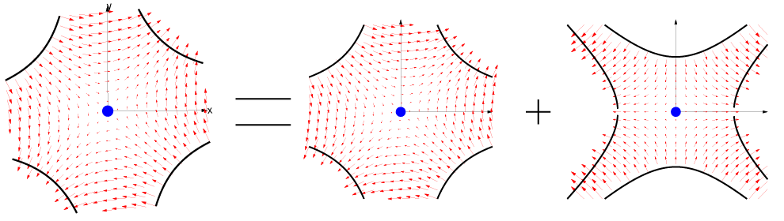
Linear coupling
In linear motion :
Source : tilted quadrupoles and tilted sextupoles
Interdependency between x-y motion
tilted quadrupole = normal quadrupole + skew quadrupole [5]
Local coupling → change in local parameters
Global coupling → change in global parameters
Preliminary studies [1, 9]
Linear coupling and beam-beam biases to luminosity calibration measurements in the Large Hadron Collider
Notes:
C : lumi intergral and prileminary linear global coupling studies
L : study of local linear coupling and premilimary beam imaging
linear coupling : describes the interaction between the motion of particles in the horizontal and
vertical planes, leading to a situation where the motion in one plane influences the motion in
the other. In an ideal accelerator, the transverse motion of particles in the x and y planes is
independent.
linear coupling could be one of the sources of non-factorization interplay with beam-beam effects
xy and phases 2by 2 diagonal matrix
horizontal and vertical planes are fully decoupled
in presence of coupling no longer diagonal
sources of coupling are tilted quadrupoles
effect depends on the strength of this tilted quadrupole and also where your beams are sitting in terms of the frequency
for non-linear motion way more complicated
two types of linear coupling

Slide 7
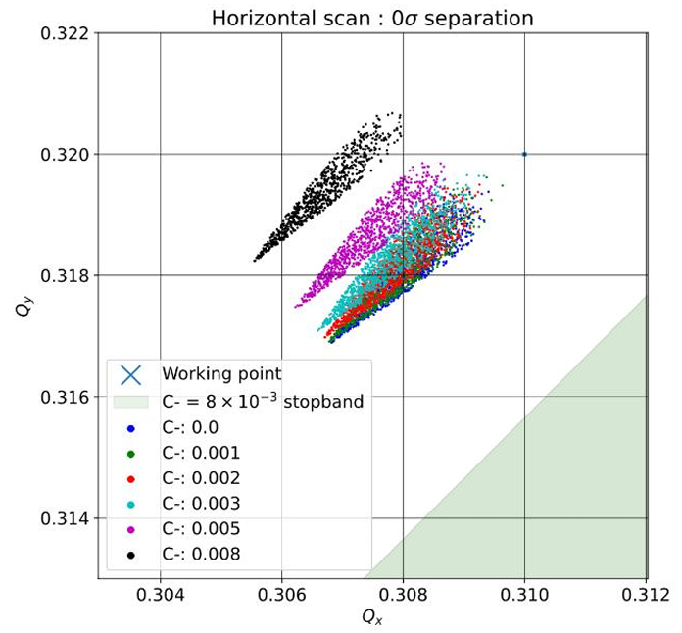
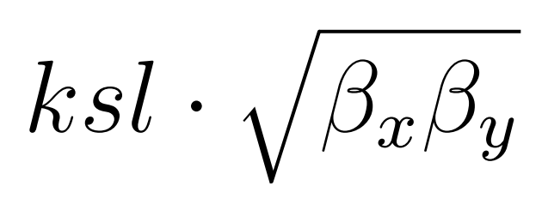
Linear local coupling
Linear global coupling
Due to tilted quadrupoles in the interaction region (IR) and cancels out of the IR
No impact on global parameters (e.g. tunes)
Impact to local beam properties (e.g. beam sizes) along the IR
Proved to be a problem in physics fills and corrected (first correction in 2022 [4])
Scaling as
Changes global parameters (i.e. tunes, tune spread)
Quantified with C⁻ coupling term
[1]
Linear coupling and beam-beam biases to luminosity calibration measurements in the Large Hadron Collider
Notes:
linear coupling : occurs due to tilted quadrupoles in the IR ans it cancels out of the IR, no impact to global parameters (i.e. tunes) but impact to the local beam properties (beam sizes) along the IR
Magnetic strenght -> explain beta as well

Slide 8
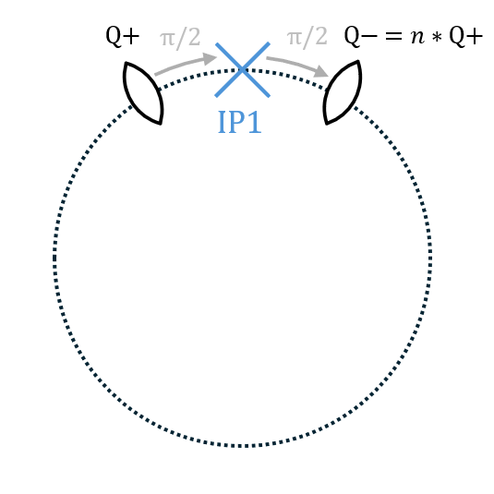
LHC model
Xsuite beam dynamics framework (Python modules)
Simplified LHC lattice, with 1IP and 2 skew quadrupoles (Q+ ∝ and Q-)
When the strength of Q+ and Q- is the same (n=1)
→ local coupling
Strength of the second quadrupole can be reduced (n<1)
→ local+global coupling
Local coupling strength ksl varying over 10⁻⁴ to 10⁻³ m⁻² [6]
typical vdM parameters
Linear coupling and beam-beam biases to luminosity calibration measurements in the Large Hadron Collider
Notes:
Rotation in phase space for the rest of the arc
Uncorrected 10-3
Corrected 10-4 (claim that they can correct up to)

Slide 9
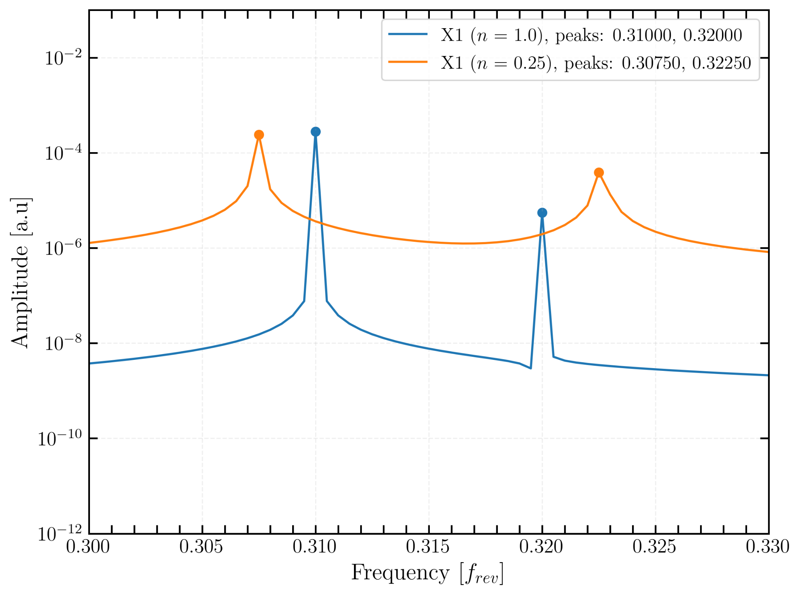
Tune shift analysis (I)
tune shift
Tune shift induced by coupling
Detectable tune shifts typically require changes of ≥ 0.0002 [7]
LHC : Q_{x} = 0.31
Q_{y} = 0.32
fully corrected (n=1)
Linear coupling and beam-beam biases to luminosity calibration measurements in the Large Hadron Collider
Notes:
frequency spectra
Tunes pushed appart

Slide 10
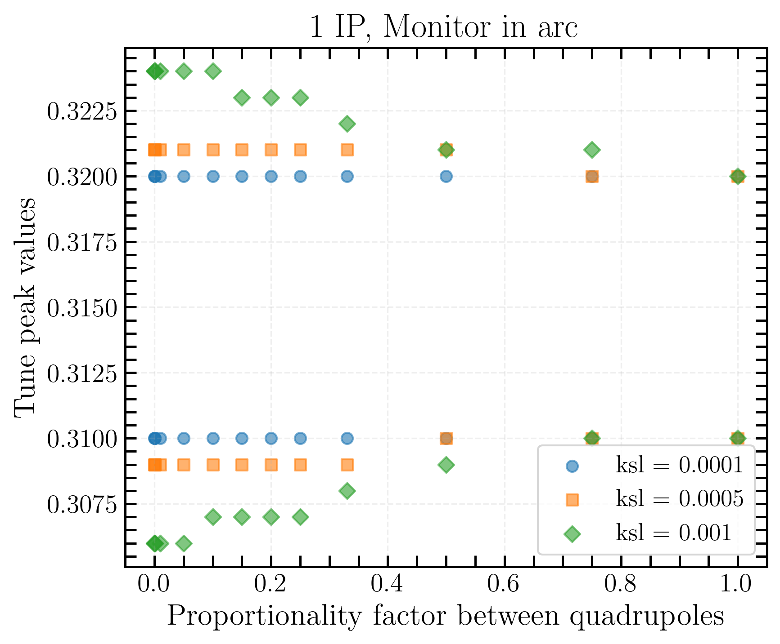
Tune shift analysis (II)
3 quadrupole coupling strengths
ksl = [10⁻⁴ , 5 · 10⁻³, 10⁻³ ].
With ksl = 0.0001, no measurable tune shift is observed.
The maximum tune shift, as n→0
is 0.0038.
Even strong sources of local-global coupling may go unnoticed during vdM scan due to the small magnitude of the associated tune shift.
n
Linear coupling and beam-beam biases to luminosity calibration measurements in the Large Hadron Collider

Slide 11
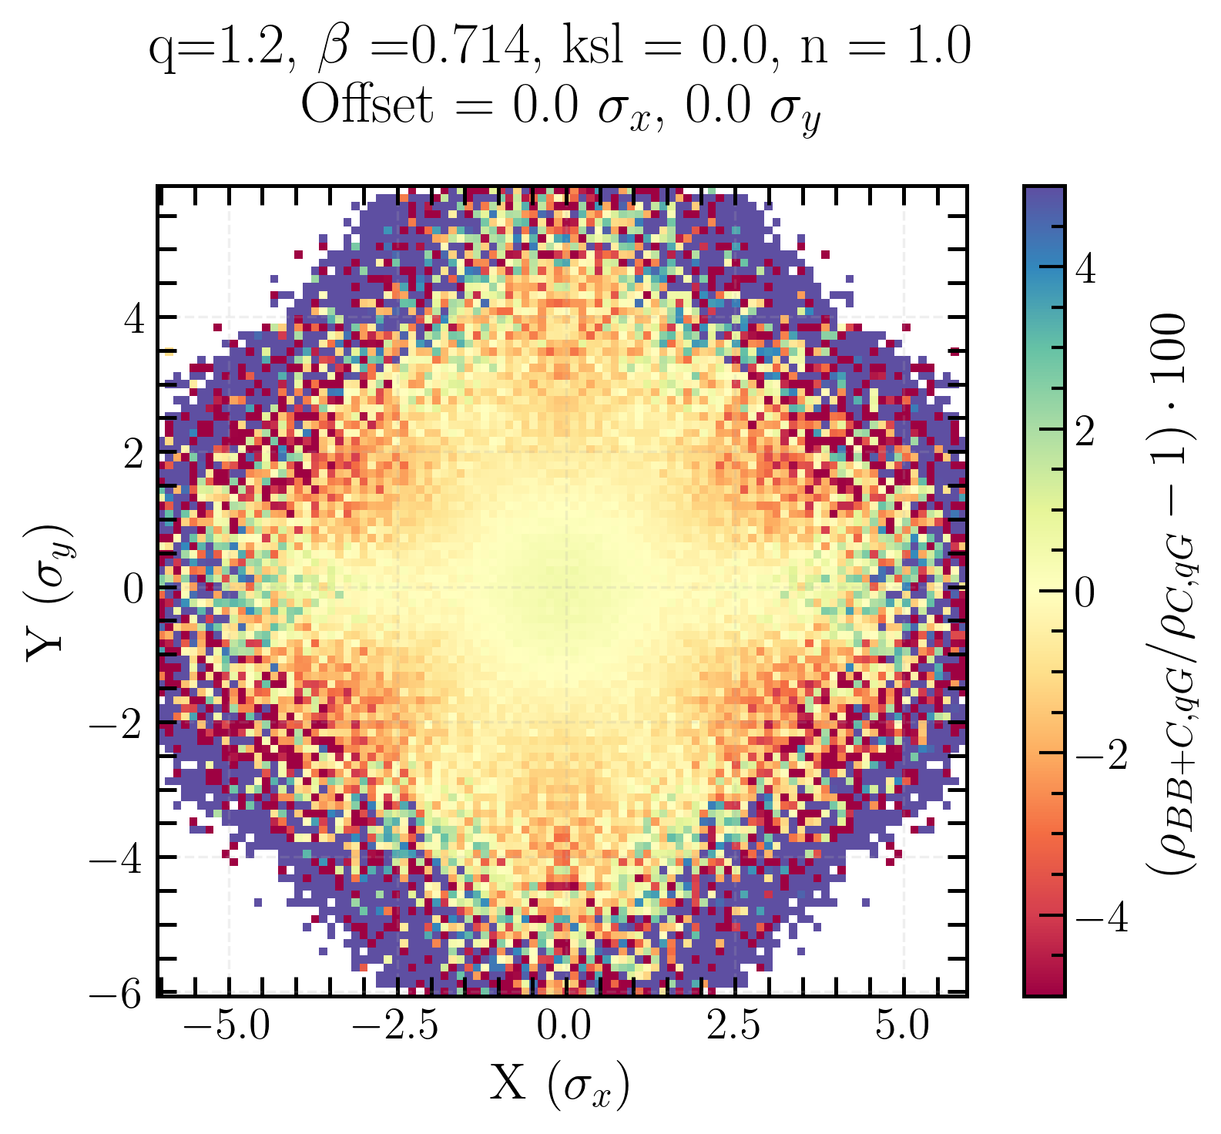
Observables
single beam xy-distribution
Single beam xy-distribution : charge density ρ for a single beam for one beam separation
Plot of the charge density or transverse luminosity distribution biases.
Linear coupling and beam-beam biases to luminosity calibration measurements in the Large Hadron Collider
Notes:
Constructed and thought to hightlight different effects
All of these are constructed
using a two-dimensional grid of size N × N, applied to either one or both beams.
Each point of the grid is assigned a charge density, it’s the representation of the distribution of particles
in transverse space.

Slide 12
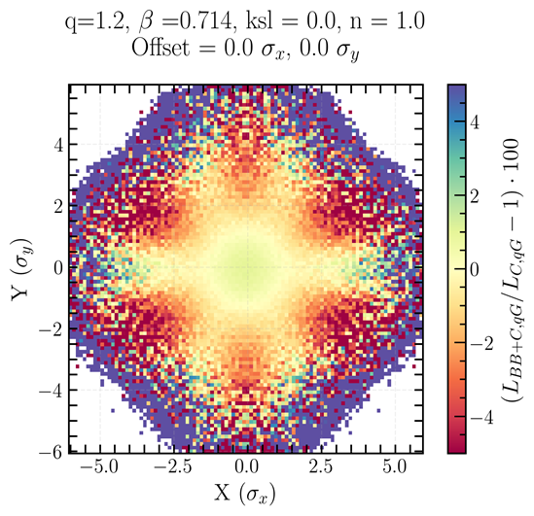
Observables
Single beam xy-distribution : charge density ρ for a single beam for one beam separation
Transverse luminosity distribution : point-by-point multiplication of charge density map of the two beams over the entire grid, for a fixed beam separation
transverse luminosity distribution
Plot of the charge density or transverse luminosity distribution biases.
Linear coupling and beam-beam biases to luminosity calibration measurements in the Large Hadron Collider
Notes:
All of these are constructed
using a two-dimensional grid of size N × N, applied to either one or both beams.
Each point of the grid is assigned a charge density, it’s the representation of the distribution of particles
in transverse space.

Slide 13
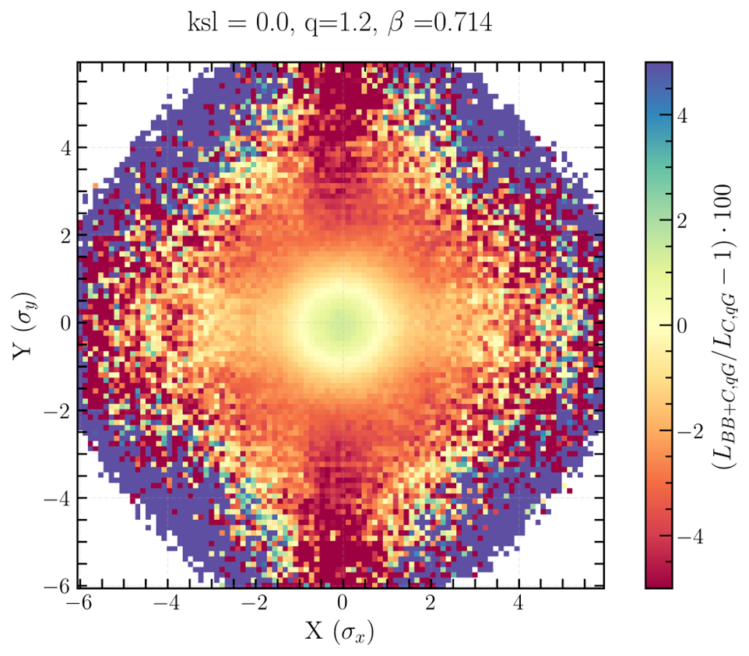
Observables
Single beam xy-distribution : charge density ρ for a single beam for one beam separation
Transverse luminosity distribution : point-by-point multiplication of charge density map of the two beams over the entire grid, for a fixed beam separation
(single) Beam imaging : (single beam xy-distribution) transverse luminosity distribution overlap of all beam separations from 0σ to 5σ
beam imaging
Plot of the charge density or transverse luminosity distribution biases.
Linear coupling and beam-beam biases to luminosity calibration measurements in the Large Hadron Collider
Notes:
All of these are constructed
using a two-dimensional grid of size N × N, applied to either one or both beams.
Each point of the grid is assigned a charge density, it’s the representation of the distribution of particles
in transverse space.

Slide 14
Nomenclature used in the following slides
L_{BB} is the overlap of the charge density maps of both beams with only beam-beam.
L_{C} is the overlap of the charge density maps of both beams with only coupling.
L_{BB+C} is the overlap of the charge density maps of both beams with beam-beam and coupling.
L₀ is the overlap of the charge density maps of both beams with neither beam-beam nor coupling.
L_{G} is the is the overlap of the charge density maps of both beams of a Gaussian beam.
L_{qG} is the overlap of the charge density maps of both beams of a q-Gaussian beam.
Same convention used for the charge density ρ, and σ_{vis}
Linear coupling and beam-beam biases to luminosity calibration measurements in the Large Hadron Collider
Notes:
Used for Bias, hightlight different effects, normalization

Slide 15
Single beam xy-distribution beam-beam bias…
Linear coupling and beam-beam biases to luminosity calibration measurements in the Large Hadron Collider

Slide 16
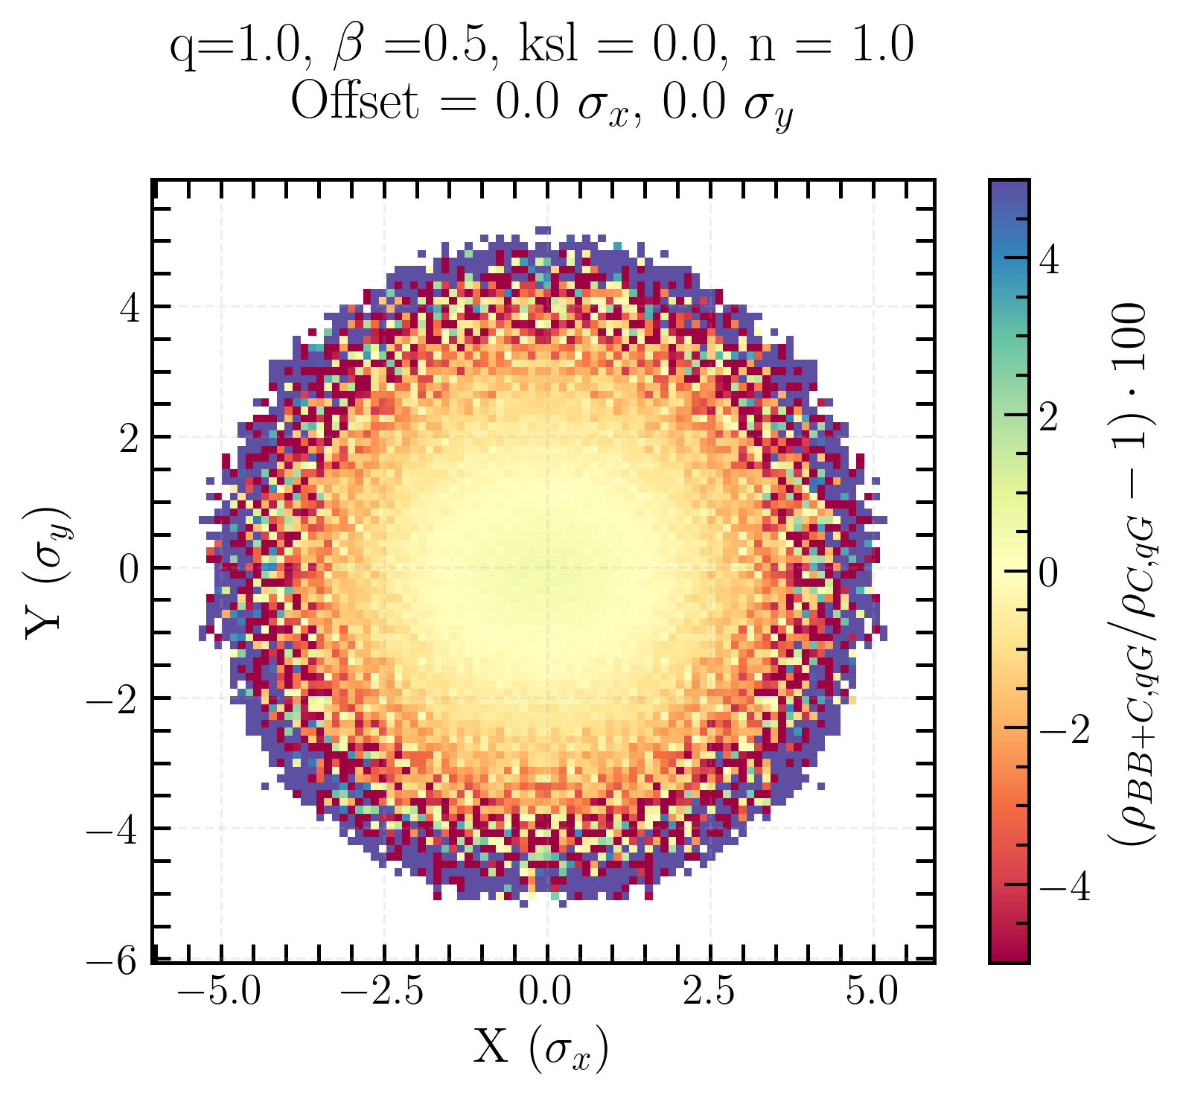
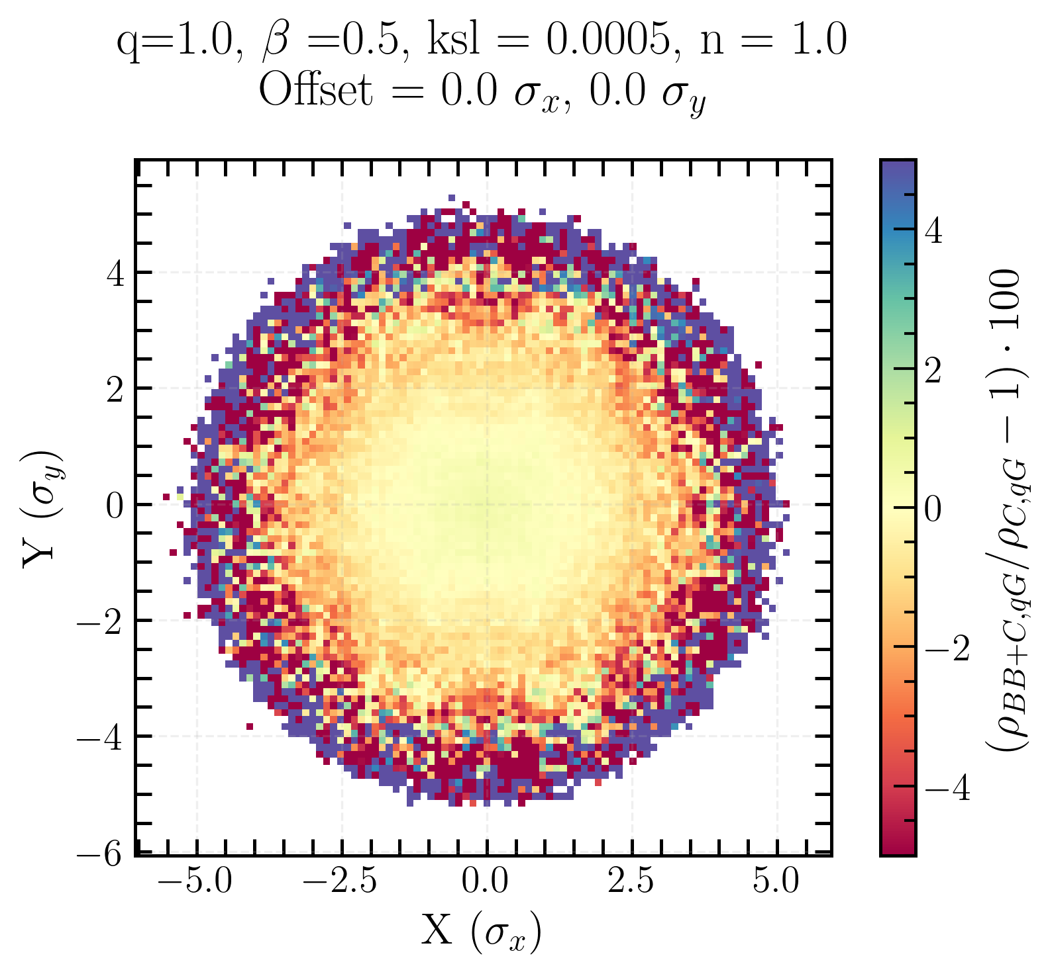
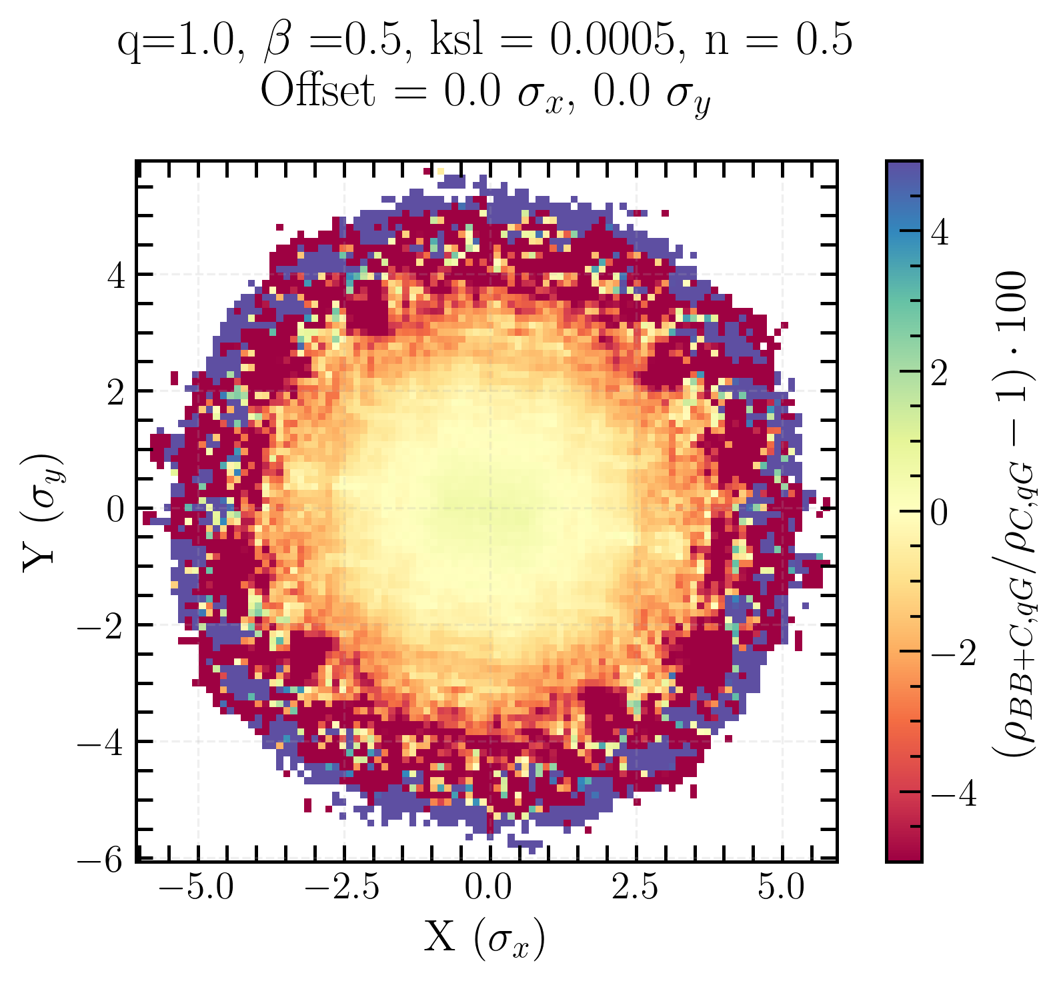
Single beam xy-distribution BB-bias for Gaussian beam
Charge density ρ bias due to beam-beam
Radial symmetry
Positive bias in the center and negative bias around
no coupling
local coupling
local + global coupling
Linear coupling and beam-beam biases to luminosity calibration measurements in the Large Hadron Collider
Notes:
radial symmetry
positive bias in the center and negative bias around -> beam-beam enhances the charge density distribution in the center, drives particles from the tails to the center

Slide 17
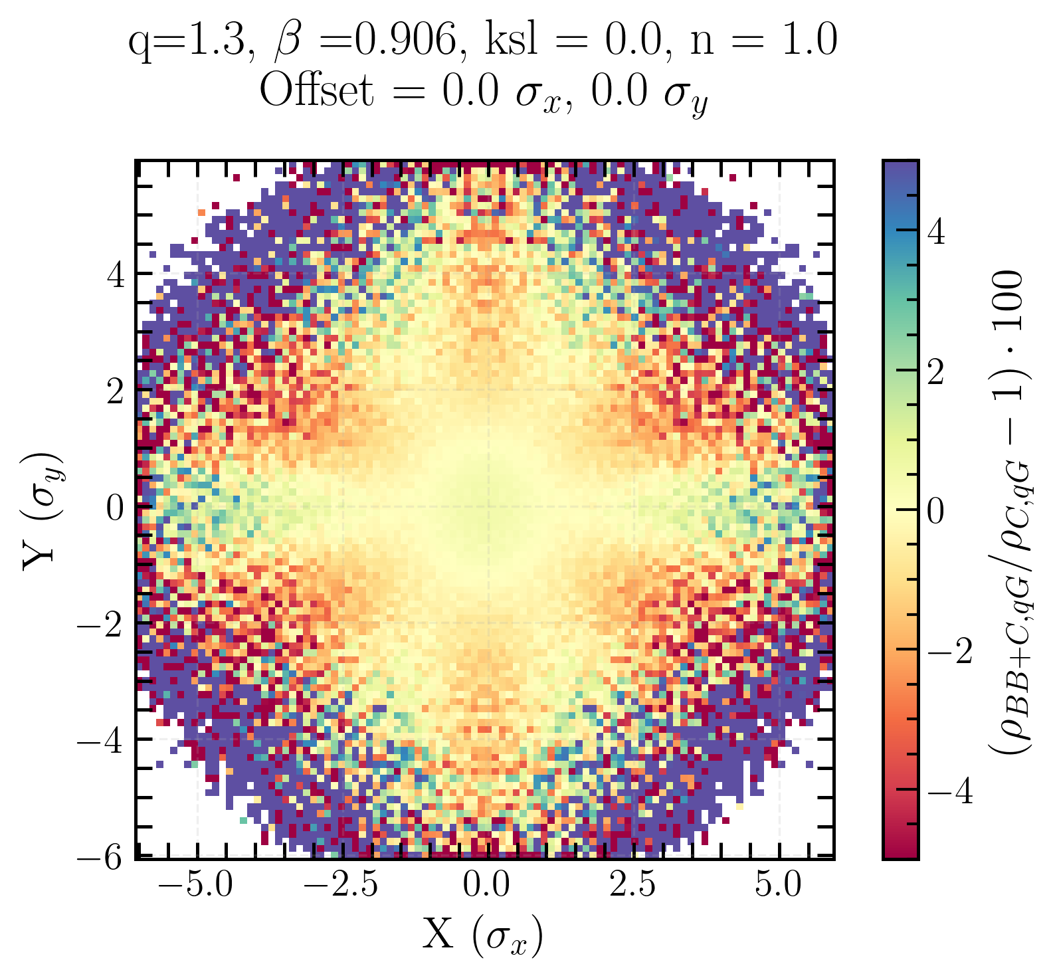
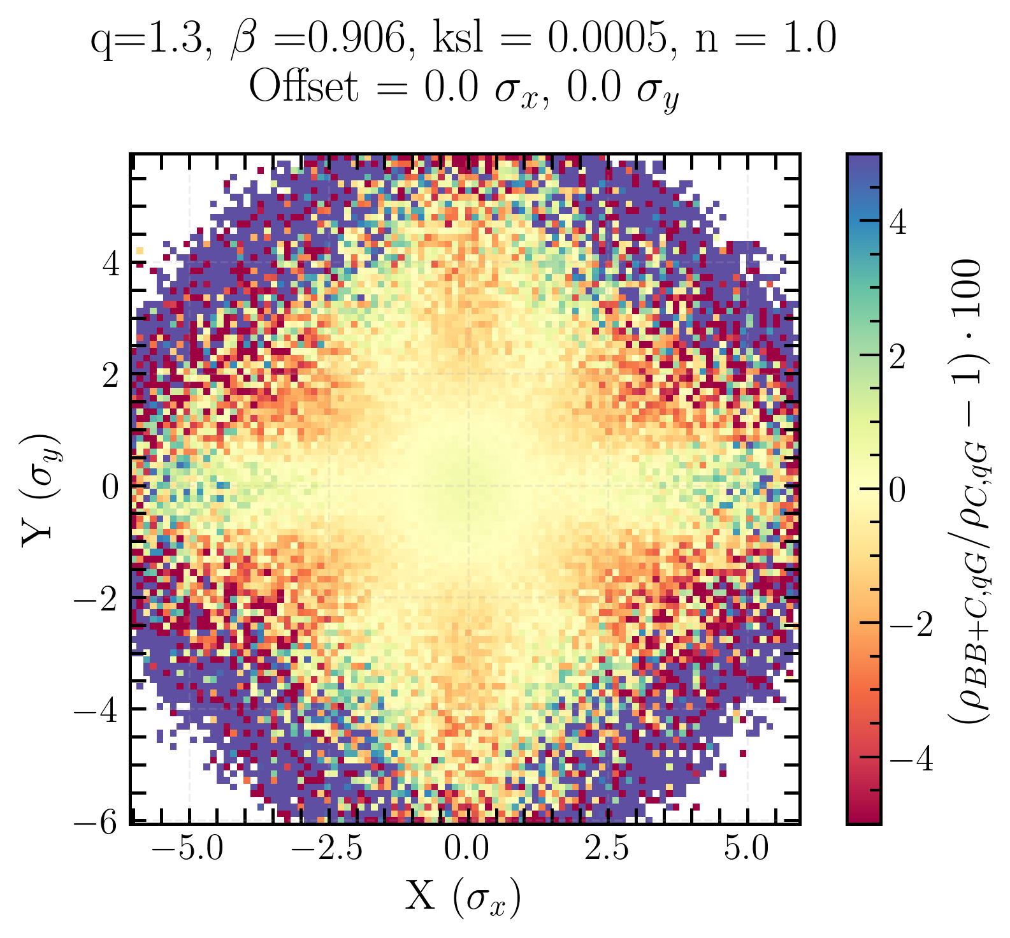
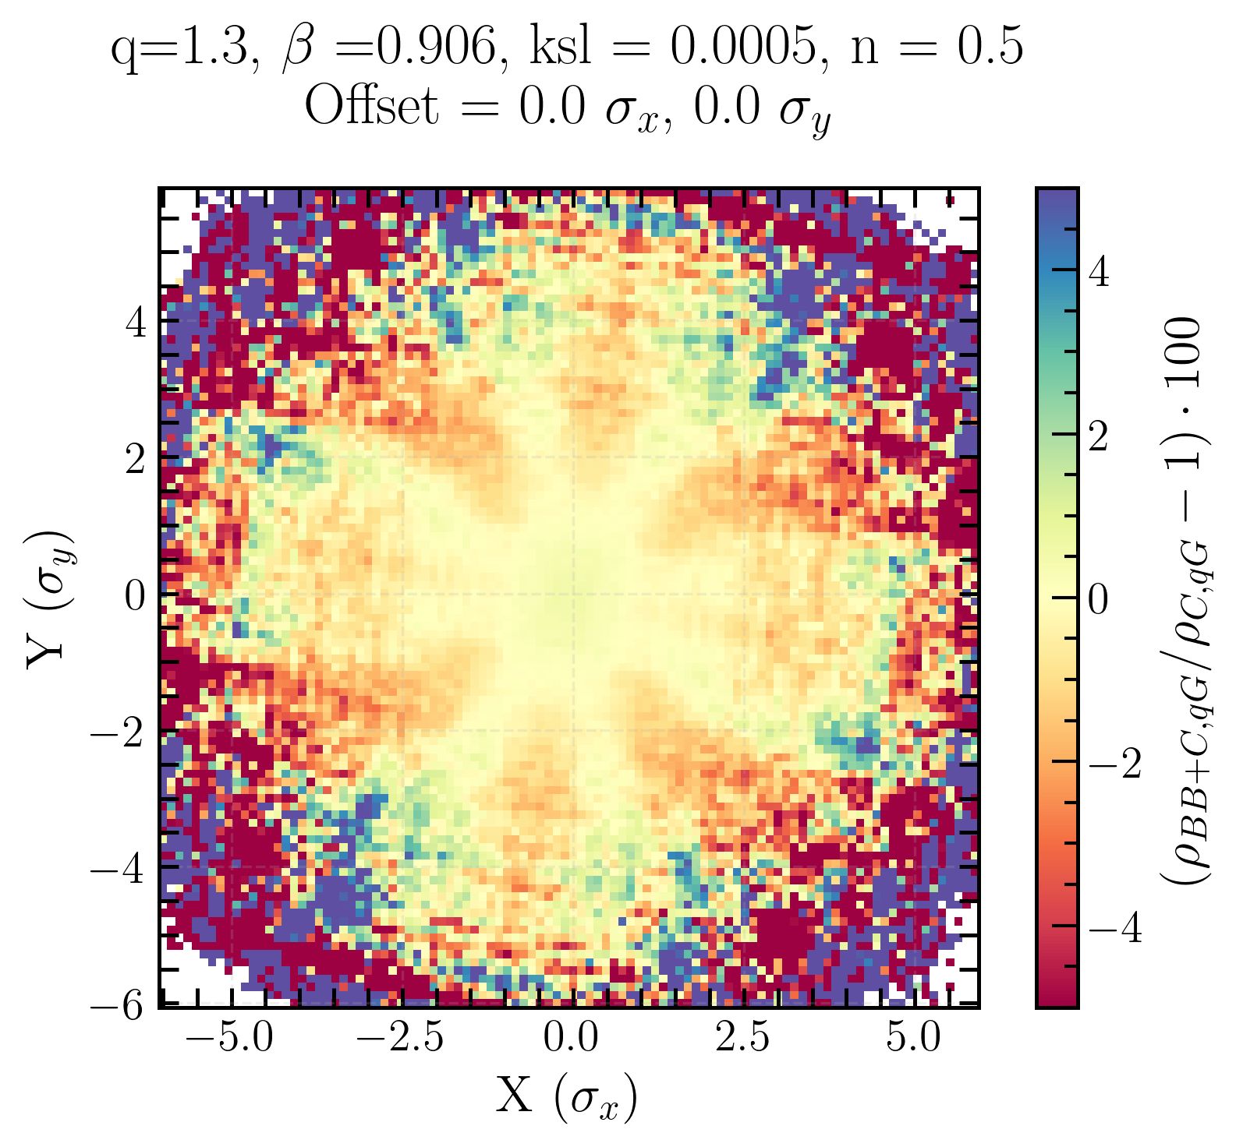
Single beam xy-distribution BB-bias for q-Gaussian beam
Initial beam distribution matters → shapes how beam-beam effects deform the transverse profile
Tilt in the local + global coupling case is now obvious
no coupling
local coupling
local + global coupling
Linear coupling and beam-beam biases to luminosity calibration measurements in the Large Hadron Collider
Notes:
highlight importance of the initial beam distribution for single beam xy-distribution

Slide 18
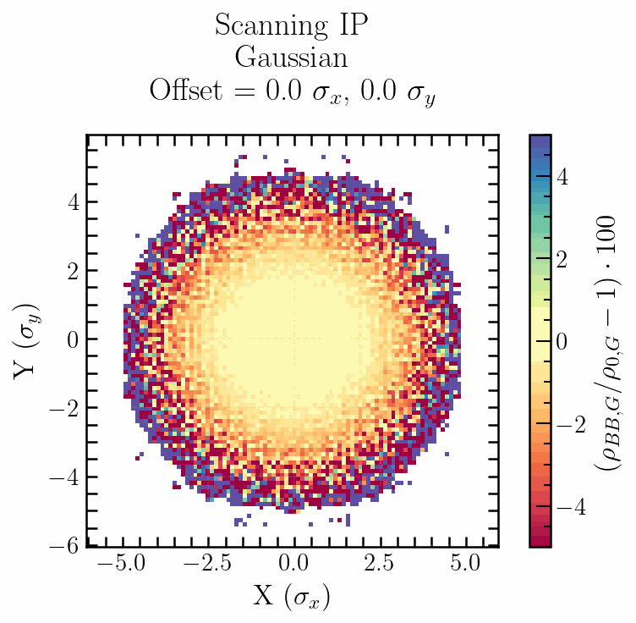
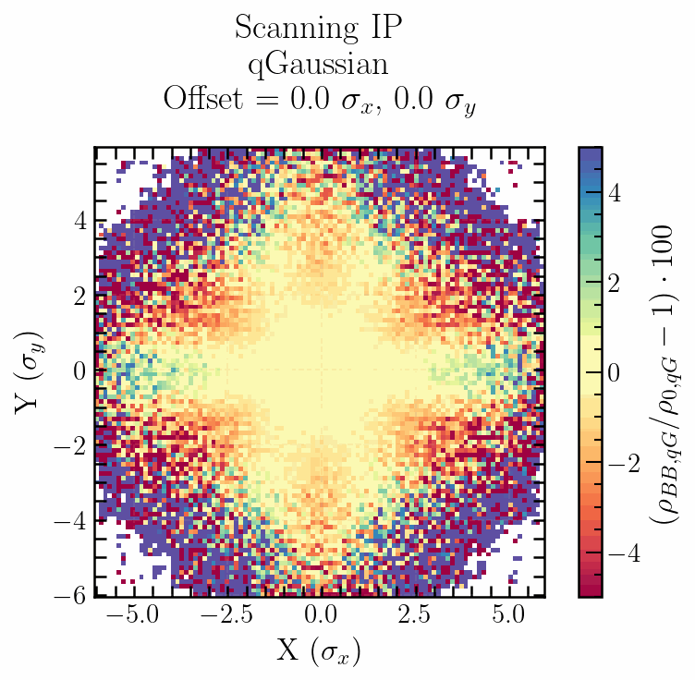
Single beam xy-distribution beam-beam bias
Gaussian
q-Gaussian
Beam-beam bias on single beam xy-distribution for x-axis scans (0𝝈_{x} to 5 𝝈_{x} in steps of 0.5)
Beam-beam interaction perturbs the single beam xy-distribution in a non-linear way that depends on the beam separation and on the initial distribution.
Linear coupling and beam-beam biases to luminosity calibration measurements in the Large Hadron Collider
Notes:
simulations during vdm scans

Slide 19
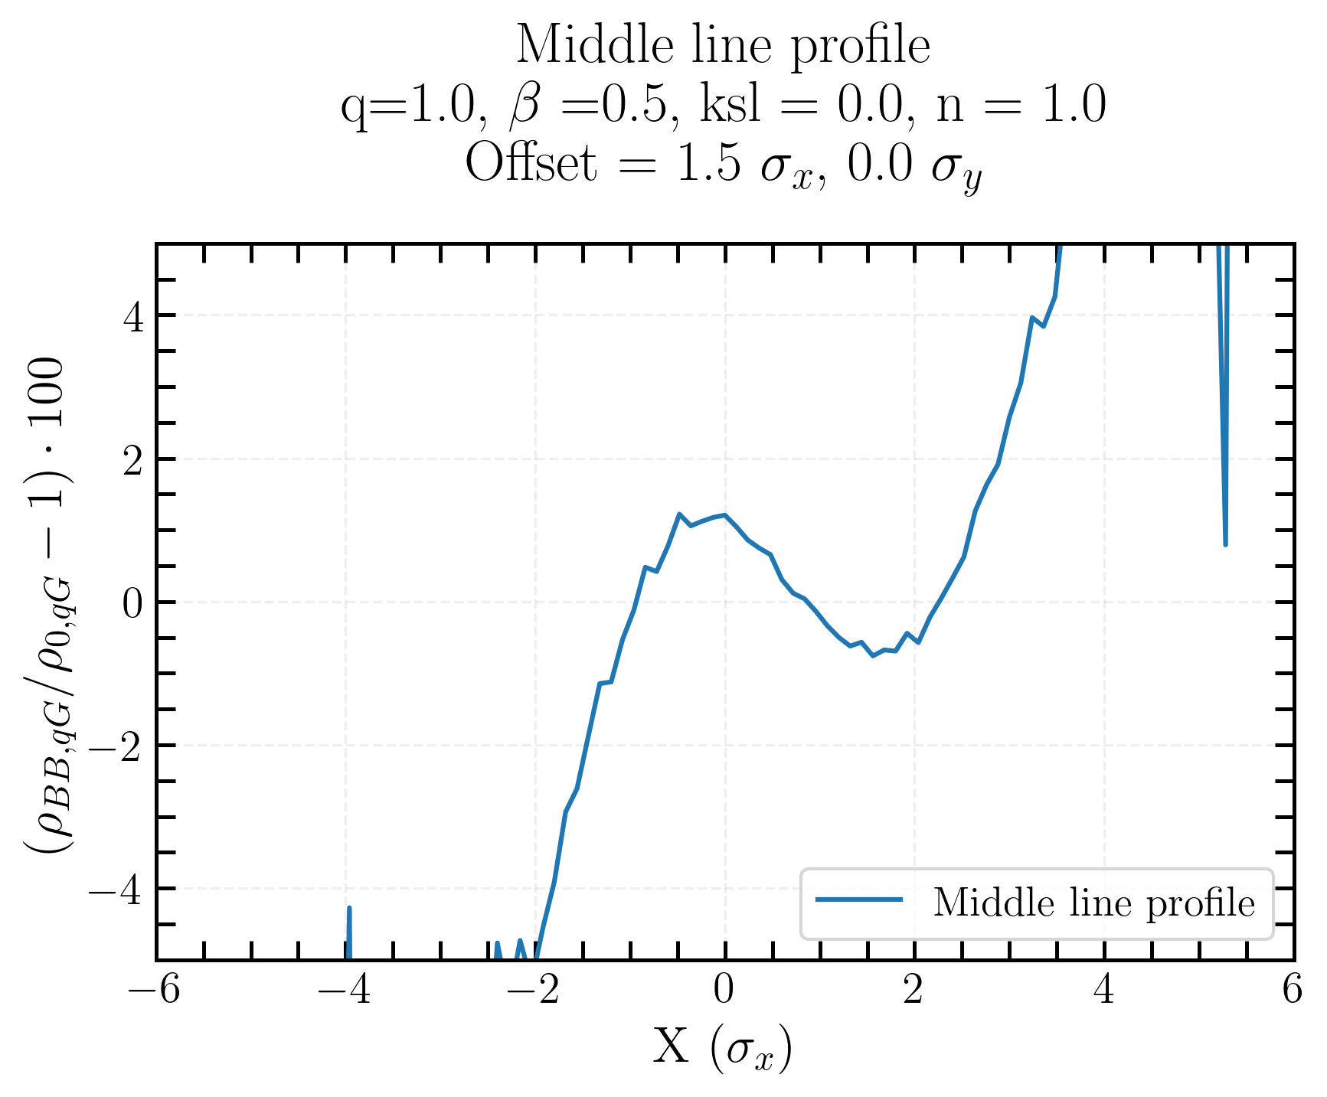
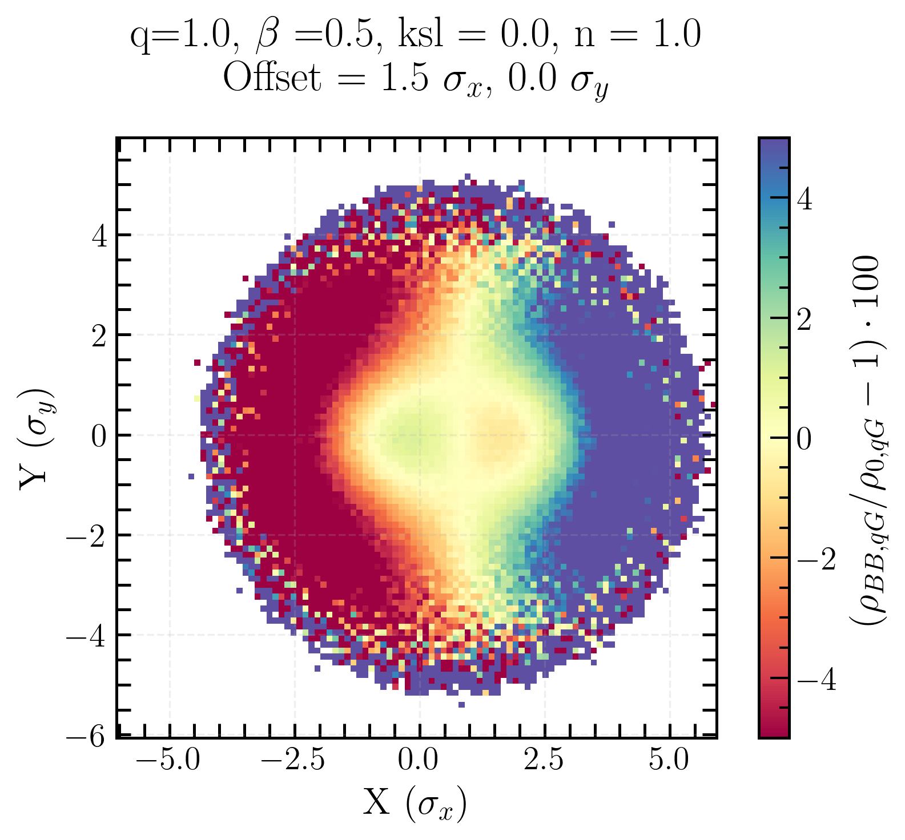
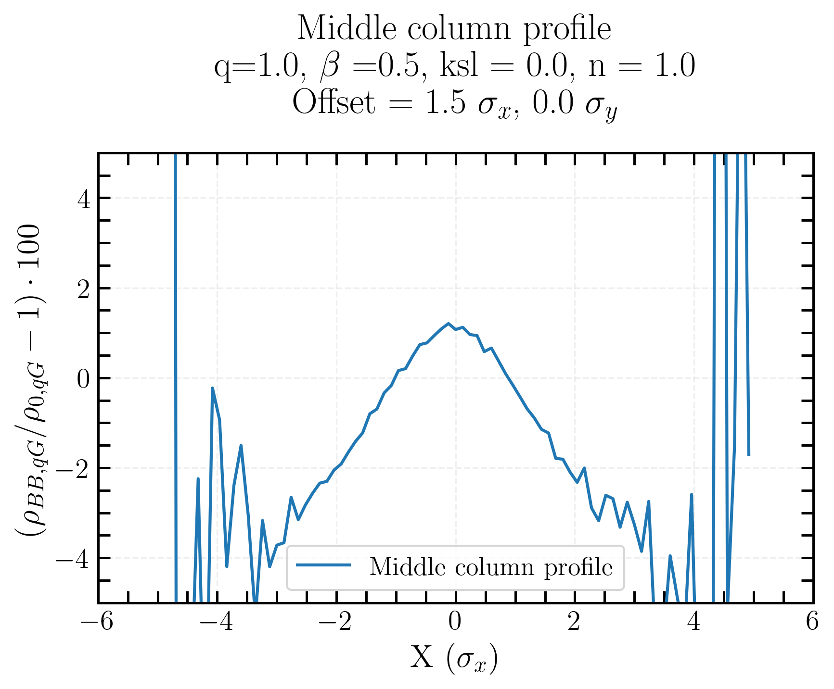
Single Gaussian beam xy-distribution BB bias, with offset
Middle line profile
ρ_{BB, qG}/ρ_{0, qG}
Induced asymmetry in the offset plane
Projection in a plane can lead to a lack of information
Middle line profile
Middle column profile
Linear coupling and beam-beam biases to luminosity calibration measurements in the Large Hadron Collider
Notes:
Middle column profile -> similar to on-axis

Slide 20
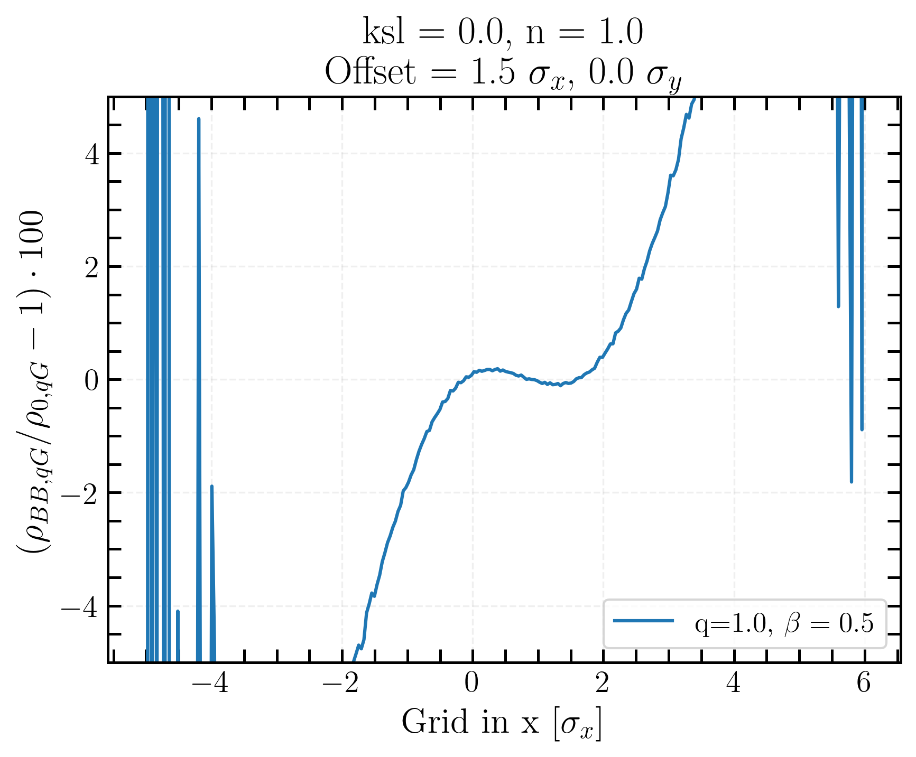
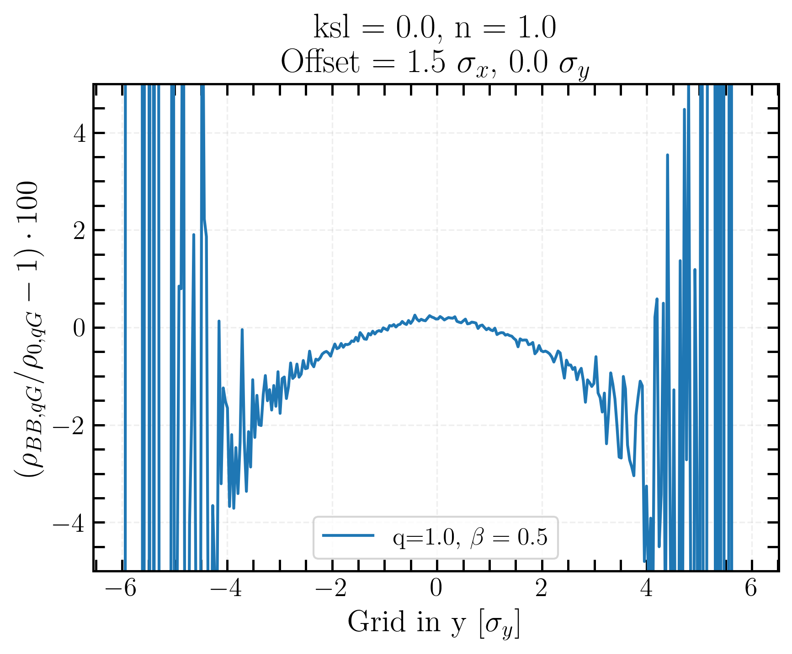
Single Gaussian beam xy-distribution BB bias, with offset
X-axis projection
ρ_{BB, qG}/ρ_{0, qG}
Projection of the charge density ρ bias obtained by summing along all column/lines
Same conclusions as before
Y-axis projection
Linear coupling and beam-beam biases to luminosity calibration measurements in the Large Hadron Collider
Notes:
what is used in this work

Slide 21
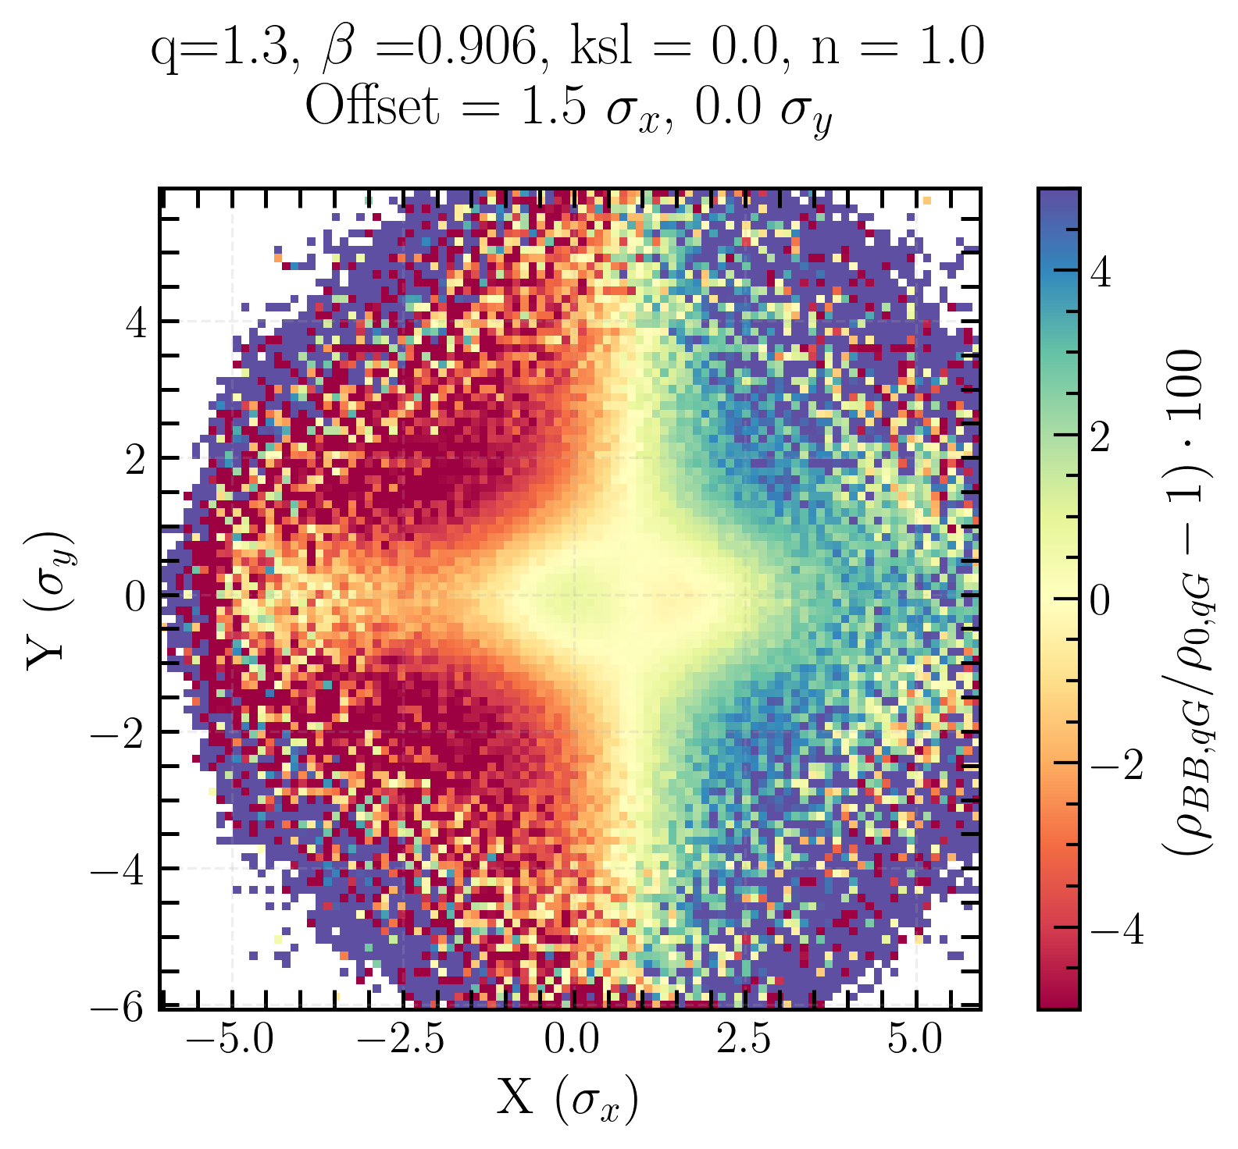
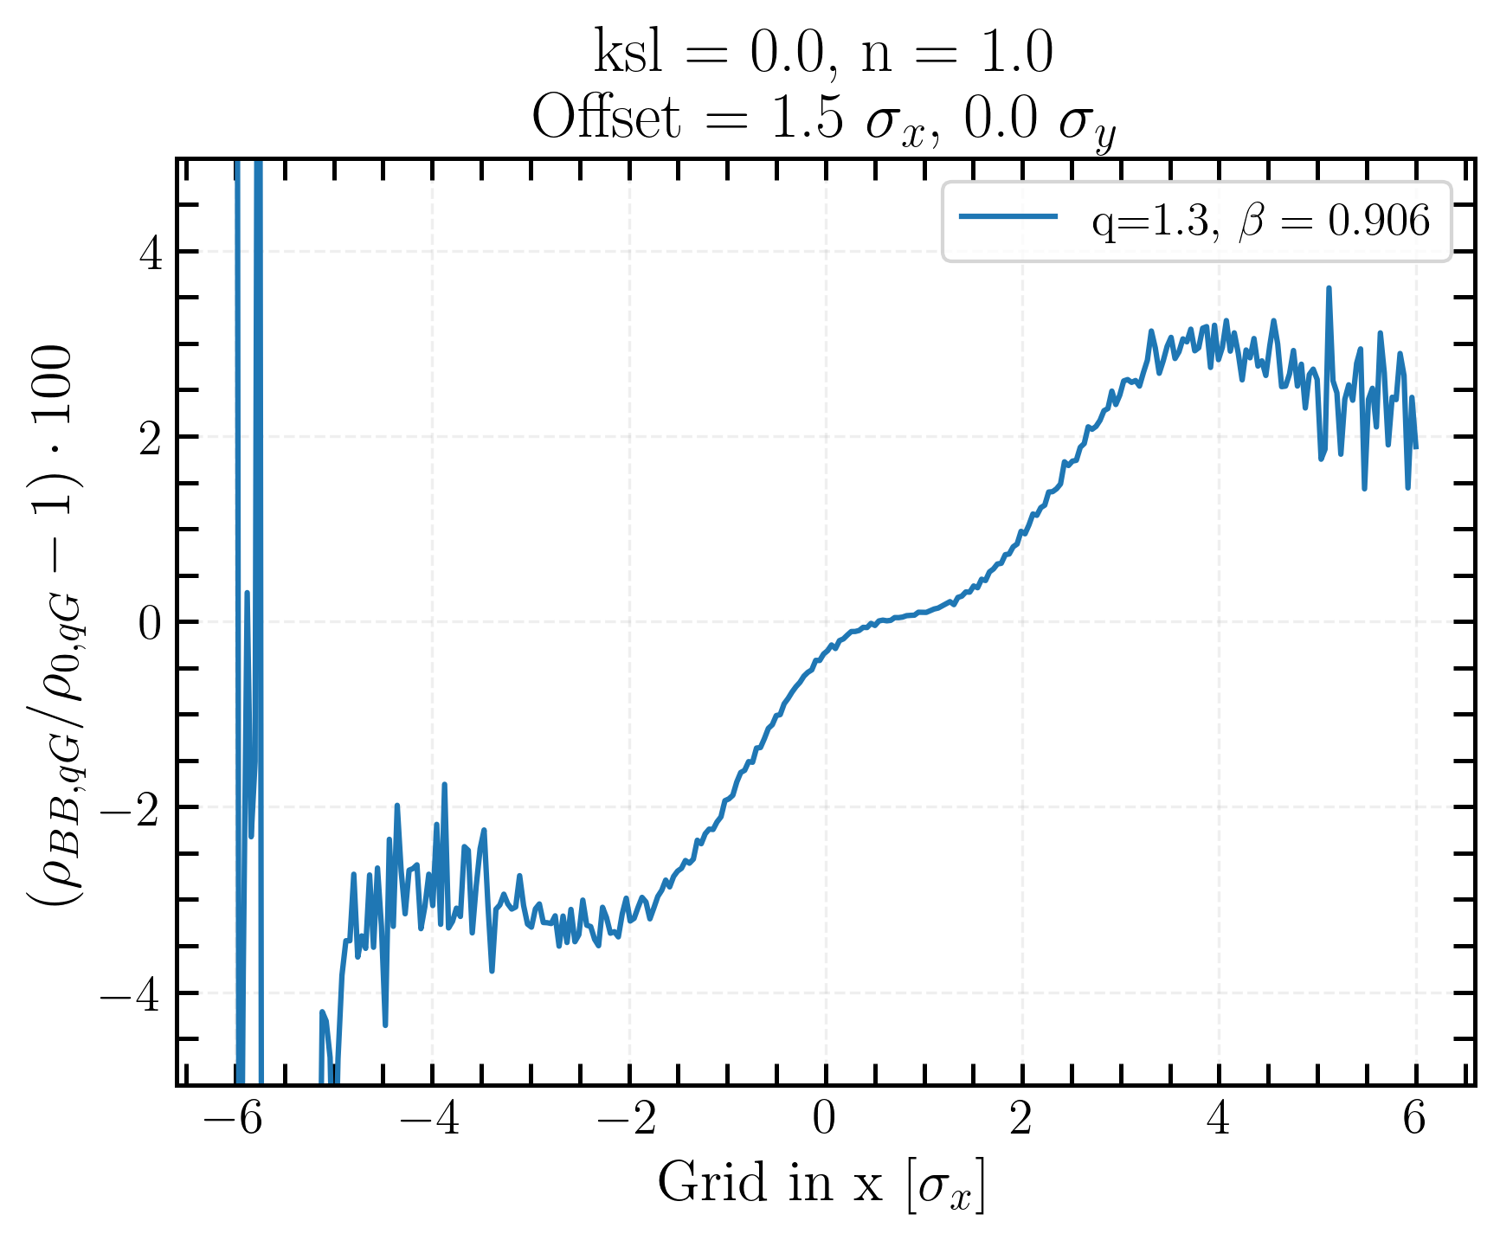
Single q-Gaussian beam xy-distribution bias, with offset
X-axis projection
Projection of the charge density ρ bias, obtained by summing along all lines
Linear coupling and beam-beam biases to luminosity calibration measurements in the Large Hadron Collider
Notes:
Completeness

Slide 22
Transverse luminosity distribution…
… beam-beam bias
… coupling bias
… beam-beam + coupling bias
Linear coupling and beam-beam biases to luminosity calibration measurements in the Large Hadron Collider

Slide 23
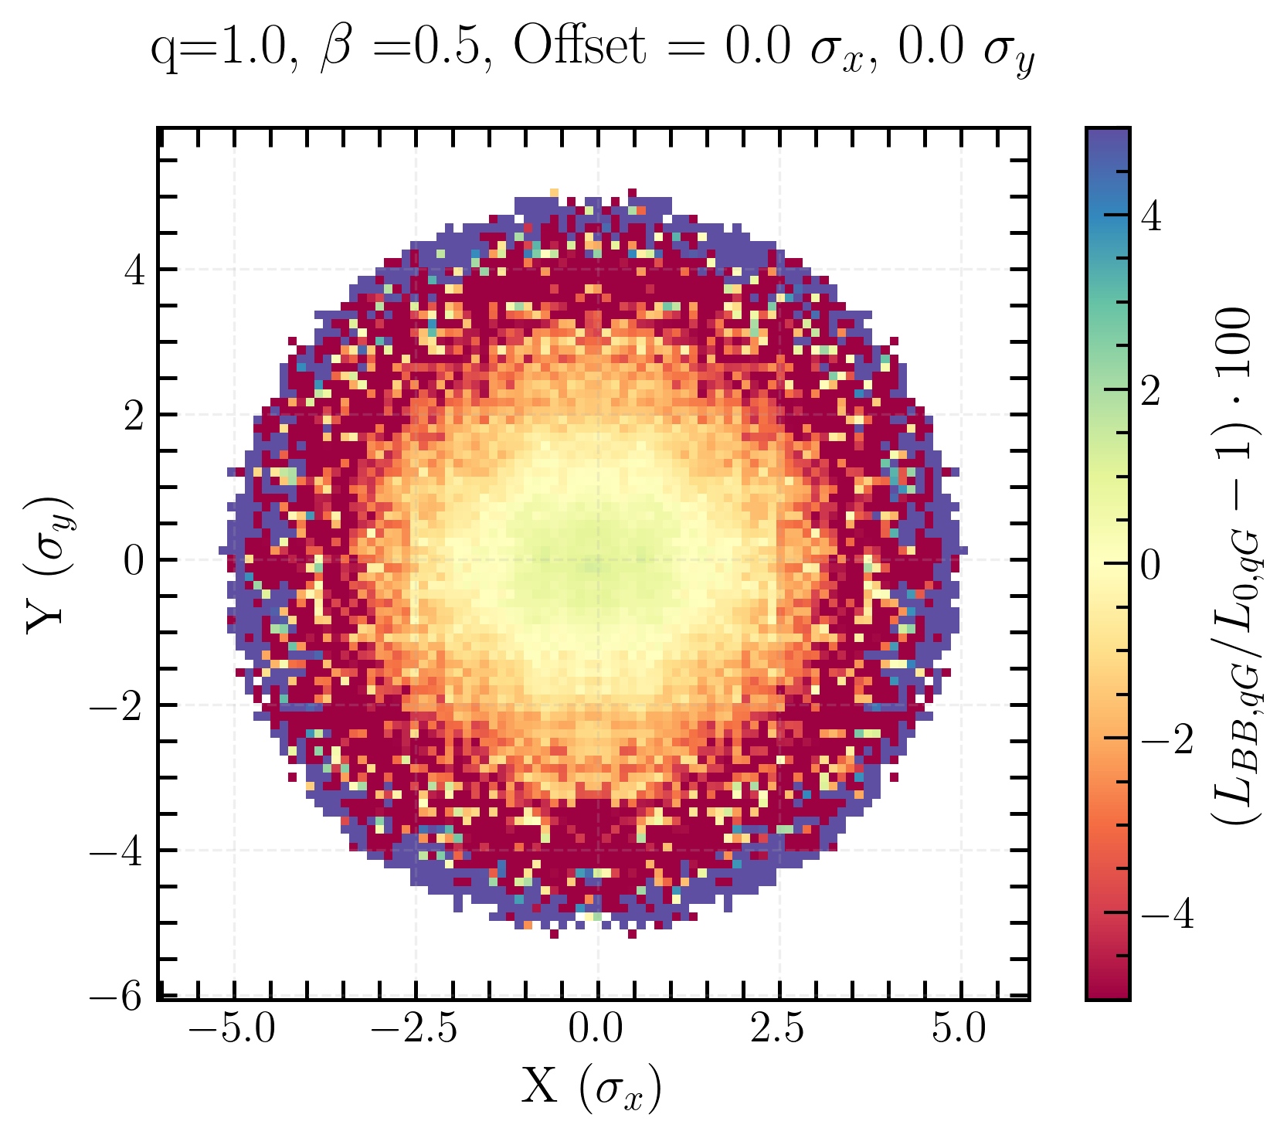
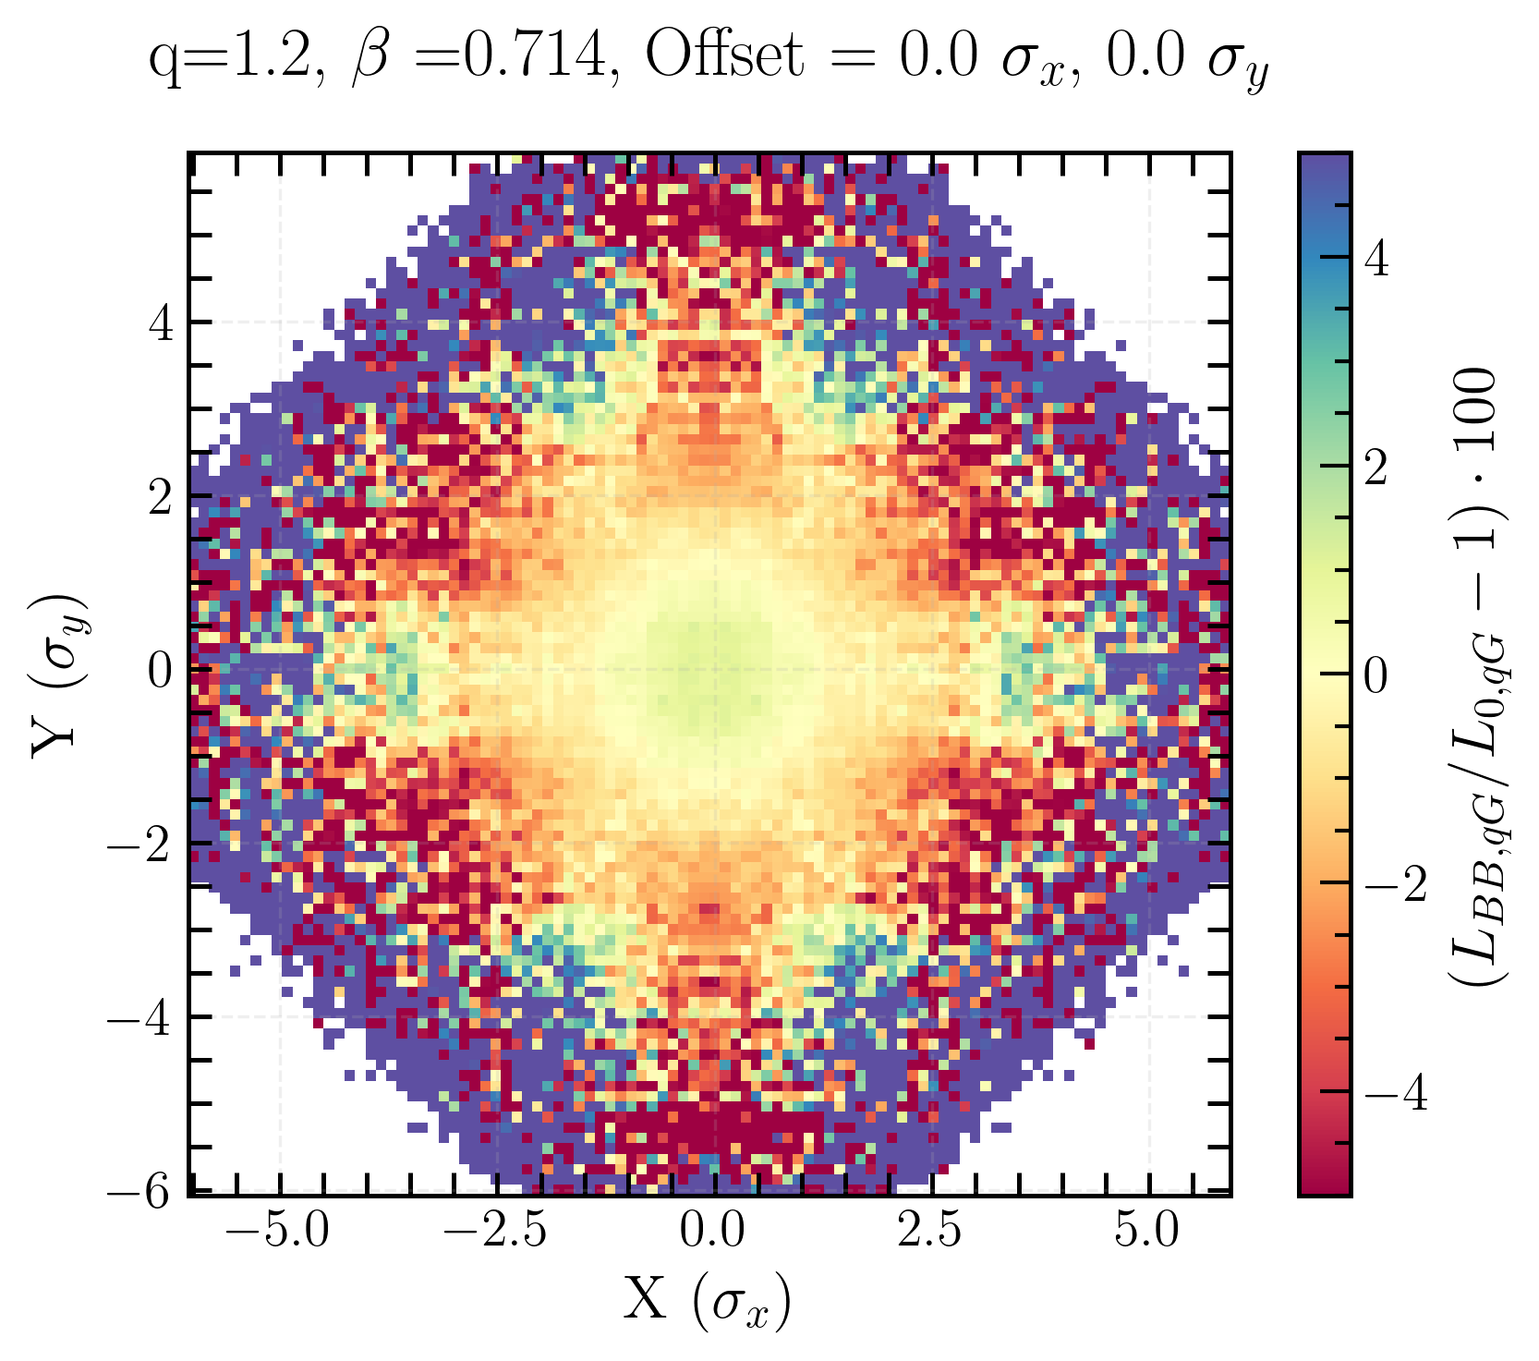
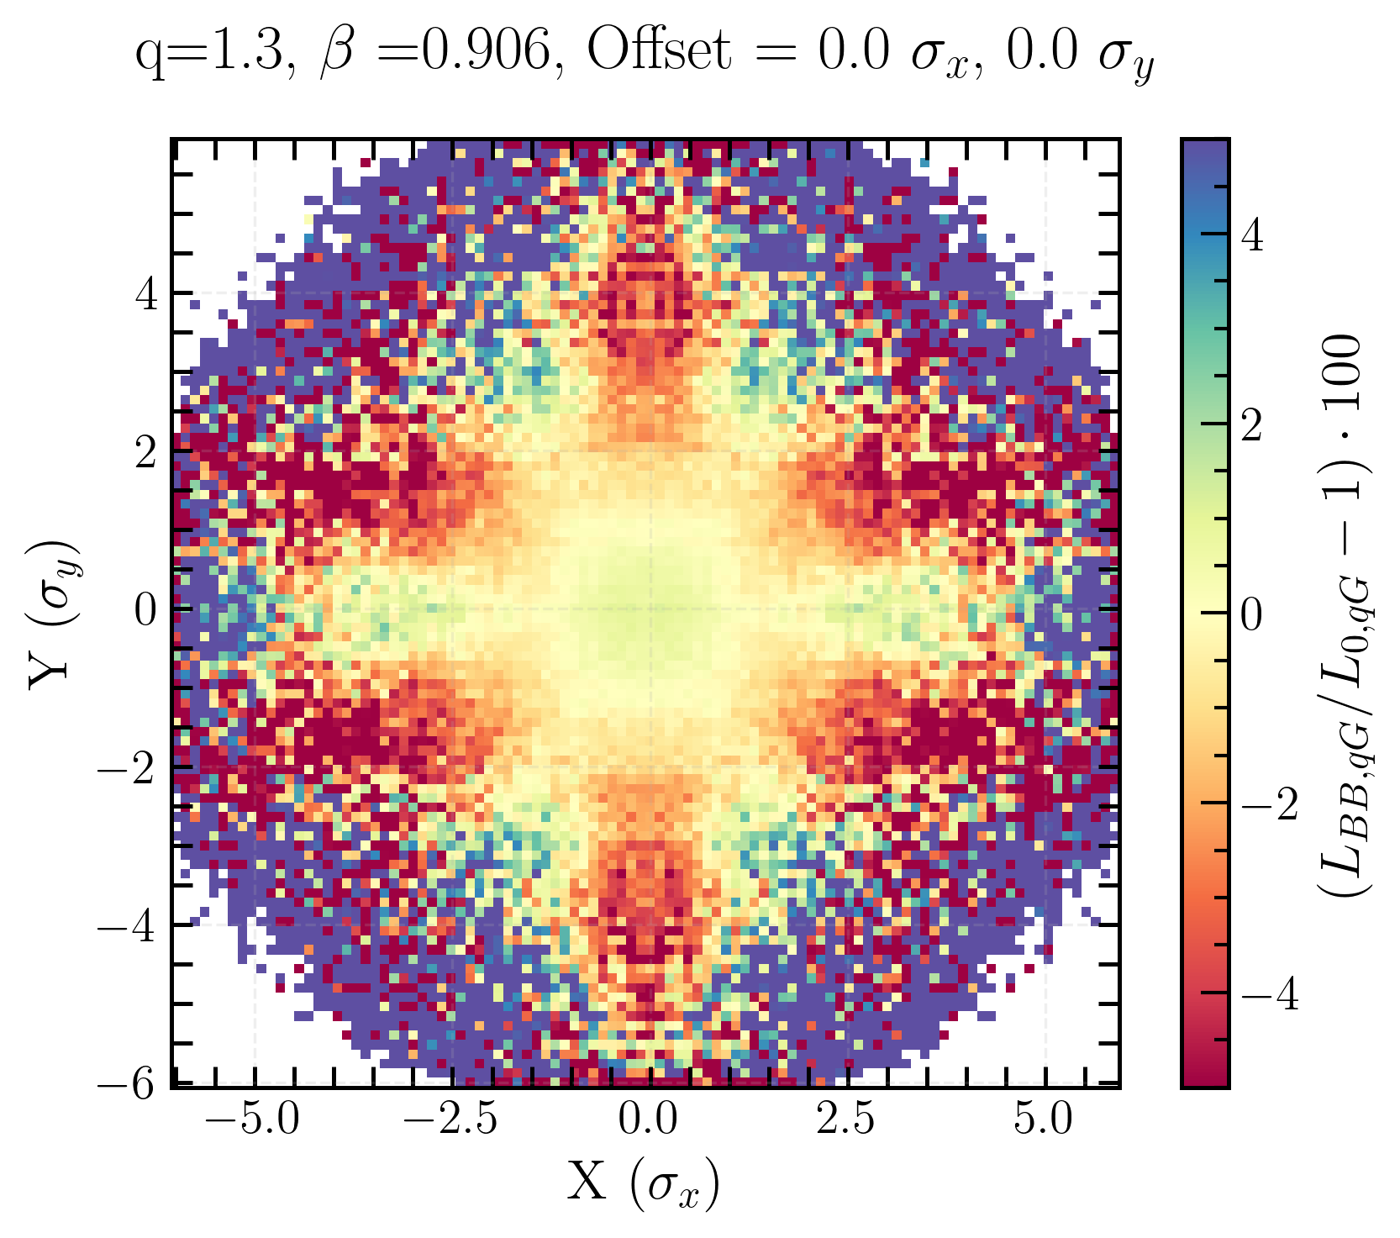
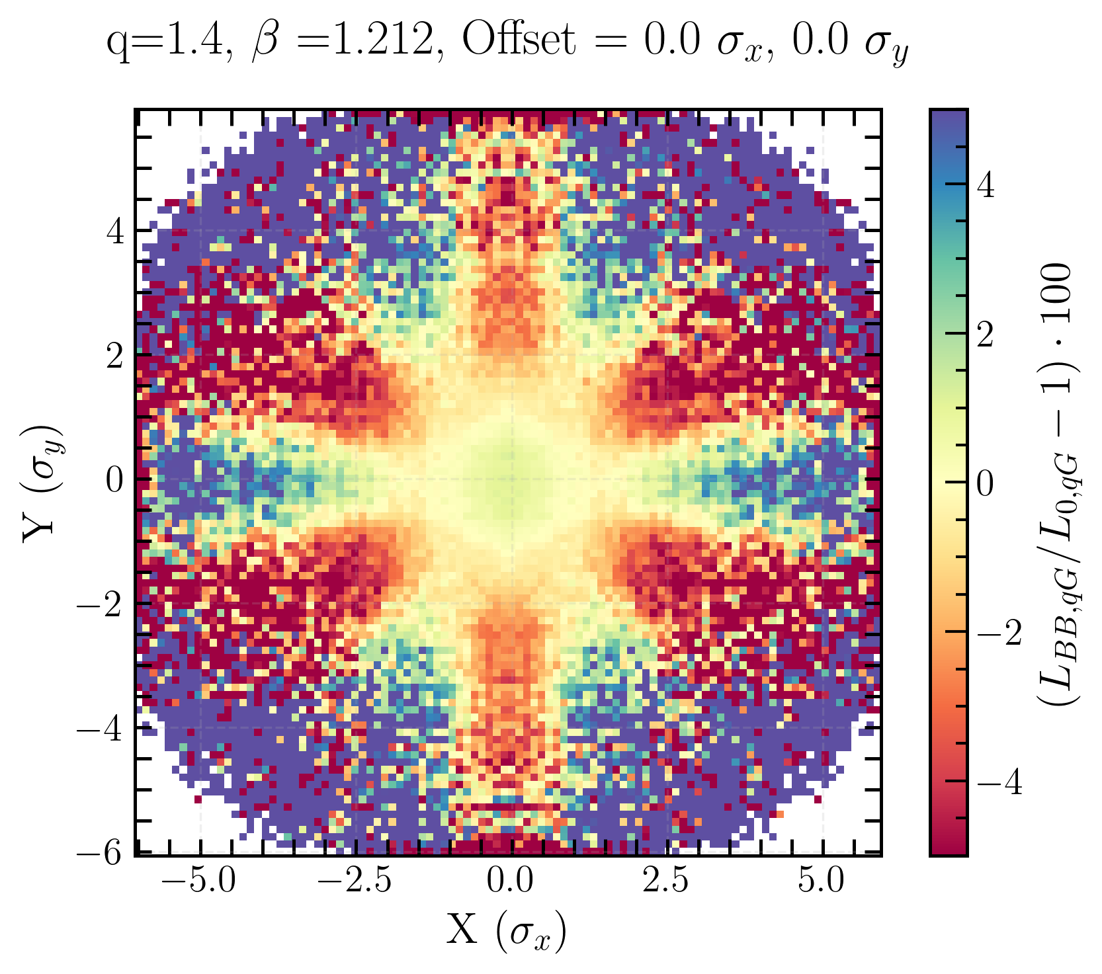
Transverse luminosity distribution for q-Gaussian
beam-beam bias
L_{BB, qG}/L_{0, qG}
strong bias pattern with an hexagonal shape
The higher the q, the sharper the bias distribution
x-y asymmetry coming from Q_{x} and Q_{y}
Linear coupling and beam-beam biases to luminosity calibration measurements in the Large Hadron Collider
Notes:
for Gaussian beams, coherent results with what Lia’s obtained

Slide 24
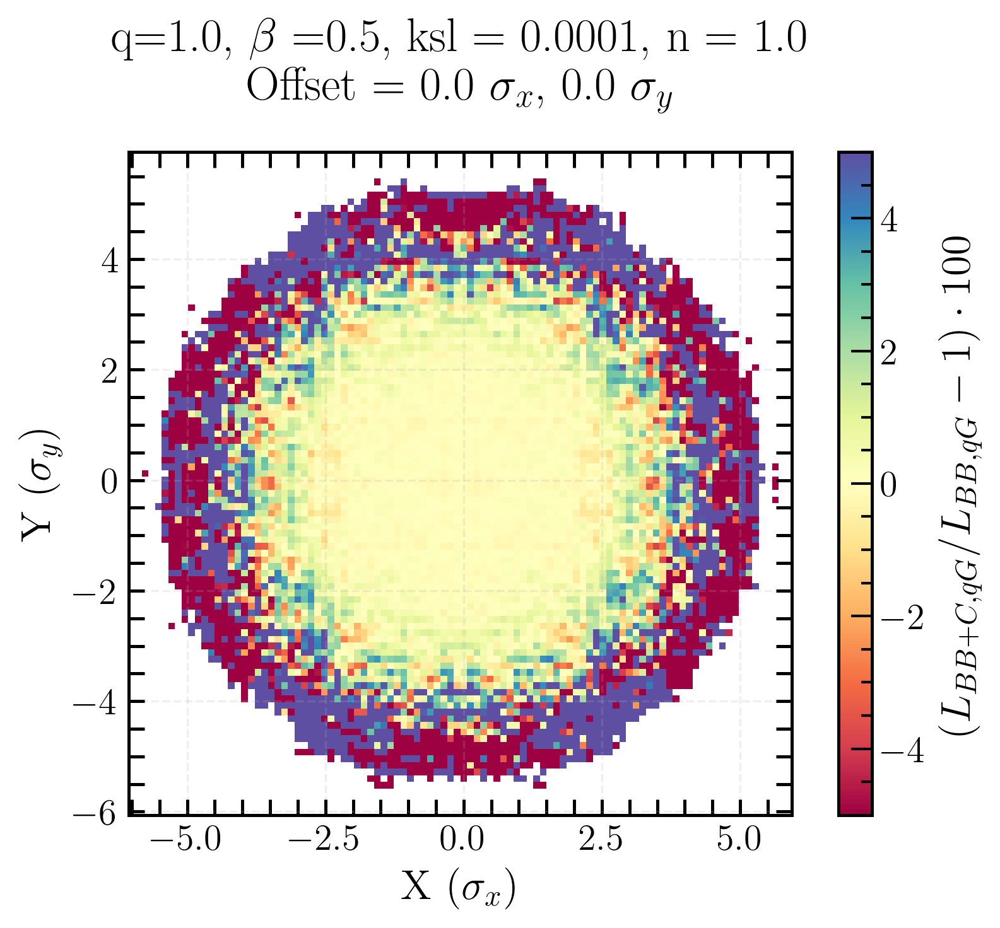
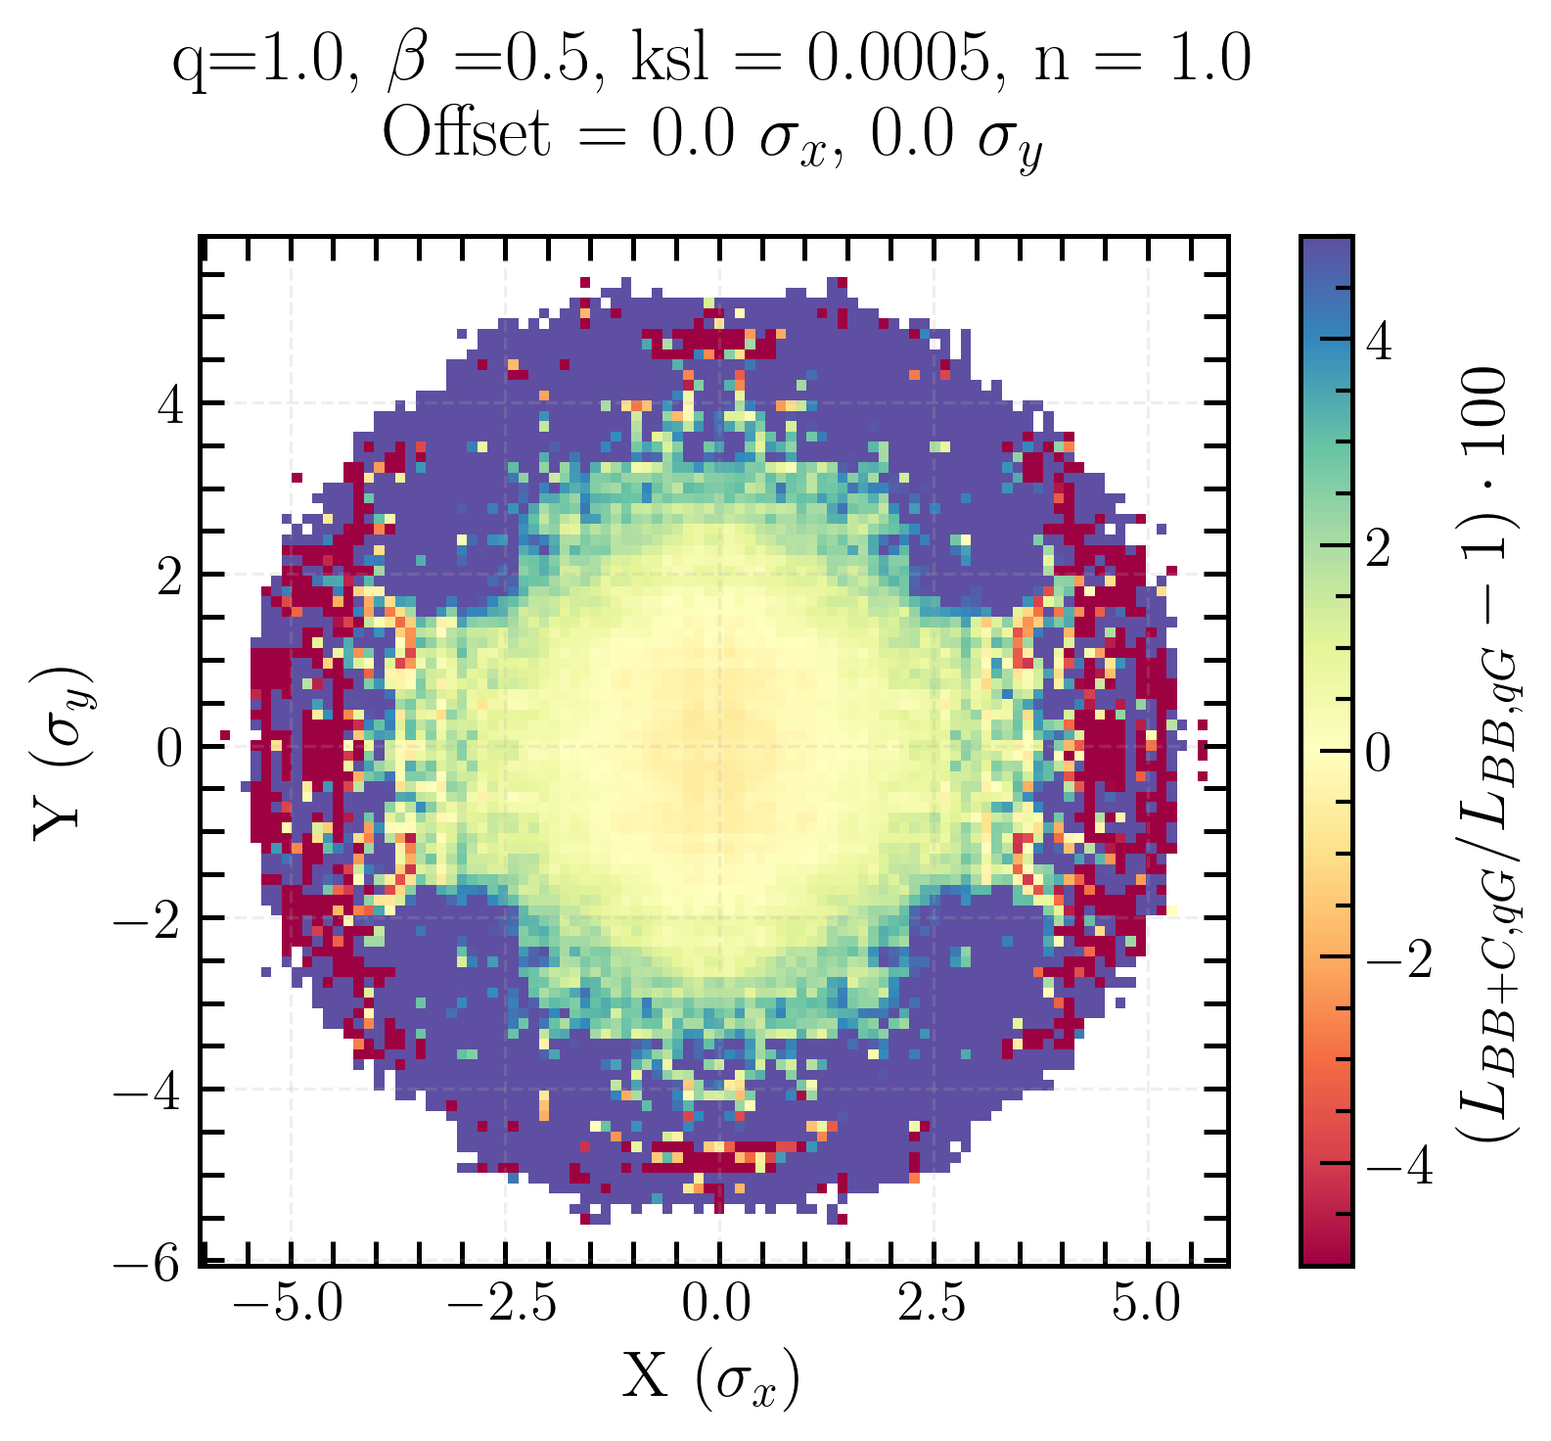
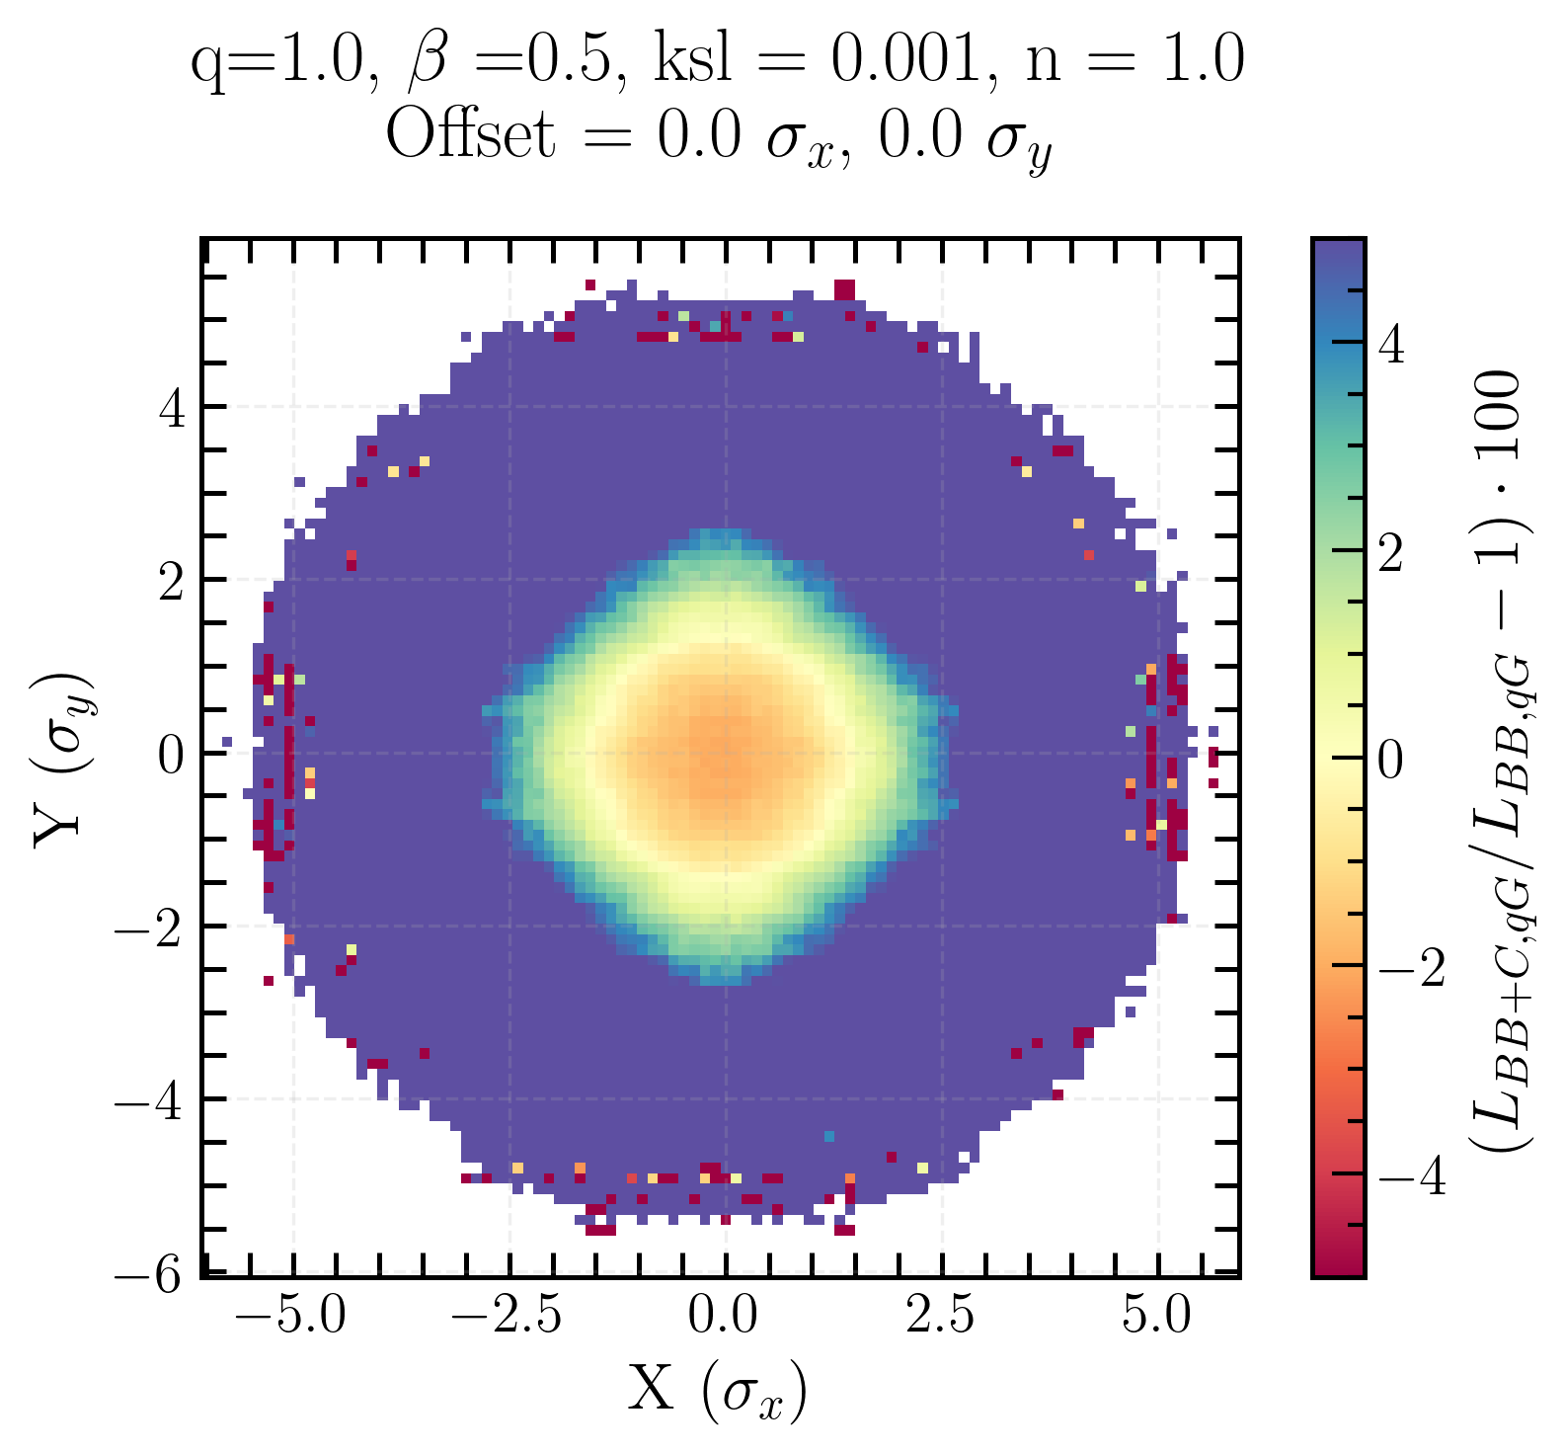
Coupling bias on transverse luminosity distribution for Gaussian beams
With increasing coupling: negative bias in the center and positive bias around
Coupling drives particles out of the center and into the tails
Linear coupling and beam-beam biases to luminosity calibration measurements in the Large Hadron Collider
Notes:
highlight importance of the initial beam distribution for single beam xy-distribution

Slide 25
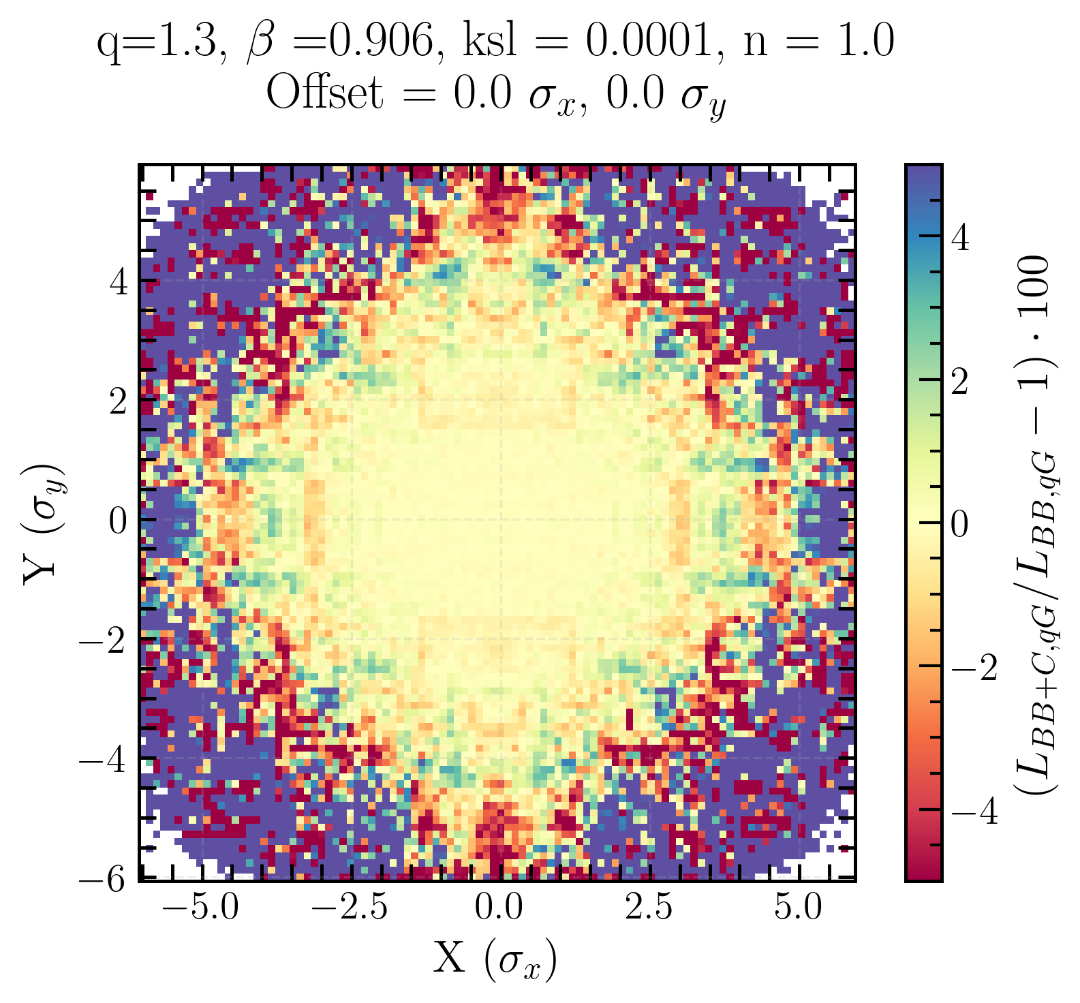
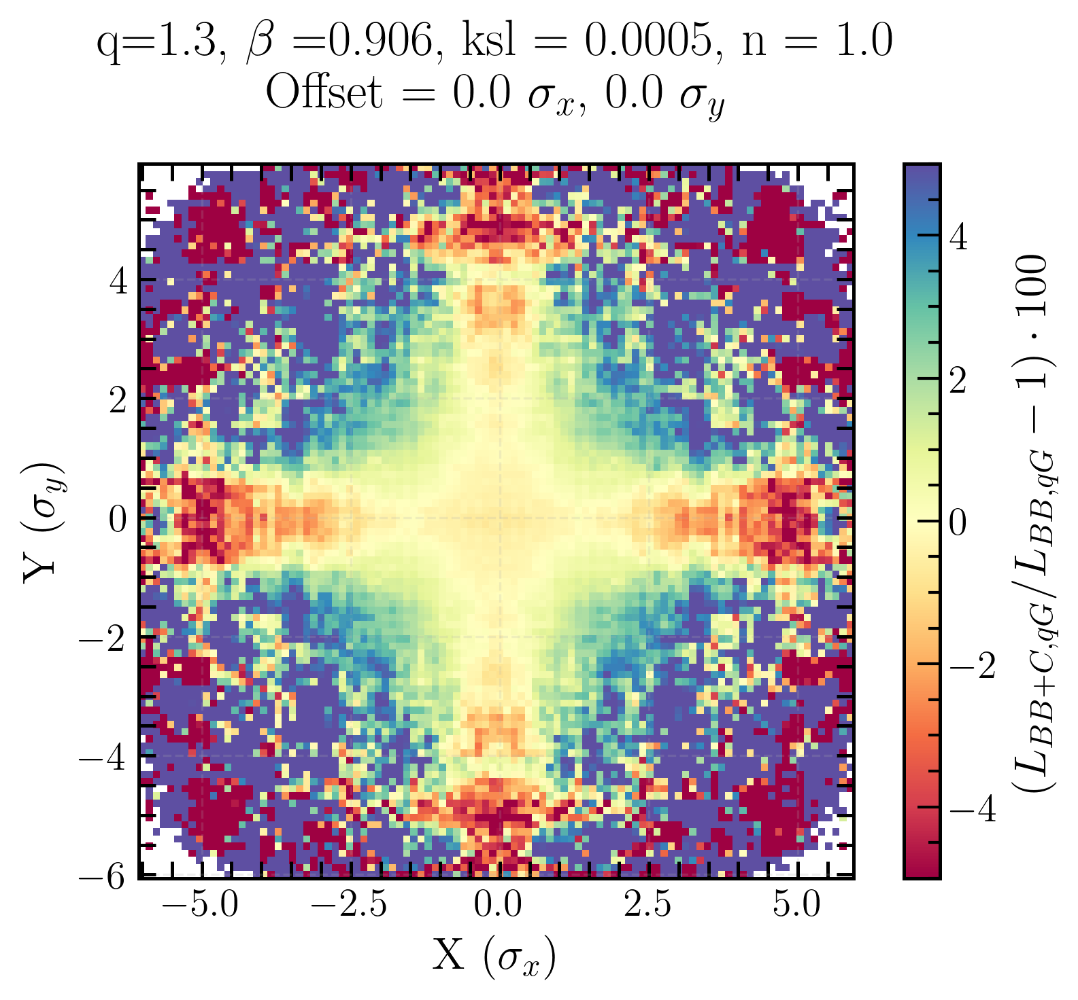
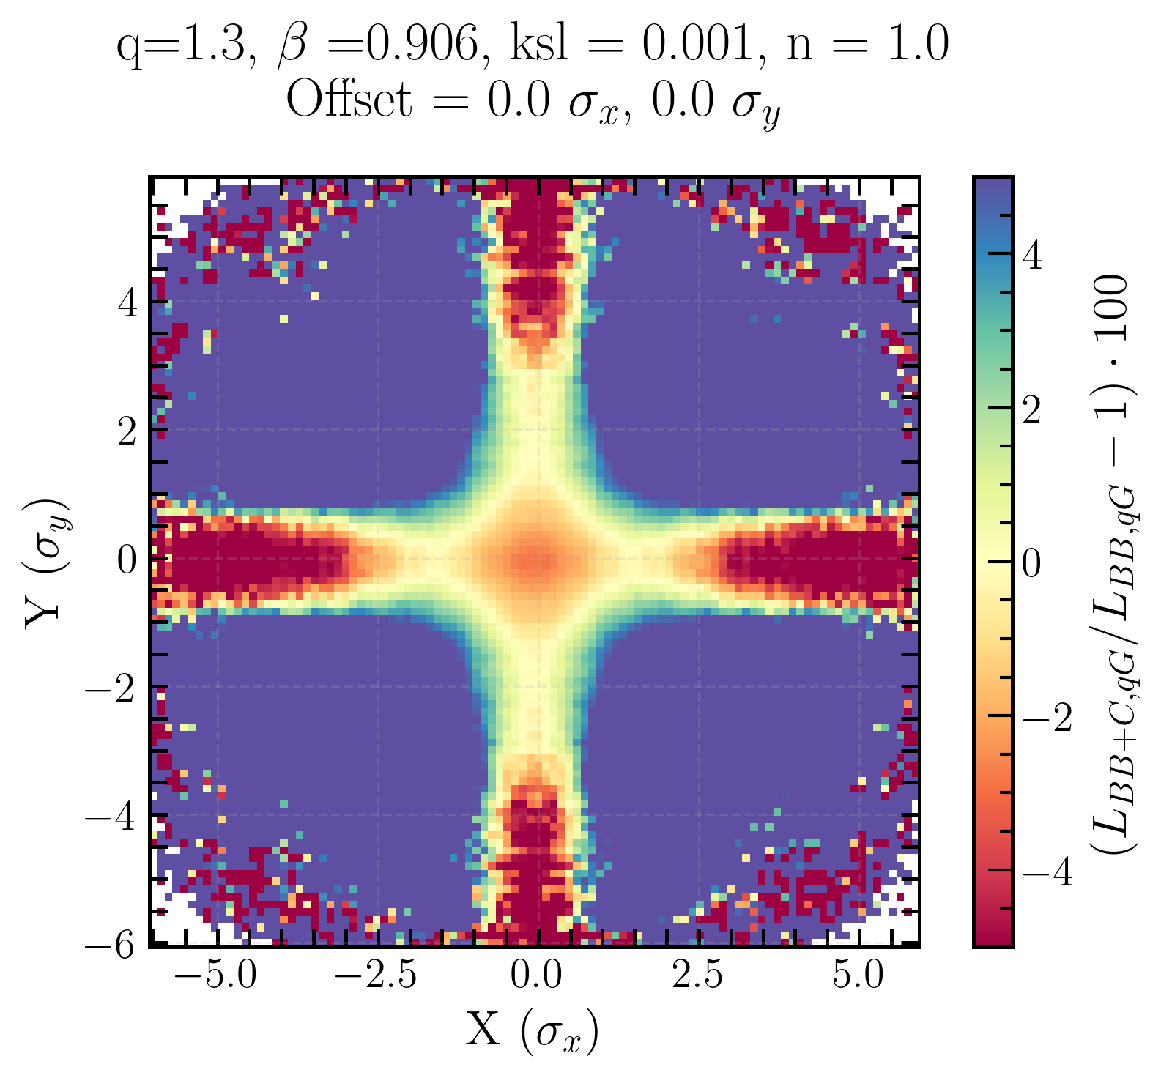
Coupling bias on transverse luminosity distribution for q-Gaussian beams
Initial beam distribution matters → shapes how local coupling deforms the transverse luminosity distribution
Linear coupling and beam-beam biases to luminosity calibration measurements in the Large Hadron Collider

Slide 26
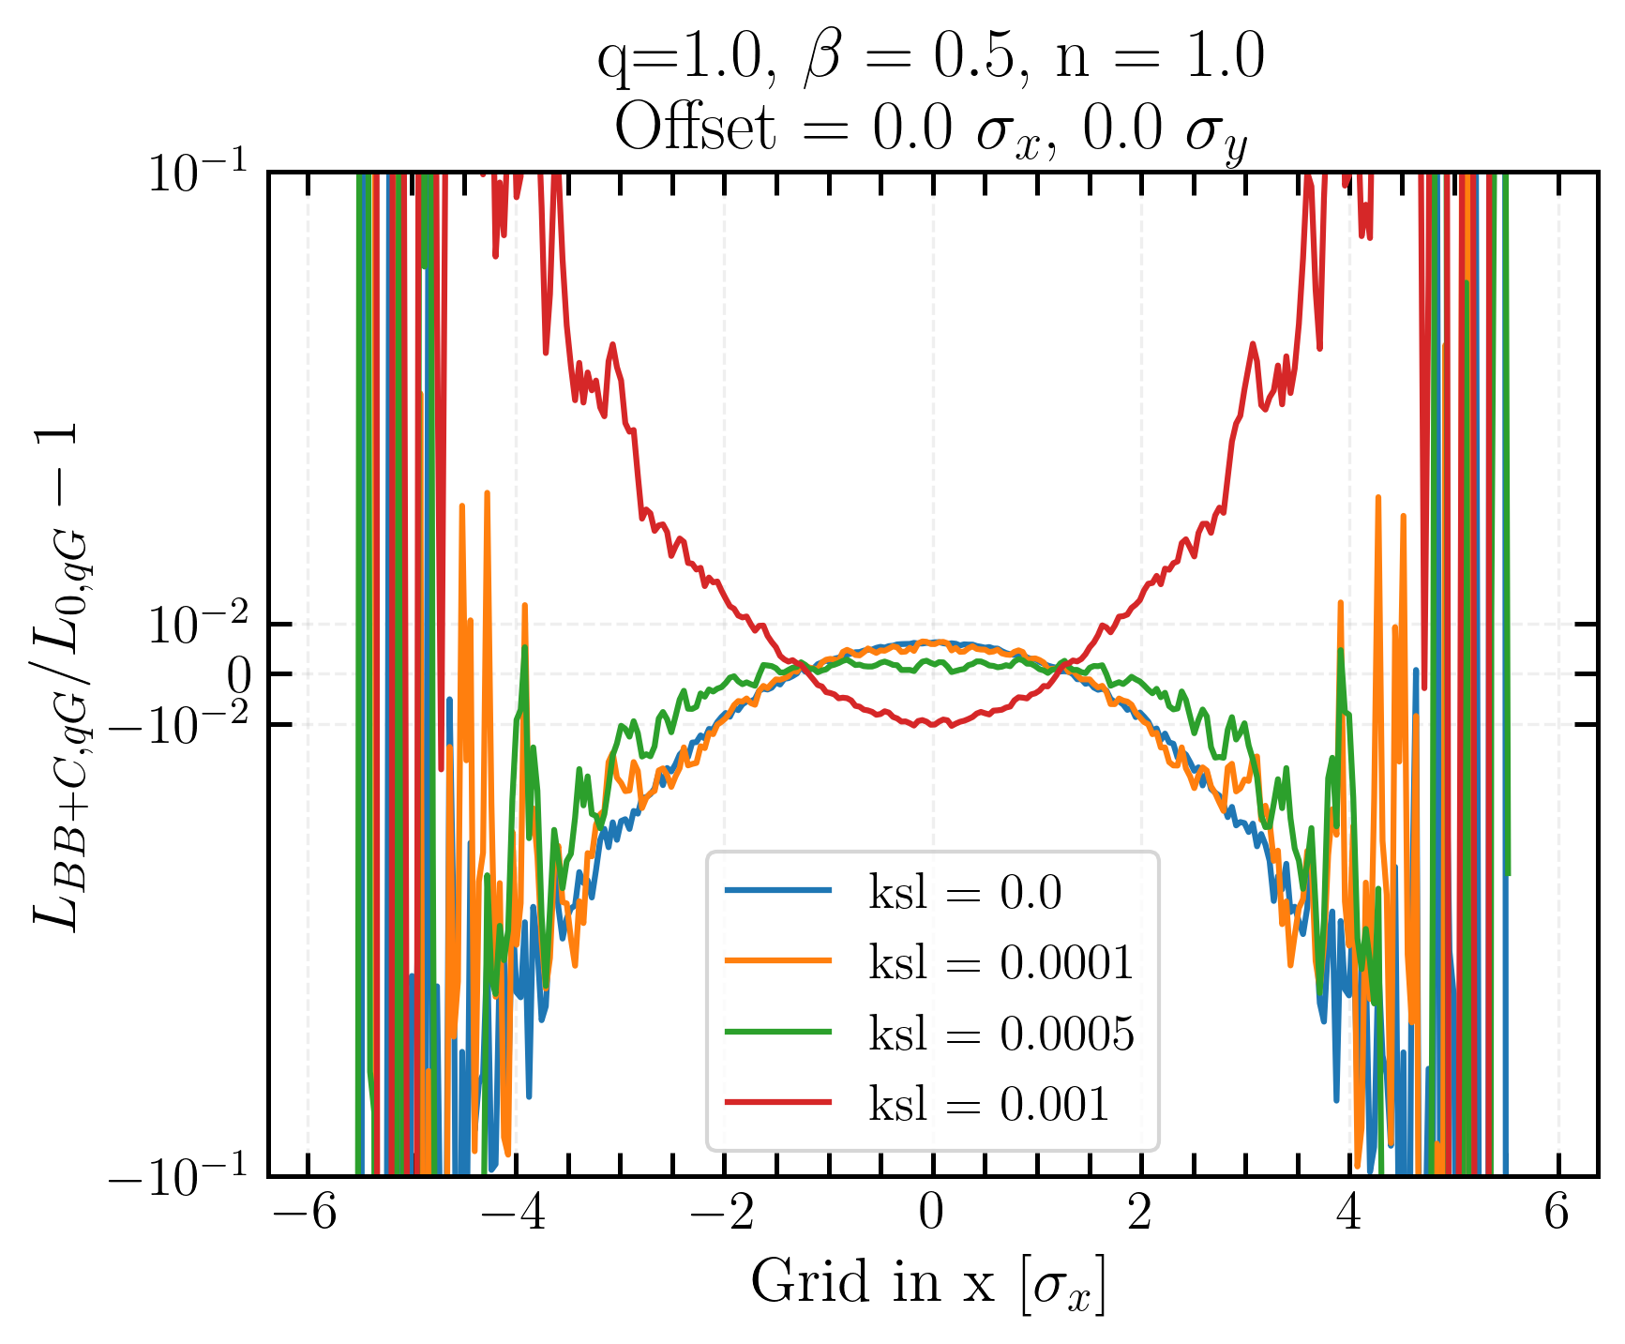
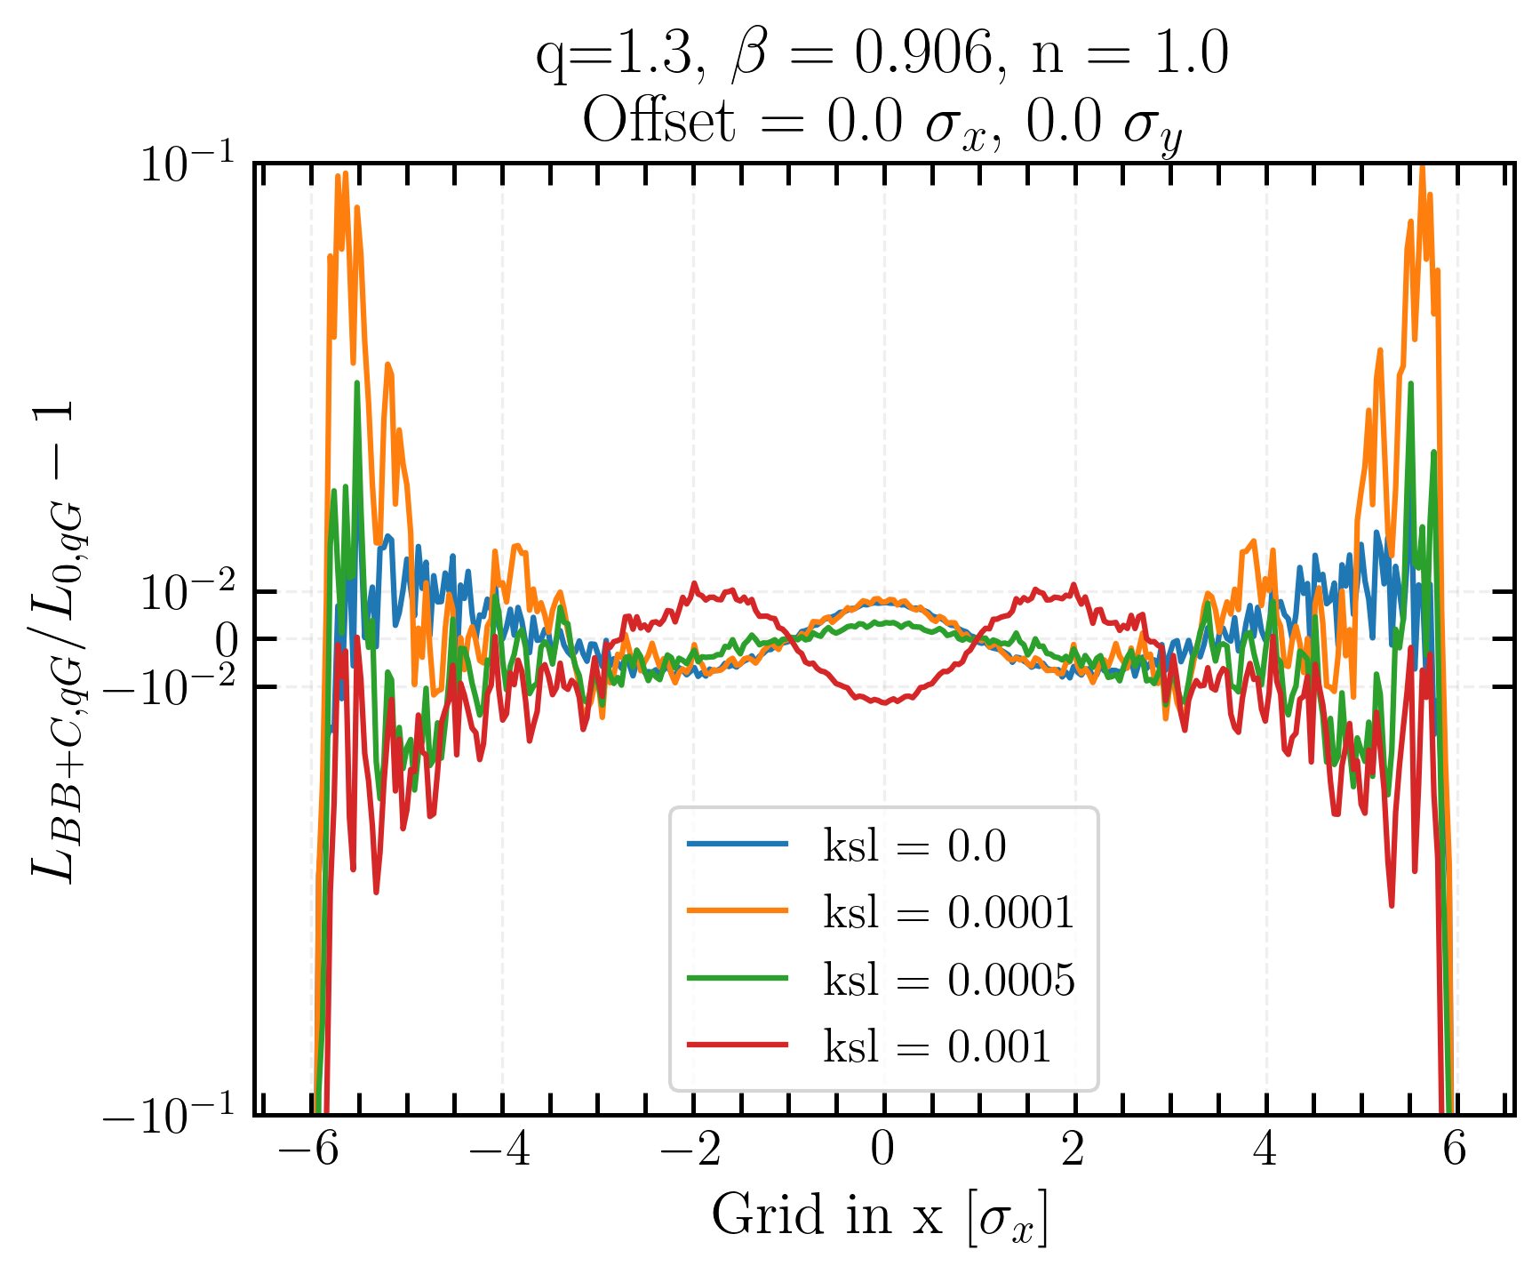
Projected transverse luminosity distribution
BB effect becomes significant for small coupling and increases L in central region
BB and coupling have opposite effects and counteract each other
Q-Gaussian tails give a very different bias respect to Gaussian
Gaussian
q-Gaussian
Linear coupling and beam-beam biases to luminosity calibration measurements in the Large Hadron Collider
Notes:
two bumps in the case of q-Gaussian,

Slide 27
Luminosity and beam-beam biases on 𝝈_{vis}
Linear coupling and beam-beam biases to luminosity calibration measurements in the Large Hadron Collider

Slide 28
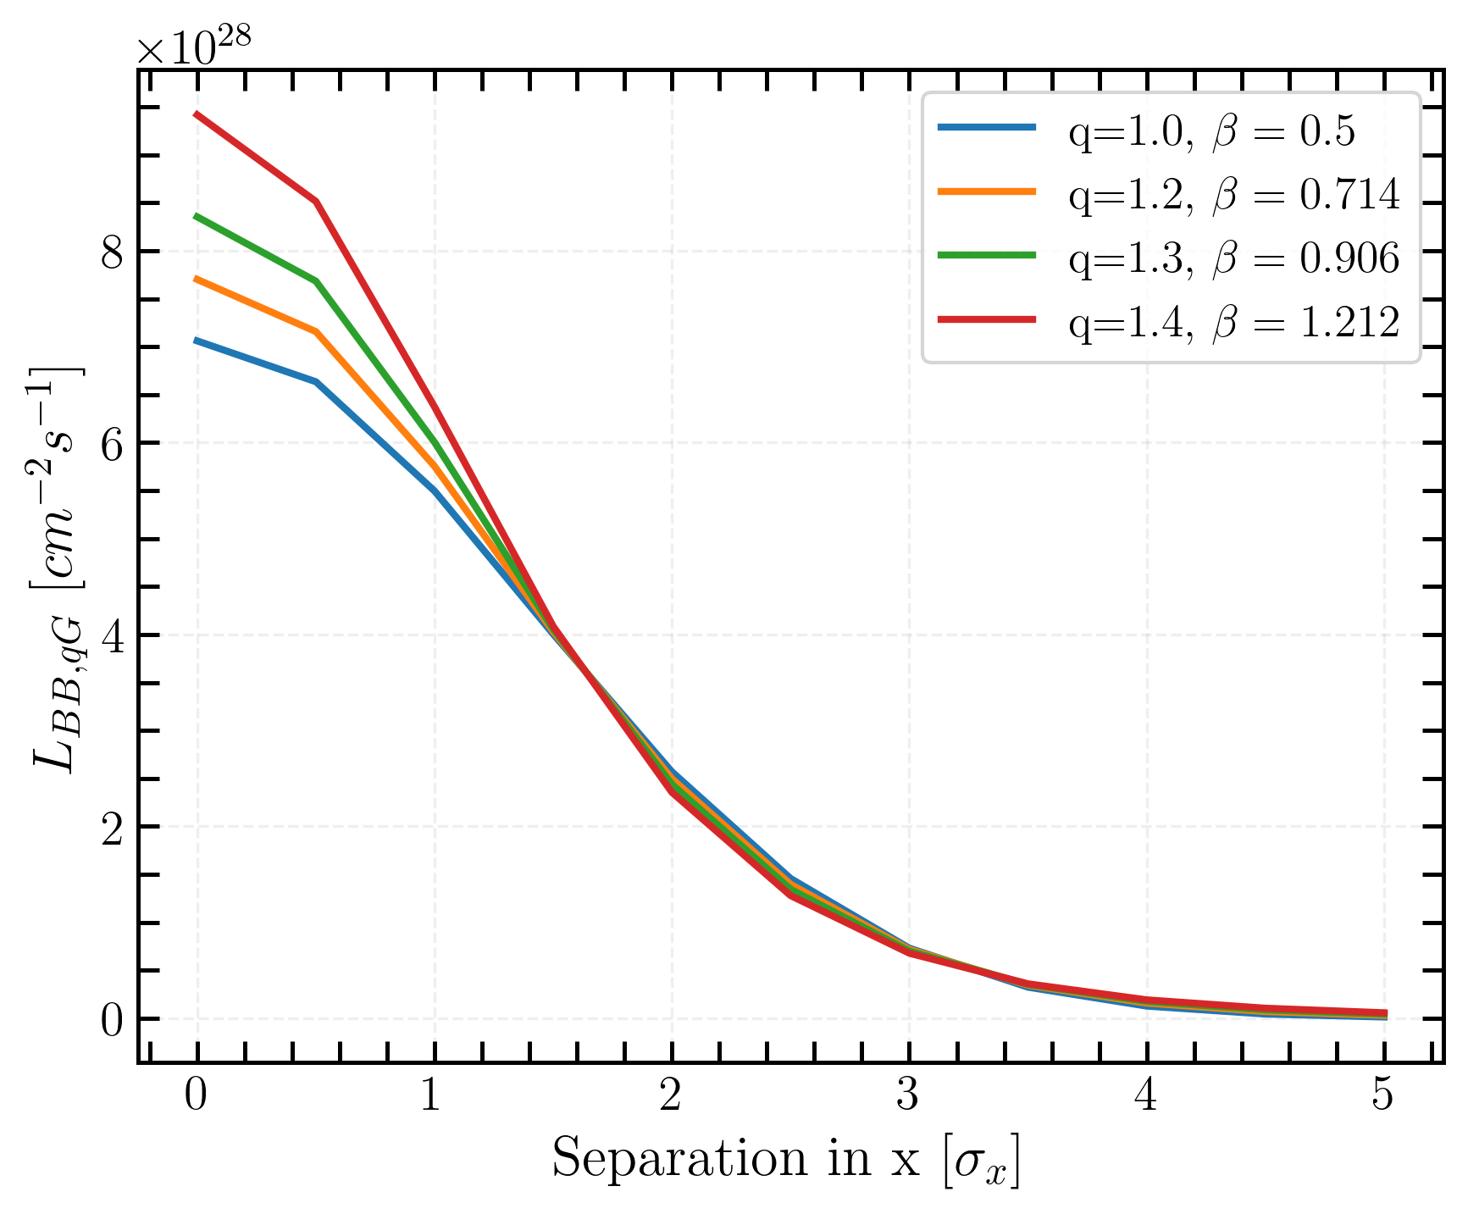
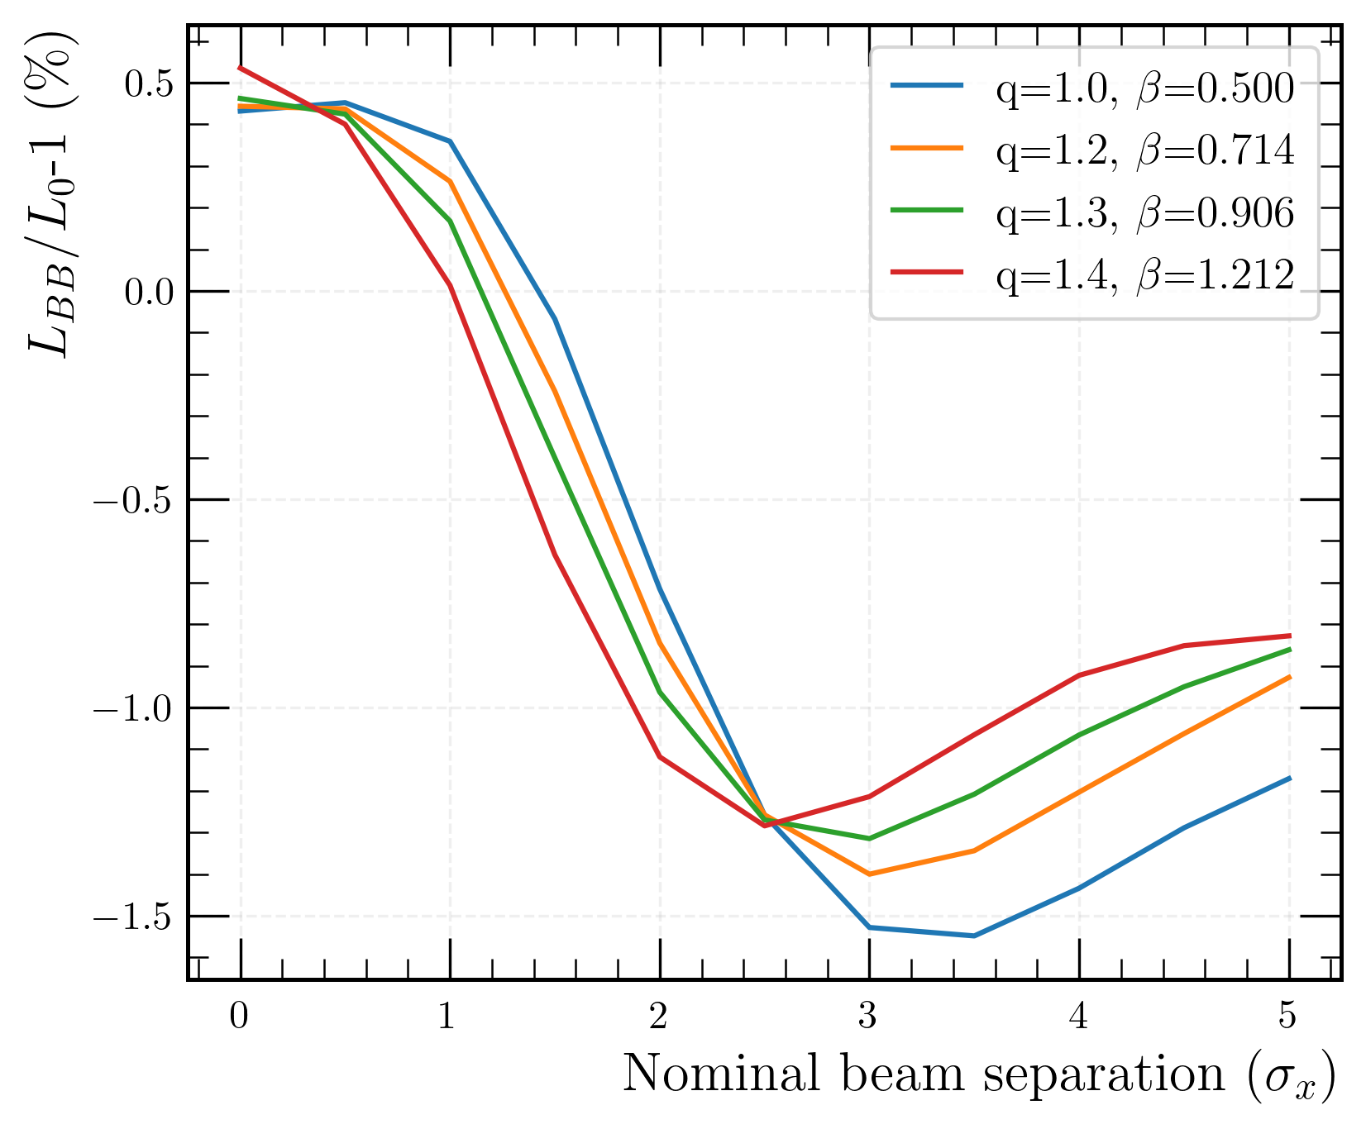
Luminosity for q-Gaussian distribution
beam-beam bias
standard Gaussian
Absolute luminosity with Xsuite numerical integrator for different q-Gaussian distributions
Beam-beam bias of the order of 2%
Positive bias for low separation (under ~ 1.5σ_{x}) and negative bias for high separation
Linear coupling and beam-beam biases to luminosity calibration measurements in the Large Hadron Collider
Notes:
30% in luminosity was measured for two different q-Gaussian distributions when
considering head-on collisions

Slide 29
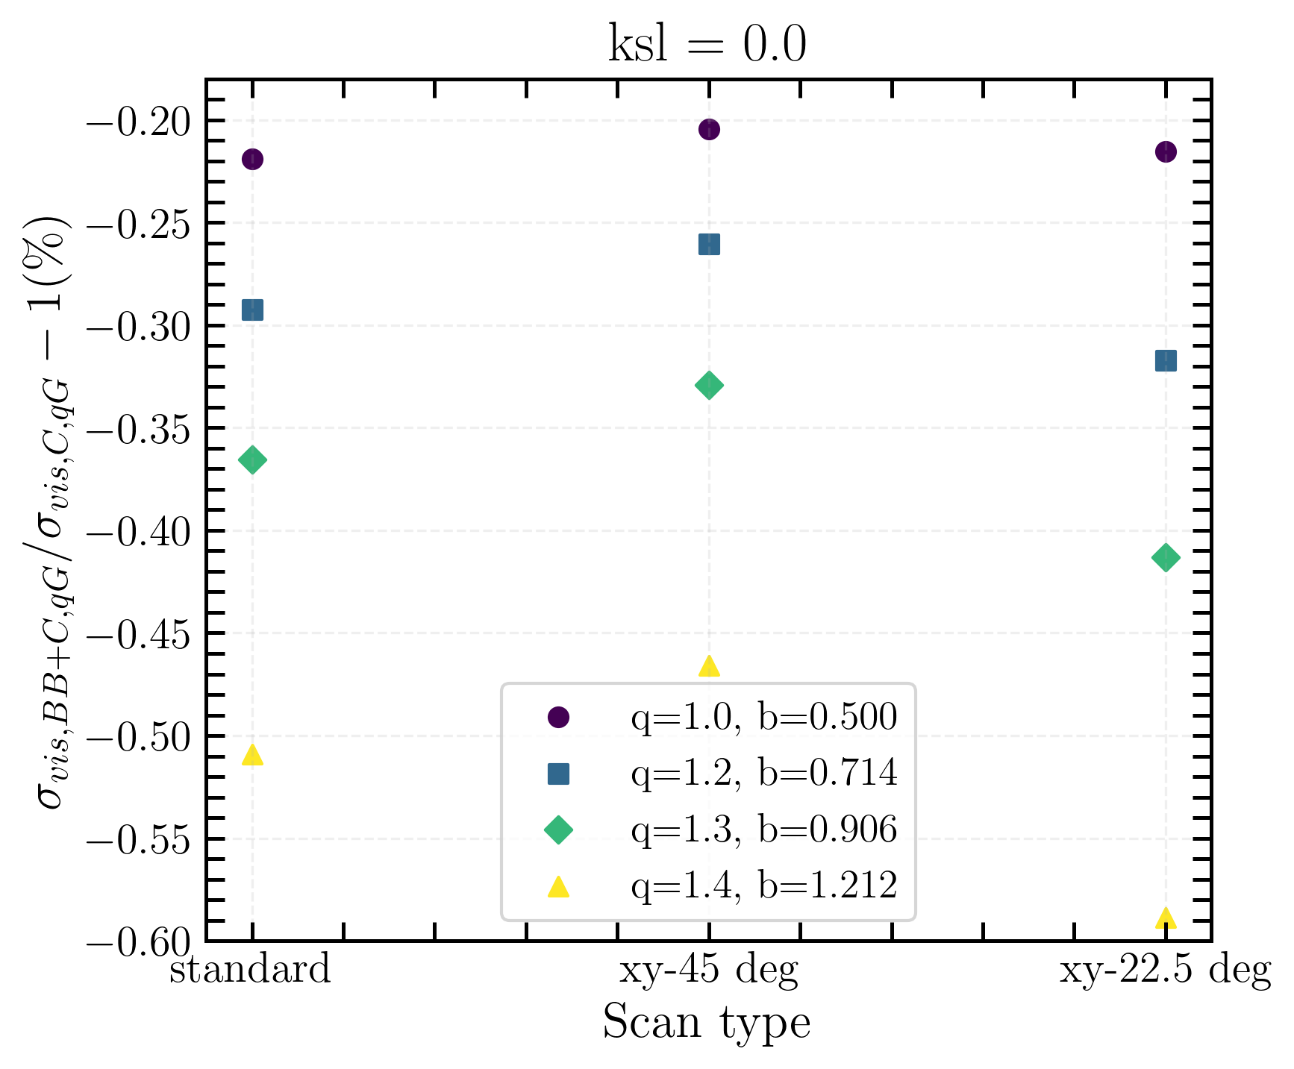
Beam-beam bias on 𝝈_{vis}
standard Gaussian
-0.2 % bias due to beam-beam for Gaussian beams under typical vdM scans
Very little difference between two different types of scan
Biggest impact on the bias comes from the distribution
( -0.6% for q = 1.4, β = 1.212)
→ Next step : computation of coupling biases on 𝝈_{vis}
Linear coupling and beam-beam biases to luminosity calibration measurements in the Large Hadron Collider
Notes:
Next step coupling bias on sigma_vis

Slide 30
Towards more realistic conditions…
Linear coupling and beam-beam biases to luminosity calibration measurements in the Large Hadron Collider

Slide 31
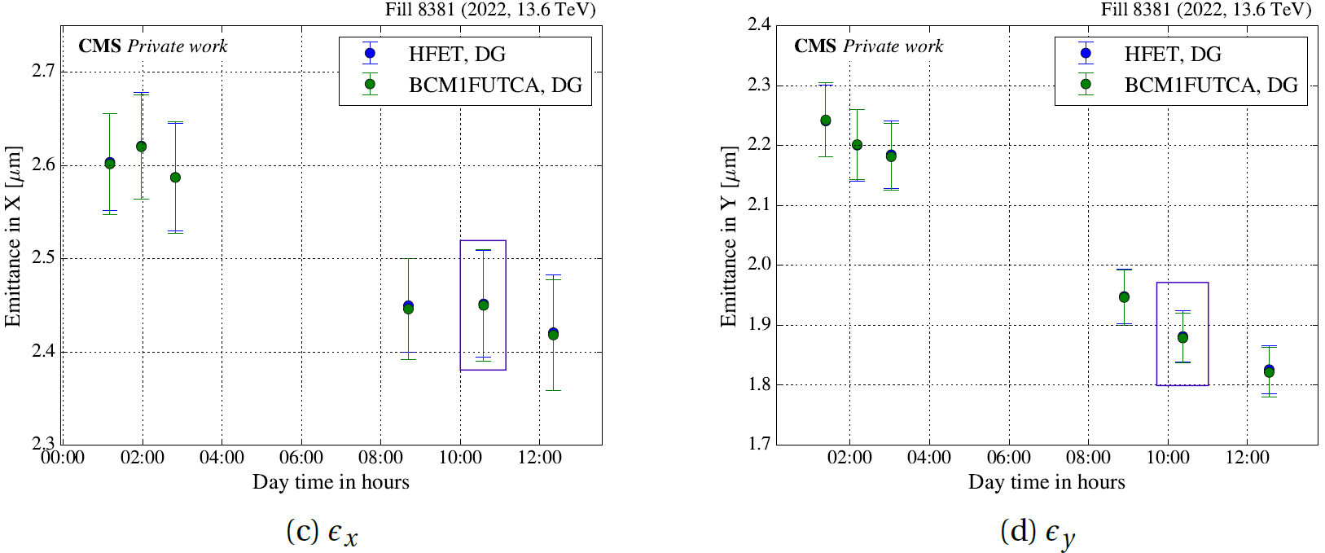
Reproducing fill 8381
Transverse beam emittances during vdM session in fill 8381, as measured by the CMS luminometers [8] :
simulated values
Adding some asymetries to the beam
Q-Gaussian with q=1.3
Local linear coupling ksl = 5 · 10⁻³ m⁻²
Linear coupling and beam-beam biases to luminosity calibration measurements in the Large Hadron Collider
Notes:
during vdM fills, as time passes, the beam becomes flatter with time due to synchrotron radiation. To better understand the implication of the shrinkage of the emittances, simulations have been conducted.
- Adding some asymetries in the beam
Q = 1.3 (one that is the closest to the beams distributions)
Linear local coupling

Slide 32
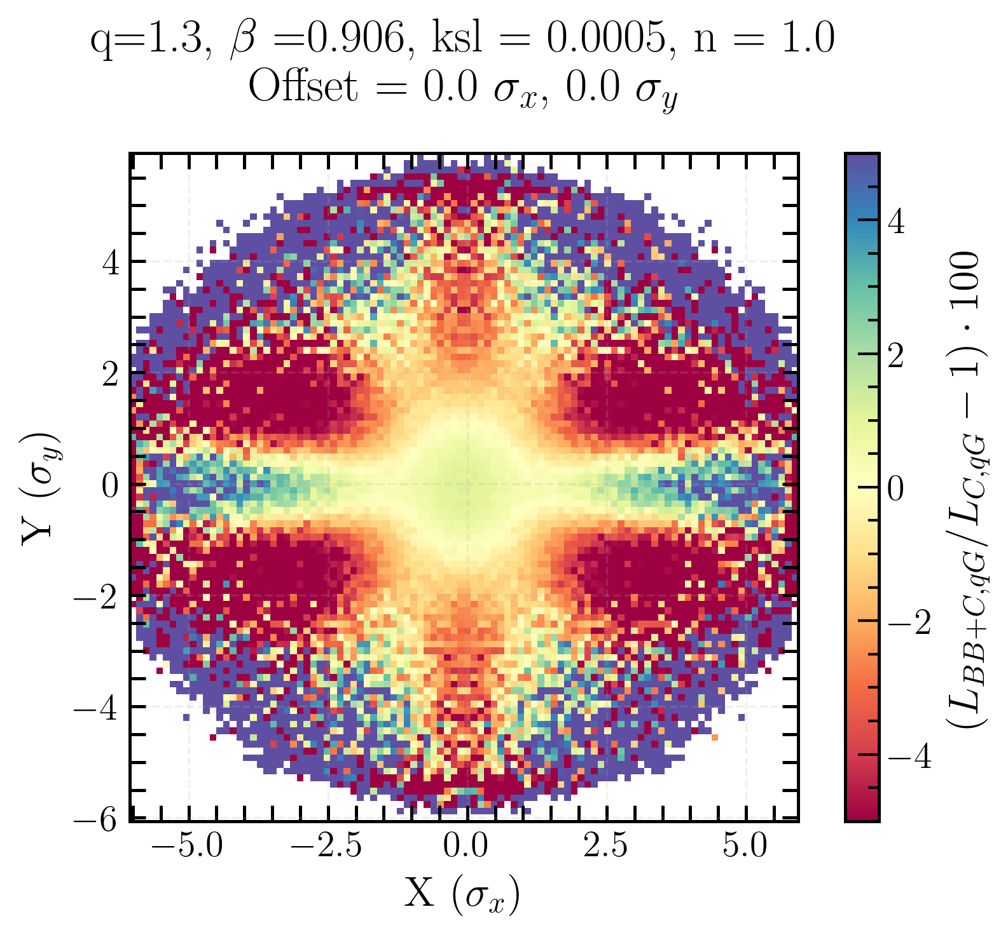


Transverse luminosity distribution biases for q-Gaussian beams
Beam-beam bias
Local coupling bias
Beam-beam+local coupling bias
Opposing effects of coupling and beam-beam are apparent
Beam-beam has a stronger effect than coupling in central region
Linear coupling and beam-beam biases to luminosity calibration measurements in the Large Hadron Collider
Notes:
in beam-beam + coupling

Slide 33
Conclusion
First characterization of the impact of beam-beam interactions and linear coupling on the transverse luminosity density, luminosity, and σ_{vis}
→ characterize and quantify
Preliminary studies on q-Gaussian distribution effects :
  Initial beam distribution matters → shapes how local coupling and beam-beam deform the transverse luminosity density
  Strong bb-bias with an hexagonal shape
Linear coupling preliminary studies :
  Modelling with local and local+global effects, qualitative study on luminosity
  Coupling drives particles out of the center and into the tails, introducing a tilt in the distribution
Beam-beam :
  effects of ~2% for Gaussian beams on luminosity, even smaller for q-Gaussian
  Squeezes particles into the center of the beam
σ_{vis} :
  Beam-beam bias up to -0.2% for Gaussian beams and up to -0.6% for q-Gaussian beams under typical vdM scan conditions
Linear coupling and beam-beam biases to luminosity calibration measurements in the Large Hadron Collider

Slide 34
Questions ?

Slide 35
References
[1] C. Zhang, “Impact of beam-beam effects and linear coupling resonance on the absolute luminosity calibration at the CERN Large Hadron Collider”, Master’s thesis, Imperial College London, 2024.
[2] M. Fitterer et al. “Effect of a Resonant Excitation on the Evolution of the Beam Emittance and Halo Population”. Technical Report CERN-ACC-NOTE-2017-0037. Geneva: CERN, 2017. https://cds.cern.ch/record/2264616.
[3] H. Timko et al. “Operational and Beam Dynamics Aspects of the RF System in 2016”. In: Proceedings of the 7th Evian Workshop on LHC Beam Operation. Evian-les-Bains, 2016, p. 193. https://cds.cern.ch/record/2293532.
[4] F. Soubelet et al., “First Interaction Region Local Coupling Corrections in the LHC Run 3,” Proceedings of IPAC2022, Bangkok, Thailand, juin 2022, pp. 1838–1841.
[5] R. Thomas, “Linear Imperfections”, CAS Lecture, 2016
[6] Private communications
[7] A. Babaev et al. “Impact of beam-beam effects on absolute luminosity calibrations at the CERN Large Hadron Collider”. The European Physical Journal C 84.1 (Jan. 2024) http://dx.doi.org/10.1140/epjc/s10052-023-12192-5.
[8] J. Wanczyk. “Precision luminosity measurement at hadron colliders”. PhD thesis. EPFL, May 2024.
[9] L. Lammert, ‘’Interplay of local linear coupling and beam-beam effects on luminosity in the LHC’’, Specialisation Semester Report, EPFL.
Linear coupling and beam-beam biases to luminosity calibration measurements in the Large Hadron Collider

Slide 36
Back-up slides
Linear coupling and beam-beam biases to luminosity calibration measurements in the Large Hadron Collider

Slide 37
Outlook…
Beyond soft-Gaussian beam-beam
  Implement self-consistent beam–beam force models
  Compare with Particle-In-Cell (PIC) simulations
  → Validate beam–beam treatment and quantify modeling biases
Modeling the full LHC complexity
  Include all four experiments (CMS, ATLAS, LHCb, ALICE)
  → Account for asymmetric optics, crossing angles, and lattice features
Beam distribution studies
  Extend to light-tailed q-Gaussians (q < 1)
  → Probe the influence of core-dominated beams on luminosity and σ_{vis}
Toward experimental validation
  Propose dedicated vdM scans and coupling configurations
  → Measure impact of non-Gaussian beams and local/global coupling
  → Bridge toward operational tools for luminosity calibration
  All these effects are weak (machine setup a in vdM), what about physics fills?
Linear coupling and beam-beam biases to luminosity calibration measurements in the Large Hadron Collider

Slide 38

Single q-Gaussian beam xy-distribution bias, with offset
Linear coupling and beam-beam biases to luminosity calibration measurements in the Large Hadron Collider

Slide 39

Simulations setup conditions
Linear coupling and beam-beam biases to luminosity calibration measurements in the Large Hadron Collider

Slide 40

x-axis scan with associated resulting change of p_{x} along the x-axis and tune footprint for Gaussian beams
Linear coupling and beam-beam biases to luminosity calibration measurements in the Large Hadron Collider

Slide 41

y-axis scan with associated resulting change of p_{x} along the x-axis and tune footprint for Gaussian beams
Linear coupling and beam-beam biases to luminosity calibration measurements in the Large Hadron Collider

Slide 42

Diagonal scan with associated resulting change of p_{x} along the x-axis and tune footprint for Gaussian beams
Linear coupling and beam-beam biases to luminosity calibration measurements in the Large Hadron Collider

Slide 43

Biases on 𝝈_{vis} for a Gaussian beam
Linear coupling and beam-beam biases to luminosity calibration measurements in the Large Hadron Collider

Slide 44




Beam-beam bias on transverse luminosity density with inverted tune values (Qx, Qy) = (60.32, 62.31)
Linear coupling and beam-beam biases to luminosity calibration measurements in the Large Hadron Collider

Slide 45


BB bias of projected transverse luminosity distribution for q-Gaussian beams
Here again, x-y asymmetry coming from the different tune values
Beam-beam manifests itself by increasing the luminosity in the center region
Linear coupling and beam-beam biases to luminosity calibration measurements in the Large Hadron Collider

