Slide 1
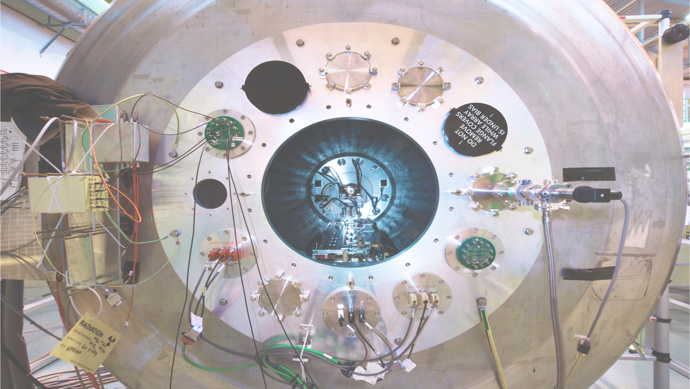





Reactions with radioactive ion beams at the ISOLDE Solenoidal Spectrometer
Liam Gaffney
University of Liverpool
Solenoidal Spectrometer Workshop
Santiago de Compostela, Spain
09-12/12/2025
1
Notes:
1

Slide 2
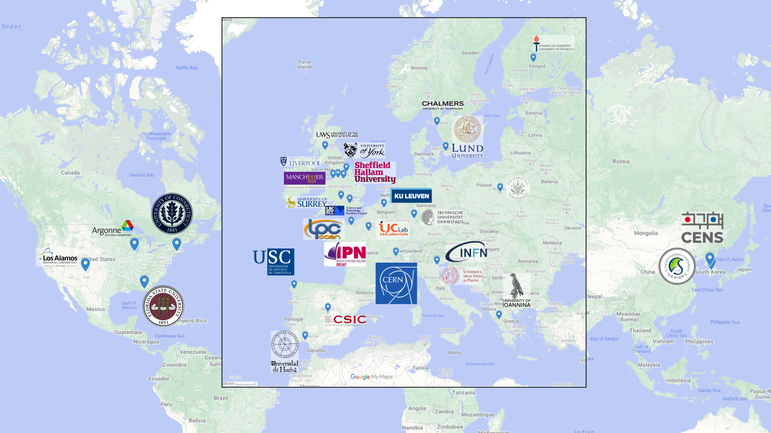








ISS operation so far
Fully commissioned in 2021, with 21 radioactive beam times up to LS3
Users from 30+ institutions, in 12 countries participated in experiments so far…
11 institutions, are signatories of the MoU

Slide 3

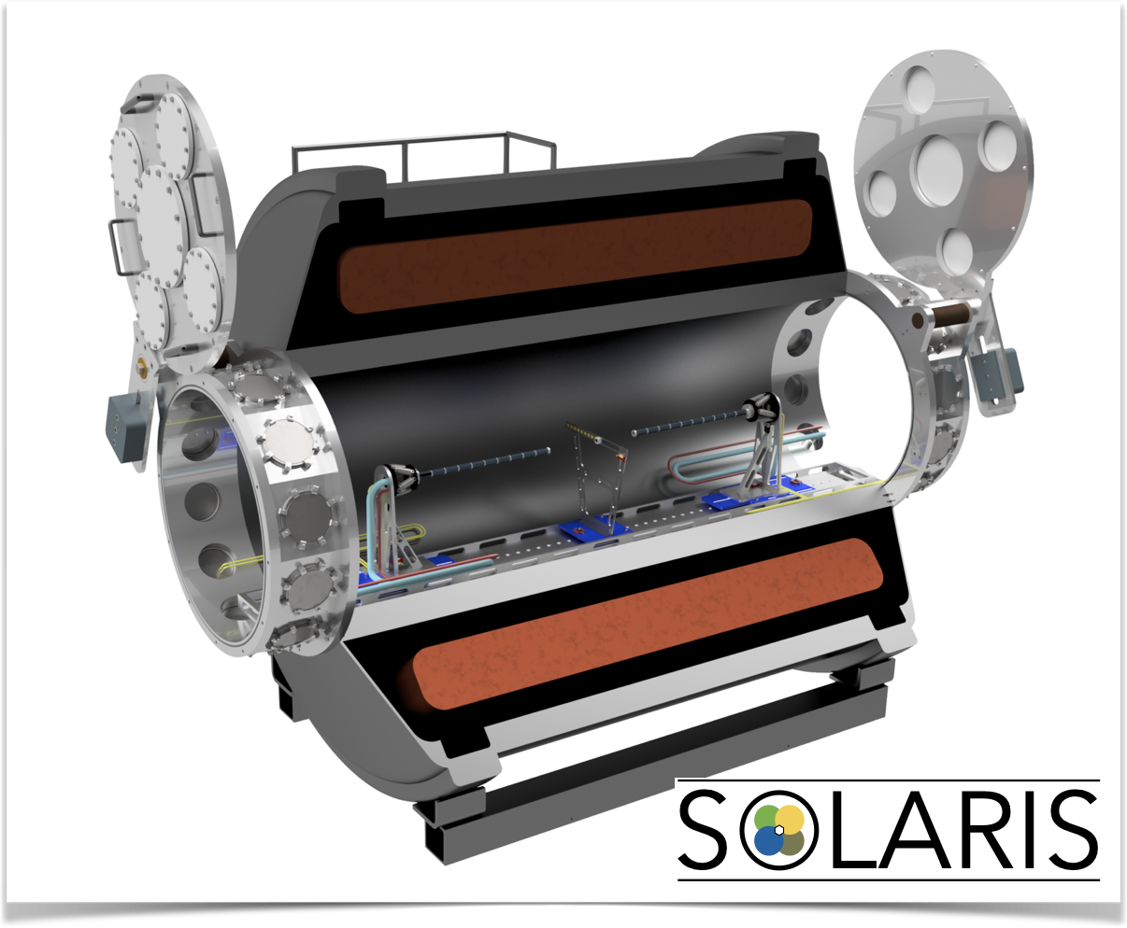
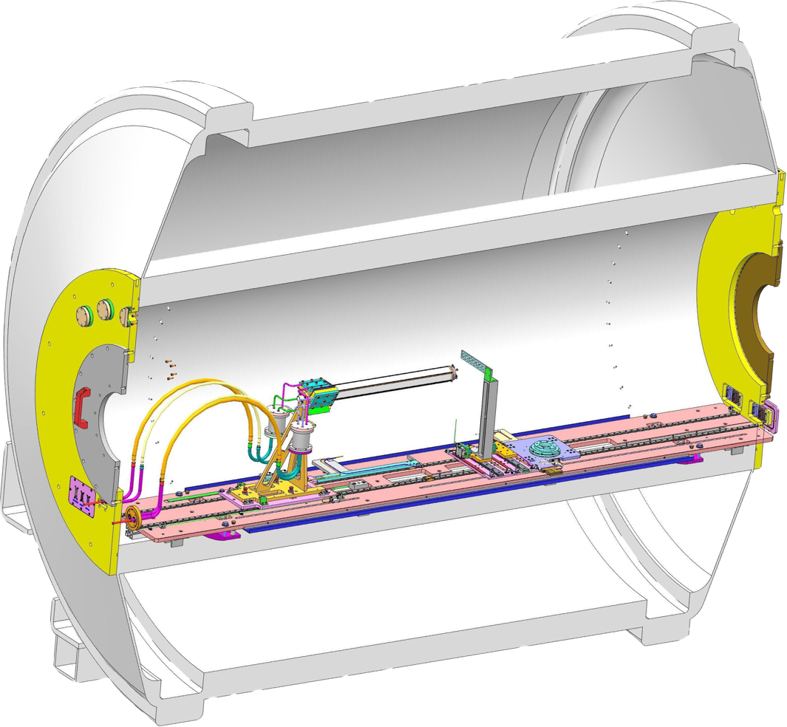

Solenoidal spectrometers around the world
HELIOS@Argonne
ISS@ISOLDE
SOLARIS@FRIB
“The pioneer” from 2008.
Stable beams, RAISOR and CARIBU.
3T MRI magnet.
Resistive-division Si array.
Since 2018 (LS2 2019-2021).
Post-accelerated ISOL beams.
Energies up to ~10 MeV/u.
Pre-LS2 with HELIOS on-axis array.
Post-LS2 double-sided Si strip array.
4T MRI magnet – clearance for 2.5 T.
Solenoidal spectrometer & SpecMAT.
From 2021 with initial configuration.
ReA6 beam line.
Early implementation using HELIOS array.
Building forward/backward dual array.
4T MRI magnet.
Solenoidal spectrometer & AT-TPC.
Slide stolen from Sean Freeman

Slide 4
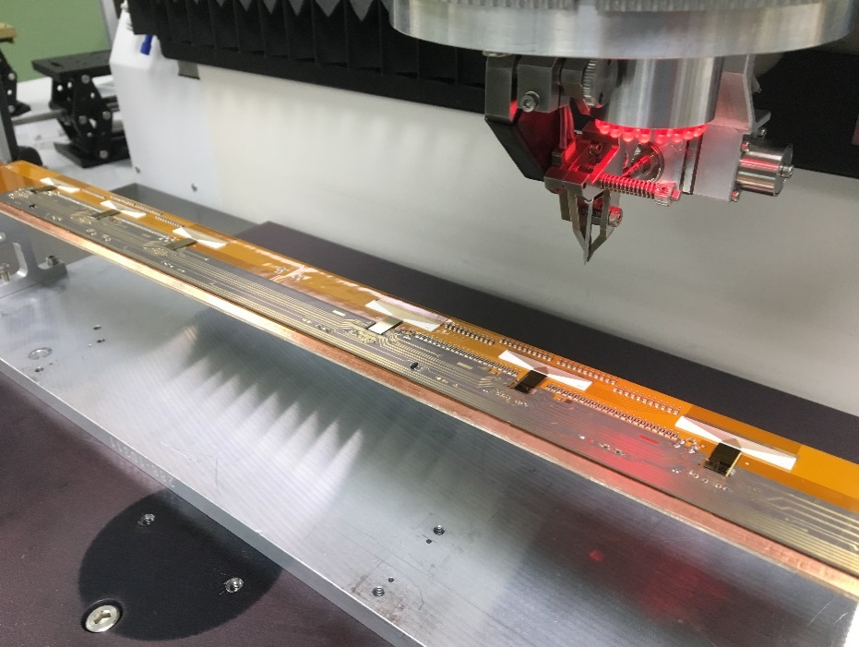
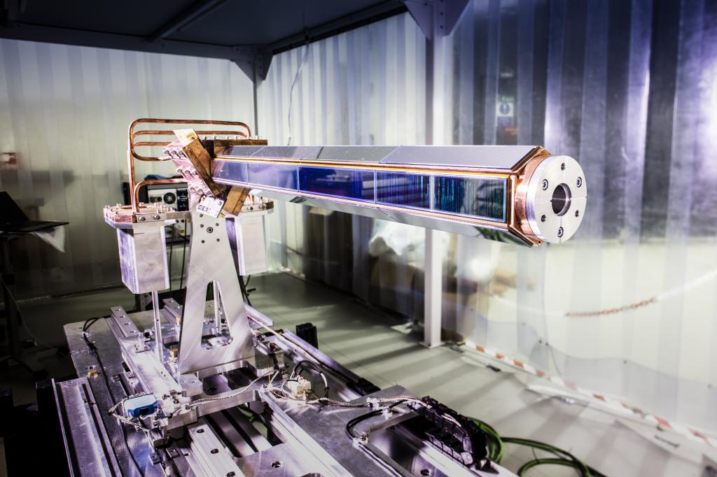

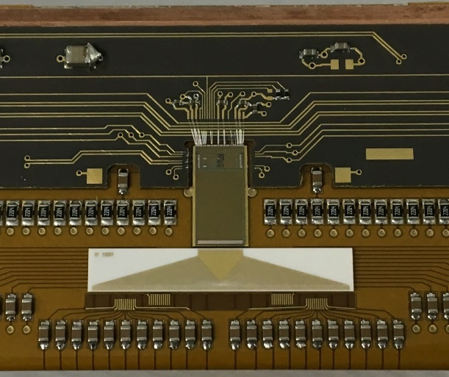
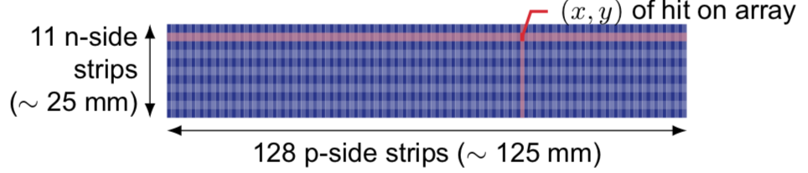
ISOLDE Solenoidal Spectrometer
~56 mm OD
~19 mm ID
~500 mm active length
On-axis silicon detector
Hexagonal array with four DSSSDs on each side.
128 x 0.95 mm p-side strips along the length.
11 x 2 mm n-side strips along the width
1800 channels → R³B ASICs for readout
Total length of silicon = 510.4 mm.
66% solid angle coverage.

Slide 5
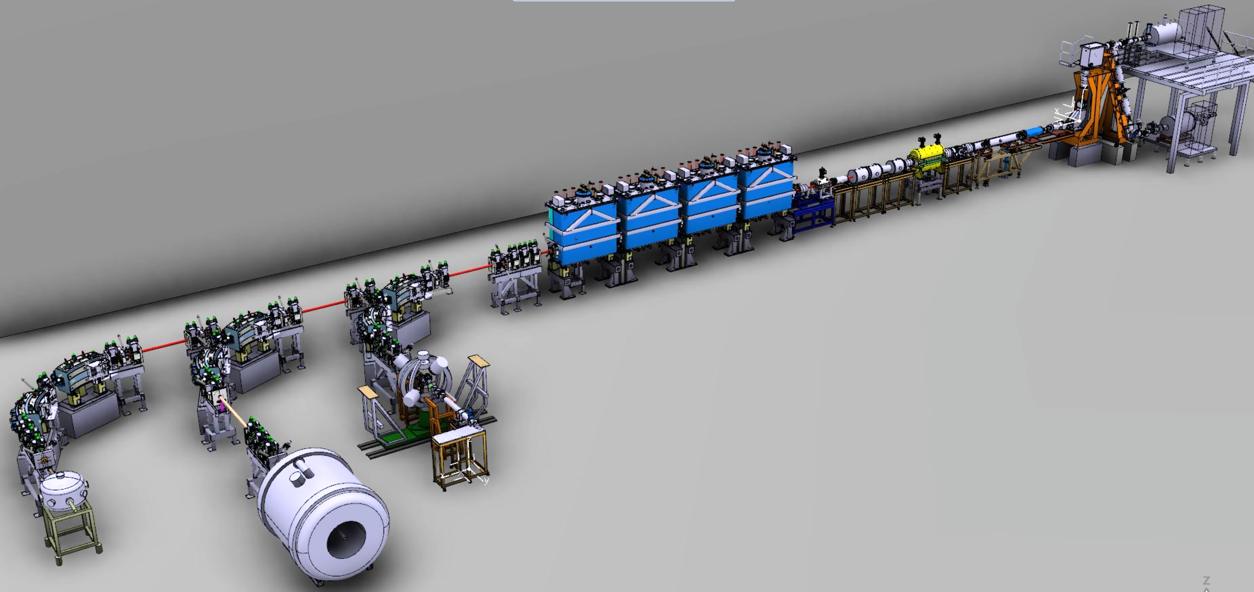
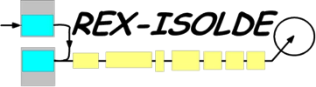


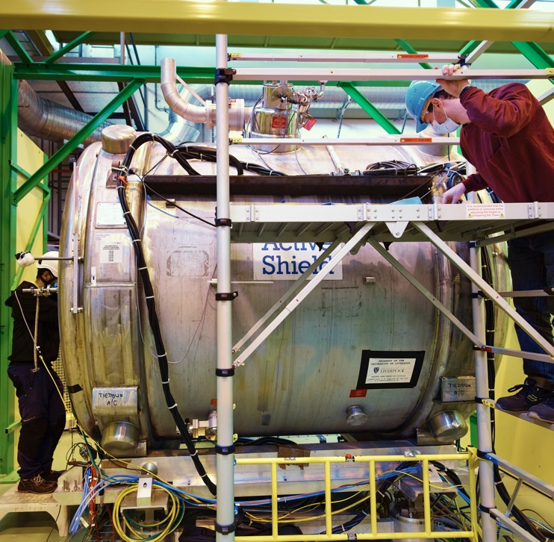

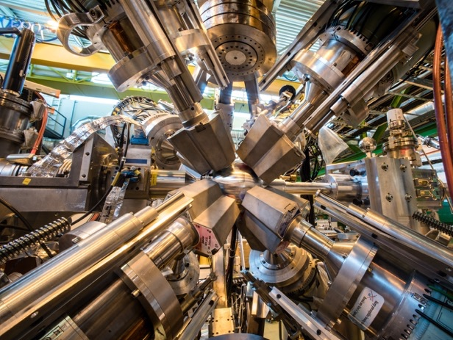

HIE-ISOLDE Phase 2 (2018)
2.83 MeV/u
10.0 MeV/u
RIB from ISOLDE
CERN Long Shutdown 3 upon us…
No beam at ISOLDE in 2026 and 2027
Moveable Setups (SEC)
Notes:
The largest amount of work in the proposal is based at HIE-ISOLDE, the post-accelerator of radioactive ion beams from ISOLDE.
Fundamentally, ISOLDE is the *ONLY* place worldwide where these isotopes can be produced and accelerated to the correct energy to determine their shapes.
This new upgrade, combing new superconducting cryomodules began it’s first physics experiments in 2016, when I was selected as a CERN research fellow to lead the first exploitation HIE-ISOLDE.
In the two operational campaigns since, experiments have been focused around the first experimental setup, Miniball, which I run.
I’ve successfully lead the setup and running of 13 experiments, including my own Coulomb excitation experiment on the octupole-deformed Barium isotopes.
However, the most exciting development that I have been working on is the ISOLDE Solenoidal Spectrometer, a former MRI magnet from a hospital in Australia being repurposed to perform nuclear reactions with radioactive ion beams.

Slide 6
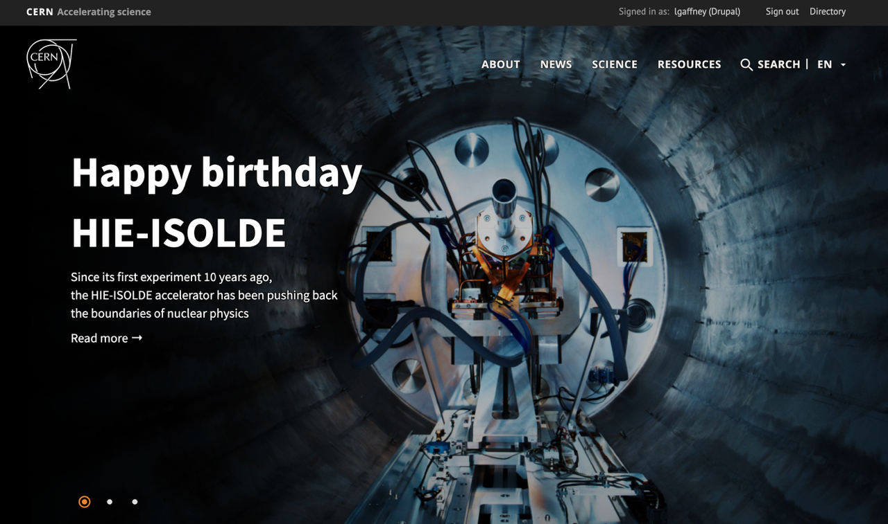
http://home.cern/
Wednesday 3rd December 2025

Slide 7
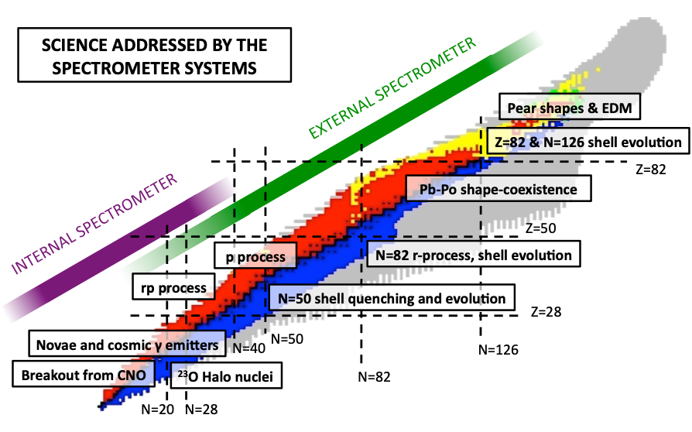
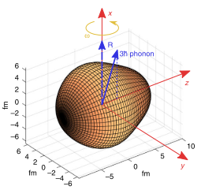


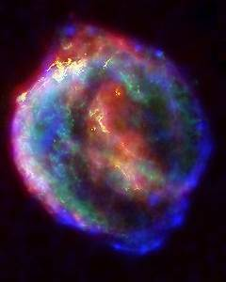
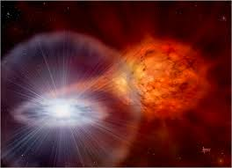
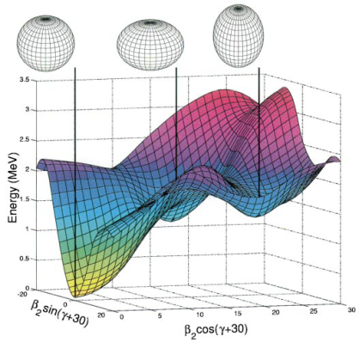

ISOL-SRS Physics
²³³U
On HIE-ISOLDE at CERN
²¹³Rn
¹⁹⁷Pb
²⁰⁷Hg
CARME
¹³⁰Xe
¹⁴⁴Ba
On CRYRING at GSI
^{109,111}Sn
¹³³Sn
^{93,95}Kr
⁶²Zn
⁶⁹Ni
³⁹K
^{50,51}Ca
²⁹Mg
³¹Mg
²⁸Na
⁸Be
¹²Be
LS2 → LS3
2021 → 2025

Slide 8
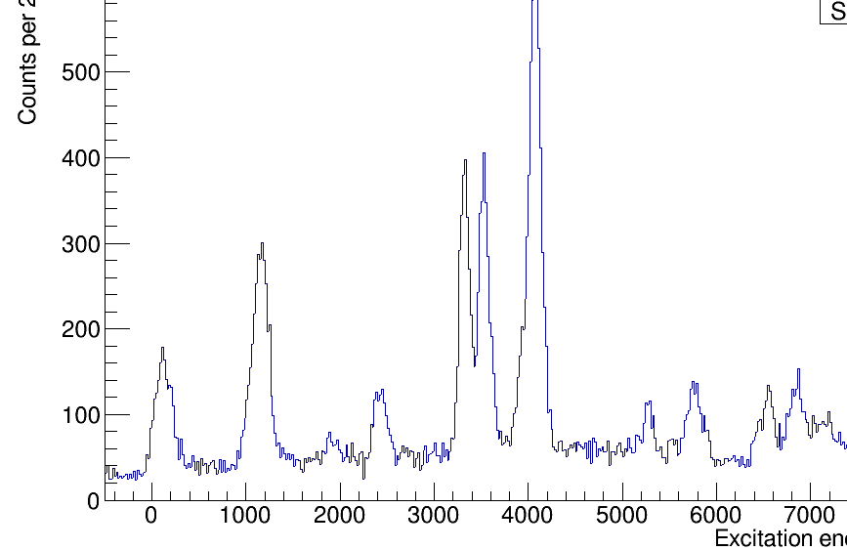
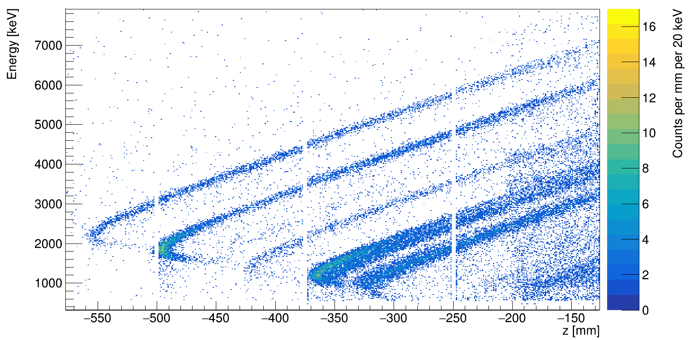
Proof-of-principle experiment at ISS
Work done by Ben Jones (Liverpool)
Stable beam following CERN’s LS2 in 2021… ²²Ne at 6.05 MeV/u.
Matching normal kinematics study with gas target! [H.F. Lutz et al. NPA 95 (1967) 591]
Implementation of precise energy calibration, pulse-height corrections, energy loss corrections, kinematic reconstruction
²²Ne(d,p)²³Ne
²²Ne(d,p)²³Ne
4270 keV
3218 keV
3422 keV
FWHM ~110 keV
1017 keV
0 keV
0 keV
2315 keV
5185 keV
1822 keV
1017 keV
2315 keV
3218 keV
Full code available: https://github.com/ISOLDESolenoidalSpectrometer/ISSSort

Slide 9
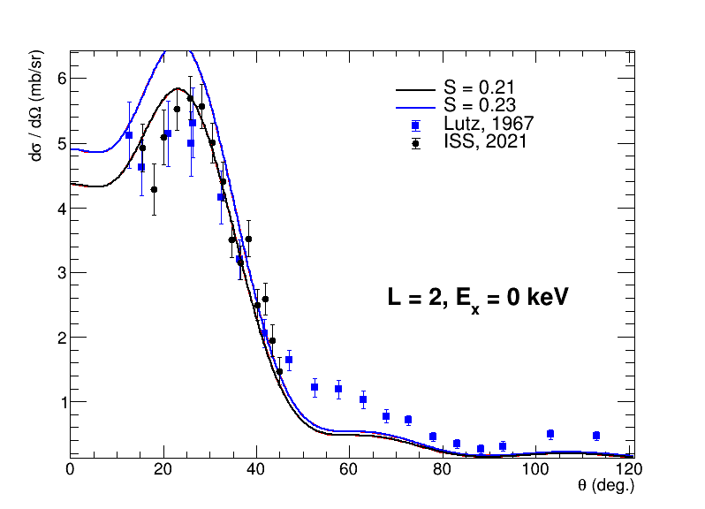
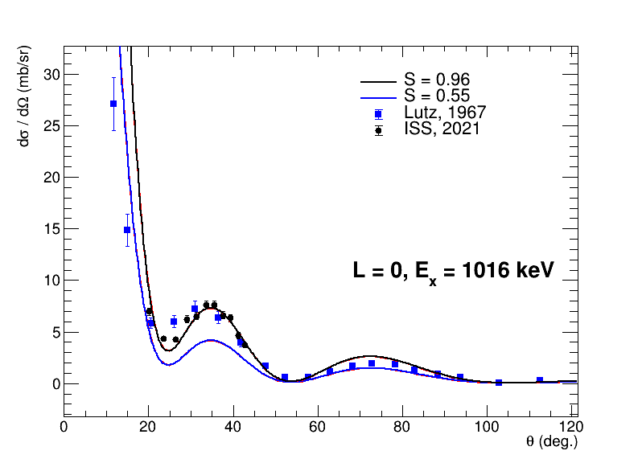
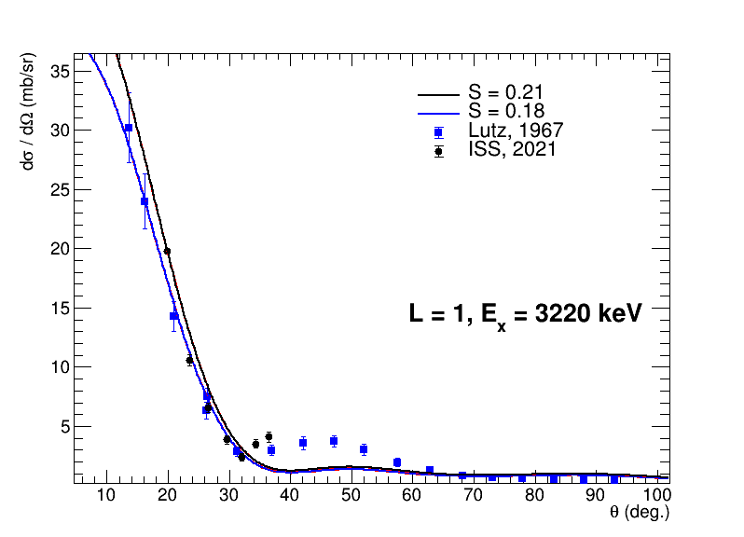
Proof-of-principle experiment at ISS
Work done by Ben Jones (Liverpool)
Stable beam following CERN’s LS2 in 2021… ²²Ne at 6.05 MeV/u.
Matching normal kinematics study with gas target! [H.F. Lutz et al. NPA 95 (1967) 591]
Implementation of precise energy calibration, pulse-height corrections, energy loss corrections, kinematic reconstruction
²²Ne(d,p)²³Ne
Full code available: https://github.com/ISOLDESolenoidalSpectrometer/ISSSort

Slide 10
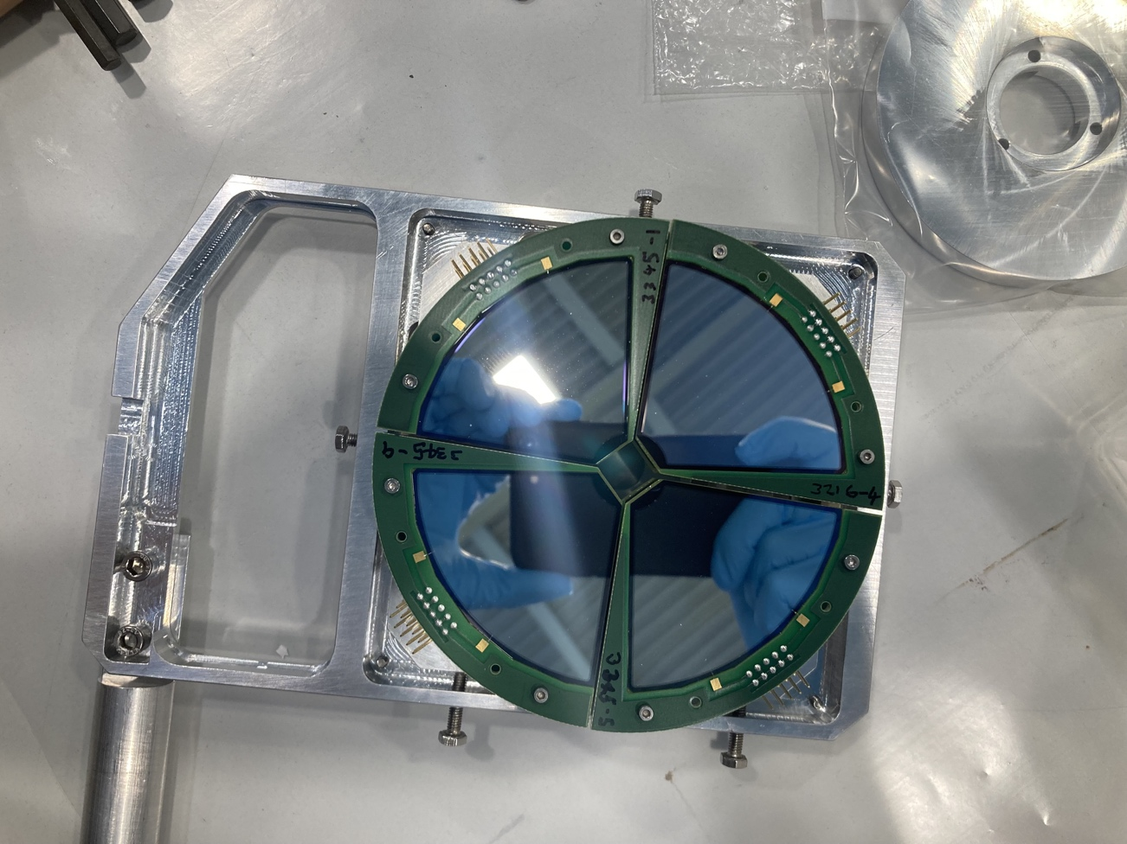
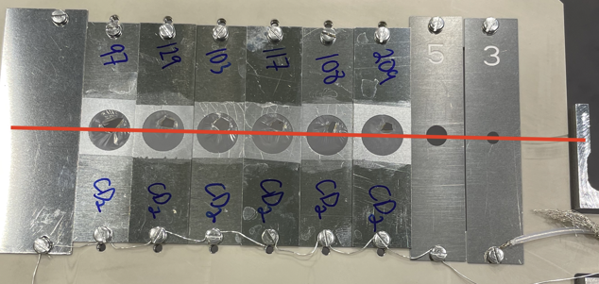
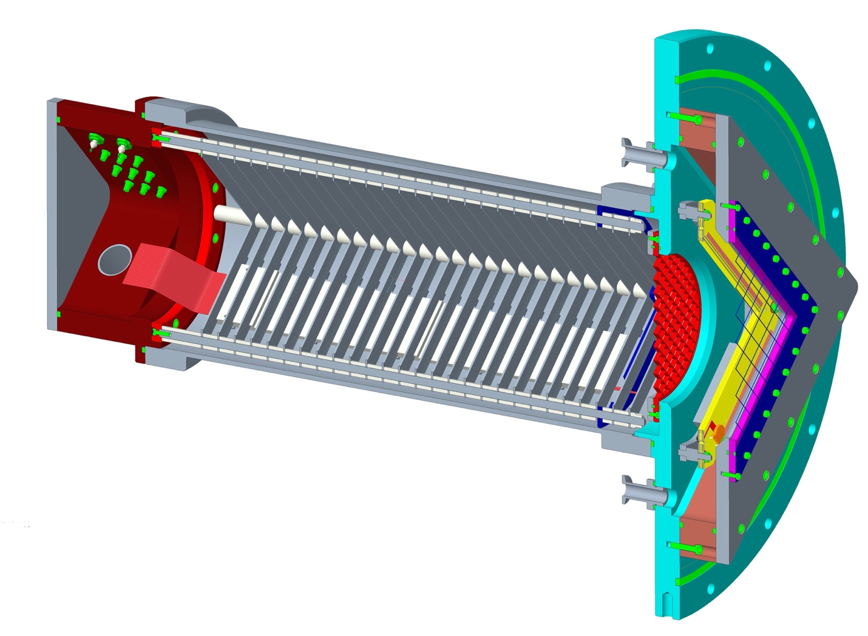
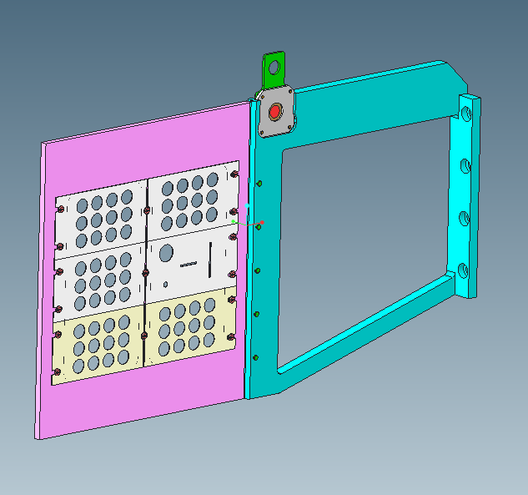
ISS modes of operation (so far…)
Si-recoil mode
Silicon ∆E-E for beam-like reaction partner; used for A < 50.
Clean selection of reaction channel; removes fusion on carbon and isobars in beam.
Gas-recoil mode
Fast-counting Bragg chamber and MWPC for medium-mass beams.
Used in beam just twice so far; fast pre-amps and zero-degree blocker being implemented for 2025 (today!).
Singles mode
High intensity or heavy beams.
FC at zero degrees, EBIS time structure to remove decay background.

Slide 11
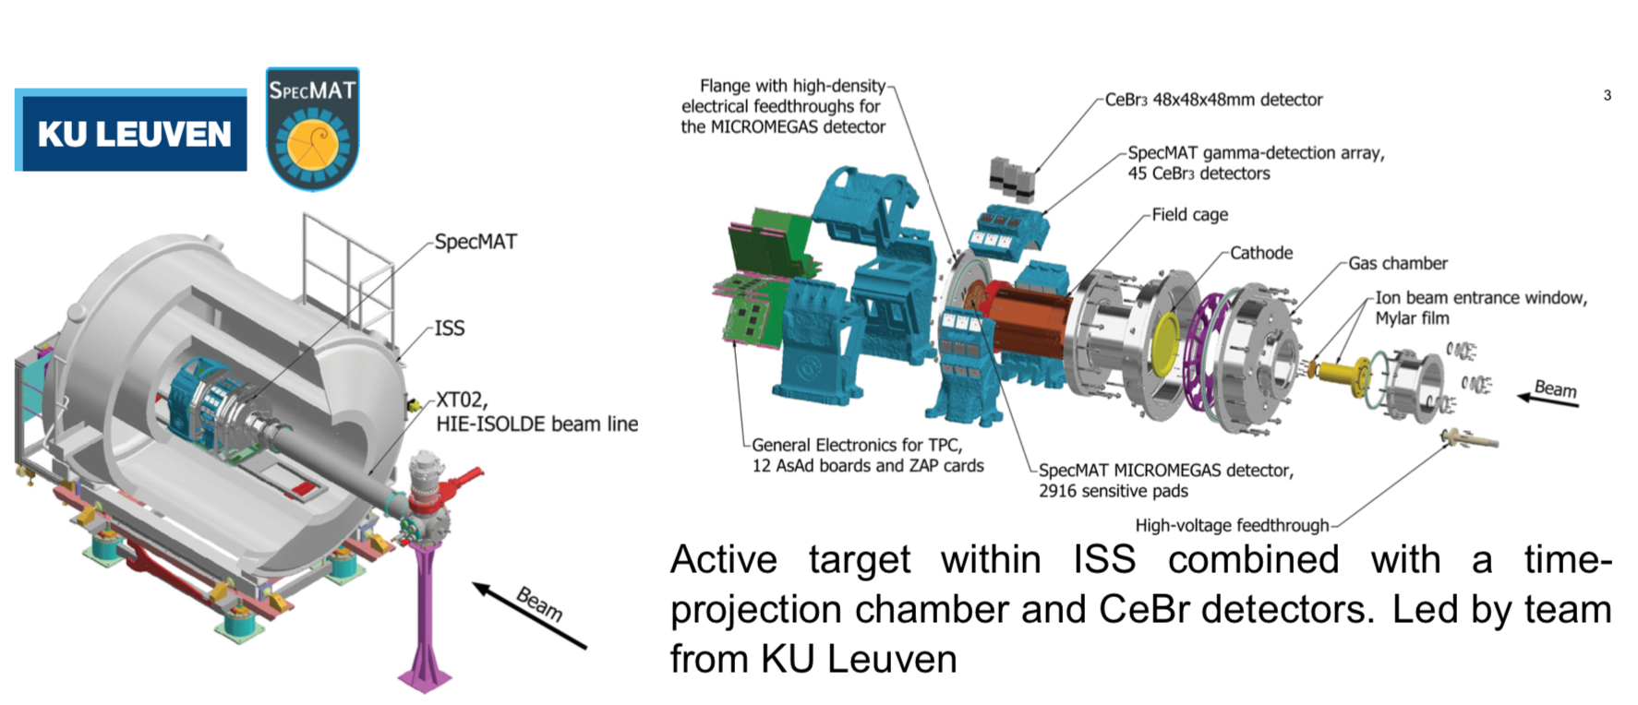
SpecMAT active target – first beam

Slide 12
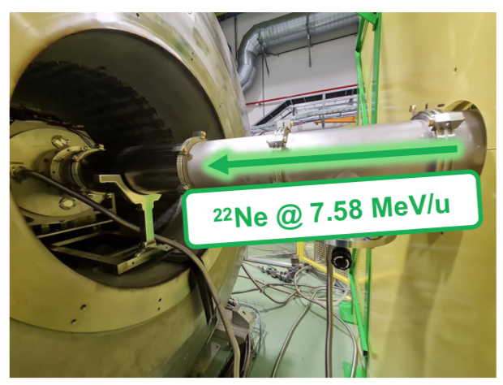
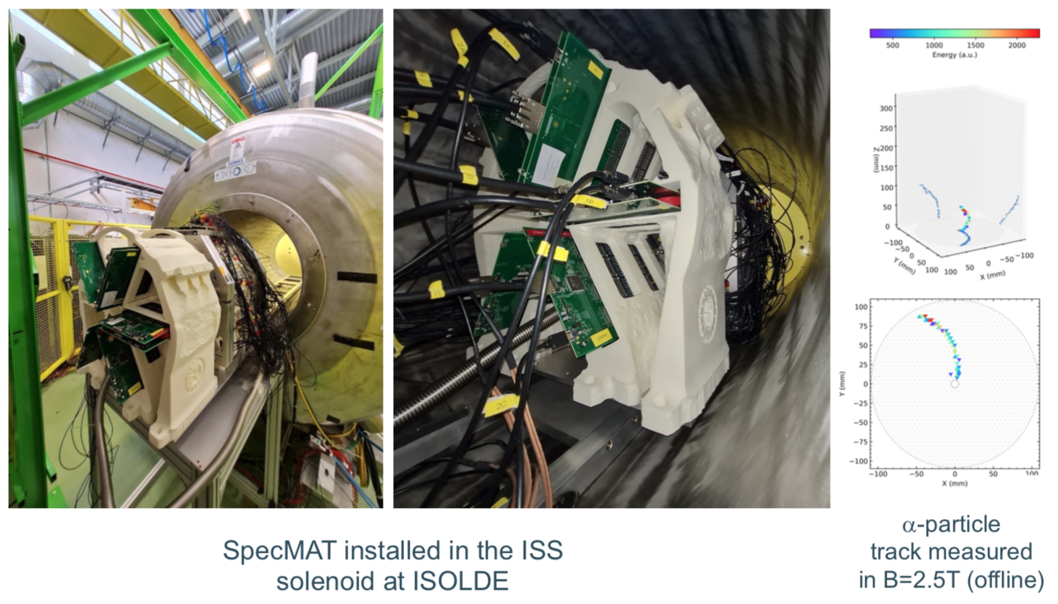
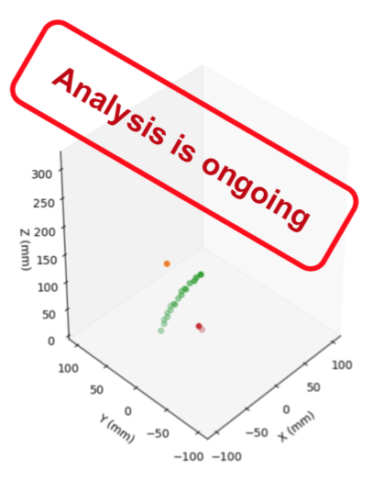
SpecMAT active target – first beam
June 2023
D₂ gas target
Thanks to Oleksii Poleshchuk (KU Leuven)

Slide 13
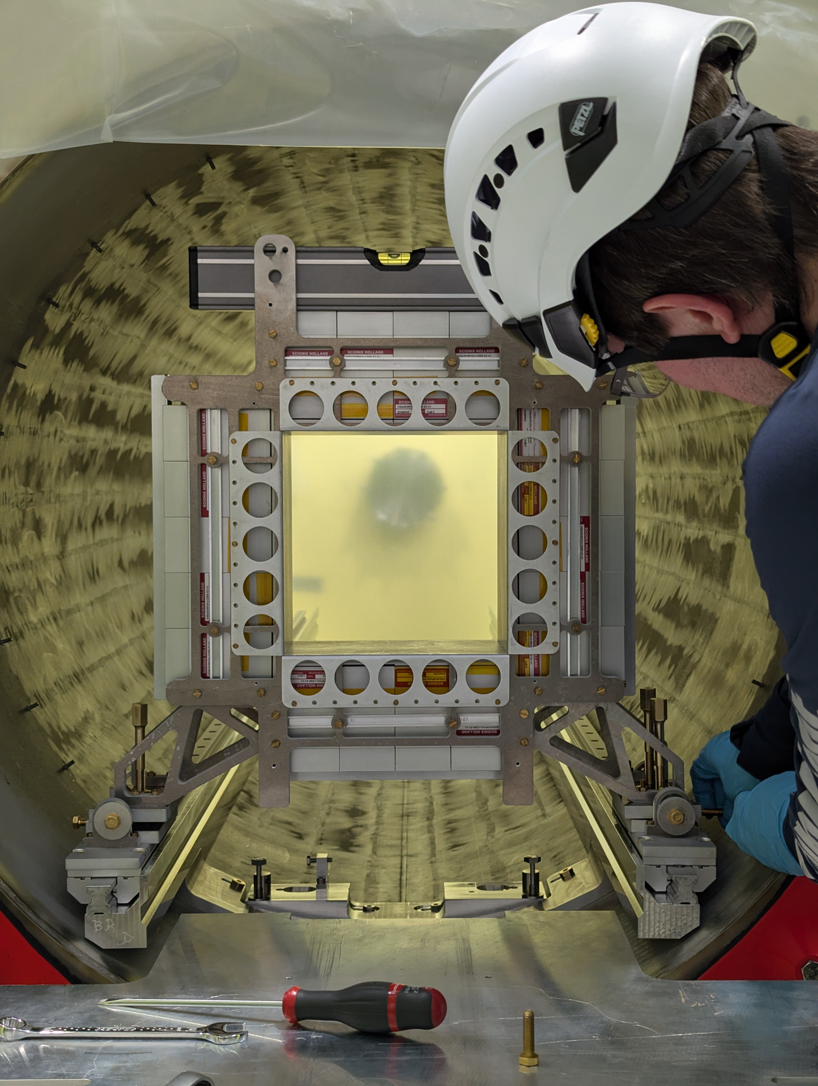
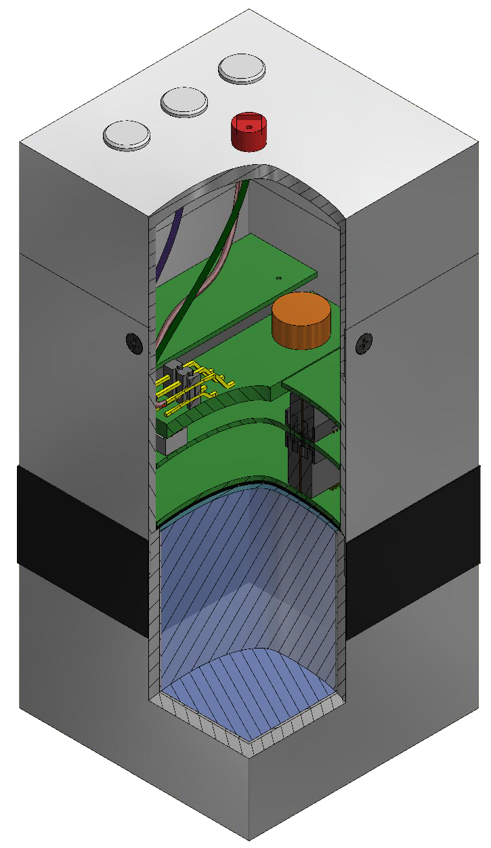
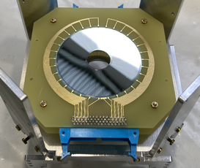
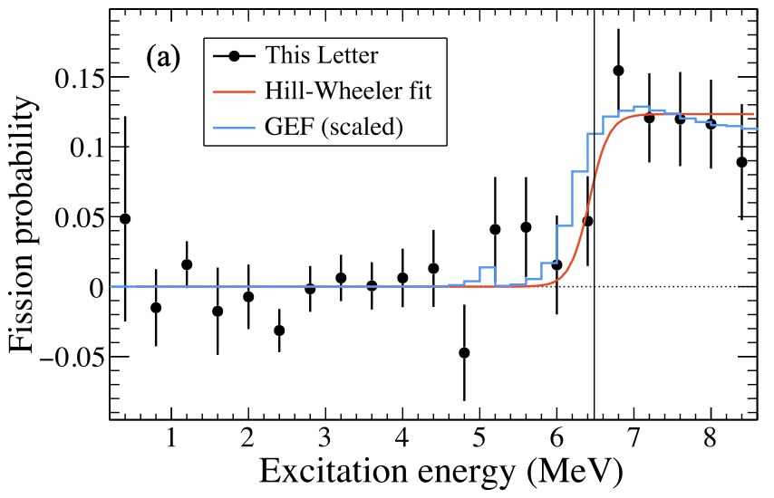

(d,p) fission setup – ²³²U
CeBr array at target position
Proof-of-principle experiment at HELIOS.
Silicon dE-E for spectroscopy of forward-focussed fragments, plus CeBr array for γ-ray detection.
LUME detectors for off-axis luminosity monitoring.
More info in talk by Maria Vittoria this morning…
²³⁸U(d,pF)
S.A. Bennett, et al.
PRL 130, 202501 (2023)

Slide 14
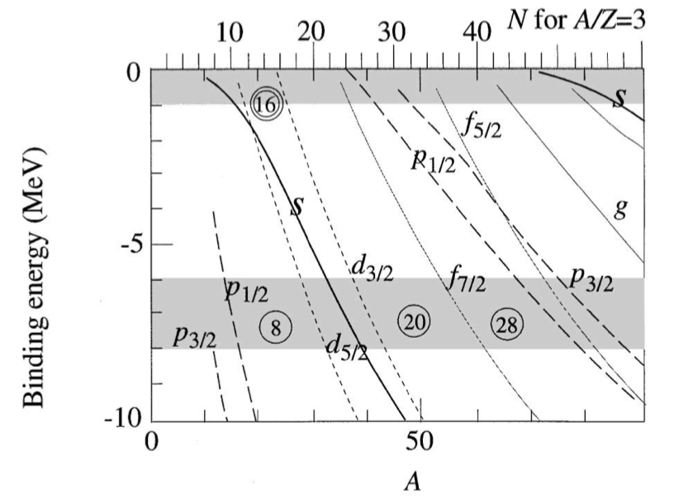
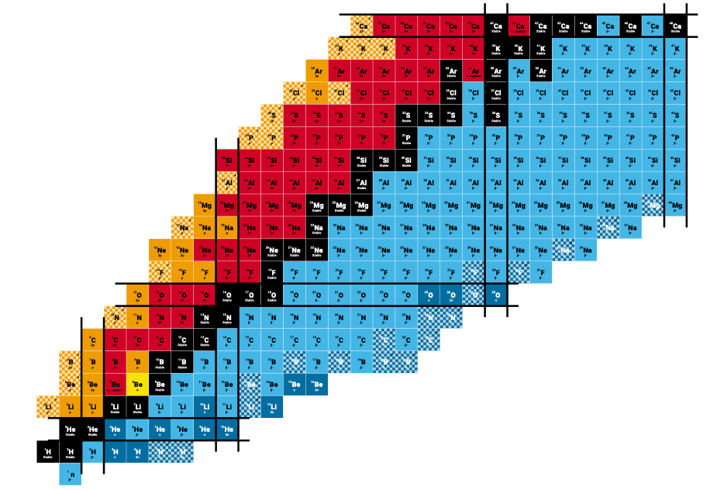
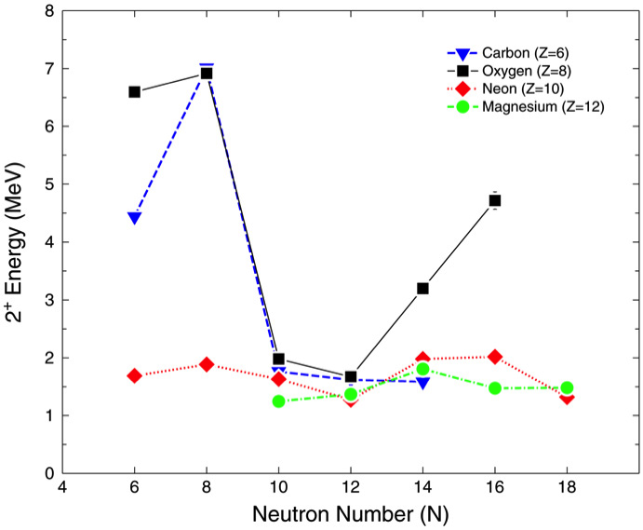
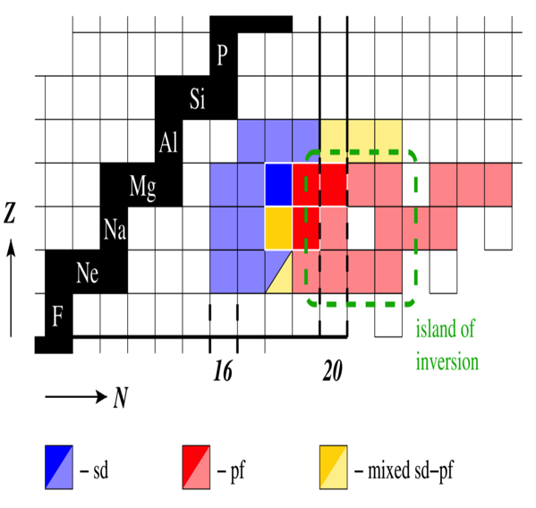
Towards the (1st) Island of Inversion
Weak binding/Finite geometry effects
N=16 shell closure
PRL 119, 182502 (2017); PRL 84, 5493 (2000)
C.R. Hoffman, et al., PLB 672 17 (2009)
N=20 Island of Inversion
Slide from David Sharp (Manchester)
P.A. Butler, et al., JPG 44, 044012 (2017)

Slide 15
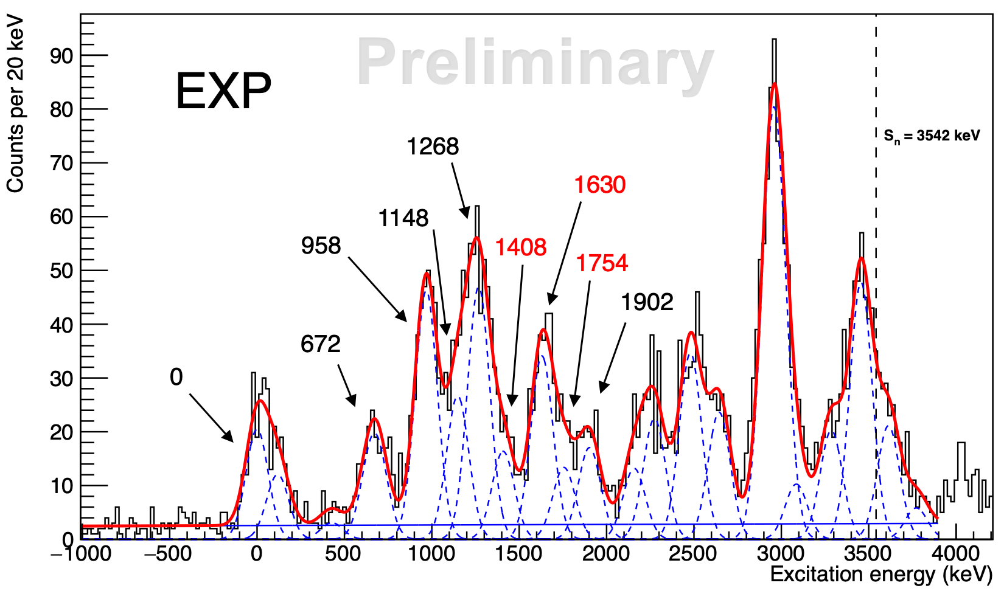
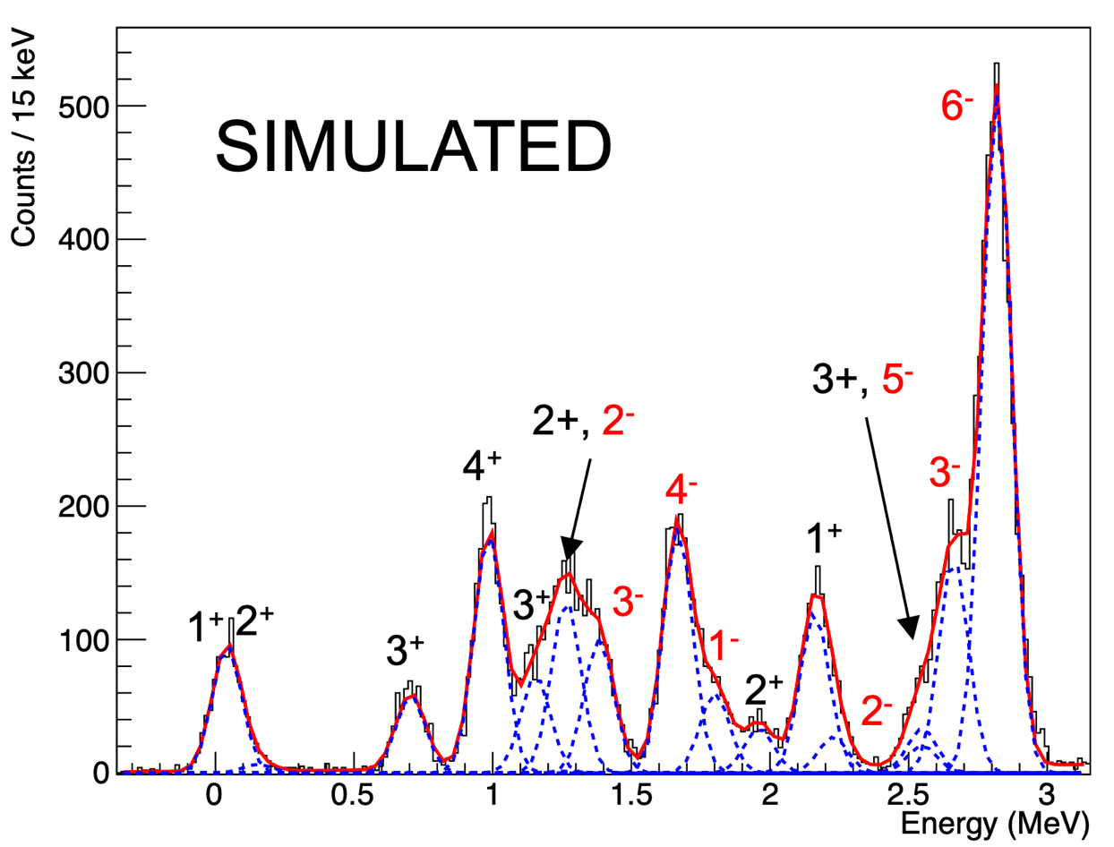

Towards the (1st) Island of Inversion
²⁷Na - 8x10⁵ pps @ 9.7 MeV/u
Range of probes already used to study IoI.
Single-particle evolution towards IoI important for tracking orbitals and occupancies…
ISOLDE provides excellent beams in this region, programme at ISS focussing on N=17 and along the Mg chain
²⁸Na
³¹Mg
P.T. MacGregor et. al., PRC 104, L051301 (2021).
³⁰Mg - 1x10⁵ pps @ 8.2 MeV/u
Analysis by Sam Reeve (Manchester)

Slide 16
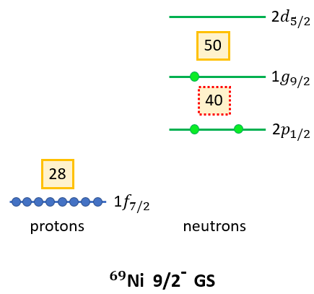
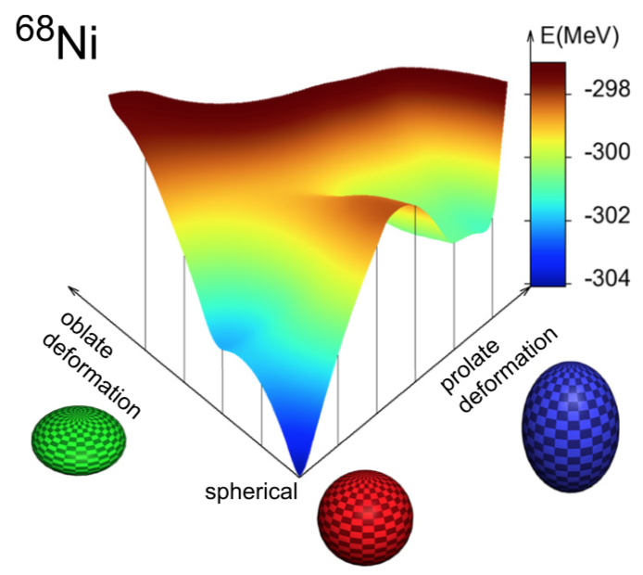
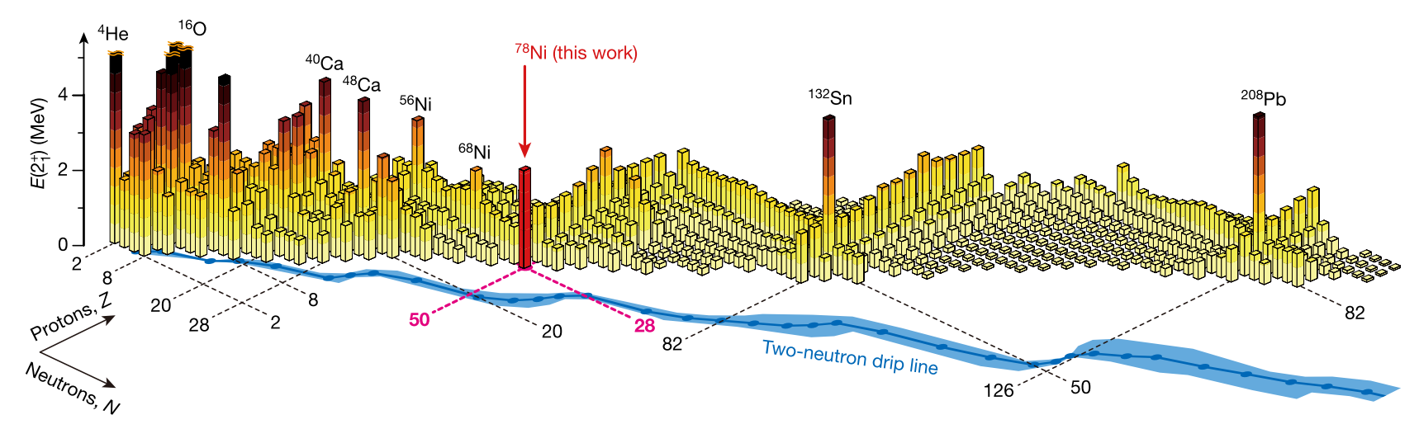
Single-particle states near to magic numbers
⁶⁸Ni
Two doubly-magic Ni isotopes at N=28 and N=50.
Sub-shell closure at N=40 → ⁶⁸Ni.
Deformed intruder states predicted.
Next two neutron orbitals define the N=50 shell gap: 1g_{9/2} ↔︎ 2d_{5/2}
T. Otsuka and Y. Tsunoda, J. Phys. G Nucl. Part. Phys. 43, 024009 (2016).
R. Taniuchi, et al, Nature 569, 53 (2019)

Slide 17
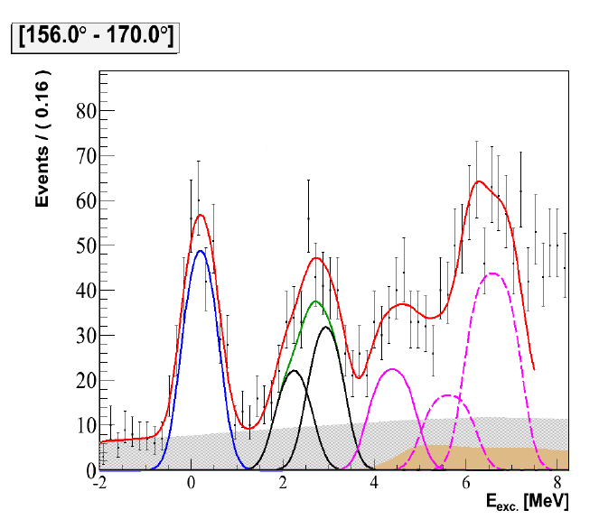
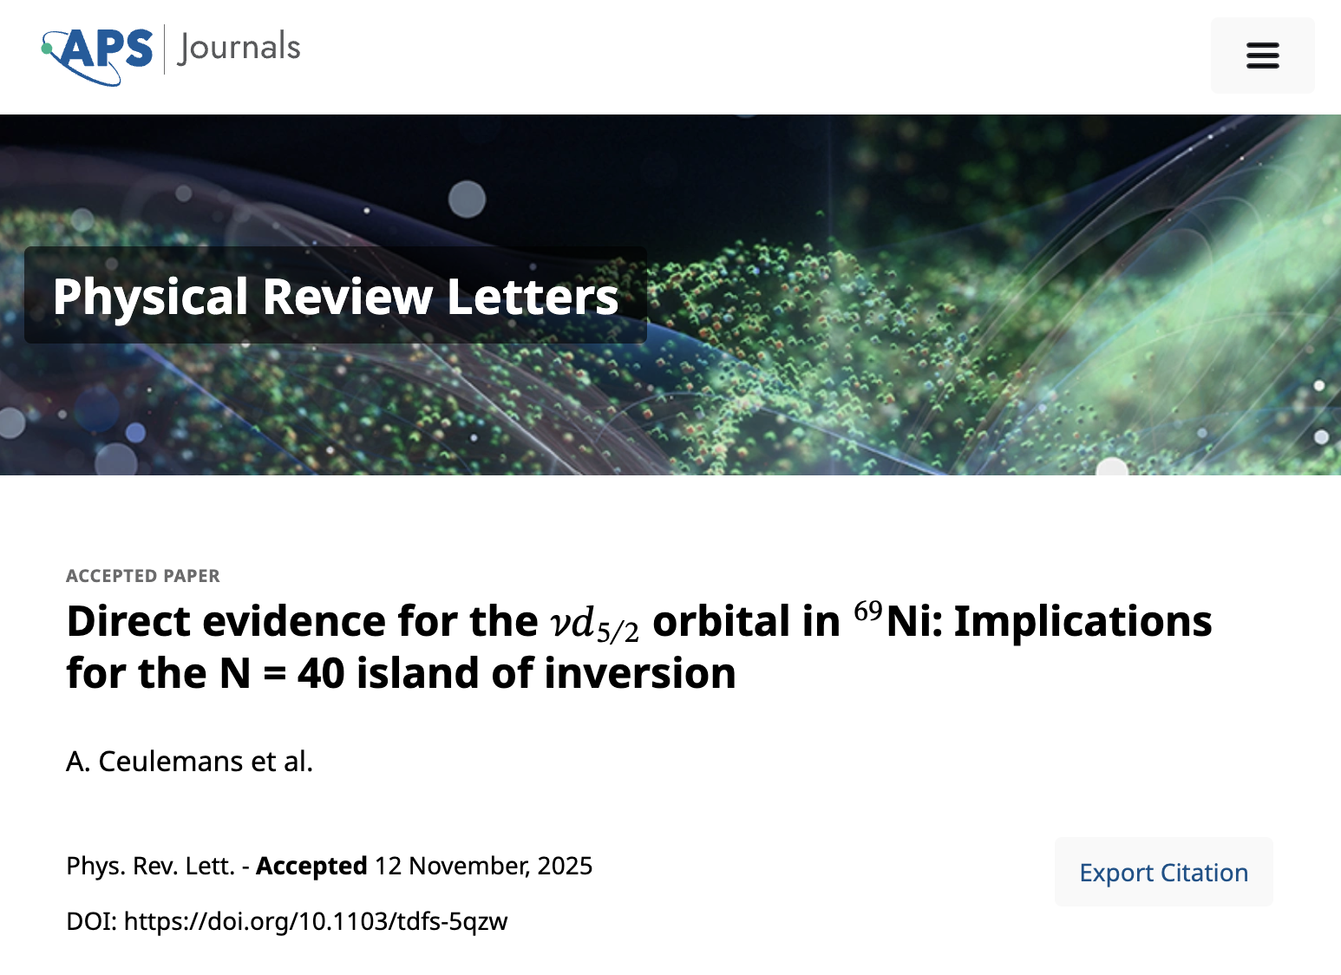
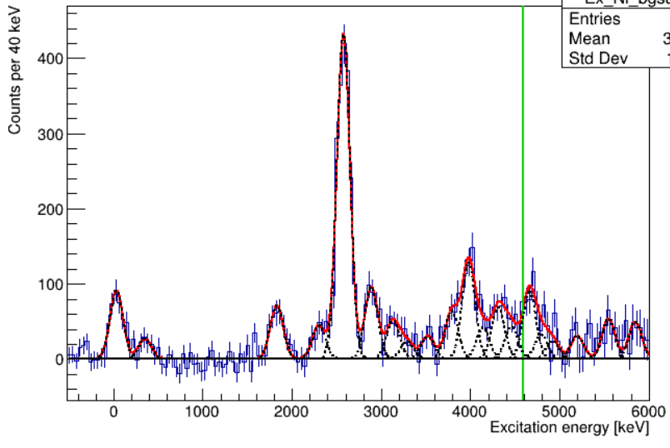
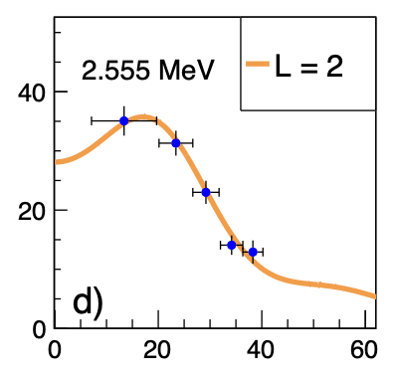



Semi-magic ⁶⁸Ni - ⁶⁸Ni(d,p)⁶⁹Ni
⁶⁹Ni @ GANIL
⁶⁸Ni beam ~2 x 10⁴ pps @ 6.0 MeV/u (matched for ℓ=2)
⁶⁹Ni @ ISS
S_{n}
GANIL experiment
(2010, unpublished, M. Moukkamad et al.)
E_{beam} = 25.14 MeV/u; CD₂ Target : 2.6 mg/cm²
2d_{5/2} candidate
Analysis by Andreas Ceulemans (KU Leuven)

Slide 18
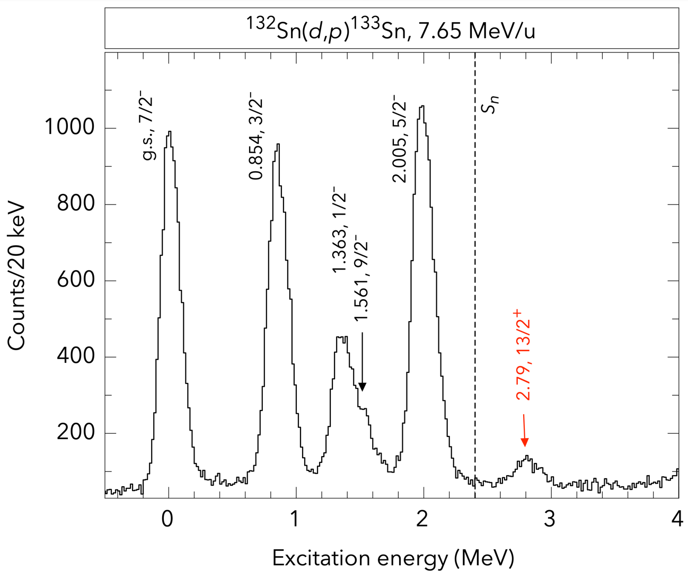

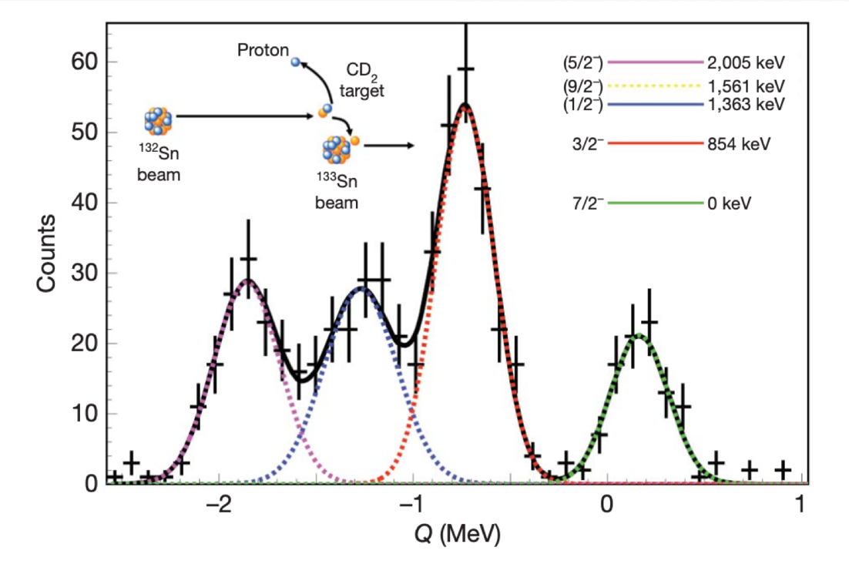

¹³²Sn(d,p) – A keystone experiment
Where does the single-particle strength lie outside of ¹³²Sn?
Location of i_{13/2} much debated
Analysis and slides by Ben Kay
Author | Energy (MeV)
Urban et al. (1999) (Inferred) | 2.694
Allmond et al. (2014) (Data, unclaimed) | 2.792
Korgul et al. (2015) (Theory/extrap.) | 2511(80), 2669(70)
Reviol et al. (2016) (Extrap.) | 2.366
Talwar et al. (2017) (Extrap.) | 2.680
Piersa-Silkowska et al. (2021) (Data, tent.) | 2.434
ISOLDE+ISS (August 2024) (First unambiguous obs.)
2.829(7)
K. Jones et al., Nature 465, 454 (2010)
P. Dyszel et al., Phys. Rev. Lett. 135, 152501 (2025)

Slide 19

Onset of deformation at N=60 – ⁹²Kr(d,p)⁹³Kr
Sr and Zr show rapid and dramatic onset of deformation at N=60.
Smooth increase for the Kr isotopic chain¹.
Low-lying intruder configurations → shape coexistence^{2,3}
Proton excitations across Z = 40 to πg_{9/2}.
Ground-state configuration at N = 60.
Filling neutron orbitals lowers energy of πg_{9/2}.
Large overlap of πg_{9/2} and νg_{7/2}…
Tensor force⁴ → Type-II shell evolution⁵
Close proximity of νs_{1/2}, νd_{3/2}, νg_{7/2}, νh_{11/2} orbitals.
Enhanced quadrupole interaction from coherent contributions → deformation
¹ M. Albers, et al., Phys. Rev. Lett. 108, 062701 (2012).
² J.E. García-Ramos and K. Heyde, Phys. Rev. C 100, 044315 (2019).
³ P.E. Garrett, M. Zielińska, and E. Clément, Prog. Part. Nucl. Phys. 163, 103931 (2021).
⁴ P. Federman and S. Pittel, Phys. Lett. B 69, 385 (1977).
⁵ T. Togashi, Y. Tsunoda, T. Otsuka, and N. Shimizu, Phys. Rev. Lett. 117, 172502 (2016).

Slide 20


Onset of deformation at N=60 – ⁹²Kr(d,p)⁹³Kr
7 states populated up to ~1 MeV; known energy from β-decay studies.
12 new states populated up to S_{n}.
Angular distributions give definitive ℓ assignments.
Locate ℓ=4 strength to observe g_{7/2} evolution
Analysis by Annie Dolan (Liverpool)
⁹³Kr
S_{n}
⁹⁴Rb
1029 keV
⁹⁴Kr
1264 keV
805 keV
⁹³Kr
1103 keV
(3/2⁺,7/2⁺)
710 keV
(3/2⁺,7/2⁺)
359 keV
(7/2⁺)
355 keV
556 keV
(3/2⁺)
117 keV
355 keV
352 keV
g_{7/2}
1/2⁺
0 keV
⁹³Kr
117 keV
d_{3/2}
0 keV
0 keV
0 keV
s_{1/2}
⁹³Kr
⁹⁵Sr
⁹⁷Zr

Slide 21




Onset of deformation at N=60 – ⁹²Kr(d,p)⁹³Kr
7 states populated up to ~1 MeV; known energy from β-decay studies.
12 new states populated up to S_{n}.
Angular distributions give definitive ℓ assignments.
Analysis by Annie Dolan (Liverpool)
⁹³Kr
S_{n}
¹⁸⁸Hg
⁹⁴Rb
DWBA analysis to extract SFs.
⁹⁴Kr
0 keV
Resolved doublet
νg_{7/2} strength found!
Cross section (mb/sr)
117 keV
355 keV
Centre of mass angle (˚)

Slide 22



Shape coexistence in the n-deficient Pb region
Shape-staggering in Hg isotopes; triplet of shapes in Pb isotopes.
Multi-particle, multi-hole excitations responsible for shape change.
First test case chosen as ¹⁹⁶Pb in the transition from spherical to mixed oblate/spherical.
T. Otsuka et al.,
J. Phys. G: Nucl. Part. Phys. 43 (2016)
J. Ojala, et al., Communications Physics 5 (2022)
B. Marsh et al., Nature Physics 14 (2018)

Slide 23



¹⁹⁶Pb(d,p) at ISS
E_{x} (keV)
Ground-state doublet strongly populated.
Search for 13/2⁺ state (T_{1/2} = 43 mins) at ~320 keV looks promising, but cross-section too large…
¹⁹⁷Pb
Coincidence with gamma ray at ~330 keV in CeBr₃ array.
Angular distribution consistent with ℓ = 1…
Assigned to missing unobserved 1/2– state.
Unfortunate doublet with 13/2⁺ state.
Most recent beam time, November 2024
… and the last for 2.5 years!!
Spokesperson Joonas Ojala (JYFL, Finland)
J. Vanhorenbeeck et al., Nuclear Physics A 531 (1991) 63

Slide 24






Bragg ionisation chamber for recoil detection
Fast-counting Bragg ionisation chamber used to diagnose beam composition in ^{93,95}Kr experiments.
Short T_{1/2} + charge breeding = in-trap decay (Rb daughter)
Fast preamps installed + 2D beam blocker mechanism.
Improvements to Mylar windows to reduce leak rate.
Full characterisation in 2025 with student from Florence.
Beam blocker failed during beam time ☹
¹³²Xe
⁹⁴Rb
⁹⁴Kr
Work done in Manchester by Frank Browne and Michał Włodarczyk
¹³²Xe
⁹⁴Rb
⁹⁴Kr

Slide 25



New 2D target ladder
Many target frames are possible, including CD₂, ¹²C foils produced at ANL by Claus Mueller-Gatermann.
Frame dedicated to tuning, including apertures and slits, which allows for beam profile measurements at the target position!
In total we have 60 target positions + tuning plate.
Vertical profile
FWHM = 1.9 mm
Horizontal profile
FWHM = 1.4 mm
Beam profile analysis by Hans Törnqvist

Slide 26




Dead layer measurements
Work done by Ben Jones (Liverpool)
DSSSD allows for the possibility to measure energy from a single strip as a function of θ.
New method developed that is independent of energy calibration of the silicon.
Alpha source

Slide 27






Dual array setup
M. Labiche (May 2015)
Sensitive reaction channel selection…
Breakup following transfer, e.g. ⁷Be(d,p)⁸Be → 2α or 7Li+p
Large angular coverage for 2α (forwards) and p (backwards)
Surrogate (n,p) and (n,α) reactions for astrophysics…
Charge exchange with “extra” proton → (d,²He).
Correlated protons in forward/backwards directions.
Demonstrator device to be built as proof-of-concept with stable beams after CERN’s LS3 (2026).
Royal Society grant (Liverpool) to test design options: nTD silicon (Micron) for PID; hybrid ASIC+digitiser for optimal timing/position/energy resolution.
Expandable to full array in the future with modular design (project bid).
nTD Si delivered today! Merry Christmas to me ☺

Slide 28
Summary and outlook
Lots of physics done so far, but busy running periods mean learning “on the job”.
Publications starting to come, PRL accepted for ⁶⁹Ni last month, many more in preparation.
Building larger collaboration has been powerful to bring complementary tools:
SpecMAT active target led by KU Leuven
Fission fragment led by Chalmers University of Technology
CeBr₃ γ-ray spectrometer from KU Leuven and Chalmers
Tritium target purchased by CSIC-IEM and there are two (t,p) experiments (not run before LS3)
we’re open to new ideas and willing to help with the integration of new equipment.
Long shutdown at ISOLDE for 2026-27; an opportunity to work on upgrades and reconciliation
new silicon array, cryo system refurbishment, flammable gas systems, etc.
HIE-ISOLDE just celebrated it’s 10-year birthday, but physics opportunities exist for more than a decade when we return in 2028… Come and join us!!

Slide 29
ISS Backup slides

Slide 30





And some technical updates
Photo by Anna Kawecka
New safety platform installed for filling and energising the magnet.
Financial contributions from EP Safety and ISOLDE for infrastructure [~6 kCHF].
Future helium refills to be performed by collaboration, not CERN cryo group!
Strict vacuum requirements from HIE-ISOLDE (8 x 10⁻⁷ mbar) for 2025.
New, bigger turbo pump (2200 l/s N₂) from STFC Daresbury [~25 kCHF]
Cryogenic pump and compressor (4600 l/s H₂O) from Liverpool [~50 kCHF]
Implementation of additional 256+ digitiser channels.
Mesytec-based DAQ developed by Chalmers [~150 kCHF].
iSeg HV mainframe to cover all silicon biasing [~50 kCHF].
Talk by Håkan Johansson later today on details.
Big Ted ->
<- Patrick MacGregor
Mesytec DAQ ->
<- Cryo pump

Slide 31

Direct reactions around the Coulomb barrier
Access to variety of nuclear structure and nuclear astro information.
Single-particle states, E_{(Ex,SP)}, ℓ, spectroscopic factors, e.g. (d,p), (p,d)…
Pair-correlations, E_{(Ex)}, ℓ, e.g. (p,t), (t,p)…
Collective properties via e.g. (p,p$′$), (d,d$′$), ($α$,$α′$), Coulex…
Need for multiple spectrometers/facilities to cover range of isotopes and energies.
Figure courtesy of Ben Kay (ANL)
ISS @ CERN
FAUST @ FRIB
Beam energy (MeV)

Slide 32

Multi-turns and protons in CD₂
Plot courtesy of Kris Haverson (Sheffield Hallam)
Experiment IS692 ⁷Be(d,p)⁸Be* (PIs: R. Smith + M. Gai)

