Slide 1



Improved Method for
($E_{x}$, $θ_{cm}$) Reconstruction for Solenoidal Spectrometer
T. L. Tang (Ryan)
Kinematics Calibration and Excitation Energy Reconstruction for Solenoidal Spectrometers
https://arxiv.org/abs/2501.04731v2

Slide 2
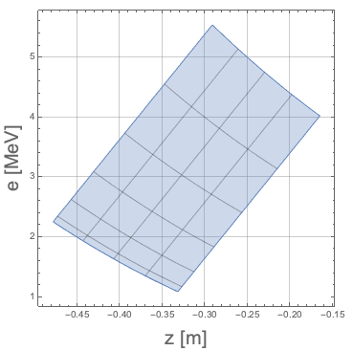




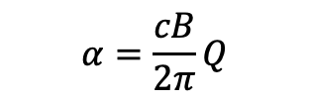

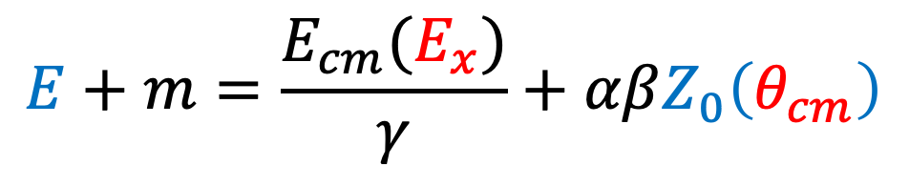

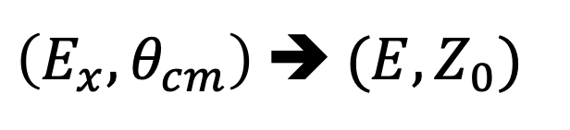
Solenoidal Spectrometer is very nice…
¹⁶O(d,p) @ 10 MeV/u, 2.85T
$$E+m=\frac{E_{cm}(E_{x})}{γ}+αβZ_{0}\left(θ_{cm}\right)$$
$$θ_{cm}=(0°,30°)$$
$$Ex=(0,4)$$
$$α=\frac{cB}{2π}Q$$
$$E_{x}$$
$E$ [MeV]
$β, γ=$ Lorentz Boost from Lab to CM frame
$$\cos{θ_{cm}}$$
$\left(E_{x}, θ_{cm}\right)$ ➔ $(E, Z_{0})$
$Z_{0}$ [m]
https://wiki.anl.gov/heliosdaq/File:Kinematics_of_HELIOS.pdf

Slide 3
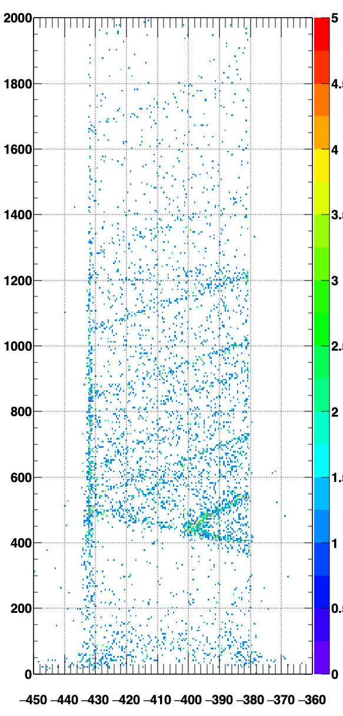
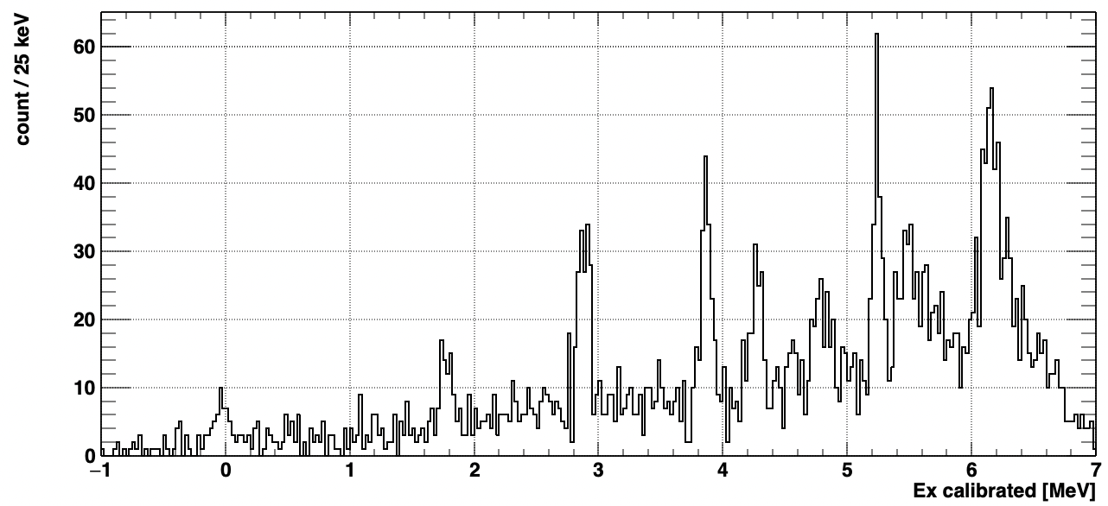
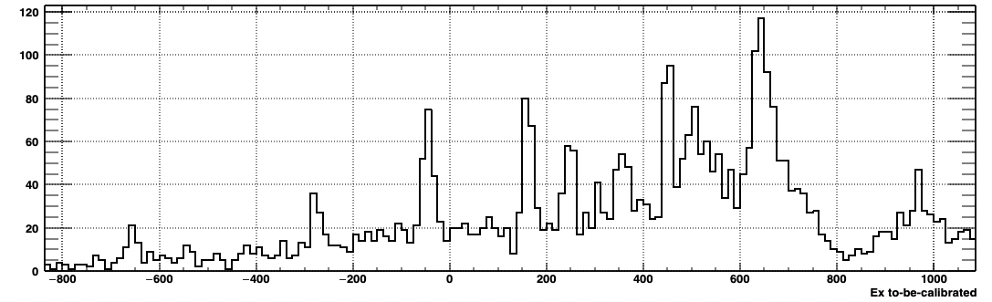
The projection method
Step 1) Projection
Step 2) Scale and offset using known states
Step 3) Sum up all detectors
Step 1
Step 2

Slide 4
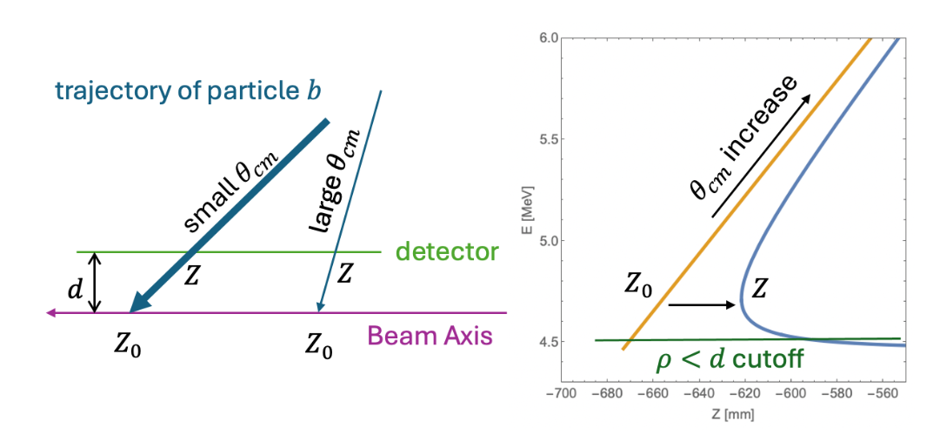
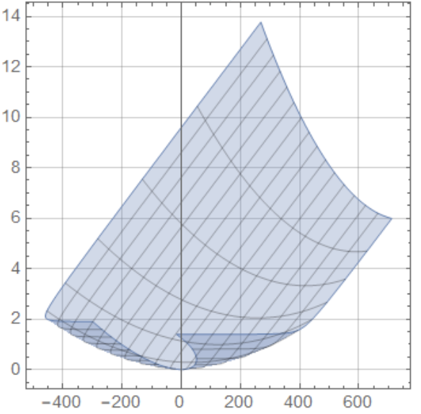

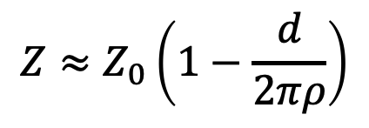
Finite Detector Radius Ruined it.
$$Z≈Z_{0}\left(1−\frac{d}{2πρ}\right)$$
$ρ=$ radius of the helix motion

Slide 5
Projection method is not very efficient
Detectors that coverage small angle need special care.
  where is small angle?
  bad energy resolution
Every detectors are treated separately
  → each detector has different energy gain
  → that is not convenience for automation

Slide 6
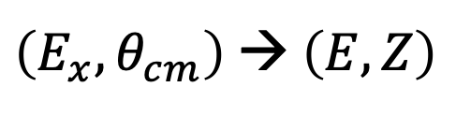


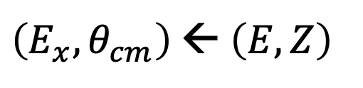
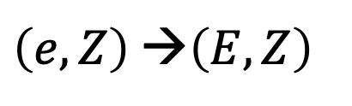
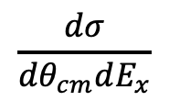
A new method
Kinematics calculation, Solenoidal spectrometer is transforming
$$E_{x}$$
$\left(E_{x}, θ_{cm}\right)$ → $\left(E, Z\right)$
$\left(E_{x}, θ_{cm}\right)$ ← $\left(E, Z\right)$
$$\frac{dσ}{dθ_{cm}dE_{x}}$$
$$θ_{cm}$$
To do the inverse transform,
need to calibrate the measured energy,
from channel into MeV
$\left(e, Z\right)$ →$\left(E, Z\right)$

Slide 7
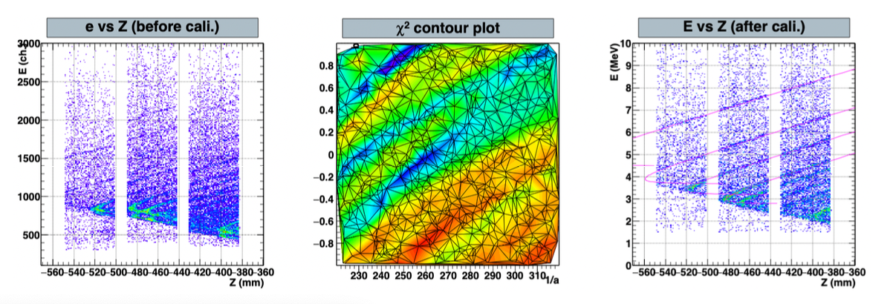
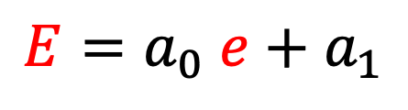
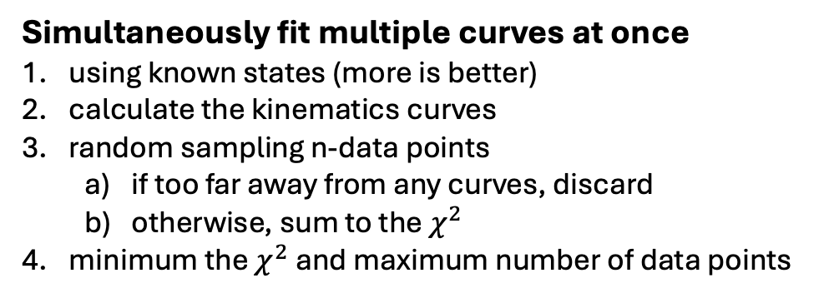


Step 1) raw $e$ to energy $E$
Simultaneously fit multiple curves at once
using known states (more is better)
calculate the kinematics curves
random sampling n-data points
  if too far away from any curves, discard
  otherwise, sum to the $χ^{2}$
minimum the $χ^{2}$ and maximum number of data points
A) alpha source ( 5.4 to 8.2 MeV for ²²⁴Th source)
B) Matching data to the kinematics lines
$$E=a_{0} e+a_{1}$$
$$a_{1}$$
$$1/a_{0}$$

Slide 8

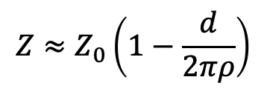
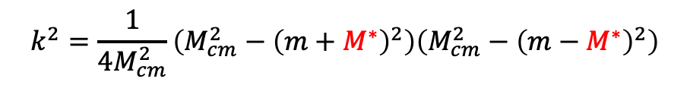
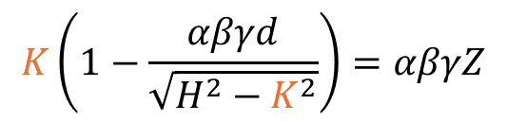
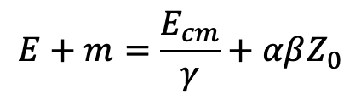



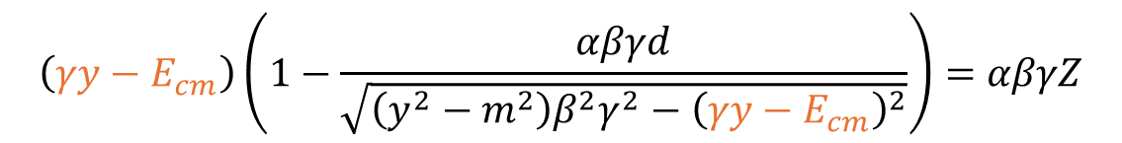



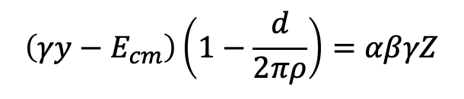

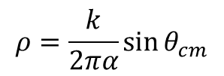




Step 2) ($E_{x}$, $θ_{cm}$) Reconstruction
Solve this system
Using these formula
$k$ is the momentum in CM frame
$$E+m=\frac{E_{cm}}{γ}+αβZ_{0}$$
$$y=γE_{cm}−γβk\cos{θ_{cm}}$$
find it, then we can deduce the $E_{x}$
$$E_{cm}^{2}=m^{2}+k^{2}$$
$$k^{2}=\frac{1}{4M_{cm}^{2}}\left(M_{cm}^{2}−{\left(m+M^{∗}\right)}^{2}\right)\left(M_{cm}^{2}−{\left(m−M^{∗}\right)}^{2}\right)$$
$$Z≈Z_{0}\left(1−\frac{d}{2πρ}\right)$$
$$ρ=\frac{k}{2πα}\sin{θ_{cm}}$$
$$M^{∗}=M+E_{x}$$
$$\left(γy−E_{cm}\right)\left(1−\frac{d}{2πρ}\right)=αβγZ$$
$$y=E+m$$
$$\left(γy−E_{cm}\right)\left(1−\frac{αβγd}{\sqrt{\left(y^{2}−m^{2}\right)β^{2}γ^{2}−{\left(γy−E_{cm}\right)}^{2}}}\right)=αβγZ$$
$$K\left(1−\frac{αβγd}{\sqrt{H^{2}−K^{2}}}\right)=αβγZ$$
$$H=βγ\sqrt{y^{2}−m^{2}}$$
$$K=γy−E_{cm}$$
$$H\sin{φ}−αβγd\tan{φ}=αβγZ$$
$$K=H\sin{φ}$$
$$\sqrt{y^{2}−m^{2}}\sin{φ}−αd\tan{φ}=αZ$$

Slide 9
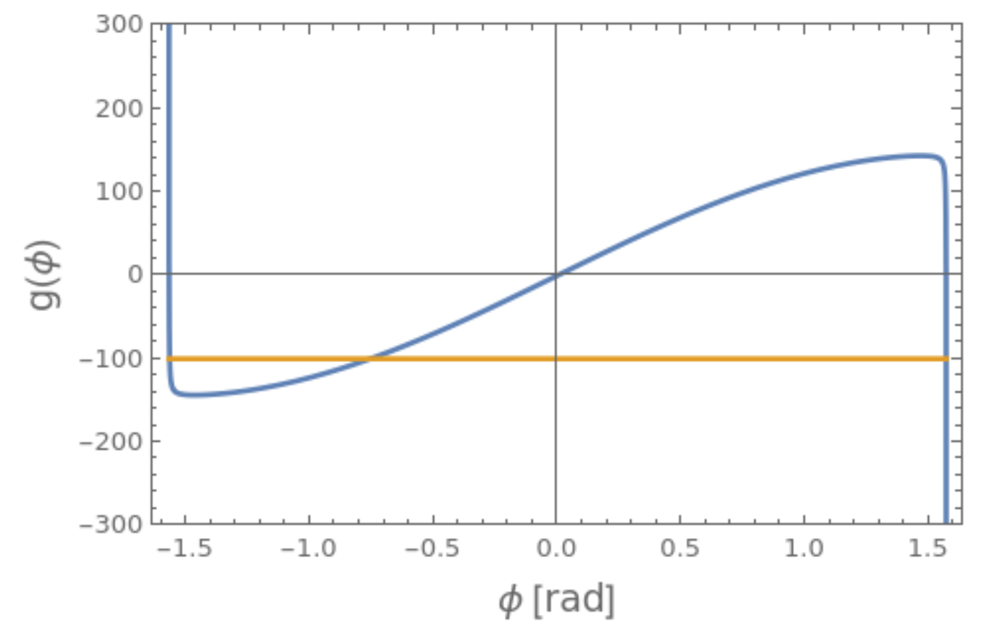
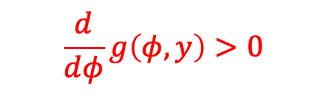
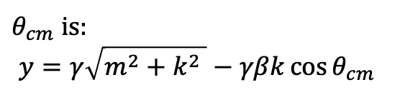

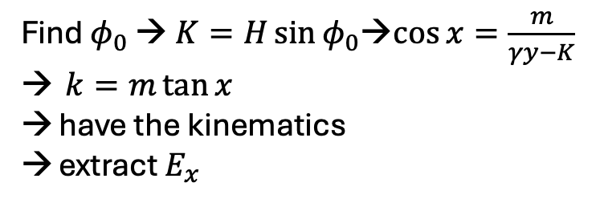
$$g\left(φ, y\right)=\sqrt{y^{2}−m^{2}}\sin{φ}−αd\tan{φ}=αZ$$
two solutions
$$\frac{d}{dφ}g\left(φ, y\right)>0$$
Find $φ_{0}$ → $K=H\sin{φ_{0}}$→$\cos{x}=\frac{m}{γy−K}$
$k=m\tan{x}$
have the kinematics
extract $E_{x}$
$θ_{cm}$ is:
$$y=γ\sqrt{m^{2}+k^{2} }−γβk\cos{θ_{cm} }$$

Slide 10
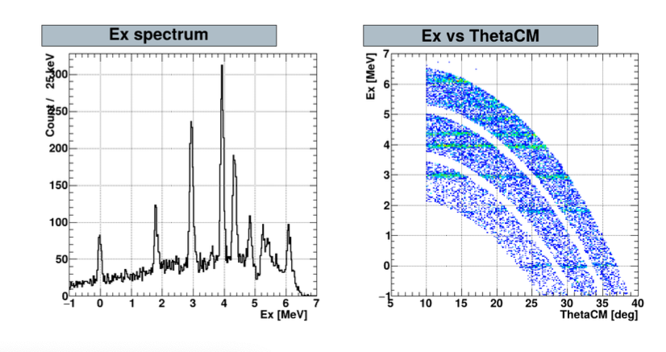
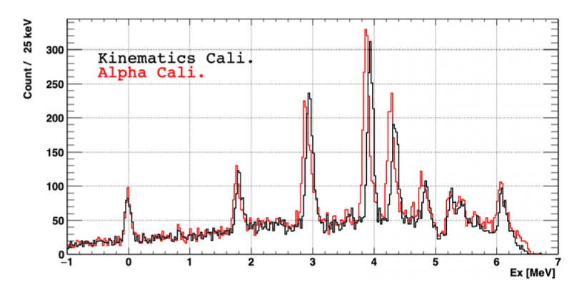
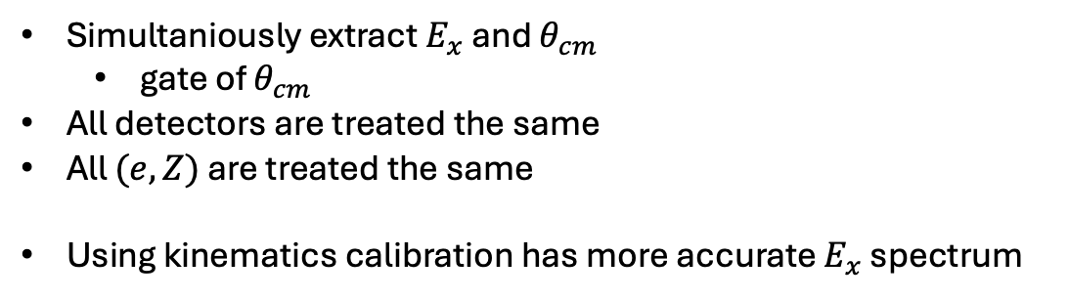
Result
Simultaniously extract $E_{x}$ and $θ_{cm}$
  gate of $θ_{cm}$
All detectors are treated the same
All $(e,Z)$ are treated the same
Using kinematics calibration has more accurate $E_{x}$ spectrum

Slide 11
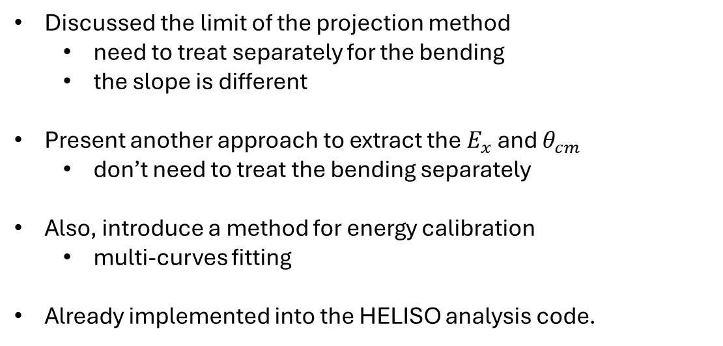
Conclusion
Discussed the limit of the projection method
  need to treat separately for the bending
  the slope is different
Present another approach to extract the $E_{x}$ and $θ_{cm}$
  don’t need to treat the bending separately
Also, introduce a method for energy calibration
  multi-curves fitting
Already implemented into the HELISO analysis code.
Kinematics Calibration and Excitation Energy Reconstruction for Solenoidal Spectrometers
https://arxiv.org/abs/2501.04731v2

Slide 13
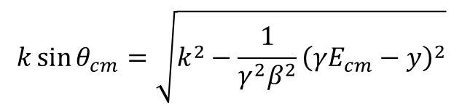
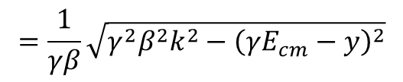


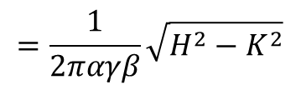





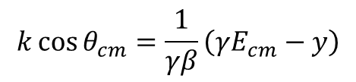


$$y=γE_{cm}−γβk\cos{θ_{cm}}$$
$$ρ=\frac{k}{2πα}\sin{θ_{cm}}$$
$$k\cos{θ_{cm}}=\frac{1}{γβ}\left(γE_{cm}−y\right)$$
$$k$$
$$=\frac{1}{2παγβ}\sqrt{H^{2}−K^{2}}$$
$$k\sin{θ_{cm}}=\sqrt{k^{2}−\frac{1}{γ^{2}β^{2}}{\left(γE_{cm}−y\right)}^{2}}$$
$$θ_{cm}$$
$$\frac{1}{γβ}\left(γE_{cm}−y\right)$$
$$=\frac{1}{γβ}\sqrt{{γ^{2}β^{2}k}^{2}−{\left(γE_{cm}−y\right)}^{2}}$$
Goal, group the term
$$γy−E_{cm}$$
$${γ^{2}β^{2}k}^{2}−{\left(γE_{cm}−y\right)}^{2}$$
$$= {γ^{2}β^{2}(E_{cm}^{2}−m}^{2}) −γ^{2}E_{cm}^{2}−y^{2}+2γyE_{cm}$$
$$=γ^{2}β^{2}E_{cm}^{2}−γ^{2}β^{2}m^{2}−γ^{2}E_{cm}^{2}−\left(γ^{2}−γ^{2}β^{2}\right)y^{2}+2γyE_{cm}$$
$$γ^{2}−γ^{2}β^{2}=1$$
$$=−E_{cm}^{2}−{γ^{2}β^{2}m}^{2}−γ^{2}y^{2}+γ^{2}β^{2}y^{2}+2γyE_{cm}$$
$$= −{γ^{2}β^{2}m}^{2}+γ^{2}β^{2}y^{2}−{\left(γy−E_{cm}\right)}^{2}$$
$$=H^{2}−K^{2}$$

