Slide 1
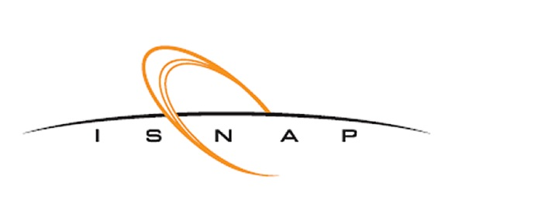


Commissioning of the Solenoid Spectrometer for Nuclear Astrophysics and Decays (SSNAPD)
Solenoidal Spectrometer Workshop, 2025
Cade Dembski, Dan Bardayan, Patrick O’Malley
University of Notre Dame
This research was supported by the National Science Foundation under grants PHY-2117687 and PHY-2310059, and the University of Notre Dame.
Update the footer: Insert/Header and Footer

Slide 2
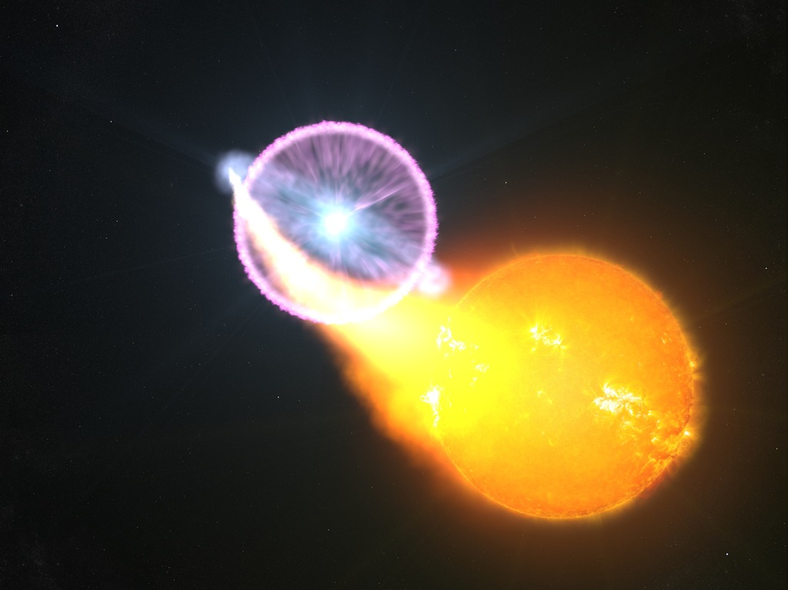
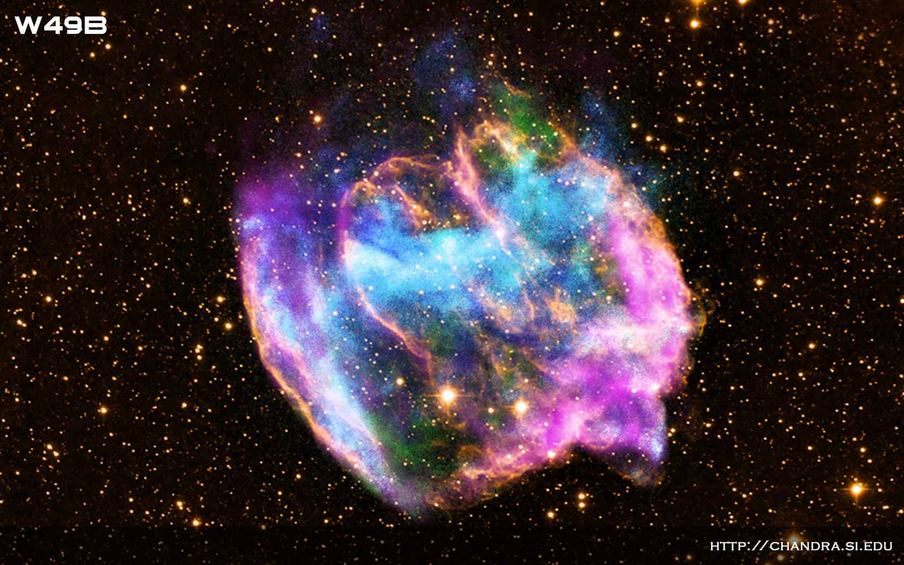
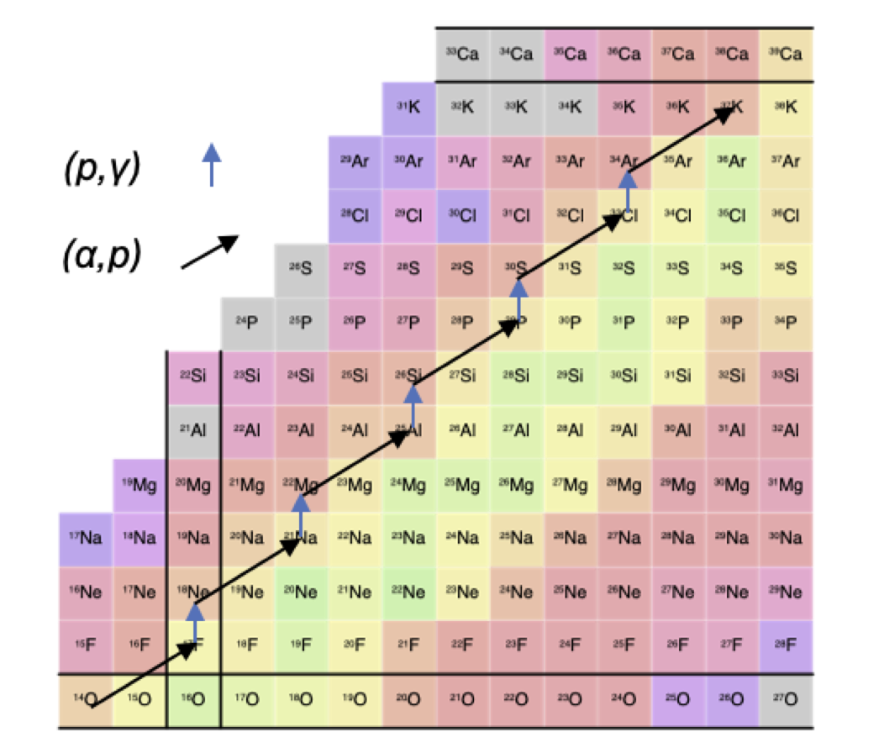
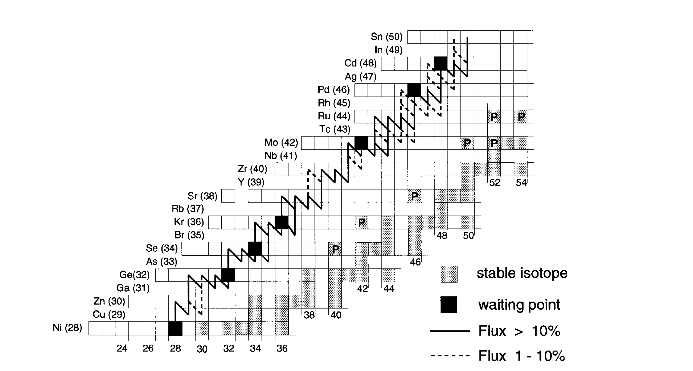
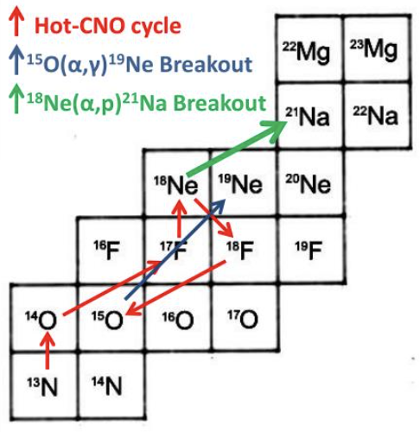
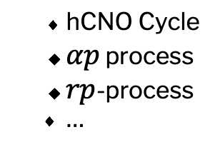

Nuclear Astrophysics and Decays - Explosive Nucleosynthesis
Nucleosynthesis occurring during cataclysmic or non-cataclysmic astrophysical explosions
Classical Novae, Type I X-ray Bursts, Core-Collapse Supernovae…
Sum of multiple nucleosynthesis processes
Image: NASA/GSFC/S. Wiessinger
Image: Chandra X-ray Observatory
hCNO Cycle
$αp$ process
$rp$-process
…
Tuff, Intl. Workshop on Physics of Nuclei at Extremes 2010
Jayatissa et al., EPJ A 61: 98
Weischer and Schatz, AIP Conf. Proc. 549 744-750
Update the footer: Insert/Header and Footer

Slide 3
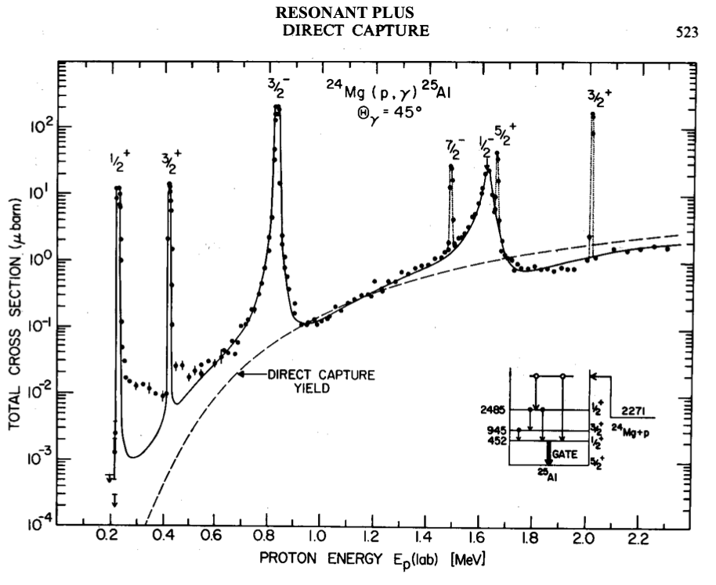
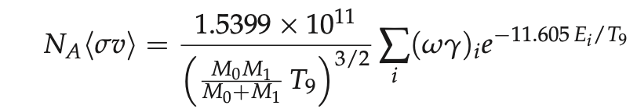
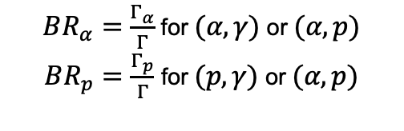
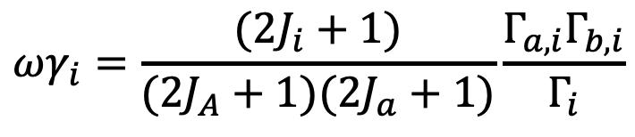
Narrow Resonance Reactions and Decay
At low masses, capture cross sections are often dominated by resonant contributions
Astrophysical reaction rates are determined by individual resonance strengths
Christian Iliadis, Nuclear Physics of Stars
For $A(a,b)B$ populating compound nucleus level i,
Decay branching ratios of compound nuclear states needed!
$$ωγ_{i}=\frac{(2J_{i}+1)}{(2J_{A}+1)(2J_{a}+1)}\frac{Γ_{a,i}Γ_{b,i}}{Γ_{i}}$$
$BR_{α}=\frac{Γ_{α}}{Γ}$ for $(α,γ)$ or $(α,p)$
$BR_{p}=\frac{Γ_{p}}{Γ}$ for $(p,γ)$ or $(α,p)$
Update the footer: Insert/Header and Footer
Figure from S.E. Woosley, UCO/Lick Observatory Lectures
https://www.ucolick.org/~woosley/ay220-15/lectures/lecture5.4x.pdf

Slide 4
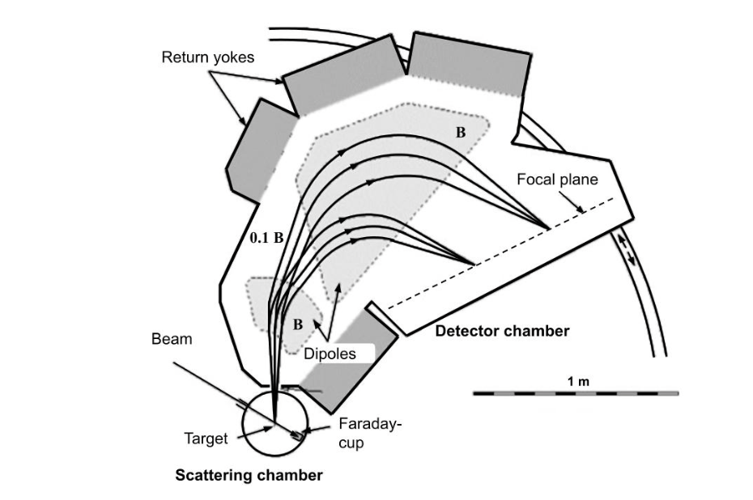
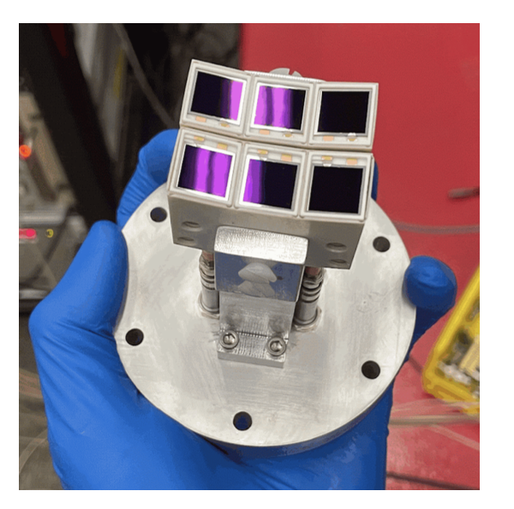
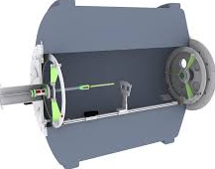

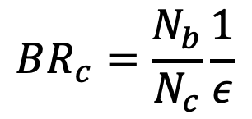

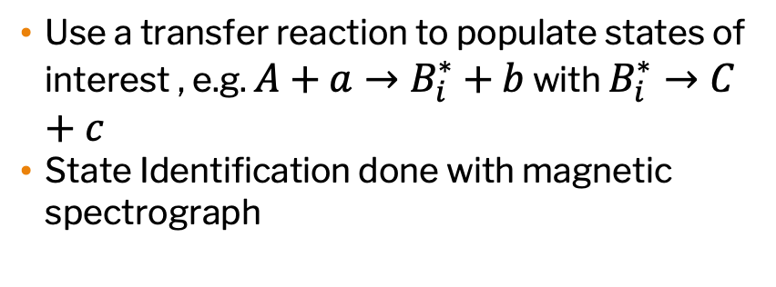


Traditional Branching Ratio Measurements
Use a transfer reaction to populate states of interest , e.g. $A+a→B_{i}^{∗}+b$ with $B_{i}^{∗}→C+c$
State Identification done with magnetic spectrograph
Figure: Carmichael et al., EPJ WoC 304 02002
Classical Novae
Type I x-Ray Burst
Position determines energy
Ejectile $b$
$$BR_{c}=\frac{N_{b}}{N_{c}}\frac{1}{ε}$$
$a$ Beam
Image: NASA/CXC/M. WEISS
Type 1a Supernovae
A Target
Decay particle $c$
Core Collapse Supernovae
$$B^{∗}$$
Si Detectors
Challenges in decay measurement:
Geometric Efficiency
Particle Identification (high electron background)
Solenoidal Spectrometer addresses both of these issues!
Helical Orbit Spectrometer, Argonne National Lab
Lighthall et al., NIM A 622 1
Update the footer: Insert/Header and Footer

Slide 5
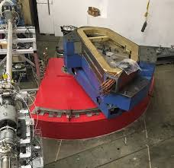
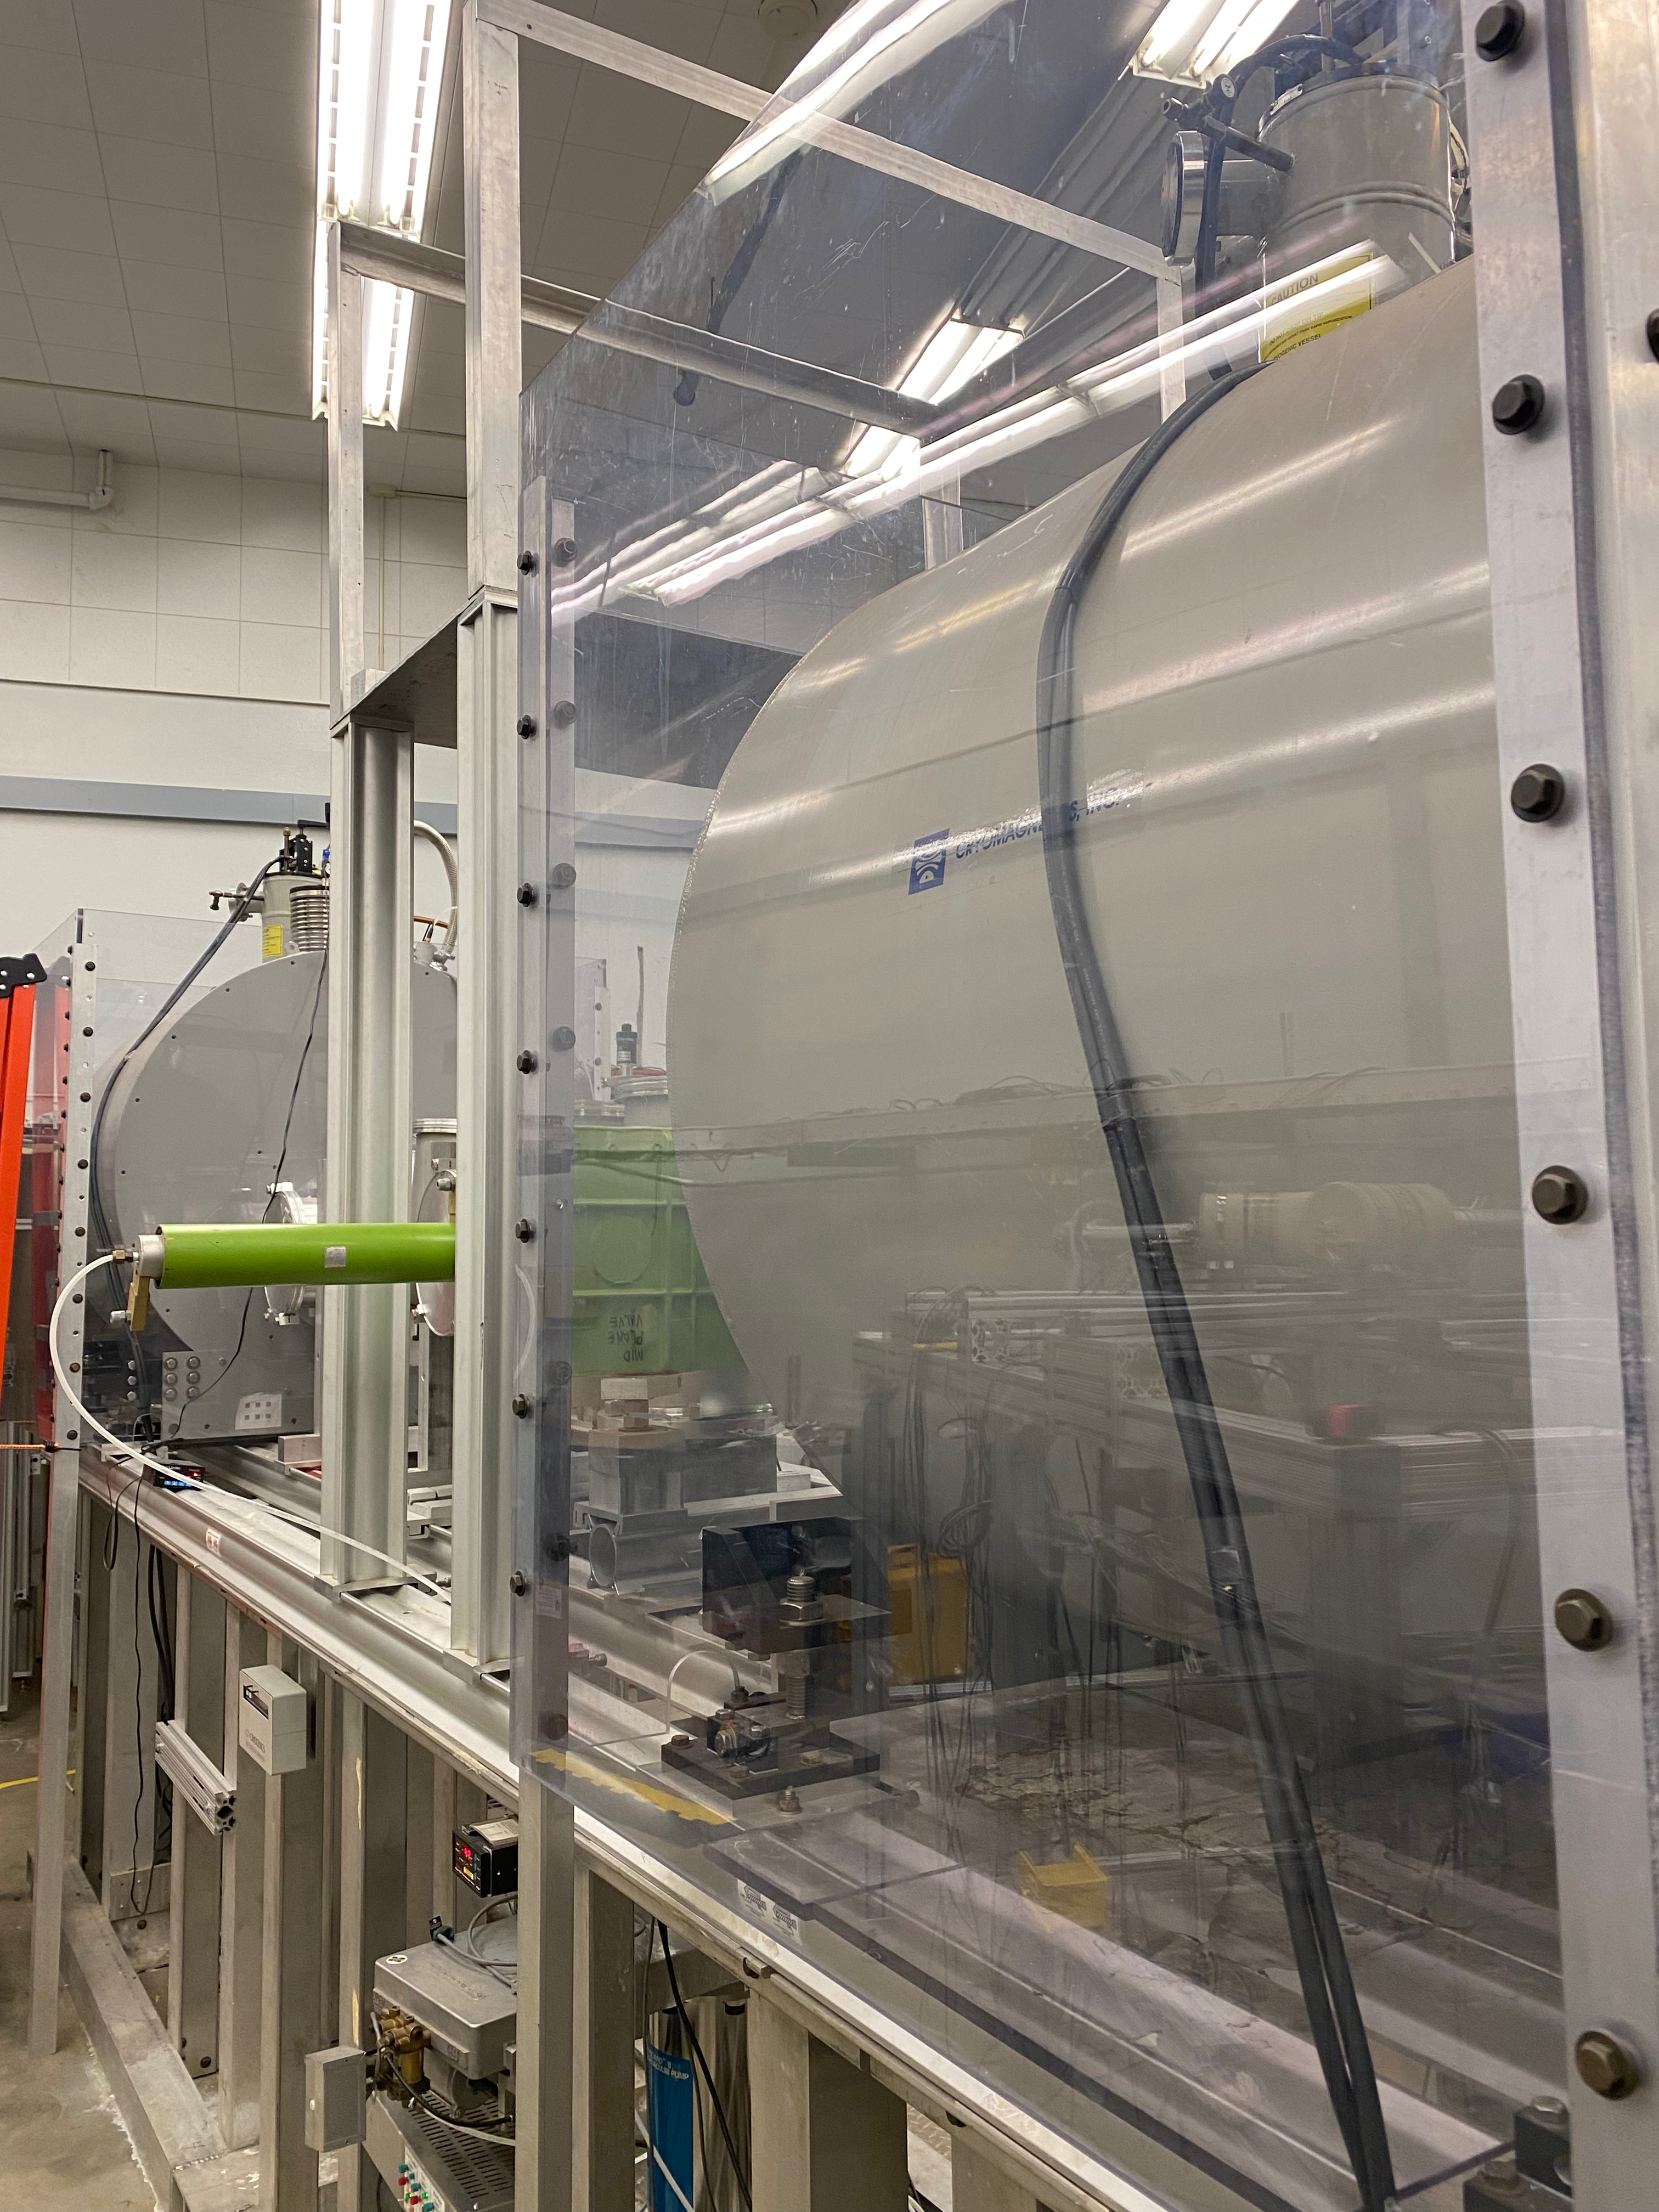
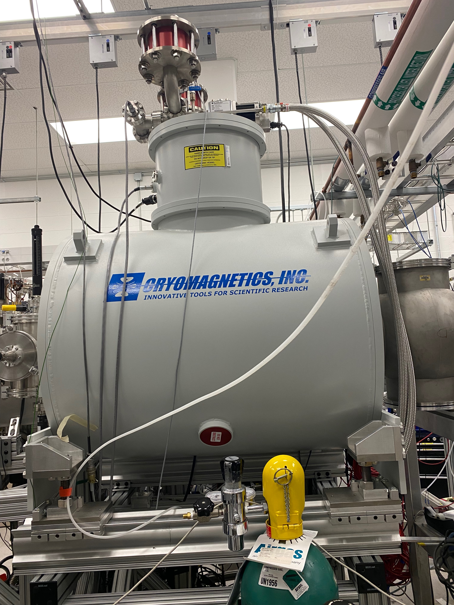
Decay Measurements at Notre Dame
Not a lot of room behind our spectrograph…
… but we have solenoids to spare!
Update the footer: Insert/Header and Footer

Slide 6
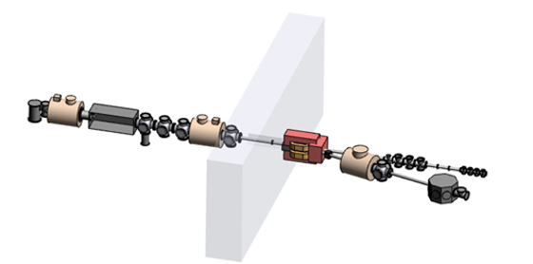








TriSol and the SSNAPD Concept
TriSol Facility - three 5-6 T superconducting solenoids (usually) used to purify radioactive ion beams produced in-flight
Magnetic Spectrometer
Ejectile Detection
Solenoidal Spectrometer
$$A+a→B_{i}^{∗}+b$$
$$B_{i}^{∗}→C+c$$
$δ$ electrons
Target $A$
$E−ΔE$ telescope
Si Detector Array
$a$ light ion beam
Decay particles $c$
Ejectile Particles $b$
Update the footer: Insert/Header and Footer

Slide 7
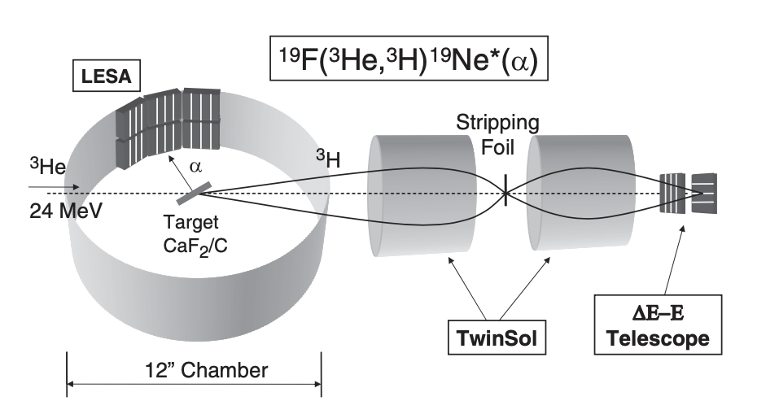
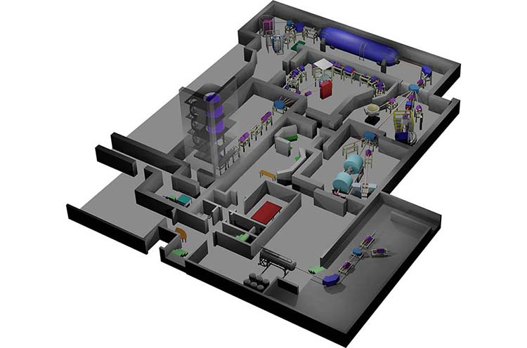
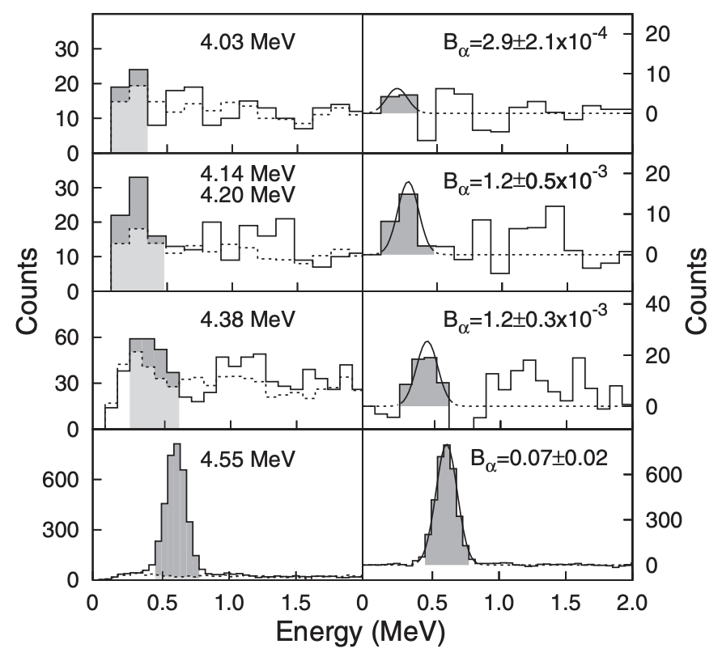
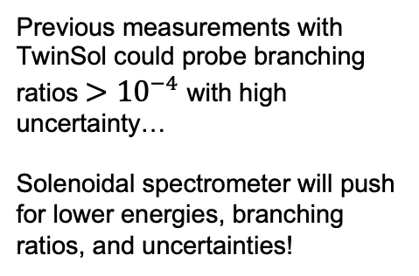
Previous Decay Measurements with TwinSol
Previous measurements with TwinSol could probe branching ratios $>{10}^{−4}$ with high uncertainty…
Solenoidal spectrometer will push for lower energies, branching ratios, and uncertainties!
Update the footer: Insert/Header and Footer
Figures from Tan et al., PRL 98 242503
Image: M.R. Hall, D.W. Bardayan et al,
PRL 122 052701
Indirect methods are necessary!

Slide 8
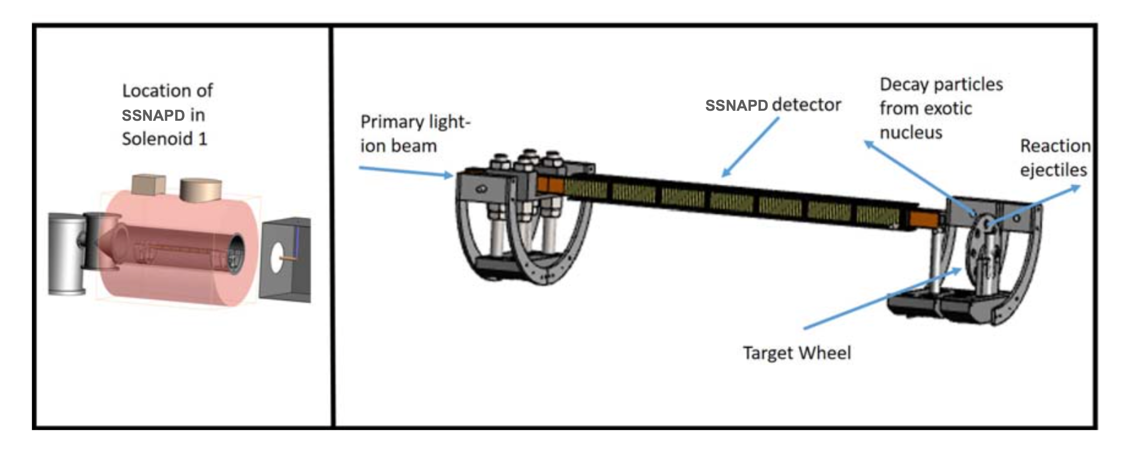
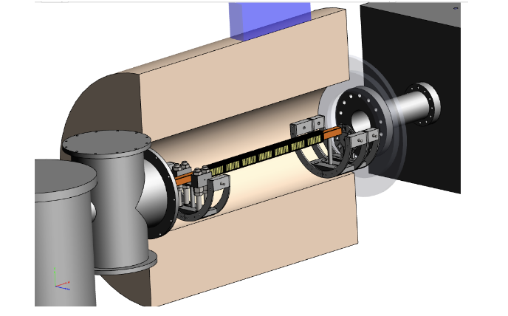
SSNAPD Concepts - Old
Update the footer: Insert/Header and Footer
Image: M.R. Hall, D.W. Bardayan et al,
PRL 122 052701
Indirect methods are necessary!

Slide 9
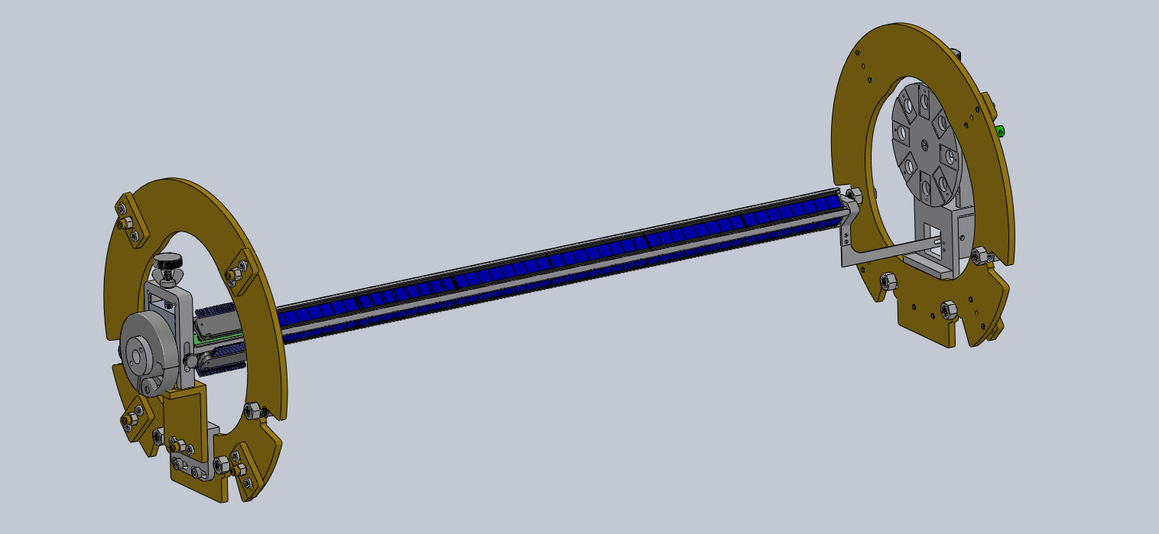
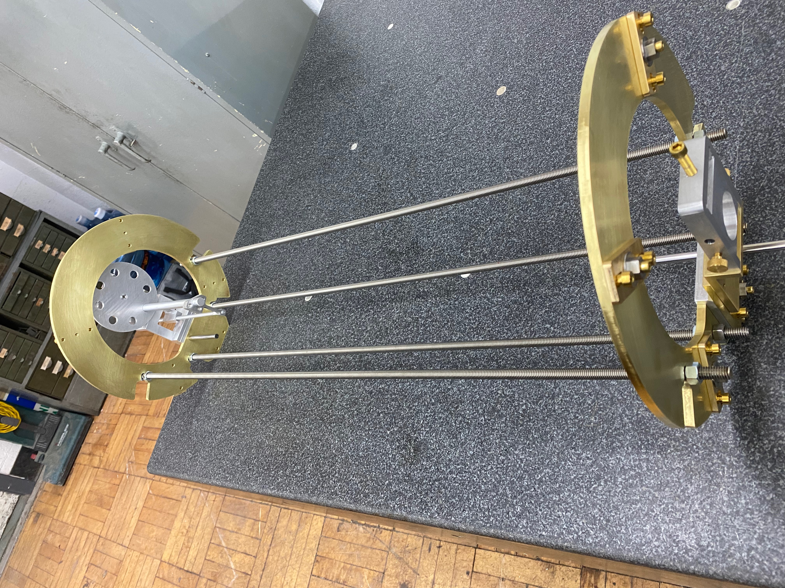
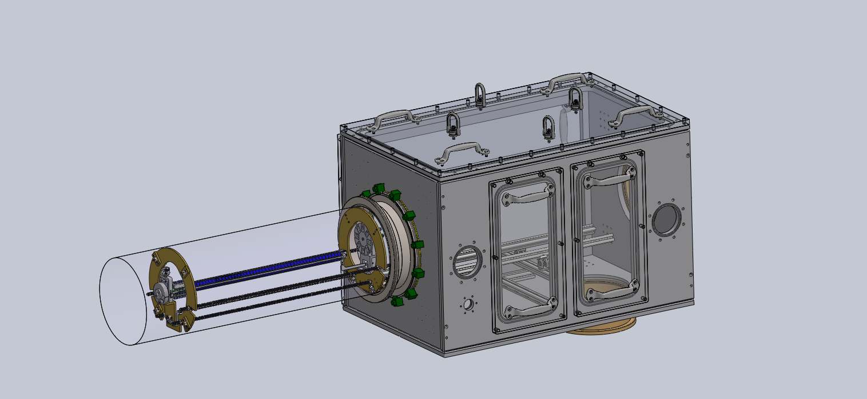
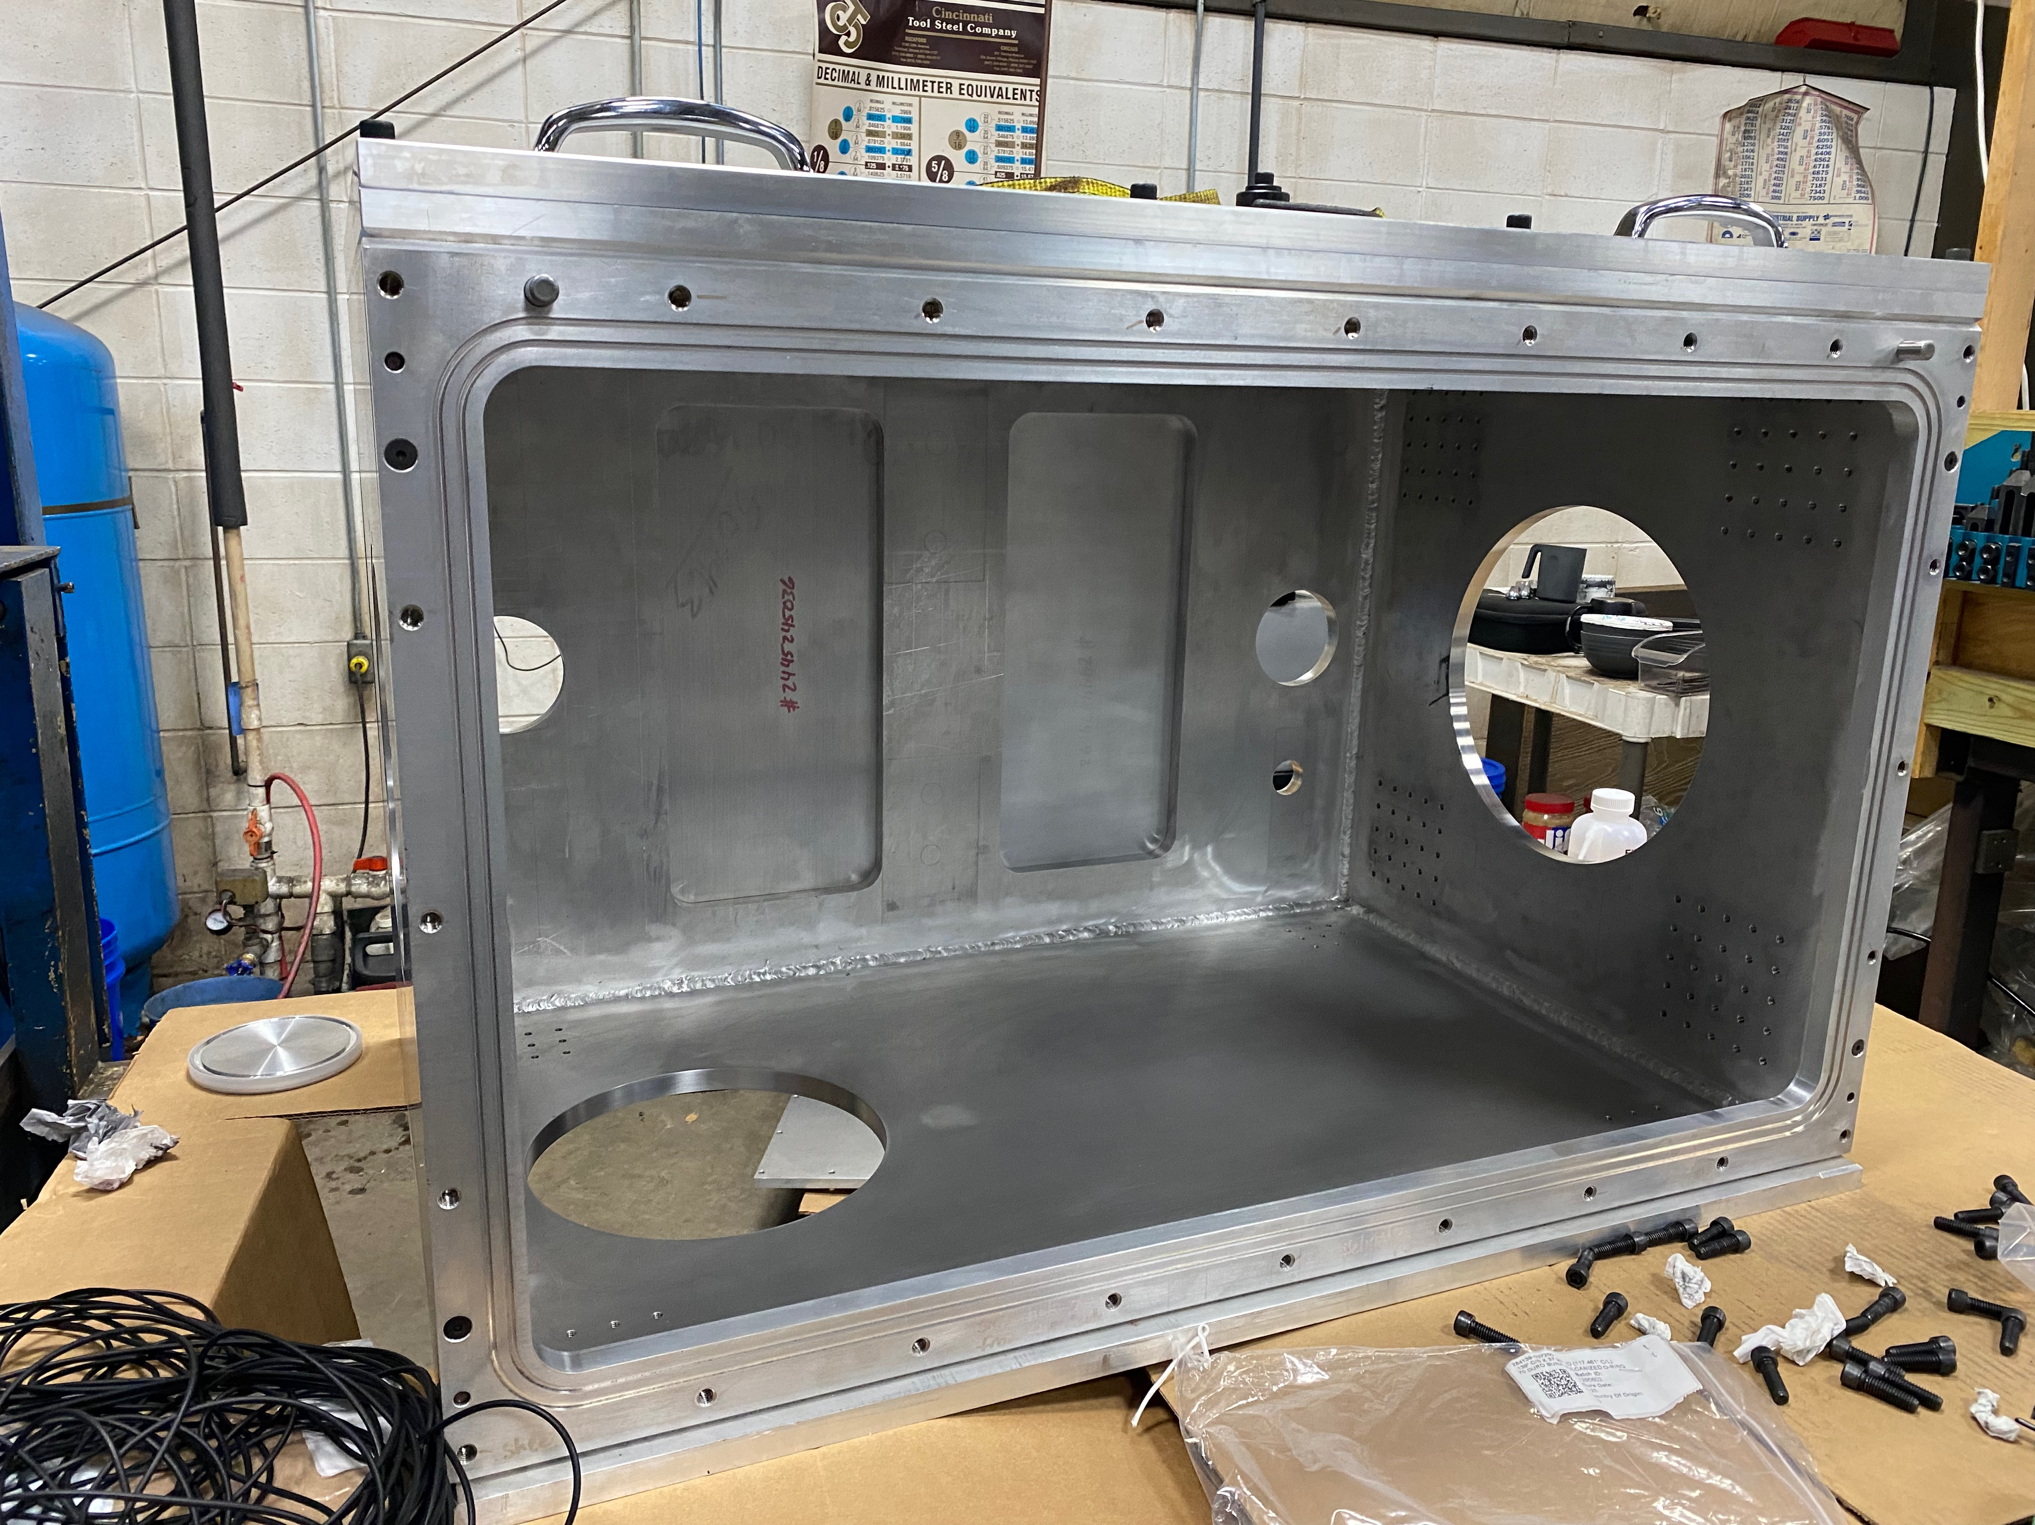
SSNAPD Concepts
Update the footer: Insert/Header and Footer
Image: M.R. Hall, D.W. Bardayan et al,
PRL 122 052701
Indirect methods are necessary!

Slide 10
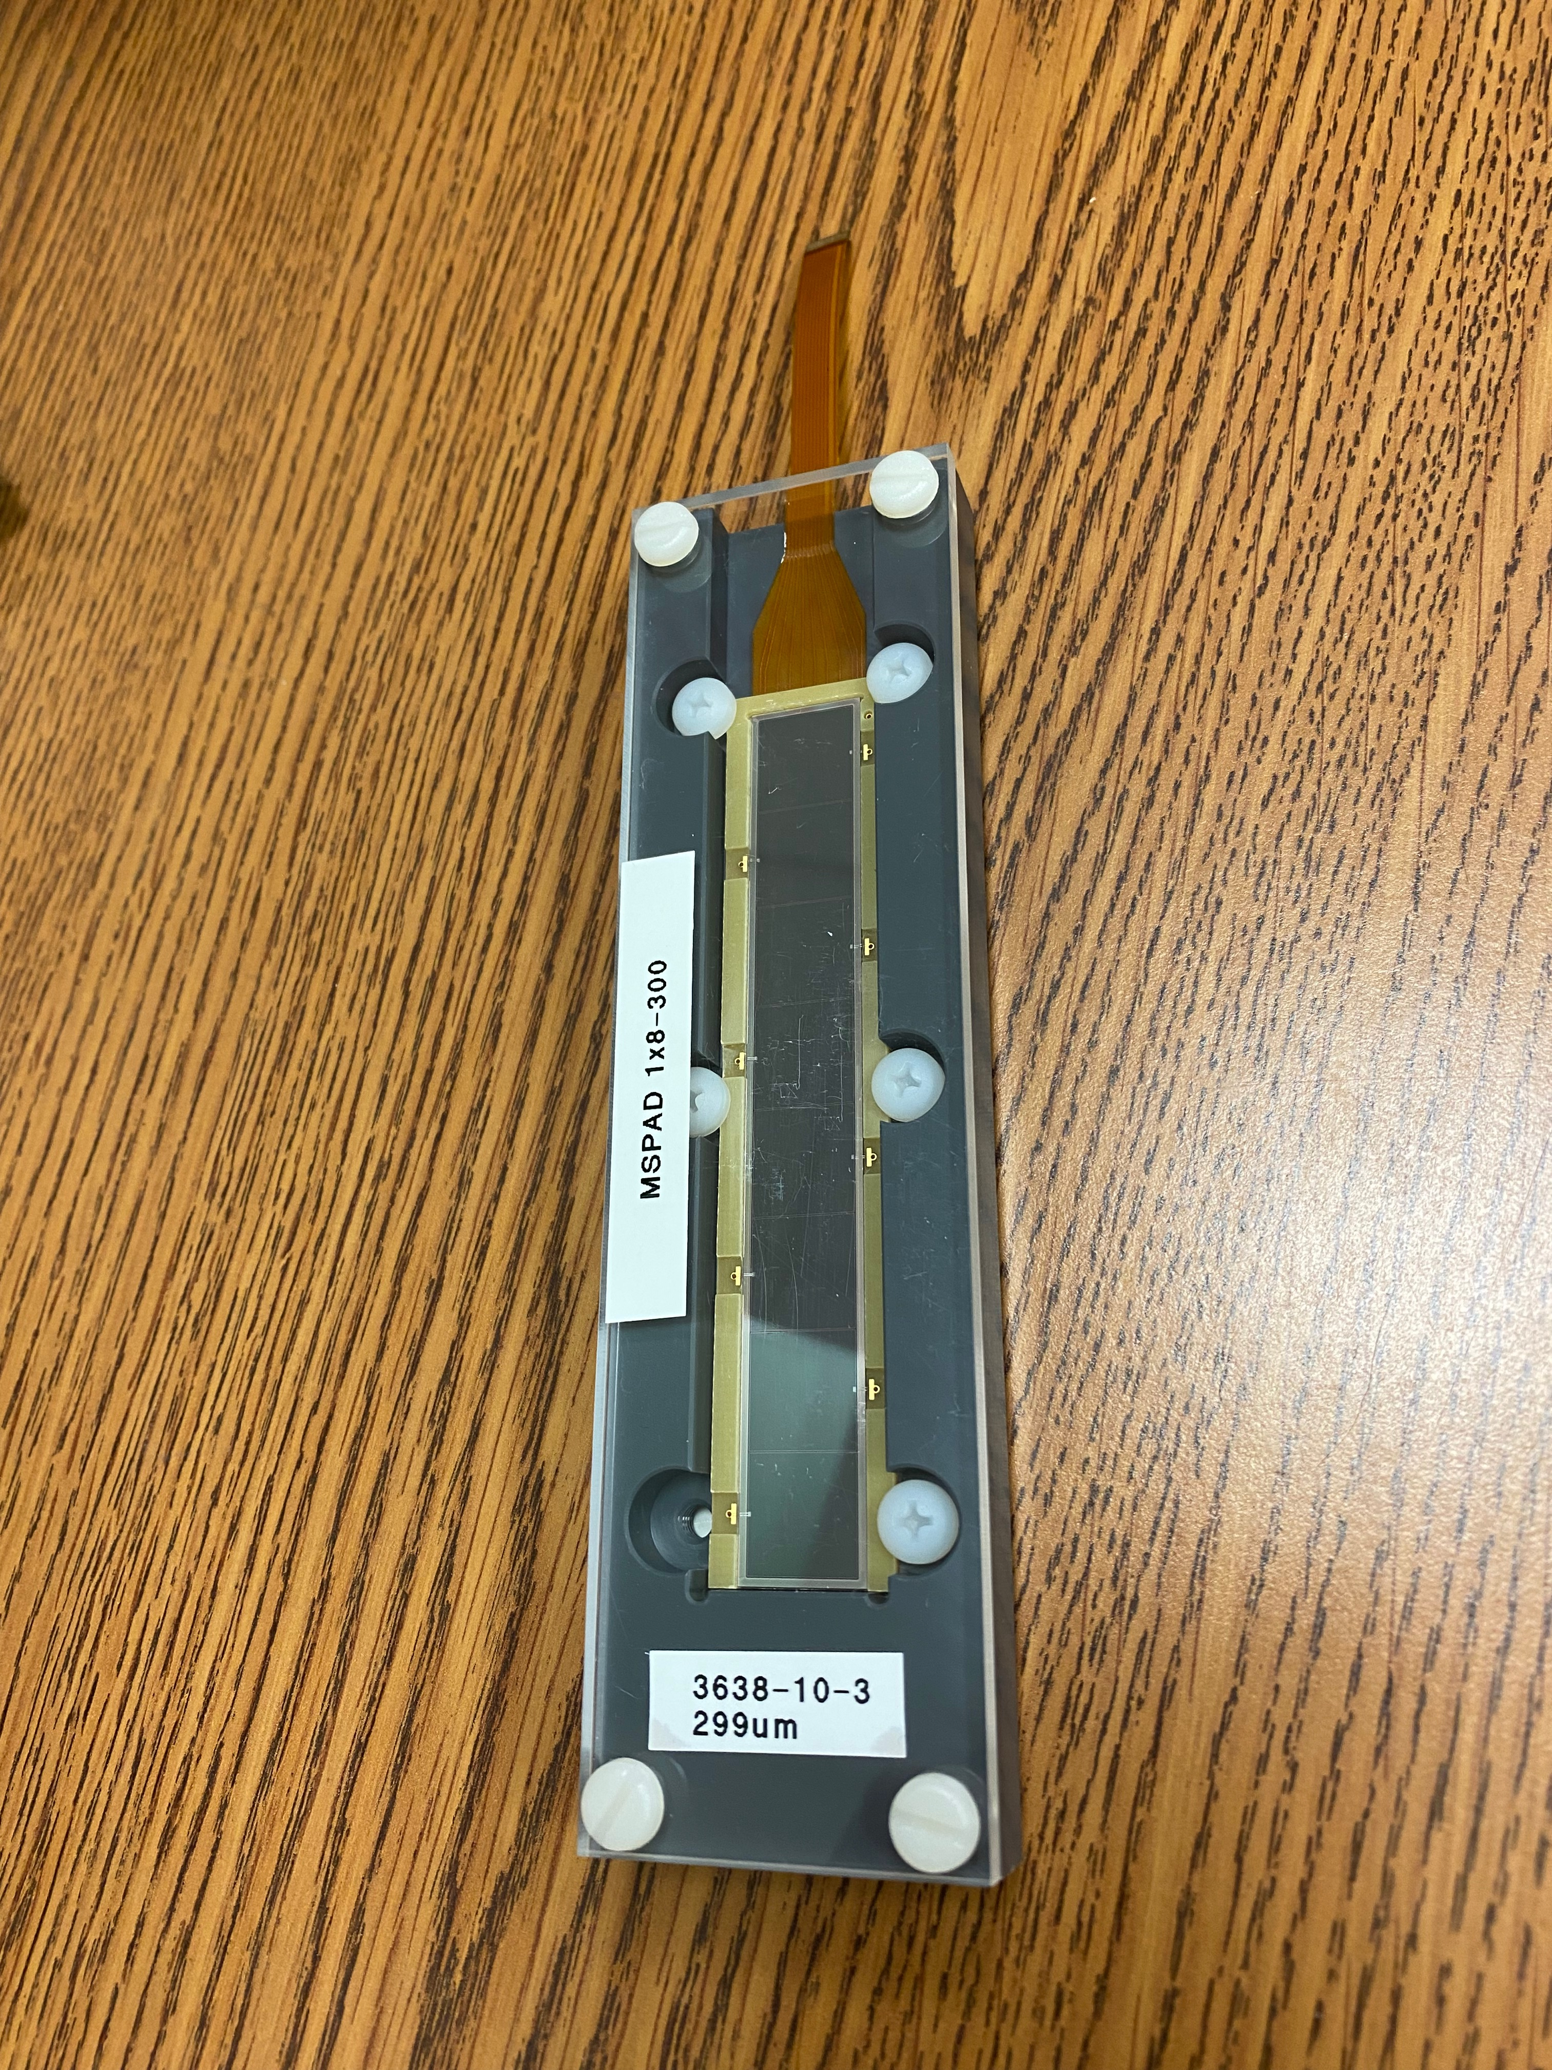
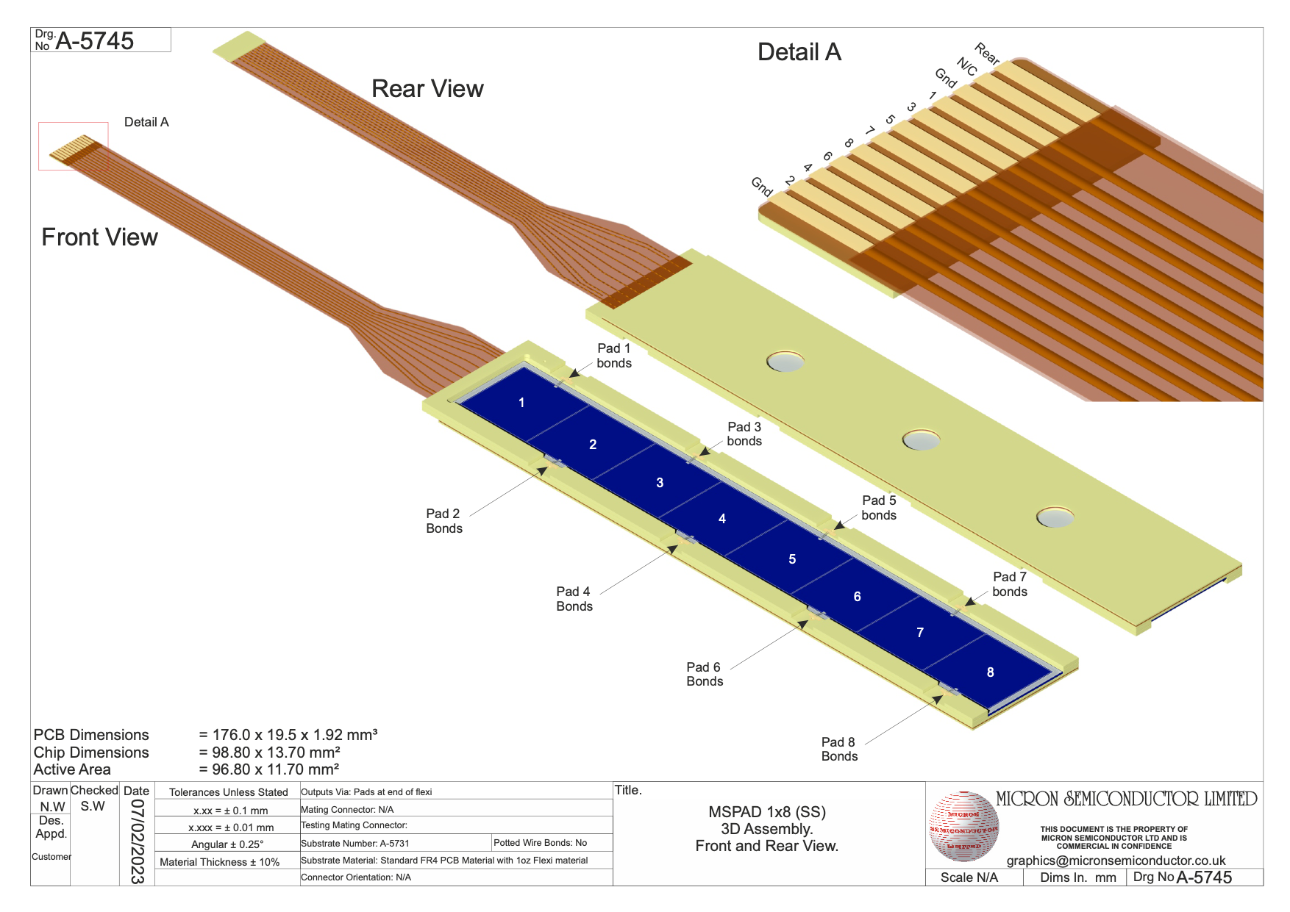
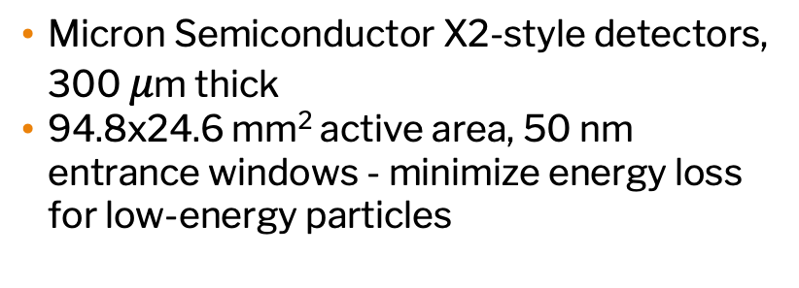
SSNAPD Silicon Detectors
Micron Semiconductor X2-style detectors, 300 $μ$m thick
94.8x24.6 mm² active area, 50 nm entrance windows - minimize energy loss for low-energy particles
Update the footer: Insert/Header and Footer

Slide 11
Getting SSNAPD Working: Two-Factor Authentication
Step One: The Solenoidal Spectrometer
Update the footer: Insert/Header and Footer

Slide 12
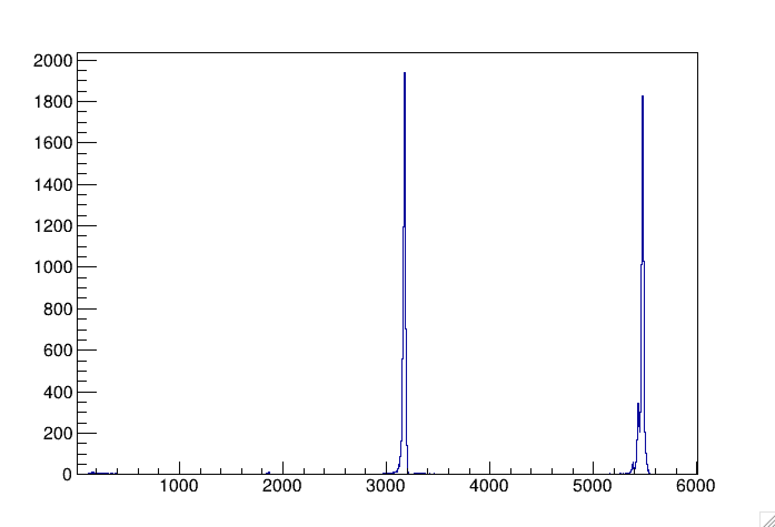
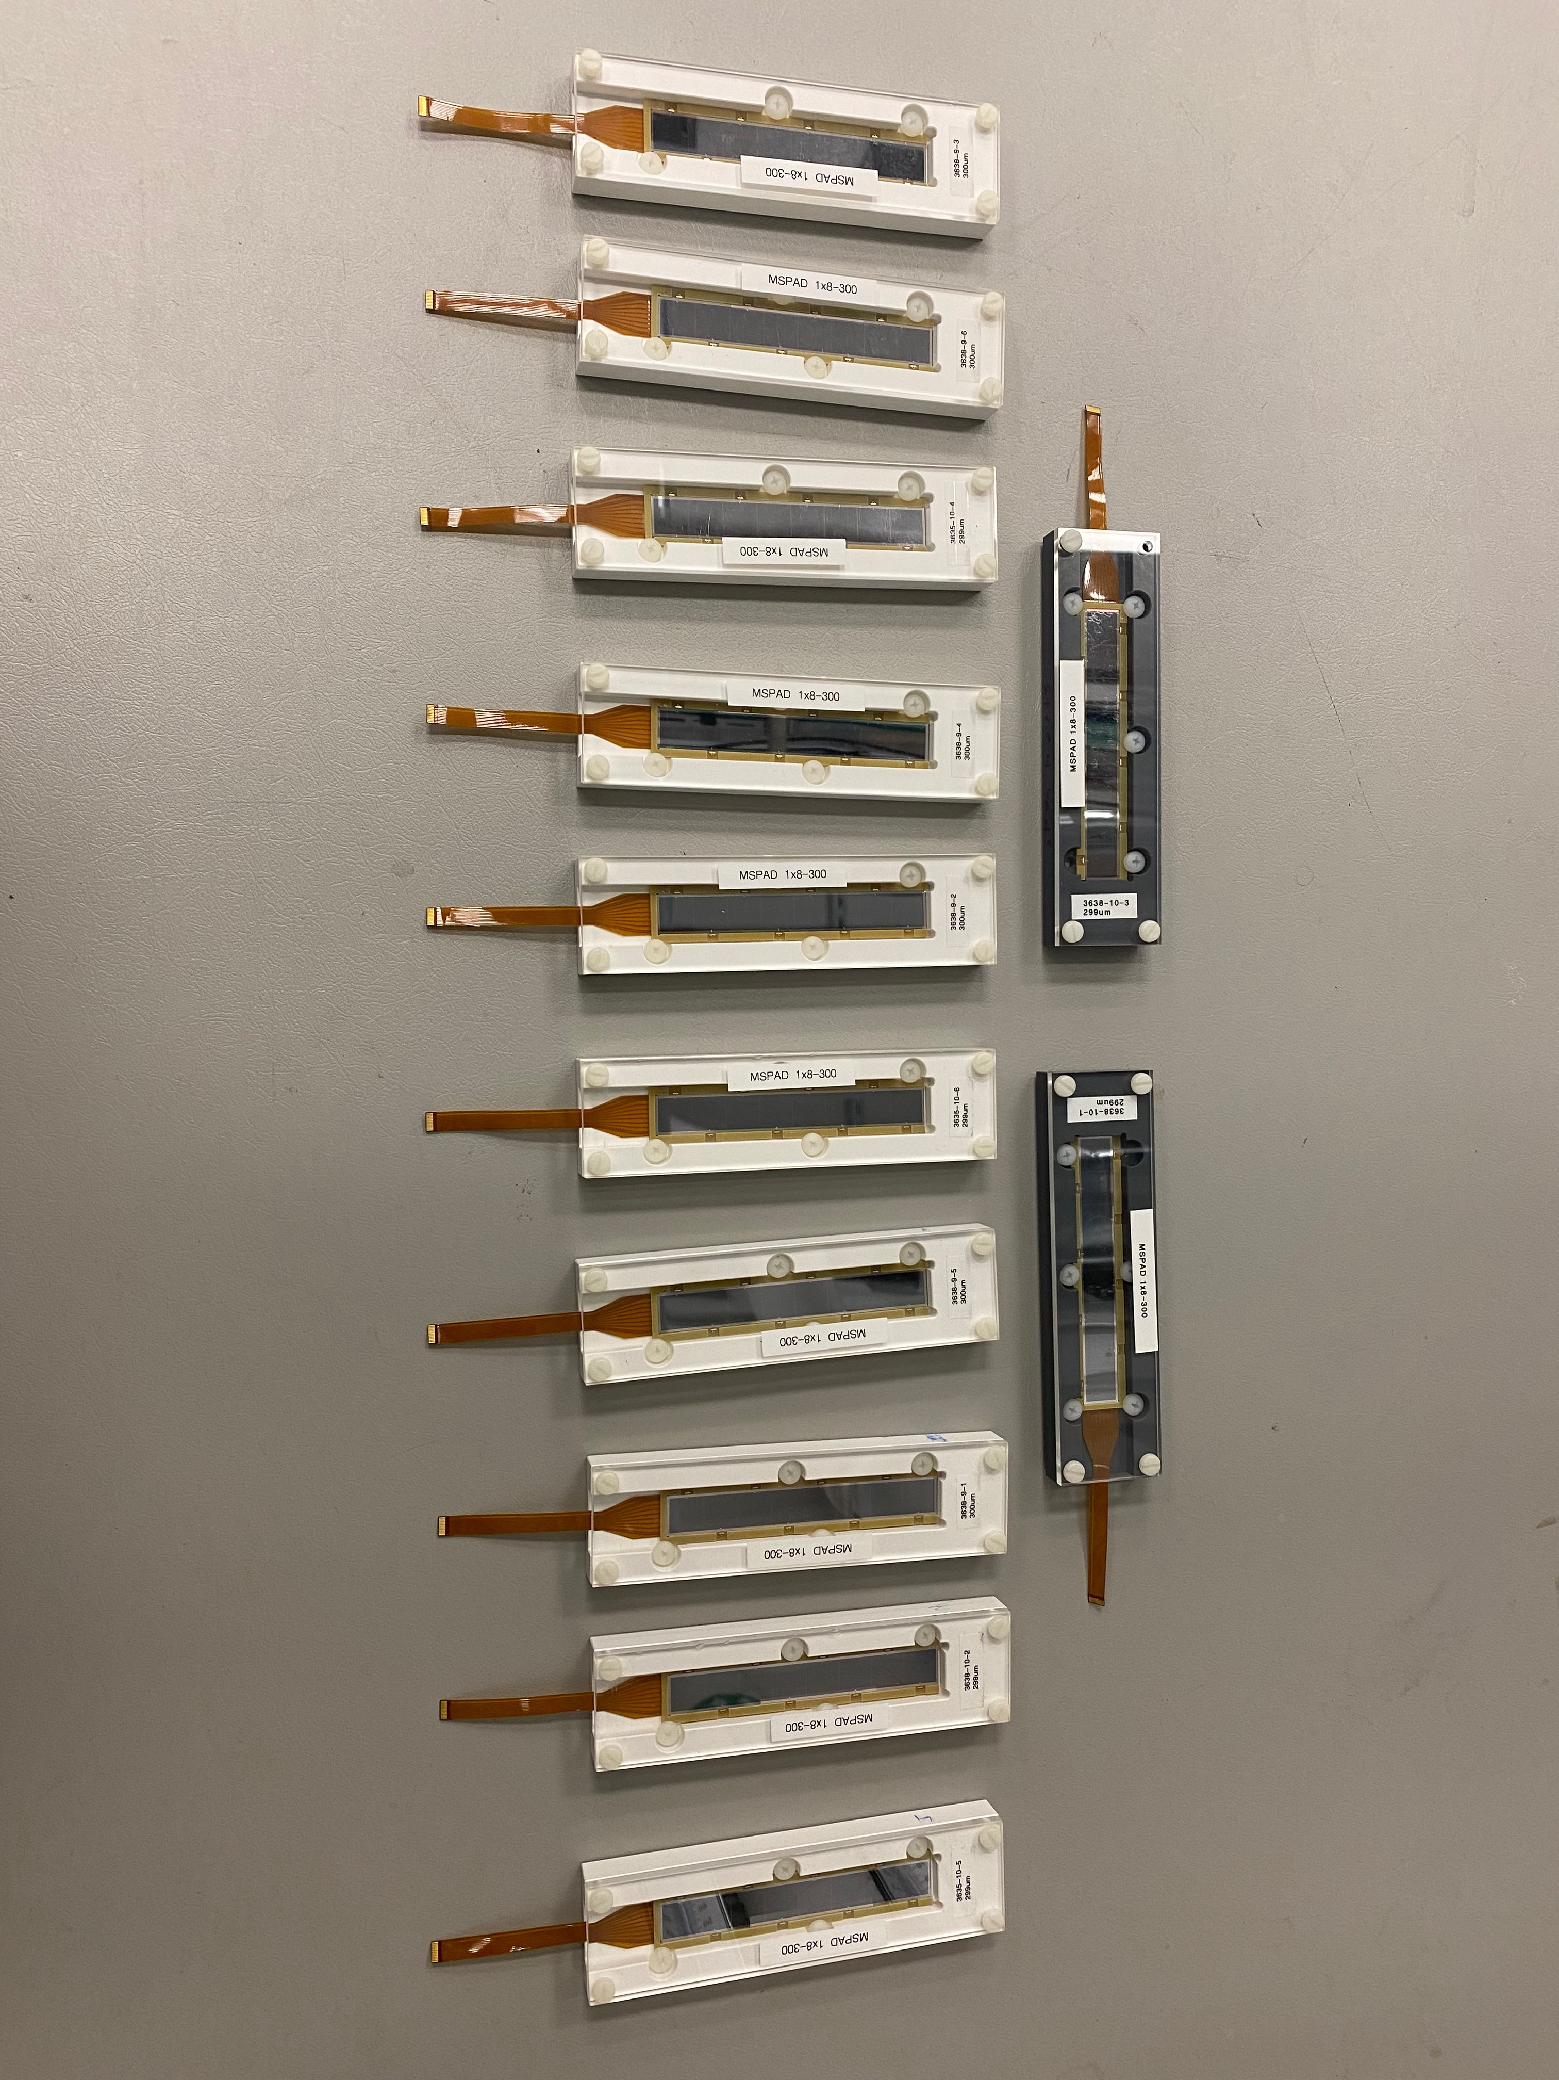


SSNAPD Detector Characterization
Mixed-$α$ Source Test
¹⁴⁸Gd
²⁴¹Am
Counts
$α$ energy (keV)
Resolution looks very good for all detectors (20-30 keV!)
Another experiment is needed to verify threshold capabilities of ~200 keV - much more scientifically limiting
Update the footer: Insert/Header and Footer

Slide 13
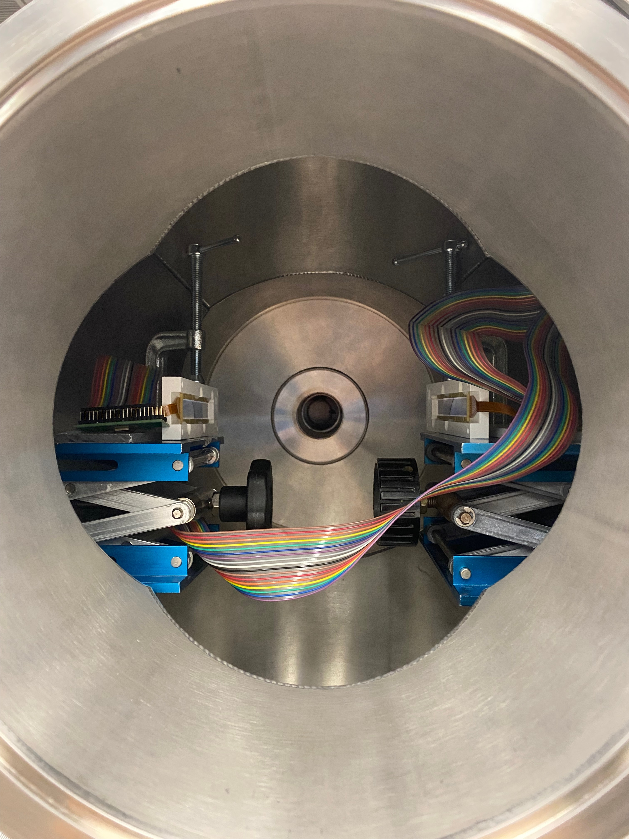
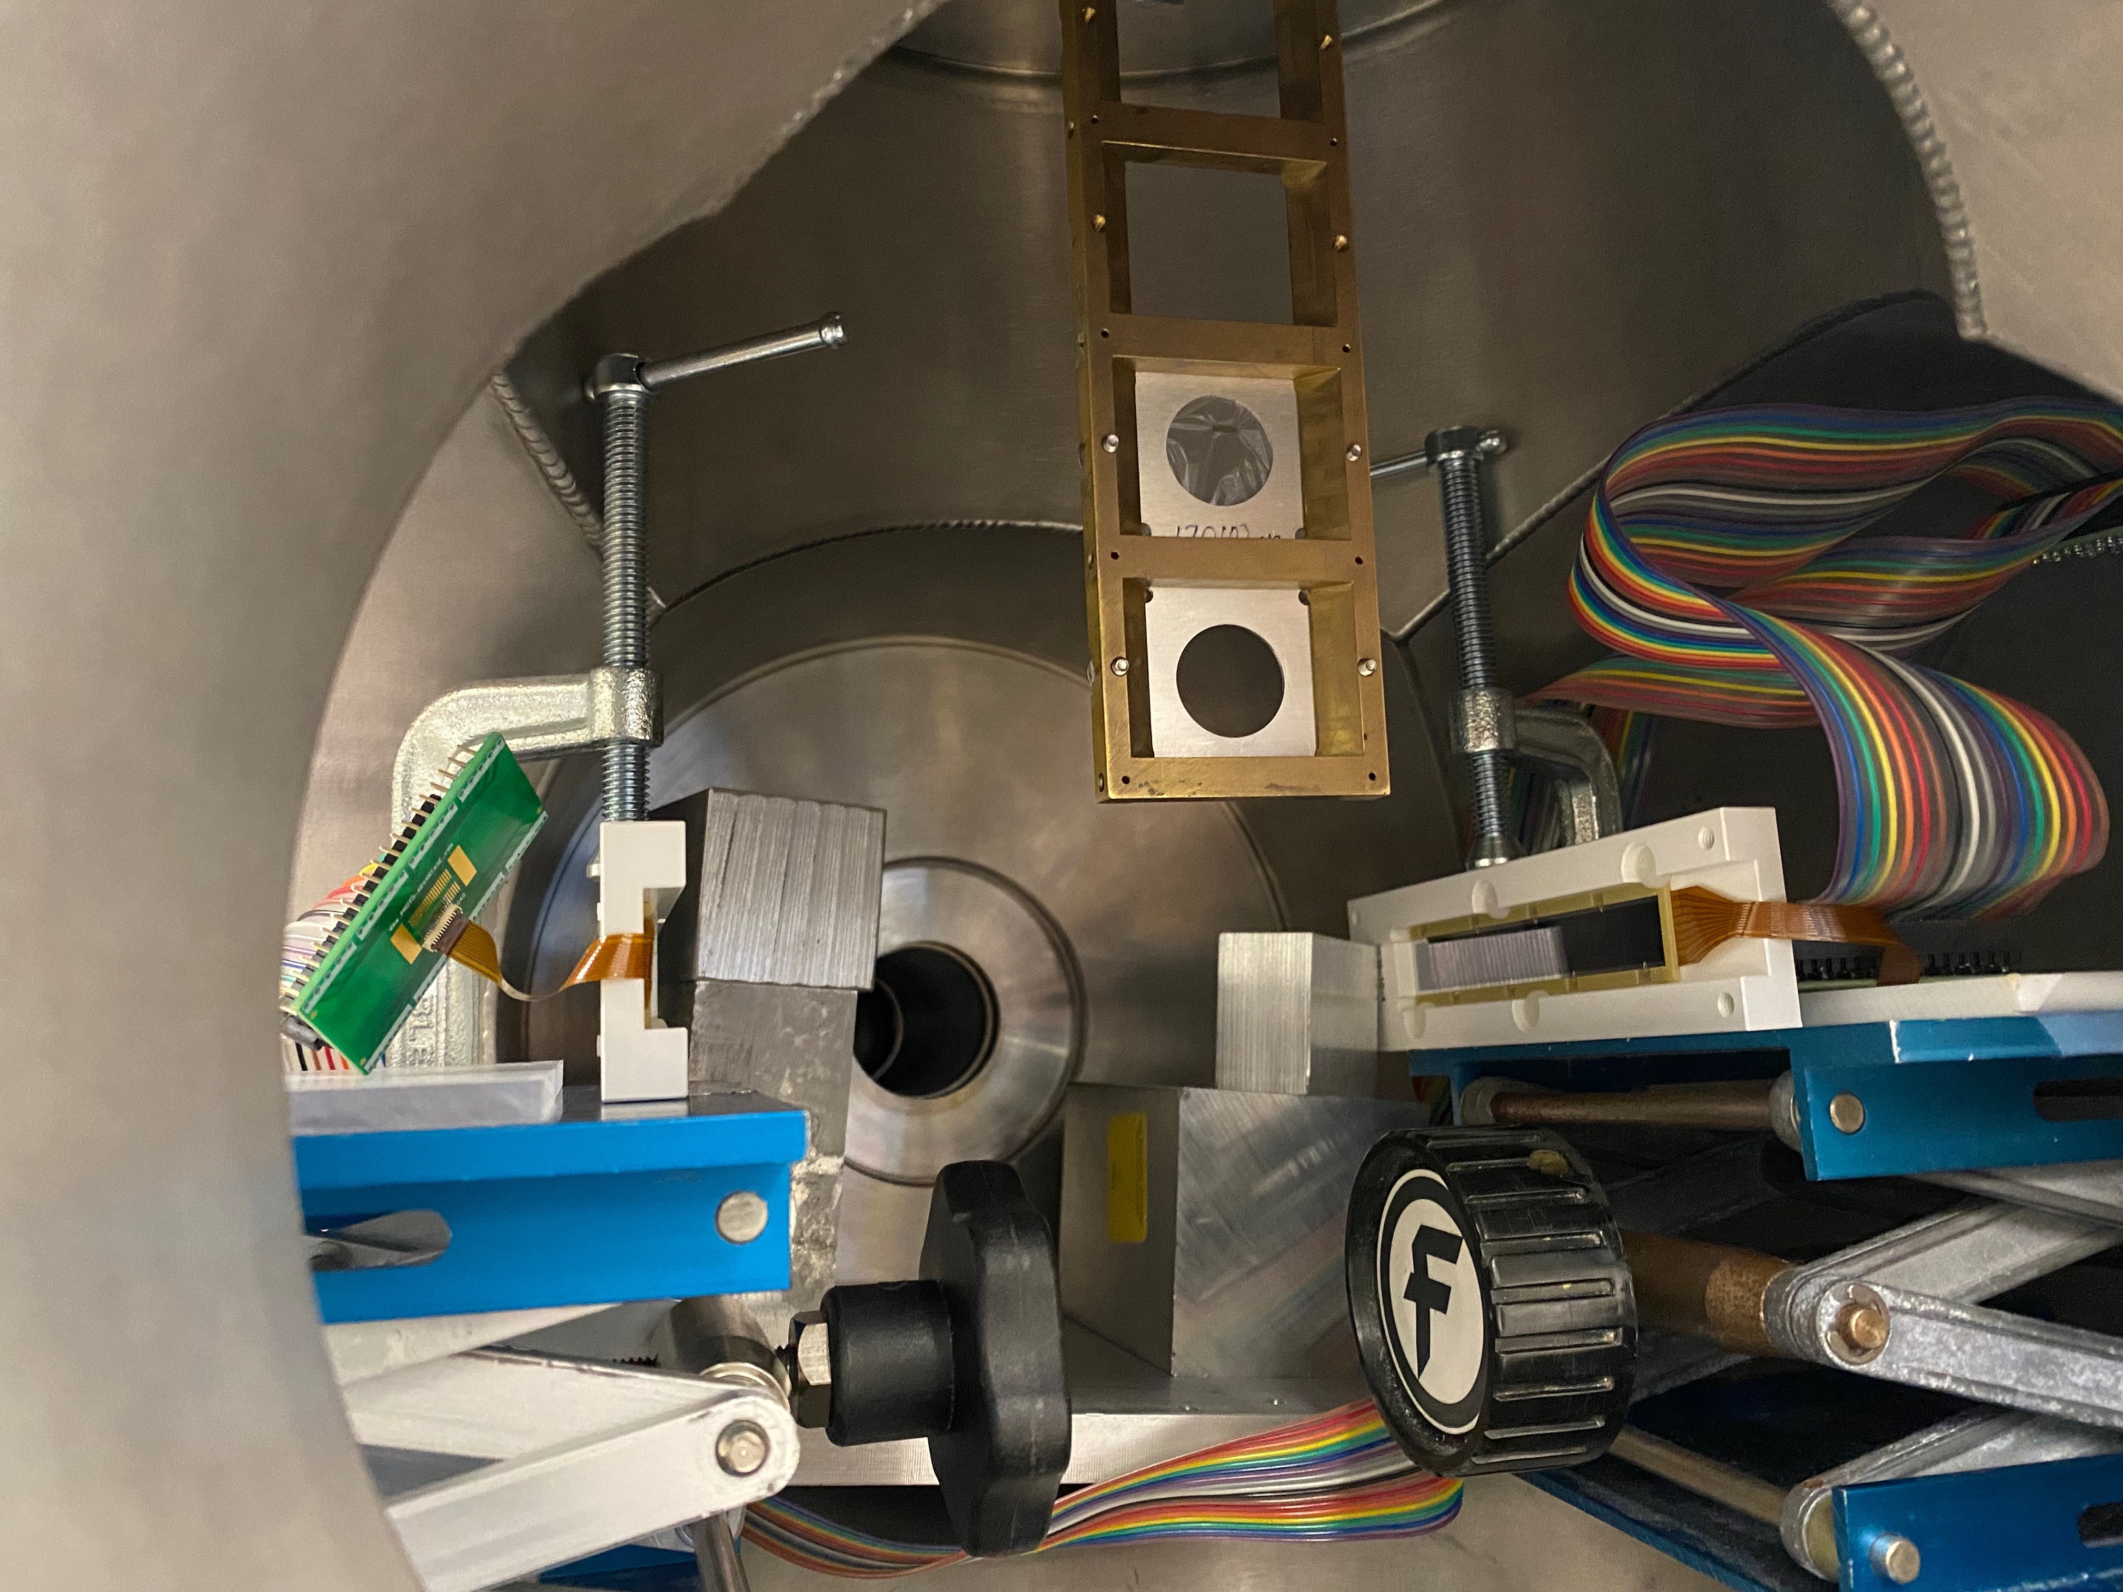
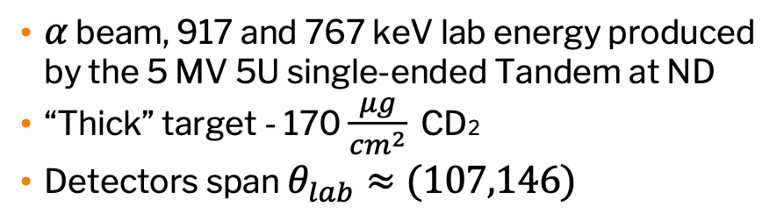

Threshold Tests - $α+$carbon backscattering
$α$ beam, 917 and 767 keV lab energy produced by the 5 MV 5U single-ended Tandem at ND
“Thick” target - 170 $\frac{μg}{cm^{2}}$ CD2
Detectors span $θ_{lab}≈(107,146)$
Update the footer: Insert/Header and Footer

Slide 14
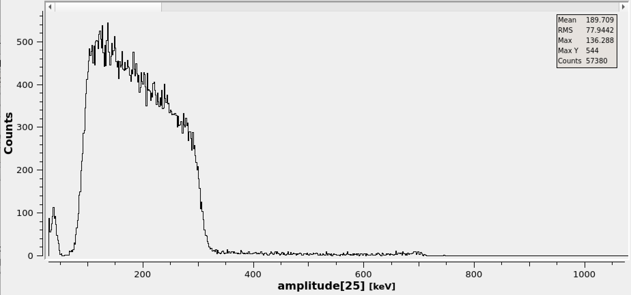
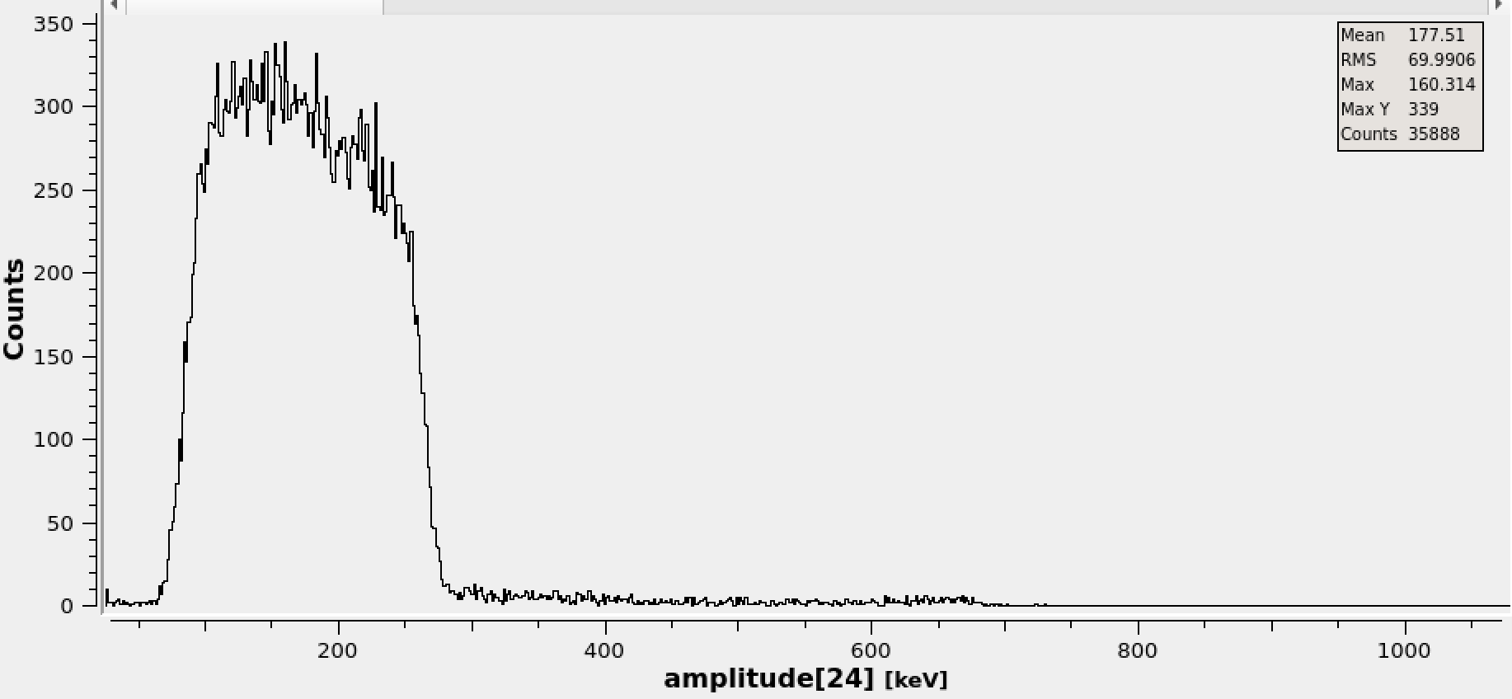
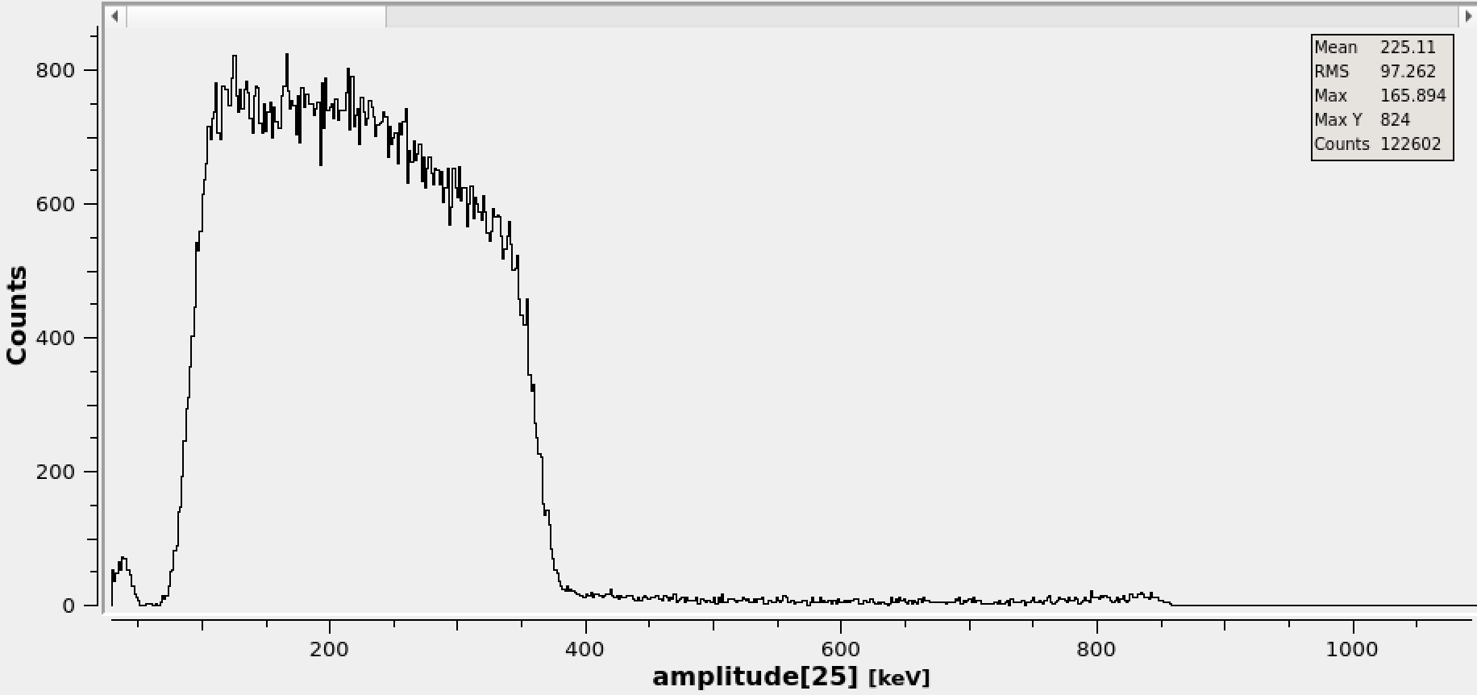
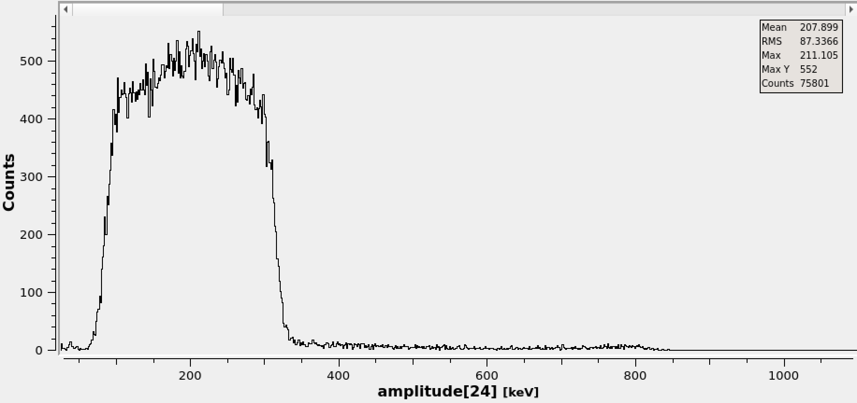
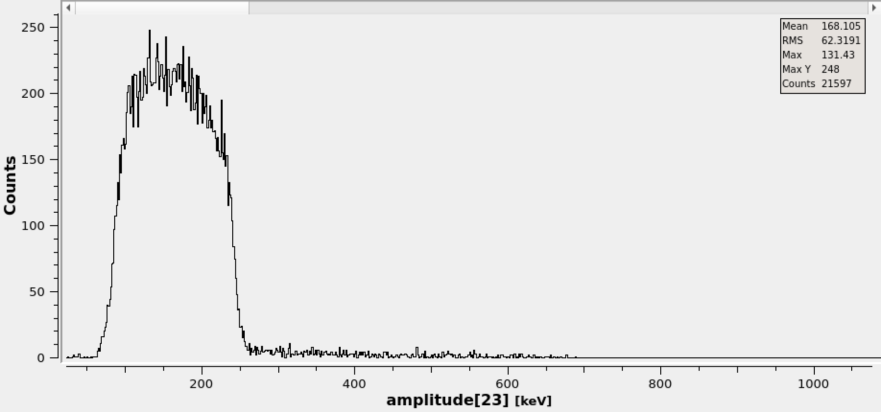

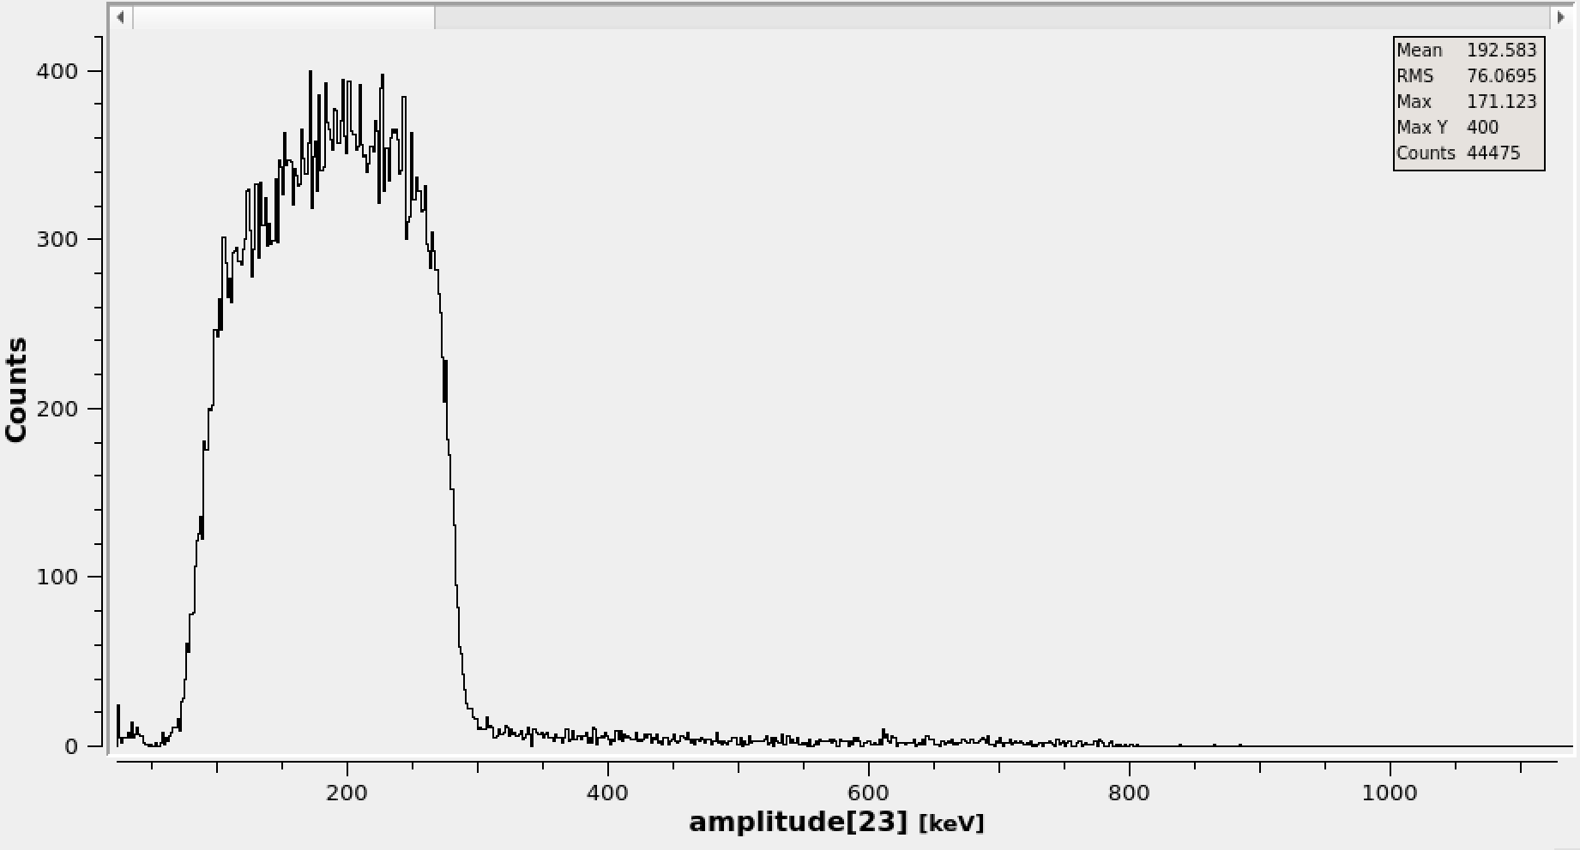
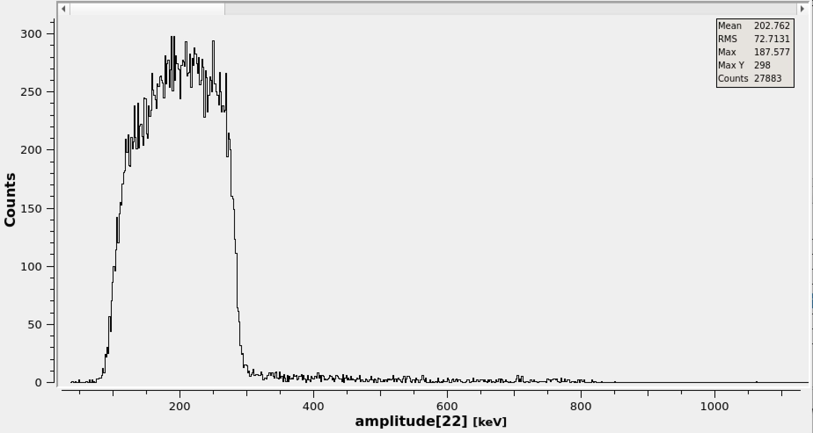






$α$ + ¹²C scattering - $E_{α}$ = 917 keV
$α$ + ¹²C scattering - $E_{α}$ = 767 keV
$$θ_{lab}≈118$$
$$θ_{lab}≈130$$
$$θ_{lab}≈138$$
$$θ_{lab}≈145$$
Scattering occurs further in target
Update the footer: Insert/Header and Footer

Slide 15
Getting SSNAPD Working: Two-Factor Authentication
Step Two: The Magnetic Spectrometer
Step One: The Solenoidal Spectrometer
When parts are delivered:
Test detectors in solenoid with carrier boards
Update the footer: Insert/Header and Footer

Slide 16
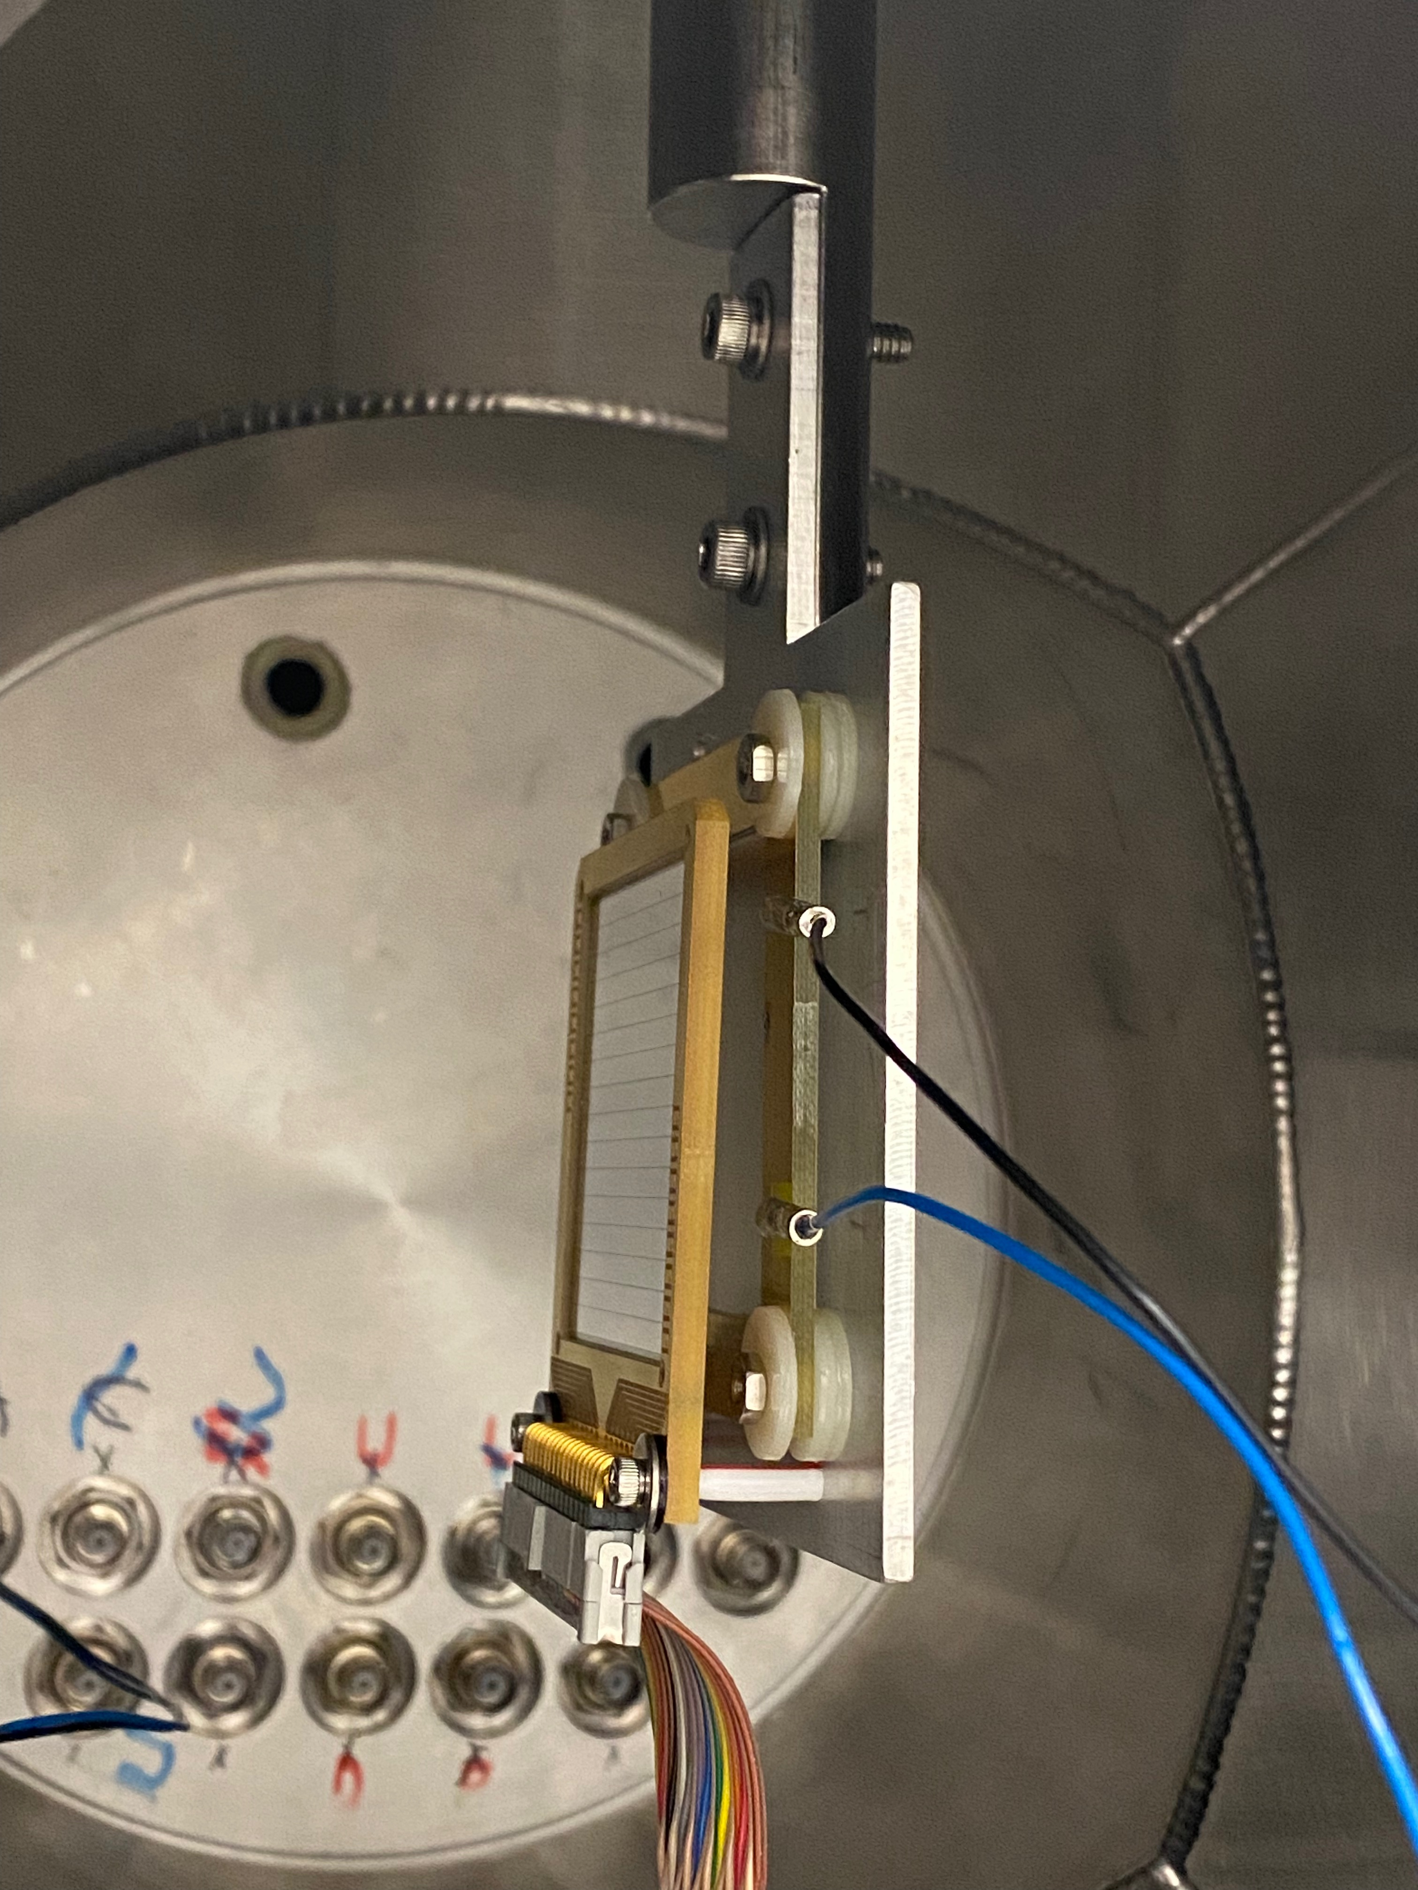
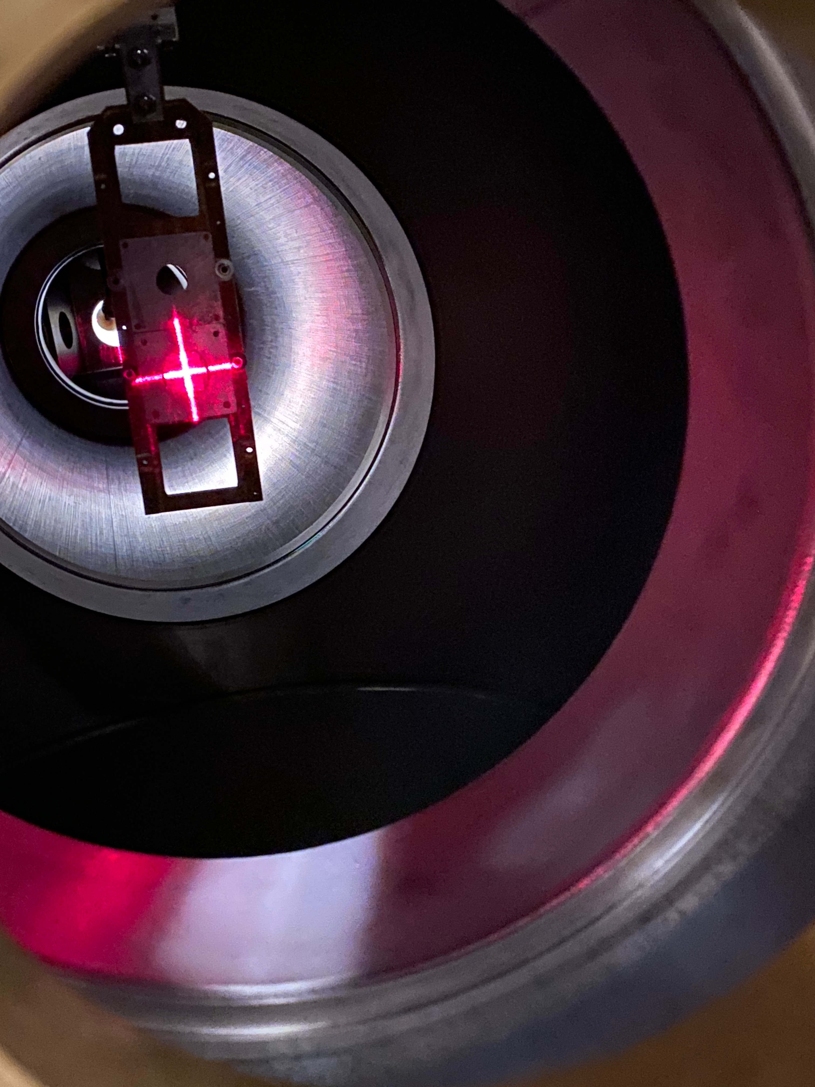
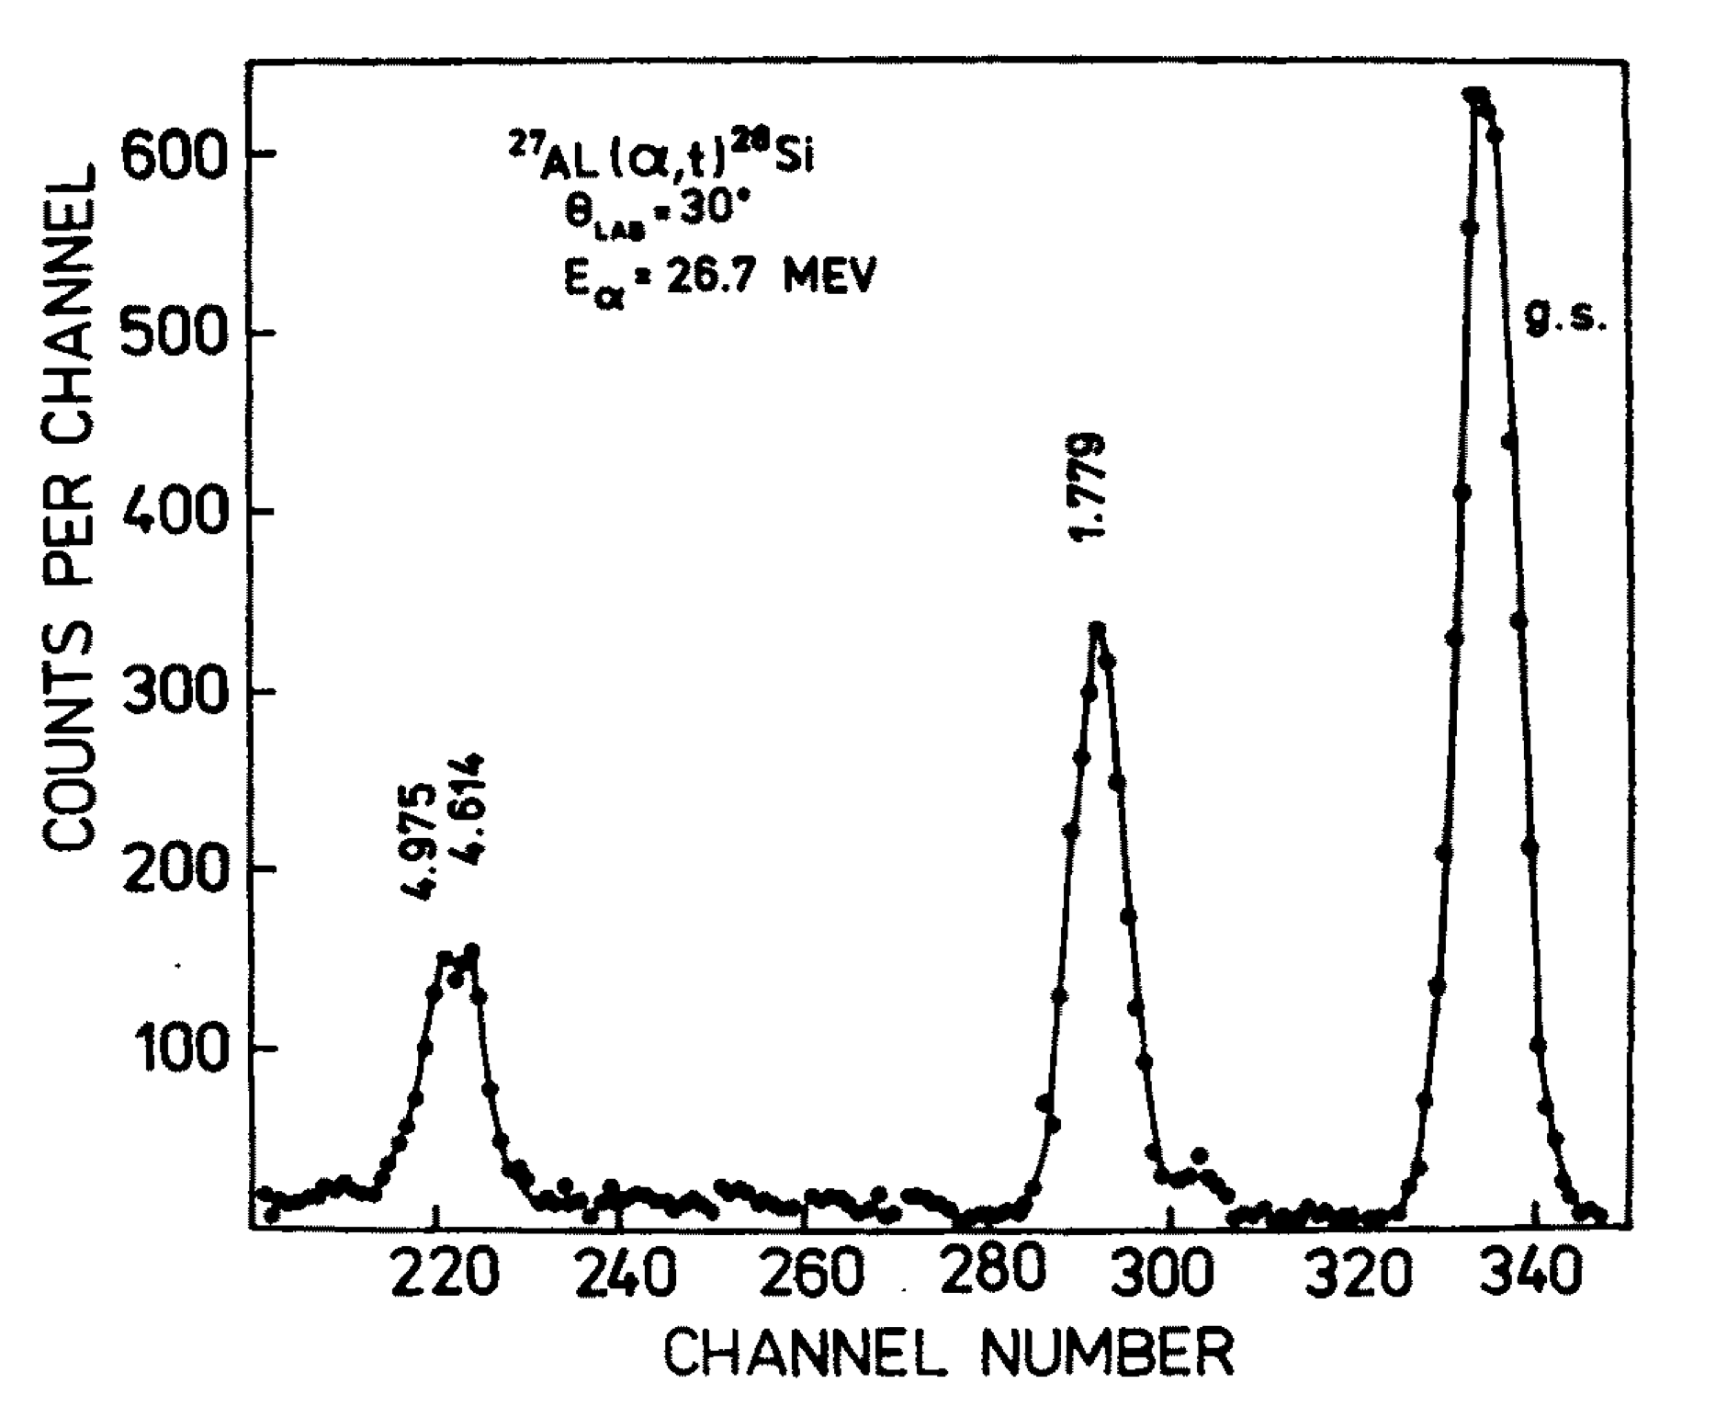
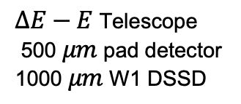
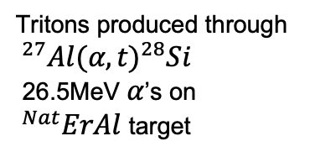

Commissioning the Magnetic Spectrometer
Main goal: demonstrate transmission of high energy (~15-18 MeV) tritons through TriSol for $(^{3}He,t)$ reactions
Secondary goal: Determine reliability of LISE++ predictions
$ΔE−E$ Telescope
500 $μm$ pad detector
1000 $μm$ W1 DSSD
Tritons produced through
$^{27}Al(α,t)^{28}Si$
26.5 MeV $α$’s on $^{Nat}ErAl$ target
Update the footer: Insert/Header and Footer
Skwirczynska et al., Acta Physica Polonica B 15 6 (1984)

Slide 17




$^{27}Al(α,t)^{28}Si$’s Ill Fate
Dead vacuum pumps and an unstable accelerator limited us to ~2 hours of beam on target for the whole week…
… but that was enough to see protons from $^{Nat}Er(α,p)$!
Natural Erbium isotopes all have ~ -8 MeV $(α,p)$ Q-values and produce protons of ~14 MeV, which punch through the telescope
Update the footer: Insert/Header and Footer

Slide 18
Getting SSNAPD Working: Two-Factor Authentication
Step Two: The Magnetic Spectrometer
Protons transmitted,
another attempt at tritons soon
Comparison with LISE++ predictions is ongoing
Step One: The Solenoidal Spectrometer
Step 3: Linking timing between the two halves of SSNAPD!
Update the footer: Insert/Header and Footer

Slide 19

Summary
SSNAPD is a new solenoidal spectrometer system measuring particle decay branching ratios at the University of Notre Dame
Development and acquiring of hardware is nearing completion
Commissioning of solenoid and ejectile detector systems soldiers on
Update the footer: Insert/Header and Footer

Slide 20

Thank You!
Update the footer: Insert/Header and Footer

Slide 21
Backup Slides
Update the footer: Insert/Header and Footer

Slide 22





SSNAPD Silicon Detector Mounting
Board design ongoing with engineers at ND!
Update the footer: Insert/Header and Footer

Slide 23


The SSNAP Detector
Experimental
Built in-house at NSL
Utilizes Micron Super X3 detectors
Originally intended to study heavy ion fusion exit channels, e.g. ¹²C(¹²C,p)²³Na
Additional commissioning done with ¹²C(d,p)¹³C
Bore
Detector Frame
Simulated
Update the footer: Insert/Header and Footer

Slide 24


SSNAP to SSNAPD Upgrades
Super X3’s were intended for detection of higher energy (~a few MeV) reaction ejectiles
Mounting infrastructure was cumbersome and resulted in poor geometric efficiency
Mounting frame design and specialized detectors make SSNAPD far more sensitive and suited for particle branching ratio studies
QOL improvements with engineering, electronics upgrades
Update the footer: Insert/Header and Footer

Slide 25



Downstream Triton Detectors
Micron W1 DSSD telescope (1000 $μm$)
First detector will give a $ΔE$ measurement, second detector total $E$ for PID
Interface directly with the same preamplifier modules as SSNAPD using individually designed vacuum feedthrough boards
Update the footer: Insert/Header and Footer

Slide 26

SSNAPD Array Characterization - Monte Carlo Simulation
Simulation framework populates excited states phenomenologically
Calculates two-body kinematics for reaction
Simulates decay at random CM angle with energy loss in target of specified material
Timing, position, energy information are simulated for multiple types of light ions using solenoid field mapping
Detection energy (MeV)
Detection Position (cm)
Update the footer: Insert/Header and Footer

Slide 27


Time Gating
Counts
Detection Time (ns)
Detection energy (MeV)
Detection energy (MeV)
Detection Position (cm)
Detection Position (cm)
Update the footer: Insert/Header and Footer

Slide 28


Ejectile Gating
Counts
Ejectile Triton Energy (MeV)
Detection energy (MeV)
$α$ energy (MeV)
Detection Position (cm)
Detection Position (cm)
Update the footer: Insert/Header and Footer

Slide 29

Gating for a Single State
Counts
Ejectile Triton Energy (MeV)
$α$ energy (MeV)
$α$ energy (MeV)
Detection Position (cm)
Detection Position (cm)
Update the footer: Insert/Header and Footer

Slide 30




How well does this work?
Total Detected $α$ particles: 628
$$BR=\frac{N_{α}}{N_{t}}∗\frac{1}{ε_{Geom}}$$
$α$ energy (MeV)
Detection Position (cm)
Using another simulation at this field strength, the geometric efficiency for particles of this energy is ~29.4%
Final BR estimate: 1.021(46)
In the simulation, states only undergo $α$-decay, so this is expected
Total Detected Tritons: 2094
Counts
Ejectile Triton Energy (MeV)
Update the footer: Insert/Header and Footer

