Slide 1





Electroweak Symmetry Restoration
@ High Energies
Tao Han
Pitt PACC
University of Pittsburgh
PPC 2026 @ UNSW
August 31 , 2026

Slide 2
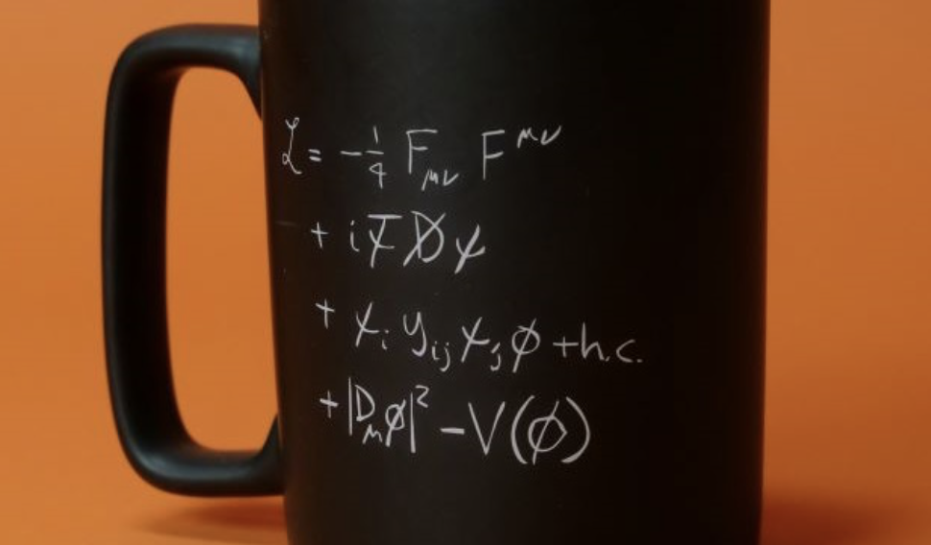
HEP: Uninterrupted discoveries
for more than half a century!
From quarks to the Higgs boson,
with heroic efforts in theory and experiments:
60’s
70’s
90’s
The Standard Model
of particle physics:
2012
Non-Abelian gauge structure
Gauge coupling universality
Spontaneous symm breaking
70’s
80’s
𝜈’s: 1930/1956
1962
2000
at what scales?

Slide 3
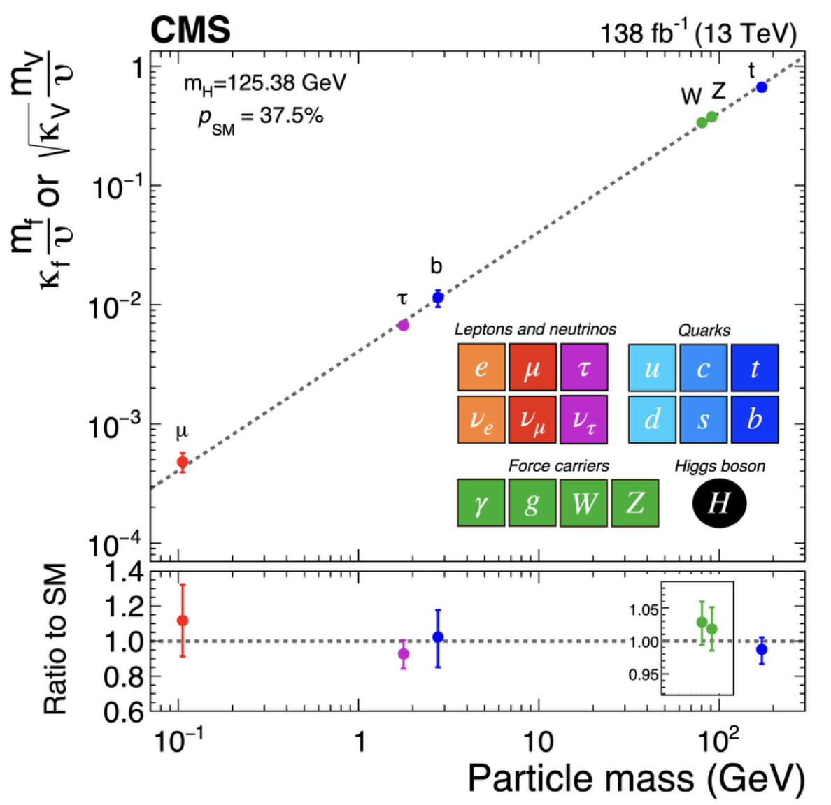
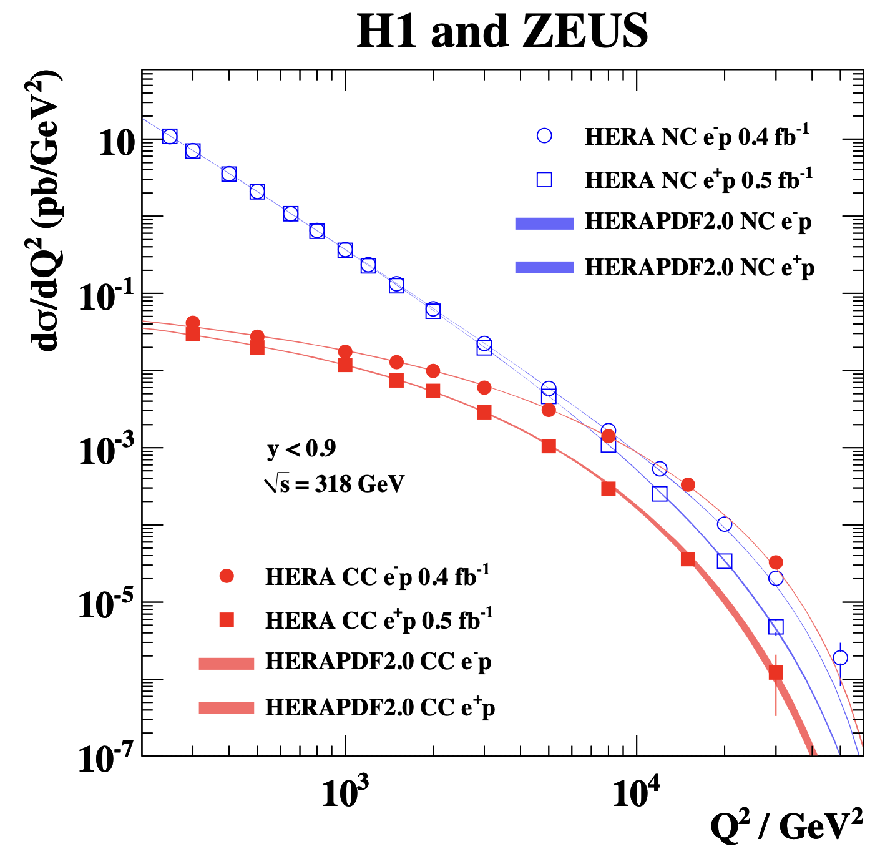
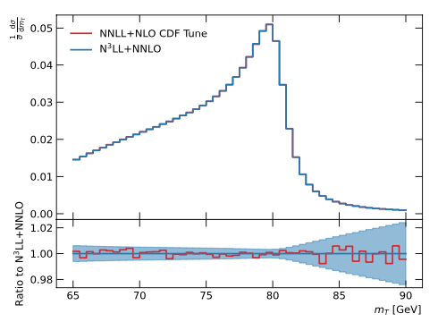
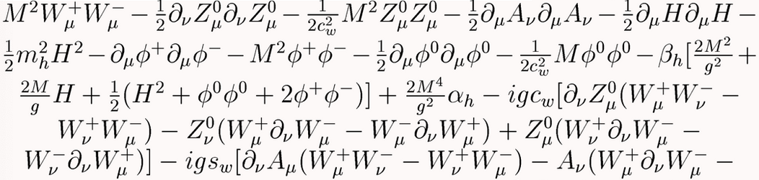
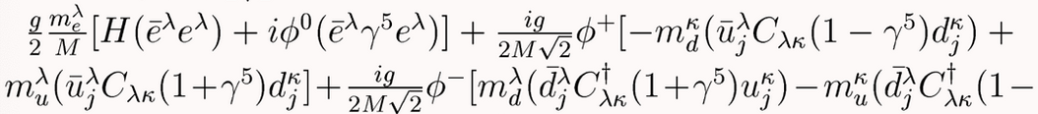
Electroweak Gauge Theory
In our daily life, we live in a deeply broken phase,
no sign of EW gauge symmetry! The “weak” force:
At the EW scale ~O(100 GeV)
𝚫m_{h}/m_{h} ~10⁻³
𝚫M_{w}/M_{w} ~10⁻⁴
Yet, we are still in a broken phase:
Short-lived
massive bosons:
Massive fermions
& flavor mixings:

Slide 4
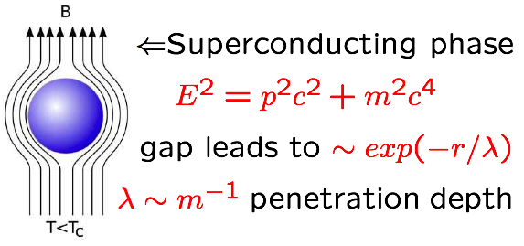

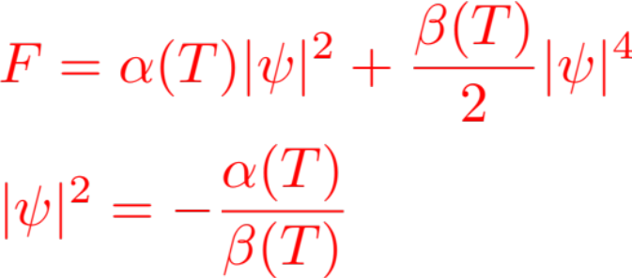
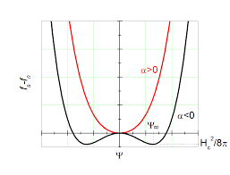
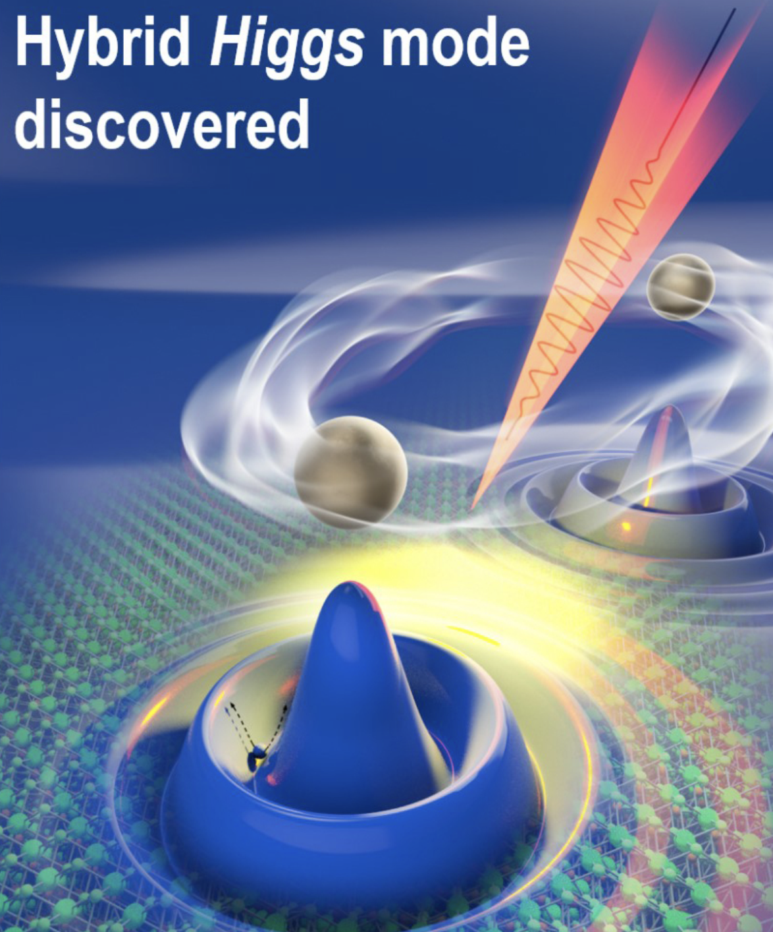
Spontaneous Symmetry Breaking
In a broken or
superconducting phase:
London penetration depth
-- the Meissner effect:
𝜆 ~ 1/M_{W} ≈ 10⁻⁹ nm, in 10⁻²⁴ s
The SM scalar sector:
Landau-Ginzburg Theory:
V =
In CM, BCS as the underlying theory to calculate
𝜶(T) & 𝜷(T)!
What is the underlying theory to calculate 𝜇² & 𝜆 ?
In any given theory: 𝜟𝘮_{h}² ∝ 𝜦² !
→ “naturalness” or Little Hierarchy problem.
Laser @ 10¹² Hz (2021)

Slide 5
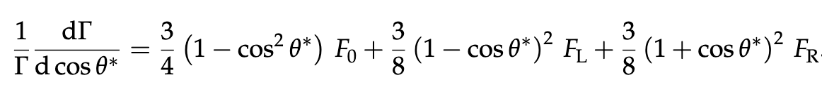
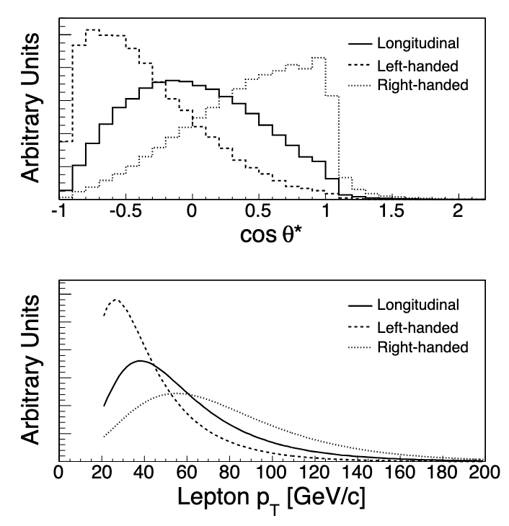
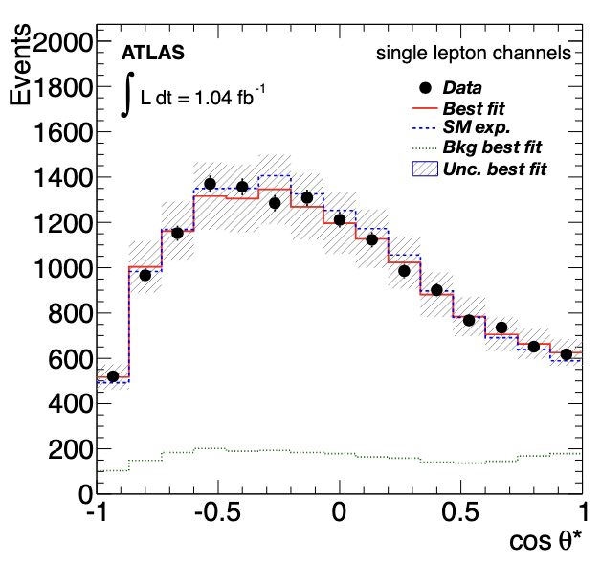


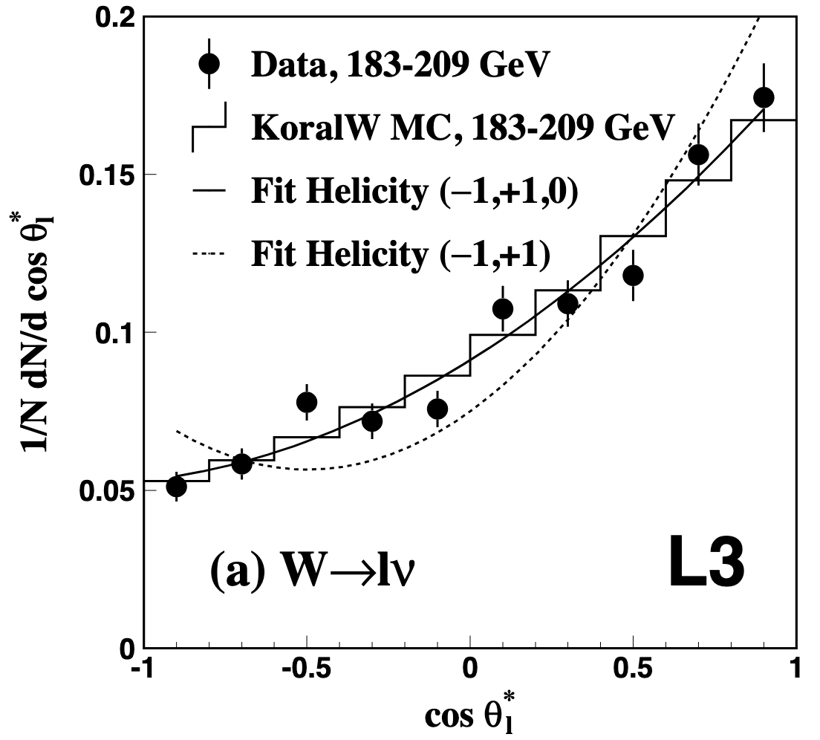
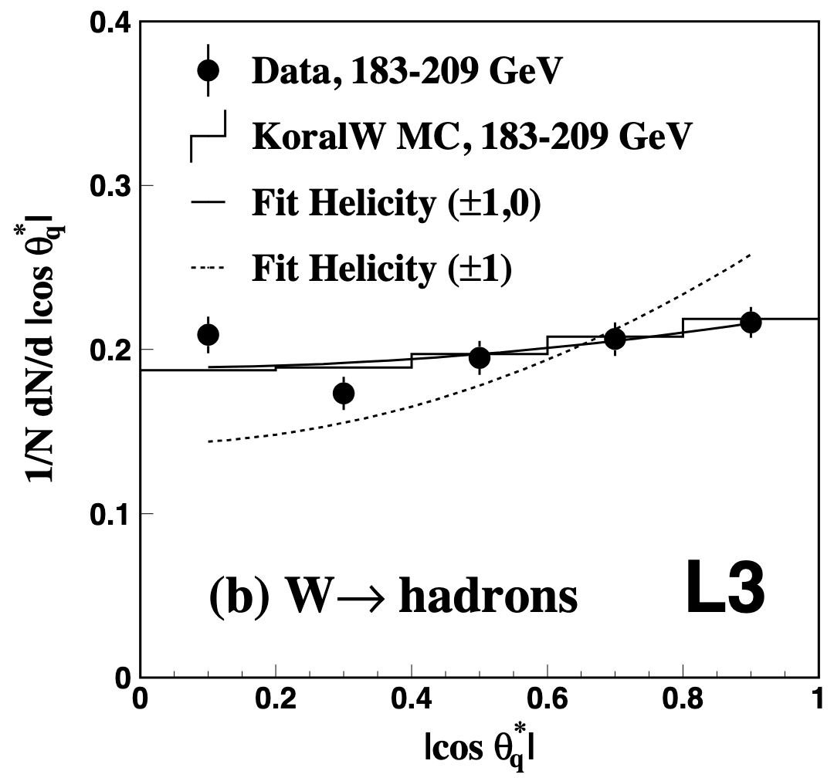
Longitudinal gauge bosons
1st observation of W_{L} in top decay (CDF/D0, 2000)
W_{L} dominant!
CDF: hep-ex/0511023;
ATLAS: 1205.2484;
CMS: 1308.3879
2nd observation: at LEP (L3, 2003)
W_{L} fits at 3𝜎
PLB557, 147(2003)

Slide 6
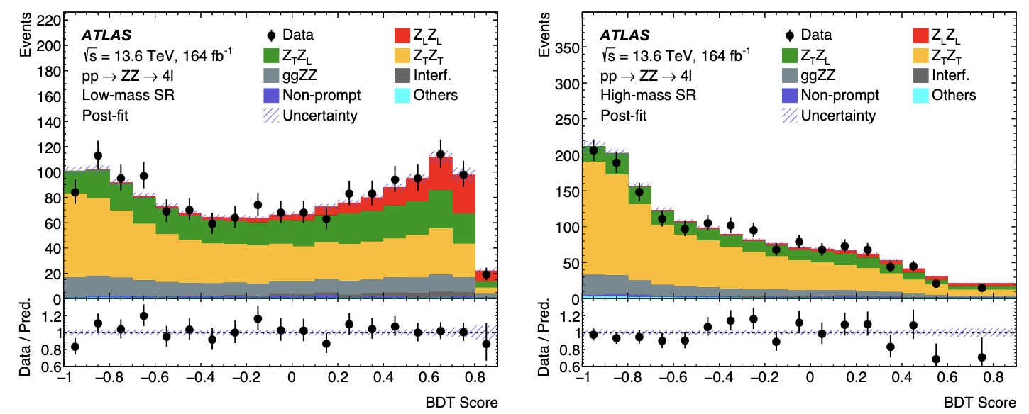


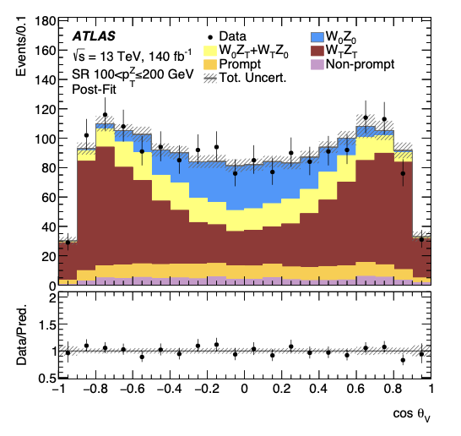
Longitudinal gauge bosons
New observation: qq → Z_{L}Z_{L} @ 6𝛔 at ATLAS / CMS
only at low scale:
not at high scale
arXiv:2607.12879
New observation: @ 7.1𝛔 at ATLAS:
W_{L}Z_{L} observation
& utilization of the
“Radiation Amplitude Zero”
ATLAS:
arXiv:2211.09435: PLB 2023
arXiv:2402.16365: PRL 2024
at high scale

Slide 7

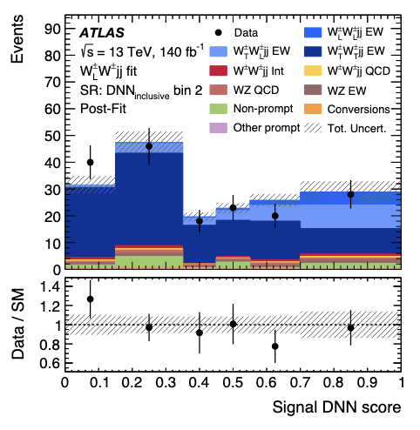
Longitudinal gauge bosons
5th observation (?):
at the LHC: at least 1 W_{L} @ 3.3𝛔
CMS: arXiv:2009.09429, ATLAS: arXiv:2503.11317
Extremely challenging!
→ great step to scrutinizing EWSB !

Slide 8


Goldstone-boson Equivalence Theorem (GET):
At high energies E>>MW, the longitudinally polarized gauge bosons behave like the corresponding Goldstone bosons. (They remember their origin!)
Lee, Quigg, Thacker (1977); M. Chanowitz, M. Gailard (1984);
Y.-P. Yao, C.-P. Yuan (1988); J. Bagger, C. Schmidt (1990) …
V_{L} wavefunction:
trivial “scalarization”
(for any vector state)
symmetry
breaking residual
Goldstone-bosons Equivalence Theorem:
At high energies:
W^{i}_{L} → Correspond to the broken generators
incomplete representation:
nothing to say about the “Higgs boson”
→ The Higgs mechanism DOES NOT require a Higgs boson!

Slide 9
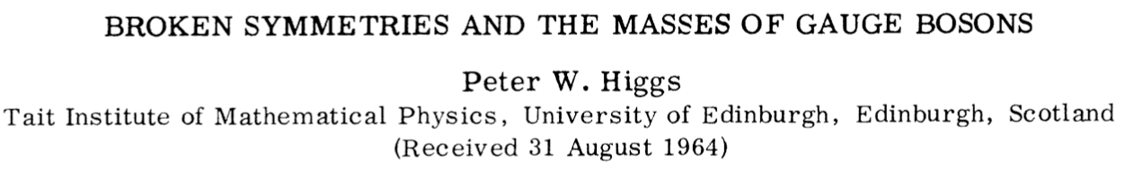
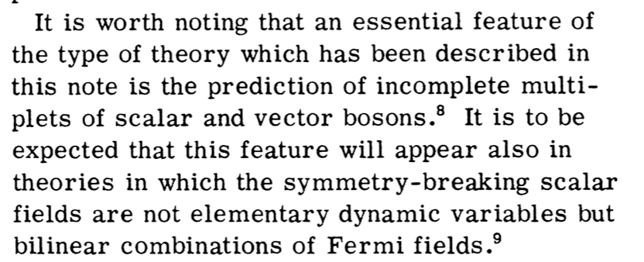
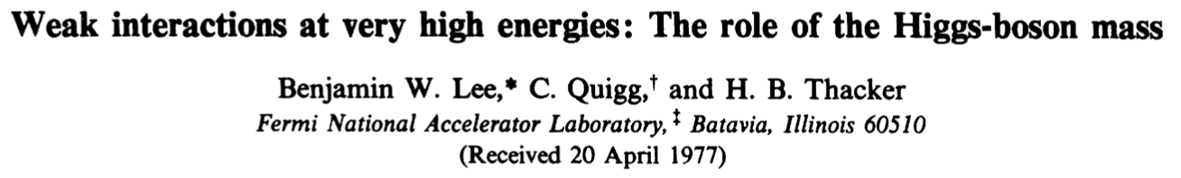
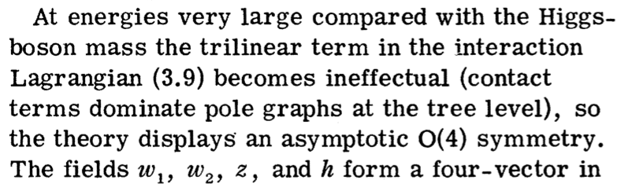
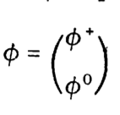
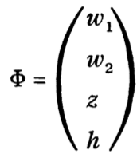
The Higgs Boson
or

Slide 10
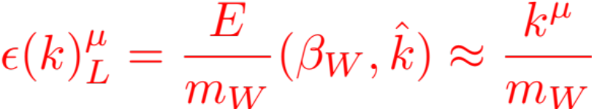
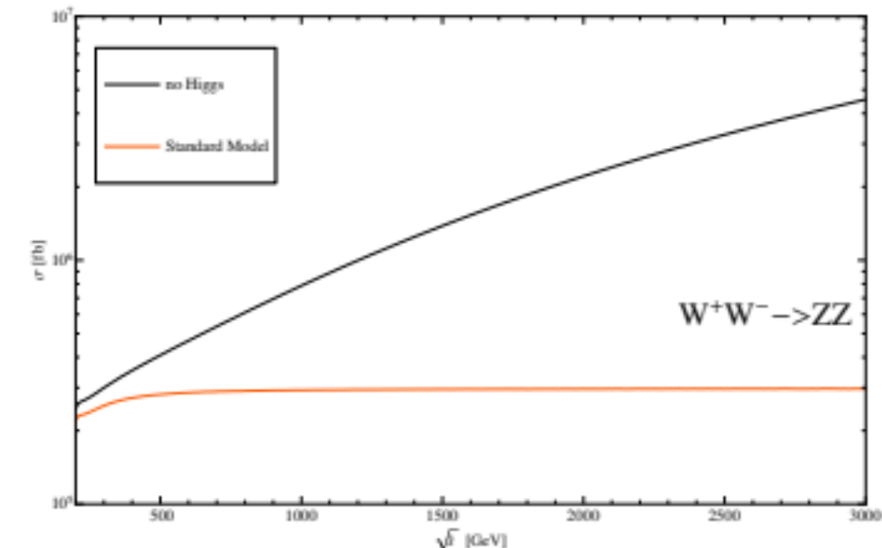
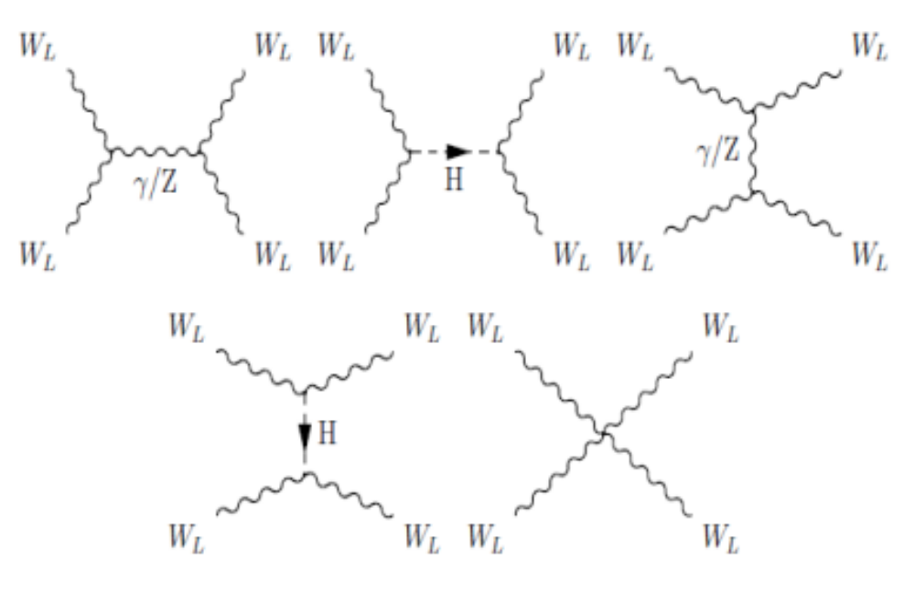
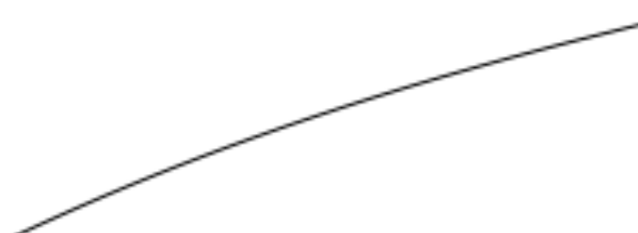
V_{L} V_{L} → V_{L} V_{L} Scattering
“Bad high-energy behavior”
The Higgs boson unitarize the amplitude:
~ s/v²
~ (g²/16π²) s/v²
~ m_{H}²/v²
Lee, Quigg, Thacker (1977)
Chanowitz, Furman, Hinchliffe (1978)
Chanowitz, Gailard (1984)
Consistent perturbative theory up to Λ (?)
New strong dynamics effects may still exist, but “delayed” to v²/Λ².

Slide 11
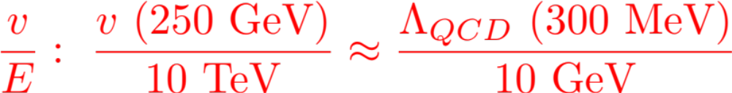
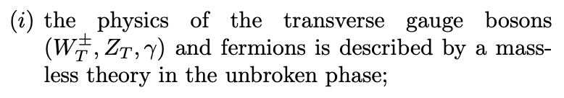

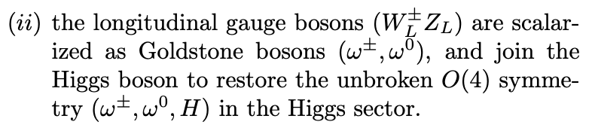
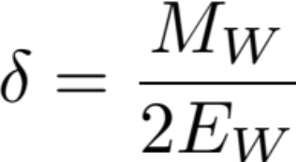
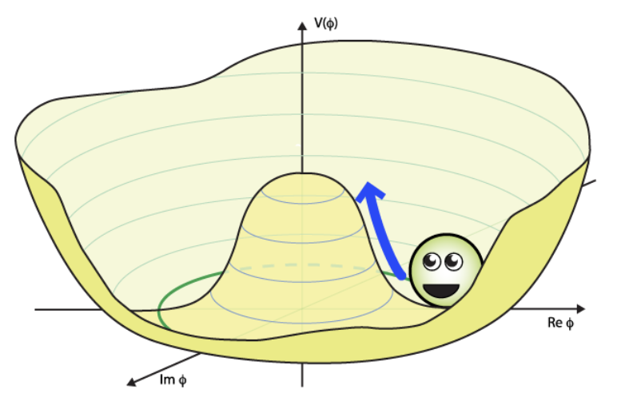
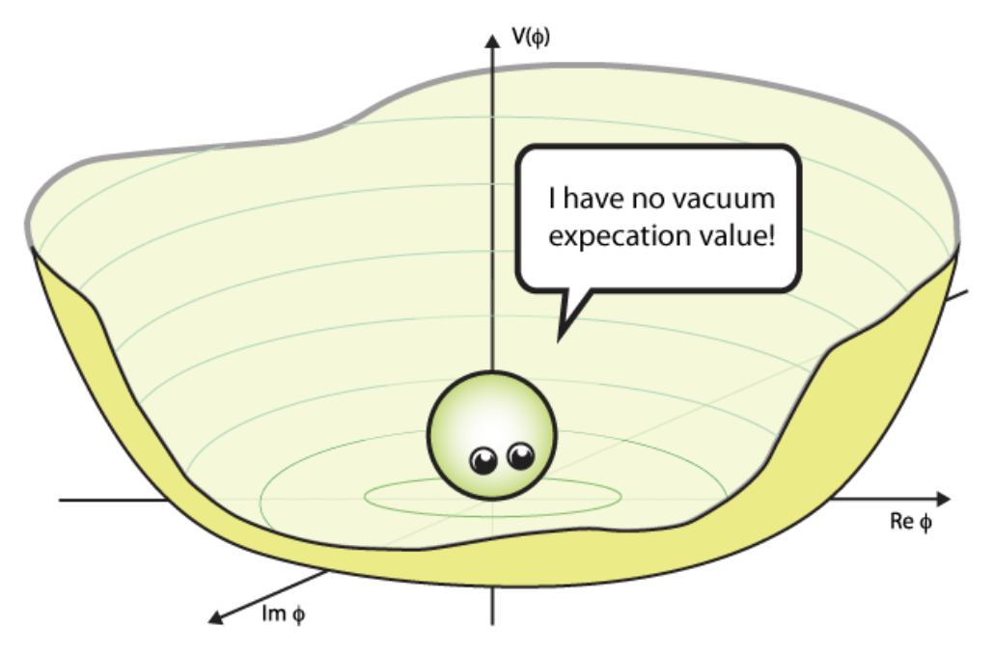




EW Symmetry Restoration (EWSR)
parametrically measured by:
R. Capdevilla, TH, arXiv:2412.12336 (PRL)

Slide 12

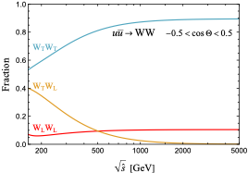
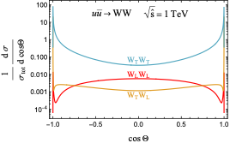
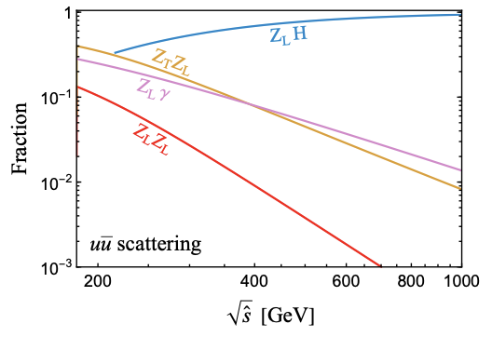

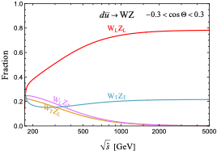
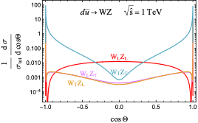
Physics with Gauge Boson Pairs
K. Cheng, TH, T. A. Wu, to appear

Slide 13
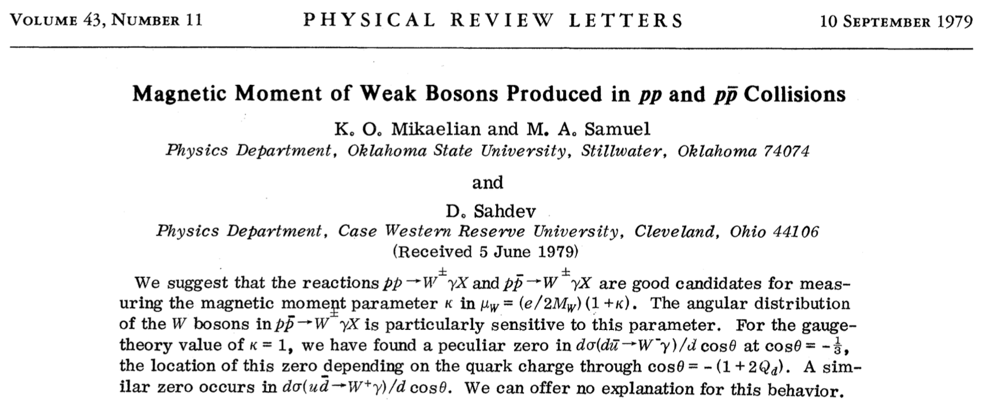
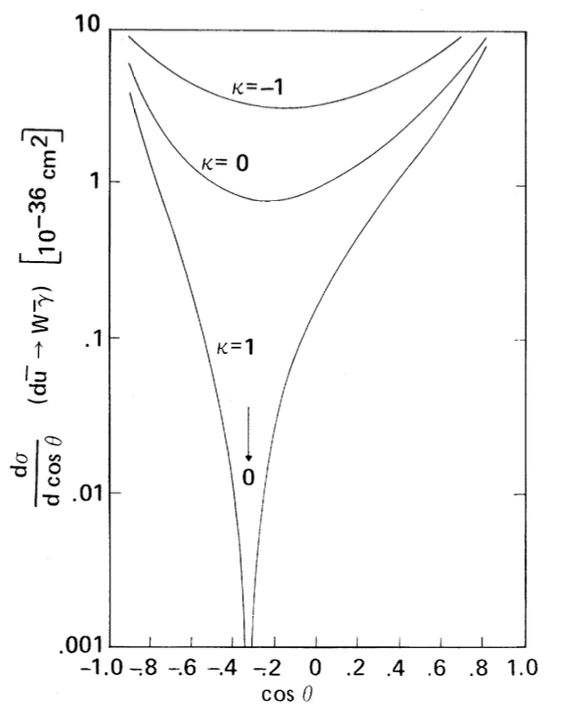
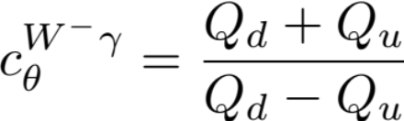
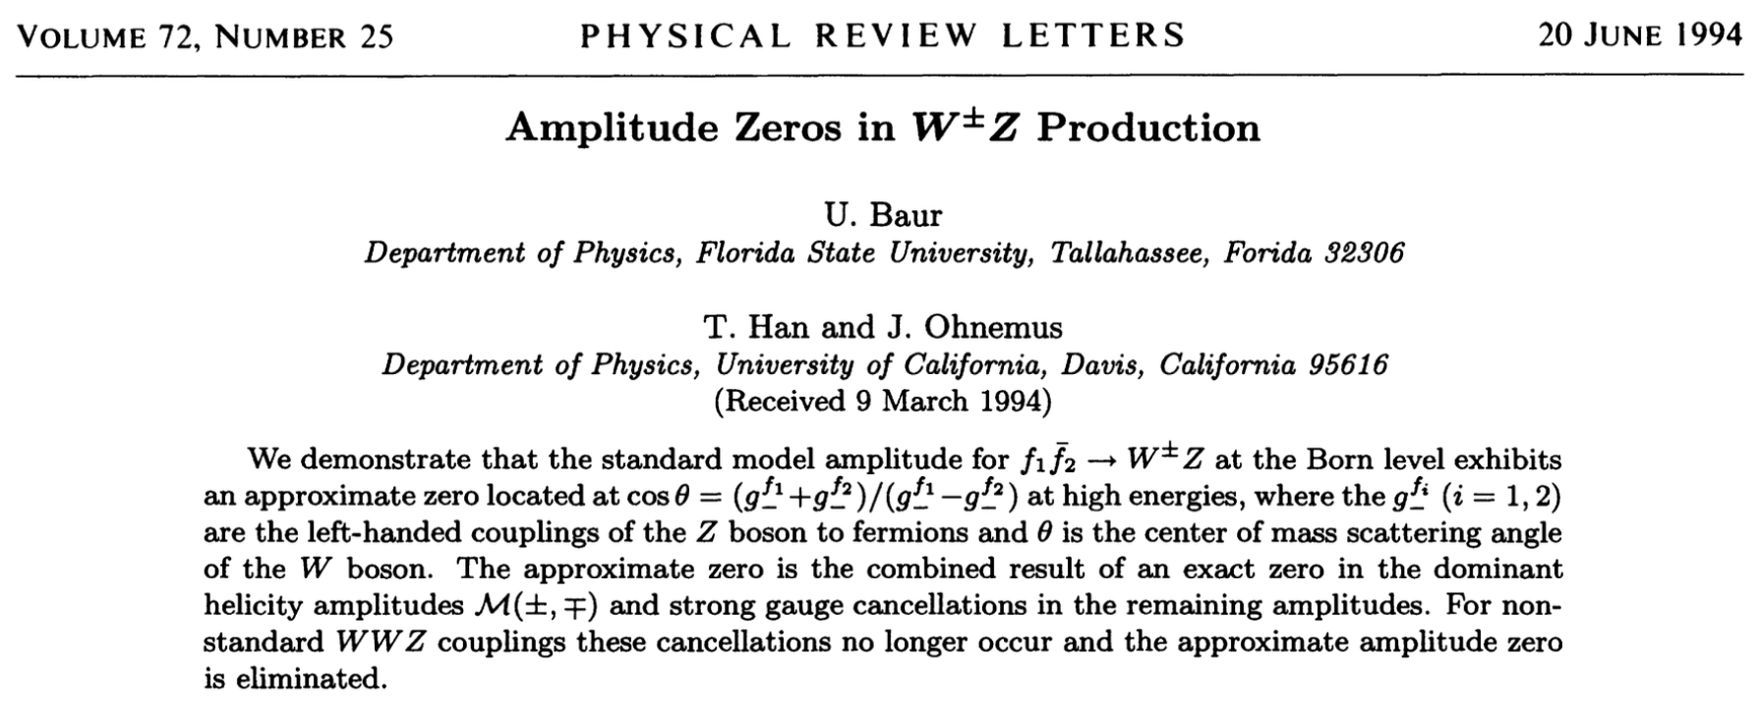
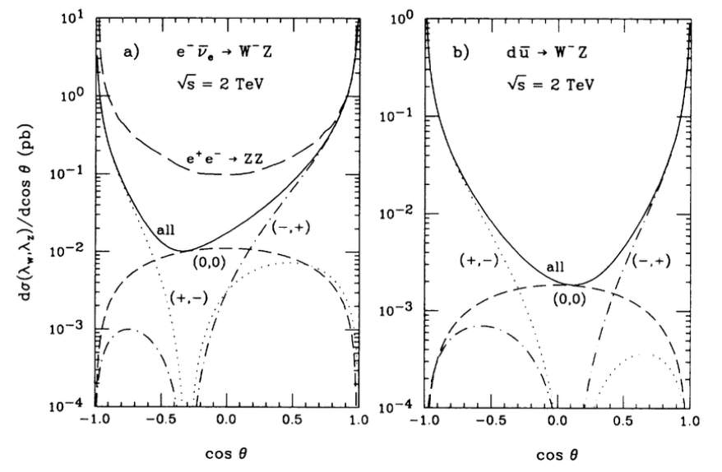
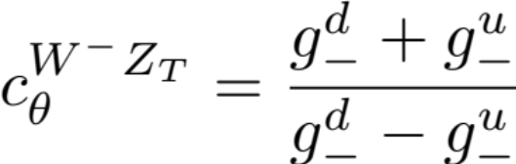
Radiation Amplitude Zeros (RAZs)
Most sensitive test for WW𝞬 self-coupling!
Most sensitive test for WWZ coupling!

Slide 14
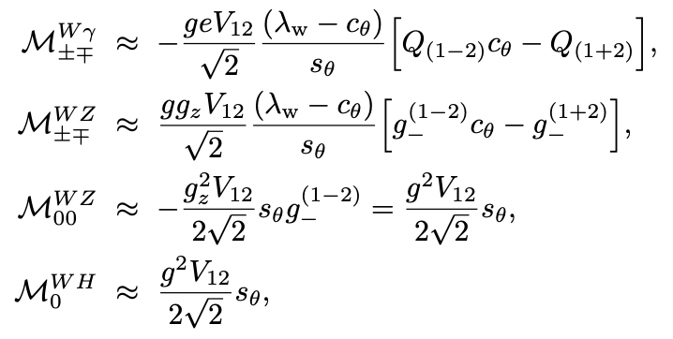
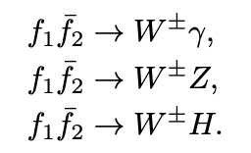
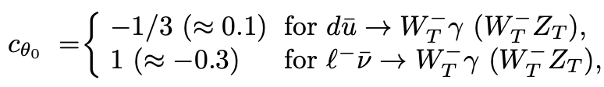
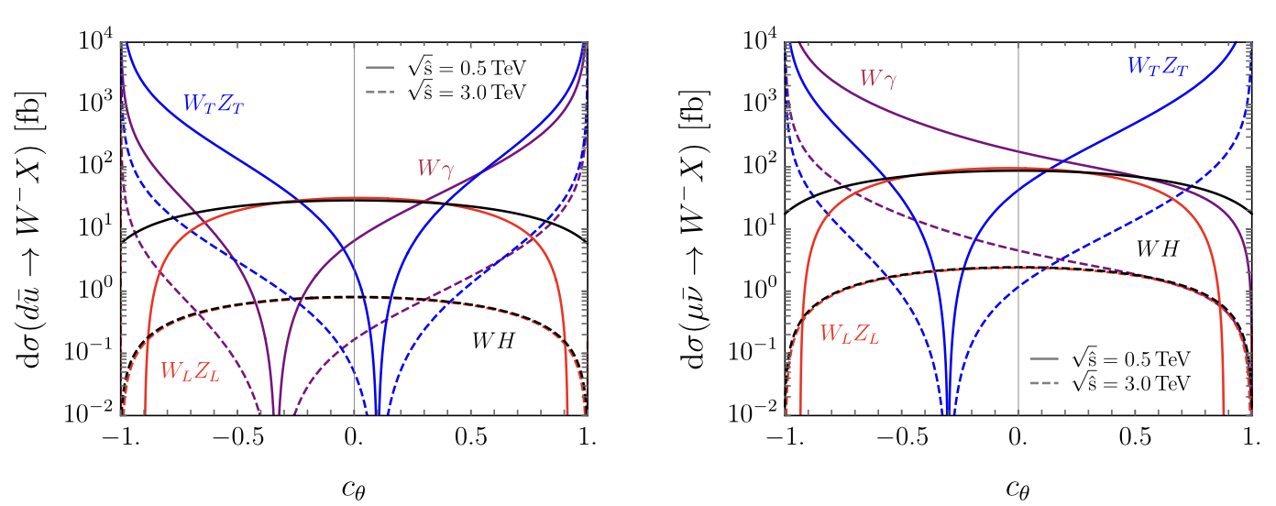
Gauge / scalar separation:
R. Capdevilla, TH, arXiv:2412.12336 (PRL)
Gauge sector: Radiation Amplitude Zeros (RAZs)
EM: ; EW (transverse):
Mikaelian, Samual (1979)
U. Baur, TH, JO, (1994)
Higgs scalar sector:

Slide 15
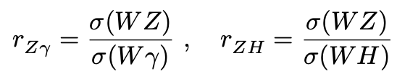







Test EWSR @ LHC / muon Collider
R. Capdevilla, TH, arXiv:2412.12336; Huang, Lewis, Lane, Liu, arXiv:2009.09429
Massless gauge sector & Higgs sector:
For 𝛅 = M_{W}/2E << 1:

Slide 16







What do we learn in testing EWSR? “endlessly confirm the correctness of SM”
- Carlo Rubia
SMEFT BSM vs. HEFT BSM
weakly coupled (SUSY, 2HDM) strongly coupled (composite)
HVV: smaller @ new scale ~ 𝞚 ; larger nearby scale ~ 4𝛑 𝞄
At the LHC: Higgs coupling SM-like ~ 10%
Z. Liu, I. Lewis, I. Mahbub, arXiv:2605.08433
(light) Fermion Yukawa’s wide open:
E. Celada, TH et al., arXiv:2312.13082

Slide 17
Conclusions
EW physics @ high energies remains exciting and challenging!
We are approaching
the EW symmetric phase measured by M_{W}/2E.
Longitudinal gauge bosons (W_{L}^{i})+ Higgs (h)
form an O(4) multiplet:
sensitive to underlying EWSB as well as BSM:
weakly coupled vs strongly coupled theories;
the symmetry could be larger or smaller than O(4).
EW PDF’s & EW jets to emerge @ high energies!
Electroweak physics @ high energies is rich!

Slide 18
Thank you!

