Slide 1

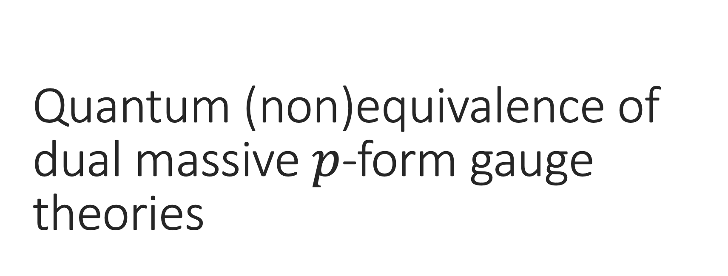
Quantum (non)equivalence of dual massive $p$-form gauge theories
Christian Canete
PPC2026 | 31st August 2026
Based on the work [arXiv:2606.29899] with Elden Loomes

Slide 2
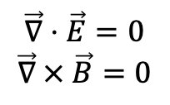

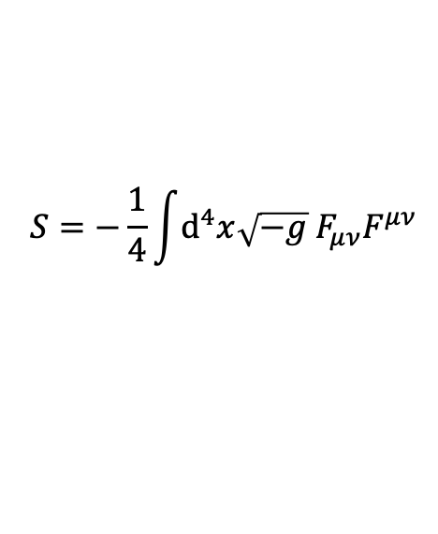




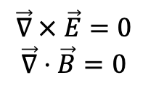
Electromagnetism is a gauge theory
Electromagnetism is described by a U(1) Abelian gauge symmetry.
Vector gauge field: $A_{μ}$
Gauge transformation: $A_{μ}→A_{μ}^{′}=A_{μ}+∂_{μ}θ$
$$S=−\frac{1}{4}\int{ⅆ^{4}x\sqrt{−g} F_{μν}F^{μν}}$$
Bulk action:
Field strength tensor: $F_{μν}≡∂_{μ}A_{ν}−∂_{ν}A_{μ}$
Equations of motion: $∇_{μ}F^{μν}=0$
Bianchi identity: $∇_{μ}F_{νρ}+∇_{ν}F_{ρμ}+∇_{ρ}F_{μν}=0$
$$\vec{∇}⋅\vec{E}=0$$
$$\vec{∇} × \vec{B}=0$$
$$\vec{∇} × \vec{E}=0$$
$$\vec{∇}⋅\vec{B}=0$$

Slide 3
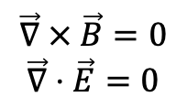

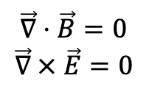
Dual theory of electromagnetism
The classical theory in vacuum is unchanged under the exchange of electric and magnetic fields.
Duality transformation: $F_{μν}→{\tilde{F}}_{μν}=−\frac{1}{2}ε_{μνρσ}F^{ρσ}$
$$\vec{∇}⋅\vec{B}=0$$
$$\vec{∇} × \vec{E}=0$$
Equations of motion: $∇_{μ}F^{μν}=0→∇_{μ}{\tilde{F}}_{νρ}+∇_{ν}{\tilde{F}}_{ρμ}+∇_{ρ}{\tilde{F}}_{μν}=0$
$$\vec{∇} × \vec{B}=0$$
$$\vec{∇}⋅\vec{E}=0$$
Bianchi identity: $∇_{μ}F_{νρ}+∇_{ν}F_{ρμ}+∇_{ρ}F_{μν}=0→∇_{μ}{\tilde{F}}^{μν}=0$
Under a duality transformation, Equations of motion $↔$ Bianchi identity

Slide 4

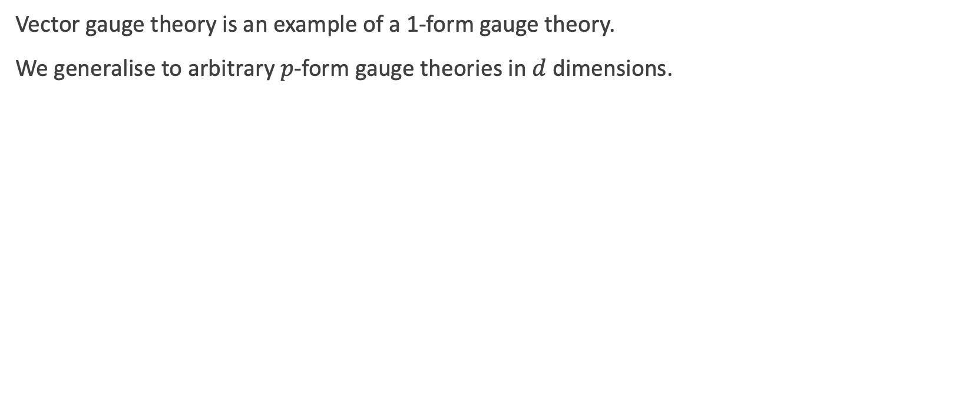




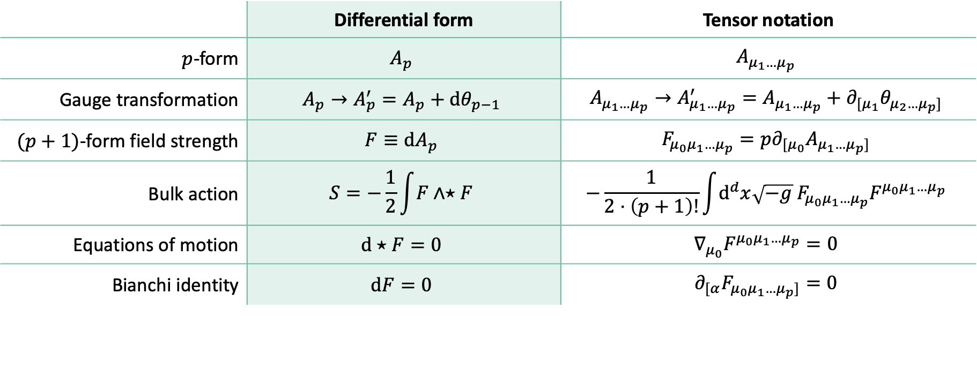


Gauge theory of massless $p$-forms
Vector gauge theory is an example of a 1-form gauge theory.
We generalise to arbitrary $p$-form gauge theories in $d$ dimensions.
 | Differential form | Tensor notation
$p$-form | $$A_{p}$$ | $$A_{μ_{1}…μ_{p}}$$
Gauge transformation | $$A_{p}→A_{p}^{′}=A_{p}+dθ_{p−1}$$ | $$A_{μ_{1}…μ_{p}}→A_{μ_{1}…μ_{p}}^{′}=A_{μ_{1}…μ_{p}}+∂_{{[μ}_{1}}θ_{μ_{2}…μ_{p}]}$$
$(p+1)$-form field strength | $$F≡dA_{p}$$ | $$F_{μ_{0}μ_{1}…μ_{p}}=p∂_{[μ_{0}}A_{μ_{1}…μ_{p}]}$$
Bulk action | $$S=−\frac{1}{2}\int{F∧⋆F}$$ | $$−\frac{1}{2⋅\left(p+1\right)!}\int{d^{d}x\sqrt{−g} F_{μ_{0}μ_{1}…μ_{p}}F^{μ_{0}μ_{1}…μ_{p}}}$$
Equations of motion | $$d⋆F=0$$ | $$∇_{μ_{0}}F^{μ_{0}μ_{1}…μ_{p}}=0$$
Bianchi identity | $$dF=0$$ | $$∂_{[α}F_{μ_{0}μ_{1}…μ_{p}]}=0$$
$p$-form: $A_{p}$
$\left(p+1\right)$-form field strength: $F≡dA_{p}$
Gauge transformation: $A_{p}→A_{p}^{′}=A+dθ_{p−1}$
Bulk action: $S=−\frac{1}{4}∫ⅆ^{4}x\sqrt{−g} F_{μν}F^{μν}$
Equations of motion: $∇_{μ}F^{μν}=0$
Bianchi identity: $∇_{μ}F_{νρ}+∇_{ν}F_{ρμ}+∇_{ρ}F_{μν}=0$

Slide 5
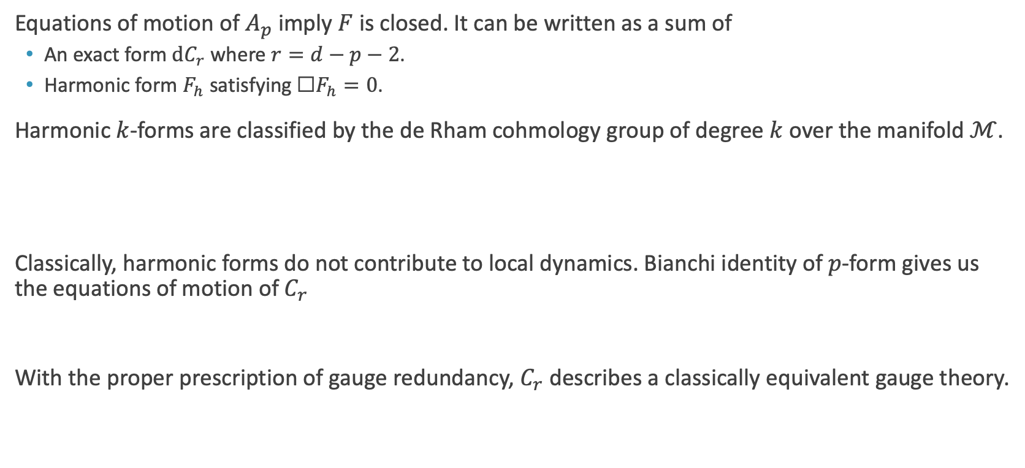

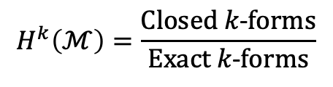

Classical duality of massless $p$-forms
Equations of motion of $A_{p}$ imply $F$ is closed. It can be written as a sum of
  An exact form $dC_{r}$ where $r=d−p−2$.
  Harmonic form $F_{h}$ satisfying $\text{☐}F_{h}=0$.
Harmonic $k$-forms are classified by the de Rham cohmology group of degree $k$ over the manifold $ℳ$.
Classically, harmonic forms do not contribute to local dynamics. Bianchi identity of $p$-form gives us the equations of motion of $C_{r}$
With the proper prescription of gauge redundancy, $C_{r}$ describes a classically equivalent gauge theory.
$$H^{k}\left(ℳ\right)=\frac{Closed k\text{−}forms}{Exact k\text{−}forms}$$
$$dF=0 ⟹d⋆dC_{r}=0$$
Massless $p$-forms are classically dual to massless $(d−p−2)$-forms

Slide 6

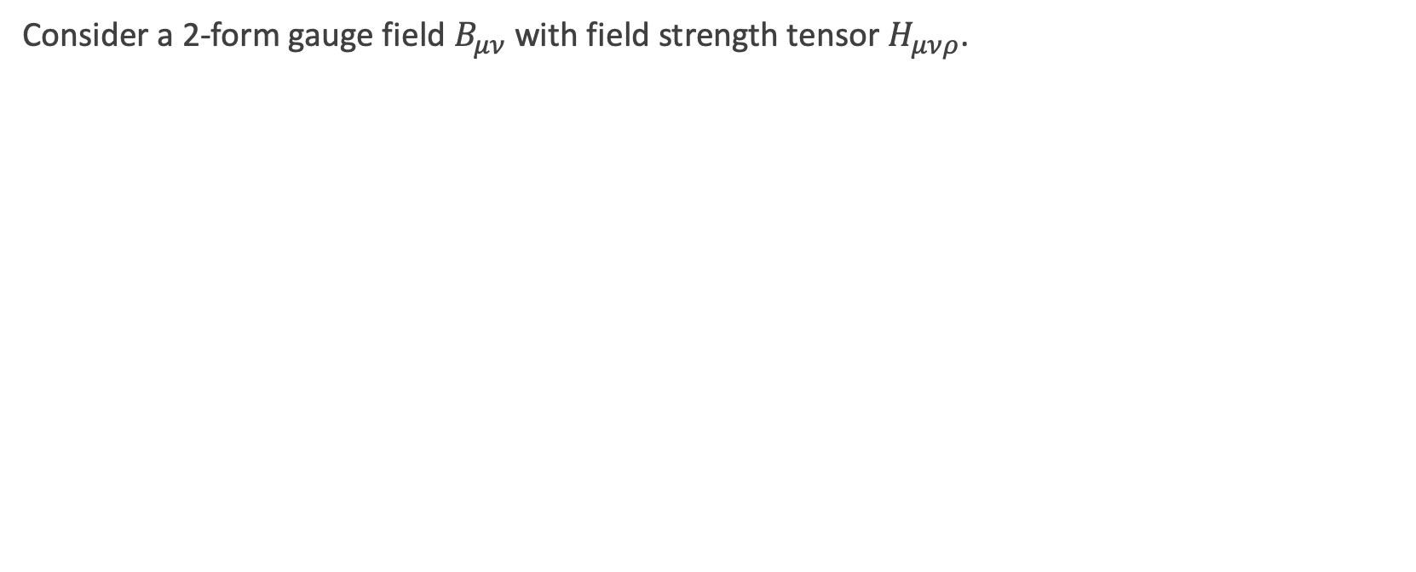
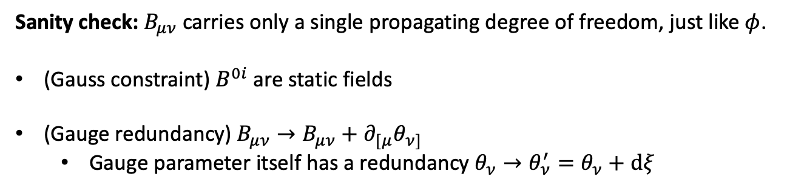

Massless 2-form are classically dual to a massless pseudoscalar field
Consider a 2-form gauge field $B_{μν}$ with field strength tensor $H_{μνρ}$.
Duality transformation: $H_{μνρ}=−\frac{1}{3!}ε_{μνρσ}∂^{σ}φ$
Equations of motion: $∇_{μ}H^{μνρ}=0 → \left(∇_{μ}∇_{ν}−∇_{ν}∇_{μ}\right)φ =0$
Bianchi identity: $∇_{[μ}H_{νρσ]}=0 → ∇_{μ}∇^{μ}φ=0$
Sanity check: $B_{μν}$ carries only a single propagating degree of freedom, just like $φ$.
(Gauss constraint) $B^{0i}$ are static fields
(Gauge redundancy) $B_{μν}→B_{μν}+∂_{[μ}θ_{ν]}$
  Gauge parameter itself has a redundancy $θ_{ν}→θ_{ν}^{′}=θ_{ν}+dξ$

Slide 7
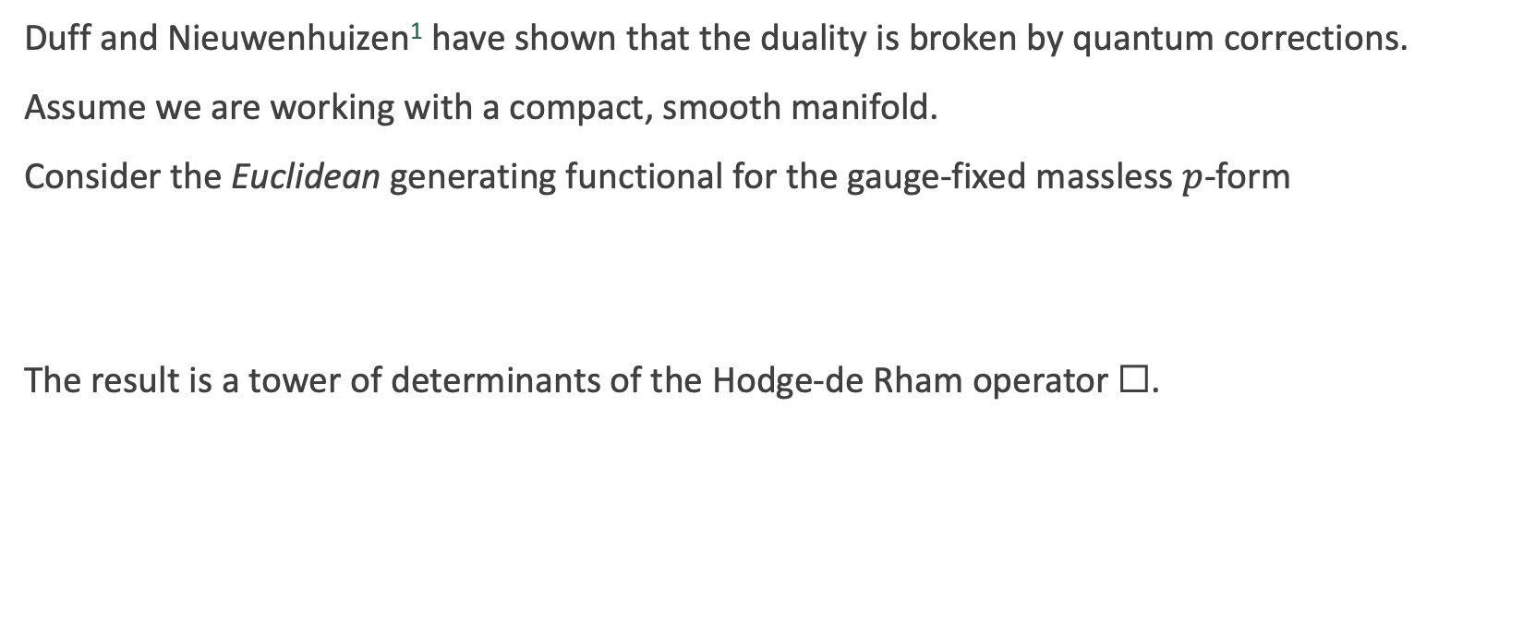
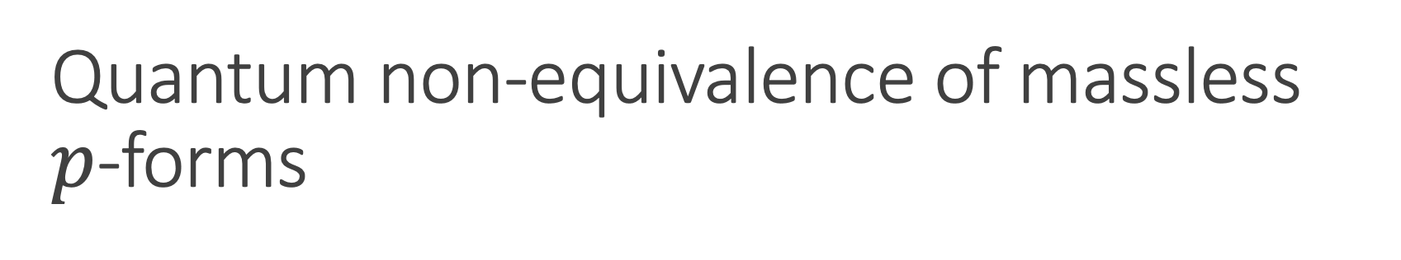
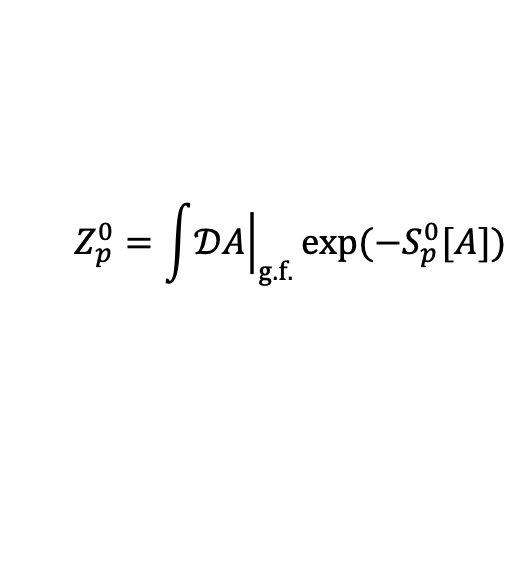
Quantum non-equivalence of massless
$p$-forms
Duff and Nieuwenhuizen¹ have shown that the duality is broken by quantum corrections.
Assume we are working with a compact, smooth manifold.
Consider the Euclidean generating functional for the gauge-fixed massless $p$-form
The result is a tower of determinants of the Hodge-de Rham operator $\text{☐}$.
$$Z_{p}^{0}=\int{{\left.𝒟A\right|}_{g.f.}}exp(−S_{p}^{0}[A])$$
$$Z_{p}^{0}={\left(det {\text{☐}}_{p}\right)}^{−1/2}{\left(det {\text{☐}}_{p−1}\right)}^{1}{\left(det {\text{☐}}_{p−2}\right)}^{−3/2}…{\left(det {\text{☐}}_{0}\right)}^{{\left(−1\right)}^{p+1}(p+1)/2}$$
¹M. Duff and P. Van Nieuwenhuizen. “Quantum inequivalence of different field representations”. Physics Letters B 94 (1980)

Slide 8
Quantum non-equivalence of massless
$p$-forms
Duff and Nieuwenhuizen¹ have shown that the duality is broken by quantum corrections.
Assume we are working with a compact, smooth manifold.
Consider the Euclidean generating functional for the gauge-fixed massless $p$-form
The result is a tower of determinants of the Hodge-de Rham operator $\text{☐}$.
$$Z_{p}^{0}=\int{{\left.𝒟A\right|}_{g.f.}}exp(−S_{p}^{0}[A])$$
$$Z_{p}^{0}={\left(det {\text{☐}}_{p}\right)}^{−1/2}{\left(det {\text{☐}}_{p−1}\right)}^{1}{\left(det {\text{☐}}_{p−2}\right)}^{−3/2}…{\left(det {\text{☐}}_{0}\right)}^{{\left(−1\right)}^{p+1}(p+1)/2}$$
Gauge field
¹M. Duff and P. Van Nieuwenhuizen. “Quantum inequivalence of different field representations”. Physics Letters B 94 (1980)

Slide 9
Quantum non-equivalence of massless
$p$-forms
Duff and Nieuwenhuizen¹ have shown that the duality is broken by quantum corrections.
Assume we are working with a compact, smooth manifold.
Consider the Euclidean generating functional for the gauge-fixed massless $p$-form
The result is a tower of determinants of the Hodge-de Rham operator $\text{☐}$.
$$Z_{p}^{0}=\int{{\left.𝒟A\right|}_{g.f.}}exp(−S_{p}^{0}[A])$$
$$Z_{p}^{0}={\left(det {\text{☐}}_{p}\right)}^{−1/2}{\left(det {\text{☐}}_{p−1}\right)}^{1}{\left(det {\text{☐}}_{p−2}\right)}^{−3/2}…{\left(det {\text{☐}}_{0}\right)}^{{\left(−1\right)}^{p+1}(p+1)/2}$$
Gauge field
Ghost fields
¹M. Duff and P. Van Nieuwenhuizen. “Quantum inequivalence of different field representations”. Physics Letters B 94 (1980)

Slide 10
Quantum non-equivalence of massless
$p$-forms
Duff and Nieuwenhuizen¹ have shown that the duality is broken by quantum corrections.
Assume we are working with a compact, smooth manifold.
Consider the Euclidean generating functional for the gauge-fixed massless $p$-form
The result is a tower of determinants of the Hodge-de Rham operator $\text{☐}$.
$$Z_{p}^{0}=\int{{\left.𝒟A\right|}_{g.f.}}exp(−S_{p}^{0}[A])$$
$$Z_{p}^{0}={\left(det {\text{☐}}_{p}\right)}^{−1/2}{\left(det {\text{☐}}_{p−1}\right)}^{1}{\left(det {\text{☐}}_{p−2}\right)}^{−3/2}…{\left(det {\text{☐}}_{0}\right)}^{{\left(−1\right)}^{p+1}(p+1)/2}$$
Gauge field
Ghost-for-ghost fields
Ghost fields
¹M. Duff and P. Van Nieuwenhuizen. “Quantum inequivalence of different field representations”. Physics Letters B 94 (1980)

Slide 11
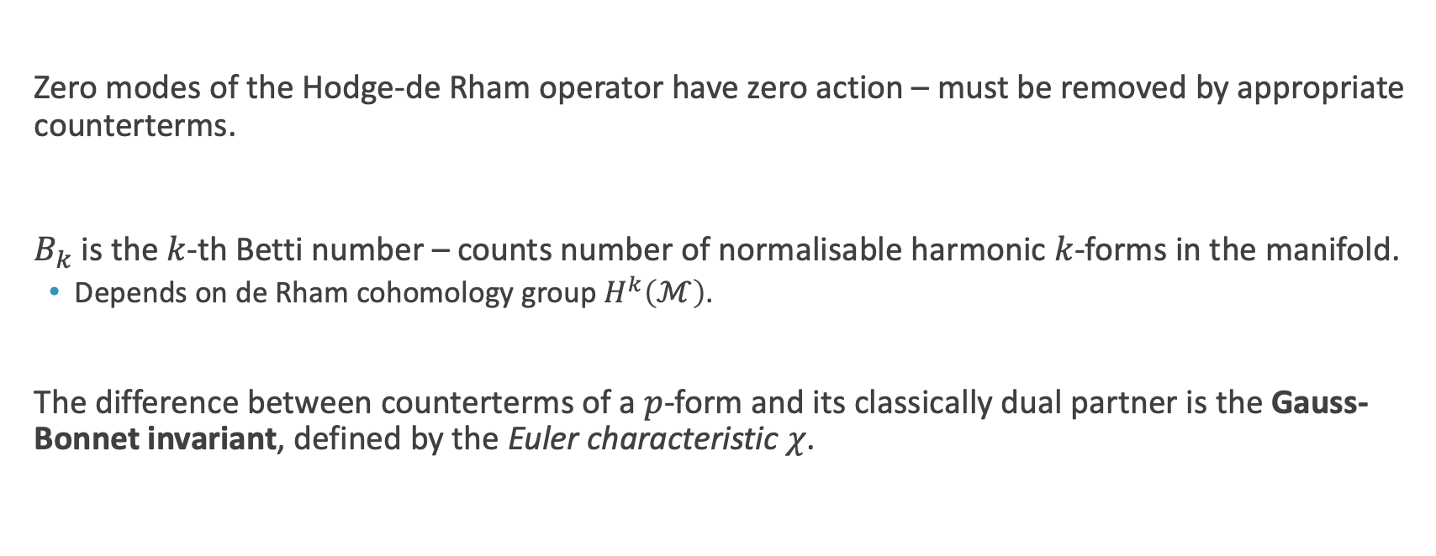
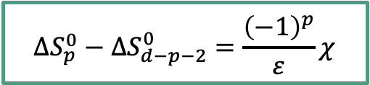
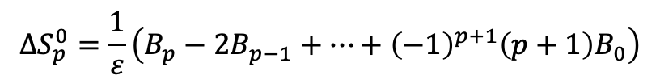
Quantum non-equivalence of massless
$p$-forms
$$Z_{p}^{0}={\left(det {\text{☐}}_{p}\right)}^{−1/2}{\left(det {\text{☐}}_{p−1}\right)}^{1}{\left(det {\text{☐}}_{p−2}\right)}^{−3/2}…{\left(det {\text{☐}}_{0}\right)}^{{\left(−1\right)}^{p+1}(p+1)/2}$$
Zero modes of the Hodge-de Rham operator have zero action – must be removed by appropriate counterterms.
$B_{k}$ is the $k$-th Betti number – counts number of normalisable harmonic $k$-forms in the manifold.
  Depends on de Rham cohomology group $H^{k}\left(ℳ\right)$.
The difference between counterterms of a $p$-form and its classically dual partner is the Gauss-Bonnet invariant, defined by the Euler characteristic $χ$.
$$ΔS_{p}^{0}=\frac{1}{ε}\left(B_{p}−2B_{p−1}+…+{\left(−1\right)}^{p+1}\left(p+1\right)B_{0}\right)$$
$$ΔS_{p}^{0}−ΔS_{d−p−2}^{0}=\frac{{\left(−1\right)}^{p}}{ε}χ$$

Slide 12
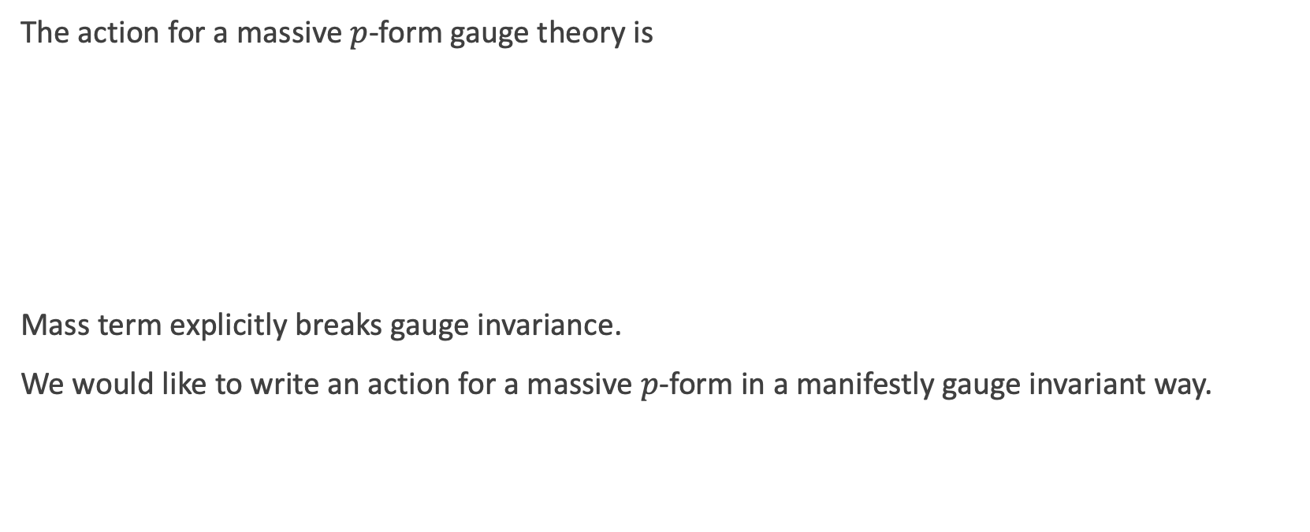

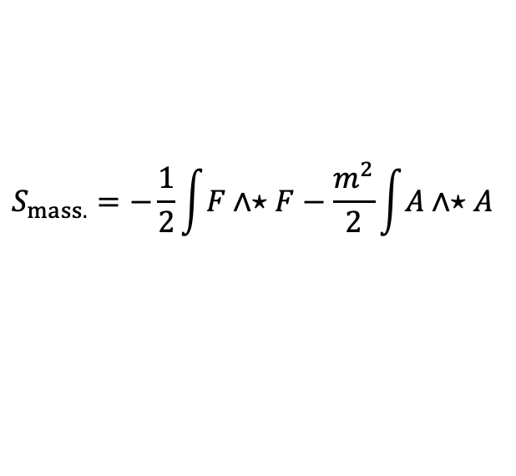
Massive $p$-form gauge theories
The action for a massive $p$-form gauge theory is
Mass term explicitly breaks gauge invariance.
We would like to write an action for a massive $p$-form in a manifestly gauge invariant way.
$$S_{mass.}=−\frac{1}{2}\int{F∧⋆F}−\frac{m^{2}}{2}\int{A∧⋆A}$$
Equations of motion: $d⋆F+{\left(−1\right)}^{p}m^{2}⋆A=0$

Slide 13
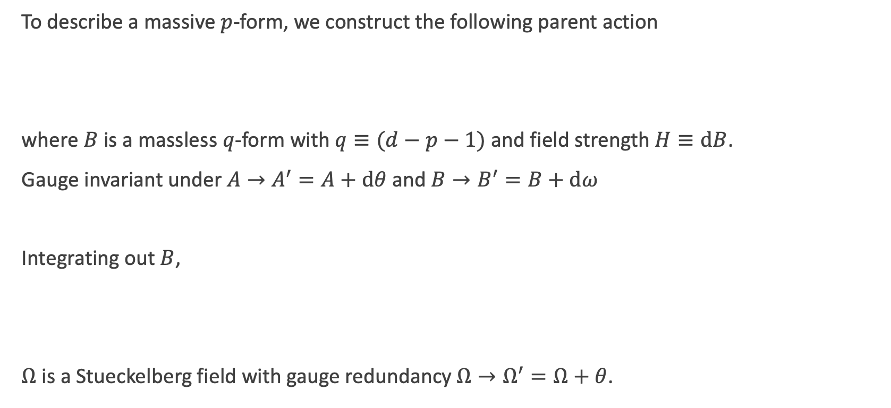

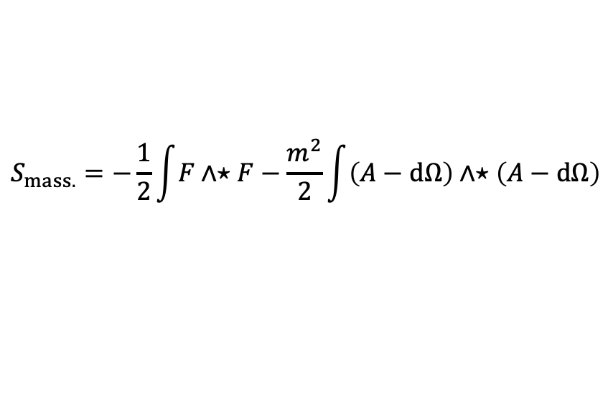
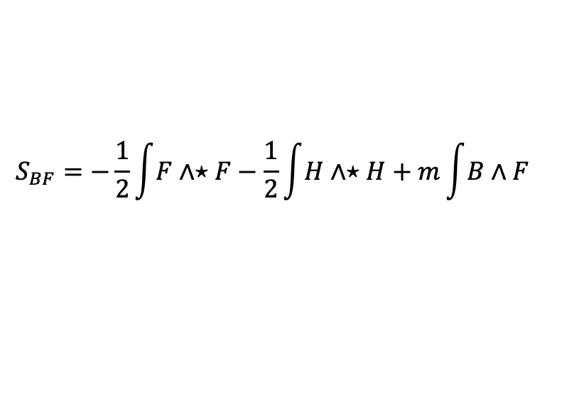
The $BF$ theory
To describe a massive $p$-form, we construct the following parent action
where $B$ is a massless $q$-form with $q≡(d−p−1)$ and field strength $H≡dB$.
Gauge invariant under $A→A^{′}=A+dθ$ and $B→B^{′}=B+dω$
Integrating out $B$,
$Ω$ is a Stueckelberg field with gauge redundancy $Ω→Ω^{′}=Ω+θ$.
$$S_{BF}=−\frac{1}{2}\int{F∧⋆F}−\frac{1}{2}\int{H∧⋆H}+m\int{B∧F}$$
$$S_{mass.}=−\frac{1}{2}\int{F∧⋆F}−\frac{m^{2}}{2}\int{\left(A−dΩ\right)∧⋆\left(A−dΩ\right)}$$

Slide 14
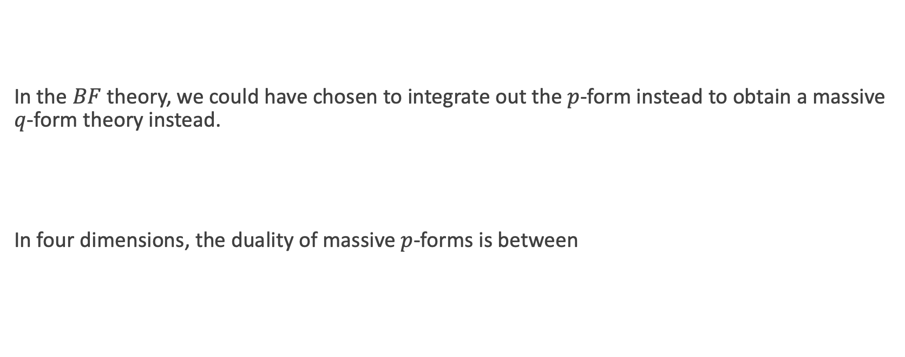



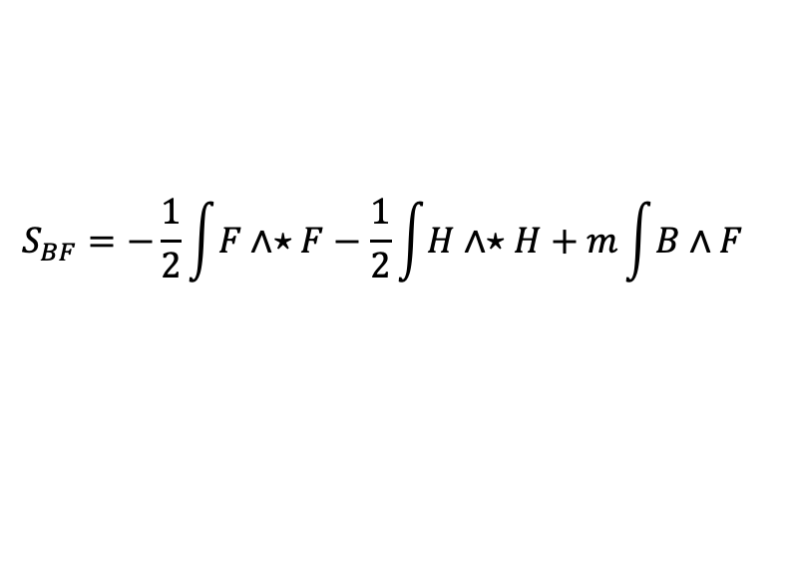
Classical equivalence of massive $p$-forms
In the $BF$ theory, we could have chosen to integrate out the $p$-form instead to obtain a massive $q$-form theory instead.
In four dimensions, the duality of massive $p$-forms is between
$$S_{BF}=−\frac{1}{2}\int{F∧⋆F}−\frac{1}{2}\int{H∧⋆H}+m\int{B∧F}$$
Massive $p$-forms are classically dual to massive $(d−p−1)$-forms
1-form $↔$ 2-form
0-form $↔$ 3-form

Slide 15
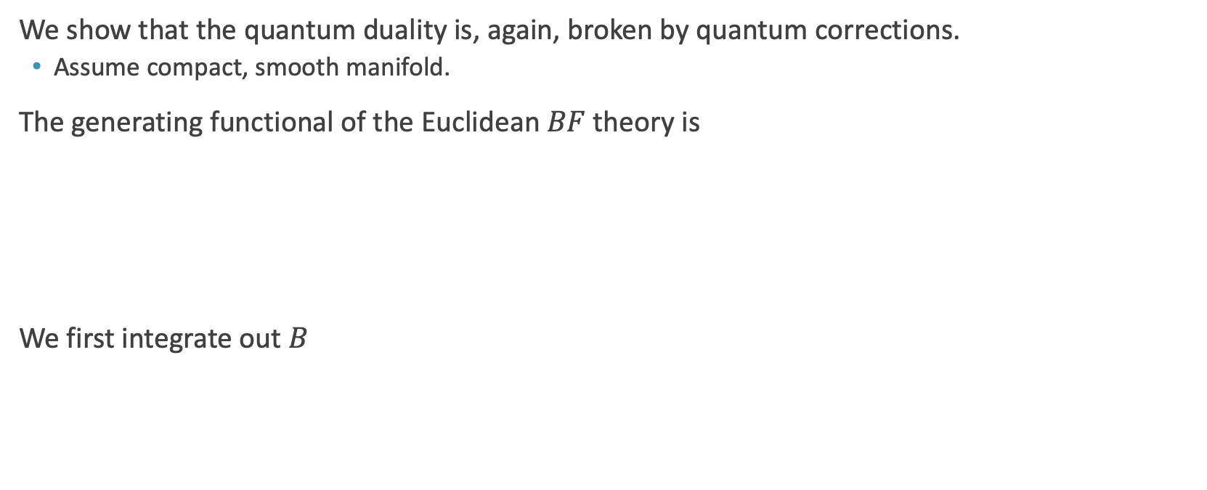
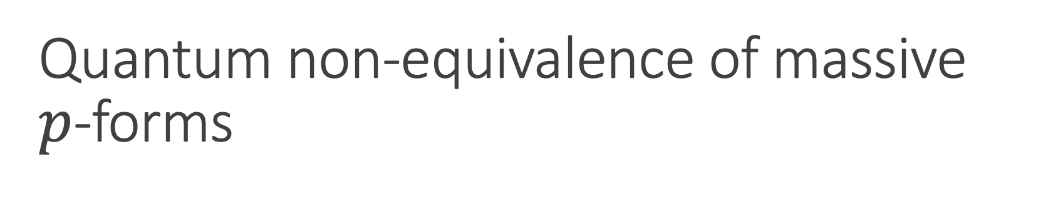
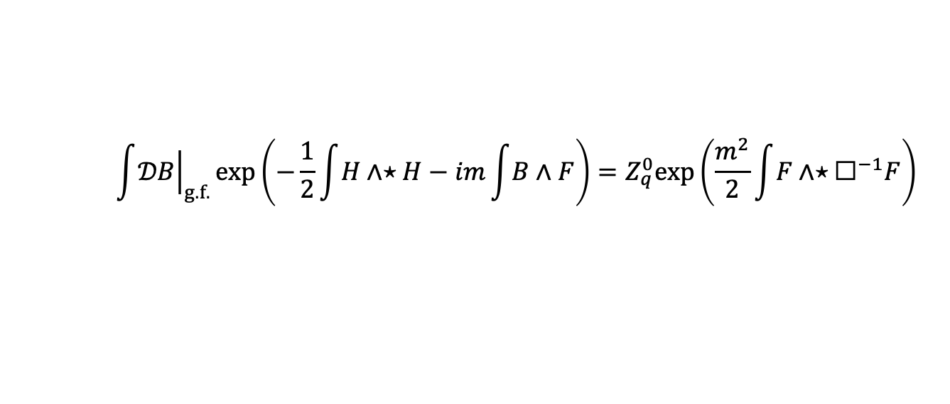
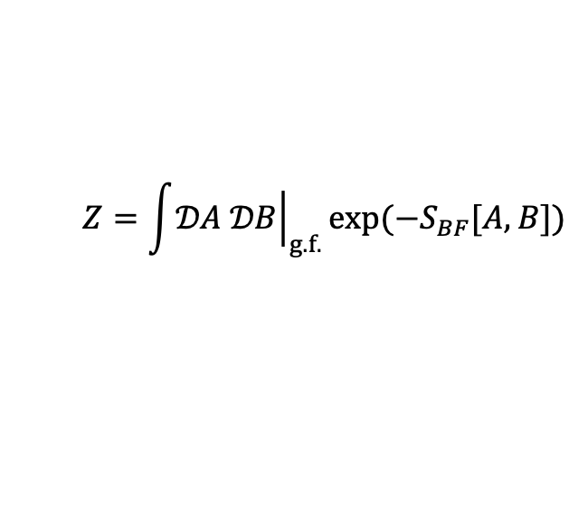
Quantum non-equivalence of massive
$p$-forms
We show that the quantum duality is, again, broken by quantum corrections.
  Assume compact, smooth manifold.
The generating functional of the Euclidean $BF$theory is
We first integrate out $B$
$$Z=\int{{\left.𝒟A 𝒟B\right|}_{g.f.}}exp(−S_{BF}[A,B])$$
$$\int{{\left.𝒟B\right|}_{g.f.}}exp\left(−\frac{1}{2}\int{H∧⋆H}−im\int{B∧F}\right)=Z_{q}^{0}exp\left(\frac{m^{2}}{2}\int{F∧⋆{\text{☐}}^{−1}F}\right)$$

Slide 16
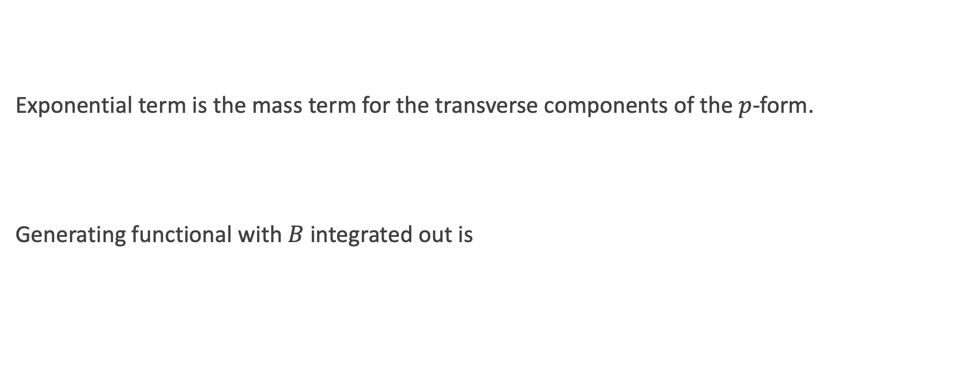
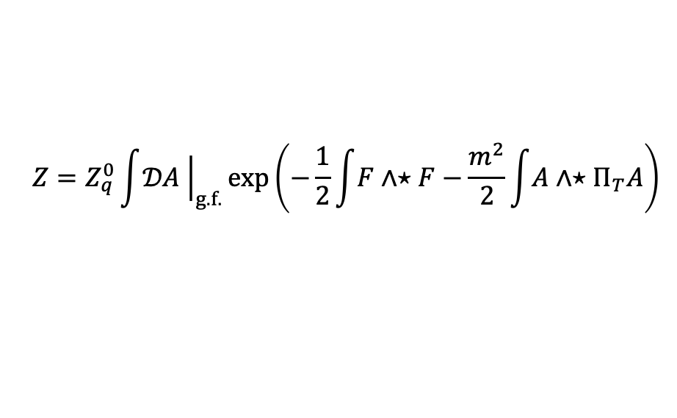
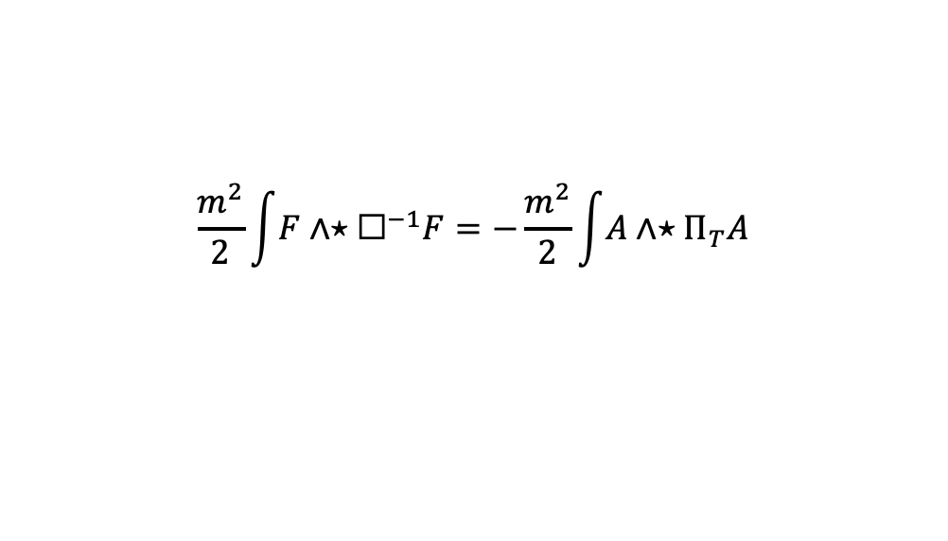
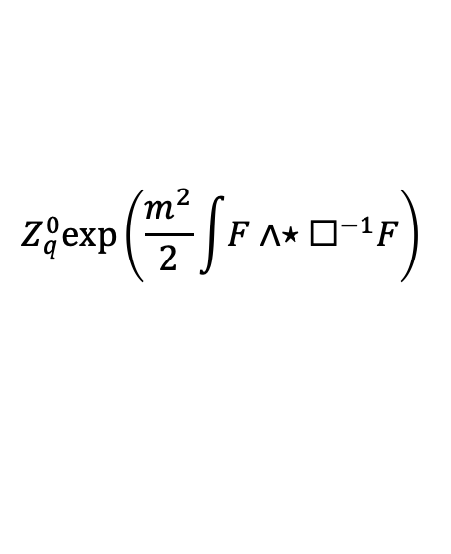
Quantum non-equivalence of massive
$p$-forms
Exponential term is the mass term for the transverse components of the $p$-form.
Generating functional with $B$ integrated out is
$$Z_{q}^{0}exp\left(\frac{m^{2}}{2}\int{F∧⋆{\text{☐}}^{−1}F}\right)$$
$$\frac{m^{2}}{2}\int{F∧⋆{\text{☐}}^{−1}F}=−\frac{m^{2}}{2}\int{A∧⋆Π_{T}A}$$
$$Z=Z_{q}^{0}\int{{\left.𝒟A \right|}_{g.f.}}exp\left(−\frac{1}{2}\int{F∧⋆F}−\frac{m^{2}}{2}\int{A∧⋆Π_{T}A}\right)$$

Slide 17
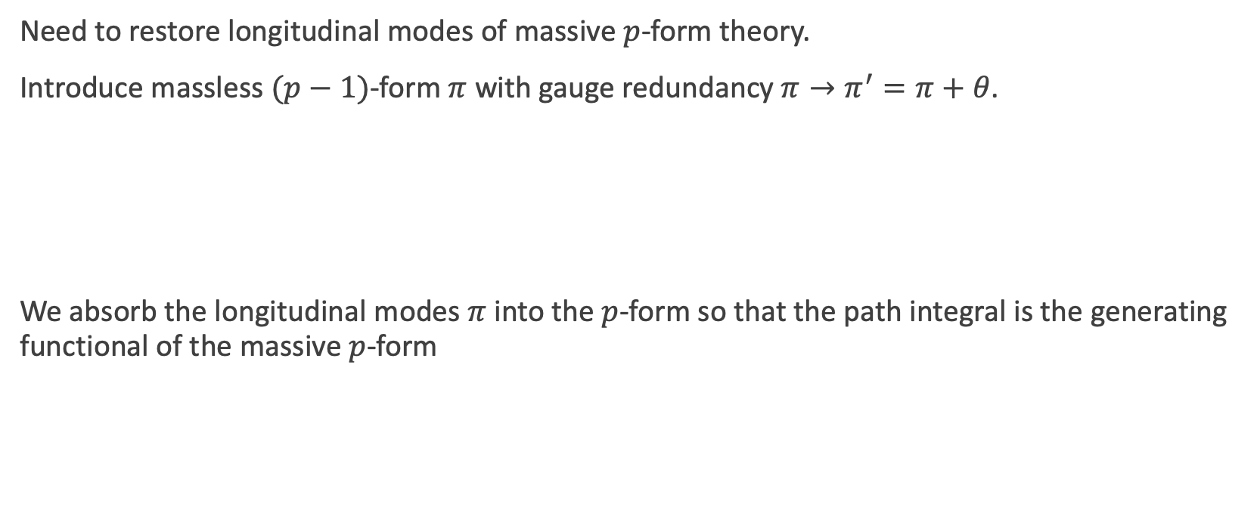
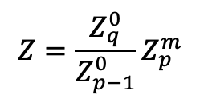
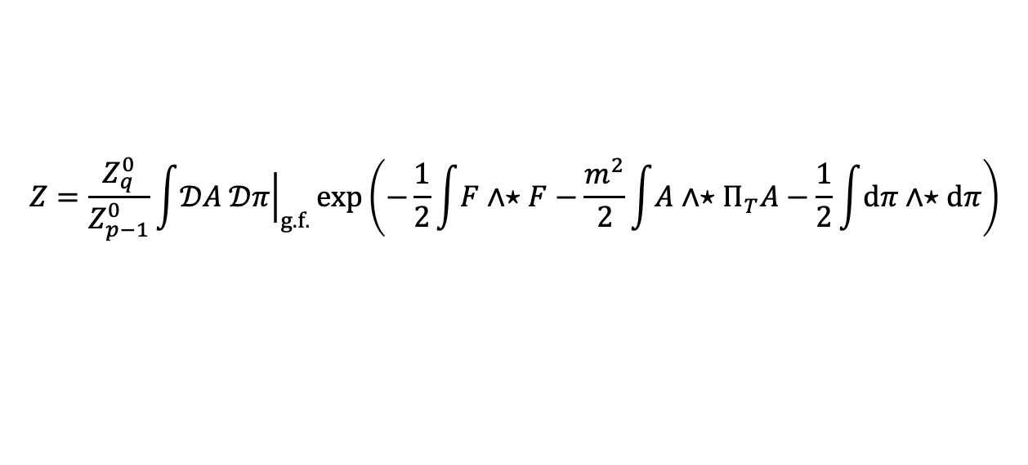
Quantum non-equivalence of massive
$p$-forms
Need to restore longitudinal modes of massive $p$-form theory.
Introduce massless $(p−1)$-form $π$ with gauge redundancy $π→π^{′}=π+θ$.
We absorb the longitudinal modes $π$ into the $p$-form so that the path integral is the generating functional of the massive $p$-form
$$Z=\frac{Z_{q}^{0}}{Z_{p−1}^{0}}\int{{\left.𝒟A 𝒟π\right|}_{g.f.}}exp\left(−\frac{1}{2}\int{F∧⋆F}−\frac{m^{2}}{2}\int{A∧⋆Π_{T}A}−\frac{1}{2}\int{dπ∧⋆dπ}\right)$$
$$Z=\frac{Z_{q}^{0}}{Z_{p−1}^{0}}Z_{p}^{m}$$

Slide 18
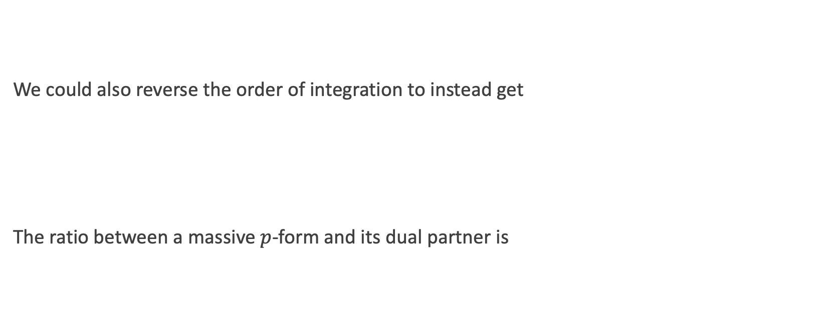
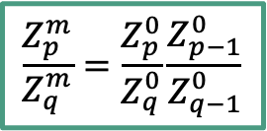
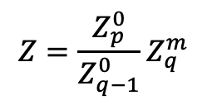
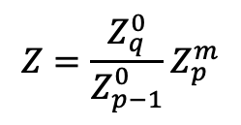
Quantum non-equivalence of massive
$p$-forms
We could also reverse the order of integration to instead get
The ratio between a massive $p$-form and its dual partner is
$$Z=\frac{Z_{q}^{0}}{Z_{p−1}^{0}}Z_{p}^{m}$$
$$Z=\frac{Z_{p}^{0}}{Z_{q−1}^{0}}Z_{q}^{m}$$
$$\frac{Z_{p}^{m}}{Z_{q}^{m}}=\frac{Z_{p}^{0}}{Z_{q}^{0}}\frac{Z_{p−1}^{0}}{Z_{q−1}^{0}}$$

Slide 19
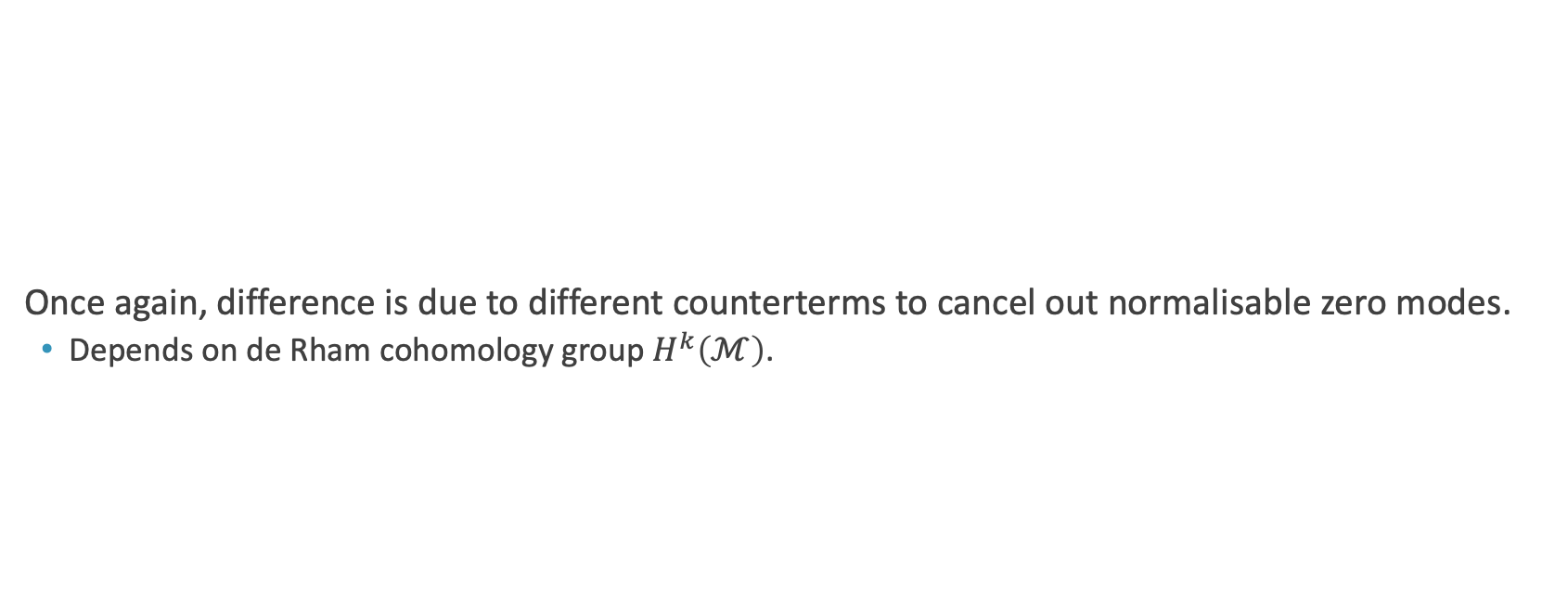
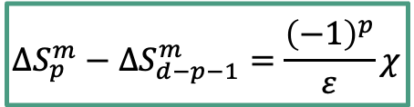
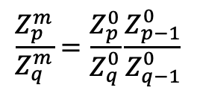
Quantum non-equivalence of massive
$p$-forms
Once again, difference is due to different counterterms to cancel out normalisable zero modes.
  Depends on de Rham cohomology group $H^{k}\left(ℳ\right)$.
$$\frac{Z_{p}^{m}}{Z_{q}^{m}}=\frac{Z_{p}^{0}}{Z_{q}^{0}}\frac{Z_{p−1}^{0}}{Z_{q−1}^{0}}$$
Equivalence is broken due to the failure of the dualisation of the massless longitudinal modes.
$$ΔS_{p}^{m}−ΔS_{d−p−1}^{m}=\frac{{\left(−1\right)}^{p}}{ε}χ$$

Slide 20
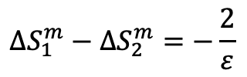
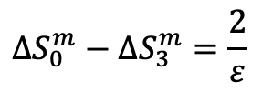
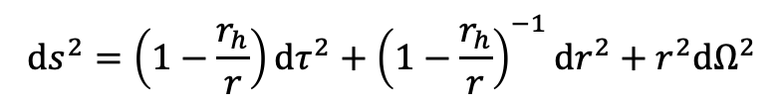
Euclidean Schwarzschild spacetime
There are two distinct harmonic 2-forms which are normalisable zero modes.
$$ds^{2}=\left(1−\frac{r_{h}}{r}\right)dτ^{2}+{\left(1−\frac{r_{h}}{r}\right)}^{−1}dr^{2}+r^{2}dΩ^{2}$$
$$ΔS_{0}^{m}−ΔS_{3}^{m}=\frac{2}{ε}$$
$$ΔS_{1}^{m}−ΔS_{2}^{m}=−\frac{2}{ε}$$

Slide 21

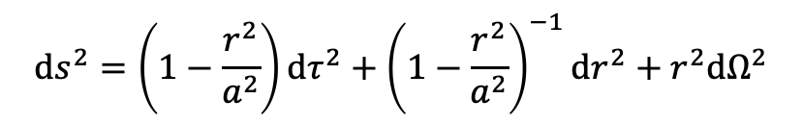
Euclidean de Sitter spacetime
The only harmonic forms are a 0-form and a $d$-form.
$$ds^{2}=\left(1−\frac{r^{2}}{a^{2}}\right)dτ^{2}+{\left(1−\frac{r^{2}}{a^{2}}\right)}^{−1}dr^{2}+r^{2}dΩ^{2}$$
$$ΔS_{0}^{m}−ΔS_{3}^{m}=\frac{2}{ε}$$
$$ΔS_{1}^{m}−ΔS_{2}^{m}=−\frac{2}{ε}$$

Slide 22
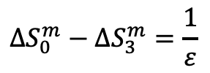
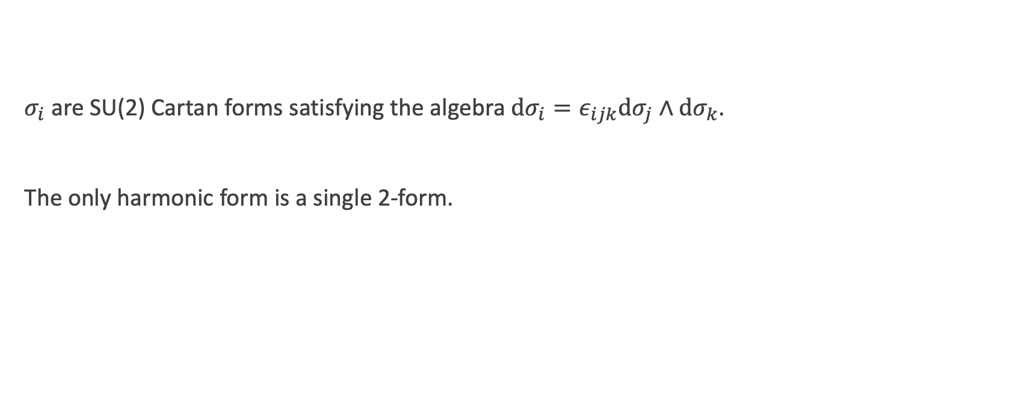
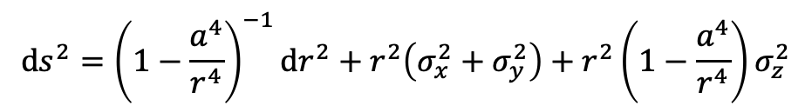

Eguchi-Hanson instantons
$σ_{i}$ are SU(2) Cartan forms satisfying the algebra $dσ_{i}=ε_{ijk}dσ_{j}∧dσ_{k}$.
The only harmonic form is a single 2-form.
$$ds^{2}={\left(1−\frac{a^{4}}{r^{4}}\right)}^{−1}dr^{2}+r^{2}\left(σ_{x}^{2}+σ_{y}^{2}\right)+r^{2}\left(1−\frac{a^{4}}{r^{4}}\right)σ_{z}^{2}$$
$$ΔS_{0}^{m}−ΔS_{3}^{m}=\frac{1}{ε}$$
$$ΔS_{1}^{m}−ΔS_{2}^{m}=−\frac{1}{ε}$$

Slide 23




Conclusion
Massless $p$-forms are classically dual to massless $(d−p−2)$-forms.
It is known that the equivalence is broken by quantum corrections in topologically non-trivial manifolds which have normalisable zero modes.
Massive $p$-forms are classically dual to massive $(d−p−1)$-forms.
We have shown that the equivalence is similarly broken, namely due to the failure of the dualisation of the massless longitudinal modes.
The non-equivalence has been explicitly shown for spacetimes with non-trivial topologies.
$$H^{k}\left(ℳ\right)=\frac{Closed k\text{−}forms}{Exact k\text{−}forms}$$
$$\frac{Z_{p}^{m}}{Z_{q}^{m}}=\frac{Z_{p}^{0}}{Z_{q}^{0}}\frac{Z_{p−1}^{0}}{Z_{q−1}^{0}}$$
$$ΔS_{p}^{m}−ΔS_{d−p−1}^{m}=\frac{{\left(−1\right)}^{p}}{ε}χ$$

