Slide 1
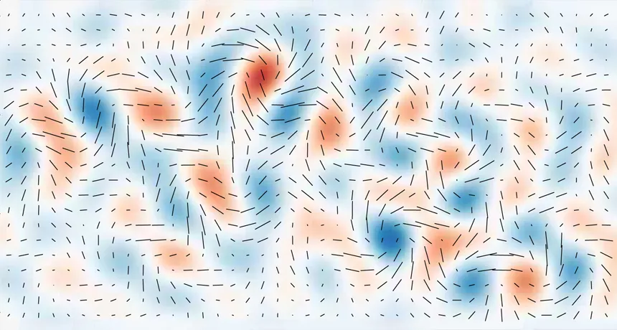
Constraints on Primordial Gravitational Waves
Alex Nemtinova,
The University of Melbourne
Supervisor: Christian Reichardt
Credit: BICEP2 Collaboration
Notes:
Today I’m going to talk about primordial gravitational waves and how we can constrain their properties.

Slide 2
Inflation predicts two types of primordial fluctuations
Scalar
Fluctuations in the inflaton
↓
Density fluctuations
↓
Structure formation
Tensor
Fluctuations of spacetime
↓
Primordial gravitational waves
No detection yet →
A test of inflation!
Notes:
They’re called primordial because they’re thought to have formed in the very early Universe. More specifically, inflation – a period of very rapid expansion of the Universe – predicts two types of primordial fluctuations. Scalar fluctuations explain the origin of structure in the Universe. Tensor fluctuations, on the other hand, are fluctuations of spacetime itself. These would appear as primordial gravitational waves. The scalar fluctuations are consistent with what we see in the Universe. But primordial gravitational waves are still missing. Detecting them would therefore provide an important test of inflation. And this is the main motivation for searching for them.

Slide 3
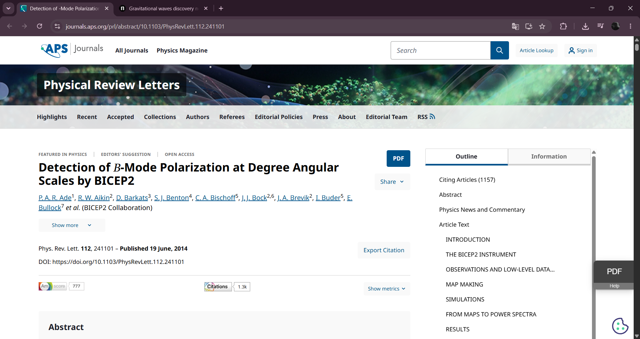
Notes:
There is an interesting story in the history of this search. In 2014, a CMB experiment reported a possible detection of primordial gravitational waves. At the time, this was a very exciting result, because it could have been the first evidence for these waves.

Slide 4
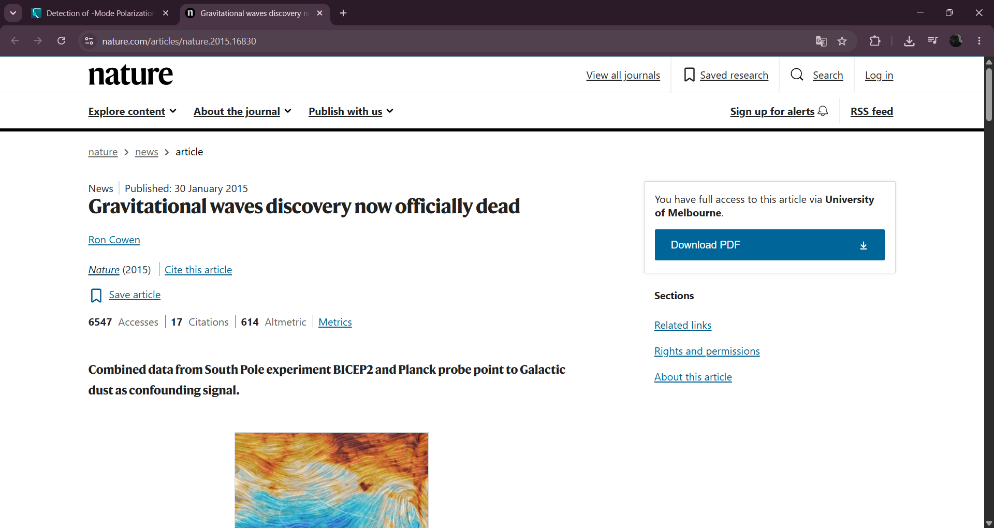
Notes:
But a few months later, they found that the signal came from galactic dust, not gravitational waves. So, they took back the result. The search for primordial gravitational waves continues. This also shows how difficult the measurement is. The primordial signal is very small, so we need to carefully remove foregrounds like galactic dust to detect it.

Slide 5
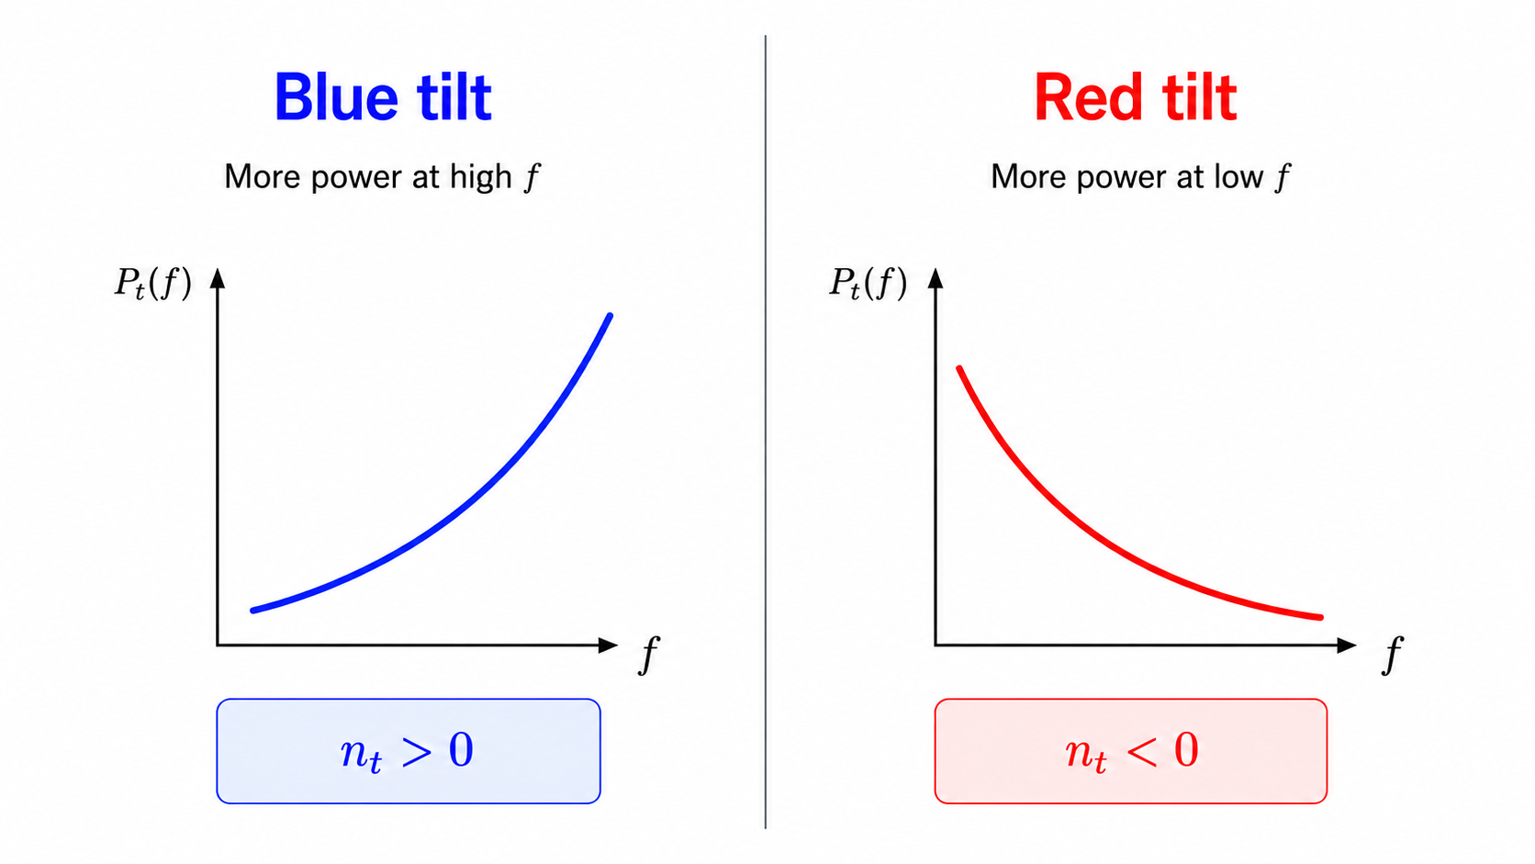
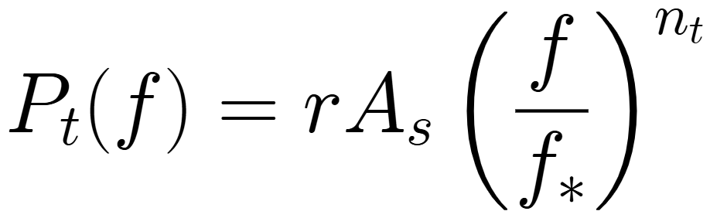
Primordial tensor power spectrum
The tensor tilt sets the frequency dependence
Notes:
Let’s now look at the primordial tensor power spectrum. There are two main parameters of primordial gravitational waves: the tensor-to-scalar ratio, r, and the tensor tilt, n_t. The tensor-to-scalar ratio tells us how strong the tensor fluctuations are compared to the scalar fluctuations. Here, A_s is the amplitude of the scalar spectrum. The tensor tilt tells us how the tensor power changes with frequency. If n_t is positive, there is more power at higher frequencies. If n_t is negative, there is more power at lower frequencies.

Slide 6
Primordial tensor power spectrum
The tensor tilt sets the frequency dependence
Slow-roll inflation: n_{t} < 0, small
Axion, multifield & Galileon models: n_{t} can be < 0 or > 0
Notes:
The power-law form of the spectrum is motivated by slow-roll inflation. In the simplest slow-roll models, n_t is expected to be small and negative. But this is not true for all inflation models. For example, some axion, multifield, and Galileon models can give either negative or positive n_t. So, in this work, I do not assume that n_t has to be small and negative. Instead, I use the data to find which values of n_t are allowed.

Slide 7
How can we observe them?
High f
Ground-based interferometers (LIGO–Virgo–KAGRA)
Pulsar Timing Arrays (NANOGrav)
Low f
Cosmic Microwave Background
Notes:
This brings us to the question: how can we observe primordial gravitational waves? Different experiments probe different frequencies. The CMB probes very low frequencies. NANOGrav and LIGO–Virgo–KAGRA probe higher frequencies. This is important for constraining the tensor tilt because positive n_t is best constrained with high-frequency data, such as NANOGrav and LVK, while negative n_t is better constrained with low-frequency CMB data.

Slide 8
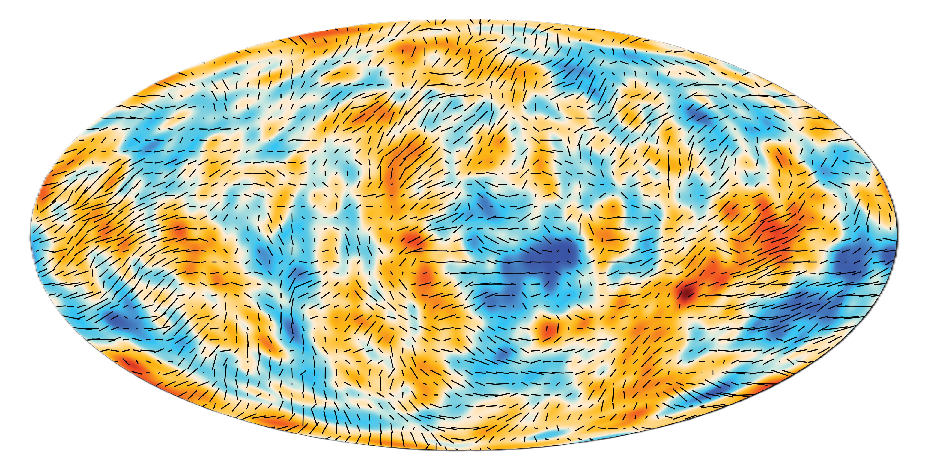
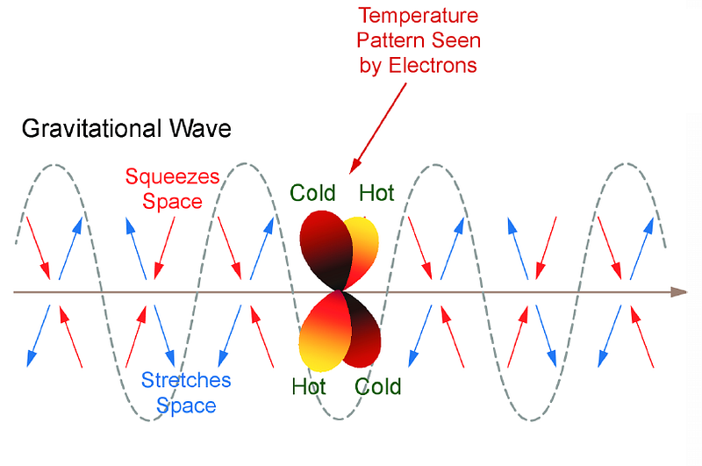
CMB
Primordial gravitational waves
→ stretch and compress spacetime
→ affect CMB temperature and polarization
→ constrained using CMB power spectra
Credit: ESA/Planck Collaboration and J. Kovac
Notes:
Let’s start with the cosmic microwave background. The CMB is light from the early Universe. As the photons travel through space, gravitational waves stretch and compress it. This makes the photons hotter in some directions and colder in others, creating a quadrupole temperature anisotropy. When these photons scatter off electrons, they become polarized. So, primordial gravitational waves also produce a characteristic polarization pattern. As a result, gravitational waves change both the temperature of the CMB – the hot and cold spots shown in this picture – and its polarization. By measuring the CMB temperature and polarization power spectra, we can search for primordial gravitational waves and constrain their properties.

Slide 9
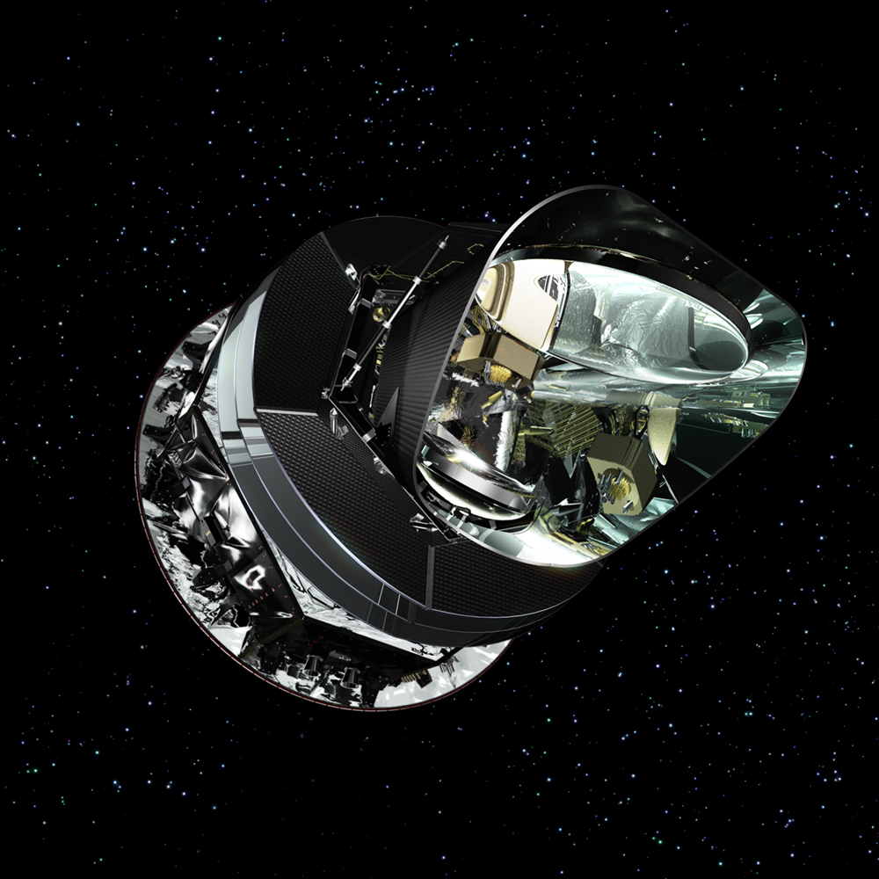
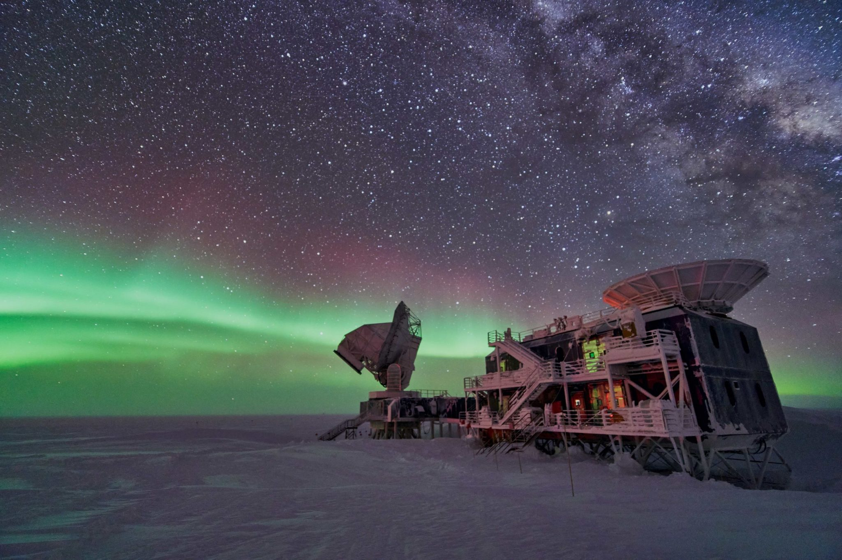
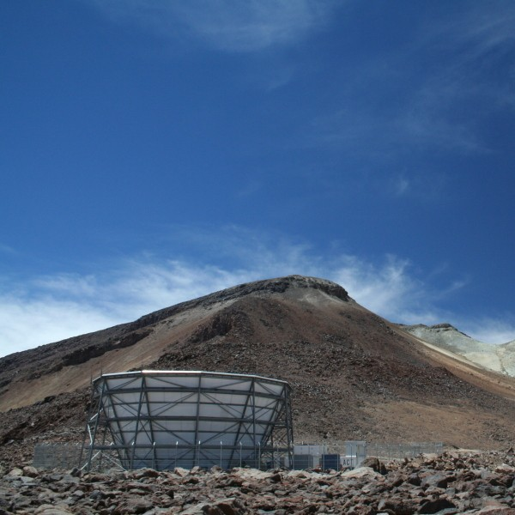
CMB experiments used in the analysis
Planck, space
ACT, Chile
SPT-3G BICEP/Keck,
South Pole
Credit: ESA/Planck Collaboration, S. Aiola, and B. Benson
Notes:
For this analysis, I use data from four major CMB experiments. These are Planck, ACT, BICEP/Keck, and SPT-3G. Planck and ACT have completed their observations, while BICEP/Keck and SPT-3G observe from the South Pole. These experiments are useful together because they give us information from different frequencies.

Slide 10
MCMC sampling
MCMC parameter estimation with Cobaya
MCMC priors:
Theoretical CMB power spectra from CLASS
Notes:
Now I’ll show how I use these data to constrain r and n_t. I run MCMC chains with Cobaya, using uniform priors on both parameters. For r, I sample from zero to two. For n_t, I sample from minus five to five. I also sample the six standard LCDM parameters, which are not shown here. For each set of parameters, CLASS calculates the theoretical CMB temperature and polarization power spectra. I then compare these spectra with the observed CMB data. The result is a posterior distribution for r and n_t. This gives us the range of values allowed by the CMB data.

Slide 11
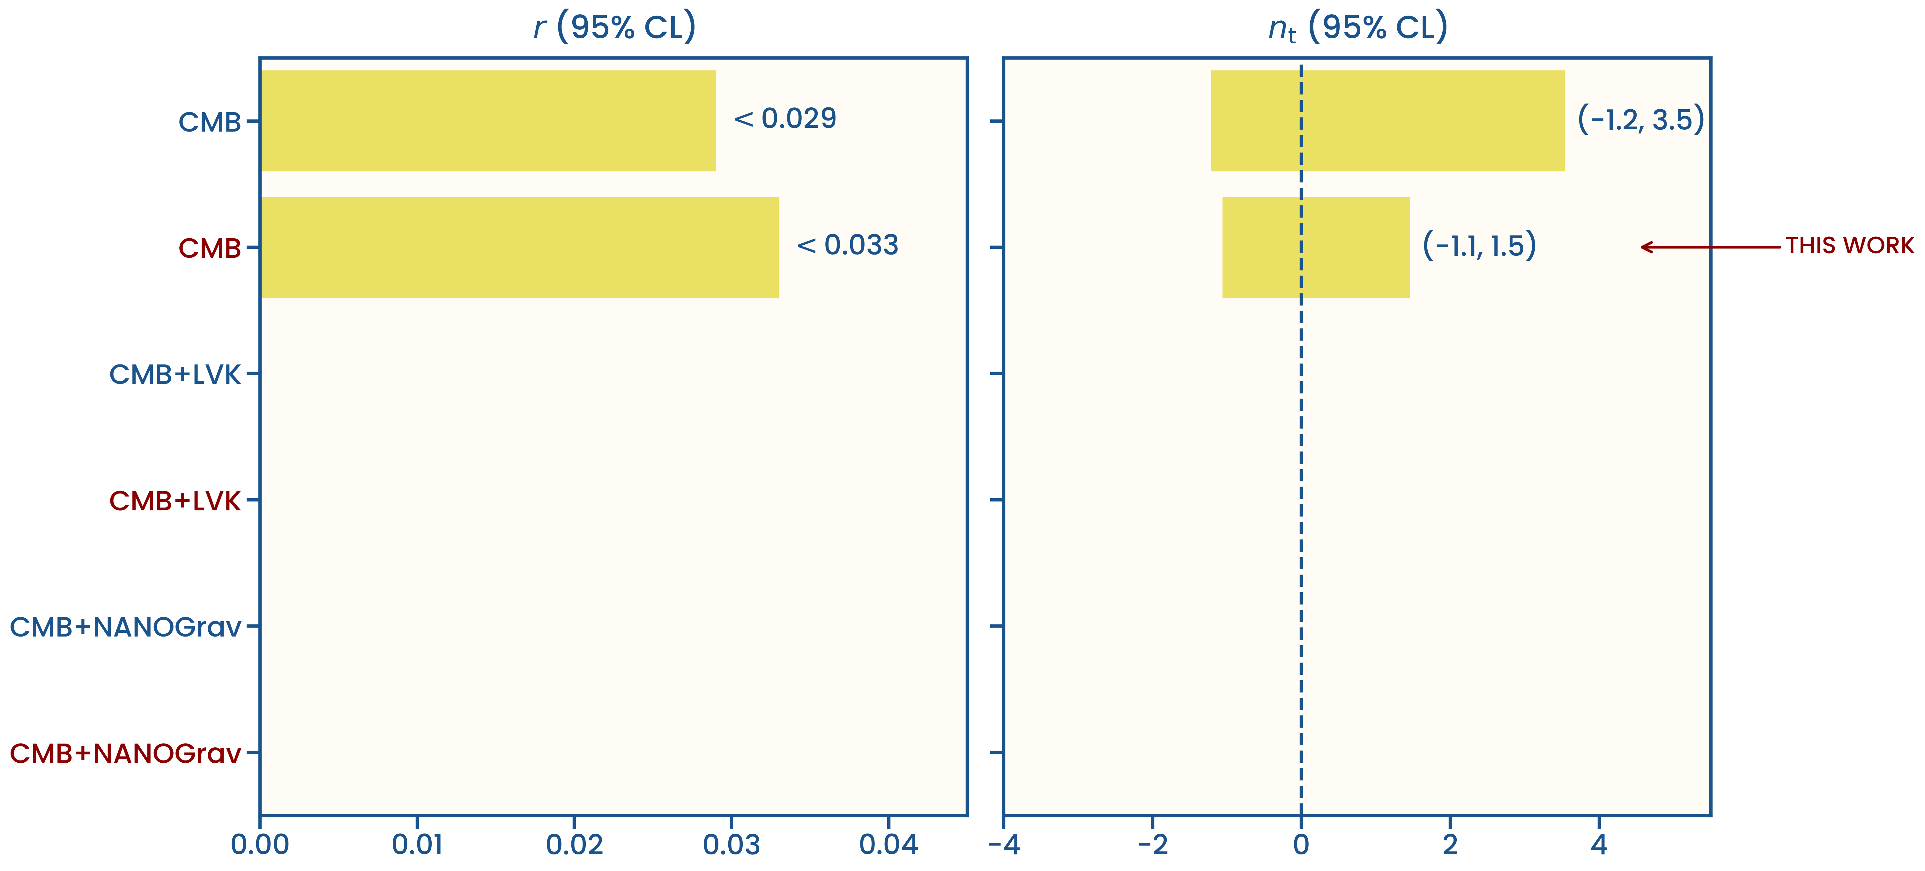
Galloni et al. vs. this work: SPT-3G + ACT improve constraints on positive tensor tilt
Galloni G. et al., JCAP 04, 062 (2023)
Notes:
These are the 2-sigma constraints on r and n_t that I get from the CMB data, along with the previous results from Galloni et al. The previous analysis used only low-frequency Planck and BICEP data. The improvement in this work mainly comes from including the higher-frequency SPT-3G and ACT data, which help constrain positive n_t. The upper limit on n_t decreases from 3.5 to 1.5. But this improvement is still limited by the frequency range of the CMB.

Slide 12
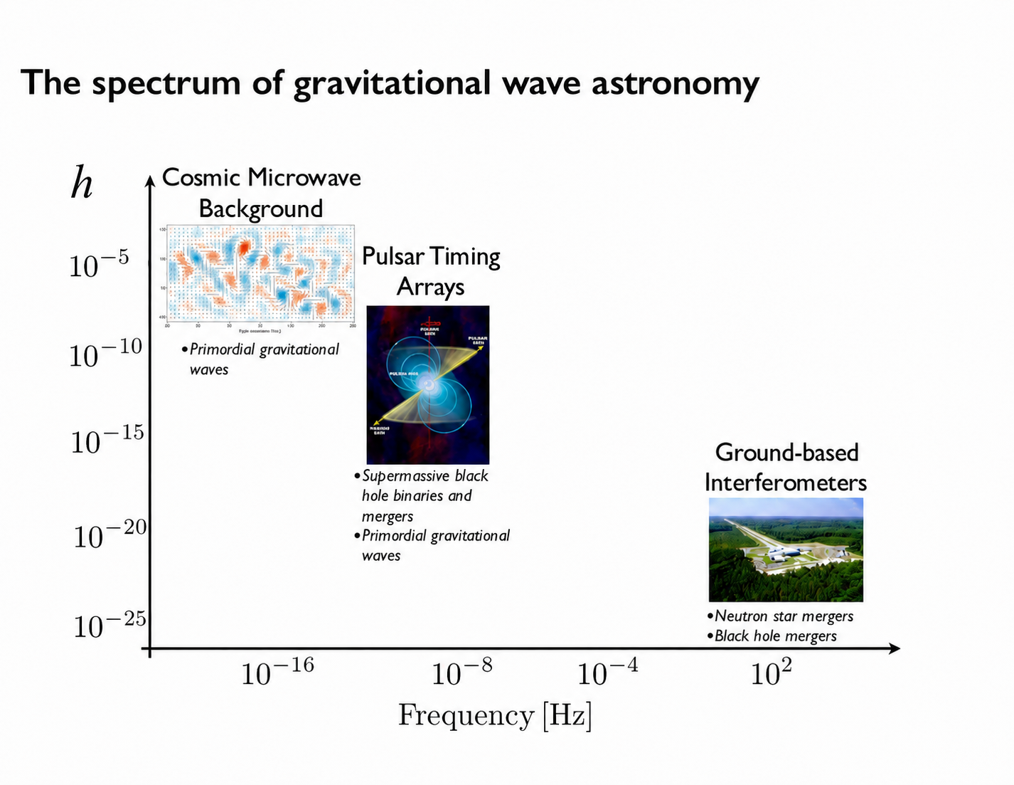
Credit: NANOGrav Collaboration
Notes:
The reason is that the CMB probes very low frequencies, so it does not give us much information about what happens at higher frequencies. By adding experiments at higher frequencies, we extend the frequency range and can constrain the tensor tilt much better.

Slide 13

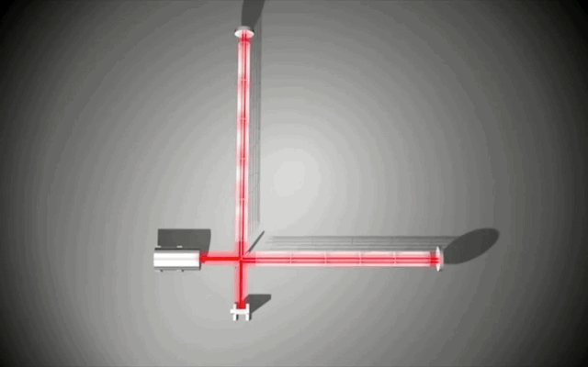
KAGRA
LIGO
LIGO
Virgo
Credit: NANOGrav Collaboration and NSF
Notes:
This is where LIGO–Virgo–KAGRA becomes important. LVK is a network of four gravitational-wave detectors: two in the US, one in Italy, and one in Japan. Each detector is a large interferometer with two perpendicular arms. The detectors use laser light to measure very small changes in the length of these arms. When a gravitational wave passes through Earth, it stretches one arm and compresses the other. This changes the travel time of the laser light, producing a measurable signal. At these frequencies, the signal is expected to be dominated by astrophysical sources, such as binary black hole and neutron star mergers.

Slide 14
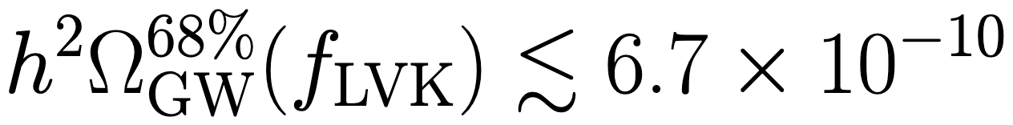
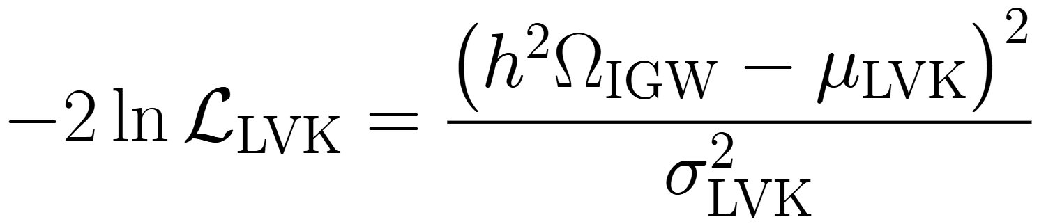
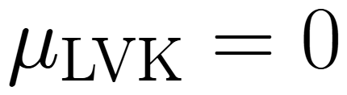
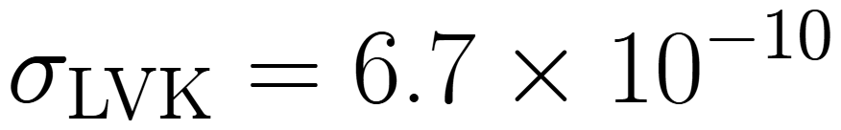
LVK: No detection → upper limit on the gravitational-wave background
LIGO Scientific Collaboration, Virgo Collaboration, and KAGRA Collaboration, Phys. Rev. D 114, 022001 (2026)
Notes:
But LVK also searches for a stochastic gravitational-wave background. So far, no signal has been detected. Instead, they set an upper limit on the gravitational-wave energy density. The upper limit is six point seven times ten to the minus ten. We can use this upper limit to constrain primordial gravitational waves. Since LVK did not detect any signal, I set the mean of the likelihood to zero and use the one-sigma upper limit for the width. I then calculate the theoretical gravitational-wave energy density from inflation and use the LVK likelihood to reweight the CMB MCMC chain. This gives the combined CMB + LVK constraints.

Slide 15
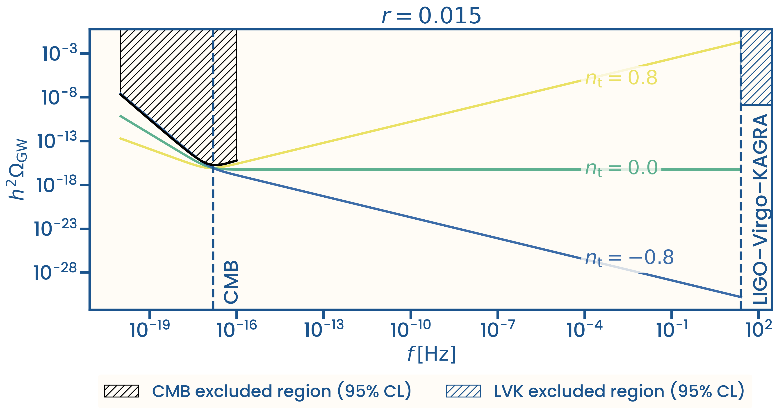
LVK strongly constrains positive tensor tilt
Notes:
These are the theoretical gravitational-wave energy-density spectra predicted by inflation for the same value of r and different values of n_t. I assume that n_t is constant over the entire frequency range from the CMB to the LVK band. This is a simplifying assumption, and it may not be accurate over such a large frequency range, but it is the only one possible given the number of data points we have. The black shaded region is excluded by the CMB at the ninety-five percent confidence level, while the blue shaded region shows the LVK upper limit at the same confidence level. We can see that the CMB strongly constrains spectra with large negative n_t, while the LVK upper limit strongly constrains spectra with large positive n_t.

Slide 16
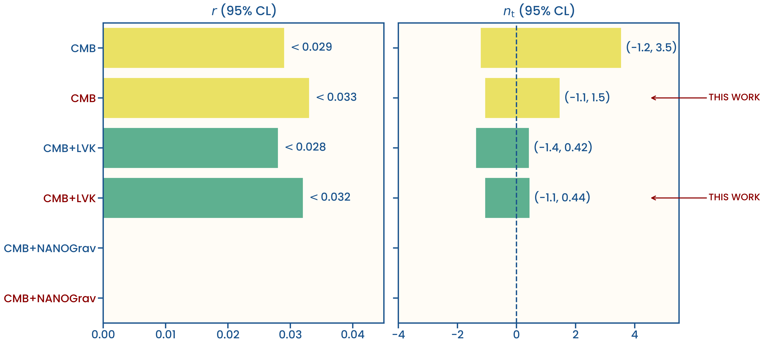
Galloni et al. vs. this work: LVK strongly constrains positive tensor tilt
Galloni G. et al., JCAP 04, 062 (2023)
Notes:
Here are the combined CMB and LVK results. As expected, the lower limit on n_t is almost unchanged and still comes from CMB data, while large positive n_t values are ruled out by LVK. This brings the ninety-five percent confidence upper limit on n_t down from 1.5 to about 0.4.

Slide 17
NANOGrav
Credit: NANOGrav Collaboration
Notes:
There is also an experiment between these two frequency ranges. The NANOGrav Pulsar Timing Array probes gravitational waves at intermediate frequencies. So now we have three different frequency ranges. Let’s look at how NANOGrav measures gravitational waves.

Slide 18
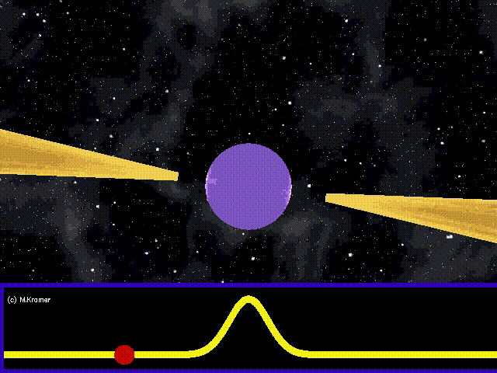
Pulsars: rapidly rotating neutron stars
Credit: B. Houlden
Notes:
NANOGrav observes pulsars, which are rapidly rotating neutron stars.

Slide 19

Pulsars: very precise clocks in space
Credit: B. Houlden
Notes:
They send out pulses at very regular times, so they act like very precise clocks in space. NANOGrav measures when these pulses arrive at Earth.

Slide 20

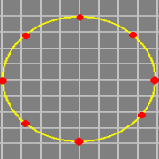
Gravitational waves: changing pulse arrival times
Credit: B. Houlden
Notes:
As gravitational waves travel through the Universe, they stretch and compress spacetime. As a result, the pulses arrive slightly earlier or later than expected.

Slide 21
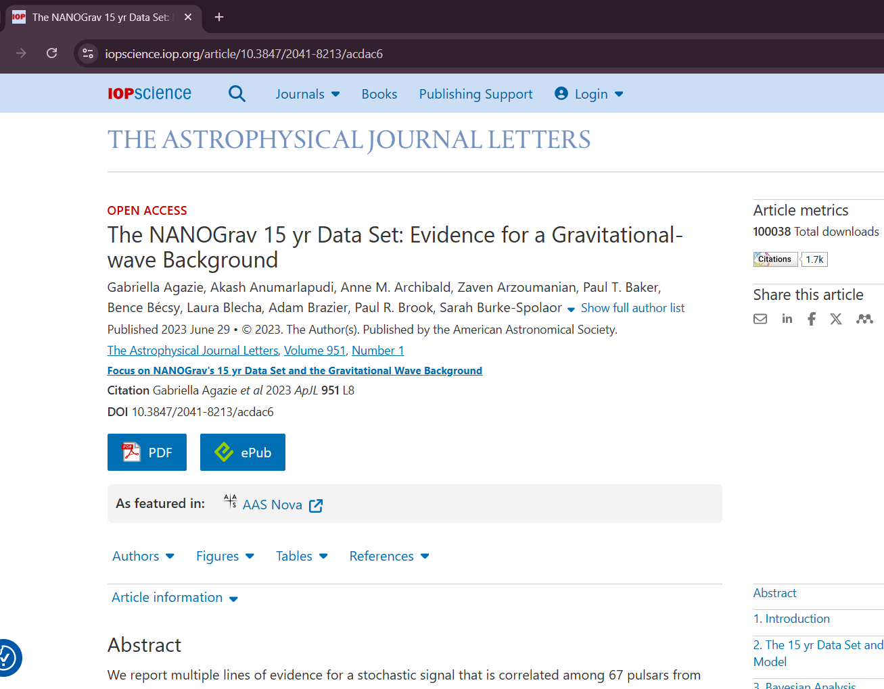
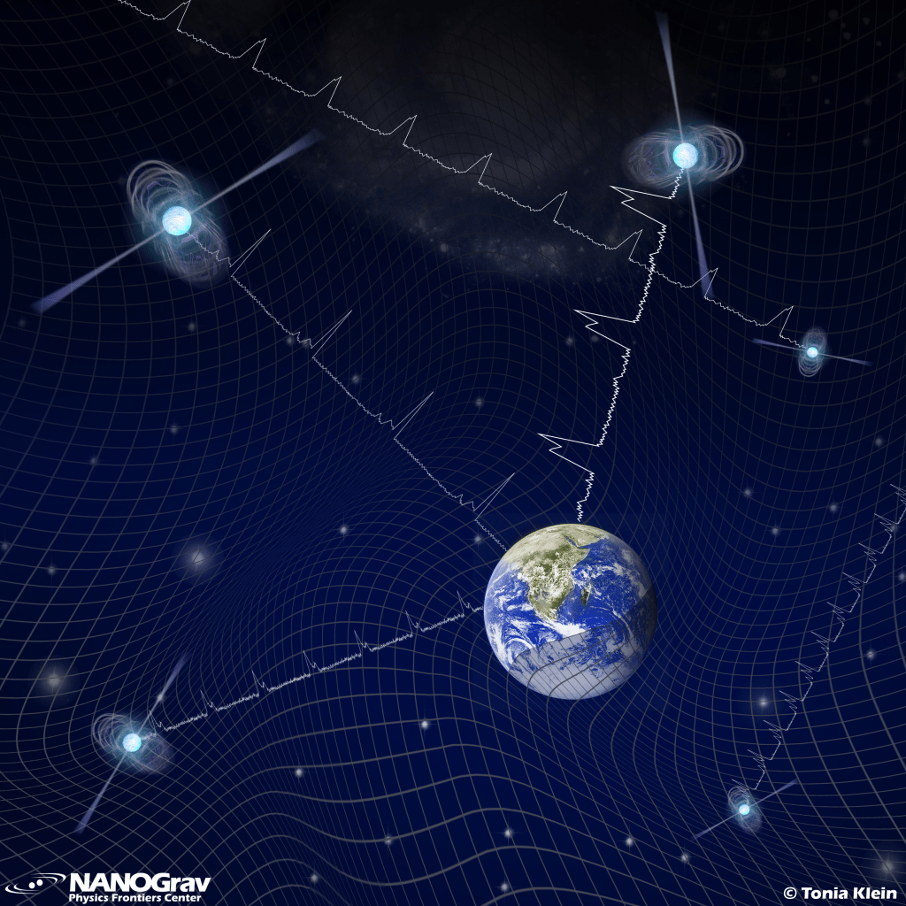
NANOGrav: searching for a common GW signal
Notes:
Of course, one pulsar is not enough. NANOGrav observes many pulsars in different directions across the sky and compares their timing. If we see a common pattern in many pulsars, this could be evidence for a stochastic gravitational-wave background. In 2023, NANOGrav reported evidence for this background, which is now at about three to four sigma. The signal is expected to be dominated by supermassive black hole binaries, but it could also include primordial gravitational waves.

Slide 22
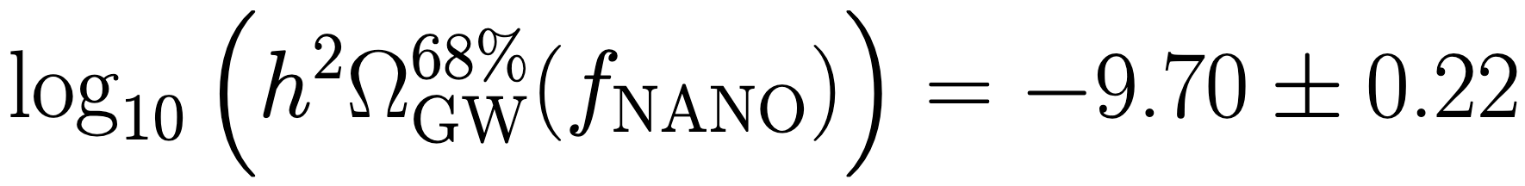
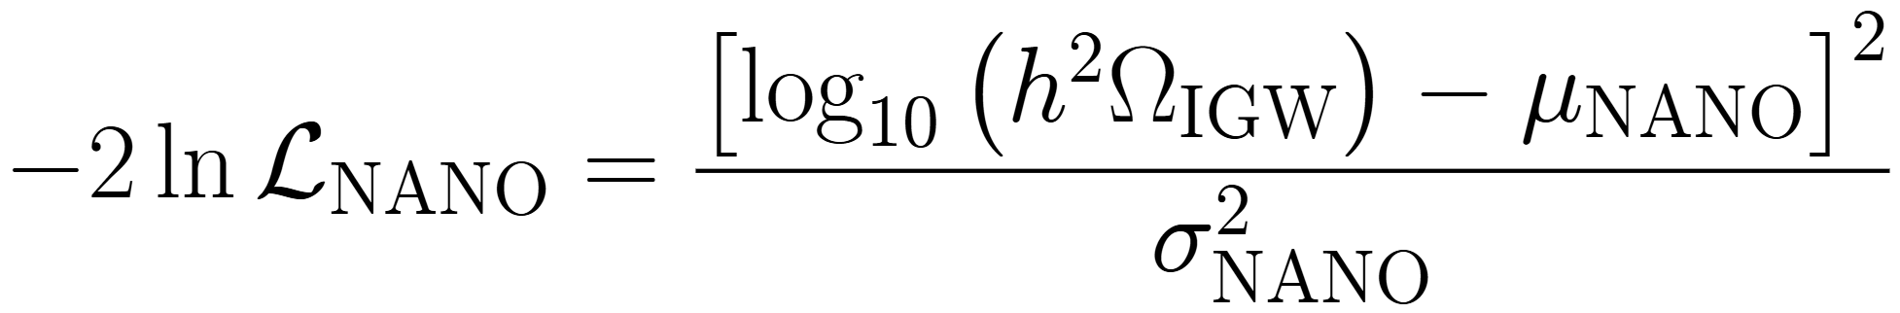
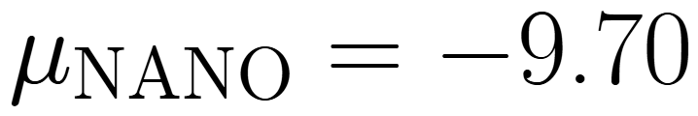
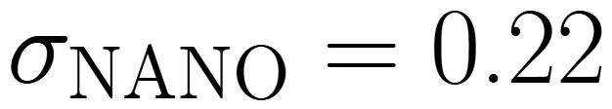
NANOGrav provides evidence for a stochastic gravitational-wave background
Agazie G. et al., ApJL 1004, L40 (2026)
Notes:
So, can we explain this signal with primordial gravitational waves? For simplicity, we first assume that the entire NANOGrav signal is of primordial origin. I construct a likelihood with mu = -9.7 and sigma = 0.22. To obtain the combined CMB + NANOGrav constraints, I calculate the theoretical gravitational-wave energy density and use the NANOGrav likelihood to reweight the CMB MCMC chain.

Slide 23
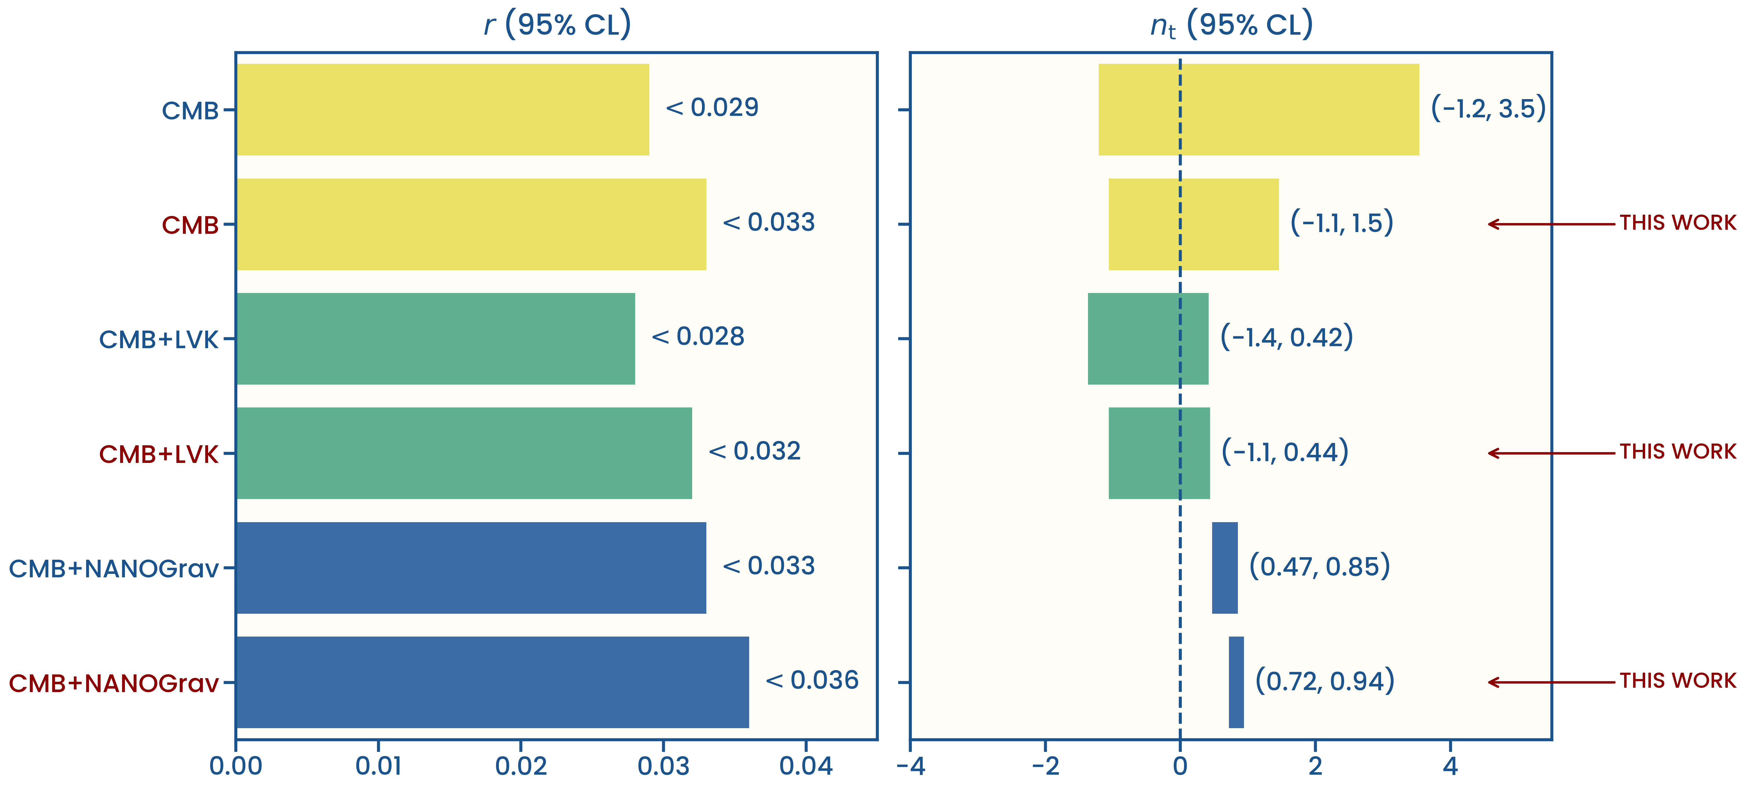
Galloni et al. vs. this work: LVK and NANOGrav results are still in tension
Galloni G. et al., JCAP 04, 062 (2023)
Notes:
Here are the combined CMB and NANOGrav results. We get a large positive value of n_t, around 0.8. The value of n_t preferred by NANOGrav is inconsistent with the LVK upper limit.

Slide 24
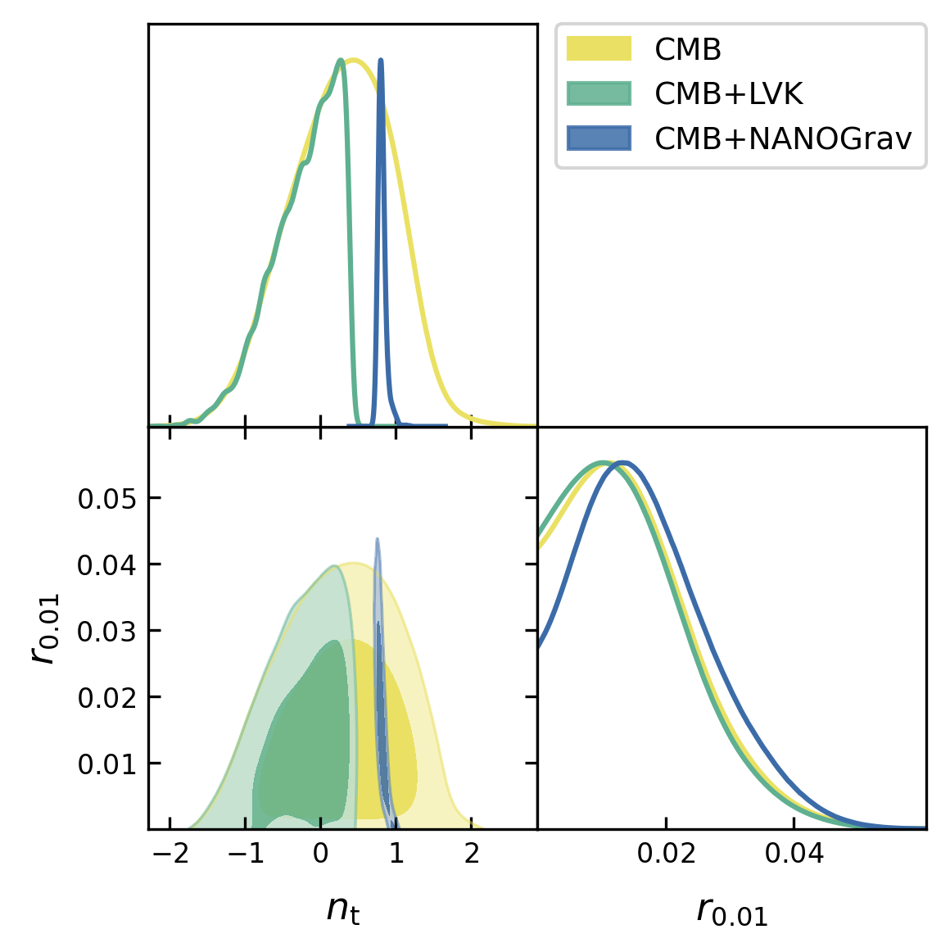
LVK and NANOGrav prefer different tensor tilts
Notes:
This plot shows the same result in parameter space. CMB + LVK is shown in green, while CMB + NANOGrav is shown in blue. The two distributions prefer very different values of n_t.

Slide 25
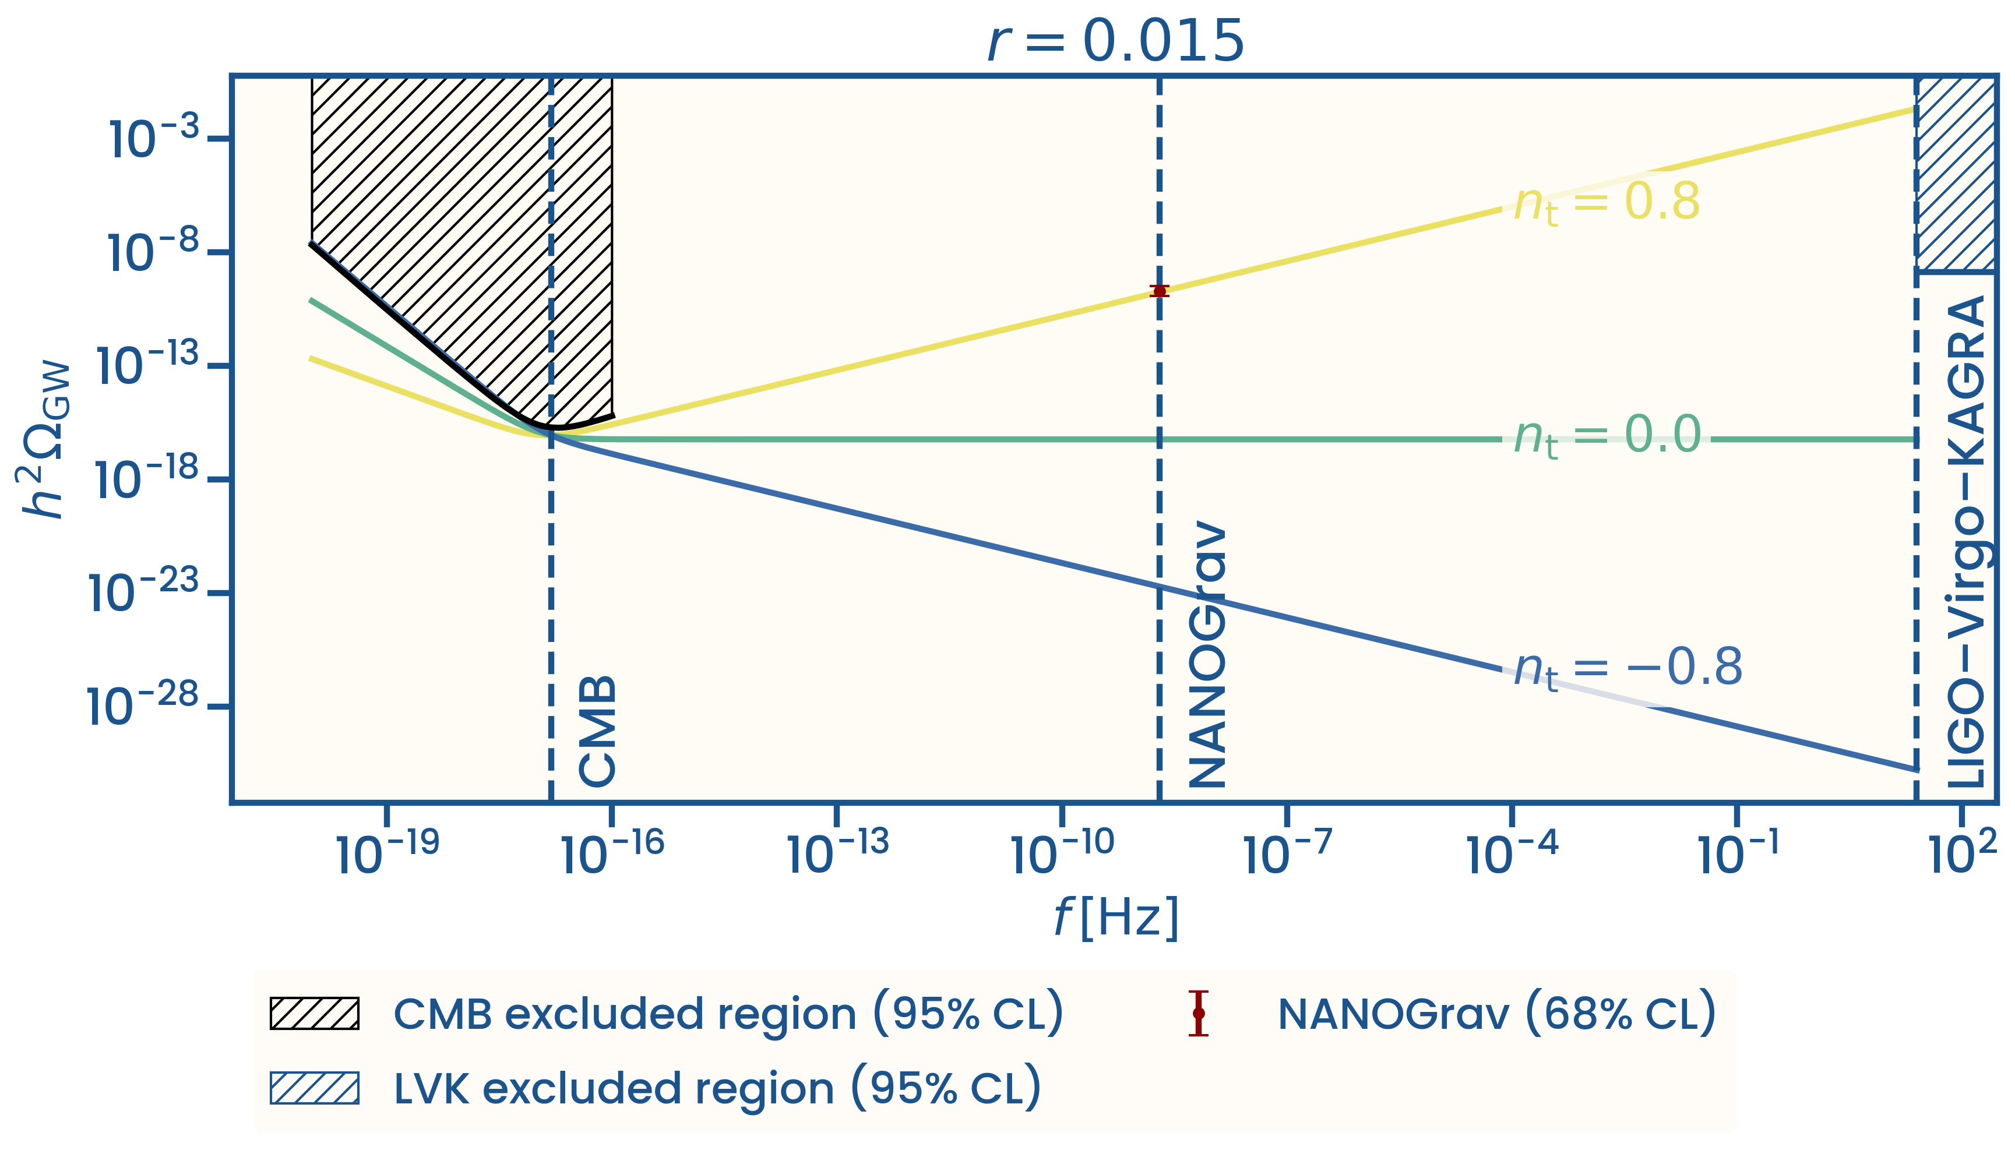
The NANOGrav signal requires a large positive tensor tilt
Notes:
This plot shows what happens when we combine these results. The NANOGrav signal is shown in red. To explain this signal with primordial gravitational waves, n_t needs to be about 0.8. But this also predicts too much power at the LVK frequency, which is not observed. This is where the tension comes from. One possible solution is to have a bump at the NANOGrav frequency, so that the primordial gravitational-wave spectrum is not a simple power law. Another possibility is that the NANOGrav signal is not entirely primordial.

Slide 26
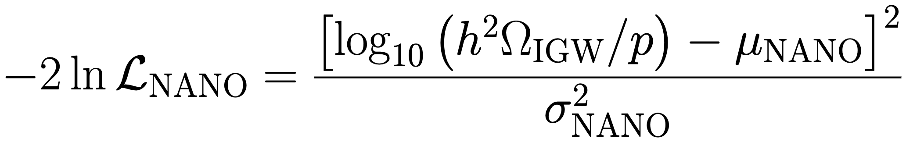
Constraining the primordial fraction of the NANOGrav signal
Agazie G. et al., ApJL 1004, L40 (2026)
Notes:
To test this second idea, we introduce a new parameter p, which describes the fraction of the NANOGrav signal coming from inflation. If p is equal to one, the whole NANOGrav signal is primordial, while if p is equal to zero, there is no primordial contribution. We can then ask how large this primordial contribution can be while staying consistent with the CMB and LVK data.

Slide 27
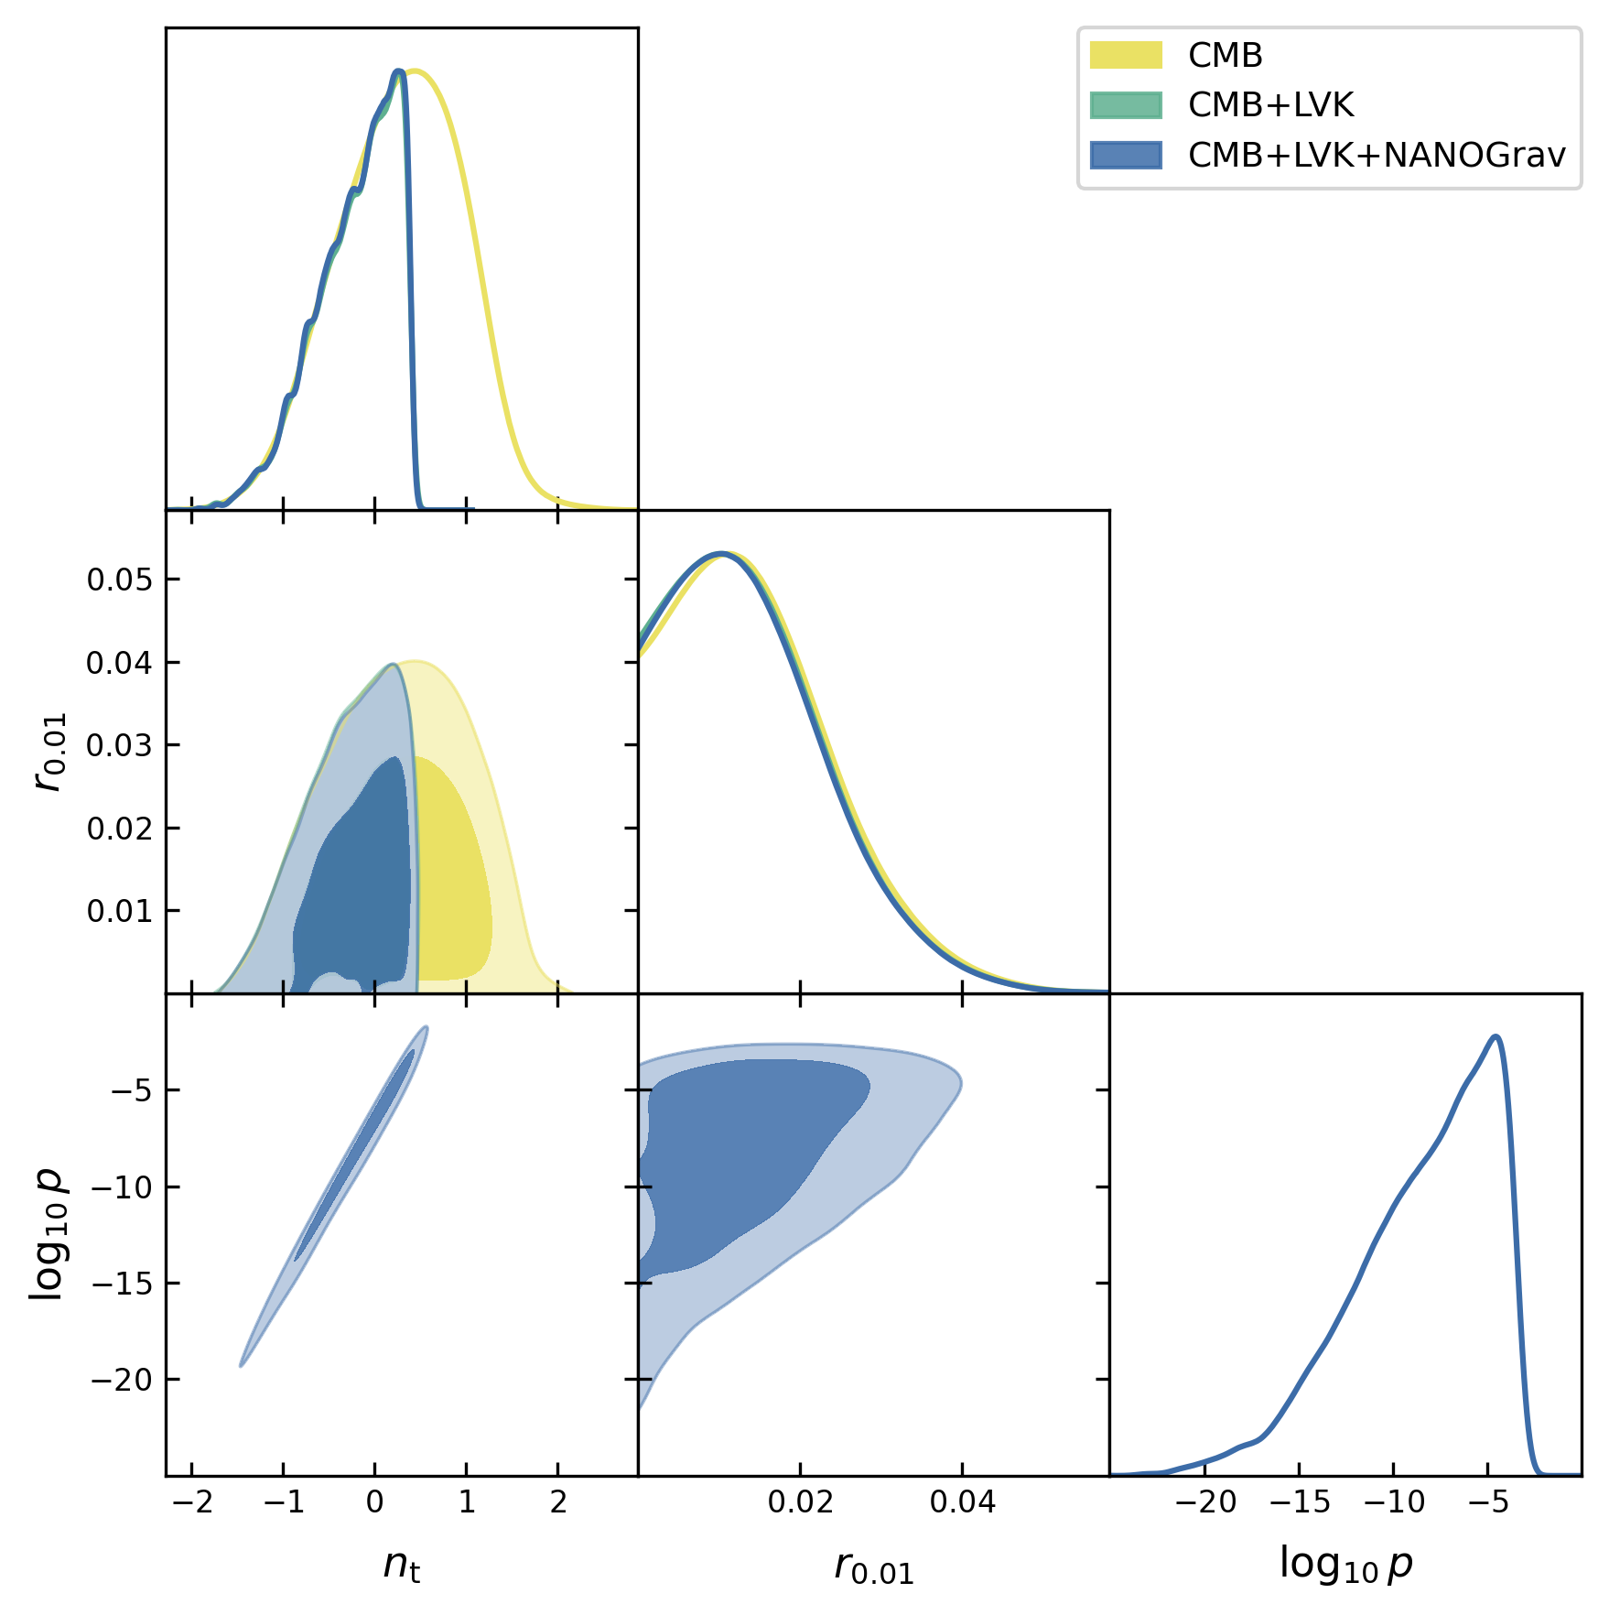
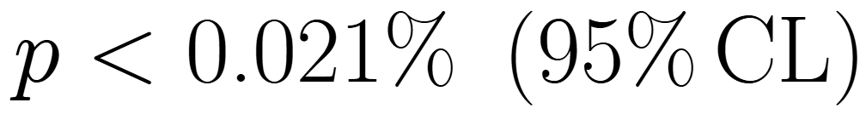
Only a small primordial fraction is allowed
Notes:
Here is the result. When p is allowed to vary, the posterior strongly prefers very small values. In other words, the data do not allow much of the NANOGrav signal to be primordial. With this approach, the LVK and NANOGrav constraints become consistent, and we recover the LVK constraints. However, the upper limit on the primordial contribution is only 0.021 percent of the total NANOGrav signal.

Slide 28
Takeaways
CMB data provide the strongest constraints on negative n_{t}
LVK strongly constrains positive n_{t}
The NANOGrav signal can only contain a small primordial contribution
Notes:
So, to summarize, the CMB strongly constrains large negative n_t, while LVK strongly constrains large positive n_t. The NANOGrav signal prefers a large positive n_t, but this is in tension with LVK. Therefore, only a very small part of the NANOGrav signal can be explained by primordial gravitational waves.

