Slide 1
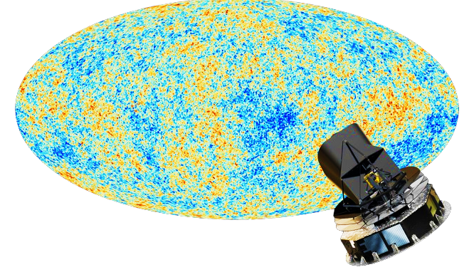
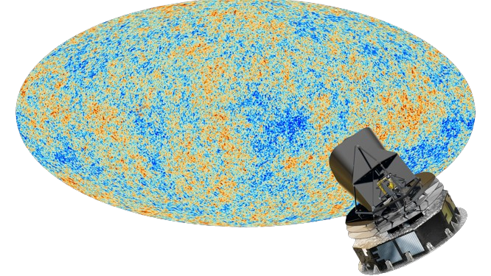


DISCOVERING AXION-LIKE PARTICLES USING CMB AS A BACKLIGHT
Planck | IPAC (caltech.edu)
Harsh Mehta
Department of Astronomy & Astrophysics,
Tata Institute of Fundamental Research, Mumbai, India
Particle Physics & Cosmology (PPC) – 2026
University of New South Wales, Sydney, Australia
1st September, 2026
www.researchgate.net
01-09-2026
Harsh Mehta

Slide 2
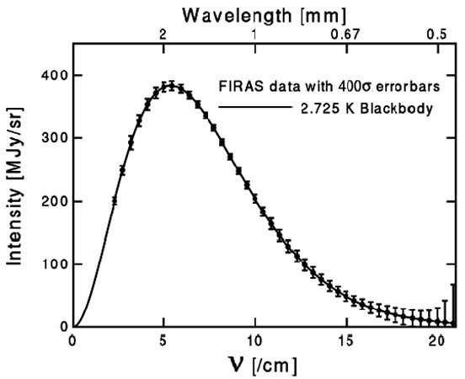
Probing Axions using spatial anisotropic spectral distortion
Planck | IPAC (caltech.edu)
Planck | IPAC (caltech.edu)
➢Axions or ALPs are cold dark matter candidates.
➢They have a weak interaction with photons.
➢The CMB is almost an ideal blackbody with T = 2.7255 K and its power spectrum is well known.
➢Deviations resulting from weak photon coupling can be probed to detect ALPs.
Nasa.gov
Observing the Big Bang, Bartelmann & Bell
www.researchgate.net
01-09-2026
Harsh Mehta
www.researchgate.net

Slide 3
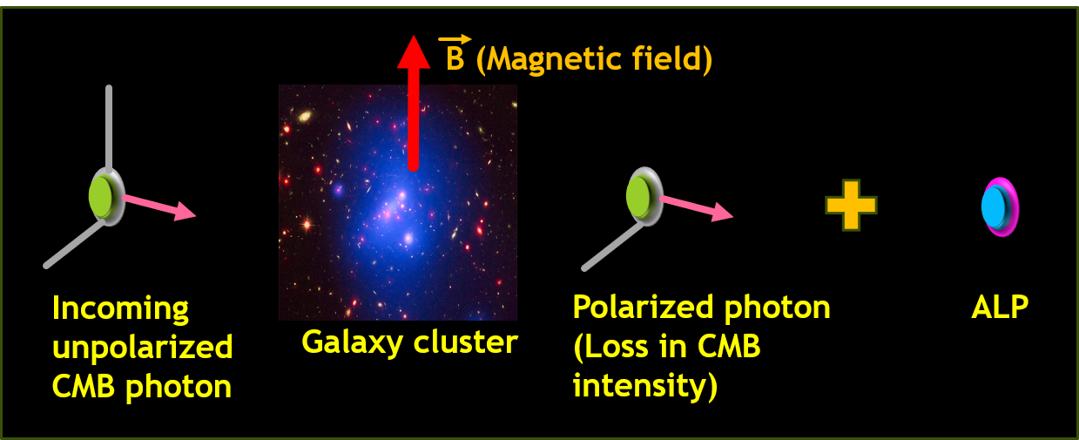
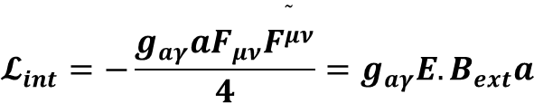
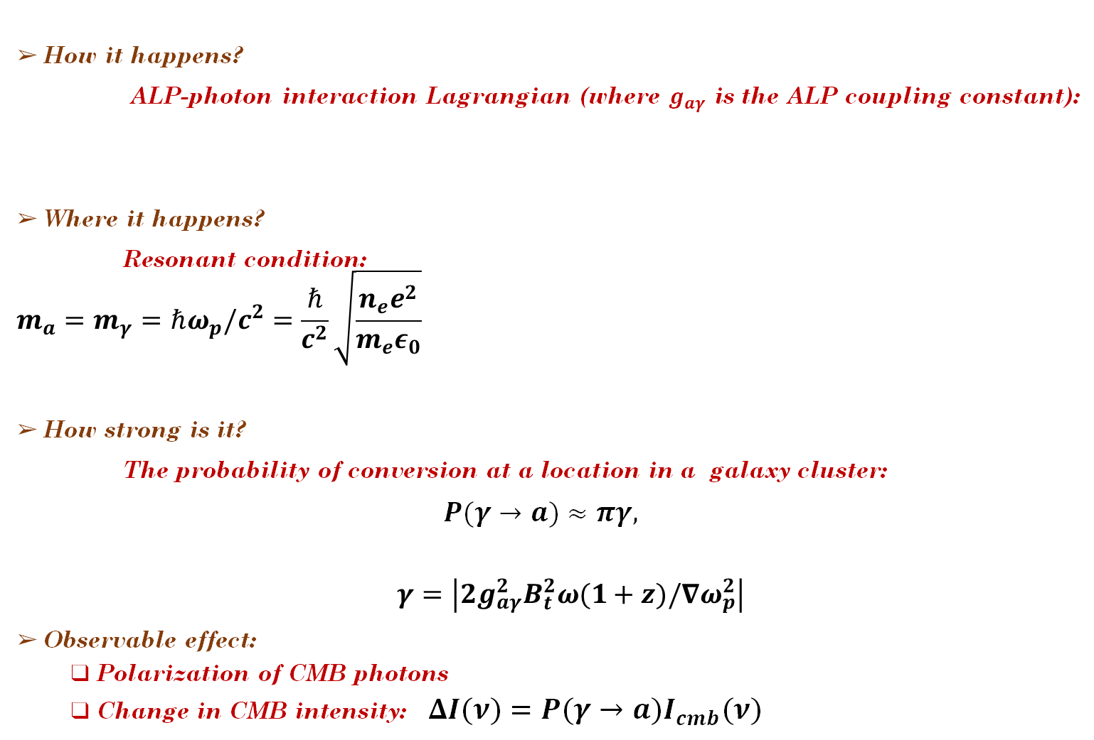
CMB photon-ALP resonant conversion
How it happens?
ALP-photon interaction Lagrangian (where $g_{aγ}$ is the ALP coupling constant):
Where it happens?
Resonant condition:
          $$m_{a}=m_{γ}=ℏω_{p}/c^{2}=\frac{ℏ}{c^{2}}\sqrt{\frac{n_{e}e^{2}}{m_{e}ε_{0}}}$$
How strong is it?
The probability of conversion at a location in a galaxy cluster:
$P(γ→a)≈πγ,$
          $γ=\left|2g_{aγ}^{2}B_{t}^{2}ω(1+z)/∇ω_{p}^{2}\right|$
Observable effect:
  Polarization of CMB photons
  Change in CMB intensity: $ΔI(ν)=P(γ→a)I_{cmb}(ν)$
Planck | IPAC (caltech.edu)
$$𝓛_{int}=−\frac{g_{aγ}aF_{μν}\overset{˜}{F^{μν}}}{4}=g_{aγ}E.B_{ext}a$$
Nasa/CXC/Univ of Missouri/M.Bradwin et al.
Nasa.gov
www.researchgate.net
01-09-2026
Harsh Mehta

Slide 4

Planck | IPAC (caltech.edu)
Nasa.gov
www.researchgate.net
28-07-2025
Harsh Mehta

Slide 5
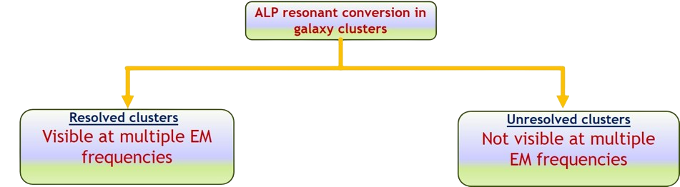
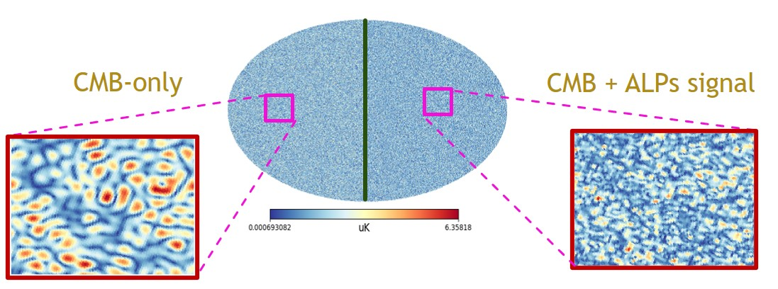
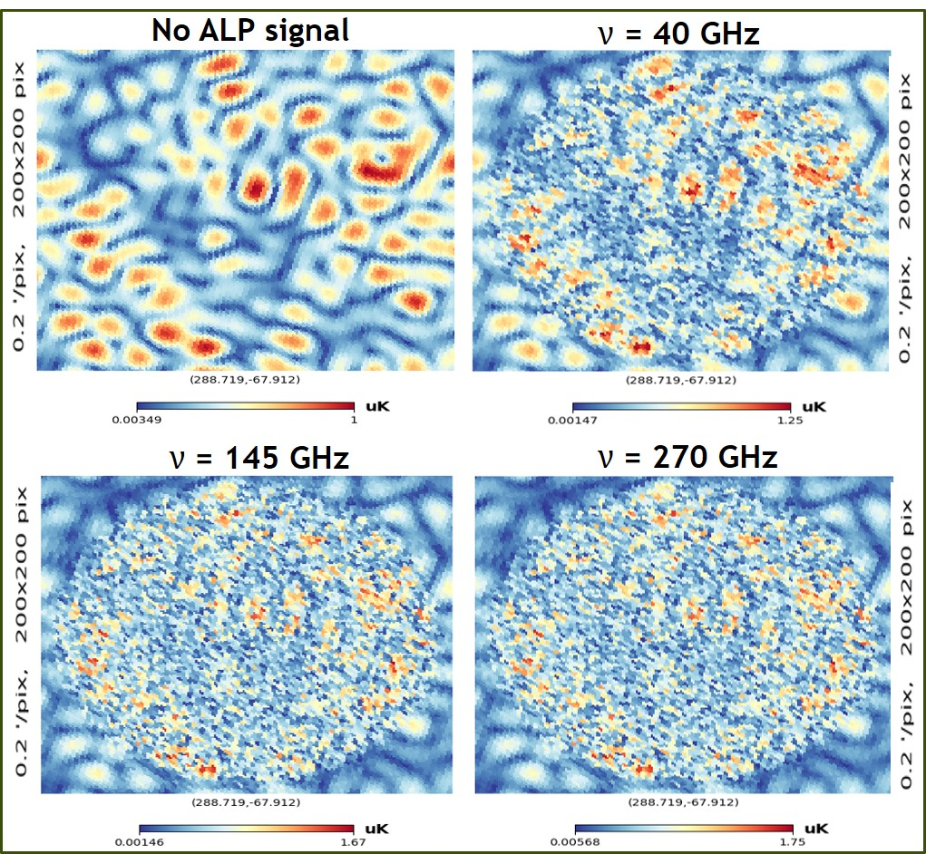
Planck | IPAC (caltech.edu)
Nasa.gov
CMB only
CMB + ALP
www.researchgate.net
01-09-2026
Harsh Mehta

Slide 6
Planck | IPAC (caltech.edu)
Nasa.gov
PROBING ALPS USING MULTI-BAND OBSERVATIONS OF RESOLVED CLUSTERS
JCAP09(2024)037 (Mehta & Mukherjee)
JCAP02(2025)050 (Mehta & Mukherjee)
www.researchgate.net
01-09-2026
Harsh Mehta

Slide 7
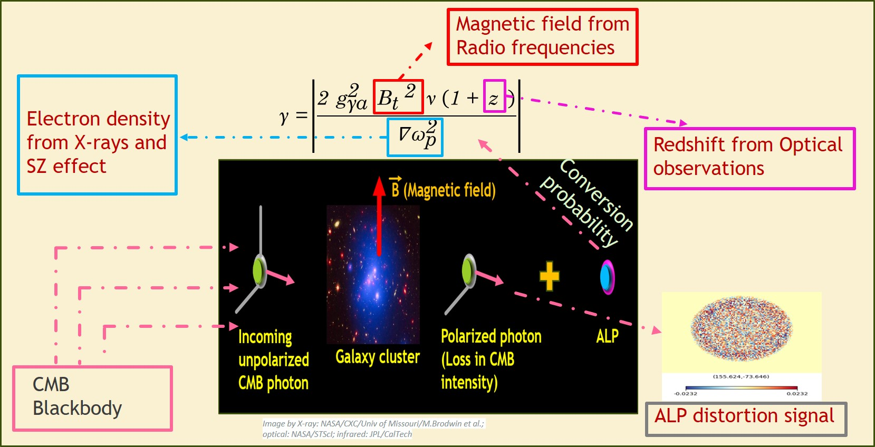
WHY MULTI-BAND OBSERVATIONS?
Planck | IPAC (caltech.edu)
Nasa.gov
www.researchgate.net
01-09-2026
Harsh Mehta

Slide 8
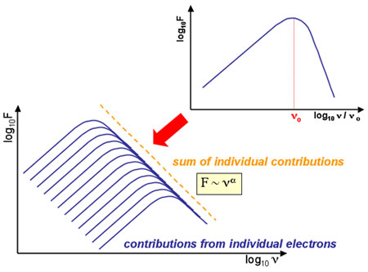
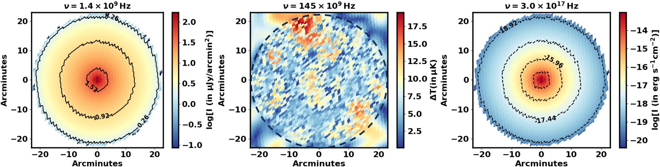
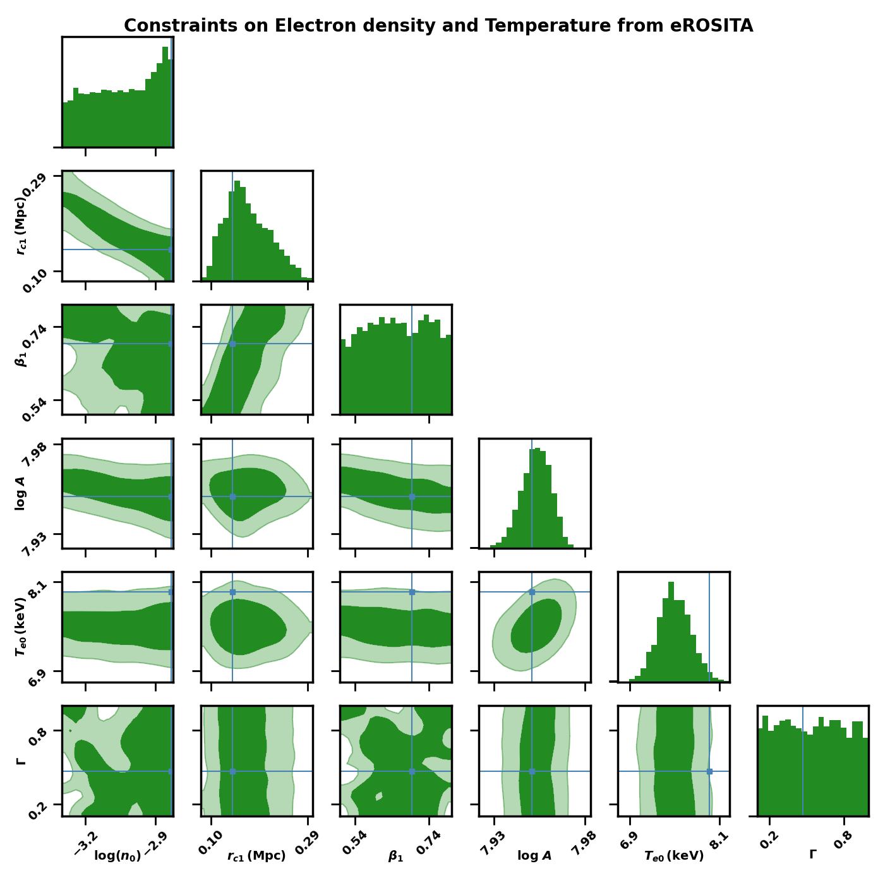
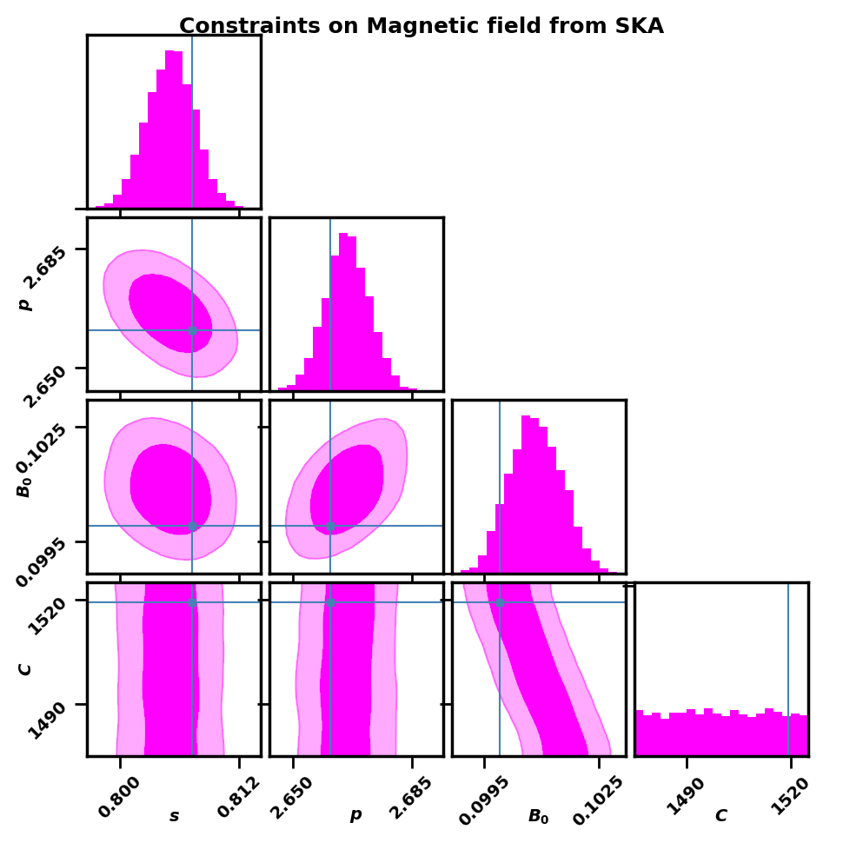

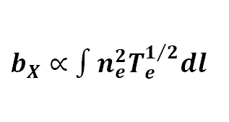
Planck | IPAC (caltech.edu)
Nasa.gov
Electron density and temperature from X-rays
$$P(ν)∝B^{(1+p)/2}ν^{(1−p)/2}$$
Magnetic field from Radio observations
$$b_{X}∝∫n_{e}^{2}T_{e}^{1/2}dl$$
JCAP02(2025)050
JCAP02(2025)050
www.researchgate.net
01-09-2026
Harsh Mehta

Slide 9
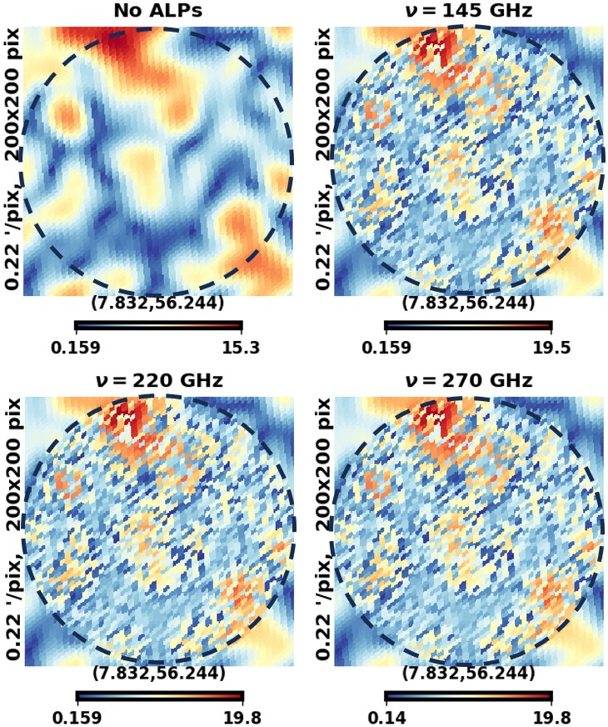
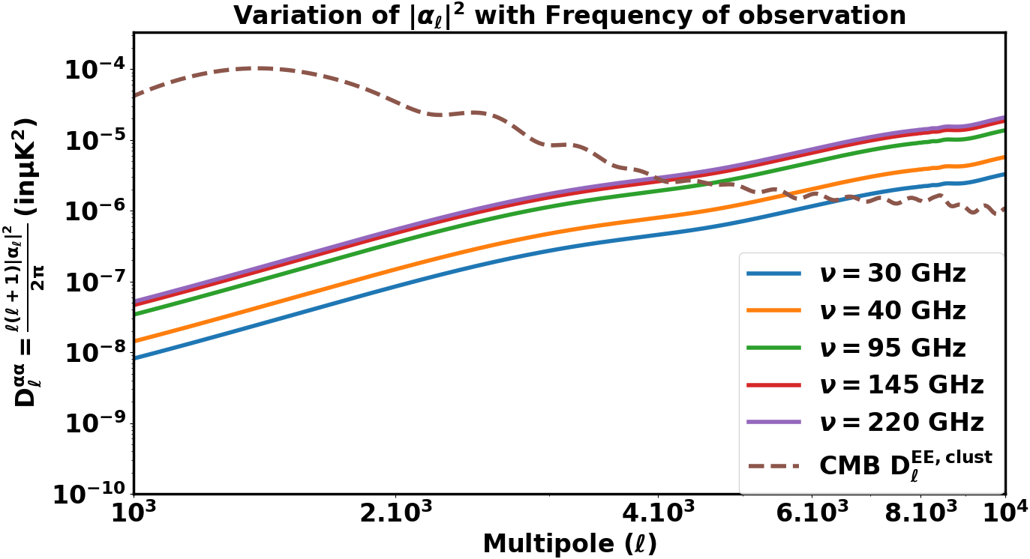
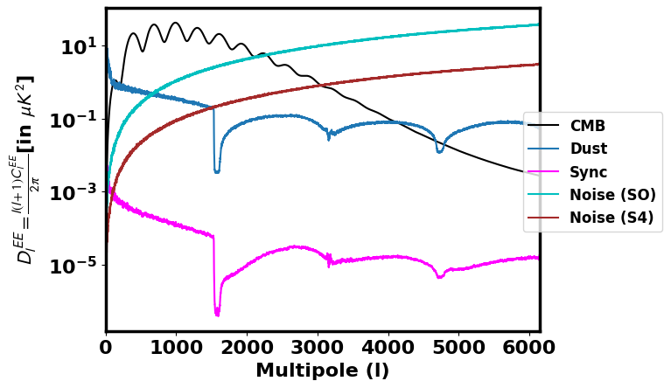


Planck | IPAC (caltech.edu)
Harmonic transform
Nasa.gov
JCAP07(2024)084
JCAP02(2025)050
The signal is decomposed to spherical harmonics:
The power spectrum is given as:
$$I^{ax}=∑_{ℓ=0}^{∞}∑_{m=−ℓ}^{ℓ}a_{ℓm}Y_{ℓm}(θ,φ)$$
$$C_{ℓ}^{ax}=⟨a_{ℓm}^{∗}a_{ℓm}⟩$$
www.researchgate.net
01-09-2026
Harsh Mehta

Slide 10
Planck | IPAC (caltech.edu)
Nasa.gov
PROBING ALPS USING UNRESOLVED CLUSTERS
JCAP07(2024)084 (Mehta & Mukherjee)
www.researchgate.net
01-09-2026
Harsh Mehta

Slide 11
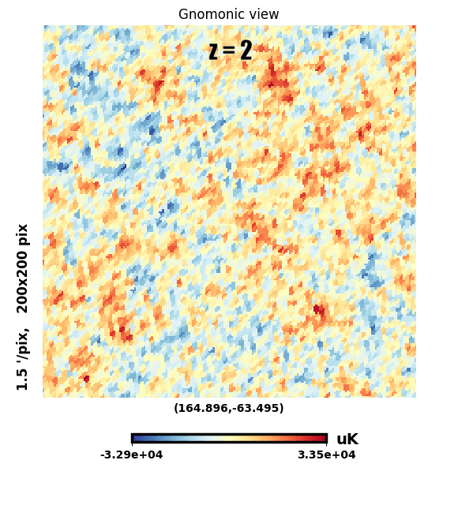
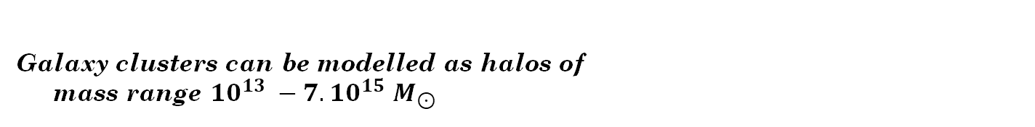
BACKGROUND SIGNAL FROM UNRESOLVED CLUSTERS
Planck | IPAC (caltech.edu)
ALP distortion signal
Nasa.gov
Galaxy clusters
Dark Matter Halos
Galaxy clusters can be modelled as halos of
mass range ${10}^{13} −7.{10}^{15}$ $M_{⊙}$
Matter density field
www.researchgate.net
01-09-2026
Harsh Mehta

Slide 12
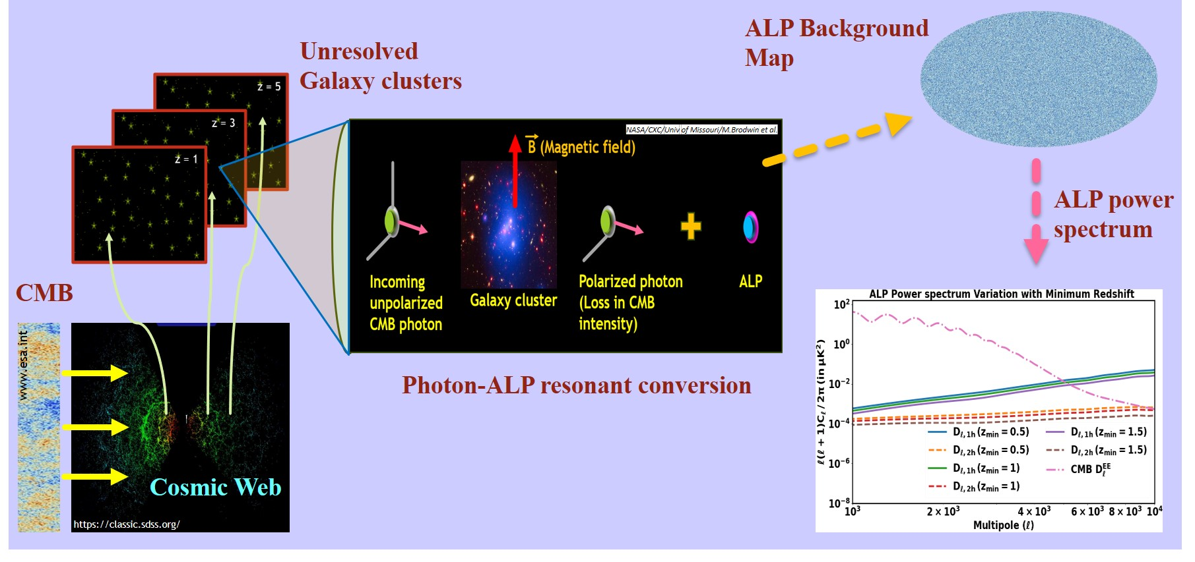
THE ALP DIFFUSED BACKGROUND
Planck | IPAC (caltech.edu)
Nasa.gov
www.researchgate.net
01-09-2026
Harsh Mehta

Slide 13
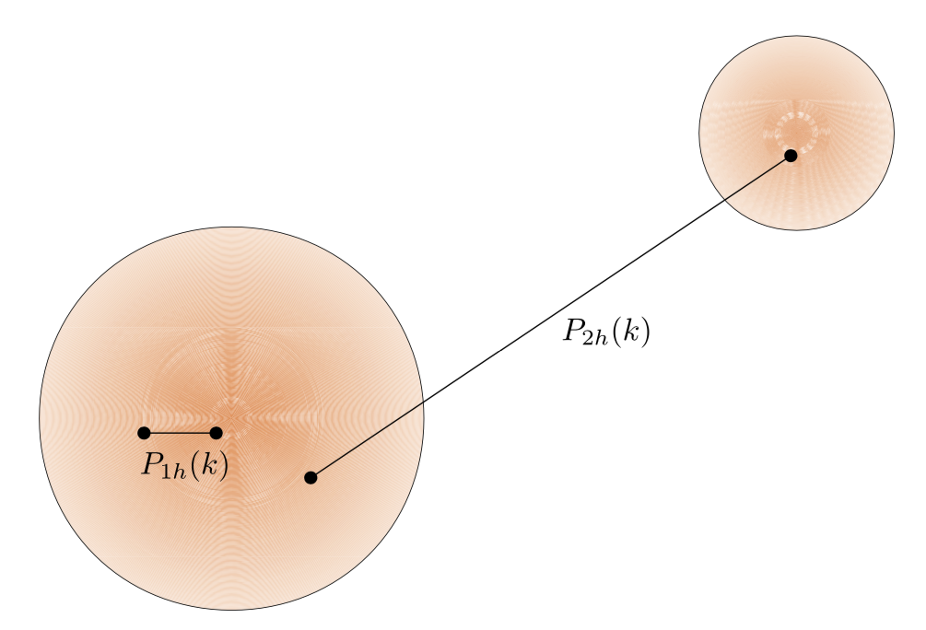
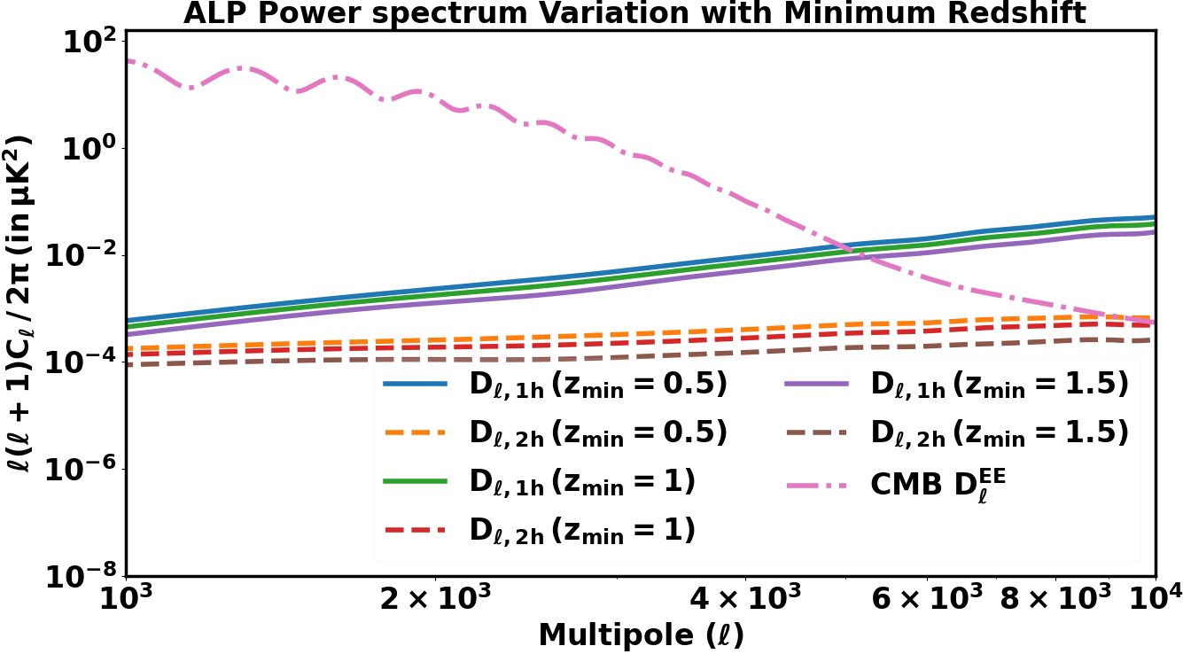
HALO MODELLING OF THE ALP BACKGROUND SIGNAL
Planck | IPAC (caltech.edu)
ALP Power spectrum can be separated into one and two halo terms
One halo: Correlations between locations within the same cluster
Two halo: Correlations between locations in different clusters
Nasa.gov
www.researchgate.net
Dodelson Modern Cosmology
01-09-2026
Harsh Mehta

Slide 14
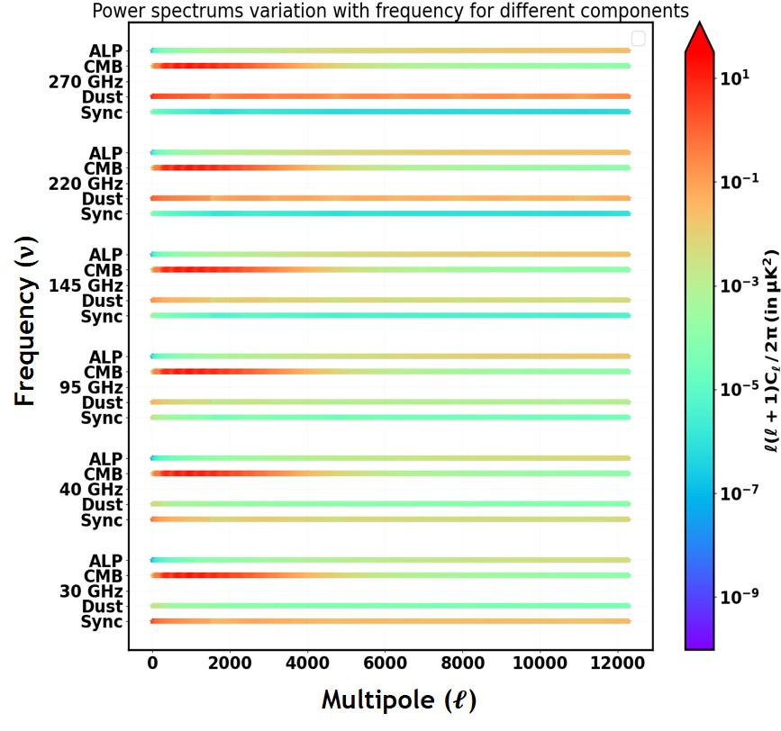
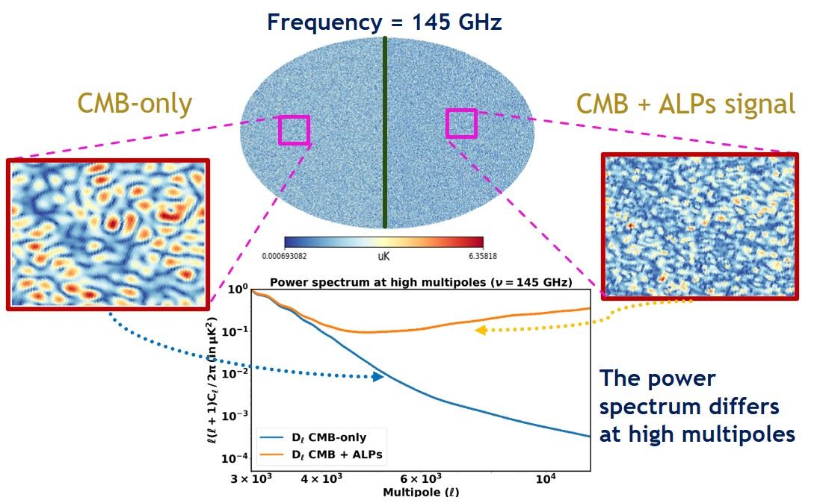
SPECTRAL & SPATIAL VARIATION OF THE ALP SIGNAL
Planck | IPAC (caltech.edu)
Nasa.gov
www.researchgate.net
01-09-2026
Harsh Mehta

Slide 15
Planck | IPAC (caltech.edu)
Nasa.gov
TURBULENT EFFECTS ON THE ALP SIGNAL
JCAP05(2025)051 (Mehta & Mukherjee)
www.researchgate.net
01-09-2026
Harsh Mehta

Slide 16




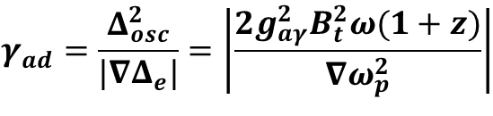
Length scales involved
Planck | IPAC (caltech.edu)
The ALP signal depends on:
  The photon-ALP oscillation scale
  The electron density variation scale
  The magnetic field variation scale
The probability of conversion at a location in a galaxy cluster:
Low Coherence length causes depolarization:
Nasa.gov
$$Δ_{e}=−ω_{p}^{2}/2ω$$
$$Δ_{a}=−m_{a}^{2}/2ω$$
$$Δ_{aγ}=g_{aγ}B_{t}/2$$
$$Δ_{osc}^{2}=(Δ_{e}−Δ_{a})^{2}+4Δ_{aγ}^{2}$$
$$γ_{ad}=\frac{Δ_{osc}^{2}}{|∇Δ_{e}|}=\left|\frac{2g_{aγ}^{2}B_{t}^{2}ω(1+z)}{∇ω_{p}^{2}}\right|$$
Polarization of the ALP signal retained
Depolarization of the ALP signal
www.researchgate.net
01-09-2026
Harsh Mehta

Slide 17
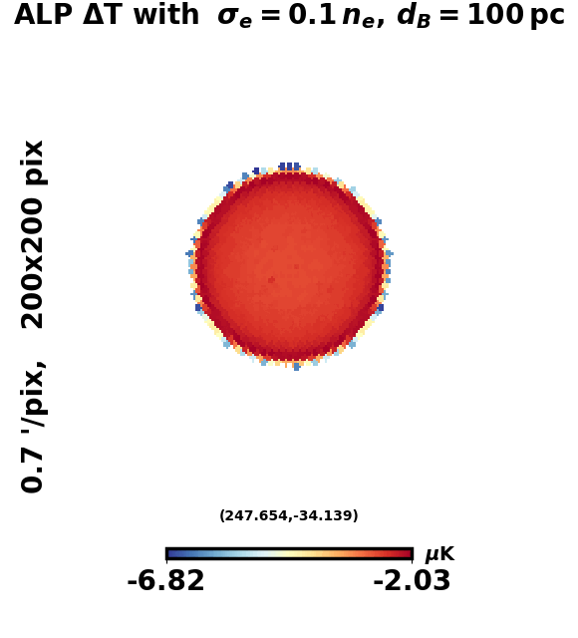
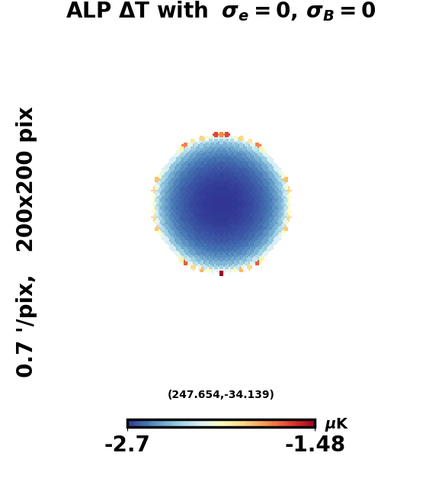
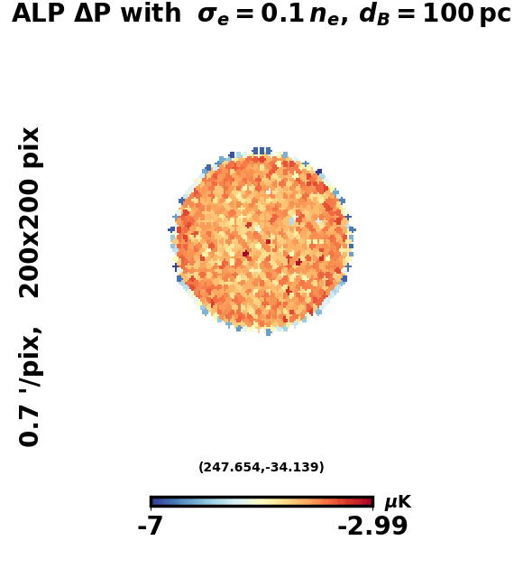
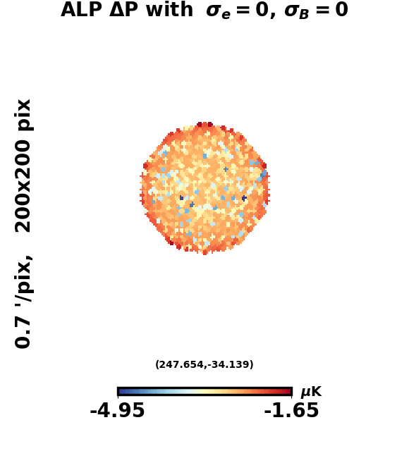
Varying magnetic field domain size
Varying magnetic field inhomogeneity
Varying electron density inhomogeneity
Planck | IPAC (caltech.edu)
Nasa.gov
www.researchgate.net
01-09-2026​
Harsh Mehta

Slide 18
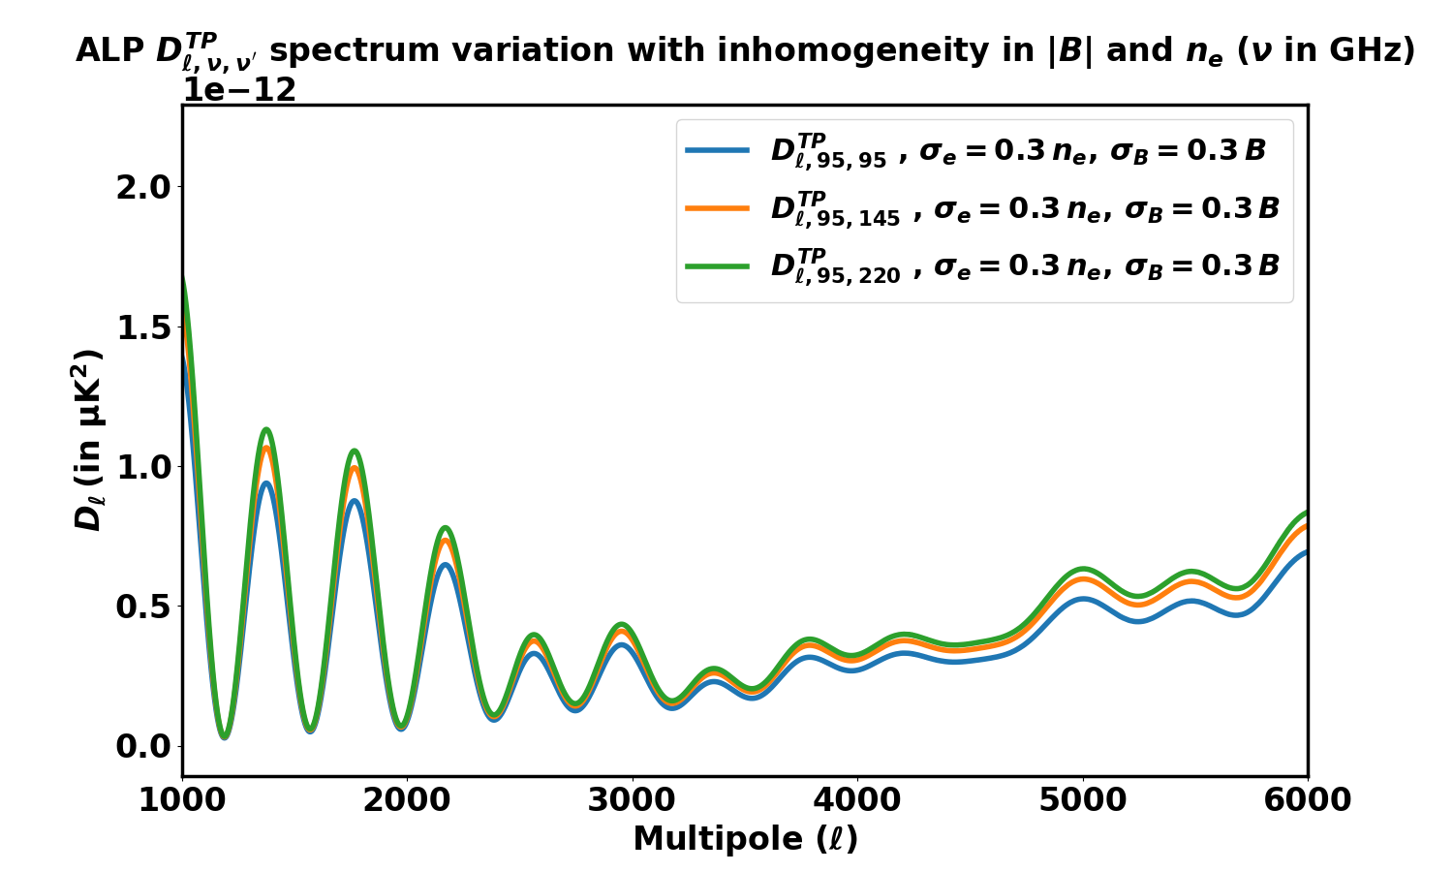
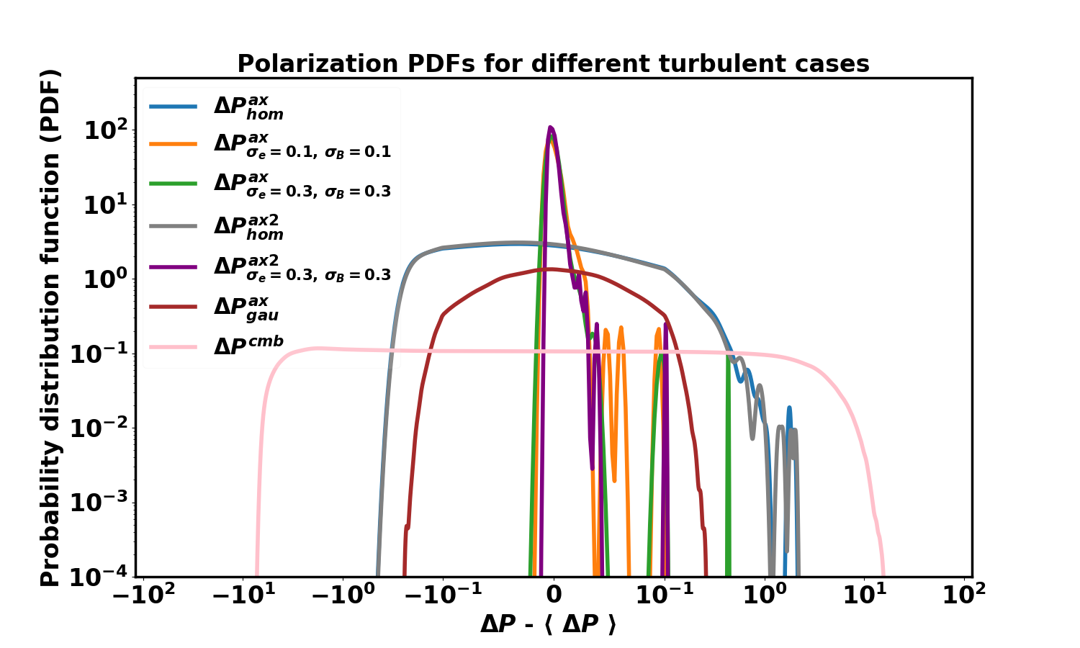
OBSERVABLES TO PROBE THE ALP SIGNAL
Planck | IPAC (caltech.edu)
Nasa.gov
Cross Temperature-Polarization (TP) power spectrum
Turbulence dependent non-Gaussian signal
JCAP05(2025)051
JCAP05(2025)051
www.researchgate.net
01-09-2026​
Harsh Mehta

Slide 19
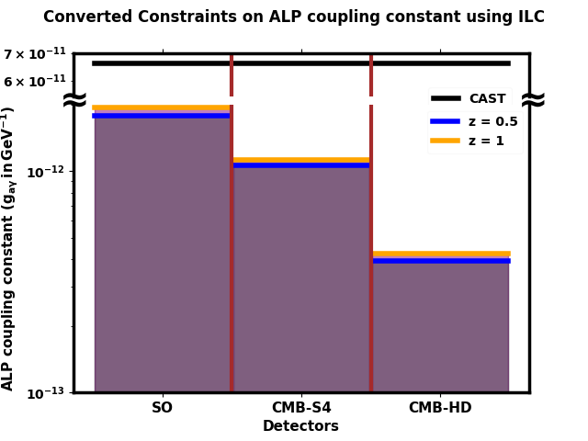
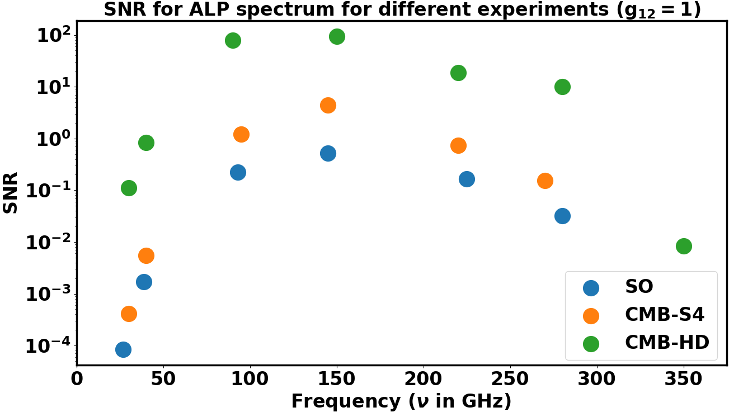

HOW WELL CAN THE ALP SIGNAL BE MEASURED?
Planck | IPAC (caltech.edu)
Nasa.gov
JCAP07(2024)084
ALP mass range: ${10}^{−15}$ - ${10}^{−11}$ eV
JCAP07(2024)084
www.researchgate.net
01-09-2026​
Harsh Mehta

Slide 20
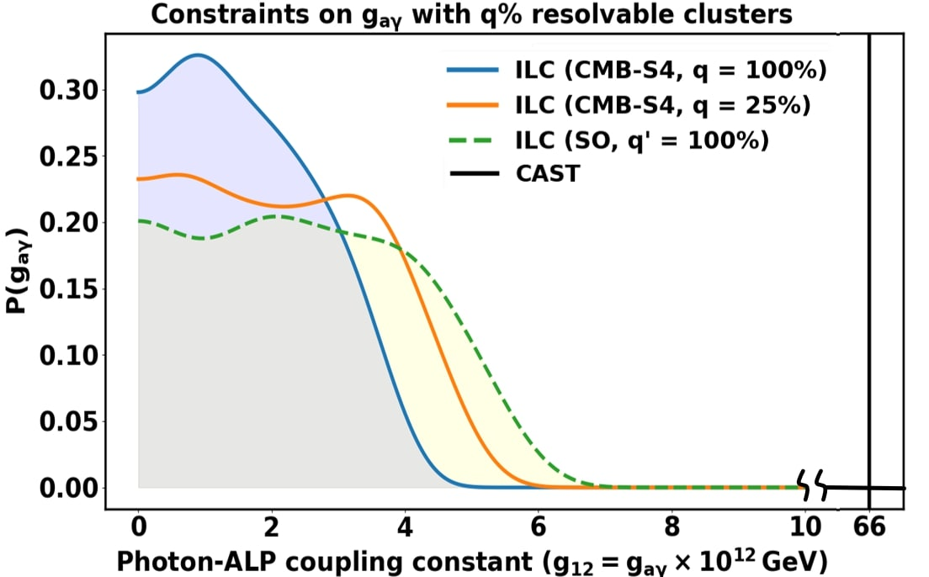
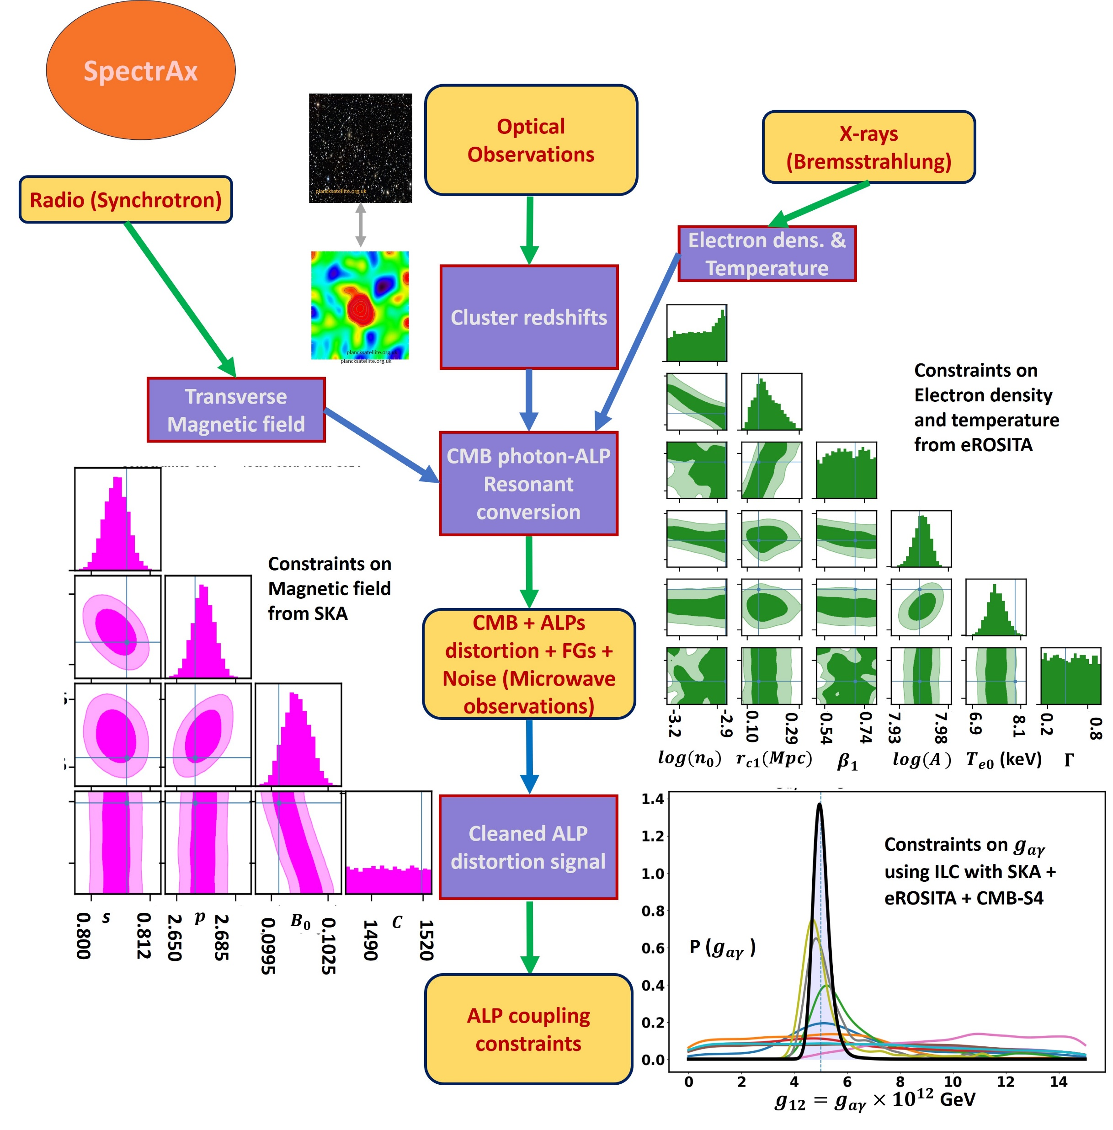
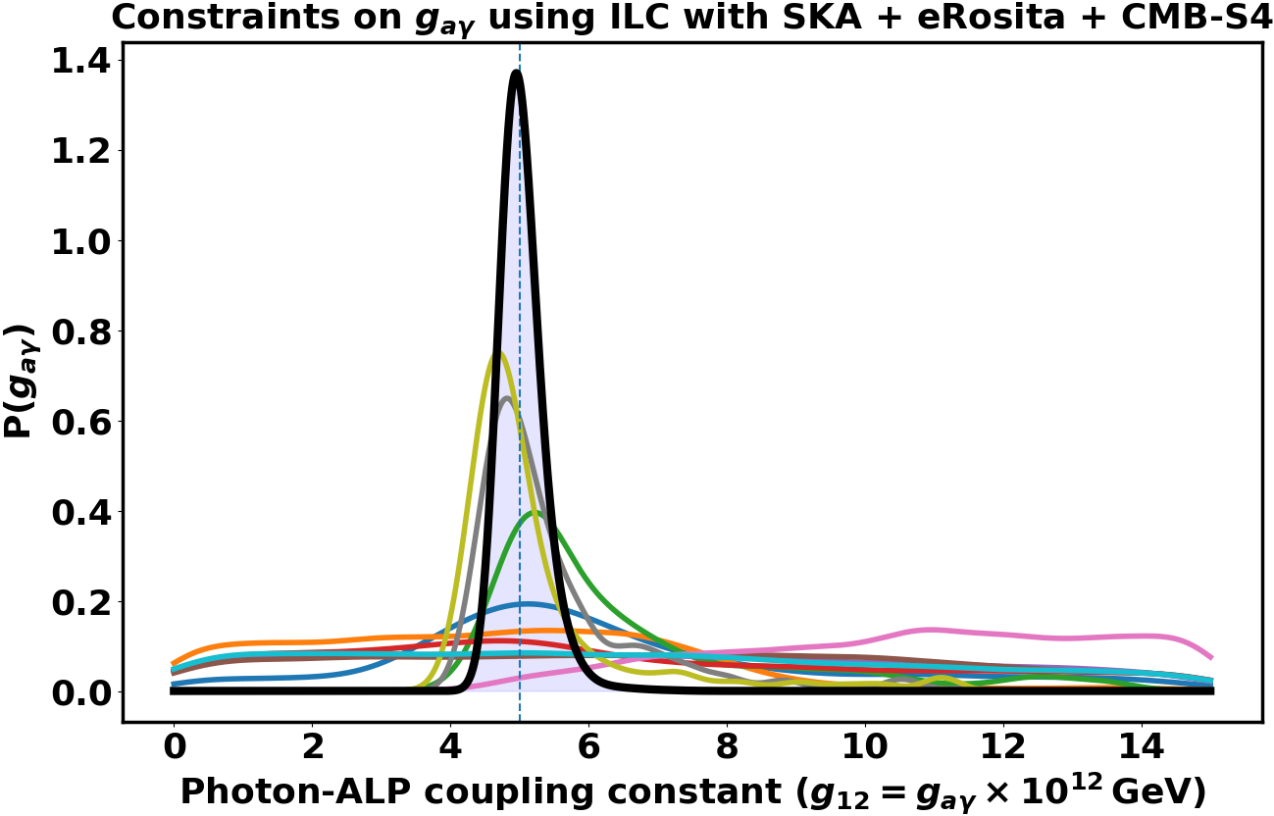
Planck | IPAC (caltech.edu)
JCAP07(2024)084
Nasa.gov
JCAP02(2025)050
JCAP02(2025)050
www.researchgate.net
01-09-2026​
Harsh Mehta

Slide 21
Planck | IPAC (caltech.edu)
Nasa.gov
Discovering ALPs using Cosmic Variance Cancellation
https://arxiv.org/abs/2505.11592 (Mehta, Dixit, Mukherjee & Silk)
www.researchgate.net
01-09-2026​
Harsh Mehta

Slide 22
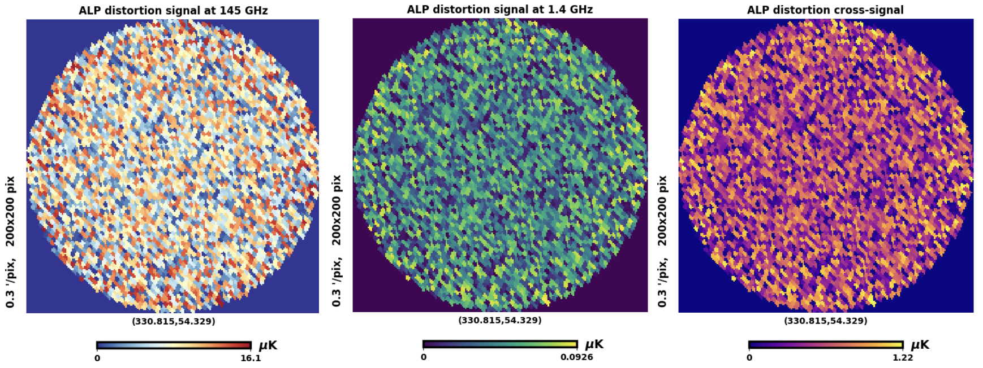
Spectral behaviour of the ALP signal
Planck | IPAC (caltech.edu)
Nasa.gov
www.researchgate.net
01-09-2026​
Harsh Mehta
Harsh Mehta

Slide 23

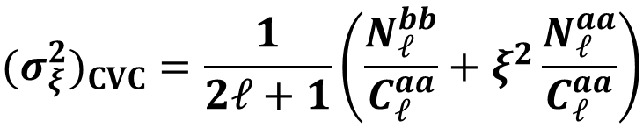
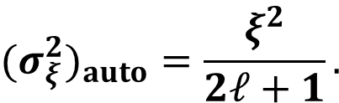


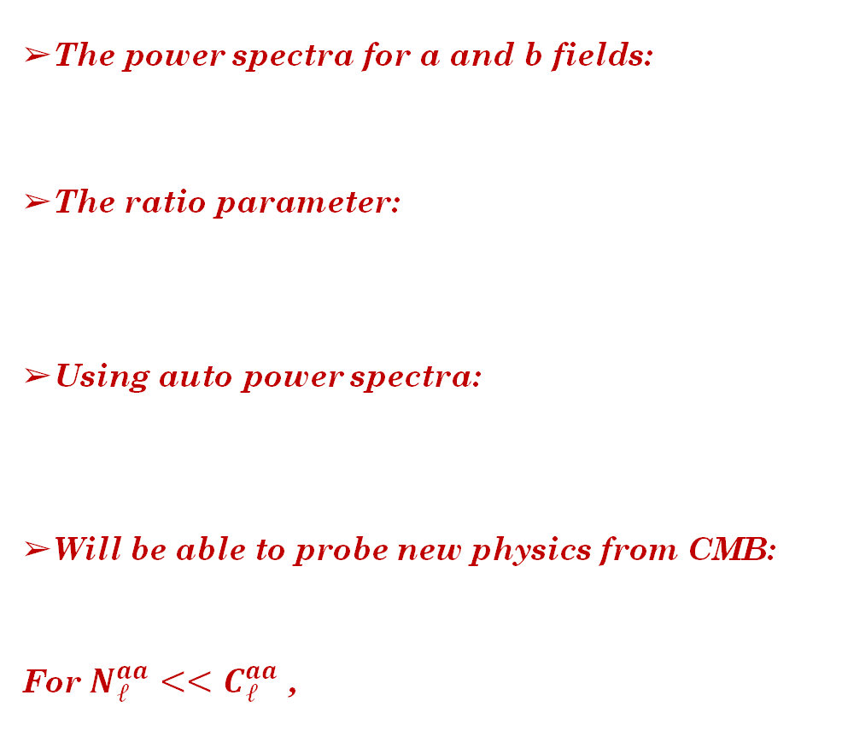
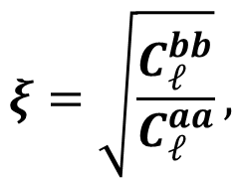
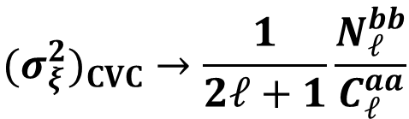
Cosmic Variance Cancellation
Planck | IPAC (caltech.edu)
The power spectra for a and b fields:
The ratio parameter:
Using auto power spectra:
Will be able to probe new physics from CMB:
For $N_{ℓ}^{aa}<<C_{ℓ}^{aa}$ ,
$$⟨a_{ℓm}^{∗}b_{ℓm}⟩=C_{ℓ}^{ab}$$
$$ξ=\sqrt{\frac{C_{ℓ}^{bb}}{C_{ℓ}^{aa}}},$$
Nasa.gov
$$(σ_{ξ}^{2})_{auto}=\frac{ξ^{2}}{2ℓ+1}.$$
$$(σ_{ξ}^{2})_{CVC}=\frac{1}{2ℓ+1}\left(\frac{N_{ℓ}^{bb}}{C_{ℓ}^{aa}}+ξ^{2}\frac{N_{ℓ}^{aa}}{C_{ℓ}^{aa}}\right)$$
For $N_{ℓ}^{aa}<<C_{ℓ}^{aa}$ and $N_{ℓ}^{bb}<<C_{ℓ}^{aa}$ ,
$$(σ_{ξ}^{2})_{CVC}→\frac{1}{2ℓ+1}\frac{N_{ℓ}^{bb}}{C_{ℓ}^{aa}}$$
$$(σ_{ξ}^{2})_{CVC}→0$$
www.researchgate.net
01-09-2026​
Harsh Mehta
Harsh Mehta

Slide 24
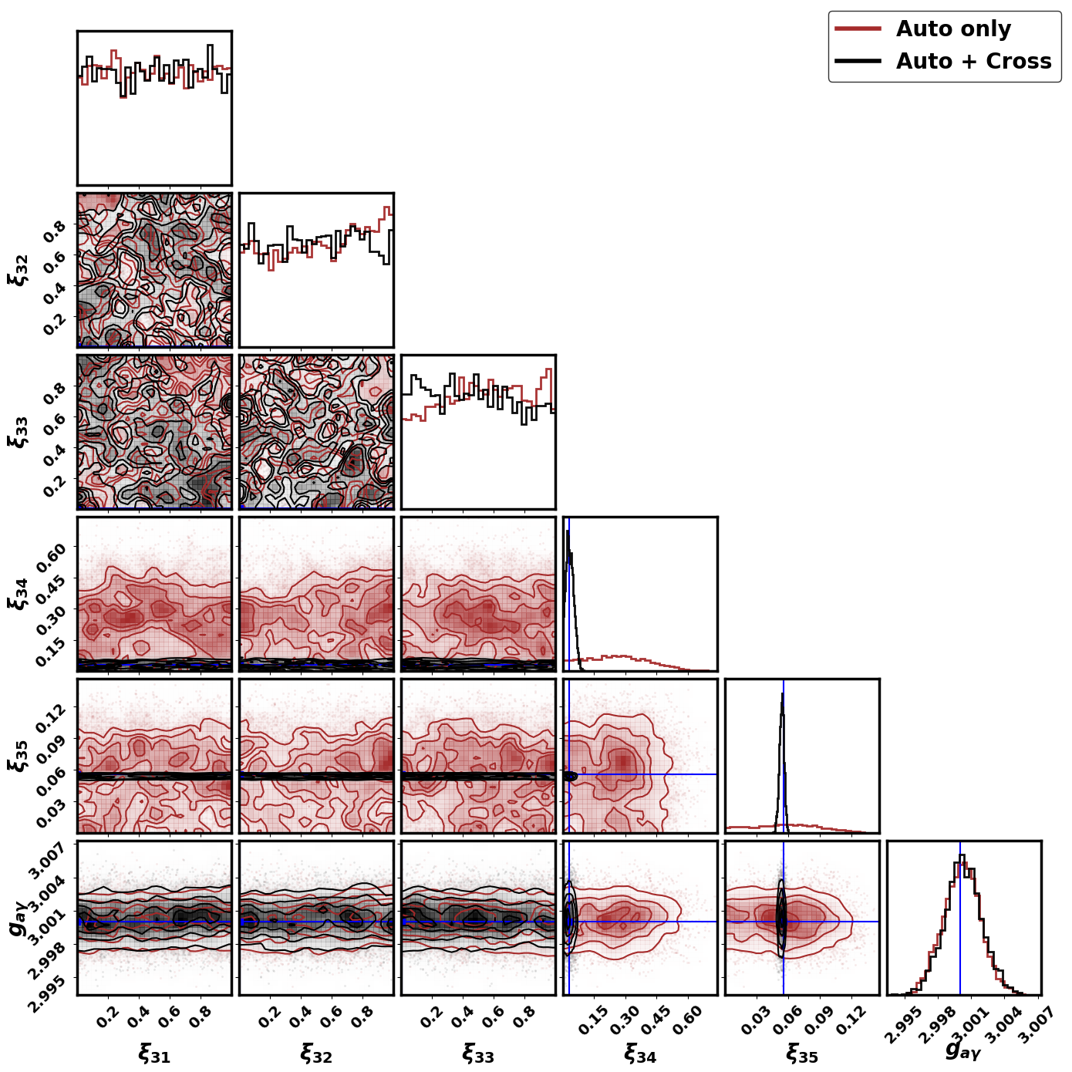
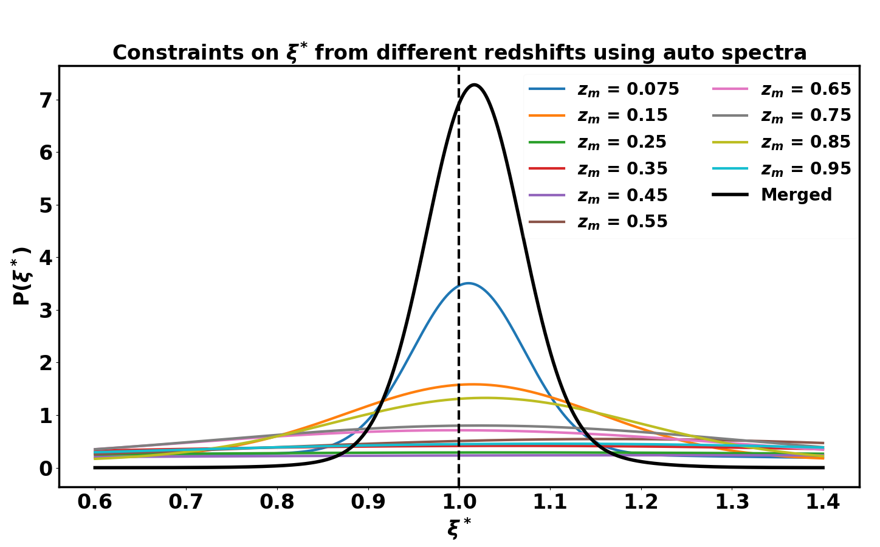
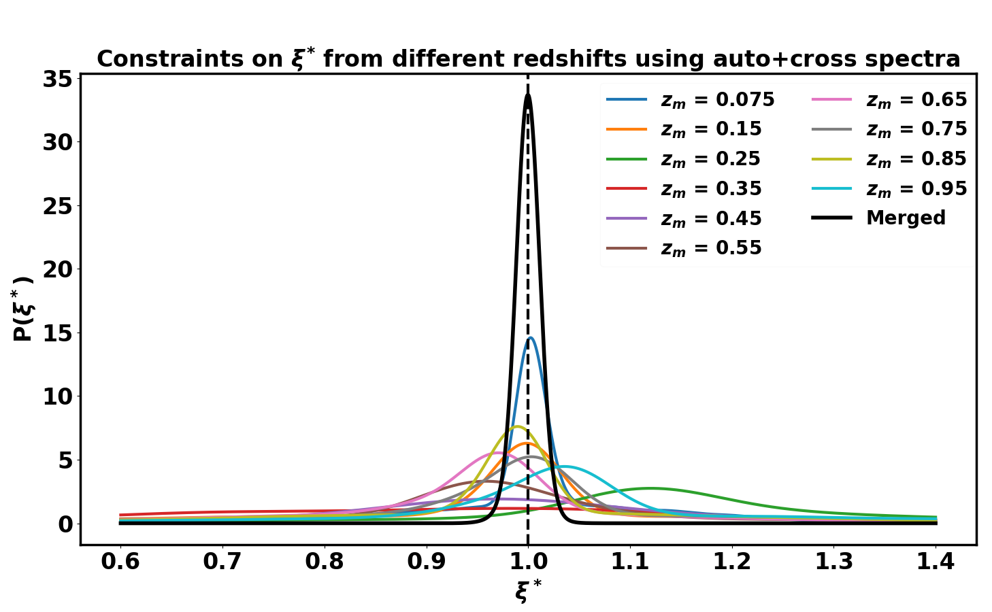
Planck | IPAC (caltech.edu)
Nasa.gov
www.researchgate.net
01-09-2026
Harsh Mehta
Harsh Mehta

Slide 25
Planck | IPAC (caltech.edu)
Nasa.gov
ALP CONVERSION IN THE MILKY WAY
JCAP08(2025)081 (Mehta & Mukherjee)
www.researchgate.net
01-09-2026
Harsh Mehta

Slide 26
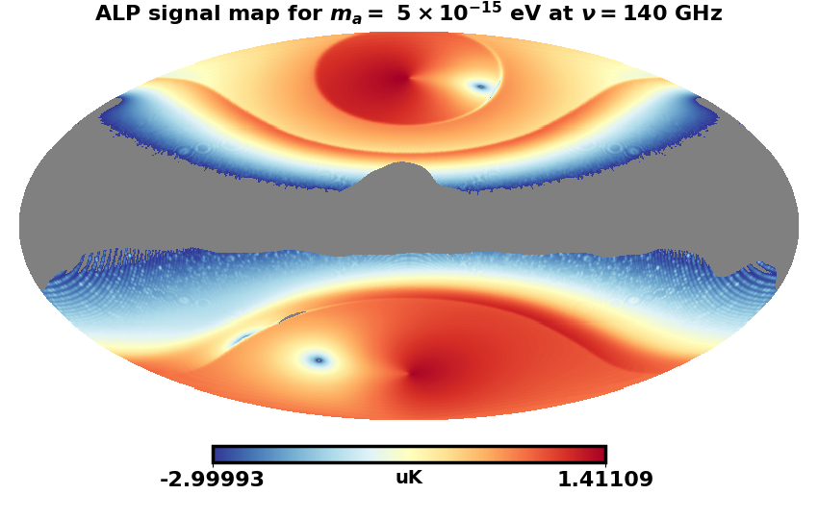
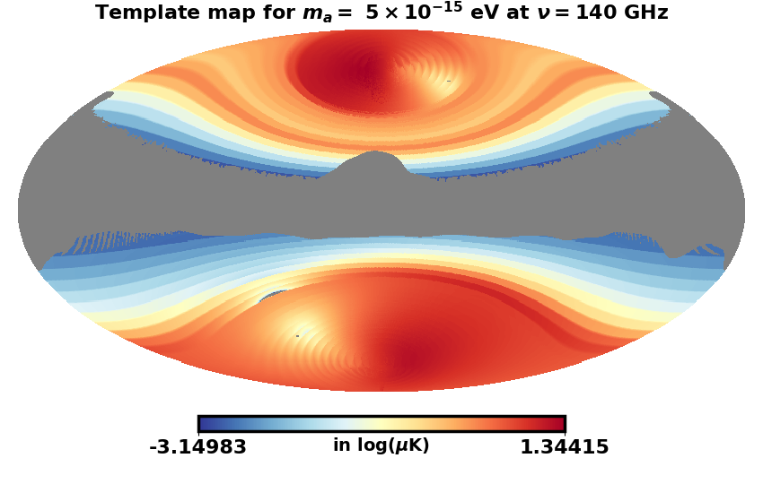
GALACTIC ALP SIGNAL MODELLING
Planck | IPAC (caltech.edu)
Turbulent profiles, difficult to model
Highly non-Gaussian signal contaminated by foregrounds
Computationally expensive 3D simulations
Solution: Spatial sky-template-based search for ALPs (fast & captures signal non-Gaussianity )
Nasa.gov
Galactic ALP distortion signal
Best-fit template
www.researchgate.net
01-09-2026
Harsh Mehta

Slide 27
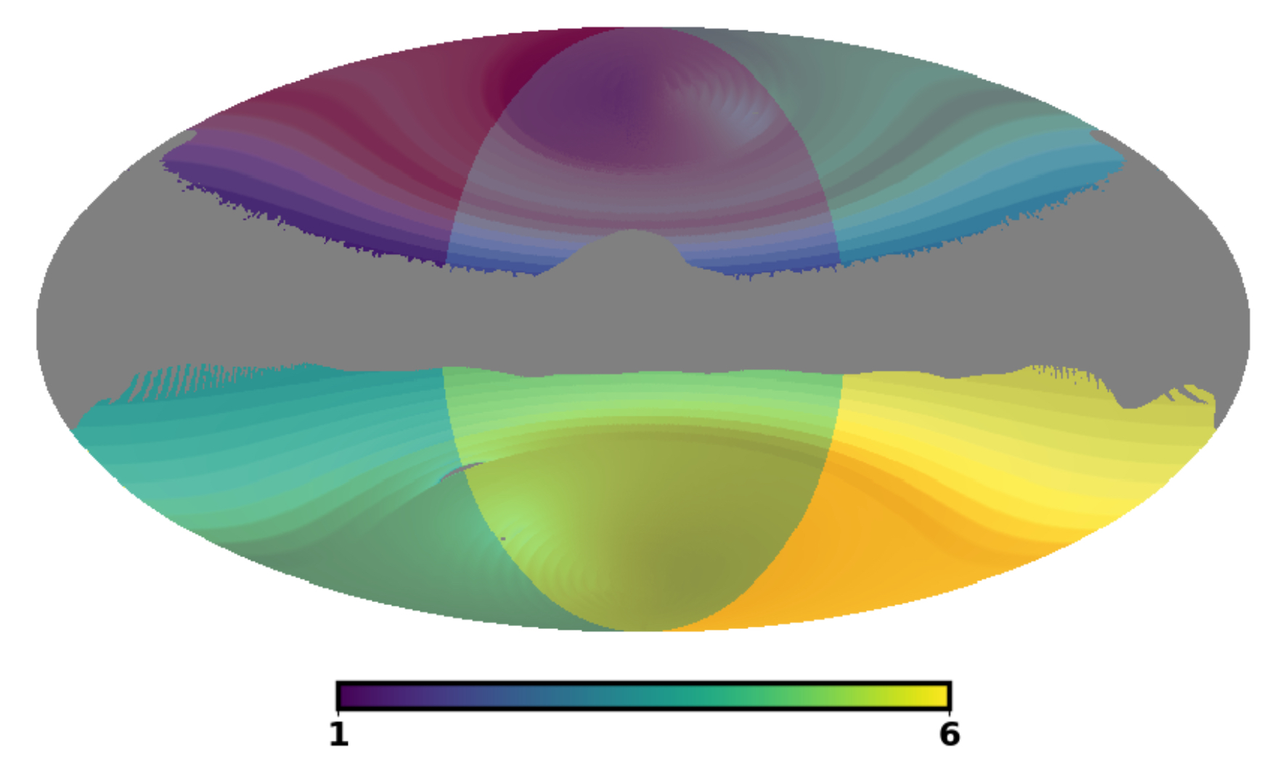
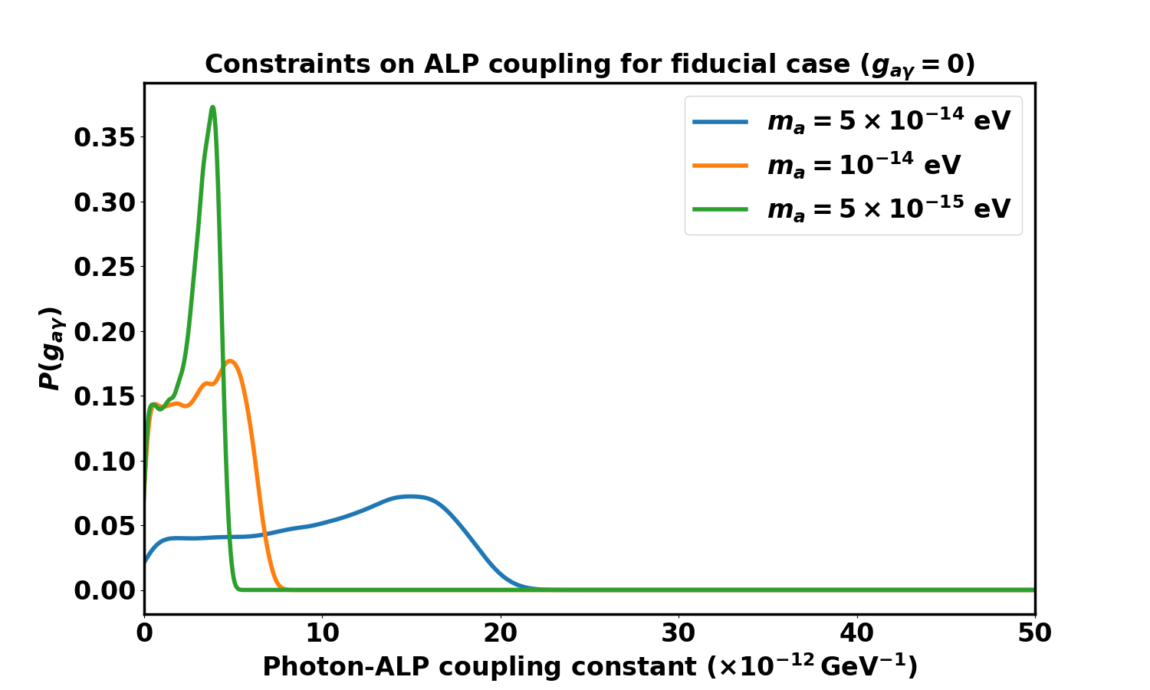

ROBUSTNESS OF THE SKY-TEMPLATE TECHNIQUE
Planck | IPAC (caltech.edu)
Nasa.gov
Constraints using Best-fit template
https://arxiv.org/abs/2505.11592
www.researchgate.net
01-09-2026
Patch-dependent inference
Harsh Mehta
https://arxiv.org/abs/2505.11592

Slide 28


SUMMARY & FUTURE OUTLOOK
Planck | IPAC (caltech.edu)
ALPs can be detected using SO and CMB-S4, which will observe a large number of clusters.
ALP signal from the Milky way using LiteBIRD.
Simulation grid can be used for other astrophysical systems (neutron stars, CGM, etc.)
Applying our pipelines on data from Atacama Cosmology Telescope (ACT), South Pole Telescope (SPT), Simons Observatory (SO), CMB-S4, etc.
SpectrAx can be used to study other cluster phenomena like Sunyaev-Zeldovich (SZ), synchrotron emission, etc.
Nasa.gov
www.researchgate.net
01-09-2026
Harsh Mehta

Slide 29







Planck | IPAC (caltech.edu)
Nasa.gov
THANK YOU
www.researchgate.net
01-09-2026
Harsh Mehta

Slide 30
Planck | IPAC (caltech.edu)
Nasa.gov
BACKUP SLIDES
www.researchgate.net
01-09-2026
Harsh Mehta

Slide 31


Cluster Realization Grid
Planck | IPAC (caltech.edu)
Nasa.gov
www.researchgate.net
01-09-2026
Harsh Mehta

Slide 32



How will the ALP signal look like?
Planck | IPAC (caltech.edu)
The ALPs of a particular mass form in a spherical shell within the spherically symmetric cluster
Observed as a disk along the cluster line of sight
Disk size generally increases for low ALP masses ($m_{a}$)
Probable mass range: ${10}^{−15}$ - ${10}^{−11}$ eV
Detecting the ALP signal:
  Challenges: Galactic foregrounds and noise
  Approaches: Power spectrum-based or Pixel-based
Nasa.gov
ALP Mass vs disk size
www.researchgate.net
01-09-2026
Harsh Mehta

Slide 33

HALO MODELLING OF THE ALP BACKGROUND SIGNAL
Planck | IPAC (caltech.edu)
ALP Power spectrum can be separated into one and two halo terms
One halo: Correlations between locations within the same cluster
${\text{C}}_{𝓵,1h}^{ax}\text{=}\int_{{\text{z}}_{min}}^{{\text{z}}_{max}}{\text{dz}}\frac{\text{d}{\text{V}}_{\text{c}}}{\text{dz}}\int_{{\text{M}}_{min}}^{{\text{M}}_{max}}{\text{dM}}\frac{\text{dn}\left(\text{M}\text{,}\text{z}\right)}{\text{dM}}{\left|{\text{α}}_{𝓵}\left(\text{M}\text{,}\text{z}\right)\right|}^{\text{2}}\text{,}$
Two halo: Correlations between locations in different clusters ${\text{C}}_{𝓵,2h}^{ax}\text{=}\int_{{\text{z}}_{min}}^{{\text{z}}_{max}}{\text{dz}}\frac{\text{d}{\text{V}}_{\text{c}}}{\text{dz}}{\text{P}}_{\text{m}}\left(\text{k}\text{=}\frac{𝓵+1/2}{r\left(z\right)}\text{,}\text{z}\right)\text{×}{\left[\int_{{\text{M}}_{min}}^{{\text{M}}_{max}}{\text{dM}}\frac{\text{dn}\left(\text{M}\text{,}\text{z}\right)}{\text{dM}}\text{b}\left(\text{M}\text{,}\text{z}\right){\text{α}}_{𝓵}\left(\text{M}\text{,}\text{z}\right)\right]}^{\text{2}},$
where halo correlation has been used:
$${\text{P}}_{\text{h}}\left(\text{k}\text{,}{\text{M}}_{\text{1}}\text{,}{\text{M}}_{\text{2}}\text{,}\text{z}\right)\text{ = }\text{b}\left({\text{M}}_{\text{1}}\text{,}\text{z}\right)\text{b}\left({\text{M}}_{\text{2}}\text{,}\text{z}\right){\text{P}}_{\text{m}}\left(\text{k}\text{,}\text{z}\right)\text{,}$$
b(M,z) is the bias factor, ${\text{P}}_{\text{m}}\left(\text{k}\text{,}\text{z}\right)$ is the matter power spectrum, ${\text{V}}_{\text{c}}$ is the comoving volume, ${\left|{\text{α}}_{𝓵}\left(\text{M}\text{,}\text{z}\right)\right|}^{\text{2}}$ is the ALP power spectrum from a cluster.
Nasa.gov
(Relatively Weak)
www.researchgate.net
01-09-2026
Dodelson Modern Cosmology
Harsh Mehta

Slide 34




CONTAMINANTS
Planck | IPAC (caltech.edu)
The galactic plane is a major source of
foreground contaminations.
Masking is required along the galactic plane and over
the bright patches
Internal Linear Combination method (ILC) weights: ${\text{w}}_{\text{aγ}}\text{=}{\text{C}}_{\text{s}}^{\text{−1}}{\text{f}}_{\text{aγ}}{\left({\text{f}}_{\text{aγ}}^{\text{T}}{\text{C}}_{\text{s}}^{\text{−1}}{\text{f}}_{\text{aγ}}\right)}^{\text{−1}}$
Observations also affected by:
  Instrument beam
  Instrument noise
Nasa.gov
Power spectra at $ν= 145$ Hz
www.researchgate.net
Harsh Mehta
Masked map
Contaminated map
01-09-2026​

Slide 35


PROFILE INFERENCES
Planck | IPAC (caltech.edu)
Nasa.gov
www.researchgate.net
Harsh Mehta
01-09-2026​

Slide 36



CROSS-MATCHING WITH OPTICAL SURVEYS
Planck | IPAC (caltech.edu)
Galaxy cluster detection methods: Red
Sequence method or the BCG method
Redshift measurements are obtained using
spectroscopic or photometric measurements
Photo-z errors considered: Up to 10% in the analysis
The clusters are cross matched with optical surveys
to obtain the redshift measurements
The redshift distribution of clusters is used
for binning them
Nasa.gov
Abell 2319 cross matching
plancksatellite.org.uk
plancksatellite.org.uk
www.researchgate.net
Harsh Mehta
01-09-2026​

Slide 37

DISTRIBUTION OF HALOS
Planck | IPAC (caltech.edu)
z = 3.5
Nasa.gov
z = 2.5
z = 1.5
z = 0.5
www.researchgate.net
01-09-2026​
Harsh Mehta

Slide 38




Cosmological Variations
$\text{P}\left(γ\text{→}\text{a}\right)∝ {\text{γ}}_{ }\text{=}\left|\frac{\text{2} g_{aγ}^{\text{2}}{ {\text{B}}_{\text{t}} }^{\text{2}}\text{ν}\left(\text{1+}\text{z}\right)}{\text{∇}{ \text{ω}}_{\text{p}}^{\text{2}}}\right|$
Planck | IPAC (caltech.edu)
Nasa.gov
(a) Variation with redshift
(b) Variation with Coupling constant
(c) Variation with frequency
Astrophysical Variations
(a) Variation with Electron density strength
(b) Variation with Magnetic field steepening
www.researchgate.net
(c) Variation with Cluster Mass
01-09-2026​
Harsh Mehta

Slide 39

Cosmological
$\text{P}\left(γ\text{→}\text{a}\right)∝ {\text{γ}}_{ }\text{=}\left|\frac{\text{2} g_{aγ}^{\text{2}}{ {\text{B}}_{\text{t}} }^{\text{2}}\text{ν}\left(\text{1+}\text{z}\right)}{\text{∇}{ \text{ω}}_{\text{p}}^{\text{2}}}\right|$
Planck | IPAC (caltech.edu)
Astrophysical
Nasa.gov
(a) Variation with redshift
(a) Variation with Electron density strength
www.researchgate.net
(b) Variation with Coupling constant
(b) Variation with Magnetic field steepening
01-09-2026​
Harsh Mehta

Slide 40



Simulation setup
Planck | IPAC (caltech.edu)
Axes being considered:
  $\overset{^}{z}→\cos{θ_{z}}$
          $$\overset{^}{x}→\sin{θ_{z}}\cos{θ_{x}}$$
                $$\overset{^}{y}→\sin{θ_{z}}\sin{θ_{x}}$$
Local gradient in electron density:
          $$∇n_{e}\left(x+d_{e}\right)=\frac{n_{e}\left(x+d_{e}\right)−n_{e}\left(x\right)}{d_{e}}$$
Profiles & Turbulence considered:
Electron density:
$n_{es}^{2}=Z\left[n_{0}^{2}\frac{{\left(r/{r_{c1}}\right)}^{−α}}{{\left(1+r^{2}/r_{c1}^{2}\right)}^{3β−α/2}}\frac{1}{{\left(1+r^{γ}/r_{s}^{γ}\right)}^{ε/γ}}+\frac{n_{02}^{2}}{{\left(1+r^{2}/r_{c2}^{2}\right)}^{3β_{2}}}\right]$
$$n_{e}\left(x,y,z\right)=n_{es}\left(r\right)+𝓖\left[n_{es}\left(r\right),σ_{e}\right]$$
Magnetic field:
            $$B_{s}\left(r\right)=B_{0}r^{−s}$$
$$B\left(x,y,z\right)=B_{s}\left(r\right)+𝓖\left[B_{s}\left(r\right),σ_{B}\right]$$
Nasa.gov
www.researchgate.net
06-06-2025
Harsh Mehta

Slide 41


ALP DISTORTION IN TEMPERATURE & POLARIZATION
Planck | IPAC (caltech.edu)
ALP signal in temperature:
$$ΔI_{T}\left(γ→a\right)=\frac{π}{2}\sum_{i=1}^{N}{ }γ_{\text{ad},i} I_{0}$$
ALP signal in polarization:
$ΔI_{Q}\left(γ→a\right)=\frac{π}{2}\sum_{i=1}^{N}{ }γ_{\text{ad},i}{\left(\cos{2θ_{x}}\right)}_{i} I_{0}, ΔI_{U}\left(γ→a\right)=\frac{π}{2}\sum_{i=1}^{N}{ }γ_{\text{ad},i}{\left(\sin{2θ_{x}}\right)}_{i} I_{0}$,
$$ΔI_{P}\left(γ→a\right)=\sqrt{ΔI_{Q}^{2}+ΔI_{U}^{2}}$$
The signal is decomposed to spherical harmonics: $I^{ax}=∑_{ℓ=0}^{∞}∑_{m=−ℓ}^{ℓ}a_{ℓm}Y_{ℓm}(θ,φ)$
The multipoles can be approximated as:
              $$𝓵=\frac{{180}^{o}}{θ (in degrees)}$$
The power spectrum is given as:
$C_{𝓵 }^{ax}$ = $⟨a_{𝓵m}^{ax ∗}a_{𝓵m}^{ax}⟩$
Nasa.gov
Polarization and Polarimetry, Sascha Tripe
www.researchgate.net
06-06-2025
Harsh Mehta
01-09-2026​

Slide 42

Summary statistics of the CMB: Power spectrum
Planck | IPAC (caltech.edu)
The signal is decomposed to spherical harmonics:
$I^{ax}{=\sum_{𝓁 =0}^{∞}{\sum_{m=−𝓁 }^{𝓁 }{ }}a_{𝓁m}^{ }Y}_{𝓁m}^{ }\left(θ,ϕ\right)$
The multipoles can be approximated as:
                $$𝓁=\frac{{180}^{o}}{θ (in degrees)}$$
The signal is affected by beam: $\overset{\sim }{a_{𝓁m}^{ax}}=B_{𝓁 }a_{𝓁m}^{ax}$
          Here $B_{𝓁 }$= $\text{exp}\left[\text{−}𝓁\left(𝓁\text{+1}\right){\text{θ}}_{\text{beam}}^{\text{2}}\text{/2}\right]$
The power spectrum is given as:
$C_{𝓁 }^{ax}$= $⟨a_{𝓁m}^{ax ∗}a_{𝓁m}^{ax}⟩$
The ALP power spectrum is estimated as: $\overset{^}{C_{𝓁}^{ax}}=\frac{{ \text{B}}_{𝓁}^{\text{−2}}}{2𝓁+1}\sum_{m=−𝓁}^{𝓁}{\overset{\sim }{a_{lm}^{ax}}} ^{∗} \overset{\sim }{a_{lm}^{ax}}$
Nasa.gov
www.researchgate.net
01-09-2026​
Harsh Mehta

Slide 43
RELEVANT PUBLICATIONS
A power spectrum approach to the search for Axion-like Particles from resolved galaxy clusters using CMB as a backlight, (Mehta and Mukherjee) JCAP09(2024)037
A Diffused Background from Axion-like Particles in the Microwave Sky, (Mehta and Mukherjee) JCAP07(2024)084
SpectrAx: spectral search of axion-like particles using multi-band observations of galaxy clusters from SKA, SO, CMB-S4 and eROSITA, (Mehta and Mukherjee) JCAP02(2025)050
Turbulence Induced Non-Gaussian Spectral Distortion in the Microwave Sky from Photon-Axion Conversion in Galaxy Clusters, (Mehta and Mukherjee) JCAP05(2025)051
The Prospect from the Upcoming CMB Experiment LiteBIRD to Discover Axion-like Particles Using Milky Way , (Mehta and Mukherjee) JCAP08(2025)081
Detecting Axion-like particles using Cosmic Variance Cancellation with CMB and Radio surveys, (Mehta, Dixit, Mukherjee and Silk) https://arxiv.org/abs/2505.11592 (Submitted in JCAP)
Planck | IPAC (caltech.edu)
Nasa.gov
THANK YOU!
www.researchgate.net
01-09-2026
Harsh Mehta

