Slide 1
Early Universe phase transitions in a Scale Invariant Standard Model
Joshua Cesca with Archil Kobakhidze
University of Sydney
Sydney Consortium for Particle Physics and Cosmology
arXiv:2603.18406 accepted for publication in JHEP

Slide 2
Contents
Motivation
The Minimal Hidden Scale-Invariant Standard Model
Initial implications of the model
Linear sigma model of chiral and electroweak symmetry breaking
Gravitational wave production
Primordial black hole production
Quark-Lepton nuggets from colour confinement
2

Slide 3

The Higgs hierarchy problem
Formulate the Standard Model in terms of a cutoff energy scale for new physics, $Λ$.
Physical mass $m_{phys}$ of the Higgs differs from the bare mass $m_{bare}$
$$m_{h phys}^{2} =m_{h bare}^{2}+A Λ^{2}+B m_{h bare}^{2}\log{\frac{Λ^{2}}{m_{h bare}^{2}}}+…$$
$m_{h phys}=125 GeV$ $Λ>{10}^{4} GeV$
No symmetry protecting the Higgs
$$G_{F}\left(x−y\right) = + + + . . .$$
3

Slide 4



Technical naturalness of other masses
Enhanced symmetry at $ξ=0$
Quantum corrections to $ξ$ are proportional to $ξ$
$ξ$ can remain small after renormalisation
E.g. Fermion mass: chiral symmetry at $y_{e}=0$
Corrections to $y_{e}$ are small $∝y_{e}$
4

Slide 5


Introducing scale symmetry
Scaling transformation:
The standard model is nearly classically scale-invariant
Except for:
Higgs mass term
Vacuum energy/cosmological constant
Renormalisation/cutoff scales
  Higgs field: $H→λ H$
  Fermion field: $ψ→λ^{3/2}$ $ψ$
  Gauge fields: $A_{μ}→λ A_{μ}$
  Volume element: $d^{4}x→λ^{−4}d^{4}x$
  Derivatives: $∂_{μ}→λ ∂_{ μ}$
But the scale invariant Standard Model (with the CW-mechanism) predicts a Higgs that is too light
$S=∫d^{4}x[−\frac{1}{4}F_{μν}F^{μν}+i\overline{Ψ}γ^{μ}D_{μ}Ψ+\overline{Ψ_{i}}y_{ij}Ψ_{j}φ+{\left|D_{μ}H\right|}^{2}+μ^{2}{\left|H\right|}^{2}−λ{\left|H\right|}^{4}$]
5

Slide 6
The minimal hidden scale-invariance Standard model
UV Lagrangian has exact classical scale invariance
Spontaneous broken by the Coleman-Weinberg mechanism
(i.e. radiative corrections)
Dimensional transmutation: dimensionless parameter exchanged for some large scale (dilaton v.e.v.)
Weakly couple that scale to the Standard Model with a small technically natural parameter
6

Slide 7




The effective potential
$V\left(h\right)={\frac{λ_{h}\left(Λ\right)}{4}(h^{2}−v_{h}^{2}(Λ))}^{2}+$ $λ_{0}(Λ)$
$$V\left(h,χ\right)=\frac{λ_{h}\left(χ\right)}{4}(h^{2}{ −ξ(χ)χ^{2})}^{2}+\frac{λ_{χ}(χ)}{4}χ^{4}$$
$$Λ=v_{χ}$$
$$m_{h}^{2}=λ_{h}(v_{χ})ξ(v_{χ})v_{χ}^{2}$$
$$λ_{0}=\frac{λ_{χ}(v_{χ})}{4}v_{χ}^{4}$$
$χ$ develops a non-zero v.e.v. $v_{χ}$
All other scales are set by $v_{χ}$
7

Slide 8



Conditions on the potential and implications
$$\frac{dV}{dχ}\left(v_{h},v_{χ}\right)=\frac{dV}{dh}\left(v_{h},v_{χ}\right)=0$$
Existence of some non-zero v.e.v.:
Cancelled cosmological constant:
$$V\left(v_{h},v_{χ}\right)=0$$
Smallness of the Higgs-dilaton coupling: $ξ\left(Λ\right)= \frac{v_{h}^{2}}{v_{χ}^{2}}∼{10}^{−34}$ (for $Λ∼M_{P}$)
Dilaton self-coupling vanishes at tree and one-loop order: $λχ\left(χ\right)∝{β′}_{λ_{χ}}$
Small dilaton mass: $m_{χ}∝ξv_{h}∼{10}^{−8}$eV
Previous work has showed that it is possible for the extremum to be a minimum
8

Slide 9
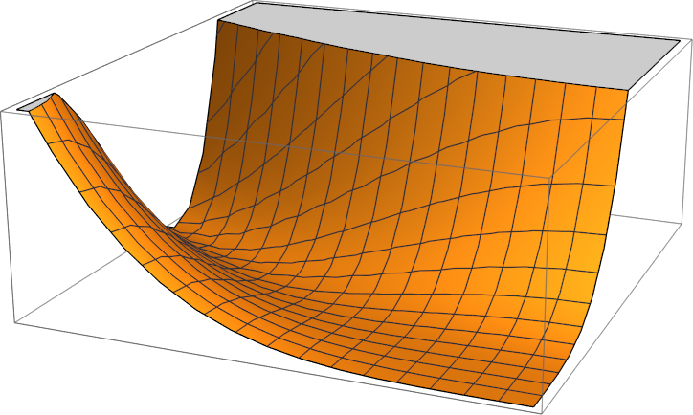
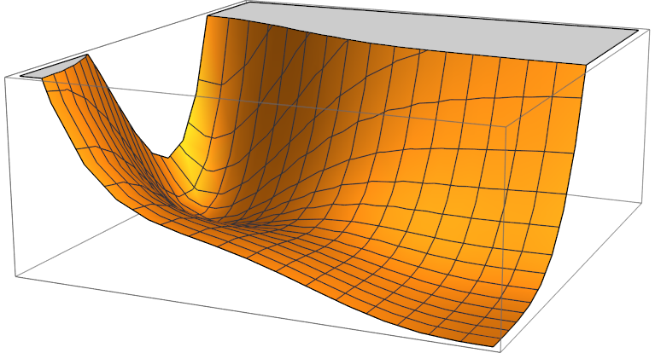









Visualising the potential
Anomaly gives a non-zero minimum
$$+{β^{′}}_{λ_{χ}}{{\left(\ln{\frac{χ}{Λ}}\right)}^{2}χ}^{4}$$
Scale invariant potential
$$V\left(h,χ\right)=\frac{λ_{h}}{4}(h^{2}{ −ξχ^{2})}^{2}+0$$
Scale invariant direction
$$(v_{h},v_{χ})$$
$$h$$
$$h$$
$$χ$$
$$χ$$
$$(0,0)$$
$$(0,0)$$
9

Slide 10

Benefits of the model
$ξ=0$ corresponds to an enhanced symmetry so the hierarchy is technically natural
A small $ξ$ means the dilaton has no impact on collider physics
Massive dilaton can be a light dark matter candidate
The only unknown is the dilaton v.e.v. which low energy physics is insensitive to
10

Slide 11
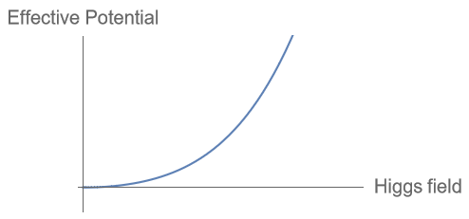
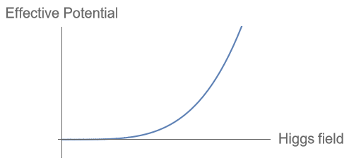
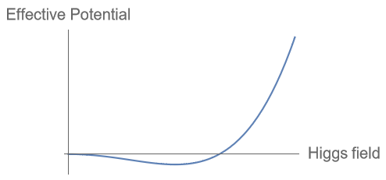
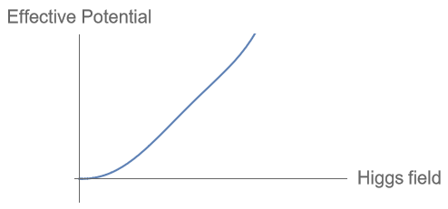
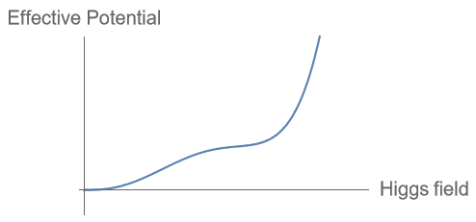
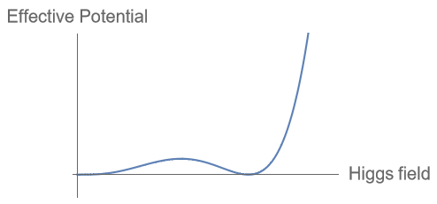


Finite temperature contributions and implications
$$V_{T}\left(h\right)=\frac{1}{24}\left(2λ_{h}+3y_{t}^{2}+\frac{9}{4}g^{2}+\frac{3}{4}{g^{′}}^{2}\right)T^{2}h^{2}$$
Increasing time
T = 0
Decreasing temperature
Standard Model:
Scale invariant model:
(along $\frac{∂V}{∂χ}=0$)
T = 0?
11

Slide 12
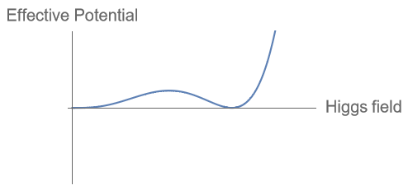
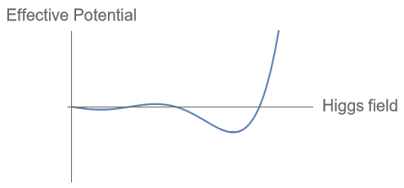
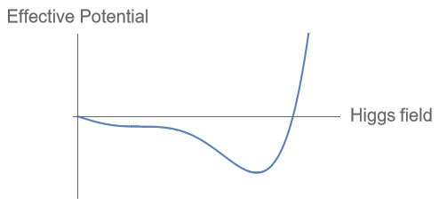

Yukawa contribution after a chiral phase transition
$Vyukawa{=y}_{u}^{ij}Q_{L}^{i}u_{R}^{j}\tilde{H}+y_{d}^{ij}Q_{L}^{i}d_{R}^{j}H+h.c$ are linear in the Higgs field
When $\left\langle \overline{q}q\right\rangle ≠0$ we might expect some ‘tipping’ of the potential
Increasing time
Decreasing temperature
12

Slide 13




Cosmological timeline
Hadronization and Chiral symmetry breaking
T $∼$ 150 MeV
Electroweak crossover
T $∼$ 140 GeV
Baryogenesis
T ≳ 4 MeV
Standard Model:
2 (3) light quarks
3 (8) light mesons
1st order
Chiral and Electroweak PTs T $∼$27 MeV
1st order Hadronization PT
T $∼$ 60 MeV
Baryogenesis
T ≳ 4 MeV
Scale invariant model:
6 massless quarks
35 massless mesons
3 (8) light mesons
13

Slide 14


Model checklist
Should be $SU{\left(6\right)}_{V}×SU{\left(6\right)}_{A}$ symmetric (except for a mass term)
Needs an order parameter $σ$ and symmetry breaking potential $V\left(σ\right)$ to model the chiral symmetry breaking
Integrating out $σ$ should reduce the theory to the usual non-linear sigma model of pions
$$ℒ =\frac{f_{π}^{2}}{4}Tr\left(∂_{μ}{U∂}^{μ}U\right)+κ Tr\left(UM\right)+h.c.$$
Should be classically scale invariant
Should be renormalizable
Will integrate out the dilaton field and just consider the effective potential, $V(h,σ)$
$$U=e^{2i\frac{Π^{a}T^{a}}{f_{π}^{2}}}$$
14

Slide 15




Linear sigma model Lagrangian and effective potential
$$ℒ =Tr\left(∂_{μ}{Φ∂}^{μ}Φ\right)+λ_{σ}{\left(Tr\left(Φ^{†} Φ\right)−n_{f}v_{σ}^{2}\right)}^{2}+λ_{κ} Tr\left(Φ^{†} ΦΦM\right)+h.c.$$
  Effective potential:
  $$V_{0}\left(σ,h\right)= \frac{λ_{σ}}{4}σ^{4}−\frac{λ_{κ}y_{t}}{2 n_{f}^{3/2}}σ^{3}h$$
  With 1-loop radiative and thermal corrections:
  $V_{CW}\left(σ,h\right)=\sum_{i}{g_{i}\frac{m_{i}^{4}(σ,h)}{64 π^{2}}\log{\frac{m_{i}^{2}(σ,h)}{Λ_{QCD}^{2}}}}$
  $$V_{T}\left(σ,h,T\right)=\sum_{i}{g_{i}\frac{T^{4}}{2π^{2}}J_{B}(\frac{m_{i}^{2}(σ,h)}{T^{2}})}$$
$Φ={\frac{σ}{\sqrt{2n_{f}}}e}^{i\sqrt{2n_{f}}\frac{Π^{a}T^{a}}{σ^{2}}}$
$$M=diag(y_{u}, y_{d}, y_{s}, y_{c}, y_{b}, y_{t})\frac{h}{\sqrt{2}}$$
Dominant contribution from:
$i=W^{±}, Z, π_{25}, π_{26},…,π_{35}$
15

Slide 16
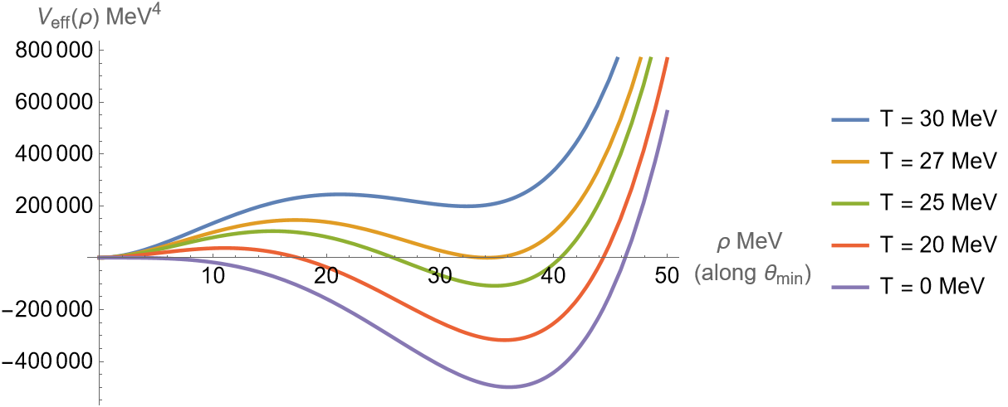

Linear sigma model effective potential
Sigma field:
$$σ=ρ\sin{θ}$$
Higgs field:
$$h=ρ\cos{θ}$$
$$θ_{min}≈0.67$$
Critical temperature:
$T_{c}=27$ MeV
16

Slide 17



First order phase transition
Metastable vacuum means the electroweak phase and chiral phase transitions are now first-order
Old vacuum
Old vacuum
Gravitational Waves
New Vacuum
New Vacuum
Semiclassical approximation for tunnelling (in the high-T limit) gives $S(T)$
Gives the percolation temperature
$T_{p}≈26$MeV
Calculate the transition probability $Γ(T)$
17

Slide 18
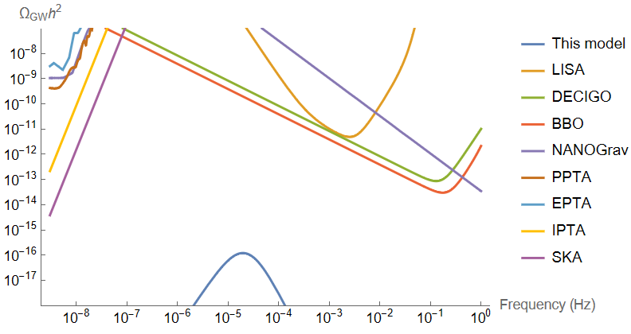


Gravitational waves
$Ω_{GW}h^{2}=2.65×{10}^{−6} \frac{H}{β}{\left(\frac{k_{v}α}{1+α}\right)}^{2}{\left(\frac{100}{g_{∗}}\right)}^{1/3}v_{w}{\left(\frac{f}{f_{sw}}\right)}^{3}{\left(\frac{7}{4+3{\left(\frac{f}{f_{sw}}\right)}^{2}}\right)}^{7/2}$
3 sources of gravitational waves:
  Collision of bubble walls
  Sounds waves (dominant here)
  Magnetohydrodynamic turbulence
Ratio of latent heat to radiation energy $α=\frac{ε_{vac}}{ε_{rad}}≈0.09$
Ratio of transition rate to Hubble scale $\frac{β}{H(T_{p})}≈4000$
Fraction of latent heat that goes into bulk motion of the plasma $κ_{v}≈0.1$
$$f_{sw}=1.9×{10}^{−5}Hz\frac{1}{v_{w}}\frac{β}{H}\left(\frac{T}{100GeV}\right){\left(\frac{g_{∗}}{100}\right)}^{1/6}$$
19

Slide 19
Primordial black holes
Collapse during a first order phase transition
Reduced pressure response during the phase transition gives a smaller critical density $δ_{c}$
Multiple possible sources for the over-densities
20

Slide 20



Primordial black holes over-densities from late transition
Transitioned universe:
$$ρ=ρ_{rad}$$
$$ρ_{rad}∝\frac{1}{a^{4}}$$
while $ρ_{vac}$ doesn’t scale
The longer the delay the higher the over density
Late patch:
$$ρ=ρ_{rad}+ρ_{vac}$$
Probability of a delay that gives the required over density $∼e^{−4×{10}^{36}}$
21

Slide 21

Primordial black holes over-densities from inflation
Inflation models predict fluctuations: $f\left(δ,M\right)∼\frac{1}{\sqrt{2πσ{\left(M\right)}^{2}}}e^{−\frac{δ^{2}}{2σ {\left(M\right)}^{2}}}$
Typically, gaussian and $σ=const.$
Normalised to CMB fluctuations: $σ\left(M\right)∝{\left(\frac{M}{M_{CMB}}\right)}^{\frac{1−n}{6}}$
If blue-tilted ($n∼1.6$) and $δ_{c}$ is sufficiently small ($∼0.05$), $Ω_{PBH}h^{2}∼0.05$
22

Slide 22

Primordial black holes mass estimate
Energy contained within a Hubble radius: $m_{PBH}= \frac{4π}{3}{\left(\frac{1}{\sqrt{3}}H^{−1}\right)}^{3}ρ_{rad}$
For the confining transition at $T∼60$ MeV : $m_{PBH}∼3M_{⊙}$
For the chiral/EW transition at $T∼27$ MeV : $m_{PBH}∼40M_{⊙}$
23

Slide 23





Quark-Lepton nuggets
A speculative model of a 1st order hadronisation phase transition
Nucleation at $T_{n}$
Bubbles wall proceeded by shock fronts
Supercooling at $T_{c}$
Quark phase
Quark phase
Shock front collisions reheat back to $T_{c}$
No more nucleation
Quark phase
Hadron phase
Hadron phase
Hadron phase
Percolation has a characteristic size
Hadron phase
Quark phase
Hadron phase
Hadron phase
$$R_{av}$$
Hadron phase
$$R_{av}$$
Hadron phase
Hadron phase
24

Slide 24

Quark-Lepton nuggets
Estimating the trapped b-l charge
Average size of shrinking quark phase bubbles: $R_{av}∼3$ m
Hadron phase baryon number density: $n_{B}^{(h)}∼Y_{B}s(T)$
Ratio at chemical equilibrium: $r=\frac{n_{B}^{(q)}}{n_{B}^{(h)}}$
Average trapped baryon number: $Q_{B}^{av}∼\frac{4π}{3}R_{av}^{3}n_{B}^{\left(q\right)}∼{10}^{37}$
25

Slide 25




Quark-Lepton nuggets free energy in the bag model
$B∼{\left(Λ_{QCD}^{\left(6\right)}\right)}^{4}→T_{c}∼60$MeV
Simple bag model:
Relevant thermodynamic potential with constrained charge:
$Ω=\left(V−\frac{4πR^{3}}{3}\right)F_{h}+\frac{4πR^{3}}{3}F_{q}−μ_{B−L}(\frac{4πR^{3}}{3}n_{B−L}\left(μ_{f},T\right)−Q_{B−L})$
$$P_{h}=P_{q}−B$$
$$\frac{π^{2}}{90}g_{∗}^{(h)}T^{4}= \frac{π^{2}}{90}g_{∗}^{(q)}T^{4}+ − B$$
Fermion degeneracy pressure
$\frac{dΩ}{dμ_{B−L}}=0$ conserves the charge
$\frac{dΩ}{dμ_{f}}=0$ relates each $μ_{f}$ to $μ_{B−L}$
$\frac{dΩ}{dR}=0$ leads to the bag model’s pressure balance equation
26

Slide 26






Quark-Lepton nuggets
Stability
$$1{\left(MeV\right)}^{−1}=7×{10}^{−22}s$$
$$Ω=−P\left(T\right)V+μ_{B−L}\left(T\right)Q_{B−L}$$
$m_{L}^{(h)}<μ_{B−L}\left(T\right)<m_{B}^{(h)}$ Free energy increases when emitting a baryon but decreases on emitting a lepton
Relevant timescales
Cooling time to chiral/EW transition:
Electron Yukawa processes:
$$∼{10}^{18}{\left(MeV\right)}^{−1}$$
$$∼{10}^{10}{\left(MeV\right)}^{−1}$$
$B→L$ sphaleron processes:
Lepton number diffusion:
$$∼{10}^{−3}Q_{B−L}^{2/3}{\left(MeV\right)}^{−1}$$
$$∼{10}^{4}{\left(MeV\right)}^{−1}$$
27

Slide 27

Quark-Lepton nuggets
Mass and abundance estimates
Low temperature limit: $m_{QN}=μ\left(T=0\right)Q_{B−L}∼{10}^{9}$ kg
Radius of quark nugget with $Q_{B−L}∼{10}^{37}$: $R∼3$ mm
Abundance: $\frac{Ω_{QN}(t_{0})}{Ω_{B}(t_{0})}=\frac{ρ_{QN}(t_{0})}{ρ_{B}(t_{0})}=\frac{μ\left(0\right)Q_{B−L} (t_{0})}{m_{B}}\frac{n_{QN(t_{QCD})}}{n_{B}(t_{QCD})}$
$=\frac{μ\left(0\right)}{m_{B}}\frac{Q_{B−L} \left(t_{0}\right)}{Q_{B} \left(t_{QCD}\right)}\left(n_{QN\left(t_{QCD}\right)}V_{QN\left(t_{QCD}\right)}\right)\frac{n_{B}^{\left(q\right)}}{n_{B}^{\left(h\right)}}∼0.03$
28

Slide 28
Summary
The scale invariant model solves the Hierarchy problem
It has only a small effect on the Standard Model today, adding just one more light, weakly interacting particle but leaving collider physics untouched
But it has a significant impact on cosmological history
  Gravitational waves (outside of range of future detectors)
  Primordial black holes from some inflation models (not dark matter)
  Quark-lepton nuggets which may survive to the present day (also not dark matter)
29

Slide 29

Speed of bubble walls and energy budget
Where does the released vacuum energy go?
$$\frac{F_{net}}{A}=\frac{F_{driving}}{A}−\frac{F_{friction}(v_{w})}{A}$$
If $\frac{F_{net}}{A}$ > 0 for all $v_{w}$ then we get a runaway bubble, and the energy mostly goes to the walls
Otherwise, we get a terminal velocity $v_{w}$ and the energy is mostly deposited inside the bubble
Found a terminal velocity $v_{w}=0.99986$ (thanks to scale invariance and 0 cosmological constant)
18

Slide 30
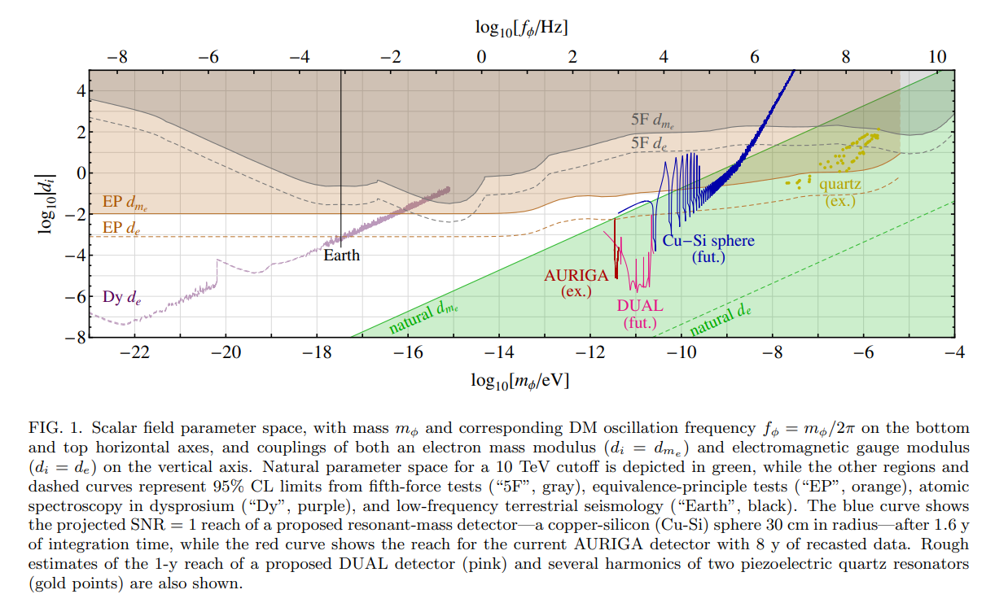


Initial implications and Viability of scale invariance
Fifth force and equivalence-Principle constraints
$ℒ⊃\frac{χ}{Λ} d_{m_{e}}m_{e}\overline{ψ}ψ$
No tree-level coupling to electron mass so expect $d_{m_{e}}∼{10}^{−2}$
$≈$ this model
Arvanitaki, Dimopoulos, and Tilburg, 2016
8

Slide 31
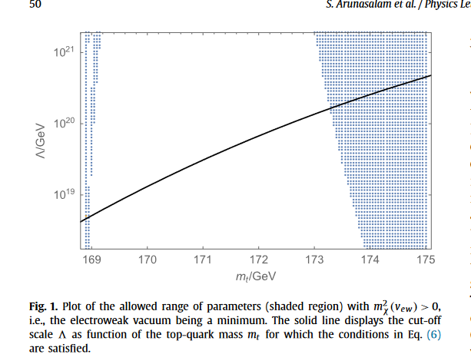

Initial implications and Viability of scale invariance
Existence of a minimum
Minimisation conditions ${\frac{∂V}{∂χ}}_{χ=v_{χ}, h=v_{h}}=0$ , ${\frac{∂V}{∂h}}_{χ=v_{χ}, h=v_{h}}=0$
Vanishing cosmological constant $V\left(v_{h},v_{χ}\right)=0$
Experimental top mass:
$$m_{t}=172.52±0.14±0.30$$
Borderline but modified by other new physics
Arunasalam et al., 2017
6

Slide 32
future work
Effect on baryogenesis
Tunnelling rate for electroweak phase transition before T=7 MeV
Interactions between the dilaton and SM particles
Formation of primordial black holes
17

