Slide 1
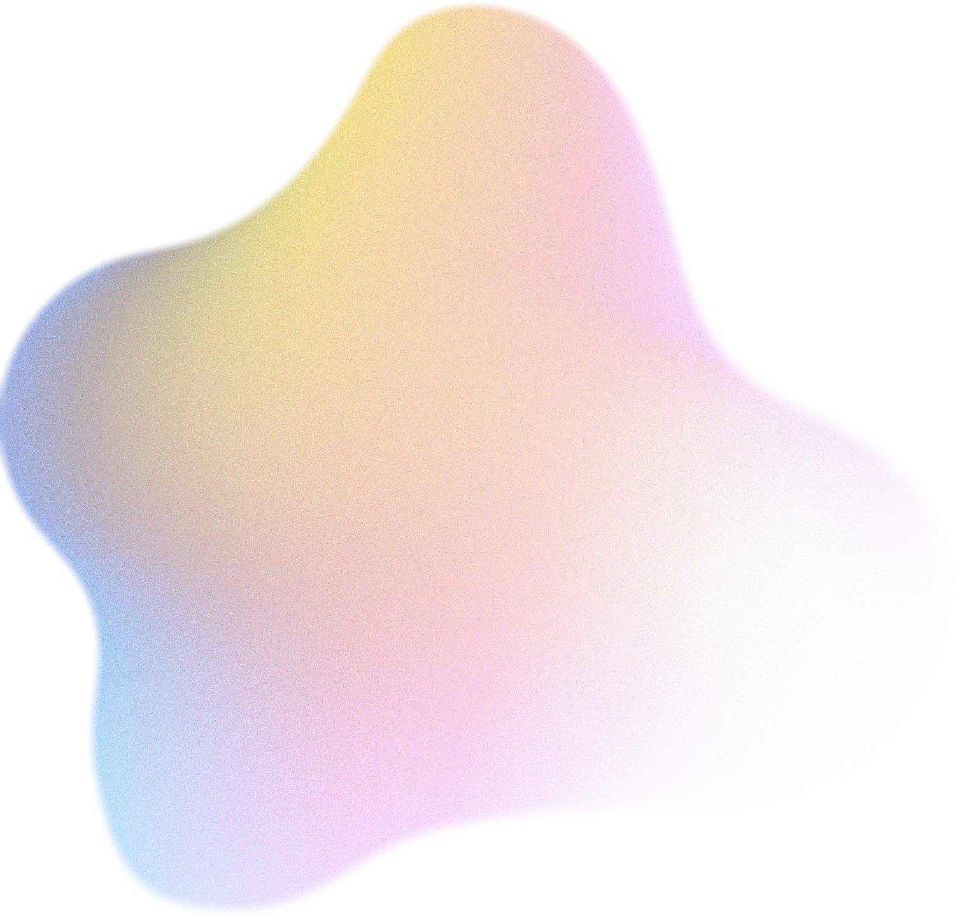
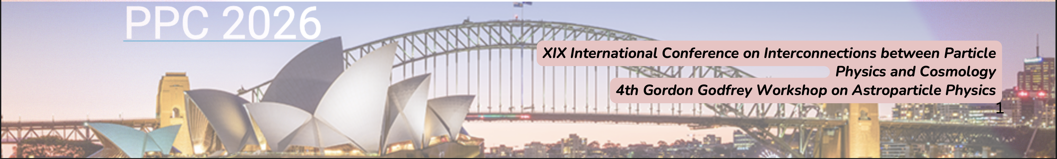
Did our universe collide with another universe?
A search for bubble universe collision signatures in the Planck CMB
Jahanvi Maheshwari
Supervisor: Dr. Jan Hamann
PhD Candidate,
UNSW School of Physics, CPPC- Sydney
UNSW School of Physics, CPPC- Sydney
1

Slide 2

  The Problem
  Detection Mechanisms
Agenda
  Modified Method
  Current Conclusions
  Future Directions
2

Slide 3


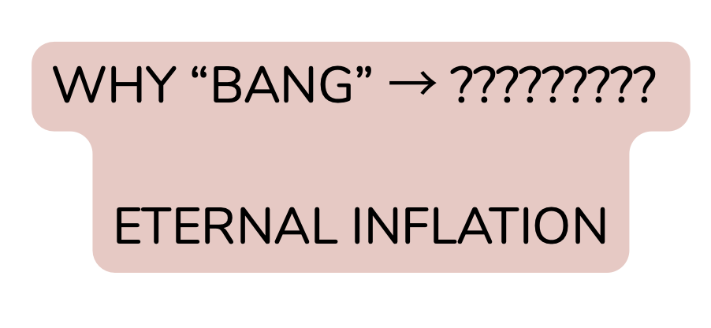
Inflation → Eternal Inflation
Inflation + Big Bang Cosmology
- Explains large scale uniformity
- Predicts mass density of universe to <1% accuracy
- Explains CMB anisotropies (quantum fluctuations)
- What “bang” → Inflation
Big Bang
Inflation
Reheating
CMB
Structure formation
Today
3
Notes:
Standard BB cosmology:
- theory- 13.8 years of evolution
- initial state was dense, hot uniform soup
- describes how universe expanded, cooled and light chemical elements formed and stars and galaxy formation
- does not describe what caused the expansion or where the matter came from
i.e. what bang, why bang!
Inflation is a modification to BB cosmology to explain the bang- propulsion outward (gravitational repulsion).
This explains the flatness and horizon problems, and data so far agrees with this model.
NOW, there is one small problem.
The repulsive gravity (inflaton) which drives inflation is metastable. And the probability of remaining in an inflating state decreases with time in any one location exponentially.
BUT, the universe is expanding exponentially meanwhile. And in any successful version/model of inflation, the exponential expansion is faster than the exponential decay of the inflaton field.
Which means, the volume that inflates increases with time, even though inflaton is decaying.
This means we have eternal inflation- as the name implies once it starts, it does not stop.
So the inflaton never disappears, but only pieces of it undergo decay and produce pocket universes. So instead of one universe, we have an infinite number of bubble universes in an ever inflating multiverse.

Slide 4

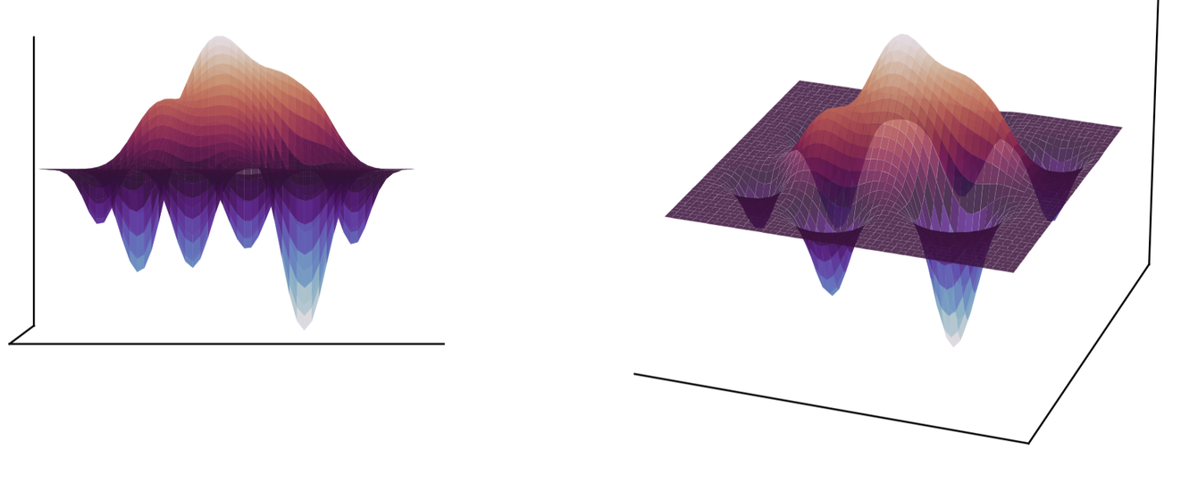
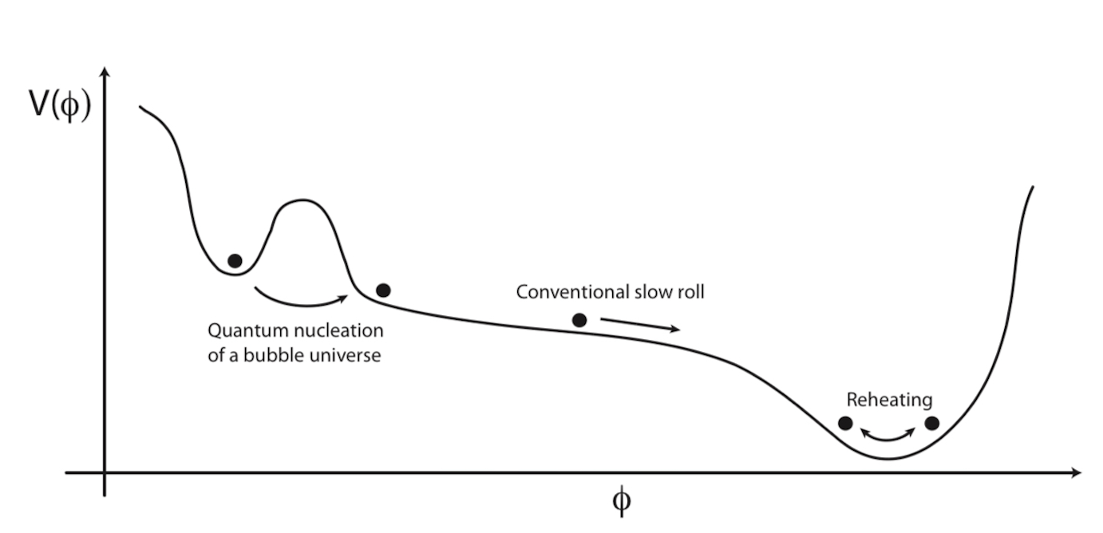

Multiverse → Bubble universes
Eternal Inflation
Bubble Nucleation
Slow roll inflation
Reheating
CMB
Structure formation
Today
(Dahlen, 2009), see [8]
4

Slide 5

Direct detection of other bubbles not possible
(Indirect methods?)
5

Slide 6



Observable multiverse signature
CMB Temperature Anisotropy
Bubble Nucleation + SR Inflation
Reheating Surface
Eternal Inflation
(Perturbed)
Spacetime Defect
CMB Polarisation Anisotropy
Bubble Collision
Radiation Shell
collision region
(domain wall)
6

Slide 7
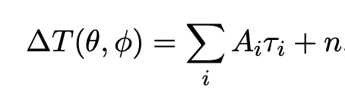
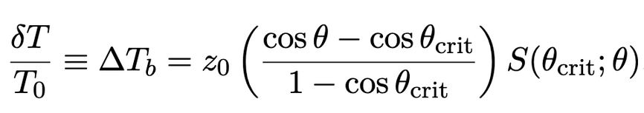

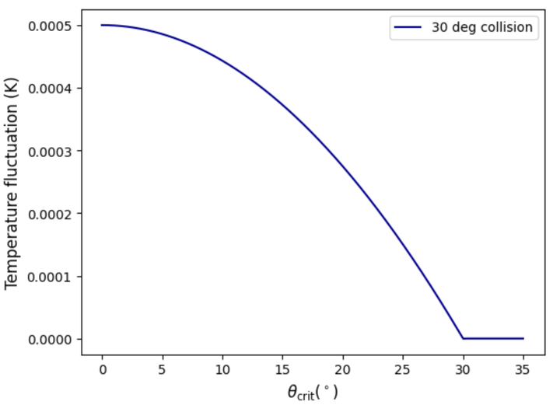

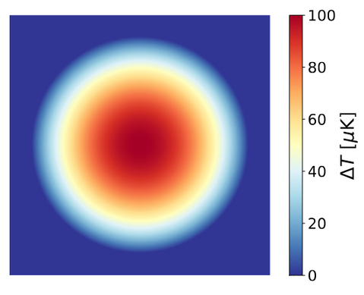
‘Crash’ Course
- SW effect- (ignores ISW, Doppler effect due to bulk vel., diffusion damping)
- Reheating surface perturbation: SMALL (linear effects only)
- Pure scalar perturbation: NO tensor component
- Single bubble collision at a single point: NO interference patterns
Compatibility: region must undergo reheating after collision
Probability: we should be able to see it
Observability: effects cannot be diluted away due to expansion
7

Slide 8

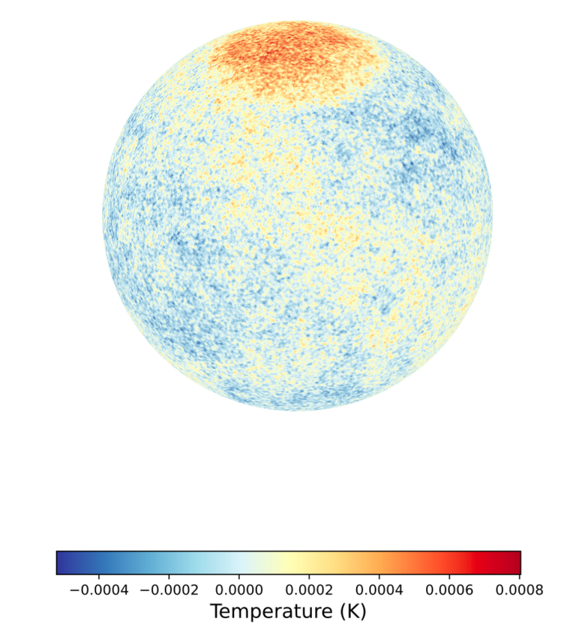
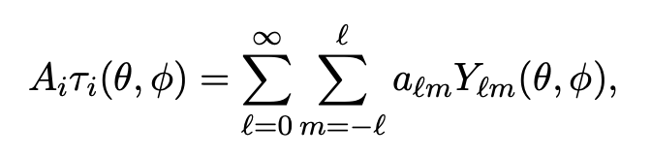

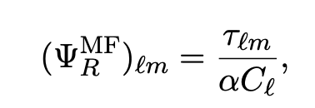
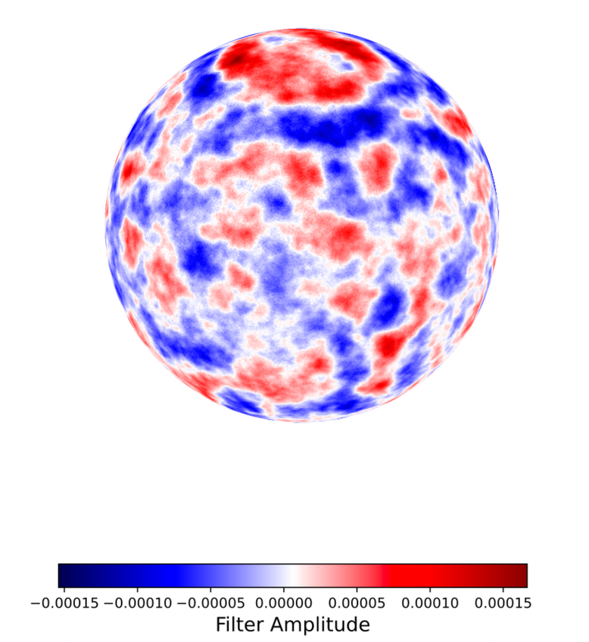
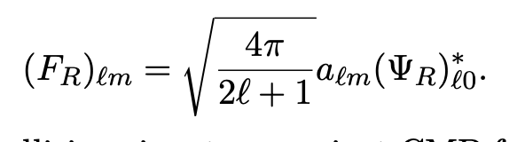
Detection Mechanisms
Highlighting hidden signals
Spherical transform
Filtering methods
- Needlet filtering
- Optimal filtering
8

Slide 9
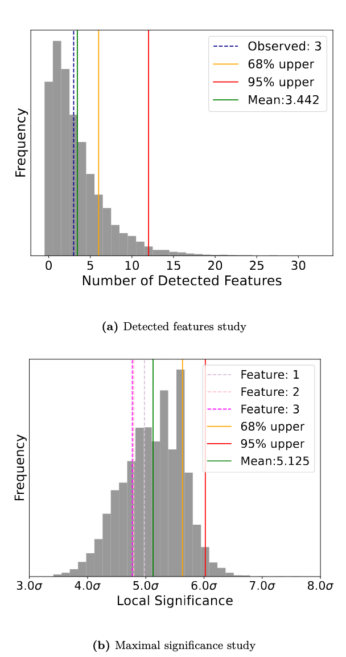
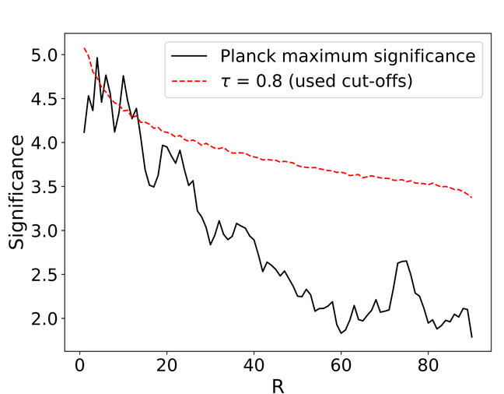
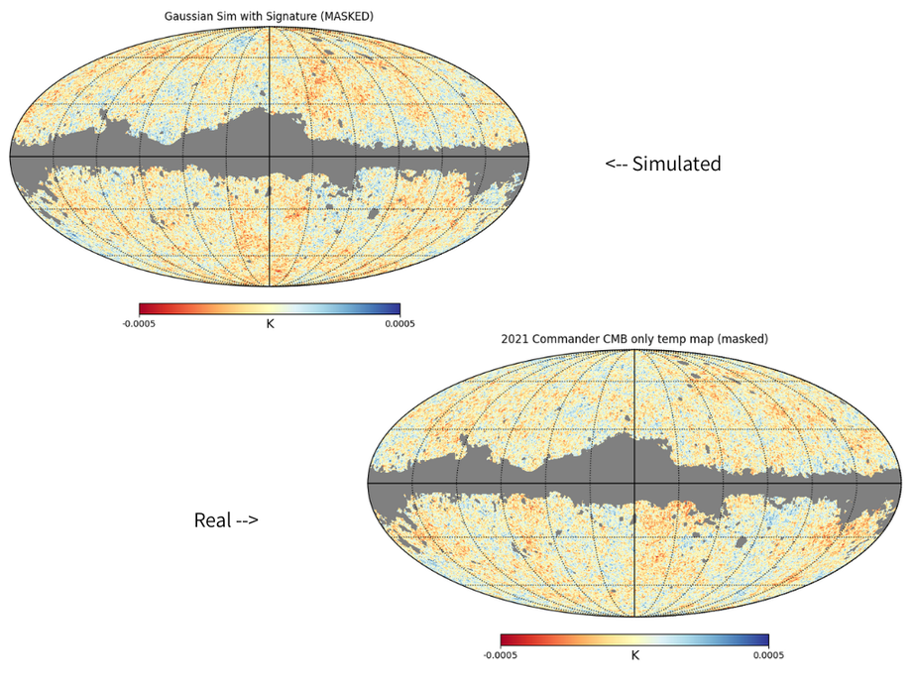
Modified Method
Application and Results
Filtering of Planck CMB
Frequentist Analysis
Validation with WMAP CMB
Future directions
Threshold Generation
Filtered maps → Local significance
Thresholds (80%) and Disc Maps
Adjacency Analysis
Parameter Reconstruction
Planck-like Simulation
Realistic CMB maps
Modelling instrumentation noise
9

Slide 10
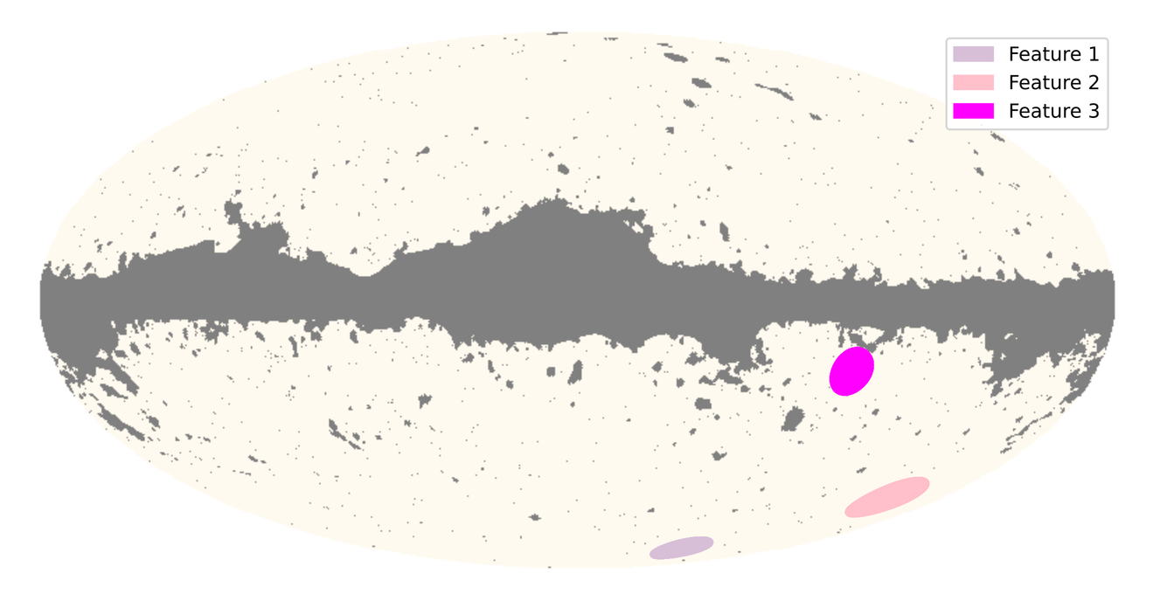
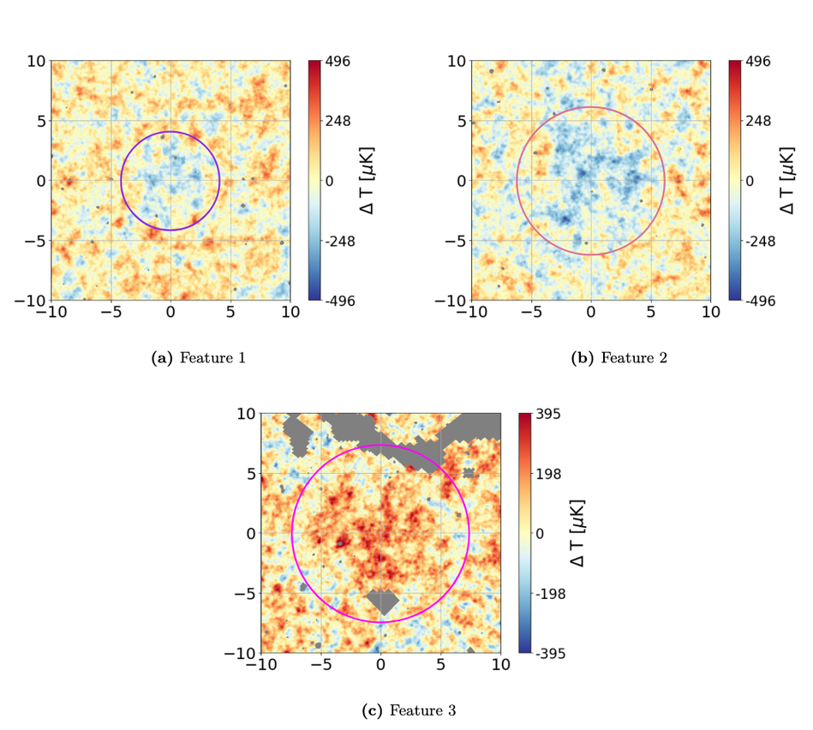
Results
3 features reported
Frequentist Analysis: 3.4 expected
Maximum significances <
Frequentist expected values
CMB Cold Spot detected!
Cold Spot!
10

Slide 11




Current Conclusions
Null hypothesis
favoured
CMB Cold Spot
Southern hemisphere power asymmetry
Other data
signatures
11

Slide 12

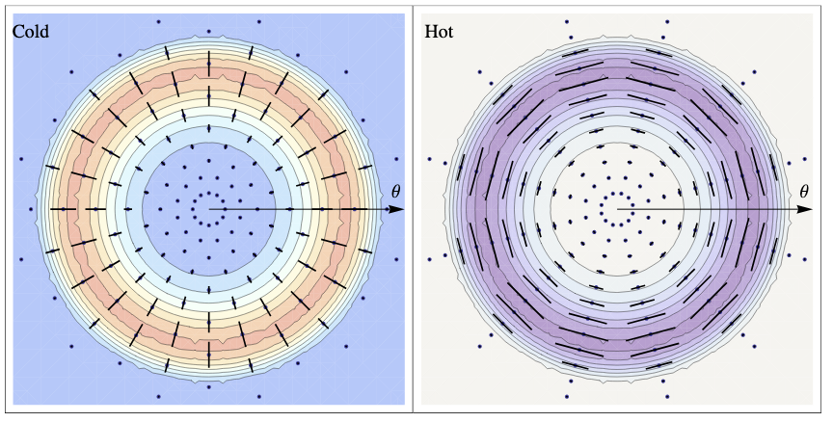
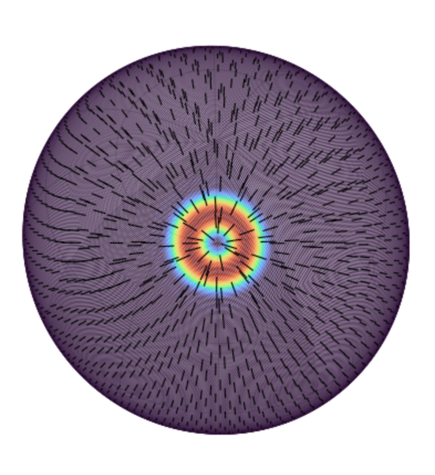
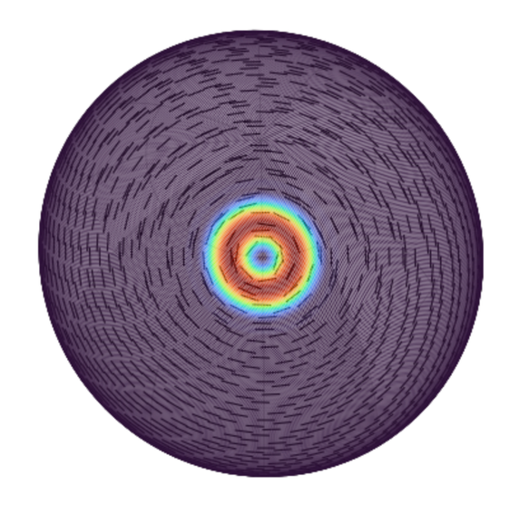
Future directions
CMB Temperature Anisotropy
E-mode, scalar perturbation
Forecasting constraints on detectability
Optimal filtering on Planck E-mode data
CMB Polarisation Anisotropy
(Czech et. al, 2010), see [6]
12

Slide 13
References
[1] Alan Guth Lectures on Early Universe (Fall 2013), MIT
https://ocw.mit.edu/courses/8-286-the-early-universe-fall-2013/
[2] Spencer Chang, Matthew Kleban, and Thomas S. Levi. Watching Worlds Collide: Effects on the CMB from Cosmological Bubble Collisions. 2009.
doi: 10.1088/1475-7516/2009/04/025. arXiv: 0810.5128 [hep-th]
[3] Stephen M. Feeney et al. First Observational Tests of Eternal Inflation: Analysis Methods and WMAP 7-Year Results. 2011.
doi: 10.1103/PhysRevD.84.043507. arXiv: 1012.3667 [astro-ph.CO].
[4] J. D. McEwen et al. Optimal filters for detecting cosmic bubble collisions. 2012.
doi:10.1103/PhysRevD.85.103502. arXiv: 1202.2861 [astro-ph.CO].
[5] M. Cruz et al. Detection of a non-gaussian spot in WMAP. 2005.
doi: 10.1111/j.1365-2966.2004.08419.x. arXiv: astro-ph/0405341.
[6] Bartłomiej Czech et al. “Polarizing bubble collisions”. In: Journal of Cosmology and Astroparticle Physics 2010.12 (Dec. 2010), pp. 023–023. issn: 1475-7516. doi: 10.1088/1475-7516/2010/12/023. url: http://dx.doi.org/10.1088/1475-7516/2010/12/023
[7] Sidney Coleman. “Fate of the false vacuum: Semiclassical theory”. In: Physical Review (May 1977).
[8] A. Dahlen. ”Odds of observing the multiverse”. 2009 arXiv: 0812.0414 .
13

Slide 14
Extra slides
14

Slide 15
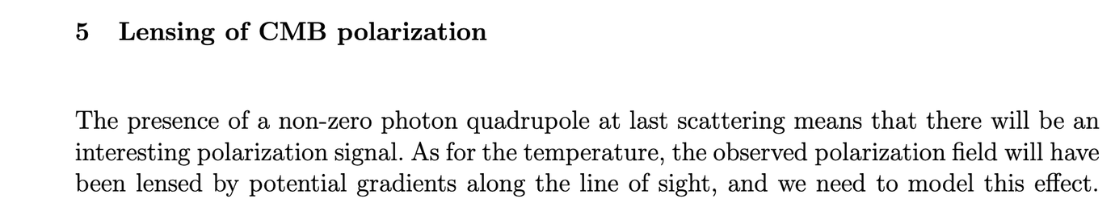
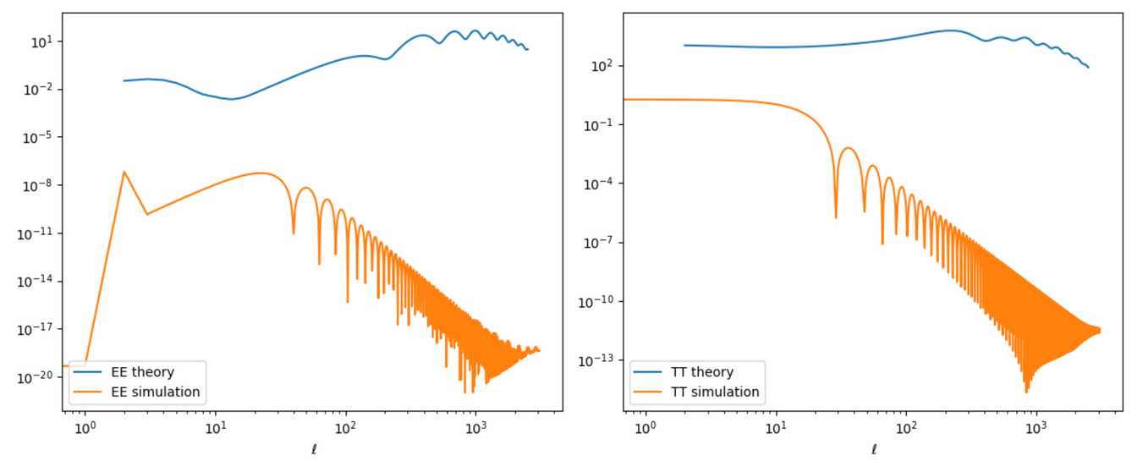
Power spectrum and lensing
15

Slide 16
String theory landscape
Borrowing from string theory (which I do not know much about), there is no unique vacuum, and there could be around 10500 long lived metastable states, any of which could be a bubble universe. This constitutes the potential landscape. Eternal inflation can produce an infinite number of bubbles of every type populating the landscape.
So string theory would govern everywhere, but each bubble would have it’s own low energy physics, standard model and vacuum energy density. [1]
16

Slide 17
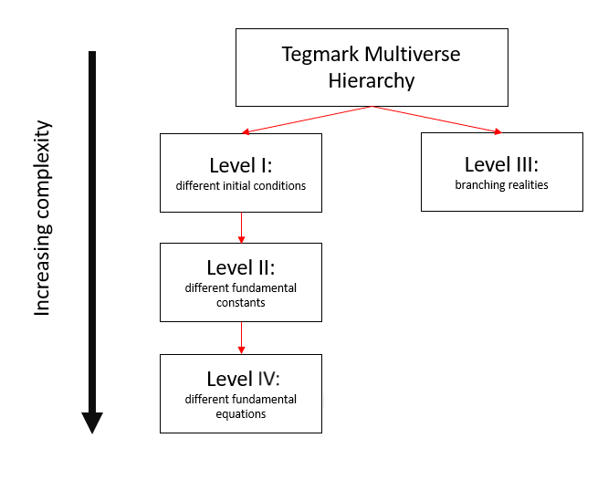
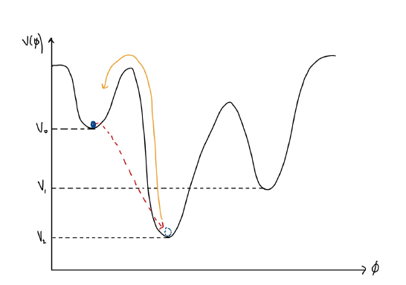
Anthropic Principle
If we have 10500 vacua, and a fraction of 10-120 have small vacuum energy densities, then we expect ~ 10380 vacua with low energy densities like our own. [1]
Weinberg (1987) explained that vacuum energy density can be explained like a selection effect, the vacuum energy density could be large is most bubble universes, but since this energy causes rapid expansion, if large and negative, universe collapses, if large and positive we cannot have structure formation. So a “critical” value is needed fr life to exist (very close to 0).
Anthropic explanation should be the last resort explanation, as they become relevant when deterministic arguments have failed. [1]
17

Slide 18
Eternal Inflation
Inflation + Big Bang Theory
- Explains large scale uniformity
- Predicts mass density of universe to <1% accuracy
- Explains CMB anisotropies (quantum fluctuations)
- What “bang”. Why “bang”?!
Multiverse Theory
- All inflationary models are eternal (i.e. it does not stop) → bubble universes
- Universe accelerated expansion, vacuum energy non-zero, Why?
- String theory motivation: no unique vacuum
- Anthropic argument, “selection effect:
- Deterministic methods?
18
Notes:
Standard BB cosmology:
- theory- 13.8 years of evolution
- initial state was dense, hot uniform soup
- describes how universe expanded, cooled and light chemical elements formed and stars and galaxy formation
- does not describe what caused the expansion or where the matter came from
i.e. what bang, why bang!
Inflation is a modification to BB cosmology to explain the bang- propulsion outward (gravitational repulsion).
This explains the flatness and horizon problems, and data so far agrees with this model.
NOW, there is one small problem.
The repulsive gravity (inflaton) which drives inflation is metastable. And the probability of remaining in an inflating state decreases with time in any one location exponentially.
BUT, the universe is expanding exponentially meanwhile. And in any successful version/model of inflation, the exponential expansion is faster than the exponential decay of the inflaton field.
Which means, the volume that inflates increases with time, even though inflaton is decaying.
This means we have eternal inflation- as the name implies once it starts, it does not stop.
So the inflaton never disappears, but only pieces of it undergo decay and produce pocket universes. So instead of one universe, we have an infinite number of bubble universes in an ever inflating multiverse.

Slide 19
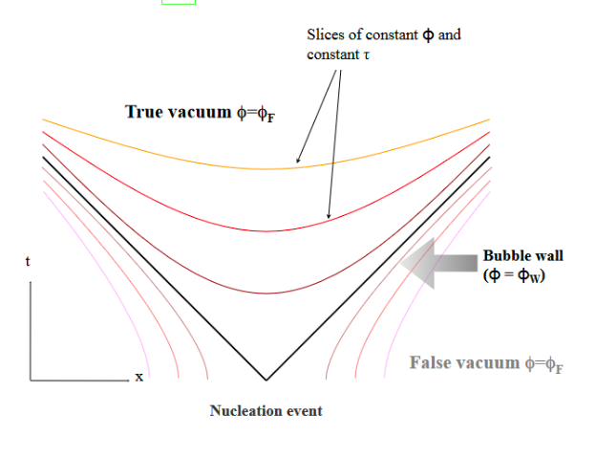
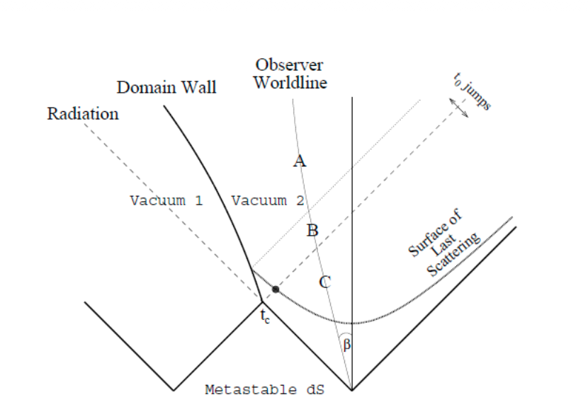
‘Crash’ Course
Collision region
+ Domain wall dynamics
dS - dS spacetime collision → Physical energy barrier - two vacuum states = domain wall
Thin-wall approximation
Timescale of collision small compared to expansion
Signature survives beyond 50-60 e-folds of inflation
19
Diagrams from [7] and [2] respectively

Slide 20
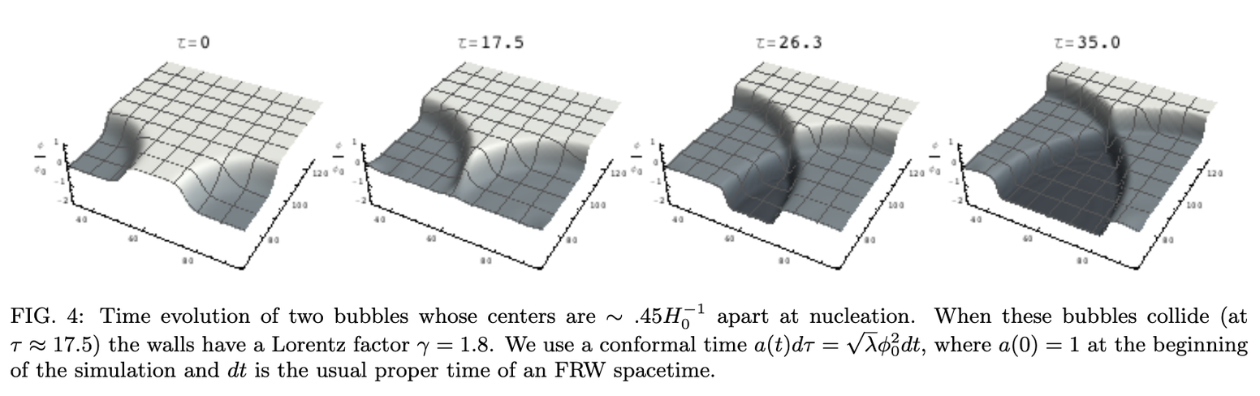
Collisions of two same bubbles
Collide and merge together
- The two bubbles have formed not too far apart with the same vacuum energy
- They evolve and collide before the energy from expansion has time to build up on the walls
- Once two bubbles collide, the walls do not have enough energy to “kick” the collision region to any other minima.
- They merge and form a non-spherical bubble-like geometry
Collide and classically transition to lower vacua
- Two bubbles formed far apart, so they have had time to expand a lot more, and more energy to be stored in the bubble walls
- Two bubbles collide and the walls convert the potential energy in the walls to kinetic energy which provides a “kick” that allows the field to go over the energy barrier to a lower minima than the one the bubbles formed in
- A new bubble of even lower minima than the parent bubbles forms
20
Diagram from: arXiv: 0907.3234
Notes:
Standard BB cosmology:
- theory- 13.8 years of evolution
- initial state was dense, hot uniform soup
- describes how universe expanded, cooled and light chemical elements formed and stars and galaxy formation
- does not describe what caused the expansion or where the matter came from
i.e. what bang, why bang!
Inflation is a modification to BB cosmology to explain the bang- propulsion outward (gravitational repulsion).
This explains the flatness and horizon problems, and data so far agrees with this model.
NOW, there is one small problem.
The repulsive gravity (inflaton) which drives inflation is metastable. And the probability of remaining in an inflating state decreases with time in any one location exponentially.
BUT, the universe is expanding exponentially meanwhile. And in any successful version/model of inflation, the exponential expansion is faster than the exponential decay of the inflaton field.
Which means, the volume that inflates increases with time, even though inflaton is decaying.
This means we have eternal inflation- as the name implies once it starts, it does not stop.
So the inflaton never disappears, but only pieces of it undergo decay and produce pocket universes. So instead of one universe, we have an infinite number of bubble universes in an ever inflating multiverse.

Slide 21

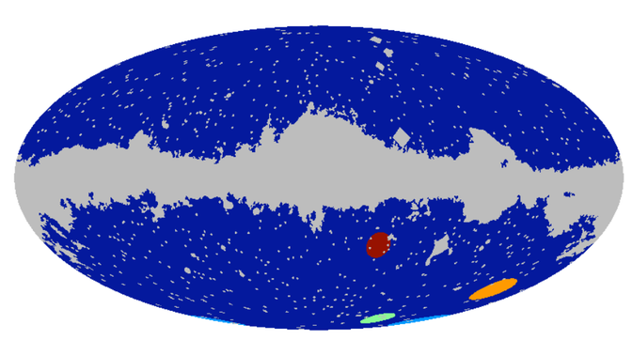
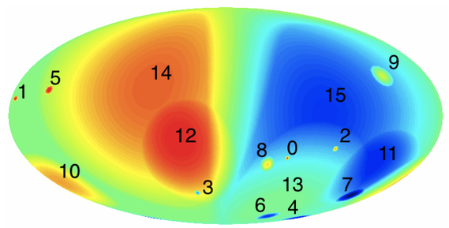
WMAP (pub.) Results
Feeney et. al. (2011) [3] | Mcewen et. al. (2012) [4]
Needlet analysis Edge detection algorithm 18 signatures reported Bayesian statistics on 4 most prominent features Null hypothesis favoured | Optimal filter analysis Established superior SNR 14 signatures reported No freq/Bayes study Open ended usage and future direction
21

Slide 22
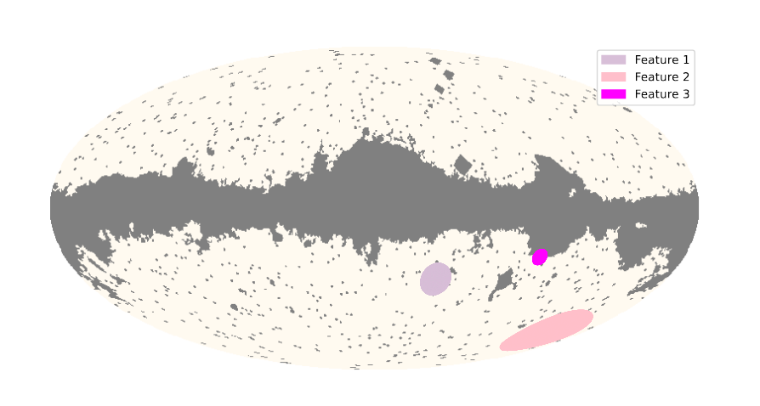
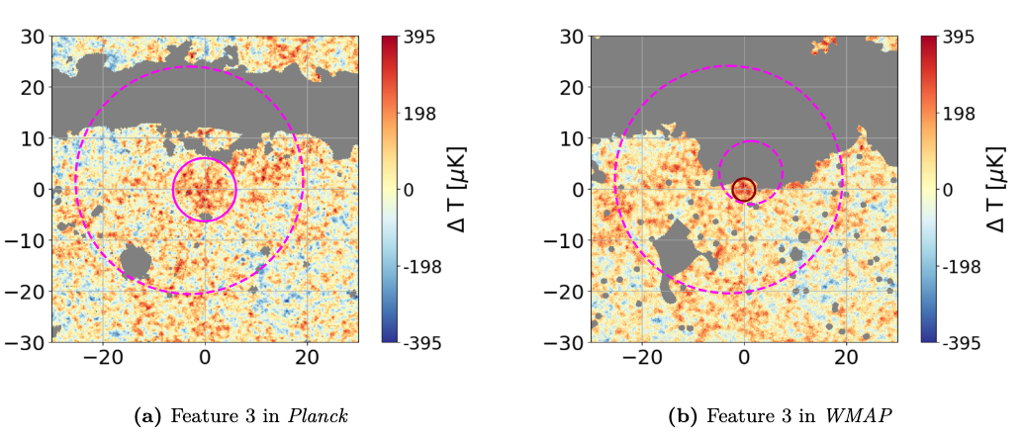
22

Slide 23
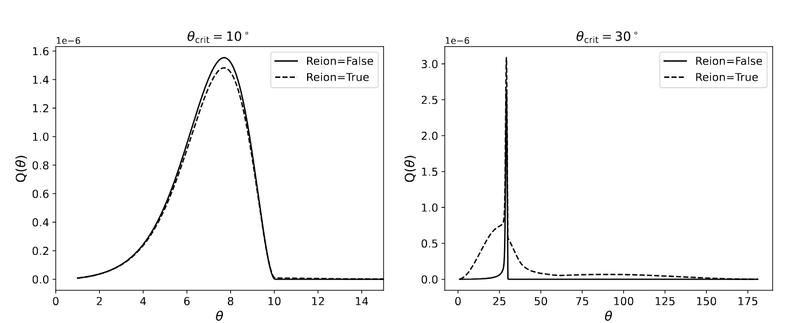
23

Slide 24
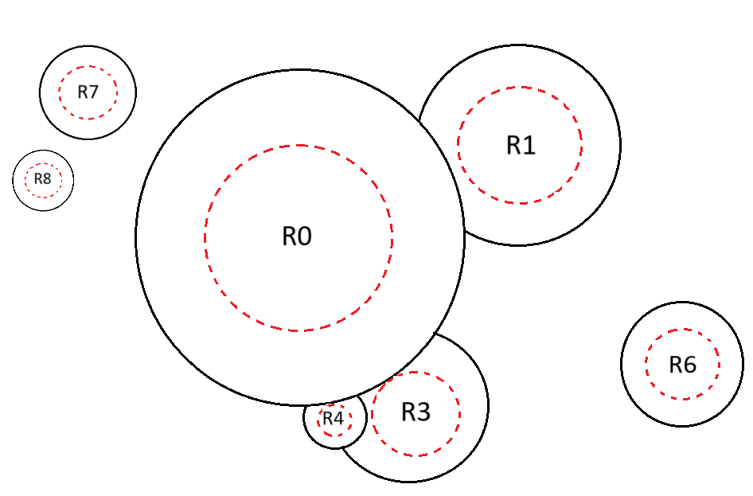
24

