Slide 1




Heavy Dark Matter in rapidly evolving massive stars
Giorgio Busoni-The University of Adelaide
PPC 2026 – SYDNEY – 01/09/2026

Slide 2
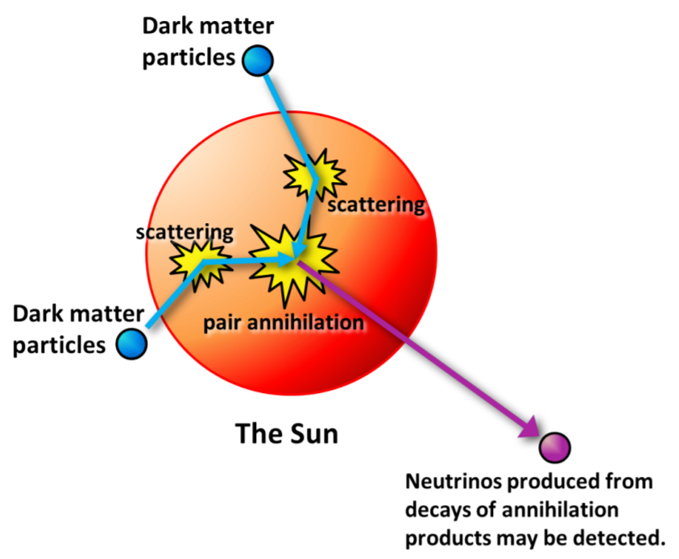
Dark Matter capture in stars
In a typical collision, the Dark Matter loses enough energy to drop below the escape velocity and hence becomes gravitationally bound to the star
Subsequent scatterings, lose energy, accumulates in the centre
Observable signal depends on Capture rate
  Probes same parameter space as Direct Detection
Notes:
If elastic scattering is possible in DD is possible on the cosntituents of the star too! In a typical collision, DM loses enough energy to drop below the escape velocity and becomes gravitationally trapped inside the star. It will undergo more scatterings and slowly accumulate in the center.

Slide 3
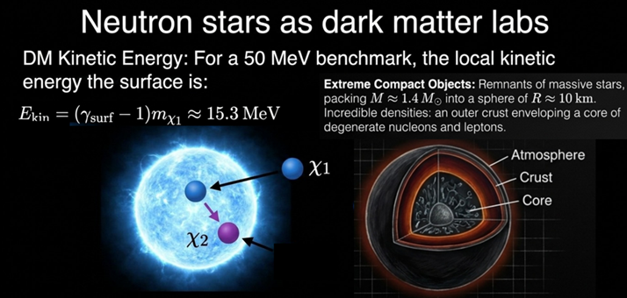
Dark Matter capture in stars
Other kind of stellar objects can be considered:
Neutron Stars
White Dwarfs
Main Sequence Stars
Exoplanets
.....
Pop III stars [this talk]
Credit Sebastian Trojanowski

Slide 4
Motivations
Why (consider Pop-III stars)?
What (could we observe/constrain)?

Slide 5
Why Pop-III stars?
/
Sensitive to ultra-heavy masses (≳ 10³–10¹⁵ GeV)
Regions not accessible to Direct Detection
Probe of heavy Dark Matter
Large number of baryonic targets
Multi-scattering regime naturally realized
Complementarity to compact objects

Slide 6
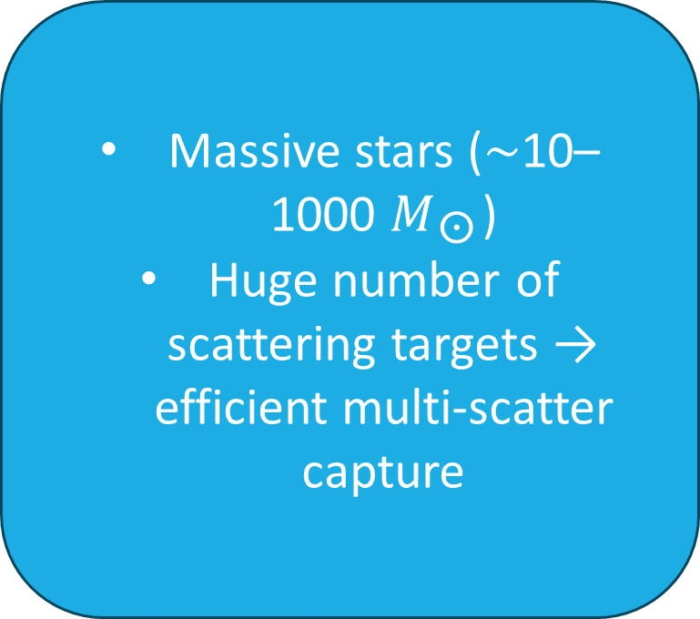
Why Pop-III stars?
/
Massive stars (∼10–1000 $M_{☉}$)
Huge number of scattering targets → efficient multi-scatter capture
Probe of heavy Dark Matter
Large number of baryonic targets
Multi-scattering regime naturally realized
Complementarity to compact objects

Slide 7
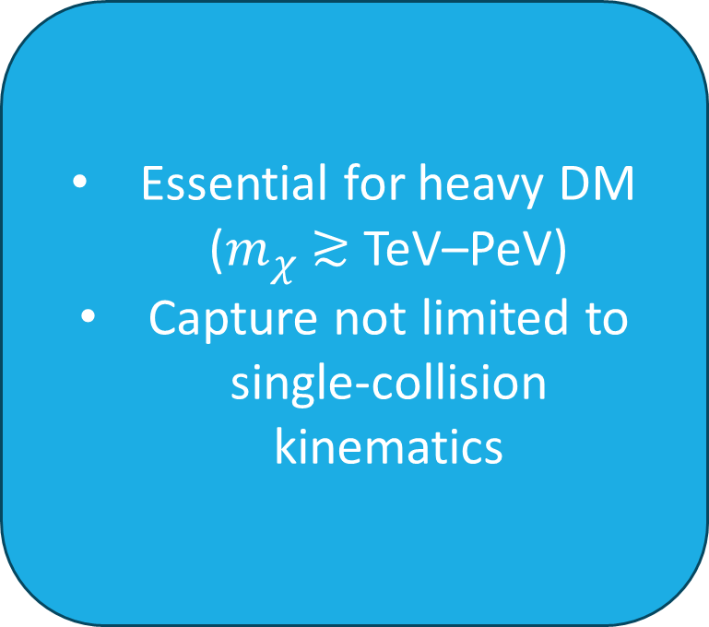
Why Pop-III stars?
/
Essential for heavy DM ($m_{χ}$ ≳ TeV–PeV)
Capture not limited to single-collision kinematics
Probe of heavy Dark Matter
Large number of baryonic targets
Multi-scattering regime naturally realized
Complementarity to compact objects

Slide 8
Why Pop-III stars?
/
Lower density than NS, but:
Larger size → higher geometric capture
Different target mix (H/He vs neutrons)
Probe of heavy Dark Matter
Large number of baryonic targets
Multi-scattering regime naturally realized
Complementarity to compact objects

Slide 9
WHAT can we observe?
Main signatures
Instability/collapse
Modification internal structure
Heat injection
Collapse usually requires very heavy DM to form a large over-density at the center
Heating is applicable on a large mass range

Slide 10
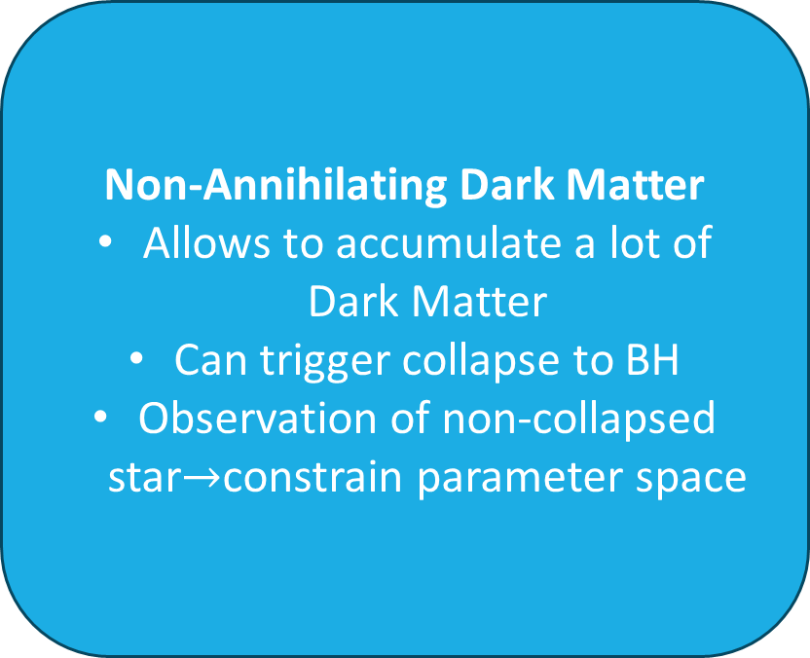

We study 2 different setups
Annihilating Dark Matter
Capture/Annihilation equilibrium
Can injected heat alter stellar evolution?
Non-Annihilating Dark Matter
Allows to accumulate a lot of Dark Matter
Can trigger collapse to BH
Observation of non-collapsed star$→$constrain parameter space
Answer: injected heat is well below the star luminosity for the considered DM density $ρ_{χ}\sim 5GeV/{cm}^{3}$
Notes:
What happens after capture?
If DM that can self-annihilate, or that comes with particle and antiparticle species, after a while the annihilation rate would go in equilibrium with the capture rate, therefore annihilations depend only on capture, and so on the elastic cross section.
If DM that cannot annihilate, like one with particle/antiparticle asymemtry, like for ordinary matter, you could accumulate a lot of DM in this case. IN both cases, that observables will depend only on the DM-nucleon elastic CS, so the same quantity probed in DD.
Now, in both scenarios DM could be kicked out from the star due to upscattering on energetic nuclei due to thermal motion. This is called evaporation.
Below a certain mass, that we call evaporation mass, evaporation dominates and one cannot accumulate a lot of DM in the star. So with these signatures one can only probe DM masses above the evap mass.

Slide 11
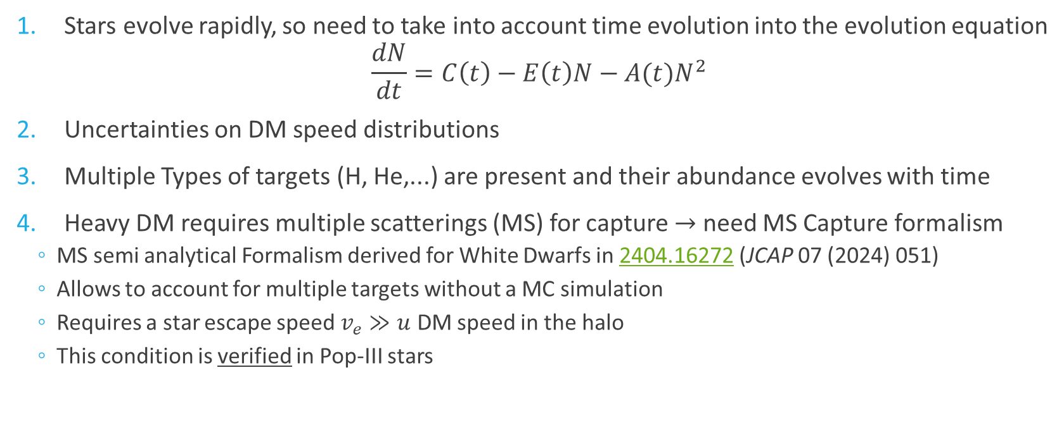
How? List of challenges
Stars evolve rapidly, so need to take into account time evolution into the evolution equation
$$\frac{dN}{dt}=C\left(t\right)−E\left(t\right)N−A(t)N^{2}$$
Uncertainties on DM speed distributions
Multiple Types of targets (H, He,...) are present and their abundance evolves with time
Heavy DM requires multiple scatterings (MS) for capture $→$ need MS Capture formalism
  MS semi analytical Formalism derived for White Dwarfs in 2404.16272 (JCAP 07 (2024) 051)
  Allows to account for multiple targets without a MC simulation
  Requires a star escape speed $v_{e}≫u$ DM speed in the halo
  This condition is verified in Pop-III stars

Slide 12
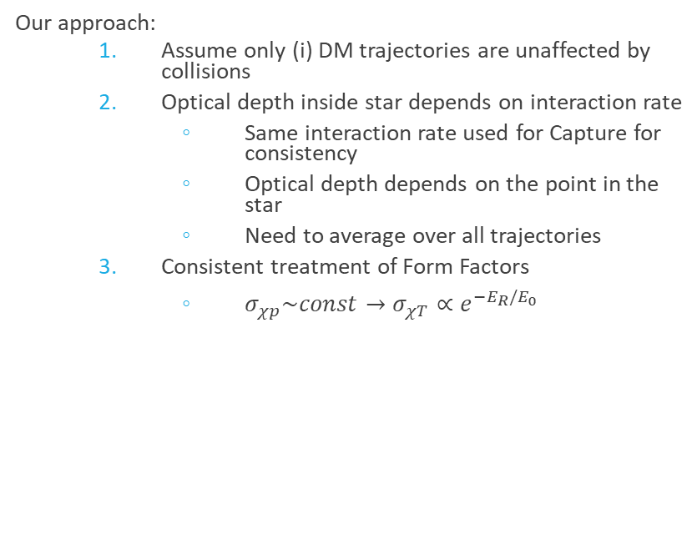
Capture Rate with MS Formalism
DM Capture usually based on Gould seminal work for Capture in the Earth, based on:
DM trajectories are unaffected by collisions
Constant escape velocity
Constant iron (target) density
DM follows linear trajectories outside and inside the Earth’s core, thereby neglecting gravitational focusing/gravity effects
Additional approximations usually made:
Simplified calculation of Star’s optical depth
Differential cross section on target d𝜎/𝑑𝑐𝑜𝑠𝜃~constant
Ad-Hoc treatment of Form factors
Require to sum infinite series
Our approach:
  Assume only (i) DM trajectories are unaffected by collisions
  Optical depth inside star depends on interaction rate
    Same interaction rate used for Capture for consistency
    Optical depth depends on the point in the star
    Need to average over all trajectories
  Consistent treatment of Form Factors
    $σ_{χp}\sim const→σ_{χT}∝e^{−E_{R}/E_{0}}$

Slide 13
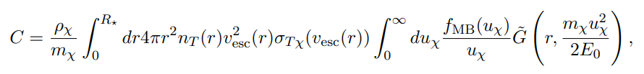
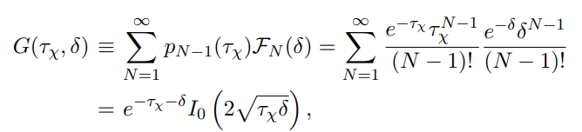
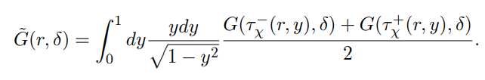
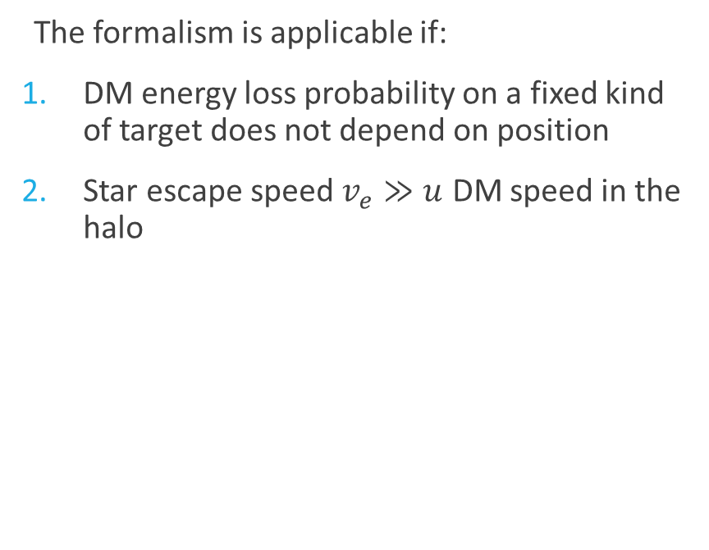
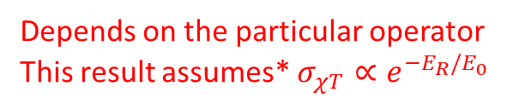
Dark Matter MS Capture Formalism
The formalism is applicable if:
DM energy loss probability on a fixed kind of target does not depend on position
Star escape speed $v_{e}≫u$ DM speed in the halo
Result
Capture rate for a single type of target can be computed as
Depends on the particular operator
This result assumes* $σ_{χT}∝e^{−E_{R}/E_{0}}$
Angular/trajectory average
*For H we needed to work out some approximated result for $G$ as this does not hold for H

Slide 14
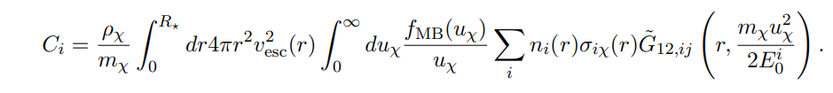



Multiple kinds of targets
Multiple kinds of targets can be implemented by convolution:
Convolutions can be nested multiple times for as many elements as necessary
  This has large impact on computing time so no more than 4 elements are considered
Capture by only scattering with i
“Mixed” Capture i+j

Slide 15
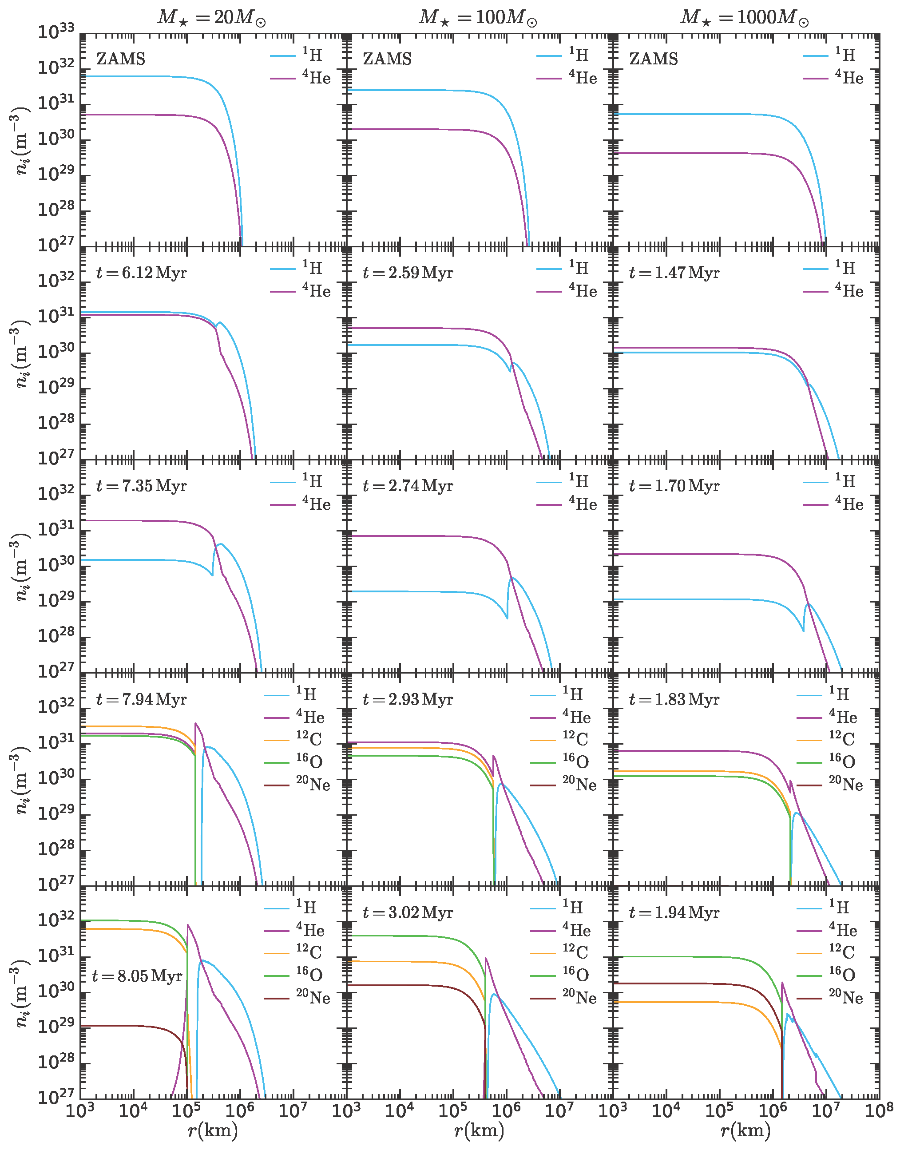
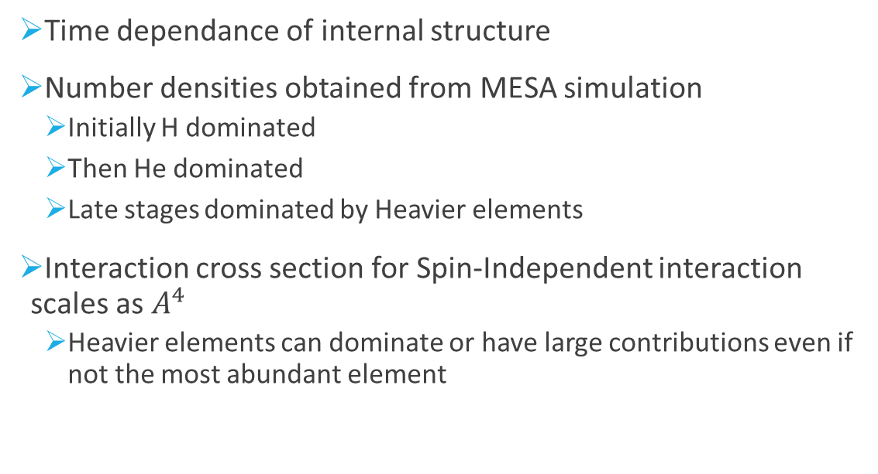
Pop-III stars as DM laboratories
Time dependance of internal structure
Number densities obtained from MESA simulation
  Initially H dominated
  Then He dominated
  Late stages dominated by Heavier elements
Interaction cross section for Spin-Independent interaction scales as $A^{4}$
  Heavier elements can dominate or have large contributions even if not the most abundant element

Slide 16
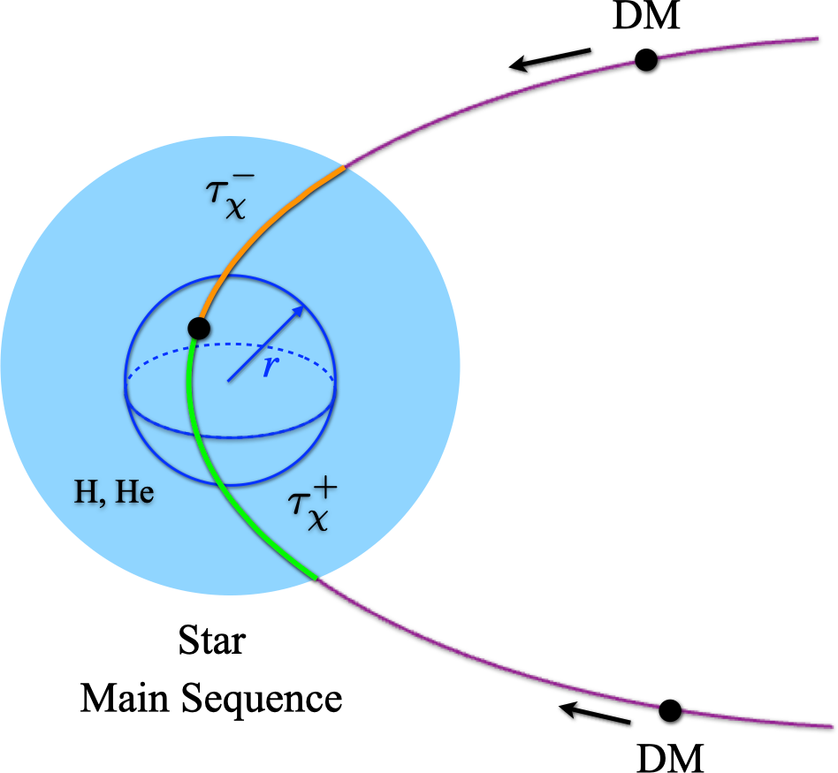
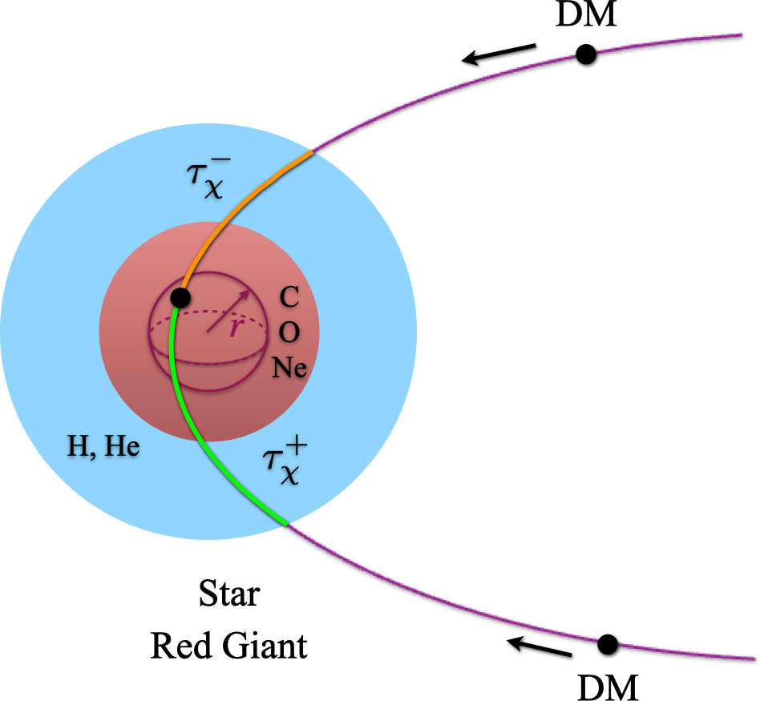
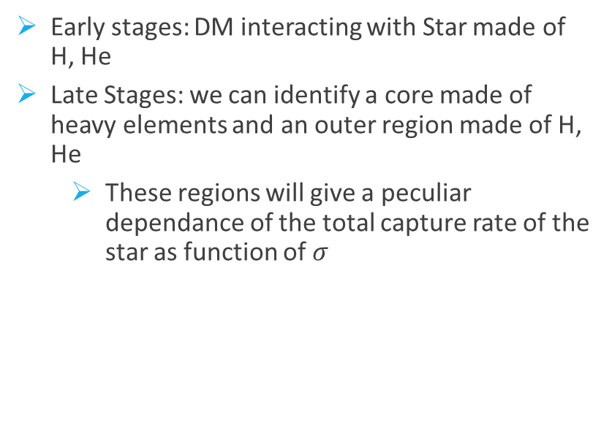
DM Capture
Early stages: DM interacting with Star made of H, He
Late Stages: we can identify a core made of heavy elements and an outer region made of H, He
  These regions will give a peculiar dependance of the total capture rate of the star as function of $σ$

Slide 17
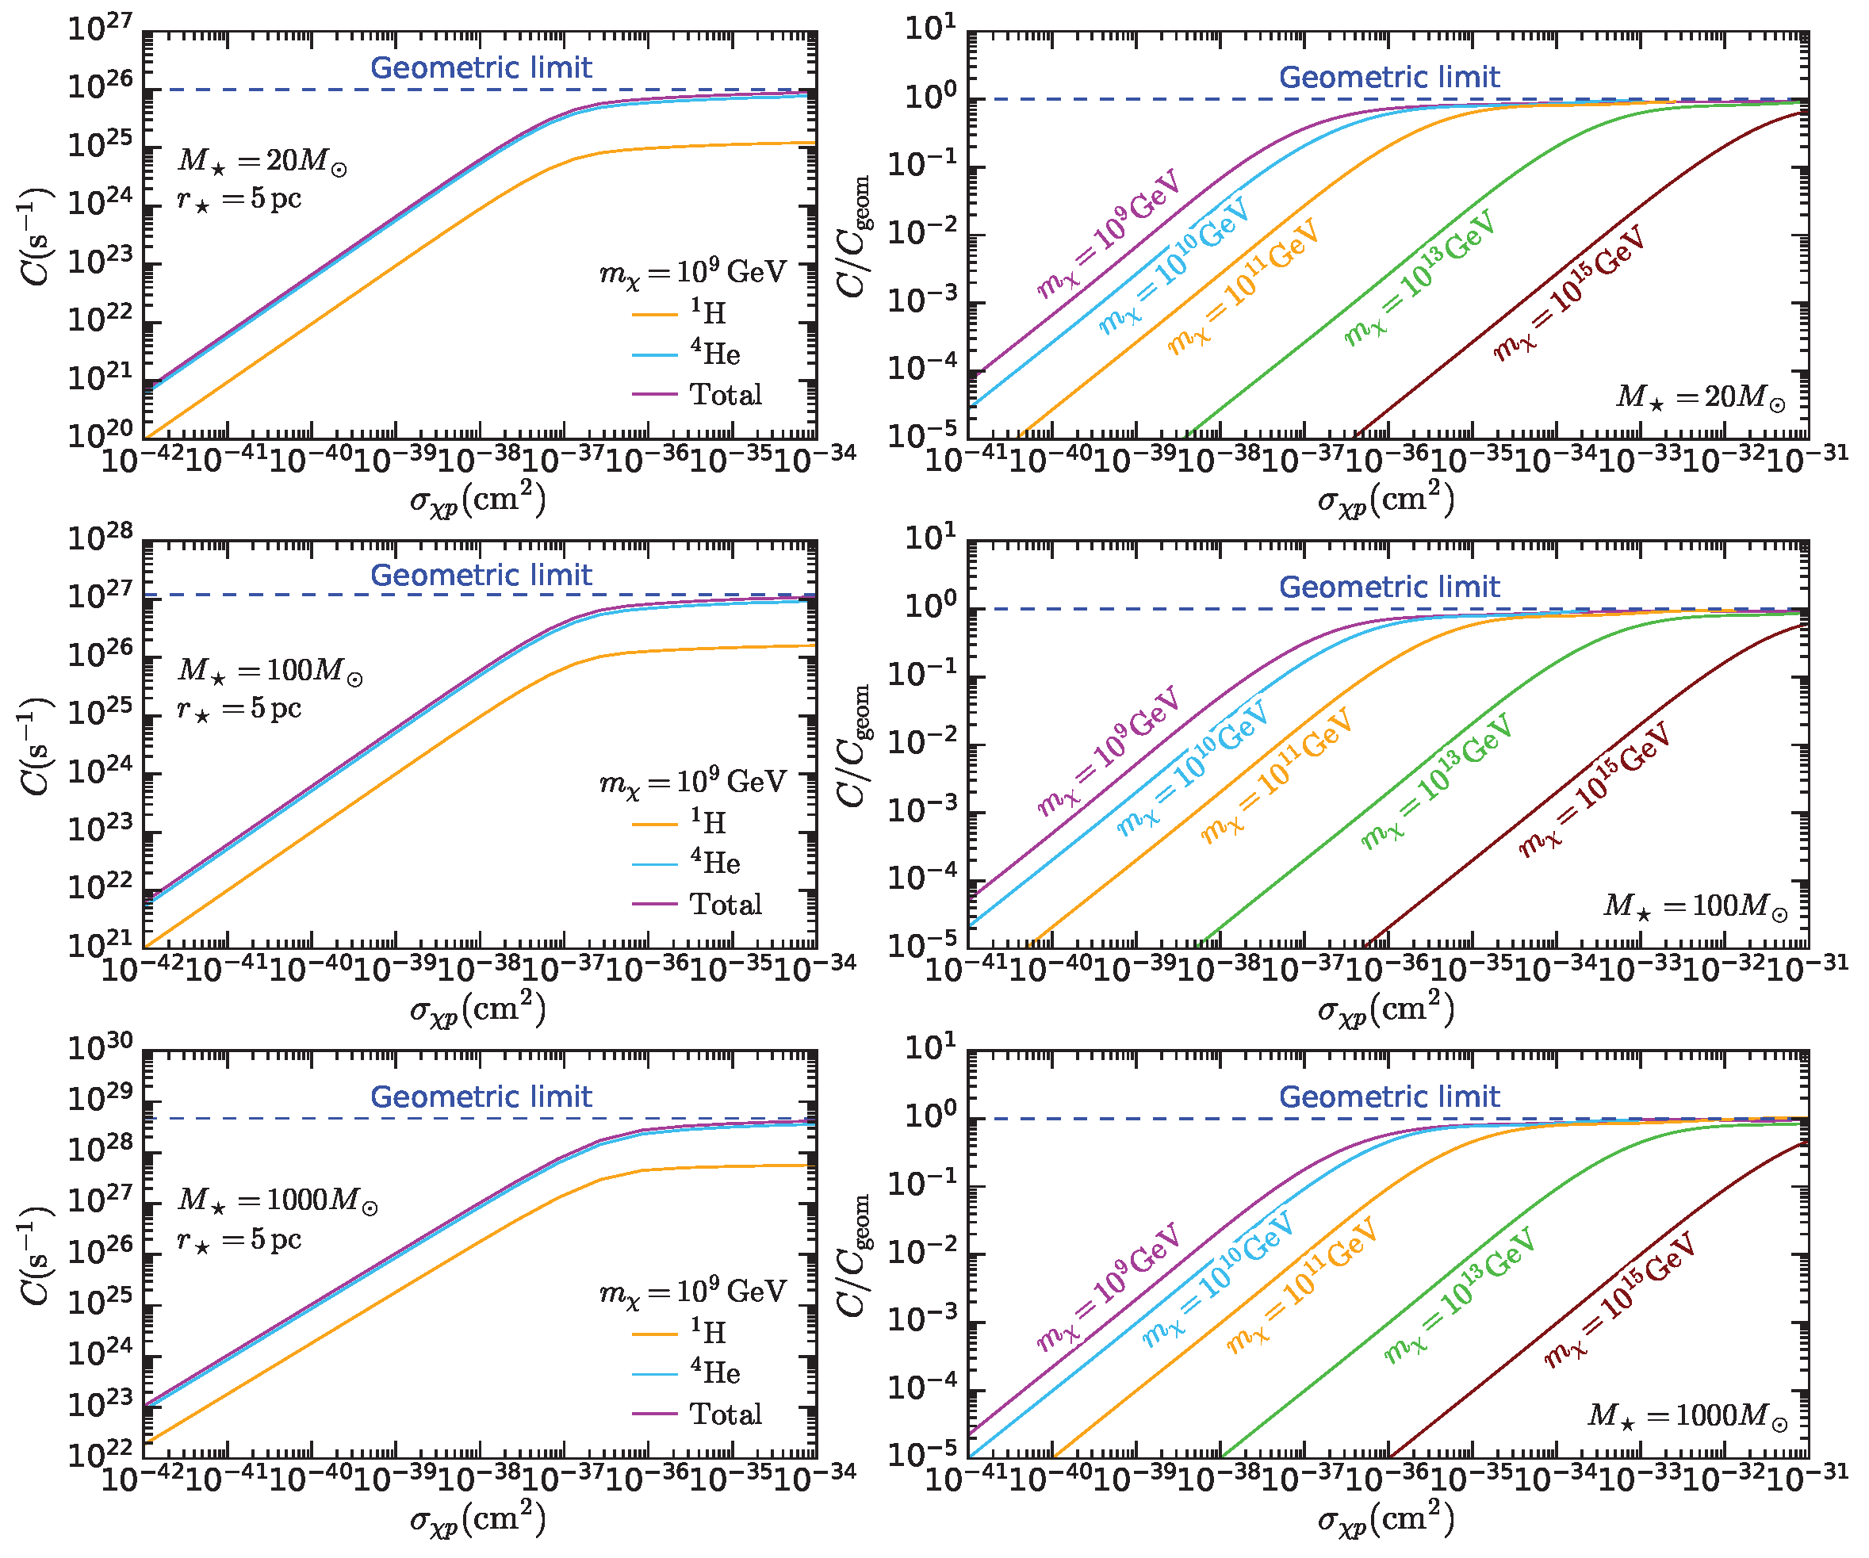
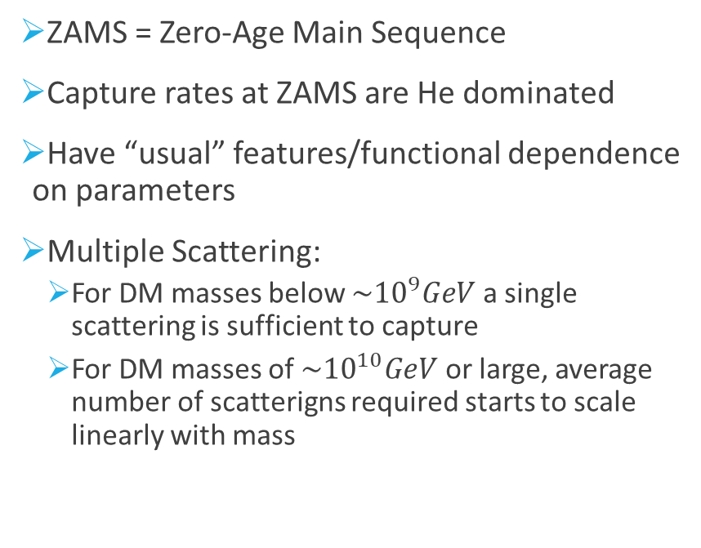
Results - ZAMS
ZAMS = Zero-Age Main Sequence
Capture rates at ZAMS are He dominated
Have “usual” features/functional dependence on parameters
Multiple Scattering:
  For DM masses below $\sim {10}^{9}GeV$ a single scattering is sufficient to capture
  For DM masses of $\sim {10}^{10}GeV$ or large, average number of scatterigns required starts to scale linearly with mass

Slide 18
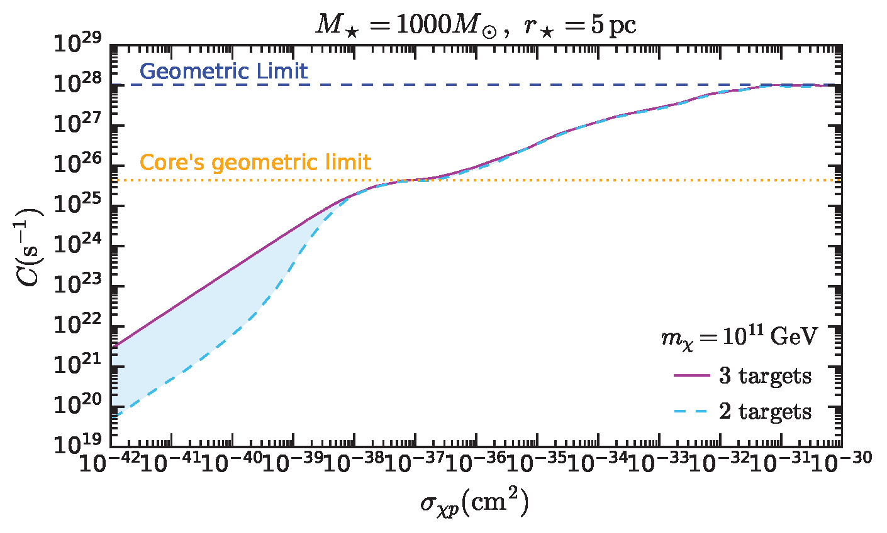
Results – Late phase
Considers scattering with three targets: O, Ne, He (or H in atmosphere)
Capture rate shows two saturation stages
  First saturation (~10⁻³⁷ cm²):
    Set by core geometric limit
    Core acts as a distinct capture region
  Higher cross sections:
    All particles crossing the core are captured
    Rate increases until stellar geometric limit
    Eventually, particles entering the atmosphere are also captured
Dashed line (two-target model):
  Includes only O+Ne (core) and He+H (atmosphere)
  Shows deficit at small cross sections
Three-target effect (shaded region):
  Important for mχ ≳ 10⁹ GeV
  Multiple scatterings become relevant

Slide 19
Non-annihilating DM: collapse
Accumulation of large densities of DM can trigger collapse to BH
Requires:
  Self gravitating condition
  Reaching critical density/DM number
  BH needs to accrete the whole star within the star’s lifetime
Large DM mass means
  Larger density, so more likely to trigger collapse, but
  Means also smaller initial BH, and more time to accrete all matter
More massive stars means
  Larger Capture rate, but
  There is more matter to accrete, so more time is needed, and
  They also have shorter life span
Observation
DATA
HR Diagram
Get age of the star
Constraints
Non-collapse implies constraints on parameter space

Slide 20
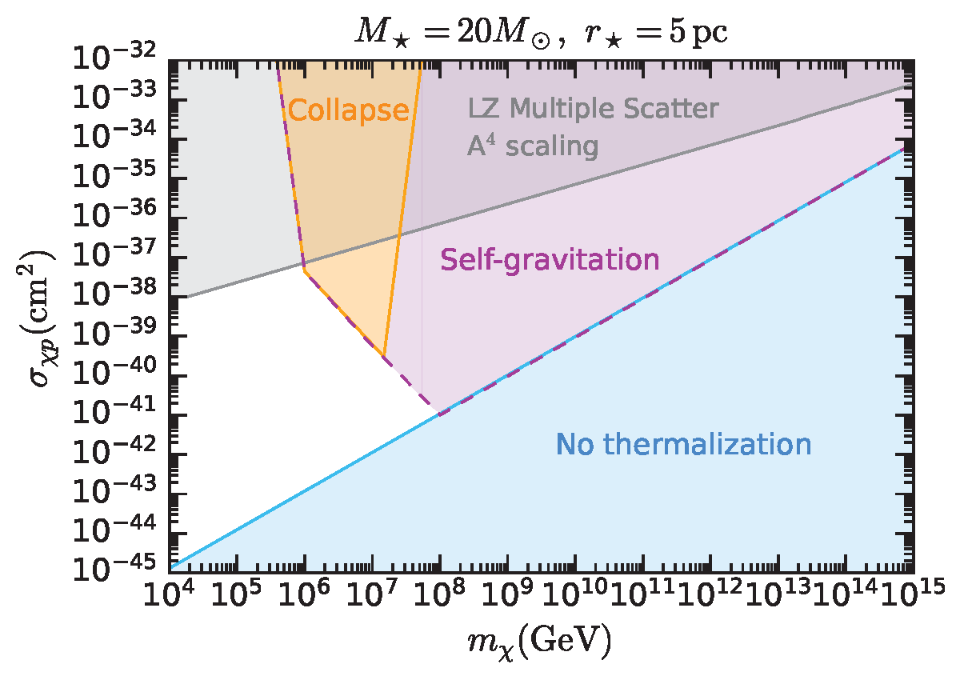
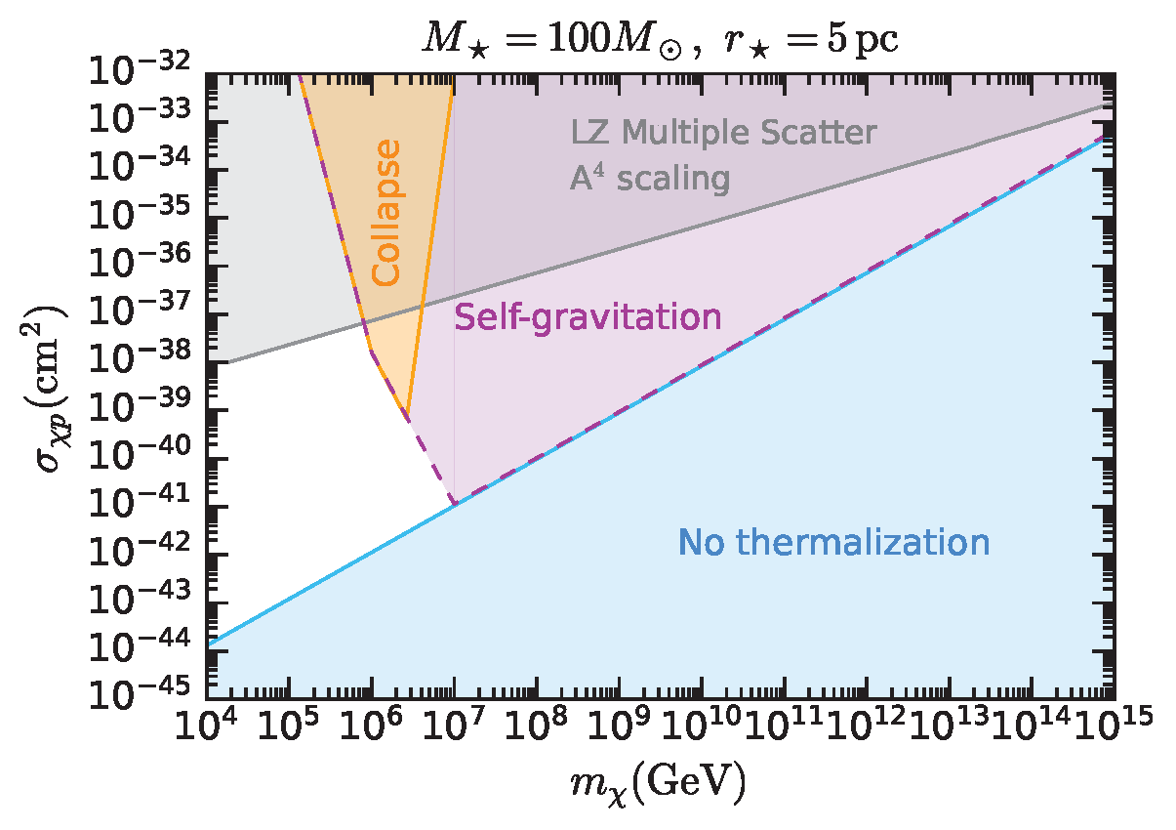
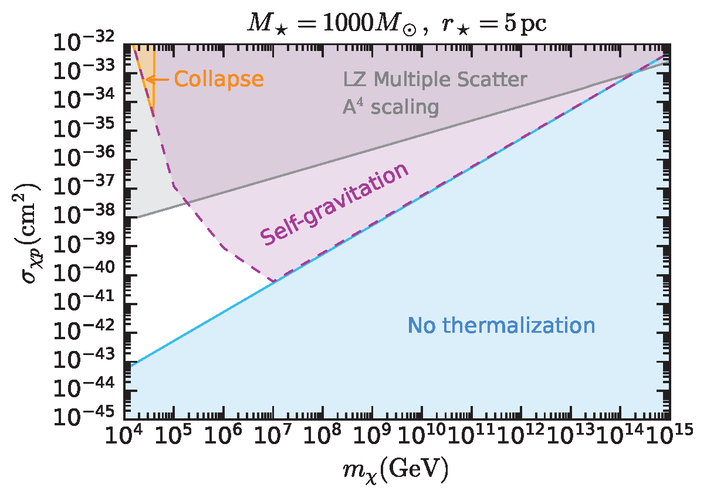
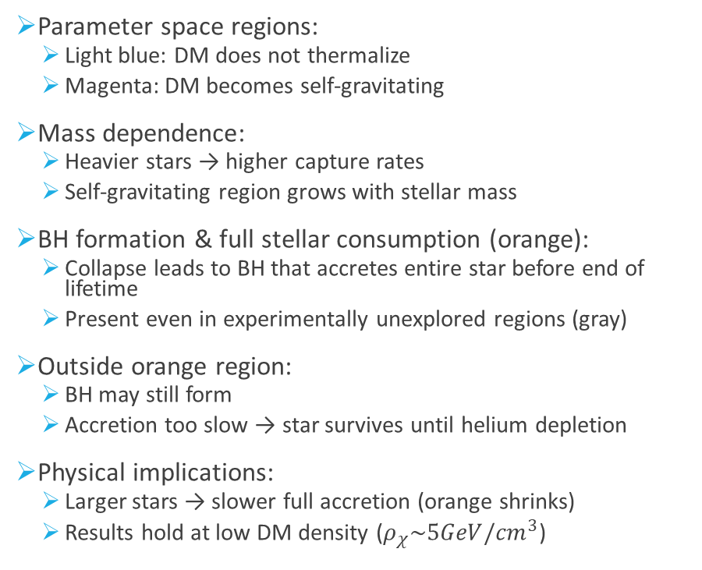
Non-annihilating DM: collapse
Parameter space regions:
  Light blue: DM does not thermalize
  Magenta: DM becomes self-gravitating
Mass dependence:
  Heavier stars → higher capture rates
  Self-gravitating region grows with stellar mass
BH formation & full stellar consumption (orange):
  Collapse leads to BH that accretes entire star before end of lifetime
  Present even in experimentally unexplored regions (gray)
Outside orange region:
  BH may still form
  Accretion too slow → star survives until helium depletion
Physical implications:
  Larger stars → slower full accretion (orange shrinks)
  Results hold at low DM density ($ρ_{χ}\sim 5GeV/{cm}^{3}$)
2512.22727 (JCAP 03 (2026) 059)

Slide 21
Conclusions
We considered Dark Matter Capture in Population III stars
We find that taking into account evolution of the star is important
  Late stage of the star previously not accounted for in literature
Late stage is sensitive to scattering over heavier elements
  We used our Multiple scattering Capture formalism to compute Capture rates
  We showed including 3 targets is essential to get the rates right at small cross section
  The star interestingly shows 2 geometric limits, one for the core and one for the whole star
We found regions of parameter space unconstrained by direct detection where DM could make the star collapse to a Black Hole
  Absence of premature stellar collapse could constrain DM parameter space (e.g. with JWST Pop III observations)

Slide 22
Backup

Slide 23
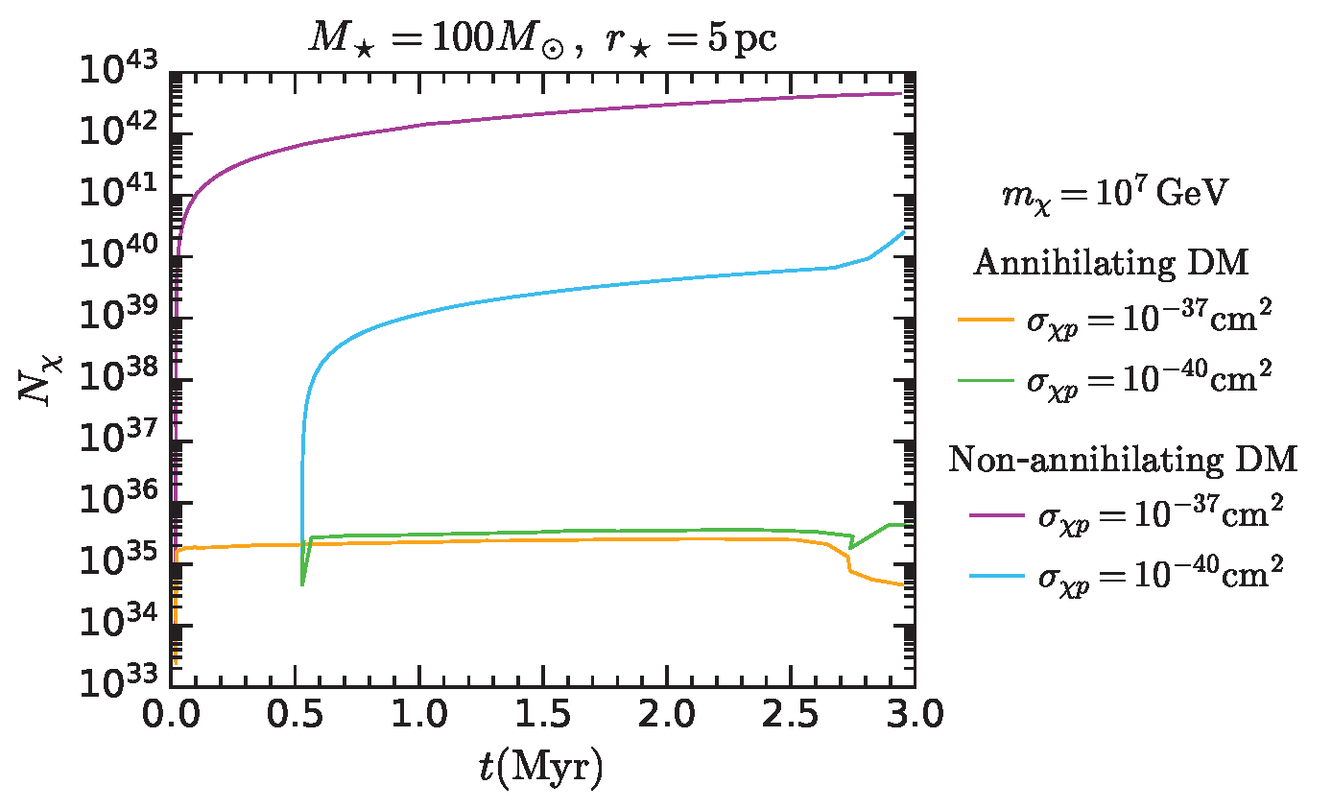
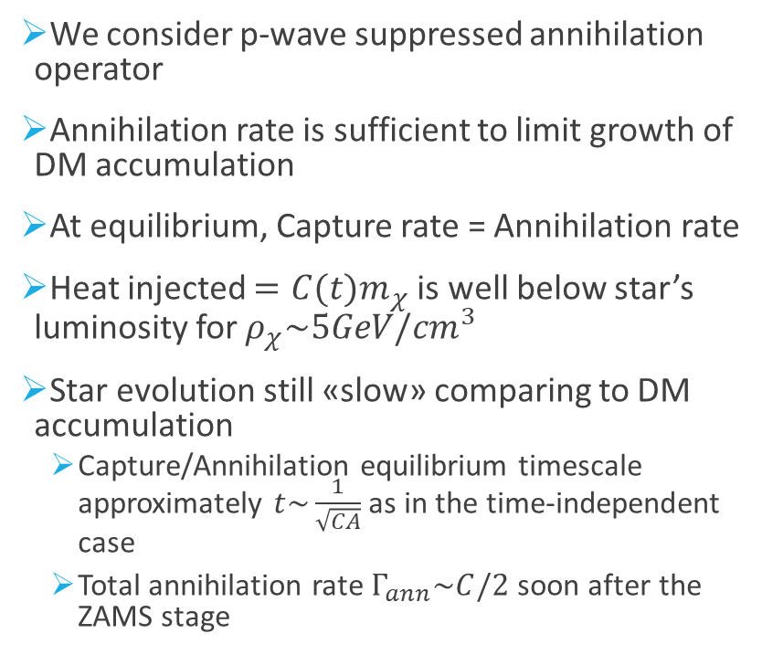
Constraints?
We consider p-wave suppressed annihilation operator
Annihilation rate is sufficient to limit growth of DM accumulation
At equilibrium, Capture rate = Annihilation rate
Heat injected $=C(t)m_{χ}$ is well below star’s luminosity for $ρ_{χ}\sim 5GeV/{cm}^{3}$
Star evolution still «slow» comparing to DM accumulation
  Capture/Annihilation equilibrium timescale approximately $t\sim \frac{1}{\sqrt{CA}}$ as in the time-independent case
  Total annihilation rate $Γ_{ann}\sim C/2$ soon after the ZAMS stage

Slide 24
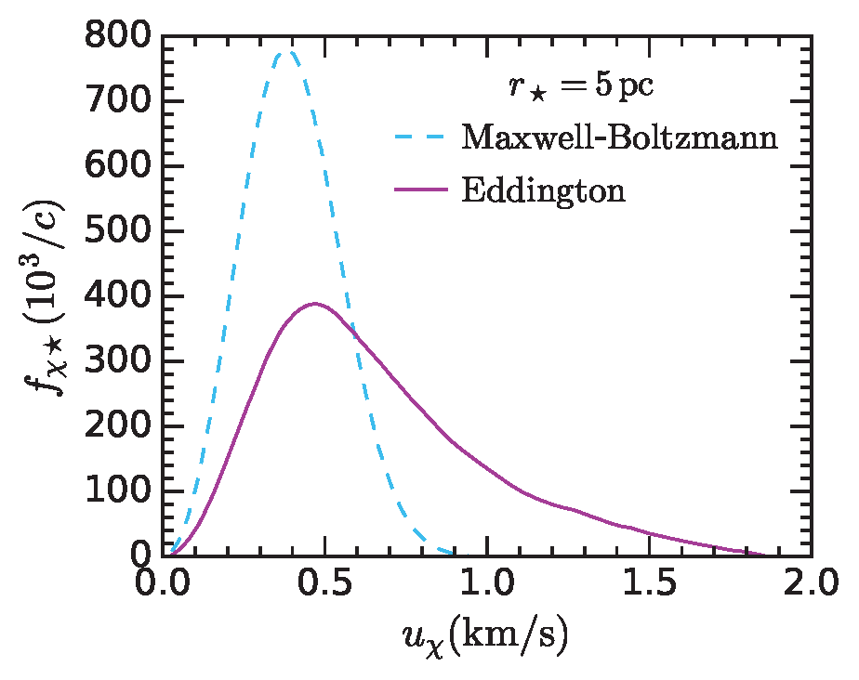
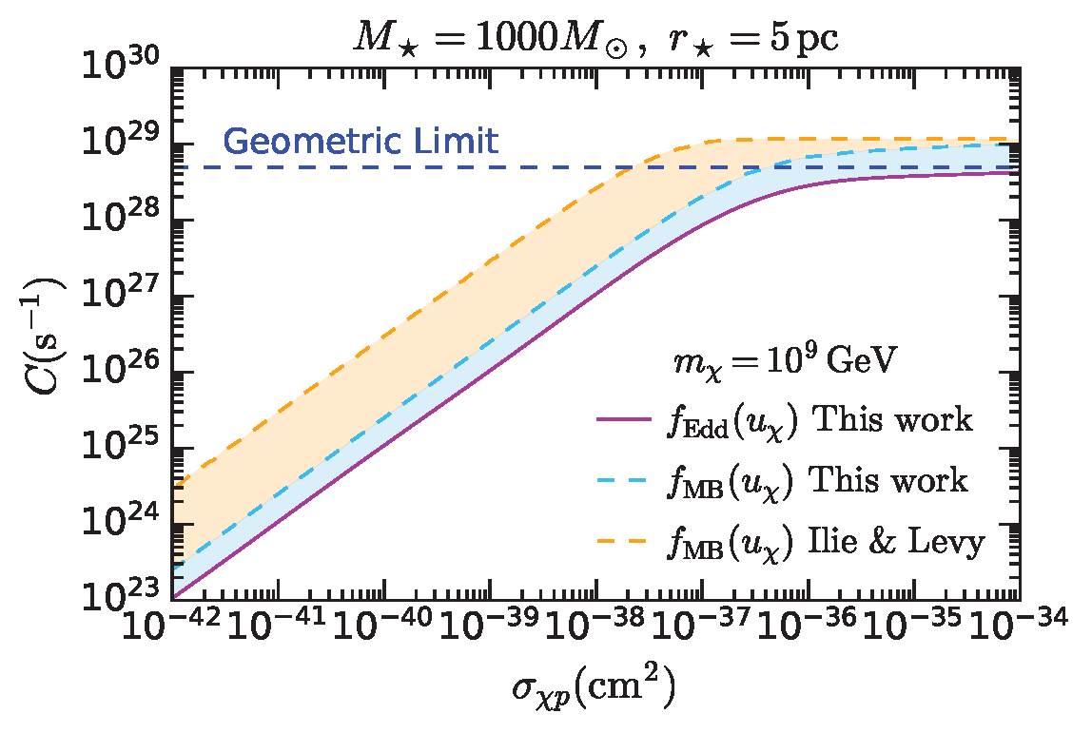
Dark Matter velocity distribution

Slide 25



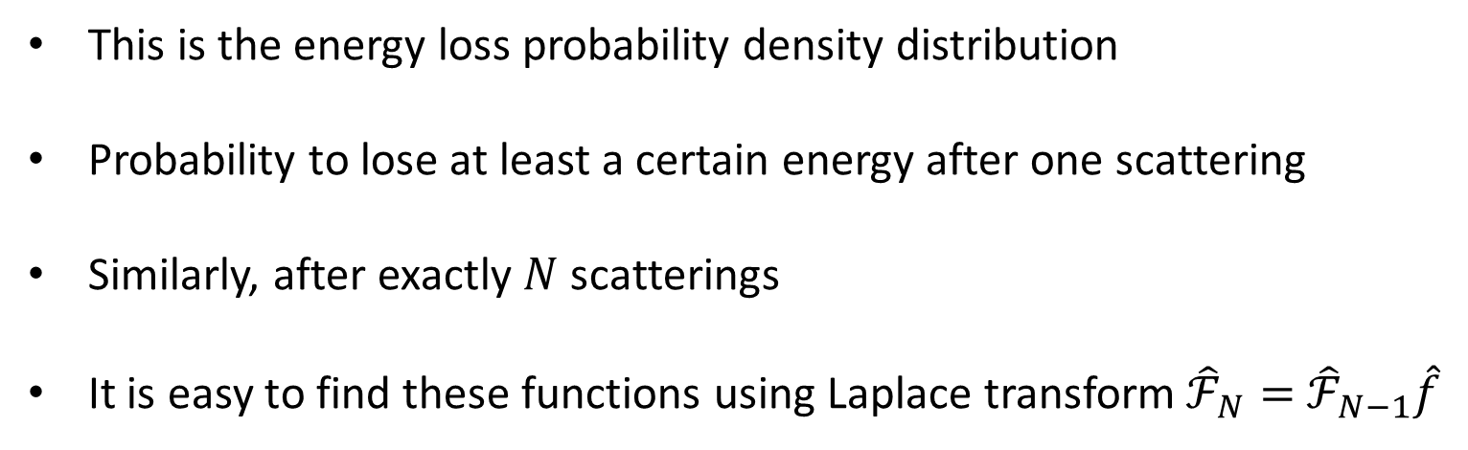
CAPTURE by multiple scattering
This is the energy loss probability density distribution
Probability to lose at least a certain energy after one scattering
Similarly, after exactly $N$ scatterings
It is easy to find these functions using Laplace transform ${\hat{ℱ}}_{N}=$ ${\hat{ℱ}}_{N−1}\hat{f}$

Slide 26
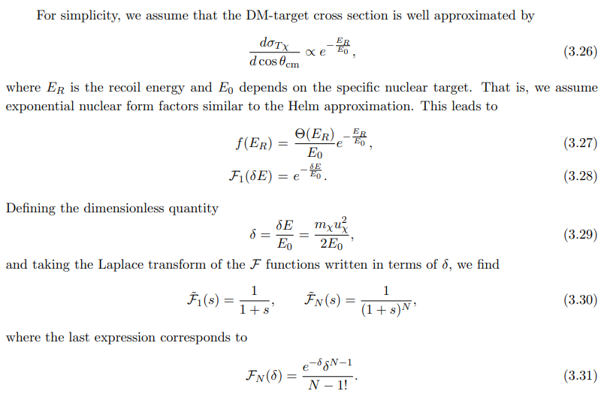
CAPTURE by multiple scattering

Slide 27

CAPTURE by multiple scattering
Probability to have interacted already N times is given by Poisson distribution
Therefore the single scattering Capture rate can be written as
The Capture rate for exactly N scatterings can be obtained as

Slide 28
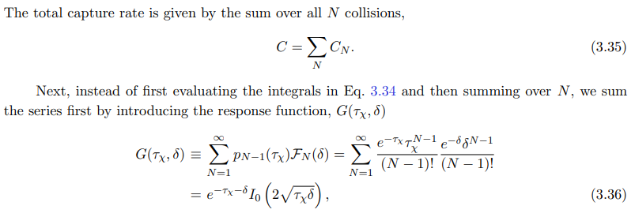

CAPTURE by multiple scattering
The resulting total Capture rate is

Slide 29
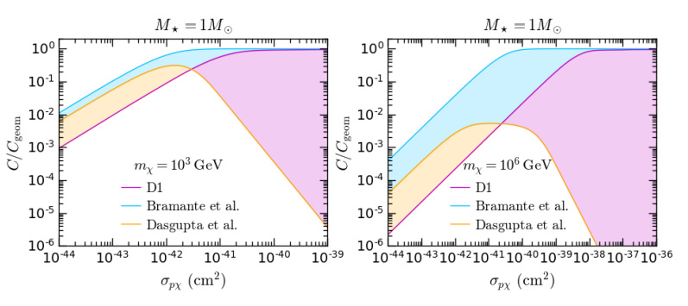
CAPTURE rate

Slide 30
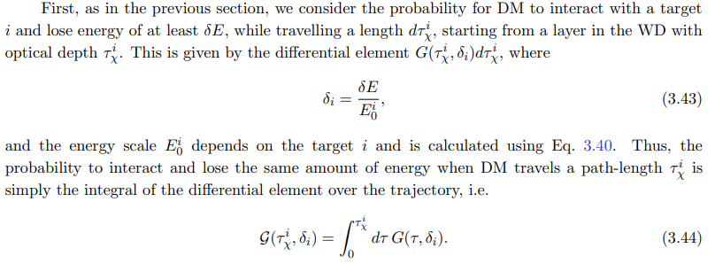
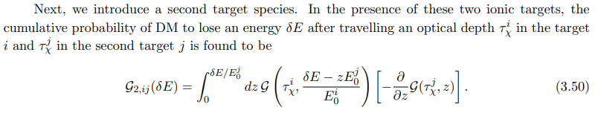
Multiple targets
Can expand the formalism to include multiple types of targets

Slide 31
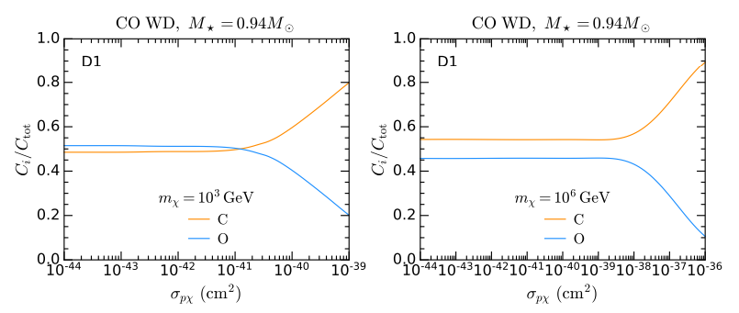
Multiple targets

