Slide 1


XIX International Conference on Interconnections between Particle Physics and Cosmology
Signatures of gravity-mediated dark matter interaction
in theories with large extra dimensions
A. Clarke, V. V. Flambaum, M. Pospelov and I. B. Samsonov
Based on arXiv: 2606.23178 [hep-ph]
Notes:
[Sources]
- Attached paper: Gravity_mediated_DM_direct_detection.pdf
[/Sources]

Slide 2

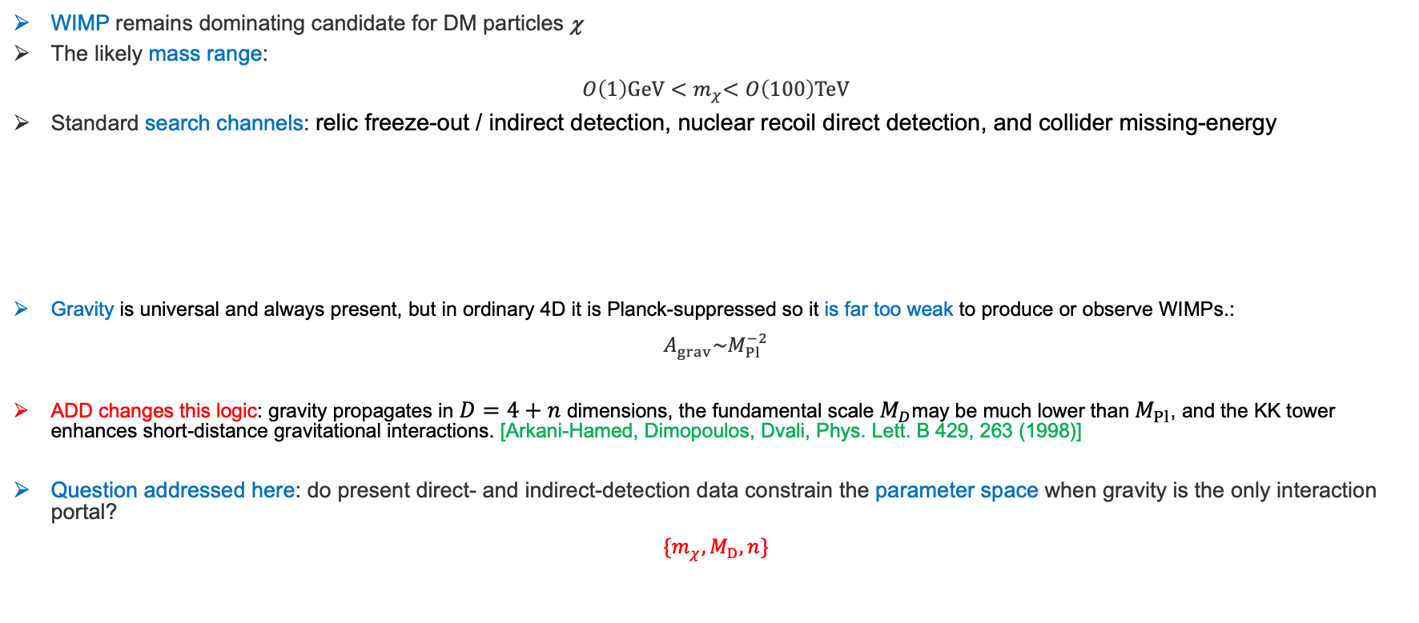




Motivations and Background
WIMP remains dominating candidate for DM particles χ
The likely mass range:
$$O\left(1\right)GeV{<m}_{χ}<O\left(100\right)TeV$$
Standard search channels: relic freeze-out / indirect detection, nuclear recoil direct detection, and collider missing-energy
Gravity is universal and always present, but in ordinary 4D it is Planck-suppressed so it is far too weak to produce or observe WIMPs.:
$$A_{grav}\sim M_{Pl}^{−2}$$
ADD changes this logic: gravity propagates in $D=4+n$ dimensions, the fundamental scale $M_{D}$may be much lower than $M_{Pl}$, and the KK tower enhances short-distance gravitational interactions. [Arkani-Hamed, Dimopoulos, Dvali, Phys. Lett. B 429, 263 (1998)]
Question addressed here: do present direct- and indirect-detection data constrain the parameter space when gravity is the only interaction portal?
$$\{m_{χ},M_{D},n\}$$
$$χ$$
$$χ$$
$$χ$$
SM
$$χ$$
SM
$$χ$$
SM
N
$$χ$$
N
SM
Assumptions
χ is stable, localized on the brane, and saturates the dark-matter abundance.
The direct-detection analysis allows χ to be elementary or sufficiently compact and composite; the indirect analysis is specialised to elementary scalar χ.

Slide 3
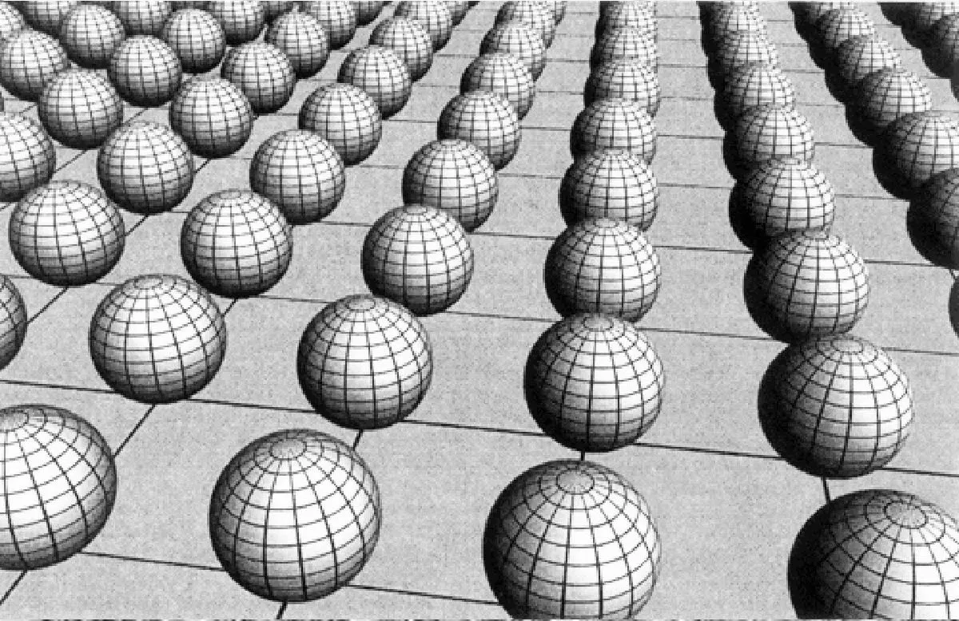
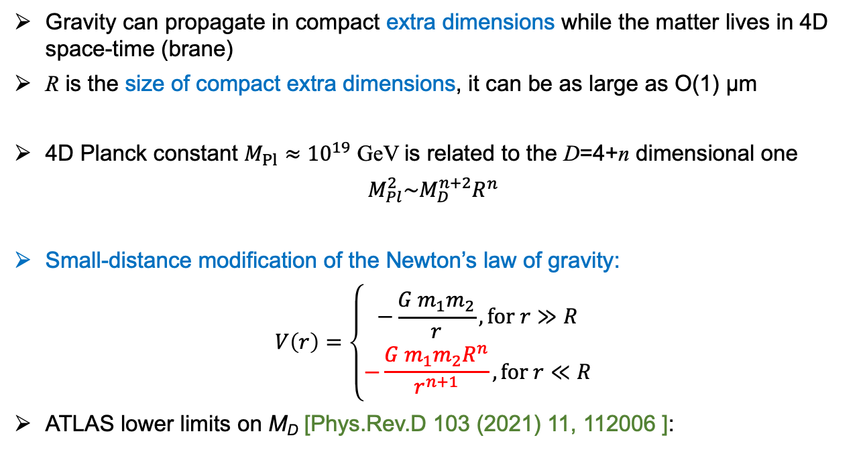
Arkani-Hamed–Dimopoulos–Dvali (ADD) model
Phys. Lett. B 429, 263 (1998)
Gravity can propagate in compact extra dimensions while the matter lives in 4D space-time (brane)
R is the size of compact extra dimensions, it can be as large as O(1) μm
4D Planck constant $M_{Pl}≈{10}^{19}$ GeV is related to the D=4+n dimensional one
$$M_{Pl}^{2}\sim M_{D}^{n+2}R^{n}$$
Small-distance modification of the Newton’s law of gravity:
$$V\left(r\right)=\left\{\begin{matrix}−\frac{G m_{1}m_{2}}{r}, for r≫R \\ −\frac{G m_{1}m_{2}R^{n}}{r^{n+1}}, for r≪R\end{matrix}\right.$$
ATLAS lower limits on M_{D} [Phys.Rev.D 103 (2021) 11, 112006 ]:
R
n | 2 | 3 | 4 | 5 | 6
M_{D} [TeV] | 11.6 | 8.6 | 7.2 | 6.4 | 5.9

Slide 4
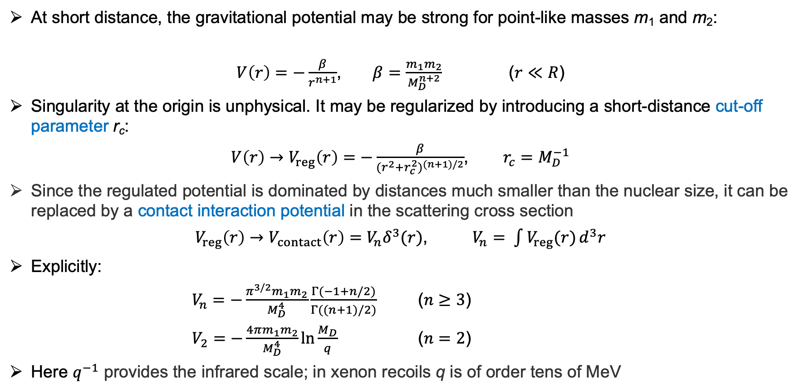
Effective short-distance interaction
At short distance, the gravitational potential may be strong for point-like masses m₁ and m₂:
$V\left(r\right)=−\frac{β}{r^{n+1}}$, $β=\frac{m_{1}m_{2}}{M_{D}^{n+2}}$ ($r≪R$)
Singularity at the origin is unphysical. It may be regularized by introducing a short-distance cut-off parameter r_{c}:
$V\left(r\right)→V_{reg}\left(r\right)=−\frac{β}{{(r^{2}+r_{c}^{2})}^{(n+1)/2}}$, $r_{c}=M_{D}^{−1}$
Since the regulated potential is dominated by distances much smaller than the nuclear size, it can be replaced by a contact interaction potential in the scattering cross section
$V_{reg}\left(r\right)→V_{contact}\left(r\right)=V_{n}δ^{3}(r)$, $V_{n}= \int{V_{reg}(r)}d^{3}r$
Explicitly:
$V_{n}=−\frac{π^{3/2}m_{1}m_{2}}{M_{D}^{4}}\frac{Γ(−1+n/2)}{Γ((n+1)/2)}$ ($n≥3$)
$V_{2}=−\frac{4πm_{1}m_{2}}{M_{D}^{4}}ln⁡\frac{M_{D}}{q}$ ($n=2$)
Here $q^{−1}$ provides the infrared scale; in xenon recoils q is of order tens of MeV

Slide 5
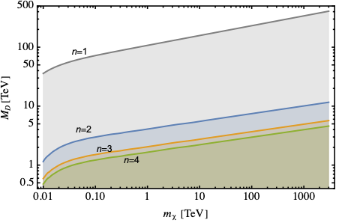
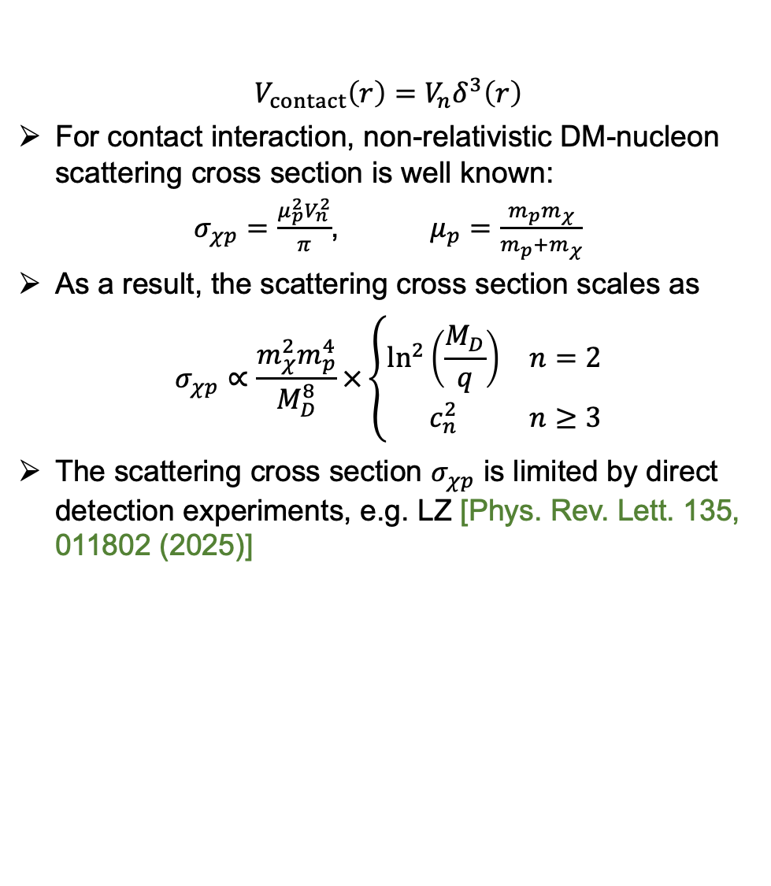
DM-nucleon scattering cross section
$$V_{contact}\left(r\right)=V_{n}δ^{3}\left(r\right)$$
For contact interaction, non-relativistic DM-nucleon scattering cross section is well known:
$σ_{χp}=\frac{μ_{p}^{2}V_{n}^{2}}{π}$, $μ_{p}=\frac{m_{p}m_{χ}}{m_{p}+m_{χ}}$
As a result, the scattering cross section scales as
$$σ_{χp}∝\frac{m_{χ}^{2}m_{p}^{4}}{M_{D}^{8}}×\left\{\begin{matrix}\ln^{2}\left(\frac{M_{D}}{q}\right) & n=2 \\ c_{n}^{2} & n≥3\end{matrix}\right.$$
The scattering cross section $σ_{χp}$ is limited by direct detection experiments, e.g. LZ [Phys. Rev. Lett. 135, 011802 (2025)]
Notes:
Lower limits on M* obtained from the LZ spin-independent scattering bound.
Mass range shown in the paper: approximately 10 GeV to 1 PeV, with extrapolation above the published 10 TeV range.
The strongest sensitivity is obtained for n = 2.
At mχ = 10 TeV: M* > 5.5, 2.7, 2.2, 1.9 and 1.8 TeV for n = 2, 3, 4, 5 and 6.
For n = 2, direct detection becomes competitive with the quoted ATLAS limit only at very large mχ, around the sub-PeV to PeV regime.

Slide 6
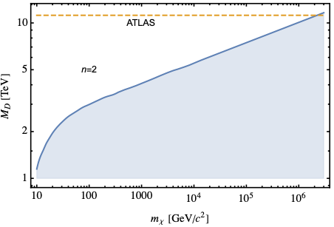
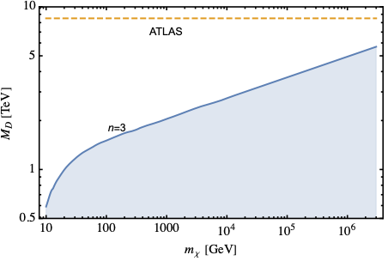
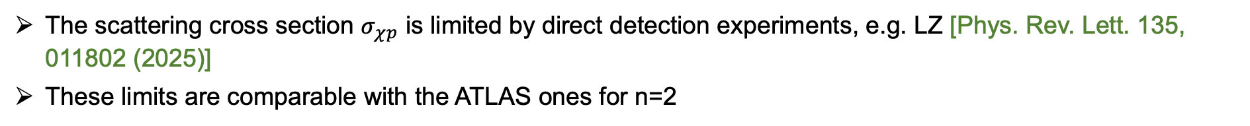
Limits from LZ experiment
The scattering cross section $σ_{χp}$ is limited by direct detection experiments, e.g. LZ [Phys. Rev. Lett. 135, 011802 (2025)]
These limits are comparable with the ATLAS ones for n=2
n=2
n=3

Slide 7
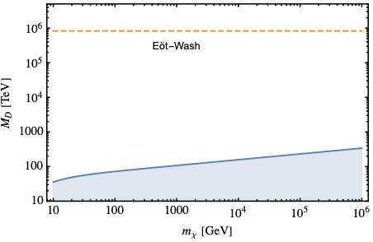
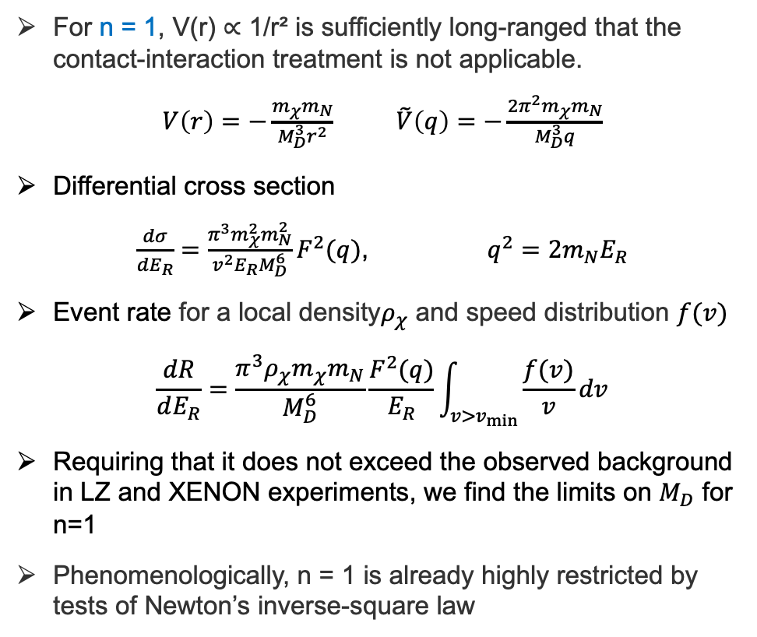
Special case: n=1 (one extra dimension)
For n = 1, V(r) ∝ 1/r² is sufficiently long-ranged that the contact-interaction treatment is not applicable.
$V\left(r\right)=−\frac{m_{χ}m_{N}}{M_{D}^{3}r^{2}}$ $\tilde{V}\left(q\right)=−\frac{2π^{2}m_{χ}m_{N}}{M_{D}^{3}q}$
Differential cross section
$\frac{dσ}{dE_{R}}=\frac{π^{3}m_{χ}^{2}m_{N}^{2}}{v^{2}E_{R}M_{D}^{6}}F^{2}(q)$, $q^{2}=2m_{N}E_{R}$
Event rate for a local density$ρ_{χ}$ and speed distribution $f(v)$
$$\frac{dR}{dE_{R}}=\frac{π^{3}ρ_{χ}m_{χ}m_{N}}{M_{D}^{6}}\frac{F^{2}(q)}{E_{R}}\int_{v>v_{min}}{\frac{f(v)}{v}dv}$$
Requiring that it does not exceed the observed background in LZ and XENON experiments, we find the limits on $M_{D}$ for n=1
Phenomenologically, n = 1 is already highly restricted by tests of Newton’s inverse-square law
n=1

Slide 8
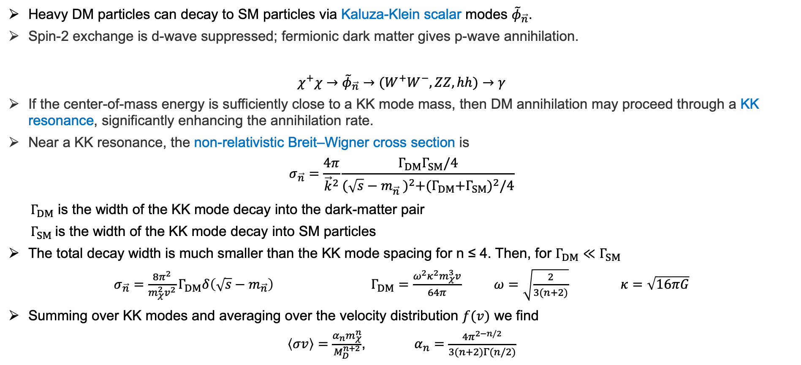
Resonant annihilation through scalar KK modes
Heavy DM particles can decay to SM particles via Kaluza-Klein scalar modes ${\tilde{φ}}_{\vec{n}}$.
Spin-2 exchange is d-wave suppressed; fermionic dark matter gives p-wave annihilation.
$$χ^{+}χ→{\tilde{φ}}_{\vec{n}}→(W^{+}W^{−},ZZ,hh)→γ$$
If the center-of-mass energy is sufficiently close to a KK mode mass, then DM annihilation may proceed through a KK resonance, significantly enhancing the annihilation rate.
Near a KK resonance, the non-relativistic Breit–Wigner cross section is
$$σ_{\vec{n}}=\frac{4π}{{\vec{k}}^{2}}\frac{Γ_{DM}Γ_{SM}/4}{{(\sqrt{s}−m_{\vec{n}}^{})}^{2}+{(Γ_{DM}{+Γ}_{SM})}^{2}/4}$$
$Γ_{DM}$ is the width of the KK mode decay into the dark-matter pair
$Γ_{SM}$is the width of the KK mode decay into SM particles
The total decay width is much smaller than the KK mode spacing for n ≤ 4. Then, for $Γ_{DM}{≪Γ}_{SM}$
$σ_{\vec{n}}=\frac{8π^{2}}{m_{χ}^{2}v^{2}}Γ_{DM}δ\left(\sqrt{s}−m_{\vec{n}}\right)$ $Γ_{DM}=\frac{ω^{2}κ^{2}m_{χ}^{3}v}{64π}$ $ω=\sqrt{\frac{2}{3(n+2)}}$ $κ=\sqrt{16πG}$
Summing over KK modes and averaging over the velocity distribution $f(v)$ we find
$\left\langle σv\right\rangle =\frac{α_{n}m_{χ}^{n}}{M_{D}^{n+2}}$, $α_{n}=\frac{4π^{2−n/2}}{3(n+2)Γ(n/2)}$

Slide 9
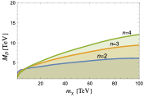
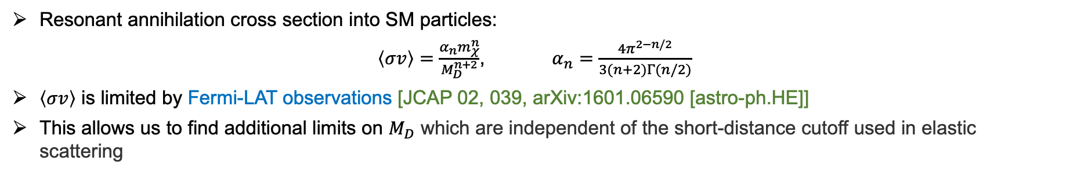
Indirect DM detection sensitivity
Resonant annihilation cross section into SM particles:
$\left\langle σv\right\rangle =\frac{α_{n}m_{χ}^{n}}{M_{D}^{n+2}}$, $α_{n}=\frac{4π^{2−n/2}}{3(n+2)Γ(n/2)}$
$\left\langle σv\right\rangle$ is limited by Fermi-LAT observations [JCAP 02, 039, arXiv:1601.06590 [astro-ph.HE]]
This allows us to find additional limits on $M_{D}$ which are independent of the short-distance cutoff used in elastic scattering

Slide 10
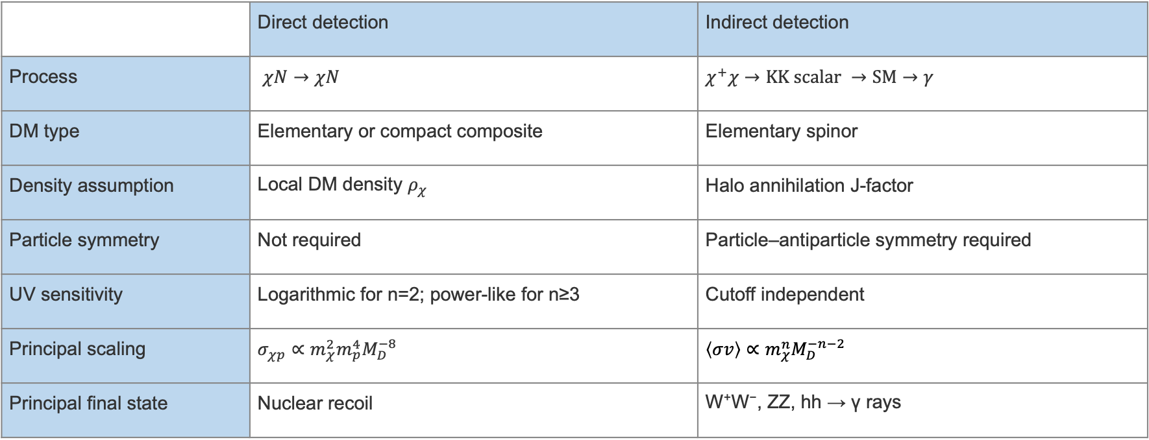
Direct vs indirect probes: different assumptions
 | Direct detection | Indirect detection
Process | $χN→χN$ | $$χ^{+}χ→KK scalar →SM→γ$$
DM type | Elementary or compact composite | Elementary spinor
Density assumption | Local DM density $ρ_{χ}$ | Halo annihilation J-factor
Particle symmetry | Not required | Particle–antiparticle symmetry required
UV sensitivity | Logarithmic for n=2; power-like for n≥3 | Cutoff independent
Principal scaling | $$σ_{χp}∝m_{χ}^{2}{m_{p}^{4}M}_{D}^{−8}$$ | $$\left\langle σv\right\rangle ∝m_{χ}^{n}M_{D}^{−n−2}$$
Principal final state | Nuclear recoil | W⁺W⁻, ZZ, hh → γ rays
The two constraints should not be combined without specifying a particle model and a cosmological history. Their value is complementarity: they interrogate the same ADD scale through independent observables.
Notes:
[Sources]
- Attached paper: Gravity_mediated_DM_direct_detection.pdf
[/Sources]

Slide 11
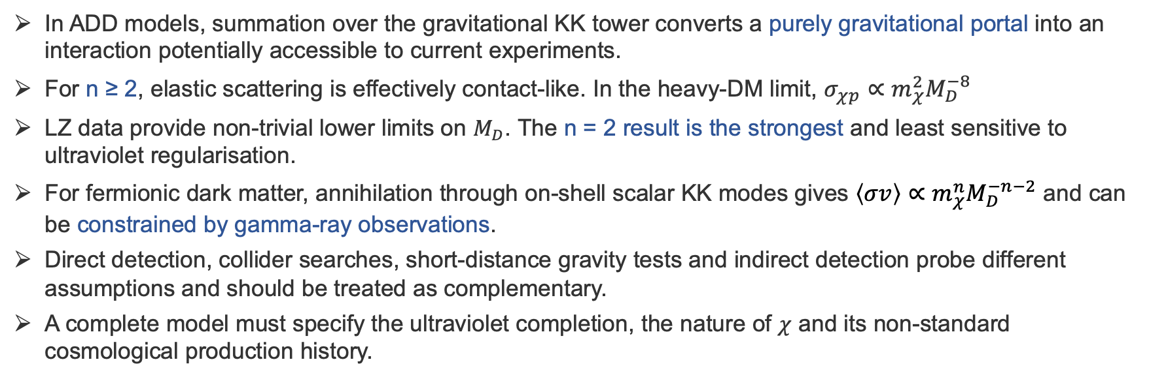
Conclusions
In ADD models, summation over the gravitational KK tower converts a purely gravitational portal into an interaction potentially accessible to current experiments.
For n ≥ 2, elastic scattering is effectively contact-like. In the heavy-DM limit, $σ_{χp}∝m_{χ}^{2}M_{D}^{−8}$
LZ data provide non-trivial lower limits on $M_{D}$. The n = 2 result is the strongest and least sensitive to ultraviolet regularisation.
For fermionic dark matter, annihilation through on-shell scalar KK modes gives $\left\langle σv\right\rangle ∝m_{χ}^{n}M_{D}^{−n−2}$ and can be constrained by gamma-ray observations.
Direct detection, collider searches, short-distance gravity tests and indirect detection probe different assumptions and should be treated as complementary.
A complete model must specify the ultraviolet completion, the nature of $χ$ and its non-standard cosmological production history.
Large extra dimensions can make gravity-mediated heavy DM experimentally testable!
Notes:
[Sources]
- Attached paper: Gravity_mediated_DM_direct_detection.pdf
[/Sources]

Slide 12
Cosmological interpretation and limitations
The analysis constrains interactions of an assumed dark-matter population; it does not provide a production mechanism for the observed abundance.
A conventional high-temperature thermal history is problematic in ADD models because excessive production of KK modes requires a low normalcy or reheating temperature, typically well below the electroweak scale.
Standard WIMP freeze-out at Tf.o. ≃ 0.05mχ is therefore not generically available for weak-scale or heavier χ in the minimal ADD cosmology.
Non-thermal production remains possible, for example through the decay of a sufficiently massive but weakly coupled inflaton.
For mχ > M*, an elementary-particle interpretation is not appropriate. Direct-detection limits may still be applied to compact composite χ provided its size is smaller than q⁻¹.
For n ≥ 3, a UV-complete construction is required to determine the order-one relation between the short-distance cutoff and M*.
Notes:
[Sources]
- Attached paper: Gravity_mediated_DM_direct_detection.pdf
- https://arxiv.org/abs/hep-ph/9807344
- https://arxiv.org/abs/hep-ph/9903224
- https://arxiv.org/abs/hep-ph/0305010
[/Sources]

