Slide 1
Searching for ultralight dark matter with atomic clocks and cavities
Filzinger, ARC, Jani, Steinel, Giani, Huntemann, Roberts
Phys. Rev. Lett. 134, 031001 (2025)
Ashlee Caddell
The University of Queensland
PPC 2026

Slide 2
Part 1
Part 2
Ultralight DM with electron couplings
Ultralight DM with quadratic couplings

Slide 3
Ultralight dark matter behaves like classical field
Causes variations in fundamental constants
Frequencies of atomic transitions depend on fundamental constants
These frequency changes are measurable

Slide 4

Ultralight dark matter behaves like classical field
Causes variations in fundamental constants
Frequencies of atomic transitions depend on fundamental constants
These frequency changes are measurable

Slide 5
Ultralight dark matter behaves like classical field
Causes variations in fundamental constants
Frequencies of atomic transitions depend on fundamental constants
These frequency changes are measurable

Slide 6

Ultralight dark matter behaves like classical field
Causes variations in fundamental constants
Frequencies of atomic transitions depend on fundamental constants
These frequency changes are measurable

Slide 7

Ultralight dark matter behaves like classical field
Causes variations in fundamental constants
Frequencies of atomic transitions depend on fundamental constants
These frequency changes are measurable
Part 1
Part 2

Slide 8

Ultralight dark matter behaves like classical field
Causes variations in fundamental constants
Frequencies of atomic transitions depend on fundamental constants
These frequency changes are measurable
Frequency variation in the oscillator

Slide 9

Ultralight dark matter behaves like classical field
Causes variations in fundamental constants
Frequencies of atomic transitions depend on fundamental constants
These frequency changes are measurable

Slide 10
Part 1
Ultralight DM with electron couplings
Filzinger, ARC, Jani, Steinel, Giani, Huntemann, Roberts, Phys. Rev. Lett. 134, 031001 (2025)

Slide 11
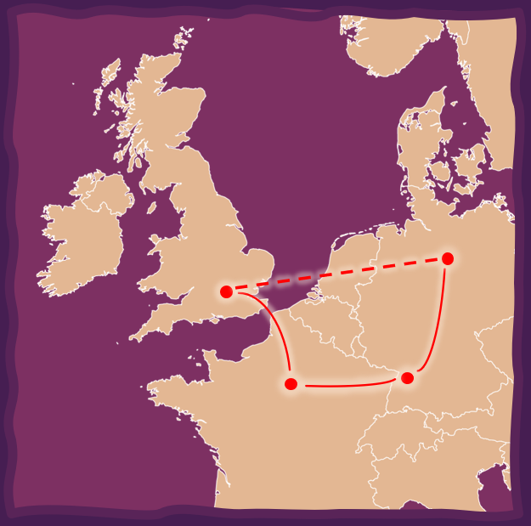
Ultrastable laser cavities
~750 km separation
Very high precision
~11 hours of data
M. Schioppo et al., Nat Commun 13, 212 (2022)

Slide 12
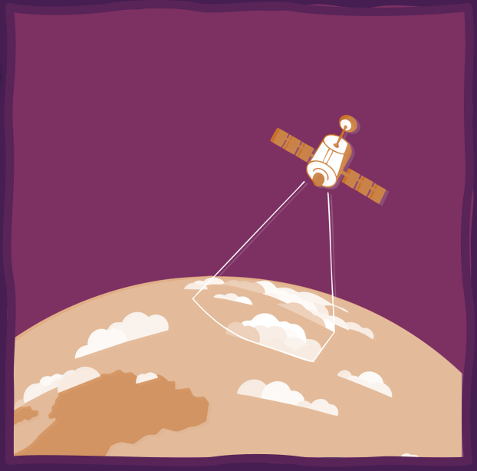
Ultrastable laser cavities
~750 km separation
Very high precision
~11 hours of data
M. Schioppo et al., Nat Commun 13, 212 (2022)
Cs & Rb atomic clocks
~50 000 km separation
Lower precision
Decades of data

Slide 13
Signal comes from separation
Signal strength scales with distance
Can use same types of oscillators
Sensitive to the temporal term
Ultrastable laser cavities
~750 km separation
Very high precision
~11 hours of data
M. Schioppo et al., Nat Commun 13, 212 (2022)
Cs & Rb atomic clocks
~50 000 km separation
Lower precision
Decades of data

Slide 14

Signal comes from separation
Signal strength scales with distance
Can use same types of oscillators
Sensitive to the temporal term
Ultrastable laser cavities
~750 km separation
Very high precision
~11 hours of data
M. Schioppo et al., Nat Commun 13, 212 (2022)
Cs & Rb atomic clocks
~50 000 km separation
Lower precision
Decades of data

Slide 15
Signal comes from separation
Signal strength scales with distance
Can use same types of oscillators
Sensitive to the temporal term
Ultrastable laser cavities
~750 km separation
Very high precision
~11 hours of data
M. Schioppo et al., Nat Commun 13, 212 (2022)
Cs & Rb atomic clocks
~50 000 km separation
Lower precision
Decades of data

Slide 16
Signal comes from separation
Signal strength scales with distance
Can use same types of oscillators
Sensitive to the temporal term
Ultrastable laser cavities
~750 km separation
Very high precision
~11 hours of data
M. Schioppo et al., Nat Commun 13, 212 (2022)
Cs & Rb atomic clocks
~50 000 km separation
Lower precision
Decades of data

Slide 17
Signal comes from separation
Signal strength scales with distance
Can use same types of oscillators
Sensitive to the temporal term
unless…
Ultrastable laser cavities
~750 km separation
Very high precision
~11 hours of data
M. Schioppo et al., Nat Commun 13, 212 (2022)
Cs & Rb atomic clocks
~50 000 km separation
Lower precision
Decades of data

Slide 18
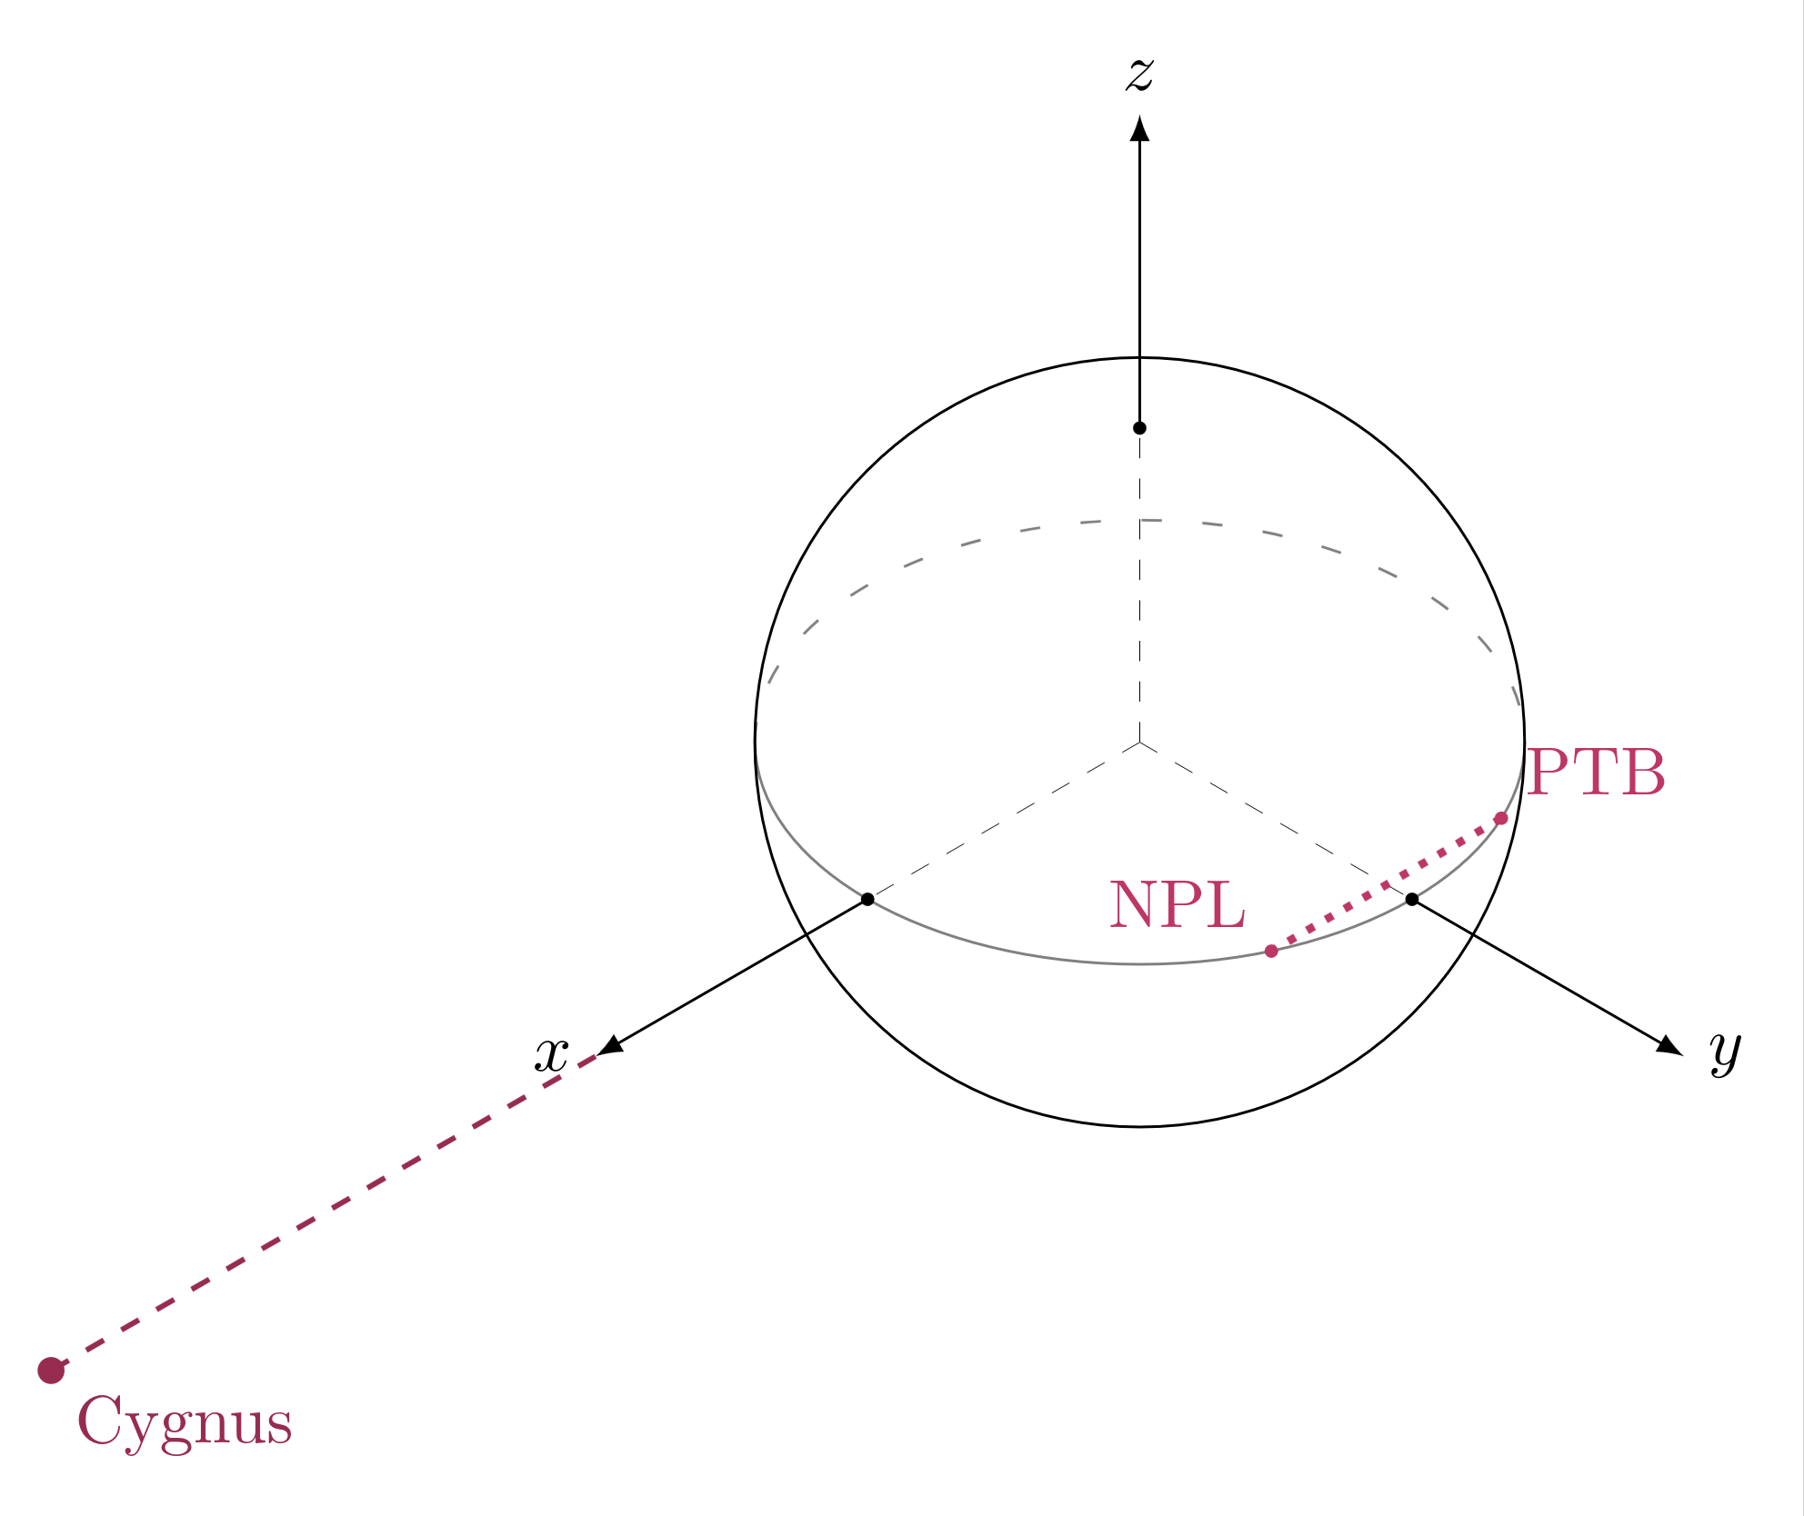
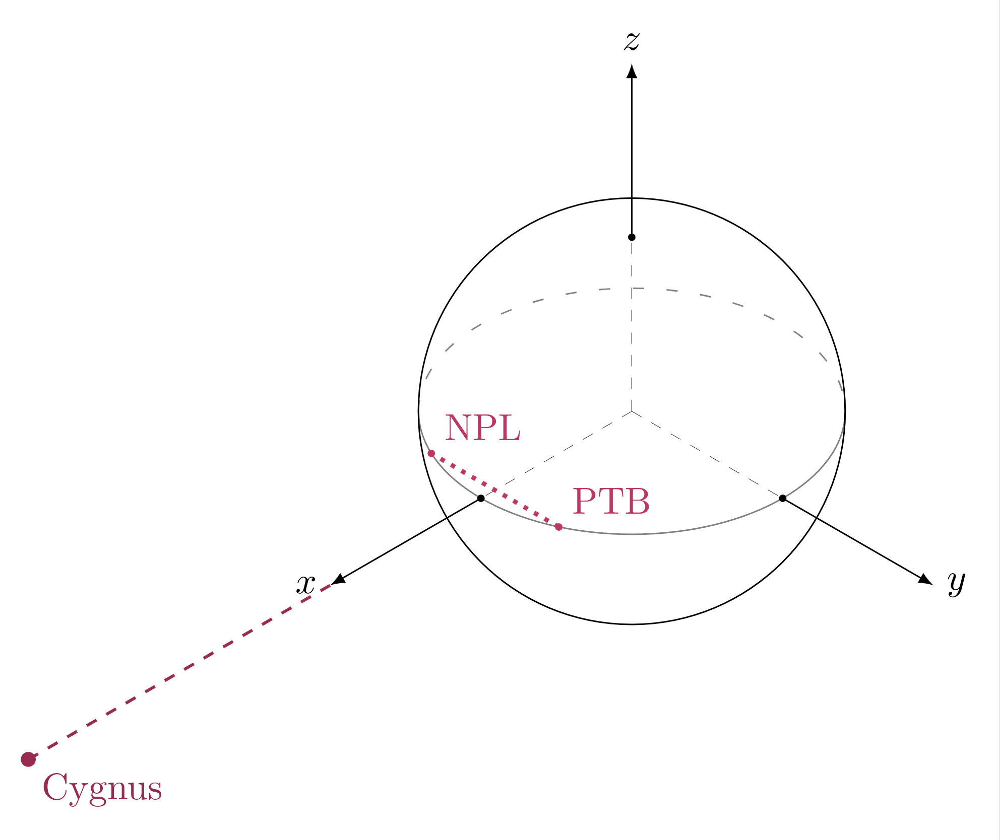
Experiment geometry
Maximum signal
Minimum signal

Slide 19
Experiment geometry
Maximum signal
Minimum signal
DAILY MODULATION!

Slide 20
Daily modulation
Good: New signal to look for, especially with longer data
Bad: Signal risks being lost completely on short time scales

Slide 21
Daily modulation
Step 1 Get Cygnus unit vector in ECI (Earth-Centered Inertial) coords
Step 2 Convert coords of NPL and PTB to ECEF (Earth-Centered Earth-Fixed)
Step 3 Convert ECEF coords to ECI for whole runtime
Step 4 Find NPL-PTB unit vector (just subtract coords and normalise)
Step 5 Dot product of Cygnus unit vector with NPL-PTB unit vector

Slide 22
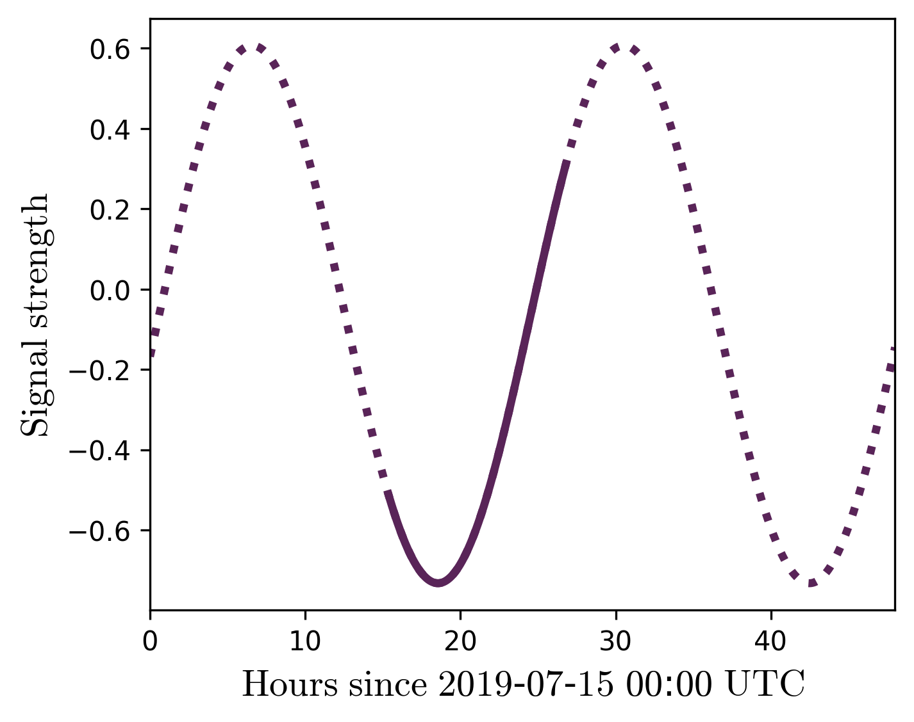
Daily modulation
Not symmetric around zero :)
Step 1 Get Cygnus unit vector in ECI (Earth-Centered Inertial) coords
Step 2 Convert coords of NPL and PTB to ECEF (Earth-Centered Earth-Fixed)
Step 3 Convert ECEF coords to ECI for whole runtime
Step 4 Find NPL-PTB unit vector (just subtract coords and normalise)
Step 5 Dot product of Cygnus unit vector with NPL-PTB unit vector

Slide 23
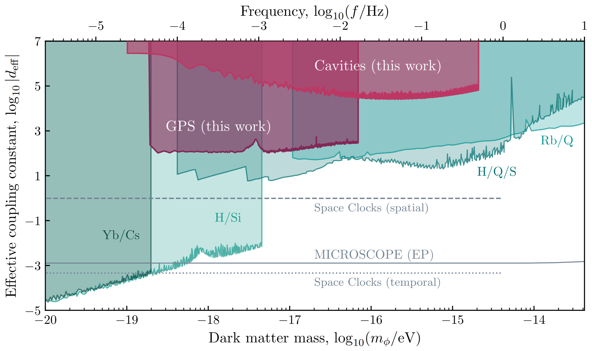
Constraints

Slide 24
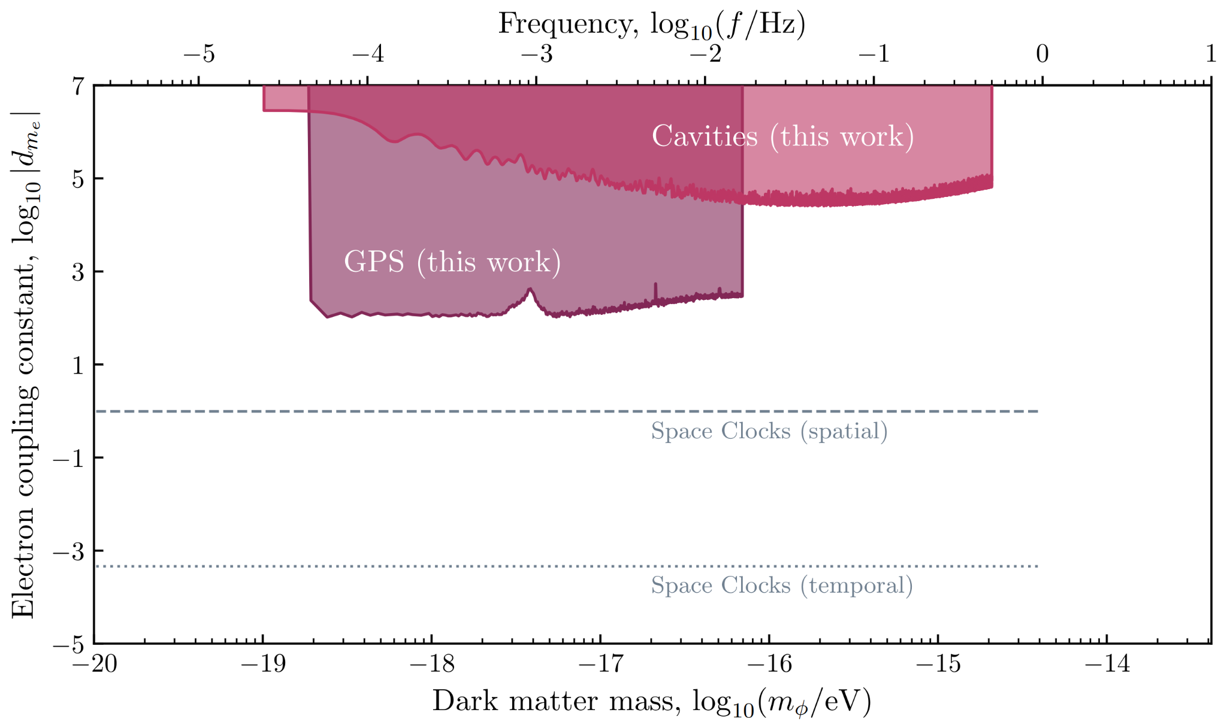
Constraints

Slide 25
Part 2
Ultralight DM with quadratic couplings
ARC, Roberts, in preparation (2026)

Slide 26
Quadratic couplings (are weird)
DM with quadratic couplings is screened by matter

Slide 27
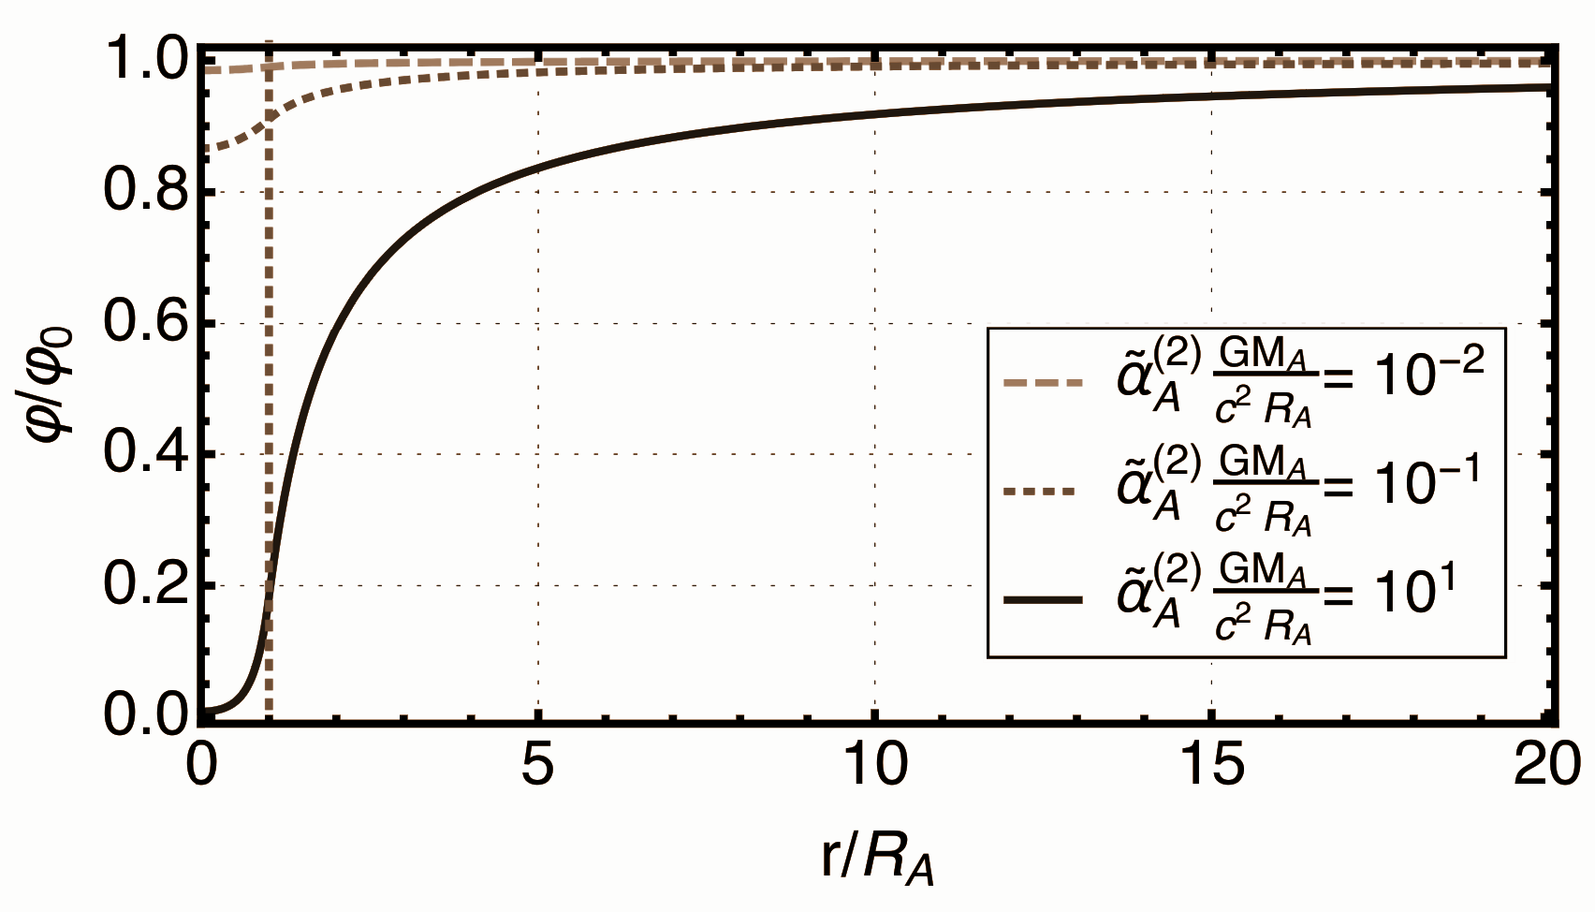
Quadratic couplings (are weird)
DM with quadratic couplings is screened by matter
A. Hees et al., Phys. Rev. D 98, 064051 (2018)

Slide 28
Quadratic couplings (are weird)
DM with quadratic couplings is screened by matter
Explains lack of terrestrial detection so far
A. Hees et al., Phys. Rev. D 98, 064051 (2018)

Slide 29
Two different atomic clocks
Need to use older data
Signal from different sensitivities to α
Atomic clocks on Earth and satellite
Can use newest data available
Signal from screening effect

Slide 30
Two different atomic clocks
Need to use older data
Signal from different sensitivities to α
Atomic clocks on Earth and satellite
Can use newest data available
Signal from screening effect

Slide 31
Two different atomic clocks
Need to use older data
Signal from different sensitivities to α
Data where no. of Cs and Rb clocks was equal:
2001 to 2002
(2001-09-19 to 2002-02-19)
Atomic clocks on Earth and satellite
Can use newest data available
Signal from screening effect
Data where there are only Rb clocks:
Mar 2024 onwards
(2024-03-05 to 2024-06-13

Slide 32


Two different atomic clocks
Need to use older data
Signal from different sensitivities to α
Atomic clocks on Earth and satellite
Can use newest data available
Signal from screening effect

Slide 33
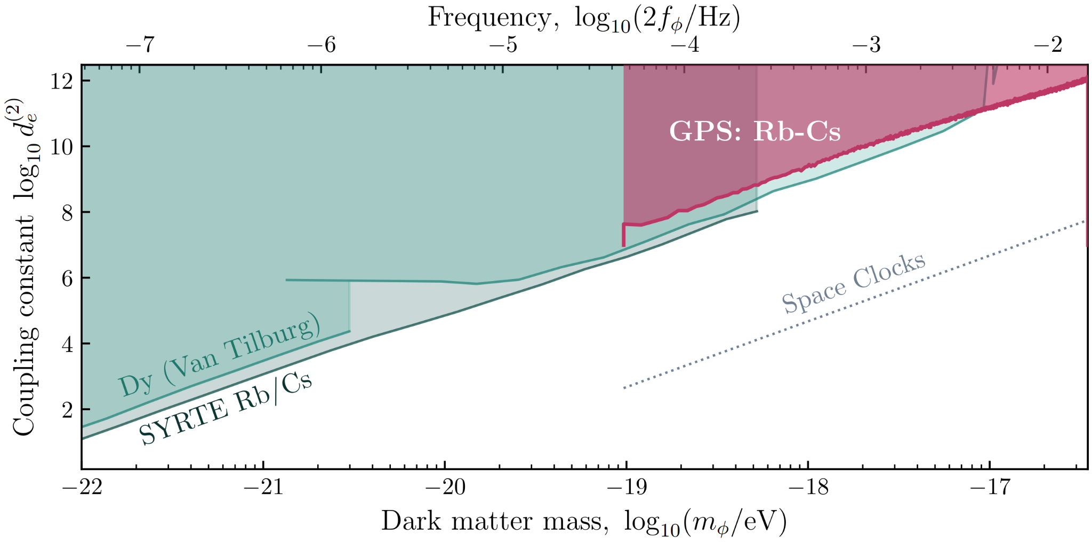
Constraints: GPS-to-GPS

Slide 34
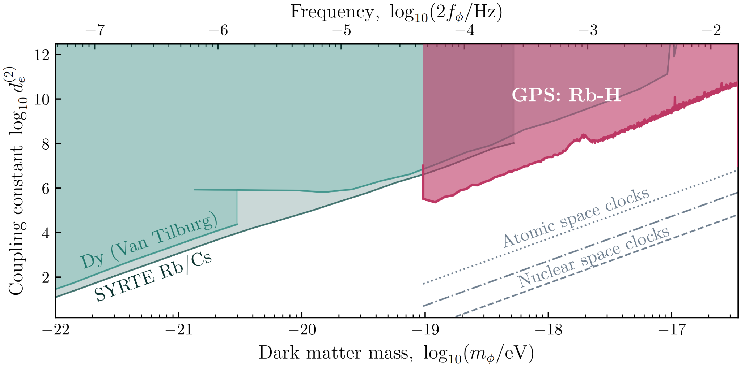
Constraints: GPS-to-ground

Slide 35
Summary
Constraints placed on electron coupling with separated ultrastable cavities and atomic clocks
  Sensitive to DM spatial distribution
  Scales linearly with distance
Quadratic couplings lead to screening effects
  Could explain lack of detection
  Also exploitable with space clocks

Slide 36
Summary
Constraints placed on electron coupling with separated ultrastable cavities and atomic clocks
  Sensitive to DM spatial distribution
  Scales linearly with distance
Quadratic couplings lead to screening effects
  Could explain lack of detection
  Also exploitable with space clocks
Thank you for listening :)

Slide 37
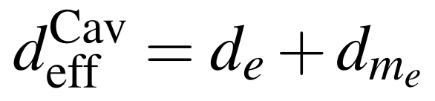

Slide 38
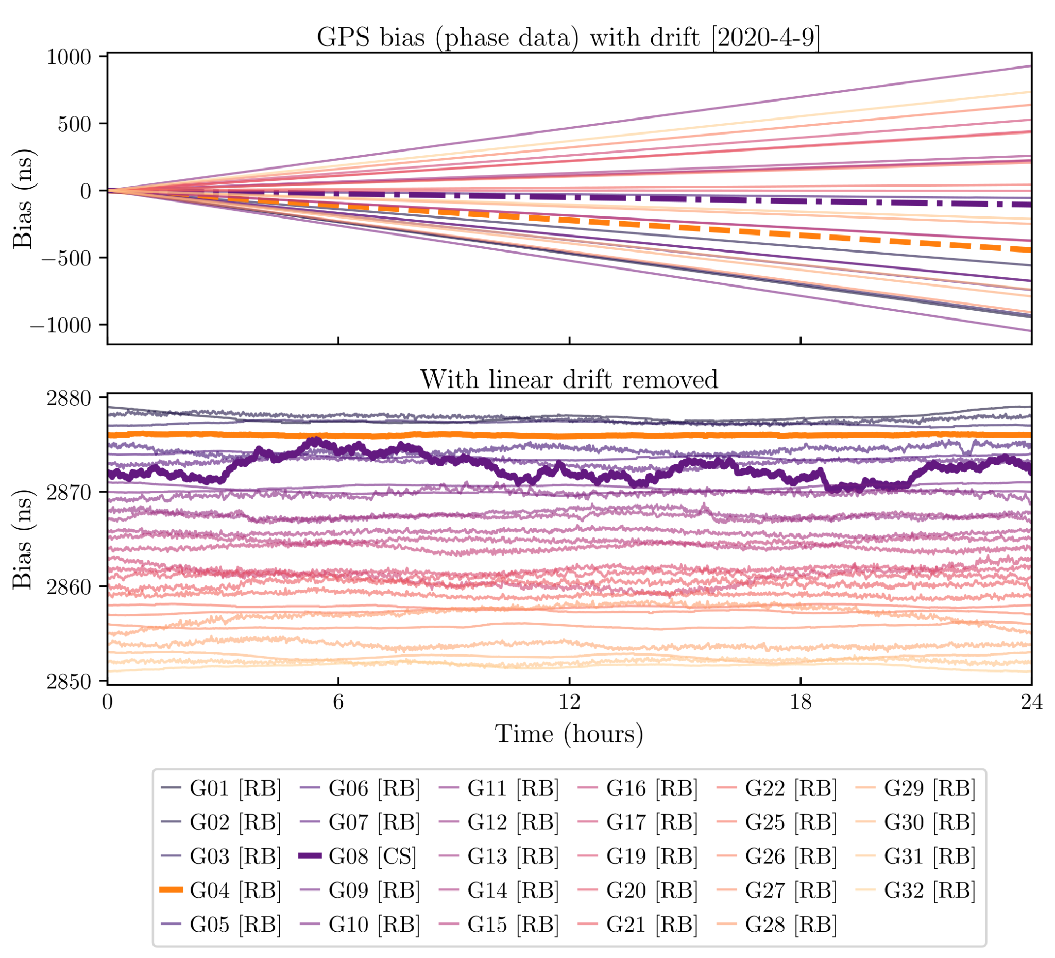

Slide 39
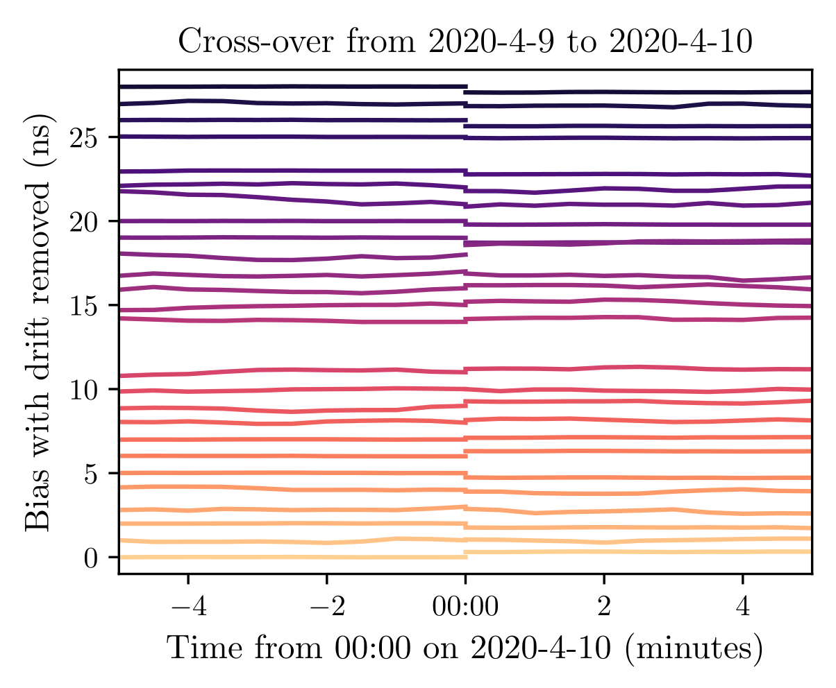

Slide 40
