Slide 1
Recent highlights from LVK: Hawking’s area law and the pair instability gap
Eric Thrane (Monash, OzGrav)
PPC / Gordon Godfrey Workshop (Sydney)
1 September, 2026
Notes:
24:00, 22:47, 25:05, 25:08

Slide 2
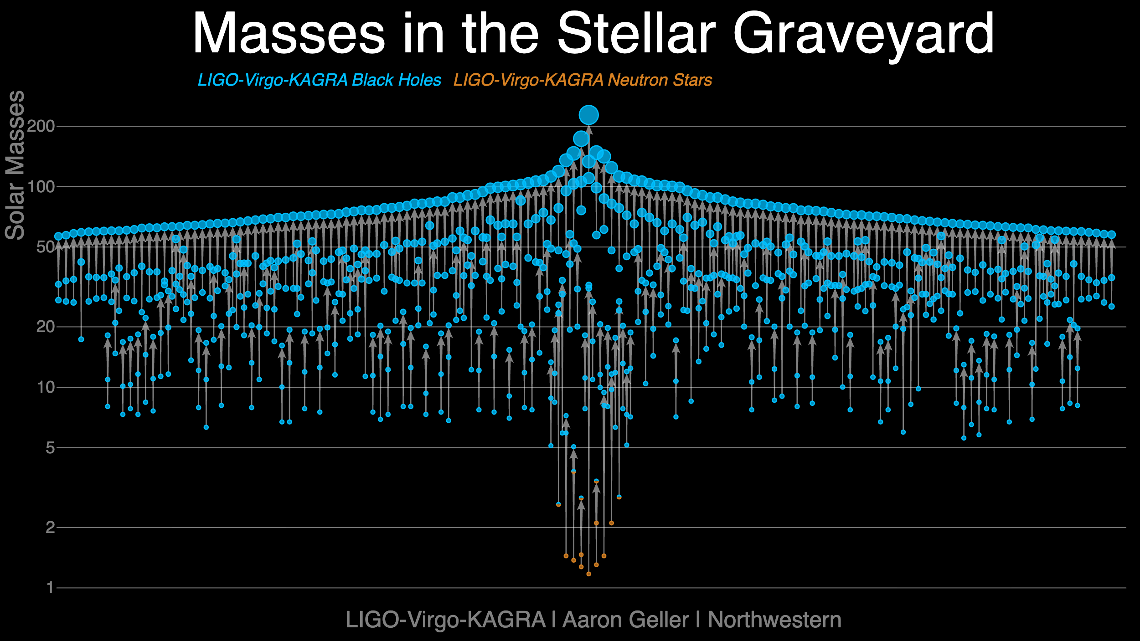
arxiv/2605.27223

Slide 3
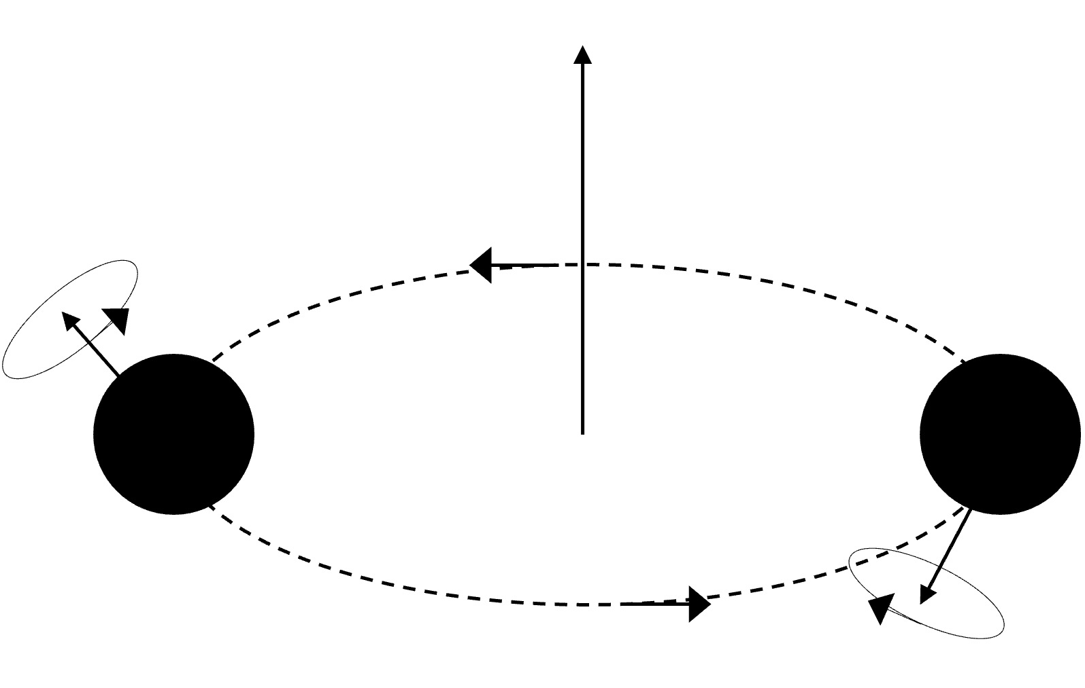
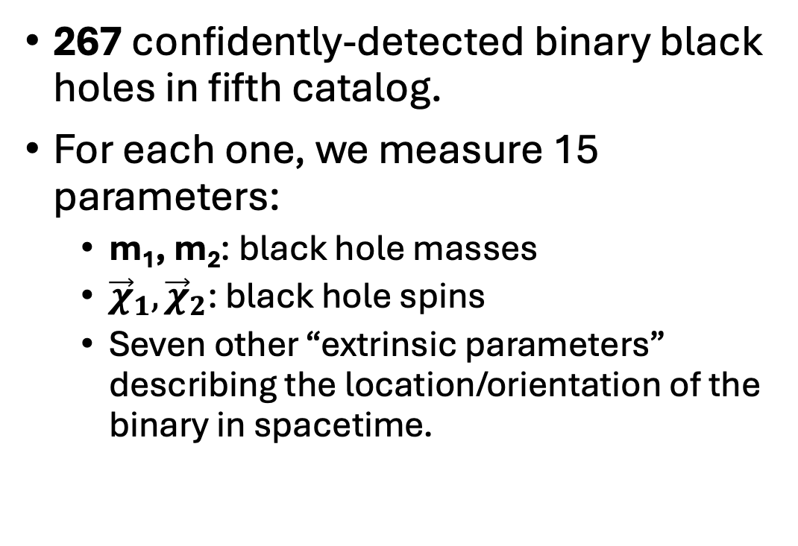



Black hole masses and spins in GWTC-5
267 confidently-detected binary black holes in fifth catalog.
For each one, we measure 15 parameters:
  m₁, m₂: black hole masses
  ${\vec{χ}}_{1},{\vec{χ}}_{2}$: black hole spins
  Seven other “extrinsic parameters” describing the location/orientation of the binary in spacetime.
$$\vec{L}$$
$${\vec{χ}}_{1}$$
m₁
m₂
$${\vec{χ}}_{2}$$
arxiv/2605.27226

Slide 4
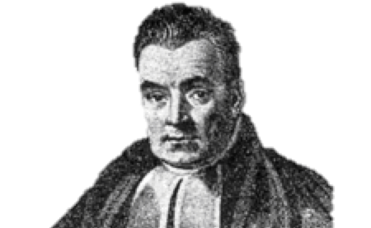
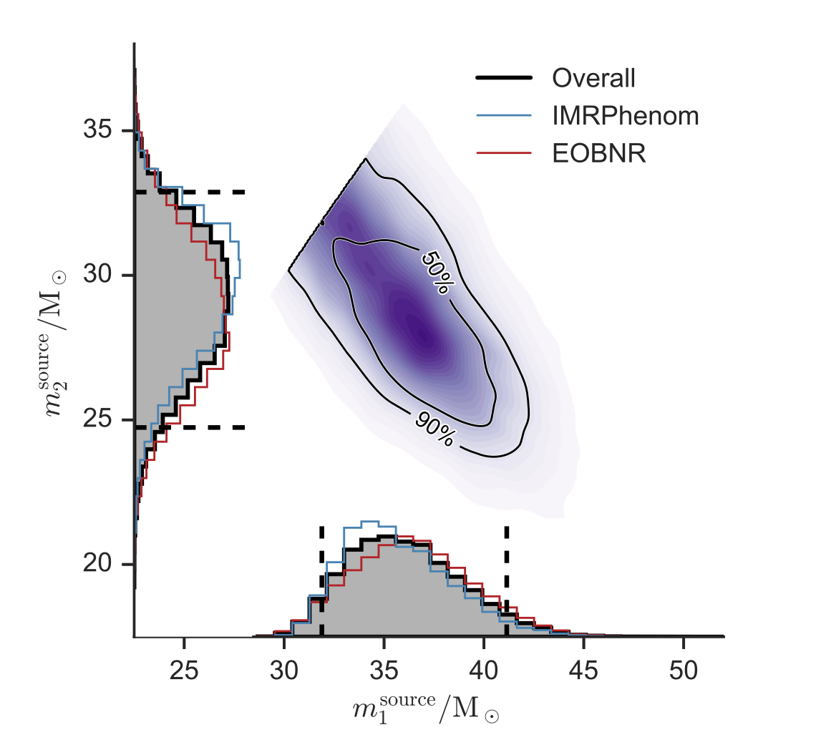
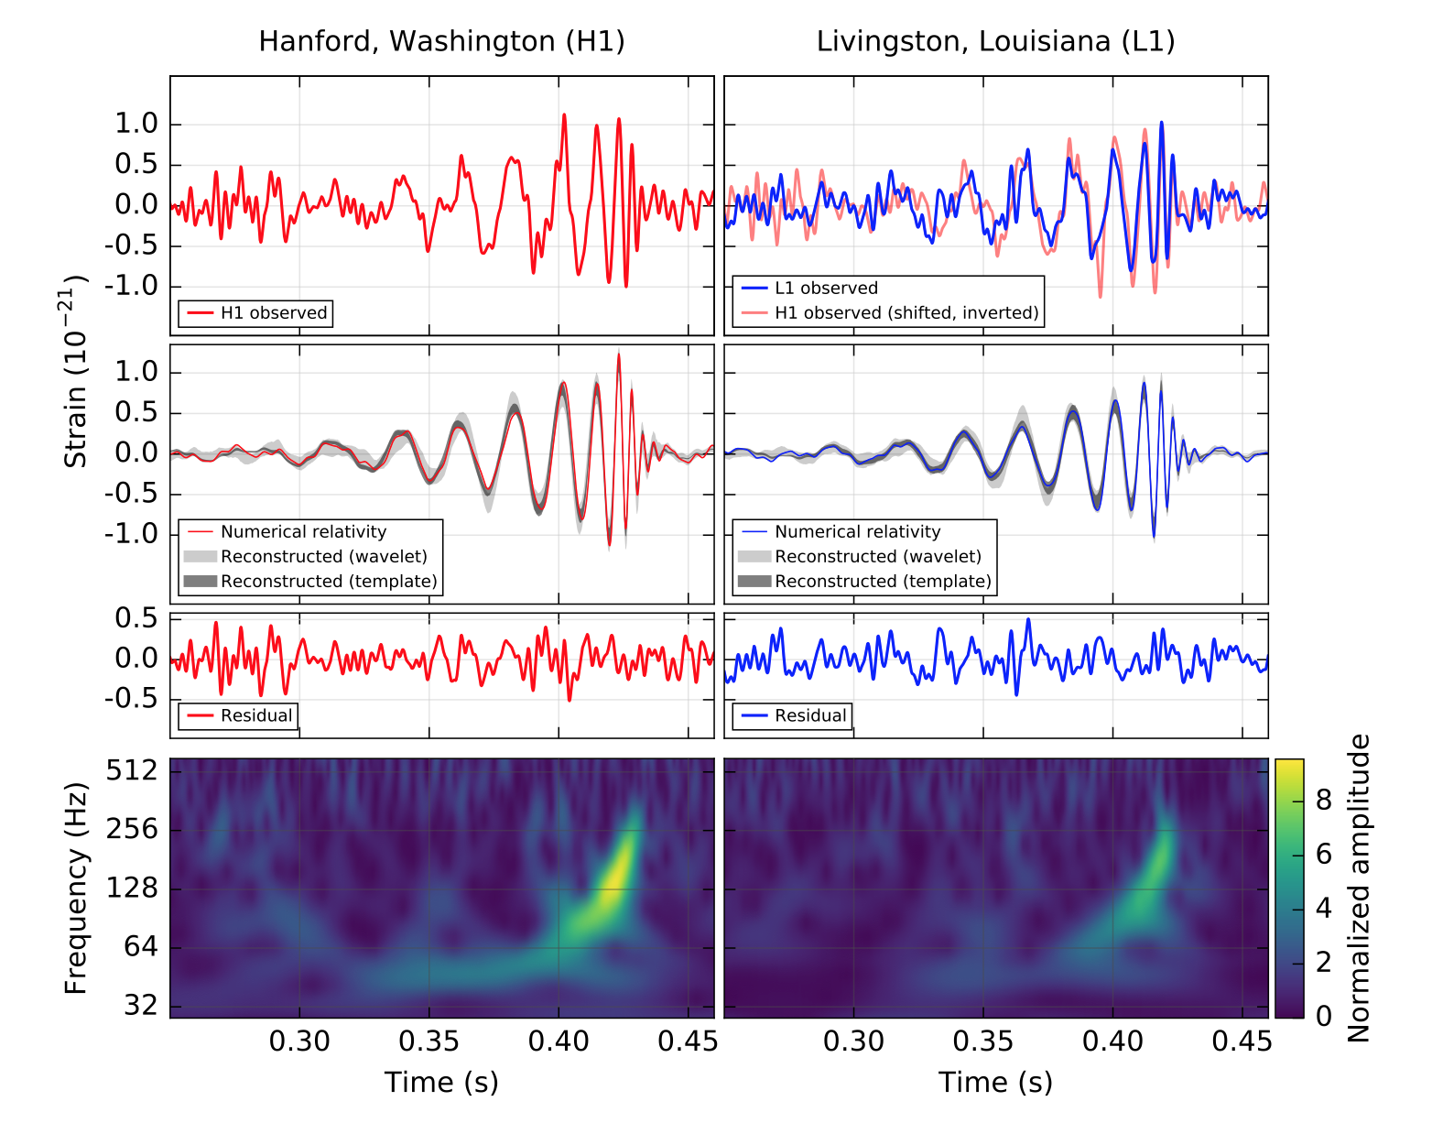
Gravitational waveform morphology
Different binary parameters yield different gravitational waveforms.
  For example, more massive binaries produce relatively shorter, lower-frequency waveforms.
  Aligned spin: binary merges at a higher frequency, spends more time in band (the orbital hang-up effect).
From the strain data, we can infer the binary properties.
Thomas Bayes

Slide 5
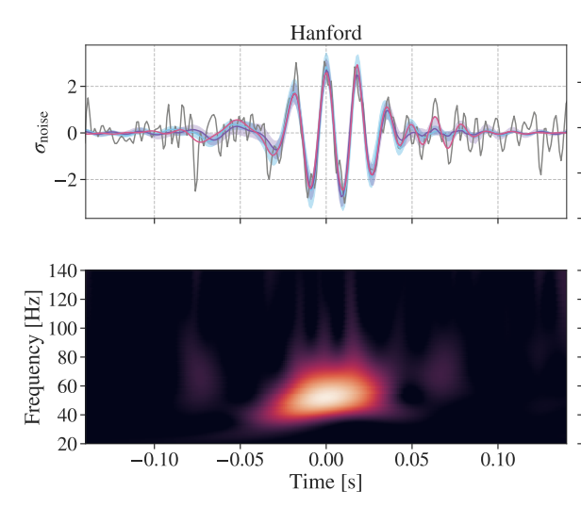
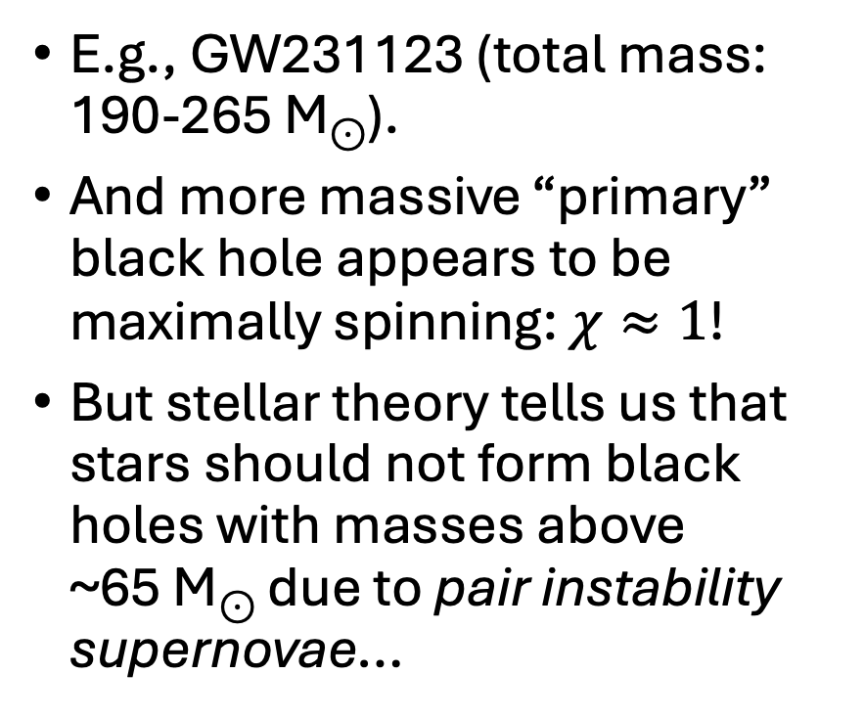
Some very massive binary black holes
E.g., GW231123 (total mass: 190-265 M⊙).
And more massive “primary” black hole appears to be maximally spinning: $χ≈1$!
But stellar theory tells us that stars should not form black holes with masses above ~65 M⊙ due to pair instability supernovae…
arxiv/2507.08219

Slide 6
Pair instability supernovae
Massive stars (>130 M birth mass) become hot enough to produce e⁺e⁻ pairs.
The pressure drops, the star heats up, leading to a runaway effect.
Above 280 M, the star is totally disrupted.
For 130-280 M, tens of solar masses ejected.
Prediction: cut-off in the black hole mass spectrum between ~35-65 M… (uncertain due to nuclear physics).
No unambiguous EM detection of pair instability supernovae.
Heger, A., & Woosley, S. E. 2002, ApJ 567 532

Slide 7
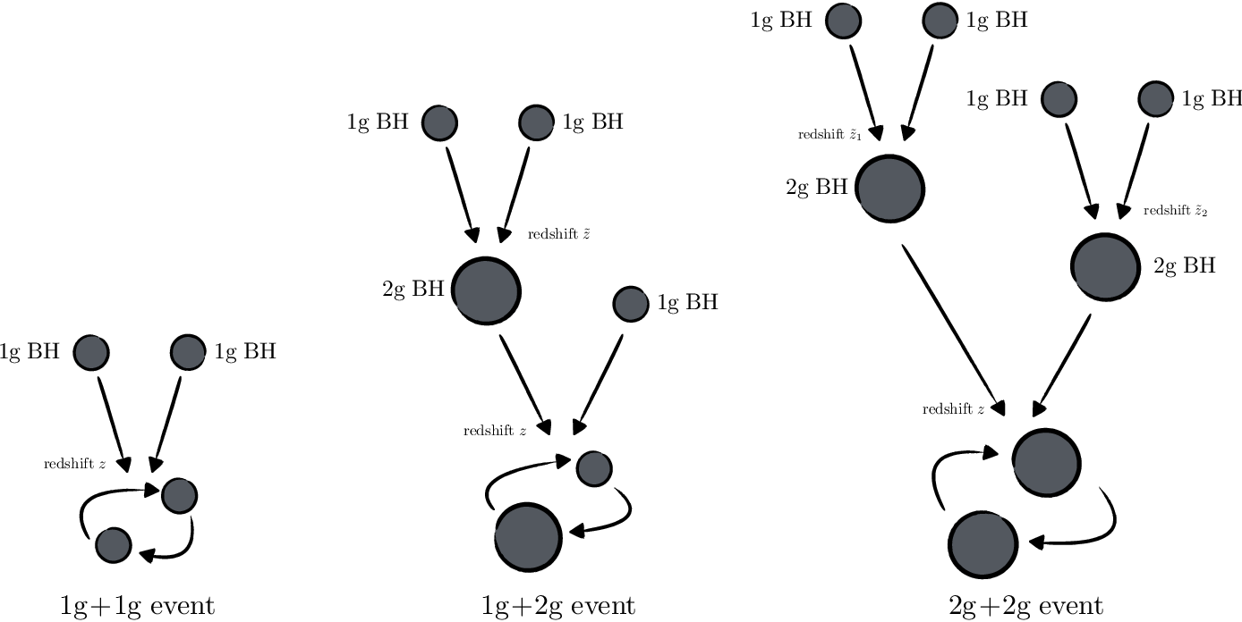
Hierarchical mergers
Basic idea: the merger products of previous mergers go on to merge again––gets around pair instability gap.
From: PhysRevD.95.124046

Slide 8
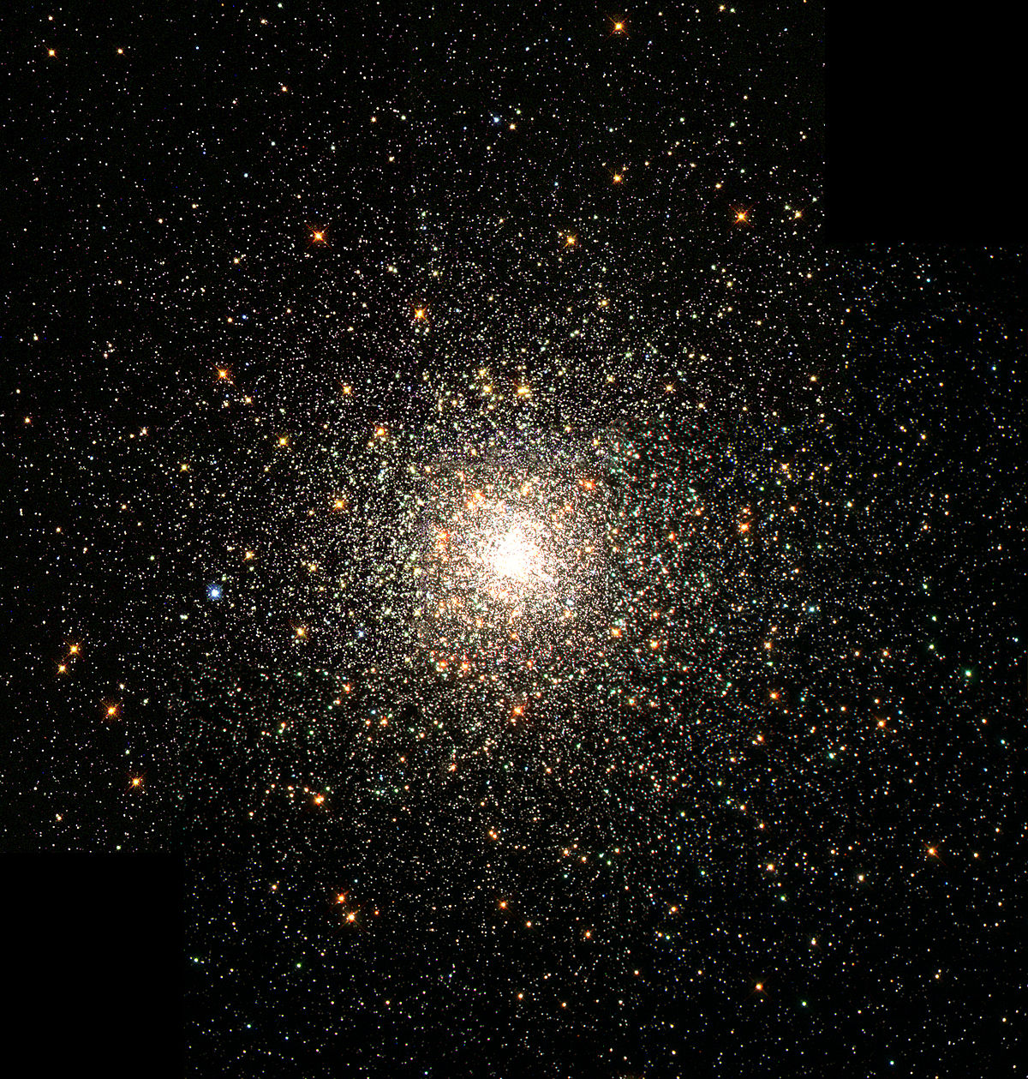
“Dynamical assembly” required
May take place in dense stellar environments
  Globular clusters
  Active galactic nuclei
  ...
Black holes wander into each other randomly.
Binaries hardened by interactions with other black holes.

Slide 9

Visualising dynamical assembly
https://michaelzevin.github.io/media/bbh_progenitors/

Slide 10
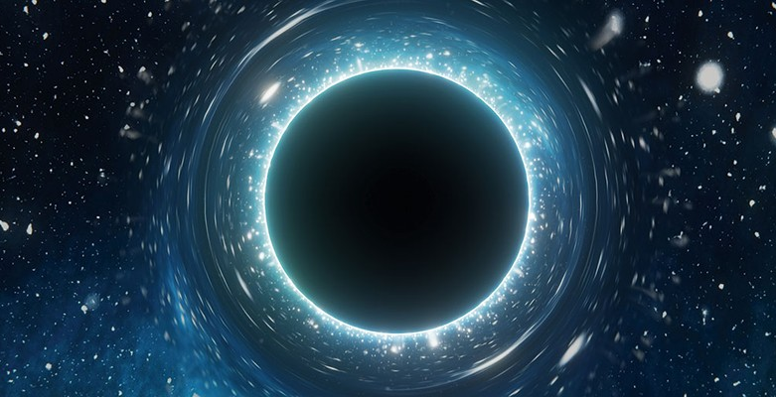
Properties of second-generation black holes
Inherit the orbital angular momentum of their parent binary: χ~0.7.
Spin vectors randomly oriented.
This is different from “field binaries” that are expected to have lower spins that are potentially aligned with the orbital angular momentum.

Slide 11
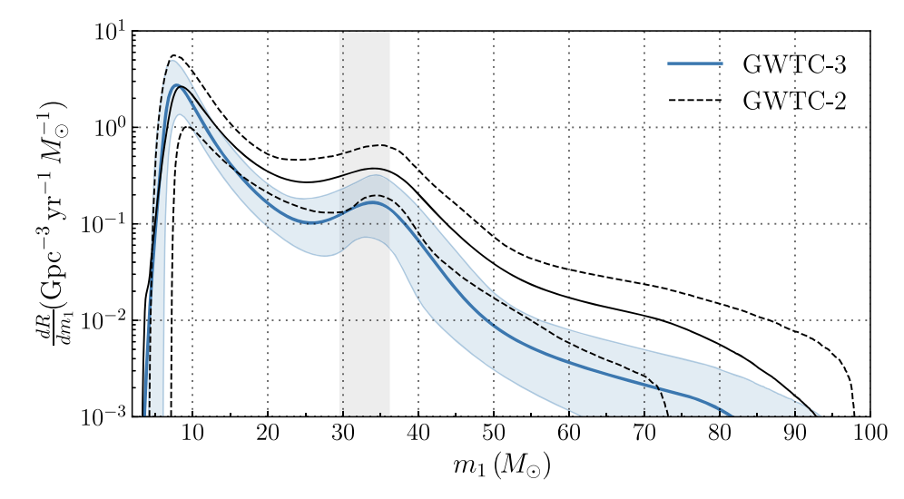

Where is the gap?!
Even if hierarchical mergers can populate the gap, it’s hard to see where the gap is in the distribution of primary black-hole mass m₁.
Where’s the gap?
arxiv/2111.03634

Slide 12
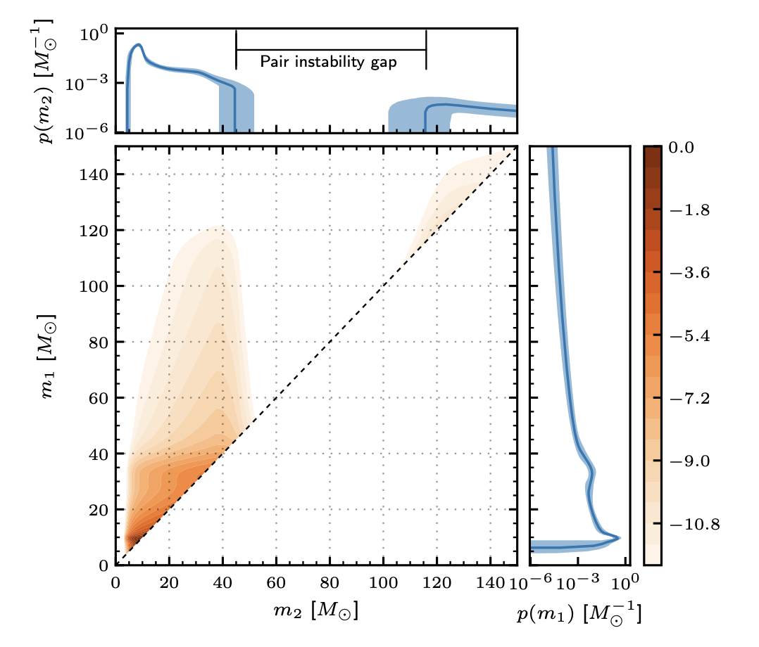
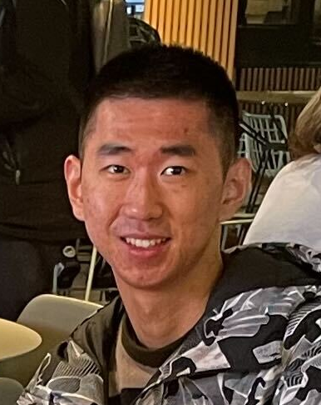
The gap was hiding in the distribution of secondary mass m₂.
Second-generation black holes are relatively rare, so they tend to pair with lighter first-generation partners.
primary mass m₁ (M)
Hui Tong
Tong+, Nature 652 874 (2026)
secondary mass m₂ (M)

Slide 13
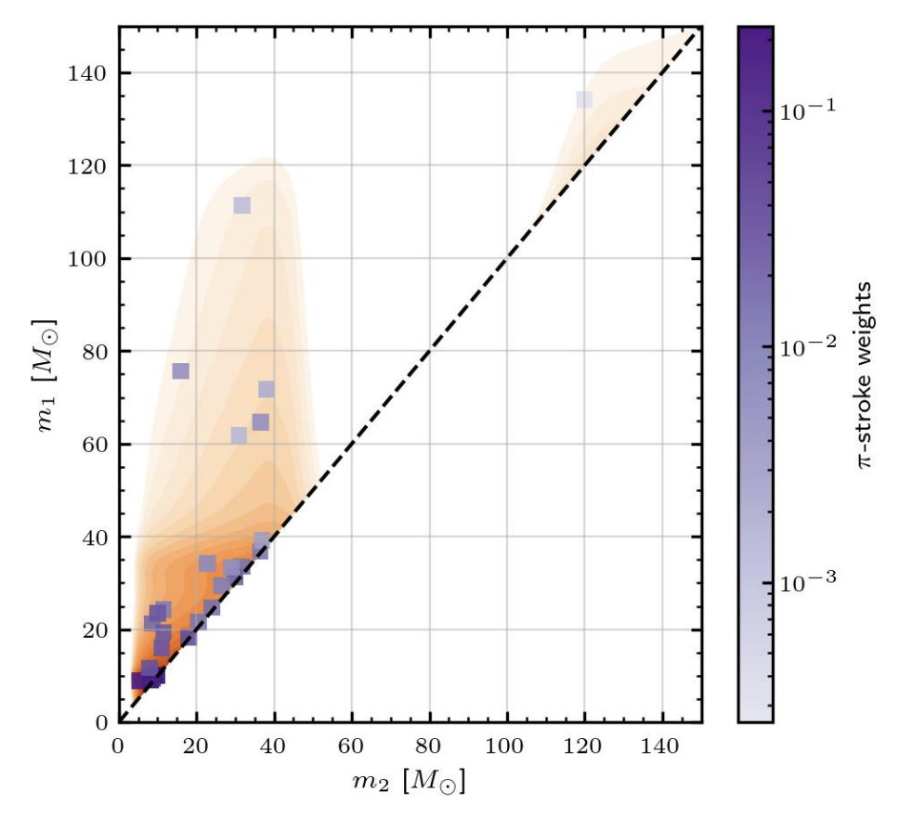

Gap also visible in model-free analysis
Purple markers: the population distribution that maximises the likelihood.
No prior, no parameterisation; determined entirely from the data.
See Payne & Thrane (2023).
Ethan Payne
(Model Six)
Tong+, Nature 652 874 (2026)

Slide 14
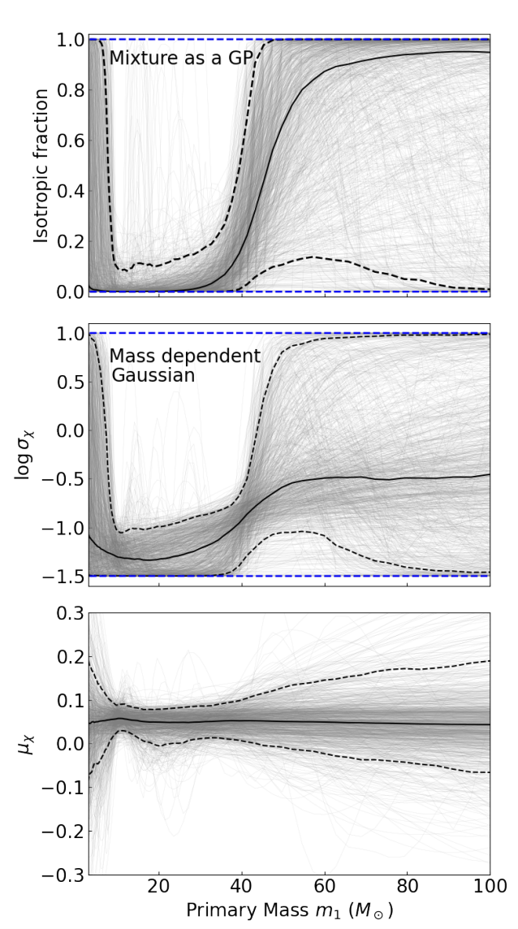
Concordant with black-hole spin evidence
Previous work by Antonini+ showed a “spin transition” at 45 M.
Below this threshold, black-hole spins are small and preferentially aligned.
Above it, they are large and isotropic... like we expect for 2G black holes.
small aligned spins
large isotropic spins
proxy for fraction of binaries with a 2G black hole
Antonini+, Nat. Astro. 10 1049 (2026)

Slide 15
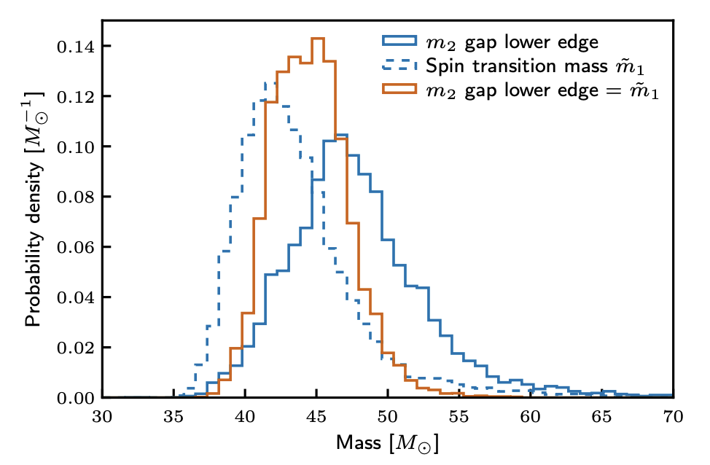
Concordant with black-hole spin evidence
The spin transition from Antonini+ is consistent with the edge of the gap from Tong+.
Provides independent evidence of the gap.
Orange = combined constraint on lower edge.
Tong+, Nature 652 874 (2026)

Slide 16
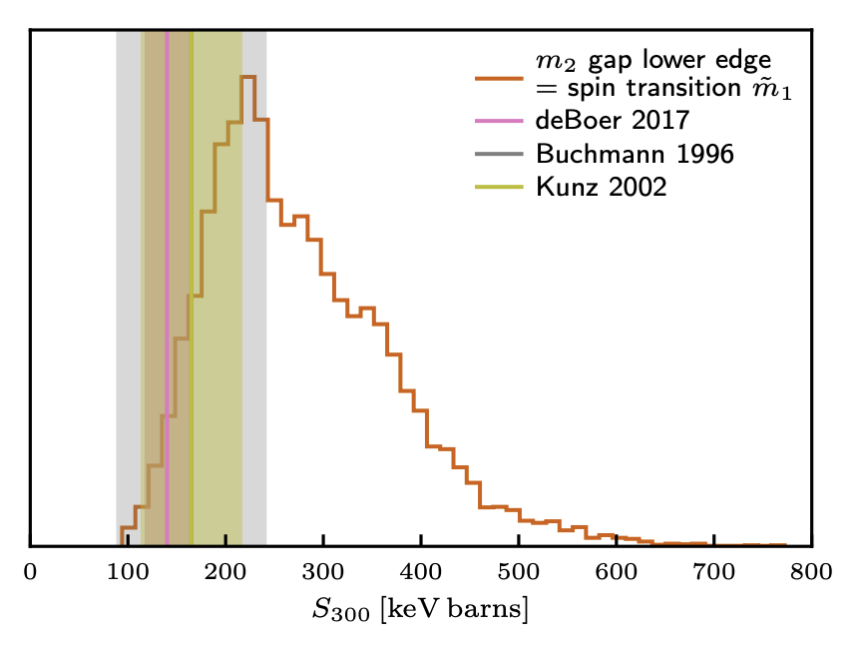
Constraints on ¹²C(α, γ)¹⁶O rate
The location of the gap is determined by the rate of α captures onto carbon.
Cannot be measured in a lab.
Crucial ingredient: more carbon = more “preheating” = more explosive.
The fact that the gap is at ~45 M and not ~65 M means lots of carbon = lower rate.
Tong+, Nature 652 874 (2026)

Slide 17
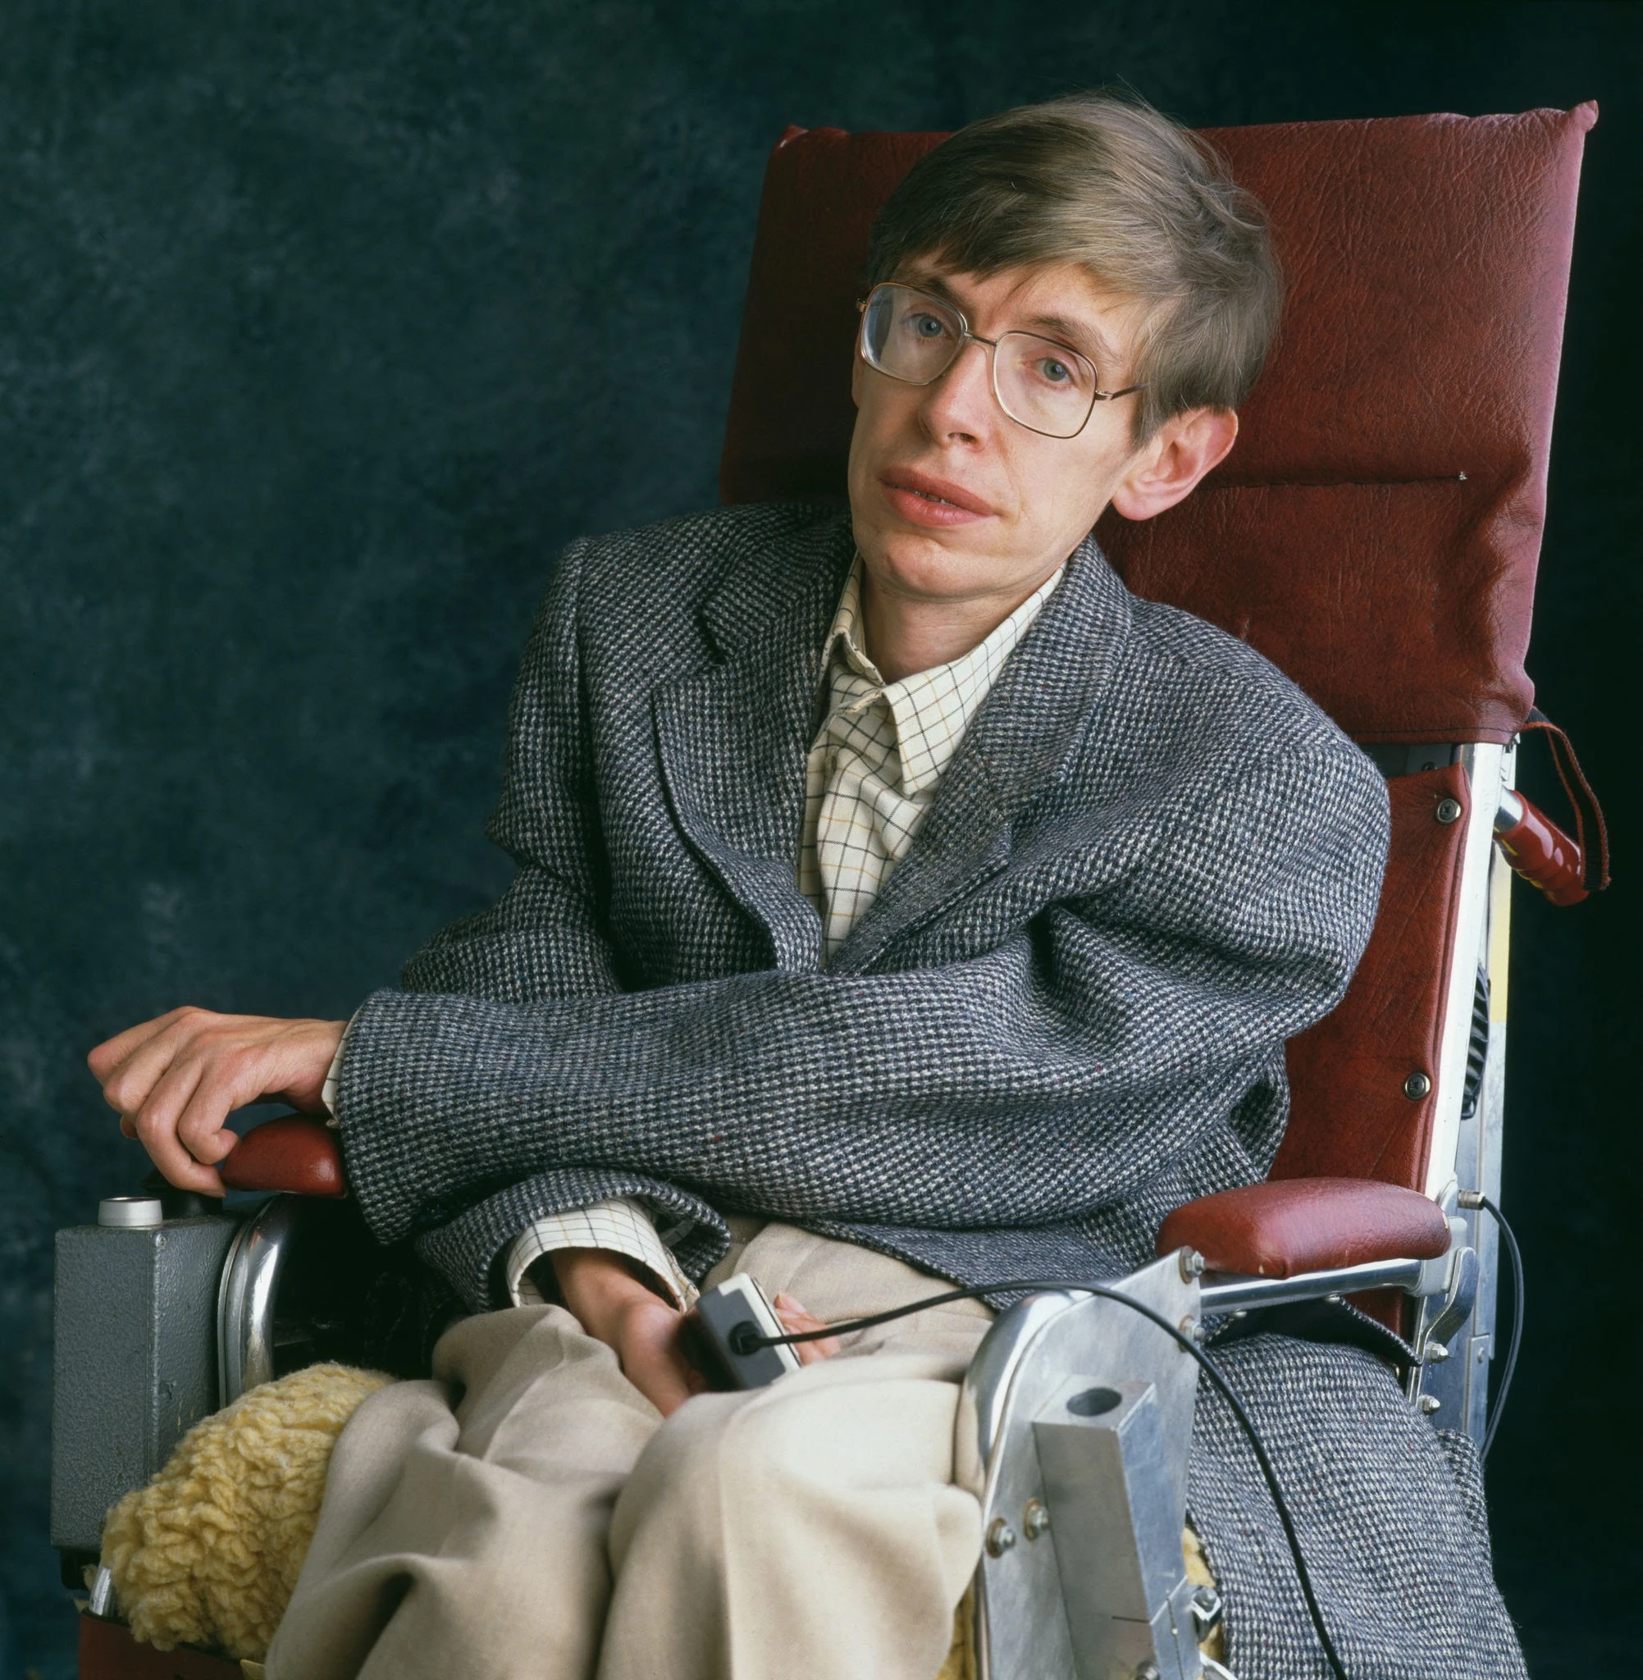
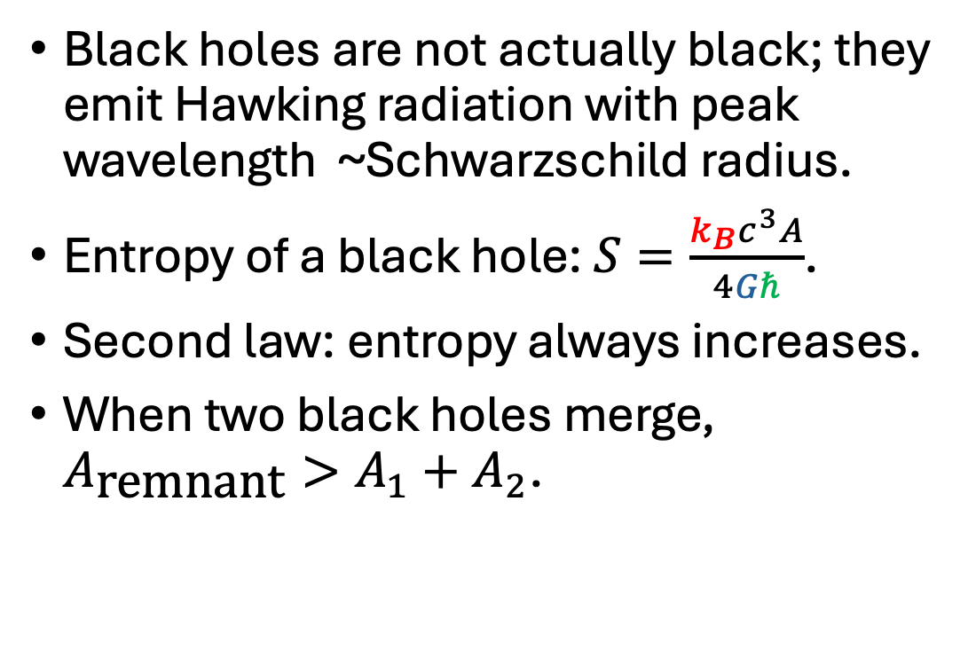
Hawking’s area law
Black holes are not actually black; they emit Hawking radiation with peak wavelength ~Schwarzschild radius.
Entropy of a black hole: $S=\frac{k_{B}c^{3}A}{4Gℏ}$.
Second law: entropy always increases.
When two black holes merge, $A_{\text{remnant}}>A_{1}+A_{2}$.

Slide 18
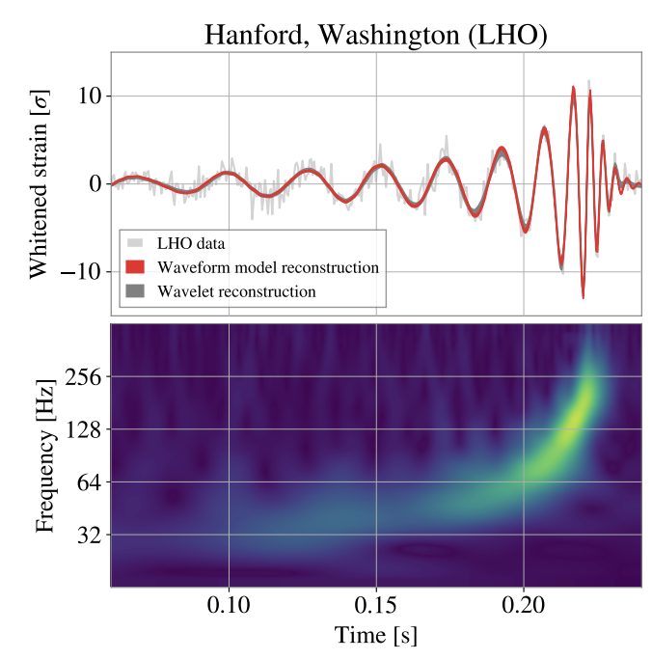
GW250114: our brightest signal yet
Similar to the first detection, GW150914.
But SNR = 80!
An exciting laboratory for tests of general relativity.
arxiv/2509.08054
See also: Lu+, Nature 655 71 (2026)

Slide 19
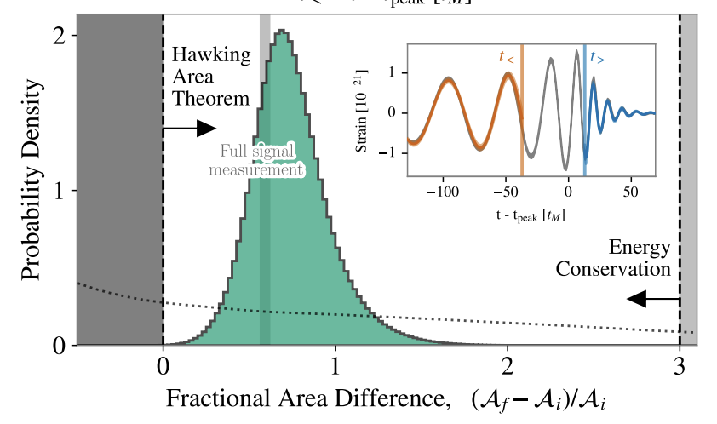
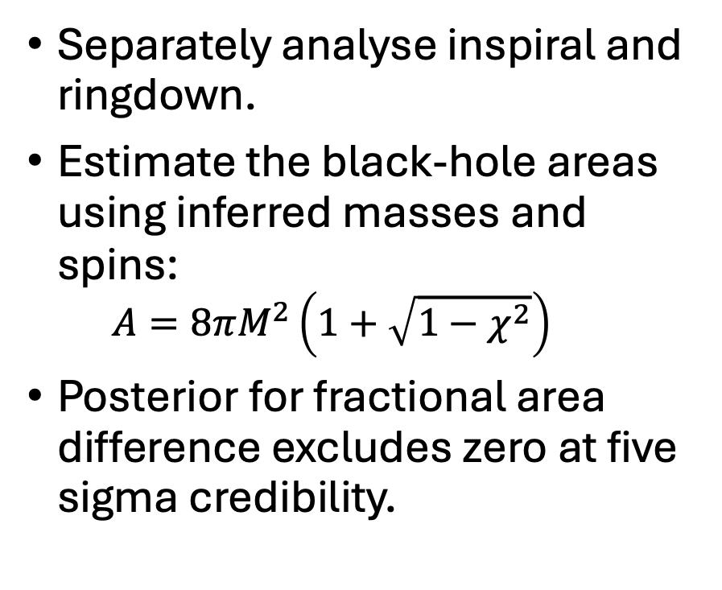
Demonstration of the area theorem at 5σ
merger
Separately analyse inspiral and ringdown.
Estimate the black-hole areas using inferred masses and spins:
  $$A=8πM^{2}\left(1+\sqrt{1−χ^{2}}\right)$$
Posterior for fractional area difference excludes zero at five sigma credibility.
inspiral
ringdown
arxiv/2509.08054

Slide 20
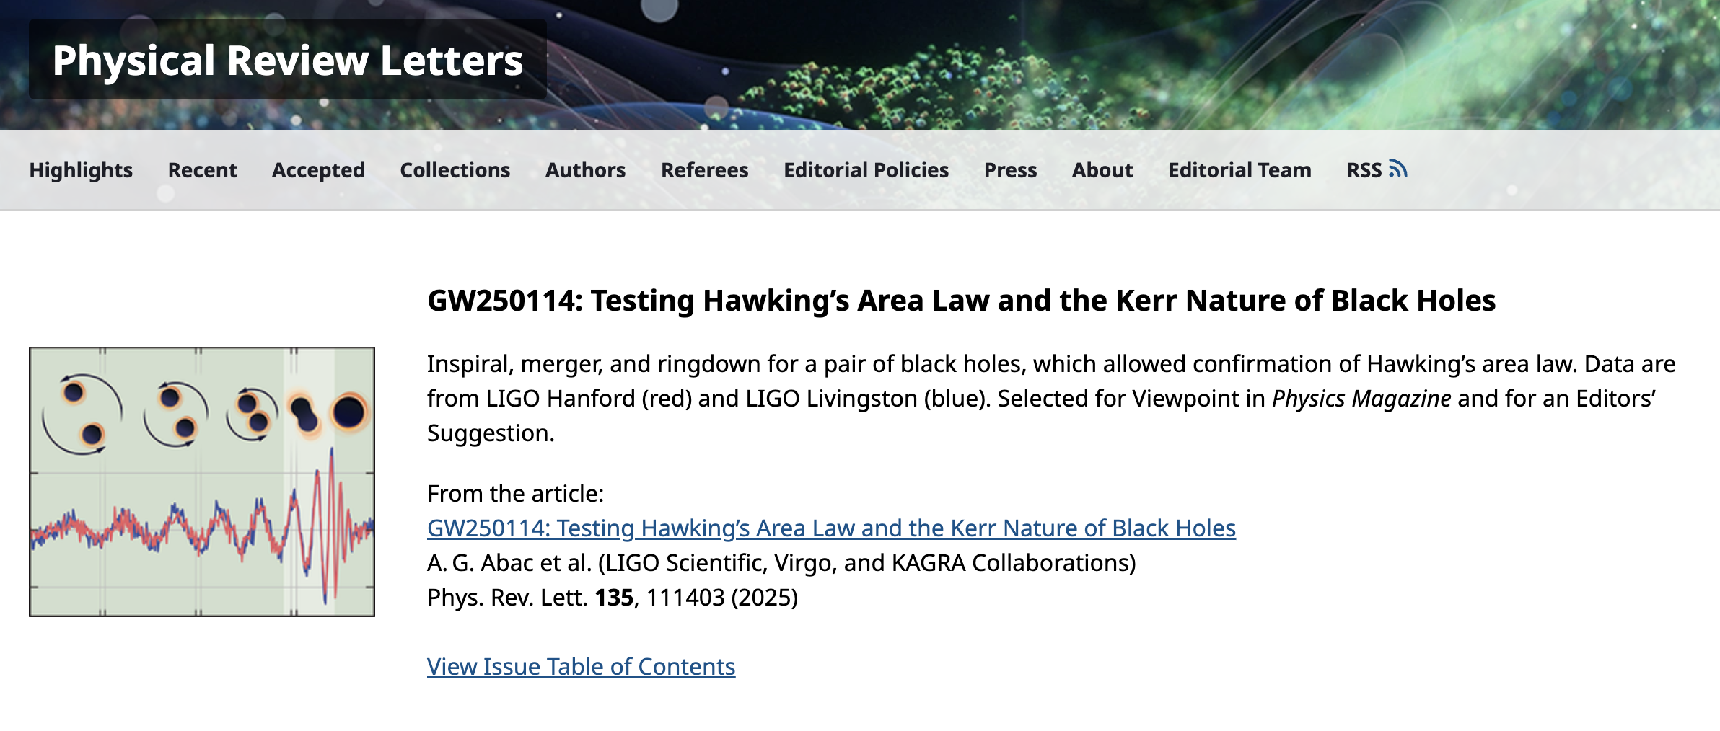
Paper featured on the cover of PRL

Slide 21
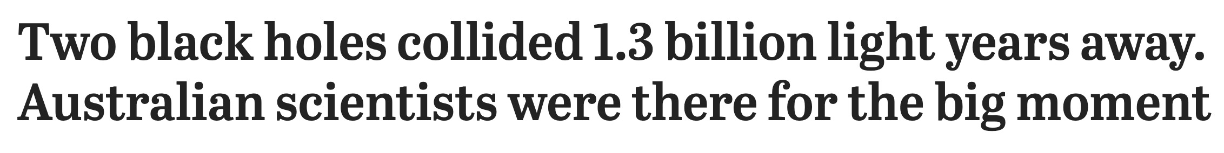
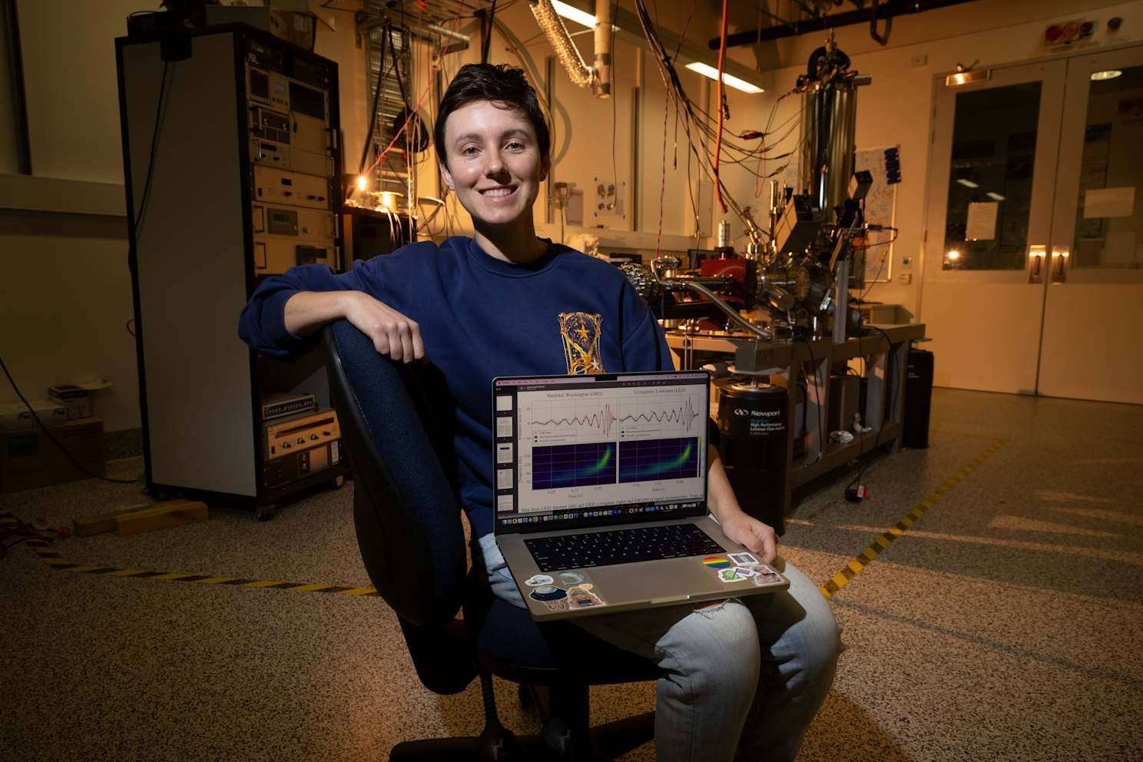

Teagan Clarke
(Princeton)
Paul Lasky

Slide 22
Measuring black-hole thermodynamics
Time permitting…
Assumed the truth of GR to calculate the area from the mass and spins.
But if GR is true, doesn’t that already imply Hawking’s second law of black hole thermodynamics?
Yes! Think of this test as a milestone showing that we can now resolve thermodynamic properties of black holes.
arxiv/2509.08054

Slide 23
Conclusions
Measurement of the pair instability gap illustrates our ability to study nuclear physics with gravitational waves.
Validation of Hawking’s area theorem highlights our ability to test fundamental physics with gravitational waves.
Exciting time for LIGO–Virgo–KAGRA.
  Analysis of GWTC-6 data ongoing… stay tuned.

Slide 24
Extra slides

Slide 25
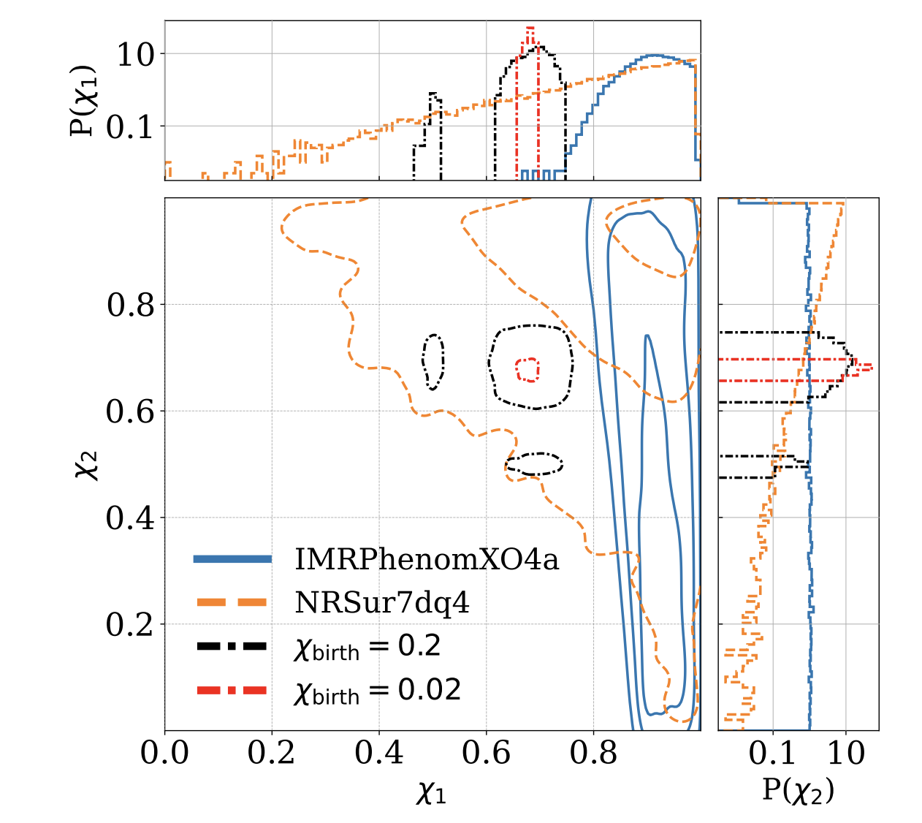
The weird spin of GW231123
Maybe a hierarchical merger, maybe not: p=5% for NRSur, p=0% for XO4a.
arxiv/2510.14363 by Passenger+

Slide 26
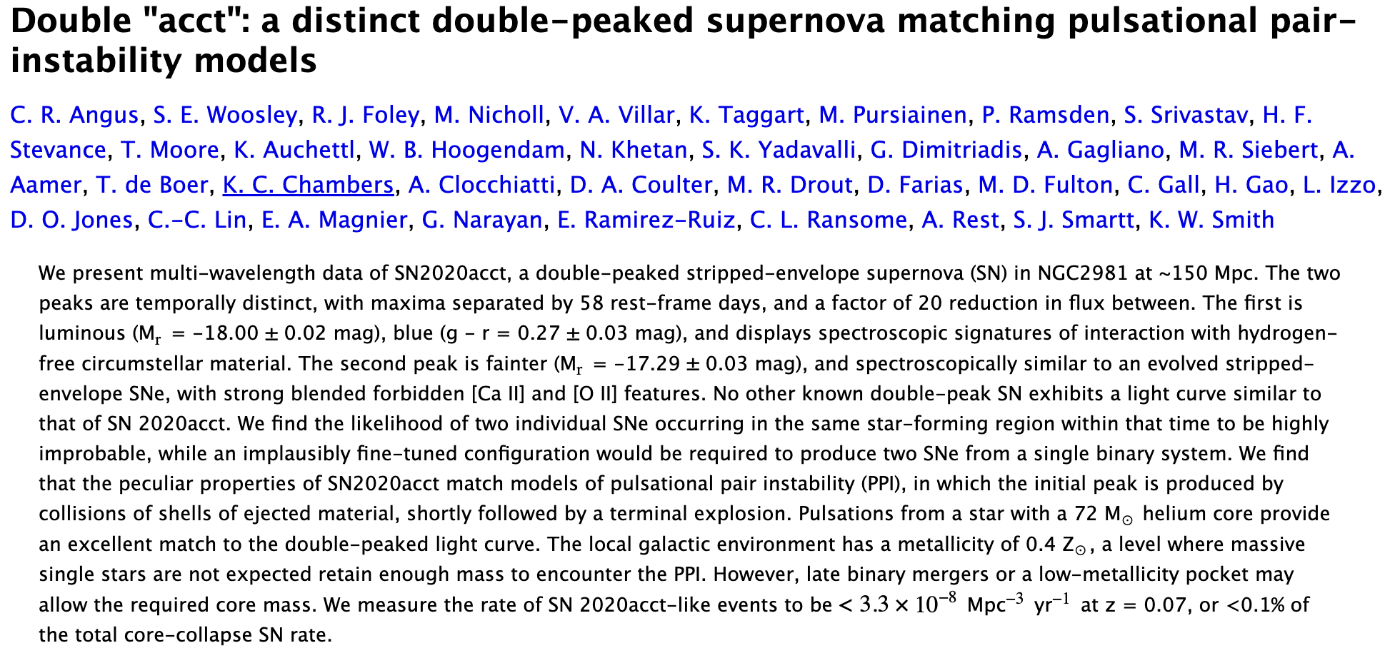
Pair instability candidates, an example
Maybe, but could be other form of episodic mass loss, wave-driven mass loss, binary effects, etc.

