Slide 1
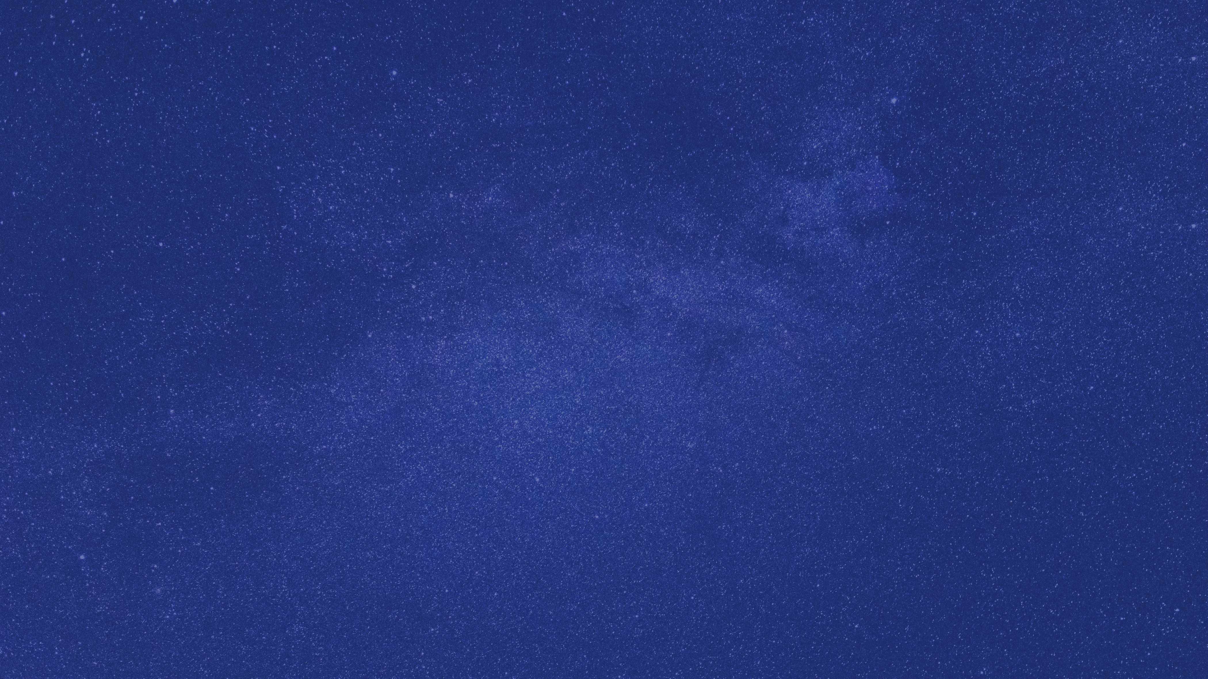
Cosmic strings
and How to find them?
In the context of HI 21cm Cosmology
Nazeef
University of New South Wales
n.nazeef@unsw.edu.au

Slide 2
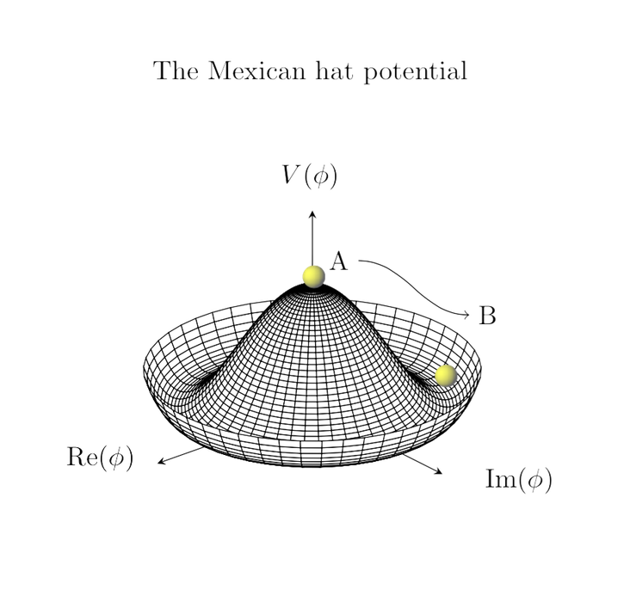

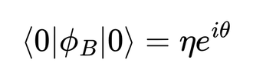
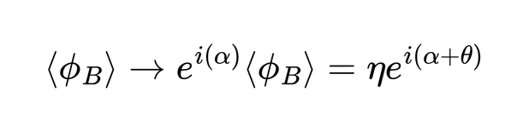
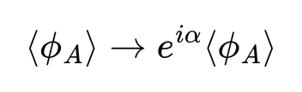
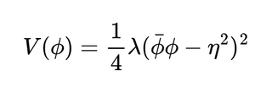
Prelude: Spontaneous Symmetry Breaking
Unbroken Symmetry
Broken Symmetry
  As hot the universe cooled, we anticipate the temperature-dependent potential’s minima evolved from Φ= 0 to a degenerate circle
Notes:
Explaining SSB using the simple Goldstone model , which has U(1) symmetry

Slide 3
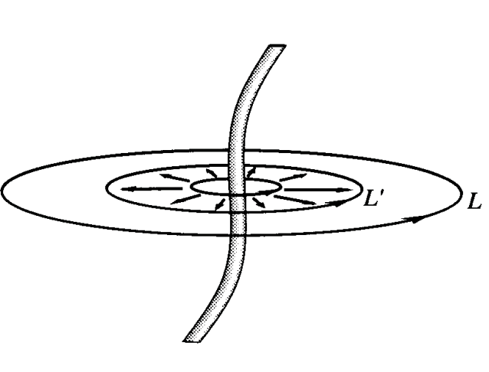
  Different (causally disconnected) regions of space can have different vacuum angles
  Non-trivial loops in the vacua phase can form, enclosing smaller loops within
  The core of the loop assumes the unbroken symmetry state with non-zero energy density, forming a
Cosmic string
Credit: Cosmic Strings and Other Topological Defects - A. Vilenkin, E. Shellard (Cambridge, 1994)
Notes:
For continuous symmetry breaking it is cosmic strings, and for discrete it is domain walls

Slide 4
what are Cosmic strings?
  1-Dimensional Topological Defects, formed during the early universe phase transitions
  They are predicted by some Grand Unified Theories(GUTs), where symmetry can produce a non-simply connected vacuum manifold.
  String theory can also produce cosmological string-like objects, known as cosmic superstrings
Notes:
non-simply connected ->unshrinkable
The distinction is that ordinary field-theoretic cosmic strings arise as topological defects from symmetry breaking, whereas cosmic superstrings originate from fundamental strings/branes in string theory. They're phenomenologically similar in some respects, but they're not simply the string-theory version of the same field-theoretic defect.

Slide 5
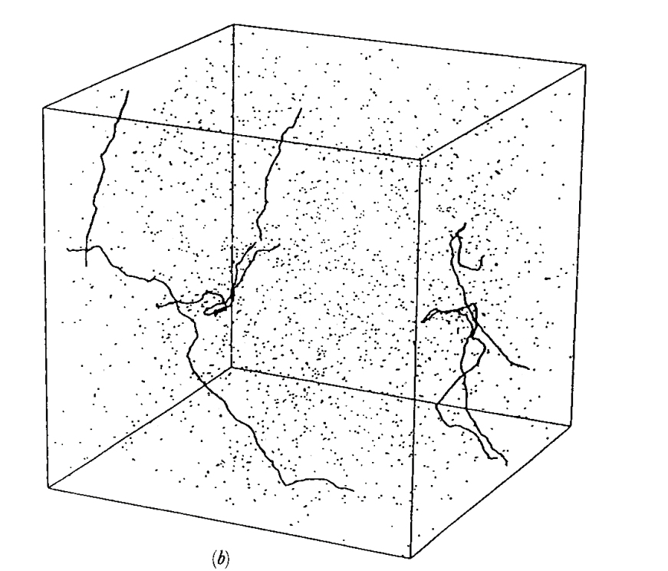



Some properties of strings
  Their linear mass density goes as,
  From Lorentz invariance of the energy-momentum tensor, the tension is equal to the mass density
  String interactions coupled with expansion achieve a scaling solution
For,
Matter-dominated era String network
Credit: Cosmic Strings and Other Topological Defects - A. Vilenkin, E. Shellard (Cambridge, 1994)
Notes:
Extreme tension pulling them to be straight

Slide 6


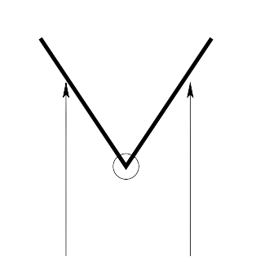
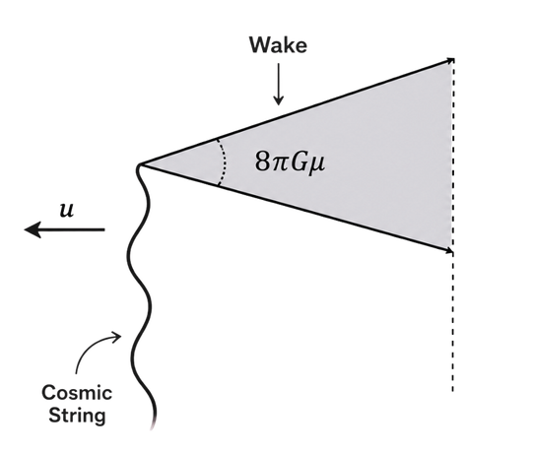
In the Wake of a cosmic string
  From the metric of a cosmic string, we find the space around the string is conical with a deficit angle of:
  For a string traveling with velocity vs , matter streaming by the string receives a velocity kick
Top view
Side view
  This leads to formation of a wedge with twice the background density

Slide 7



Wake in image space
Ideal Square shape
Gradient Brightness
Slanted Projected Area

Slide 8
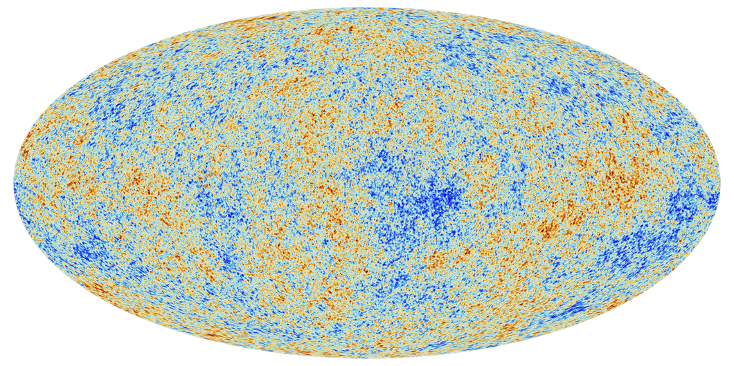
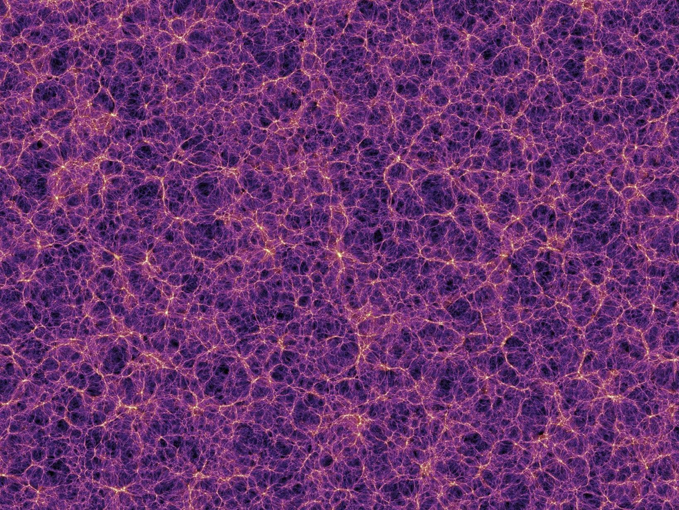

How cAN WE DETECT COSMIC STRINGS?
Line discontnuities in CMB anisotropies
Cosmic Microwave Background
Rectangular regions with excess polarization
Large Scale Structure Maps
  Thin planar enhanced densities
21cm maps
  Wedge Shaped enhanced patch

Slide 9
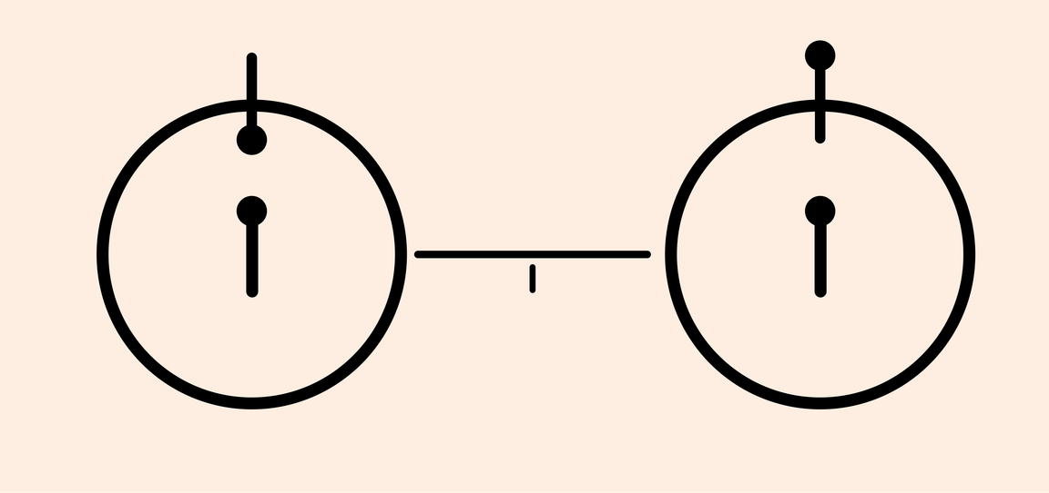
Interlude: 21 cm cosmology
  Hydrogen’s 1s ground state has two possible hyperfine states decided by spins:
Parallel
&
Anti-parallel
  The transition of states emits/absorbs 21cm radiation; the characteristic time of this transition is 10⁷ years!
  Spin-flip emissions are the only probe to the Cosmic Dark ages, mapping cosmic history from Recombination till Reionization
Credit: Pioneer Plaque

Slide 10

Interlude 2: Radio Interferometry
  Angular resolution ~
To achieve arcmin resolution at redshifted 21 cm wavelengths, we would require diameter ~ Kms
  Possible by spreading out antennas, each pair of antennas observes one Fourier mode of sky brightness
  Creating baselines that sample both long and short Fourier modes are critical for complete observation; the rotation of the Earth helps
  Astrophysical foregrounds and instrumental noise, need to be well-modelled and subtracted

Slide 11
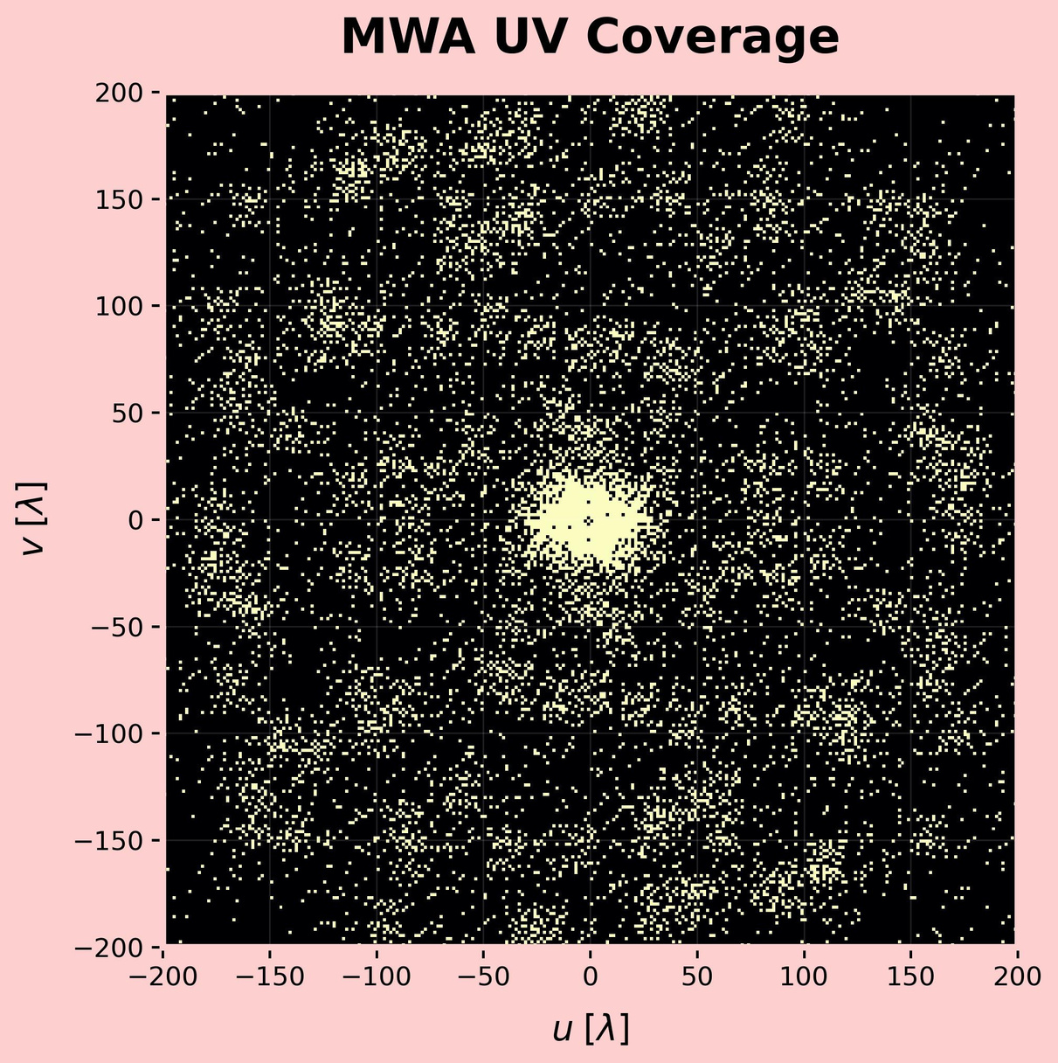
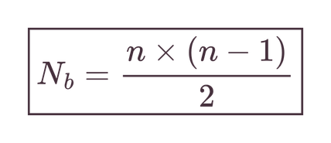
Murchison Widefield Array (MWA)
  Instrument in Western Australia
  Precursor to SKA
  Each point in the UV plane is a baseline for n antennas

Slide 12
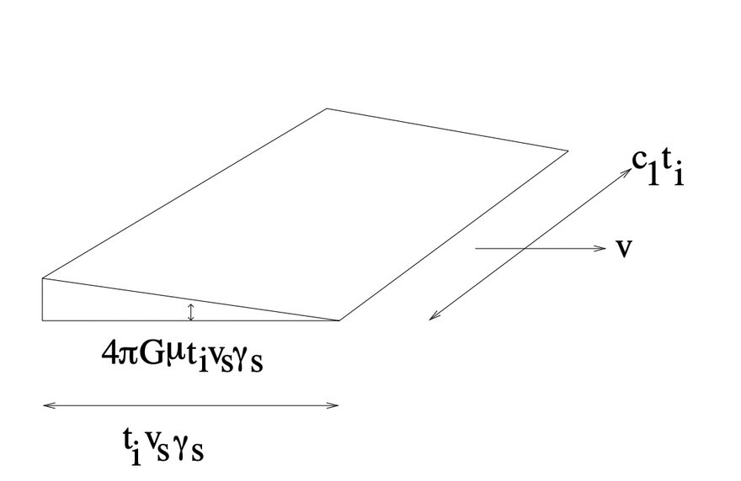
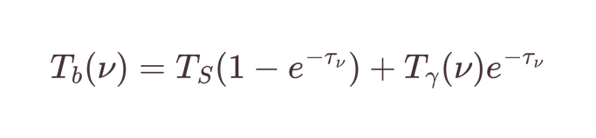
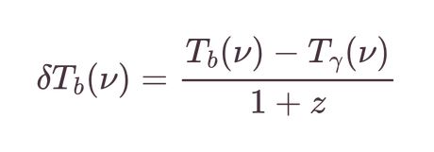
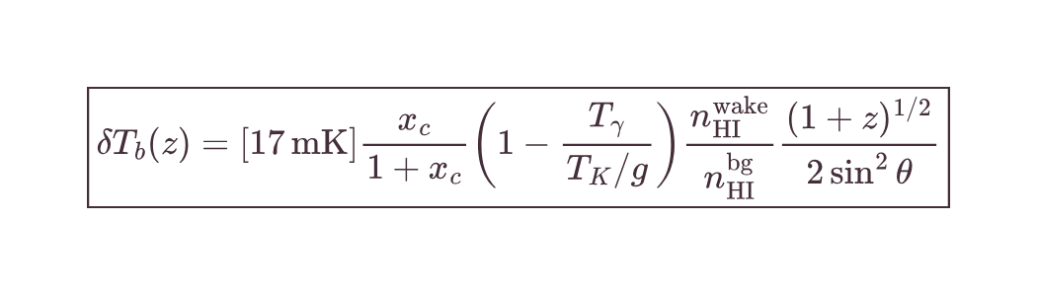
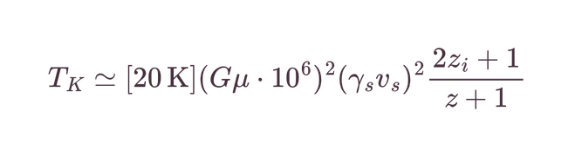
Cosmic string wakes in 21 cm
  The wedge-shaped cosmic string wakes, either emits or absorbs 21 cm
  We observe the contrast of 21 cm radiation from HI clouds and that of CMB photons

Slide 13
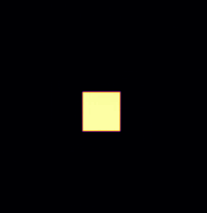
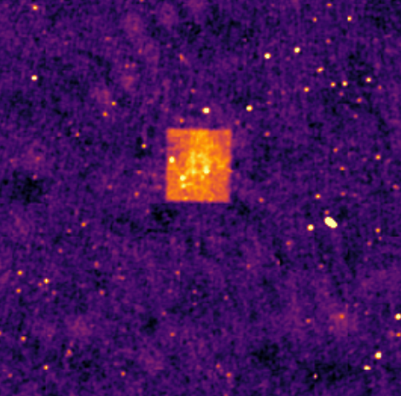
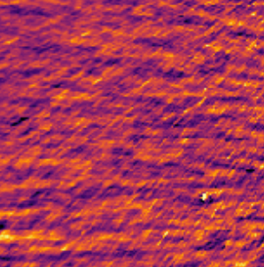
In search of wakes
  Wakes are the dominant source of non-linear fluctuations in redshifts larger than that of reionization
  They have distinct geometry, looking at image space:
Foregrounds
Realistic
Flux

Slide 14
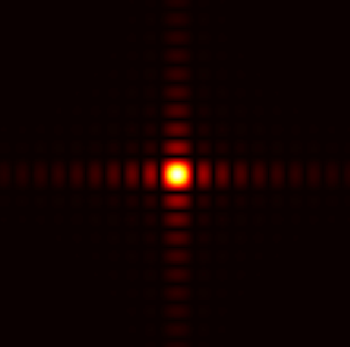
Fourier space
  The distinct quadrilateral geometry of the wake translates to a unique ridge-like pattern in fourier space
Computing
Fourier transform

Slide 15
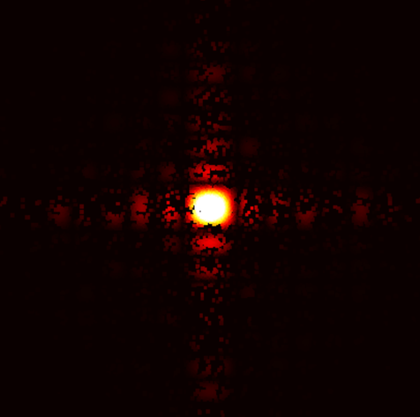
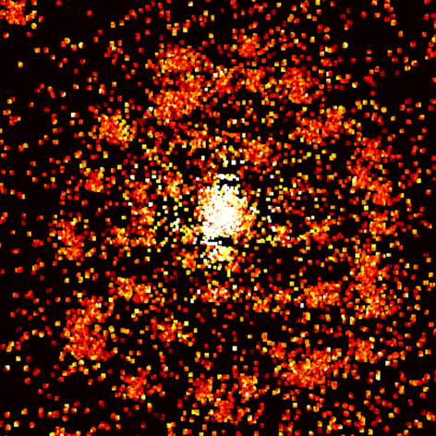
Simulating the Wakes
  Woden simulates the MWA visibilities by forward modelling the instrument response
  Along with the source signal, we can introduce foregrounds and instrumental effects such as thermal and gain noise
Foregrounds in
EoR0 field

Slide 16
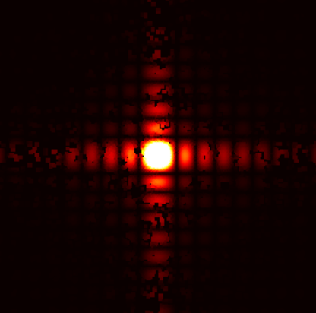
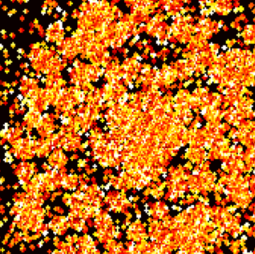
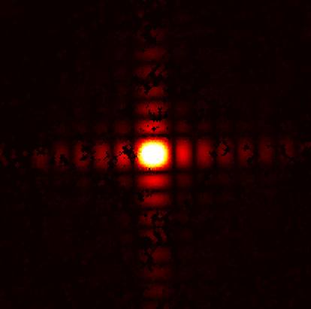
Firstly, an upgrade...
128 tiles to
256 tiles
Realistic Flux
Foreground subtracted

Slide 17
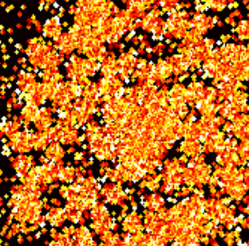
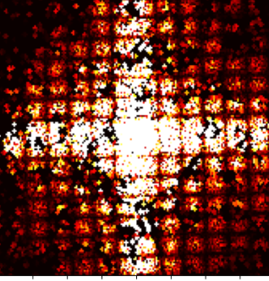
But what’s the difference?
  For a wake at a fixed redshift of emission, the frequency width is very narrow
  This kHz width is encompassed by a single fine frequency channel of MWA
  As the frequency responses for consecutive channels are near identical, we can exploit this to subtract noise
With wake
No wake
Residual
-
=
Notes:
But the residual 1e-6 in magnitude

Slide 18
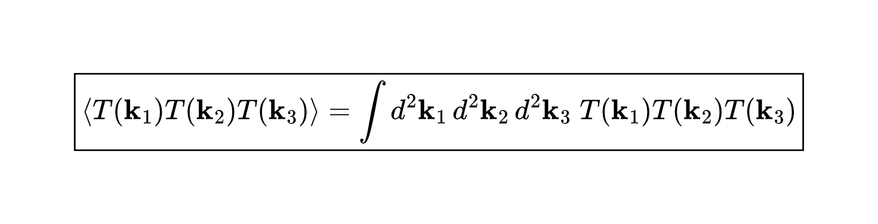
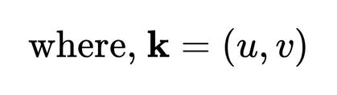
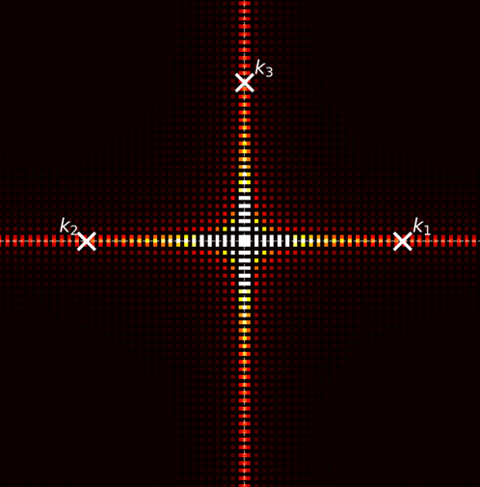



3-point function
  To statistically exploit the ridge-like pattern, we can compute the triple correlation function of the form
  This function is tuned, for wakes by selecting,
Maibach et al., Phys. Rev. D 104, 123535 (2021)

Slide 19
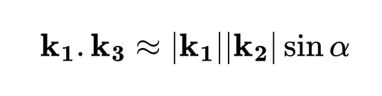
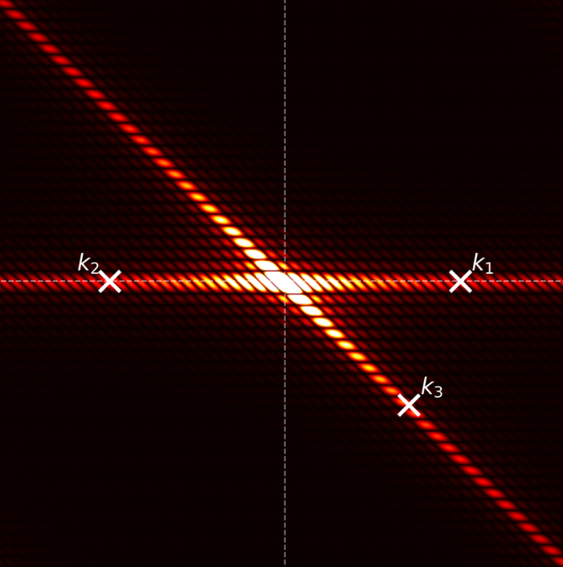


Further tuning,
  For a parallelogram shaped wake signal we select,
So to compute 3-point function,
  Vary
  Rotate
Maibach et al., Phys. Rev. D 104, 123535 (2021)

Slide 20

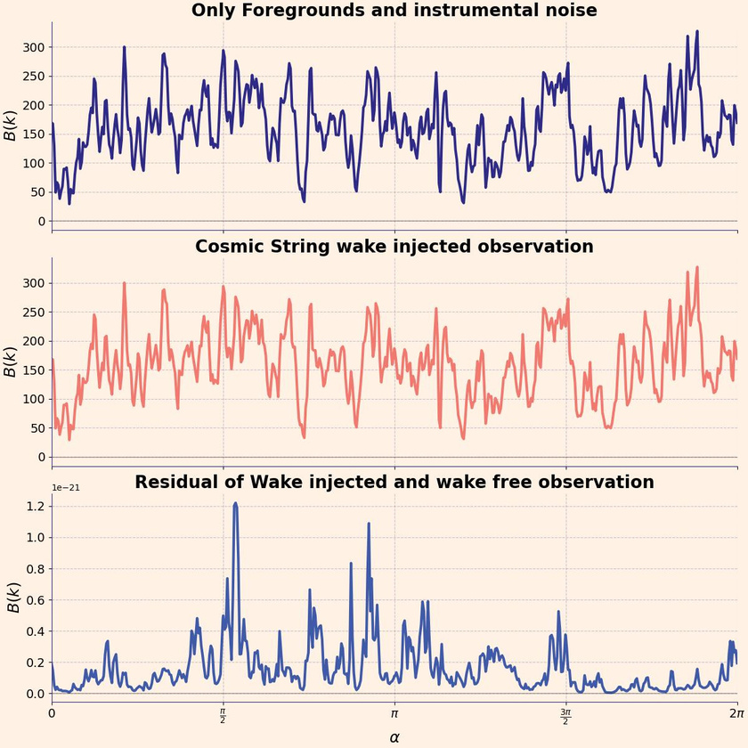
Deconstructing the 3-point function
  We can keep fixed, and vary
Where F(α) is defined as the 3-point function integrated over k, and a function of
From the residual, the aliasing and UV holes contribute considerably

Slide 21
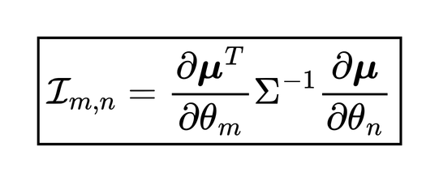
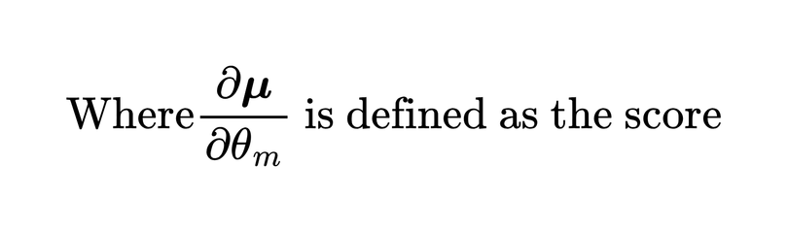
Steps to Fisher:
  Fisher information quantifies an observable’s ability to constrain a parameter Θ
  If we assume the covariance matrix is identity, or different alpha values are independent, we get the Gram matrix for the score

Slide 22
parameters and their relations
Parameters:
Relations:
  String tension is well constrained if the velocity factor is fixed, else degenerate
  Redshift of formation informs the observable and is well constrained
  Thermal noise and foreground removal are slightly correlated with wake parameters
  Instrumental gain does not inform the observable
  String tension (Gμ)
  String velocity factor (v_{s}γ_{s})
  Redshift of formation
  Thermal noise
  Foreground removal
  Instrumental gain

Slide 23
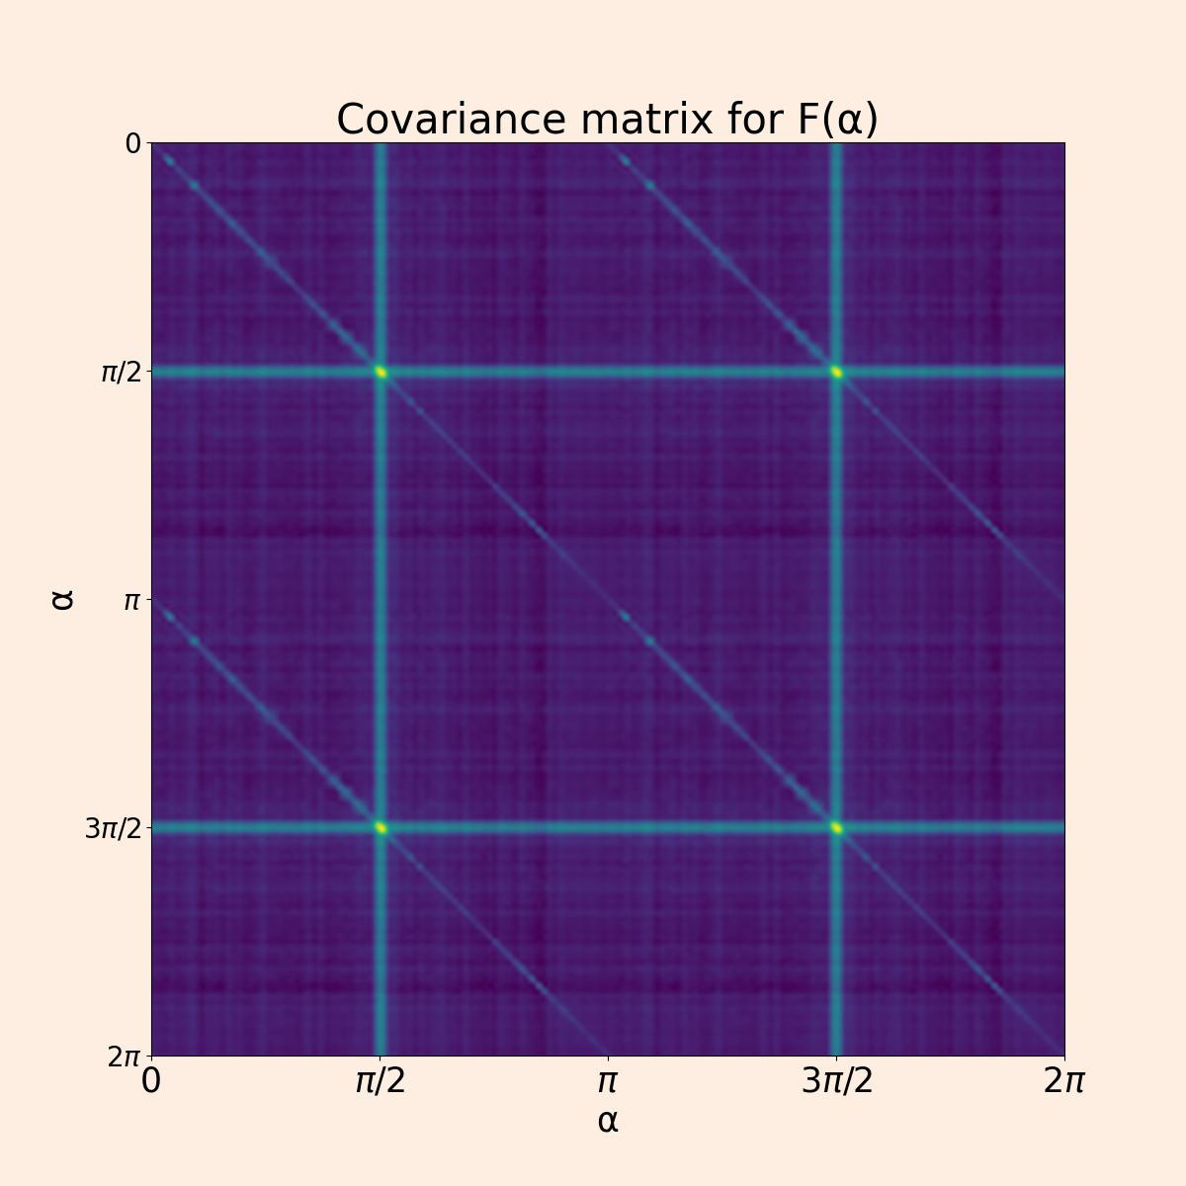
The alpha values are periodically correlated
But this will need a lot of simulations!

Slide 24
Postlude: The way ahead
  I will apply 3-point function analysis to 256 tile observations from next observing cycle of MWA
  New choice of statistics: simulation-based inference for parameter constraining with an autoencoder neural network
  SKA will have a comprehensive UV coverage

Slide 25
Encore: Summary
  Cosmic strings are 1D topological defects, whose wakes are overdense envelopes with distinct signatures in 21 cm maps
  Wakes have unique geometry in Fourier space, along with a narrow frequency width, which can be exploited to model/subtract noise
  3-point function is sensitive to wake parameters, but the wake identification is not apparent
  Further investigation of periodic noise and UV-coverage holes must be done
  A new statistic might prove better; one such attempt can be to use a simulation-based inference approach with an autoencoder

