Slide 1
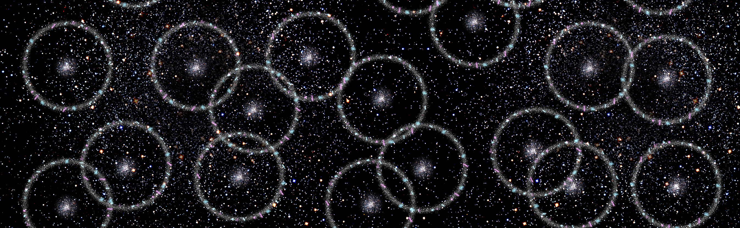
Cosmology with large-scale spectroscopic surveys
Cullan Howlett
Senior Lecturer, University of Queensland

Slide 2
Contents
Galaxy surveys are perhaps the most promising modern way of pinning down the precise nature of the cosmos. There’s a real possibility that we’ll ~finish mapping the Universe in our lifetimes.
How spectroscopic galaxy surveys constrain cosmology and particle physics
Current constraints
Future outlook

Slide 3
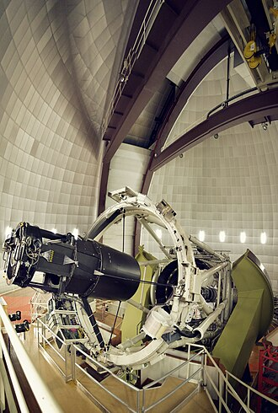
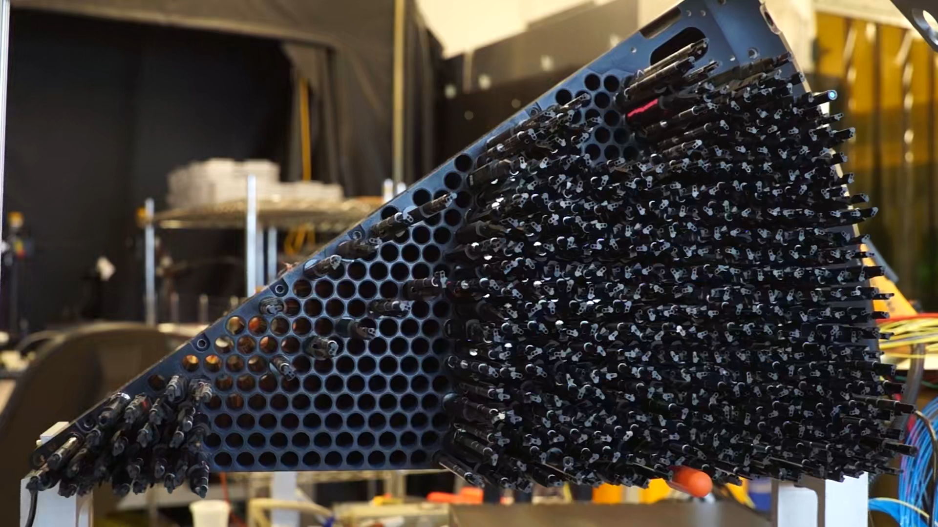
Spectroscopic galaxy surveys
Credit: Michael Schubnell
Statistical analysis of the large-scale structure of the Universe – mapped via galaxy redshifts – provides a huge amount of cosmological information
Credit: Ahilan Parameswaran

Slide 4
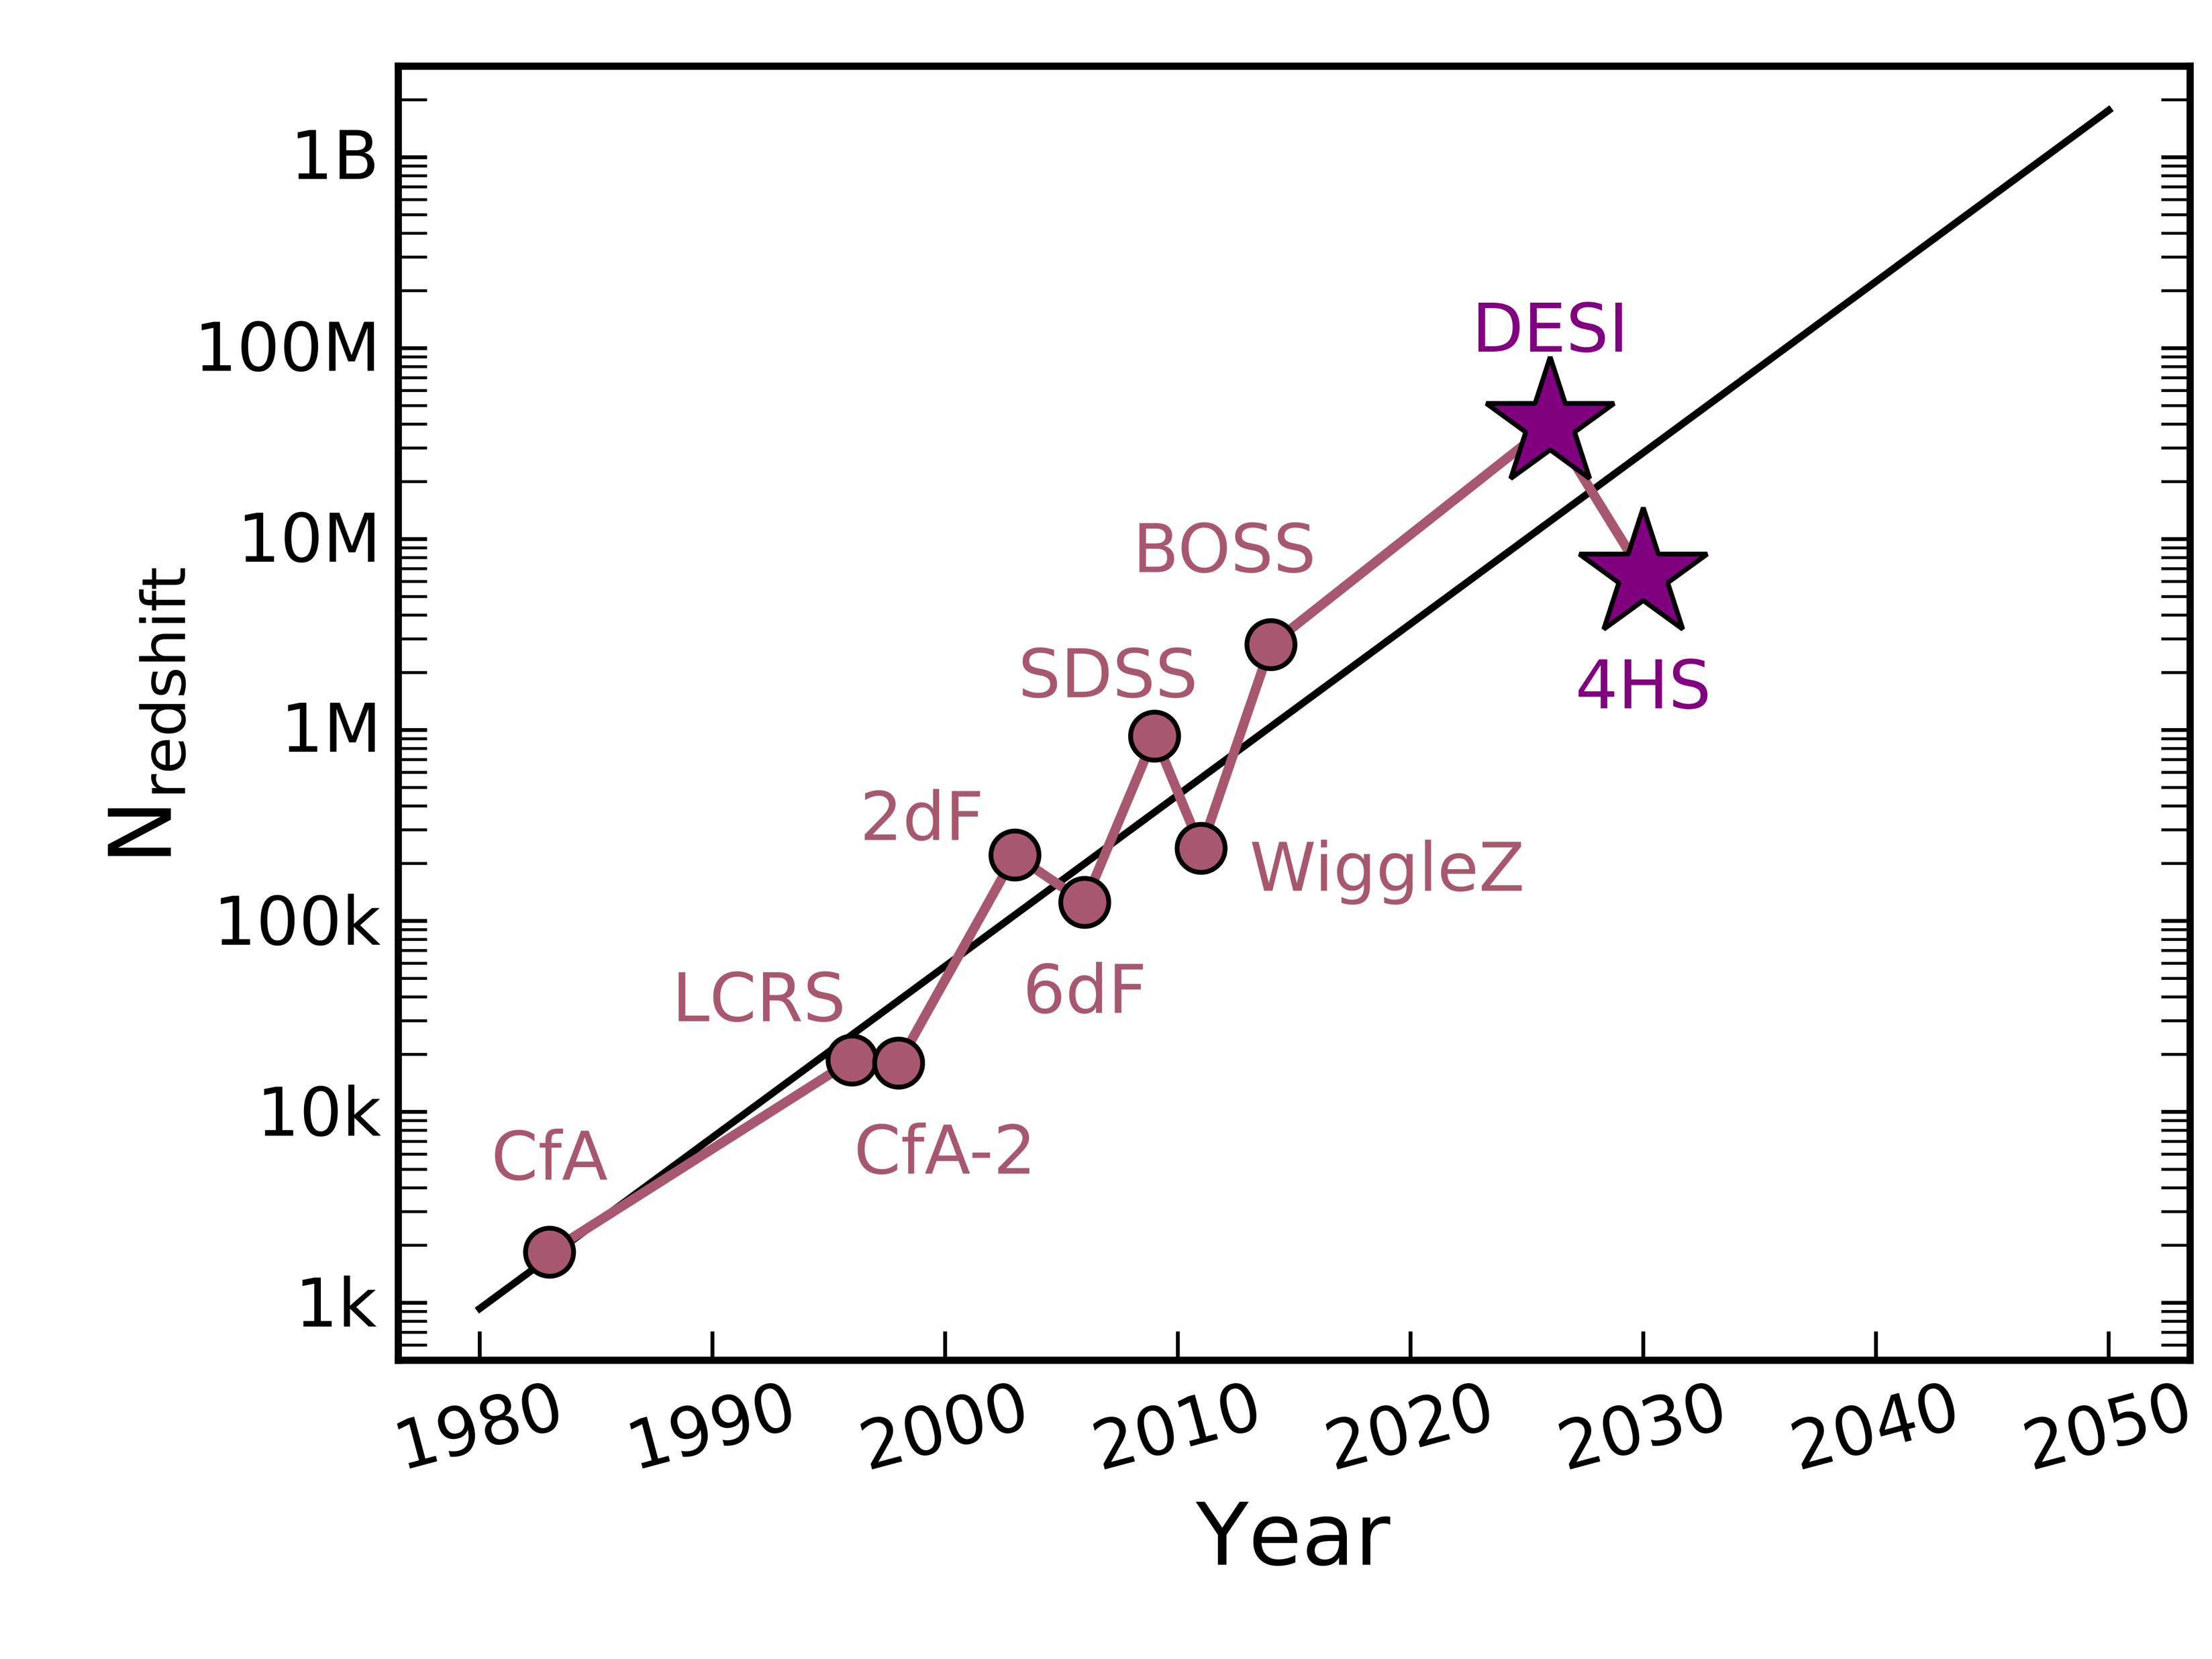
Spectroscopic galaxy surveys
Current state of the art surveys measure10s of millions of redshifts
Credit: Claire Lamman/DESI Collaboration
The most advanced (timeline) is the Dark Energy Spectroscopic Instrument (DESI)

Slide 5
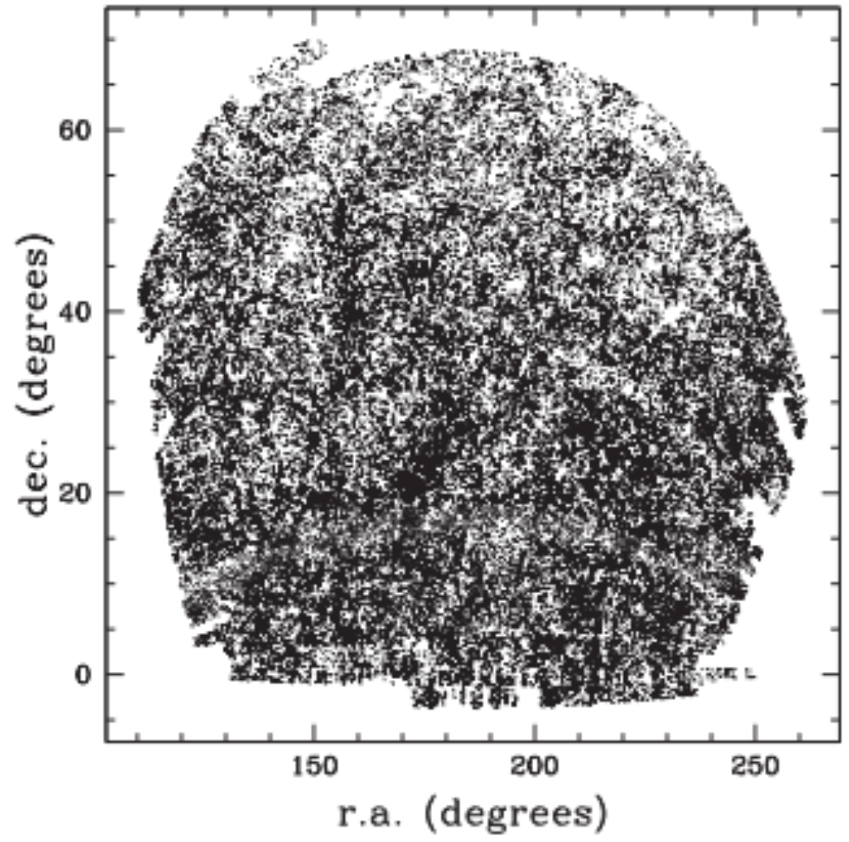
Galaxy clustering
One of our simplest but most useful tools is the two-point correlation function.
Ross et. al., 2015
This describes the probability, above random, of finding two galaxies separated by some distance and can be theoretically modelled for different cosmologies

Slide 6
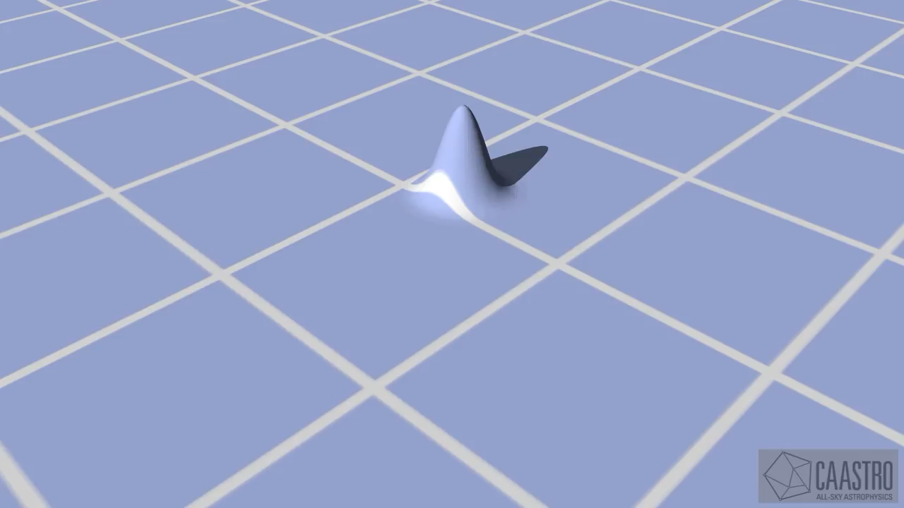
Galaxy clustering

Slide 7
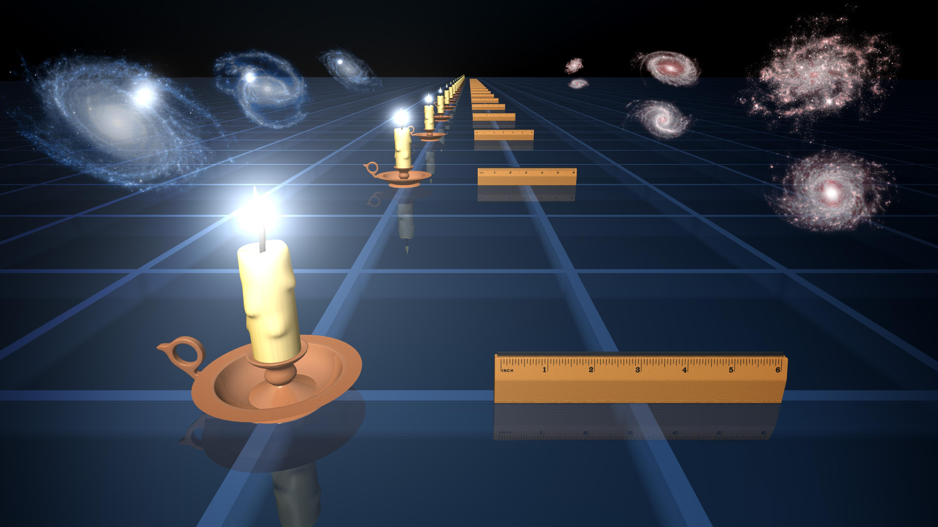
Baryon Acoustic Oscillations
Because we expect the BAO to be fixed since the early Universe, they act as ‘standard rulers’
They are great for measuring distance ratios. For absolute distances we need their intrinsic size (r_{d})

Slide 8
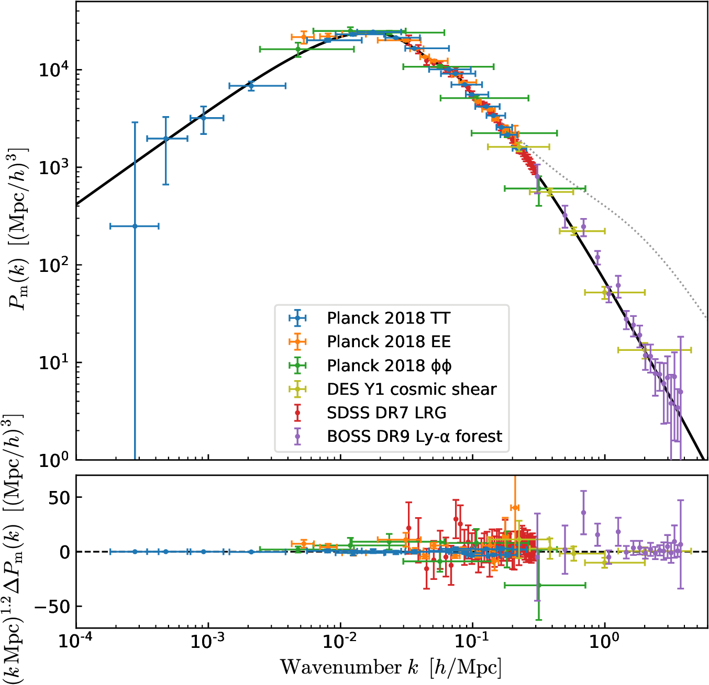
Beyond BAO
Chabanier et. al., 2019
“Full-modelling” of the power spectrum contains a huge amount more information.

Slide 9
Beyond BAO
Chabanier et. al., 2019
The large-scale modes tell us about inflation.

Slide 10
Beyond BAO
Chabanier et. al., 2019
The turnover scale is another standard ruler, given by the size of the Universe at matter-radiation equality.

Slide 11
Beyond BAO
Chabanier et. al., 2019
The amplitude of the BAO and the slope tell us the relative abundance of baryons to dark matter
Also baryonic physics, neutrinos and thermal dark matter properties

Slide 12
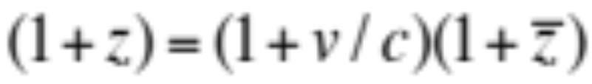
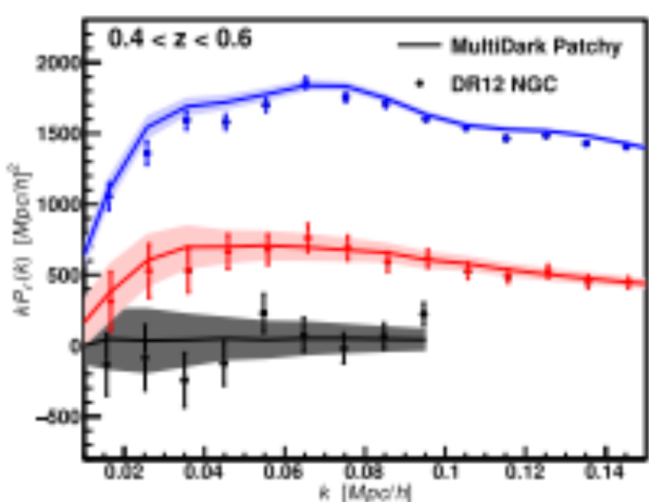
Redshift Space Distortions
Contaminant
Galaxy positions inferred from this
This should be isotropic
Furthermore, the clustering of inferred galaxy positions depends on the angle to the line of sight
Howlett et. al., 2015
Fourier transform and compress based on angle to line of sight.
Beutler et. al., 2017

Slide 13
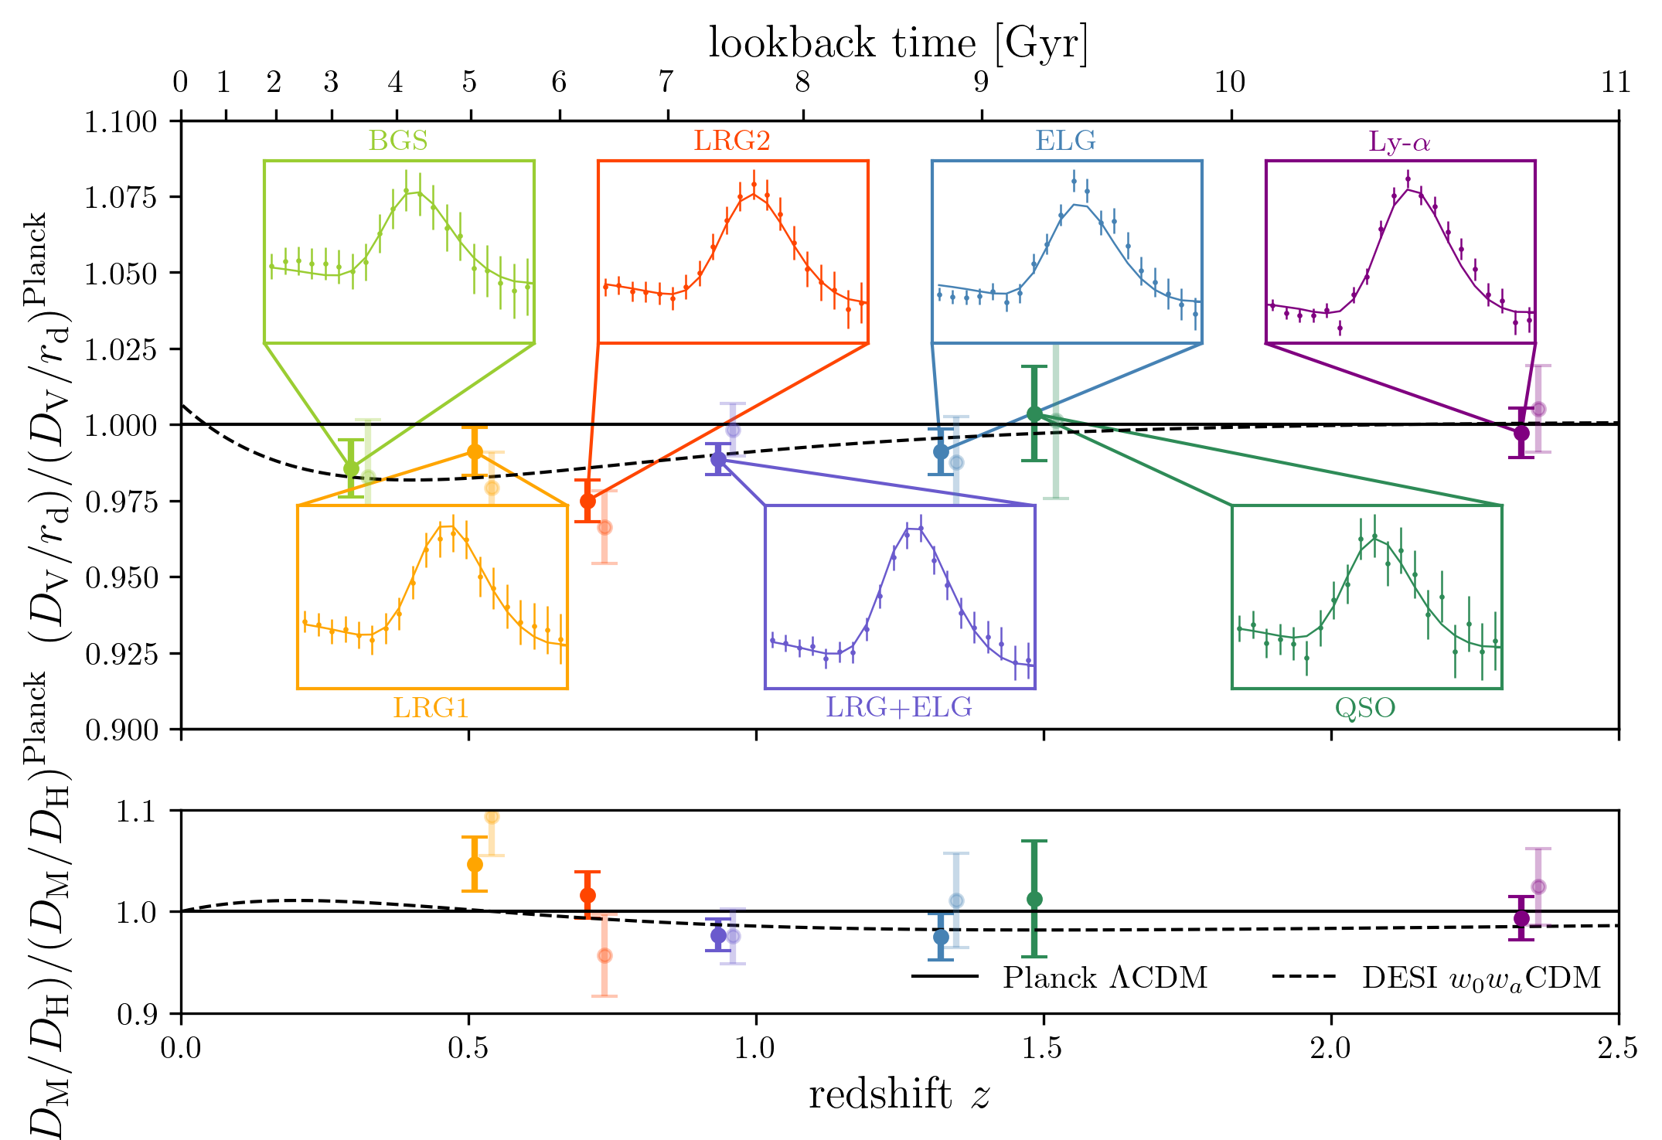
Dark Energy Constraints
A key unknown in cosmology is the equation of state of Dark Energy.
The simplest models have this as a Cosmological Constant (Λ).
DESI+CMB+Type Ia supernovae hint at time varying dark energy

Slide 14
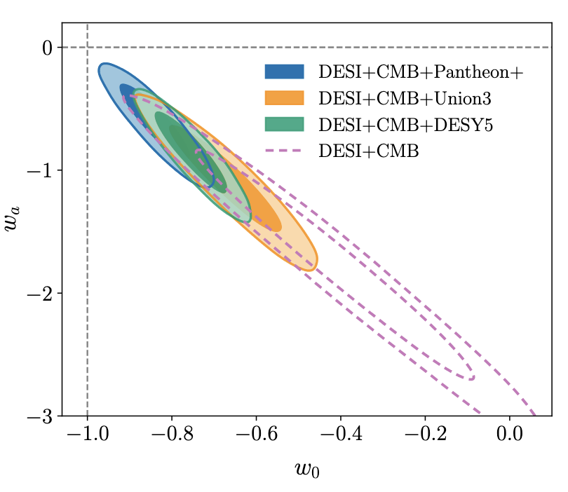
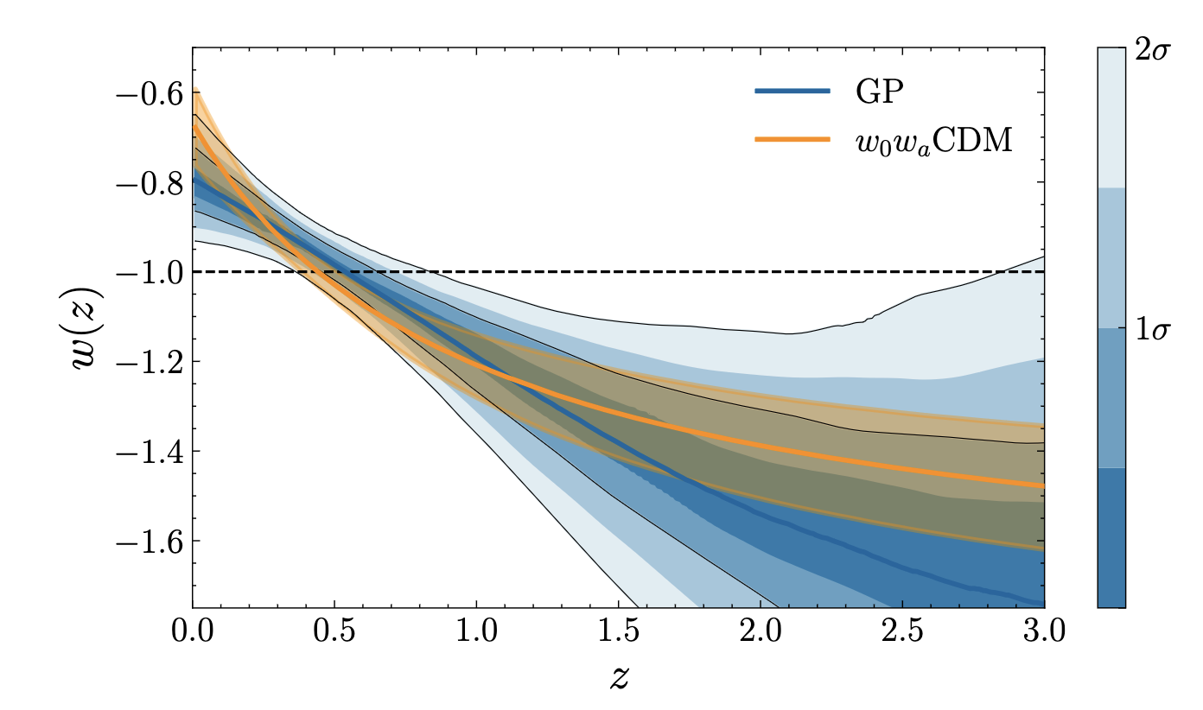
Dark Energy Constraints
DESI Collaboration 2025
Lodha et al., 2025
The preference for linearly time-varying Dark Energy over a cosmological constant is 2.8 - 4.2σ

Slide 15
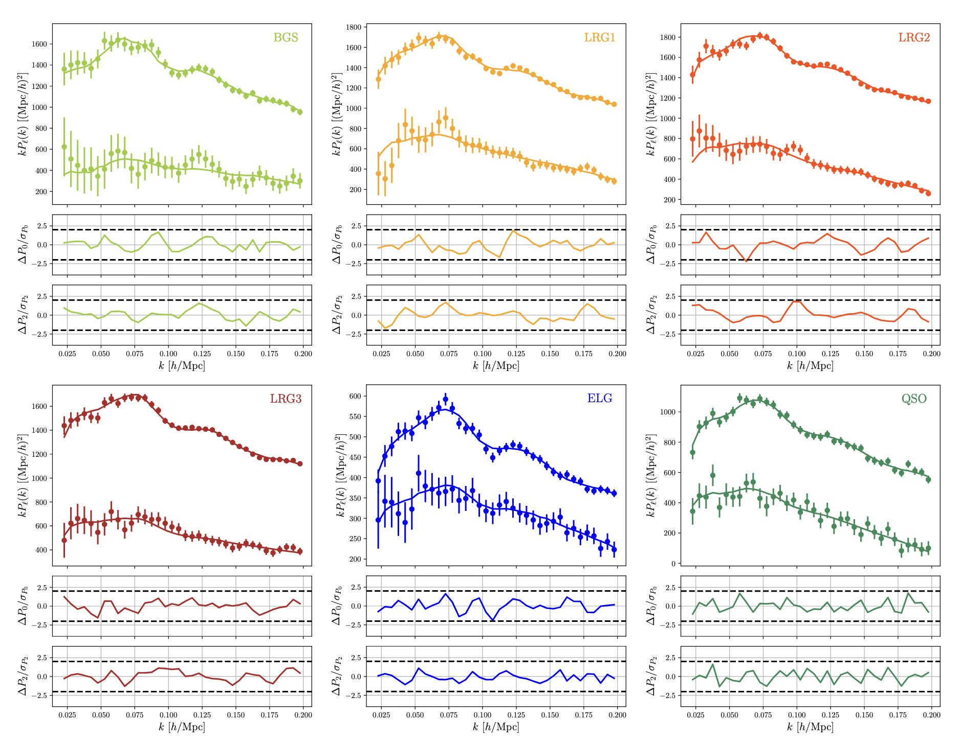
Tests of General Relativity
DESI Collaboration 2024 V
For more information, we can fit the full-shape of the clustering over cosmic history

Slide 16
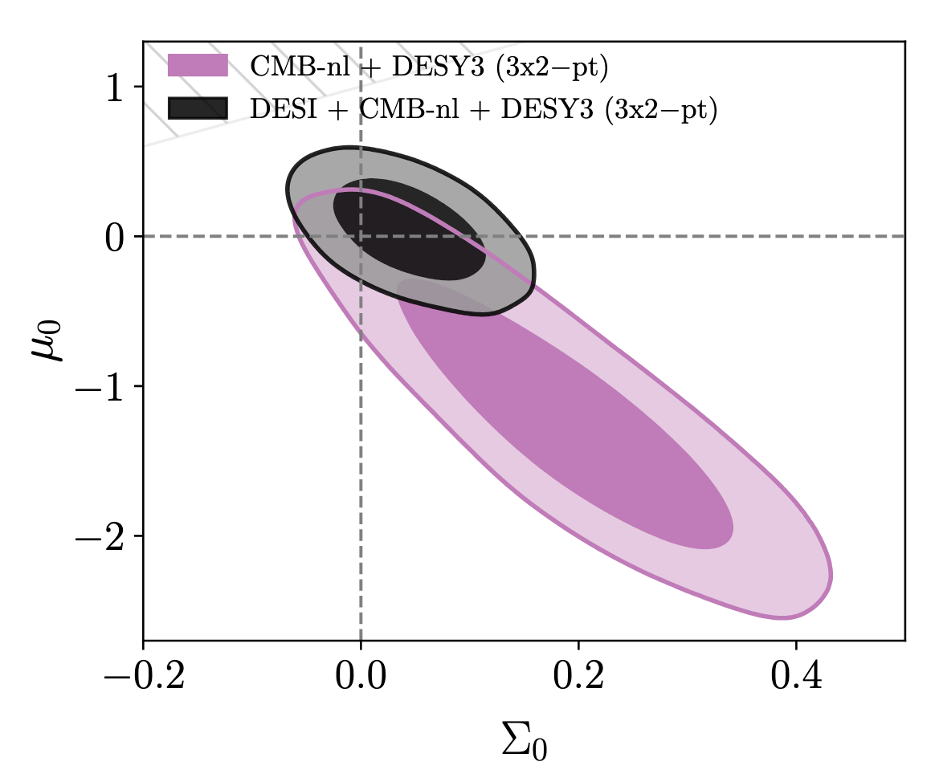
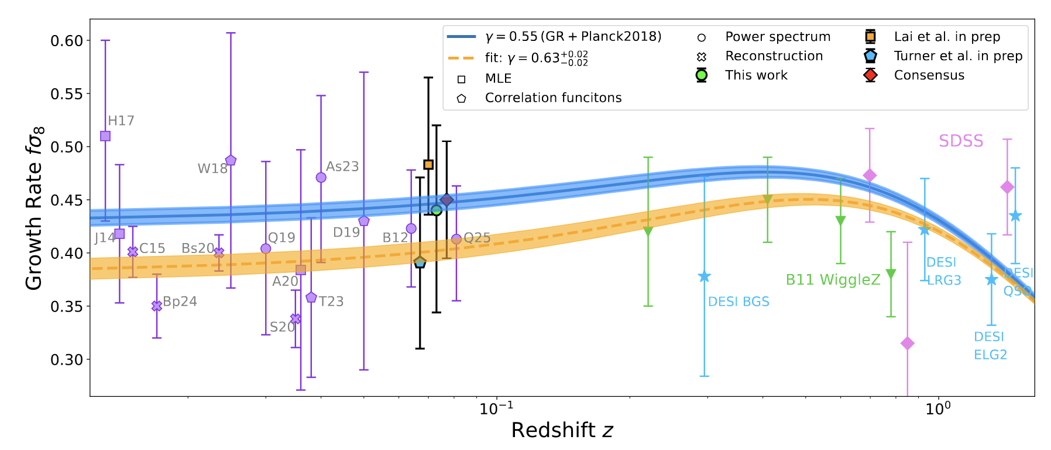
Tests of General Relativity
Full-modelling DE results consistent with BAO-only
No serious indication of anything beyond GR…yet
DESI 2024 VII
Qin et al., 2026

Slide 17
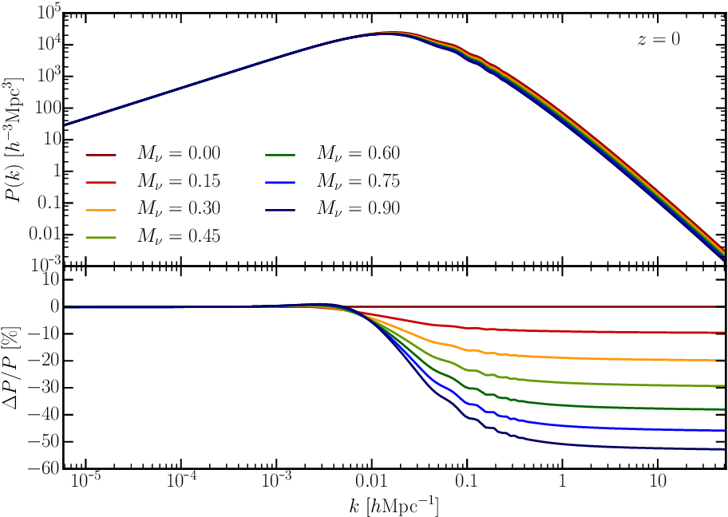
Neutrinos - Masses
Neutrinos act as a form of warm dark matter and suppress the growth of small scale structures.
However, most current information doesn’t come from this scale dependence but instead comes from their impact on the expansion history
Ω_{r}(z_{cmb}) → Ω_{m}(z₀)

Slide 18
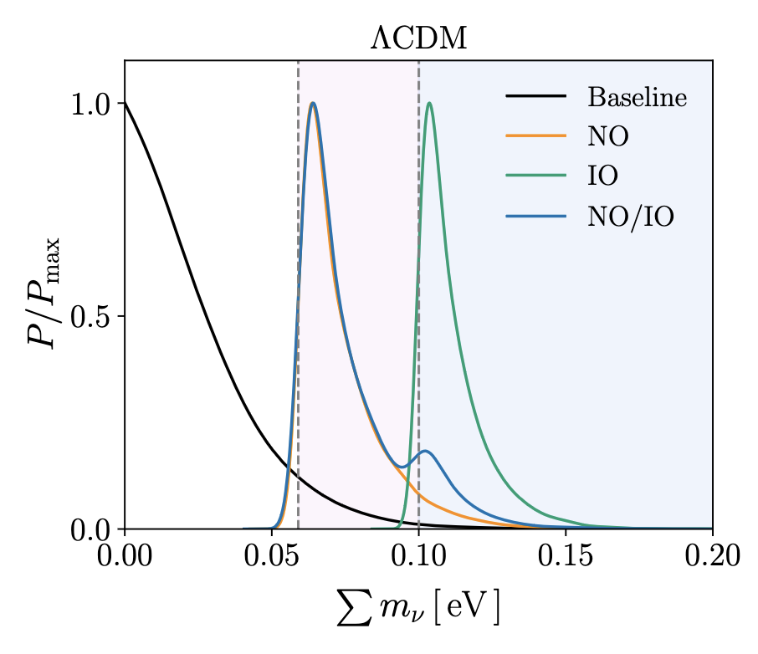
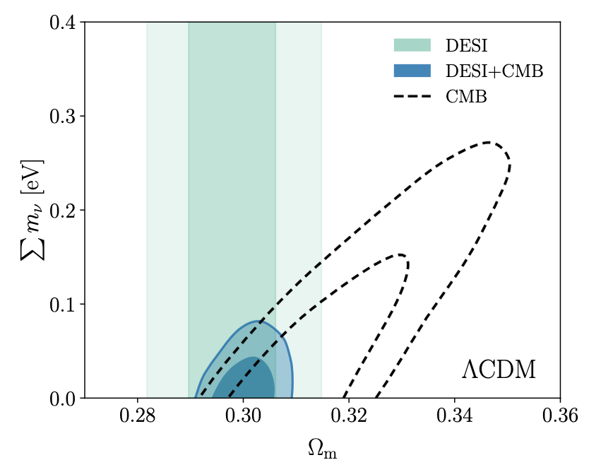
Neutrinos - Masses
At first glance, the latest DESI constraints prefer the normal hierarchy (or even no neutrinos!)
Elbers et al., 2025
But this is mostly driven by small differences in the preferred matter densities between datasets.
DESI Collaboration 2025

Slide 19
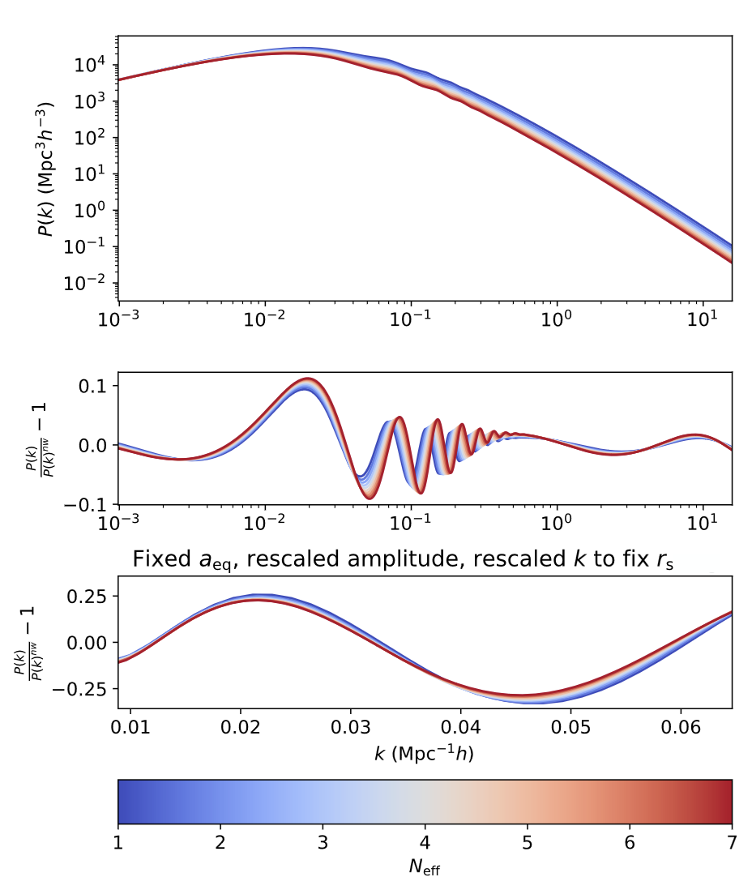
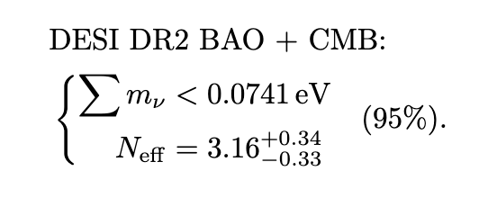
Neutrinos – N_{eff}
Different numbers of relativistic species also change the evolution of the BAO and small-scales
Whitford et al., 2025
(Elbers et al., 2025)
Neutrinos can also be seen as a phase-shift in the BAO
Detected at ~3σ in DESI data

Slide 20
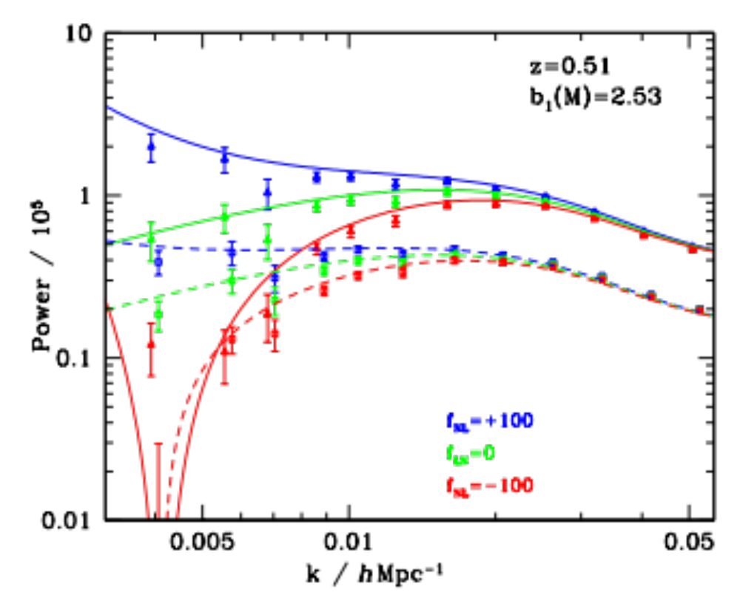
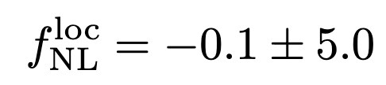

Primordial non-Gaussianity
(local) primordial non-Gaussianity changes the tails of the PDF of density fluctuations which then changes the abundance of massive halos
This adds scale-dependence to large-scale galaxy clustering
Desjacques & Seljak 2010
Clustering constraints are comparable to CMB
Planck DR4 (Jung et al., 2025)
DESI DR1 (Chaussidon et al., 2025)

Slide 21
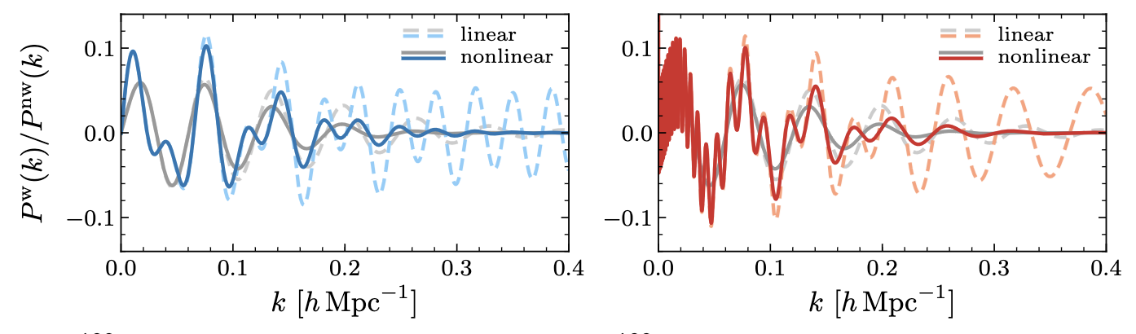
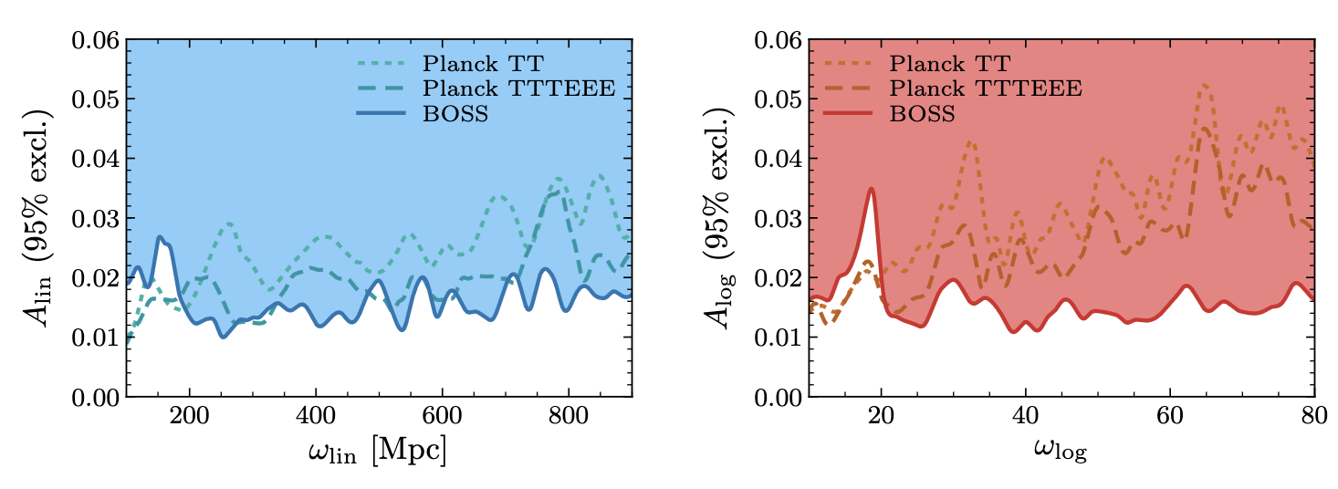
Primordial oscillatory features
Different inflation models can give rise to oscillatory features in the primordial spectrum that can be constrained in clustering akin to BAO
Beutler et al., 2019

Slide 22
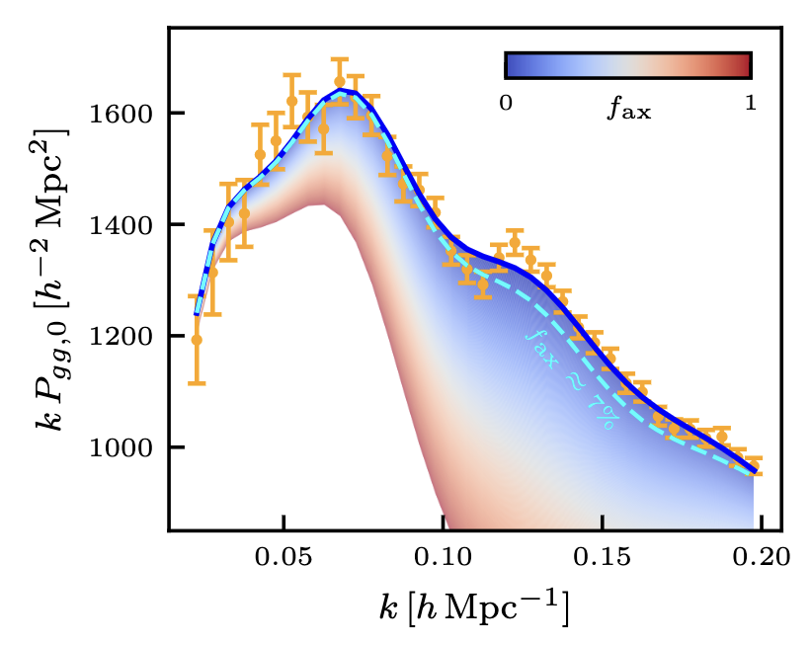
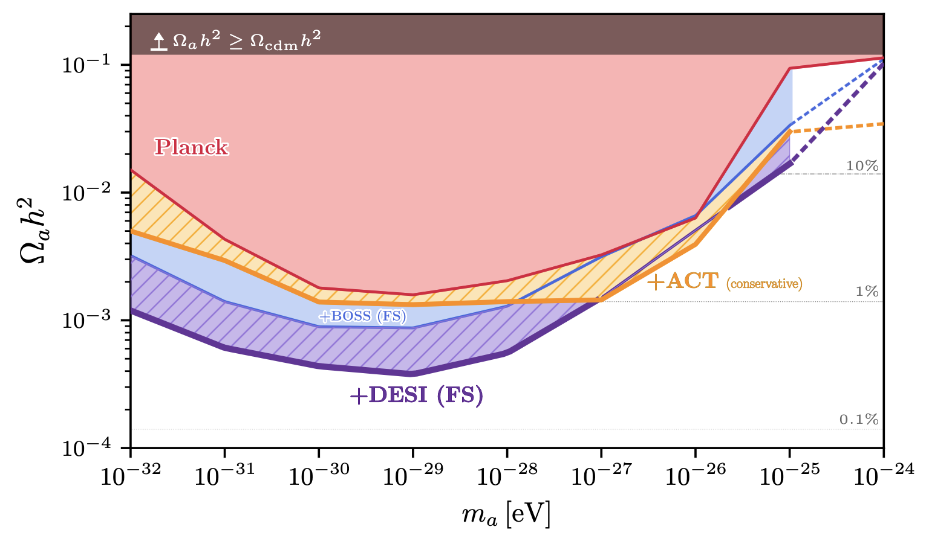
Warm DM and ultra-light axions
ULAs and other DM candidates can modify the non-linear galaxy power spectrum
Verdiani et al., 2026

Slide 23



So what’s next?
DESI has completed its original 5-year plan
  public Data Release 2 ~mid 2027
  We are currently observing run-1b, with run-2 to start ~2029.
Euclid expected to release first galaxy clustering results and data over the next 9 months.
The 4-metre Multi Object Spectrograph (4MOST) starts main survey operations later this year.
The linear z<=1.5 universe will be almost cosmic variance limited after these surveys

Slide 24
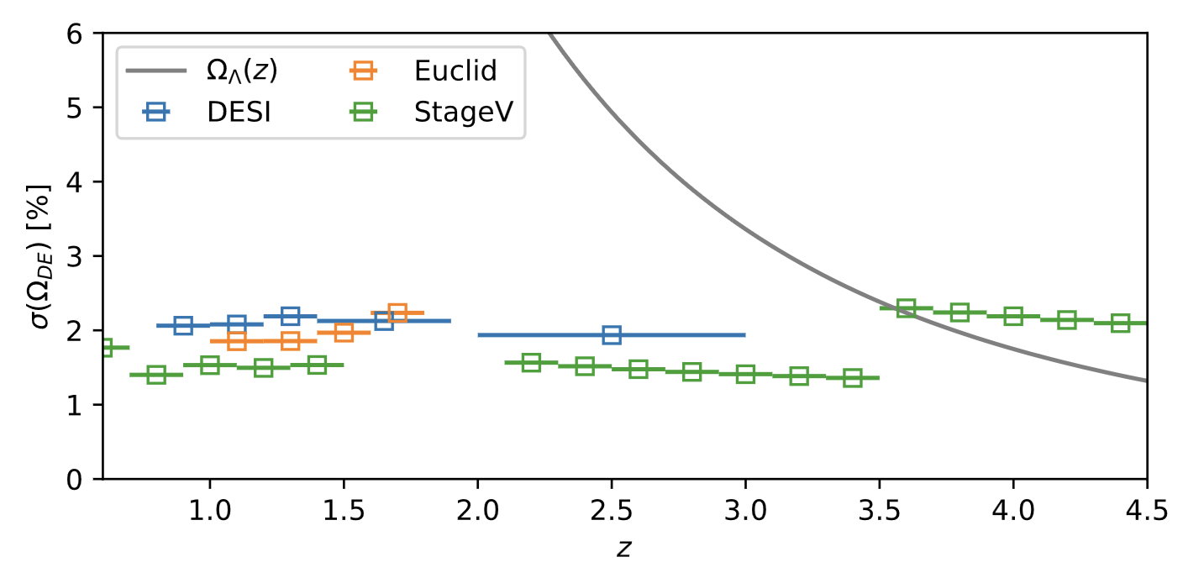
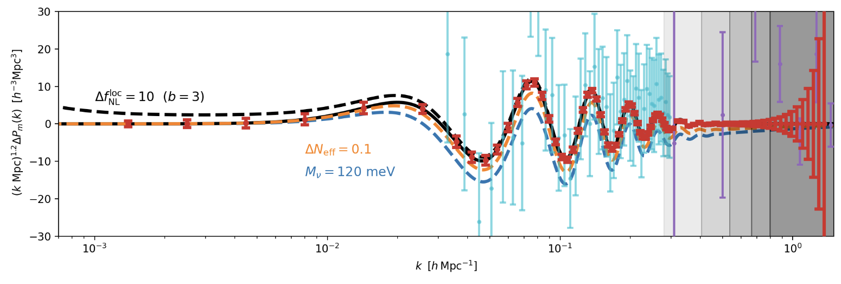
So what’s next?
Future surveys (Stage V) will hence probe the high-z transition from matter to DE domination
And focus on non-linear physics, neutrinos and the primordial universe
Besuner et al., 2025

Slide 25
Conclusions
Galaxy surveys are perhaps the most promising modern way of pinning down the precise nature of the cosmos. There’s a real possibility that we’ll ~finish mapping the Universe in our lifetimes.
Stage-V

