Slide 1
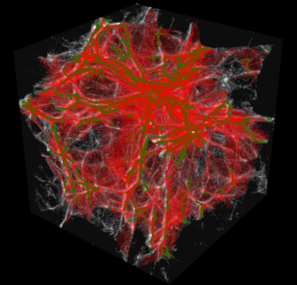
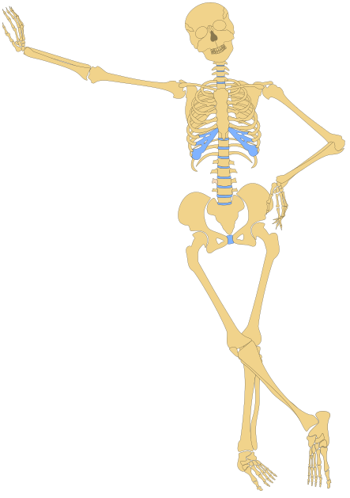

Caustic Skeleton
of the Local Cosmic Web
Amelie Read
Supervised by Prof. Celine Boehm and Dr Job Feldbrugge

Slide 2
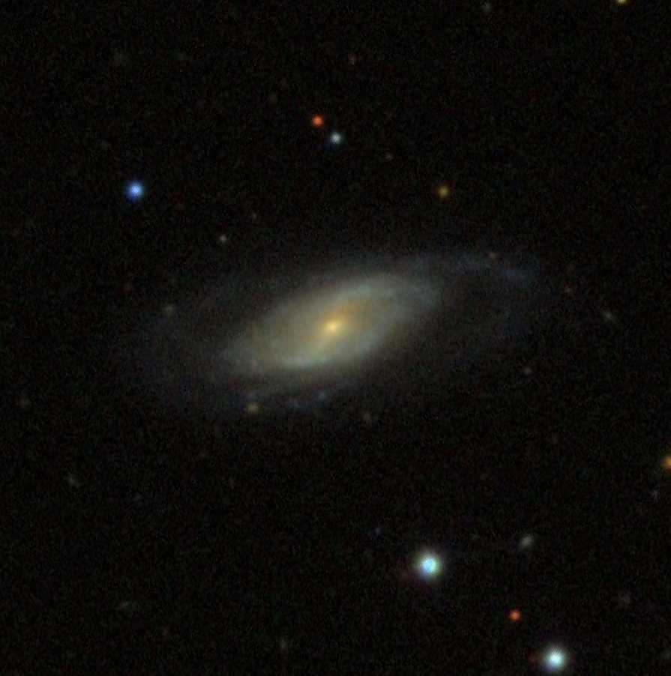
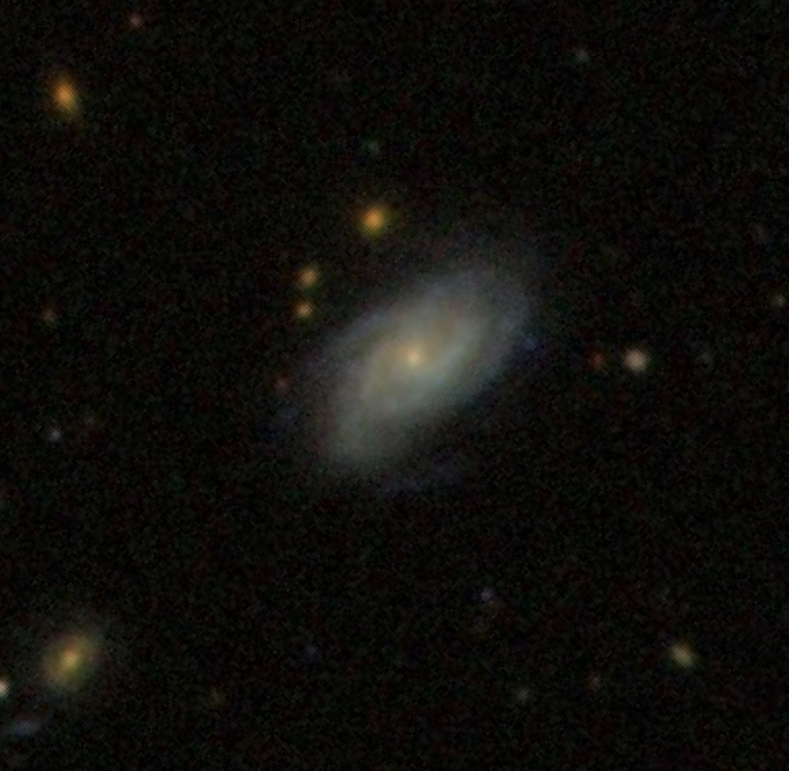
Z 221-23
Z 127-34
~ 10 kpc
SDSS
1
Notes:
So, looking at these two galaxies from afar, we can’t really say whether there’s anything significantly different about them, right?

Slide 3
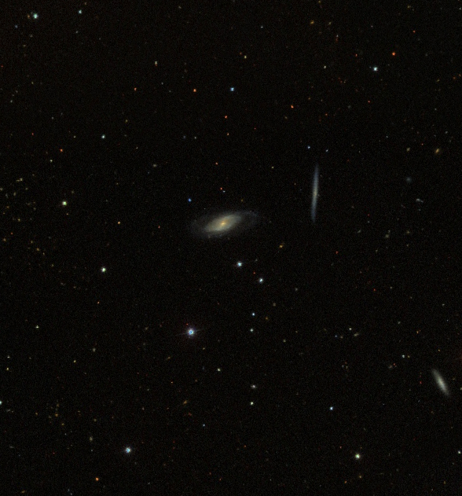
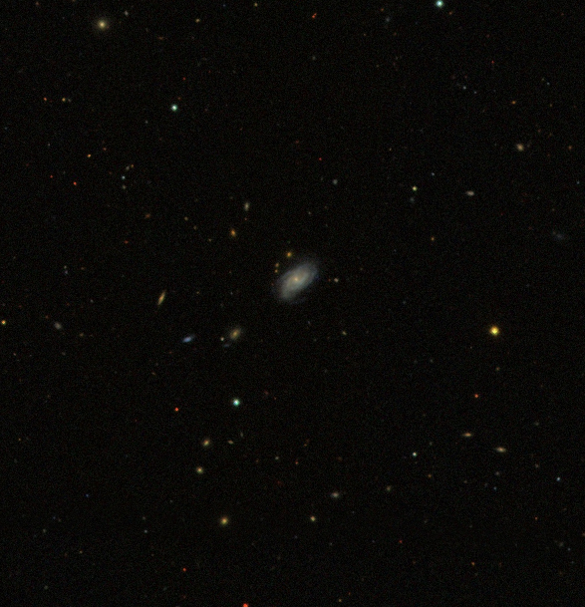
~ 100 kpc
SDSS
2
Notes:
But if we zoom out a bit, we do see a bit of a difference in their surroundings

Slide 4
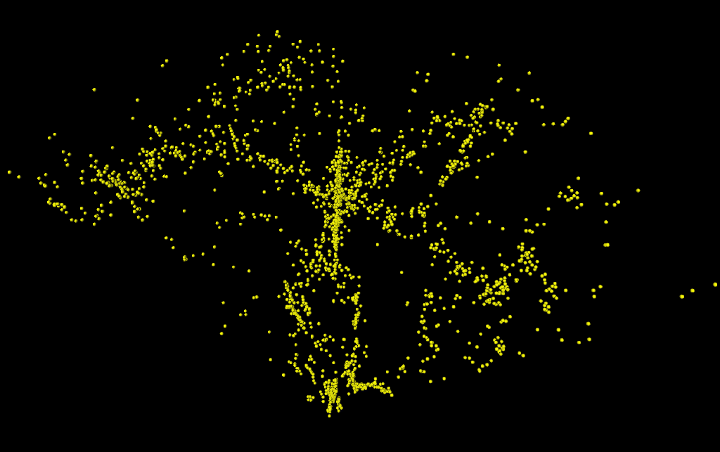
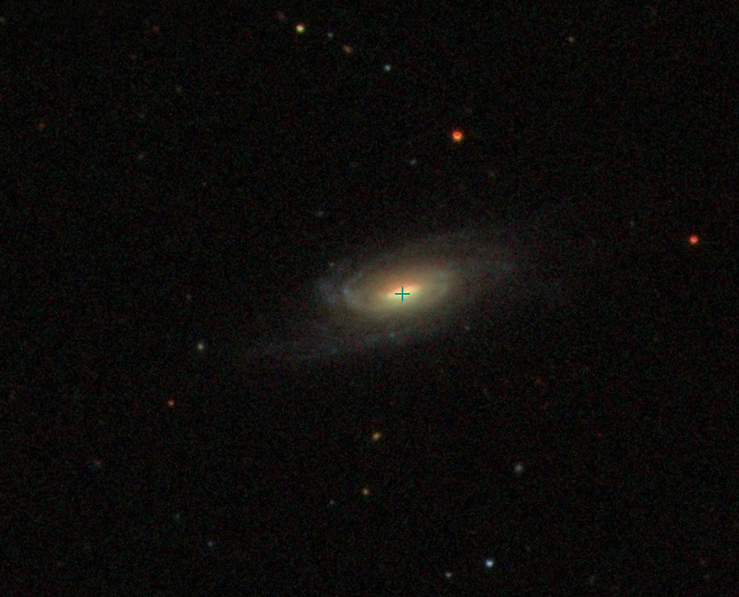
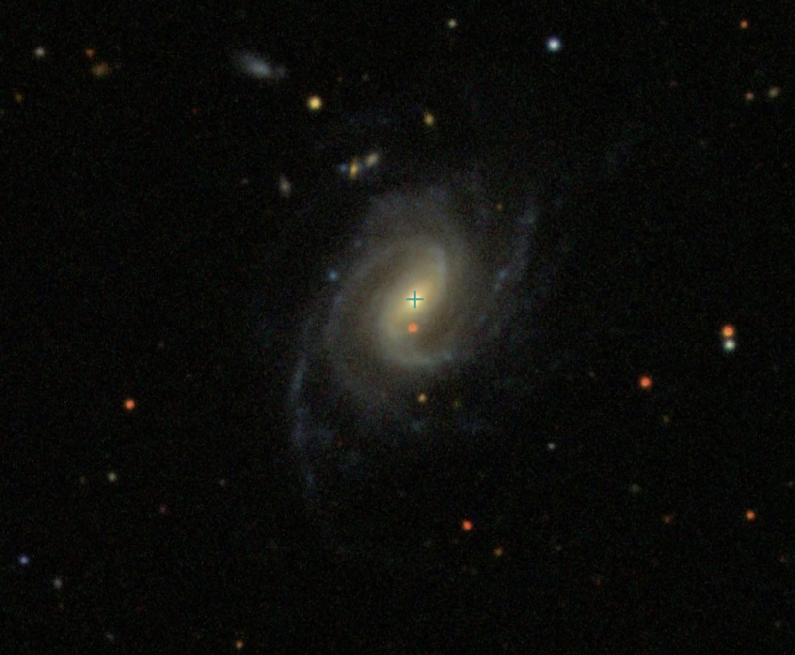
Coma Supercluster
YOU ARE HERE
~ 10 Mpc
De Lapparent et al. (1985)
De Lapparent et al. (1985)
3
Notes:
But if were to zoom out again, we would find that these galaxies actually in the same supercluster, known as coma, with around 100,000 other galaxies.
And if we zoom out again

Slide 5
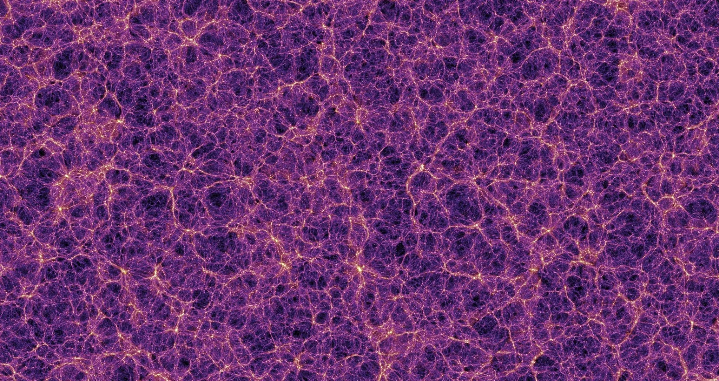
The Cosmic Web
~ 100 Mpc
Credit: Springel et al. (2005)
4
Notes:
We see that on extremely large scales, individual galaxies are simply pinpricks in what we call the cosmic web

Slide 6
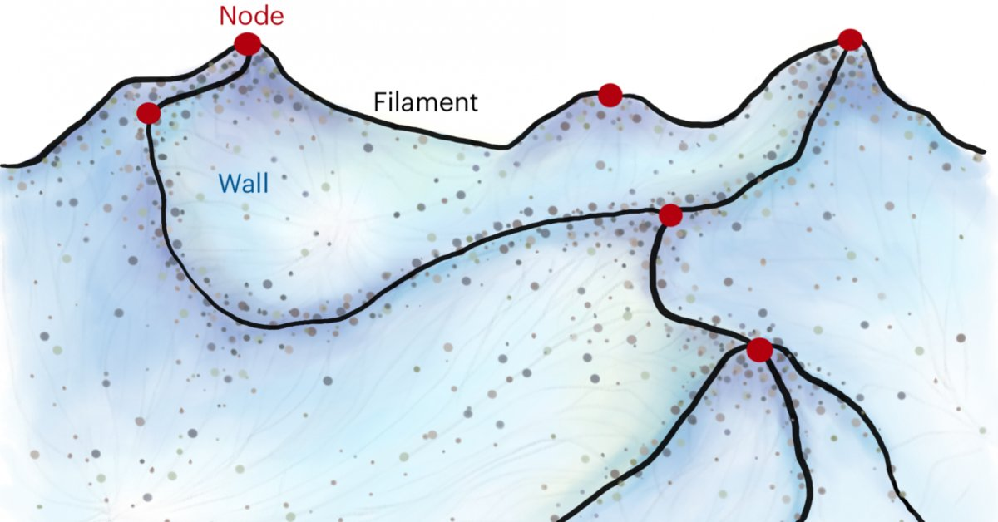
The Cosmic Web
Cluster
Credit: Daniela Galárraga-Espinosa/MPA
~ 100 Mpc
Credit: Springel et al. (2005)
5
Notes:
Like a web, we see long elongated string-like filaments that connect at highly concentrated nodes
And in this 3d web, galaxies also sit along sheet-like walls that envelope voids which are devoid of galaxies like the holes in a web.

Slide 7
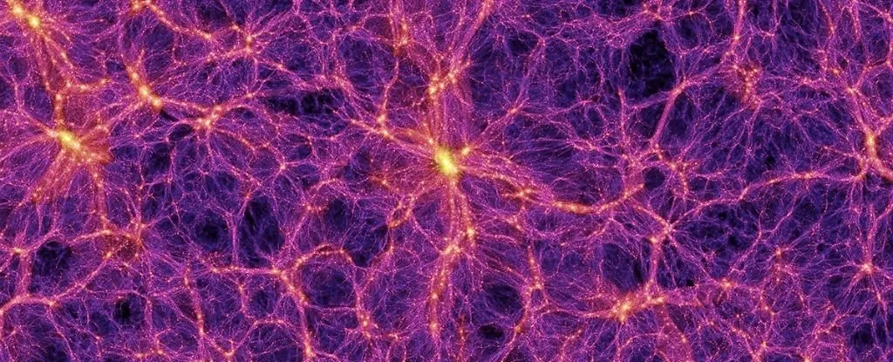
Large-Scale Structure in the Cosmic Web
Clusters, Filaments, Walls, Voids
Credit: Springel et al. (2005)
Pivotal in galaxy formation and evolution (Jones et al. 2010, Tempel and Libeskind 2013, Aragon Calvo et al. 2019, Barsanti et al. 2022)
Sensitive to underlying cosmology (Li 2011, Lavaux & Wandelt 2010, 2012, Bos et al. 2012, Hidding et al. 2013)
Cluster
Conclusions
You can describe the topic of the section here
Credit: Daniela Galárraga-Espinosa/MPA
6
Notes:
So the reason we care a lot about the large-scale structures of the cosmic web, is that they are pivotal in galaxy formation and evolution - studies have demonstrated a connection between the large-scale cosmic environment of a galaxy and its observed properties.
Also, the structure and dynamics of the cosmic web are sensitive to our universe’s underlying cosmology, and so it is also a useful probe of fundamental physics

Slide 8

Credit: Springel et al. (2005)
Cluster
Cluster
Credit: Daniela Galárraga-Espinosa/MPA
7
Notes:
So in order to understand the cosmic web, and the nature of our universe, we want to dissect it and break it apart into its components, its skeleton of clusters, filaments and walls,

Slide 9

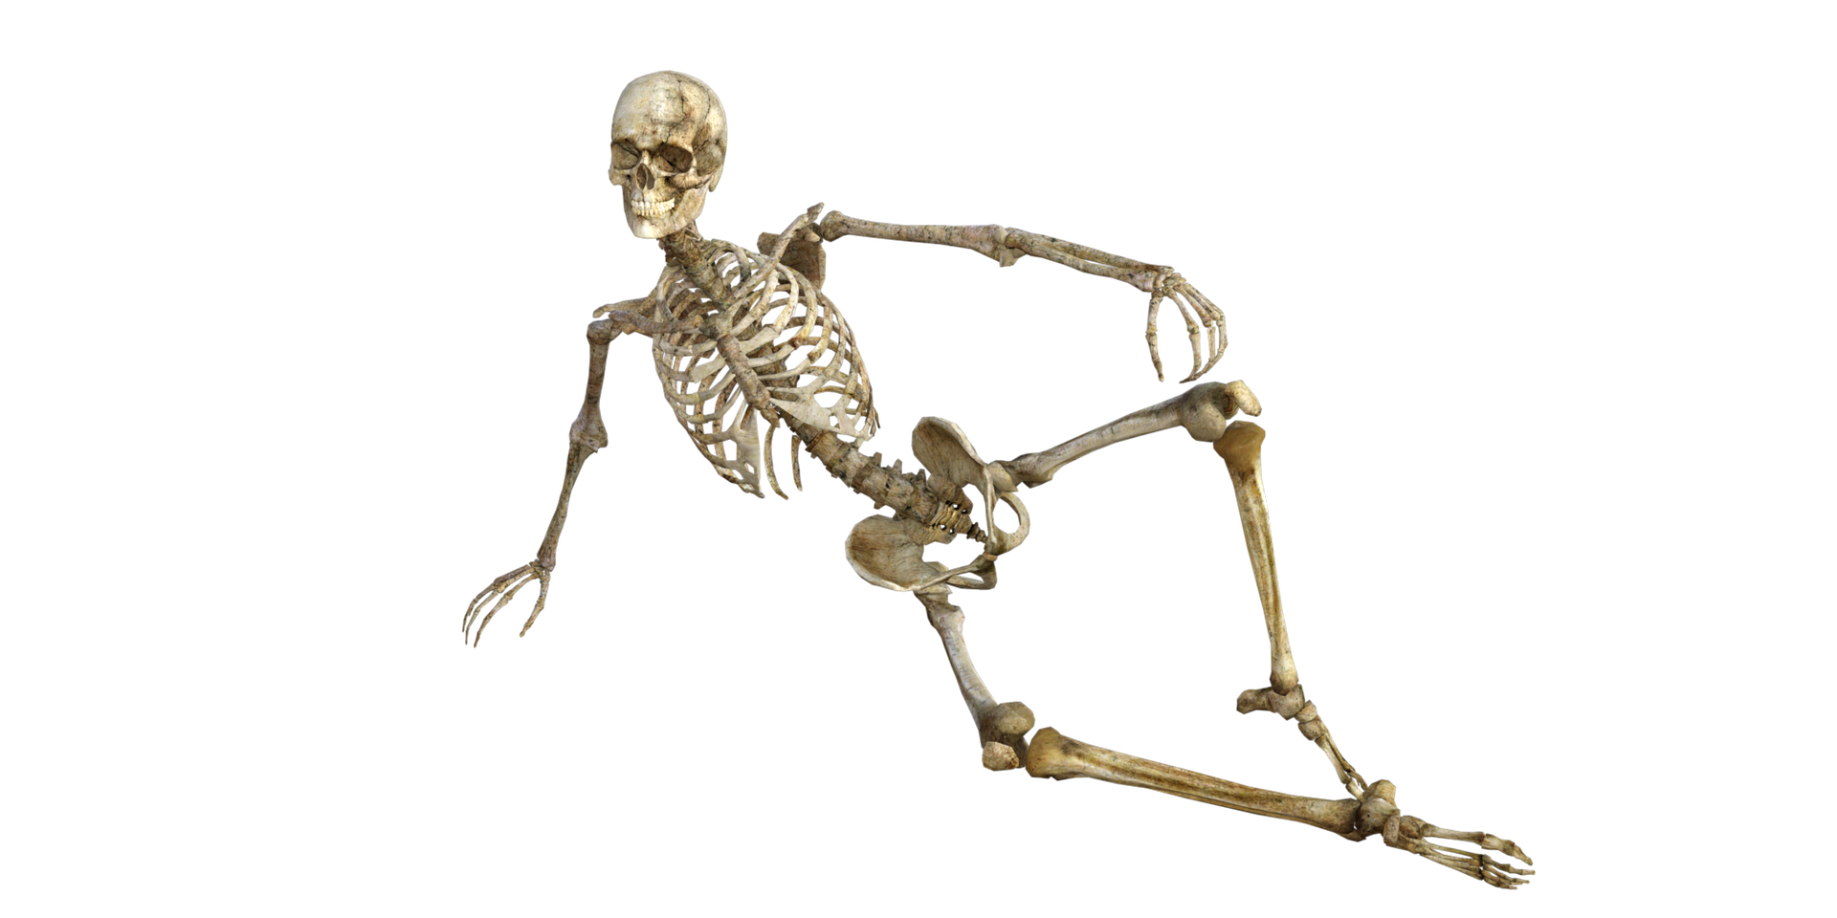

Untangling the Cosmic Web
! THEORY IN DEVELOPMENT !
Caustic Skeleton Theory
Arnold, Shandarin and Zel’dovich (1982) -------- Feldbrugge et al. (2018)
Classify large-scale structure analytically according to formation history
Cluster
Credit: Daniela Galárraga-Espinosa/MPA
8
Notes:
And this is where Caustic Skeleton Theory comes in, it is an analytic approach to classifying observed large scale structures according to their formation history.
This theory has been around since the 1980s, but only recently revived by Dr Feldbrugge, and I’m now working with him, to further develop and demonstrate the power of this technique

Slide 10
! THEORY IN DEVELOPMENT !
Caustic Skeleton Theory
Arnold, Shandarin and Zel’dovich (1982) -------- Feldbrugge et al. (2018)
Classify large-scale structure analytically according to formation history
Both in Filaments!
9
Notes:
In fact, with this I can tell that those two galaxies from before are both in filaments.

Slide 11
! THEORY IN DEVELOPMENT !
Caustic Skeleton Theory
Arnold, Shandarin and Zel’dovich (1982) -------- Feldbrugge et al. (2018)
Classify large-scale structure analytically according to formation history
A-type
Different types of Filaments?!
D-type
10
Notes:
But what if i were to tell you that caustic skeleton theory actually says that they are in different kinds of filaments?
The existence of different types of filaments is a prediction unique to caustic skeleton theory, because traditional structure classifying methods tend to overlook that last point about formation history, and so miss out on capturing the rich information contained in the dynamical evolution of the cosmic web.

Slide 12
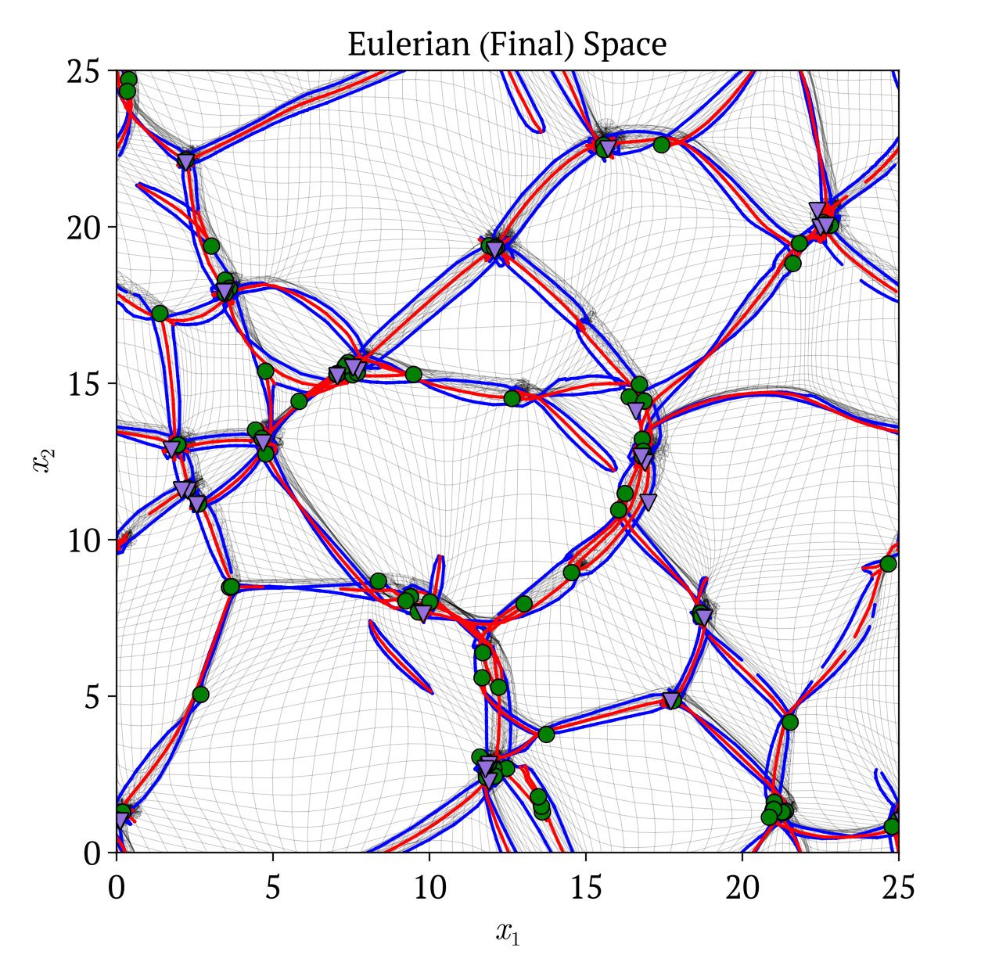
1. How does Caustic Skeleton Theory work?
2. Applying to
2D simulations
3. Applying to observations
A-type?
D-type?
11
Notes:
So first, im going to briefly take you through how caustic skeleton theory works, and where this prediction of A and D type filaments comes from.
Then i will show how we can apply it to simulations to successfully extract large-scale structures
Finally, I will show how we can then apply caustic skeleton theory to observations, to uncover the nature and history of the large scale environment of galaxies

Slide 13

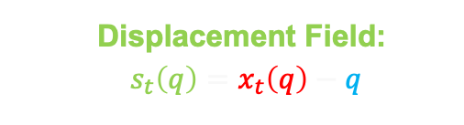
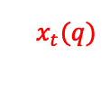
Lagrangian Fluid Dynamics
Divide into mass elements
$$x_{t}(q)$$
Lagrangian (Initial)
Coordinates
Eulerian (Final)
Coordinates
Collisionless
Cosmological
Dark Matter Fluid
on Large-scales
$$q$$
Displacement Field:
$s_{t}\left(q\right)=x_{t}\left(q\right)−q$
12
Notes:
So, the backbone of caustic skeleton theory is lagrangian fluid dynamics
On large scales, we treat the universe as a collisionless cosmological dark matter fluid, which we divide into equal infinitesimal mass elements.
We call an element’s initial position in this grid its lagrangian coordinate.
As the cosmological fluid evolves, we can trace its path to its final or eulerian position xt(q)
And from this we define a displacement field, which is simply each element’s final minus initial position.

Slide 14
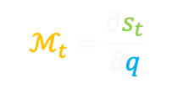
Lagrangian Fluid Dynamics
Divide into mass elements
$$x_{t}(q)$$
Lagrangian (Initial)
Coordinates
Eulerian (Final)
Coordinates
Collisionless
Cosmological
Dark Matter Fluid
on Large-scales
$$q$$
Displacement Field:
$s_{t}\left(q\right)=x_{t}\left(q\right)−q$
Deformation Tensor:
$$ℳ_{t}=\frac{∂s_{t}}{∂q}$$
12
Notes:
These mass elements can undergo general deformations, which are encoded in the Deformation Tensor, simply put this is the derivative of the displacement field.

Slide 15
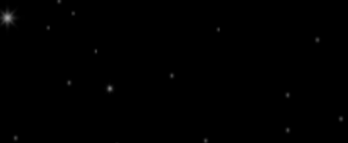



Caustics
2D phase-space sheet
Critical Points in $x_{t}\left(q\right)$
In 1D:
Lagrangian (Initial) $q$
Eulerian (Final) $x_{t}(q)$
13
Notes:
So some of you may have heard of caustics before in gravitational lensing or optics, but in this context they are simply critical points in the lagrangian map xt(q)
this is a simple 1 dimensional example. imagine some mass elements evenly spaced along this string. To start, their initial and final positions will be the same so the plot on the right is just a 1-1 line.
So what im going to do is take this string,

Slide 16

Caustics
2D phase-space sheet
Critical Points in $x_{t}\left(q\right)$
In 1D:
fold
x
Displacement Field:
$s_{t}\left(q\right)=x_{t}\left(q\right)−q$
Lagrangian (Initial) $q$
caustic
shell-crossing
x
Eulerian (Final) $x_{t}(q)$
13
Notes:
And essentially fold it, bringing one end through the other,
So on the left, we see that the two darkest particles crossed this middle particle, which we call shell-crossing
And as we can see on the right a critical point has developed at the same place as this shell-crossing, and so this is our caustic.
You can go between the caustics position in lagrangian and eulerian space simply by using the displacement field.

Slide 17
Caustics
2D phase-space sheet
Critical Points in $x_{t}\left(q\right)$
Multi-stream region
In 1D:
fold
x
Displacement Field:
$s_{t}\left(q\right)=x_{t}\left(q\right)−q$
Lagrangian (Initial) $q$
caustic
shell-crossing
x
Eulerian (Final) $x_{t}(q)$
Multi-stream regions mark beginning of gravitational collapse
~ caustics should be good tracers of structure ~
13
Notes:
Now, caustics are important, because they indicate the transition from a region with no particles, to a multi-stream region
And multi-stream regions are significant because their emergence marks the beginning of gravitational collapse
in this simplified scenario particles just easily moved past each other – but with realistic gravity we might expect them to stick together and collapse into a bounded structure around the shell crossing or caustic point
And this is why we expect that these caustics should indeed be good tracers of large scale structure
but how do we find caustics?

Slide 18
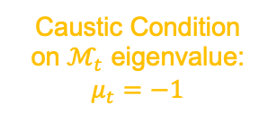
Caustics
2D phase-space sheet
Critical Points in $x_{t}\left(q\right)$
Multi-stream region
In 1D:
fold
x
Caustic Condition
on $ℳ_{t}$ eigenvalue:
$$μ_{t}=−1$$
Lagrangian (Initial) $q$
caustic
shell-crossing
x
Eulerian (Final) $x_{t}(q)$
Multi-stream regions mark beginning of gravitational collapse
~ caustics should be good tracers of structure ~
13
Notes:
well with a little bit of maths, it can be shown that this fold caustic can be found by enforcing this condition on the eigenvalue field mu of the deformation tensor.

Slide 19
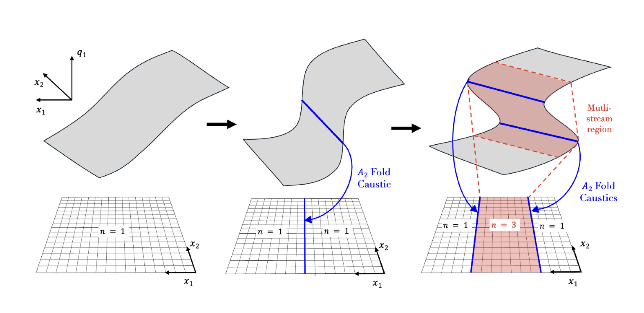
Caustics
2D phase-space sheet
Critical Points in $x_{t}\left(q\right)$
In 2D:
14
Notes:
Now to try get an intuition of caustics in higher dimensions,
Consider this scenario, where we are mapping a 2d distribution of particles from two initial lagrangian coordinates, only one of which is shown here in the vertical direction, to two final eulerian positions, which form the plane at the bottom,
so to start, we have just a 1-1 sheet, which is single streaming everywhere in the plane below.

Slide 20
Caustics
2D phase-space sheet
Critical Points in $x_{t}\left(q\right)$
In 2D:
14
Notes:
As the sheet then evolves, an instantaneous fold caustic forms when the mapping from lagrangian to eulerian space becomes degenerate, same as the 1d scenario,
This is the first instance of shell-crossing

Slide 21
Caustics
2D phase-space sheet
Critical Points in $x_{t}\left(q\right)$
In 2D:
Multi-stream regions mark beginning of gravitational collapse
~ caustics should be good tracers of structure ~
14
Notes:
If we let it further evolve, the sheet has continued to fold over itself, such that the instantaneous shell-crossing is now happening along two different sections of the sheet, manifesting as two fold lines that bound a region containing three streams.
Visualizing caustics in 3d is even more difficult, since the lagrangian mapping becomes 6 dimensional.

Slide 22

THE FABRIC
OF THE
UNIVERSE
15
Notes:
So let’s just think of the universe as a piece of fabric.
after the big bang the universe is quite uniform, but there are little bumps and creases left in it as a result of it’s violent birth

Slide 23
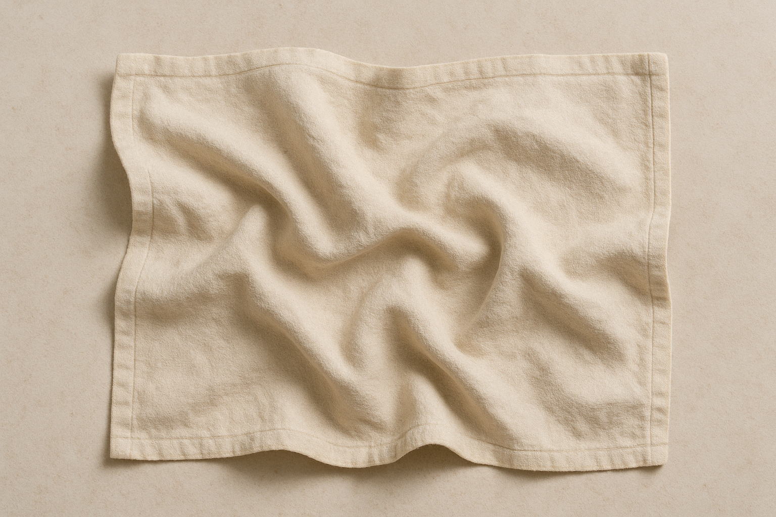
THE FABRIC
OF THE
UNIVERSE
16
Notes:
As the universe ages, because of gravity those initial little creases grow

Slide 24
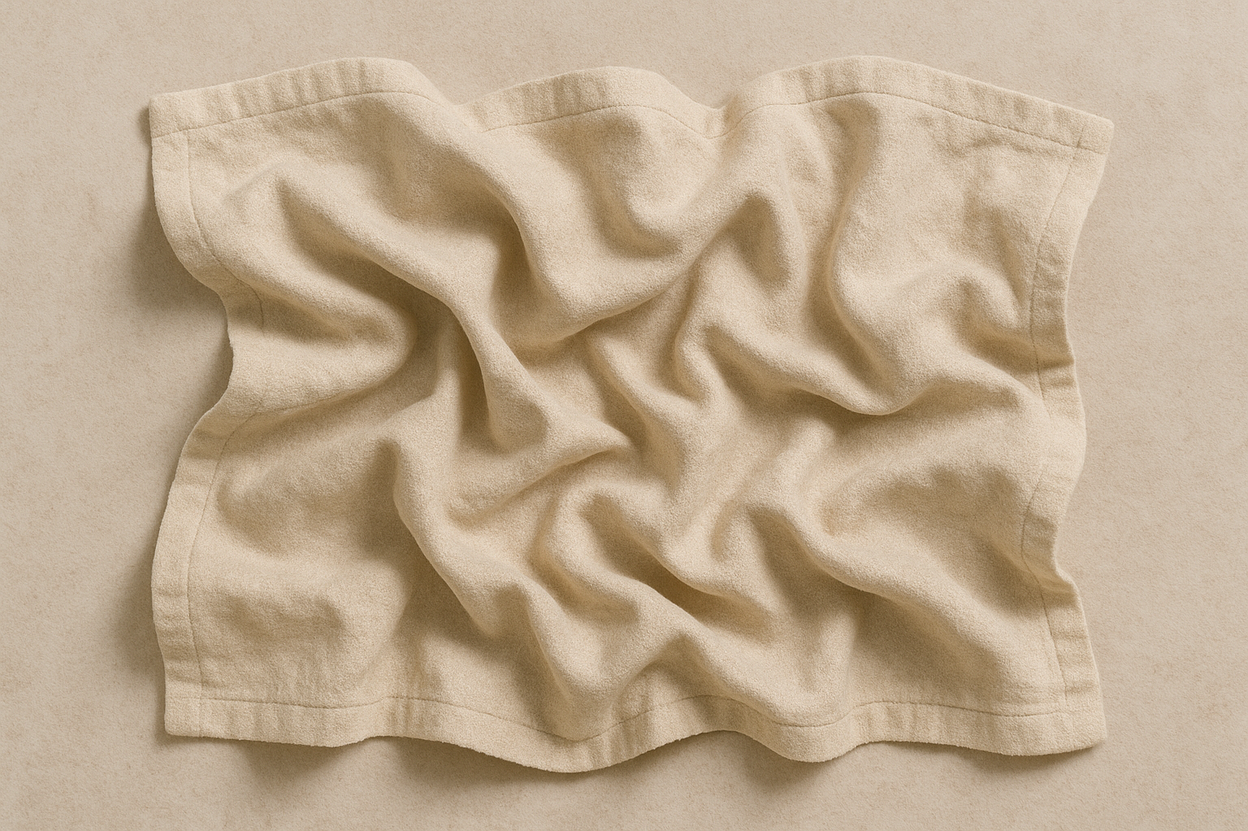
THE FABRIC
OF THE
UNIVERSE
17
Notes:
And grow, all the way up until today.
At this stage, the sheet has folded over itself in some places
these folds create the highly concentrated multistream regions which are the sights of structure formation.

Slide 25
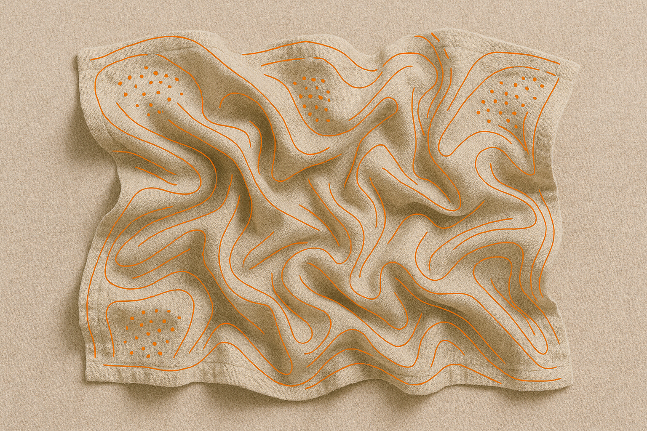
Caustics
18
Notes:
Now even just by eye, we can draw along these folds,
And this is essentially what caustic skeleton theory does, it takes what the almost flat sheet looked like initially and what it looks like now. and is able to draw these lines by exploiting the rich mathematical structure contained in the way the sheet must have folded.

Slide 26
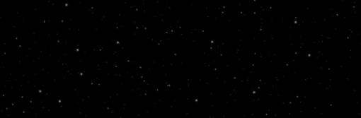
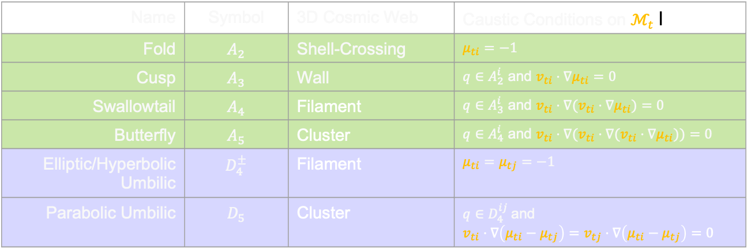
Caustics
Name | Symbol | 3D Cosmic Web | Caustic Conditions on $ℳ_{t}$ l
Fold | $$A_{2}$$ | Shell-Crossing | $$μ_{ti}=−1$$
Cusp | $$A_{3}$$ | Wall | $q∈A_{2}^{i}$ and $v_{ti}⋅∇μ_{ti}=0$
Swallowtail | $$A_{4}$$ | Filament | $q∈A_{3}^{i}$ and ${v_{ti}⋅∇(v}_{ti}⋅∇μ_{ti})=0$
Butterfly | $$A_{5}$$ | Cluster | $q∈A_{4}^{i}$ and ${{v_{ti}⋅∇(v}_{ti}⋅∇(v}_{ti}⋅∇μ_{ti}))=0$
Elliptic/Hyperbolic Umbilic | $$D_{4}^{±}$$ | Filament | $$μ_{ti}=μ_{tj}=−1$$
Parabolic Umbilic | $$D_{5}$$ | Cluster | $q∈D_{4}^{ij}$and $$v_{ti}⋅∇\left(μ_{ti}−μ_{tj}\right)=v_{tj}⋅∇\left(μ_{ti}−μ_{tj}\right)=0$$
19
Notes:
in 3d there are multiple different types of caustics because of the different shapes or topologies critical points can take on in a higher dimensional lagrangian mapping.
There is a lot of information in this table, but all you need to take away is that are two types of caustics, A type and D-type, and each caustic can be associated with a cosmic web structure, like walls, filaments and clusters, and each can be found by just asserting these caustic conditions on the eigenvalues mu and eigenvectors v of the deformation tensor.
So the lines we draw along the ridges of the sheet are like filaments. and a cluster forms where multiple ridges meet up

Slide 27
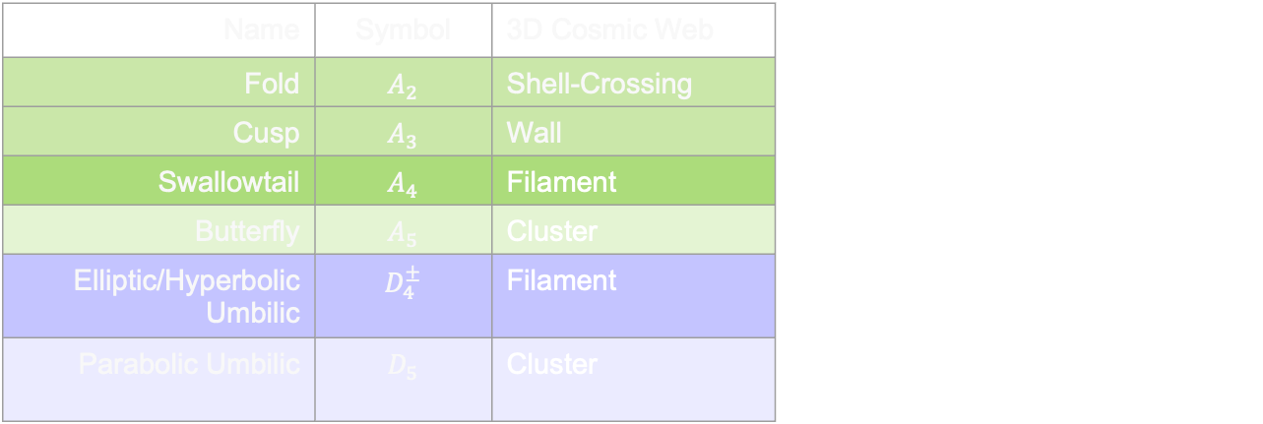
Caustics in the Cosmic Web
Prediction of
Caustic Skeleton Theory:
Name | Symbol | 3D Cosmic Web
Fold | $$A_{2}$$ | Shell-Crossing
Cusp | $$A_{3}$$ | Wall
Swallowtail | $$A_{4}$$ | Filament
Butterfly | $$A_{5}$$ | Cluster
Elliptic/Hyperbolic Umbilic | $$D_{4}^{±}$$ | Filament
Parabolic Umbilic | $$D_{5}$$ | Cluster
2 types of filaments
2 types of clusters
20
Notes:
But, remarkably caustic skeleton theory predicts that there are actually two types of filaments and two types of clusters.
This is what other structure identifiers miss because they don’t take into account the full dynamical evolution of the cosmic web.

Slide 28
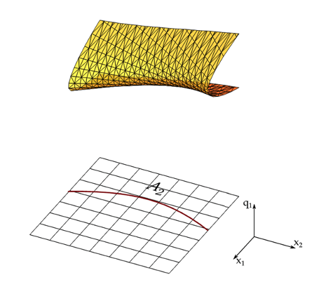

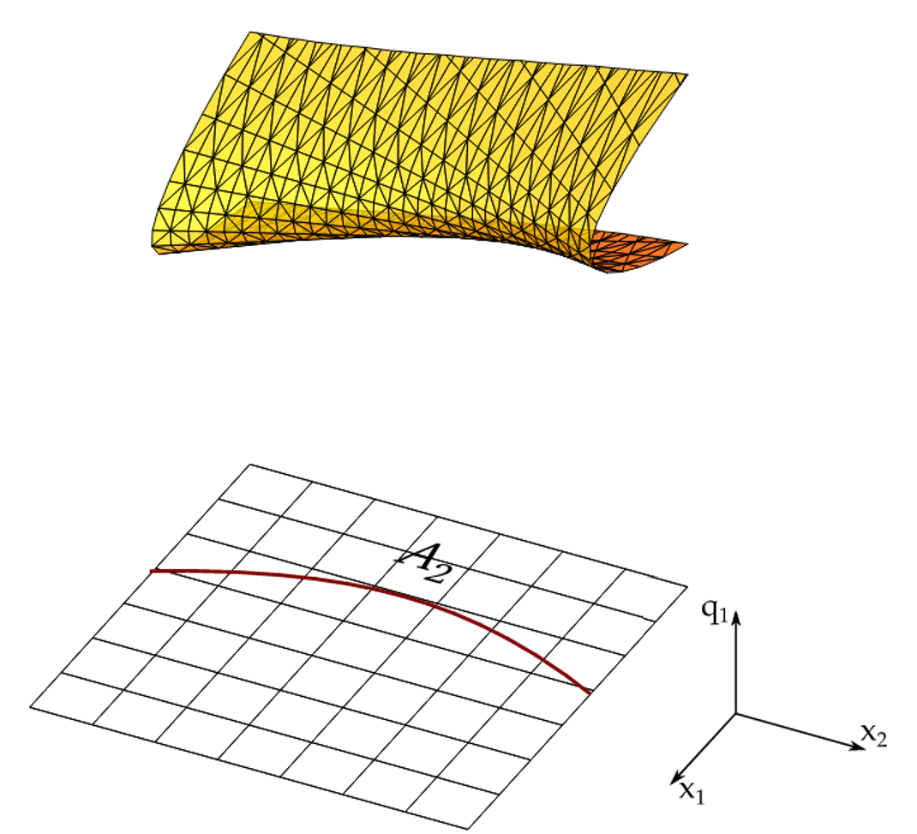
2D Clusters:
A-Type Points
Hidding et al. (2013)
21
Notes:
To get an idea of how different A-type and D-type filaments are clusters come about lets consider a 2d scenario, Same as the 2d fold caustic before we’re mapping from two initial lagrangian coordinates, only one shown here, to two final eulerian positions forming the plane

Slide 29
2D Clusters:
A-Type Points
Hidding et al. (2013)
21
Notes:
First for an A-type cluster, we see how a sheet that’s already folded, undergoes a folding in a different direction.
Instantaneously in the centre frame a crease forms before the sheet continues to pass over itself, so we see an A4 caustic point form in eulerian space,
Even though this point is transient, it marks where a bounded cluster would form as the overlapping streams would collapse into each other with realistic gravity

Slide 30
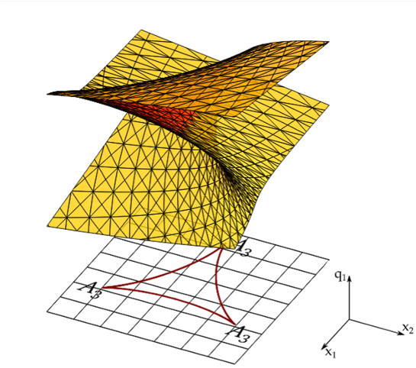
2D Clusters:
A-Type Points
D-Type Points
Hidding et al. (2013)
21
Notes:
But with D-type caustic points, the way the sheet folds is more complicated, the sheet twists around itself
This also leads to a cluster, but just in different way.
They may look morphologically similar at a distance, but they have distinct folding histories
And that’s how caustic skeleton theory can tell these clusters apart.
So there may be systematic differences hidden beneath the surface which we have so far overlooked, between the properties of galaxies within for instance

Slide 31
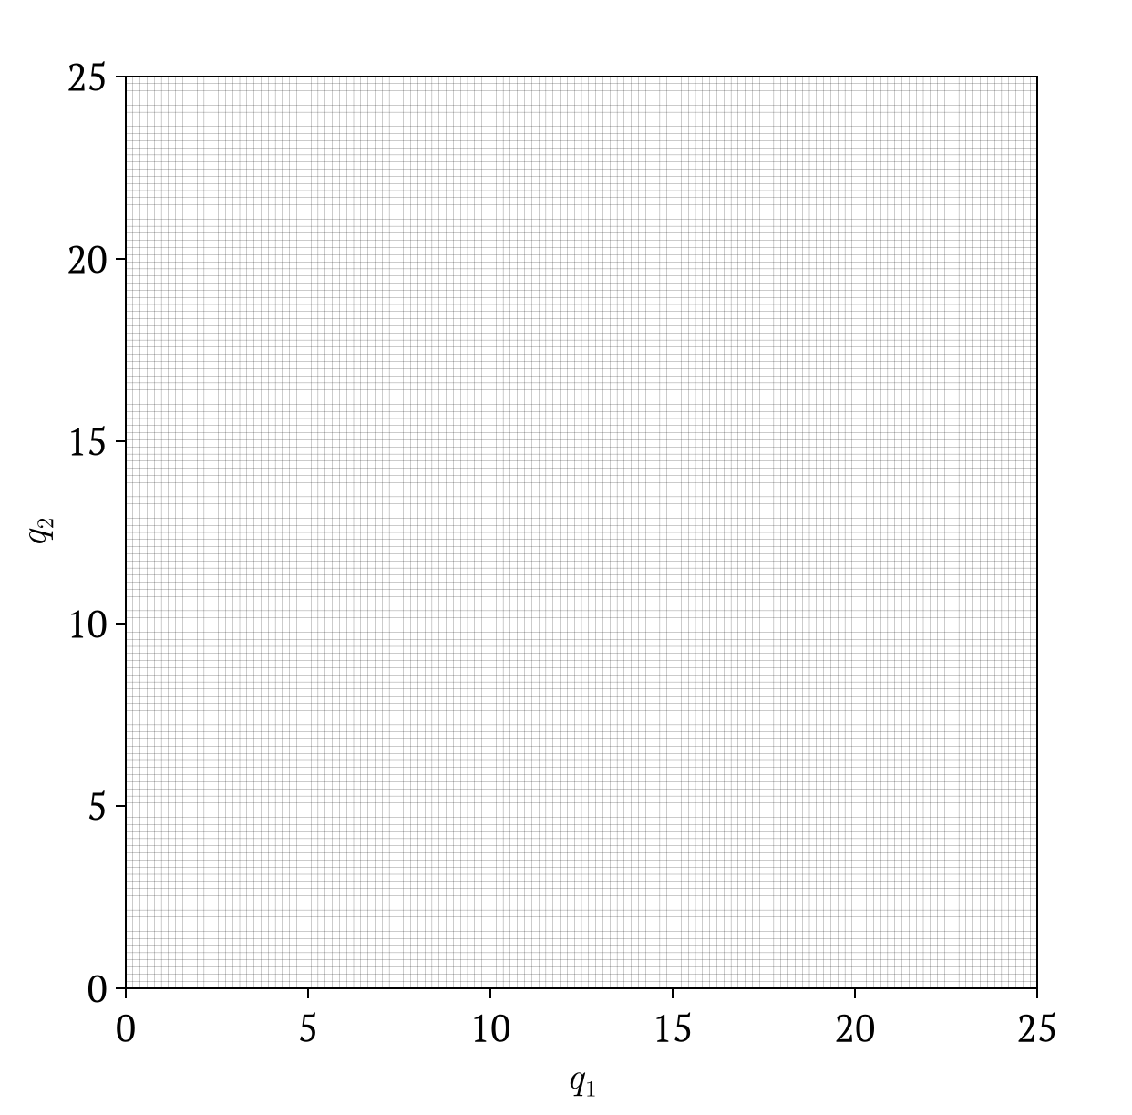
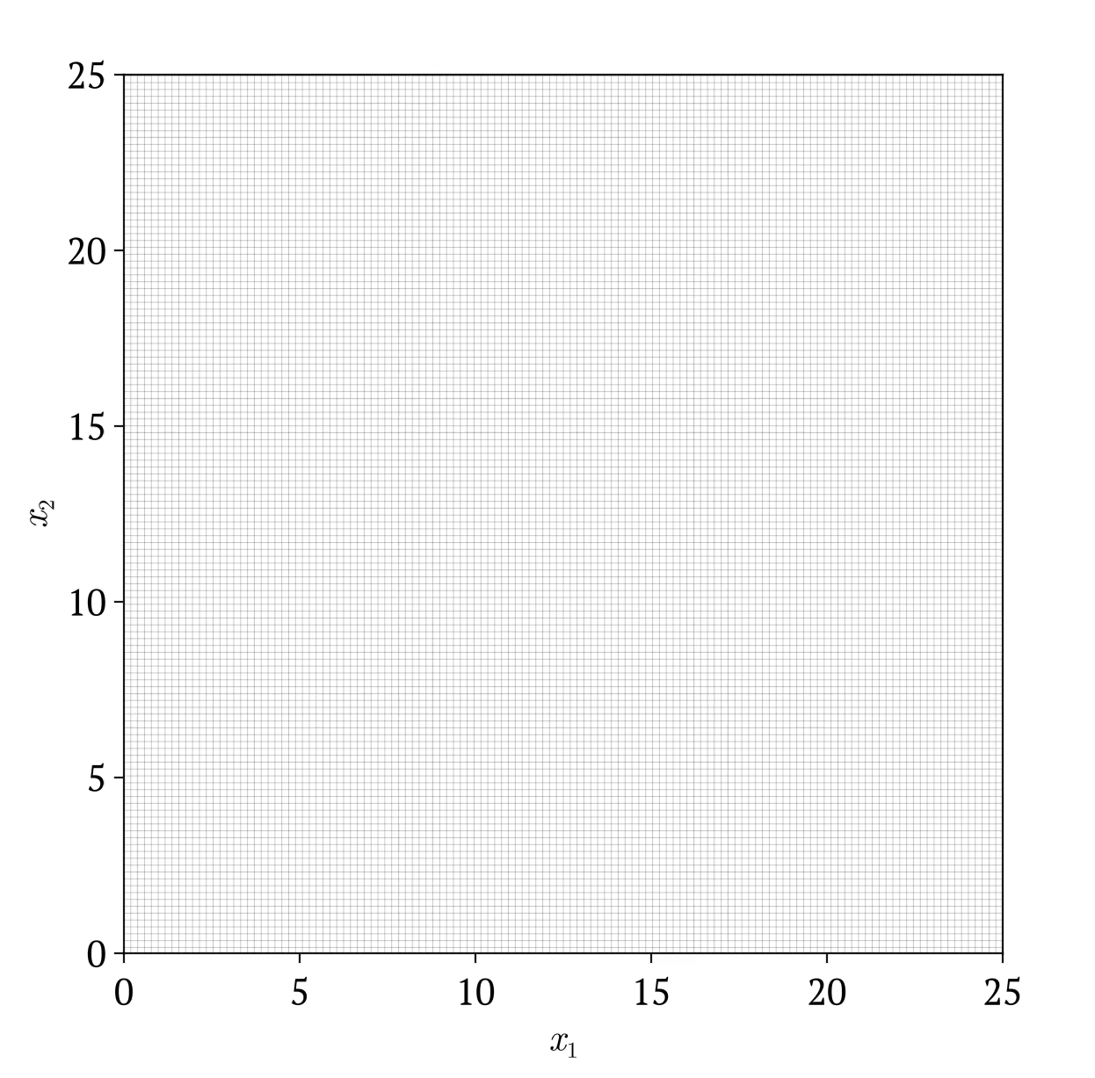
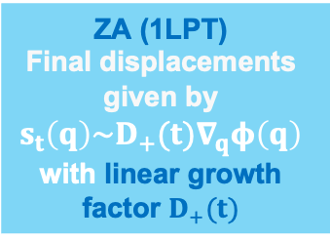
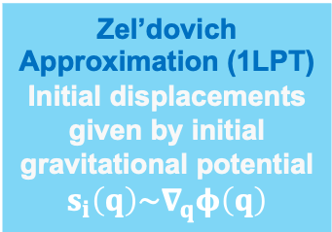
Caustics in simulations
Lagrangian (Initial) Space
Eulerian (Final) Space
Zel’dovich Approximation (1LPT)
Initial displacements given by initial gravitational potential
$$s_{i}\left(q\right)\sim ∇_{q}φ\left(q\right)$$
ZA (1LPT)
Final displacements given by
$$s_{t}\left(q\right)\sim D_{+}(t)∇_{q}φ\left(q\right)$$
with linear growth factor $D_{+}(t)$
22
Notes:
Now that you have an intuition of the theory behind caustic skeleton theory, we can apply it to simulations. Again, for easier demonstration of this, I’ll just show you how it works on 2d simulations
So we start with our initial conditions on the left. And despite how it looks, this isn’t a perfect grid, there are tiny little perturbations given by the gradient of the gravitational potential at early times according to first order Lagrangian perturbation theory, also known as the Zel’dovich approximation.
We could use this first order approximation to continue to evolve the particle distribution until today.
This is just a rescaling of those initial tiny perturbations by the linear growth factor D+,
So this way we can actually see all the structure that is already contained within the small initial perturbations
And we can see how multiple particle streams overlap, and fold into even more complex overlapping structures.

Slide 32
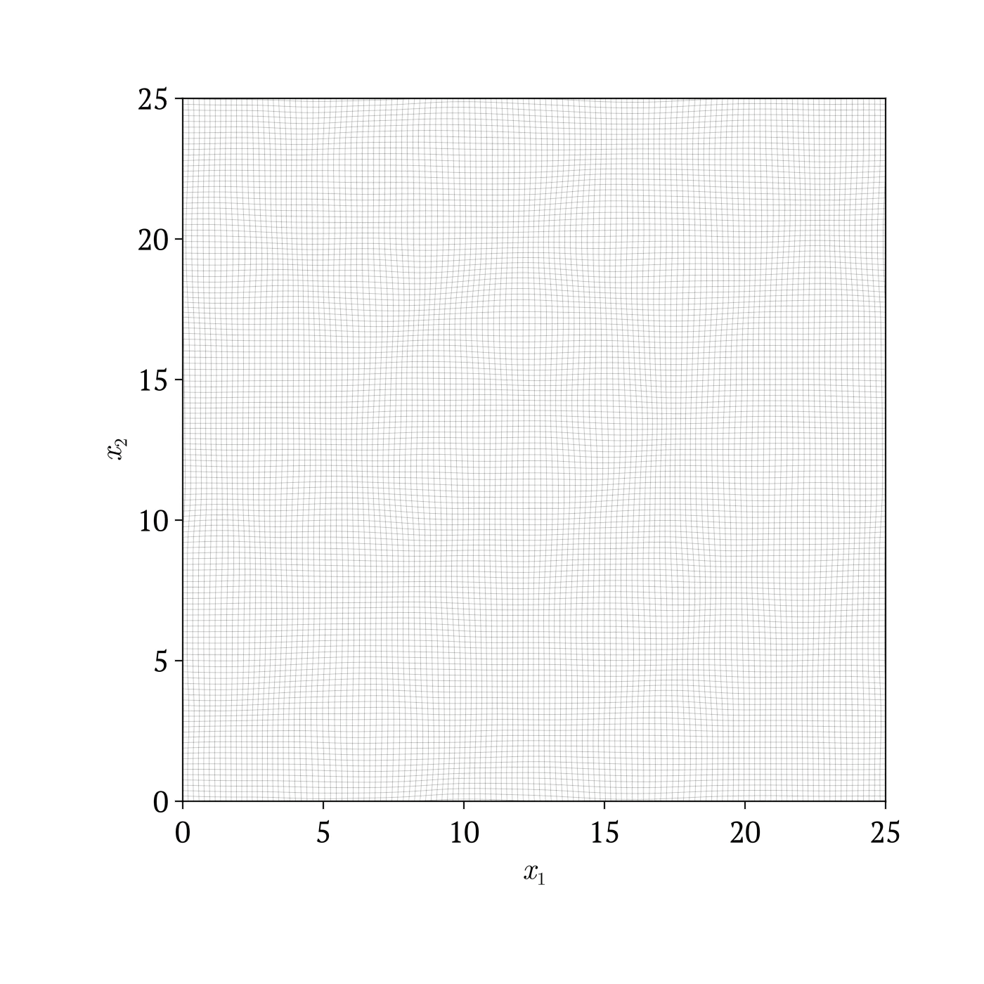
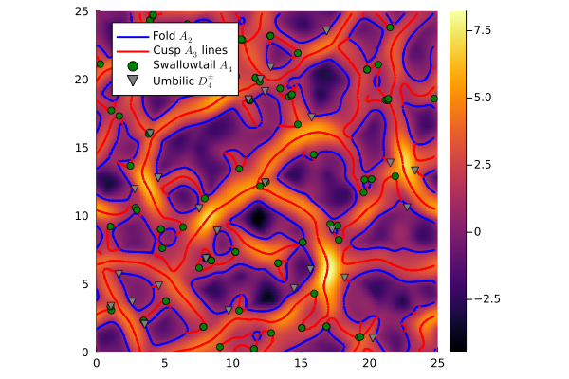
Caustics in simulations
Lagrangian (Initial) Space
Eulerian (Final) Space
Zel’dovich Approximation (1LPT)
Initial displacements given by initial gravitational potential
$$s_{i}\left(q\right)\sim ∇_{q}φ\left(q\right)$$
Caustics mark where multistream regions emerge
23
Notes:
So we can use caustic skeleton theory, to exactly identify where the multistream regions are emerging, bounded by blue fold lines
The red A3 lines trace the ridges of these mutlistream regions as they extend outwards, and so trace filament like structures
Then in the more complex regions where the sheet folds in on itself further, we see the green and purple caustic points emerging,
I said before that these points are technically transient but since they mark the points of cluster formation, we keep track of them here

Slide 33
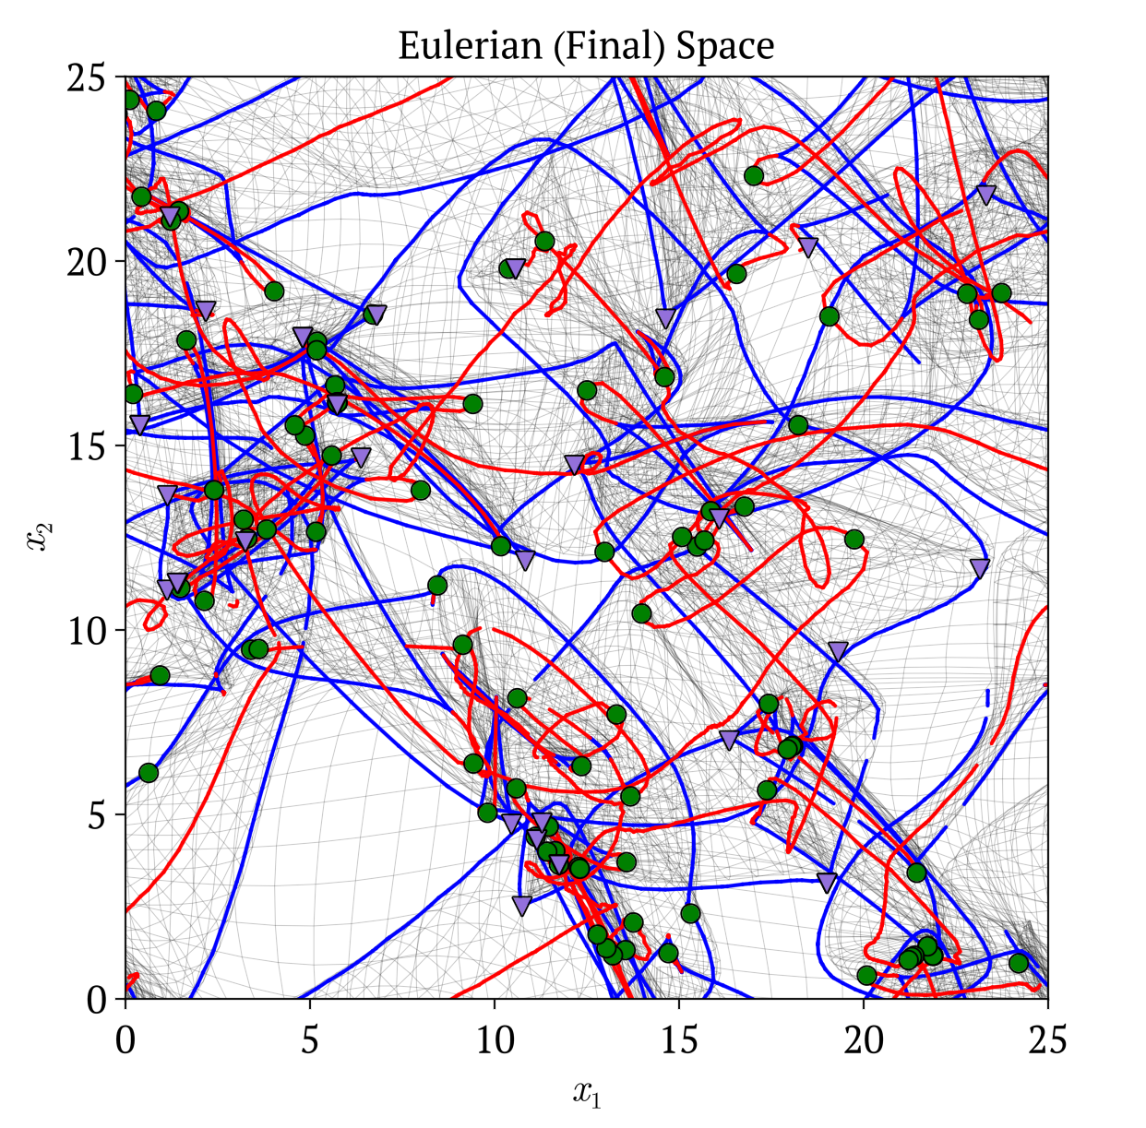
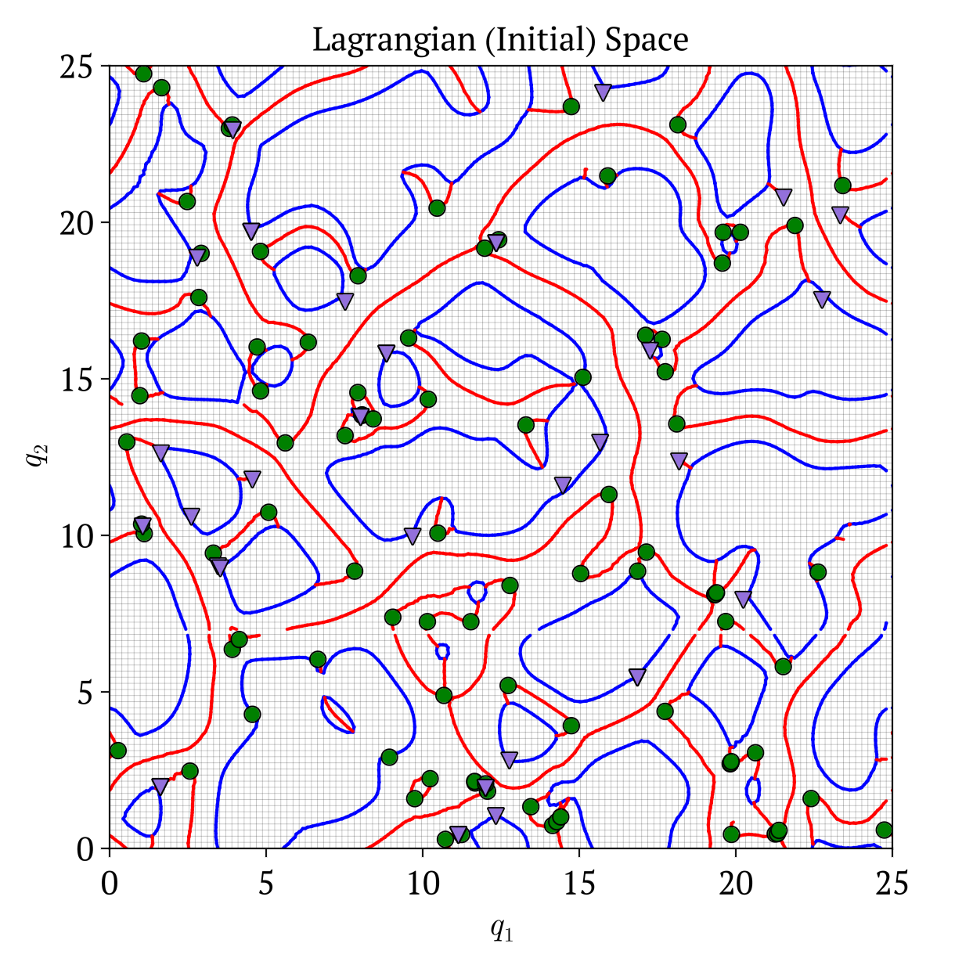
Caustics in simulations
Lagrangian (Initial) Space
Eulerian (Final) Space
Caustics mark where multistream regions emerge
24
Notes:
Now, since these caustics are emerging in a simple linear flow in this case, we can easily trace back the exact to their exact corresponding points in the initial Lagrangian space
Right now, it just looks like we’ve randomly drawn lines on a grid.
But as we know, the zel’dovich approximation inherently captures all the structure on the right, through a simple rescaling.

Slide 34
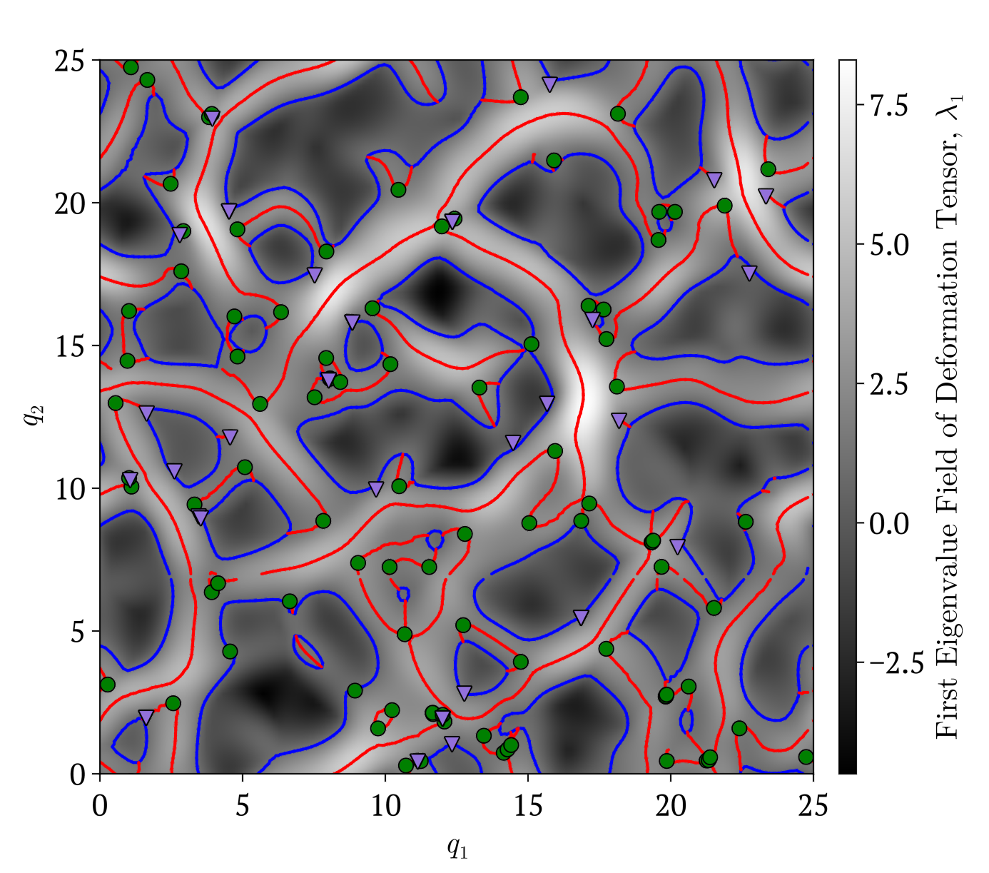

Caustics in simulations
Lagrangian (Initial) Space
Caustics are embedded in initial conditions
Eulerian (Final) Space
Caustics mark
where ZA fails:
non-linear structure growth begins
Caustics mark where multistream regions emerge
Caustic conditions on $ℳ_{ZA}=∂s_{ZA}/∂q$
25
Notes:
So, when I underlay the magnitude of the largest eigenvalue field of the deformation tensor of these first order displacements, we can now visually see that the lagrangian space caustics depend on it. The folds appear to be contours and the A3 lines flow along the ridges of the eigenvalue landscape.
This is why the caustic conditions are written in terms of the eigenvalues and eigenvectors of the deformation tensor.
So the caustics are effectively already embedded in the initial conditions, and this is where they are calculated,
in lagrangian coordinates.
Now, the Zeldovich approximation is just a first order simplification of structure growth. But caustic skeleton theory can in principle can be used with any higher order perturbation theory.
But, we don’t really need to go to a higher order theory to get what we want
That’s because inherently, where the Zeldovich approximation fails is precisely where caustics form, as multistream regions emerge and non-linear structure growth begins.
So the caustics we’ve already calculated on the left here in the initial space are actually still quite accurate

Slide 35
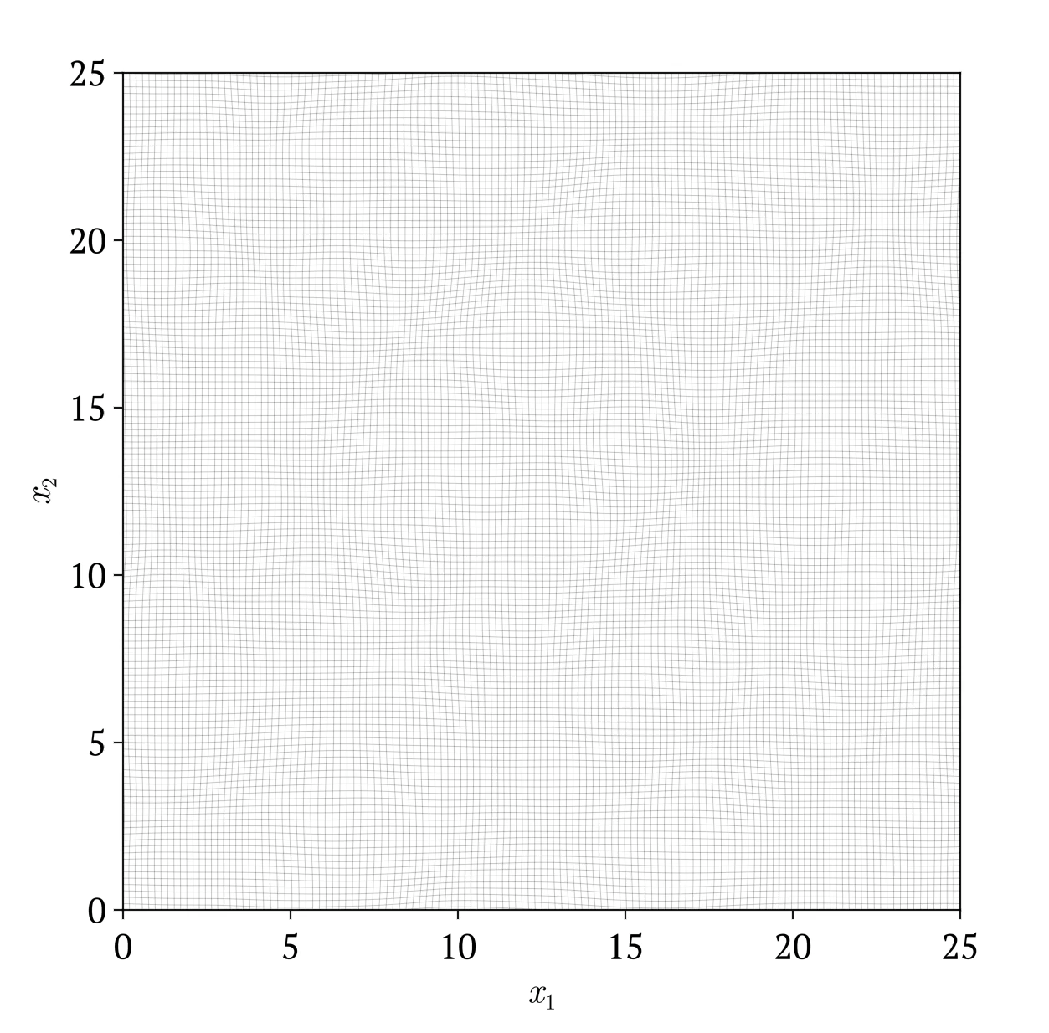

Caustics in simulations
Lagrangian (Initial) Space
Caustics are embedded in initial conditions
Eulerian (Final) Space
$s_{t}\left(q\right)$ given by
N-body simulation
Caustic conditions on $ℳ_{ZA}=∂s_{ZA}/∂q$
26
Notes:
To see this, using the same initial linear displacements, lets instead consider using a proper N-body simulation to evolve the particle distribution to present.
Compared to before, the multistream regions are much tighter, and clusters can be seen because of the realistic gravity

Slide 36
Caustics in simulations
Lagrangian (Initial) Space
Caustics are embedded in initial conditions
Eulerian (Final) Space
$s_{t}\left(q\right)$ given by
N-body simulation
Caustic conditions on $ℳ_{ZA}=∂s_{ZA}/∂q$
27
Notes:
So taking the lagrangian space caustics I calculated with the Zel'dovich approximation, I project them into eulerian space using the displacement field of the simulation
And as you can see the A3 lines perfectly align with the filaments, and D4 and A4 points collect at the clusters. – no fancy higher order theory needed
So clearly Caustic Skeleton theory has proven very effective at classifying structure in simulations. But, since the framework is still relatively new it has thus far remained quite abstract and in the mathematical world.

Slide 37
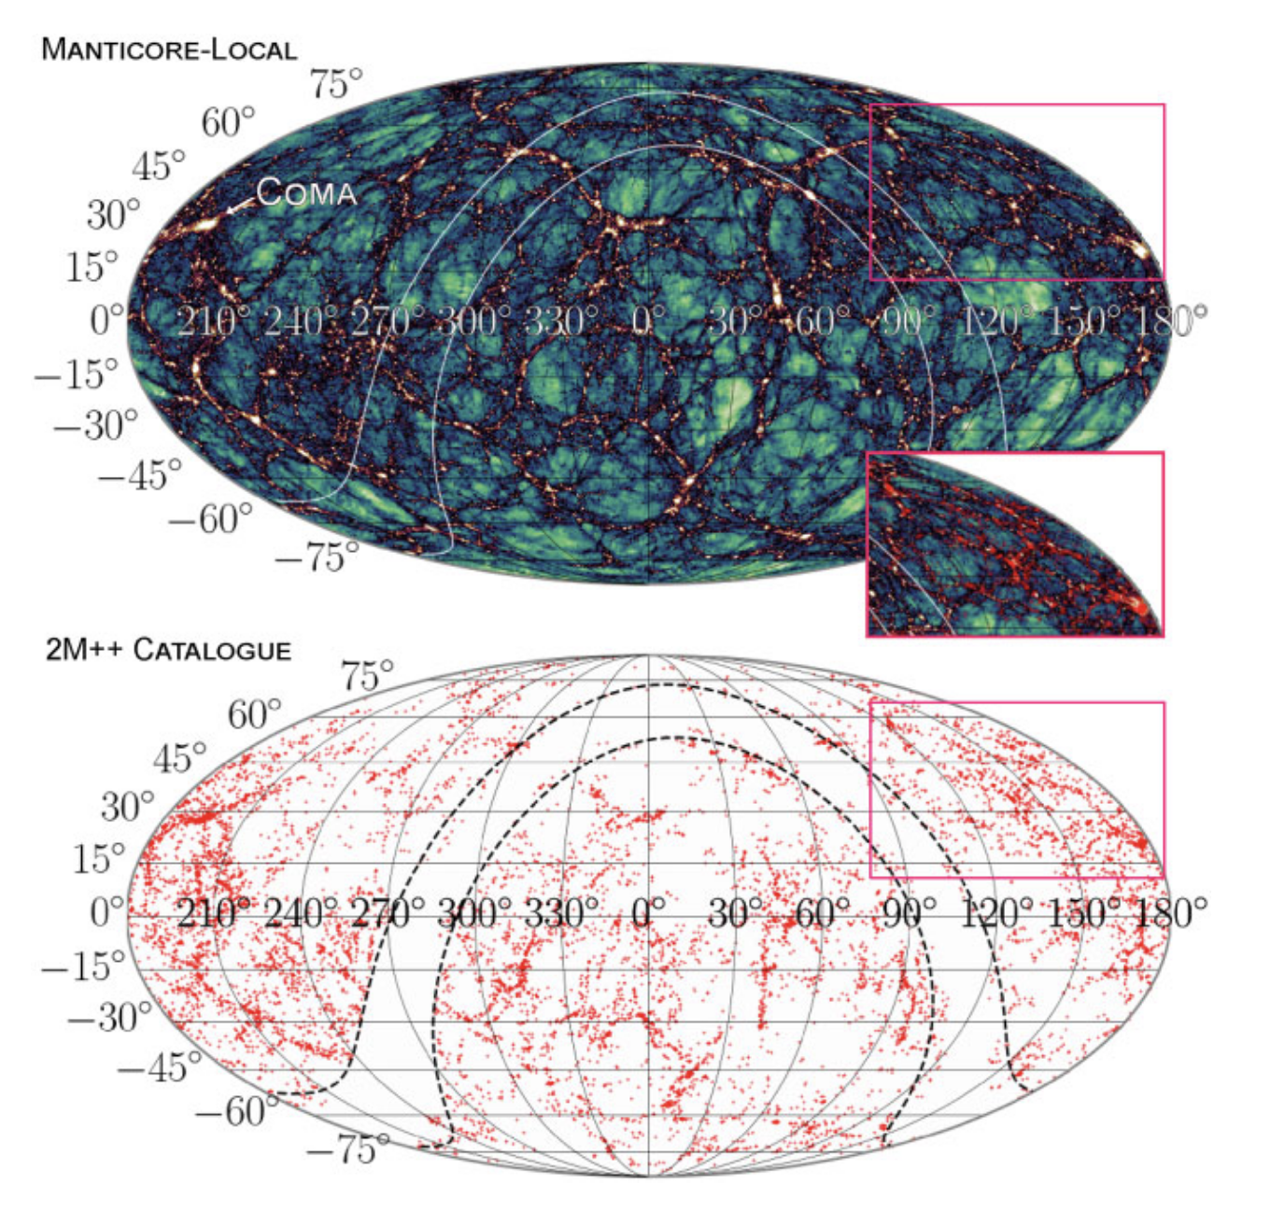
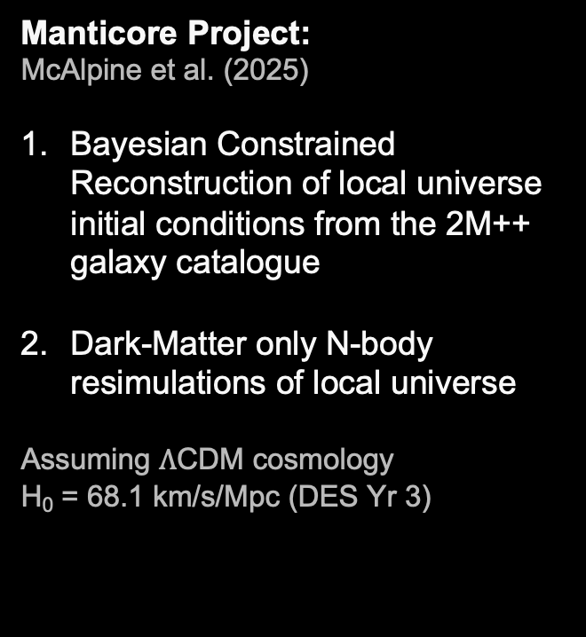
Applying to Observations
Manticore Project:
McAlpine et al. (2025)
Bayesian Constrained Reconstruction of local universe initial conditions from the 2M++ galaxy catalogue
Dark-Matter only N-body resimulations of local universe
Assuming $Λ$CDM cosmology
H₀ = 68.1 km/s/Mpc (DES Yr 3)
Clas
28
Notes:
So right now, I’m working to bring caustic skeleton theory into reality by applying it to real observations.
We have been granted access to the Manticore project, which uses the 2M++ galaxy catalogue shown in the bottom panel, to infer a constrained reconstruction of the initial conditions they evolved from, they used Bayesian techniques and assumed a lamda cdm cosmology with parameters from DES yr 3.
The top panel then shows one of the dark matter-only resimulations that they ran on these initial conditions to show that they indeed successfully replicate our local universe.

Slide 38
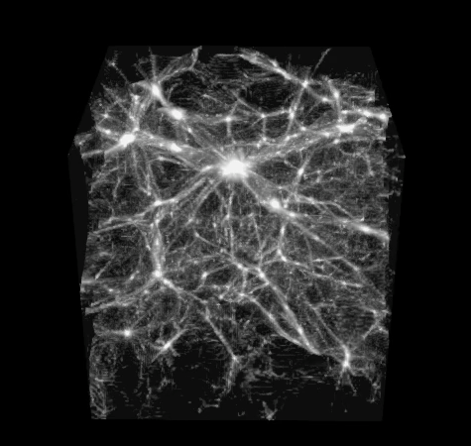
The Stickman’s Skeleton
Simulation
Observations
Dark Matter Density Field
De Lapparent et al. (1985)
Coma Cluster
29
Notes:
So armed with this local universe simulation, we aimed to first dissect the skeleton of the stickman,
this famous structure was first observed back in 1985 and has the coma cluster sitting at its heart.
on the left is the galaxy distribution we observe, and the right is the Mancitore simulation dark matter density field around the coma cluster

Slide 39
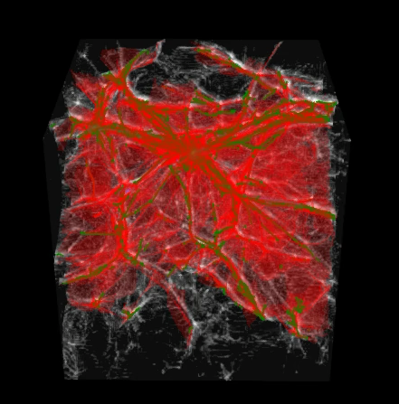
The Stickman’s Skeleton
Simulation
Observations
Dark Matter Density Field
De Lapparent et al. (1985)
Coma Cluster
30
Notes:
I ran my caustic skeleton finding algorithm on this simulation,
And instantly you can see the green filaments light up along the densest parts of the density field, and we can now see the walls in red as well stretching between them
But since it can be tricky viewing things in 3d

Slide 40
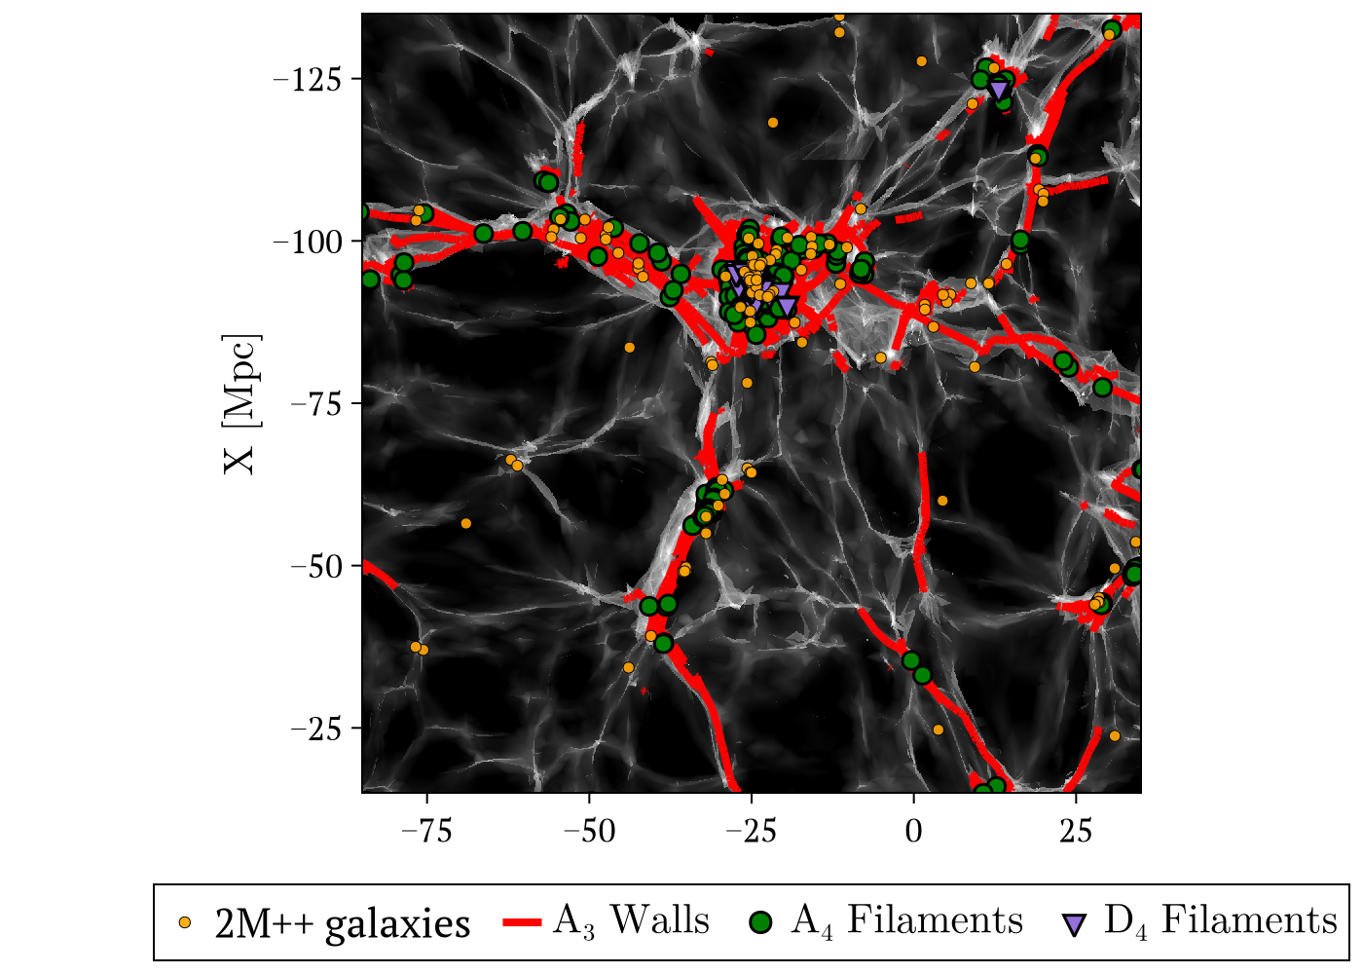
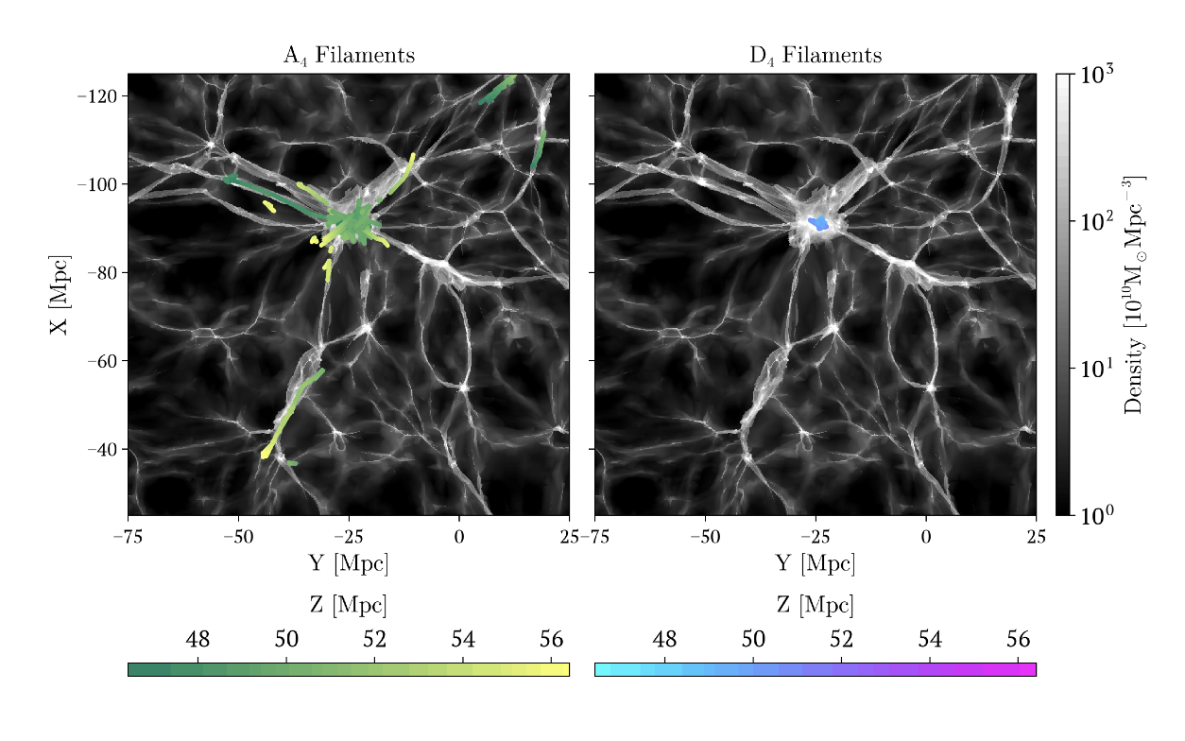
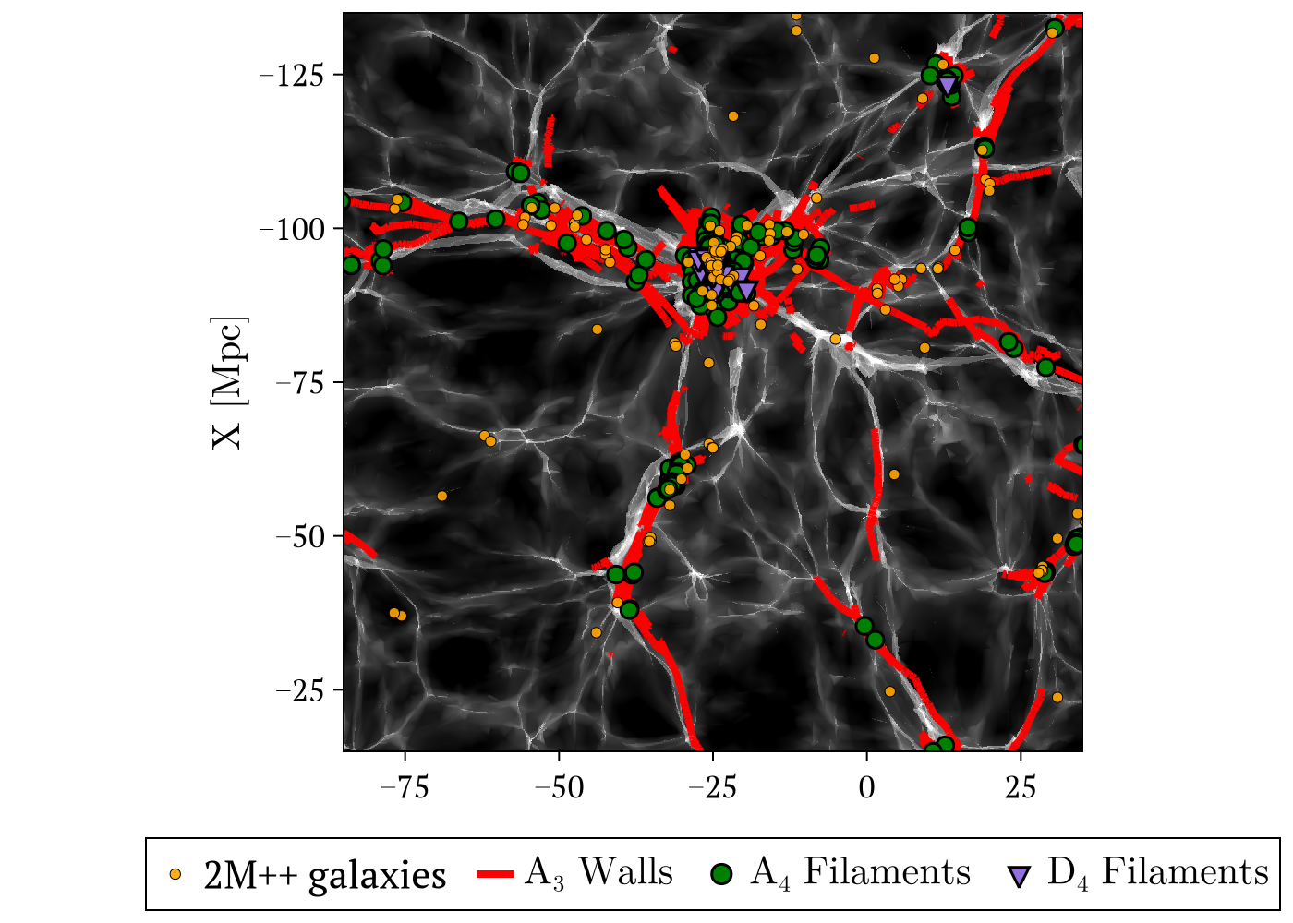
The Stickman’s Skeleton
Simulation
Observations
Slice of Dark Matter Density Field
De Lapparent et al. (1985)
Coma Cluster
31
Notes:
I’ll instead show you a slice through the simulation field and the caustics I’ve calculated. Because of this the walls appear as lines, and the A4 and D4 filaments appear as points.
In this view we can see that the caustics do very nicely match the density field, and we can actually see the arms and legs of the stickman’s skeleton
I’ve also added on the 2M++ galaxies in orange that sit within 1 Mpc of the plane of this slice.
So now we can ask, what can the caustic skeleton tell us about the large scale environment of these galaxies?

Slide 41
Caustic Skeleton Theory characterises cosmic environments
1.
Topology
2.
3.
32
Notes:
Well today I’d like to focus on three key aspects of cosmic environments that the theory can characterise
To start, we have additional insight into the topology of the cosmic environment, through this additional distinction between A type and D type environments

Slide 42
Classifying Galaxies
Z 127-34
Z 221-23
33
Notes:
So the two galaxies I showed you from before – two seemingly very similar galaxies, actually sit in distinct large-scale cosmic environments.
The top one sits nearby a D4 filament, whereas the one on the bottom is only close to A4 filaments.
This topological classification of a galaxies large scale environment can also be viewed as an insight into the environment’s formation history, as we know how these A and D type caustics emerge in the dark matter flow

Slide 43
Caustic Skeleton Theory characterises cosmic environments
1.
Topology
2.
Age and History
3.
34
Notes:
This leads to the next key property we can infer, the age and history of cosmic environments

Slide 44
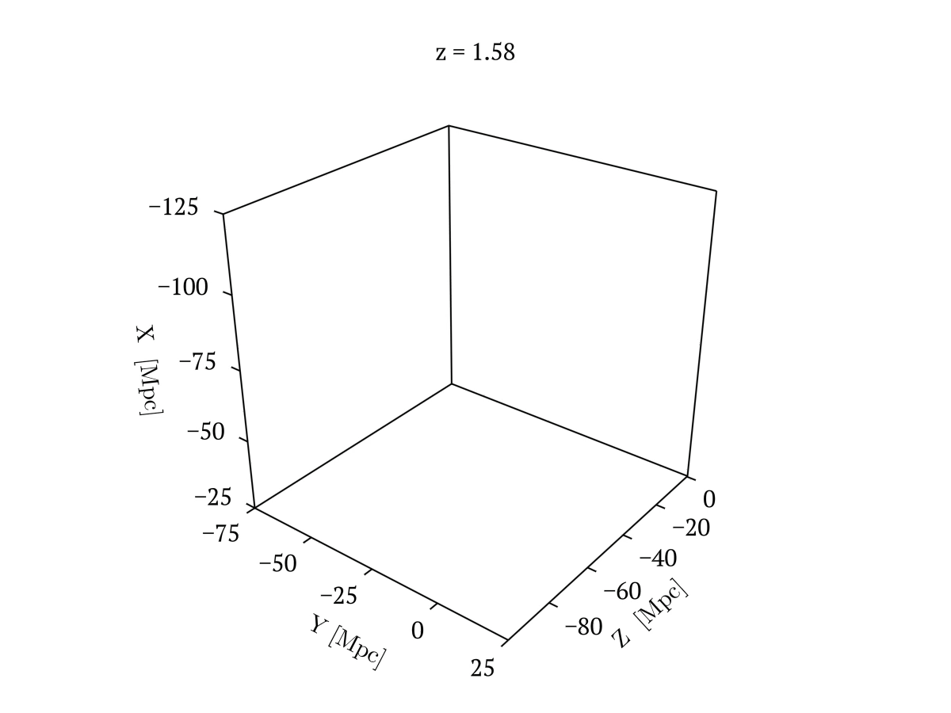

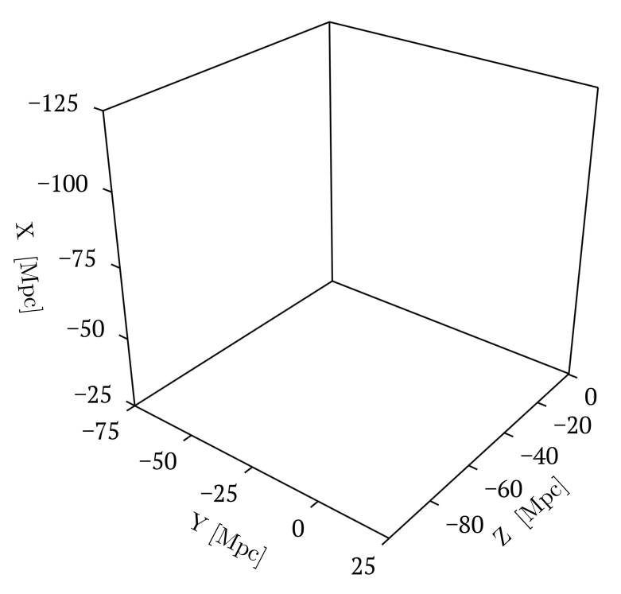
Evolution of the Coma Cluster
A₄ Filaments
D₄ Filaments
35
Notes:
Since I’m working with a simulation of the local universe, we can fully trace the formation and evolution of these caustics around the coma cluster.
I’ve separated out the A4 filaments on the left and D4 on the right. You can see that the walls form first, which is consistent with hierarchical formation.

Slide 45
Formation Time
Caustics form hierarchically
Clusters form on filaments
Filaments form on walls
Walls form in shell-crossed regions
Formation time of caustic defined as time of
first Shell-crossing
36
Notes:
Now, the construction of caustics actually provides us with quite a natural definition of formation time.
So caustics form successively, in a hierarchy.
You can see this in this snippet from the 2d sim from before,
the blue fold lines form first. But as they spread out, the emerging red lines actually trace the directions these blue fold lines are extending
and then the green and purple caustic cluster points form on these red filamentary lines
What this means for the 3d cosmic web, is that clusters must form on filaments, filaments must form on walls, and walls must form in regions that have already undergone shell-crossing
Using this idea, for any cluster or point along a filament, we can define formation time of the caustic as the time at which shell-crossing first occurred for that point, since this is the definitive beginning on non-linear collapse in that region.

Slide 46
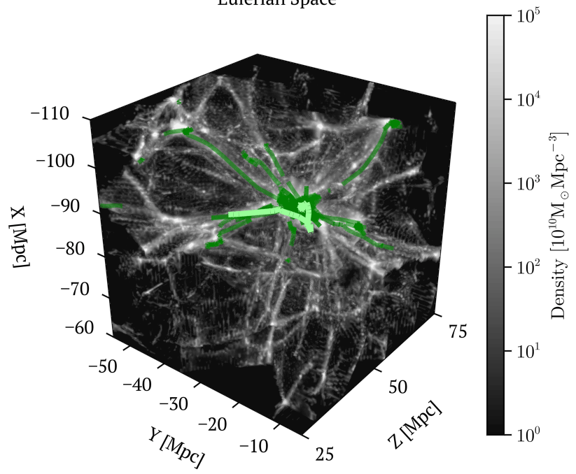
Formation history of an individual filament
Eulerian (Final) Space
37
Notes:
So using this definition of formation time, lets take a look at the formation history of an individual filament around the coma cluster
Here ive just zoomed in around the coma cluster, and plotted the A4 filaments, with the single filament of interest highlighted

Slide 47
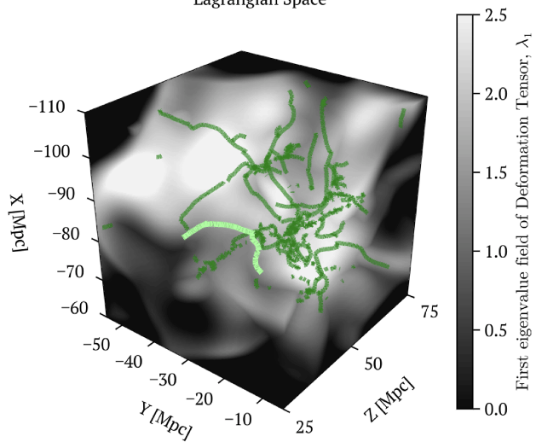
Formation history of an individual filament
Lagrangian (Initial) Space
Eulerian (Final) Space
37
Notes:
Now of course, we can view the filament in lagrangian space, where it is actually calculated, based on the eigenvalue field of the first order deformation tensor
It is important to understand here that even though we can view the filament in initial space, it is not actually a filament yet, since no shell-crossing has occurred.
We are simply marking the points in the fluid that will at some point in the future undergo shell crossing and form these caustics on the right that actually correspond to filaments

Slide 48

Formation history of an individual filament
Lagrangian (Initial) Space
Eulerian (Final) Space
38
Notes:
Here, I’ve now projected this individual filament onto the Y-Z plane.
And I’ve identified the time at which each point along this filament underwent first shell crossing to colour code it by formation time.
The formation time is presented here in terms of the linear growth factor, this comes from the Zeldovich approximation as mentioned before, so it goes from 0 to 1 today.

Slide 49

Formation history of an individual filament
Filament forms in disjoint segments and merges at different times
The filament is stretched and compressed in different sections
38
Notes:
Now, if we look at the formation time along the filament, we see there are various local maxima and minima.
So if you imagine taking a line and raising it from the bottom to top as formation time increases, we first encounter two separate local minima.
So the filament first forms at the pink points in disjoint segments, but then when we reach a local maxima, these segments merge at the blue points, and so on.
We can also see how the filament has evolved in the simulation flow, as the bottom left tail end has clearly been stretched out, whereas the other end has been tightly compressed and wound up within the coma cluster.
So through caustics we have obtained quite a comprehensive understanding of this filament’s history.

Slide 50
Classifying Galaxies
Formed earlier (z ~ 0.4)
Z 127-34
Z 221-23
Formed later (z ~ 0.1)
39
Notes:
So again, coming back to these galaxies from before,
I can tell you that the D4 filament dominating the galaxy on top’s environment formed at around a redshift of 0.4
Earlier, than the A4 filament near the bottom galaxy which formed around a redshift of 0.1
Now this is great, but there is one more piece to this puzzle missing,
as you may have noticed in the plots I’ve shown so far there does seem to still be a lot of smaller structure here that appears uncaptured,

Slide 51
Caustic Skeleton Theory characterises cosmic environments
1.
Topology
2.
Age and History
3.
Scale
40
Notes:
This is is where we need to address the scale of the cosmic environments we are looking at

Slide 52


Multiscale Skeleton
Gaussian Filter: $W_{σ}(q)=\frac{1}{2πσ}e^{− \frac{q^{2}}{2σ^{2}}}$
to pick out structures of a specific scale length
$σ=2$ Mpc
41
Notes:
So before, I actually smoothed the simulation field using a Gaussian filter with a smoothing scale of 2 Mpc.
The cosmic web is highly multiscale in nature, so this way I can just pick out the size of the structures that I want to look at

Slide 53


Multiscale Skeleton
Gaussian Filter: $W_{σ}(q)=\frac{1}{2πσ}e^{− \frac{q^{2}}{2σ^{2}}}$
to pick out structures of a specific scale length
$σ=1$ Mpc
(Small scales)
$σ=2$ Mpc
41
Notes:
So if I use a smaller smoothing length, I pick up a lot more of the embedded smaller scale structures

Slide 54


Multiscale Skeleton
Gaussian Filter: $W_{σ}(q)=\frac{1}{2πσ}e^{− \frac{q^{2}}{2σ^{2}}}$
to pick out structures of a specific scale length
$σ=3$ Mpc
(Large scales)
$σ=1$ Mpc
(Small scales)
$σ=2$ Mpc
41
Notes:
And if I then use an even larger smoothing length, we pick up the fewer but longer more coherent structures.
We can see the walls in red tend to dominate the larger scales, whereas the number of filaments we find explodes towards the small scales

Slide 55





Multiscale Skeleton
$A_{4}$ Filament
$D_{4}$ Filament
$A_{4}$ Filament
$σ=3$ Mpc
(Large scales)
$σ=1$ Mpc
(Small scales)
$σ=2$ Mpc
42
Notes:
So it seems that out galaxy classifications from before aren’t so clear anymore.
At a 2 Mpc smoothing length, we found this galaxy from before sits close to a D4 filament.
But at larger scales this D4 filament seems to disappear. And then if we look at smaller scales its also no longer here.
This D4 filament has a very specific characteristic scale of influence.
So in this way, caustic skeleton theory highlights that the large-scale environment of a galaxy has a unique multi-scale signature that must be accounted for.

Slide 56
Test predictions of
Caustic Skeleton Theory
Observable statistical differences in the
properties of galaxies residing in
A-type vs D-type
filaments and clusters
Older vs younger
environments
Larger vs smaller
scale environments
43
Notes:
now there are many exciting avenues forward, with caustic skeleton theory we can untangle analytically both the multi-scale structure and history of the cosmic web simultaneously .
So in particular, we want to test the key predictions of caustic skeleton theory by determining whether there are indeed differences in the properties of galaxies residing in A type versus D type filaments and clusters and older versues younger or larger versus smaller scale environments as well.
It would be amazing if we can determine a galaxy’s properties just from the way its large scale environment folded

Slide 57



Acknowledgements
Professor Celine Boehm
Dr Job Feldbrugge
Professor Rien van de Weygaert
The Aquila Consortium for providing access to Manticore simulations
Preprint v1 available: arXiv:2604.22213
44
Notes:
I would like to thank my supervisors and collaborators
And also we have a preliminary version of a paper on the caustic skeleton of the local cosmic web available on the arxiv
I already showed some of the results from this paper today in this talk, but there are more if you are interested.

Slide 58


Slide 59

Classifying galaxies in the Stickman
Density Hierarchy
(5 Mpc threshold)
D₄ Filaments
A₄ Filaments
A₃ walls
Voids
D₄ Filaments dominate galaxy environments around Coma cluster towards smaller scales
Notes:
We can learn something about the nature of the stickman and the coma cluster, by classifying the caustic environments of the 2M++ galaxies at a variety of smoothing lengths.
So caustics also follow a density hierarchy, where D4 filaments are the densest, followed by A4, A3 and of course single stream void regions are the least dense
So using a simple 5 Mpc threshold we associate every 2M++ galaxy in the 100 Mpc cubed stickmn region with a caustic.
Here we see that at the largest smoothing scales, most galaxies cannot be associated to a structure. However, as we go to smaller scales the smaller scale filaments begin to dominate the environments of galaxies. And in particular, the D4 filaments overtake the A4 filaments at the smallest scale considered here.
So, with this detailed map of caustics in the local Universe, we have already been able to extract so much rich information about the coma cluster, a real structure in our local universe.

Slide 60


Bayesian Reconstruction
BORG (Bayesian Origin Reconstruction from Galaxies) algorithm Jasche & Wandelt (2013)
              Generate ensemble of most plausible constrained realisations of initial density field
              that under gravitational evolution give rise to the observed structures
Manticore project McAlpine et al. (2025) Test whether observed galaxy data can be reconciled with $Λ$CDM model
Sample Gaussian White Noise Field
White Noise Field modulated by primordial power spectrum P₀(K)
Evolve forward using a differentiable approximate gravity solver (COLA)
Transform particles to redshift space
Dark Matter density field transformed into a predicted galaxy distribution using galaxy bias model with set of free parameters (jointly inferred)
Priors on final density field consistent with $Λ$CDM model (using $Λ$CDM simulations with same survey selection effects)
Priors on initial density field consistent with inflationary initial conditions
Evaluate likelihood function (relating observed galaxies to synthetic galaxy field)
Compute gradients of posterior distribution with respect to initial white noise field
Hamiltonian Monte Carlo sampler uses gradients to propose new correlated sample of White Noise Field
Produces correlated Markov chain of samples from the full posterior distribution over initial conditions and bias parameters

Slide 61

2D Filaments: A₃ cusp lines
Hidding et al. (2013)
Notes:
In this case it appears that the sheet initially twists in the centre, which produces an A3 cusp point when projected into eulerian space at the bottom,
as the twists or A3 cusps move outwards we see the sheet is actually folding over itself in the middle, so down in eulerian space we have two A2 fold caustics which join at A3 cusps.
here visually we see how different caustics represent fundamentally different topologies or ways of distorting this sheet.

Slide 62





2D Filaments: A₃ cusp lines
$$q_{2}$$
Lagrangian (Initial) Space
$$q_{1}$$
A₂ Fold lines
A₃ cusp points
$$x_{2}$$
Eulerian (Final) Space
$$x_{1}$$
Hidding et al. (2013)
Notes:
Ok, lets now view these caustics in both the lagrangian coordinates on top and eulerian coordiantes on the bottom separately.
So its clear that A3 cusp caustics are actually points, not lines.
But, if I just draw a line between them, lets see what happens if the sheet were to continue folding over itself and the cusps move further outwards

Slide 63
2D Filaments: A₃ cusp lines
$$q_{2}$$
Lagrangian (Initial) Space
A₂ Fold lines
$$q_{1}$$
A₃ cusp points
$$x_{2}$$
Eulerian (Final) Space
$$x_{1}$$
Hidding et al. (2013)
A₃ lines trace where cusps formed
Notes:
So the line grows because it is tracing where a cusp has previously formed or passed through, leaving gravitationally collapsing regions in its wake, so it is in fact these A3 lines that we associate with filaments in 2D.

Slide 64




Caustic Conditions
Feldbrugge et al. (2018)
At shell crossing point, Lagrangian points q near caustic point q_{s}, map onto the same Eulerian position x_{t}(q_{s}) along the tangential direction T to the Lagrangian curve C
    → The directional derivative of x_{t} along the
    tangential direction vanishes $\frac{∂x_{t}}{∂q}T=0$
    → $\left(I+\frac{∂s_{t}}{∂q}\right)T=0$
    → $(I+ℳ_{t})T=0$
    → $\left(I+ℳ_{t}\right)𝒱_{t}𝒱_{t}^{−1}T=0$
    → $\left(I+ℳ_{td}\right)𝒱_{t}^{−1}T=0$
    → $\left(1+μ_{it}\right)v_{it}^{∗}∙T=0$
Given an arbitrary manifold M ⊂ L we can consider all curves C ⊂ M passing through the caustic point q_{s} ∈ M .
The variety x_{t}(M) contains a singularity at q_{s} ∈ M if and only if there exists at least one tangent vector T ∈T_{qs}M to one such curve satisying this caustic condition
$ℳ_{t}$is diagnolisable
$ℳ_{t}v_{it}=μ_{it}v_{it}$
$${v_{it}∙v}_{jt}^{∗}=δ_{ij}$$

Slide 65


Caustics Conditions
Density at a caustic is infinite
Eulerian (density today)
Lagrangian (initial density)
?
??
$$ρ_{t}\left(x\right)$$
=
$$ρ_{i}\left(q\right)$$

Slide 66

Caustics Conditions
Density at a caustic is infinite
Eulerian (density today)
Lagrangian (initial density)
$$\sum_{all streams}{ }$$
??
$$ρ_{t}\left(x\right)$$
=
$$ρ_{i}\left(q\right)$$

Slide 67


Caustics Conditions
Density at a caustic is infinite
Eulerian (density today)
Lagrangian (initial density)
$$\sum_{all streams}{ }$$
$${\left|det \frac{∂x_{t}\left(q\right)}{∂q}\right|}^{−1}$$
Change of Coordinates
using Lagrangian map
$$x_{t}\left(q\right)=q+s_{t}\left(q\right)$$
$$ρ_{t}\left(x\right)$$
=
$$ρ_{i}\left(q\right)$$

Slide 68

Caustics Conditions
Density at a caustic is infinite
Eulerian (density today)
Lagrangian (initial density)
$$\sum_{all streams}{ }$$
$${\left|det \frac{∂x_{t}\left(q\right)}{∂q}\right|}^{−1}$$
Change of Coordinates
using Lagrangian map
$$x_{t}\left(q\right)=q+s_{t}\left(q\right)$$
$$ρ_{t}\left(x\right)$$
=
$$ρ_{i}\left(q\right)$$
$${\left|det\left(I+\frac{∂s_{t}\left(q\right)}{∂q}\right)\right|}^{−1}$$

Slide 69


Caustics Conditions
Density at a caustic is infinite
Eulerian (density today)
Lagrangian (initial density)
$$\sum_{all streams}{ }$$
$${\left|det \frac{∂x_{t}\left(q\right)}{∂q}\right|}^{−1}$$
Change of Coordinates
using Lagrangian map
$$x_{t}\left(q\right)=q+s_{t}\left(q\right)$$
$$ρ_{t}\left(x\right)$$
=
$$ρ_{i}\left(q\right)$$
$${\left|det\left(I+\frac{∂s_{t}\left(q\right)}{∂q}\right)\right|}^{−1}={\left|det\left(I+ℳ\right)\right|}^{−1}$$
$ℳ$is diagnolisable
$ℳv_{i}=μ_{i}v_{i}$

Slide 70

Caustics Conditions
Density at a caustic is infinite
Eulerian (density today)
Lagrangian (initial density)
$$\sum_{all streams}{ }$$
$${\left|det \frac{∂x_{t}\left(q\right)}{∂q}\right|}^{−1}$$
Change of Coordinates
using Lagrangian map
$$x_{t}\left(q\right)=q+s_{t}\left(q\right)$$
$$ρ_{t}\left(x\right)$$
=
$$ρ_{i}\left(q\right)$$
$${\left|det\left(I+\frac{∂s_{t}\left(q\right)}{∂q}\right)\right|}^{−1}={\left|det\left(I+ℳ\right)\right|}^{−1}={\left|(1+μ_{t1}\left(q\right))(1+μ_{t2}\left(q\right))(1+μ_{t3}\left(q\right))\right|}^{−1}$$
Conditions on eigenvalues and eigenvectors of the Deformation Tensor
e.g. $μ_{t1}\left(q\right)=−1$ is a fold (A₂) caustic condition!
Notes:
Under the assumption that the deformation tensor is diagonalizable

Slide 71



Catastrophe Theory
Catastrophes occur at isolated degenerate critical points
$$f\left(q,x\right)=\frac{1}{4}{(q+x_{t}\left(q\right)+)}^{2}+\frac{1}{2}φ\left(q\right)$$
$$\frac{∂}{∂q}f\left(q,x\right)=\frac{1}{2}q+\frac{1}{2}x_{t}\left(q\right)+\frac{1}{2}\frac{∂}{∂q}φ(q)$$
$$\frac{∂^{2}}{∂q^{2}} f\left(q,x\right)=I+\frac{∂^{2}}{∂q^{2}}φ(q)$$
Lagrangian Fluid Dynamics:
$$=0$$
$$x_{t}\left(q\right)= q+s_{t}\left(q\right)$$
$$\frac{∂}{∂q}x_{t}\left(q\right)= I+ℳ$$
Catastrophes = Degenerate critical points of $f\left(q\right)$ = Critical Points of $x_{t}\left(q\right)$ = Caustics

