Slide 1

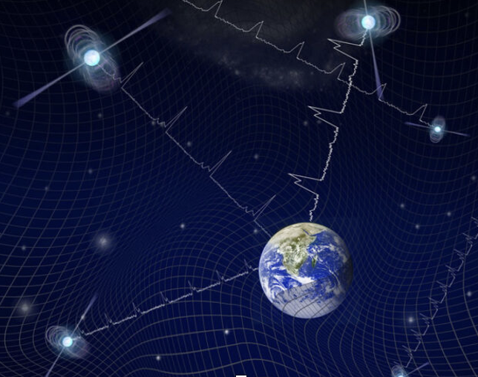
Particle Physics and Cosmology - PPC2026
Pulsar Timing Arrays as Probe
of Massive Gravity
Tina Kahniashvili
Carnegie Mellon University, USA · Ilia State University, Georgia
September 1, 2026

Slide 2




Outline
Collaboration
Why Gravitational Waves Based Tests?
Why New Physics?
Maybe Massive Gravity?
Pulsar Timing Arrays – Theory & Data
Interpretation – What Did We Learn
Results
Take Home Thoughts & Future Work
Marcus Bosca Chris Choi Murman Gurgenidze
Barnabas P2oczos

Slide 3
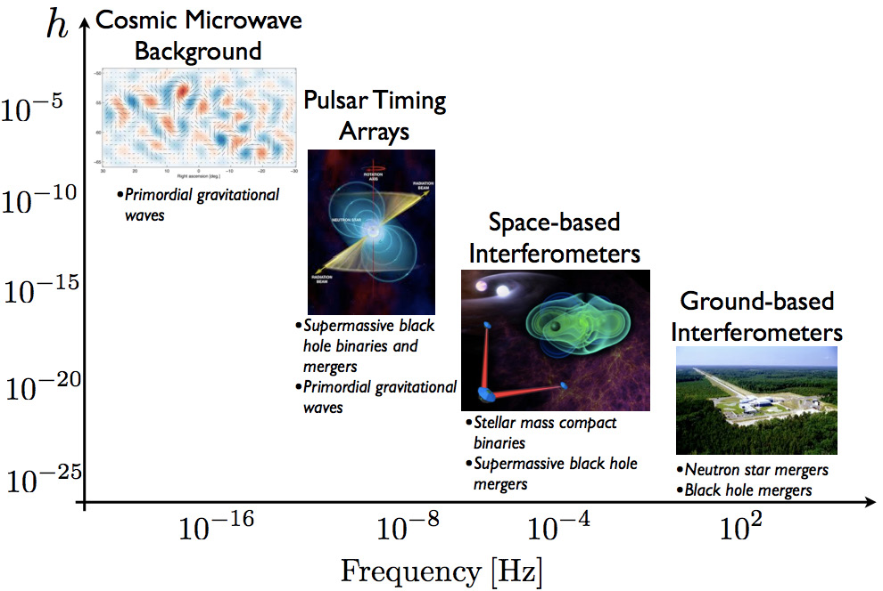
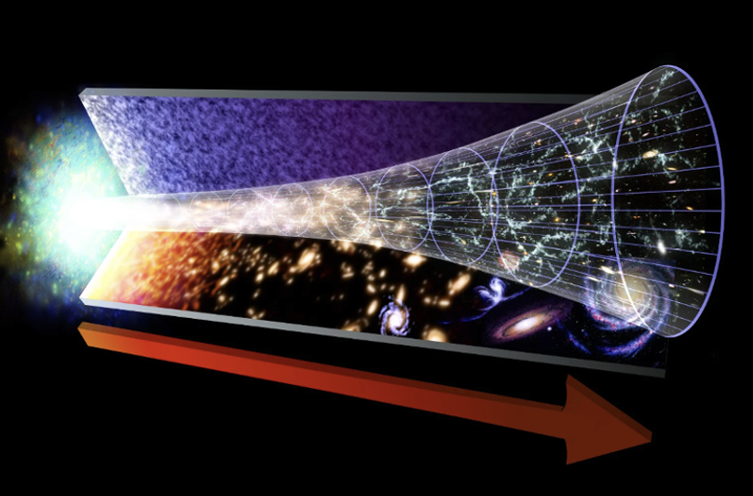
Why Gravitational Waves ?

Slide 4
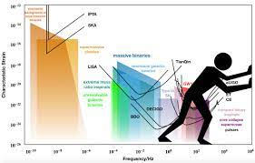
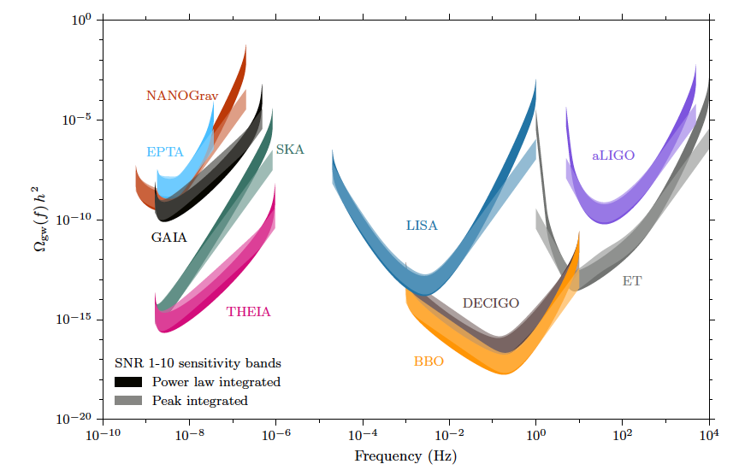
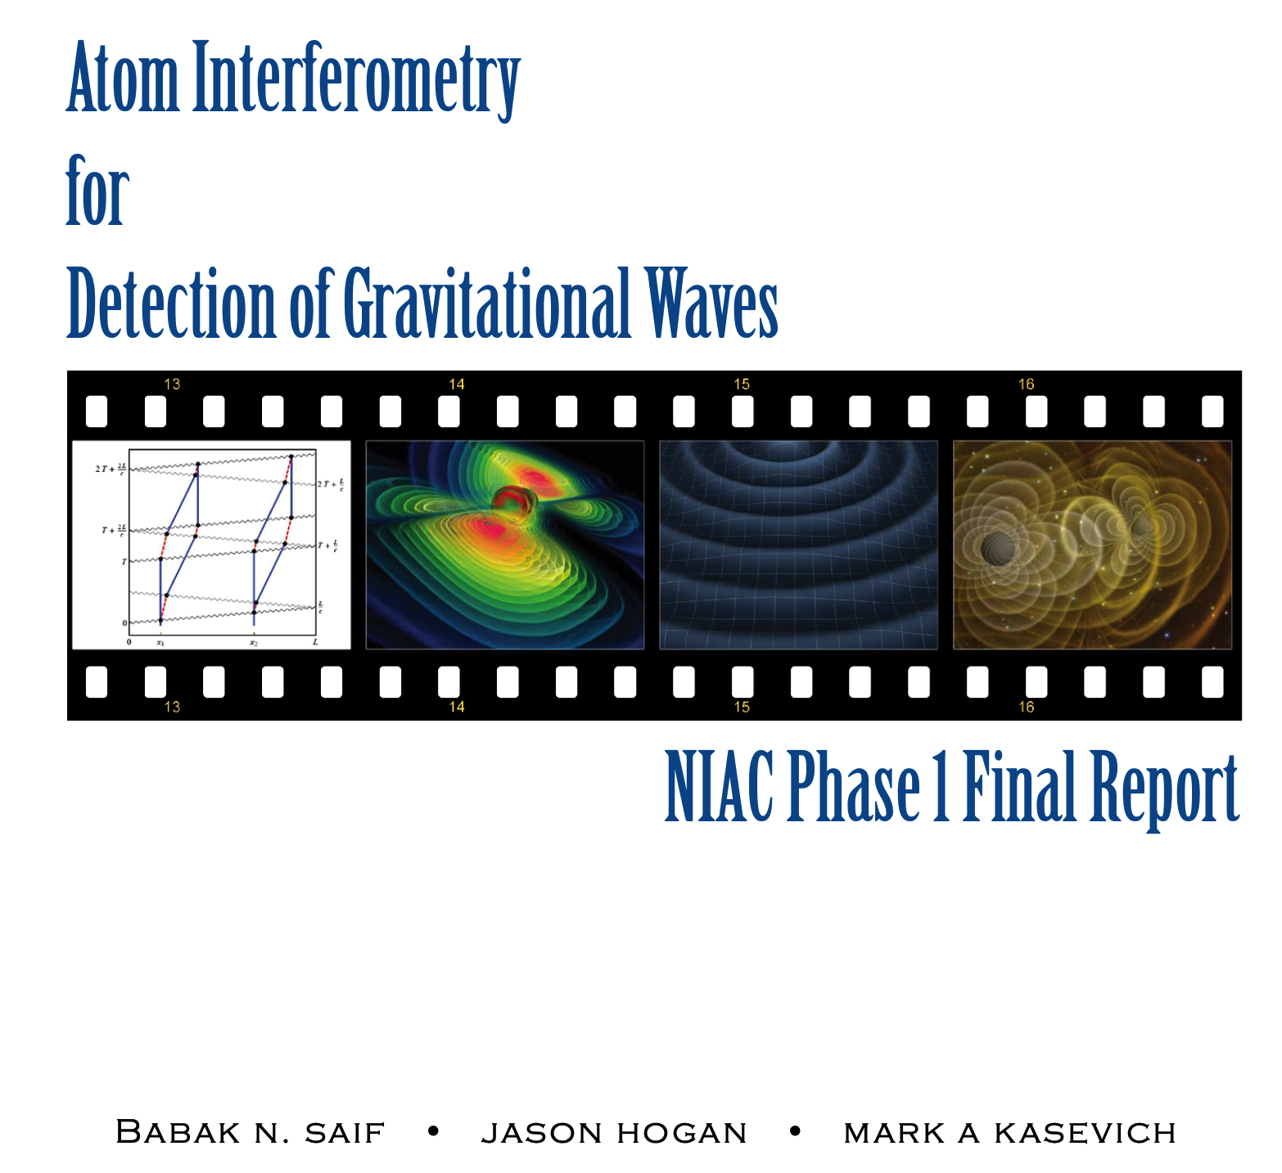
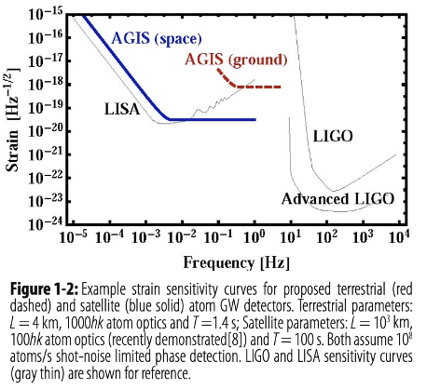
What is next?
Credit CERN
Garcia Bellido et al. 2020
Connection with High Energy Particle Physics – the best laboratory to test the energy scales EVEN near the Planck scale

Slide 5

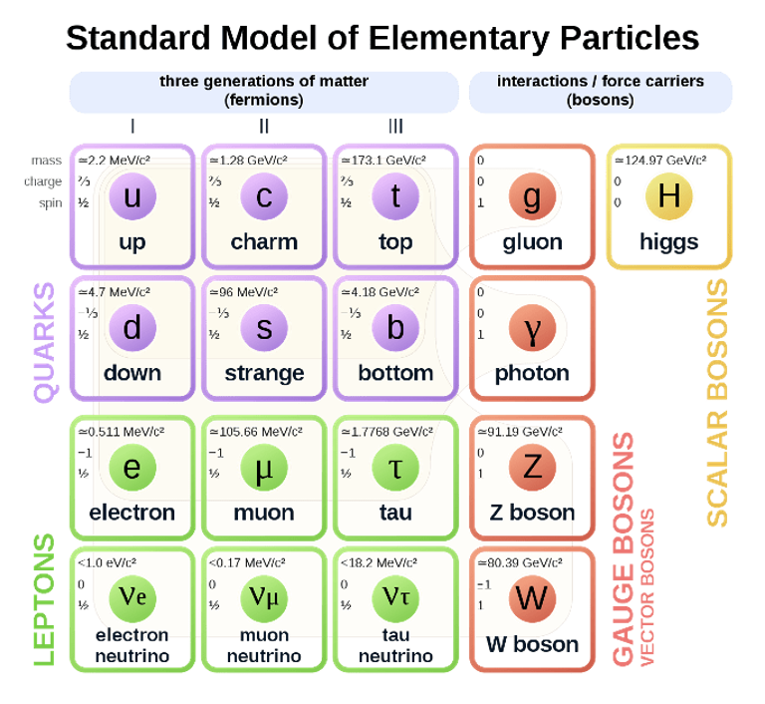
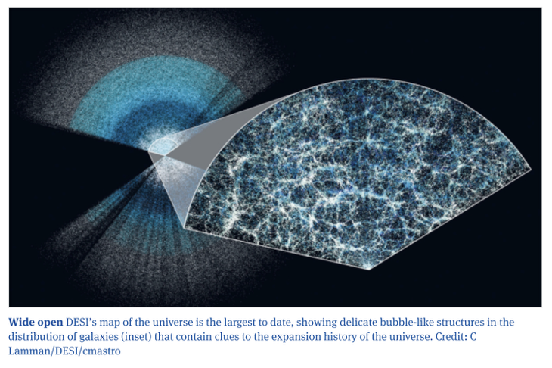
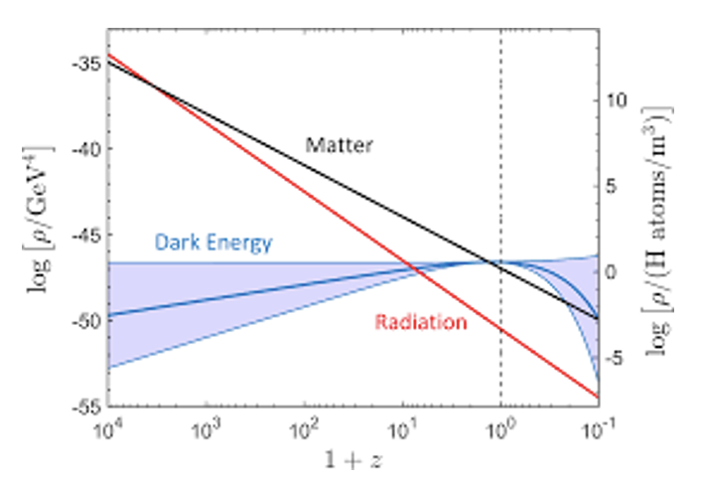
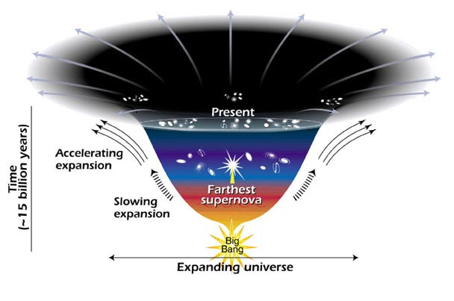
Why NEW Physics

Slide 6
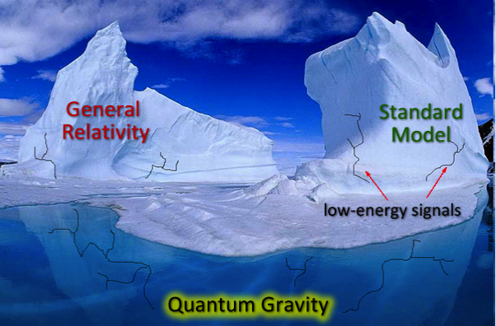
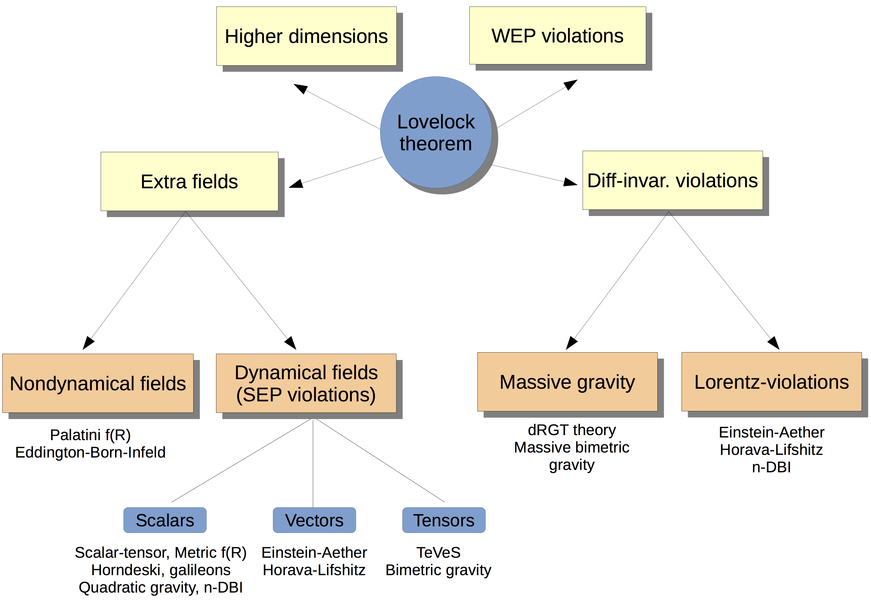
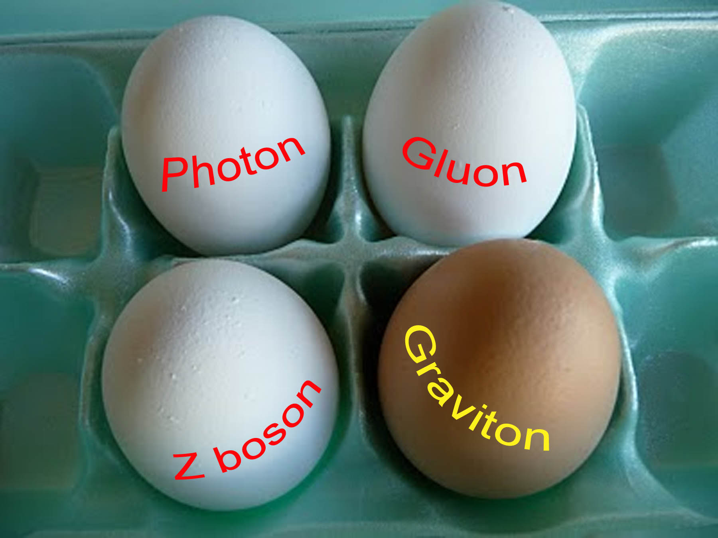
Modifications of General Relativity
Berti et al.

Slide 7
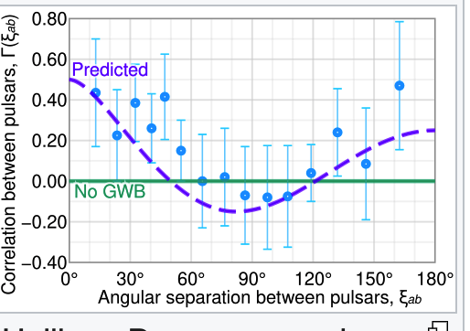
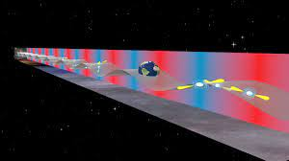
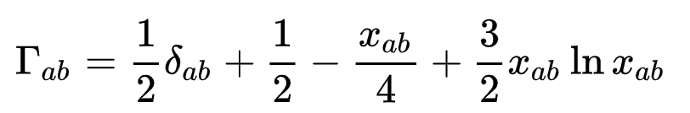


Pulsar Timing Arrays
In 1983, Hellings and Downs[ extended this idea to an array of pulsars and found that a stochastic background of GWs would produce a distinctive GW signature: a quadrupolar spatial correlation between arrival times of pulses emitted by different millisecond pulsar pairings that depends only on the pairing's angular separation in the sky as viewed from Earth (actually the solar system barycenter). The key property of a pulsar timing array is that the signal from a stochastic GW background will be correlated across the sightlines of pulsar pairs, while that from the other noise processes will not.
Credit: NANOGrav
The proposal to use pulsars as GW detectors was originally made by Sazhin (1978) and Detweiler (1979) iThe idea is to treat the solar system barycenter and a galactic pulsar as opposite ends of an imaginary arm in space.
overlap reduction function
Assumptions: Isotropic GW that obeys Einstein’s general relativity. It is valid for "long-arm" detectors like pulsar timing arrays, where the wavelengths of typical GWs are much shorter than the "long-arm" distance between Earth and typical pulsars

Slide 8
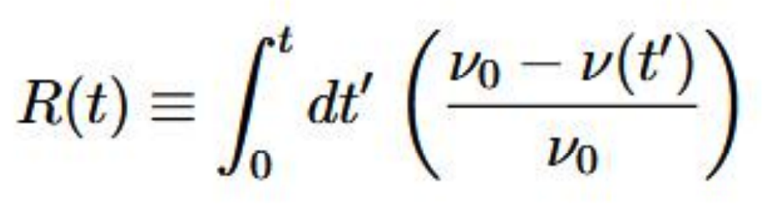
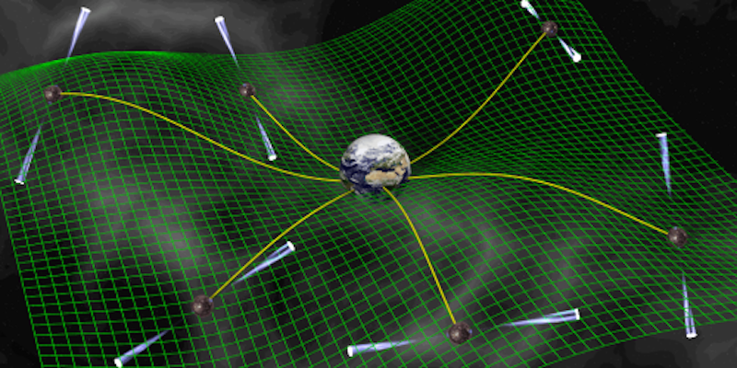
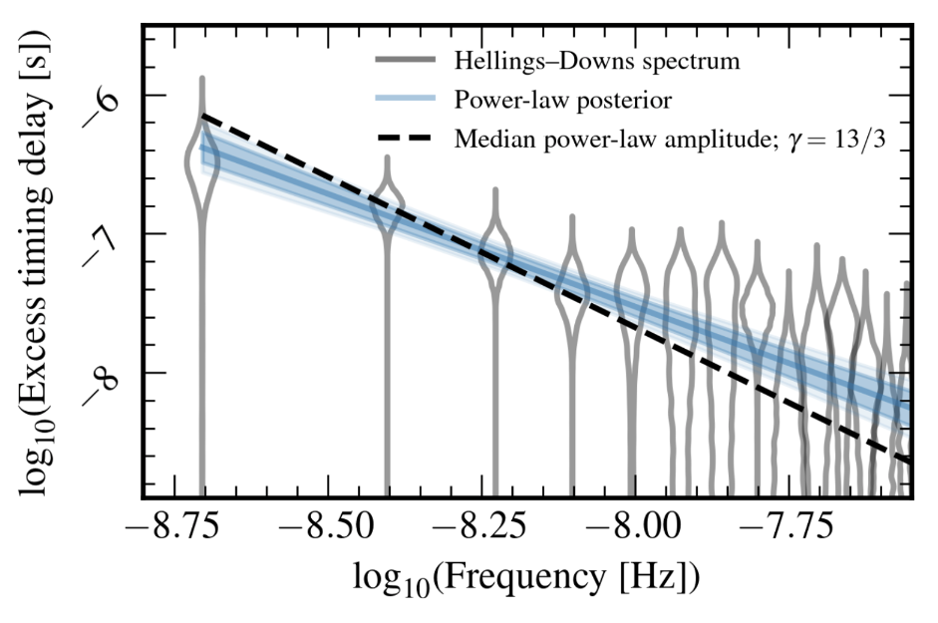
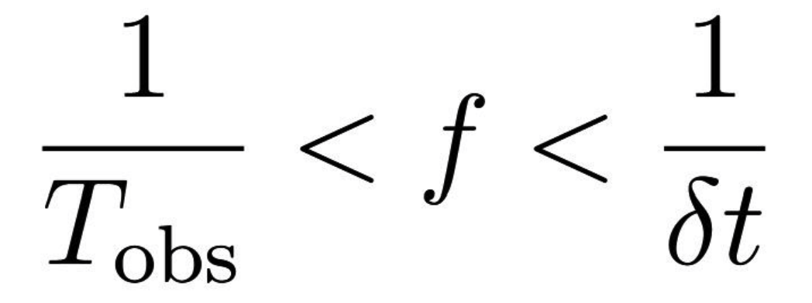
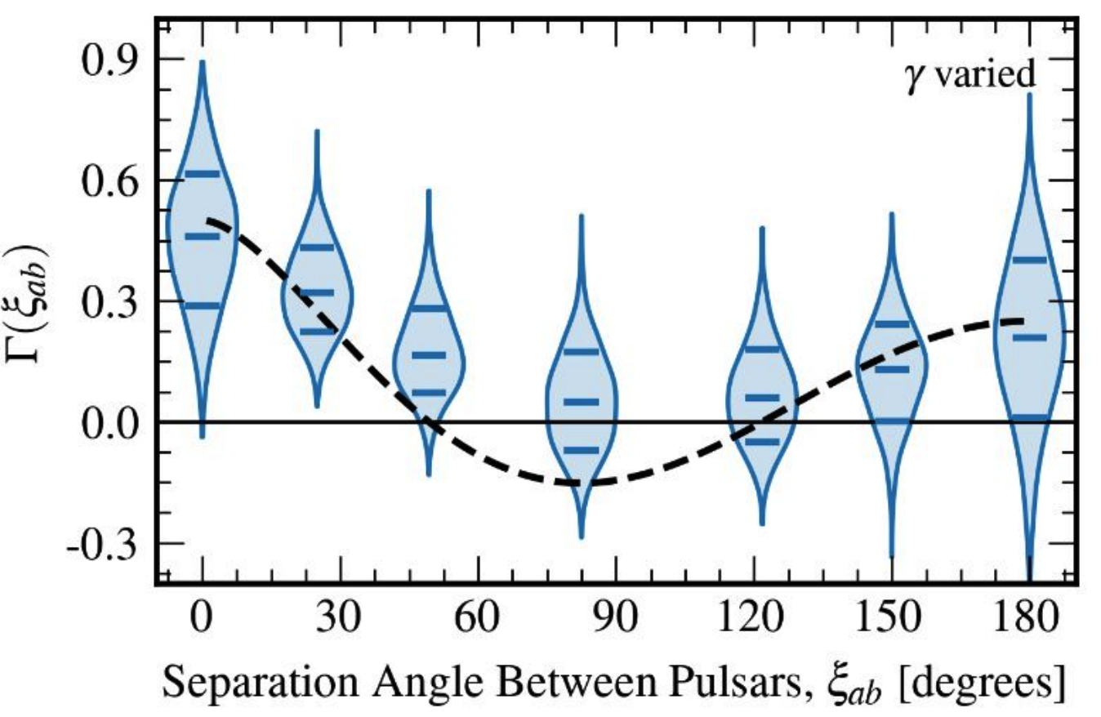


Stochastic Gravitational Waves Detection
Detection residuals in the time delay in the pulsar signals
The pulsar acts as the reference clock at one end of the arm sending out regular signals which are monitored by an observer on Earth. The effect of a passing long-wavelength GW would be to perturb the galactic spacetime and cause a small change in the observed time of arrival of the pulses.
Credit: NANOGrav

Slide 9
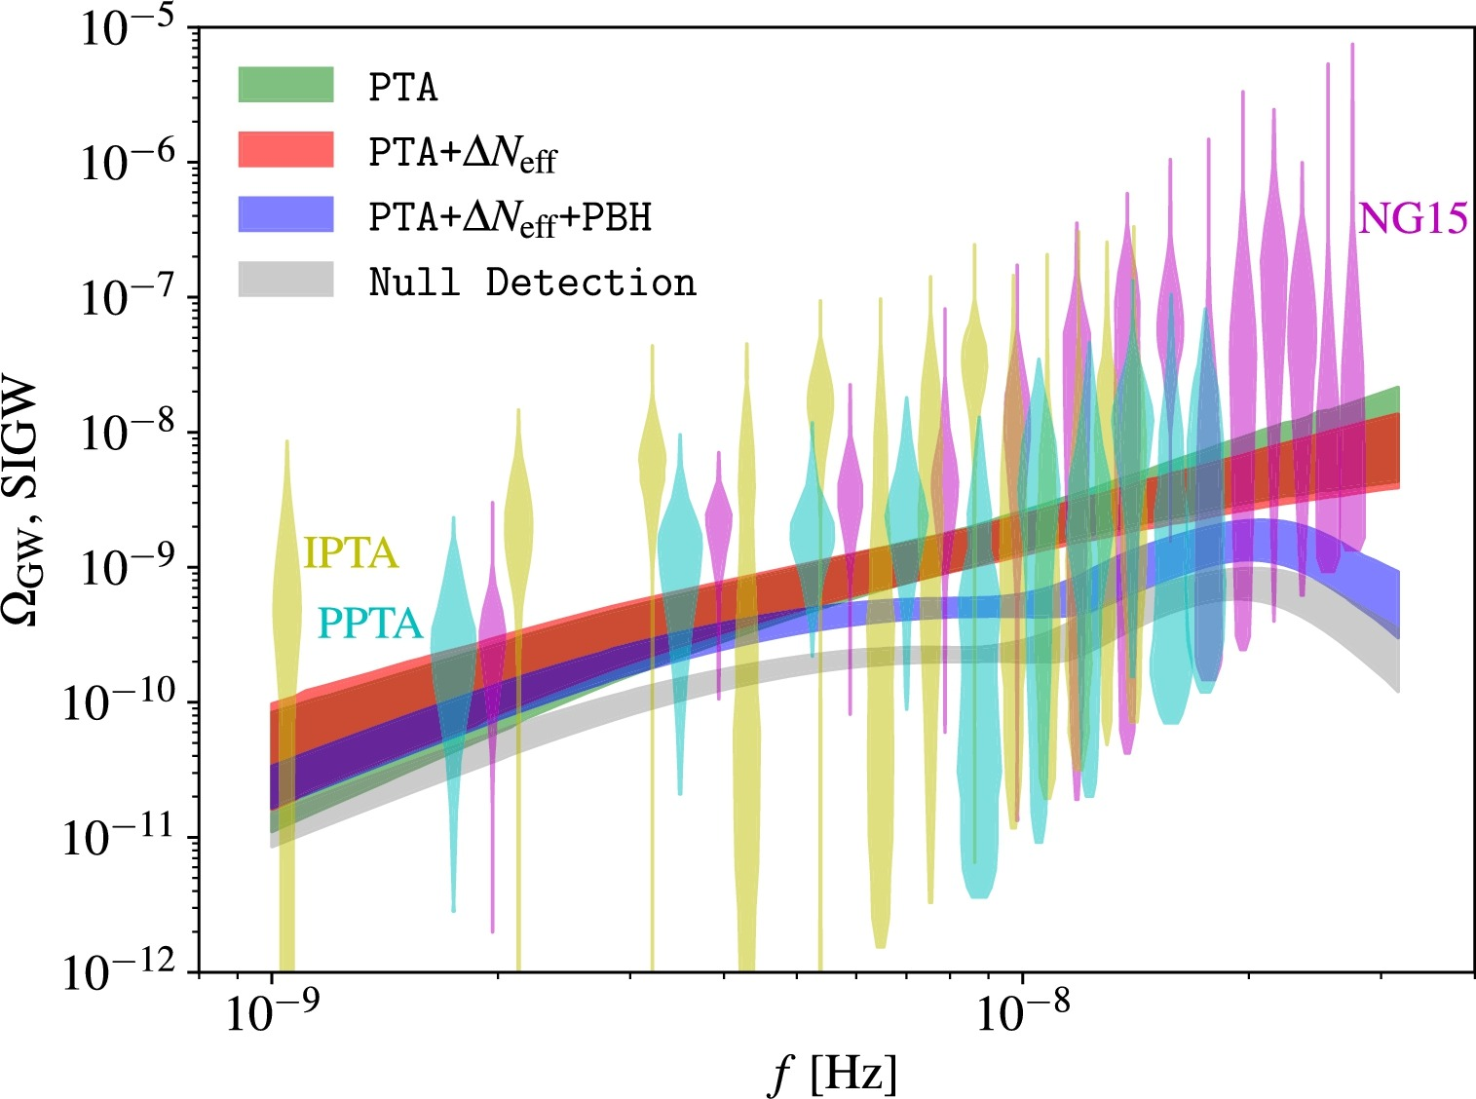
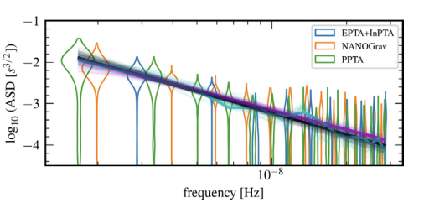
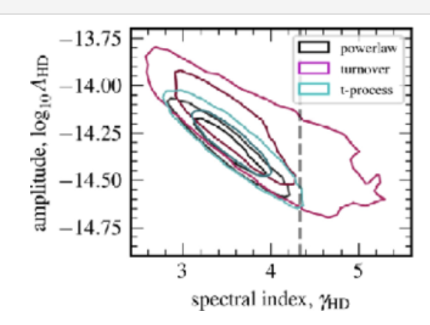
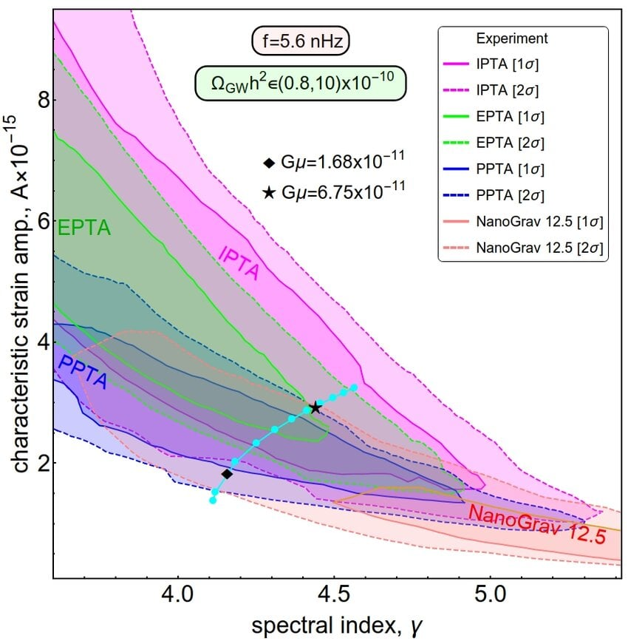
Combined PTA Results
Cong et al. 2025
Agazie et al. 2024
A combined fit (cyan curve) to NANOGrav, PPTA, EPTA, and IPTA data in the (A, γ) plane. The diamond and the star shaped points are the two chosen benchmark scenarios of the proposed model.
Posterior distributions of SIGW and comparison with experimental data. The magenta, yellow and cyan regions show the measured Ω_{GW} posterior from NANOGrav 15 years result (NG15), IPTA and PPTA respectively. The green, red, and blue contours show our 68% C.L. posterior for SIGW
Saad 2022

Slide 10
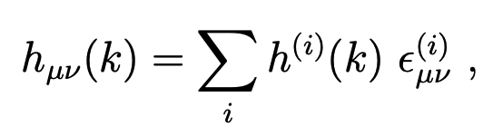
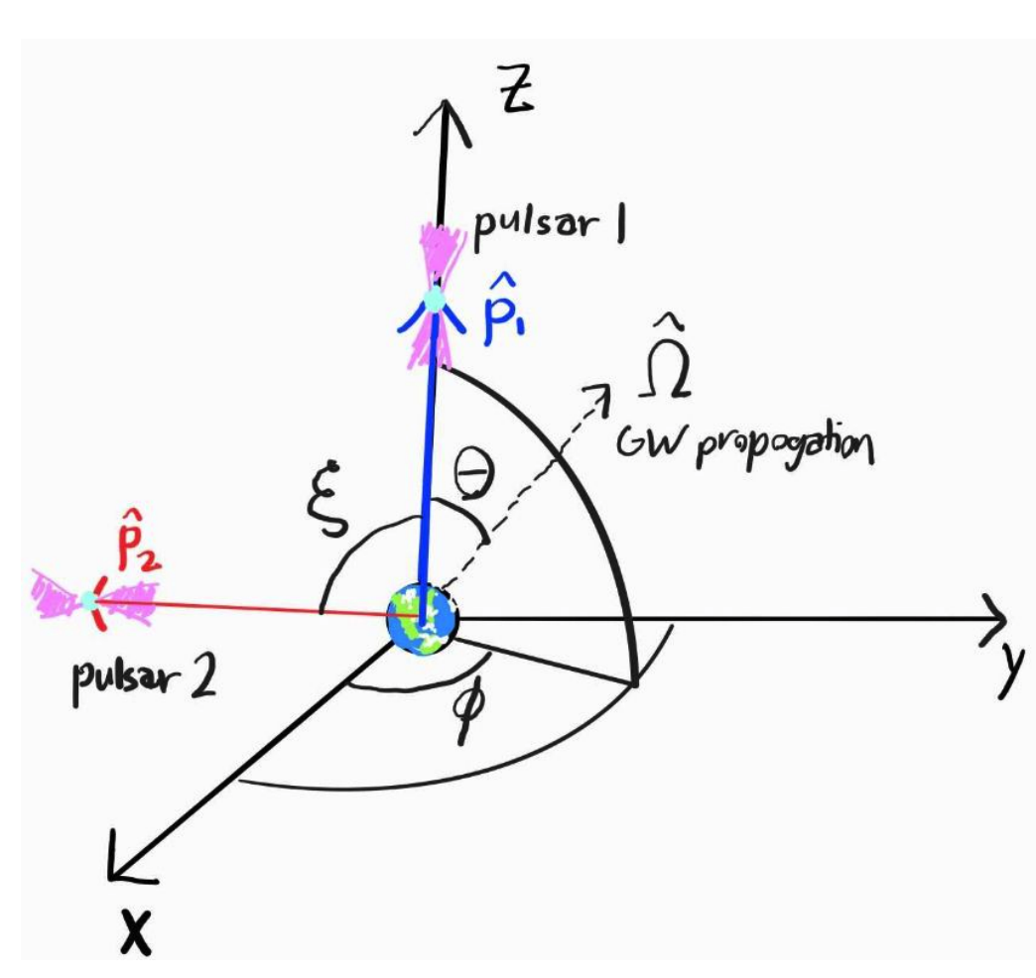
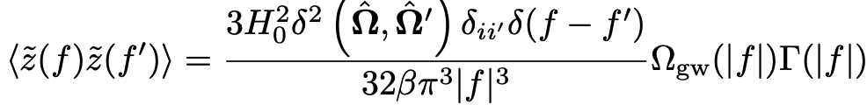
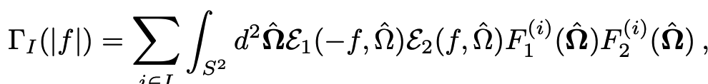


Stochastic Gravitational Waves Detection
$ε_{μν}^{i}$ polarization tensor
In the barycenter reference frame of the solar system, the frequency shift is characterized by the redshift $z\left(t\right)=\frac{ν_{0}−ν\left(t\right)}{ν_{0}}$ and averaged redshift: $\tilde{z}\left(f\right)≡∫d^{2}\hat{Ω}$ $z(f,Ω)$
β is the normalization factor introduced so that Γ(|f|) = 1/2 for coaligned coincident pulsars to match
the Hellings-Downs (HD) correlation
Credit Chris, Choi

Slide 11
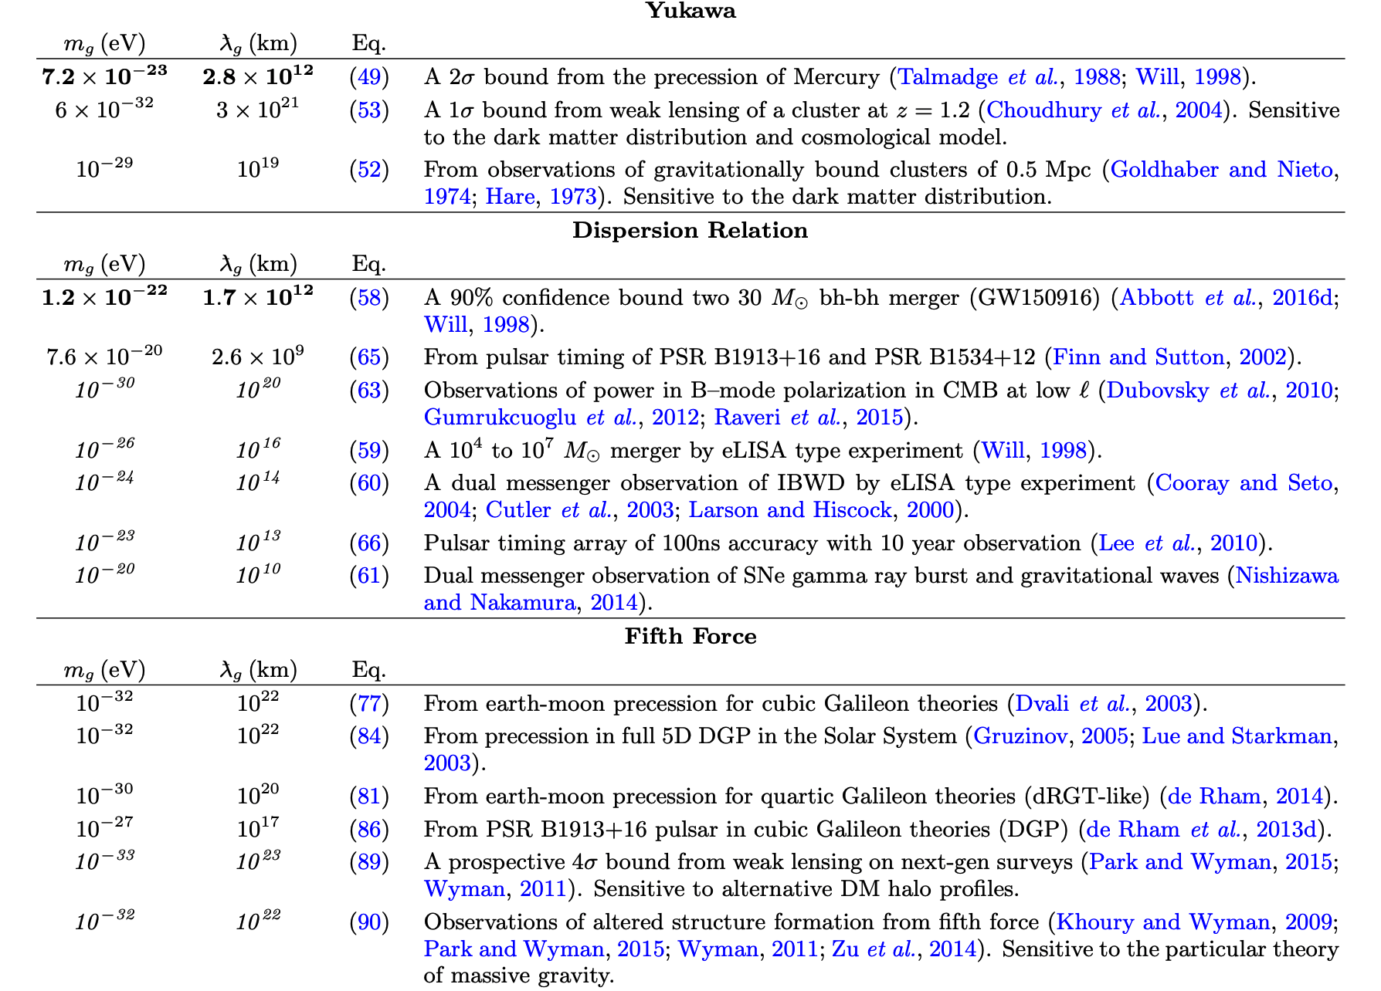
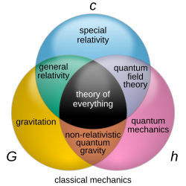
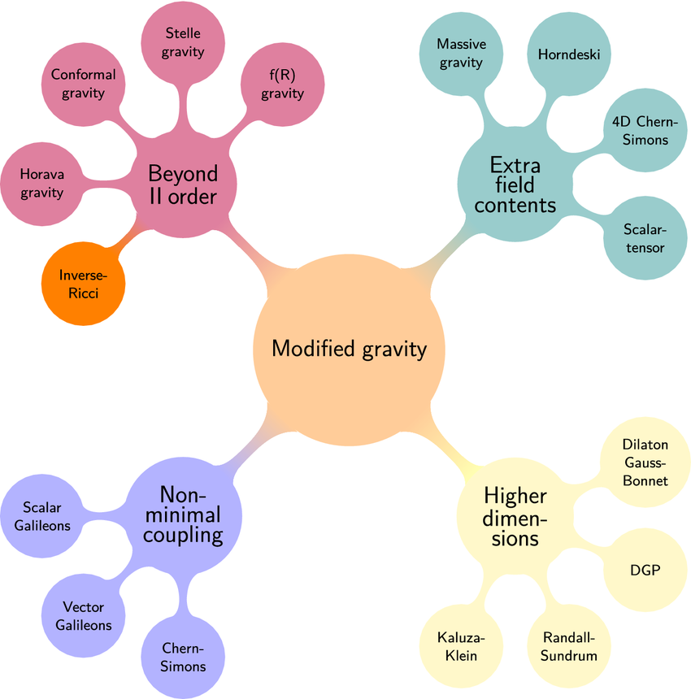
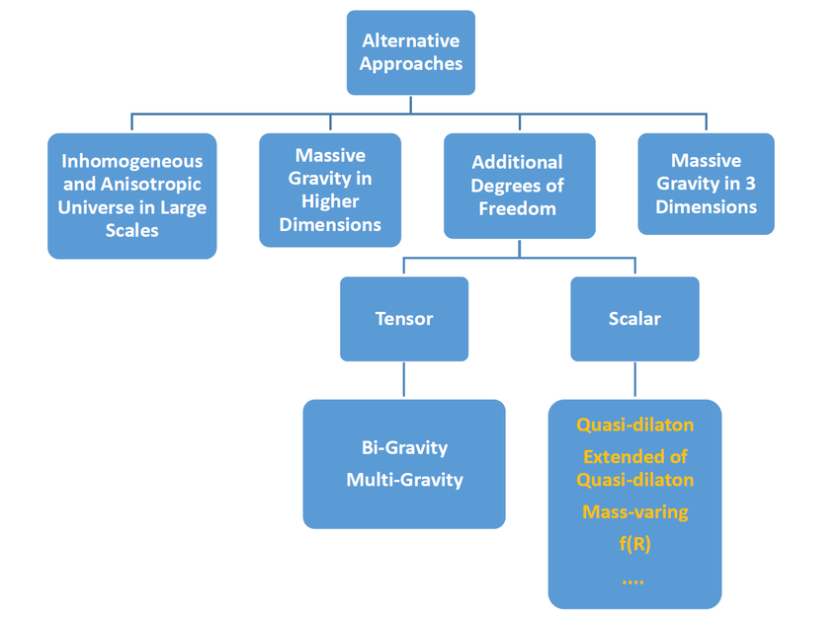
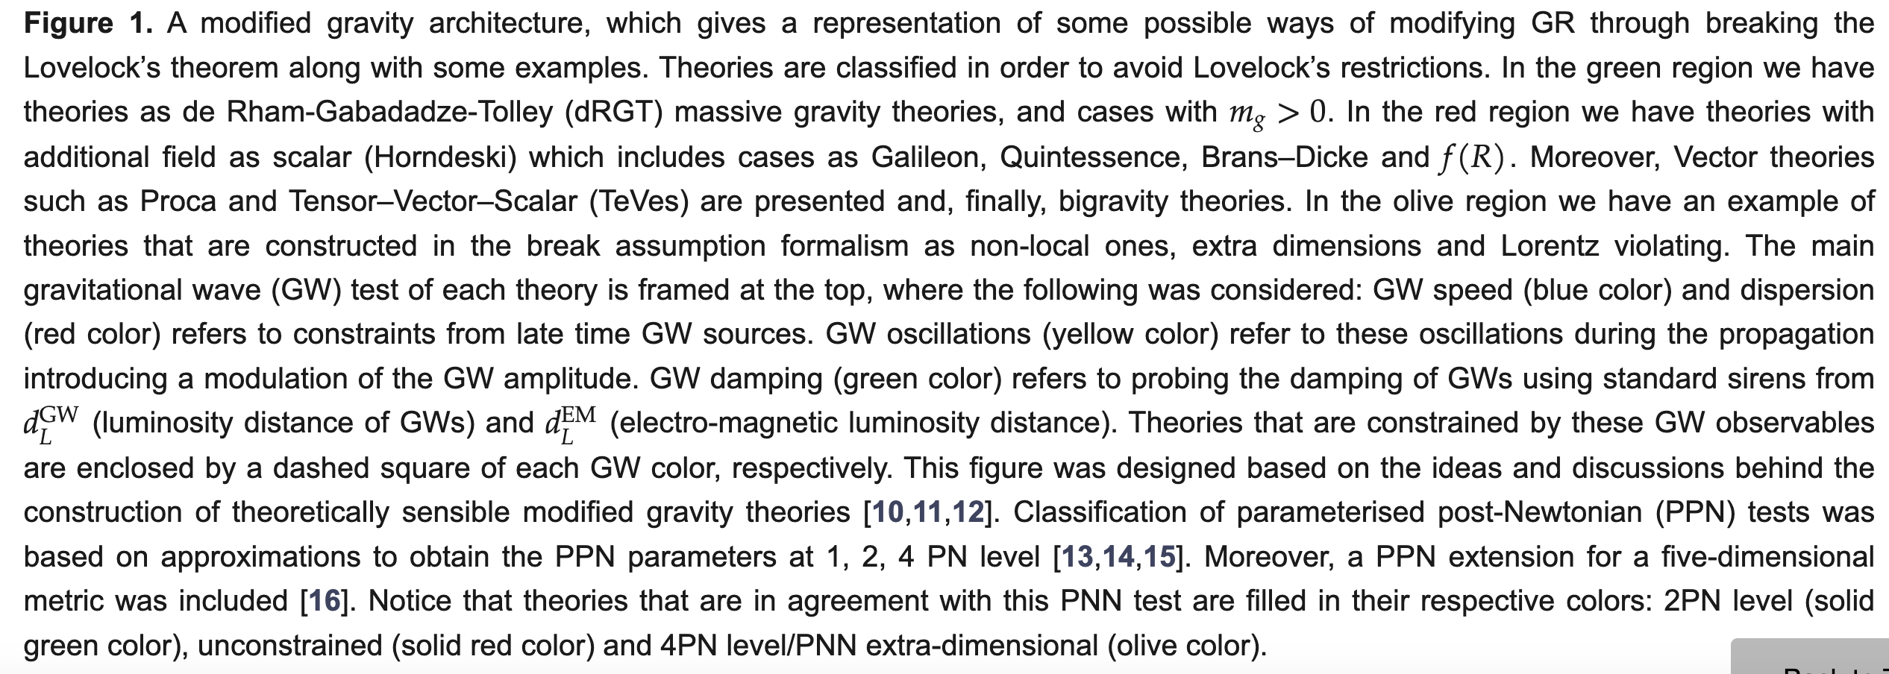
Massive Gravity
Shankaranarayanan & Johnson
Sobhan Kazempour
De Rham 2017
Escamilla-Rivera and Fabris 2021

Slide 12
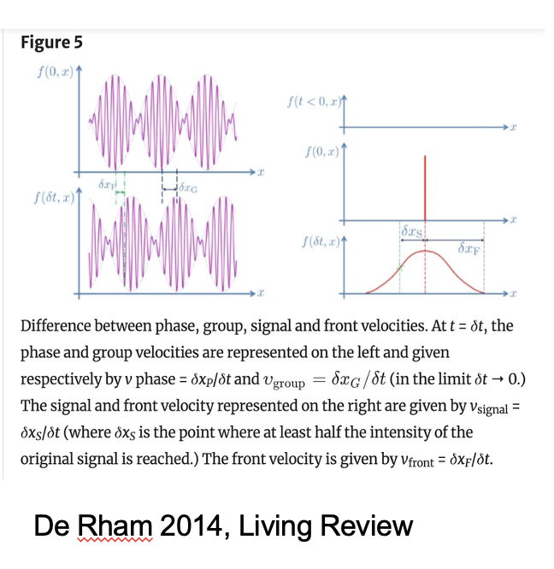
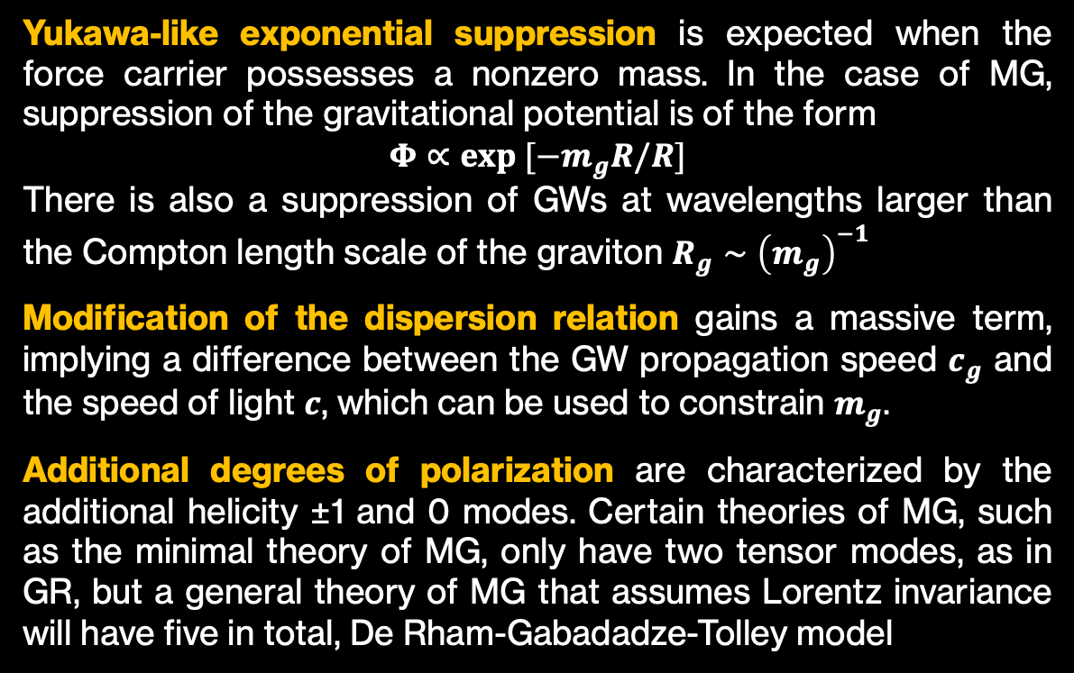
Tests of Massive Gravity
Fiertz-Pauli 1937
Yukawa-like exponential suppression is expected when the force carrier possesses a nonzero mass. In the case of MG, suppression of the gravitational potential is of the form
$$Φ∝exp [−m_{g}R/R]$$
There is also a suppression of GWs at wavelengths larger than the Compton length scale of the graviton $R_{g}∼{\left(m_{g}\right)}^{−1}$
Modification of the dispersion relation gains a massive term, implying a difference between the GW propagation speed $c_{g}$ and the speed of light $c$, which can be used to constrain $m_{g}$.
Additional degrees of polarization are characterized by the additional helicity ±1 and 0 modes. Certain theories of MG, such as the minimal theory of MG, only have two tensor modes, as in GR, but a general theory of MG that assumes Lorentz invariance will have five in total, De Rham-Gabadadze-Tolley model

Slide 13
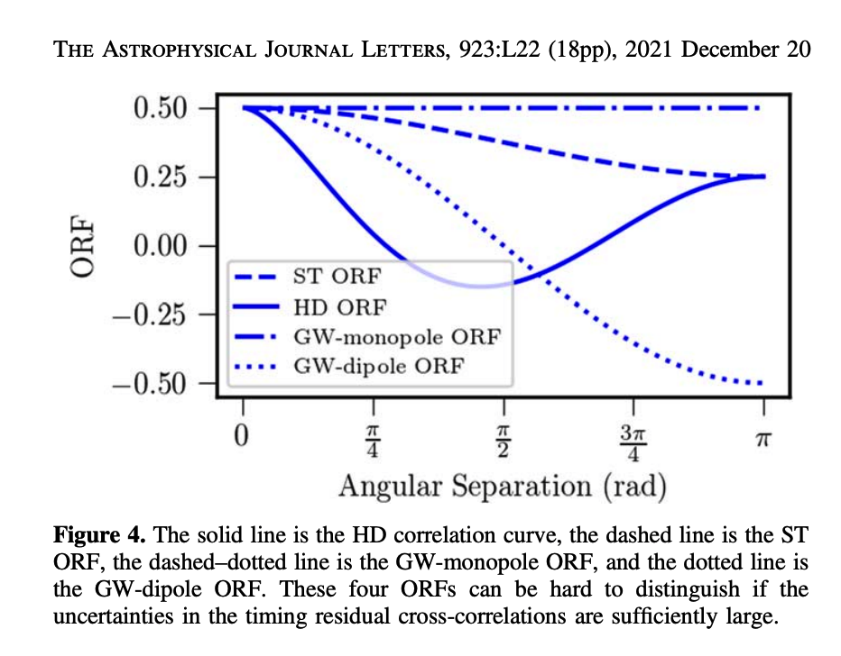
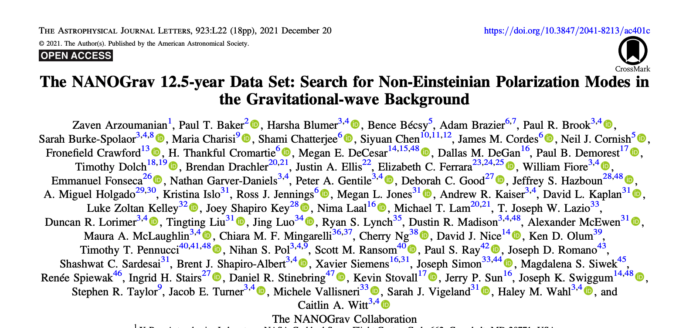
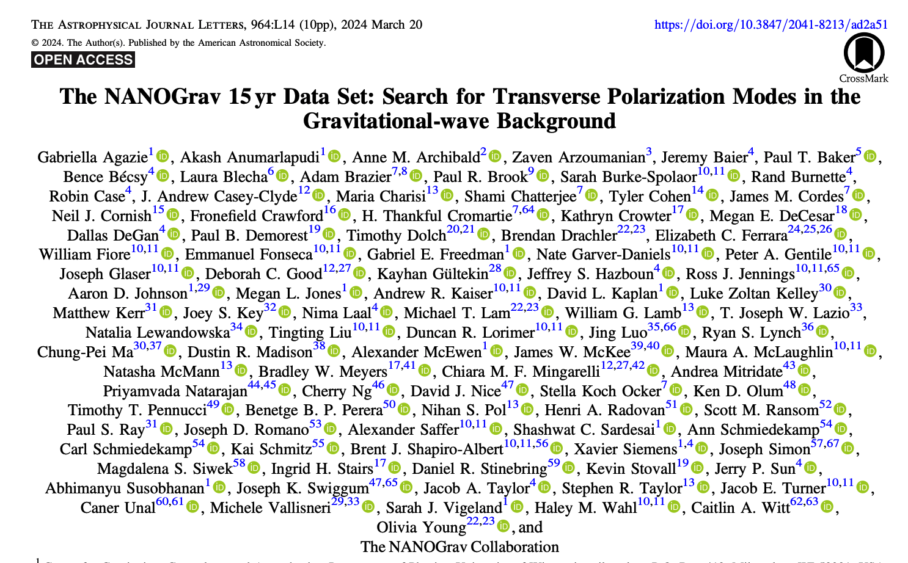
Pulsar Timing Arrays Data and
Additional Polarizations
The analyses in this Letter, as well as those in Bernardo & Ng (2023c) and Chen et al. (2023), do not rule out the possibility of ST correlations in our data. However, our analysis also shows no statistical need for an additional stochastic process with ST correlations.

Slide 14




PTAs are sensitive to both: modified propagation
and
the additional polarization sectors.
$$ω^{2}= k^{2}+m_{g}^{2} →v_{g}=\sqrt{(1−m_{g}^{2}/ω^{2})}$$
5 polarization degrees of freedom
tensor: helicity ±2
vector: helicity ±1
scalar: helicity 0
low frequency cut-off,
no signal below $ω=m_{g}$
$Ω_{S}$ $Ω_{V} Ω_{T}$
$$m_{g} ≾10^{−24}eV$$
Results does not depend if the source is astrophysical or cosmological

Slide 15
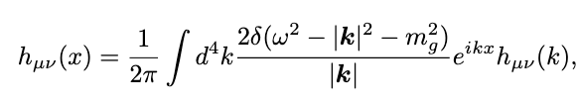
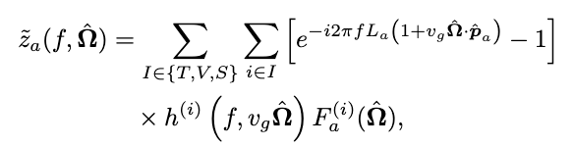
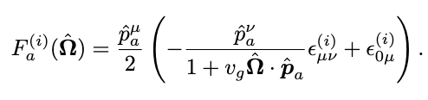
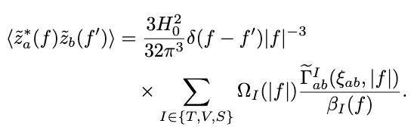
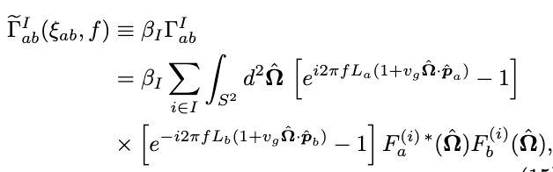

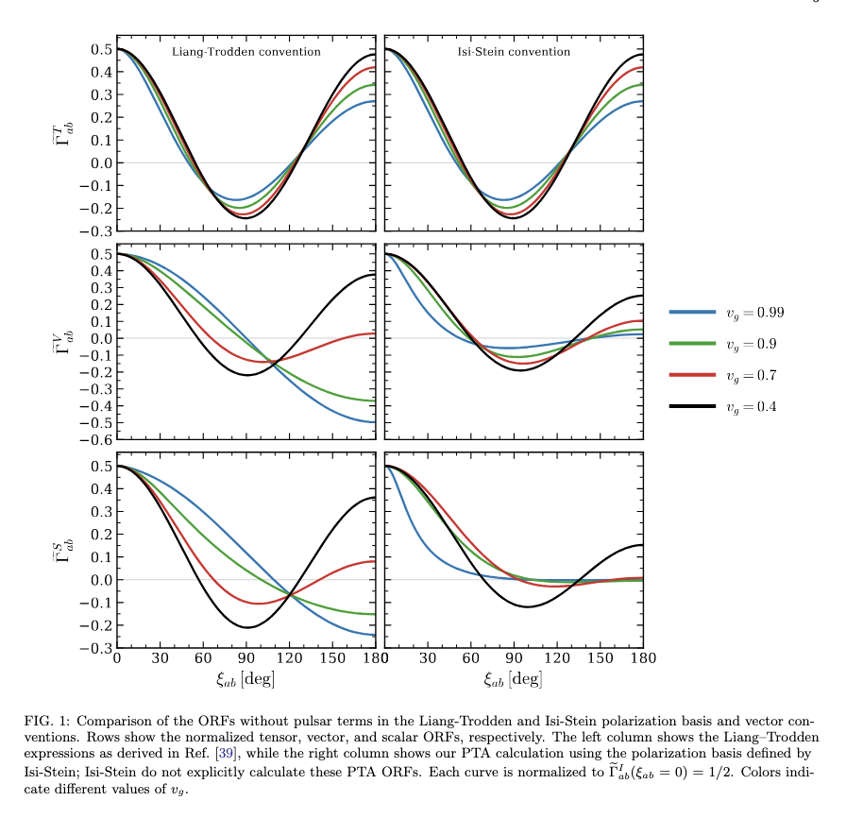

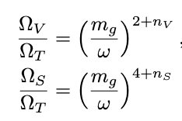
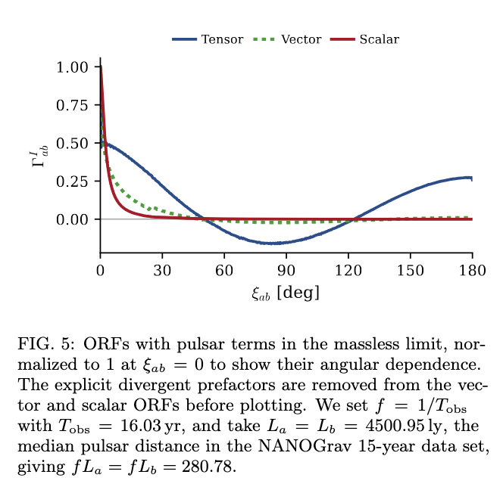
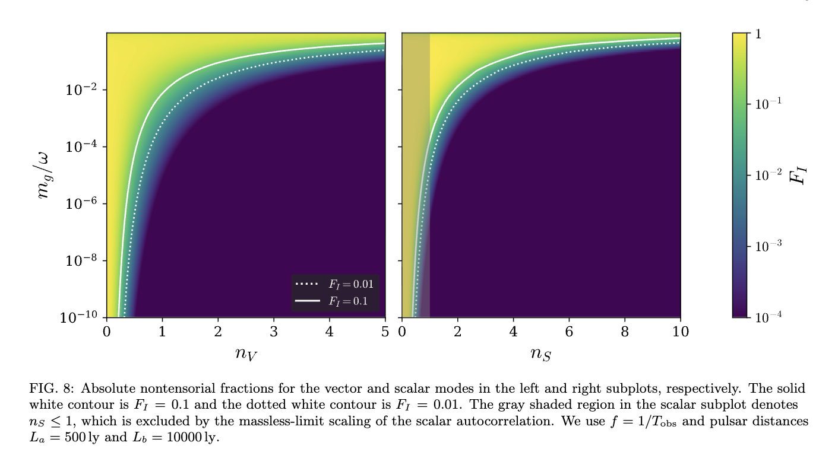

Modification of ORF
PTA collaborations
PTA directly measure the times of arrival of pulsar signals, which correspond to the integral of $z\left(t\right)=\left(ν_{0}−ν\left(t\right)\right){/ν}_{0}$ - time residual
Anholm, et al. 2008
Liang & Trodden, 2021
Choi, TK, Poczos 2026 (in preparation)
Notes:
A limitation of our formalism is the treatment of vector and scalar suppression. Our prescription is motivated phenomenologically and is thus a useful first step, but should not be conflated with the Vainshtein mechanism [64]. In ghost-free massive gravity, the Vainshtein mechanism is associated with nonlinear interactions of the scalar mode,

Slide 16
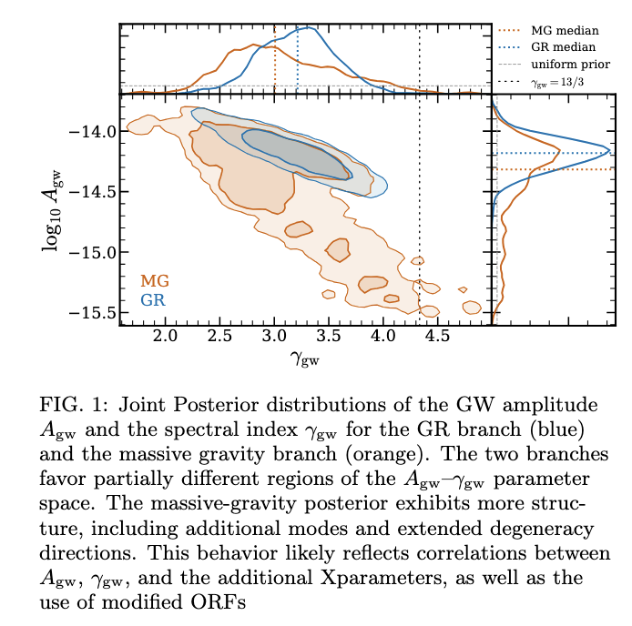


Preliminary Results: NanoGrav
ModificationPreliminary Results
Choi, Bosca, TK, Poczos, et al. 2026 (in preparation)
$$A_{gw}={(4.8}_{−4.3}^{+5.2} )× {10}^{−15}, { γ}_{gw} = {3.01}_{−0.66}^{+1.04}$$
Unlike in Wu et al. 2023, the posteriors distributions of $A_{gw}$and $γ_{gw}$ inferred for massive gravity are not necessarily consistent with those of GR
Credit: Chris Choi

Slide 17


Preliminary Results: NanoGrav
$$m_{g}= \left({2.6}_{−2.5}^{+4.9}\right)× {10}^{−24}eV,$$
$n_{V}= {2.0}_{−1.8}^{+1.8} \&. n_S = {4.2}_{2.8}^{+3.4},$
$BF =1.238±0.015$.
The distrubtion of the parameters in massive gravity, while they do overlap substantially with the ones for GR, contain a richer structure. The distrubtion of $A_{gw}$ for massive gravity is broad,er with a lower median and a wider tail for smaller values of $A_{gw}$ compared to GR. The spectral index shows a similar pattern: the median is lower for massive gravity and the distribution is broader.
These differences can be attributed to the behavior observed in the effective ORF. Since both of the models are being tested against the same set of data, they should predict a similar signal in order to produce maximal agreement with observation.
Choi, Bosca, TK, Poczos 2026 (in preparation)

Slide 18


Preliminary Results: NanoGrav
ModificationPreliminary Results
The total spectrum of massive gravity energy density lies in the range preferred by the PTA common-process reconstruction. A concrete observable of massive gravity in an extended PTA campaign would be a low-frequency enhancement of the energy-density spectrum, driven by the increasing relative contribution of the scalar and vector modes.
Choi, Bosca, TK, Poczos 2026 (in preparation)
Credit: Chris Choi
Choi, Bosca, TK, Poczos 2026 (in preparation)

Slide 19



Preliminary Results: NanoGrav
Effective ORFs from the massive gravity (MG) analysis, compared with the HD correlation. The blue violins show the NANOGrav frequency-independent spline reconstruction; the horizontal bars mark the 16th , 50th , and 84th percentiles at each angular knot. Colored points show the effective ORF for every pulsar pair, at the 14 Fourier frequencies $f_{i} = i/T_{obs};$the color bar gives the Fourier index $i.$ The black dotted curve shows the HD correlation. The largest departures from HD occur in the lowest-frequency bins, where the MG prediction exhibits enhanced correlations at small angular separations. At higher frequencies, the MG predictions converge toward HD.
In addition, the modified dispersion relation implies a propagation threshold: modes with $f < f_{g} = m_{g} /(2π)$have imaginary $k$ and are therefore non-propagating.
Choi, Bosca, TK, Poczos 2026 (in preparation)

Slide 20




Preliminary Results: EPTA
Credit Marcus Bosca
Overview of the full EPTA DR2 dataset. Empty circles denote legacy data, while filled squares show new EPTA backends. Vertical lines bound the range of the ‘DR2new’ dataset.
Joint Posterior distributions for the graviton mass, $m_{g}$, and the vector/scalar suppression indices, $n_{V}$ and $n_{S}$. Distributions show that each of these parameters are poorly constrained due to the MCMC being prior-dependent. This fundamentally exemplifies that the EPTA dataset, like the NANOGrav dataset, also cannot probe SGWB frequencies low enough to differentiate the MG model from GR, and to constrain graviton mass and suppression.
Credit: EPTA

Slide 21



Preliminary Results: EPTA
Joint Posterior distribution organized and evolving by mass bins from highest mass to lowest mass. The lowest mass bin approaches the GR case, which exemplifies the effective behavior in the limit of masslessness.
Joint Posterior distribution for the GW amplitude, $A_{GW}$ and the spectral index, $γ_{GW}$ for a GR model (blue) and a Massive Gravity model (orange) for the EPTA DR2new+dataset. The branches occupy a very similar area in the $A_{GW} −γ_{GW}$$ parameter space. The strongest deviations of the MG branch from the GR branch occur at large masses, as expected. The use of modified ORF still provides more complex structure for the MG branch, like for the NANOGrav posteriors.
Credit Marcus Bosca

Slide 22



The Hellings–Downs correlation tells us that the signal is gravitational-wave-like, but it does not tell us whether the background is astrophysical or primordial. For that, we need spectral, statistical, anisotropy, and polarization information.
For a PTA, separating an astrophysical stochastic gravitational-wave background—mainly supermassive black-hole binaries (SMBHBs)—from a cosmological primordial background is difficult because PTA measures the combined stochastic signal. The discrimination comes from looking for differences in spectral shape, angular correlations, statistics, and polarization.

Slide 23







Kinematic anisotropy
Status and outlook:
Current PTA and SKAO data sensitivity is not enough to constrain dipole in any significant capacity [Cruz et al. 2606.25845]
Extensions: astrometric observables alongside PTAs, and spectra departing from a pure power law can be pass forward to detect kinematic dipole.
Cruz et al. 2606.25845

Slide 24



To Do:
Redifine receiving functions based on Liang & Troddden formalism and re-do complete analysis
Main difference in derivation
v2 follows the perturbed photon trajectory but does not consistently include the perturbed four-velocities of the emitter and receiver.
The perturbation of the emitter’s and receiver’s four-velocities.
v3 adds the timelike geodesics of the pulsar and Earth observers.

Slide 25
Take-home message
PTAs probe gravity on the largest accessible scales
• Massive gravity leaves characteristic frequency- and angle-dependent signatures in pulsar timing correlations.
• The strongest departures from GR occur at the lowest frequencies, where the graviton-mass cutoff and additional polarizations become important.
• Current PTA data do not yet significantly favor massive gravity over GR and provide only weak constraints on the graviton mass and extra-mode suppression.
• Kinematic anisotropy provides a complementary observable for testing the nature and propagation of the gravitational-wave background; however, PTA and SKA are not sensitible enough to provide detection of our proper motion.
PTAs are not only gravitational-wave detectors — they are precision tests of gravity.

Slide 26



Acknowledgements
PPC2026 Organizers
Collaborators: Barnabas Poczos (and on future project Alberto Roper Pol and Hippolyte Jean Hugo Quelquejay-Leclere)
Students: Marcus Bosca, Chris Choi, Murman Gurgenidze
Partial support from:
Shota Rustaveli National Science Foundation of Georgia FR24-901
NASA Astrophysics Theory Program: ATP80NSSC22K0825
NSF Astrophysics and Astronomy Research Grant Program: AST2307698 & AST2408411

