Slide 1
PARTICLE BEAMS
in Medicine
Rehanah Razak & Josie McGarrigle

Slide 2
01
• Cancer •

Slide 3
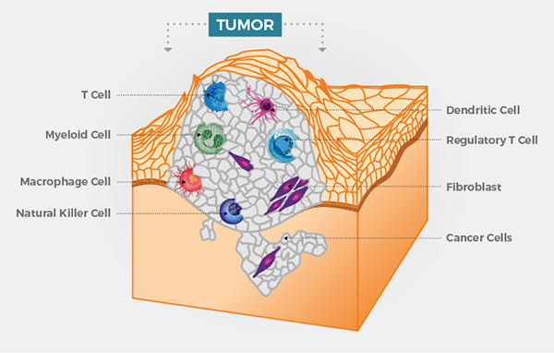
• Cancer
Disease in which cells grow and proliferate excessively and spread to other parts of the body.
Normal cells grow and multiply to form new cells as the body needs them. When they grow old or become damaged, they die, and new cells take their place.
Cancerous tumours corrupt nearby tissues and can travel through the body to form new tumours in a process called metastasis.
Figure 1.1. Diagram of a cancerous tumour and the surrounding cells.

Slide 4
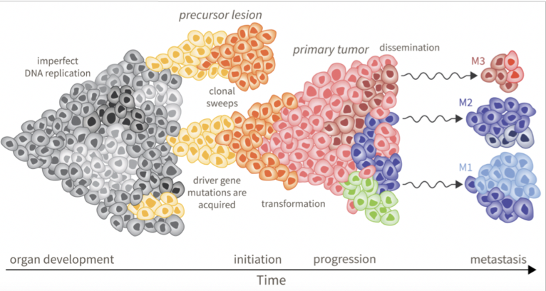
• Radiotherapy
Radiotherapy is a method of cancer treatment that exploits the interaction between human tissue and radiation.
When tissue absorbs radiation, the DNA can start to break up which stops the tissue from being able to reproduce.
Figure 1.2. Diagram to show cell development from imperfect DNA replication to a full tumour, to small sections of cancerous tissue being broken off in metastasis

Slide 5
02
• Radiation Therapy •

Slide 6
Indirectly ionising
(non charged particles)
Directly ionising
(charged particles)
Photons (x-ray/gamma)
Neutrons
Light- electrons & positrons
Heavy- protons & ions

Slide 7
Indirectly ionising
(non charged particles)
Directly ionising
(charged particles)
Photons (x-ray/gamma)
Neutrons
Light- electrons & positrons
Heavy- protons & ions

Slide 8
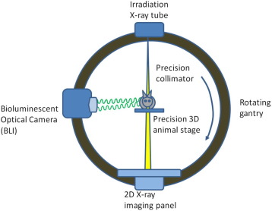
• X-rays (also known as conventional-RT)
Traditional form of radiotherapy
Creation of secondary particles.
Secondary particles create double helix break
Figure 2.1. Schematic of the set up of x-ray beam therapy.

Slide 9
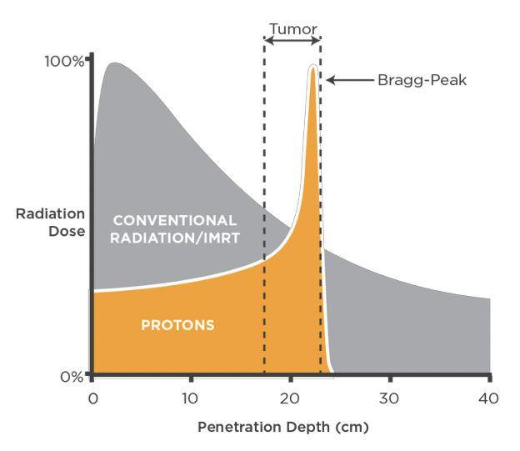
• X-rays (also known as conventional-RT)
Coulomb interactions from secondary particles
Attenuated steadily through material layer
Entrance and exit dose
Figure 2.2. Graph to show the Bragg peak of protons (orange) as they move through a patient’s body compared to x-ray-based radiotherapy (grey). The dashed grey line proposes a suitable depth at which the beam would have optimal tumour radiation efficiency based on the Bragg peak

Slide 10
Indirectly ionising
(non charged particles)
Directly ionising
(charged particles)
Photons (x-ray/gamma)
Neutrons
Light- electrons & positrons
Heavy- protons & ions

Slide 11
• Heavy charged particles (protons and ions)
Ions are less attenuated by the material layer, having a more direct route to the tumour leading to little energy deposited
The absorbed dose of radiation as ions move through the body gradually increases with depth and lower speed until having a sudden spike upon collision with the tumour and stopping - the Bragg peak.
Optimal energy distribution is carried out by ‘overlapping’ the Bragg peak with the tumour by ‘spreading’ the Bragg peak to create constant dose profile over the tumour region.
Figure 2.2. Graph to show the Bragg peak of protons (orange) as they move through a patient’s body compared to x-ray-based radiotherapy (grey). The dashed grey line proposes a suitable depth at which the beam would have optimal tumour radiation efficiency based on the Bragg peak

Slide 12
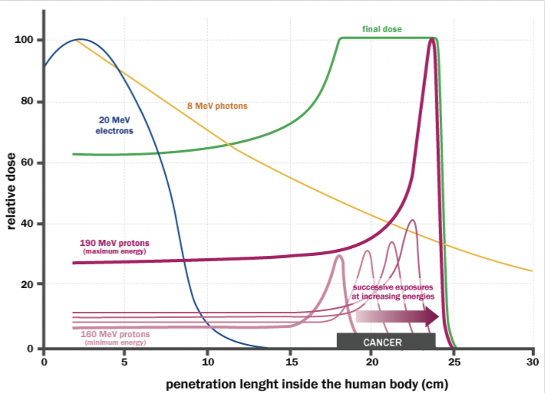
• Dose deposition profiles
Green line- proton/ion ‘Spread-Out Bragg Peak’ (SOBP) across the tumour profile
Yellow- photon (x-ray/gamma) dose deposition, exponential attenuation
Blue- electrons dose deposition, quick fall off due to scattering
Pink- single energy proton track with a Bragg peak at the end of its range
Ions- instead depositing all of its energy in the Bragg peak region, it remains at a low level afterwards, only gradually decreases, leaving a residue (fragmentation tail).
Figure 2.3 A graph showing the relationship between different kinds of therapeutically relevant particles (with their energies shown) and their ability to penetrate inside the human body.

Slide 13
03
• Acceleration •
Notes:
●We’re now moving into how we actually generate the high-energy particle beams used in radiotherapy.
●The goal is to speed up charged particles—like protons—so they have enough energy to penetrate the body and deliver their radiation dose precisely at the tumour site.

Slide 14
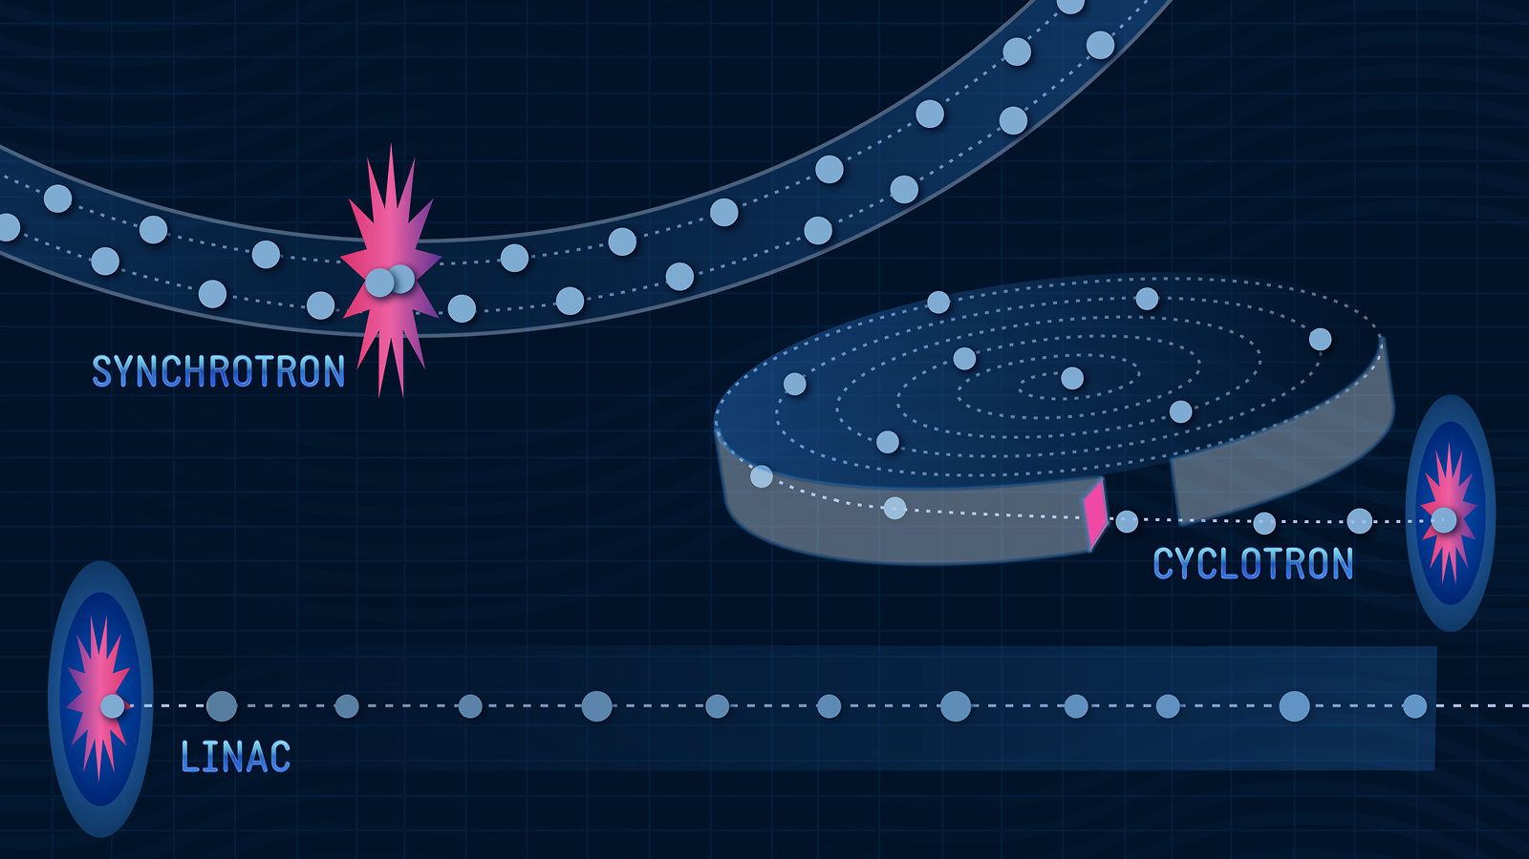
• Particle acceleration
Relativistic effects
Above 511 keV, all electrons travel very close to the speed of light, energy increase is ‘seen’ as an apparent increase in mass
Heavier particles require higher energies to achieve the speed of light
Linear acceleration
Multiple sections each add energy
Circular acceleration
Particles/charges travel in a circular orbit, gaining energy in each orbit as they travel past an accelerating section
All accelerated charges radiate electromagnetic energy
Figure 3.1. Depiction of linear and circular acceleration.
Notes:
●Below about 511 keV, particles behave as we’d expect: they gain speed with added energy.
●But once we go above that threshold, relativistic effects kick in. Particles like electrons approach the speed of light, and any extra energy goes into the apparent increase of their mass, not speed.
●This means we need much more powerful and precise acceleration techniques, especially for heavier particles like protons or carbon ions, which are used in radiotherapy treatment.
●So, how do we do that? Let’s look at different ways we can accelerate these particles.
●There are two main methods for accelerating particles: linear and circular acceleration.
●In linear accelerators (linacs), particles pass through a series of structures that boost their energy in a straight line—like giving a child a push on a swing every time they pass by.
●In circular accelerators, the particles go around in loops and get boosts each time they pass the same accelerating section. This saves space compared to linacs.
●But there’s a trade-off: as charged particles bend around corners, they radiate energy—especially light particles like electrons. That energy loss needs to be compensated.
●Fortunately, for protons and heavier ions, the radiation loss is much less, which makes circular accelerators very useful for medical applications.

Slide 15
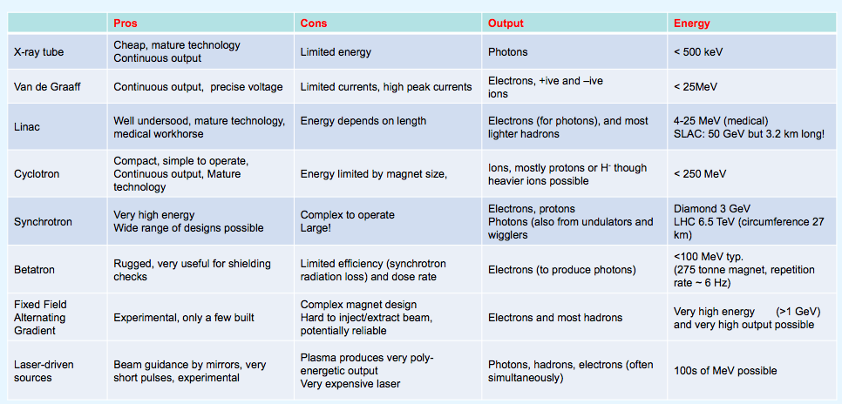
• Comparing types of accelerators
Can therefore see that protons can be accelerated using cyclotron, synchrotron or laser-driven sources.
Notes:
●These are the different types of accelerators with their respective pros and cons but… what types of accelerators are actually used in medicine?
●There are three main types:
○Cyclotrons – reliable and commonly used in hospitals.
○Synchrotrons – more advanced and flexible in how they can operate
○Laser-driven accelerators – a newer, experimental technology with exciting possibilities.
●These are all capable of accelerating protons, and some can even accelerate carbon ions, which are especially effective in damaging cancer cells.
●Each system has its own strengths depending on what kind of treatment is needed.

Slide 16
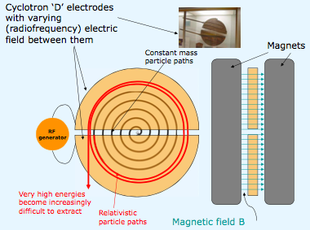
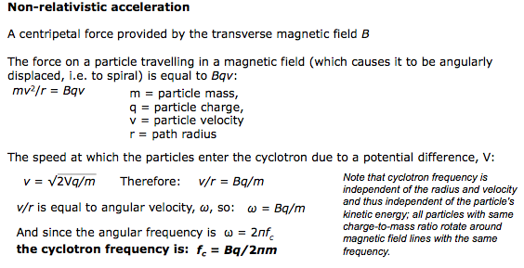
• Cyclotron
Figure 3.2. Diagram showing the schematic of cyclotrons.
Notes:
●The cyclotron is one of the earliest and still most common types of particle accelerator.
●It uses two D-shaped electrodes, called ‘Dees’, inside a strong magnetic field.
●Charged particles spiral outwards from the centre, gaining energy each time they cross the gap between the Dees, which has a high-voltage electric field.
●This method gives a continuous beam, which is useful for treatments.
●However, the energy is fixed once the machine is built. To adjust the penetration depth of the beam, we use external degraders, which can reduce precision and efficiency.
●Degraders are wedges or slabs of material placed in the path of a charged particle beam to reduce its energy before it reaches the patient. This essentially slows the particles down, decreasing their penetration depth in tissue.

Slide 17
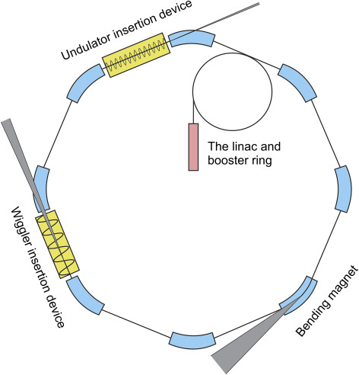
• Synchrotron
Particles are not allowed to spiral outward with increasing energy
Fixed radius
Most of the iron in the centre can now be removed
‘Dees’ – reduced to small accelerating units on circumference
Frequency of the alternating accelerating voltage and magnetic field strength need to rise in synchronism with particle velocity
Complex control system to fine tune accelerating voltage and current in magnets
Bunched production process
Figure 3.3. Diagram showing the schematic of Synchrotrons.
Notes:
●In a synchrotron, the particles travel in a circular path—but unlike the cyclotron, the radius of the particle's trajectory stays the same.
●Instead, we synchronise the frequency of the accelerating electric field and the strength of the magnetic field with the particle’s speed.
●This allows the particle to keep gaining energy without spiralling outwards.
●Synchrotrons can deliver variable beam energies, which means we can target tumours at different depths without needing degraders.
●They are also capable of accelerating heavier ions.
●The downside is that they produce particles in pulses (not a continuous stream) and require a complex control system—but the precision is worth it.

Slide 18
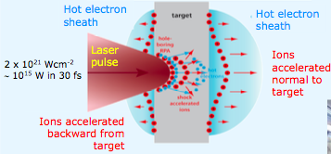
• Laser-driven acceleration
Ultra-high field acceleration gradient, high brightness, high laminarity, ultra-low emittance and scalable energy cut-off, ultra-short pulse duration, energy-dependent collimation which increases with proton energy.
Potentially allows controlling the accelerated ion species by changing the target material, as well as producing multispecies ion beams, a capability that could be valuable for mixed field irradiations, currently not possible even with the more advanced RF accelerators.
Figure 3.4. Diagram showing the schematic of laser-driven acceleration.
Notes:
●Now let’s look at a new and developing technology: laser-driven acceleration.
●These use incredibly intense laser pulses focused onto a target material. The laser energy ionises the target and blasts out particles like protons or ions at very high speeds.
●This happens over a distance of just a few millimetres, which makes it potentially much more compact than traditional accelerators.
●What’s exciting is the flexibility: by changing the target material, you can control the type and energy of particles produced.
●This could one day allow for customised treatments using different ion types—a feature not available with today’s RF accelerators.
●It’s still mostly in research labs for now, but the potential is huge for future radiotherapy options.
●Laser-driven acceleration is one of the core principles behind the project we work on.
●So, in summary, accelerators are the engines behind particle beam therapy. Whether it’s a tried-and-tested cyclotron, a precise synchrotron, or a futuristic laser-driven setup, they all aim to give particles the energy they need to destroy tumours while sparing as much healthy tissue as possible.

