Slide 1
Notes:
If time: talk about the interaction – hadrons: mesons and baryons, what interaction length each has – strong – nuclei, electrically charged:

Slide 2
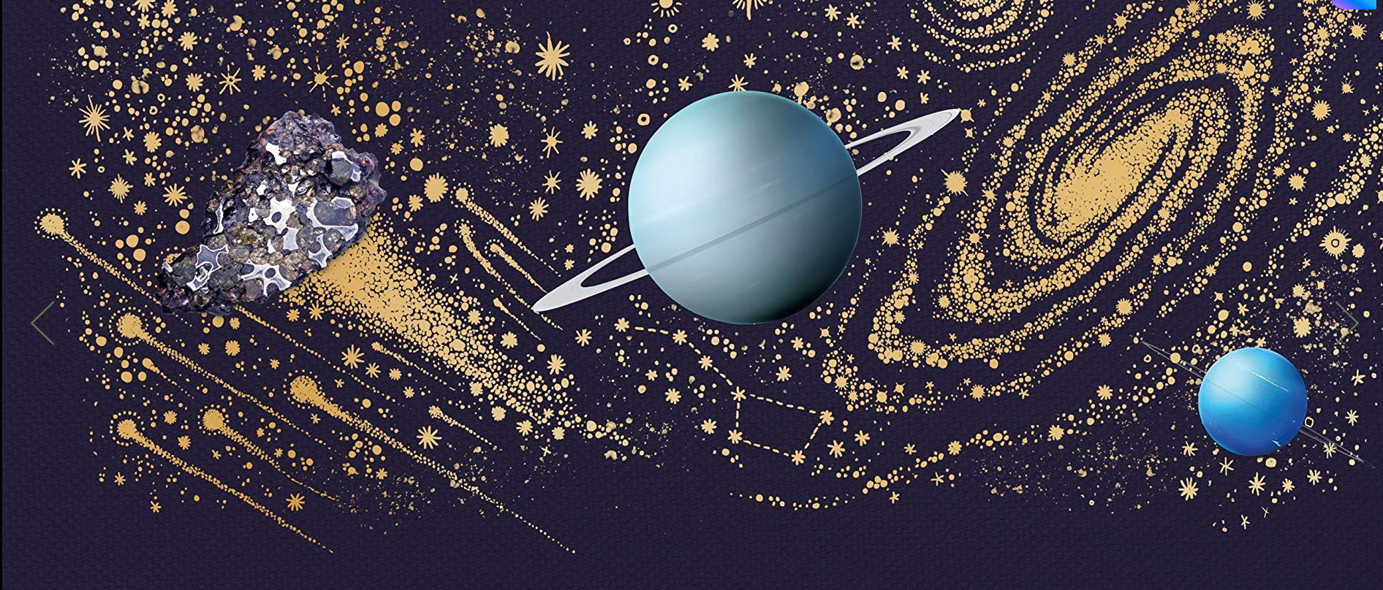
A Grand Unified Theory*
*and our best theory so far: The Standard Model
Ms Irene Andreou

Slide 3
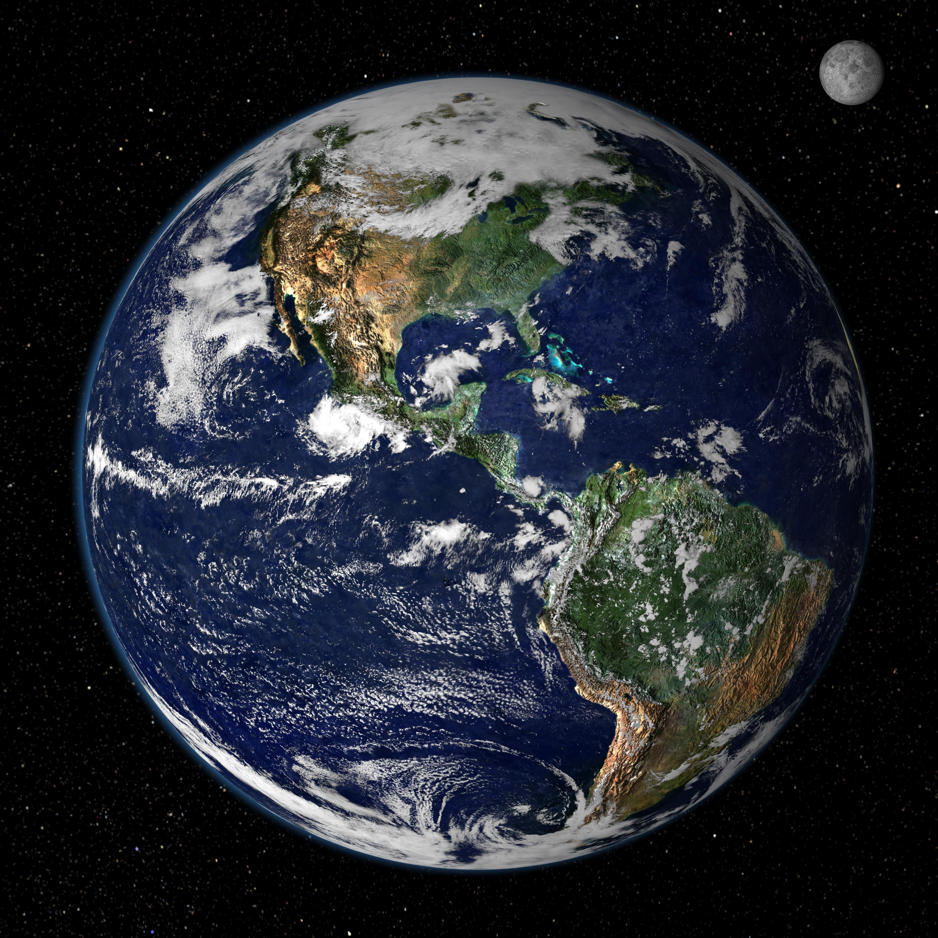
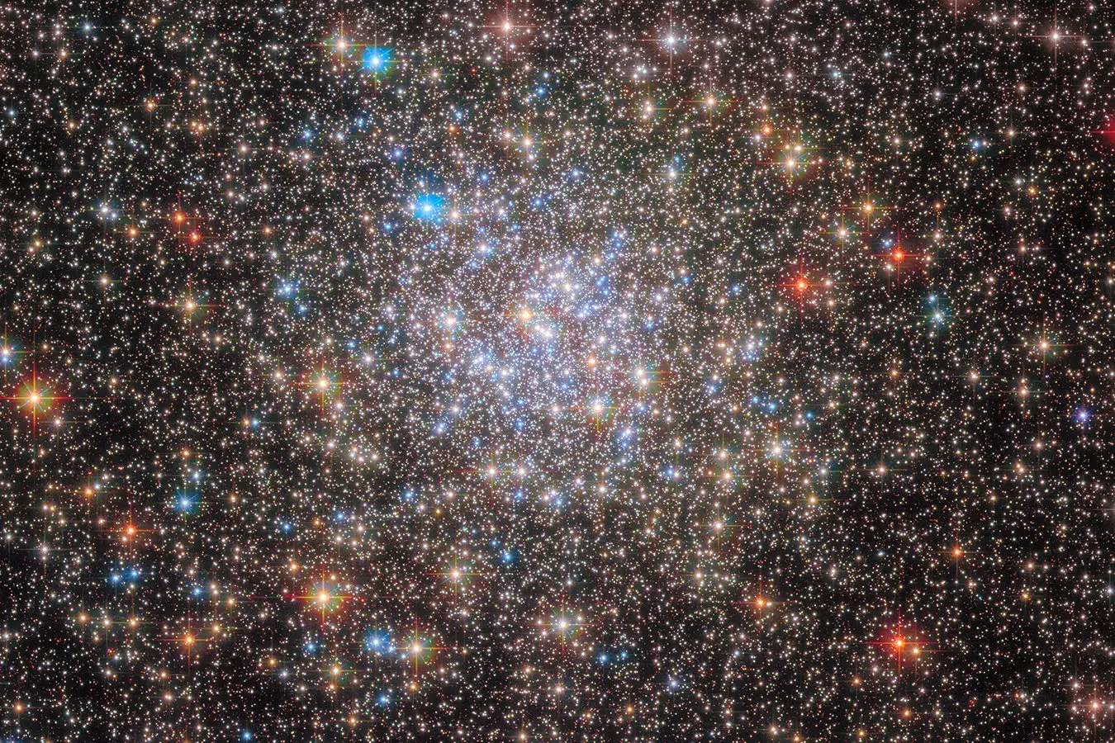
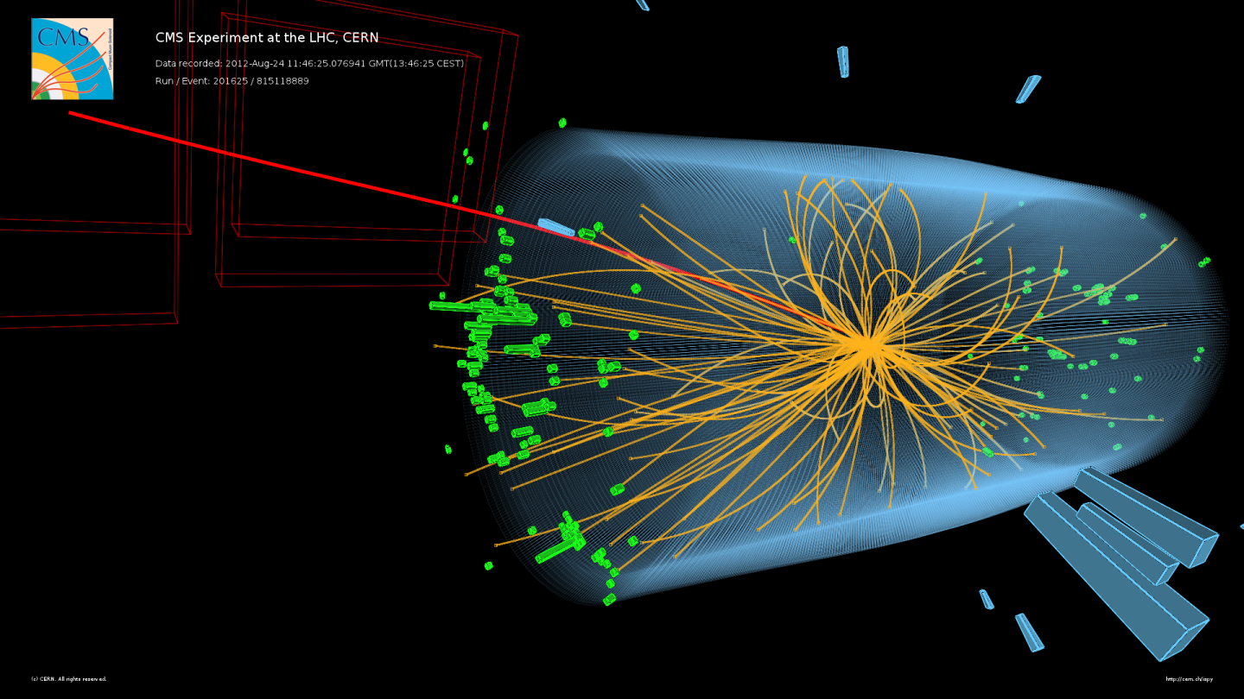
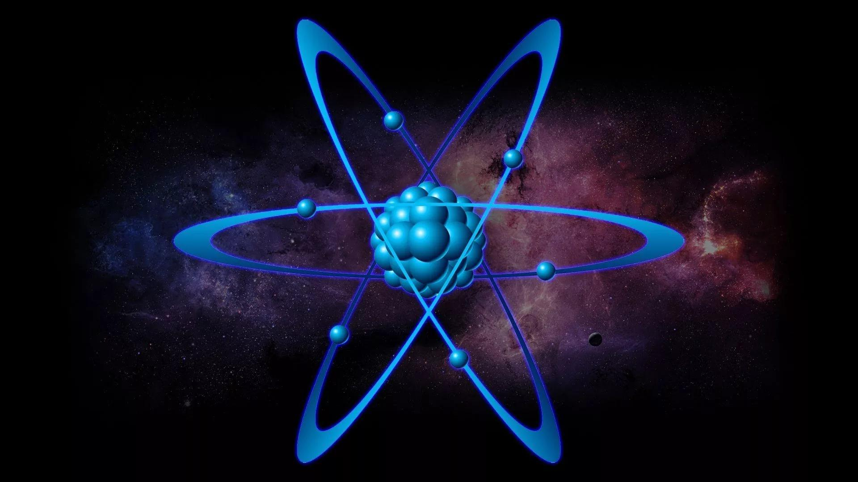

Slide 4
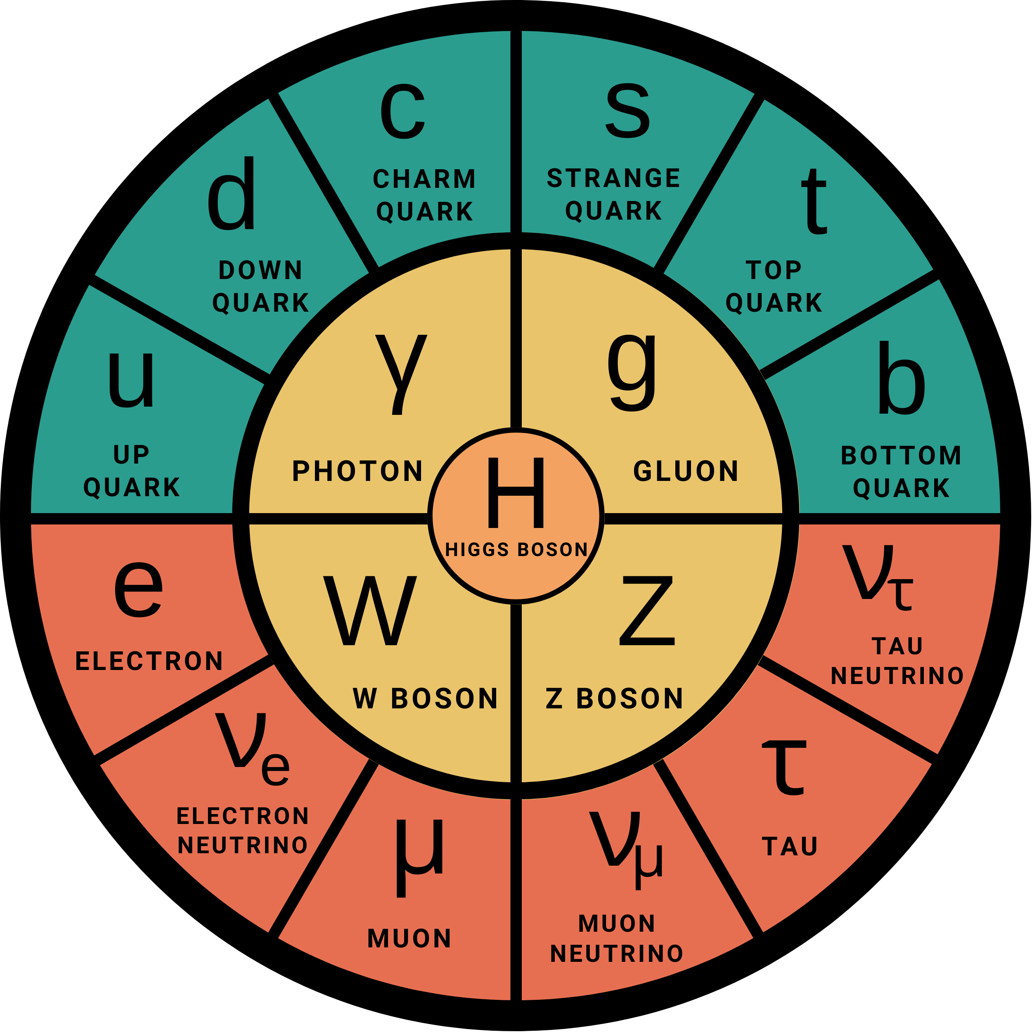
The Standard Model

Slide 5

Quantum Field Theory

Slide 6

Quantum Field Theory

Slide 7
The Standard Model

Slide 8
Fermions
e
e
µ
µ
τ
τ
0.511 MeV/c²
105.66 MeV/c²
1.78 GeV/c²
electron
muon
tau
ν_{e}
ν_{e}
ν_{µ}
ν_{µ}
ν_{τ}
ν_{τ}
electron neutrino
muon neutrino
tau neutrino
u
u
c
c
t
t
2.2 MeV/c²
1.28 GeV/c²
173.1 GeV/c²
up quark
charm quark
top quark
d
d
s
s
b
b
4.7 MeV/c²
96 MeV/c²
4.18 GeV/c²
down quark
strange quark
bottom quark
Notes:
Maybe mention antimatter?

Slide 9
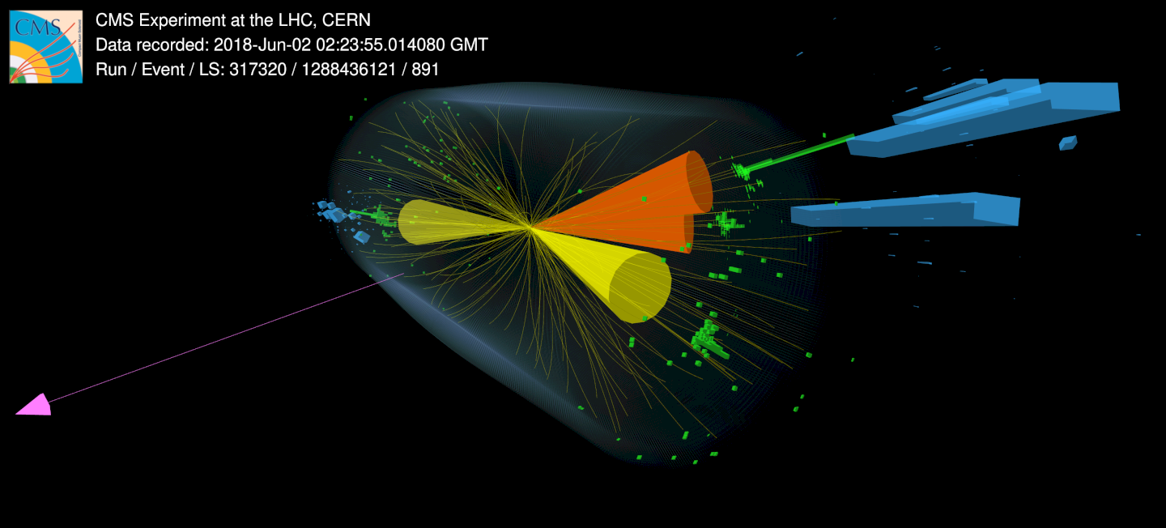
Notes:
If time: talk about the interaction – hadrons: mesons and baryons, what interaction length each has – strong – nuclei, electrically charged:

Slide 10
Forces
The Strong Force
Binds quarks together to form protons and neutrons.
Strong enough to hold protons and neutrons together inside a nucleus.
The Electromagnetic Force
Causes electric and magnetic fields.
Responsible for the attraction and repulsion of electrically charged particles.
The Weak Force
Responsible for the radioactive decay and creation of elements heavier than hydrogen.
Causes the transformation of protons to neutrons and vice-versa.
g
γ
Z⁰
W±
Notes:
Mention electroweak unification – Abdus Salam!!! - Nobel two floors up! (level 3)

Slide 11
Interactions
γ
e
µ
τ
ν_{e}
ν_{µ}
ν_{τ}
u
c
t
d
s
b

Slide 12
Forces
The Strong Force
Binds quarks together to form protons and neutrons.
Strong enough to hold protons and neutrons together inside a nucleus.
The Electromagnetic Force
Causes electric and magnetic fields.
Responsible for the attraction and repulsion of electrically charged particles.
The Weak Force
Responsible for the radioactive decay and creation of elements heavier than hydrogen.
Causes the transformation of protons to neutrons and vice-versa.
g
γ
Z⁰
W±
Notes:
Mention electroweak unification – Abdus Salam!!! - Nobel two floors up! (level 3)

Slide 13
Interactions
g
e
µ
τ
ν_{e}
ν_{µ}
ν_{τ}
u
c
t
d
s
b

Slide 14
Forces
The Strong Force
Binds quarks together to form protons and neutrons.
Strong enough to hold protons and neutrons together inside a nucleus.
The Electromagnetic Force
Causes electric and magnetic fields.
Responsible for the attraction and repulsion of electrically charged particles.
The Weak Force
Responsible for the radioactive decay and creation of elements heavier than hydrogen.
Causes the transformation of protons to neutrons and vice-versa.
g
γ
Z⁰
W±
Notes:
Mention electroweak unification – Abdus Salam!!! - Nobel two floors up! (level 3)

Slide 15
Interactions
Z⁰
W±
e
µ
τ
ν_{e}
ν_{µ}
ν_{τ}
u
c
t
d
s
b

Slide 16
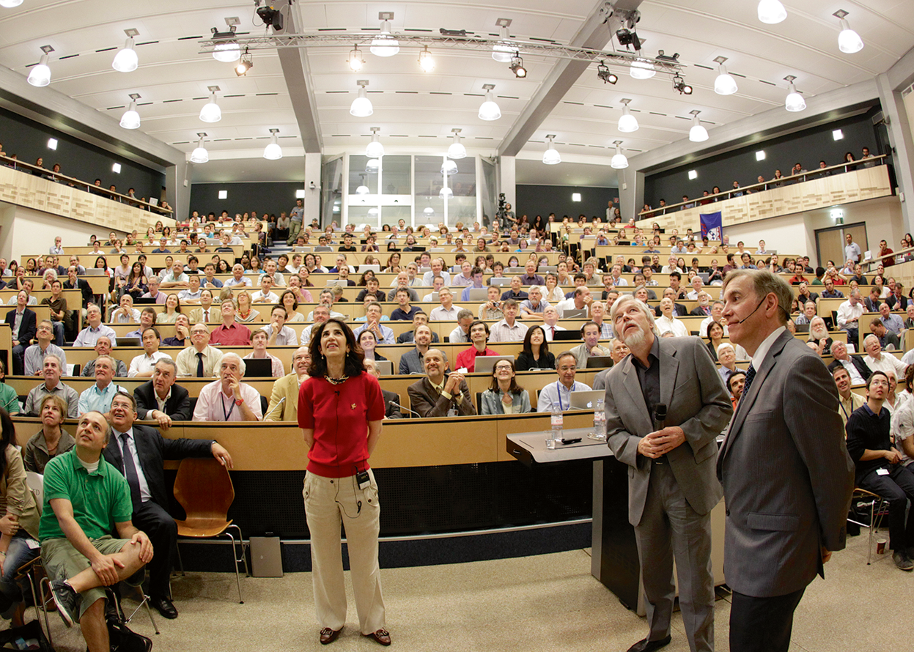
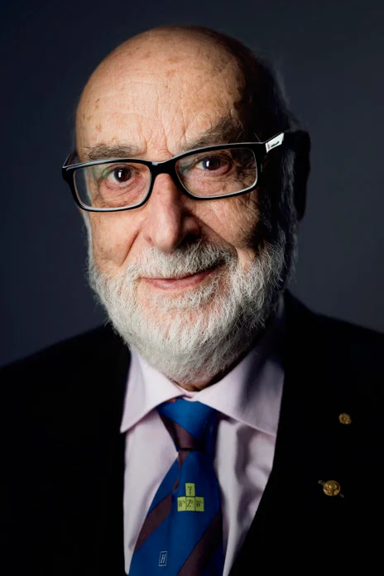
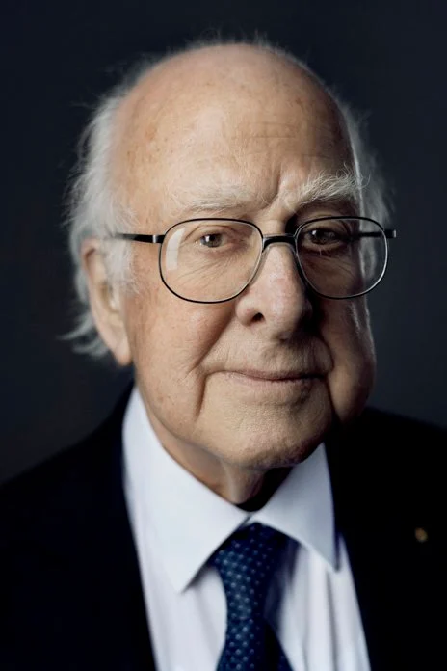
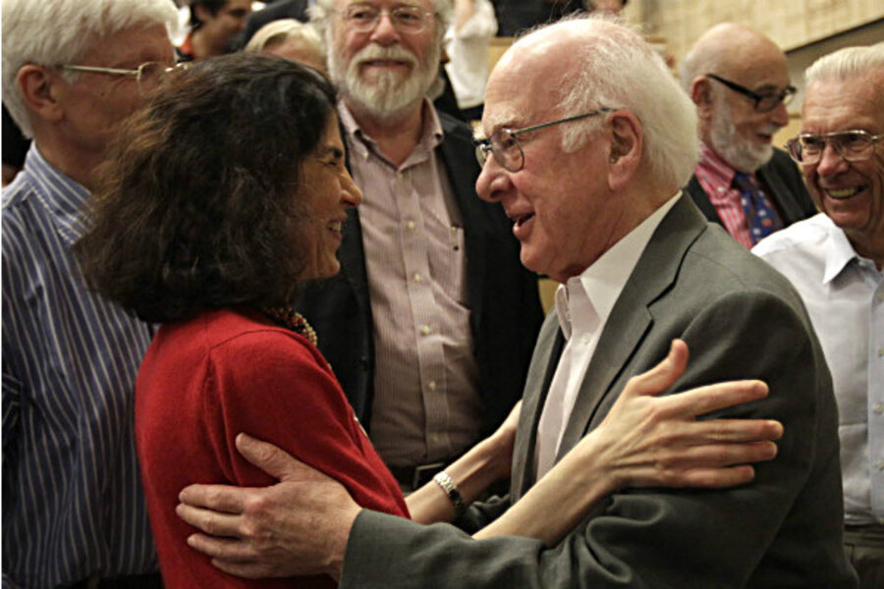
Bosons
g
γ
Z⁰
W±
H
Notes:
Add pictures of other people, Weinberg

Slide 17
Interactions
H
e
µ
τ
ν_{e}
ν_{µ}
ν_{τ}
u
c
t
d
s
b

Slide 18
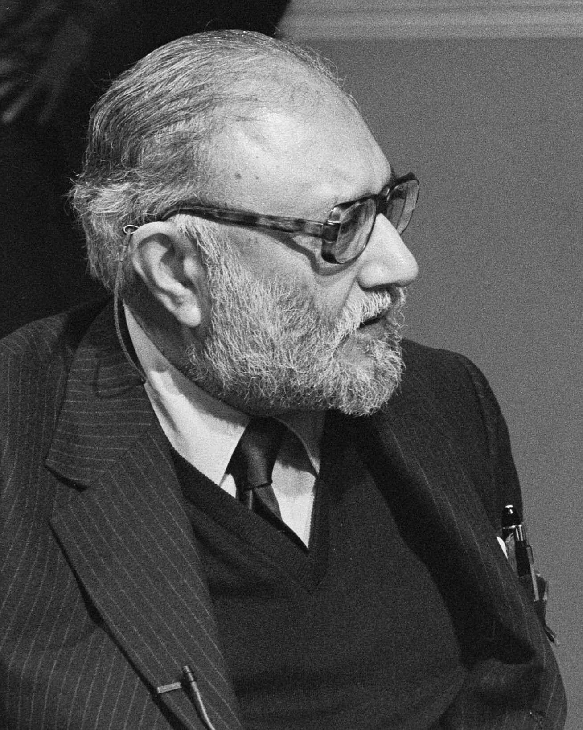
Forces
The Strong Force
Binds quarks together to form protons and neutrons.
Strong enough to hold protons and neutrons together inside a nucleus.
Electroweak Unification
The Electromagnetic Force
Causes electric and magnetic fields.
Responsible for the attraction and repulsion of electrically charged particles.
The Weak Force
Responsible for the radioactive decay and creation of elements heavier than hydrogen.
Causes the transformation of protons to neutrons and vice-versa.
g
γ
Z⁰
W±
Notes:
Mention electroweak unification – Abdus Salam!!! - Nobel two floors up! (level 3)

Slide 19
The Standard Model

Slide 20
The successes
Predicted the existence of:
W±, Z bosons
Gluon
Top quark
Charm quark
Higgs boson
All predictions were experimentally confirmed with good precision!

Slide 21



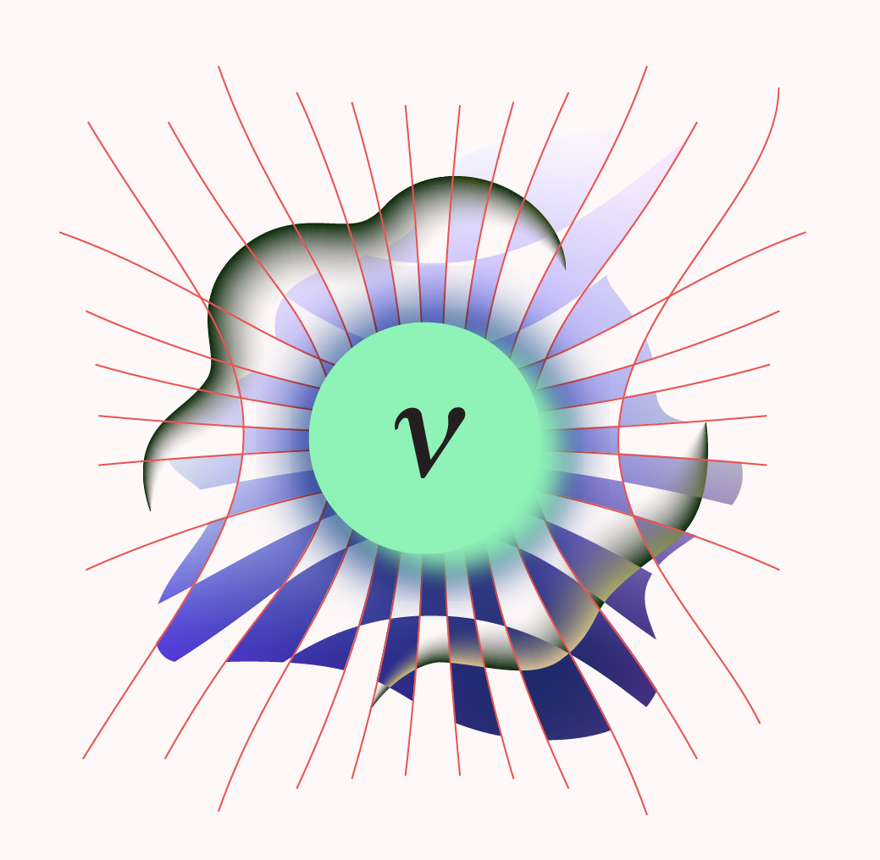
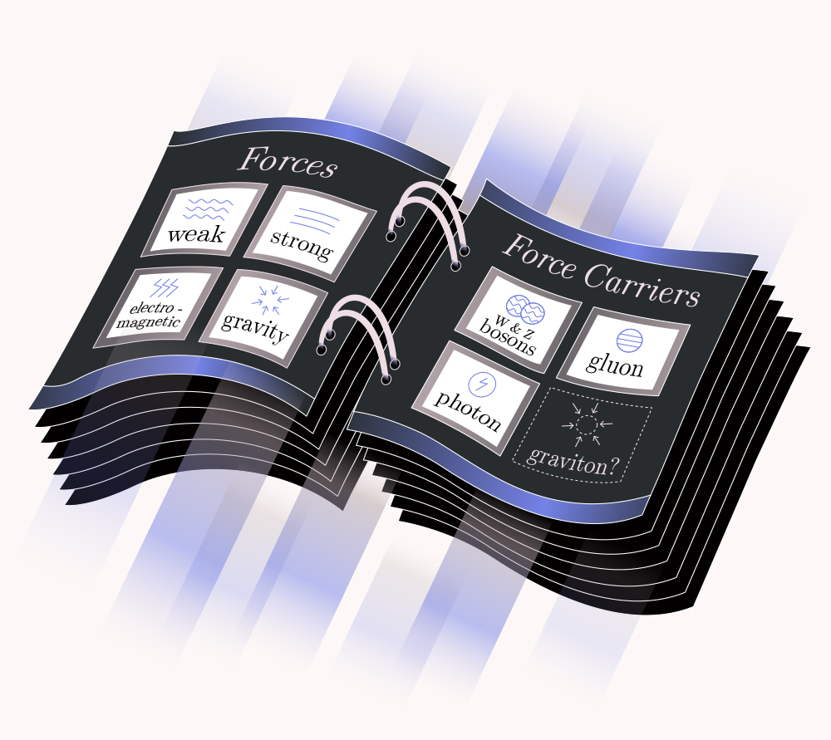
The limitations
Gravity
Accelerating expansion of the Universe
Matter dominance
Dark matter
Massive neutrinos

Slide 22
A lot of unsolved mysteries of the Standard Model
Exciting future for the Particle Physics community

Slide 23
Thank you!
Questions?
Notes:
Check with Jon on his slide what he says

Slide 24
References
Intro Slide: The Mysteries of the Universe: Discover the best-kept secrets of space (DK Children's Anthologies) https://www.amazon.co.uk/Mysteries-Universe-Discover-best-kept-secrets/dp/0241412471
Slide 3: Universe: https://www.newscientist.com/article/2371382-why-darkness-between-stars-reveals-more-about-the-universe-than-light/
Earth: https://earthobservatory.nasa.gov/images/885/earth-from-space
Atom: https://wallpapercave.com/w/wp4667431
CMS Display: https://cds.cern.ch/record/1633370
Slide 4: https://www.redbubble.com/i/poster/The-Standard-Model-by-Sus-Snail-Co/65945899.LVTDI
Slide 9: https://cds.cern.ch/record/2775764
Slide 16: https://www.nature.com/articles/s42254-022-00489-5, https://images.app.goo.gl/XcviXnBFsh6FdY3F6, https://www.nobelprize.org/prizes/physics/2013/summary/
Slide 18: https://en.wikipedia.org/wiki/Abdus_Salam
Slide 21: https://www.symmetrymagazine.org/article/six-weighty-facts-about-gravity, https://www.symmetrymagazine.org/article/five-mysteries-the-standard-model-cant-explain

