Slide 1
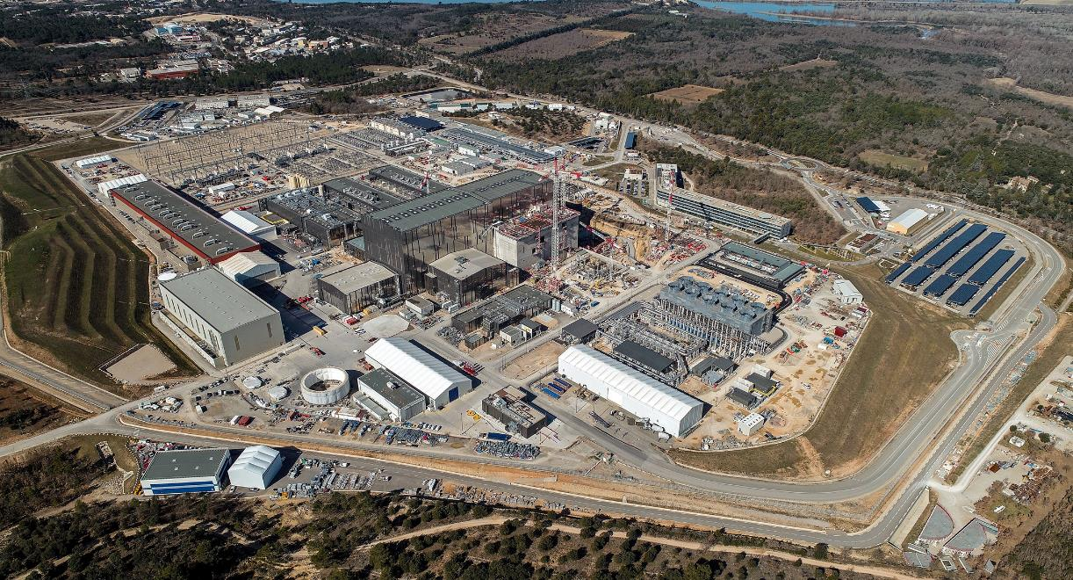

Introduction to Fusion Physics & the ITER Project: progress and challenges
Dr Evangelia Dimovasili
Radiological Monitoring Officer

Slide 2
CONTENTS OF THE PRESENTATION
Fusion: definition, facts, plasma physics in brief
ITER Project:
- a bit of history
- mission
- technology
- progress
- challenges

Slide 3
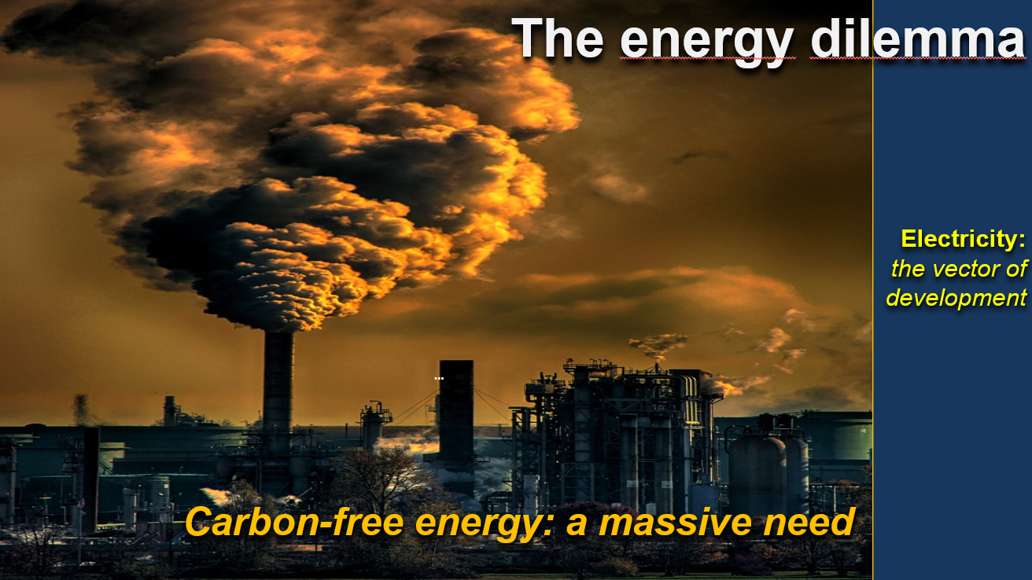
Debriefing to CPH & CPO, E. Dimovasili & C. Seropian on behalf of Advisory Board, 27 June 2025

Slide 4
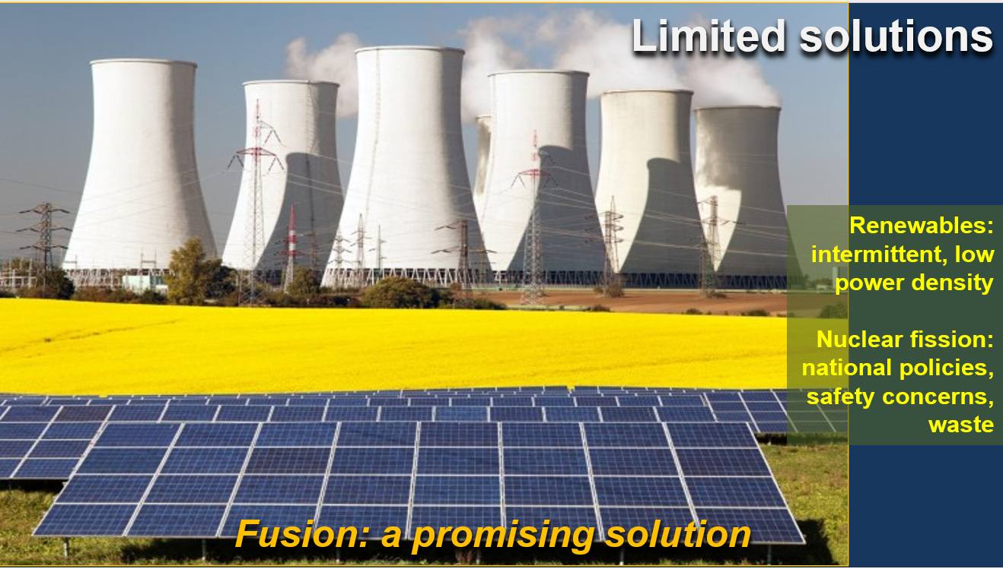
Debriefing to CPH & CPO, E. Dimovasili & C. Seropian on behalf of Advisory Board, 27 June 2025

Slide 5
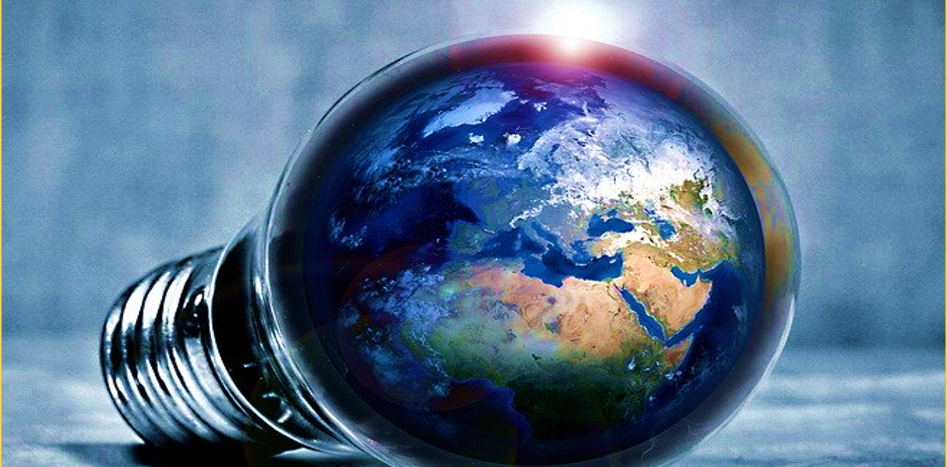

text
a
HYDROGEN FUSION
Carbon-free
Abundant fuel supply
No long-lived, highly radioactive waste
Safe
Difficult engineering challenges
text
text
5
text

Slide 6
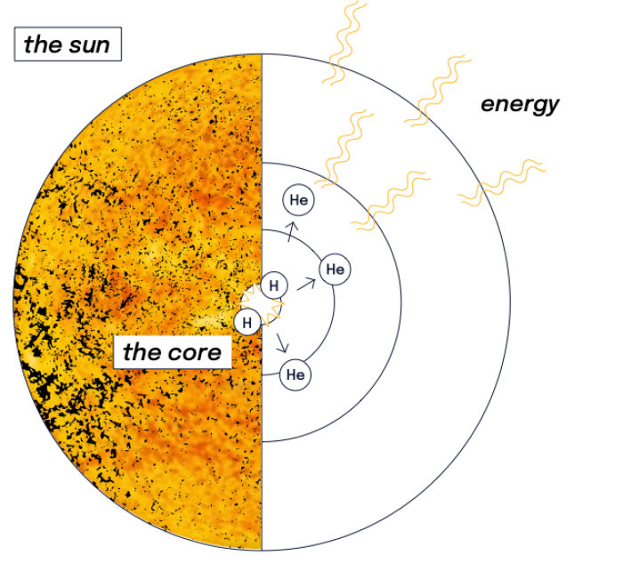
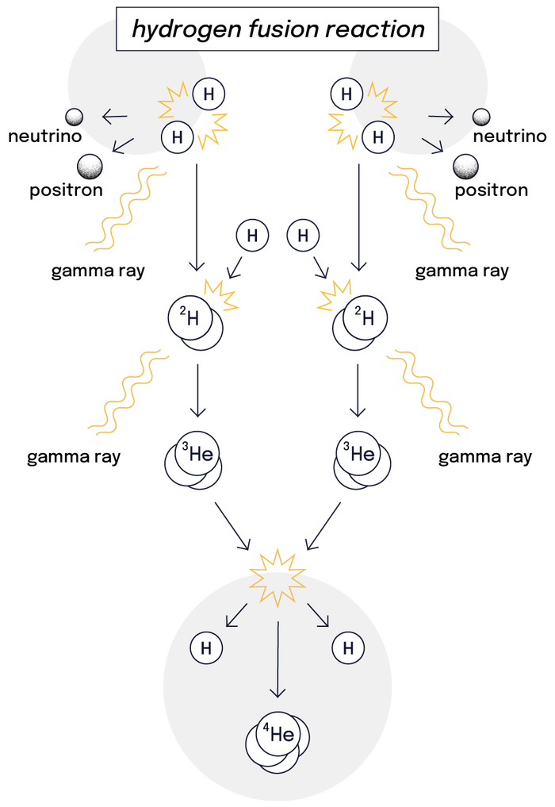
FUSION
Fusion is the energy source of the Universe, occurring in the core of the Sun and stars
core temperatures reach 15,000,000 °C

Slide 7
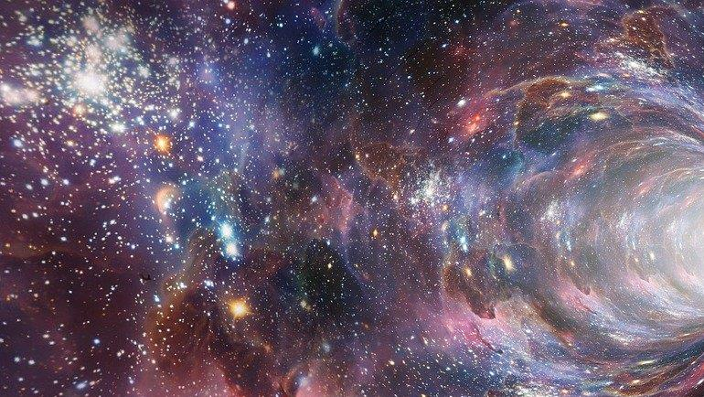
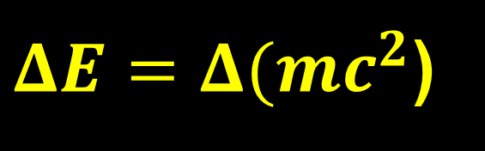
text
a
FUSION IN THE UNIVERSE
Source of light, heat, and life on Earth
Made possible by gravitational force (to overcome electrostatic repulsion)
& and the huge scale of Sun & the stars
text
text
$ΔE=Δ(mc^{2}$)
7
text

Slide 8
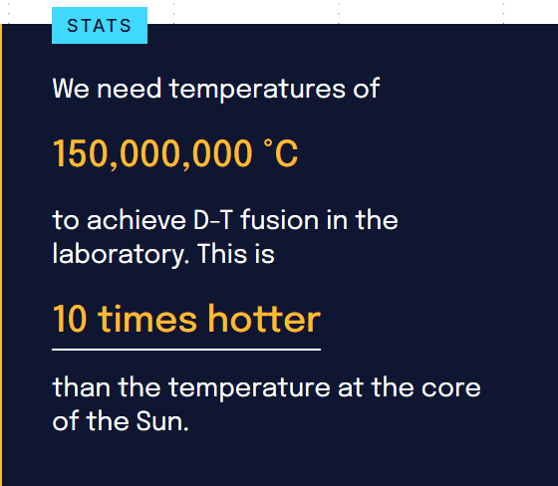
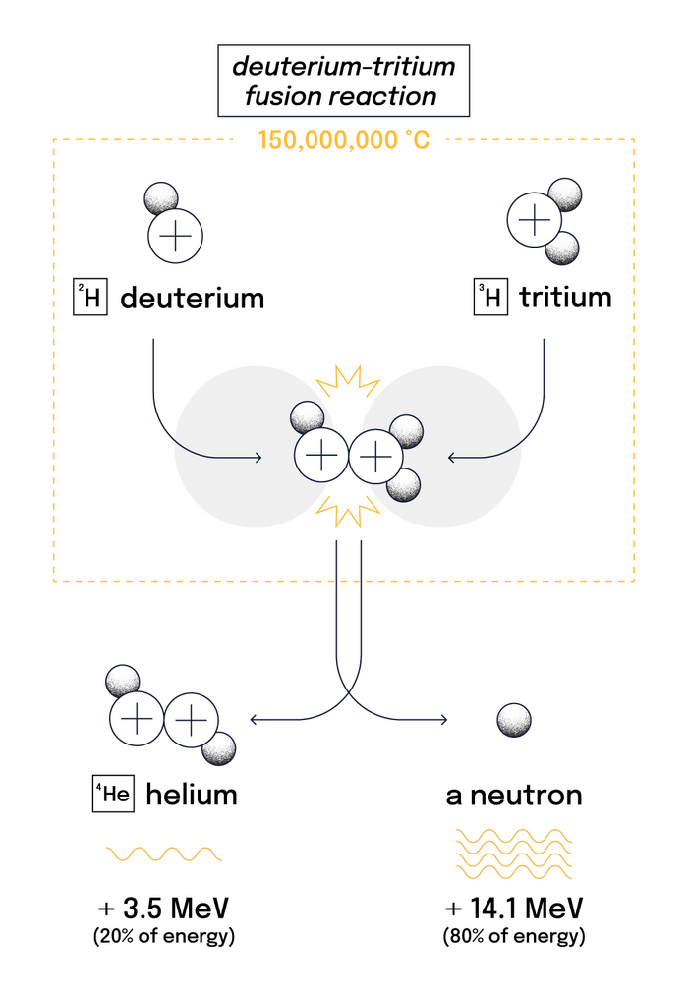
FUSION ON EARTH
Three conditions for fusion in a laboratory:
Very high temperature (to provoke high-energy collisions)
Sufficient plasma particle density (to increase likelihood for collisions)
Sufficient confinement time (to hold the plasma within a defined volume).

Slide 9
FUSION ON EARTH
Gravity is a very weak force compared to the forces of nuclear physics, and it can confine a hot plasma only when the mass is very large.
Possible in the Sun and stars, but not for the much smaller and much hotter plasmas that we wish to confine on Earth.
Fusion power density in the core of the Sun is very low, only 270 W/m3, compared to the MW/m3 required for a commercial power plant.
Other methods of providing confinement have to be found on Earth!
Two alternative ways to solve this problem:
1st approach: magnetic fields to form an insulating layer around the hot fuel → magnetic confinement (ITER)
2nd approach: compress and heat the fuel very quickly - fusion energy released before the fuel has time to expand
→ inertial confinement (National Ignition Facility (NIF) at Livermore).

Slide 10
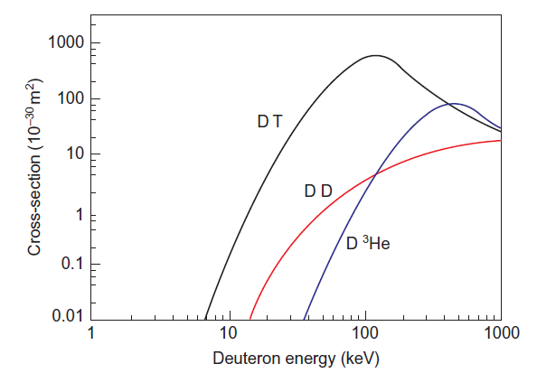
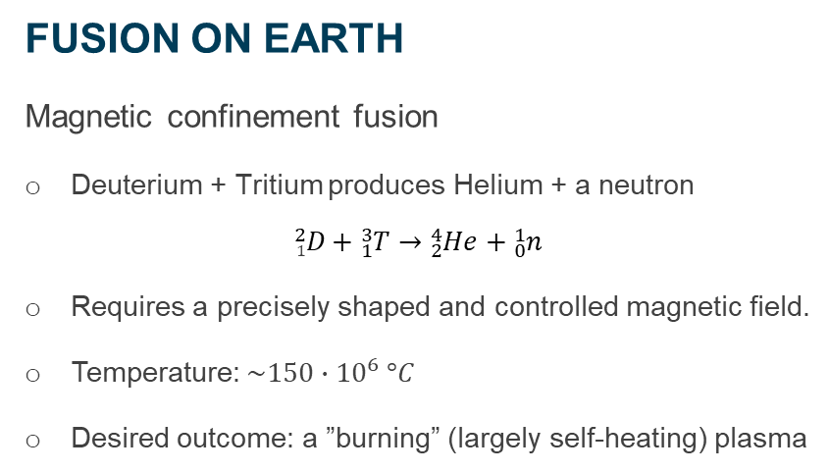
FUSION ON EARTH
FUSION ON EARTH
Magnetic confinement fusion
Deuterium + Tritium produces Helium + a neutron
$${}_{1}^{2}D+{}_{1}^{3}T→{}_{2}^{4}{He}+{}_{0}^{1}n$$
Requires a precisely shaped and controlled magnetic field.
Temperature: $\sim 150∙{10}^{6} °C$
Desired outcome: a ”burning” (largely self-heating) plasma
The figure shows why the DT reaction is the most favorable—it offers the highest probability of fusion (the largest cross-section) at the lowest energy.

Slide 11
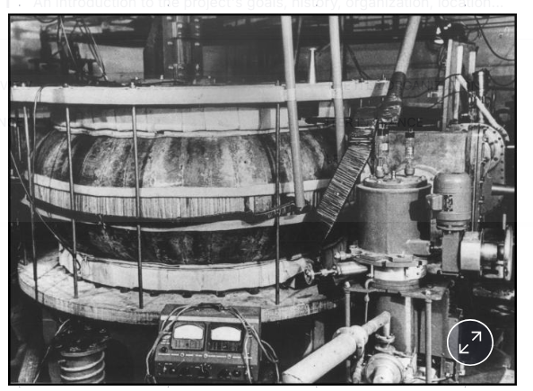
FUSION ON EARTH
Following the first fusion experiments in the 1930s, fusion physics laboratories were established in nearly every industrialized nation. By the mid-1950s "fusion machines" were operating in the Soviet Union, the United Kingdom, the United States, France, Germany and Japan. Through experiments on these machines, scientists' understanding of the fusion process was gradually refined.
The first small-size devices (1950s-1970s) were basic devices without sophisticated control systems and technology, but they demonstrated that high temperature plasmas could be generated and that energy could be confined.
The world's first tokamak device: the Russian T1 tokamak at the Kurchatov Institute in Moscow. Plasmas with a volume of 0.4 cubic metres were produced in its copper vacuum vessel.
‘ TOroidalnaya Kamera’ for “toroidal chamber,”
and
MAgnitnaya Katushka’ for “magnetic coil’
Debriefing to CPH & CPO, E. Dimovasili & C. Seropian on behalf of Advisory Board, 27 June 2025

Slide 12
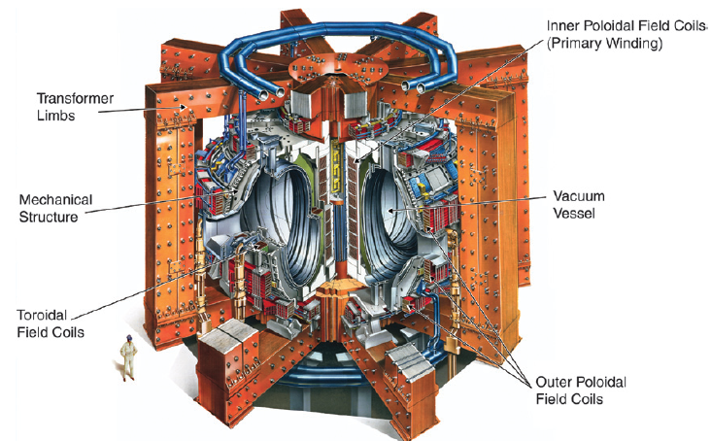
FUSION ON EARTH
The Joint European Torus (JET), at Culham in the United Kingdom, and the Tokamak Fusion Test Reactor (TFTR), at Princeton in the United States, have produced more than 10 MW (albeit for only a few seconds), showing
that fusion can work in practice.
The next step is the International Thermonuclear Experimental Reactor (ITER), which will produce 500 MW for up to 10 minutes, thereby confirming that it is possible to build a full-size fusion power plant.

Slide 13
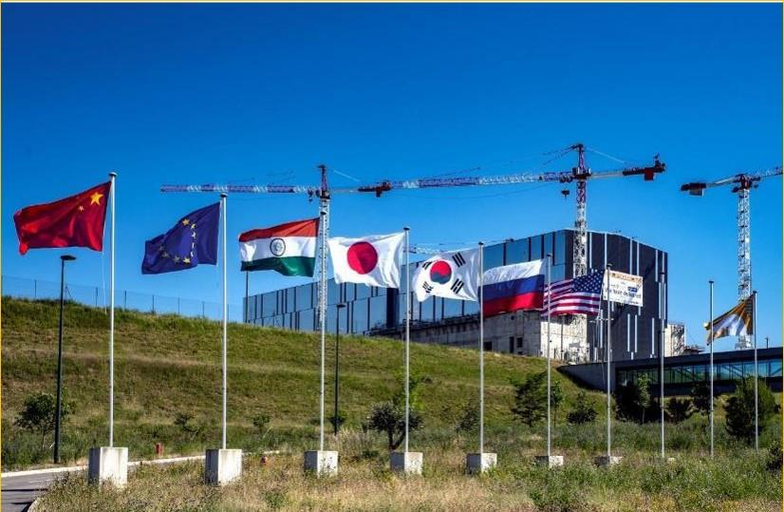
text
A GENERATIONAL CHALLENGE
United in a common cause: to transform our energy legacy.
a
text
text
China EU India Japan Korea Russia USA
13
text

Slide 14
What will ITER do?
1) Achieve a deuterium-tritium plasma in which the fusion conditions are sustained mostly by
internal fusion heating
2) Generate 500 MW of fusion power in its plasma for long pulses
3) Contribute to the demonstration of the integrated operation of technologies for a fusion power
plant
4) Test tritium breeding
5) Demonstrate the safety characteristics of a fusion device

Slide 15
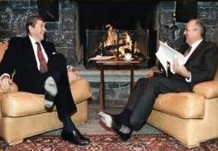
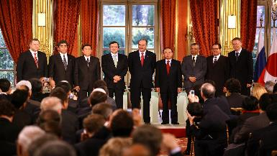
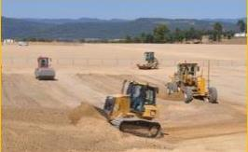
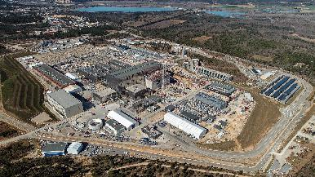
THE ITER NARRATIVE: FROM IDEA TO REALITY
November 1985
November 2006
August 2010
Today

Slide 16
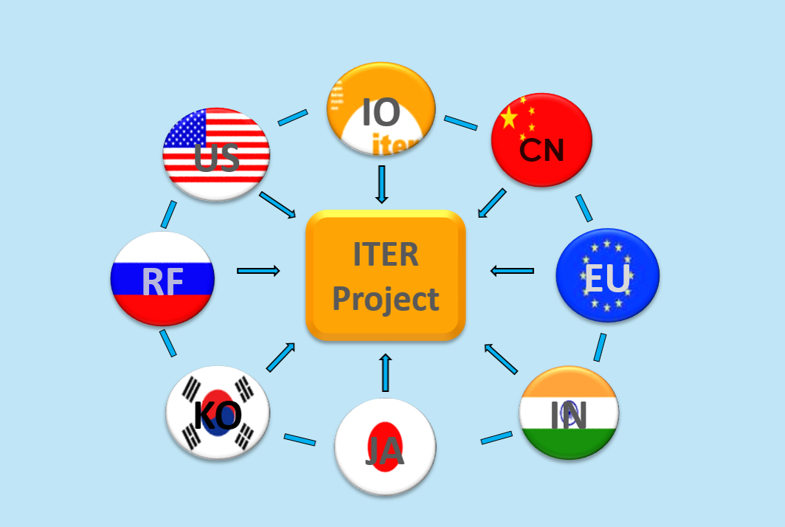
text
AN INTEGRATED PROJECT
ITER Organization and Domestic Agencies
Members contribute “in-kind” (80-90%)
Domestic Agencies procure these in-kind contributions
Europe, as host, contributes ~45%
Non-EU members contribute ~9% each
a
text
text
How is it done;
16
text

Slide 17
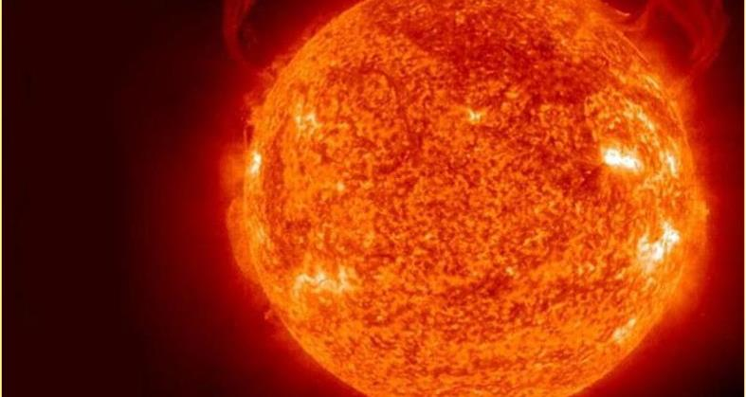
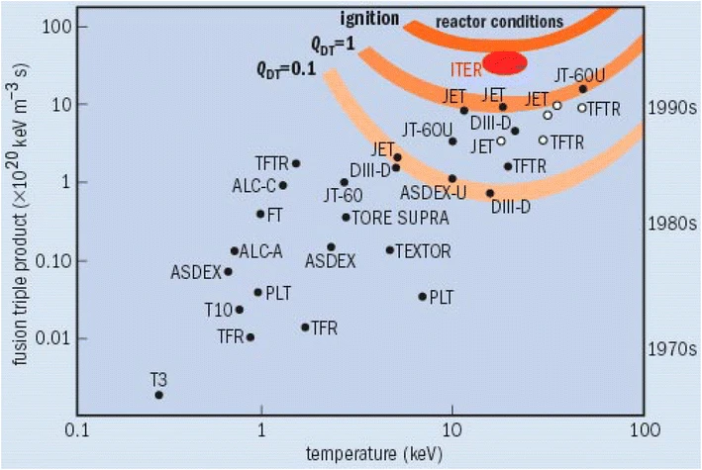
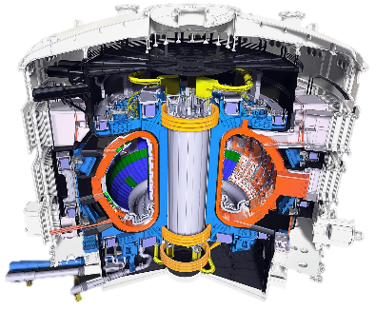

text
MISSION OF ITER
To demonstrate the scientific and technological feasibility of fusion power for peaceful purposes at industrial scale
To create a controlled “burning” plasma
To achieve Q ≥ 10
text
text
By Horvath, A., Rachlew, E., Nuclear power in the 21st century: Challenges and possibilities.
Ambio 45, 38–49 (2016).
https://doi.org/10.1007/s13280-015-0732-y Figure 4, CC BY 4.0,
https://commons.wikimedia.org/w/index.php?curid=102602591
17
text

Slide 18
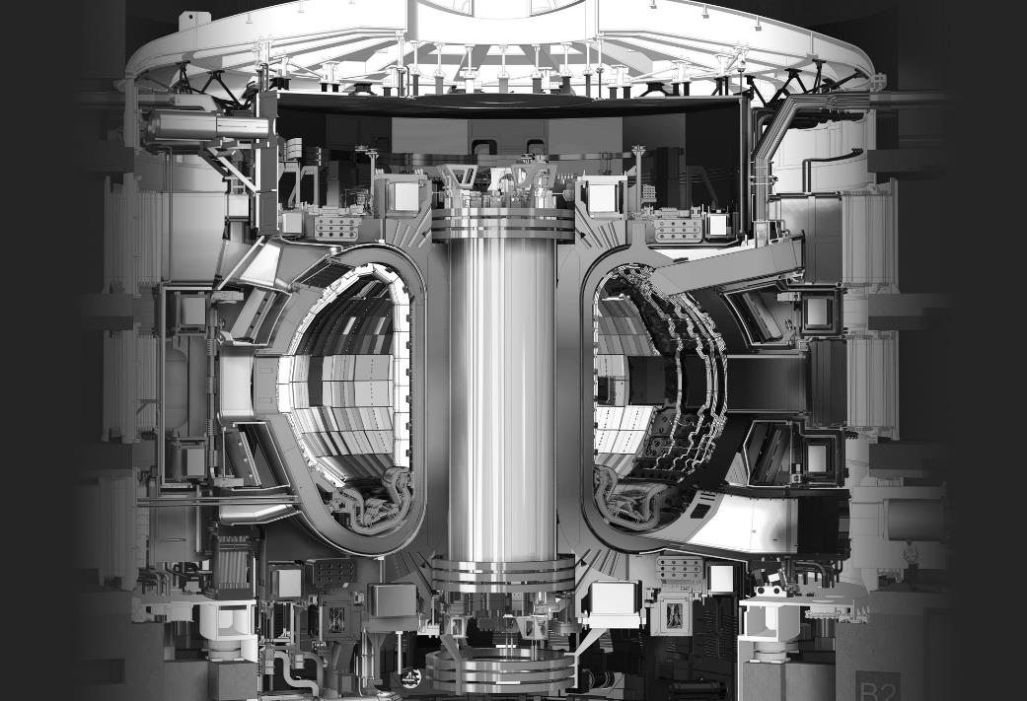
text
THE RECIPE
Inject DT gas.
Inject electric current to convert the gas to plasma.
Inject electromagnetic waves.
Inject high-energy neutral particles.
Combine these techniques to reach 150-million degrees.
text
text
18
text

Slide 19



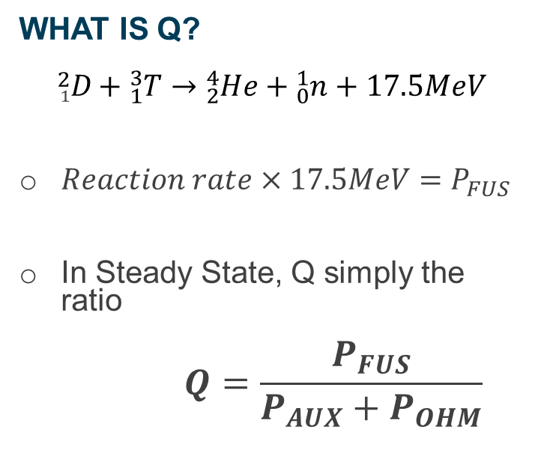

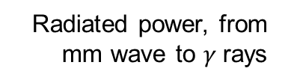

WHAT IS Q?
$${}_{1}^{2}D+{}_{1}^{3}T→{}_{2}^{4}{He}+{}_{0}^{1}{n+17.5MeV}$$
$Reaction rate×17.5MeV=P_{FUS}$
In Steady State, Q simply the ratio
$$Q=\frac{P_{FUS}}{P_{AUX}+P_{OHM}}$$
Radiated power, from mm wave to $γ$rays
WALLS
Auxillliary power injected by heating systems
PLASMA
$$P_{RAD}$$
$$P_{AUX}$$
$$P_{FUS}={{ P}_{α} + P}_{n}$$
Fusion products
$$P_{OHM}$$
$$P_{CON}$$
Ohmic power injected by coils
Conducted
power
Q > 1 means the core of the machine, the plasma, produces power
Q > 10 means net power can be generated in principle despite external inefficiencies

Slide 20
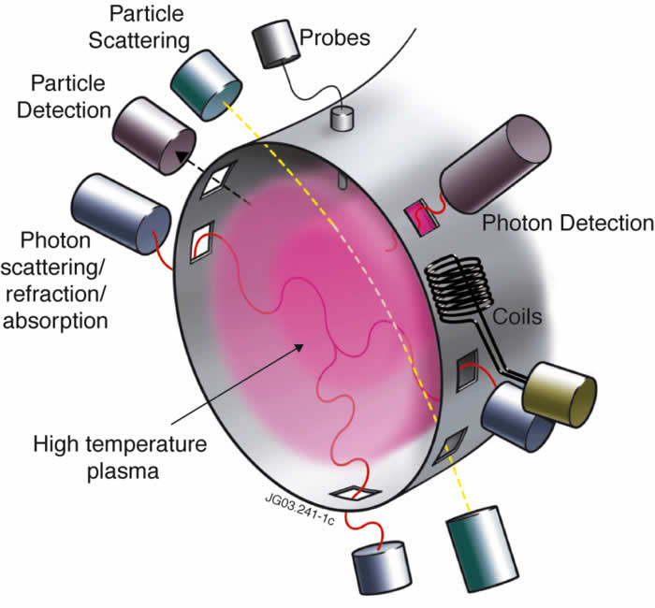
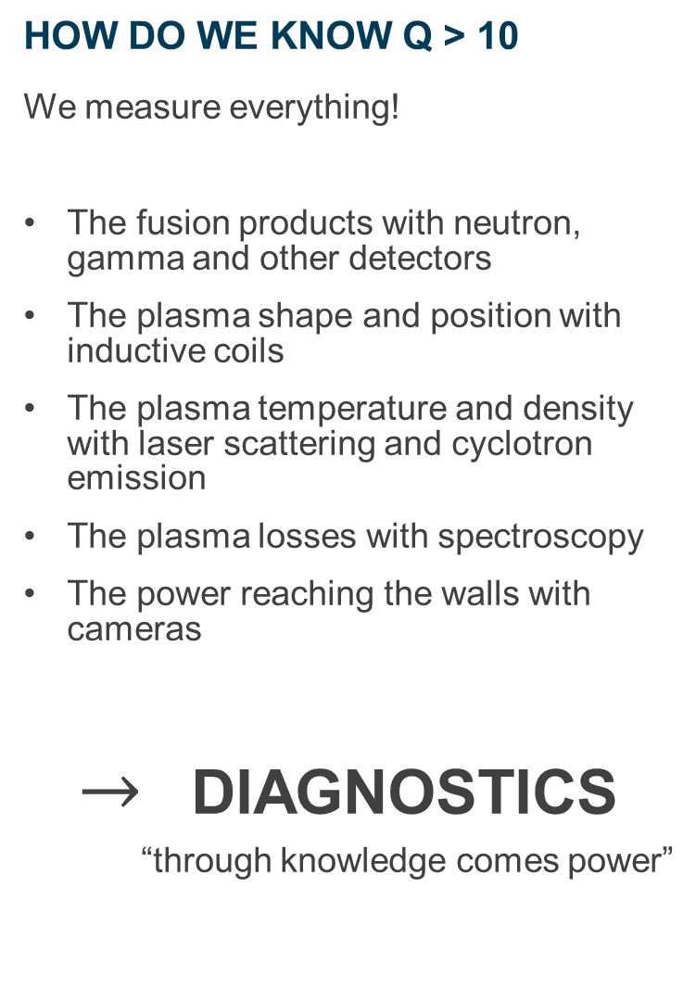
HOW DO WE KNOW Q > 10
We measure everything!
The fusion products with neutron, gamma and other detectors
The plasma shape and position with inductive coils
The plasma temperature and density with laser scattering and cyclotron emission
The plasma losses with spectroscopy
The power reaching the walls with cameras
$→$ DIAGNOSTICS
“through knowledge comes power”
Credit: Peter Stott (2013) & JET

Slide 21
Let’s take a look at what is needed?
50 different diagnostics identified for different measurement roles;
Just over 100 projects in all;
Some system already completed-many left to do
PBS55-Engineering of:
Q- Equatorial Ports
U- Upper Ports
L- Lower ports
NW- Windows
NE- Electrical Services
PBS55 - Diagnostics
A- Magnetics systems
B- Neutrons systems
C- Optical systems
D- Bolometry systems
E- Spectroscopy systems
F- Microwave systems
G- Operational systems
PBS57- IVVS
+PBS58- PPTF
+TSM
Some of the world’s best engineers and scientists and project experts – bright, committed, enthusiastic and curious people….!

Slide 22
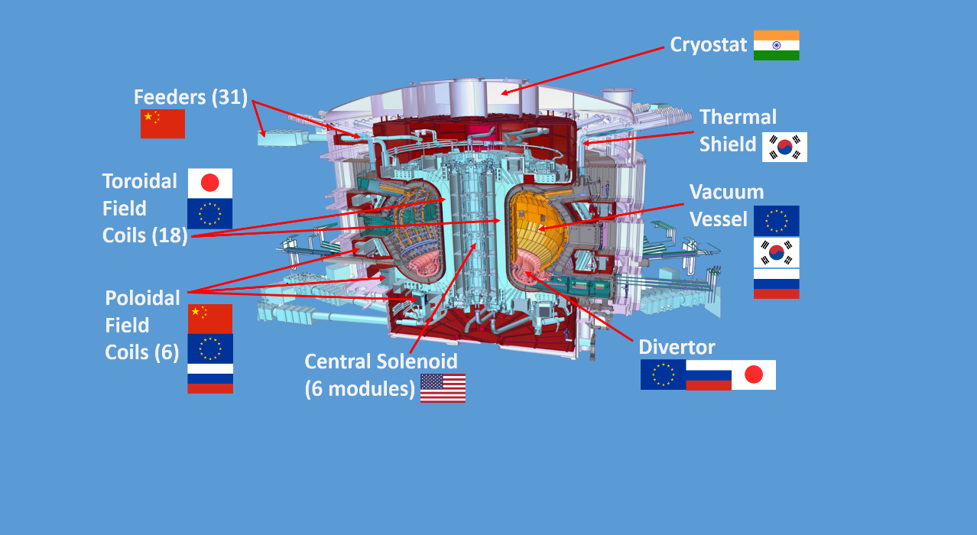
text
TK complex: 23,000 tons
80m tall (including basement levels)
120 m long and 80m wide
Plasma radius= 6.2m
Plasma volume= 840m3
text
text
WHO MANUFACTURES WHAT?
The ITER Tokamak is comprised of more than 1 million components. This shows a simplified breakdown of ITER Member contributions.
ITER Members share all intellectual property.
22
text

Slide 23
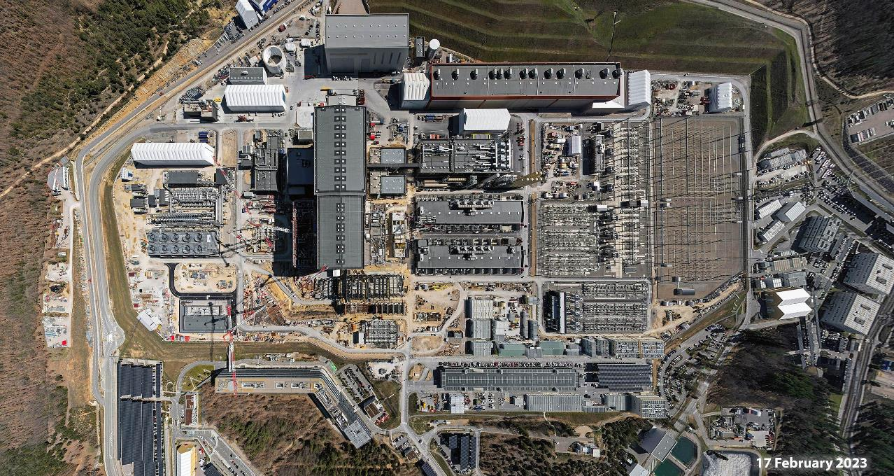
text
Cryostat Upper Cylinder
Cryostat workshop
Assembly Hall
PF Coils winding facility
Radiofrequency Building
Switchyard
Tokamak Building
Cryogenics plant
Heat Rejection System
Magnet Conversion
text
text
Tritium Building
Neutral Beam Building
Diagnostics Building
Headquarters Building
Contractors Area
WORKSITE CONSTRUCTION
Aerial perspective
text

Slide 24
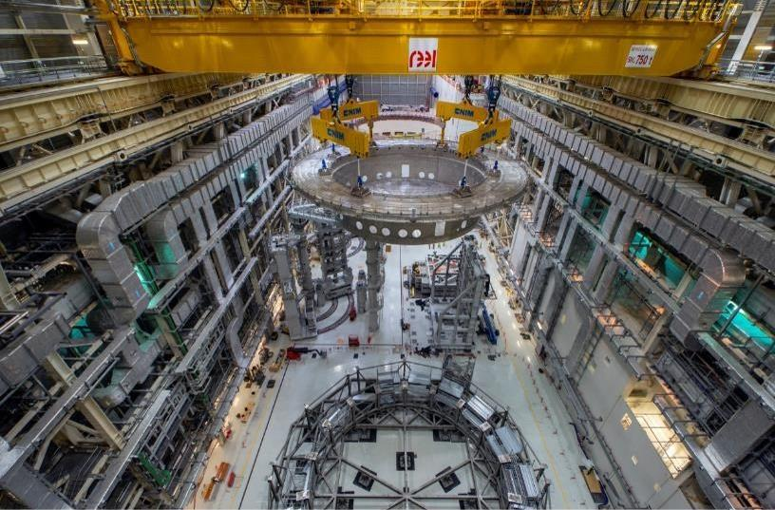
text
ASSEMBLING THE MACHINE
Cryostat Base installation (1350 tonnes), traversing the Assembly Hall.
May 2020
a
text
text
24
text

Slide 25
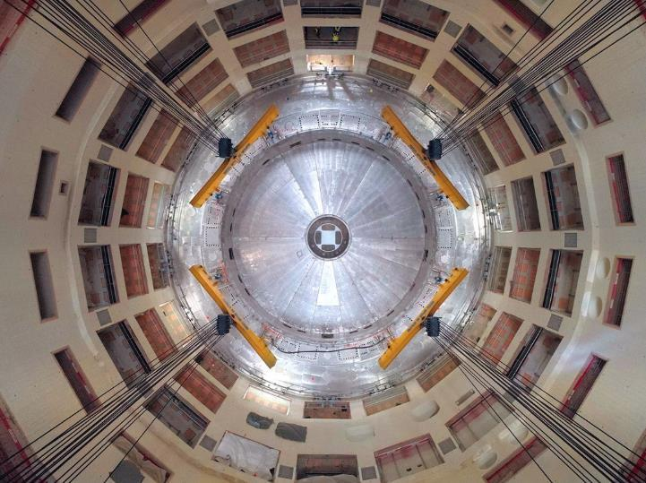
text
ASSEMBLING THE MACHINE
[Tokamak Pit, top-down view]
The Cryostat Base, 30 metres in diameter, was positioned with a final tolerance under 3 mm at all metrology points.
text
text
25
text

Slide 26
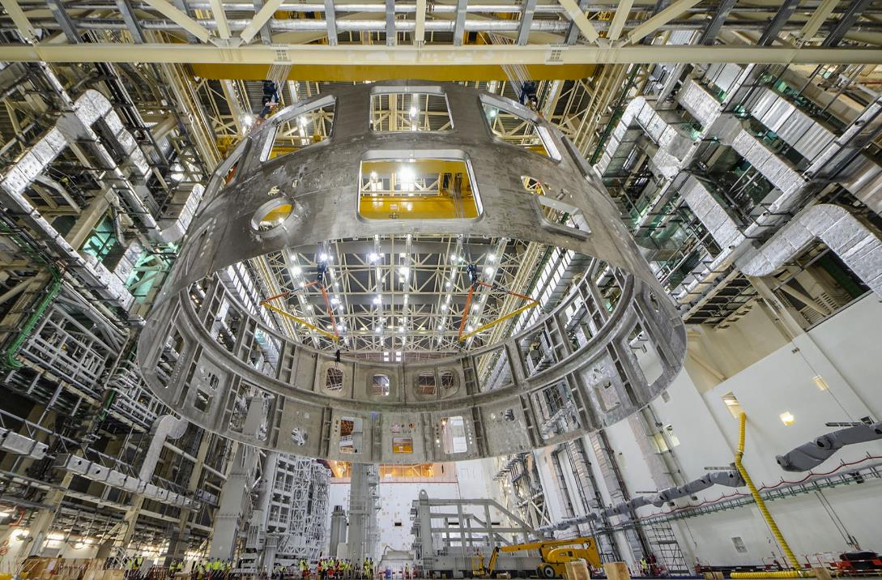
text
ASSEMBLING THE MACHINE
Cryostat Lower Cylinder installation
August 2020
a
text
text
26
text

Slide 27
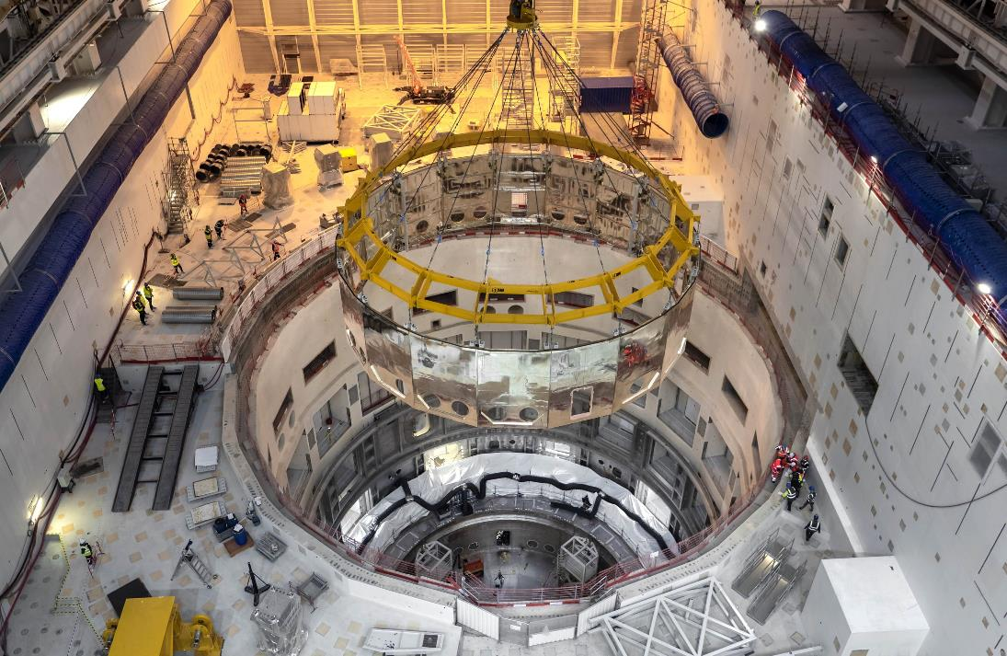
text
ASSEMBLING THE MACHINE
Lower Cryostat Thermal Shield installation
January 2021
text
text
27
text

Slide 28
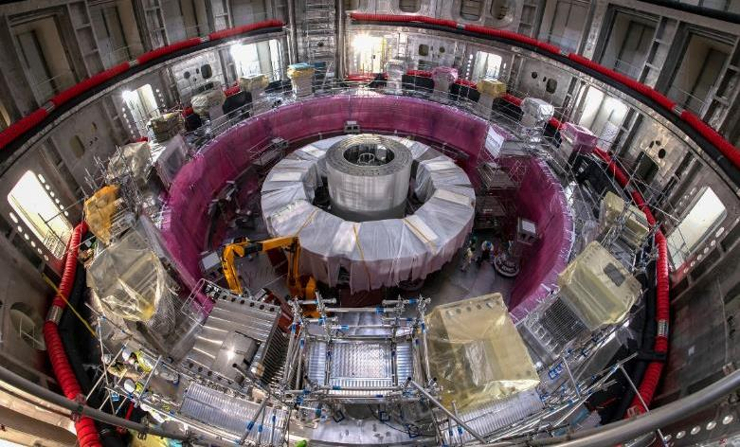
text
ASSEMBLING THE MACHINE
Poloidal Field Coil #6 installation
April 2021
text
text
28
text

Slide 29
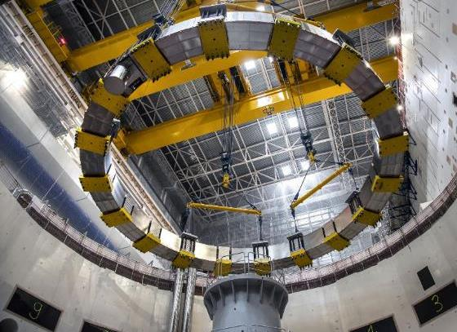
text
ASSEMBLING THE MACHINE
Poloidal Field Coil #5 installation
September 2021
text
text
29
text

Slide 30
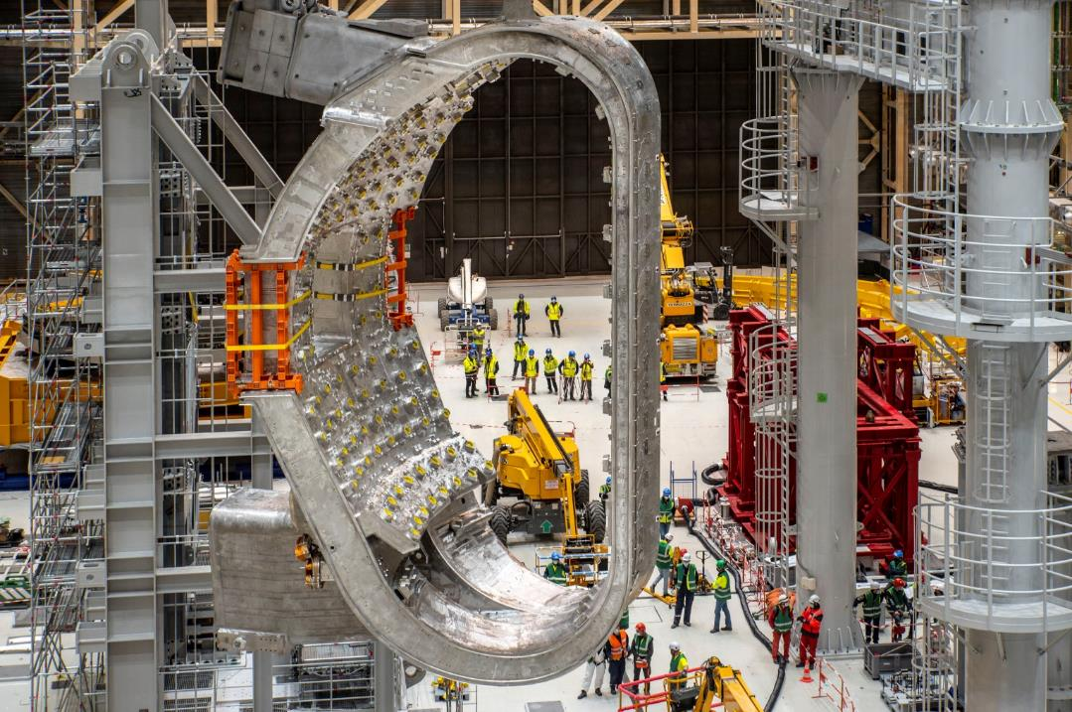
text
FIRST SECTOR SUBASSEMBLY
Vacuum Vessel Sector 6 placed on the Sector Sub-Assembly Tool
May-June 2021
a
text
text
30
text

Slide 31
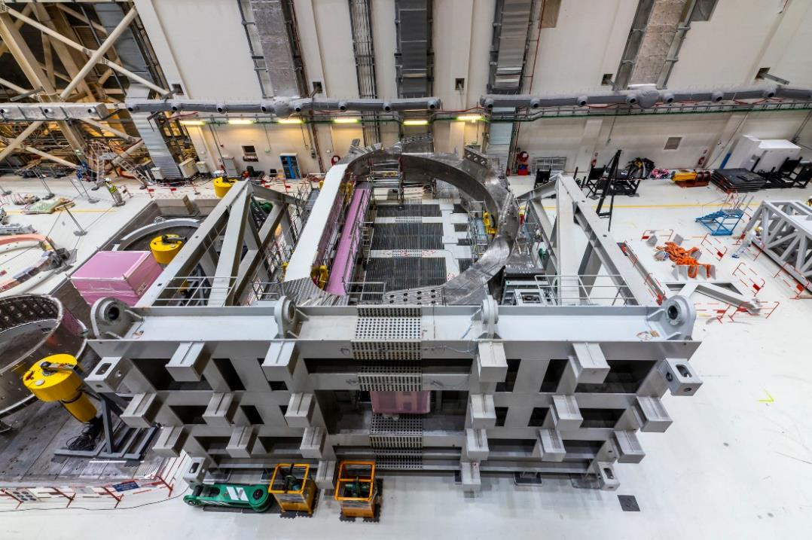
text
FIRST SECTOR SUBASSEMBLY
Toroidal Field Coil #12 placed on the “upending” tool.
May-June 2021
a
text
text
31
text

Slide 32
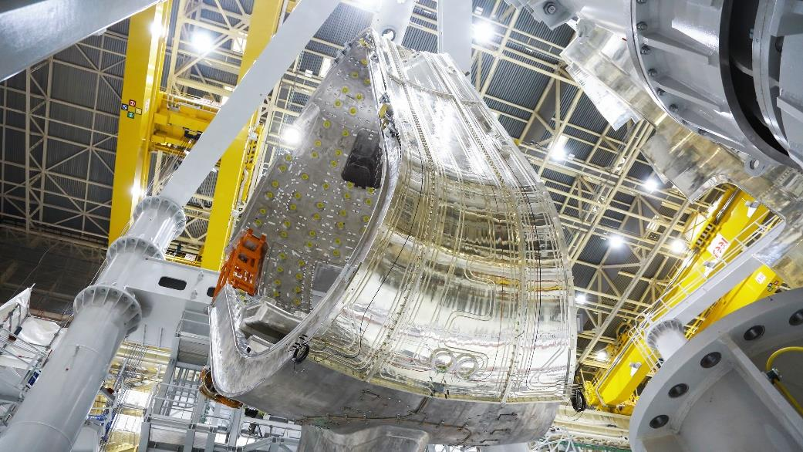
text
FIRST SECTOR SUBASSEMBLY
Thermal Shield added to the Vacuum Vessel sector
May-June 2021
a
text
text
32
text

Slide 33
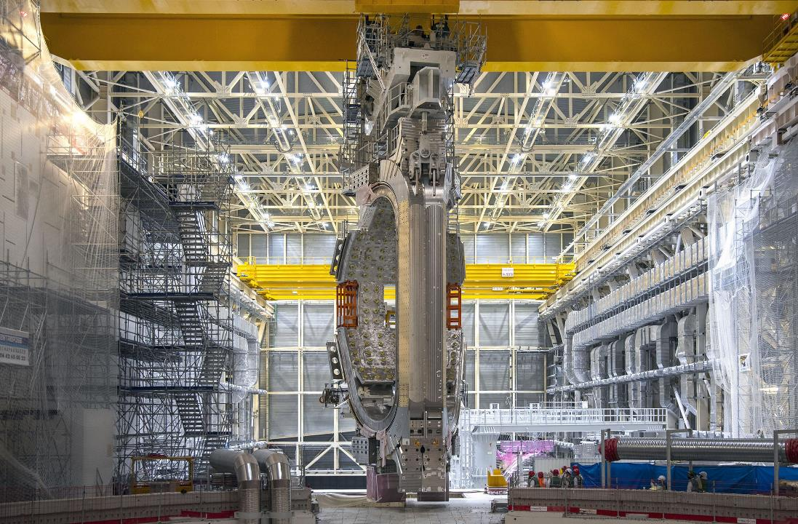
text
ASSEMBLING THE MACHINE
First complete Vacuum Vessel Sector Module lifted
May 2022
text
text
33
text

Slide 34
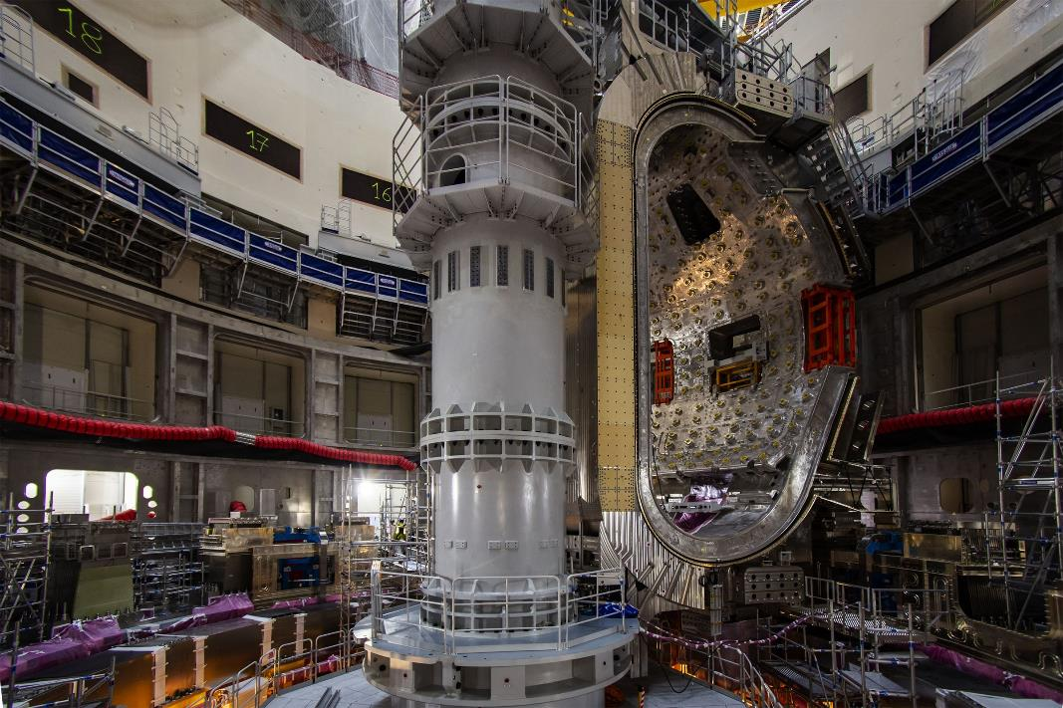
text
ASSEMBLING THE MACHINE
First complete Vacuum Vessel Sector Module installation
May 2022
text
text
34
text

Slide 35
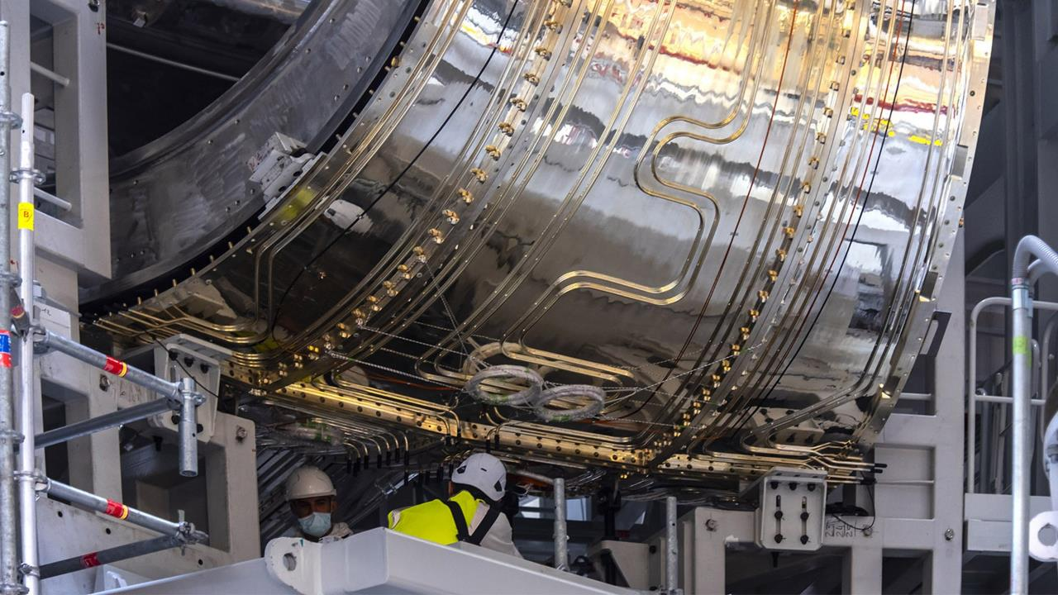
text
a
CHALLENGES OF FIRST-OF-A-KIND COMPONENTS
Leakage identified in thermal shield cooling piping due to chloride stress corrosion.
Corrosion of the silver coating that was intended to reflect infra-red also found.
Repair strategy defined; repairs underway
text
text
35
text

Slide 36
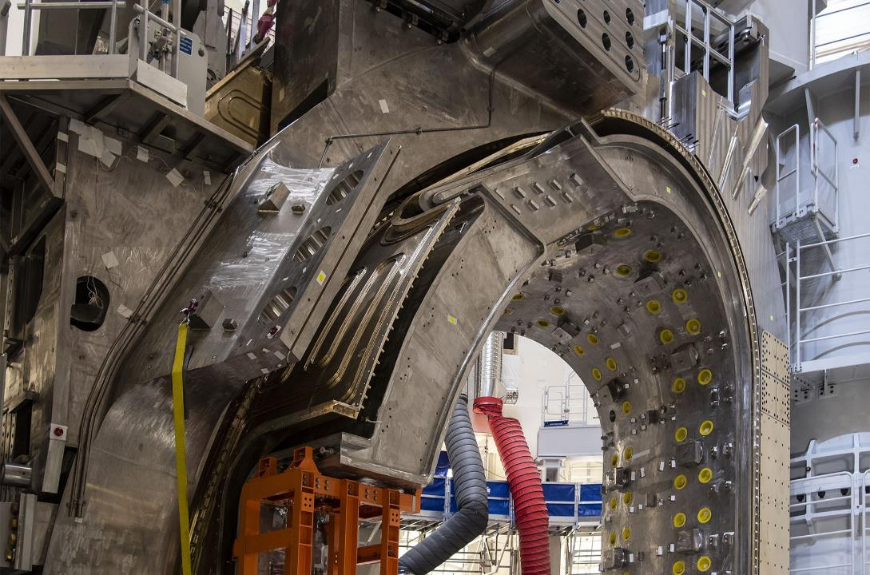
text
CHALLENGES OF FIRST-OF-A-KIND COMPONENTS
Geometric non-conformities found in Vacuum Vessel sector field joints.
Repair strategy defined and repairs started
text
text
36
text

Slide 37
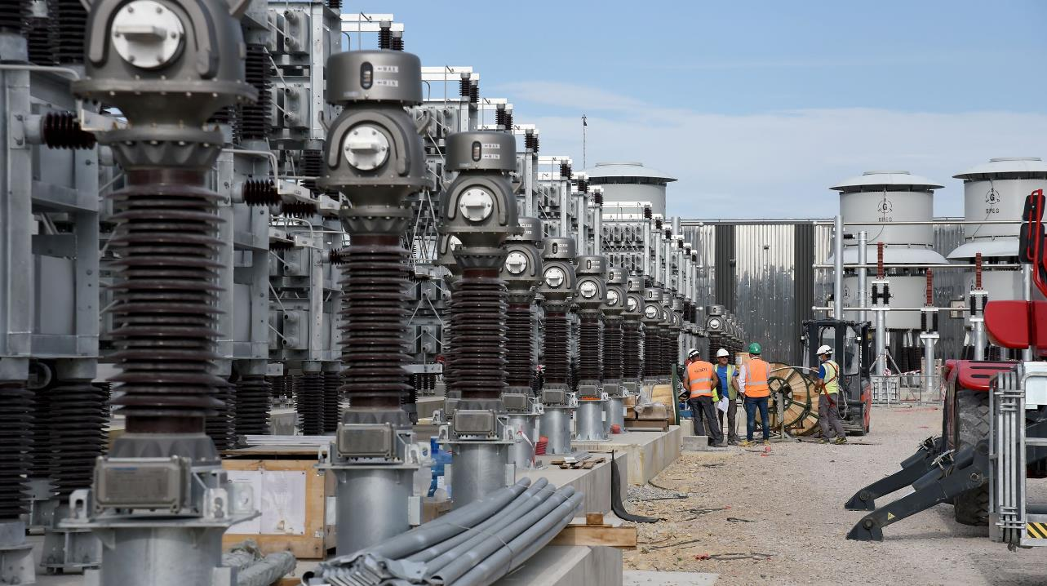
text
text
text
PLANT SUPPORT SYSTEMS
ITER has two overall power supply systems: the steady-state electrical network, commissioned in January 2019; and the pulsed-power electrical system (sometimes called “reactive power compensation”), for which the equipment is largely installed.
37
text

Slide 38
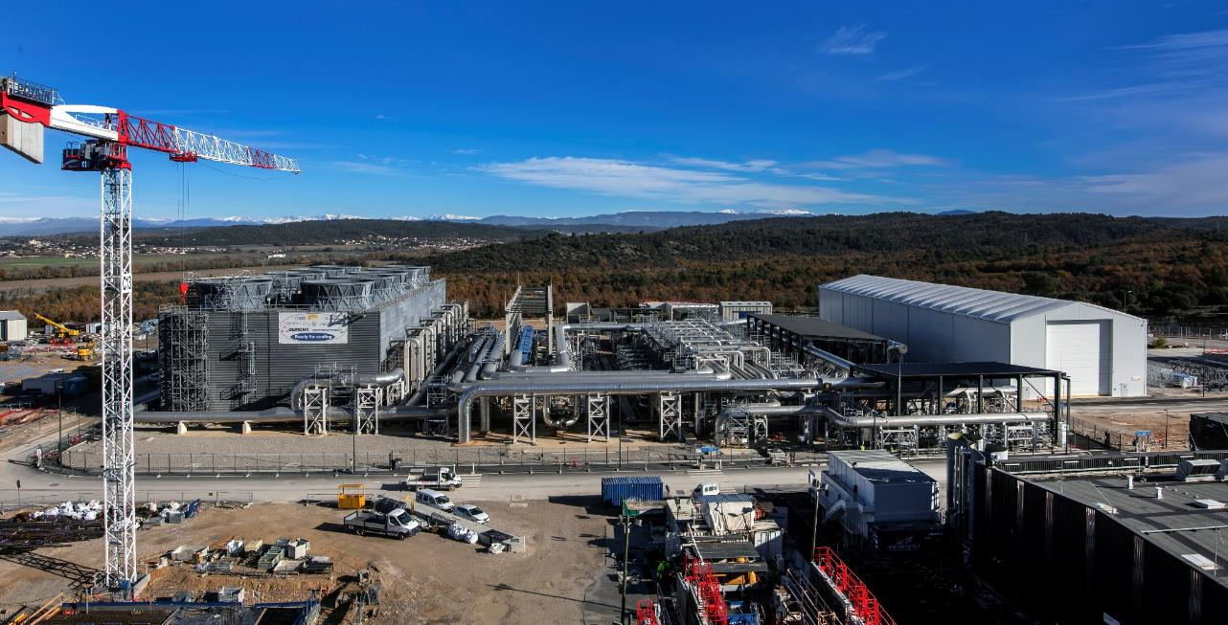
text
text
text
PLANT SUPPORT SYSTEMS
Heat Rejection System: ITER’s cooling water systems will be capable of removing ~1.2 gigawatts of heat. Equipment installation is complete, and the system is now in pre-commissioning phase.
38
text

Slide 39
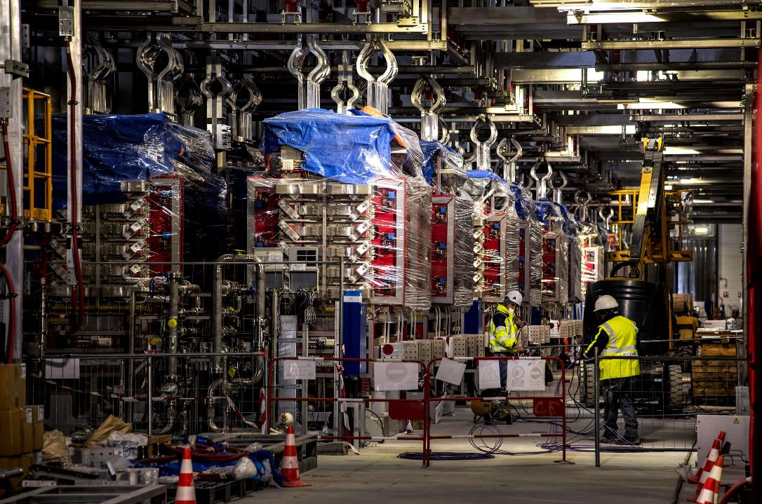
text
PLANT SUPPORT SYSTEMS
Equipment installation is 100% complete in Magnet Power Conversion Building #33; and is nearly complete in Building #32.
text
text
39
text

Slide 40
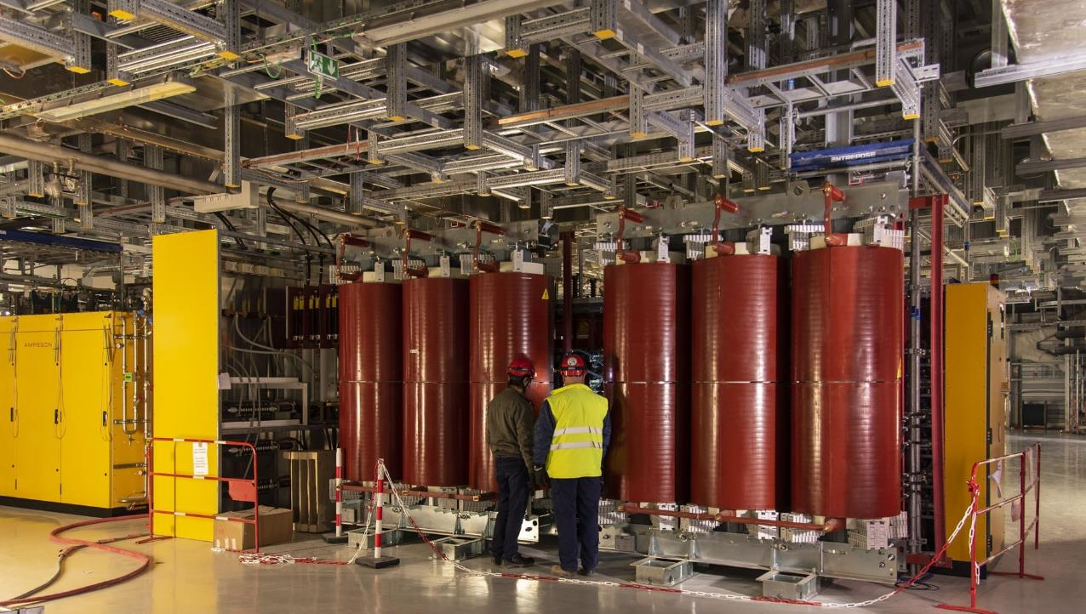
text
PLANT SUPPORT SYSTEMS
In the Radiofrequency Building, one of the two sets of high-voltage power supplies for the electron cyclotron resonance heating (ECRH) system is installed.
November 2022
a
text
text
40
text

Slide 41
ADDRESSING CHALLENGES
The current ITER cost and schedule “baseline” was set in 2016. Given recent challenges, a review of the baseline is underway, and a new baseline proposal was presented to the ITER Council in 2024.
Key challenges and considerations include:
Known delays created by the Covid-19 pandemic and First-of-a-Kind technical challenges.
Repairs to the Vacuum Vessel sectors and Thermal Shield cooling pipes, as described earlier.
Ensuring mutual alignment with ASN, the French nuclear safety regulator, on any concerns.
Ensuring a strong quality culture, project-wide.
Opportunities to offset future risks by further testing of completed components.
Adjustments to the scope of First Plasma (the first experimental campaign) or machine design elements that could add efficiency while preserving performance goals.
A new baseline proposal was presented to the ITER Council in June 2024.

Slide 42
FUSION ON EARTH
To get to a commercial fusion power plant based on the tokamak concept, will require three major steps:
1. To show that fusion is scientifically feasible—has been achieved by the three big tokamaks: TFTR, JET, and JT-60U.
2. The second stage- usually known as the Next Step- requires an even bigger experiment that will test most of the technical features needed for a power plant (including superconducting magnetic field coils and tritium production, in order to show that fusion is technically feasible.
3. The third step, tentatively known as DEMO will be to build a prototype fusion power plant producing
electricity routinely and reliably to show that fusion is commercially feasible.
Optimistic plans in the 1970s aimed at starting the Next Step in the 1980s and having the DEMO stage operating early in the 21st century, but various factors have combined to delay these plans by at least two decades.

Slide 43
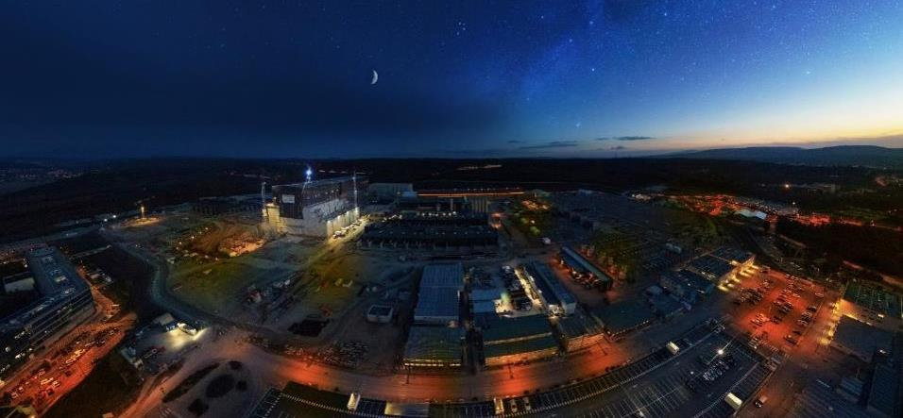
Thank you!

Slide 44
EXTRA SLIDES

Slide 45
What will ITER do?
The phases of ITER
The ITER Members are procuring the components and systems of the ITER machine and plant and shipping them to the ITER site, where the ITER Organization teams have the overall responsibility for the successful installation and assembly of all components.
Systems and services will be commissioned progressively, before an integrated commissioning phase demonstrates that the all systems required for the first experimental program perform as expected. The experimental exploitation of ITER will follow.
Operation will be carried out according to a detailed Research Plan—a document that describes the progressive operation phases of ITER. In 2024, the ITER Organization and the seven ITER Domestic Agencies presented an updated project baseline (technical scope, cost and schedule) to the ITER Council for approval and, within that, a new baseline ITER Research Plan.
The overall approach, which was approved, foresees a Start of Research Operation phase (SRO), that will feature a machine equipped with a divertor, blanket shield blocks and other key components and systems, allowing for hydrogen and deuterium-deuterium plasmas that culminate in the operation of the machine in long pulses at full magnetic energy and plasma current.
The initial phase will be followed by deuterium-tritium operation 1 (DT-1) with limited fluence, and finally a machine upgrade to enable a more extensive DT-2 phase with the target to complete all project goals including the Q=10 project specification.

