Slide 1




Cal Poly Overview
Jennifer Klay
Cal Poly San Luis Obispo

Slide 2
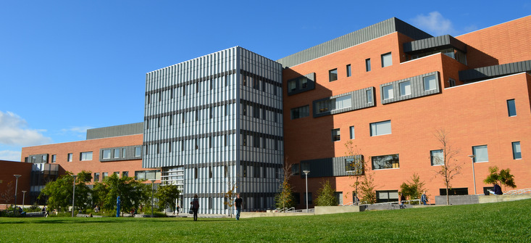
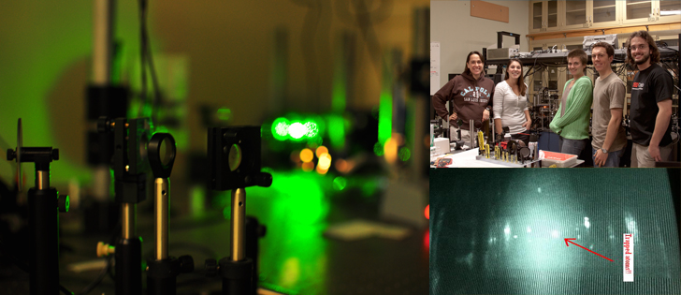
Our Department
Predominantly Undergraduate Institution
200 Majors, 35 TT Faculty, 15 Full-time Lecturers
“Learn by Doing” approach to teaching
No TAs, faculty teach all classes
Research with undergraduates is core to our mission
Department Chair 2022-2028: J. Klay
Tenure-track hire (all areas of physics) in 2025-26 (more to come)
Transitioning to semesters in Fall 2026

Slide 3
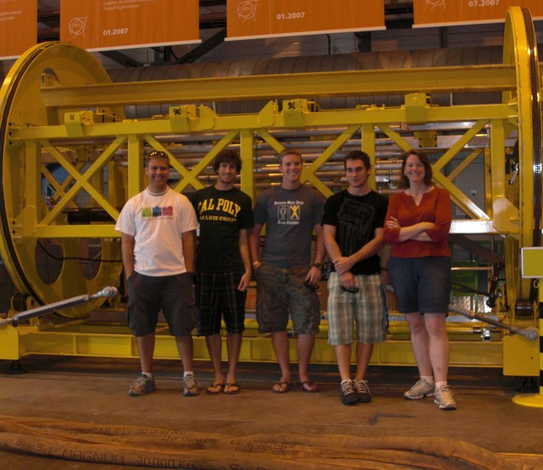
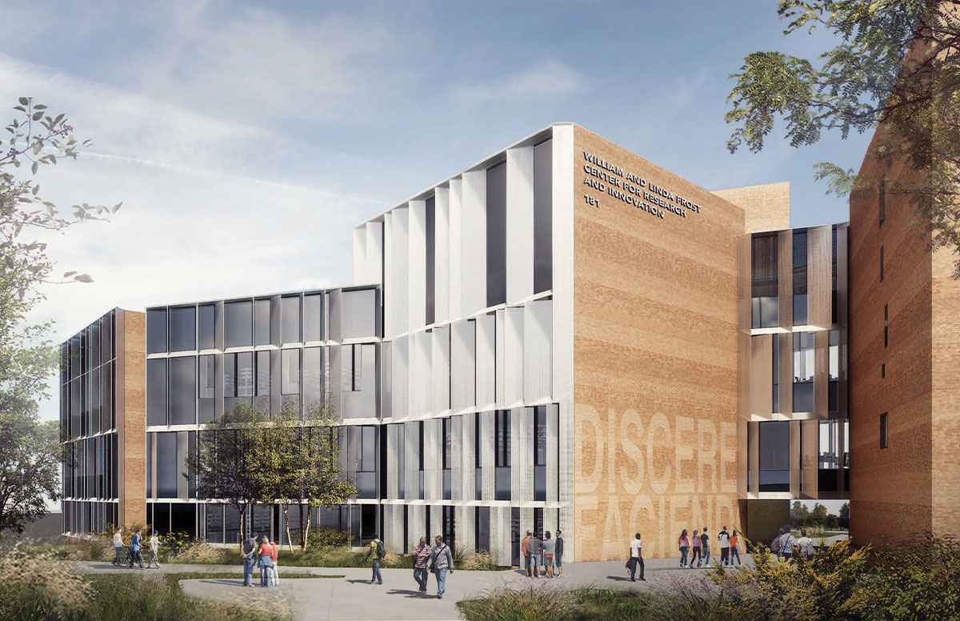
Nuclear Group at Cal Poly
Eighteen years of funding from NSF, DOE-NE, LLNL/LANL ($2.8M)
71 undergraduate research students
  30 senior projects, 28 external presentations
Detector development, simulations, software, data analysis, computational physics
State-of-the-art lab space, machine shop
  William and Linda Frost
  Center for Research and
  Innovation (opened May 2023)
Group at ALICE, 2010

Slide 4
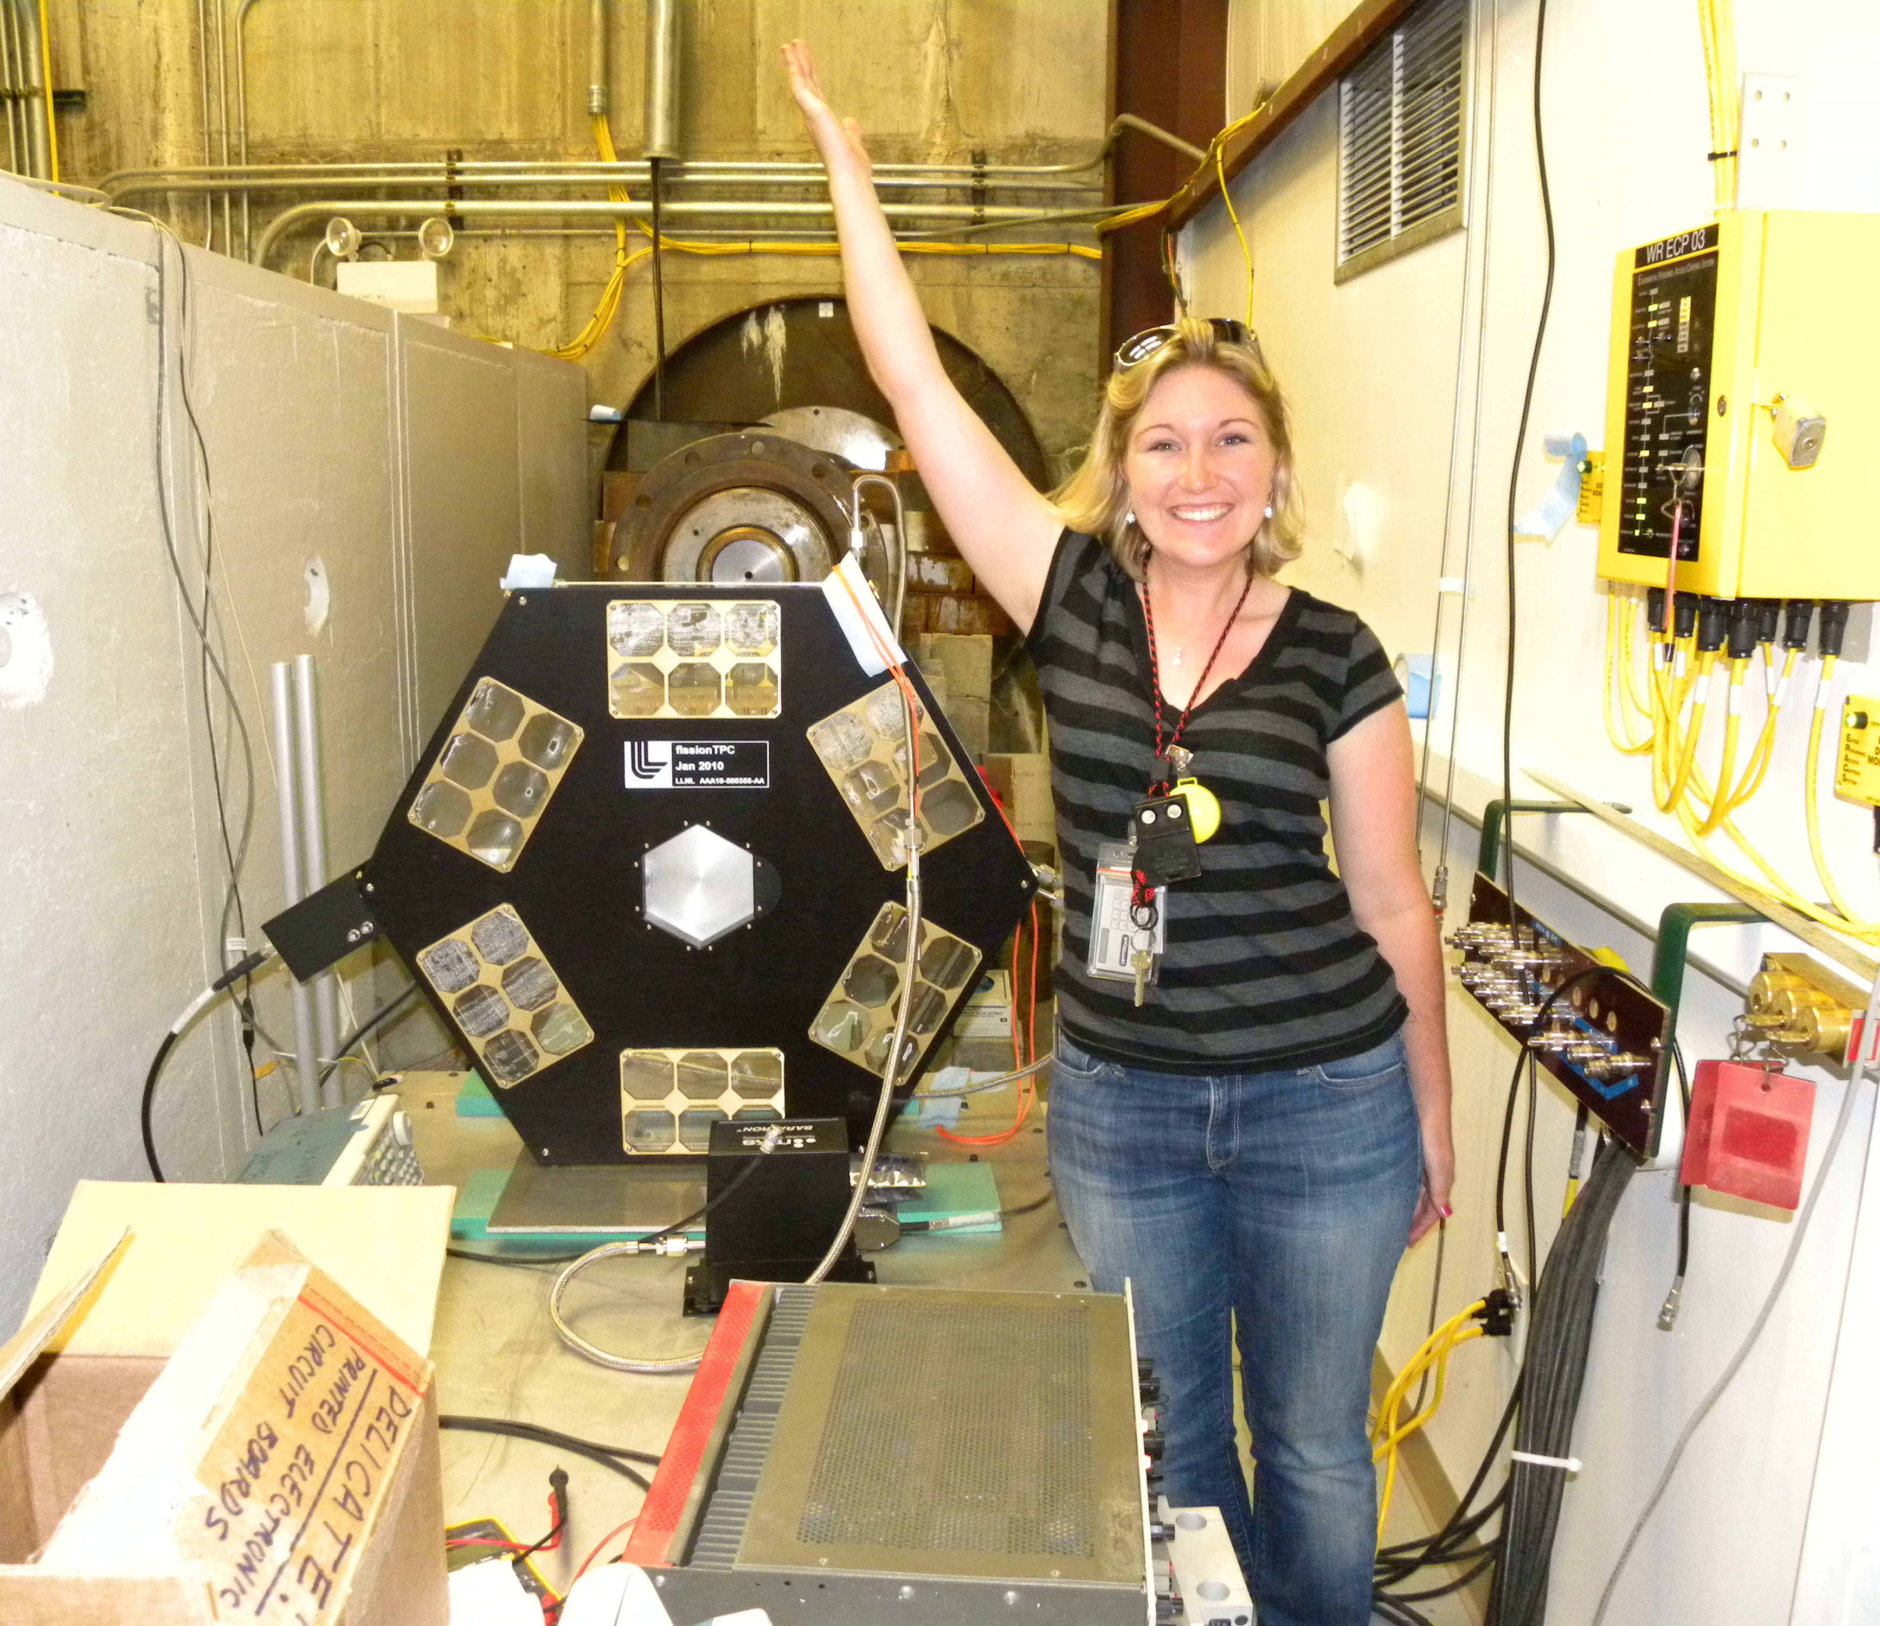
NIFFTE
Neutron Induced Fission Fragment Tracking Experiment
LANSCE Experiment (2008-2025)
  Funded through DOE-NE, direct contracts to LANL/LLNL ($1.4M to Cal Poly)
  Nine publications, two in preparation
  J. Klay, Executive Council Chair (2009-present)
  Ramping down (final papers in 2024-2025)
Student involvement:
  19 undergrads, 5 senior projects
  Data collection and experiment monitoring (remote)
  Simulations and data analysis of ternary fission
D. Duke, 2011

Slide 5
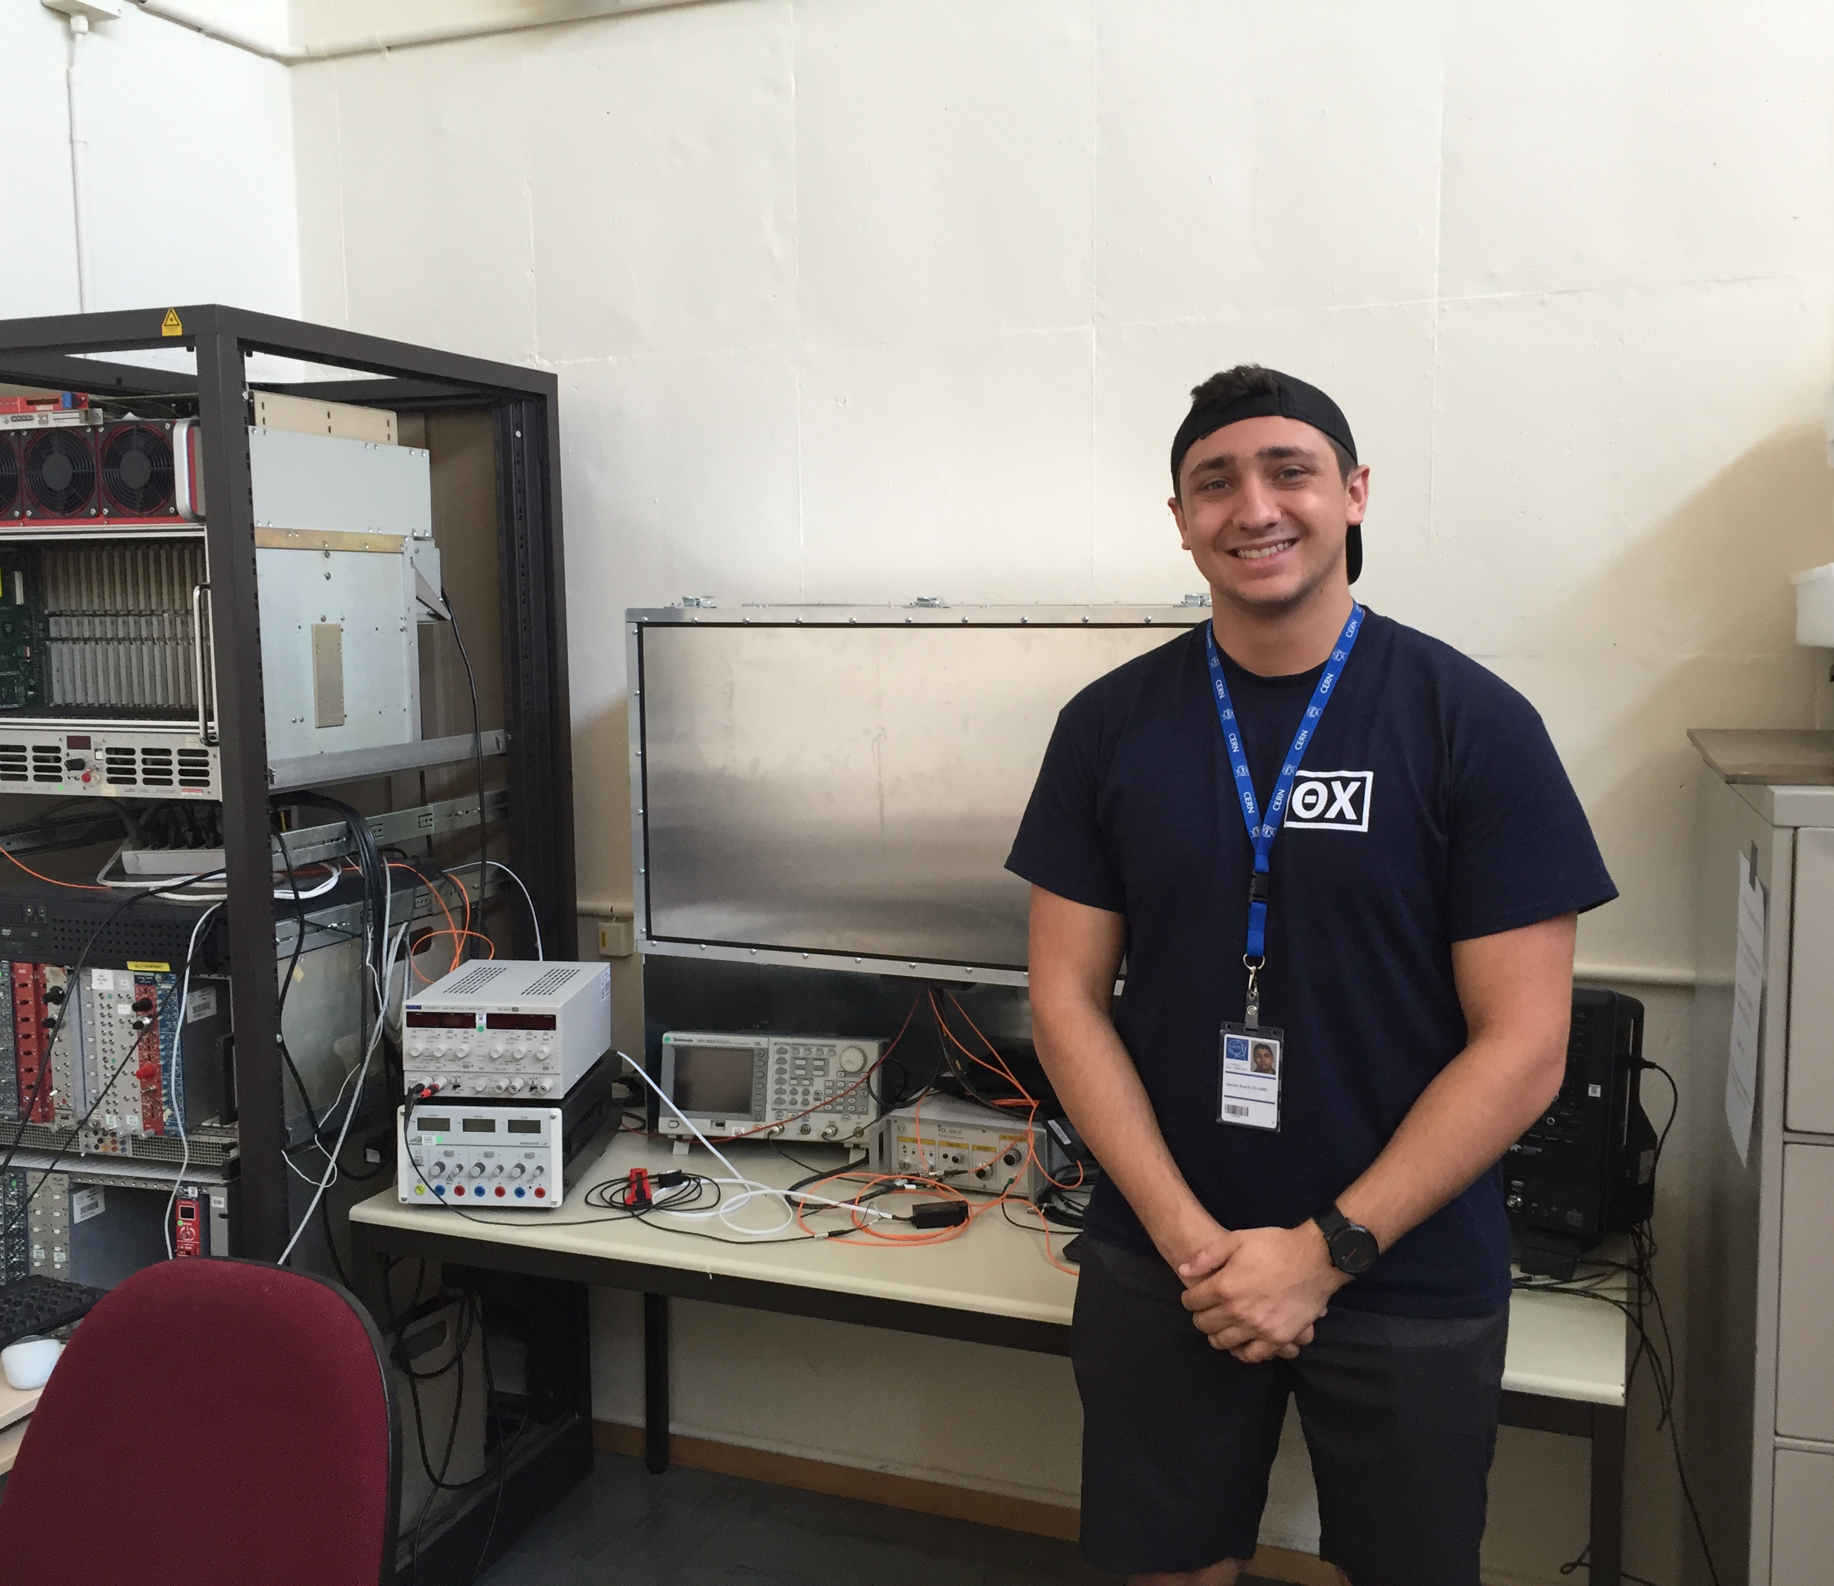
ALICE
Heavy Quark Jets and Fast Interaction Trigger Detector
RUI grants from NSF to explore heavy quark energy loss ($871k, 2007-2016)
MRI and RUI grants from NSF to help build,test, commission, operate FT0 in Run 3 ($571k, 2016-2025)
Student involvement:
  36 undergrads, 26 to CERN, 20 senior projects
Research infrastructure:
  ps blue laser, Photonis MCP-PMT test stand, Wiener HV module, CAEN desktop digitizer, fast scopes, 5 tons of low-background lead bricks, other equipment available on loan from department
A. Guard, 2018

Slide 6
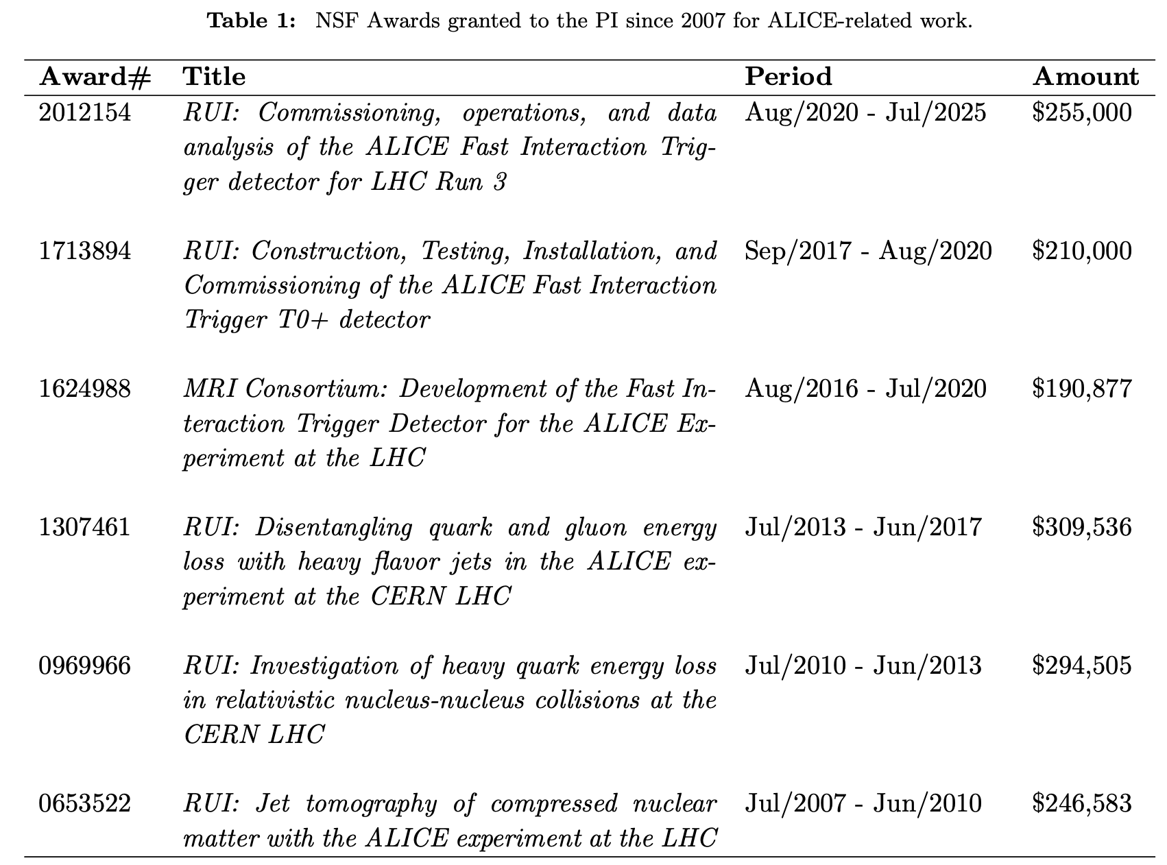
NSF Funding and Outcomes
ALICE @ Cal Poly SLO
6 NSF Awards: $1.5M over 18 years
36 students participated since 2007
26 traveled to CERN to collaborate, work
on hardware/software, collect/analyze data
24 went directly (or after a master’s degree) to industry
20 and counting wrote senior projects on their work in ALICE
2 went to national labs as lab technicians after BS in physics
2 became high school science teachers
2 returned to Cal Poly as instructional support technicians

Slide 7
Major Activities of Cal Poly in ALICE
Data collection shifts in the ALICE control room by students and PI nearly every summer for ~15 years
Beam test data collection and analysis for the EMCal
Simulations and software development for the EMCal
Development and procurement of Micro-Channel-Plate Photo Multiplier Tubes (MCP-PMTs) for ALICE FIT T0+ detector upgrade
Construction of light-tight box for bench testing MCP-PMTs at CERN
Construction and setup of Cal Poly lab for MCP-PMT testing and development
Installation of ALICE FIT T0+ detector in ALICE cavern
Development of software description of ALICE FIT T0+ geometry for simulations
Analysis of ALICE FIT T0+ occupancy simulations and trigger efficiency
NEW! Development of machine-learning algorithms for ALICE FIT detector data analysis
Contributed to 3 technical papers and 3 technical design reports on ALICE EMCal and FIT detector upgrade
20 Cal Poly senior projects written by students on ALICE-related work
Dozens of student presentations at local and regional conferences; two students won awards for best oral presentations at regional APS meetings

Slide 8
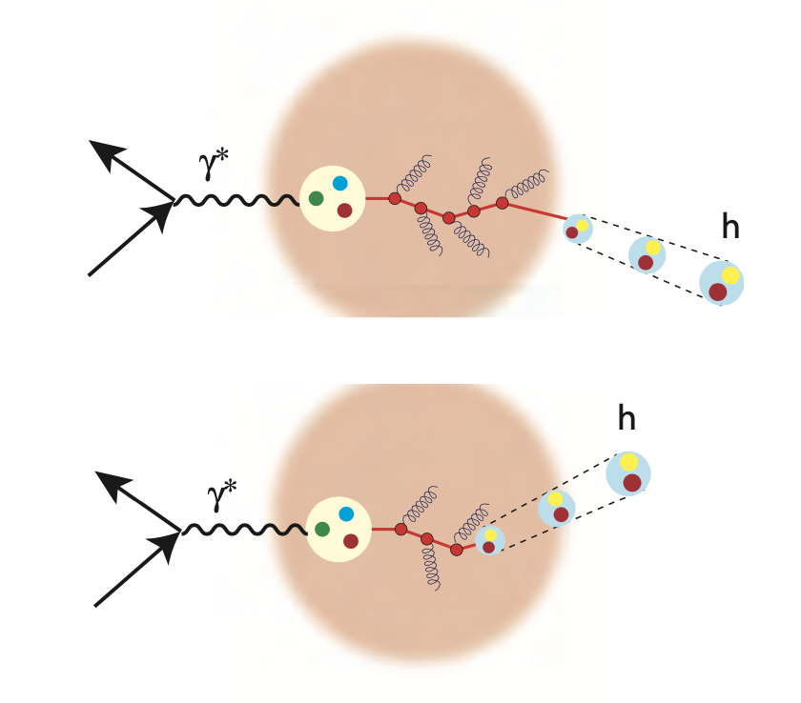
EIC Research Interests
Jets and Detector Development (Triggering)
Expertise in software, simulations
  Detector specifications (geometry)
  Secondary particle production (analysis)
Interest in Machine Learning applied to ALICE/ePIC
  Area of growth for group
Experience with detector component testing, development
  Trigger detectors, calorimeters
Physics Focus: jet physics in e-p, e-A collisions
  Jets as a probe of nuclear structure, high density gluon matter
  Heavy quark jet identification, dead-cone effect

Slide 9
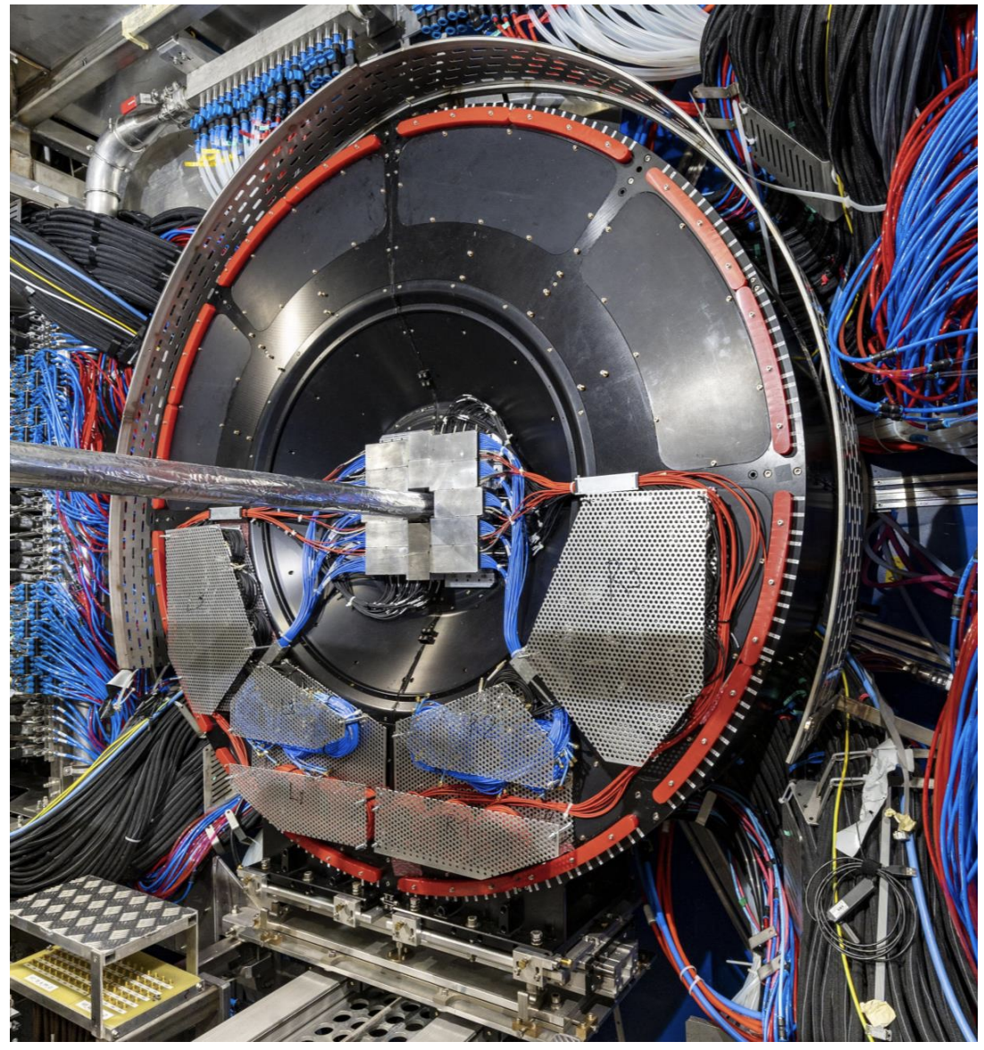
NSF Proposal 2025-2028
Submitted in December 2024, Status pending
RUI: Machine Learning for ALICE Run 3 Data and ePIC Simulation Studies
Goals: application of machine learning algorithms to data collected by the ALICE experiment at CERN during the Large Hadron Collider’s third run from 2022-2026 and to simulated output for the ePIC detector, a project under development for the Brookhaven National Laboratory Electron-Ion Collider
Activities: calibrate and analyze data from the ALICE Fast Interaction Trigger detector; apply algorithms to simulation output for ePIC, to optimize the detector’s design and capabilities.

Slide 10
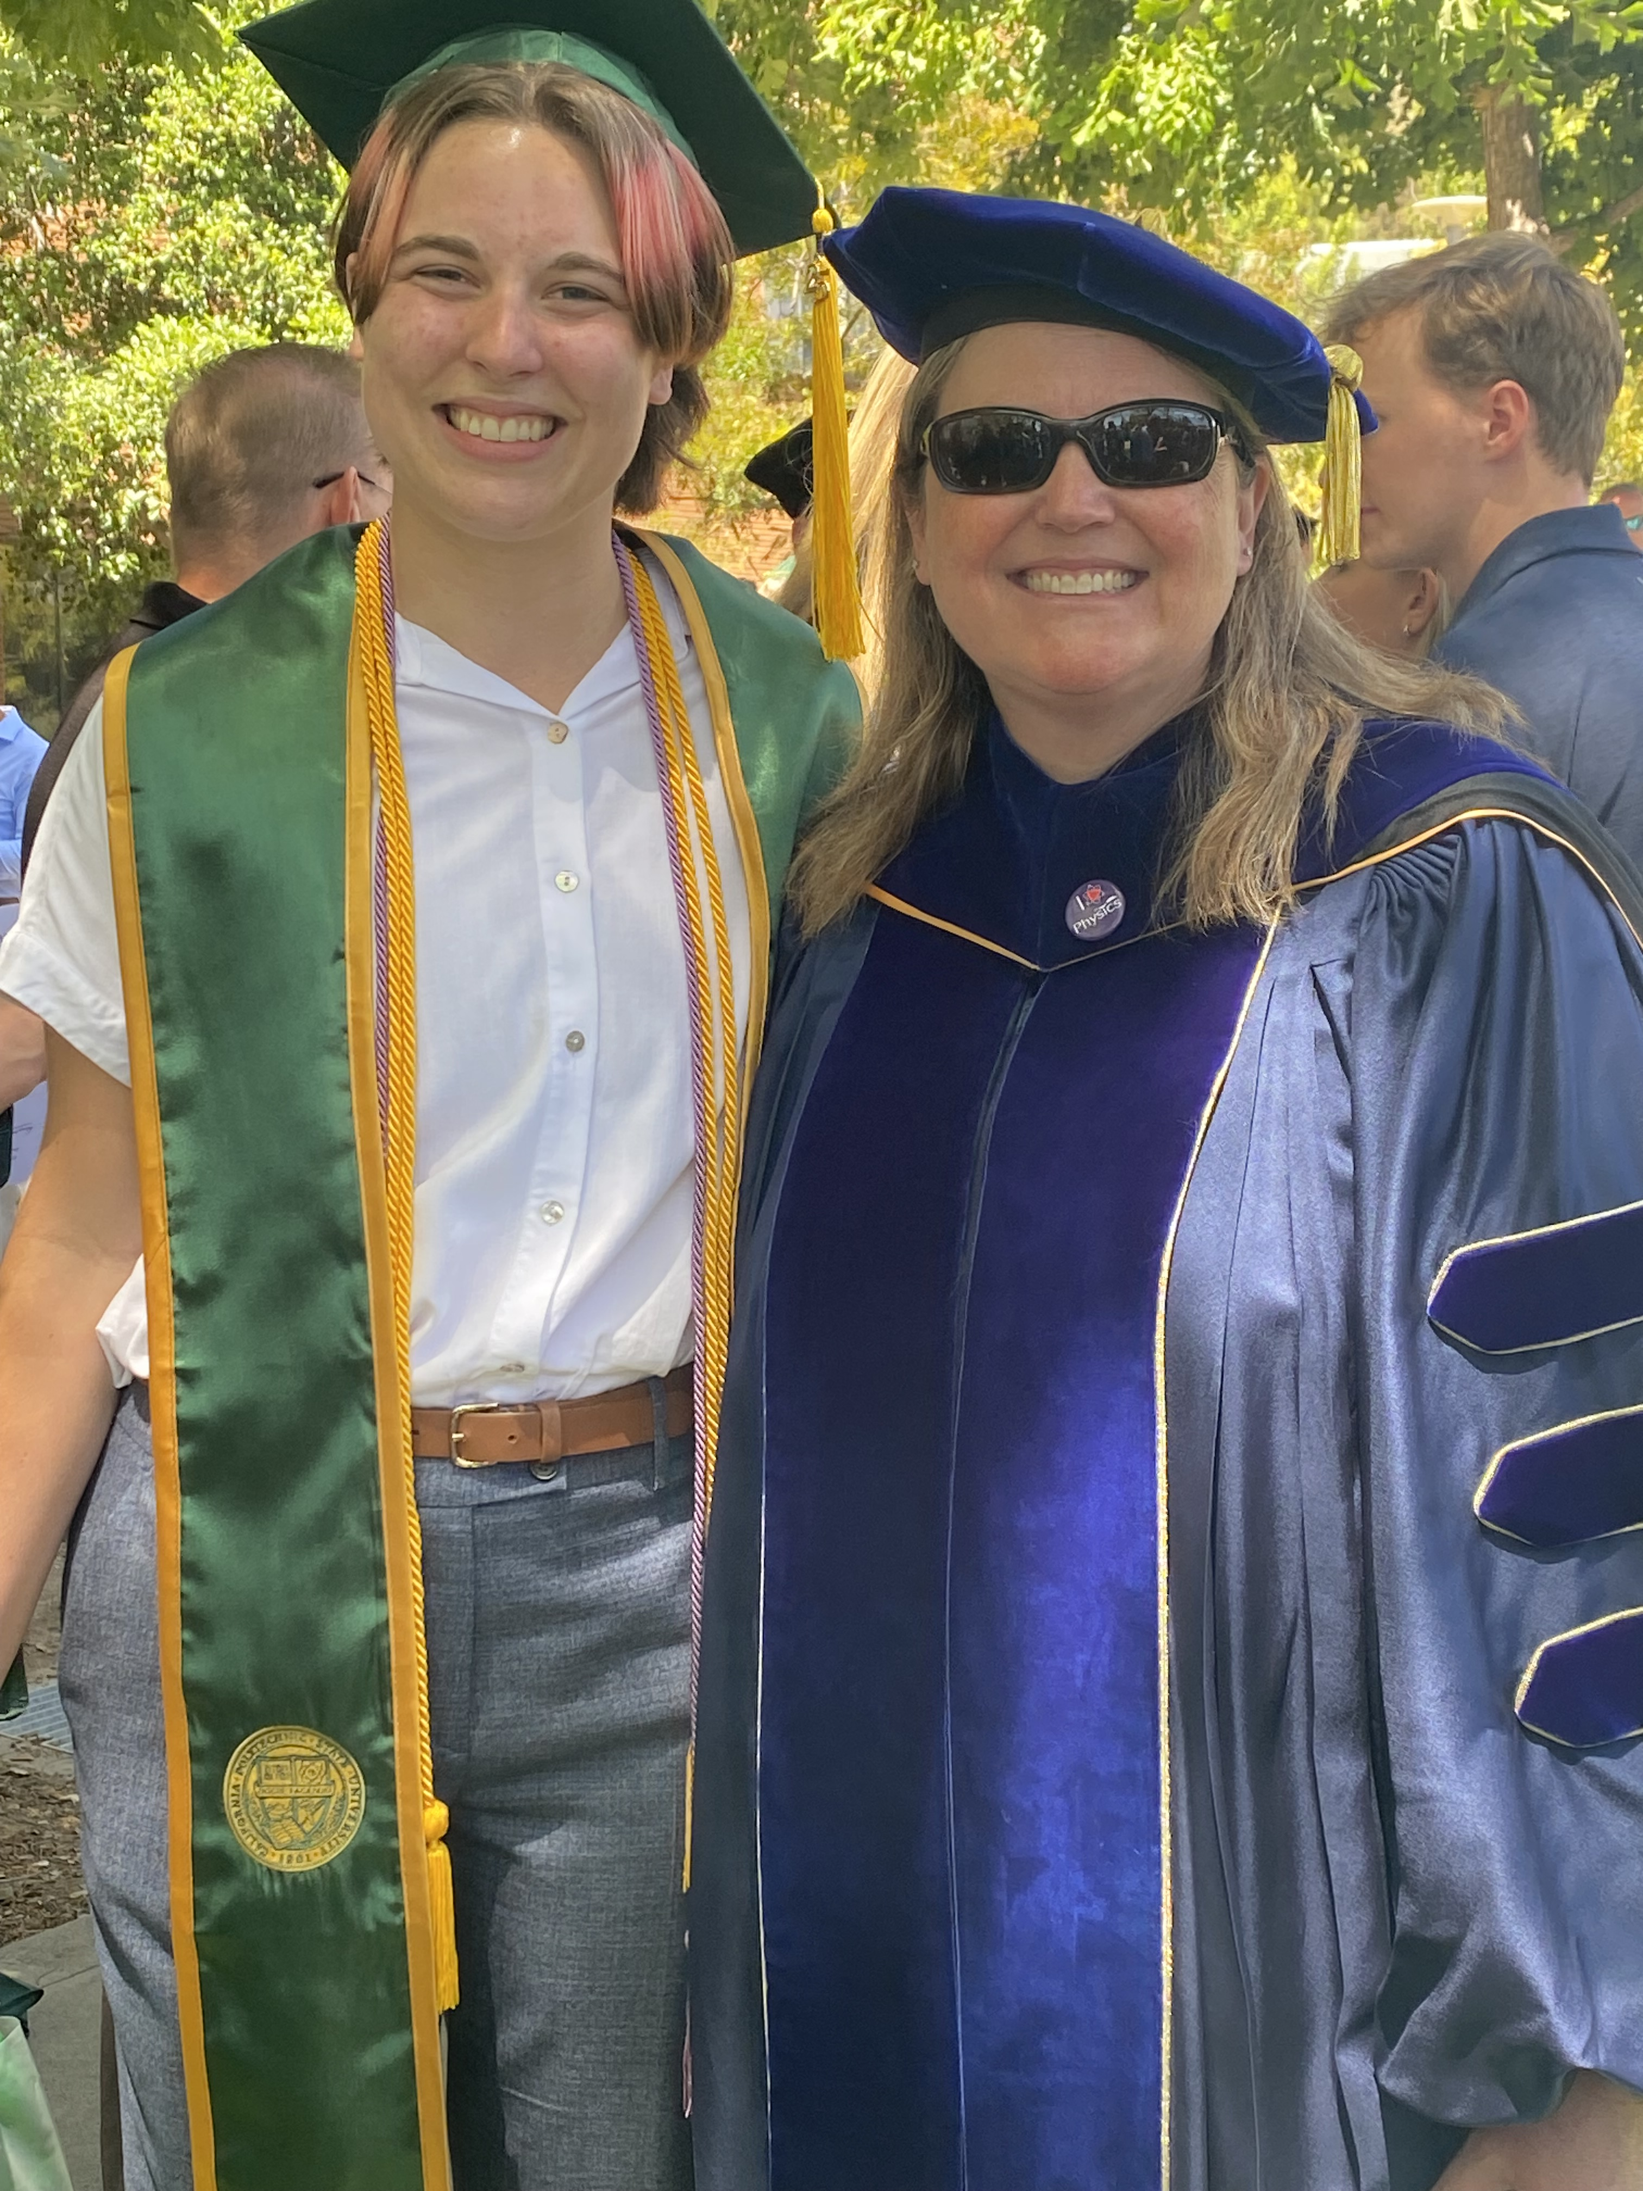
EIC Work in 2024-2025
First Senior Project Student – Dylan Spencer
https://orcid.org/0009-0002-8787-2655
Activities: PYTHIA Simulations, EIC software workshop, learning about ML algorithms
Senior project: “π⁰ Transverse Momentum ROOT Analysis using Pythia Simulated ePIC Data”
Dylan graduated June 2026, starting grad school with Christina Markert’s ALICE group at UT Austin in Fall 2025

Slide 11
Next steps…
Two returning students: Isaac, Ricardo
Recruit new student(s) for ML training, ePIC/ALICE work
Interface work between ALICE FIT/FOCAL projects and ePIC
Identify local funding to maintain research activities
Pending outcome of NSF proposal (Reapply)

